Slide 1

California Department of Education
California New State Standards
And The Arts
Carrie Roberts
Literacy, History, and Arts Leadership Office

Slide 2
California Department of Education
The Right Title
The Arts and California’s New State Standards
Carrie Roberts
Literacy, History, and Arts Leadership Office
Notes:
I want to make it clear that the arts have their own standards and all students should have access to instruction in the arts.
All educators need to understand that as students study and create in the arts, they use the potential of the human mind
to its full and unique capacity.

Slide 3
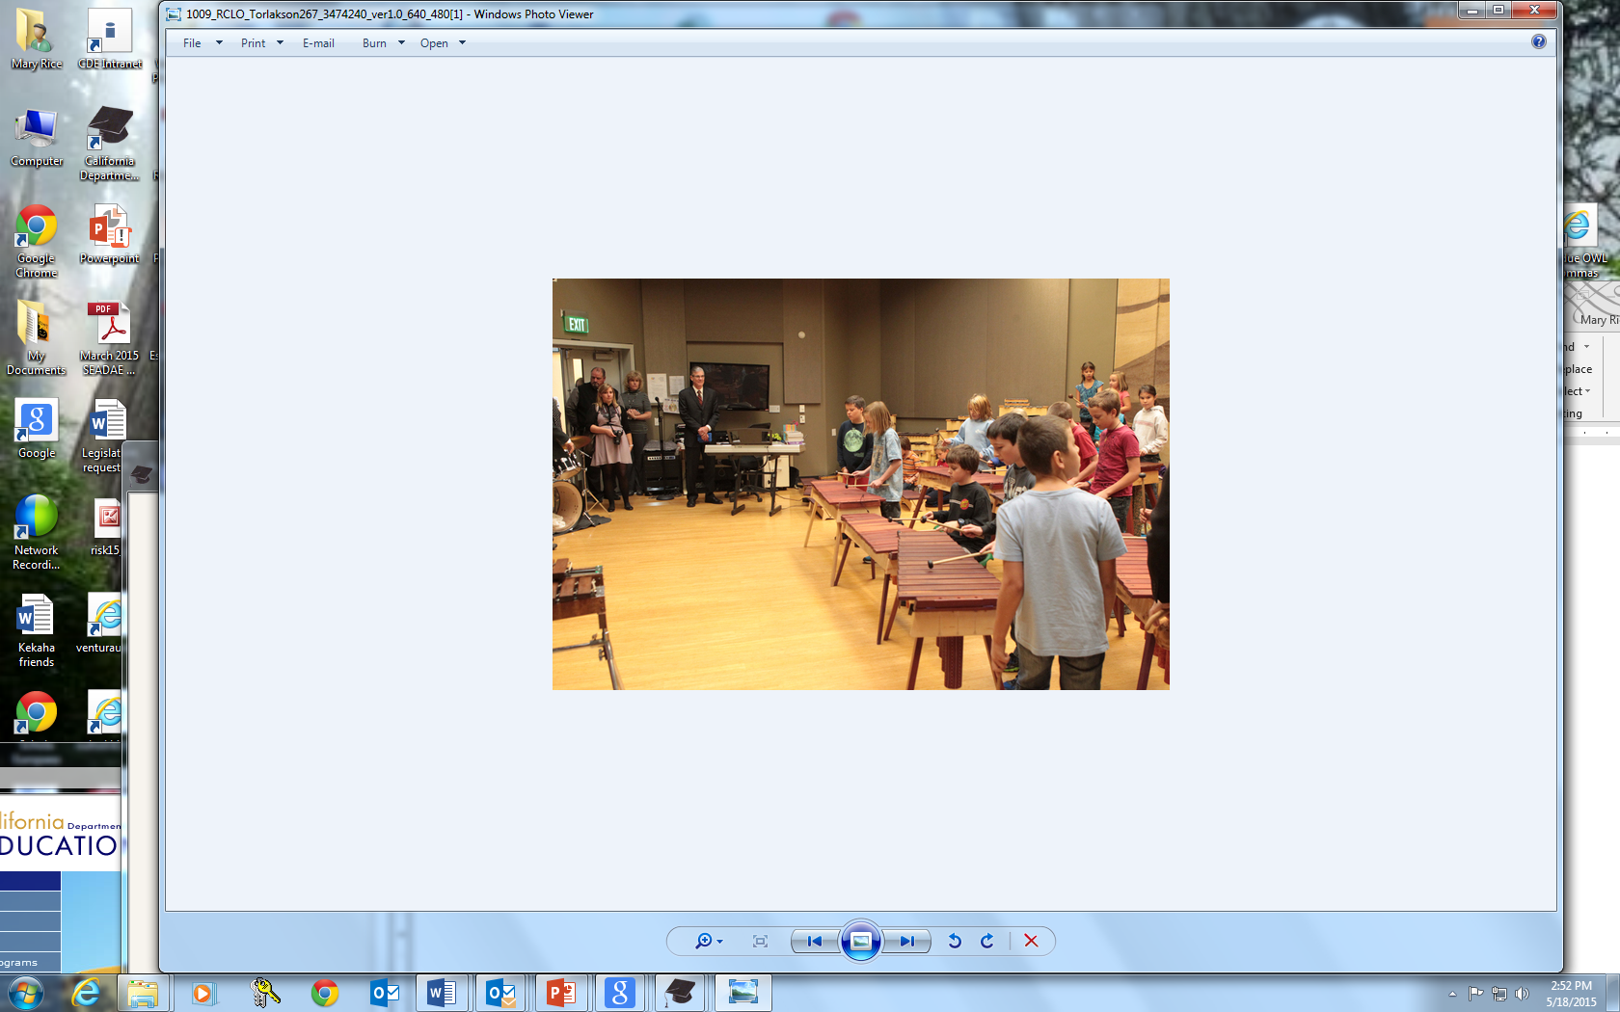
Redding School for the Arts
Notes:
Tom Torlakson, SSPI is a supporter of the arts as part of his belief in teaching the Whole Child.
Art is not an “if we have time subject area” although it has become that in many schools.
It is a core subject area with a set of content standards.

Slide 4
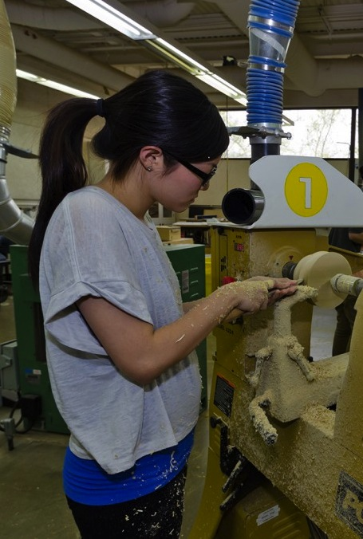
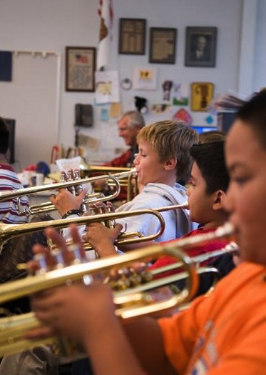
CA EDUCATION CODE
51210, 51220
“
The adopted course of study for grades 1-12 shall include visual and performing arts, including instruction in the subjects of dance, music, theatre, and visual arts.
”
4
Notes:
The arts are specifically addressed in the Education Code – an indication that they have long been a valued part of a quality education in California schools.

Slide 5

A Perfect Example
Watch this very short video and think about why it was engaging.
https://vimeo.com/51933492
Notes:
My topic today is Art and the new state standards. I want to share with you a very short video about the CCSS but I want you to think about why the video is engaging.
Talk to your elbow partner for 30 secs about how the visual/digital component affected the message and who created it.

Slide 6
The Arts and Student Achievement
How are the arts central and essential in helping students achieve the expectations of the new state standards?
Knowledge
Observation
Evidence and Choices
(David Coleman, blog.artusa.org/2012/09/17)
Link:
https://www.teachingchannel.org/videos/critical-thinking-for-students
Notes:
In the artusa.org blog, David Coleman refers to the arts as central and essential to achieving the CCSS. In the blog article, he covers
3 critical points:
Knowledge – in content areas and rigorous materials meeting text complexity requirements
Observation - arts uniquely place a priority on the careful observation required when applying that skill to reading
Evidence and Choices – CCSS requires that analysis includes the ability to cite evidence as the basis of understanding;
noticing and analyzing choices artists make strengthens the same skill in reading
I want to add to more than what David Coleman said, the standards for Mathematical practice that focus on the habits of mind that artists and students working in the arts use consistently are almost one and the same but applied to different content.
The NGSS include science an Engineering standards and also require students to design solutions. This will require an understanding of design techniques which happen to be included in the arts standards.
I want to share with you a very short quote from an elementary art teacher in New York that I think you may agree with. 13:48

Slide 7
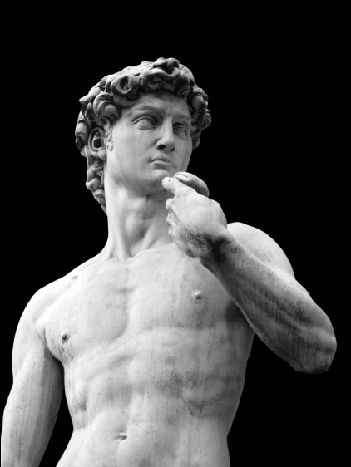
New State Standards Present Opportunities
Provide an exciting opportunity for ALL teachers but today I want to say especially arts teachers and elementary teachers.
Help students have a deeper understanding of concepts in all content areas, but also teach arts concepts for their own sake.
To recognize works of art as one type of text which can be “read”.
Notes:
The CCSS is an opportunity for all teachers to re-think their instructional practices.
All teachers can utilize the arts to help teach literacy skills, and help as students dive deeper into science with the nest generation science standards.. I will be giving you some examples today that will help you see how students can read works of art just as they read a poem by Shakespeare or a speech by Winston Churchill or Abraham Lincoln.

Slide 8

David Coleman, CCSS for ELA Author
“There is no such thing as doing the nuts and bolts of reading in Kindergarten through 5th grade without coherently developing knowledge in science, and history, and the arts…it is the deep foundation in rich knowledge and vocabulary depth that allows you to access more complex text.”
Notes:
Coleman: “Let’s not get confused here that [the CCSS] are adding back nice things [history, arts, science] that are an addendum to literacy. We are adding the cornerstones of literacy, which are the foundations of knowledge, that make literacy happen.”

Slide 9

Anchor Standards for ELA
Reading:
Read closely to determine what the text says explicitly and to make logical inferences from it; cite specific textual evidence when writing or speaking to support conclusions drawn from the text.
Writing:
Write arguments to support claims in an analysis of substantive topics or texts using valid reasoning and relevant and sufficient evidence.
Notes:
Let’s take a closer look at the CCSS for ELA. These are the college and career Readiness anchor standard #1 for reading and writing. Each of the ELA grade level standards is based on the anchor standards. From the video I showed you a few minutes ago, you have a good picture in your mind of the staircase and how the standards for each grade level become more complex as you move through the grade levels. Remember the standards are expectations of what students know and are able to do.
Read the anchor standard 1 for reading and writing. Think about a grade you teach or are familiar with and then talk to your table about what you see as the expectation of this standard – What would a student be able to do or demonstrate that would indicate he or she has met this standard?
Share with your table and share out a few

Slide 10
Reading a work of drama: referenced in 26 standards at all grade levels
RI.K.7: With prompting and support, describe the relationship between illustrations and the text in which they appear.
RL.5.3: Compare and contrast two or more characters, settings or events in a story or drama, drawing on specific details in the text (e.g., how characters interact.)
Using songs in instruction: referenced one time, at the second-grade level
RL.2.4: Describe how words and phrases (e.g., regular beats, alliteration, rhymes, repeated lines) supply rhythm and meaning in a story, poem, or song.
Comparing the same work in different media: referenced in 12 standards
RL.6.7: Compare and contrast the experience of reading a story, drama, or poem to listening to or viewing an audio, video, or live version of the text, including contrasting what they “see” and “hear” when reading the text to what they perceive when they listen or watch.
Analyzing and interpreting images: referenced in 17 standards

Slide 11
Visual and Performing Arts Standards
Responding to, Analyzing, and Making Judgments About Works in the Visual Arts
Students analyze, assess, and derive meaning from works of art, including their own, according to the elements of art, the principles of design, and aesthetic qualities.
  Derive Meaning
  4.1 Define their own points of view and investigate the effects from cultures other than their own.
  4.2 Develop a theory about the artist’s intent in a series of works of art, using reasoned statements to support personal opinions.
  4.3 Construct an interpretation of a work of art based on the form and content of the work.

Slide 12
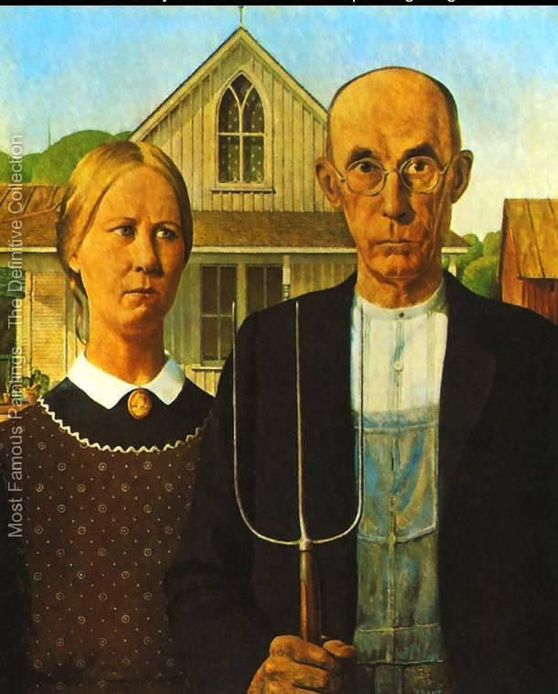
Notes:
Let’s think about this standard as a visual arts History/SS or an ELA teacher might. I want you to be the students for this next activity. This concept of looking for evidence or supporting details can be difficult when looking at a piece of writing. But giving students a playing field that is more concrete can help. So as a table group or with a partner look carefully at this picture and take two minutes to list what you think the artist might be trying to convey or the mood of it, or your interpretation or understanding about the people in the picture or even just how it makes you feel. Make a vertical list and include the details and evidence which you are basing your opinions or interpretations of the painting on.
Somber farmers, hardworking, maybe a little disappointed in life,
Now this is a very famous painting which means some of you have information about this work of art. Remember to use only the evidence that is in the painting itself.

Slide 13
AESTHETIC VALUING
Responding to, Analyzing, and Making Judgments About Works in the Visual Arts
Make Informed Judgments
4.3 Formulate and support a position regarding the aesthetic value of a specific work of art and change or defend that position after considering the views of others.
4.5 Employ the conventions of art criticism in writing and speaking about works of art.

Slide 14
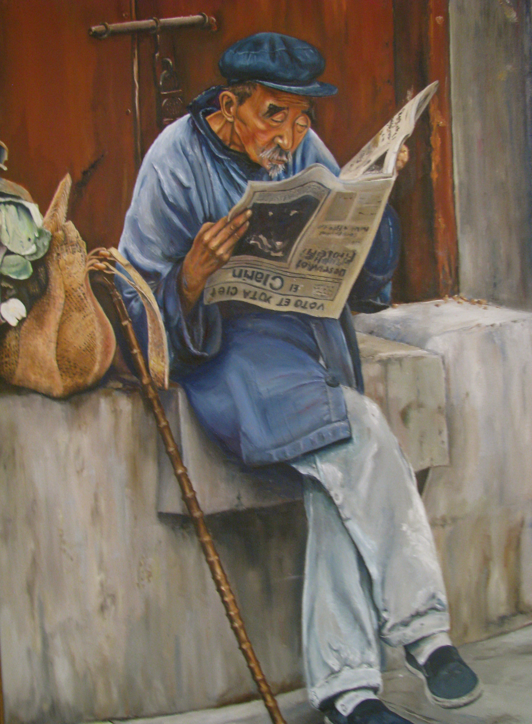
Notes:
Again practice with this painting. List your opinion or feelings or understanding of this man and what his life might be like or what the artist might be saying. But this time as you list an opinion provide the evidence from the painting that supports your opinion. Work independently for a minute and then collaborate or share with a partner or your table group.
You just did 2 close readings of non-print text. Think about how this would help students understand this abstract idea of close reading and looking for evidence.
I chose visual art to demonstrate this strategy but you could use a short clip from a movie or a scene from a play or a piece of music or a dance performance.

Slide 15

Reading Art
“In an age when literacy dominates public discourse on education, we must begin to think more broadly about what students read. Sure—the new Common Core State Standards support the “reading” and scrutiny of other forms of high-quality text. Works of art can, indeed should, be “read” in a very similar way to a poem by Shakespeare or a speech by Winston Churchill.” Lynne Munson
http://blog.artsusa.org/tag/english-language-arts/ (Sept. 13, 2012)
Additional resource link: Arts Integration Lesson Plans and other resources from edutopia.org
http://www.edutopia.org/stw-arts-integration-resources-lesson-plans
Notes:
The quote on this slide is from Lynne Munson, in a blog article referenced here. She also discusses Art, Speaking and Listening;
Art, Informative Writing with good examples of works of art to use, grade level specific strategies and standards references. This is a good article to read later to expand your knowledge of these connections.
The second resource link is to Edutopia’s Arts Integration Lesson Plans and resources, which has a rich collection of resources for interacting with works of art and addressing content standards. One particularly helpful presentation is in the section called Artful Thinking.

Slide 16
Responding to, Analyzing, and Making Judgments About Works of Dance
Students critically assess and derive meaning from works of dance, performance of dancers, and original works according to the elements of dance and aesthetic qualities.
Description, Analysis, and Criticism of Dance
4.1 Use dance vocabulary to identify and support personal preferences for dances observed or performed.
4.2 Apply specific criteria to analyze and assess the quality of a dance performance by well-known dancers or dance companies (e.g., technical skill, musicality, dynamics, mood).

Slide 17
Reading Dance
Dance is often used to tell a story or convey a message. Like a story or a book, each dance has a beginning, middle and
an end. Dance is made up of “movement
materials”, connected into “phrases” and put together into a complete dance.
https://www.teachingchannel.org/videos/teaching-emotions-through-dance?fd=1
Notes:
Video sjpw 0-2:20,
9:45 – 11
13:15 - end
We are going to look at a short clip of two dances. I want you to look at each one carefully for the message being conveyed and your evidence for your interpretation. Write down your thoughts and evidence as you watch the video.
After viewing both videos and looking at your notes, discuss with your partner the evidence that supports your understanding of the message.
I wanted to find to 2 very different types of dance that would provide a contrast so that the details and evidence would be very different.
This might also work well as a compare and contrast the two dances and the possible message each one is conveying.

Slide 18
Arts References in Common Core Standards for
Speaking and Listening
16 arts links in 66 standards
Most references are related to Anchor Standard #5:
Make strategic use of digital media and visual displays of data to express information and enhance understanding of presentations
Notes:
Do you remember the video you saw about the Common Core at the beginning? It took an artist with expertise in the digital media to make that information com alive and give everyone in the room a better understanding of the CC. I am not sure people really think about the artists who add so much to our understanding of the world around us. Another ex: Instagram – National geographic. Images captured by photographers and the stories they tell are amazing.

Slide 19
Standard 5: Make strategic use of digital media and digital displays of data to express information and enhance understanding of presentations
SL.K.5: Add drawings or other visual displays to descriptions as desired to provide additional detail.
SL.2.5: Create audio recordings of stories or poems; add drawings or other visual displays to stories or recounts of experiences when appropriate to clarify ideas, thoughts, and feelings
SL.5.5: Include multimedia components (e.g., graphics, sound) and visual displays in presentations when appropriate to enhance the development of main ideas or themes.
SL.8.5: Integrate multimedia and visual displays into presentations to clarify information, strengthen claims and evidence, and add interest.
SL.11-12.5: Make strategic use of digital media (e.g., textual, graphical, audio, visual, and interactive elements) in presentations to enhance understanding of findings, reasoning, and evidence and to add interest.
Notes:
The vidoe at the beginning gave you the staircase visual of how the CC standards build on eachother as a student progresses through grade levels. This is anchor standard #5 and the grade level standards below that progress.
Note: drawing-based standards give way to media arts as the grades progress. We’re interested in thinking more about this, because in connecting the new standards to the Common Core we obviously want to capitalize on existing arts references in the standards, but also to note that there’s an opportunity here to push back a little bit against some assumptions that the Common Core seems to be operating with, that equate certain arts disciplines with certain grade levels.

Slide 20

Focus on integrating 21st century skills, including critical thinking, problem solving, communication, collaboration, creativity, and innovation, as a competency-based approach to learning in all core academic content areas, including English language arts, mathematics, history-social science, science, health education, the arts, and world languages.
Notes:
The following are two quotes from the CC standards document. Teachers in the the other content areas will need to become more adept at the 21st century skills as they integrate these skills into their teaching. These skills are already part of your repertoire as teachers within the arts so you can begin to share and offer to collaborate with teachers in other content areas to build these skills.

Slide 21

Promote higher order thinking skills and interdisciplinary approaches that integrate the use of supportive technologies, inquiry, and problem-based learning to provide contexts for pupils to apply learning in relevant, real-world scenarios and that prepare pupils for college, career, and citizenship in the 21st century.

Slide 22
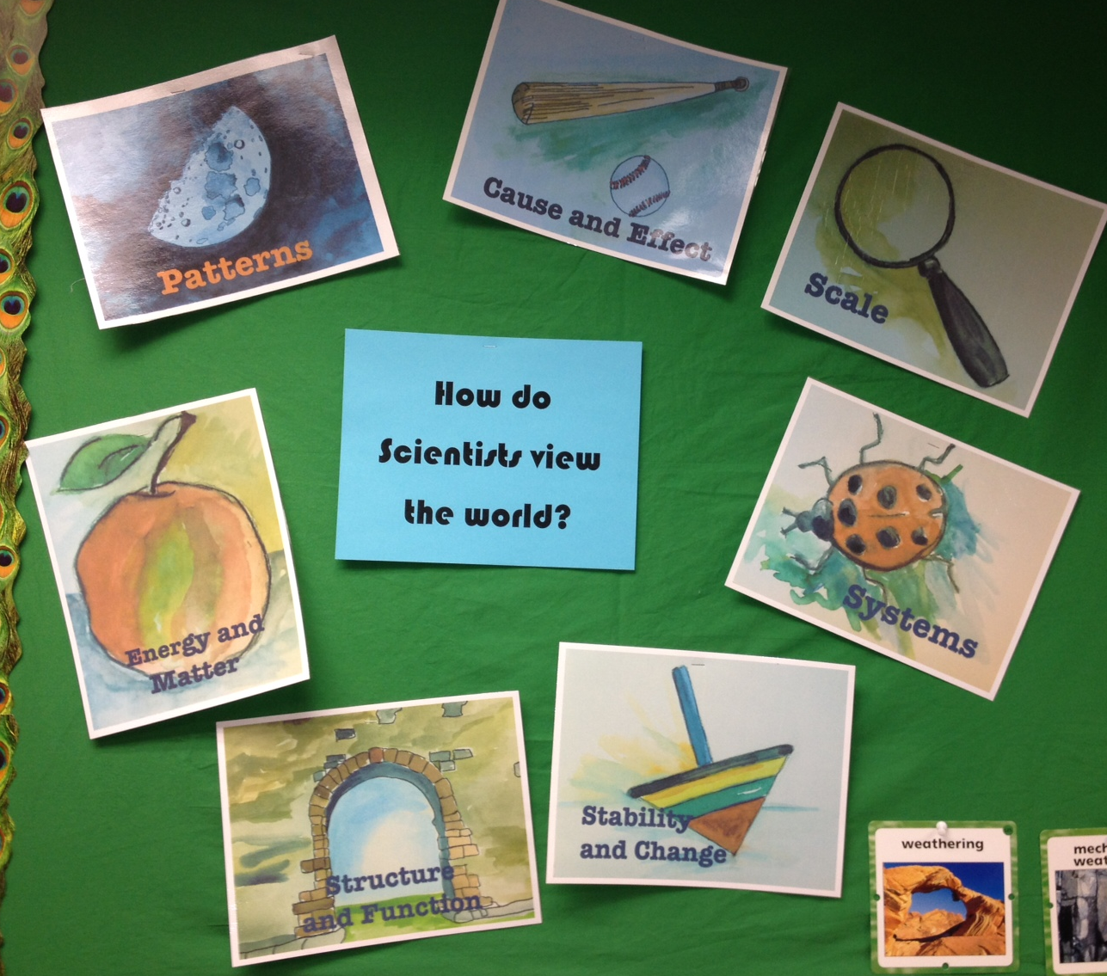
Crosscutting Concepts
Patterns
Cause and Effect
Scale, Proportion, and Quantity
Systems and System Models
Energy and Matter: Flows, Cycles, and Conservation
Structure and Function
Stability and Change
Notes:
Quickly review the 7 CCCs that were chosen for the NGSS. This picture from a second grade class. Artwork by James Taylor.

Slide 23
Eight Practices of Science and Engineering Included in NGSS
1. Asking questions and defining problems
2. Developing and using models
3. Planning and carrying out investigations
4. Analyzing and interpreting data
5. Using mathematics and computational thinking
6. Constructing explanations and designing solutions
7. Engaging in argument from evidence
8. Obtaining, evaluating, and communicating information
Notes:
The eight practices of science and engineering that the Framework identifies as essential for all students to learn and describes in detail are listed below:

Slide 24
Sample Performance Expectations
Matter and Energy in Organisms and Ecosystems
http://www.nextgenscience.org/5meoe-matter-energy-organisms-ecosystems

Slide 25

Let’s see what is available…
Teaching Channel:
https://www.teachingchannel.org/videos/math-teaching-techniques
https://www.teachingchannel.org/videos/visualizing-geometry-lesson
https://www.teachingchannel.org/videos/increase-engagement-and-understanding?fd=1
https://www.teachingchannel.org/videos/using-the-arts-to-promote-critical-thinking?fd=1
https://www.teachingchannel.org/videos/teaching-democracy-through-art
Notes:
Art for art’s sake is the ultimate goal. Now here is the but – not everyone shares this ideal in education. I come from the very academic side of education. I talk to these people every day. Some teachers teach art as a core subject, many do not. What I have for you here are some examples of teachers bringing the arts into the classroom in different ways. Many teachers don’t teach the arts because to be honest, they don’t know how and they don’t feel comfortable teaching something they are not confident in. I won’t show the entire videos here but I want to share a few examples that you might be able to bring back to your schools to encourage other teachers to find a comfort level and try it out.
Rappin Math start and then 5:45, 12:30
Visualizing Geometry – modeling abstract thinking in concrete ways
Interactive stations
Using arts to develop Critical thinking: 12:30 13:40 CCSS
Teaching Emotions Through Dance: 00:37-01:32, and 01:33-2:57, and 10:05-11:05, and 13:13-14:37

Slide 26
Fight for The Arts
Like a small boat
On the ocean
Sending big waves
Into motion
Like how a single word
Can make a heart open
I might only have one match
But I can make an explosion
Rachel Platten, 2015
https://www.youtube.com/watch?v=xo1VInw-SKc
Read more:
- Fight Song Lyrics | MetroLyrics
Notes:
One last idea to share with you today. Teachers are under tremendous pressure. Principals are under tremendous pressure. We are all busy with new standards and assessments. I tis overwhelming and I don’t envy any of you at this point. BUT it is a multi-year process and teachers are like superman in what they manage to accomplish in a day. Ask for help and collaborate with other teachers. It makes a difference – even if you are just crying together. With that I want to to say, each and everyone of you makes a difference in a student’s life. You may not ever receive the recognition but you do. Keep fighting and remember this.

Slide 27

Every child is an artist. The problem is how to remain an artist once we grow up.
Pablo Picasso

Slide 28

Contact Information
Carrie Roberts
916 324-6599
croberts@cde.ca.gov
Mary Rice
916 319-0270
mrice@cde.ca.gov

