Slide 1

Tutorial of Module 12
Notes:
Welcome to Module 12: Leadership in Arts Education. This is part of Creativity at the Core, a project of the CCSESA Arts Initiative. Thank you to the Los Angeles and Riverside County Office of Education for the development of the module.

Slide 2

Tutorial Audience
Administrators at these levels:
County Level Administrators
District Level Administrators
District VAPA Leads
VAPA Chairpersons
School Site Principals
Notes:
If you found this, the module is for YOU! Regardless of where you are on your arts education leadership path, you’ll find something beneficial.
PC: https://p1.pxfuel.com/preview/618/828/956/acoustic-guitar-guitar-musical-instrument-music.jpg

Slide 3
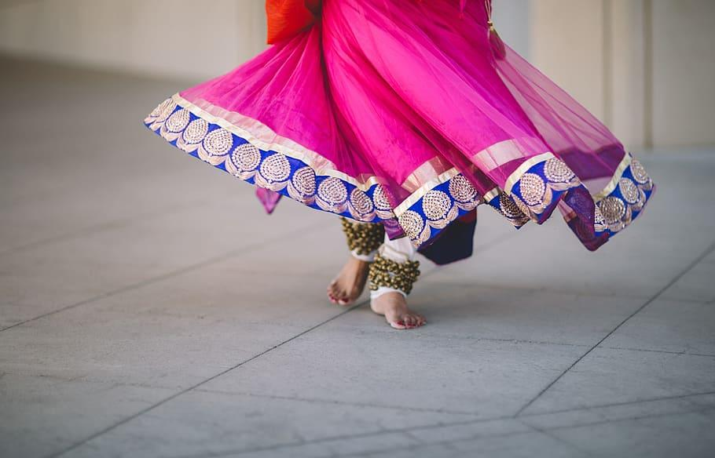
Module Purpose
Module 12: Leadership in Arts Education
The intent of Module 12: Leadership in Arts Education is to provide a ‘go-to’ resource for administrators to learn how to build a sustainable arts education program and support their general and arts specialist teachers.
The sections address advocacy, strategic planning, partnerships, arts integration, cultural responsiveness, equity, evaluating arts programming, understanding the California Arts Education Framework and California Arts Standards for Public Schools, and learning about program sustainability. This module includes multiple PowerPoints and videos that can be a self-paced course or used to train others.
Notes:
We are so glad you are here!
PC: https://p0.pxfuel.com/preview/397/230/566/floor-people-woman-dancing.jpg

Slide 4

Materials Needed
All you need is…
Committing to various chunks of time for:
Content PowerPoints & Webinars
(approx. 15 minutes each)
Take Five for Arts Ed Videos
(each approx. 5 minutes long)
Notes:
The module was developed to be accessible and chunked into digestible segments.
PC: https://p1.pxfuel.com/preview/737/511/737/still-items-things-picture-frames-wood.jpg

Slide 5

Module Overview of Key Topics
This module is divided into seven sections.
Section 1: Leadership in Arts Education Overview
Section 2: An Administrator’s Guide to Arts Advocacy
Section 3: Cultural Responsiveness in Arts Education
Section 4: Arts Integration Leadership
Section 5: Arts Partnerships
Section 6: Leadership Development through Creative Action Planning
Section 7: Take Five for Arts Ed
Notes:
There are several sections to fully address leadership in arts education. Each section was developed by a statewide leader and are rich in content and resources.
PC: https://p1.pxfuel.com/preview/1008/874/360/fabric-swatches-colorful-sample-cloth-textile.jpg

Slide 6


Take Five for Arts Ed
See the Playlist in the Resources!
Take Five for Arts Ed is an inspirational space for leaders and an important component of Creativity at the Core Module 12: Leadership in Arts Education. The video series highlights school arts leaders in diverse settings across the state. The videos are about FIVE minutes long and answer FIVE questions. The video assets are linked below and are a resource for Module 12.
What is the first arts experience you remember?
What is your favorite art form? Why?
Why do you value the Arts for students?
How are you making a place for the Arts in your sphere of influence?
What advice would you give an upcoming leader (site, district, county, organization) in arts education?
Notes:
We are excited to share these inspirational videos with you. Learn how others successfully supported arts education in California. Share them on social media, use them to open a meeting, or just “take five” and be inspired yourself.
PC: https://p1.pxfuel.com/preview/558/648/989/clapper-board-clapper-movie-film.jpg

Slide 7
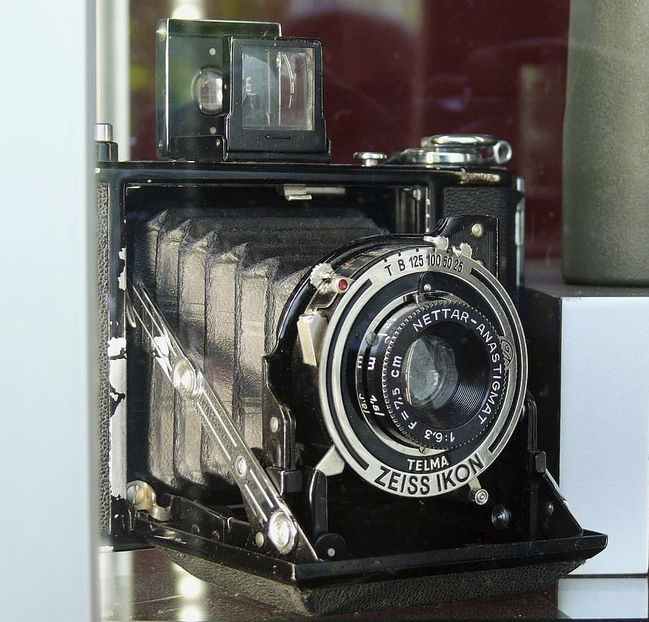
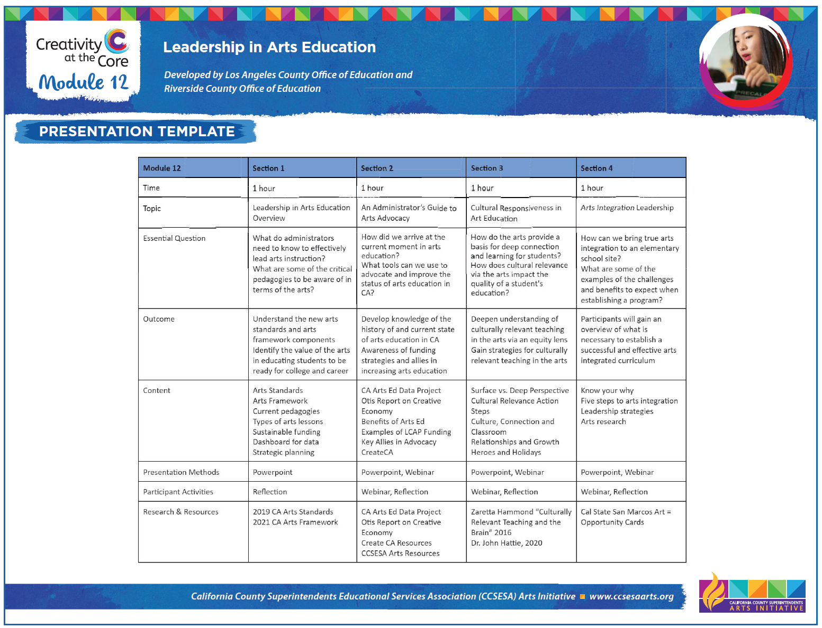
Presentation Chart
Visit the Presentation Template for a complete overview of Module 12: Leadership in Arts Education. It is available under the downloads.
Notes:
The presentation is an overview of all the sections.
PC: https://www.pxfuel.com/en/free-photo-jecry

Slide 8
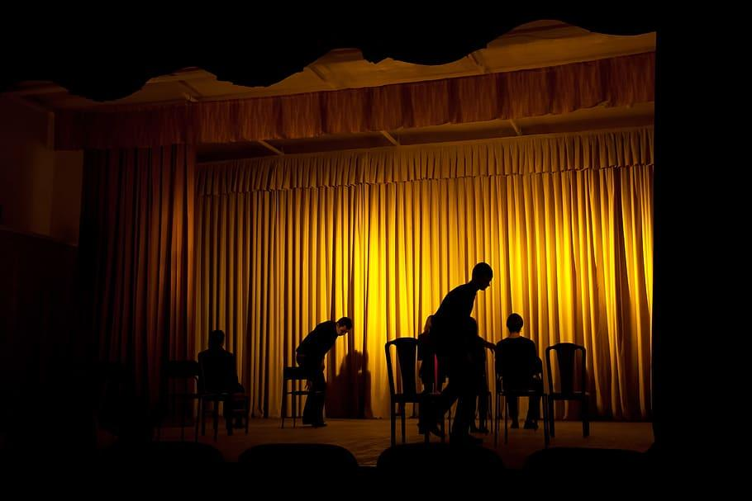
Content Outline, Handouts, & Resources
Here’s what you have access to:
Administrator’s Checklist
Administrator Observation Tool
Funding & LCAP Self-Assessment Tool
Arts Integration Handout
Arts Advocacy Handout
Overview Content Outline
Take Five for Arts Ed Videos
Content Webinars & PowerPoints
Notes:
There are several components that make up Module 12! Please visit the Resources and Downloads.
PC: https://p0.pxfuel.com/preview/118/109/114/act-arts-audience-backdrop.jpg

Slide 9





Jeannine Flores
Arts & STEAM Coordinator
Los Angeles County Office of Education
Region 11
Flores_Jeannine@lacoe.edu
Louisa Higgins
Arts Administrator
Riverside County Office of Education
Region 10
LHiggins@rcoe.us
Notes:
Reach out to Jeannine, Louisa, your county arts lead, or CCSESA Arts if you have any questions! Thanks.

