Slide 1

Arts Advocacy
with
Pat Wayne

Slide 2

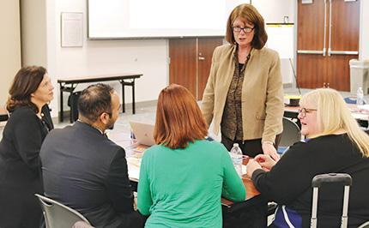
An Administrator’s Guide to Arts Education Advocacy
An Administrators Guide to
Arts Education Advocacy
Notes:
Protesters - https://openclipart.org/image/800px/213878
Collaborators – My personal photo

Slide 3
Administrators
Parents
Government agencies
The Arts Education Ecosystem
Educators
Students
Business
Teaching Artists
School Board Members

Slide 4

Photo by Tolga Ulkan
Notes:
Unsplash.com

Slide 5
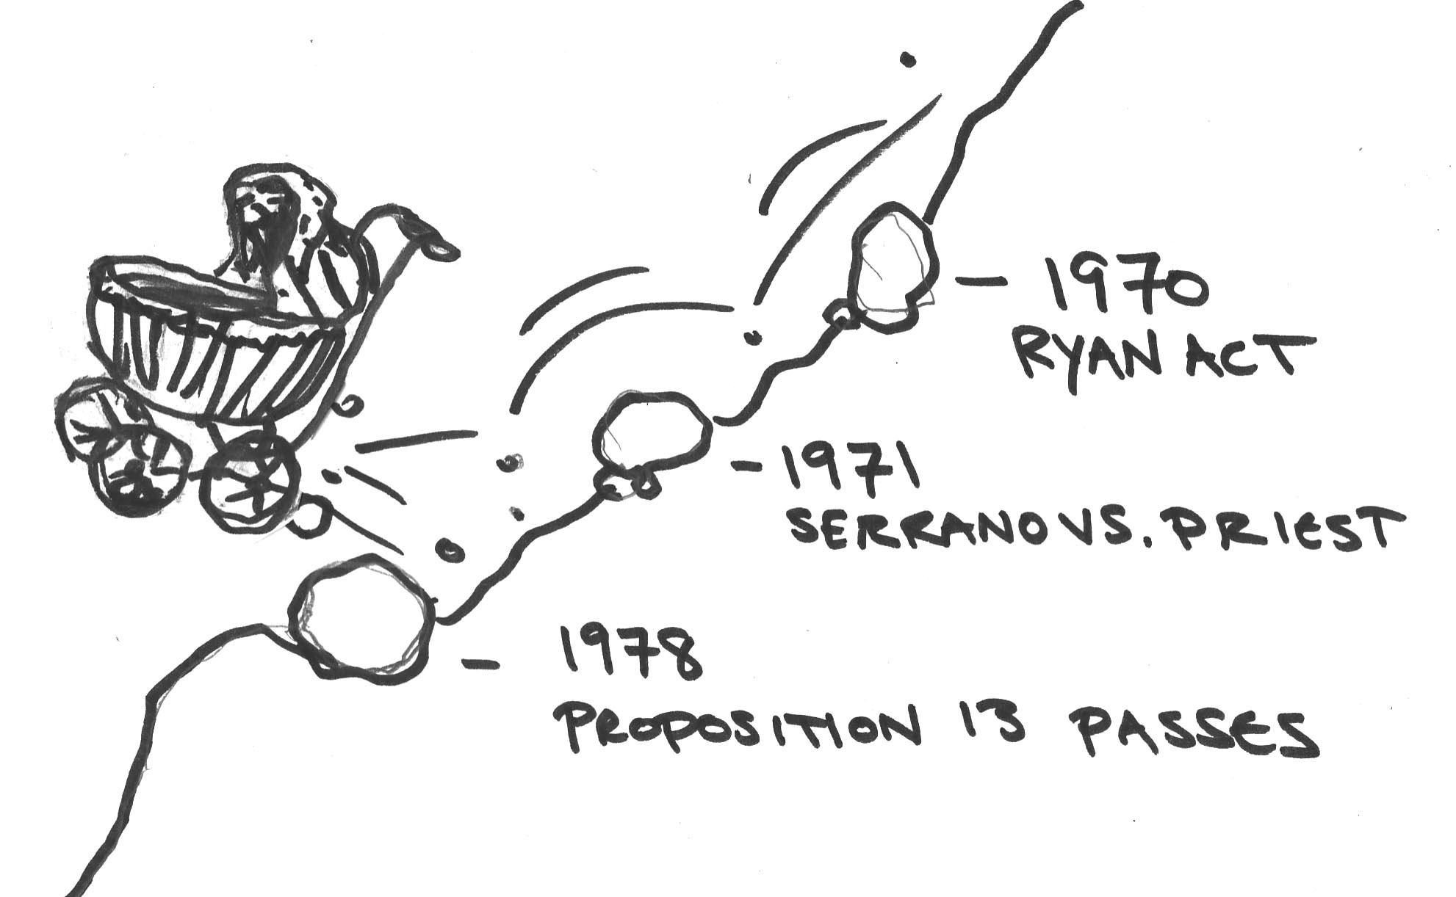

Outcome = Inequitable Arts ED

Slide 6


To the Rescue: PTA & Arts Orgs
Grants to
Arts Organizations
School
Fundraisers
Photo by Bob Ghost

Slide 7

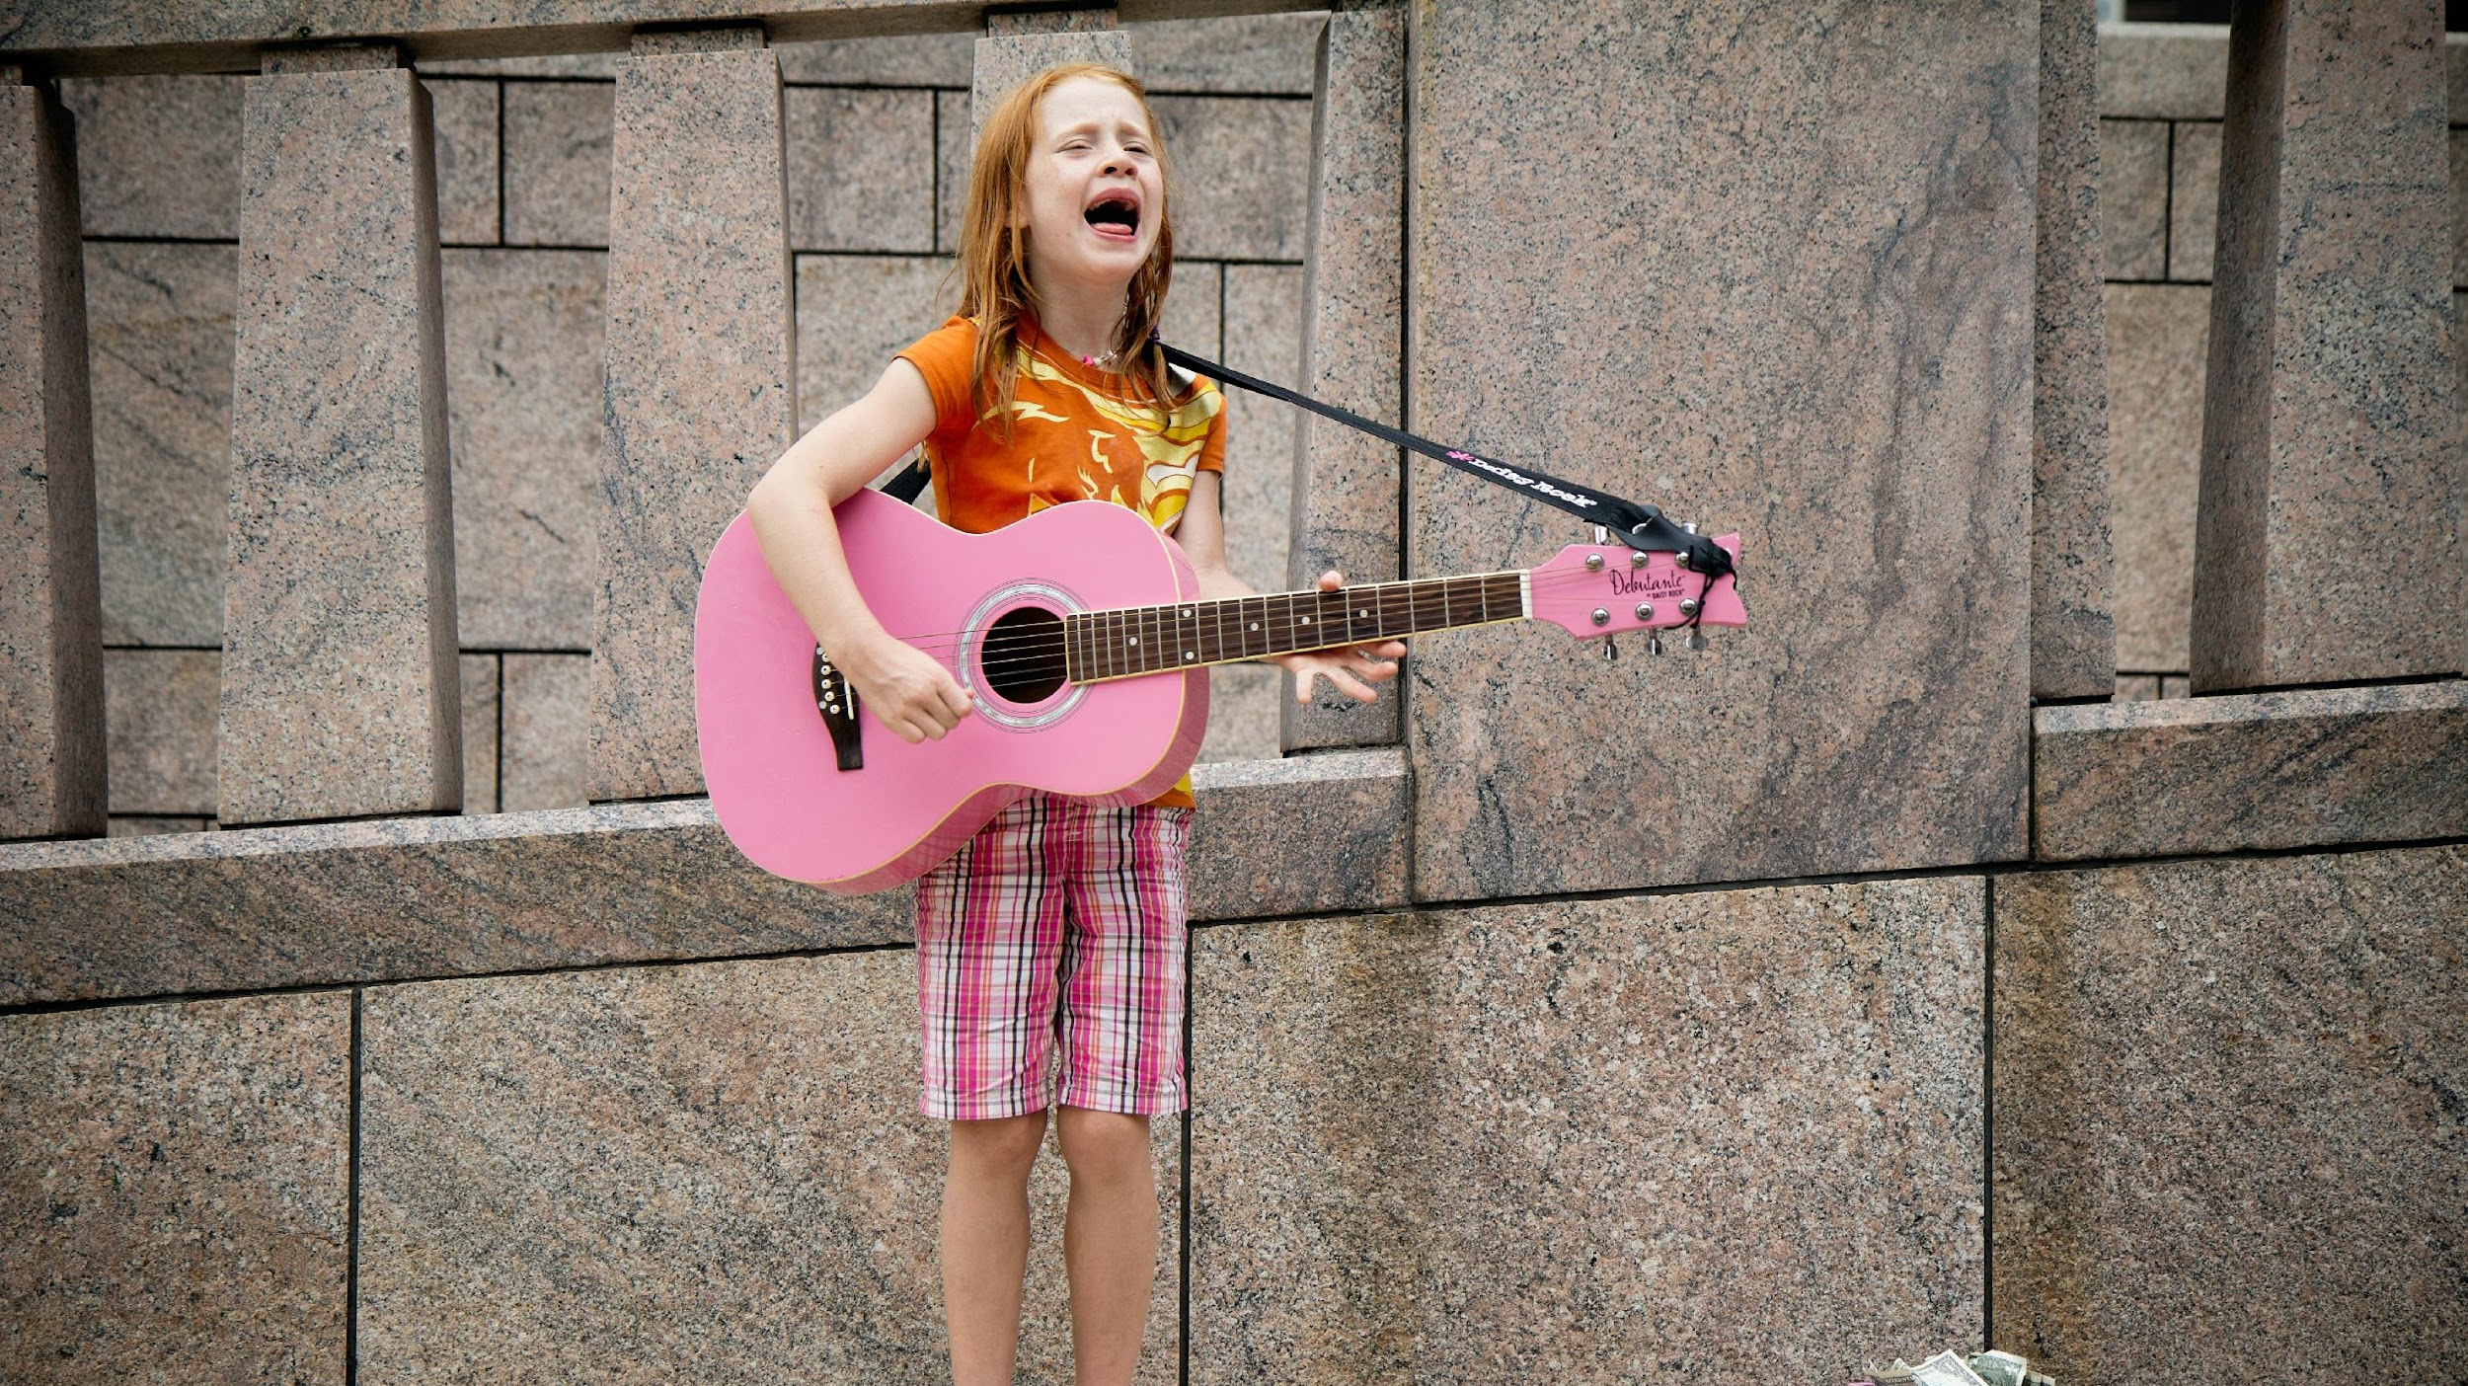


Building Creativity Muscles
Photo by senjuti kundu
Photo by felix koutchinski
Photo by kindred hues
Photo by kelly sikkema
Notes:
Arts Orange County paid image

Slide 8
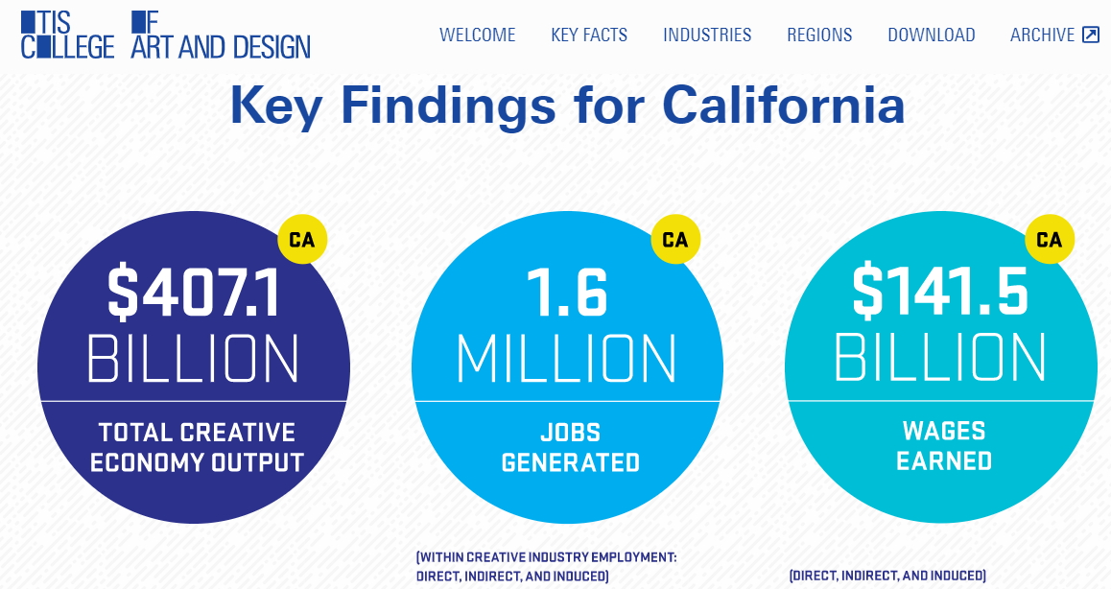
Pre-Covid 2018 Stats
Source: Otis College Resources on the Creative Economy
Notes:
Otis College of Art & Design Report

Slide 9
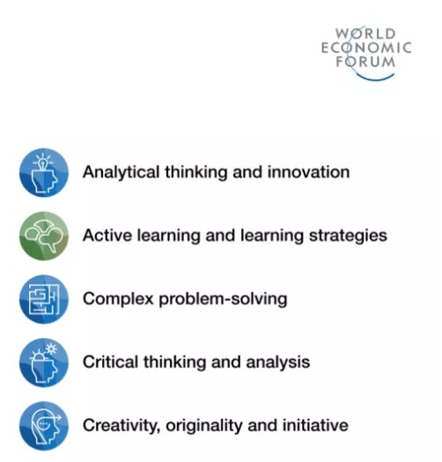
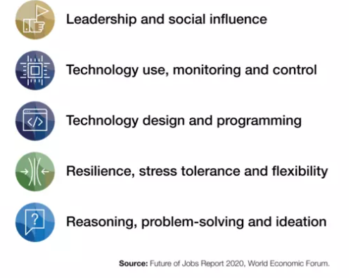
Top Ten Skills of 2025
Source: World Economic Forum- Top Ten Skills of 2025

Slide 10
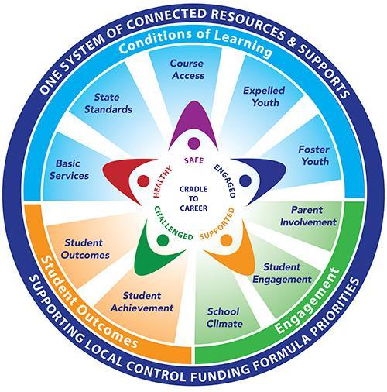
Arts as a Solution Partner
Accomplishing the 10 Priorities
Priority 2: Accomplishing the State Standards
Priority 5 : Student Engagement
Priority 7: Course Access
Notes:
Image – CDE website

Slide 11
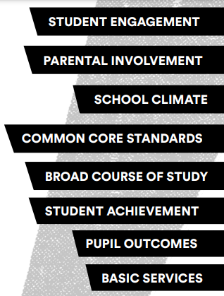
Arts and the Local Control Funding Formula
Benefits of an Arts Education
Higher attendance rates and lower dropout rates
Increases parent and community involvement
Decreases disciplinary problem and encourages
positive student attitudes
Boosts test scores and achievement in literacy, math skills
especially for English Language Learners and low income students
Increases graduation rates, fosters 21st century work skills
such as creativity, critical thinking and collaboration
Source: Create CA LCFF flyer
Notes:
Image from Create CA flyer:

Slide 12
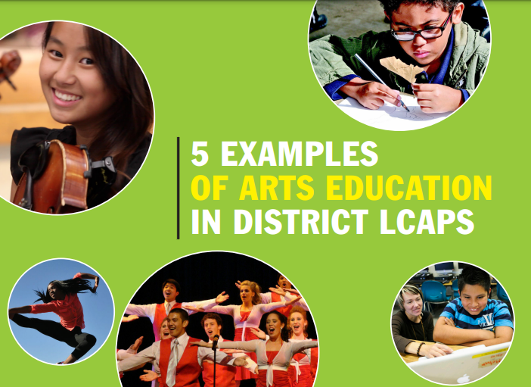
Notes:
Front cover of report

Slide 13

FRAMING POINTS
  Arts for Every Student is not new
  Compliance with Ed Code
  State Standards and Framework
  Jobs in Creative Industry
  Achieve LCAP goals
STEP #1:
Frame the Issue for Decision Makers

Slide 14
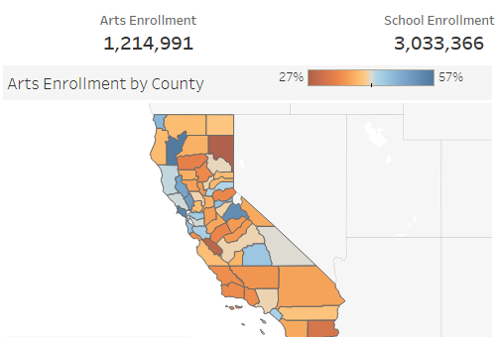
.
KNOW YOUR DATA
Create CA Data Project
Notes:
Screenshot of data project - https://createca.org/california-arts-education-data-project/

Slide 15
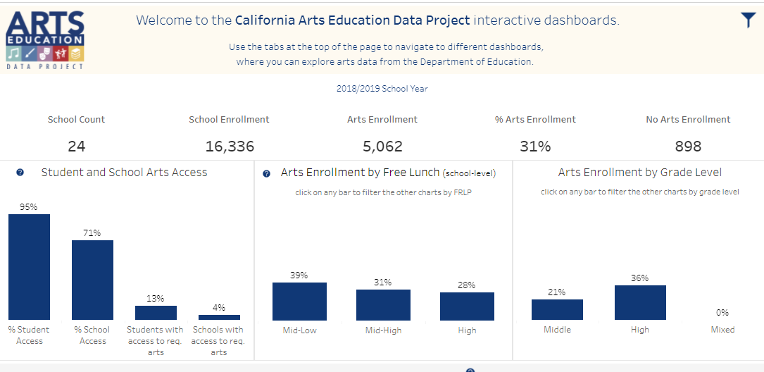
General Overview Dashboard
Create CA Data Project

Slide 16
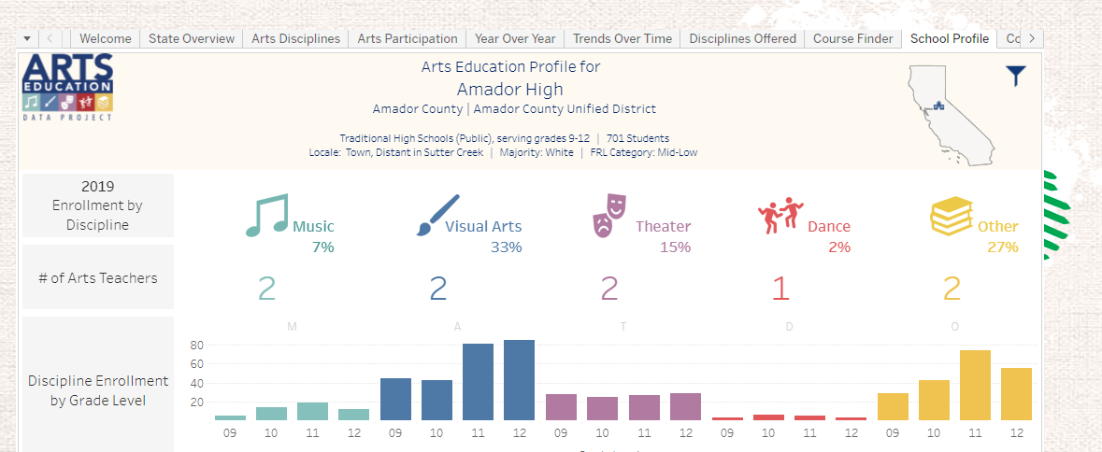
School Profile
Create CA Data Project

Slide 17

Steps to Improving
Arts Education
Determine the Ask
Make a Plan
Investigate the Data
Frame the Issue

Slide 18
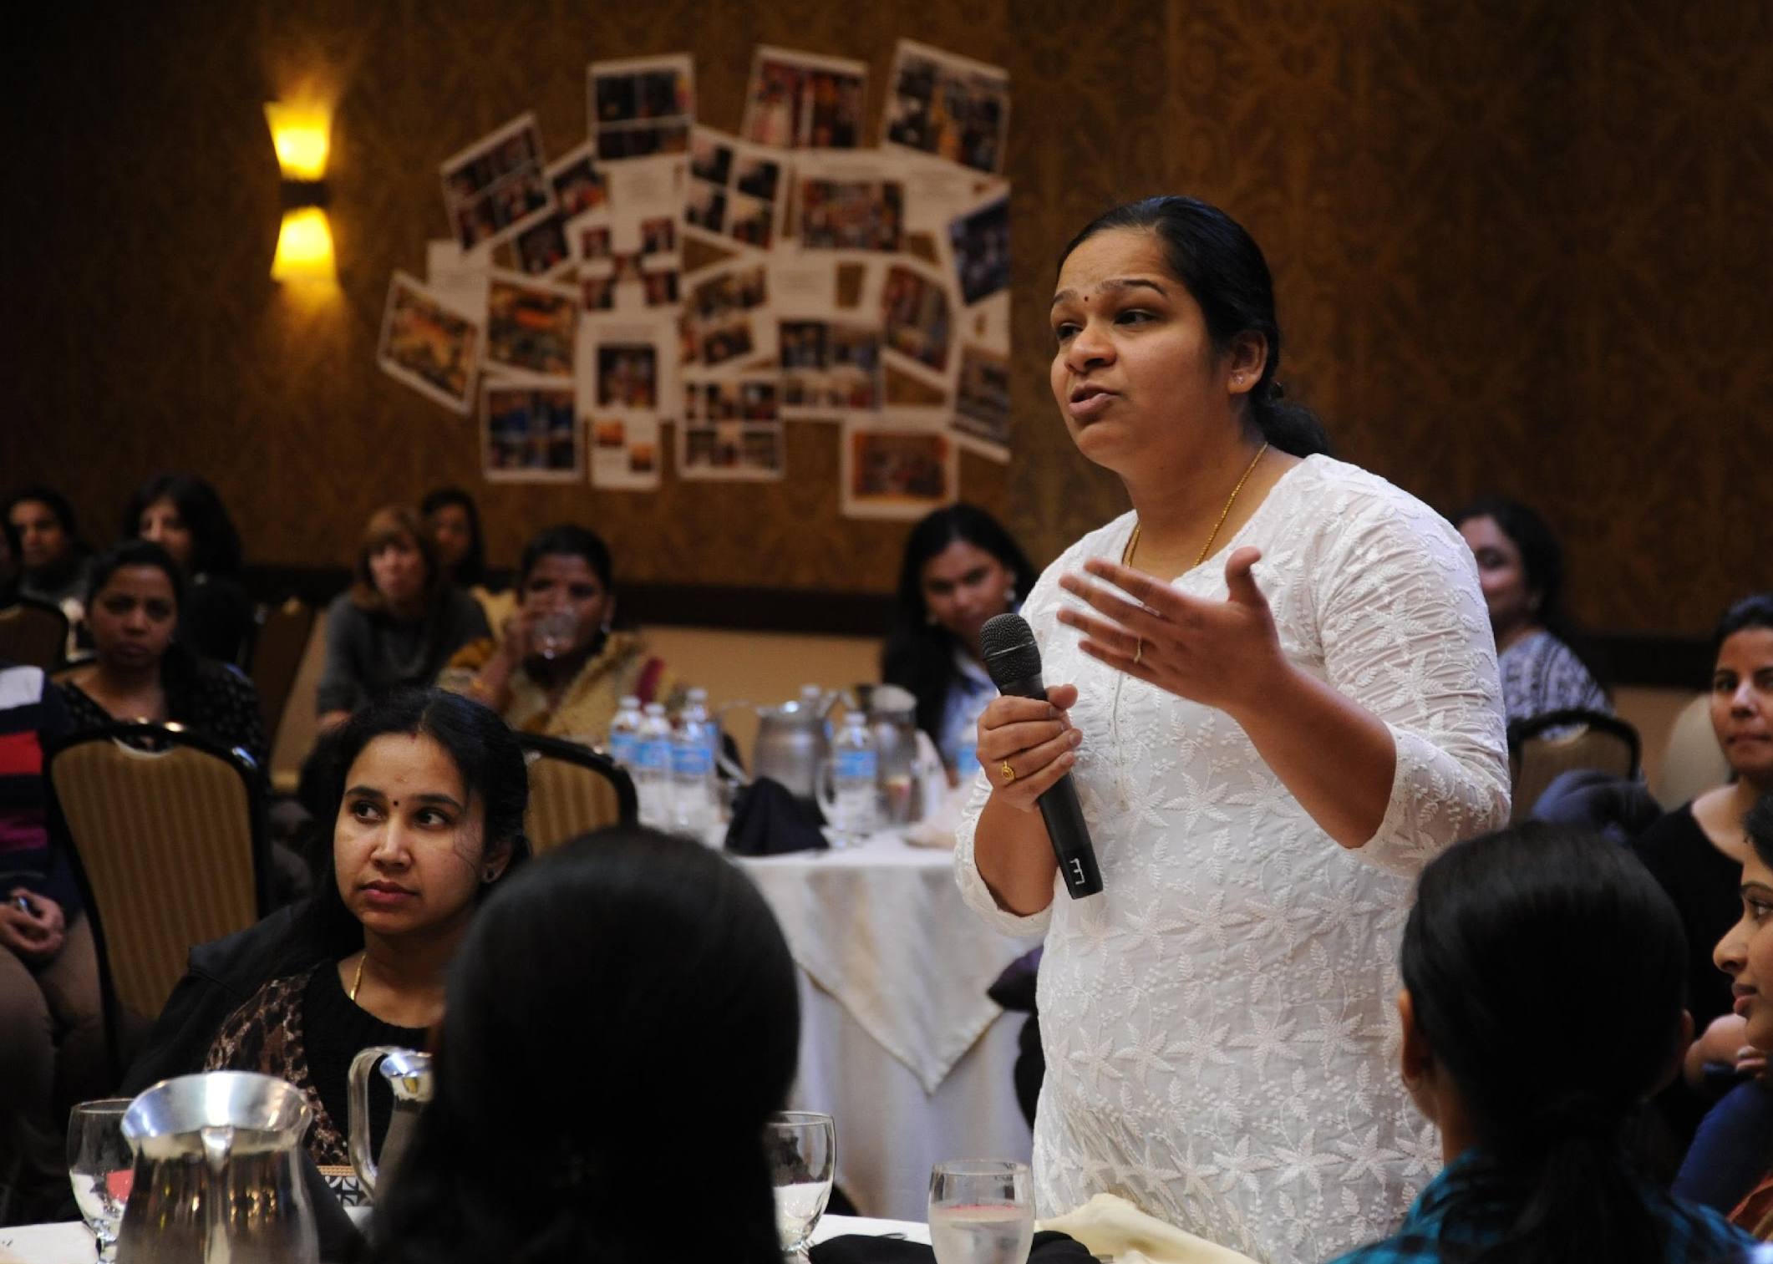
KEY Allies: Parents and Students
Photo by wonderlane
Notes:
Unsplash.com

Slide 19
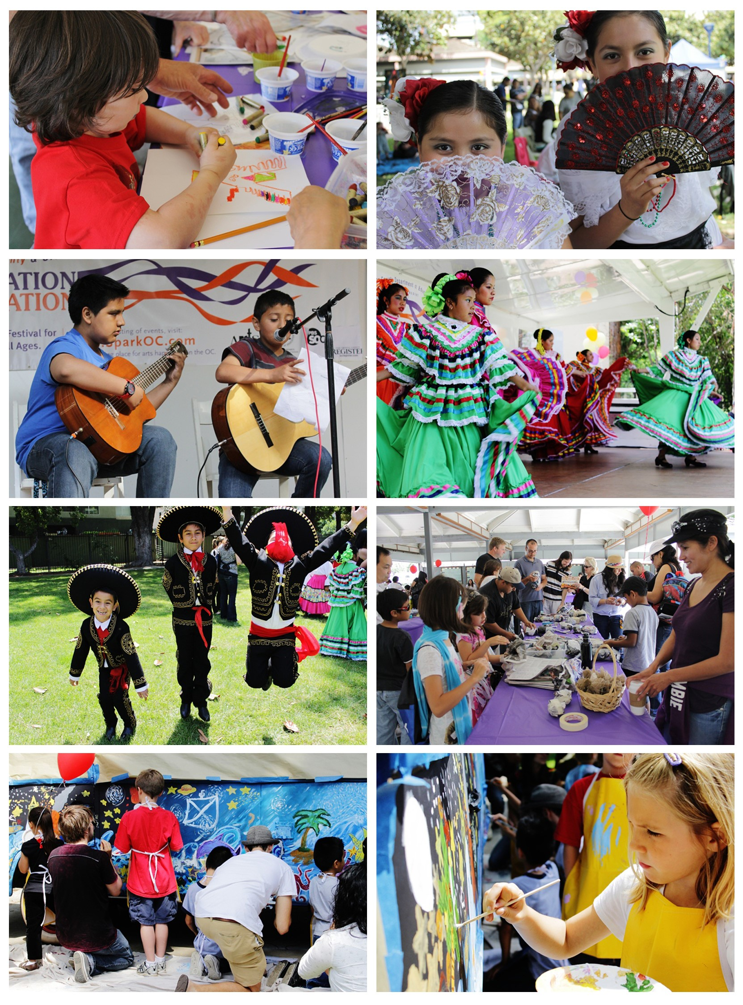


My Ask of YOU
Sign up for CCSESA’s Monthly Arts Newsletter
https://lp.constantcontactpages.com/su/V19NXgY/CaCountyArts
Advocacy
News
www.createca.org
Photos: Arts OC Imagination Celebration
Notes:
Photos taken by me

Slide 20
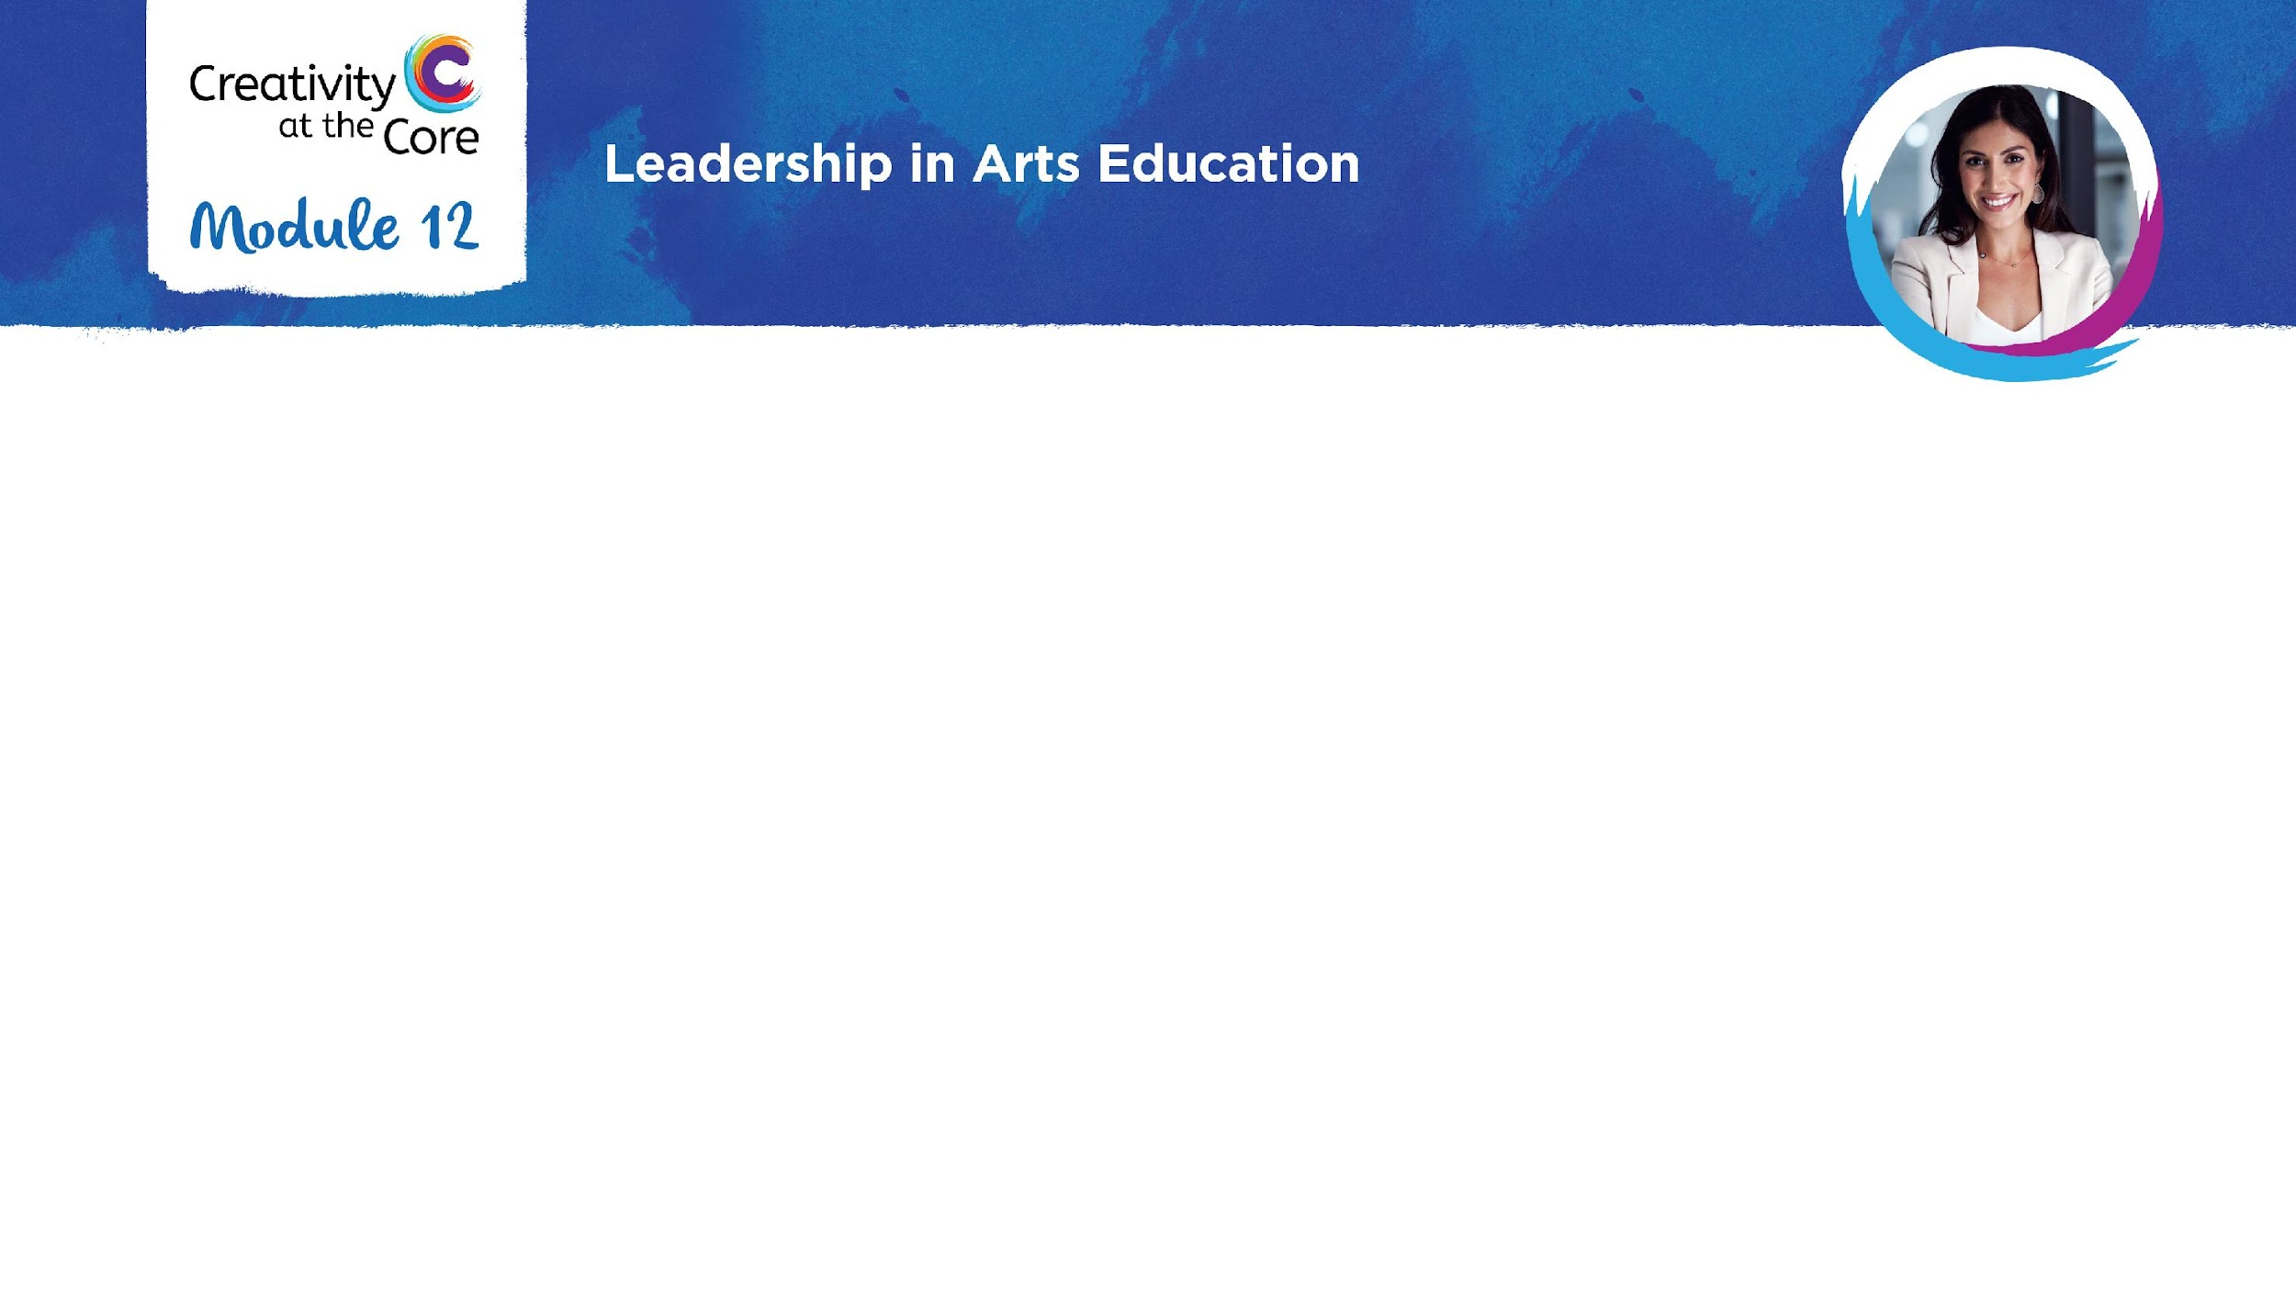
Your Next Step for Moving Forward:
Contact:
County Office Arts Lead
Director of CCSESA Statewide Arts Initiative who will connect you with a support team
CREATE CA Director of Programs
Don’t forget to check out the list of Resources for contact information

