Slide 1
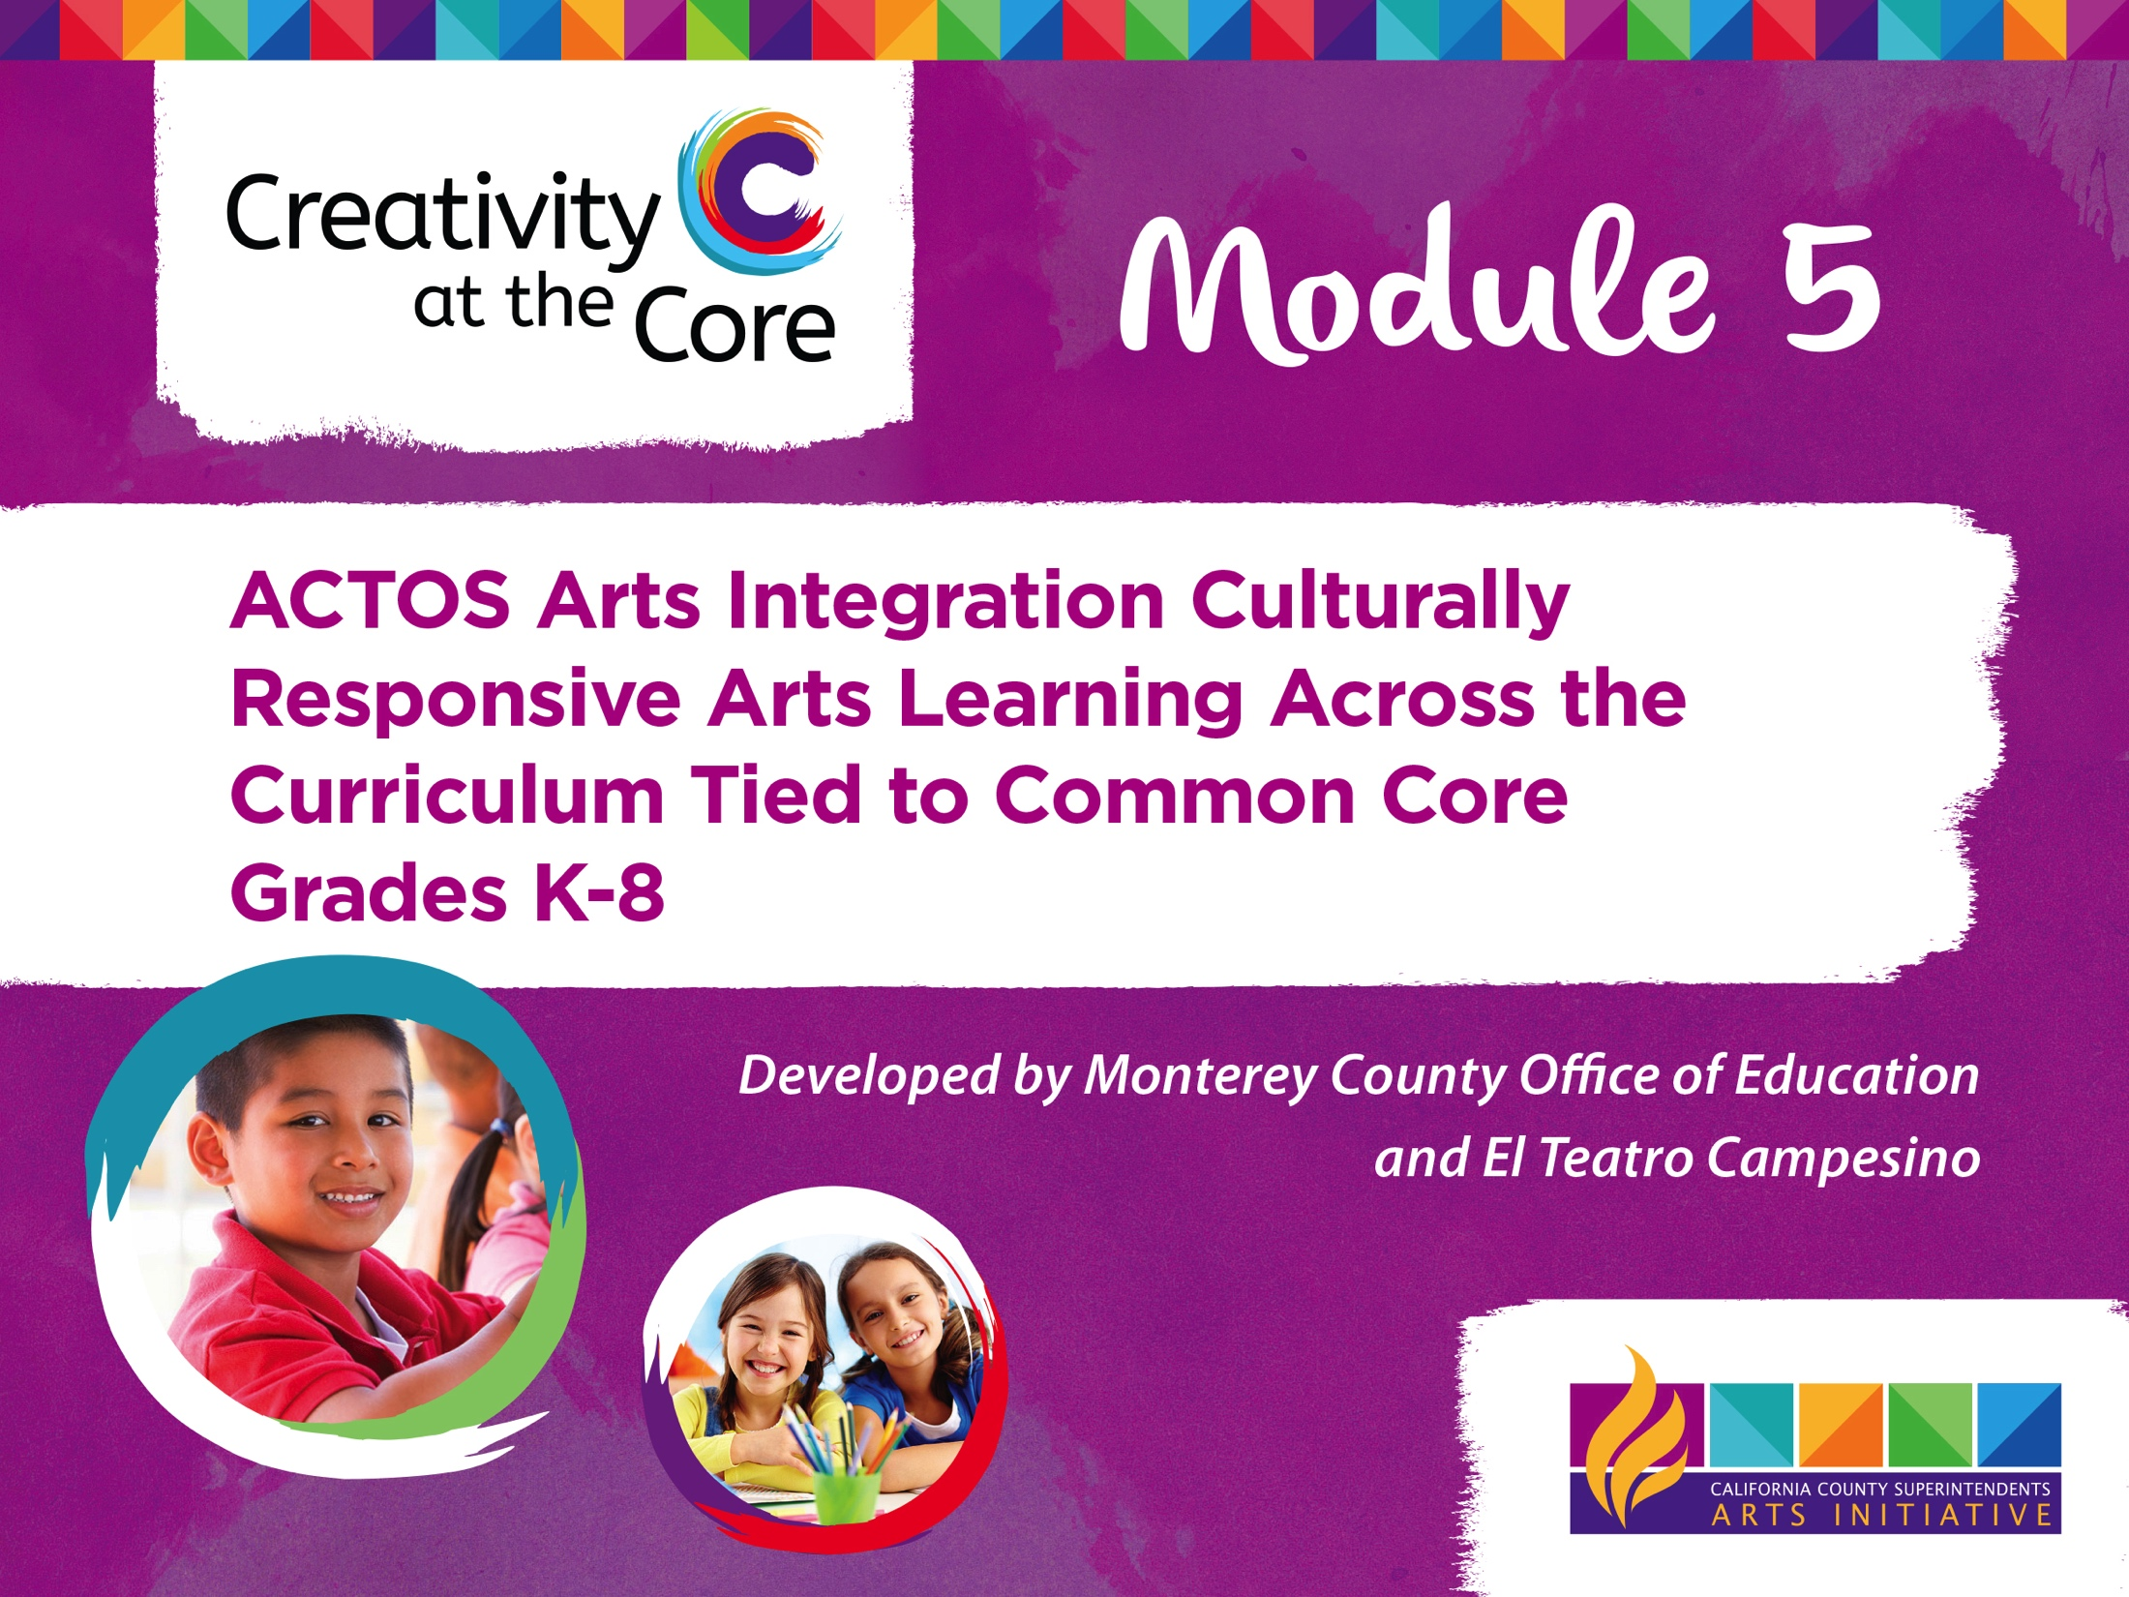

Slide 2
Arts Integration
Creativity at the Core
This module will cover key strategies for teaching arts integration that is culturally responsive.
The strategies in this module can be incorporated across the curriculum for K-8 teachers and learners.

Slide 3

21st Century Learners
Thinkers and problem solvers for the 21st century must possess the following abilities:
Analyze, synthesize and evaluate data
Apply knowledge to create new ideas
Find multiple solutions to problems
Predict and resolve conflict
Communicate and express new ideas
Work collaboratively

Slide 4
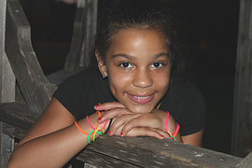
Future Thinkers
How will we impart these abilities to our future thinkers and problem solvers?
Education! Providing opportunities for our students to learn via the creative process.

Slide 5
CCSESA Arts Initiative
CCSESA Arts Initiative through funding from the California Arts Council has chosen MCOE to participate in the creation of professional learning modules focused Arts Integration and Common Core State Standards.

Slide 6
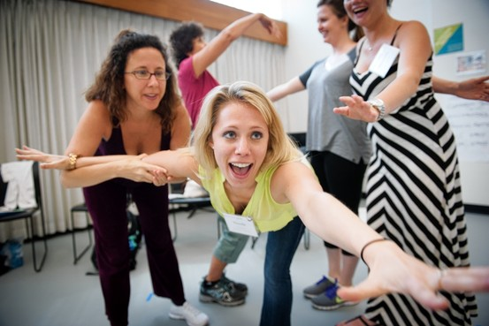
Regional Arts Leads and Arts Org Leaders
11 designated Regional Arts Lead County Offices will partner with arts organizations to develop and pilot one professional learning module focused on a key topic related to Visual and Performing Arts and Common Core State Standards.

Slide 7


Partnership
MCOE and world renowned theater company El Teatro Campesino have teamed up to develop a professional learning module that will provide arts integrated pedagogies tied to Visual and Performing Arts and CCSS.

Slide 8

El Teatro Campesino

Slide 9
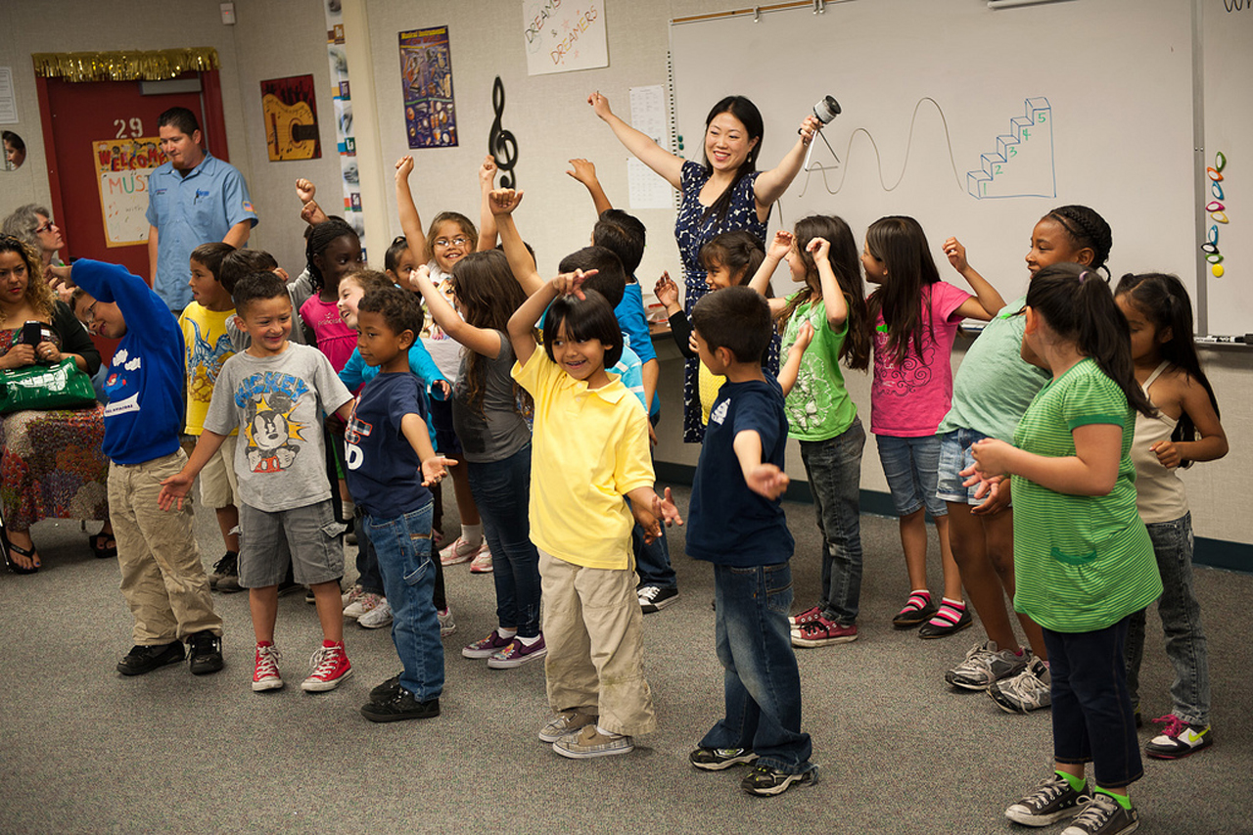
Creativity at the Core
ACTOS: Why theater?
https://www.youtube.com/watch?v=8Sr4P6woodk

Slide 10
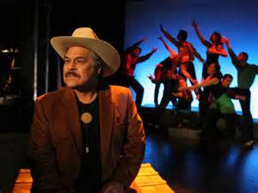
The Four Roads
Learn more about El Teatro’s work at:
http://hidvl.nyu.edu/video/000539742.html

Slide 11

A.C.T.O.S
Arts Integrated Instructional Pedagogy

Slide 12
A.C.T.O.S
A.C.T.O.S.
A.C.T.O.S is an arts integrated instructional pedagogy that ties visual and performing arts and CCSS instructional practices.
A.C.T.O.S is based in a culturally and linguistically responsive teaching pedagogy

Slide 13
A.C.T.O.S.
Activate Learner
Cultivate Meaning /Heart
Teach to Learn
Open Minds
Serve Community

Slide 14
A.C.T.O.S.
Activate Learner
Cultivate Heart and Meaning
VAPA Hands On
Kinesthetic Opener
Anticipatory Set
Ties to text or stimuli
Learners make meaningful connections with subject material
Laying groundwork for understanding

Slide 15
A.C.T.O.S
A.C.T.O.S.
Teach To Learn
Open Minds
CCSS
Model Skill Development &
Content Learning
Student Collaborative Practice
Reflection using the CCSS skill modeled

Slide 16
A.C.T.O.S
A.C.T.O.S.
Serve Community
Shared Learning
Check for Understanding
Demonstration
Ties to Kinesthetic Opener

Slide 17
Engagement
“Tell me and I forget
Show me and I may remember
Involve me and I’ll understand.”
- Chinese Proverb

Slide 18
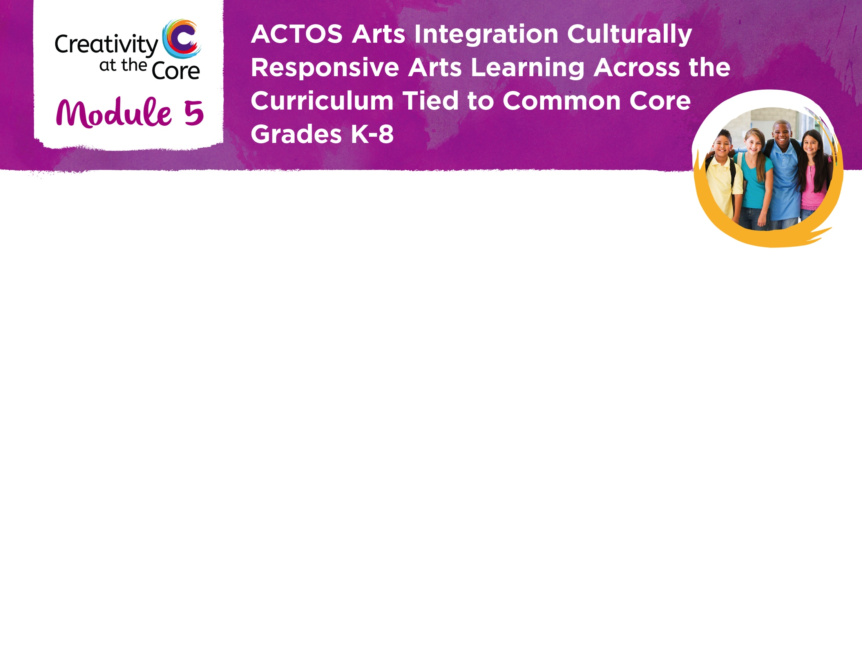
We hope you can utilize some of these strategies in your educational setting.

