Slide 1
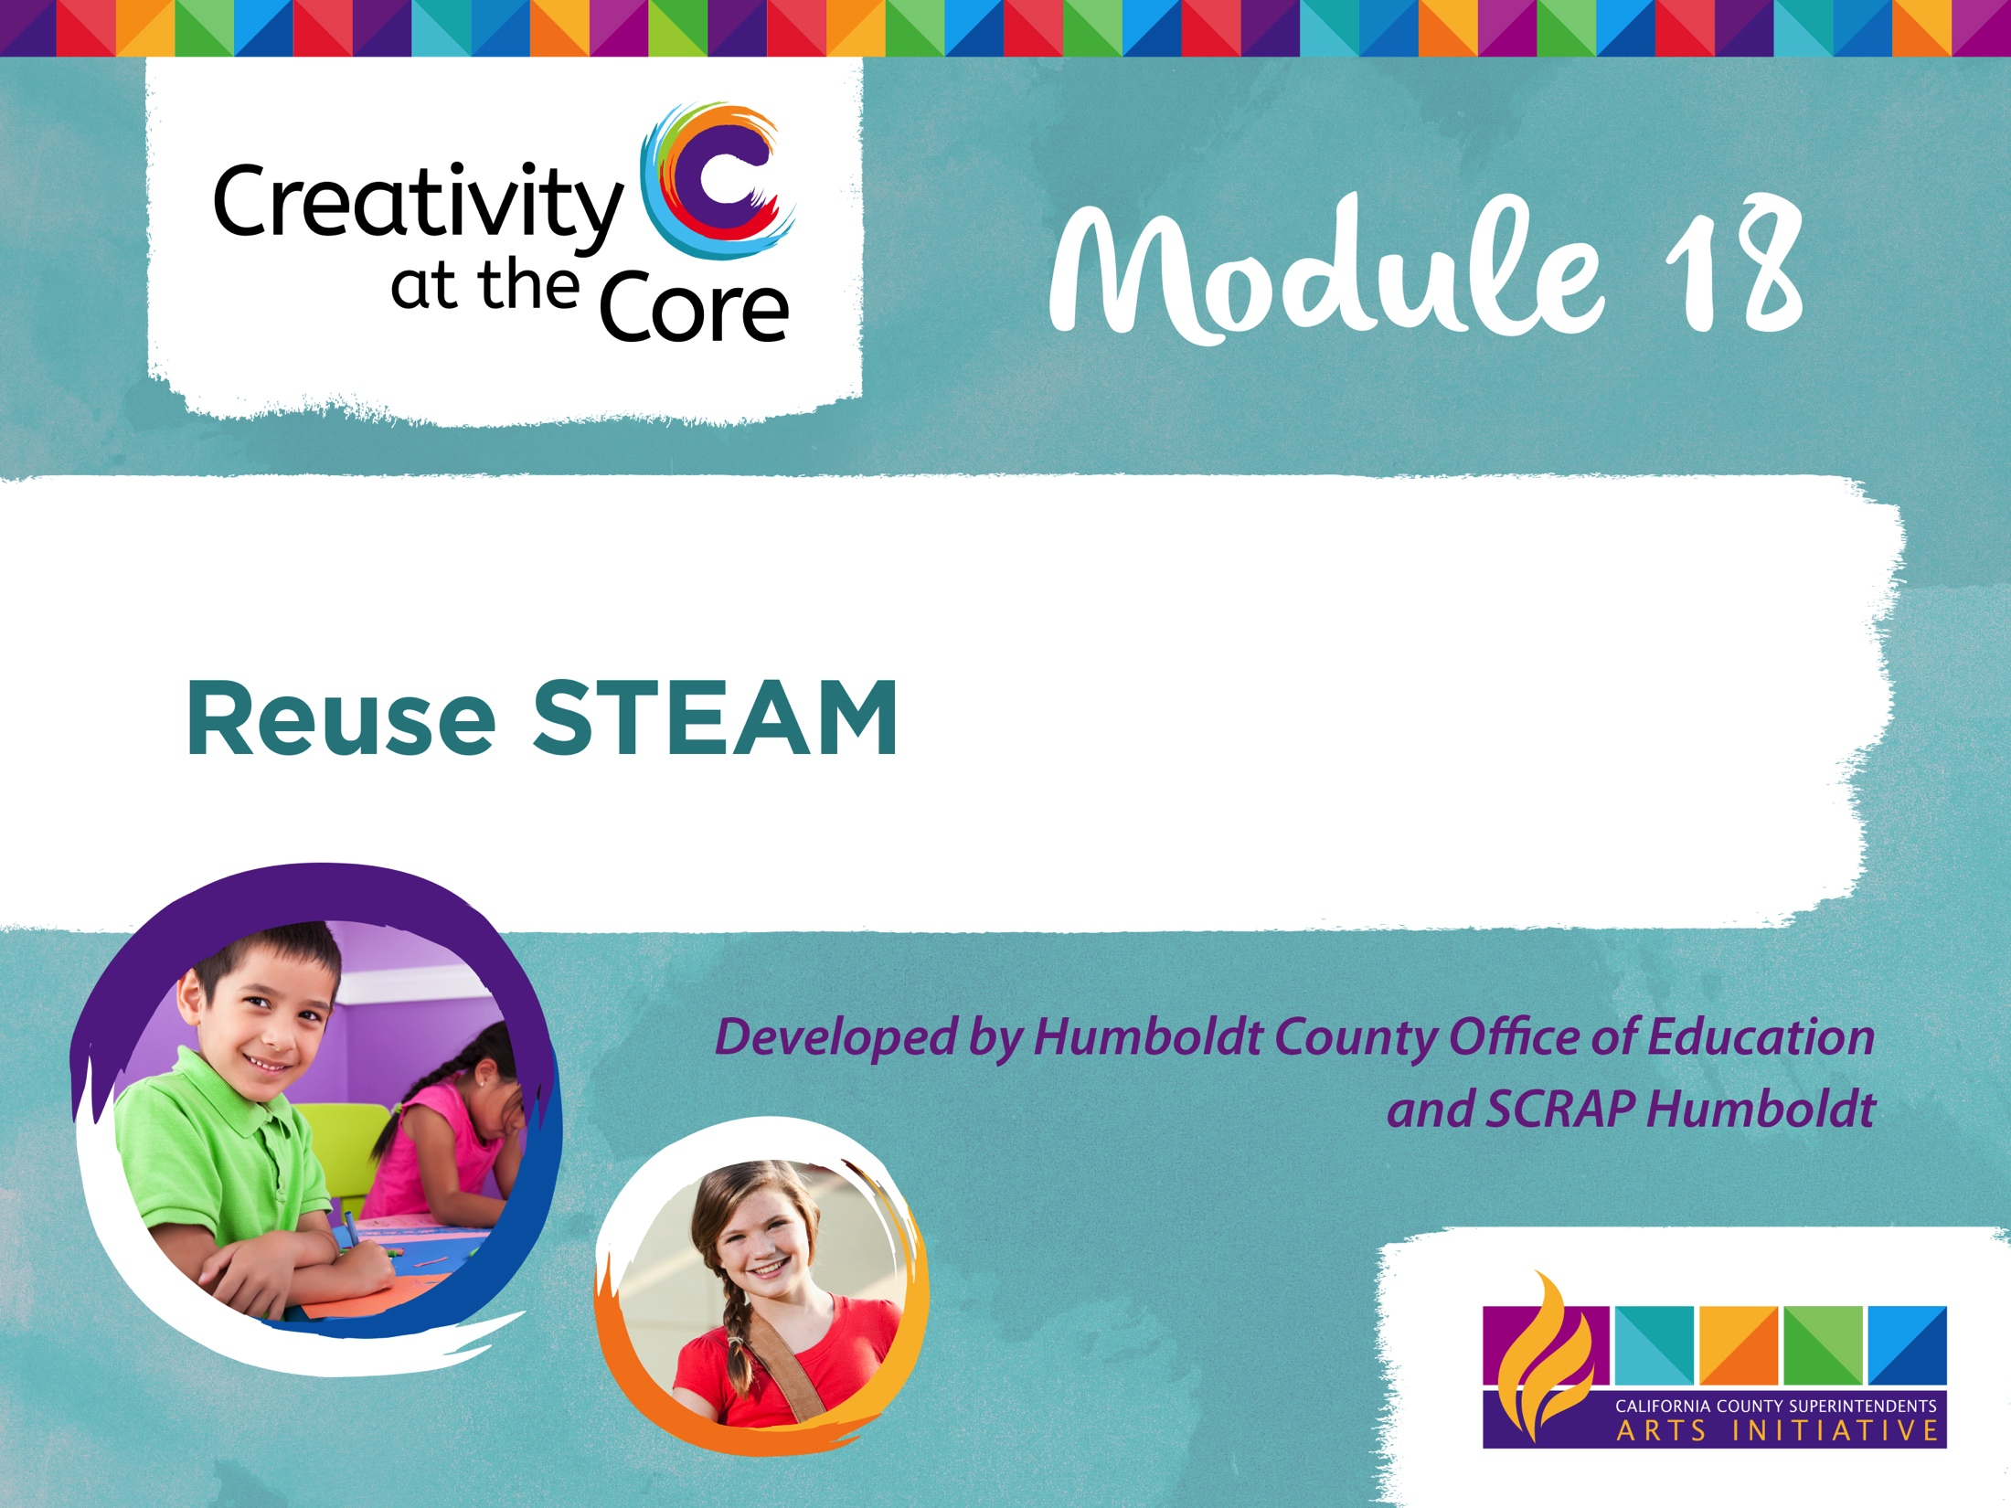

Slide 2
K-2: Paper, Paper Everywhere!
Theme:
Looking more closely at materials with short “life spans” that pass through their hands everyday, students will think critically about reducing waste by repurposing and redesigning these items.
Science, Technology, Engineering, Arts and Mathematics are integrated throughout this module.

Slide 3
K-2: Paper, Paper Everywhere!
In this module students will:
Explore the many ways they use paper each day
Design and conduct simple experiments to test the properties of different paper types
Learn how paper is made and recycled
Design and make their own recycled paper
Learn about the color wheel
Experiment with paper pulp as a painting medium for artistic expression
Create an iMovie trailer to document the process

Slide 4
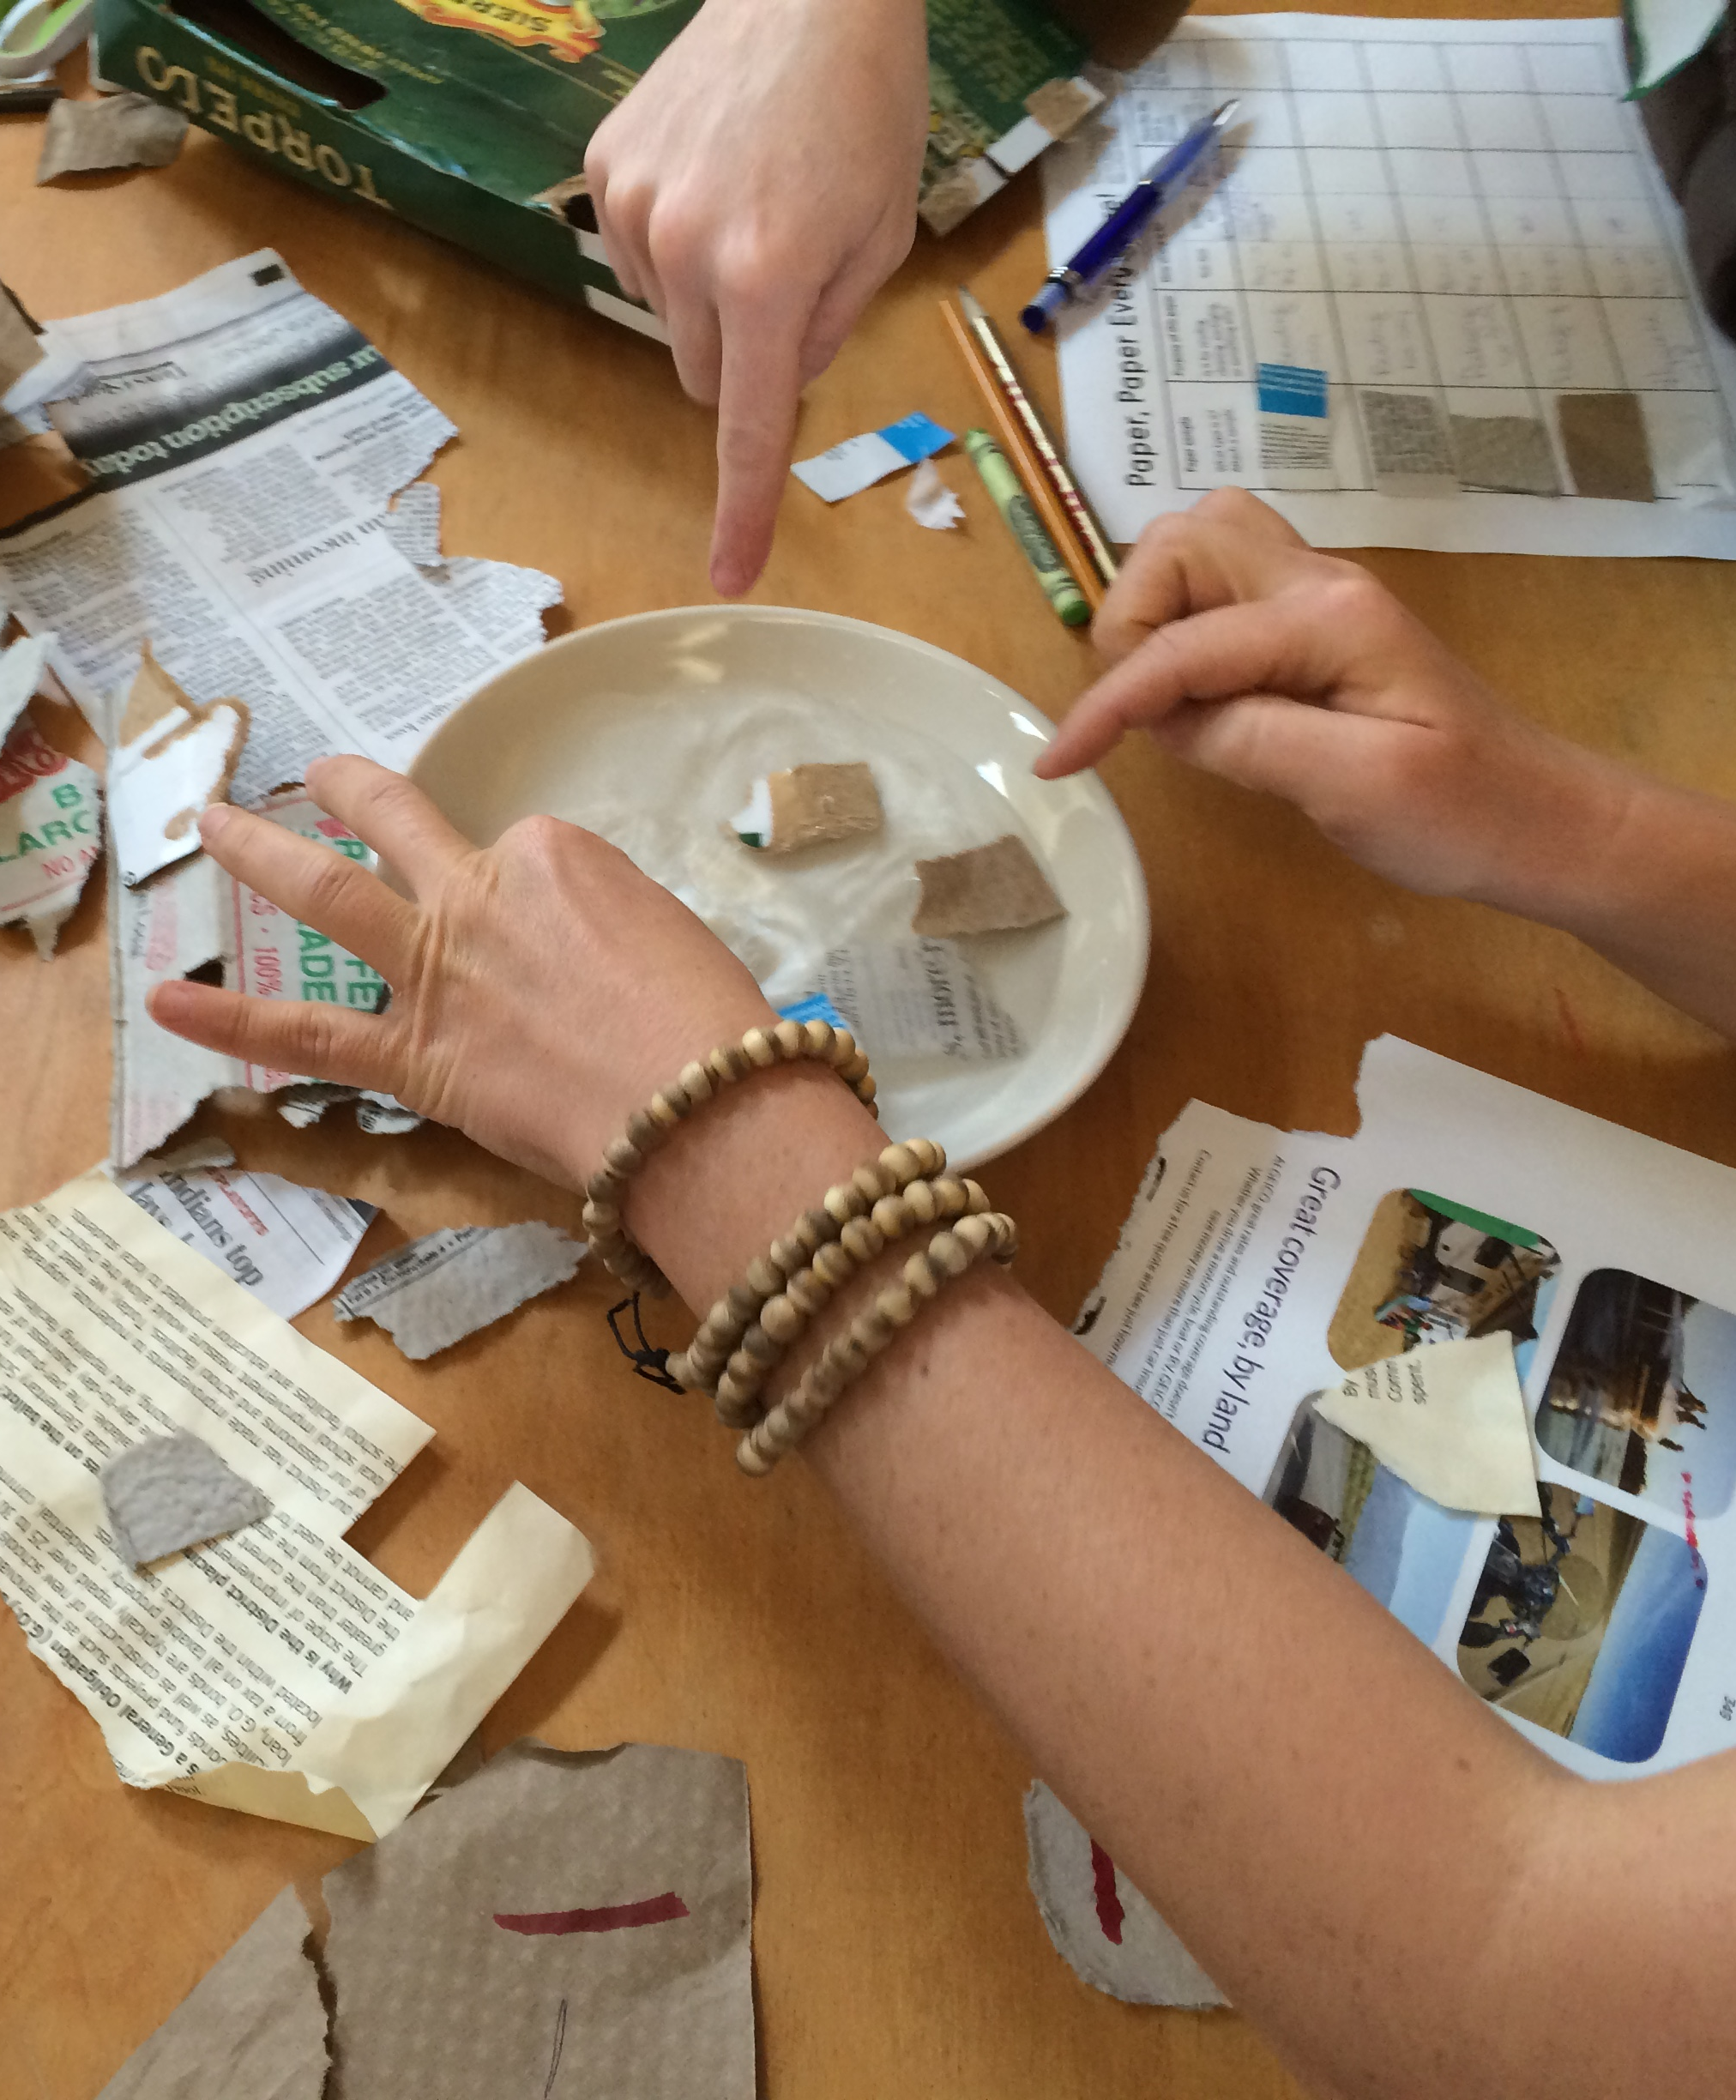
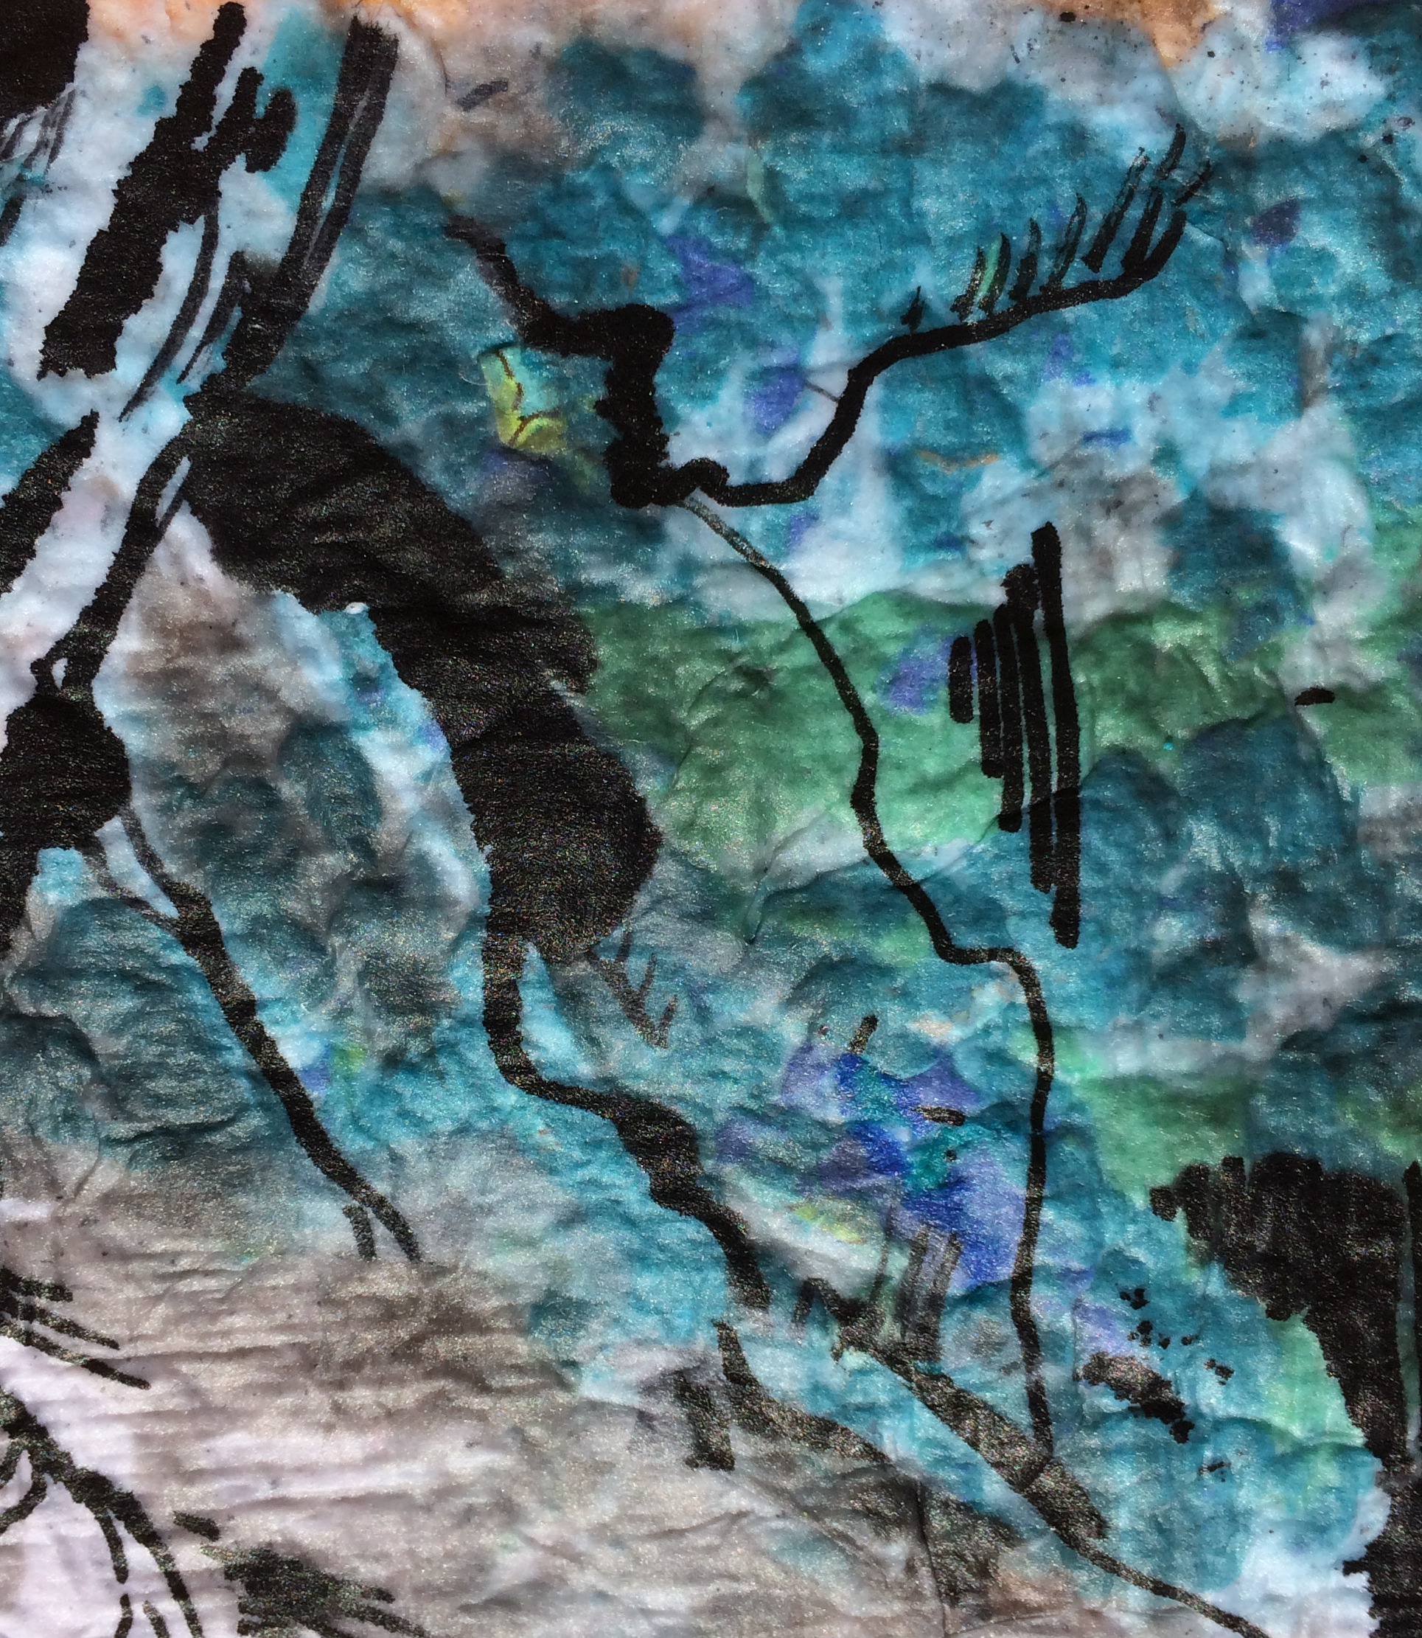
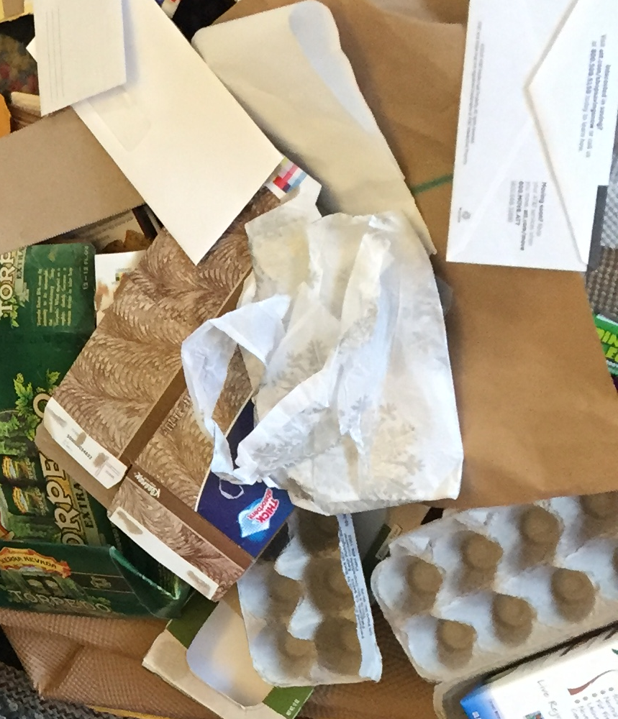
Process
Search Investigate Transform

Slide 5
Paper, Paper Everywhere!
Paper Search
Students search their classroom, school, and/or home for ways they use paper and collect a wide variety of samples
Notes:
Part 1: Paper, Paper Everywhere!
Ask students to conduct a search for paper in their classroom, school, and/or home to collect samples and get thinking about all the ways they use paper each day. Students should collect a wide variety of paper types (i.e. junk mail, paper towel, paper cup, cereal box, magazine, post-it note, birthday card, etc.) and bring their bag of samples back to class.

Slide 6
Paper, Paper Everywhere!
Categorize
What are the different paper samples used for?
Students work in small groups to organize paper samples into categories by use
Notes:
Categorize: Once a wide variety of paper products are collected, students work in small groups to organize them into categories. Talk with the class to generate a list of category types (e.g. packaging, reading material, cleaning, etc.) by asking for their ideas about paper uses.

Slide 7
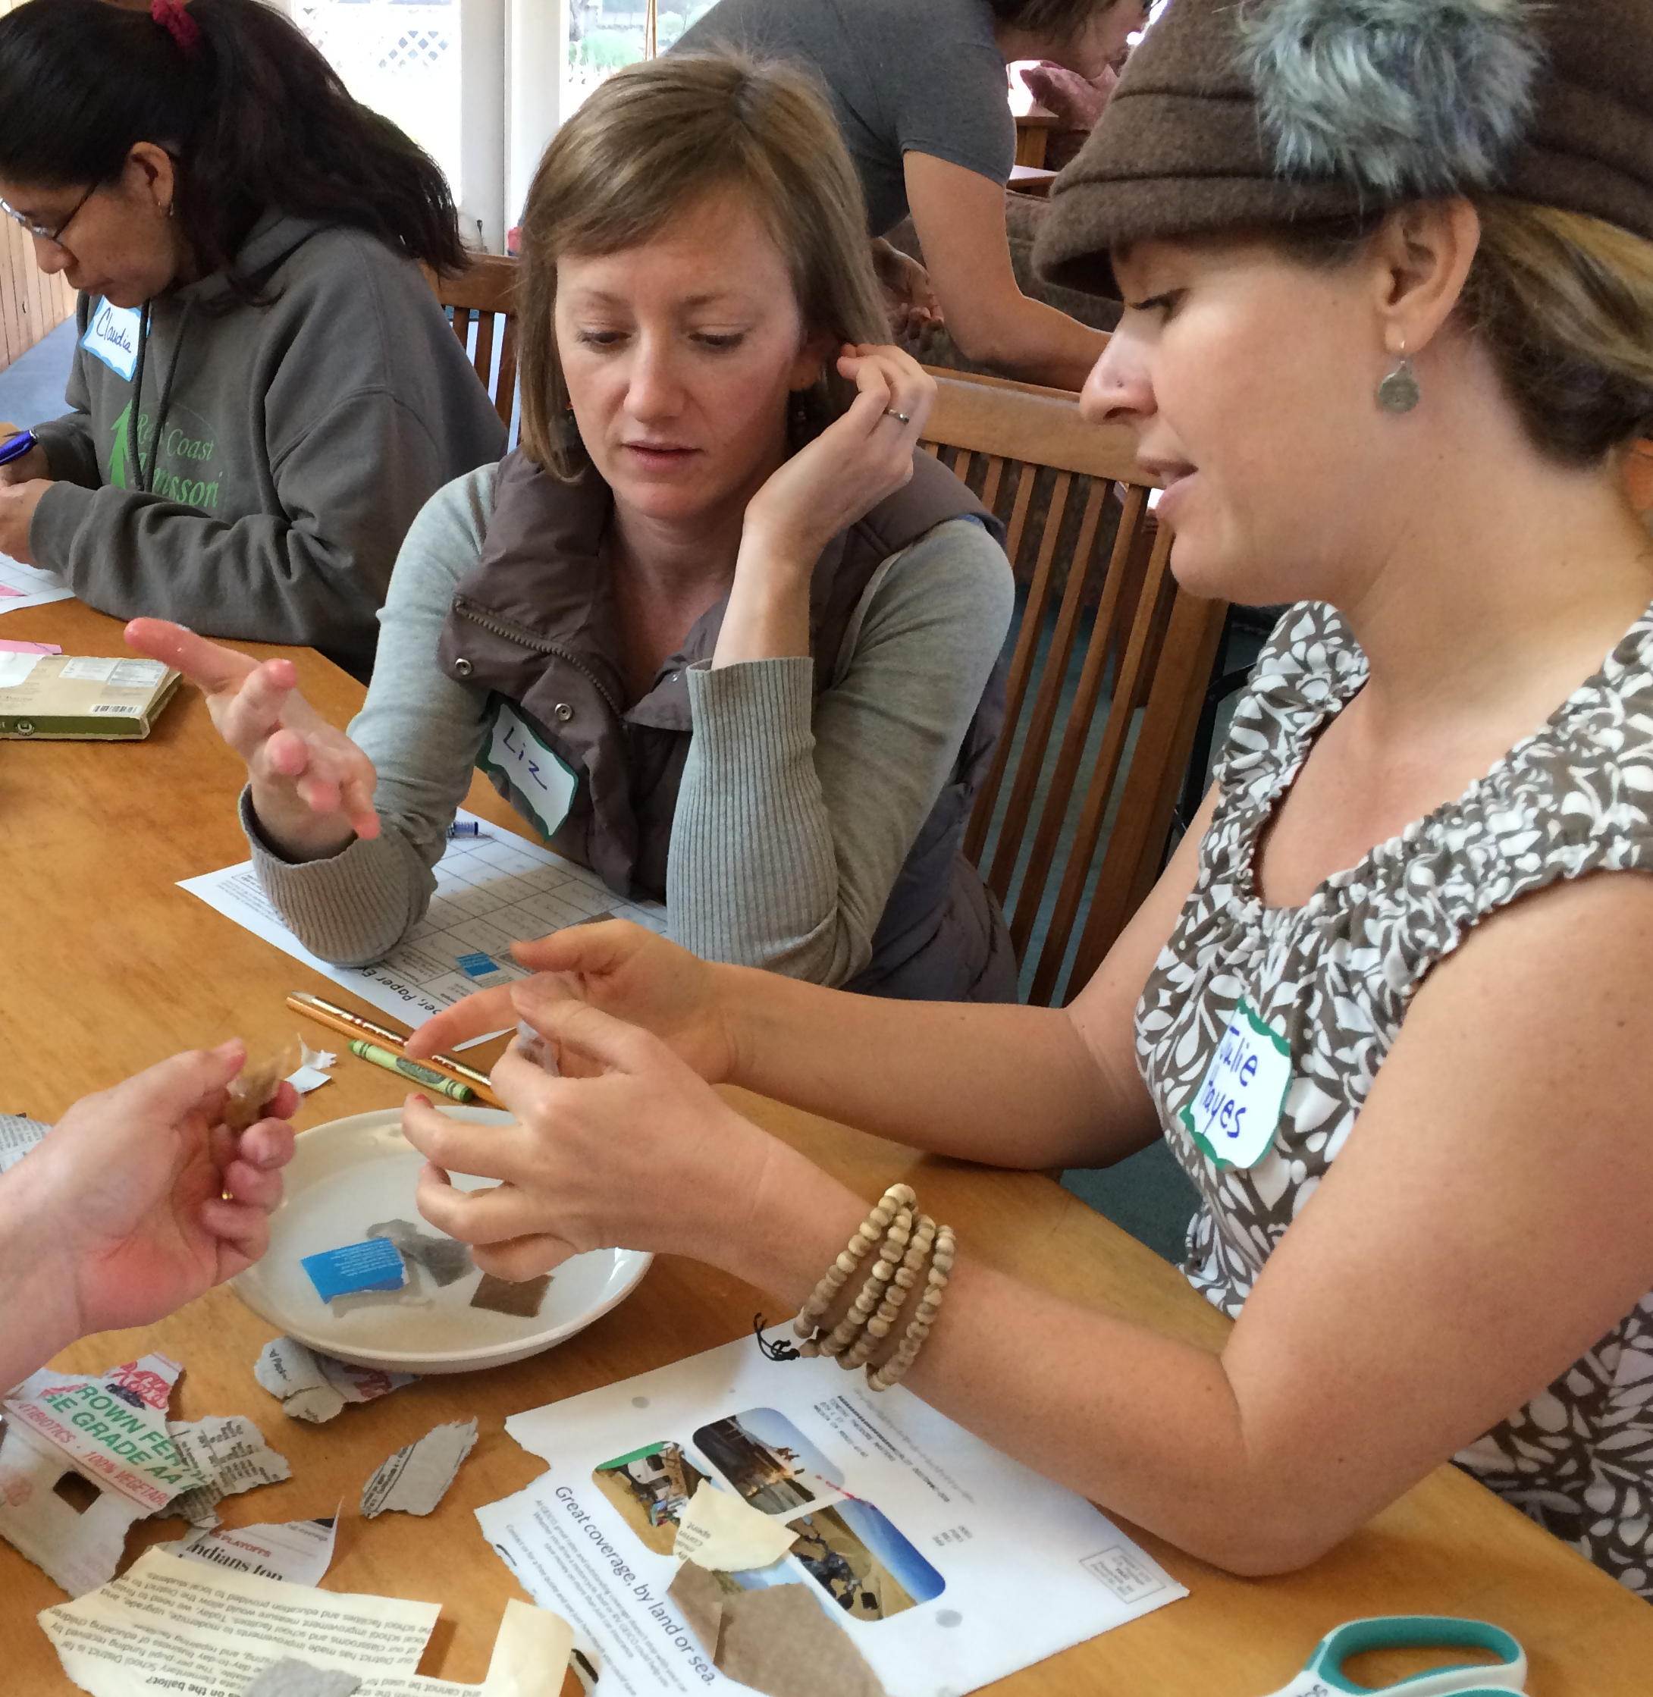
Discovering Properties of Paper
Design simple experiments
Develop uniform procedures
Plan how to describe results

Slide 8
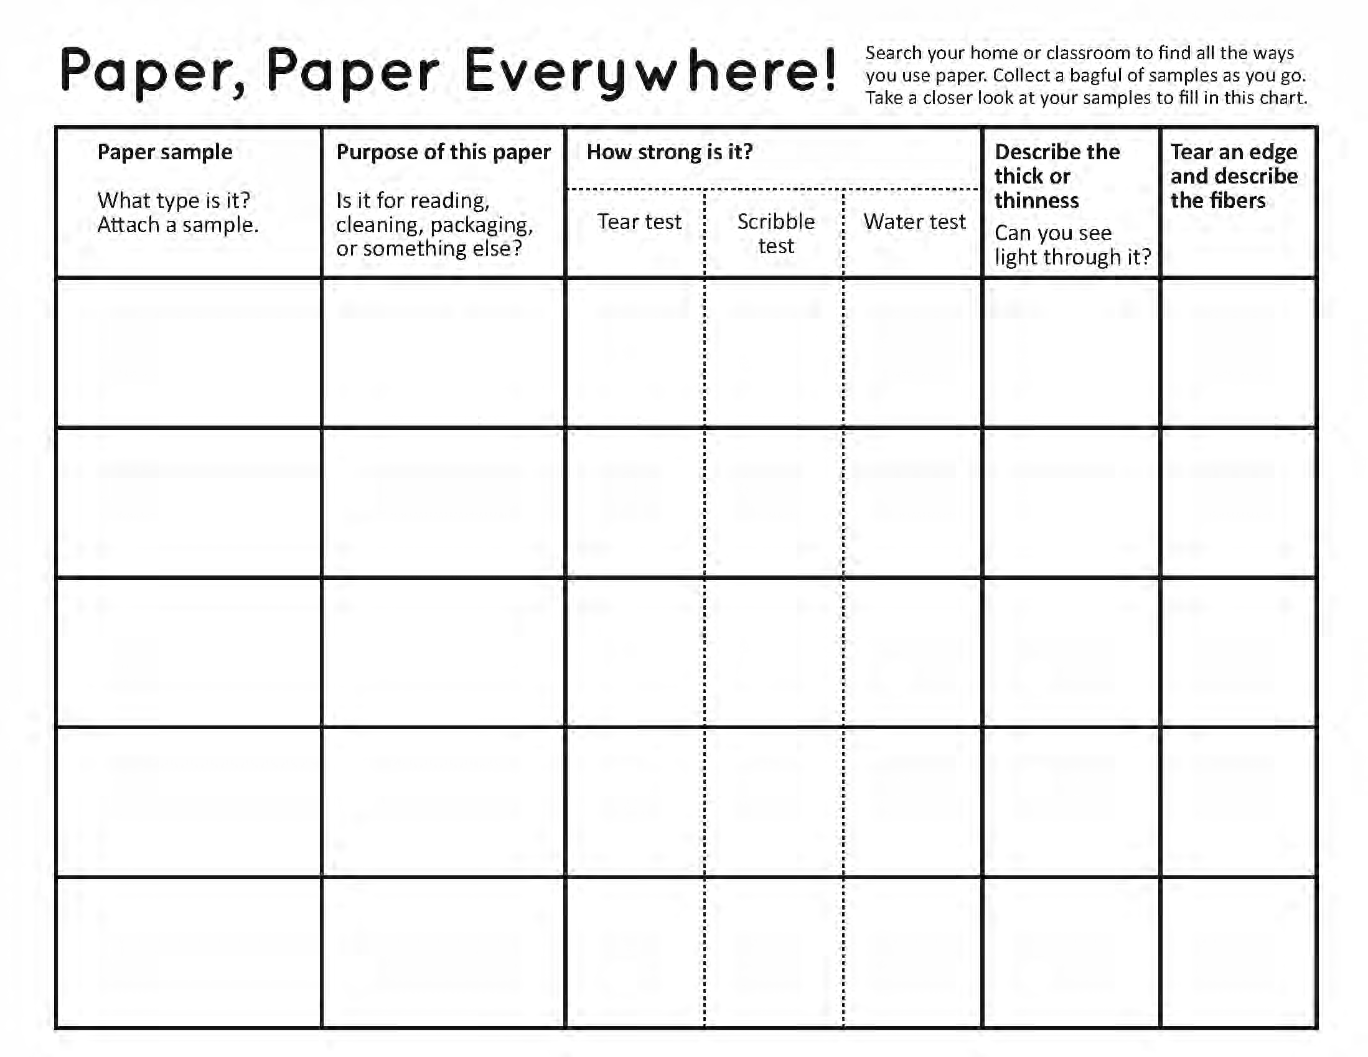
Graphic Organizer
Notes:
This graphic organizer will be used as a place to collect information about the variety of paper samples and will be referred back to when choosing which types of paper to combine in a formula for making recycled sheets.

Slide 9
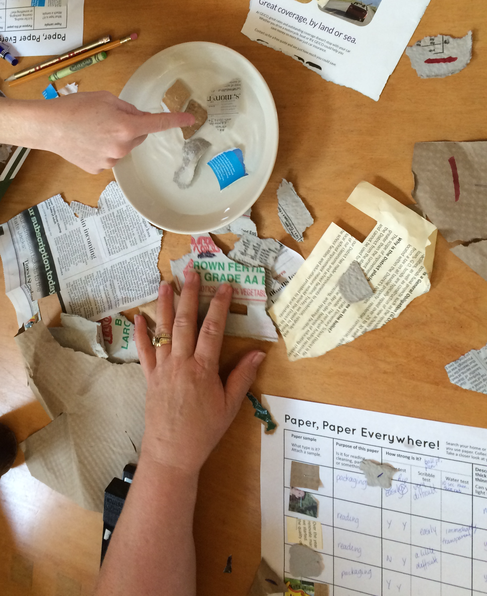
Properties of Paper
Investigate
What types of properties can you observe in your paper samples?
Paper strength
Texture
Thin/thickness
Transparency
Water resistance
Others?
Notes:
Investigate: Explain to students that they will be testing the properties of paper samples from different categories. Discuss with students the types of properties they can observe in their paper samples (i.e. paper strength, texture, thin/thickness, etc.). Allow students to experiment with materials and come up with ideas for how to test for these properties. Help them to develop uniform procedures for doing so

Slide 10
Designing Experiments
Investigate
How can you test for these properties?
Develop methods in small groups or as a class
Paper strength – gauge how easily paper tears and/or how well it holds up to scribbling
Thin/thickness
Transparency – can you see light through it?
Water resistance – does paper fall apart after soaking in water?
Others?
Notes:
Ideas for tests include:
Tear Test: hold left and right edges of paper and try to tear apart, or hold top of paper and try to rip downwards.
Scribble test: Scribble on paper with a pencil for 3 seconds and see if it rips through
Water test: Leave paper sample in water for 1 minute and see if it falls apart easily when handled.
Teacher demonstrates how to do chosen tests and describe paper thickness. Model filling in the Graphic Organizer Handout as students select up to 5 varied paper samples to test (ideally one from each group they had been sorted in to, and with a large enough sample size to experiment with). Students cut a piece of each paper sample and use a glue stick to attach them to the page. Teacher may choose to have students work in small groups to test their samples, or lead the entire class through the activity. Either way, the graphic organizer is filled in as information is collected.

Slide 11
Describing Results
Investigate
How can you describe the results of your tests?
Develop methods in small groups or as a class.
Encourage students to think like a scientist and try out many ideas before finding the “best” way!
Ranking from strongest to weakest
Counting the number scribbles before making a hole
How many ____ can the sample hold once wet
Using numbers versus symbols (happy/sad face) to describe results
Notes:
Model filling in the Graphic Organizer handout as students select up to 5 varied paper samples to test (ideally one from each group they had been sorted in to, and with a large enough sample size to experiment with). Students cut a piece of each paper sample and use a glue stick or stapler to attach them to the page. Teacher may choose to have students work in small groups to test their samples, or lead the entire class through the activity. Either way, the graphic organizer is filled in as information is collected.
Recording Results: Instead of describing the results of the paper tests, students may rank each sample. For example, testing the strength of 5 samples, the one that is the most difficult to tear would be given a #1, the easiest to tear would be given a #5. Or, if the paper falls apart after soaking in water it get a “sad face”, if it holds up this is indicated with a “happy face”. Encourage students to come up with a wide variety of ways to test the properties of their samples and record the results of these tests. For example, how many times can you scribble back and forth before making a hole in the paper, how many pennies/erasers/markers can the paper hold before tearing once wet, how does the strength of the paper change after soaking for 10 seconds, 1 minute, 10 minutes, etc.

Slide 12
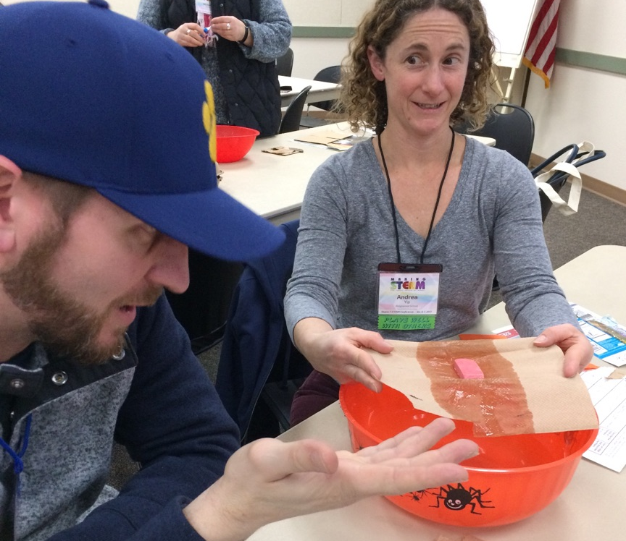
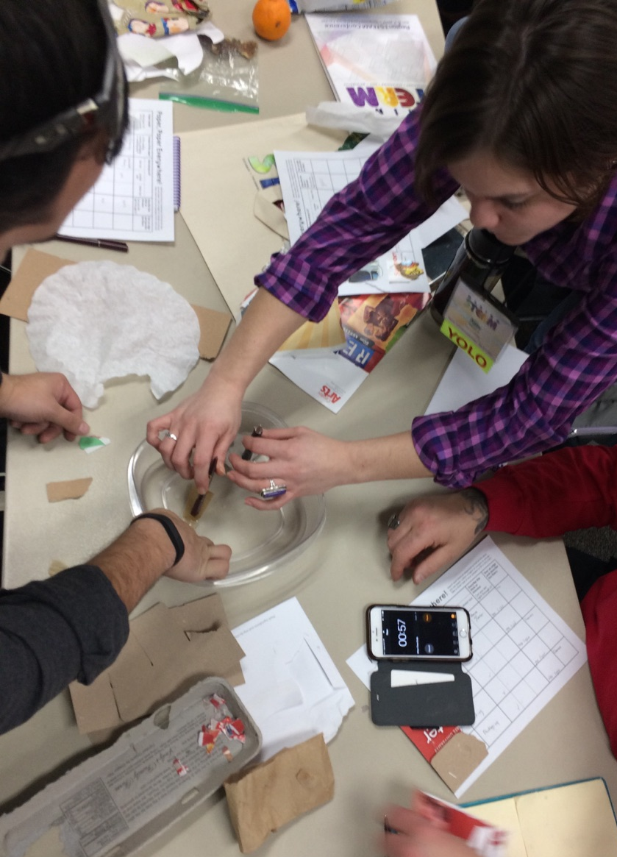
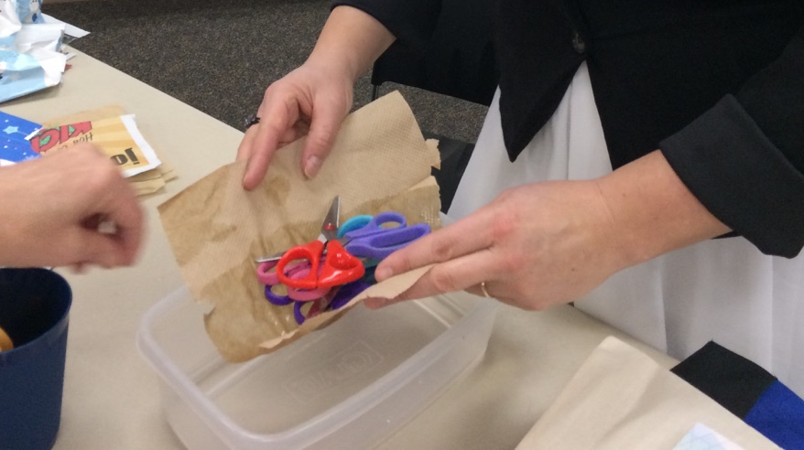
Testing samples
Notes:
Model filling in the Graphic Organizer handout as students select up to 5 varied paper samples to test (ideally one from each group they had been sorted in to, and with a large enough sample size to experiment with). Students cut a piece of each paper sample and use a glue stick or stapler to attach them to the page. Teacher may choose to have students work in small groups to test their samples, or lead the entire class through the activity. Either way, the graphic organizer is filled in as information is collected.
Recording Results: Instead of describing the results of the paper tests, students may rank each sample. For example, testing the strength of 5 samples, the one that is the most difficult to tear would be given a #1, the easiest to tear would be given a #5. Or, if the paper falls apart after soaking in water it get a “sad face”, if it holds up this is indicated with a “happy face”. Encourage students to come up with a wide variety of ways to test the properties of their samples and record the results of these tests. For example, how many times can you scribble back and forth before making a hole in the paper, how many pennies/erasers/markers can the paper hold before tearing once wet, how does the strength of the paper change after soaking for 10 seconds, 1 minute, 10 minutes, etc.

Slide 13

Take a Closer Look
Can you find the TREE in your PAPER?
Notes:
A Closer Look: Ask students to tear a piece from their first paper samples and observe the edge. Use magnifying glasses for a better view of the fuzzy edge of paper fibers.
Ask students:
Where does this “fuzz” come from and how does it make paper? (The “fuzz” is actually paper fibers. The fibers you see are the cellulose cells that make the wood of a tree strong. Through the paper making process they have been separated from the other cells that make up trees and rearranged into flat sheets – paper!)

Slide 14
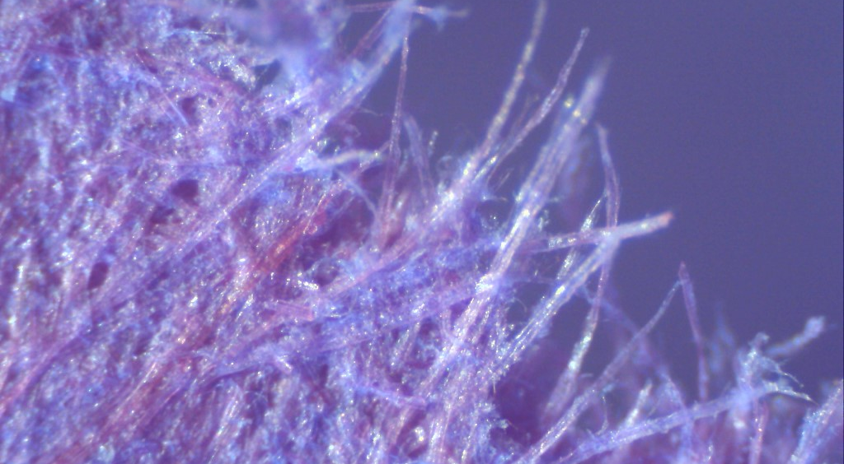
Paper Fibers
The “fuzzy edge” of torn paper is a great place to view paper fibers.
Notes:
If possible, use a digital dissecting microscope, “presenter”, or document camera to project large images of the fiber edges for the class to see. This picture is of the torn edge of purple construction paper at 100x magnification.
Ask students to look at the fiber edges of their other paper samples and describe or draw them in the final column of their graphic organizer. Observe the color, length, and texture of the fibers.
Do some paper types have longer fibers than others? Are the fibers in some paper types different colors? Do some fibers have straight fibers and others more bent and jagged?
Observe fibers using a magnifying glass. Show fibers through “document camera” or digitally projected dissecting microscope to view color, length, and texture of fibers. Describe fibers in final column of the graphic organizer.

Slide 15
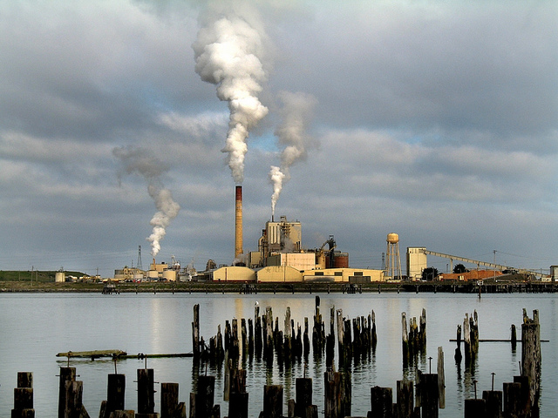
Freeing Fibers at the Factory
Evergreen Pulp Mill, Samoa, CA | April 2006
Photo credit: Dave Glass
Notes:
Part 2: Fibers at the Factory
We know paper comes from trees, but ask students how a tree is transformed into paper.

Slide 16
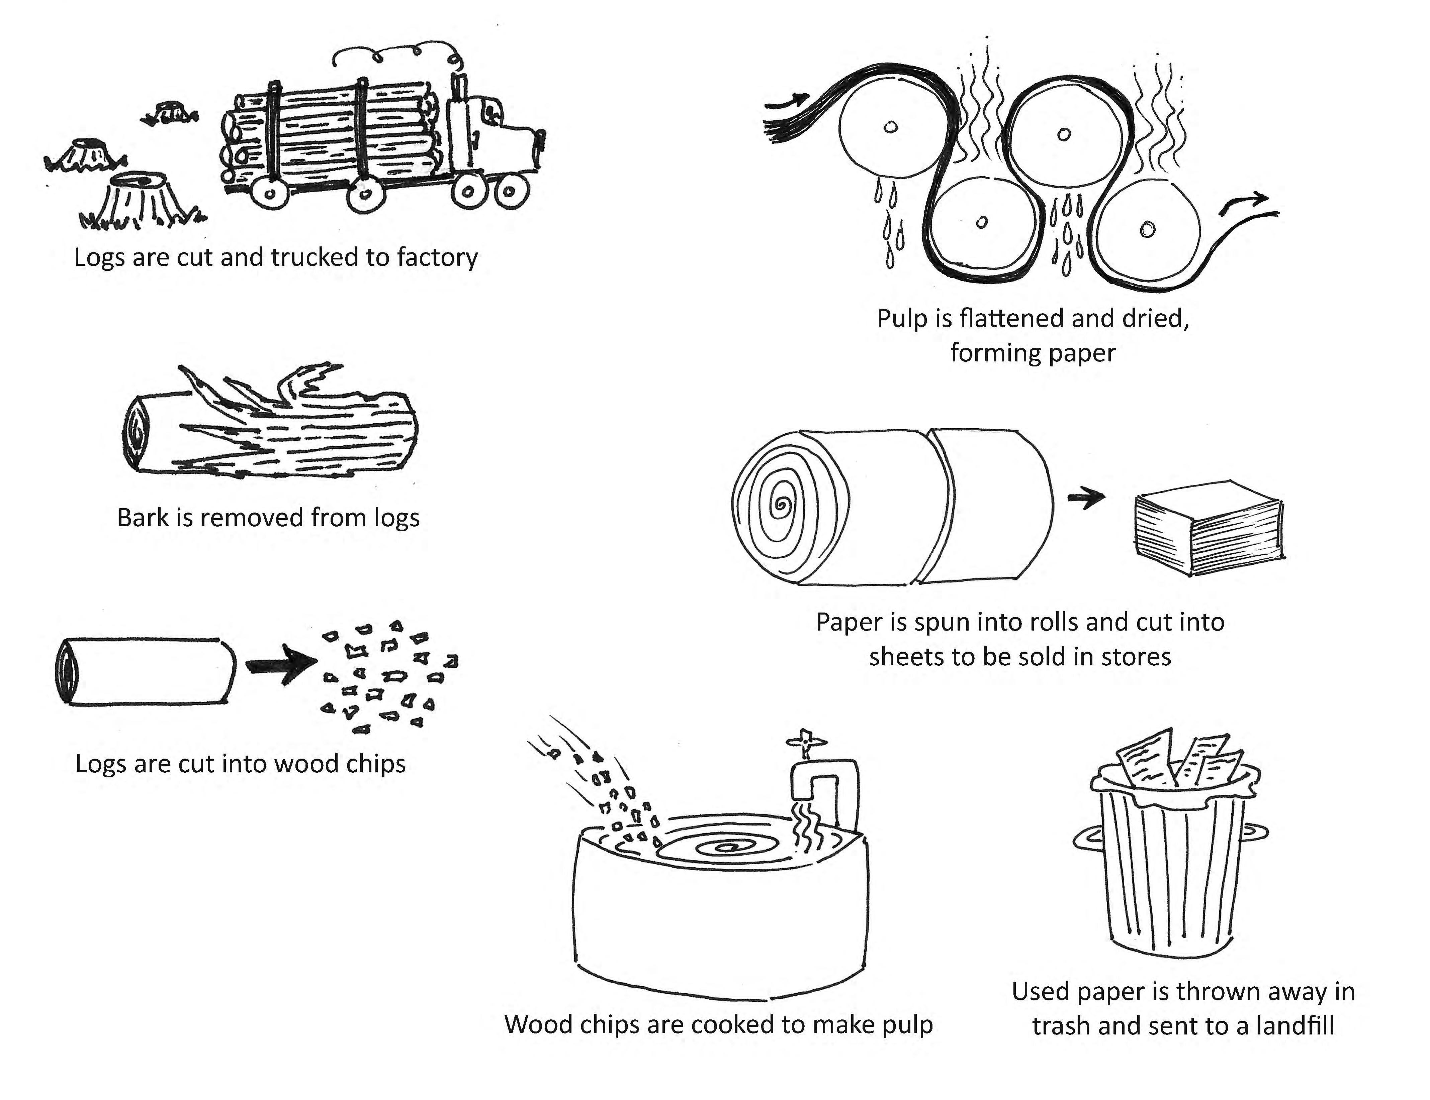
Sequencing Steps at the Factory
Notes:
Using cards of photographic images from the paper manufacturing process, ask students to work in small groups to arrange them in sequence – from tree to finished paper.
Show students video footage of the paper making process and learn about the resources used to create a piece of paper.
“How It’s Made: Copy Paper”, 4.5 minutes (Note that video uses the word “paste” instead of “pulp”): https://www.youtube.com/watch?v=9Kt5dHMBvYM)
“From Tree to Paper: How It’s Made”, 1.5 minutes: https://www.youtube.com/watch?v=fZ3HQ9lBHuA
This website is rich with information on the papermaking process and can help answer questions students may have: http://www.paperonline.org/paper-making/paper-production/papermaking
Read this description, provided by Wonderopolis, if needed to summarize and simplify the process.
http://wonderopolis.org/wonder/how-do-you-make-paper-from-a-tree
“Wonderopolis is brought to life by the National Center for Families Learning”
Wood (pun intended!) you believe paper is made from trees? It's true! Let's take a look at how trees are turned into all sorts of paper.
If you look at a tree, you might have a hard time imagining how something so tall and strong could be turned into something as thin and weak as a sheet of paper. The process begins with the raw wood, which is made up of fibers called "cellulose."
The cellulose fibers are stuck together with a natural glue called "lignin." When the lignin is removed and the cellulose fibers are separated and reorganized, paper can be made.
It's also possible to make paper from a variety of other types of plant fibers, such as cotton, flax, bamboo and hemp. For example, cotton fibers are often used to make the paper that money is printed on. The overwhelming majority(about 95 percent) of the raw material used to make paper, though, comes from trees.
To make paper from trees, the raw wood must first be turned into "pulp." Woodpulp is a watery “soup" of cellulose wood fibers, lignin, water and the chemicals used during the pulping process.
Wood can be turned to pulp in a couple of different ways. Mechanical pulping involves using machines to grind wood chips into pulp.
The resulting pulp retains most of its lignin, though. The short fibers created by grinding leads to weak paper most suitable for newsprint, phone books or other types of low-strength papers.
The more commonly used method is chemical pulping, also known as “kraft." Chemicals are used to separate lignin from the cellulose fibers, leaving a pulp mixture that can make stronger papers.
Depending on what type of paper is desired, the pulp mixture might need to be bleached to create whiter paper. Papermakers use a variety of chemicals to bleach pulp to the color they want.
Once the pulp is ready, it is then used to make paper in a process that is quite similar (in the basics) to the process first used by the ancient Chinese more than 1,900 years ago. Because the pulp mixture is so watery (sometimes as much as 99 percent water!), the cellulose fibers need to be separated from the watery mixture.
Huge machines spray the pulp mixture onto moving mesh screens to make a layered mat. The mat of pulp then goes through several processes to remove water and dry it out.
Finally, the mat is run through heated rollers to squeeze out any remaining water and compress it into one continuous roll of paper that can be up to 30 feet wide.
When the paper has the desired thickness, it may be colored or coated with special chemicals to give it a special texture, extra strength or water resistance. As a last step, the paper rolls are cut to size and packaged for shipping to other facilities for additional processing to turn it into all sorts of specialized papers.

Slide 17
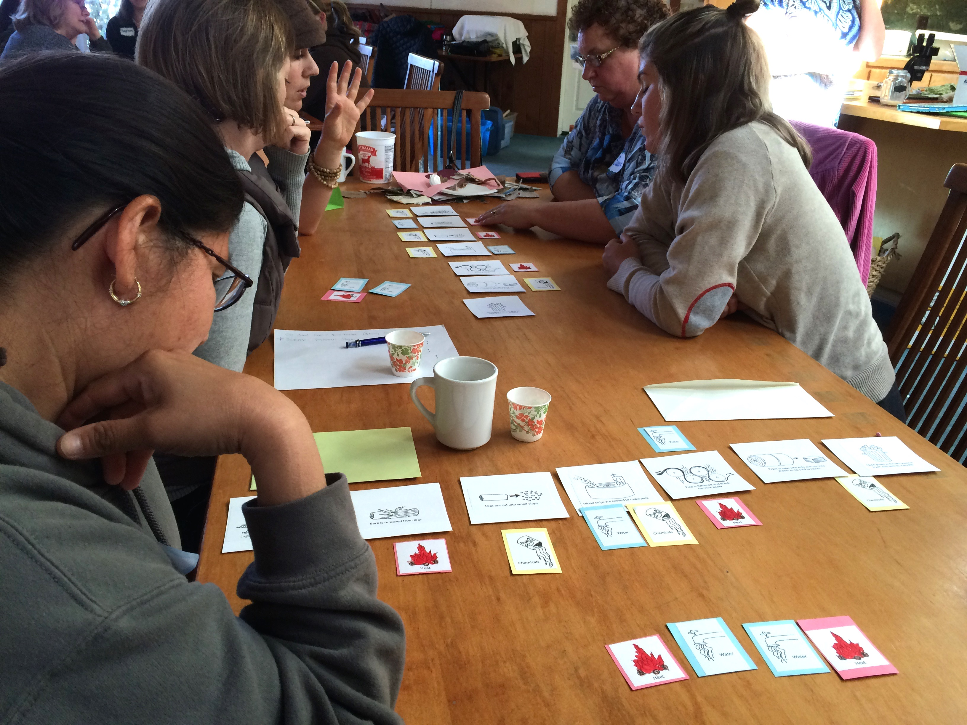
Adding Inputs: heat, water, chemicals
Notes:
After viewing video footage of papermaking at the factory, students revisit their cards to check for accuracy and add input cards of WATER, HEAT, CHEMICALS where they are used in the process.
Correct sequence:
Logs are cut and trucked to factory
Bark is removed from logs
Logs are cut into wood chips
Wood chips are cooked to make pulp
Pulp is flattened and dried, forming paper
Paper is spun into rolls and cut into sheets to be sold in stores
Used paper is thrown away in trash and sent to a landfill

Slide 18
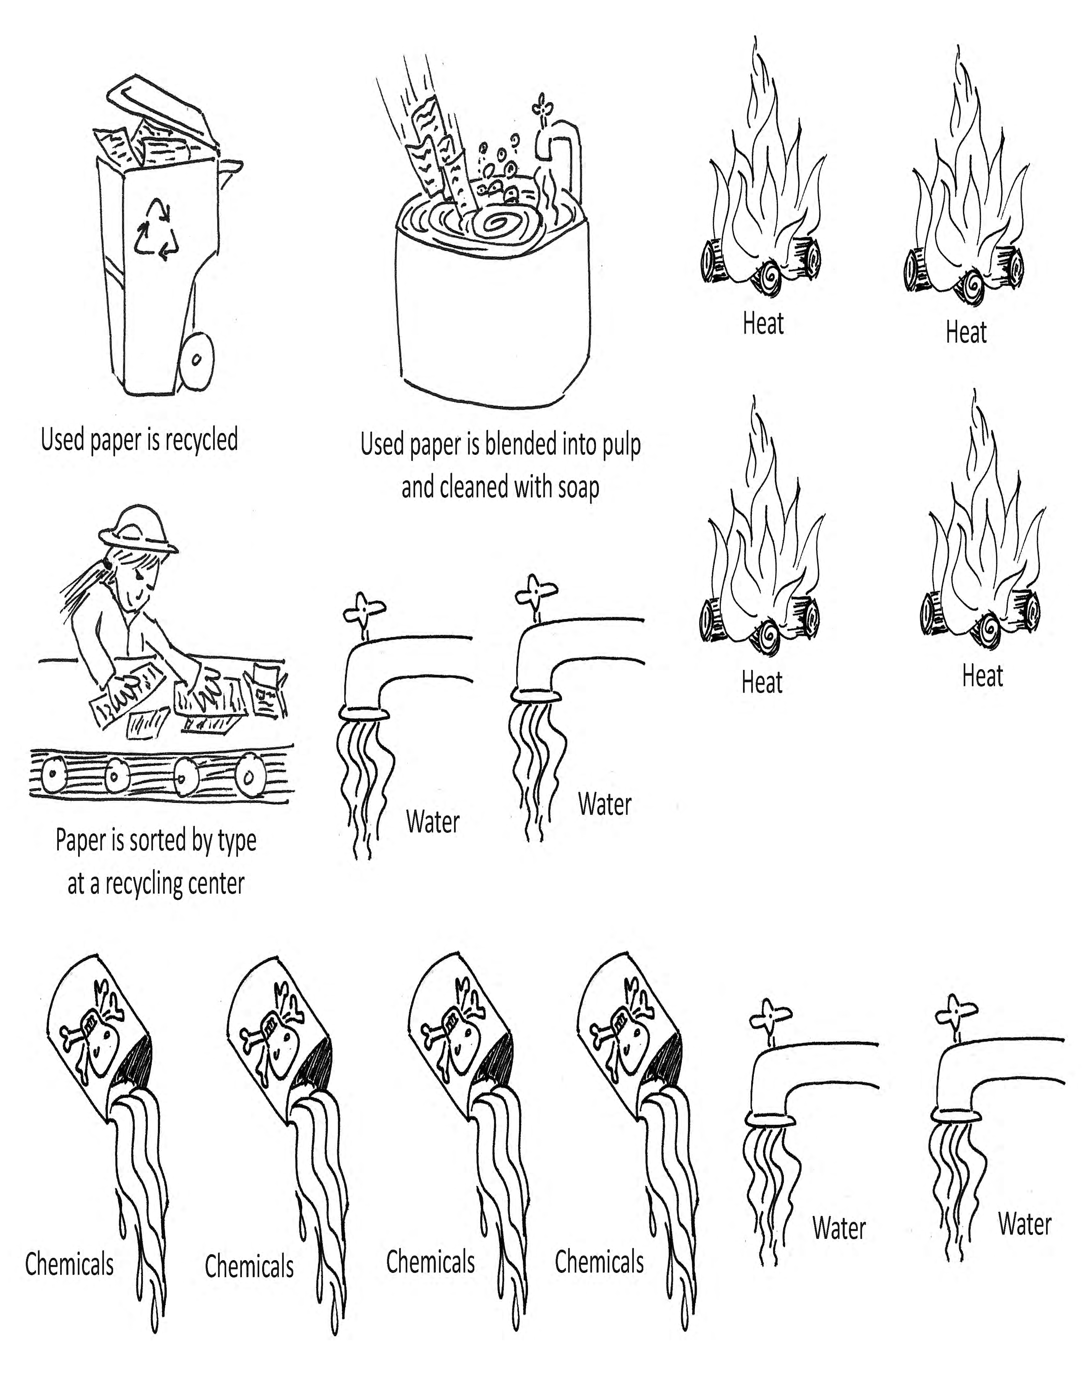
Closing the Loop: Paper Recycling
Notes:
Students see video footage of paper being recycled and add additional cards to their sequence to allow for recycled content input.
“How It’s Made: Paper Recycling”, 5.5 minutes: https://www.youtube.com/watch?v=2c8YxMb0tlk
What steps in the process are not needed when paper is recycled? What resources are saved by recycling old paper fibers? Instead of all the steps making a straight line, do they now make a CIRCLE?

Slide 19
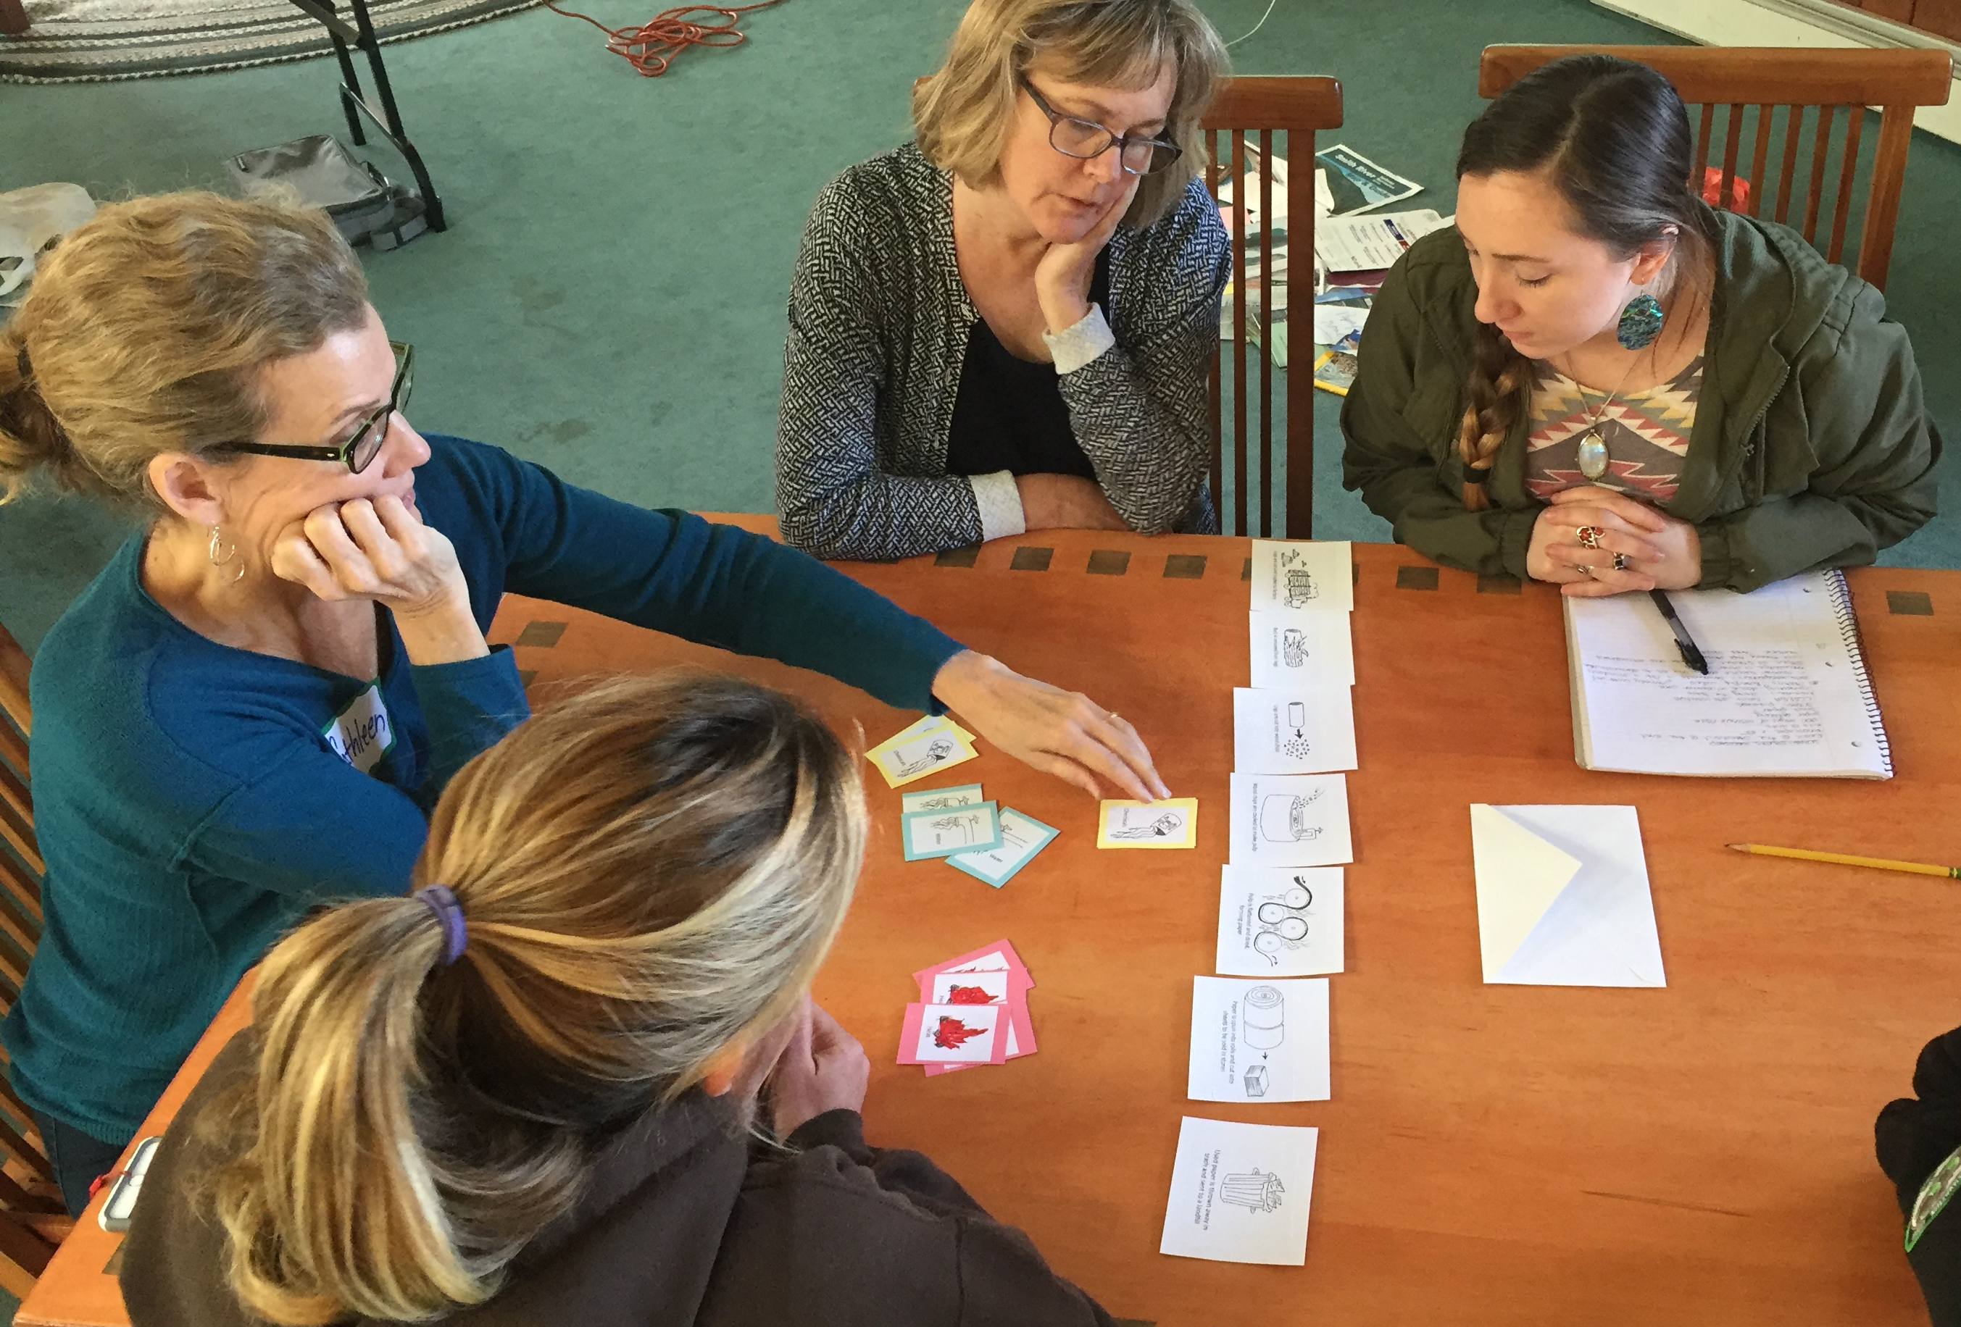
Extend Fiber “Life Spans”: RECYCLE
Recycle!

Slide 20

Recycled Content?
Look for recycling symbols and information on samples
Is there a connection between recycled content and the descriptive words or strength test results for each group?
When observing your paper fibers, did you see any evidence of recycled content? (i.e. “short, jagged fibers or little bits of different colored paper or remnant ink mixed in with the fibers)
Notes:
Students explore their collection of paper types to look for recycled content symbols and information.
When a marketer says a product was made with recycled content, it should be able to show the product was made from materials recovered or separated from the "waste stream" and re-used. A manufacturer may use:
pre-consumer recycled content from the manufacturing process. For example, paper scraps left over when envelopes are cut.
post-consumer recycled content from products that people or businesses already used. For example, newspapers, shipping boxes, magazines, etc.
If a product says it’s made with recycled materials, look for specifics. Are the claims about the product, the packaging, or both? How much of the product or package is made with recycled content? Unless the product or package contains 100 percent recycled materials, the label should tell you what portion is recycled.
The universal recycling symbol tells you a product or package is recyclable or was made with recycled content.
Revisit the samples from the Graphic Organizer:
Do some groups have more recycled content than others?
Is there a connection between recycled content and the descriptive words or strength test results for each group?
When observing your paper fibers, did you see any evidence of recycled content? (i.e. “short, jagged fibers or little bits of different colored paper or remnant ink mixed in with the fibers)
Typically, paper used made from recycled content will have fibers of multiple colors (and/or remnant specks of ink) that are broken, jagged or bent in many places, and relatively short in appearance – a result of going through the paper making process multiple times. These fibers are often more weak, or have less “integrity”, as a result. They are more common in disposable products (paper used for cleaning/hygiene, egg cartons, newspaper, chipboard – cereal and cracker boxes, and cardboard).
Each time a fiber goes through the paper making process it is “chopped” and becomes, literally, shorter. A singular paper fiber can make it through the process roughly ten times before it is too small to be captured by the screen where pulp is collected to make new sheets of paper.
Having learned that each paper fiber is chopped up by the recycling process and can only survive the process at most ten times (losing strength in each “life”), does paper strength correlate to recycled content?

Slide 21
Ten “Lives” with Recycling
Each time a fiber goes through the paper making process it is “chopped” and becomes, literally, shorter.
A singular paper fiber can make it through the process roughly ten times before it is too small to be captured by the screen where pulp is collected to make new sheets of paper.
Does paper strength correlate to recycled content?

Slide 22
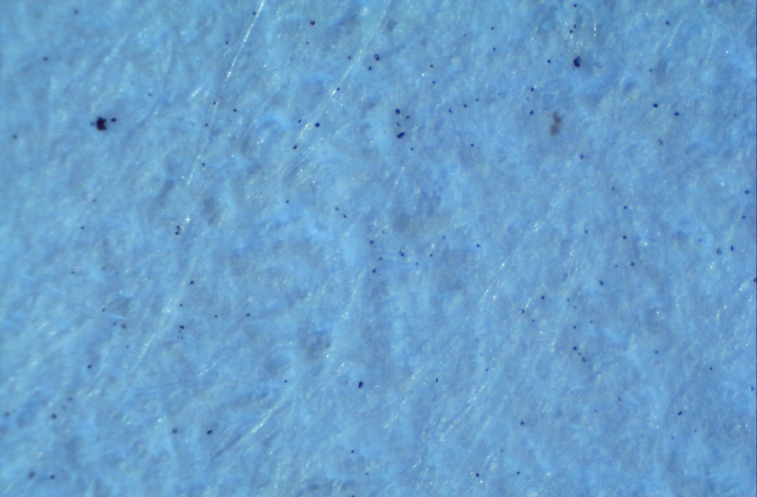
Zooming In On
PAPER FIBERS
Notes:
The series of slides that follow are images of a variety of paper samples taken at different magnifications through a digital microsope. If you do not have access to such a device, these may be useful for viewing the fibers more clearly. They are engaging to use as a slideshow with the entire class to look for evidence of recycled content: jagged fibers, bits of different colors or print mixed in with fibers, etc.

Slide 23
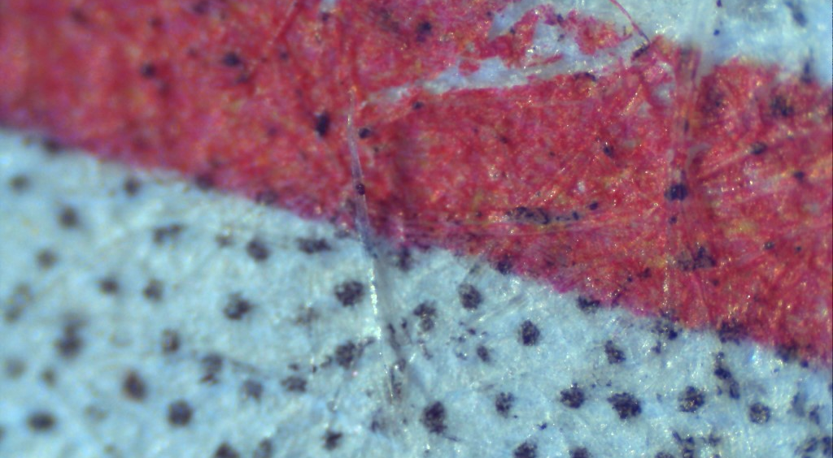
Newspaper at 40x
Notes:
Made with recycled content. Four color process print is interesting to view when magnified to see how dots of color trick the eye into seeing uniform color when viewed at a distance.

Slide 24
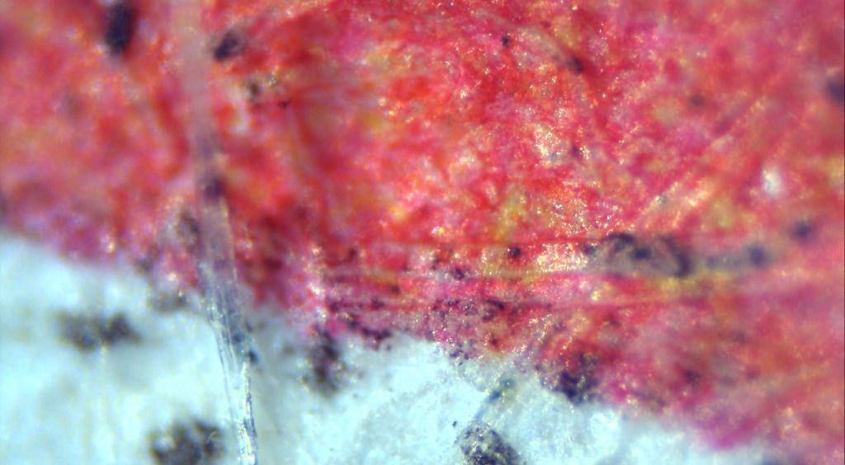
Newspaper at 100x

Slide 25
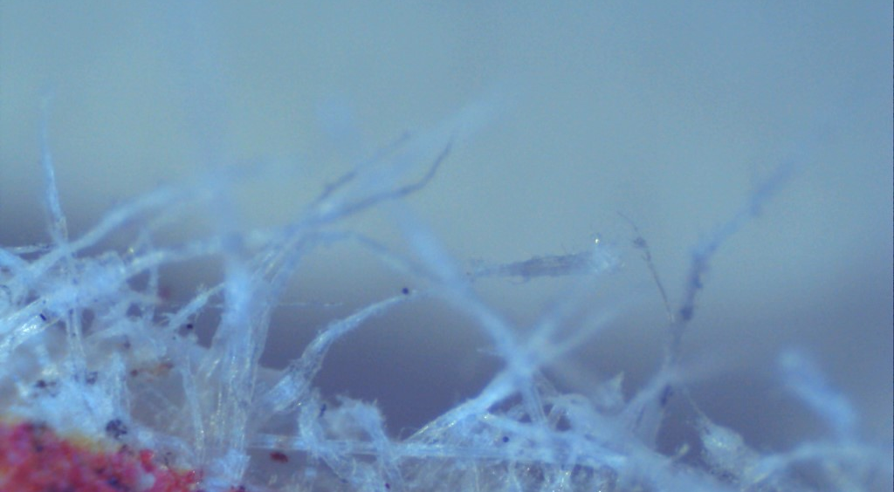
Newspaper at 100x

Slide 26
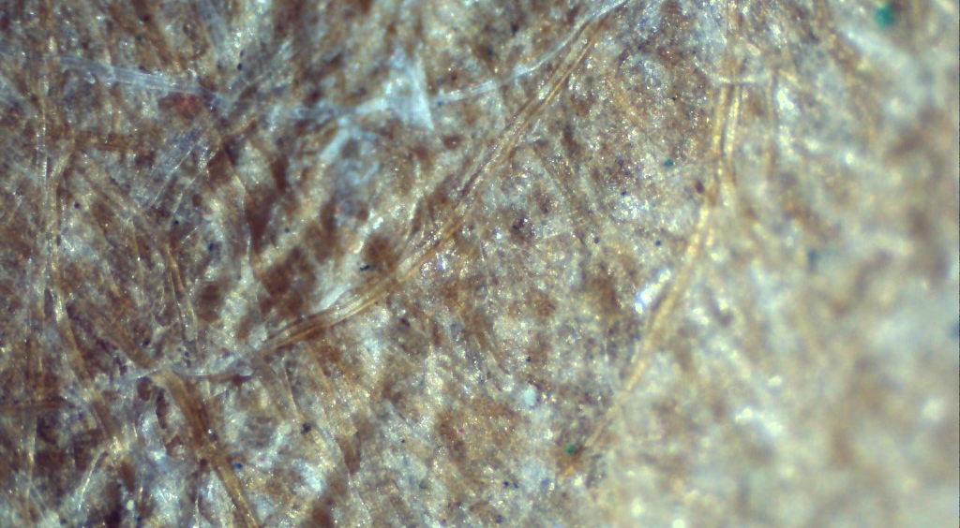
Cereal box (chipboard) at 40x
Notes:
Note fibers of different colors indicating recycled content

Slide 27
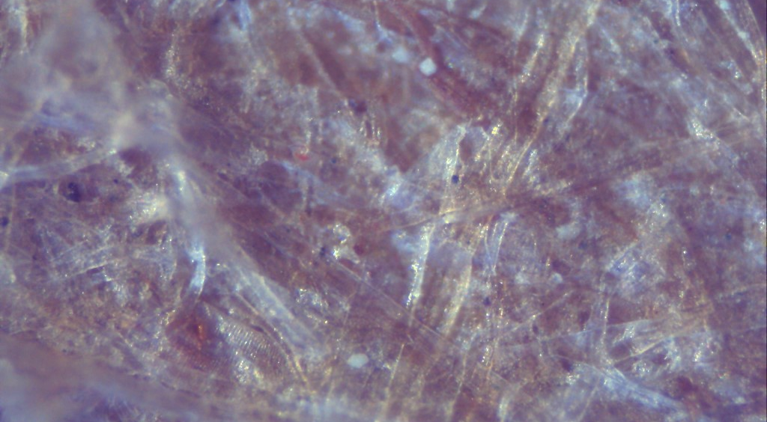
Cereal box (chipboard) at 100x
Notes:
Note bits of different colors indicating recycled content

Slide 28
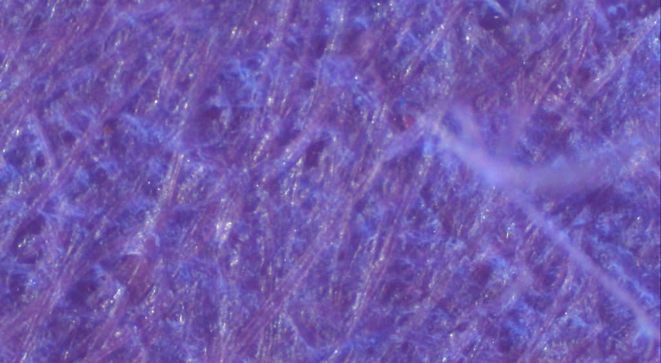
Construction paper at 40x

Slide 29
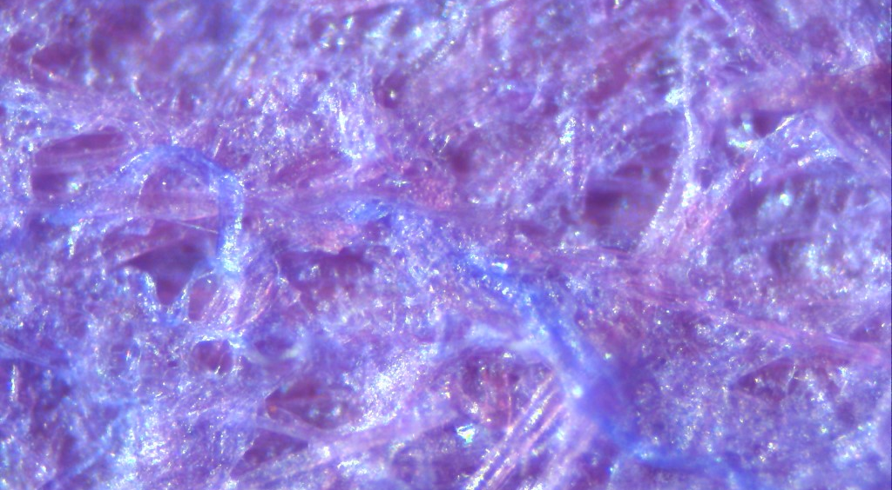
Construction paper at 100x

Slide 30
Construction paper at 100x
Notes:
Note how smooth and straight fibers are indicating this paper was made with brand new fibers, not recycled content

Slide 31
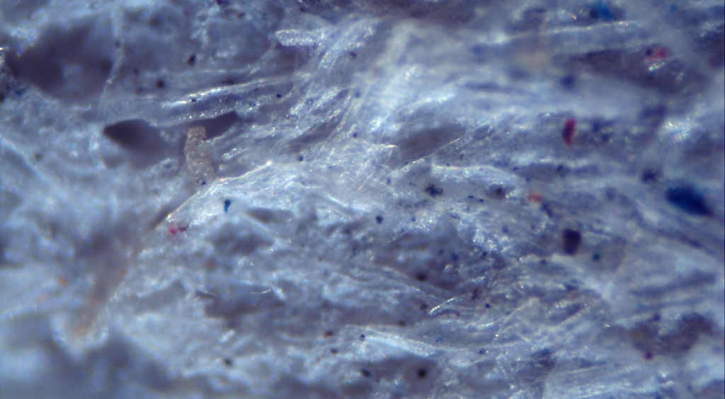
Egg carton at 40x
Notes:
Egg cartons represent the last “life” of paper fibers. These fibers are so short and weak from being recycled so many times that they cannot be used to make new paper. They are not large enough to be picked up by the pulp screens and are not useful to paper manufacturers. This is why egg cartons are often not accepted in recycling bins, and are instead encouraged to be used in compost or as fire starter. Note all the bits of color mixed in with the fibers and the “fluffy” texture.

Slide 32
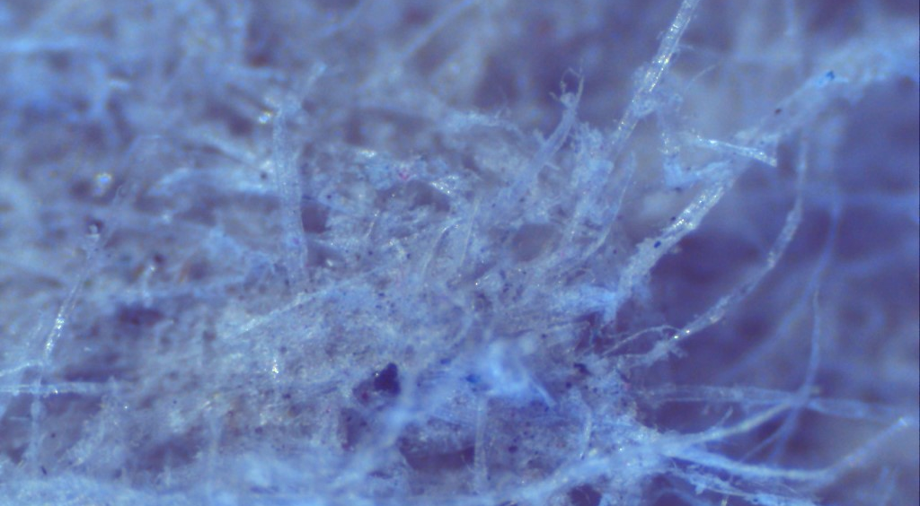
Egg carton at 40x

Slide 33
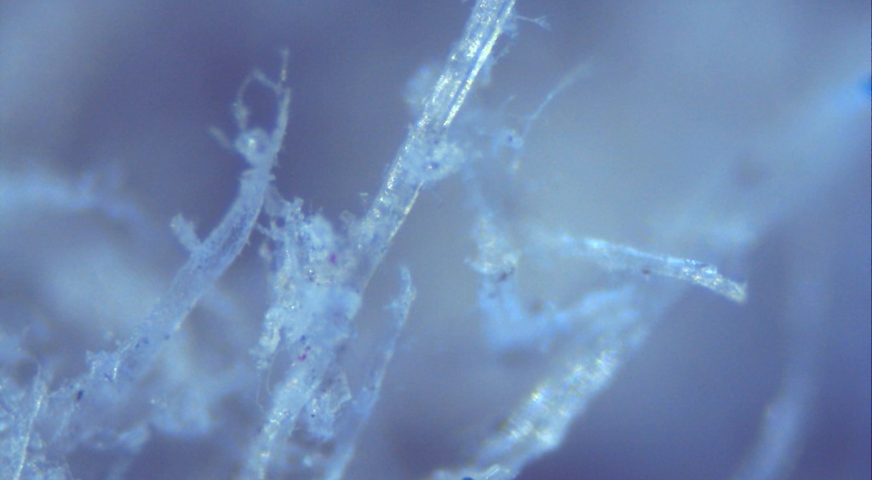
Egg carton at 100x
Notes:
Jagged, torn fibers indicate recycled content

Slide 34
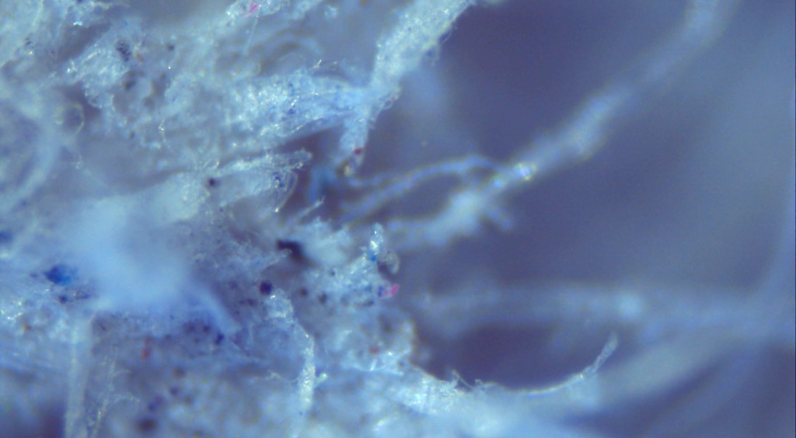
Egg carton at 100x

Slide 35
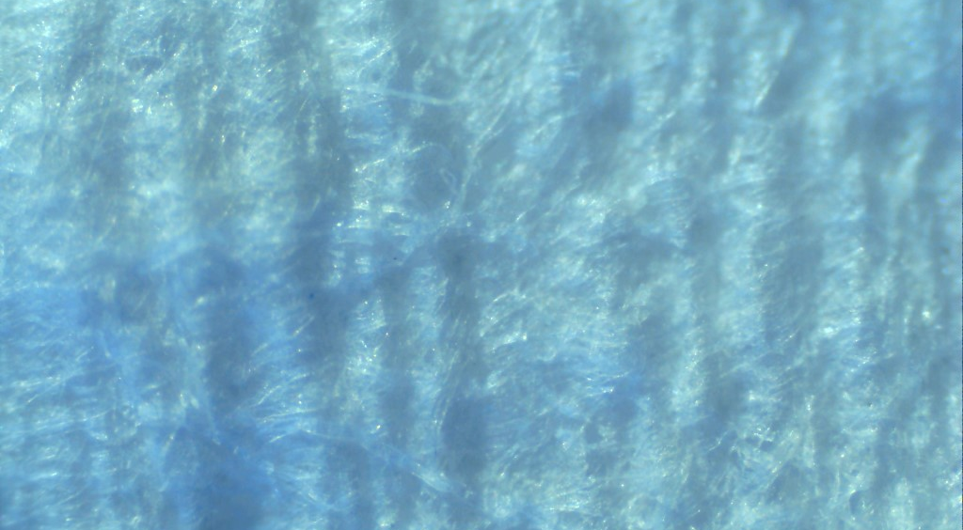
Paper towel at 40x
Notes:
Note the wave-like texture of the paper towel. This is by design to make the paper absorbent. Paper towels are a highly engineered product!

Slide 36
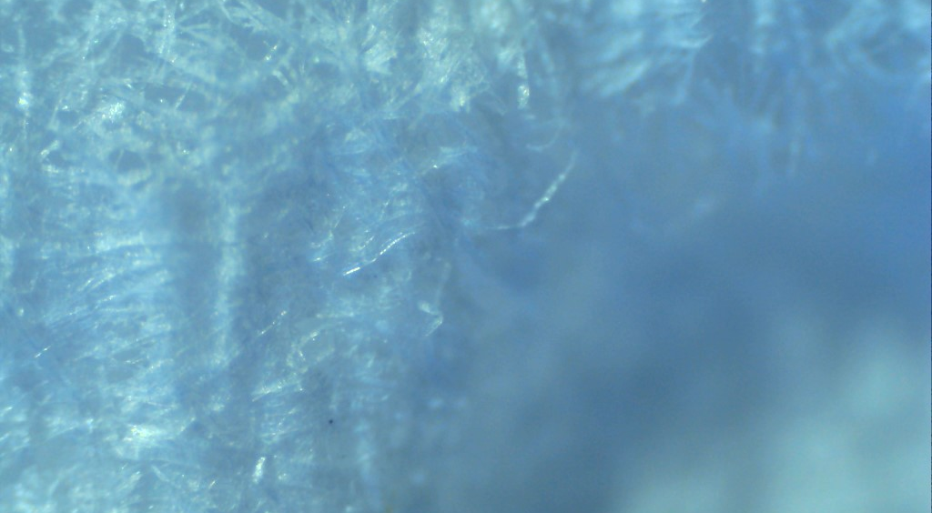
Paper towel at 100x

Slide 37
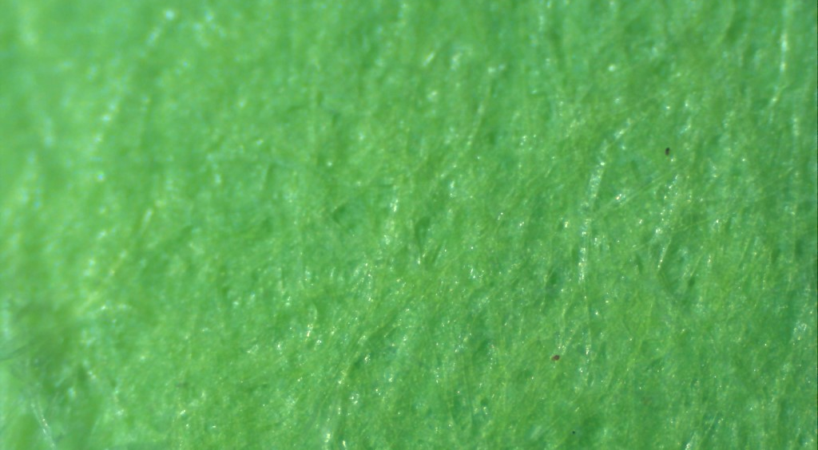
Copy paper at 40x

Slide 38
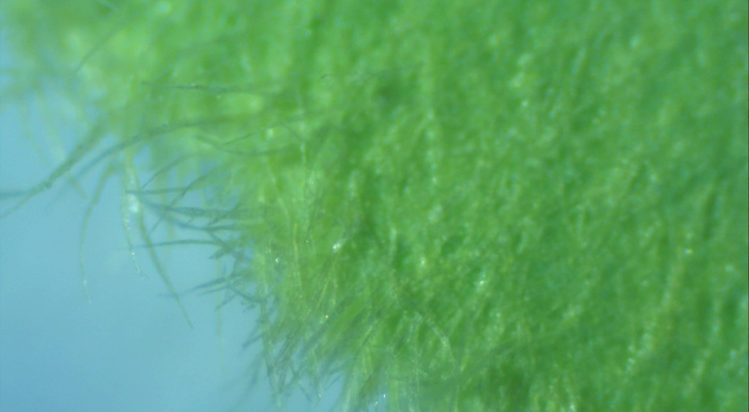
Copy paper at 100x
Notes:
Smooth, “long” fibers and uniform color indicate no recycled content

Slide 39
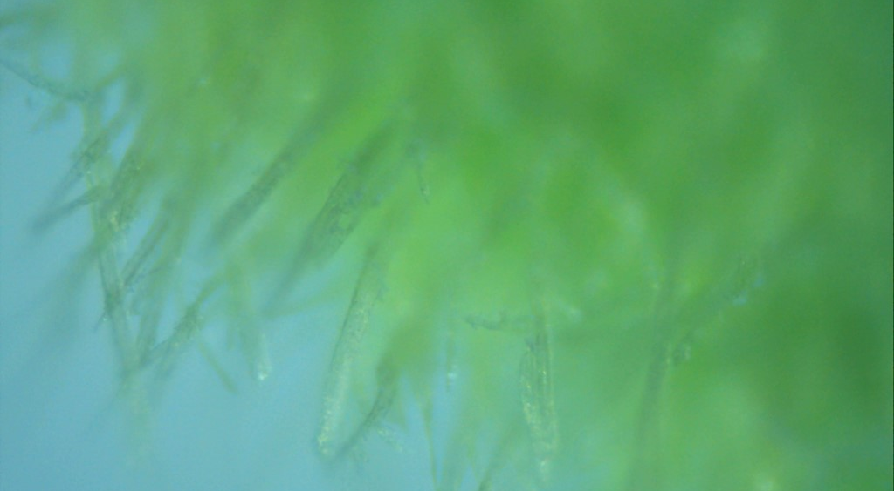
Copy paper at 100x

Slide 40
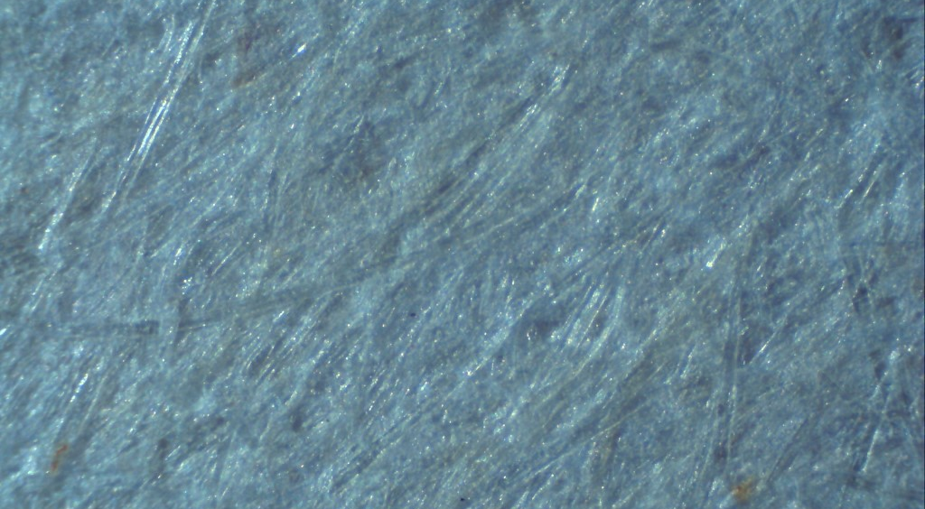
Lined notebook paper at 40x

Slide 41
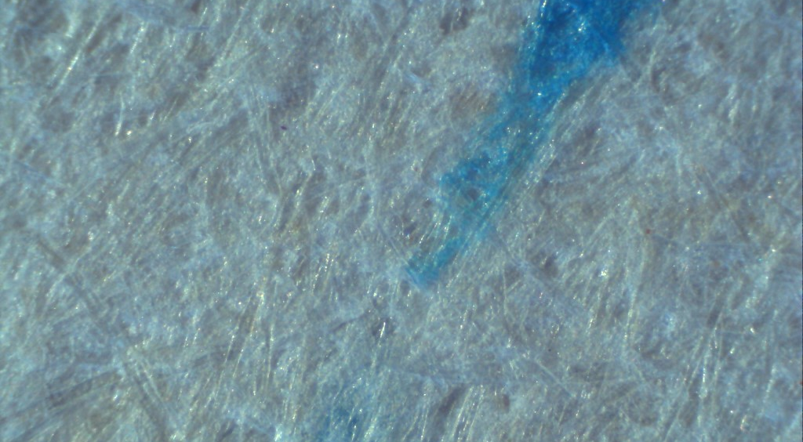
Lined notebook paper at 100x

Slide 42
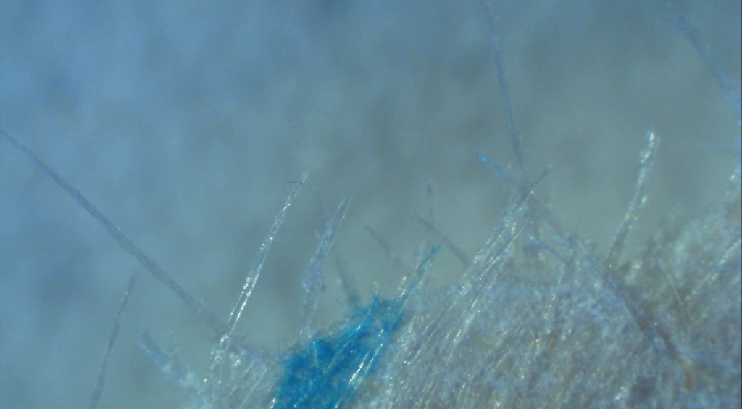
Lined notebook paper at 100x

