Slide 1
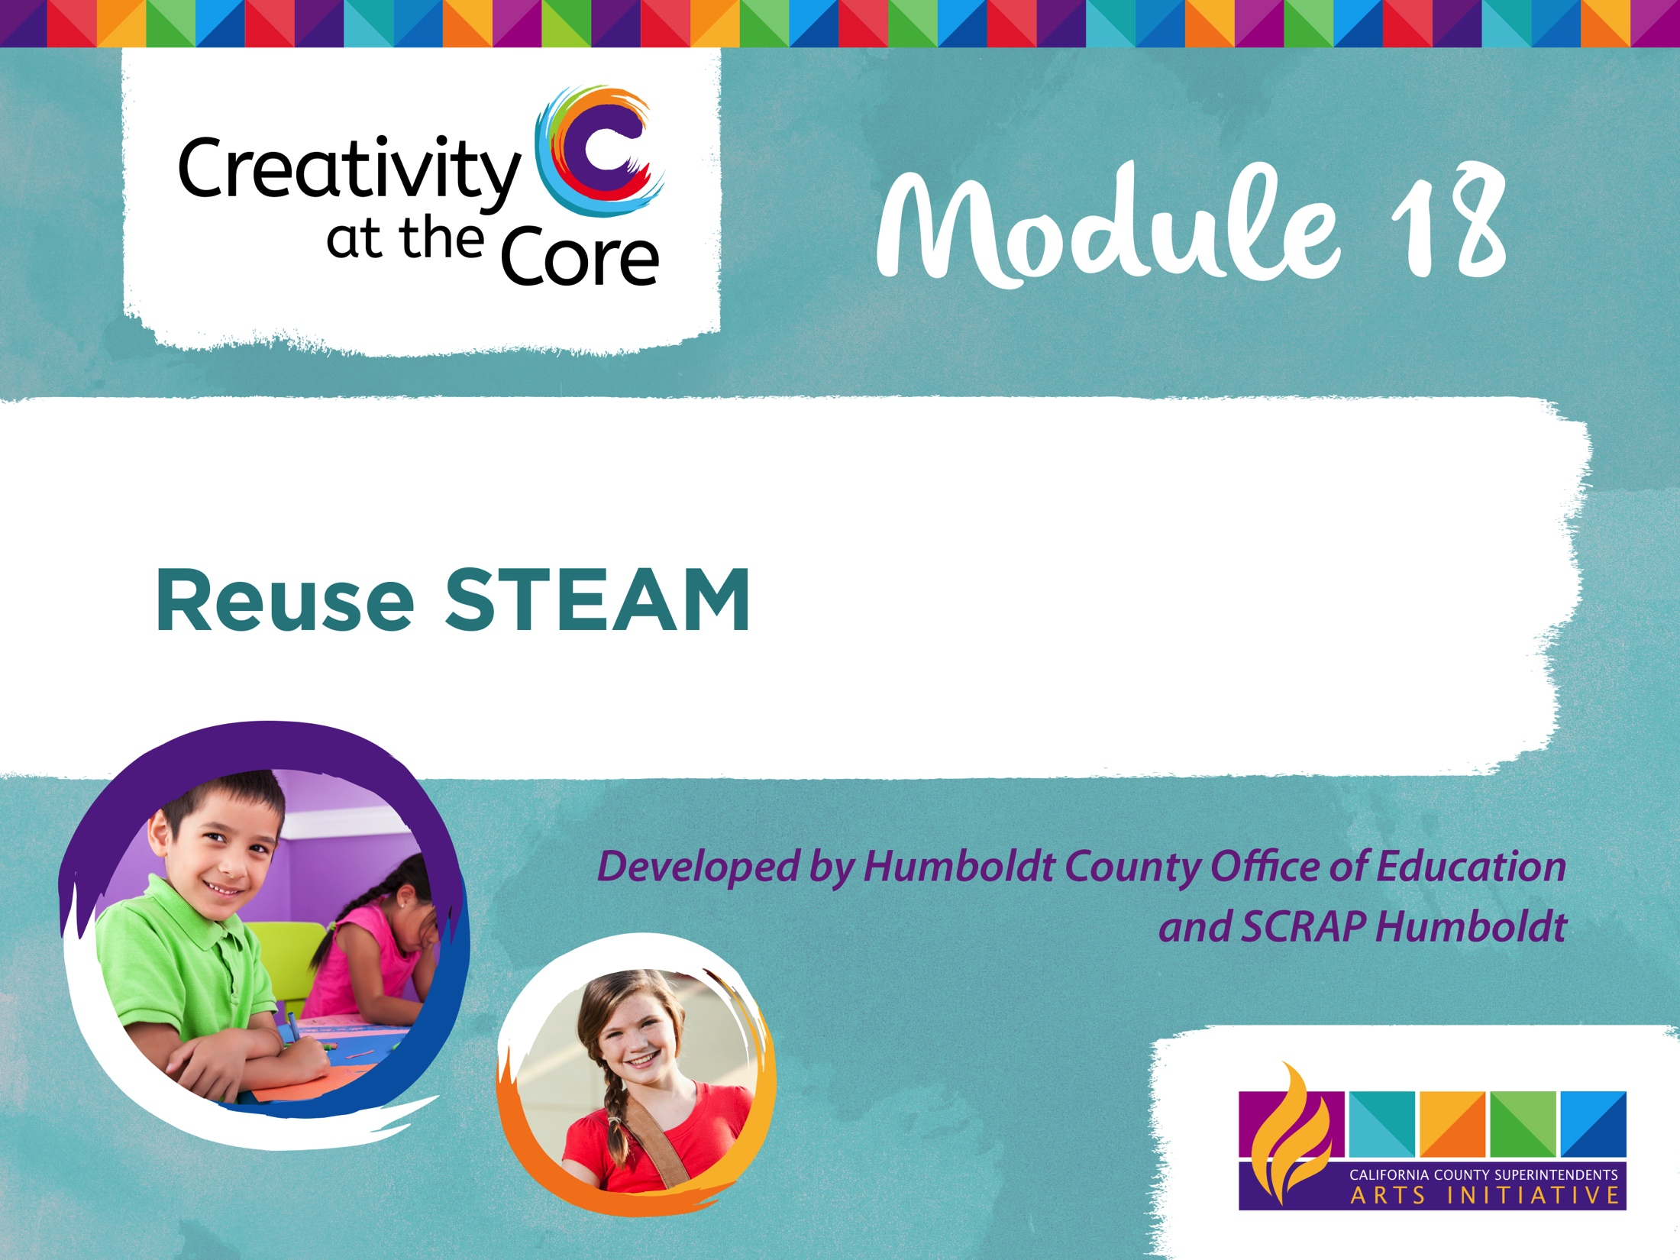

Slide 2
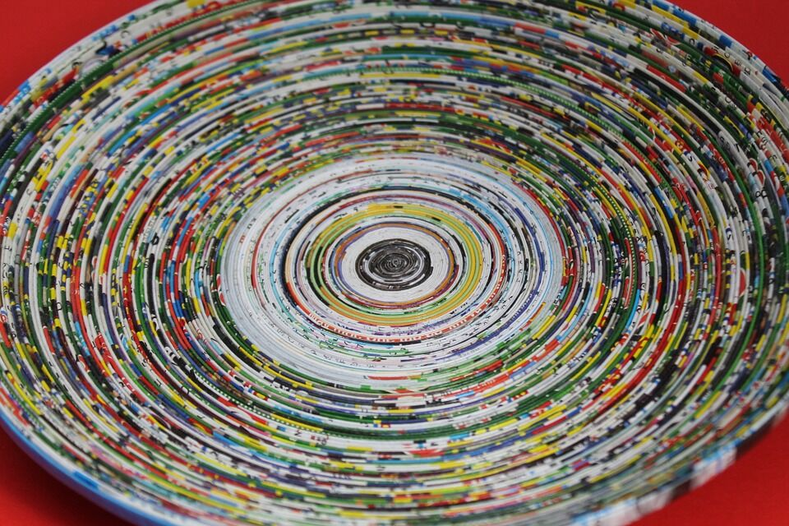
Expand the Loop through Creative Reuse
Notes:
Part 3: Expand the “Loop” Through Creative Reuse
Creative reuse sees all materials as equal and doesn't discriminate between new and used. One doesn't need brand new canvas to paint on, when the definition of what a canvas could be is expanded and broadened to encompass all materials. By holding all materials as equal, versus valuing them differently if they are new or used, we extend the lifespan of that material, thus conserving the natural resources that material is made from. By viewing objects as materials, we expand how we see them.
Creative reuse, also known as upcycling or repurposing, is the process of taking materials or products that are unwanted for their original function and with the addition of creativity, they are then transformed into something else. For example, a bottle cap from a soda bottle could be reimagined and reused as an earring, or a washer, or checker pieces or used as a wheel on a handmade car. By expanding the definition of how we see, think and use materials, we infuse creative problem solving into projects.
Paper can be transformed in a number of ways by creatively reusing it as a material. Here is one example of a bowl made from spiraled paper.
Open Image Source: https://pixabay.com/en/basket-art-paper-colorful-red-610387/

Slide 3
Creative Reuse Definition
Also known as upcycling or repurposing, is when the addition of creativity to an already manufactured item brings a new function.
A CD jewel case can become a bird feeder, wine corks turned into a cork board, a t-shirt transformed into a rug.*
*Definition courtesy of The Reuse Alliance

Slide 4
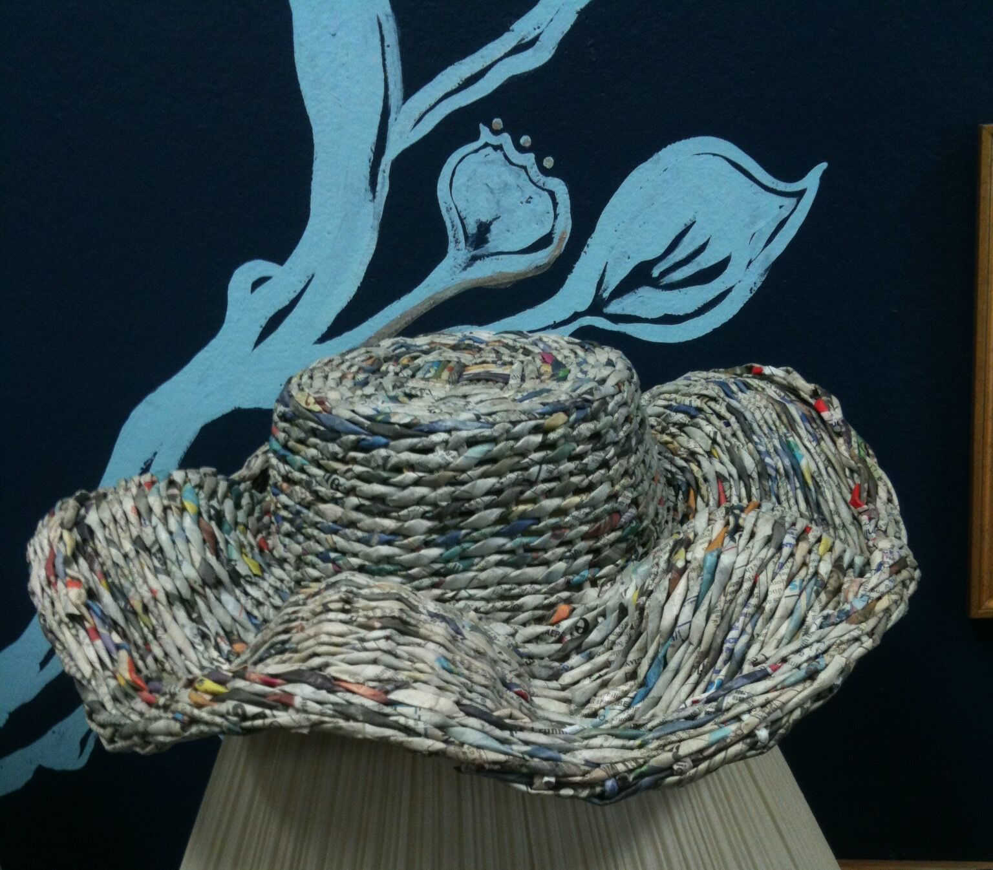
Notes:
Paper has been woven together to create a hat, or if you turned it upside down it could be a basket.
Photograph by Tibora Bea Girczyc-Blum

Slide 5
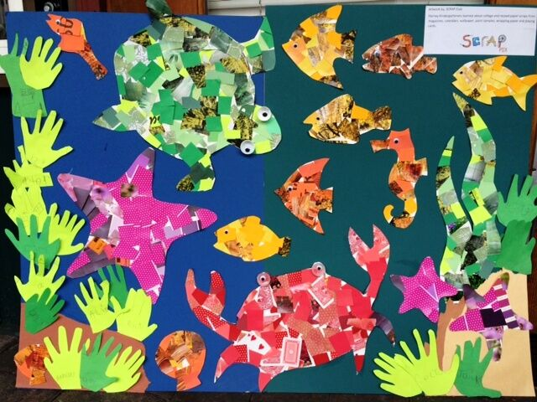
Notes:
Various colors and textures of paper are used to create color in this image. For example, the red of the crab is made up of a variety of types of paper, like playing cards. Photograph courtesy of SCRAP PDX.

Slide 6
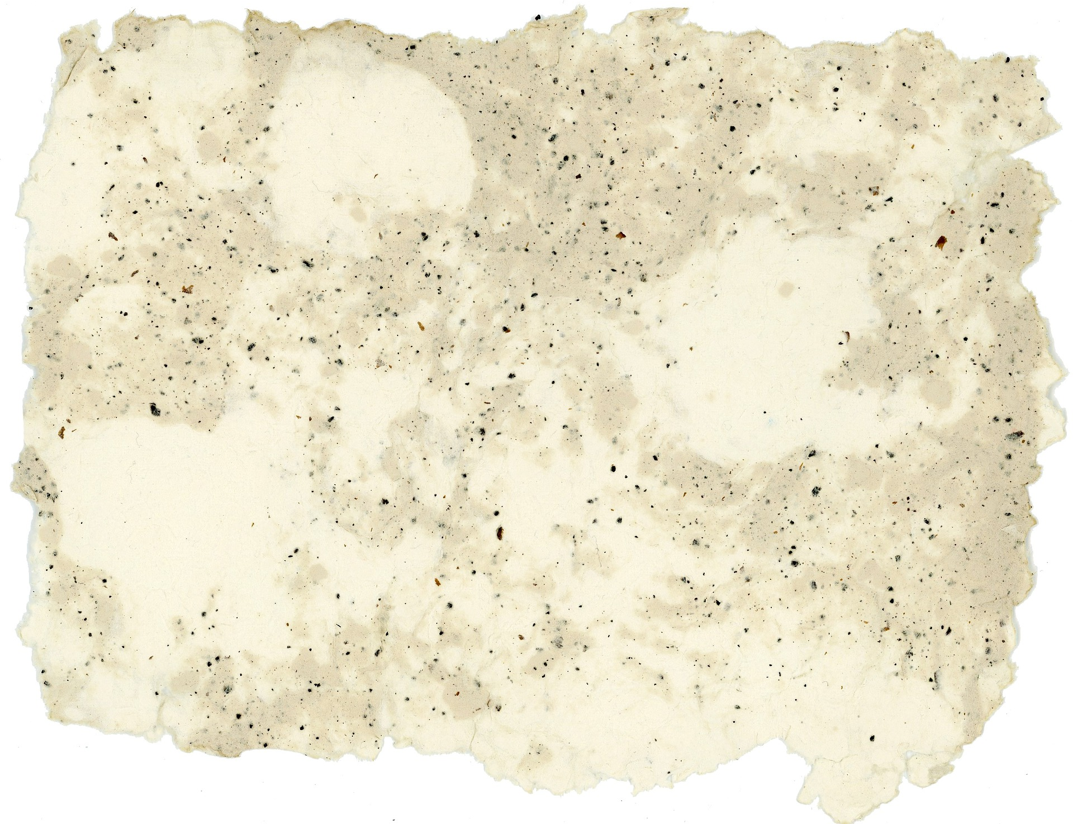
Notes:
Creative reuse can help make this handmade paper into a growing medium by adding seeds to it.
Open Image Source on pixabay.

Slide 7
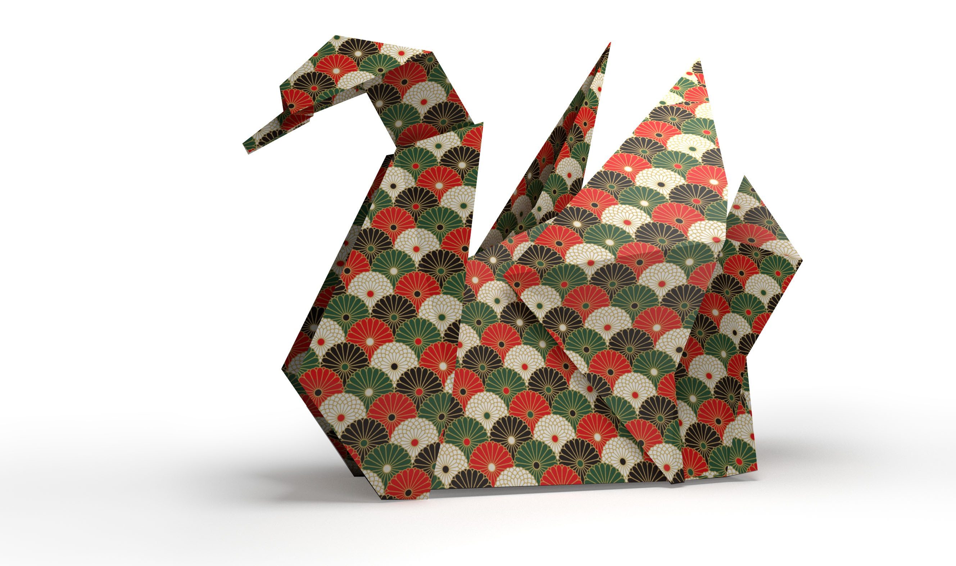
Notes:
Another way to transform paper is to fold it. This is the Japanese art of folding paper, called Origami.

Slide 8
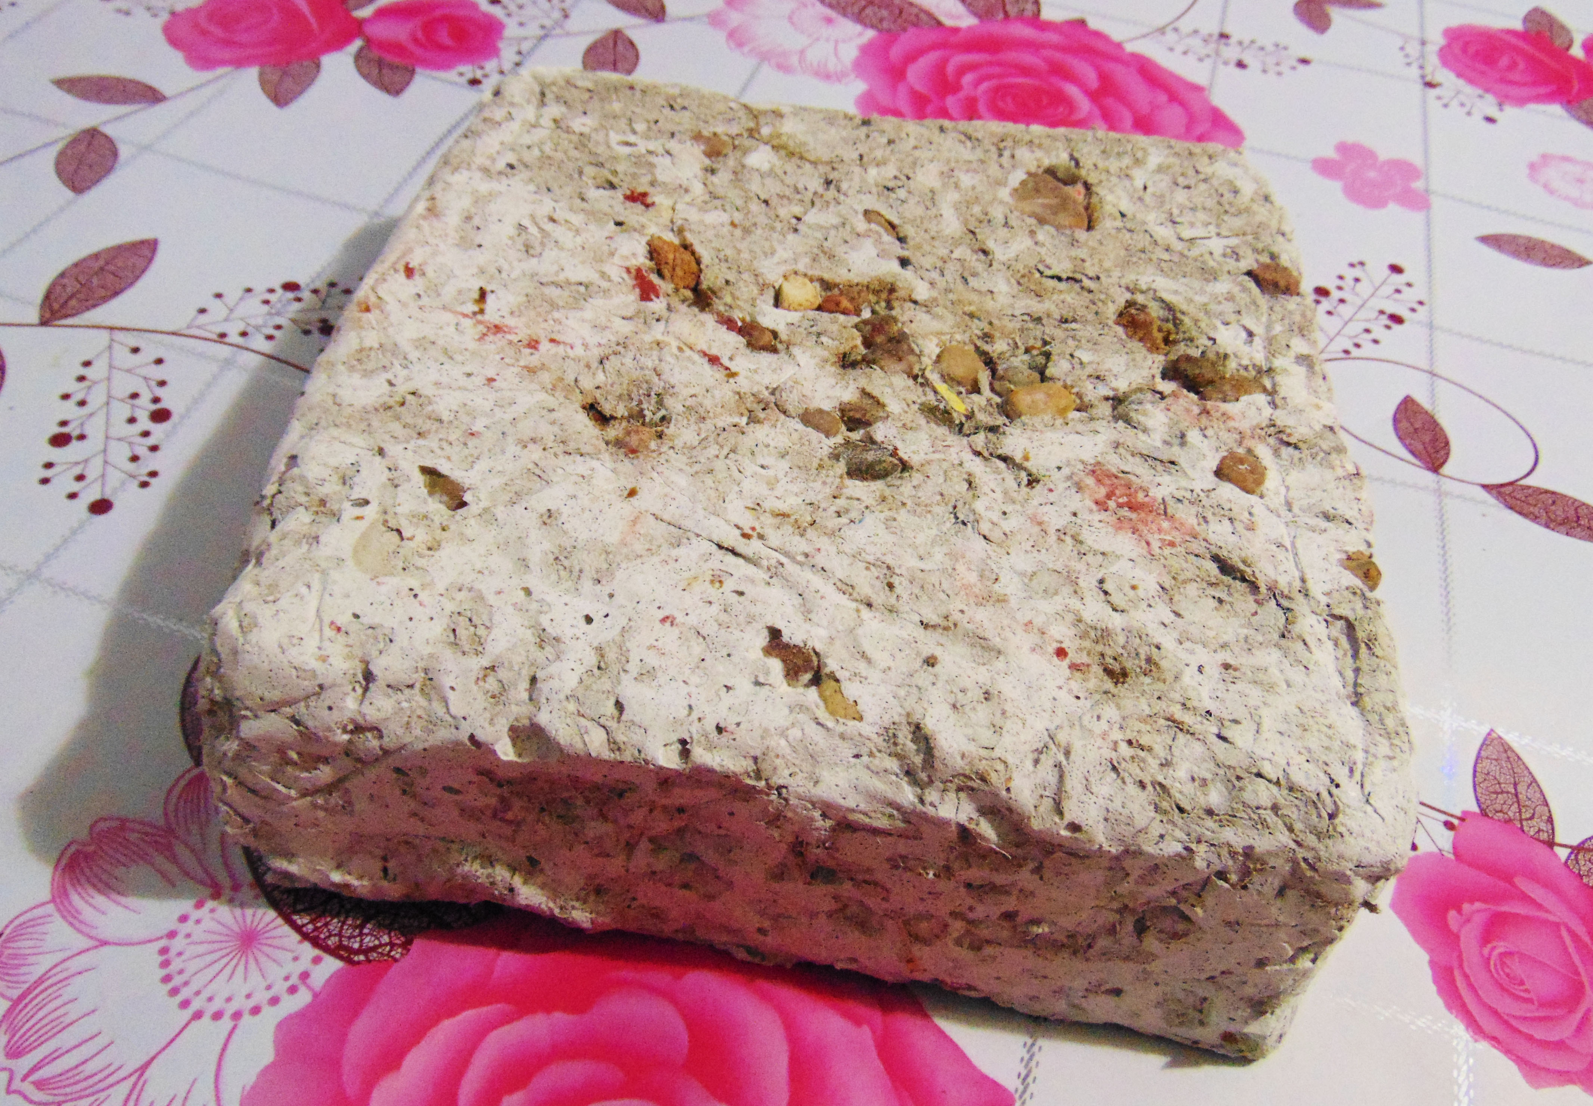
Notes:
Papercrete is created by combining paper and cement or clay to create a fibrous mixture. This is poured into forms to create blocks, with which to build with.
Image Source: https://upload.wikimedia.org/wikipedia/commons/0/07/Papercrete_block1.jpg

Slide 9
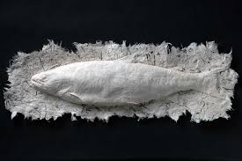
Notes:
This artist makes a mold (like an ice cube tray)of a fish and presses handmade paper into it to create a 3D paper fish.
Image courtesy of the artist: Lonnie Hutson: http://lonniehutson.com
Links to other paper artists:
This is a great summary of artists who use paper as a medium : A collection of paper artists
Artist Laurence Vallieres, uses cardboard to construct large animals. www.Laurencevallieres.com

Slide 10
The Creative Reuse Lens
Engineer
Artist
Tech Savvy
Mathematician
Scientist
Think like a DESIGNER

Slide 11
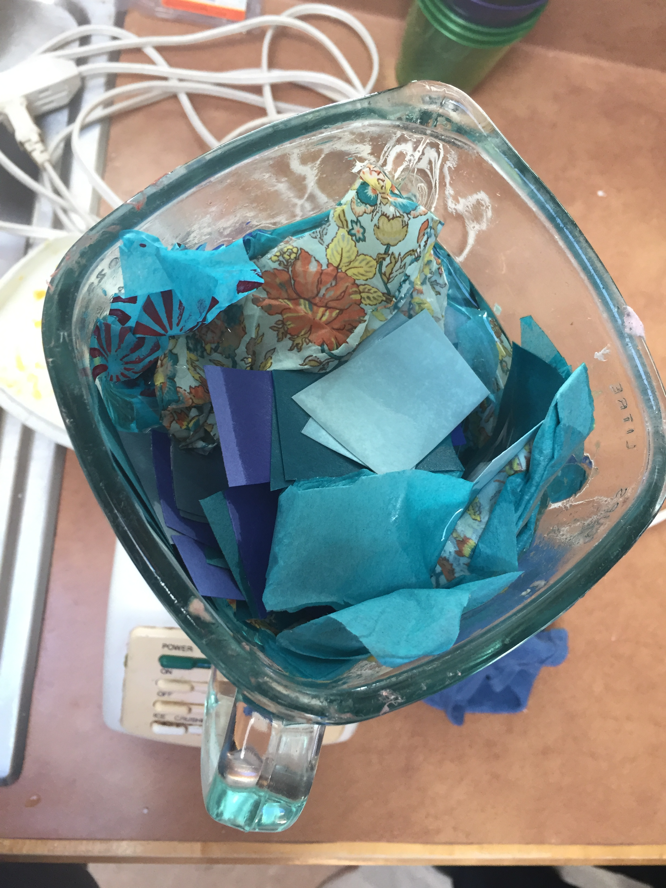
Transforming Fibers
Notes:
Students use what they have learned about paper fibers and paper types to design their own recycled content paper and will model the manufacturing process in their own classroom. Ask students to revisit their Graphic Organizer and to consider which combination of paper fibers would make the “ultimate paper”. Consider the rankings for strength, how many times the paper fibers may have already been recycled, or perhaps interesting colors or textures, etc. when choosing paper with fibers that, when blended together into pulp would yield the highest quality paper.
Note: Paper samples that did not breakdown in water have been treated with a coating that enables them to have “wet strength”. Wet strength treatment is used in packaging that could become moist due to condensation (frozen food boxes, six-pack carriers), paper products that carry food and liquids (paper plates and cups, milk cartons), and in items where the contents inside cannot be exposed to moisture (paper ream wrappers). These cannot theoretically be recycled because the paper fibers will not breakdown into pulp when blended. Keep this in mind when consider the students’ recycled paper “recipe”.

Slide 12
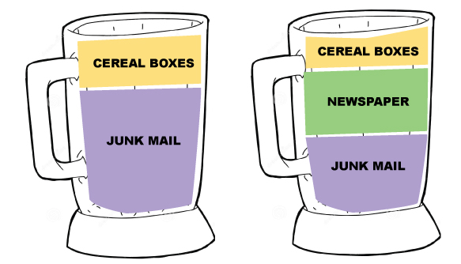
Recycled Papermaking
Students choose which fibers (i.e. paper samples) to use in their formula
Represent the formula as a simple graph to show proportions

Slide 13
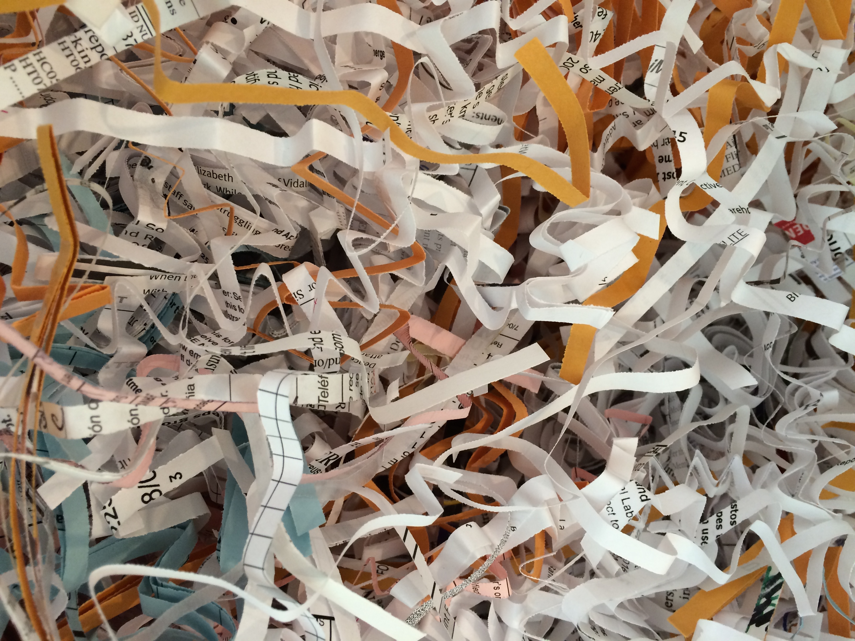
1. Choose fibers
Notes:
Whichever paper types students choose to create their recycled paper with, it needs to be torn or cut into small pieces before being put in a blender. Shredded paper is excellent to use as a base fiber (or all the fiber) for your recycled papermaking project.

Slide 14
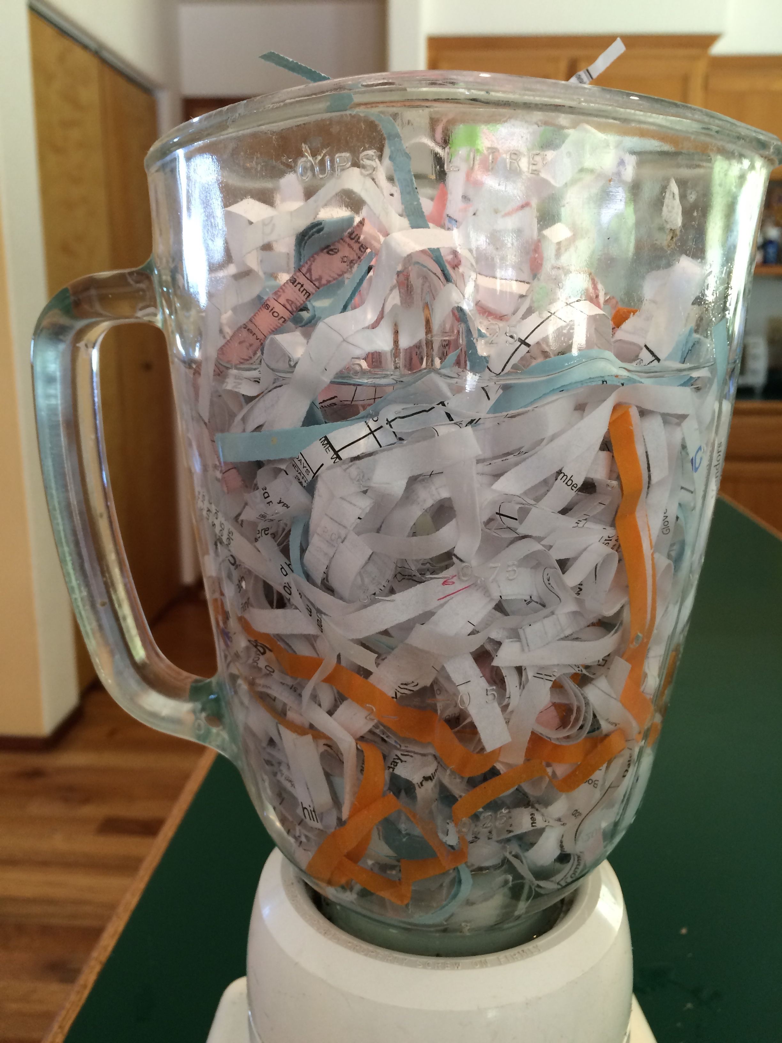
2. Pack blender
Notes:
Put paper pieces in the blender but avoid packing them in too tightly. Keeping the paper pieces loose helps keep from overwhelming your blender. Fill belnder nearly to the top with water.

Slide 15
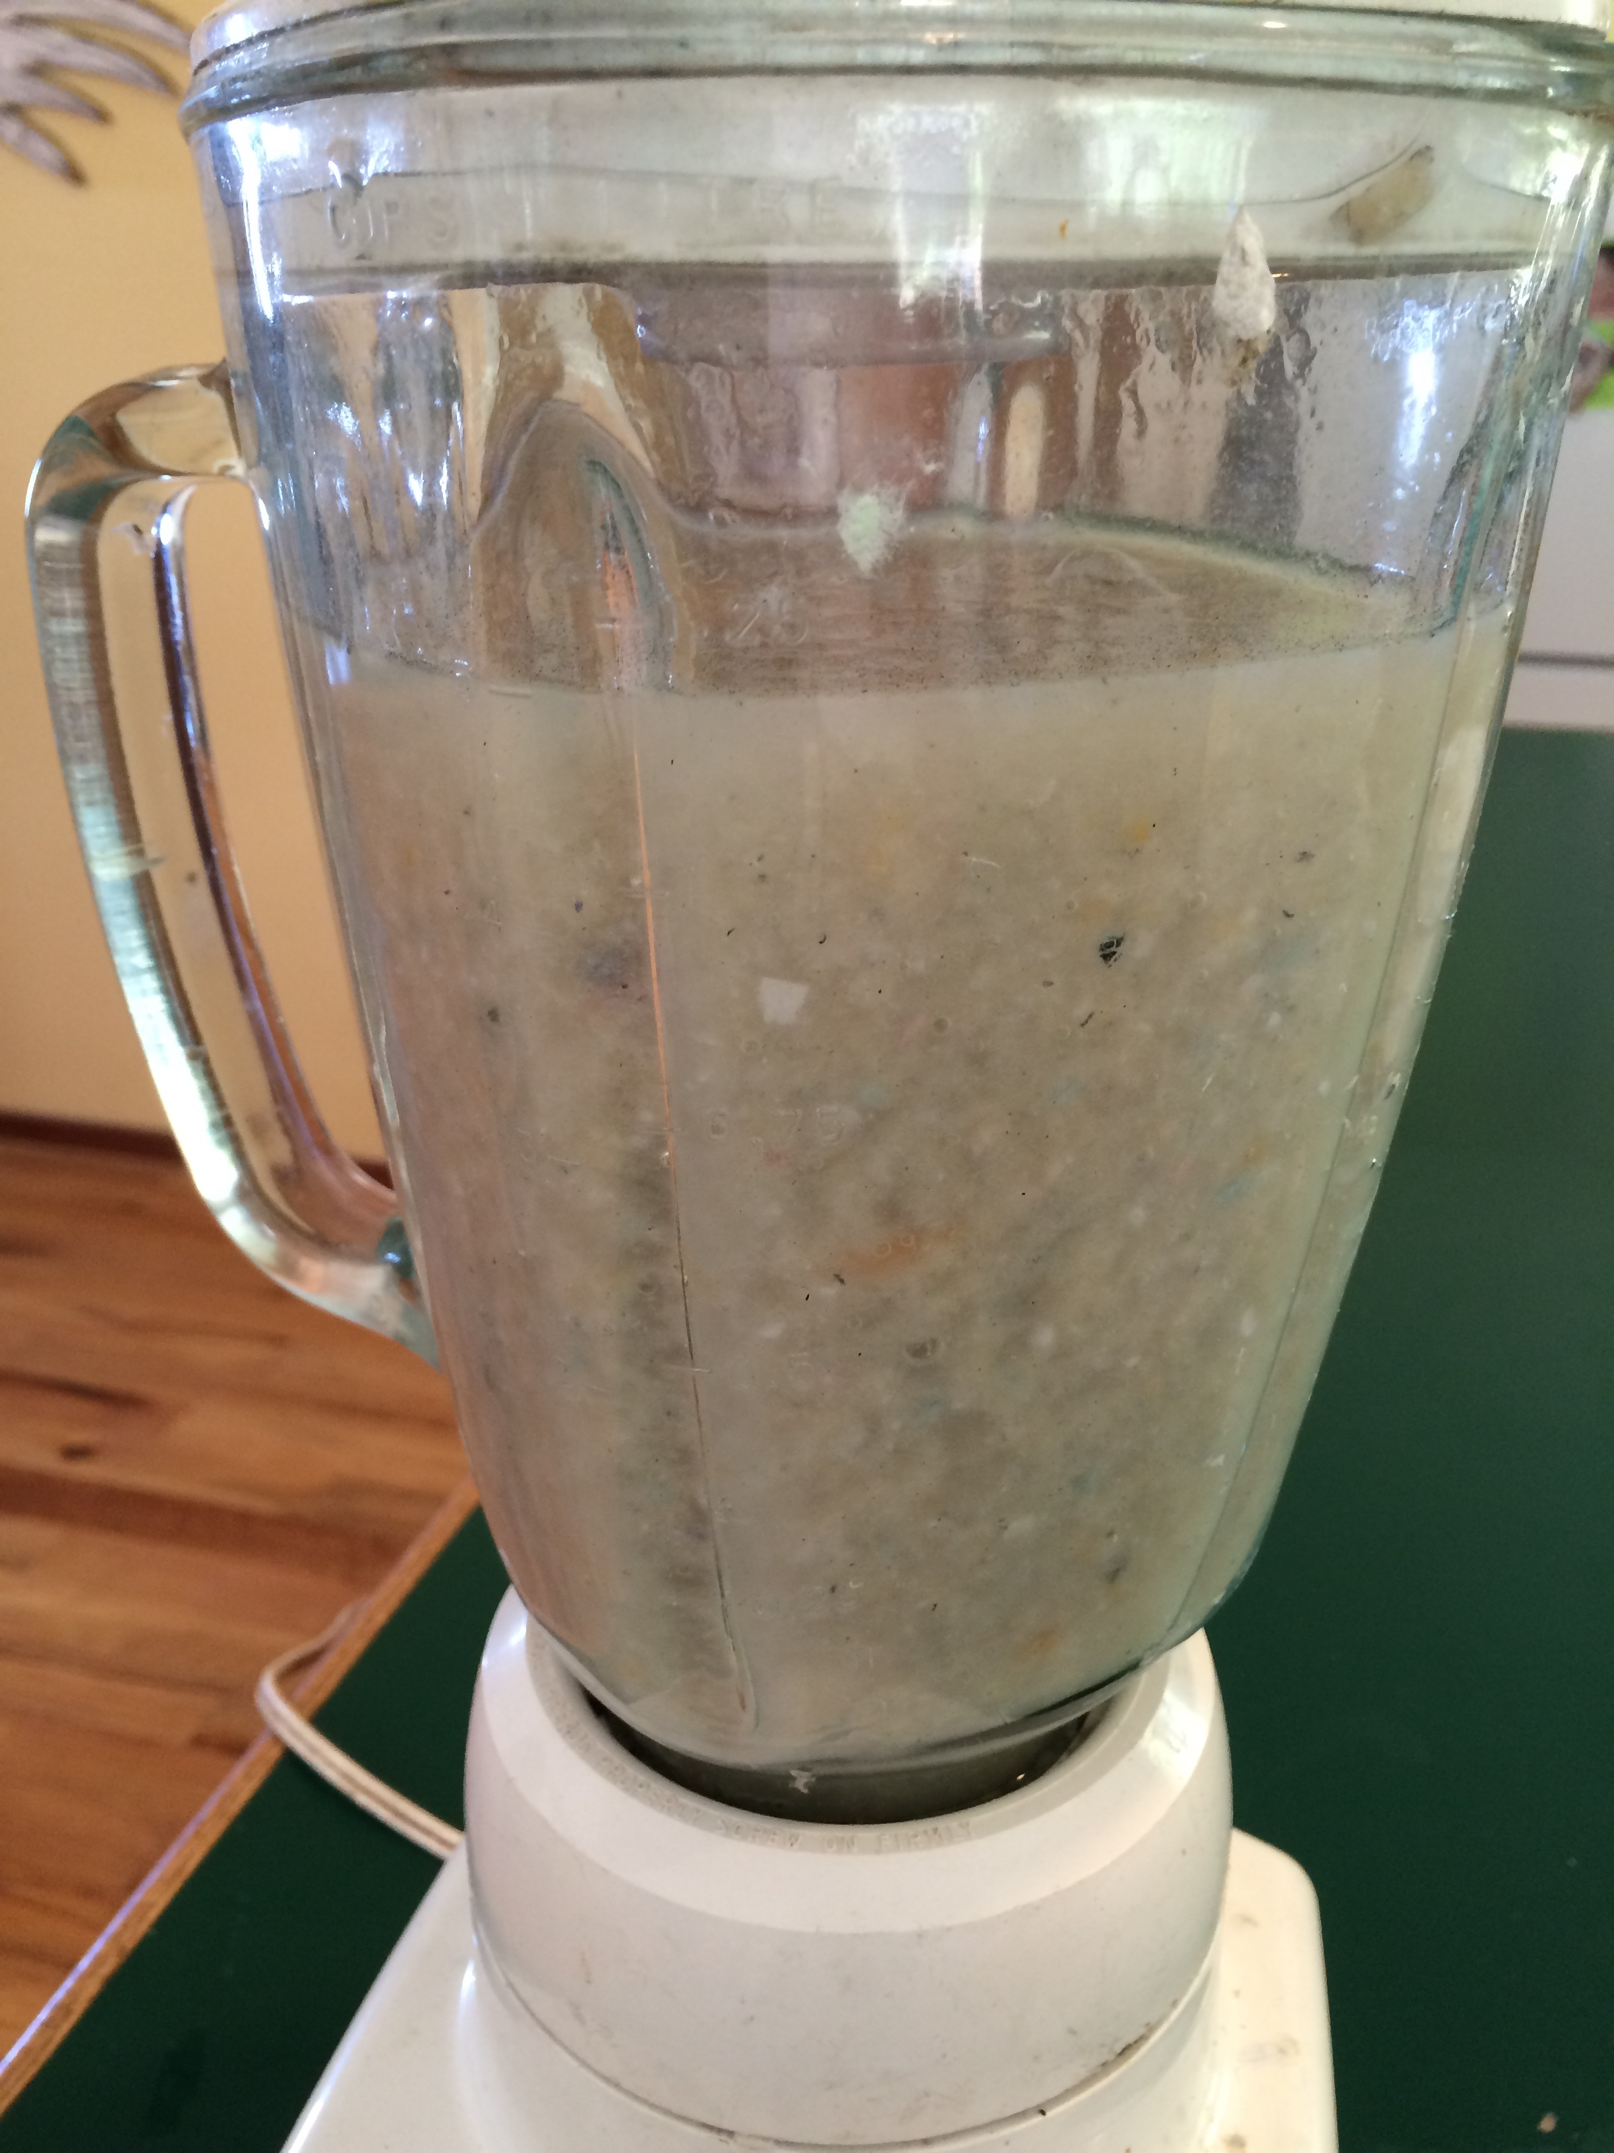
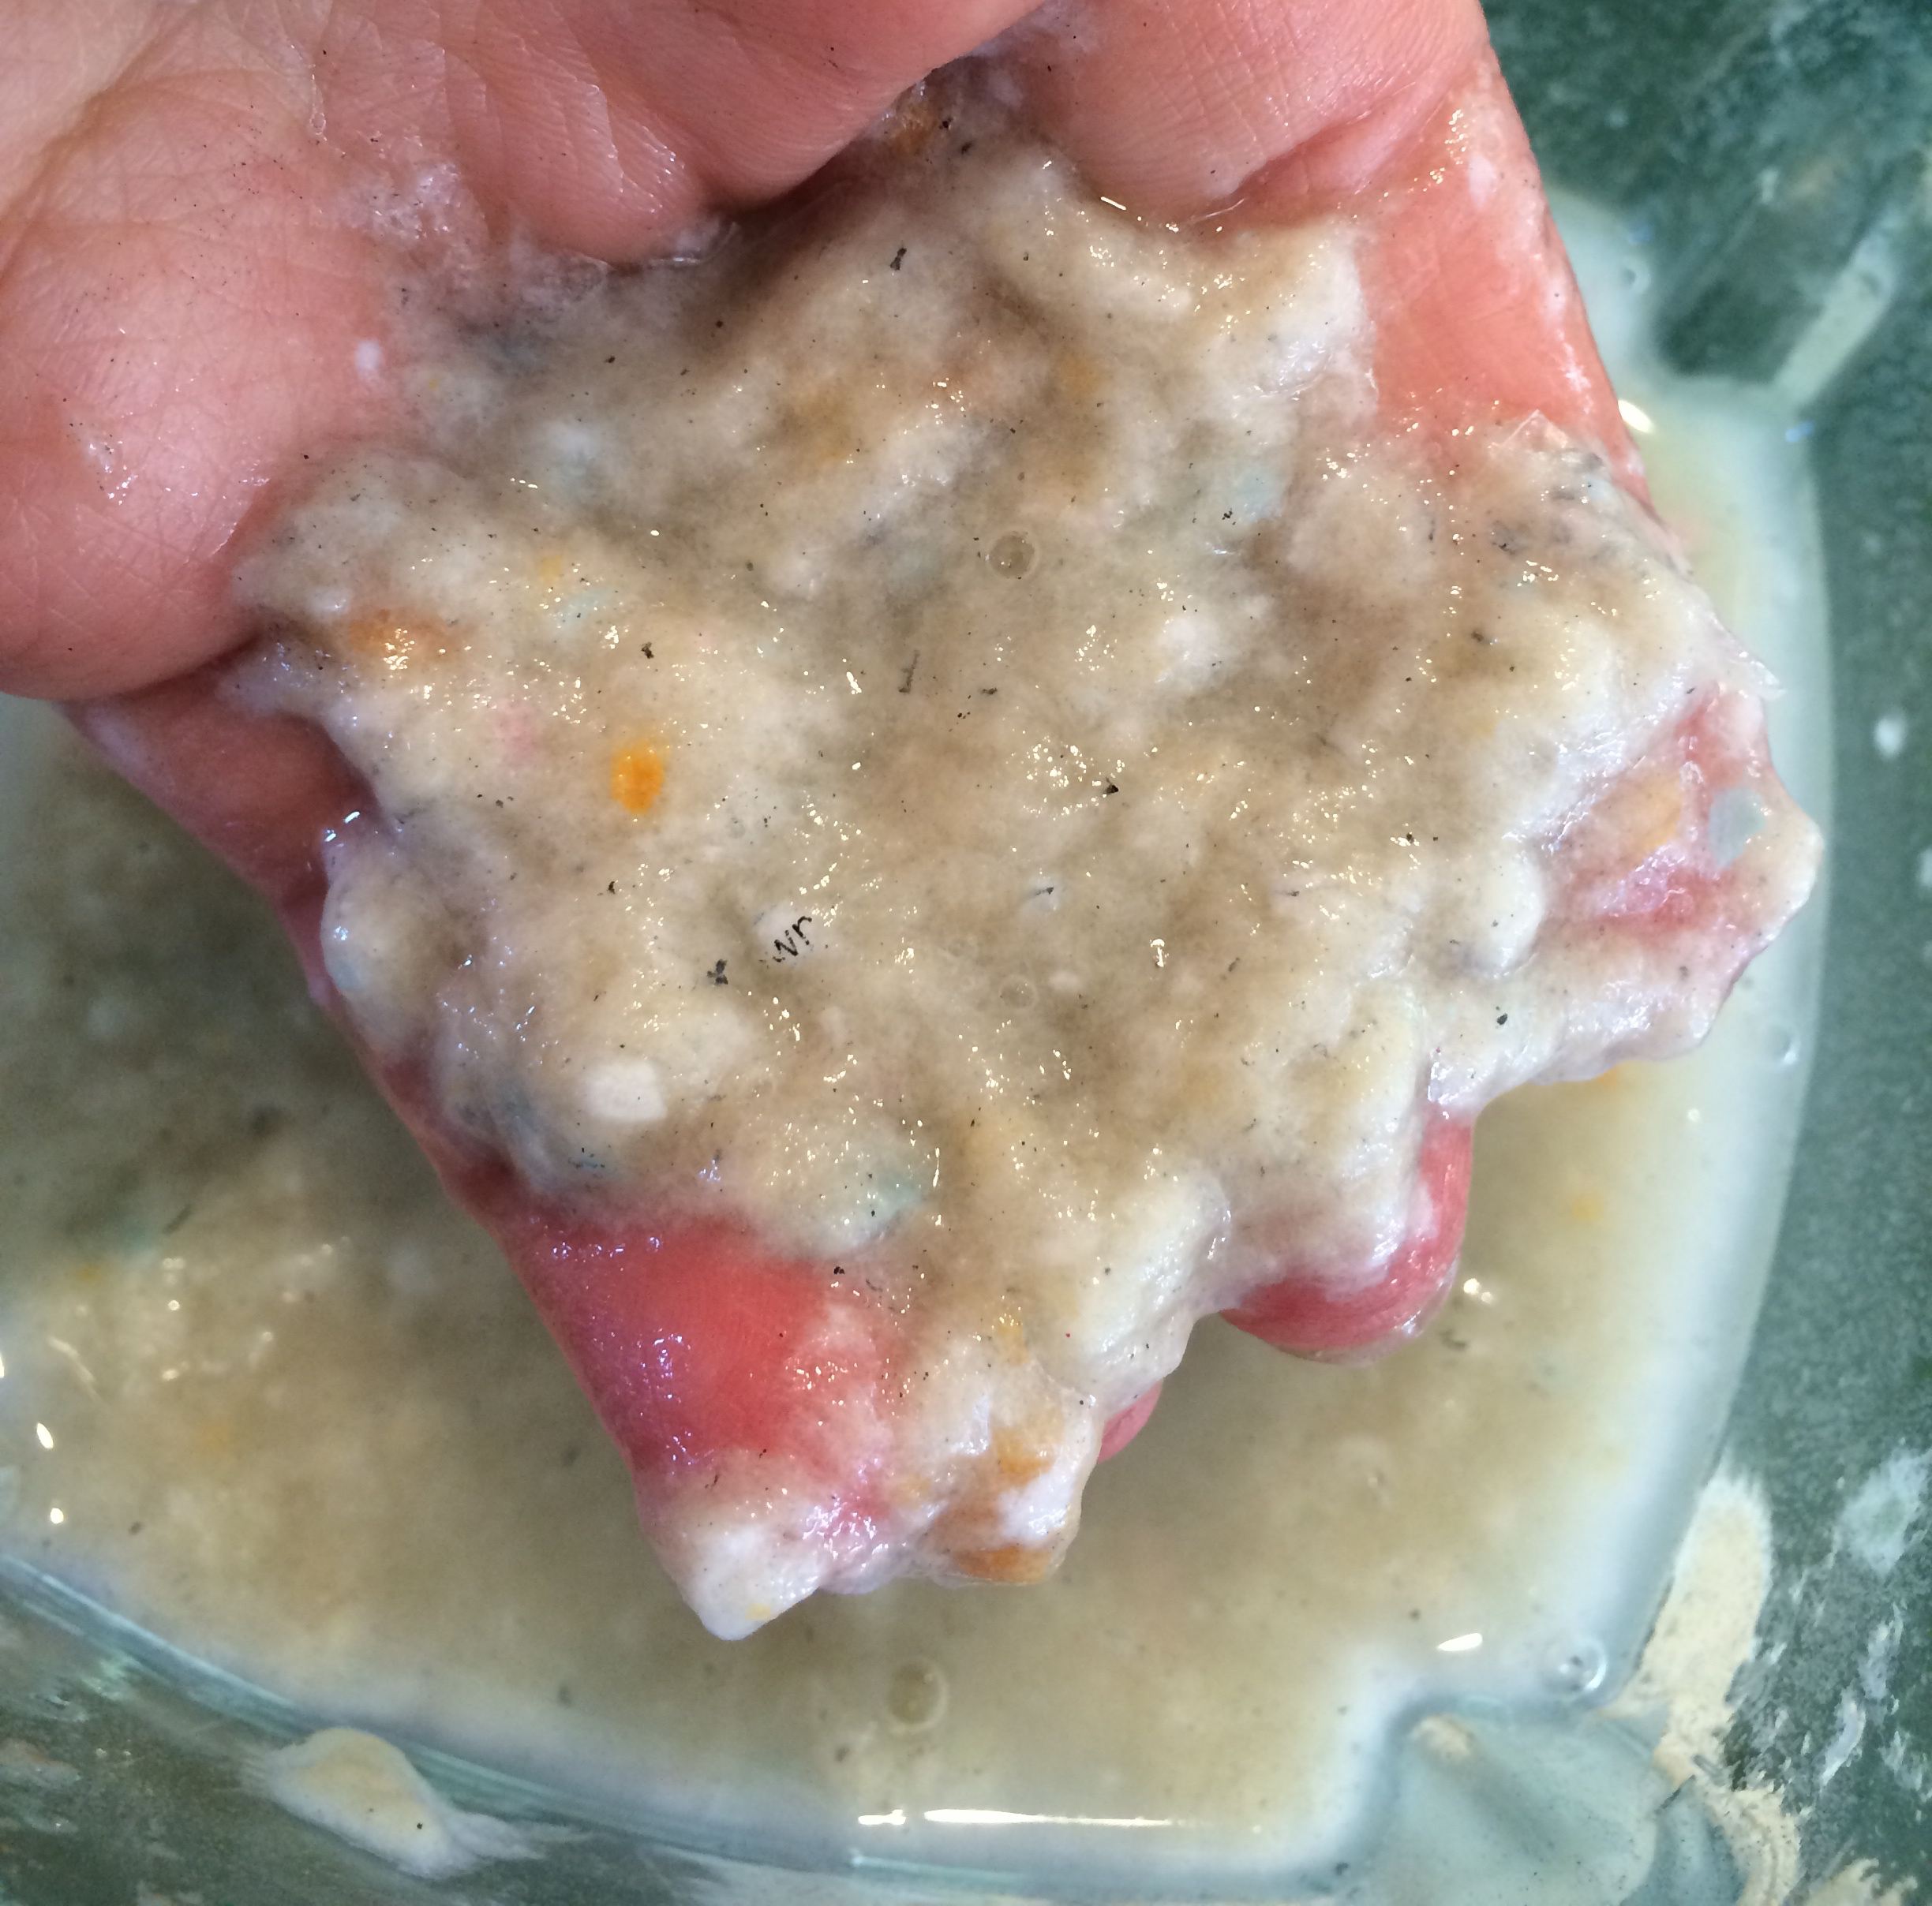
3. Blend to make pulp
Notes:
Instead of just pureeing your paper fibers, use the PULSE button to blend them into paper pulp. Don’t forget to put the top on your blender!

Slide 16
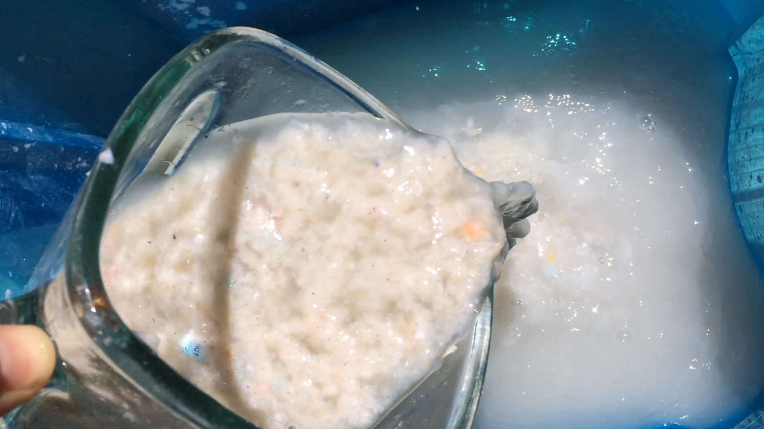
4. Pour pulp into a tub
Notes:
Use a “Rubbermaid tote” or equivalent container as the basin of paper pulp. It will take approximately 5 blenders of pulp to make enough to get started with the papermaking process.
Check the consistency of your pulp. You will need to add about the equivalent amount of water to dilute it. Too thick and oatmeal-like and the paper you make will be like an egg carton. Pulp that is too dilute will make very thin and fragile paper like tissue. It helps to have a bucket on hand with undiluted pulp for adding in a class of students rotates through the papermaking station. With each piece of paper that is made, a bit of pulp is removed making the tub more dillute. Add in more undiluted pulp for with every 6 or so sheets that are made.

Slide 17
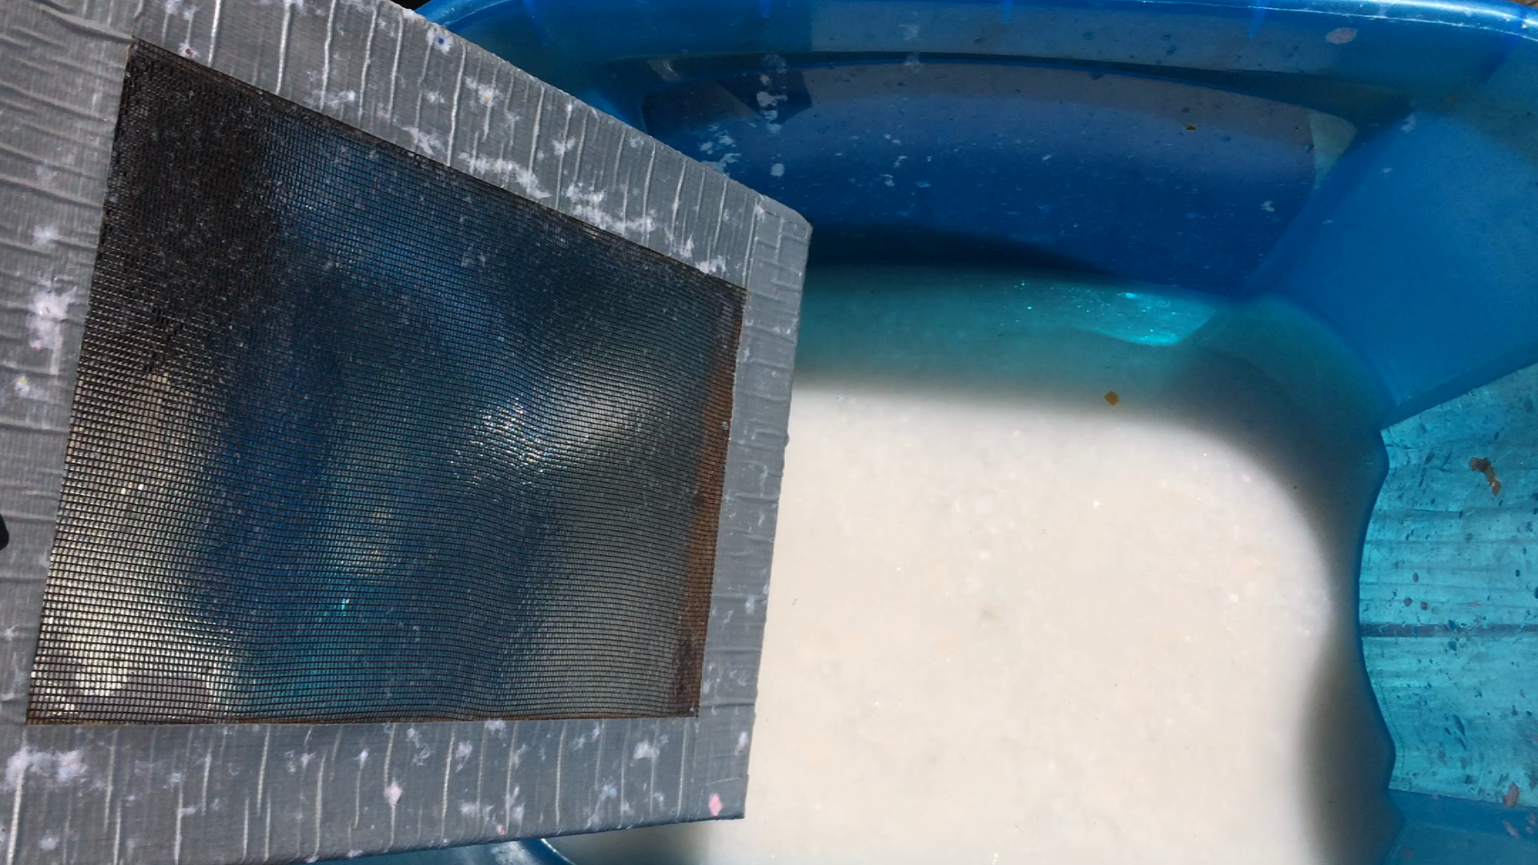
5. Dip screen in pulp tub
Notes:
Swirl pulp before dipping in screen to evenly distribute fibers. Hold screen on edges, submerge to bottom of tub, and lift up while keeping the flat surface pointing towards the sky.
Note: The flat surface of the screen should face up.

Slide 18
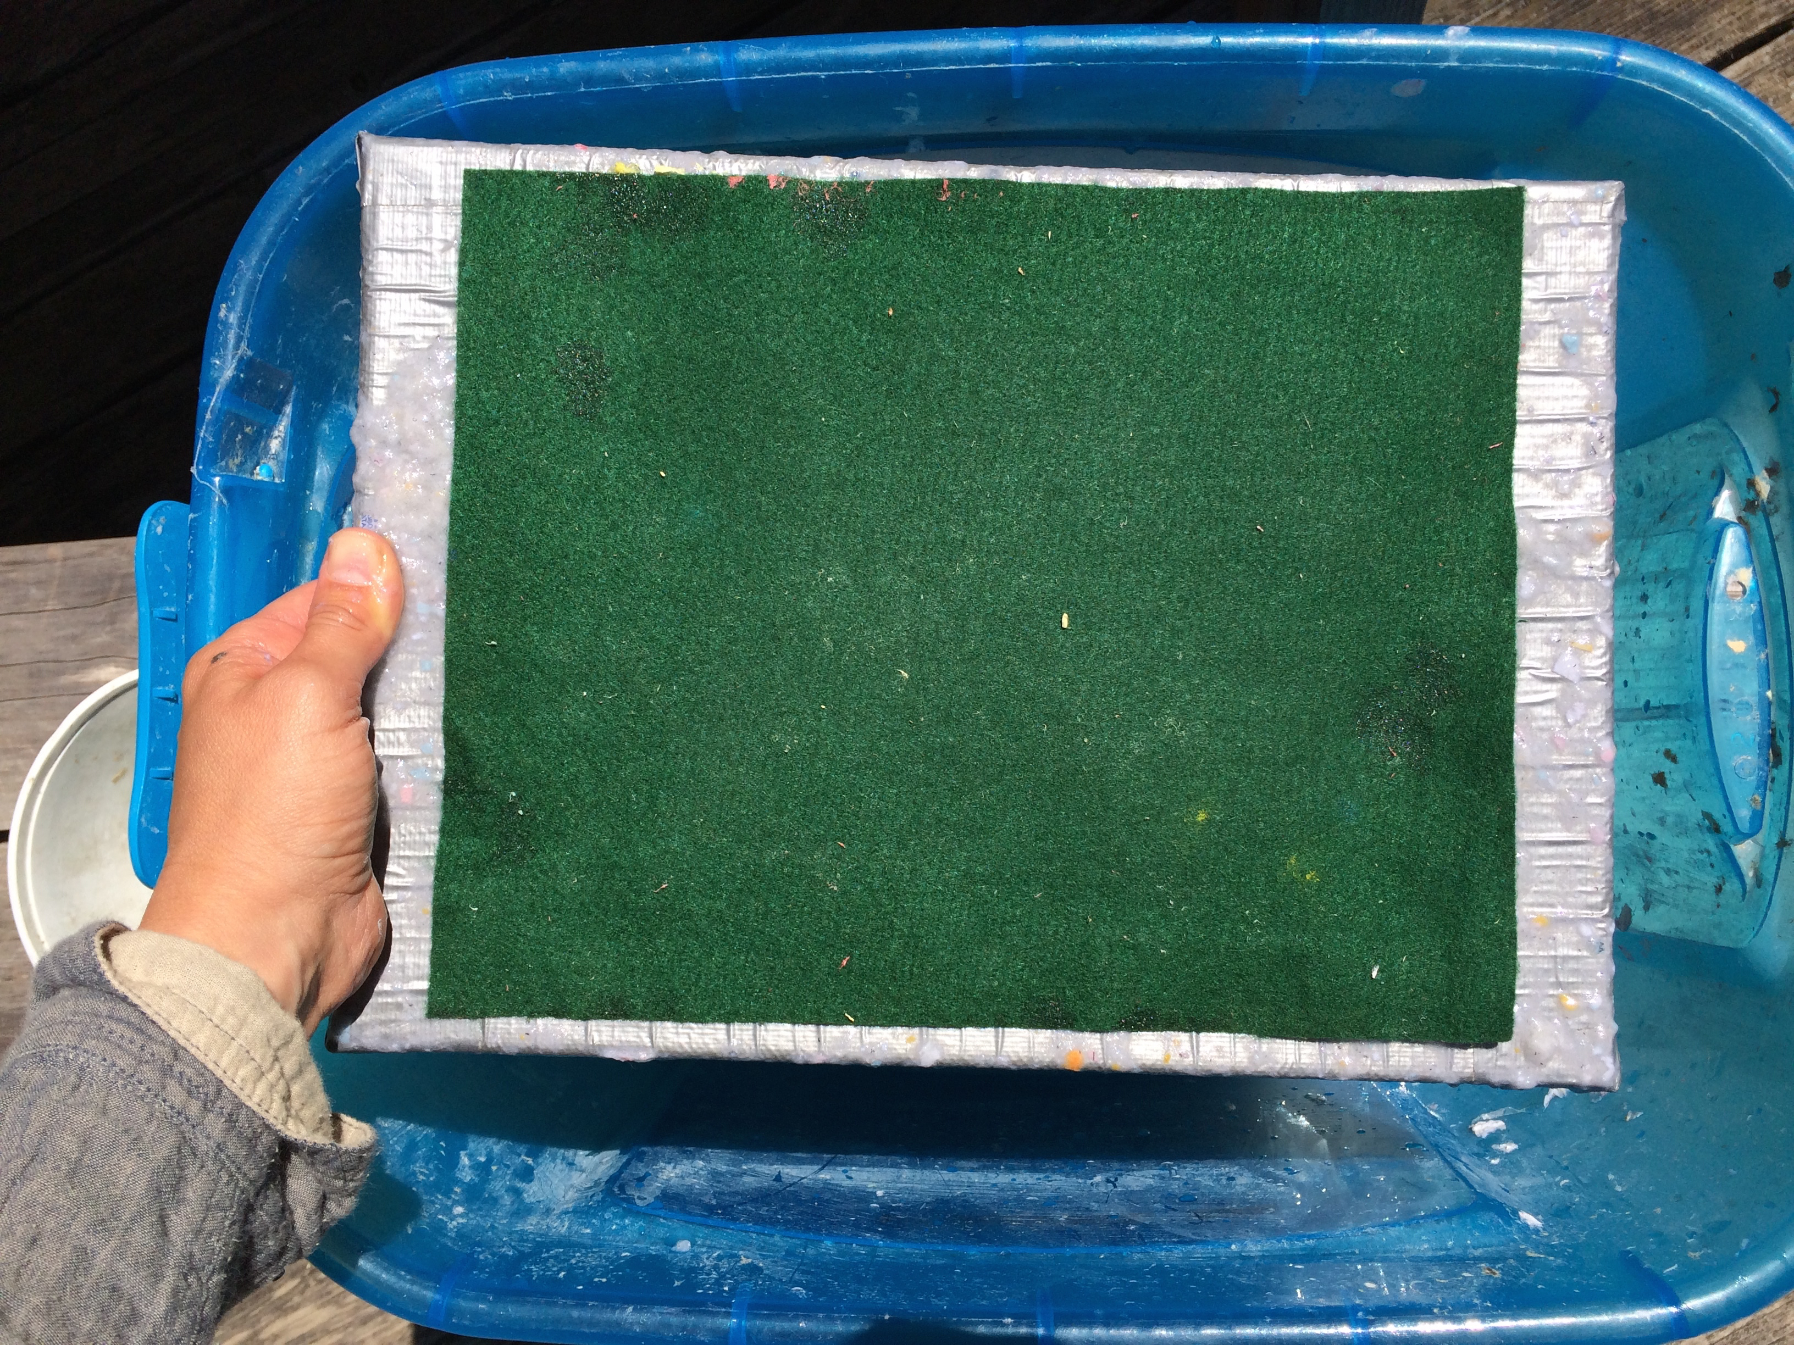
6. Place felt on top
Notes:
A few pieces of newspaper folded together are a suitable alternative to felt

Slide 19
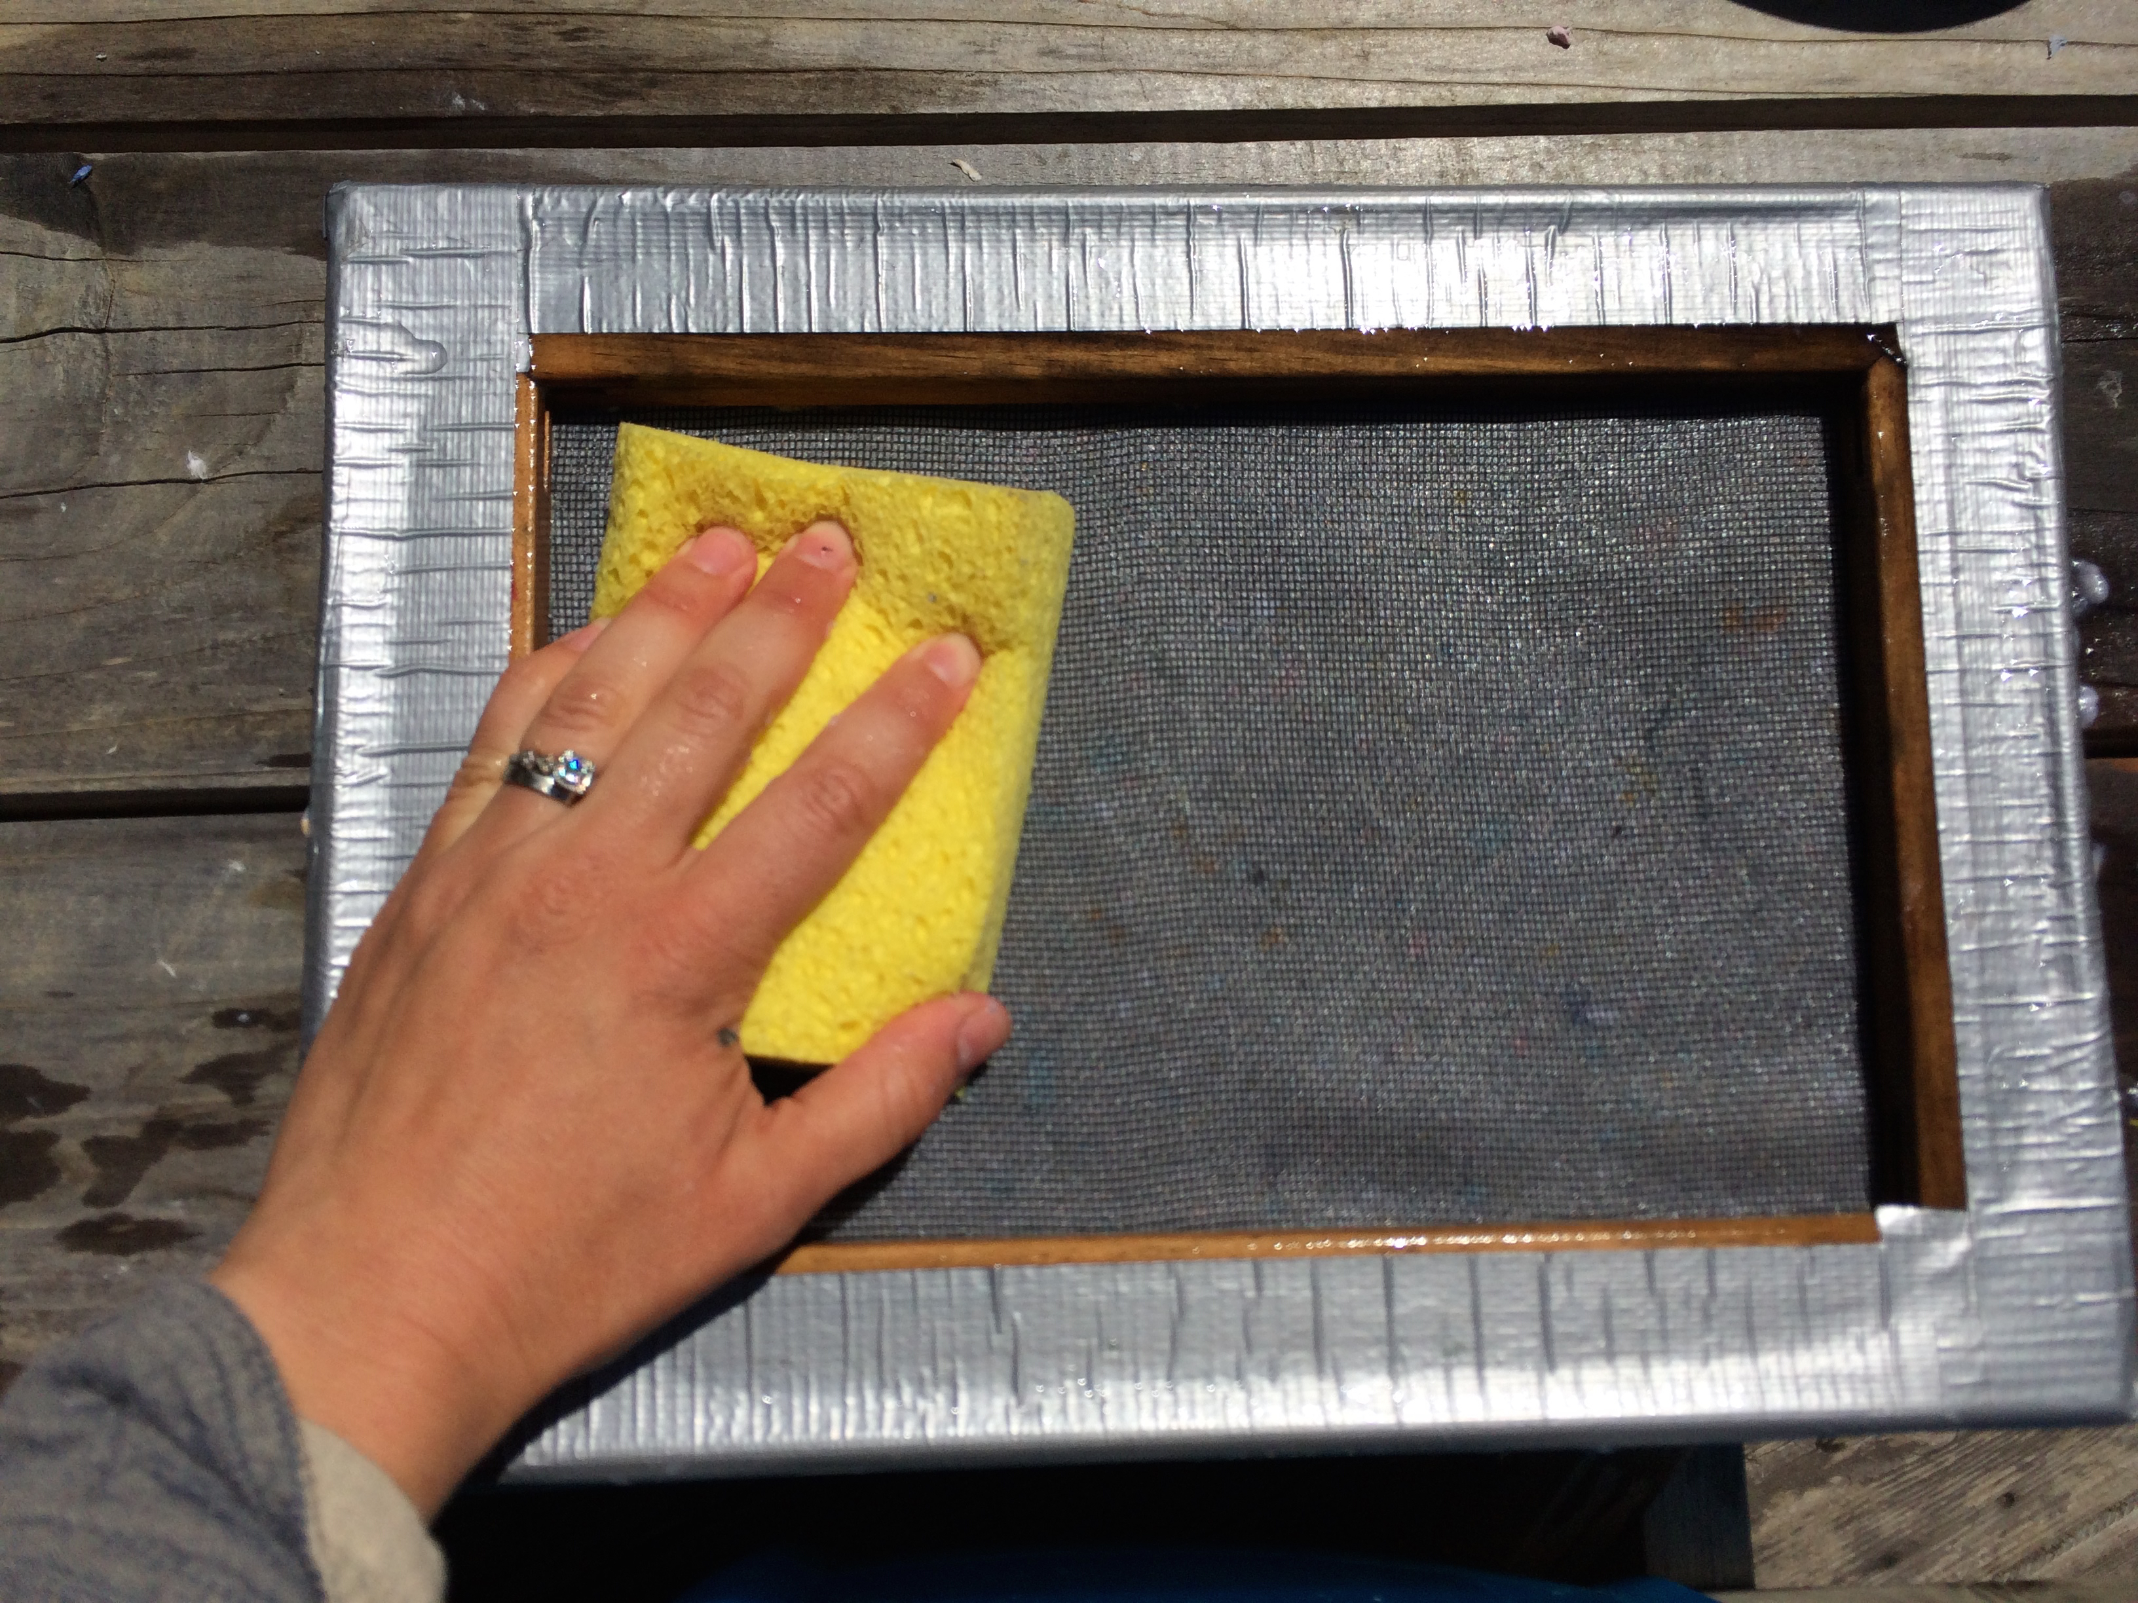
7. Remove water
Notes:
Gently flip over and use a sponge to PRESS (not RUB) on the screen to soak up water. Squeeze the sponge repeatedly over a bowl to remove excess water before absorbing more through the screen.

Slide 20
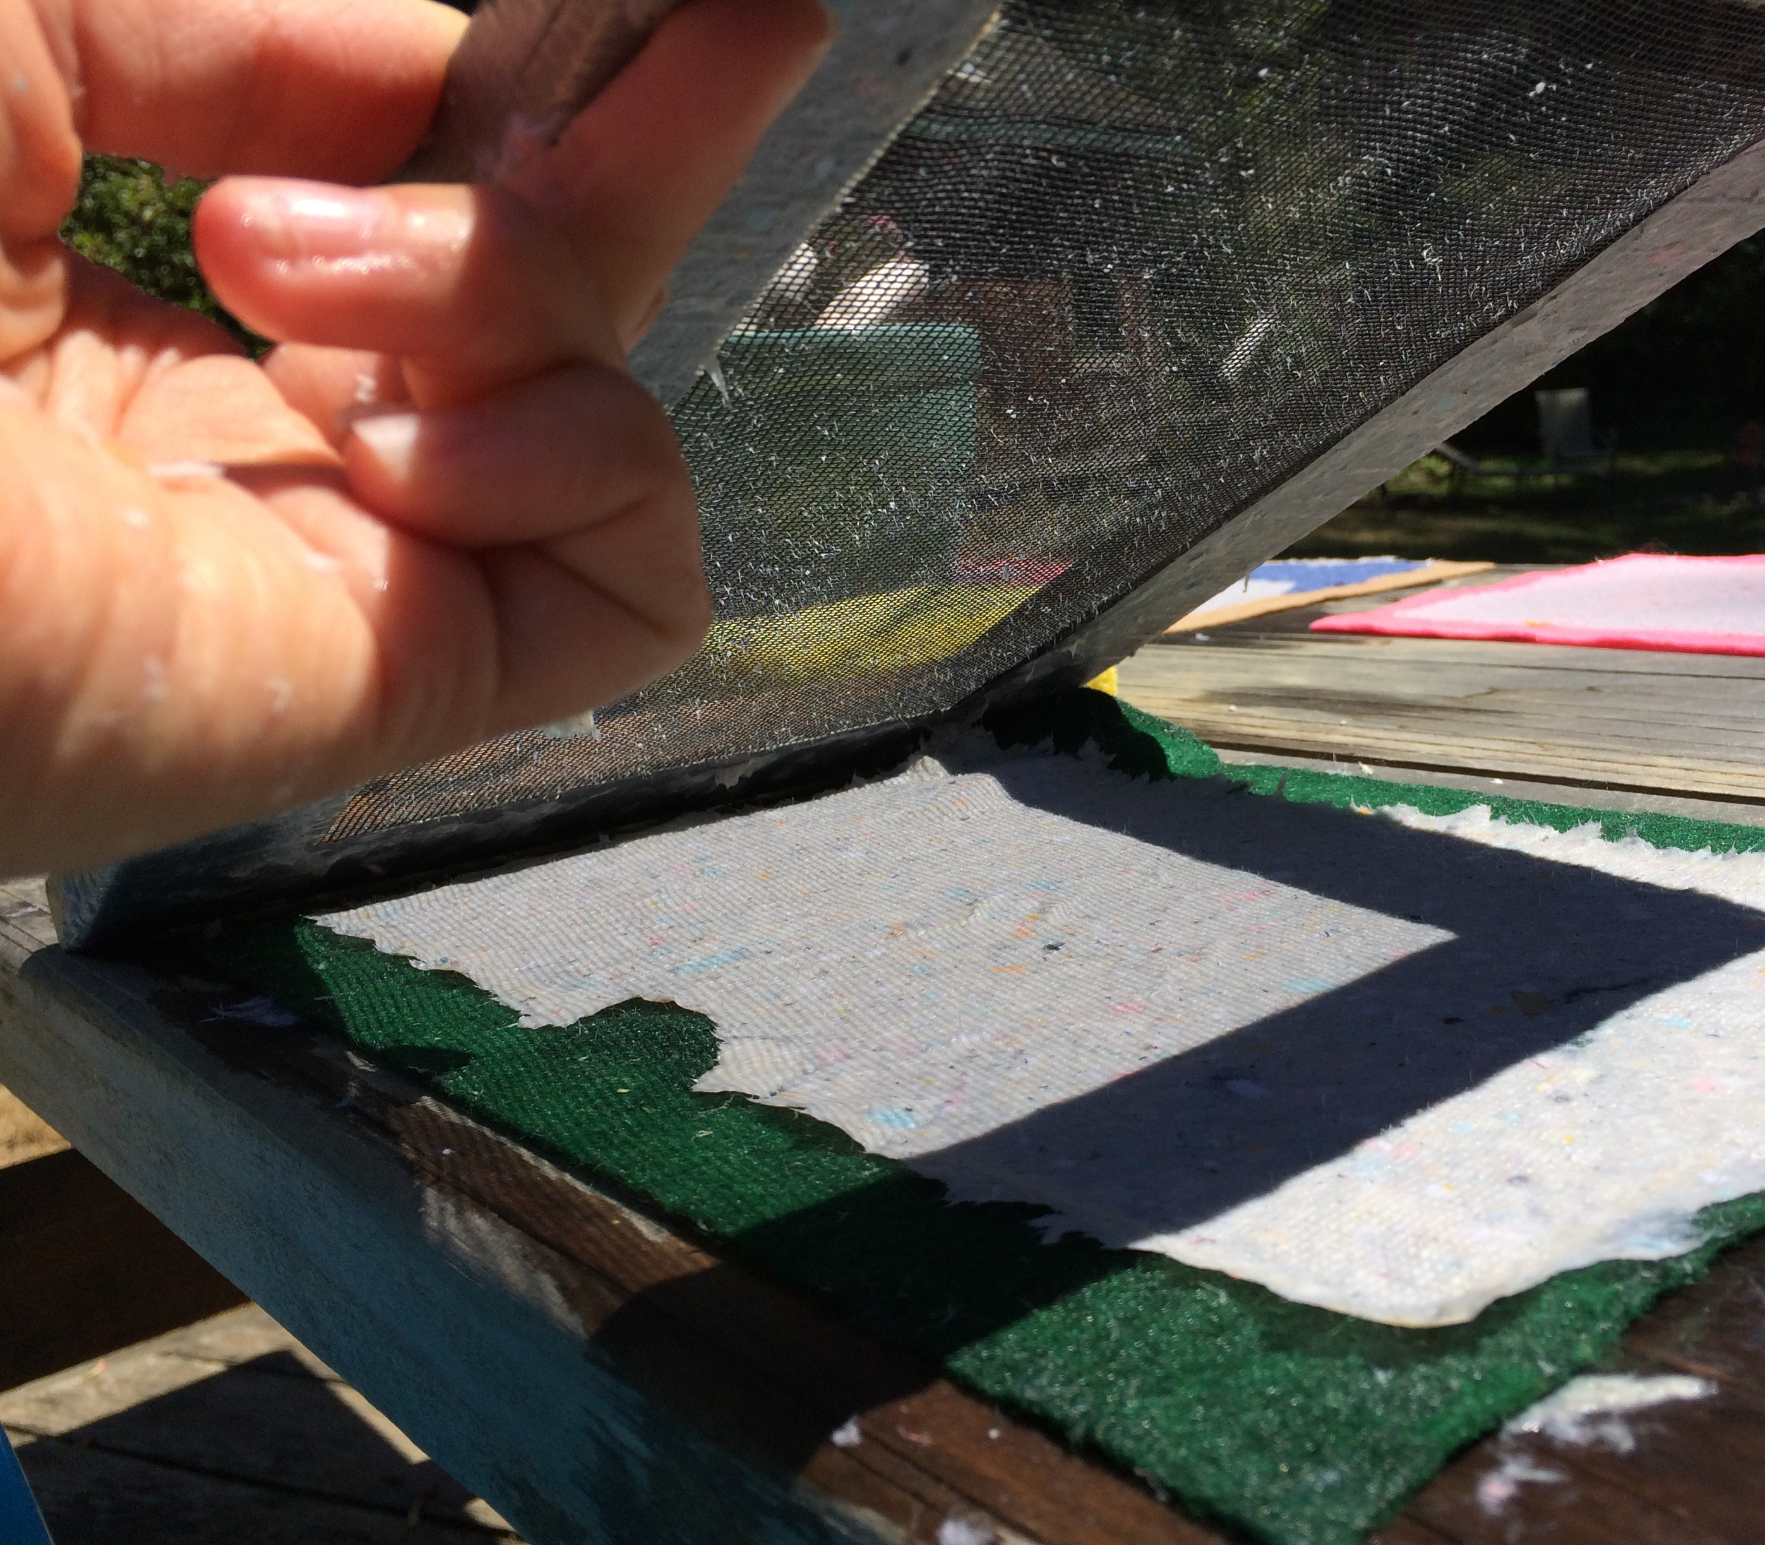
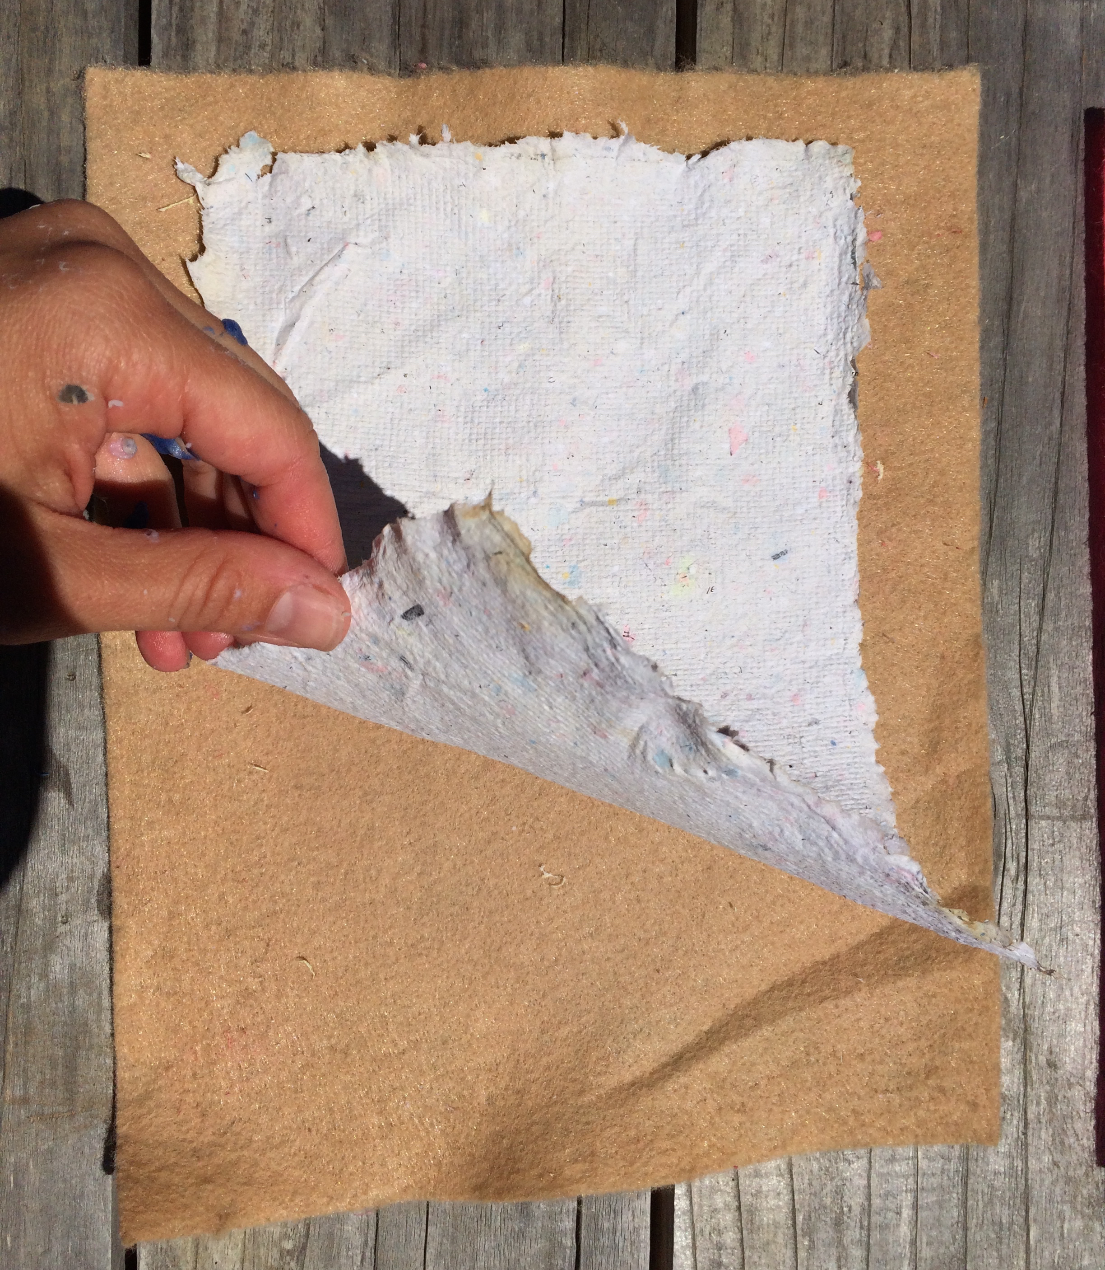
8. Remove screen and dry
Notes:
Flick the top of the screen to keep it from sticking to your new sheet of paper as you carefully it. It helps to begin with one corner as you lift the frame off. Your paper just needs to dry and will then peel easily off of the felt.
Drying times will vary based on the weather and location. Left in the sun, paper will dry in a few hours, but in doors could take a day or two. You can set up an easy indoor drying rack by layering sheets of cardboard between small paper cups.
Newly made recycled paper sheets can tested again using the student-designed strength tests to determine the Ultimate Paper!
The fibers of some of the originally collected paper types were too weak and short to be recycled as they had reached the end of their “lifespan.”
How can people avoid throwing these away?
What ideas do students have to creatively reuse things like egg cartons or avoid using disposable paper products like tissues?

