Slide 1
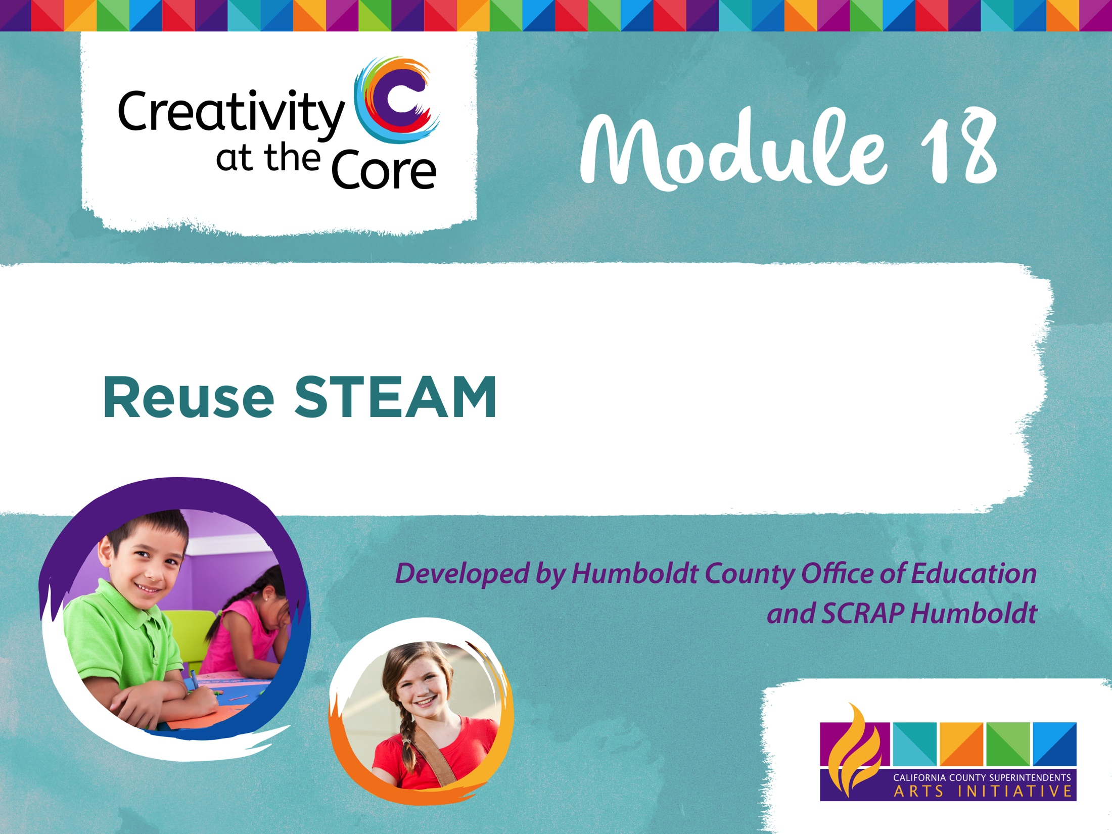

Slide 2
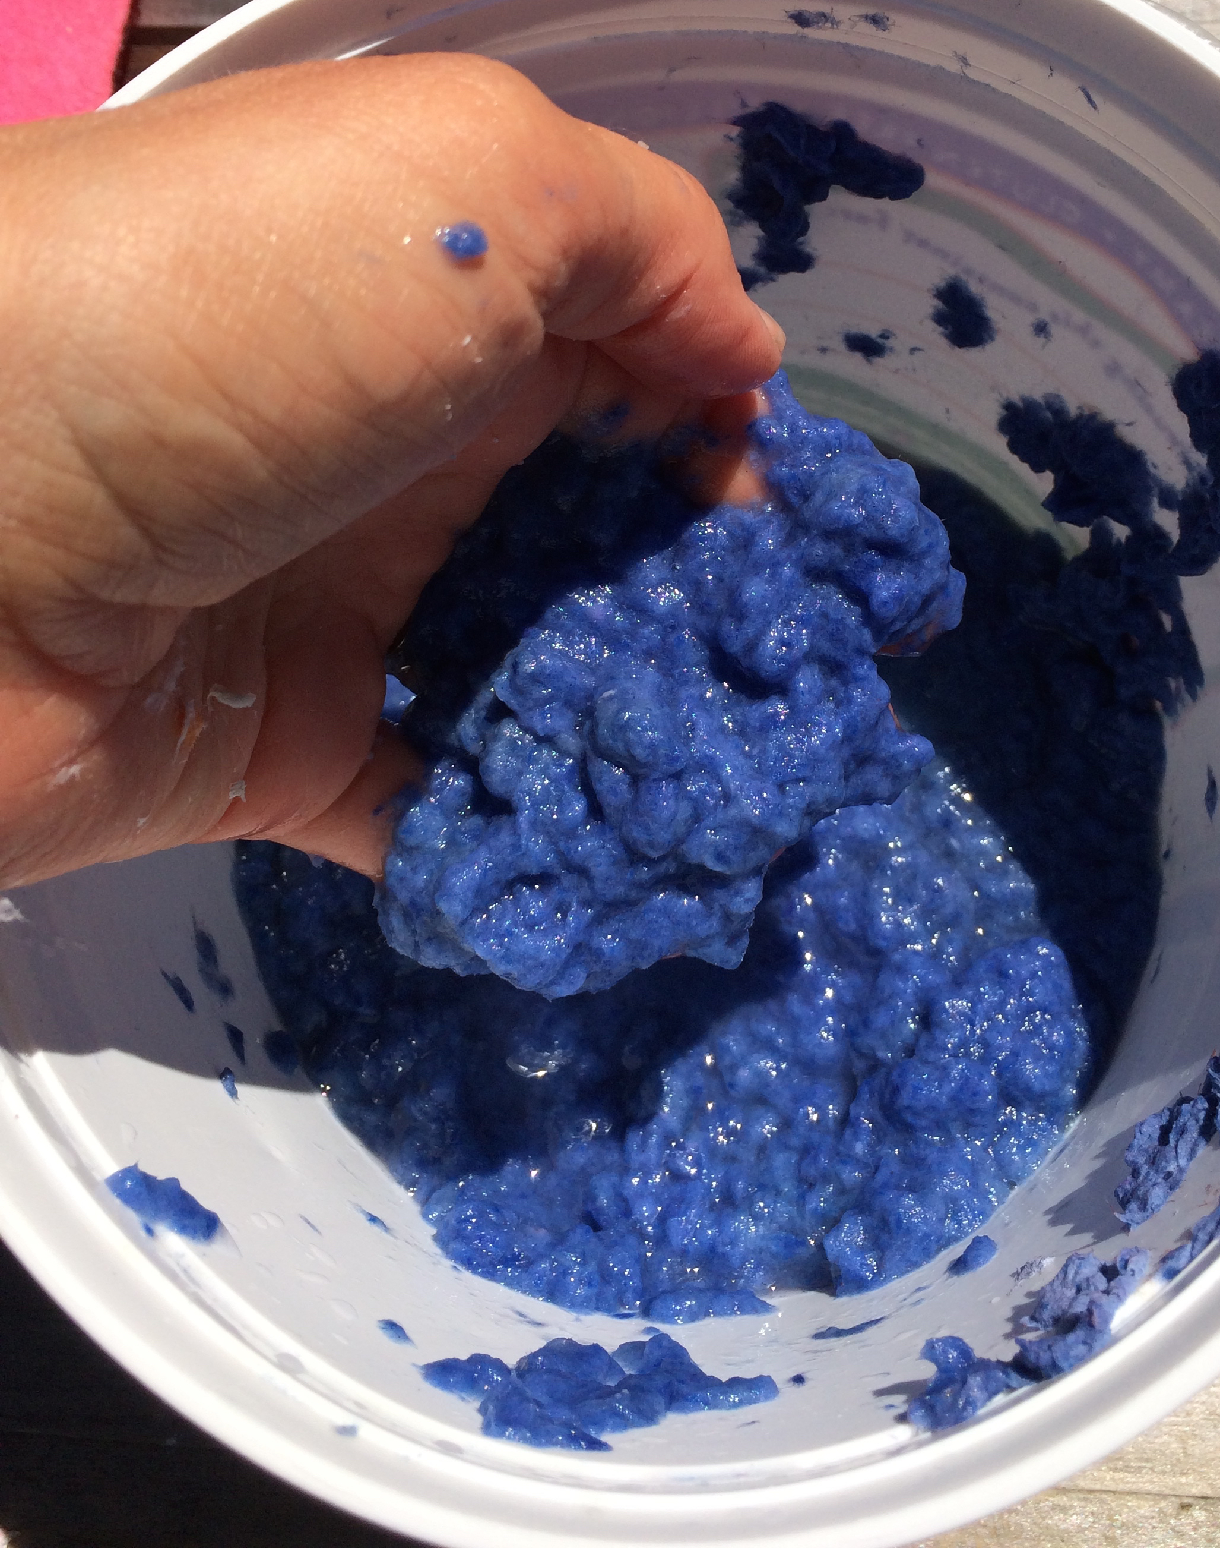
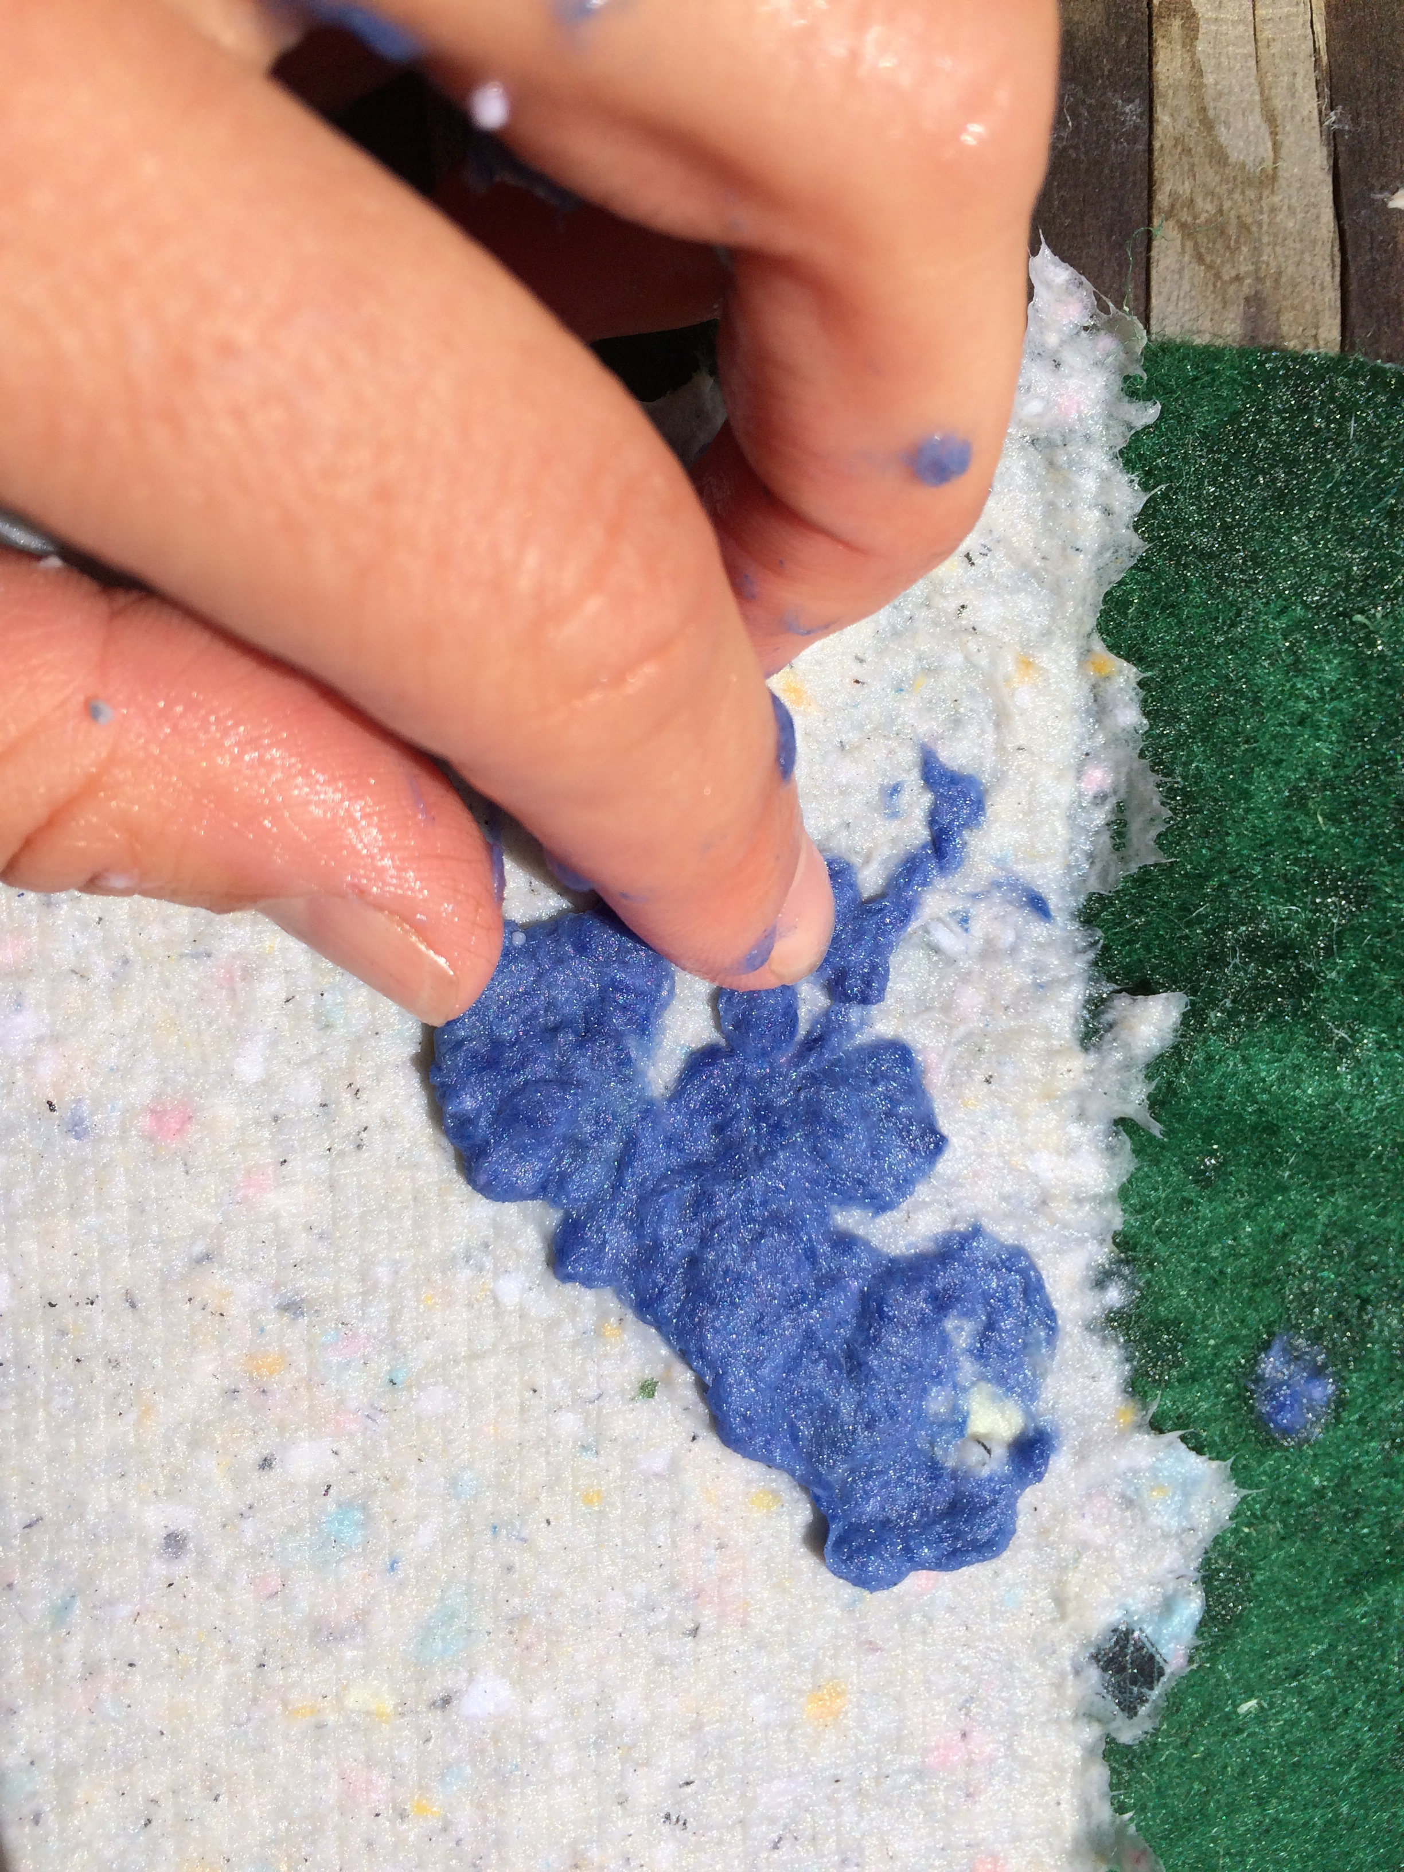
Painting with Paper Pulp
Notes:
Create different colors of paper pulp to paint with by using colorful paper scraps (construction paper works great) as the base for your pulp. After blending, strain out excess water to create a concentrated pulp. This is then applied to a base, still wet piece of paper in small bits to create a design. Students can experiment with color mixing by blended samples of colored pulps to see what color they will create.

Slide 3
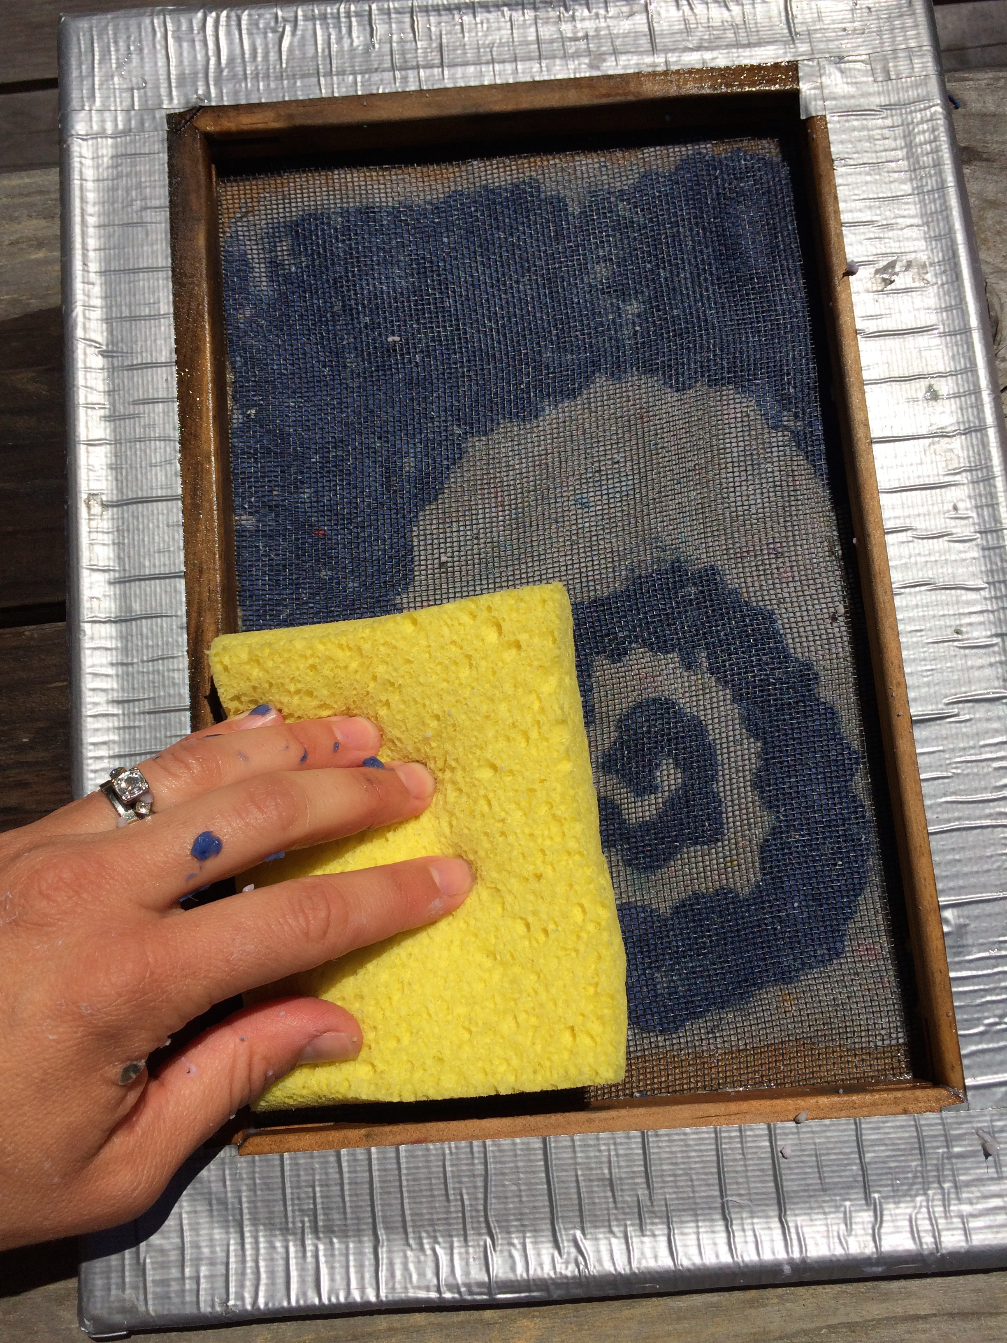
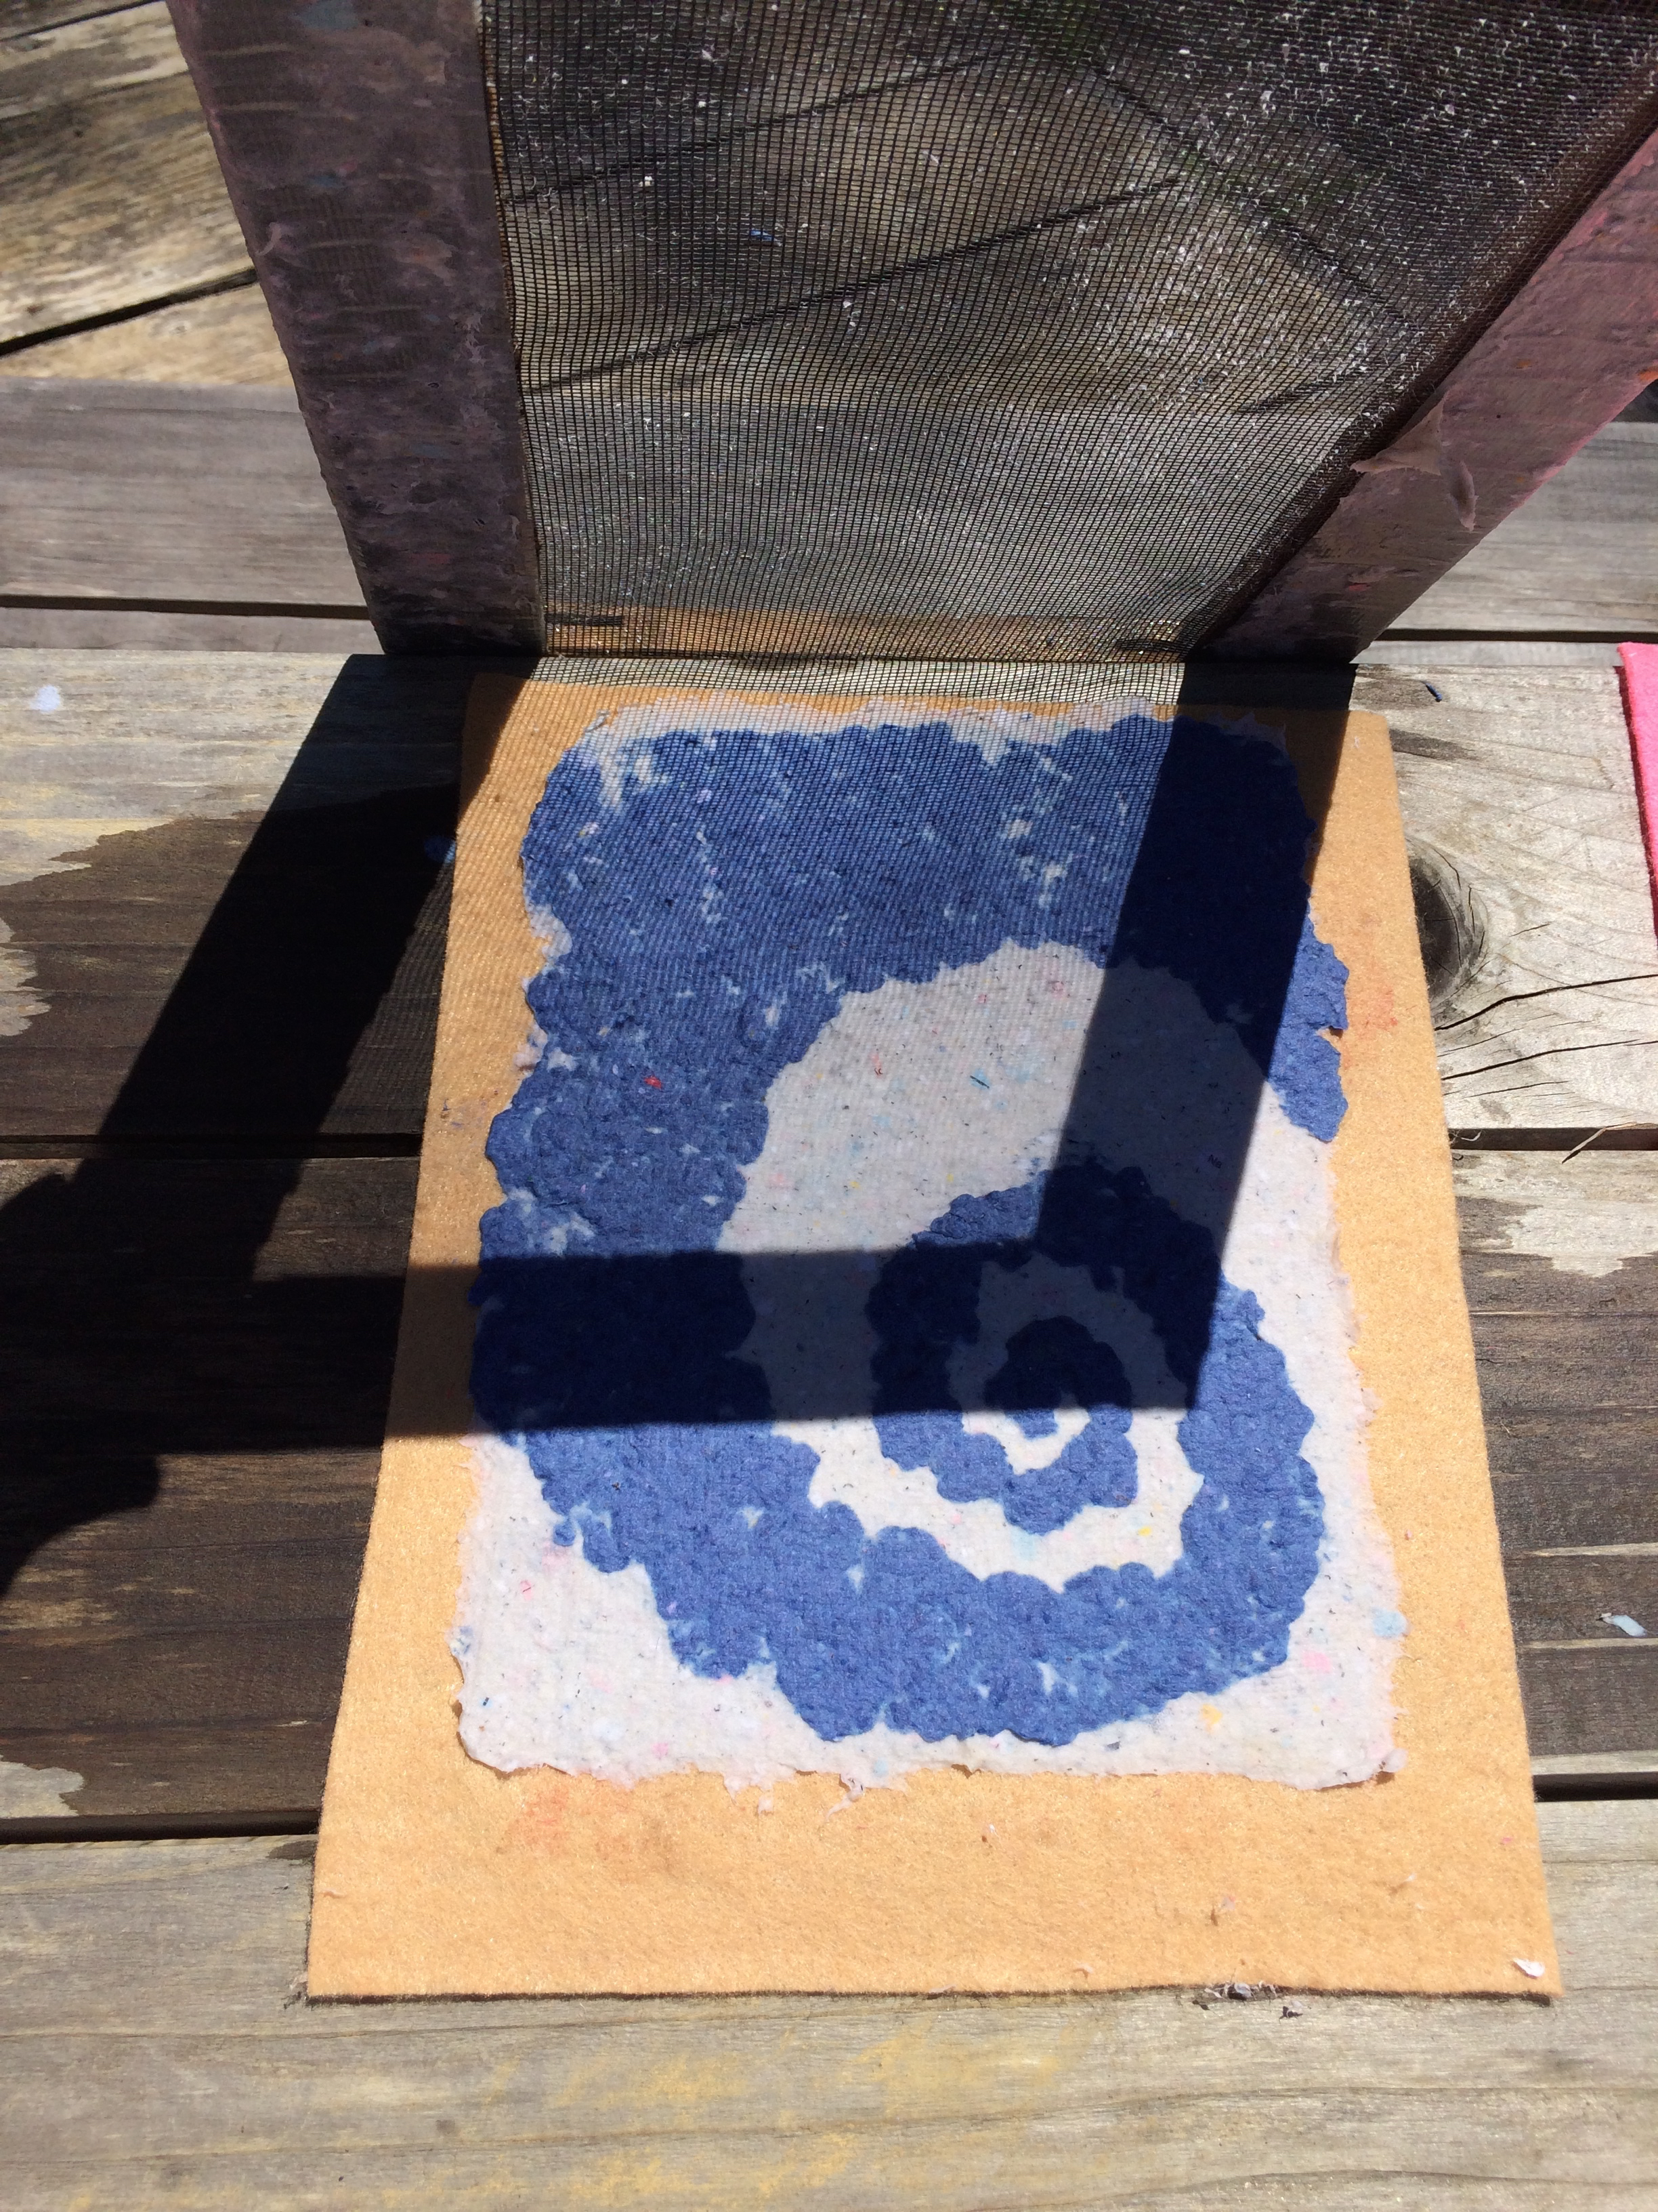
Soak up excess water
Notes:
When design is complete, place the screen over the paper again and use the sponge to soak up extra water.

Slide 4
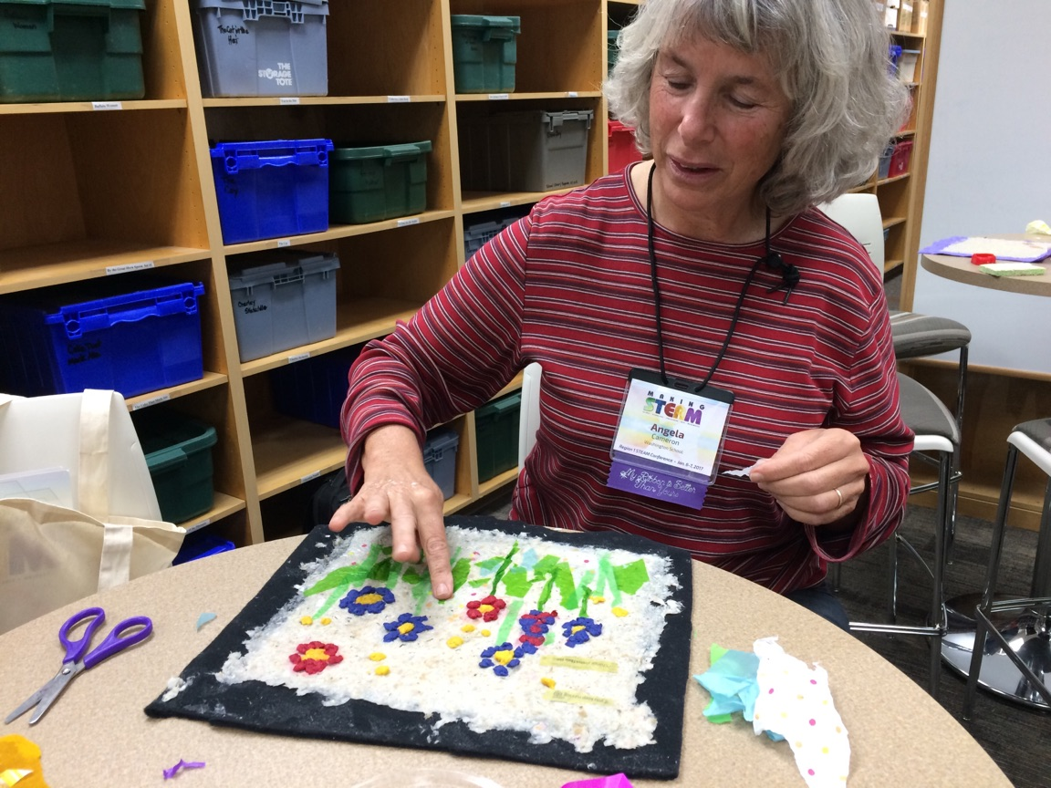
Experiment with designs!

Slide 5
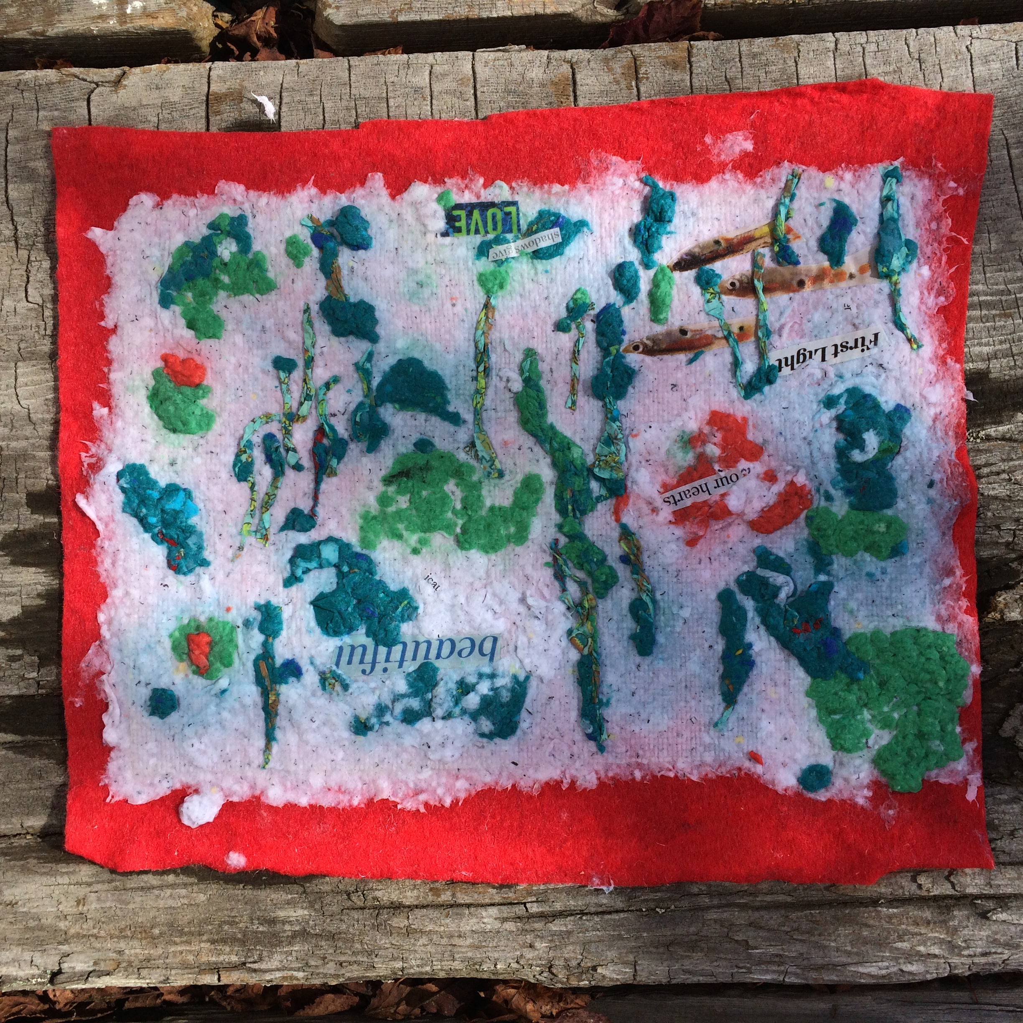
Add text
Notes:
Keep the original selection of paper samples on hand for creative reuse. Text and other features from paper products can be torn off or cut out and pressed right into wet pulp to make exciting design elements!

Slide 6
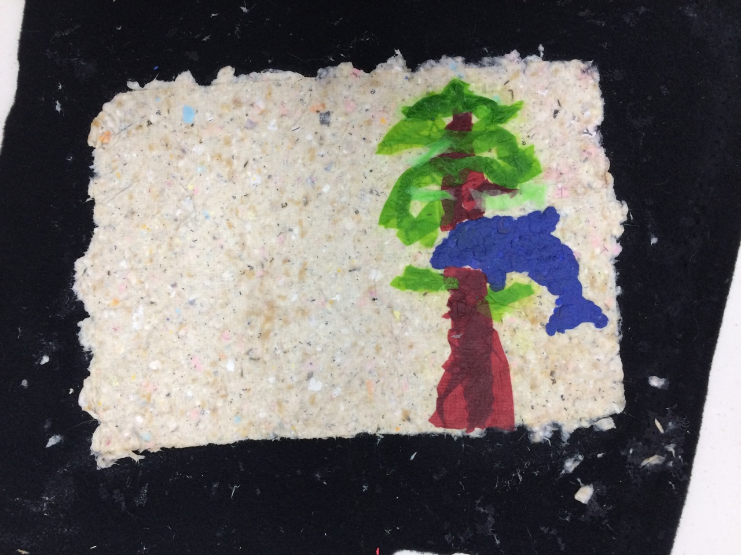
Use cookie cutters as shape molds
Notes:
Press pulp into the cookies cutters to use them as a mold. Carefully lift it off the paper base and a perfect shape is left behind.

Slide 7
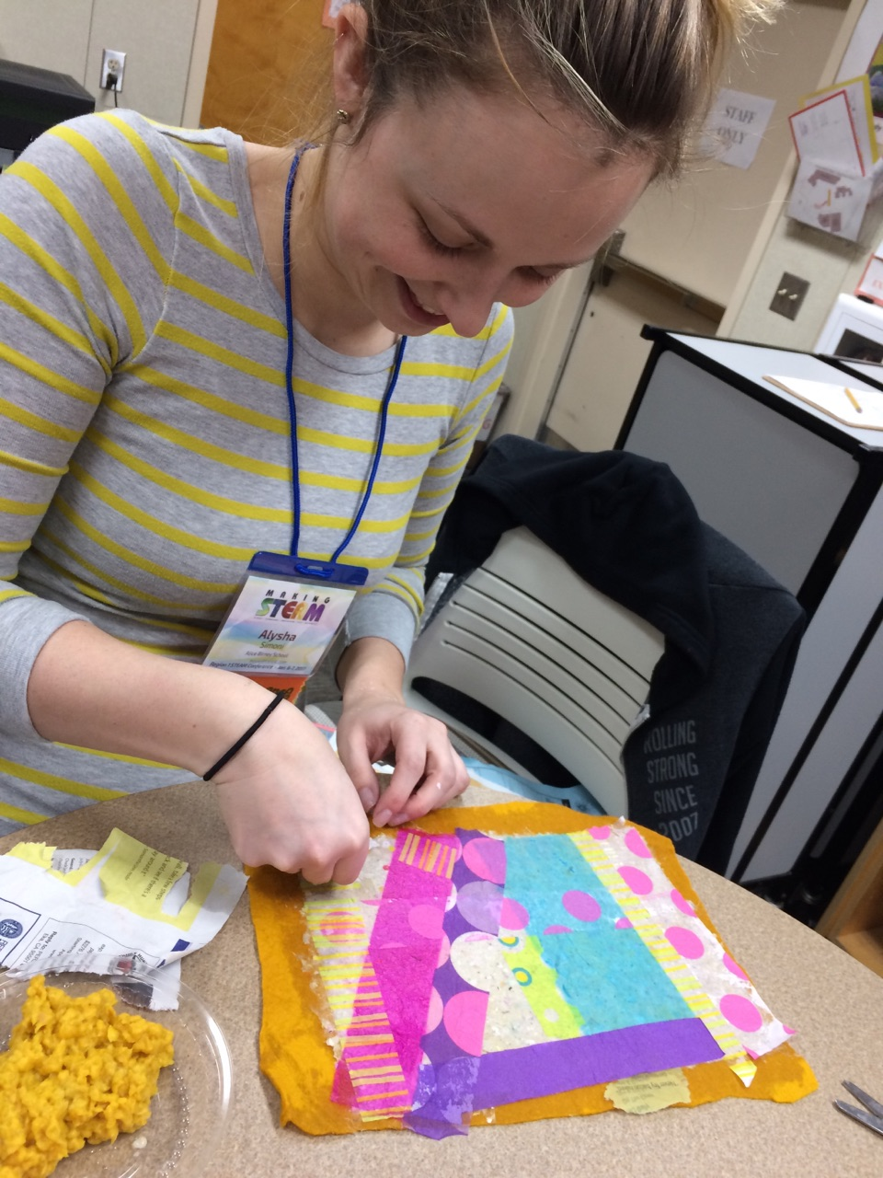
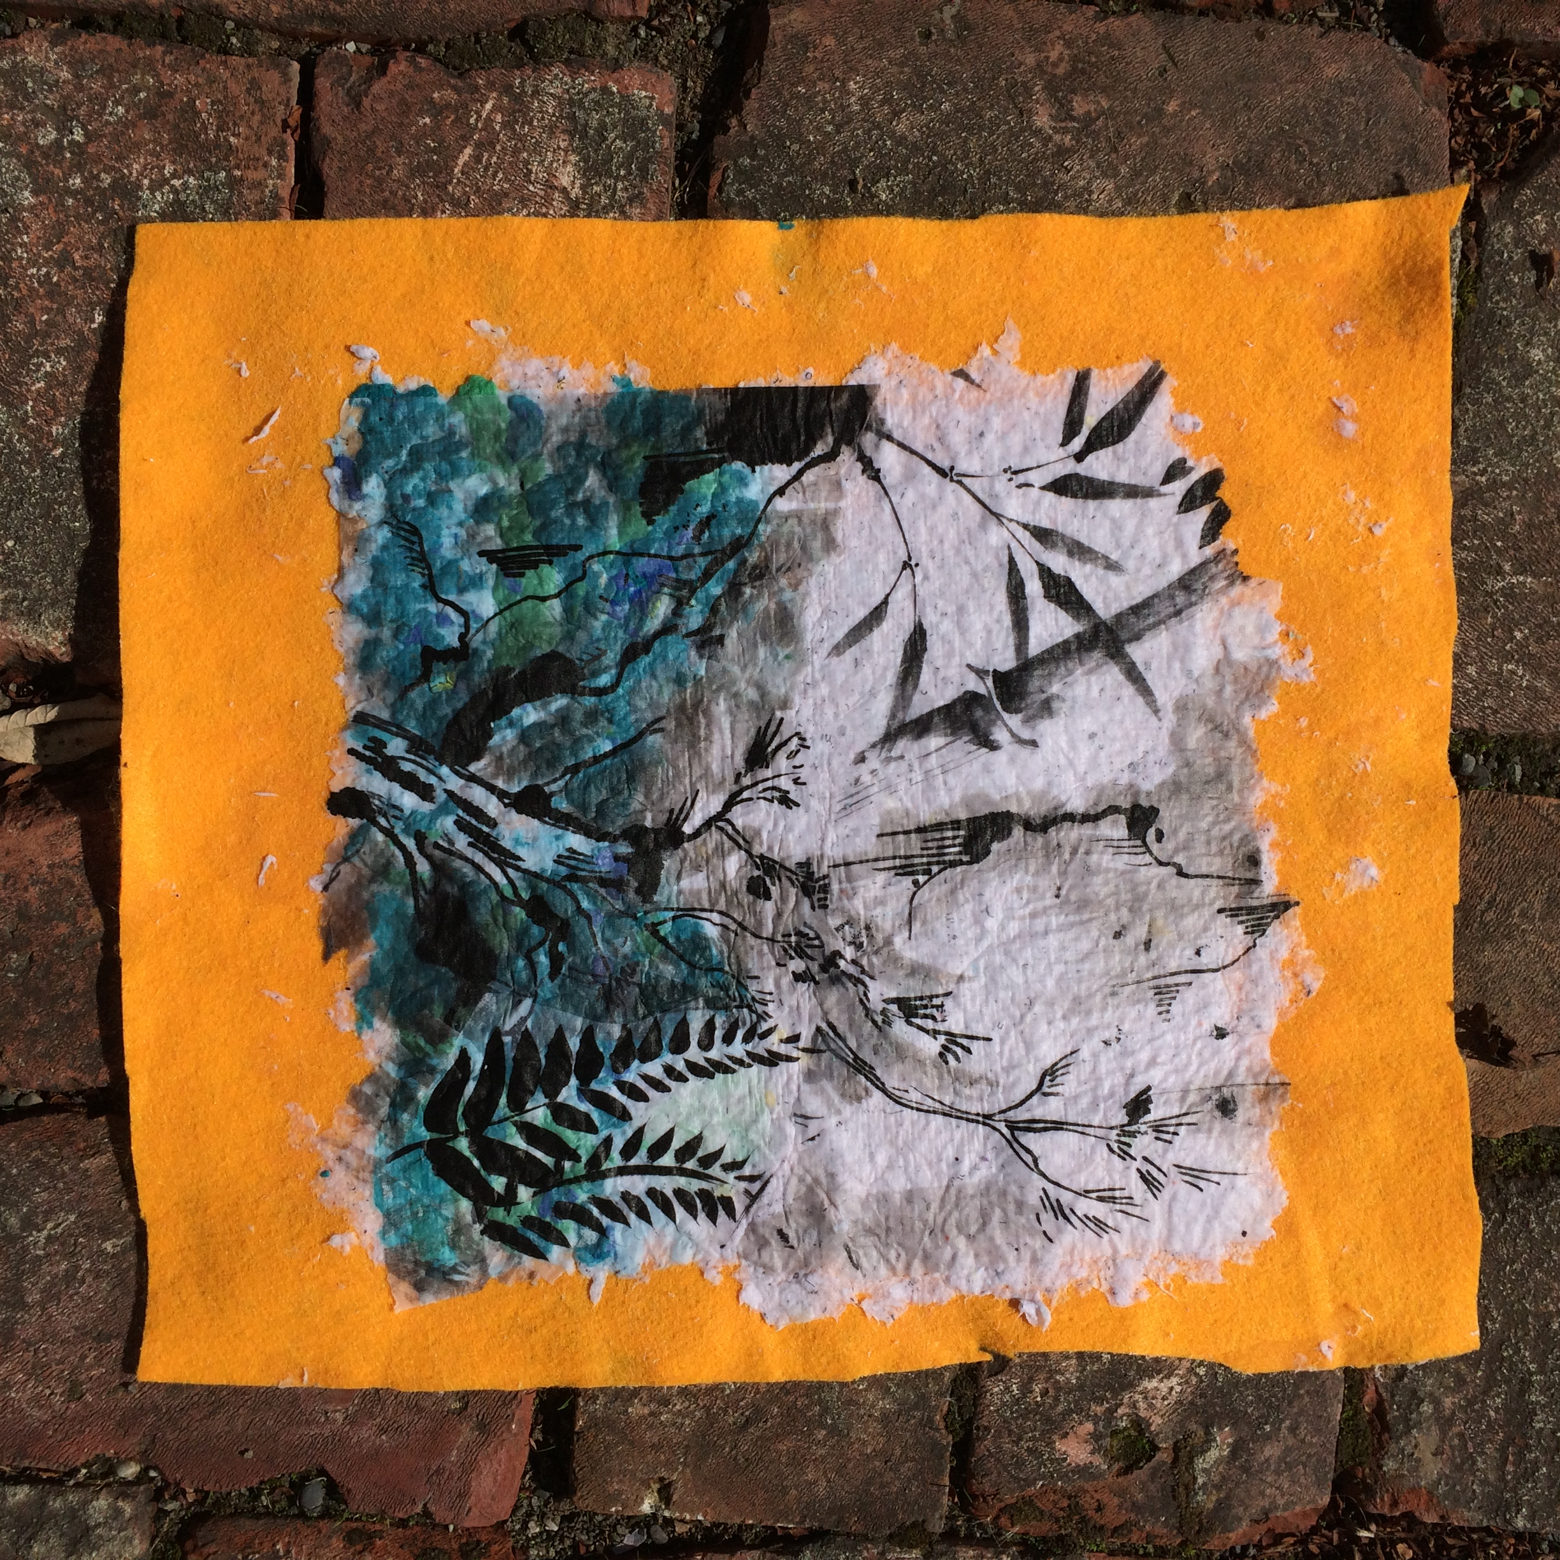
Create layers with transparent papers
Notes:
Revisit graphic organizer to choose transparent papers to use.

Slide 8
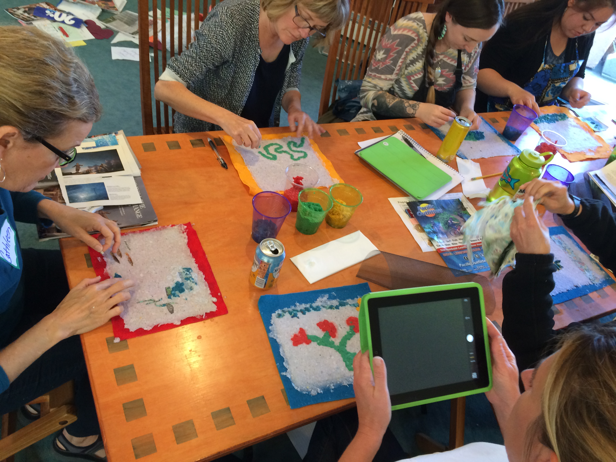
Document to create video presentation
Notes:
Demonstrate understanding through creating a video presentation on iMovie (iPad) or Video Editor aka We Video (android).
In small groups, create a short movie for the class.
How to from Android: https://www.wevideo.com/academy
Trailer about we video: https://play.google.com/store/apps/details?id=com.wevideo.mobile.android
How to from apple: https://help.apple.com/imovie/ipad/2.2/
How to from a teacher: https://iteachwithipads.net/2013/06/17/using-imovie-in-the-classroom/
Have students take photos or video on the tablet as they are working on their paper project.
Have students click and drag images as directed in app. Have students focus on telling the story of paper and showing how they decided to create an image.

Slide 9
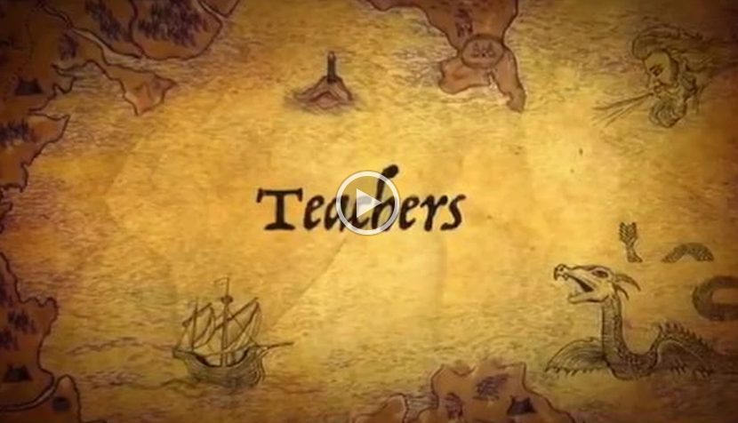
Demonstrate Understanding
Create a Movie Trailer to document papermaking process
Notes:
Use this link to view a sample iMovie Trailer creating during a module piloting workshop: https://drive.google.com/file/d/0B3t1l-cJ-FW1QmNQdVRmWTB5bGM/view

Slide 10
Module Developed By:
Allison Poklemba
North Coast CREEC Coordinator
North Coast CREEC (CA Regional Environmental Education Community) Network
creec.org
Stacy Young
Regional Arts Lead
Humboldt County Office of Education
Tibora Girczyc-Blum
Arts Educator & Consultant
SCRAP USA Special Projects Coordinator
Founder of SCRAP Humboldt
scraphumboldt.org

Slide 11

CREEC Network
The California Regional Environmental Education Community Network is a communication network supporting the environmental literacy of California’s students by providing teachers with access to high quality environmental education resources.
www.creec.org

Slide 12
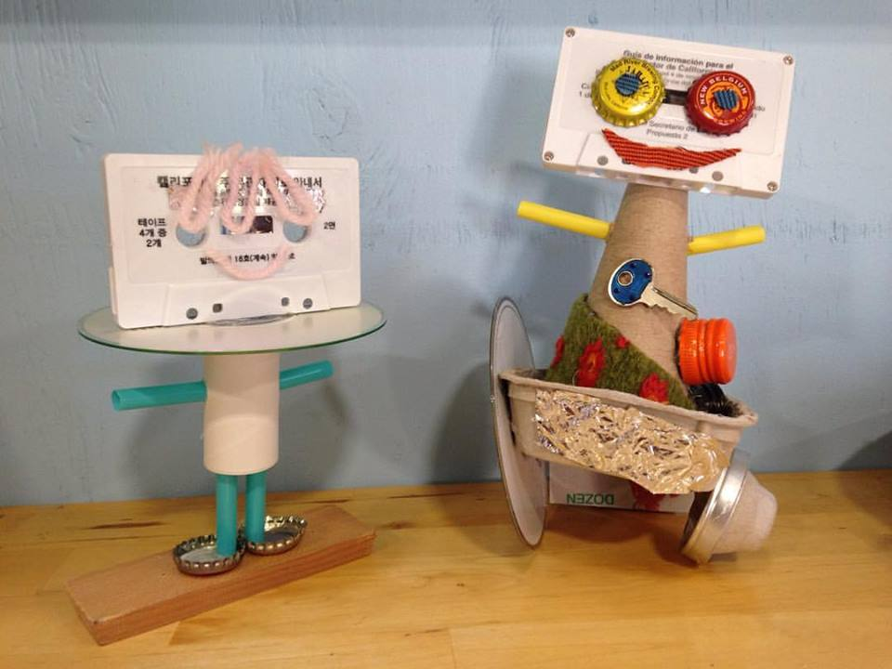

SCRAP Humboldt
SCRAP Humboldt is a 501(c)(3) nonprofit organization and is a part of SCRAP USA, a national creative reuse center network.
Our mission is to inspire creative reuse and environmentally sustainable behavior by providing educational programs and affordable materials to the community.

Slide 13
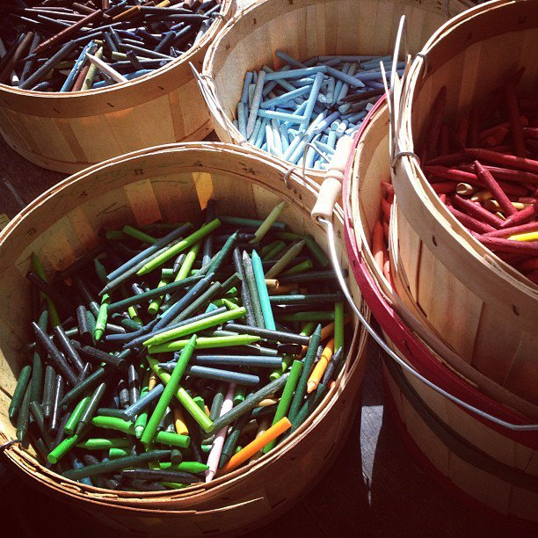
Creative Reuse Centers in CA
Arcata – SCRAP Humboldt
Indio – S.C.R.A.P Gallery
Long Beach - Long Beach Depot for Creative Reuse
Los Angeles – reDiscover at Smart Space
Los Angeles – Trash for Teaching, Inc
Moutain View – FabMo
Oakland – East Bay Depot for Creative Reuse
Orange County – Child Creativity Lab
Pasadena - Remainders Creative Reuse
Redwood City – RAFT
Riverside – Riverside Arts and ReUse Exchange
Roseville – ReCREATE
Sacramento – RAFT
San Diego – Art FORM
San Francisco – SCRAP
San Jose – Resource Area for Teaching ( RAFT)
Santa Barbara – Art from Scrap
Westlake Village – CReATE Studio & CReATE on Your Campus
Not in California?
This is a great resource to find a
creative reuse center near you.

Slide 14
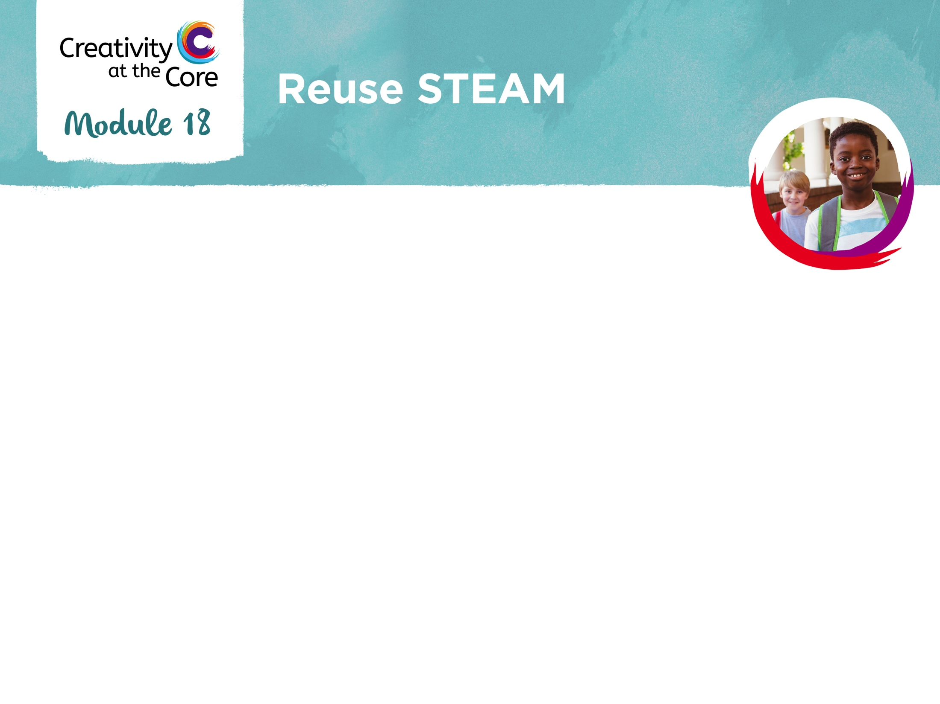
Thank you!

