Slide 1
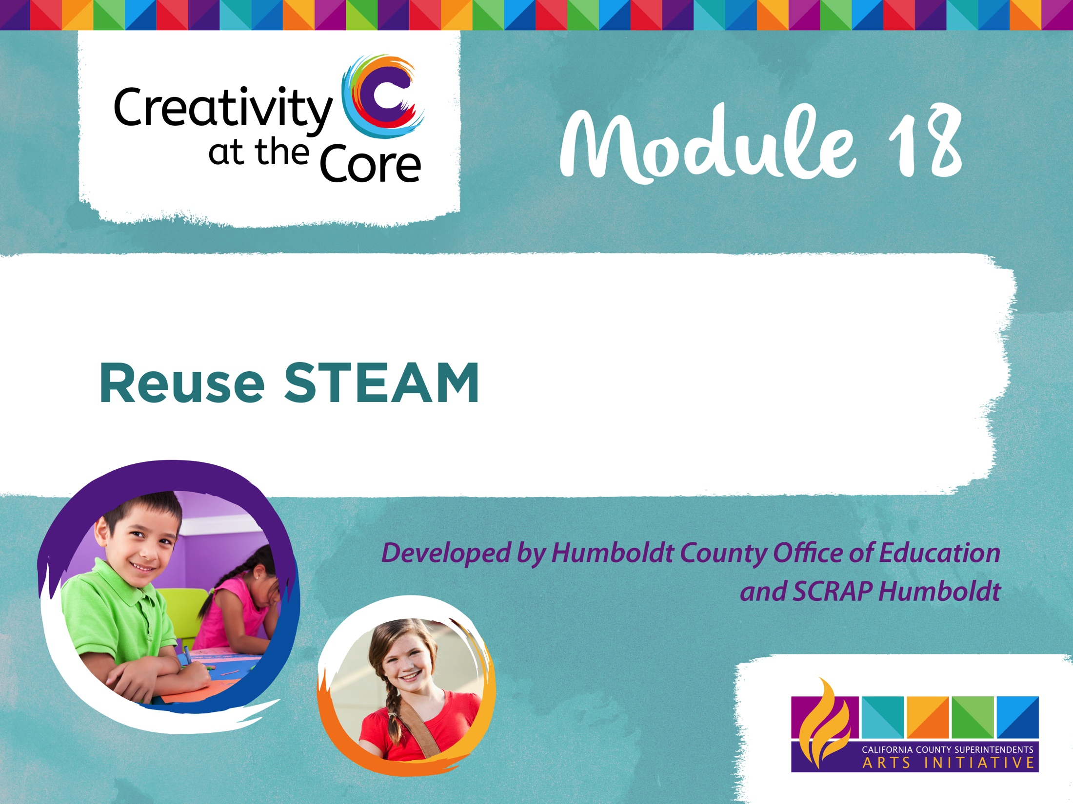

Slide 2
3-5: Plastics Reimagined
Theme:
Looking more closely at materials with short “life spans” that pass through their hands everyday, students will think critically about reducing waste by repurposing and redesigning these items.
Science, Technology, Engineering, Arts and Mathematics are integrated throughout this module.

Slide 3
3-5: Plastics Reimagined
In this module students will:
Explore the many ways they use disposable plastics each day
Design and conduct simple experiments to test the properties of different plastic types
Learn how plastic is made and recycled
Engage in a design challenge, creatively reusing discarded plastic
Create Prezi or Google Slides to share design challenge solution
Notes:
In this unit of study students will look closely at disposable plastics, particularly plastic food wrappers, bags, and containers that they use each day. They will explore which of these are recyclable in their community, and which are not, and learn about what happens when plastics are recycled. Since the integrity of plastic is reduced so greatly when it is recycled, students will consider reducing and reusing as the best options for minimizing this type of plastic waste. A design challenge will ask students to create and design plans for an easily replicable, useful plastic item by creatively reusing plastic packaging. Students will document their iterations and create a Prezi to present their final piece.

Slide 4
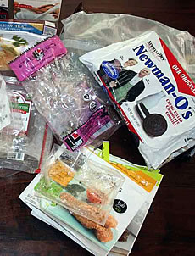
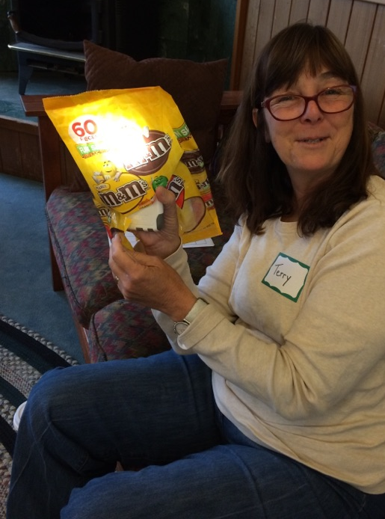
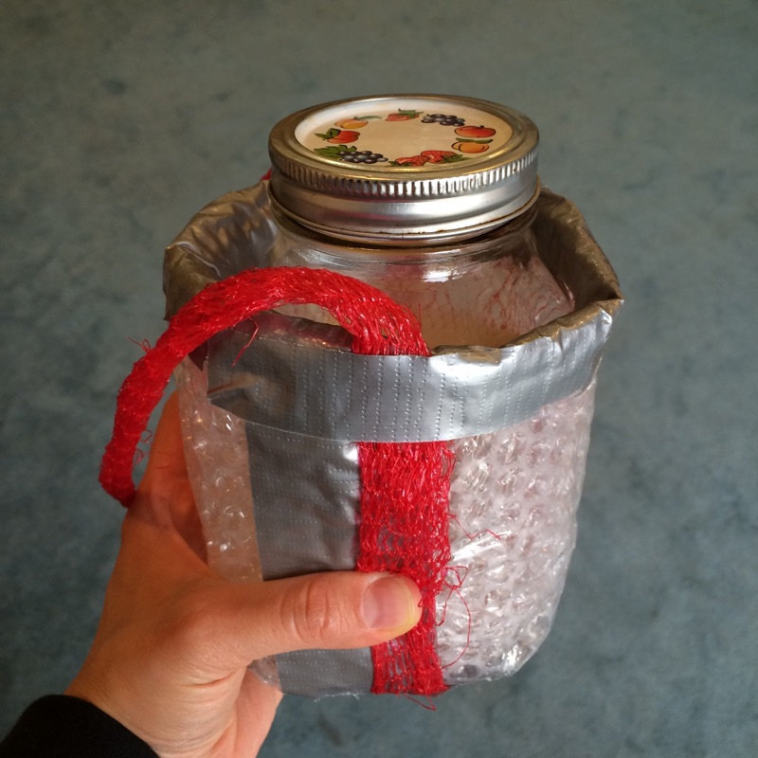
Process
Search Investigate Transform

Slide 5
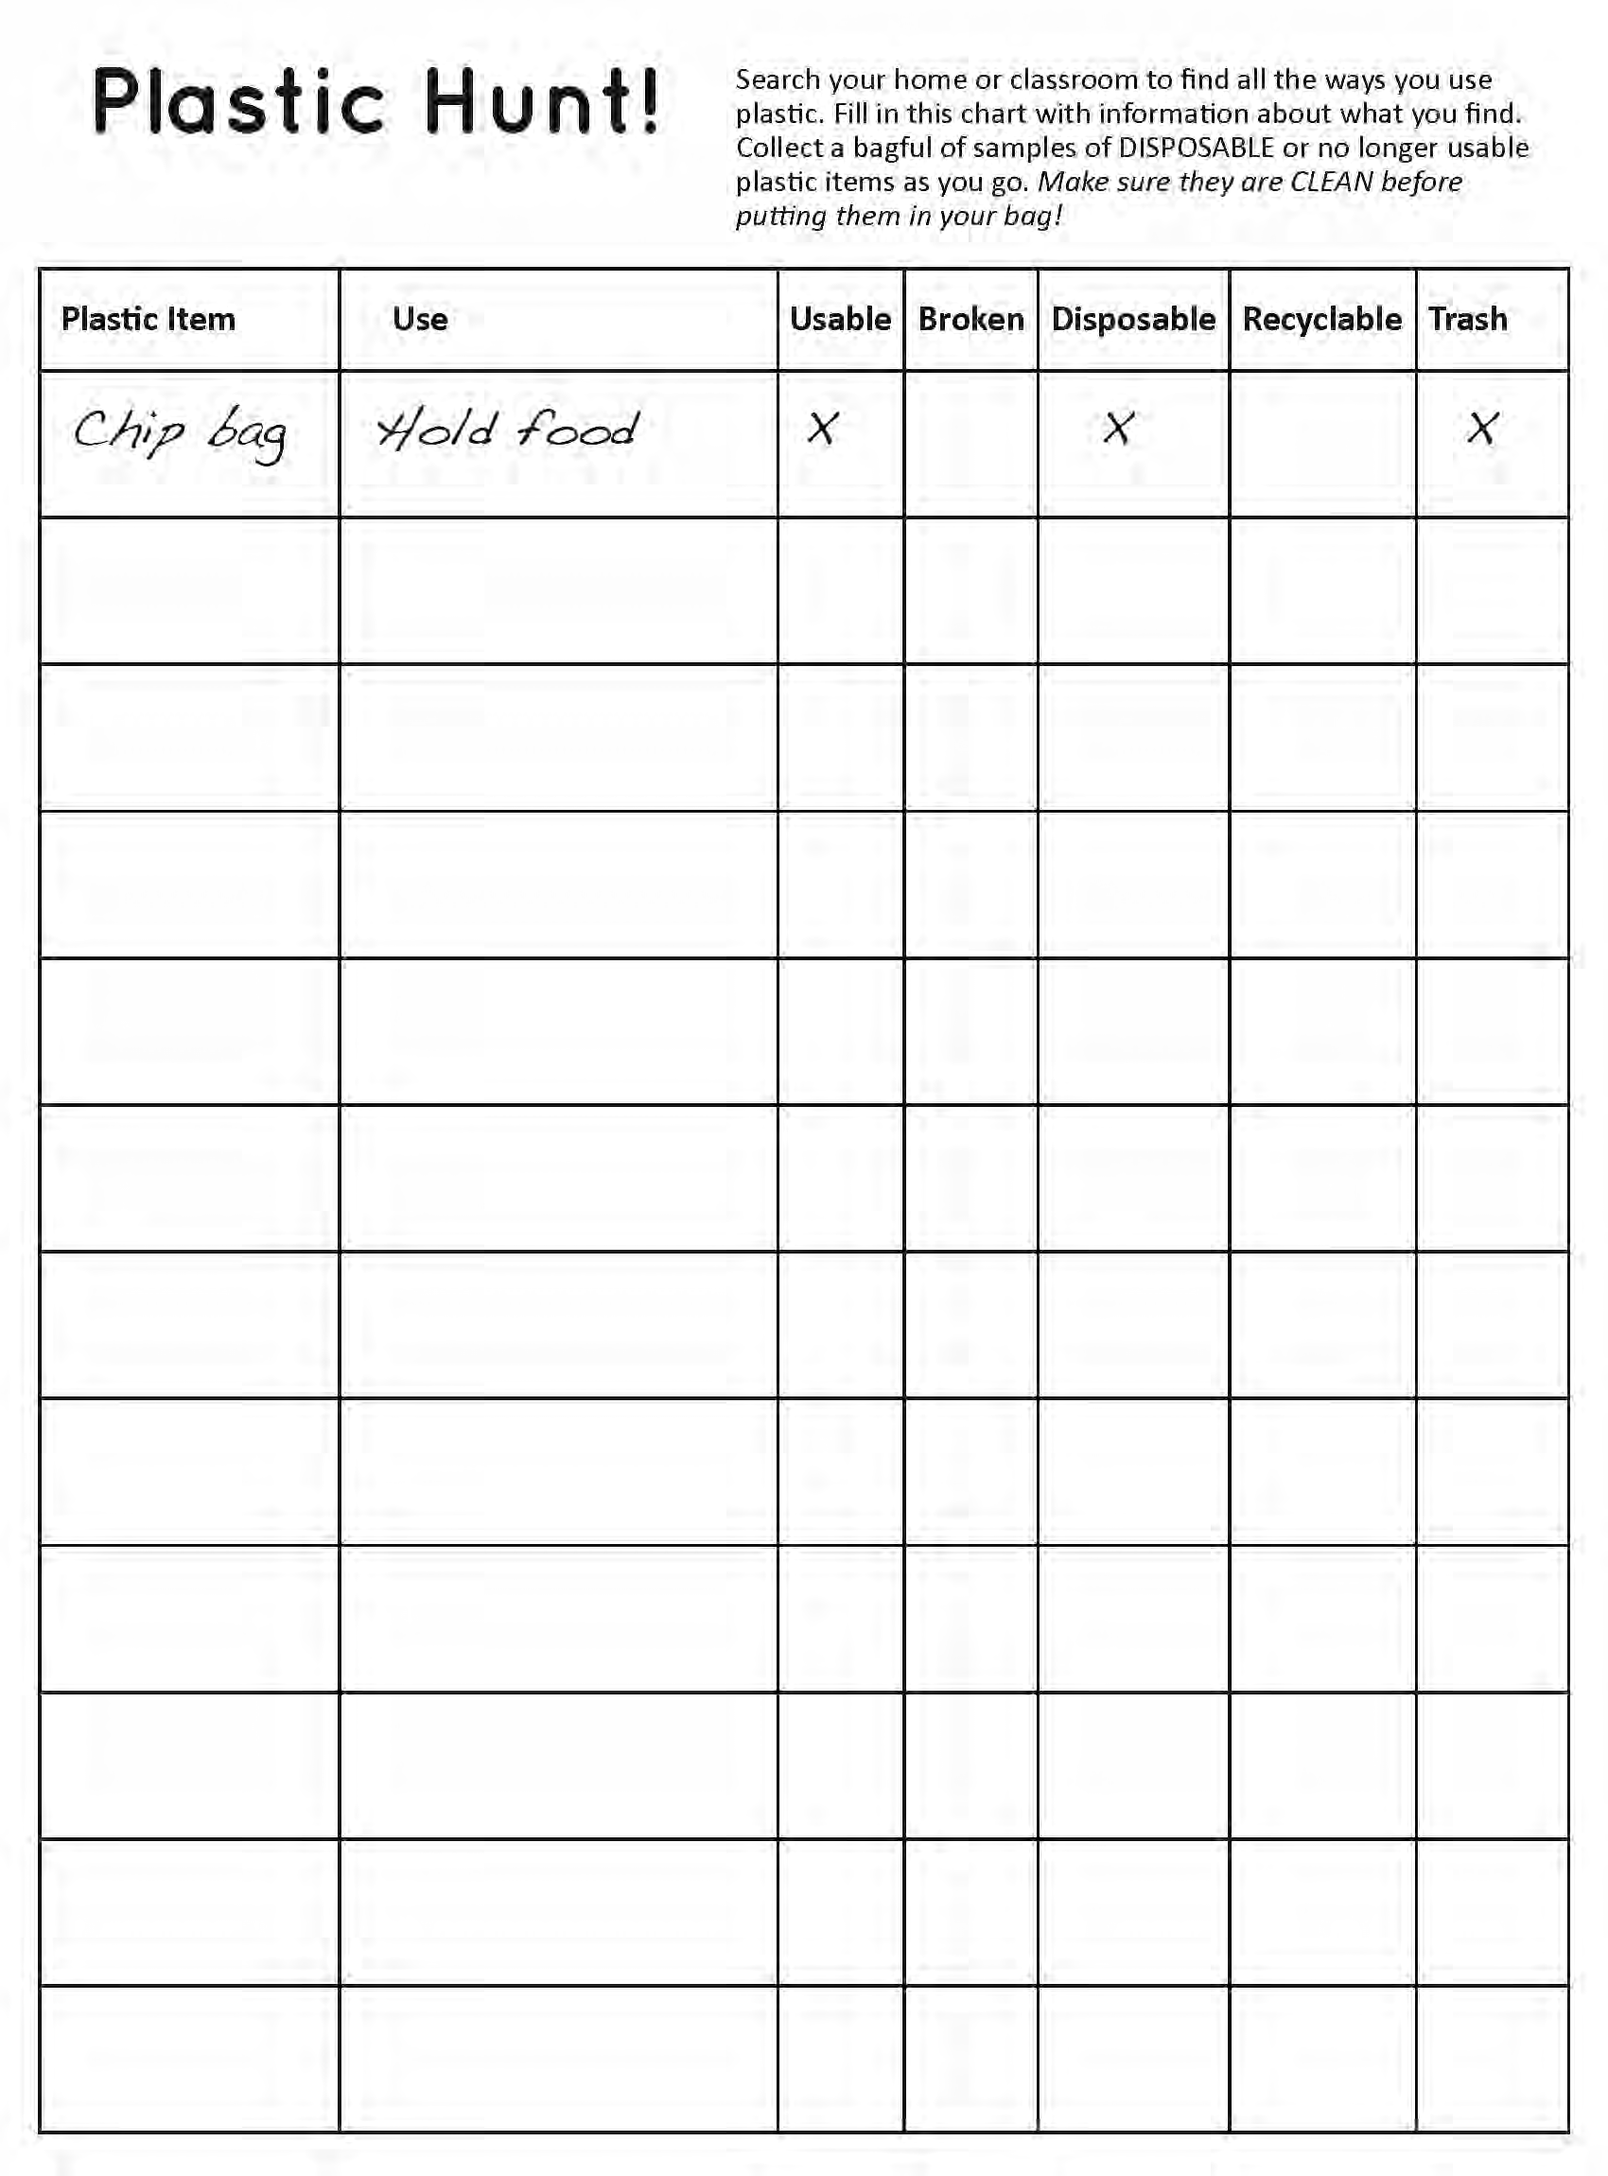
Plastic, Plastic Everywhere!
Plastic Search
Students search their classroom, school, and/or home for ways they use disposable plastic and collect a wide variety of samples
Notes:
Part 1: Plastics Are Forever
Plastics Search: Students conduct a search for plastics in their classroom, school, and/or home to make a list of all the ways they use plastics each day on the Plastic Hunt handout. Along the way, students collect samples of disposable plastics (utensils, food containers, bags, snack wrappers, packaging, shampoo bottles, etc.) and return to the classroom with their CLEAN samples. What percentage of the list are food-related plastics?

Slide 6
What do these have in common?
Categorize
What are the different plastic samples used for?
Do plastics in the same category have similar properties?
Students work in small groups to organize plastic samples into categories by use
Notes:
Categorize: Once a wide variety of disposable plastic products are collected, students work in small groups to organize them into categories. Talk with the class to generate a list of category types: By use (holding liquids, packaging, etc.), by properties of the material (flexible, rigid, stretchy, brittle, etc.), or other ideas that the students generate.
This sorting activity can be repeated to see how plastic items change groupings by category type. Do any of the same plastic items remain together even when the category titles change?

Slide 7
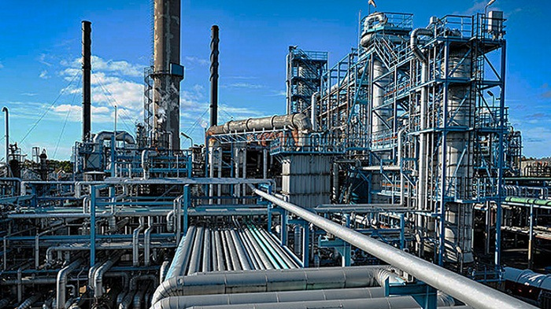
The Big Picture
Learn how plastics are made, recycled, disposed of, break down into smaller and smaller pieces over time but never disappear
Notes:
The Big Picture: Through group activity and by watching video footage students learn how plastics are made, recycled, disposed of, and break down into smaller and smaller pieces over time but never disappear.
Video Options:
“From Oil To Plastic” (9 min.) https://www.youtube.com/watch?v=IwdUwffecsM
“How It’s Made: Plastic Bottles and Jars” (5 min.) https://www.youtube.com/watch?v=ZfyPCujUPms&list=PL5E05E0D2FEEA5739&index=8 “The Majestic Plastic Bag: A Mockumentary” (4 min.) https://www.youtube.com/watch?v=GLgh9h2ePYw&index=2&list=PLQaabtnNpchwa8p-ceLKivaCYxMJ_j4Hv
“How It’s Made: Plastic Bags” (5 min.) https://www.youtube.com/watch?v=8CfL5xl2N1Q&index=7&list=PLQaabtnNpchwa8p-ceLKivaCYxMJ_j4Hv
Are there non-plastic, or non-disposable alternatives for any of the plastic items collected in the Plastic Hunt?

Slide 8
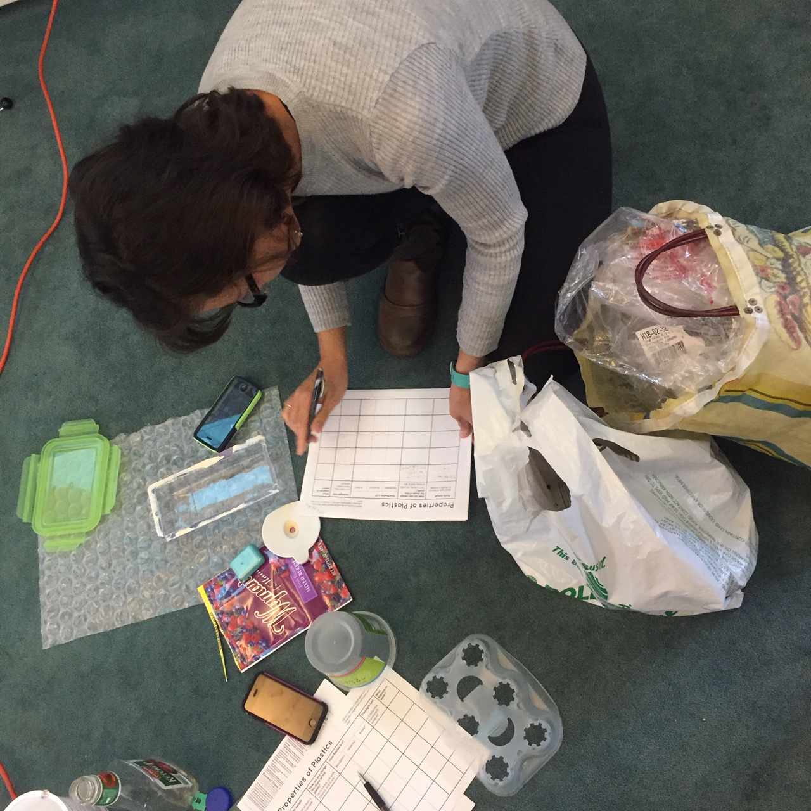
Discovering Properties of Plastics
Design simple experiments
Develop uniform procedures
Plan how to describe results
Notes:
Investigate: Explain to students that they will be testing the properties of plastic samples from the different categories they generated. Discuss with students the types of properties they can observe in their plastic samples (i.e. stretchy, rigid, shiny, clear, colorful, can cut easily with scissors, etc.). Students have time to experiment with the materials in each category and come up with ideas for how to test for these properties. Help students to develop uniform procedures for doing so. Ideas for tests include:
Does it float? What happens when a flashlight shines on it or through it (reflective, translucent, opaque)? Can you cut though it easily? Is it bendable? How much does it stretch? Etc.
Teacher demonstrates how to do chosen tests and describe the results.

Slide 9
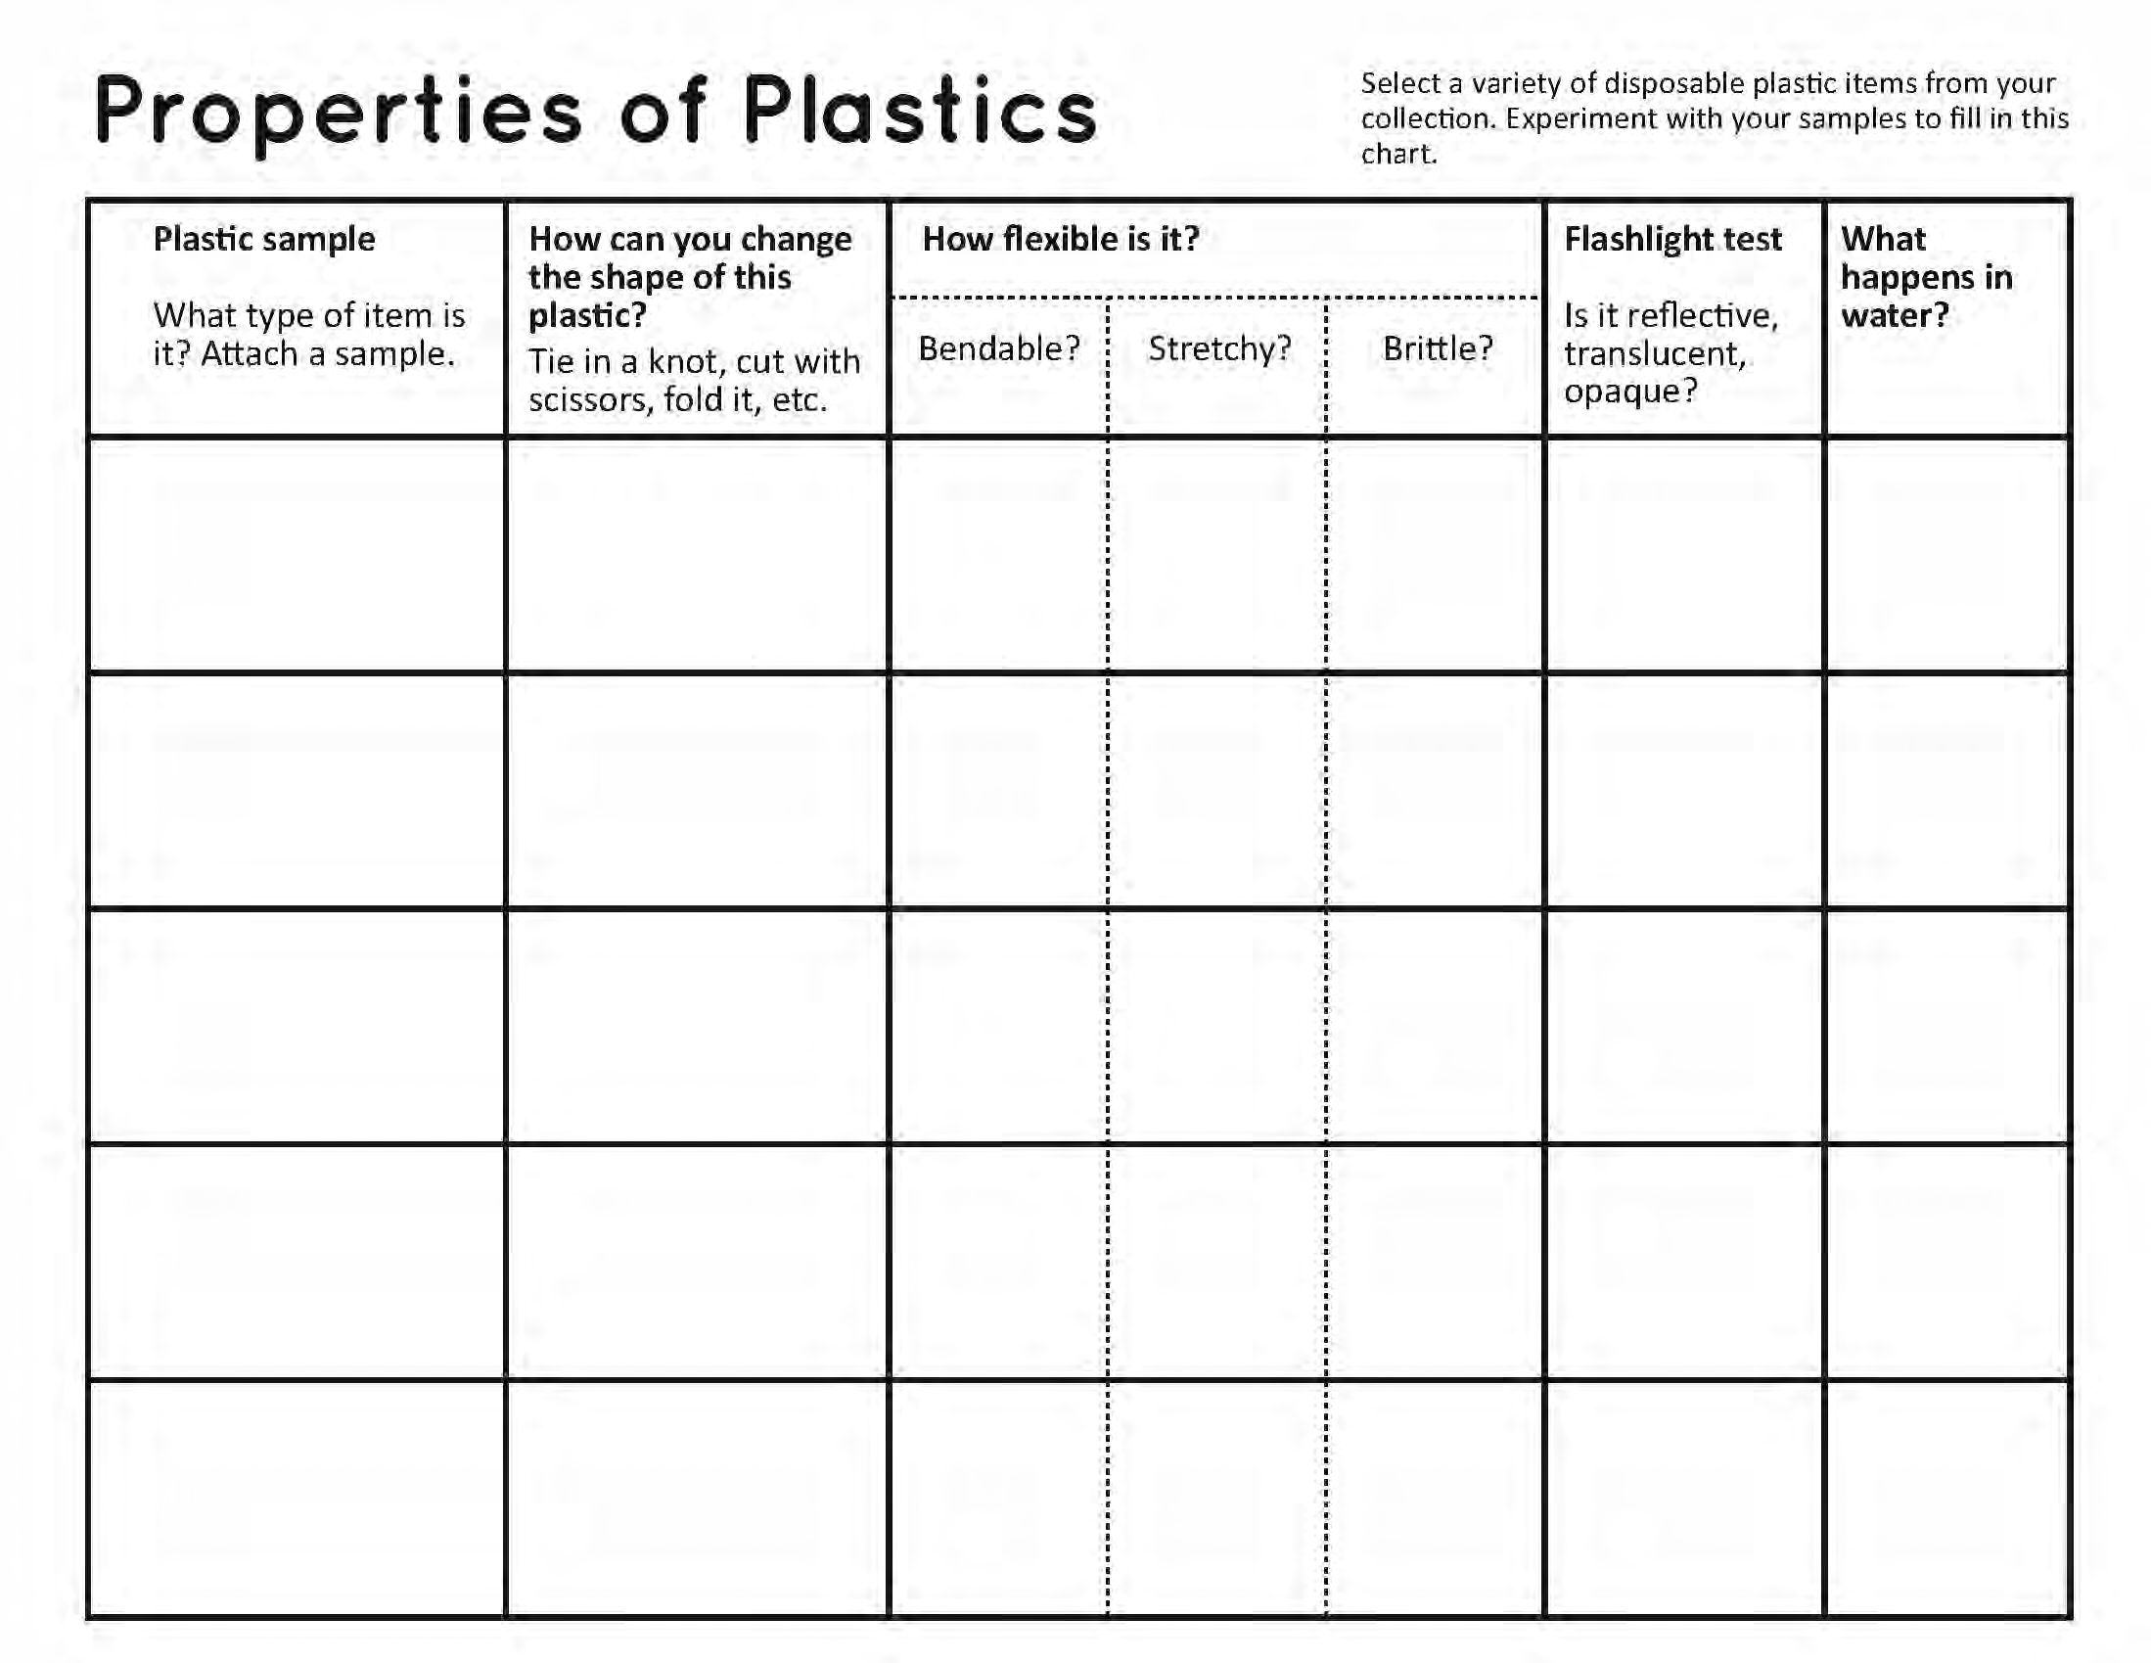
Graphic Organizer
Notes:
Model filling in Properties of Plastics worksheet as students select up to 5 varied plastic samples to test (ideally one from each group they had been sorted in to, and with a large enough sample size to experiment with). Students cut a piece of each plastic sample and use a glue stick or stapler to attach them to the page. Teacher may choose to have students work in small groups to test their samples, or lead the entire class through the activity. Either way, the graphic organizer is filled in as information is collected through the investigations.
OPTION: Instead of describing the results of the qualitative tests, students may rank each sample. For example, testing the rigidity of 5 samples, the one that is the most difficult to bend would be given a #1, the easiest to bend would be given a #5.

Slide 10
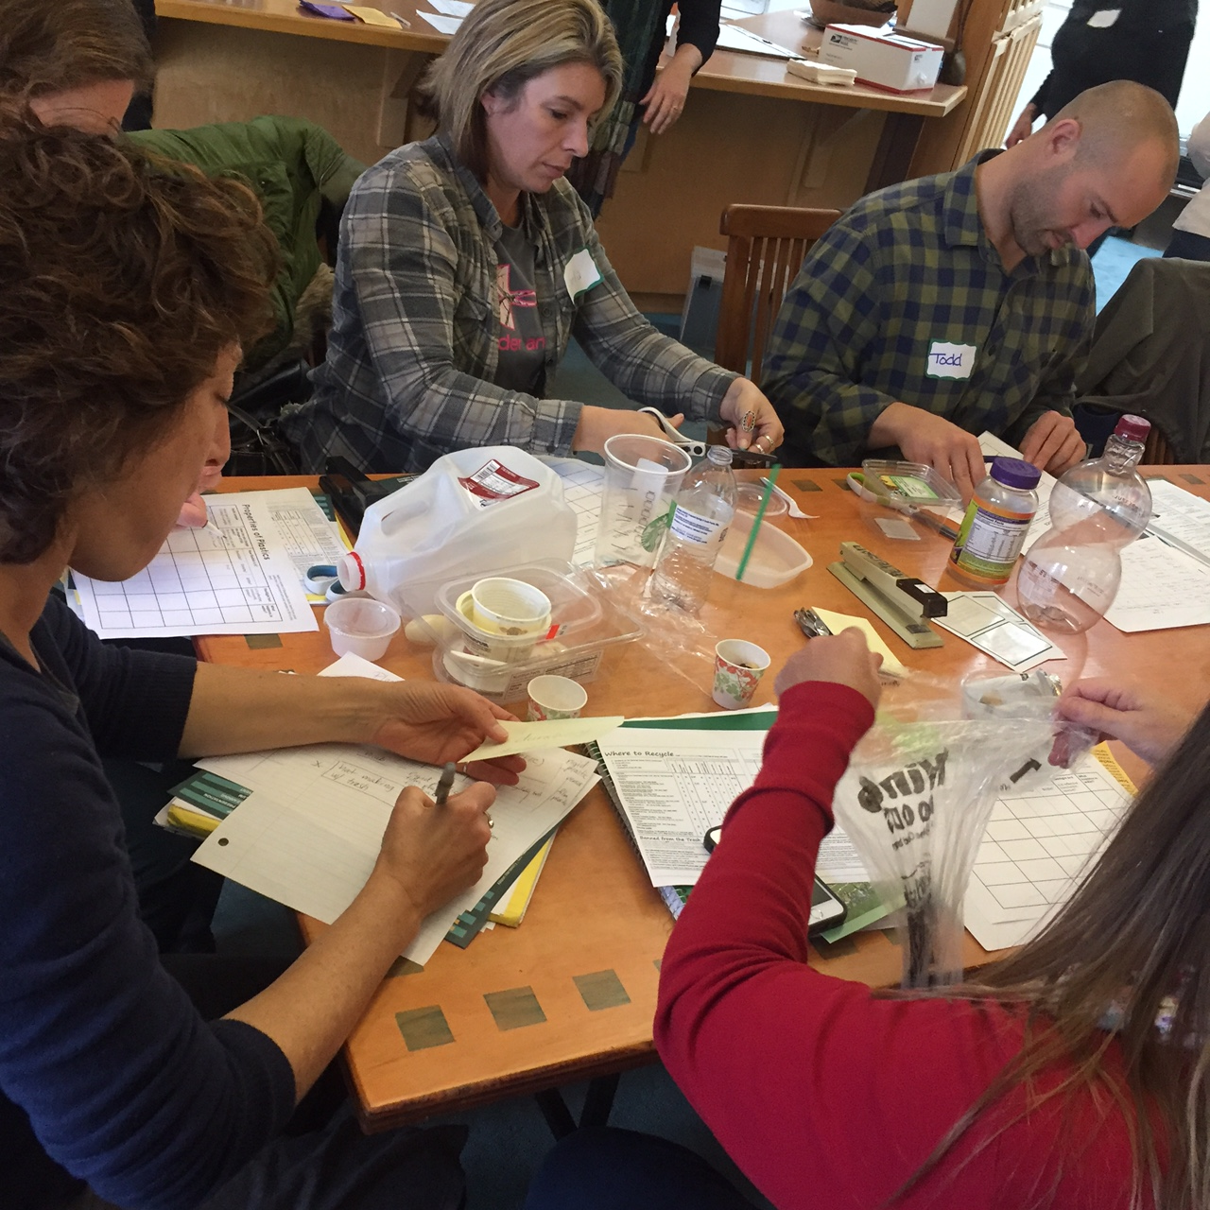
Properties of Plastics
Investigate
What types of properties can you observe in your plastic samples?
Stretchy?
Bendable?
Transparent?
Buoyant?
Others?

Slide 11
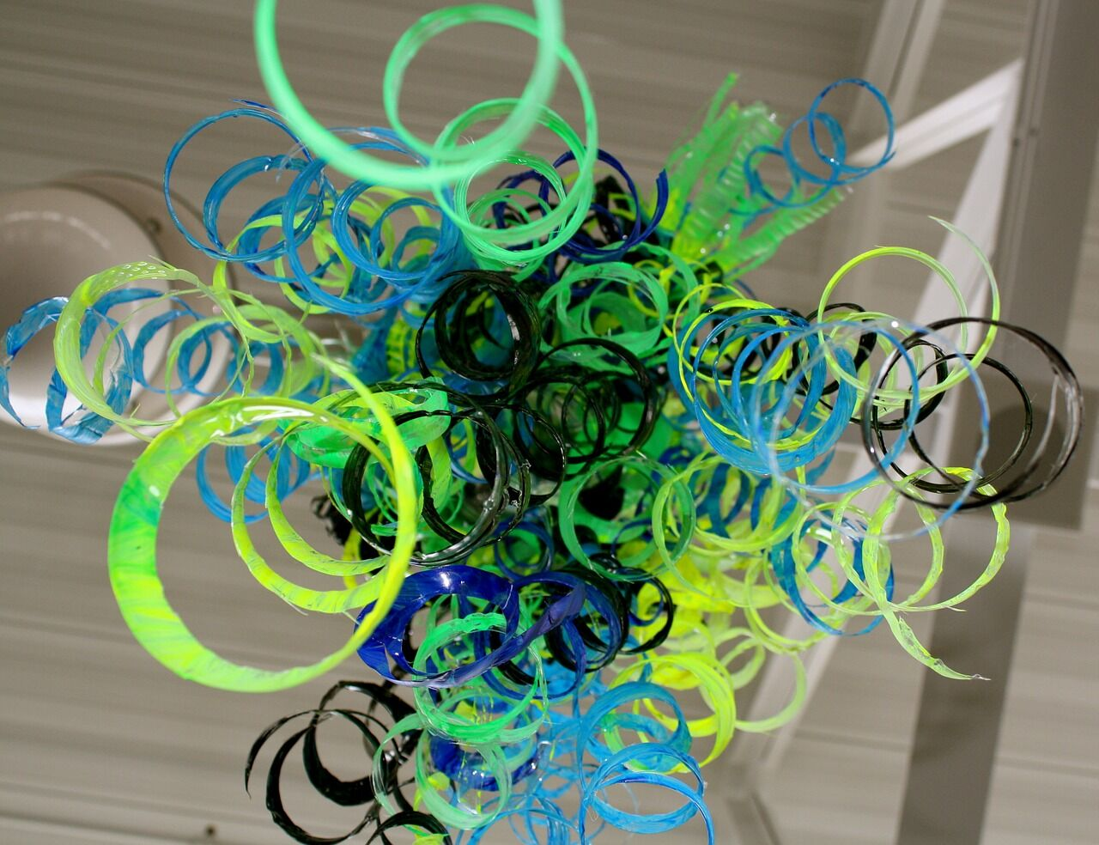
Plastics Reimagined
Notes:
Part 2: Reuse: A Better Option
Let’s Define the 5 R’s!
See if the class can come up with their own definition for each one.
Reduce: To purchase less ”stuff”, Reducing one’s own belongings.
Reuse: reusing something over and over again; ceramic coffee mugs, stainless steel water bottles
Recycle: to make something new from ( something that has been used before; to send (used newspapers, bottles, cans, etcl. )
Refuse: to say “no” to single use items. “ oh no thank you, I have my reusable bag right here”
Rot: Compost
Creative Reuse is the focus of this project and is a subset of Reuse.
Sometimes we think of creative reuse like this, If you are stuck on a desert island and needed to make a bag but only had – thread, granola bar wrappers, and plastic water bottles – How would you make it? Creative reuse is the reuse of an object through the addition of creativity and creative problem solving. For example, when a plastic water bottle (no longer wanted for its original function) is cut and creatively reused as a funnel.

Slide 12
Creative Reuse Definition
Also known as upcycling or repurposing, is when the addition of creativity to an already manufactured item brings a new function.
A CD jewel case can become a bird feeder, wine corks turned into a cork board, a t-shirt transformed into a rug.*
*Definition courtesy of The Reuse Alliance

Slide 13
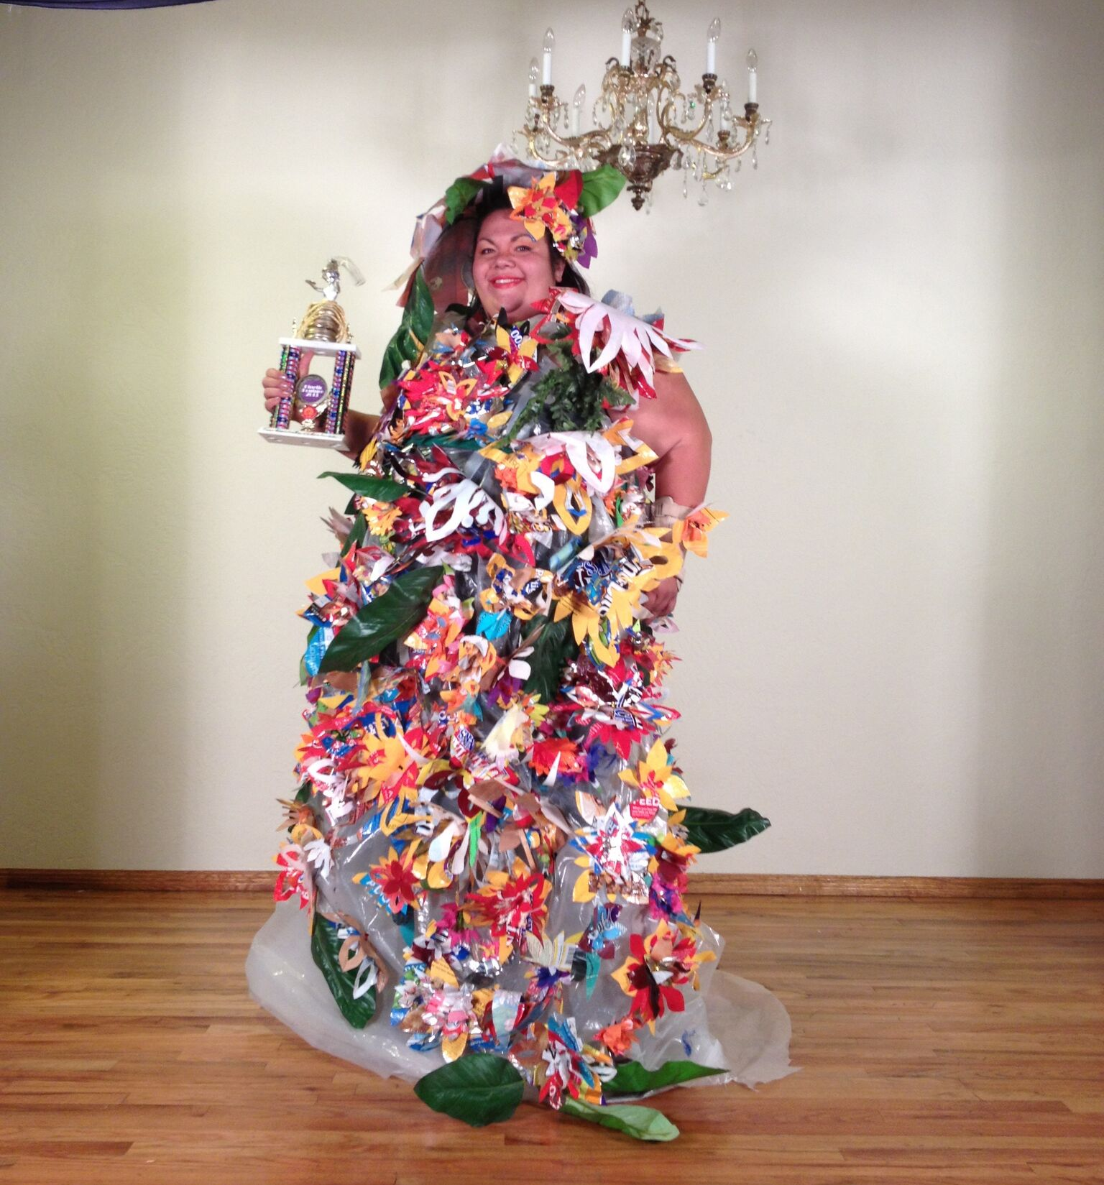
Plastics Reimagined
Notes:
Students view pictures of amazingly transformed plastic items to gain insight into techniques and be inspired by what is possible.
Can you guess what went into making this dress?
Can you see all of the chip and candy bags? What shapes are they cut into? The candy and chip bags were collected and cut into the shapes of flowers and leaves.
Photograph by Tibora Girczyc-Blum

Slide 14
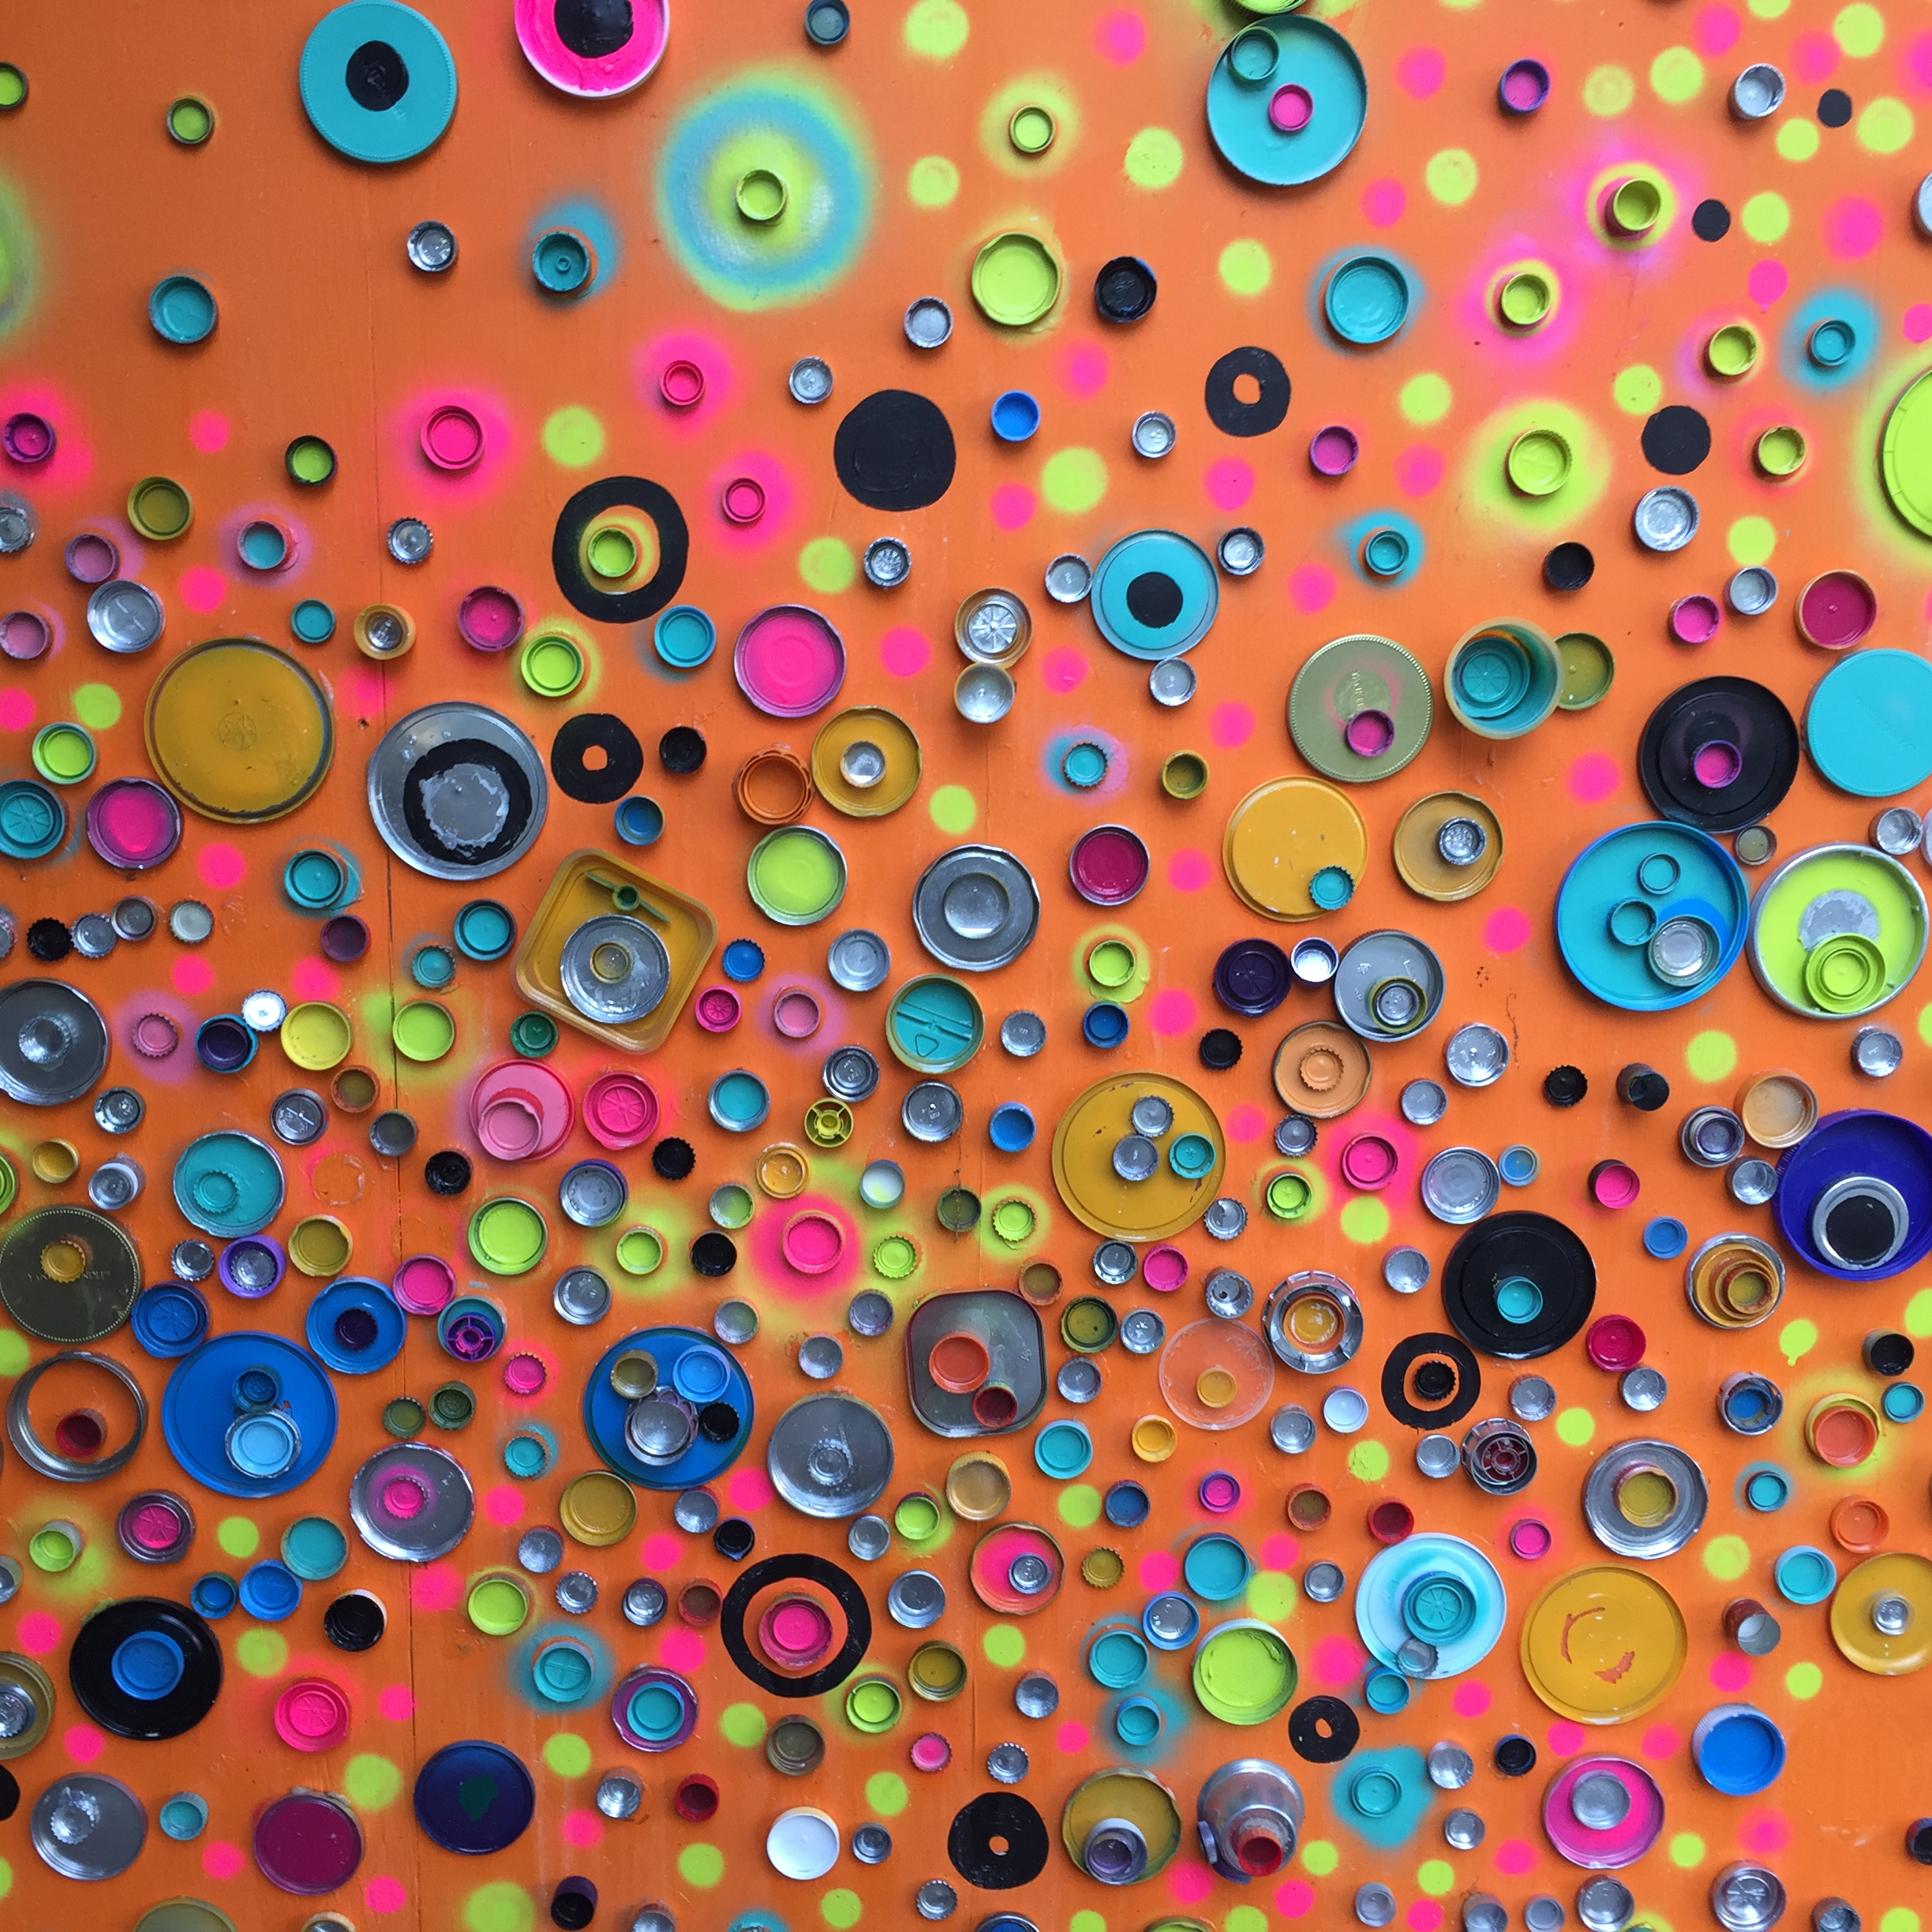
Plastics Reimagined
Notes:
Plastics can be used as a material or just for their color! How many different types or different colored bottle caps can you find?
Photograph by Tibora Girczyc-Blum

Slide 15
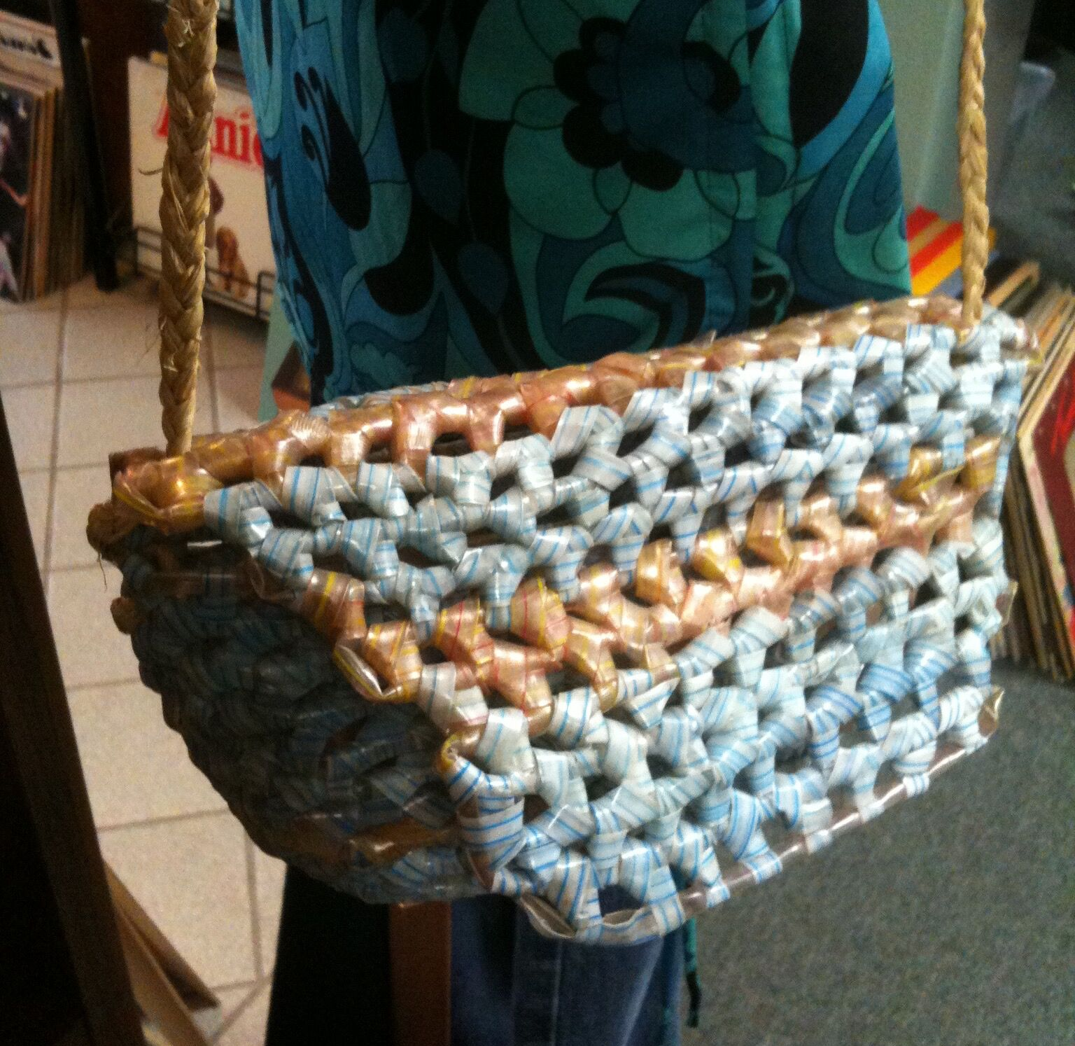
Plastics Reimagined
Notes:
Can you tell what type of plastic is used to make this bag?
Answer: drinking straws
Photograph by Tibora Girczyc-Blum

Slide 16
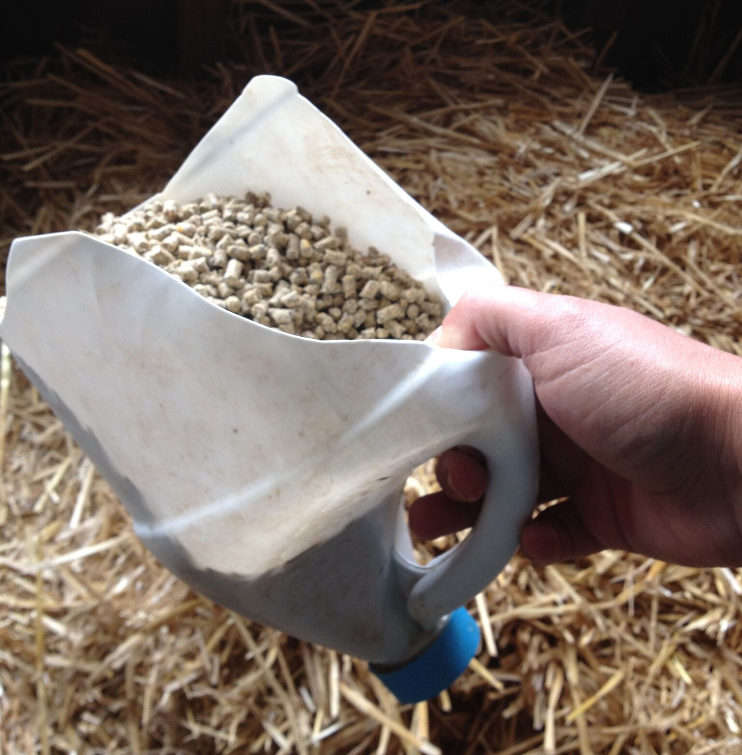
Plastics Reimagined
Notes:
What did this used to be?
This plastic bottle was transformed into a scoop and is a great example of creative reuse.
Photograph by Tibora Girczyc-Blum

Slide 17
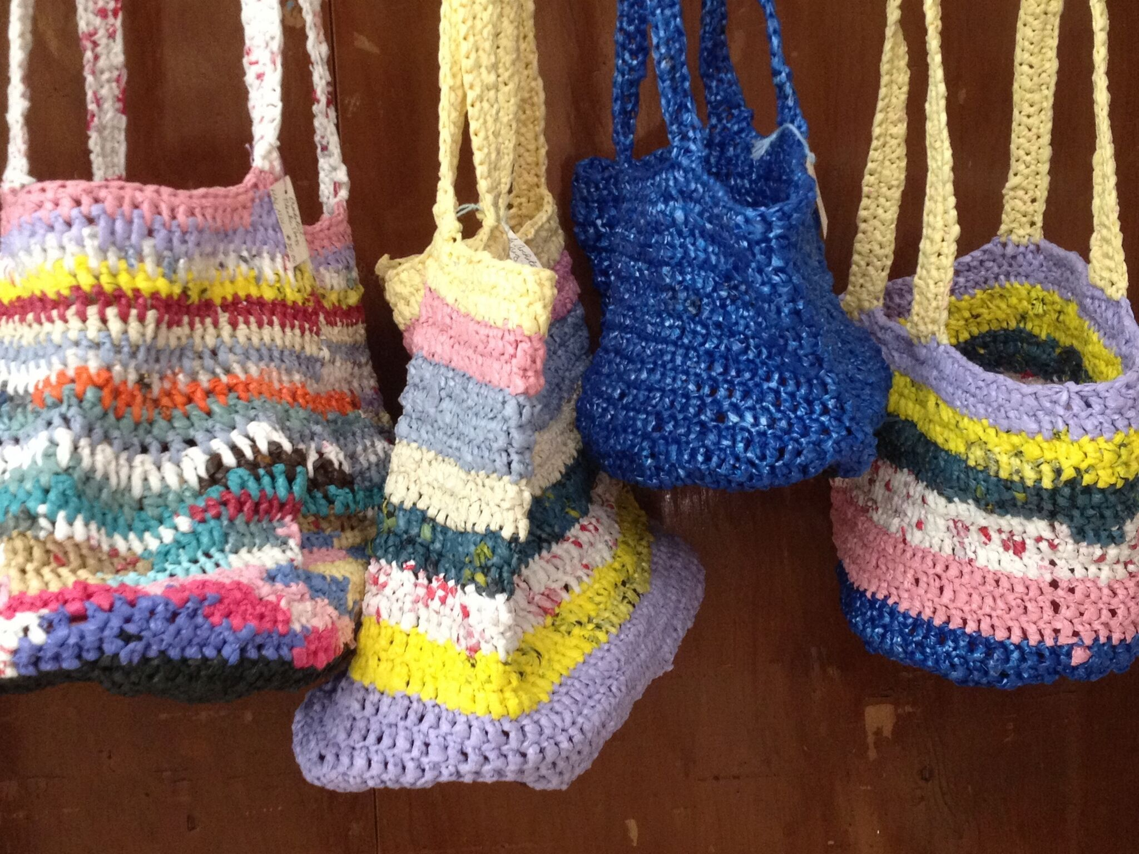
Plastics Reimagined
Notes:
Plastic bags were manipulated to create plastic bag yarn also known as "plarn". The plarn was then crocheted together to create these bags.
Photograph by Tibora Girczyc-Blum

Slide 18
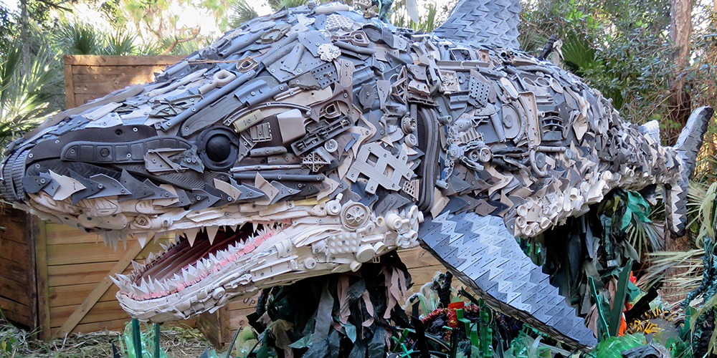
Plastics Reimagined
Notes:
Washed Ashore is an organization in Bandon, Oregon that creates animals from marine debris that washes up on the beach.Image courtesy of ⓒWashedAshore.org

Slide 19
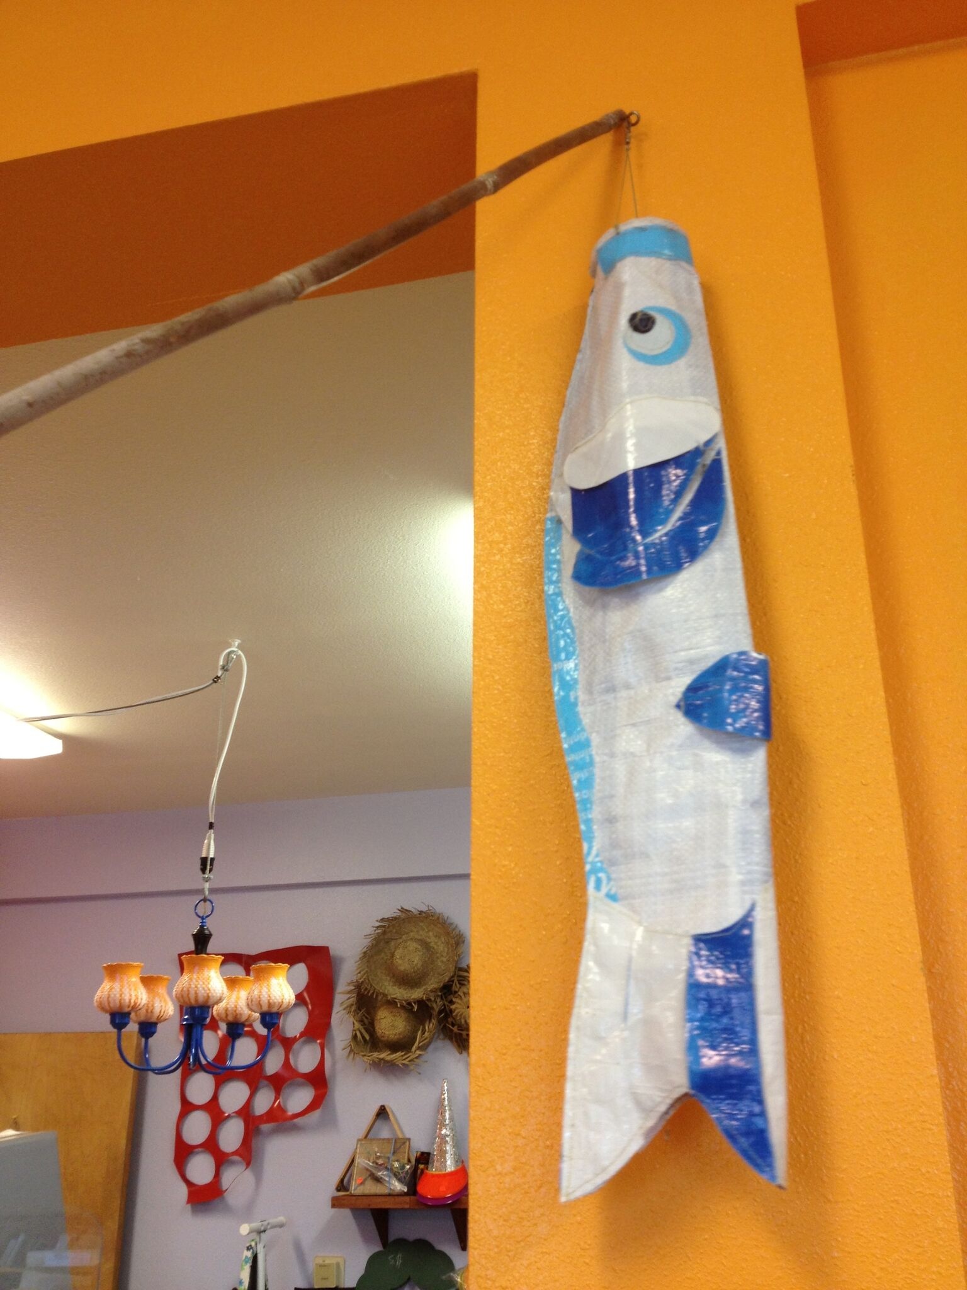
Plastics Reimagined
Notes:
What is this bird windsock made from?
Is made from a birdseed bag! Can you tell how the artist constructed it?
Wind sock by Patti Johnson, permission granted by the artist. Photograph by Tibora Girczyc-Blum

Slide 20
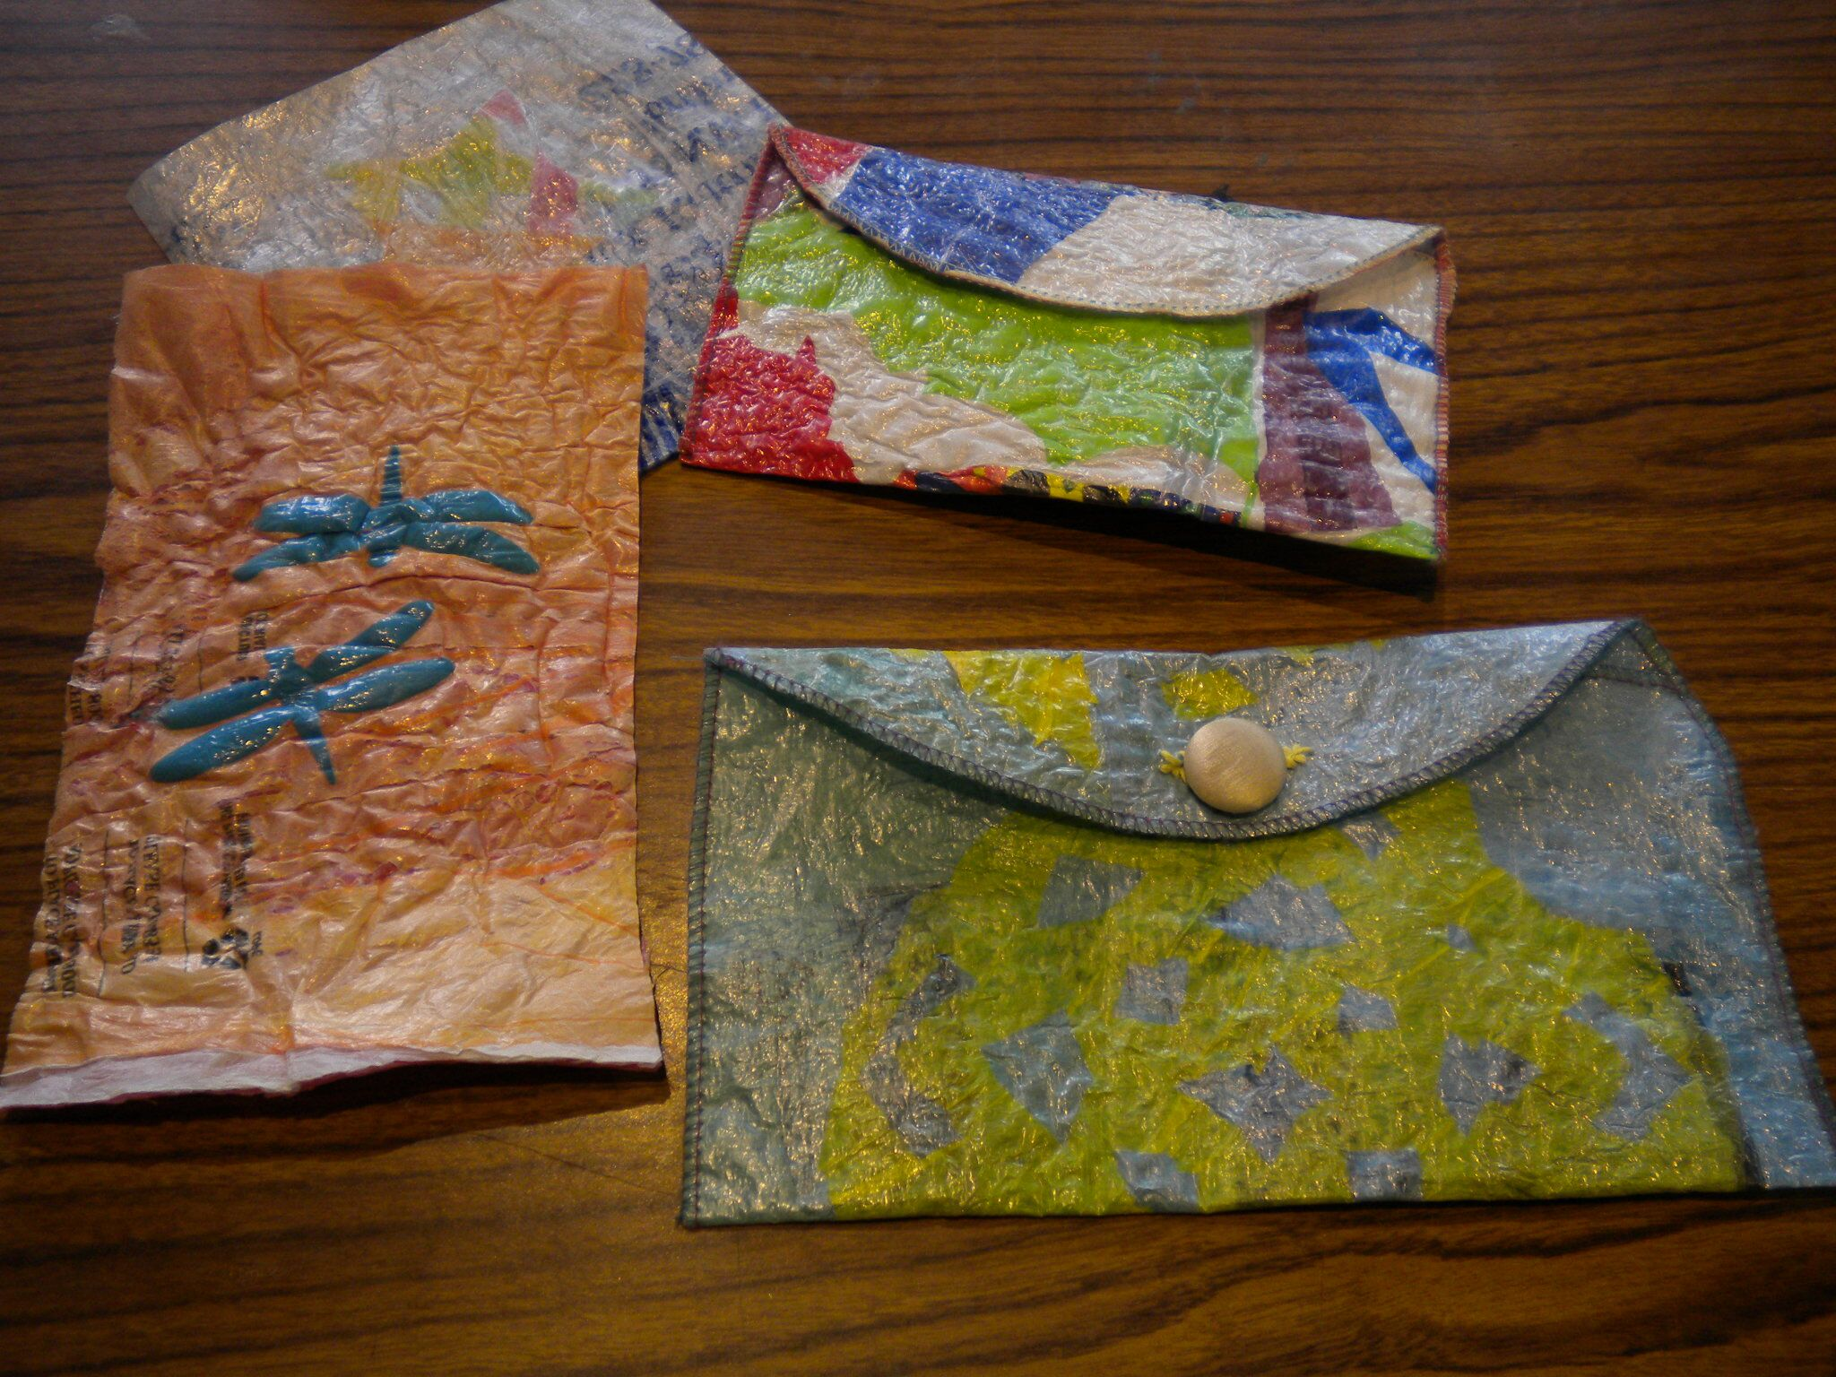
Plastics Reimagined
Notes:
With proper ventilation, plastic bags were fused together using an iron to make a stronger, sturdier material. That material was then used to create these pouches.
Photograph courtesy of SCRAP PDX.

Slide 21
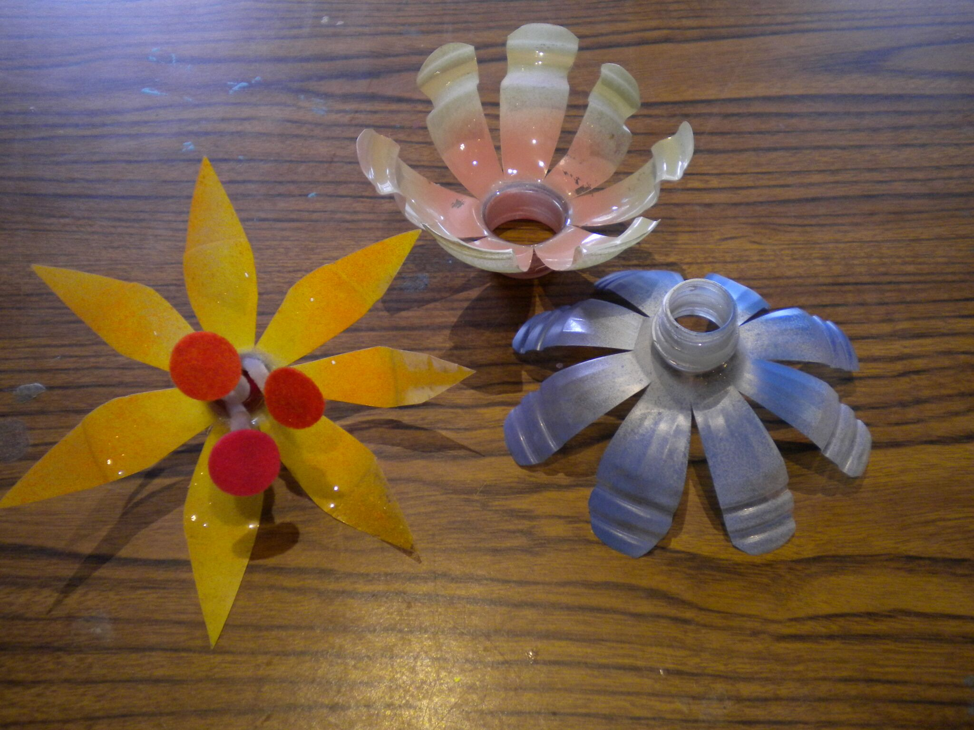
Plastics Reimagined
Notes:
Can you guess what these used to be?
What part of the plastic bottle is this from?
Photograph courtesy of SCRAP PDX.

Slide 22
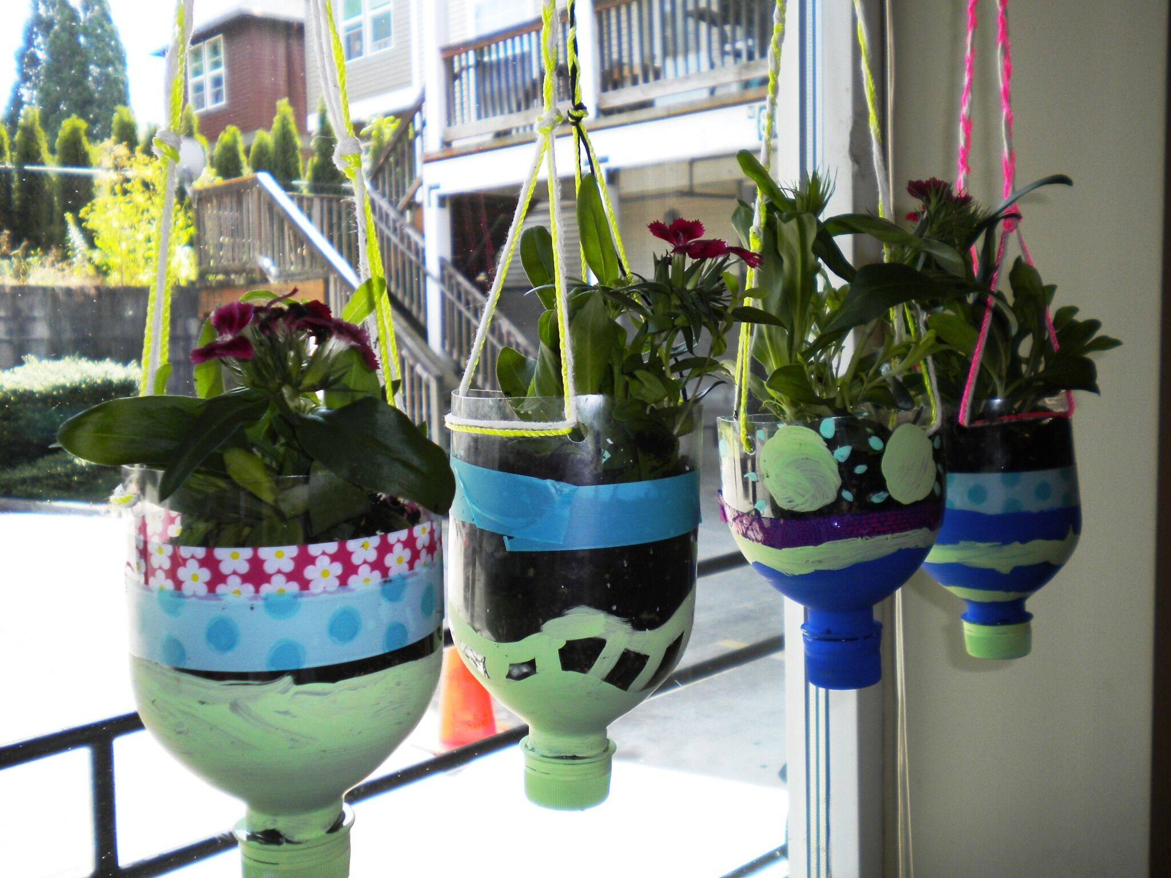
Plastics Reimagined
Notes:
Can you guess what these used to be?
If you guessed plastic water bottles, then you are correct! What else could you make out of a plastic water bottle?
Photograph courtesy of SCRAP PDX.

Slide 23
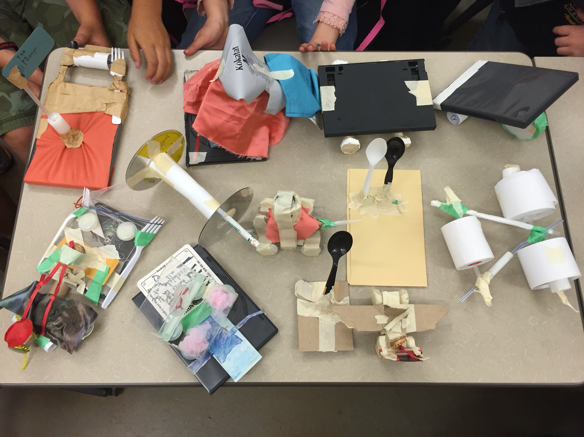
Plastics Reimagined
Notes:
Plastics are great materials to design and construct models from. This image is from a workshop where students designed various future transportation types.Canyou guess which ones are for land, air or sea?
Photograph by Tibora Girczyc-Blum

Slide 24
The Creative Reuse Lens
Engineer
Artist
Tech Savvy
Mathematician
Scientist
Think like a DESIGNER
Notes:
Part 3: Design Challenge

Slide 25
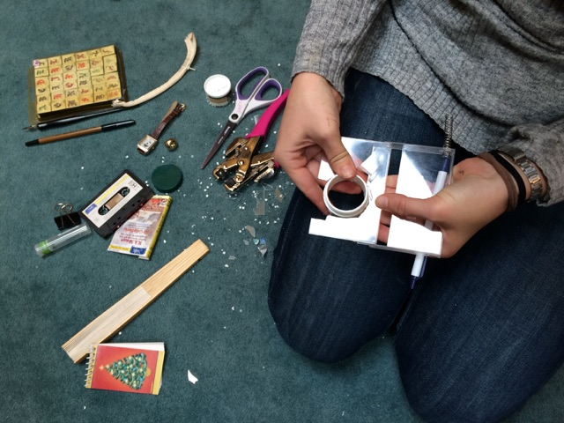
Design Challenge
Notes:
Exploring and testing the materials first, and discovering how many ways they use disposable plastics each day, acts as an attention-grabbing story for students. The project is framed in a real-world context: the disposable plastics they are utilizing still have value before they are degraded through recycling (or no longer used through landfilling). Through testing the materials students discover that it is strong, or flexible, or beautiful, or durable, or… it only needs to be reimagined instead of landfilled or recycled. Providing this context for the design challenge creates relevance, purpose, and meaning – a reason for being inventive, there is a problem at hand worth solving. Students are encouraged to enjoy the creative process, which involves both Thinking and Doing.

Slide 26
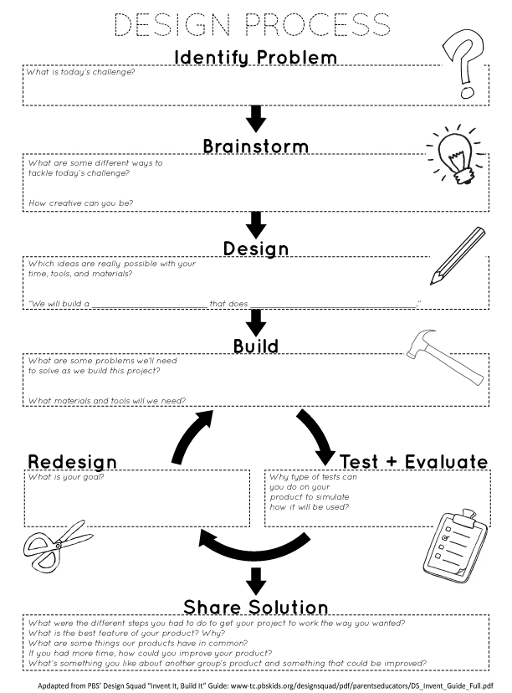
Designing like an engineer
The design process involves both THINKING and DOING
Notes:
Using the collected plastic packaging as materials, the Properties of Plastics graphic organizer, and Elements and Principles of Art handout as guides, students work in small teams to brainstorm ideas for transforming the trash before them into a useful item (reflective dog collar or vest, a jump-rope, a lunchbox, etc.). The Design Process Handout will guide students through the creative process of designing a product as it leads them through the same steps an engineer or inventor would use. Students create a prototype of their item, share it with the class for feedback, and make changes as needed:
1. Identify Problem
2. Brainstorm
3. Design
4. Build
5. Test and Evaluate
6. Redesign
7. Share Solution
Note: It can be helpful to set design challenge parameters for your class to provide some direction for what students create, such as: types of transportation, puppets, something to solve a problem in the classroom, something that would be useful in the garden, something to carry your lunch in, etc.
Design Resources for Educators
http://www.designthinkingforeducators.com/
Engineering Resources for elementary and middle school students:
http://engineeryourlife.org/
http://www.discovere.org/
http://pbskids.org/designsquad/
http://www.howtoons.com/ Use everyday objects to invent toys you can build
http://lemelson.mit.edu/
http://www-tc.pbskids.org/designsquad/pdf/parentseducators/DS_Invent_Guide_Full.pdf
“Green” design activities and challenges
http://pbskids.org/designsquad/parentseducators/resources/index.html?category=green
PBS Design Squad
http://pbskids.org/designsquad/parentseducators/index.html

Slide 27
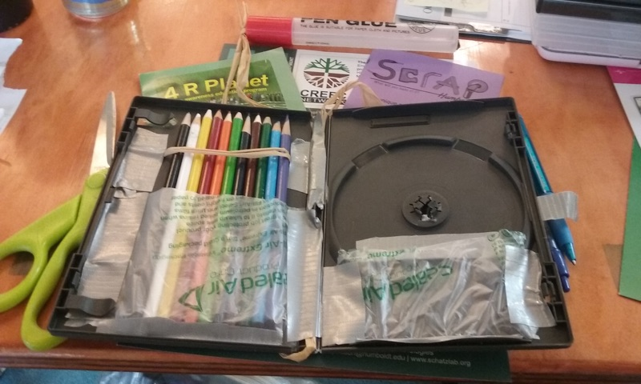
Create a Prezi to share solutions
Field Sketching Kit made from DVD case
Notes:
Once the item is finalized, each team creates plans/directions for creating the item so that others can easily replicate it. These directions are presented through a Prezi. Go to https://prezi.com/ to get started creating a presentation. View this Prezi on how to make a Prezi: http://prezi.com/pdoaavoysiij/?utm_campaign=share&utm_medium=copy&rc=ex0share
View these sample Prezi’s about plastic: https://prezi.com/explore/search/?search=plastic#search=plastic&reusable=true&page=1&users=less

Slide 28
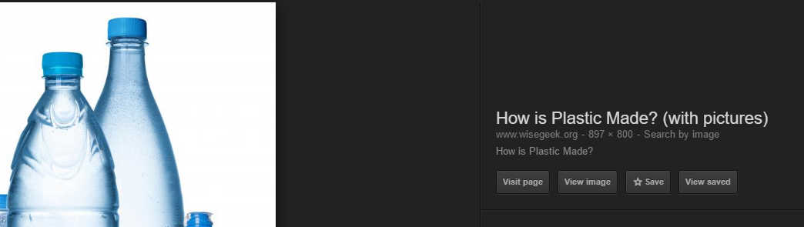
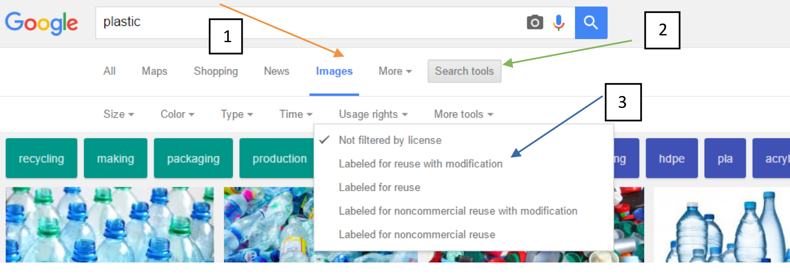
Or use Google Slides to share solutions
Notes:
See Google Slides handout for complete instructions
Either create a Google presentation for the class and then create a slide for each student and assign each student a slide number or have a small group of students create a Google presentation and work on collaboratively. https://docs.google.com/presentation/u/0/
For students who want to record their entire presentation, Screencast video is a recording video of the screen with audio from a microphone. Install Snagit for the Chrome browser.
A great place to look for images that are copyright free is www.search.creativecommons.org
When using Google search, type in the keyword (in this case plastic), click images, search tools, usage rights “Labeled for reuse with modification”.

Slide 29
Module Developed By:
Allison Poklemba
North Coast CREEC Coordinator
North Coast CREEC (CA Regional Environmental Education Community) Network
creec.org
Stacy Young
Regional Arts Lead
Humboldt County Office of Education
Tibora Girczyc-Blum
Arts Educator & Consultant
SCRAP USA Special Projects Coordinator
Founder of SCRAP Humboldt
scraphumboldt.org

Slide 30

CREEC Network
The California Regional Environmental Education Community Network is a communication network supporting the environmental literacy of California’s students by providing teachers with access to high quality environmental education resources.
www.creec.org

Slide 31
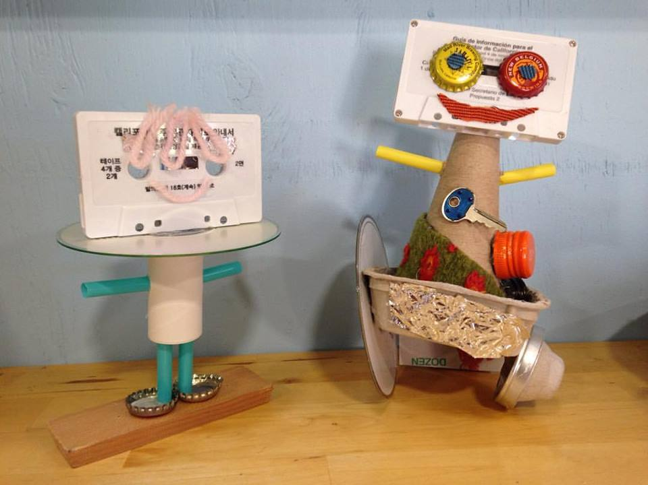

SCRAP Humboldt
SCRAP Humboldt is a 501(c)(3) nonprofit organization and is a part of SCRAP USA, a national creative reuse center network.
Our mission is to inspire creative reuse and environmentally sustainable behavior by providing educational programs and affordable materials to the community.

Slide 32
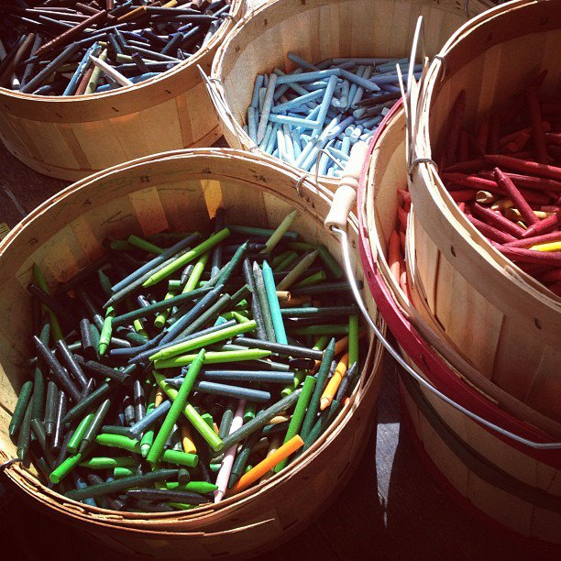
Creative Reuse Centers in CA
Arcata – SCRAP Humboldt
Indio – S.C.R.A.P Gallery
Long Beach - Long Beach Depot for Creative Reuse
Los Angeles – reDiscover at Smart Space
Los Angeles – Trash for Teaching, Inc
Moutain View – FabMo
Oakland – East Bay Depot for Creative Reuse
Orange County – Child Creativity Lab
Pasadena - Remainders Creative Reuse
Redwood City – RAFT
Riverside – Riverside Arts and ReUse Exchange
Roseville – ReCREATE
Sacramento – RAFT
San Diego – Art FORM
San Francisco – SCRAP
San Jose – Resource Area for Teaching ( RAFT)
Santa Barbara – Art from Scrap
Westlake Village – CReATE Studio & CReATE on Your Campus
Not in California?
This is a great resource to find a
creative reuse center near you.

Slide 33
Thank you!

