Slide 1
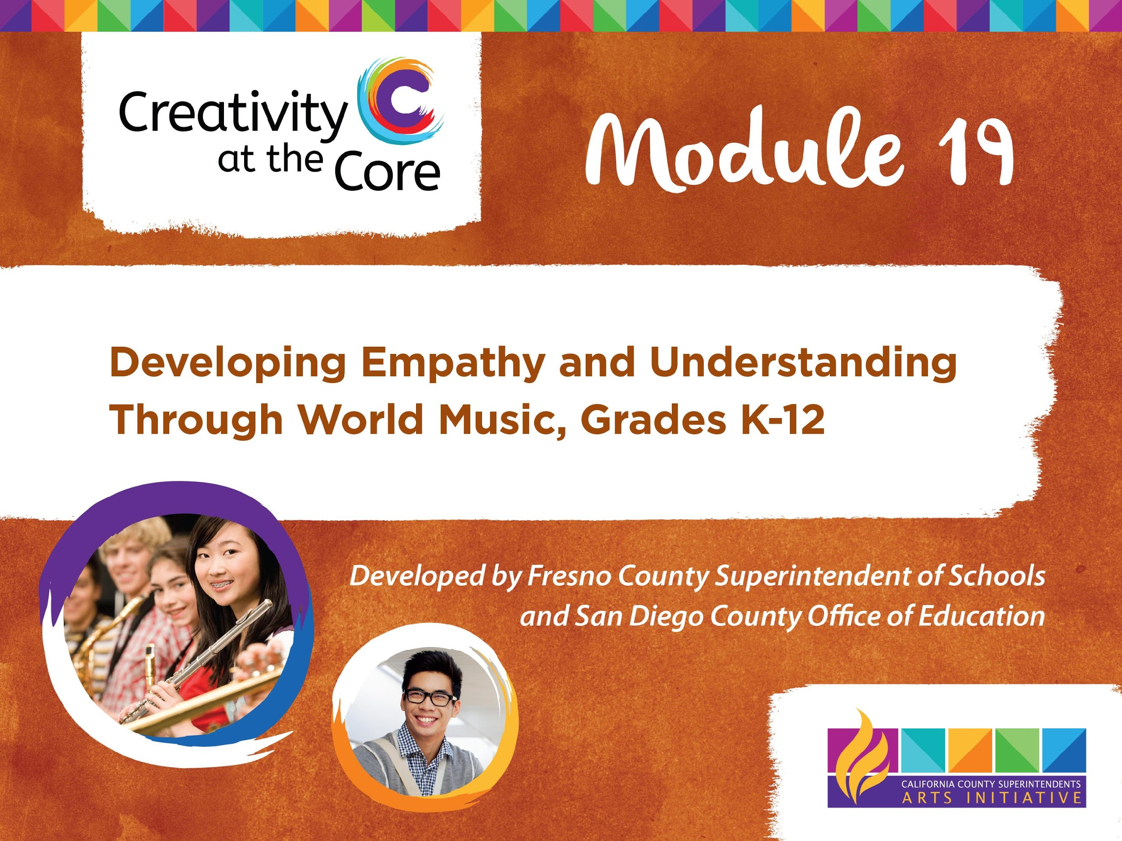

Slide 2
LEARNING OUTCOMES
Demonstrate appropriate use of six elements of music
Demonstrate understanding of empathy
Demonstrate understanding of the role music plays in our lives
Demonstrate the role music plays in the lives of people living in Ireland

Slide 3
Bubble Gum, Bubble Gum
Bubble Gum,
Bubble Gum,
In a dish.
How many pieces
Do you wish?

Slide 4
Lesson 1 Elements of Music
Beat
The steady pulse of music

Slide 5
Lesson 1 Elements of Music
Tempo
The speed of the beat
(fast, medium, or slow)

Slide 6
Lesson 2 Elements of Music
Pitch
The highness or lowness of sounds
(high, medium, or low)

Slide 7
Respectful Listening Guide
Always Be Kind
Be Silent
Check your Body Language

Slide 8
Ireland
Official Language of Ireland: English
Travel to Ireland: airplane, boat
Animals living in Ireland: red fox, otter, badger, pygmy shrew
Notes:
Please add facts relative to other appropriate content standards

Slide 9
Lesson 3 Elements of Music
Duration
The length of a sound
(short or long)

Slide 10
Lesson 3 Elements of Music
Dynamics
The loudness or softness of a sound
(high, medium, or low)

Slide 11
Lesson 3 Elements of Music
Timbre
The quality or tone color of a sound. It distinguishes one instrument sound from another.

Slide 12
LESSON 2 WARM UP
IRISH WORDS
Suas = Up
Síos = Down
Amach = Out
Isteach = In

Slide 13
LESSON 2 WARM UP
Rólaí Pólaí
Rólaí Pólaí,
suas, suas, suas.
Rólaí Pólaí,
síos, síos, síos.
Rólaí Pólaí,
amach, amach, amach.
Rólaí Pólaí,
isteach, isteach, isteach.

Slide 14
LESSON 2 WARM UP
“The Bog Down in the Valley”
Traditional Irish Folk Song
CHORUS:
O-ro the rattlin' bog, the bog down in the valley-o
O-ro the rattlin' bog, the bog down in the valley-o

Slide 15
LESSON 2 WARM UP
“The Bog Down in the Valley”
Traditional Irish Folk Song
VERSE 1:
And in that bog there was a tree,
A rare tree, a rattlin' tree
With the tree in the bog
And the bog down in the valley-o.

Slide 16
LESSON 2 WARM UP
“The Bog Down in the Valley”
Traditional Irish Folk Song
VERSE 2:
Now on that tree there was a limb,
A rare limb, a rattlin' limb
With the limb on the tree and the tree in the bog
And the bog down in the valley-o.

Slide 17
LESSON 2 WARM UP
“The Bog Down in the Valley”
Traditional Irish Folk Song
VERSE 3:
Now on that limb there was a branch,
A rare branch, a rattlin' branch
With the branch on the limb and the limb on the tree And the tree in the bog
And the bog down in the valley-o.

Slide 18
LESSON 2 WARM UP
“The Bog Down in the Valley”
Traditional Irish Folk Song
ALL OTHER VERSES:
Repeat the process for the verses adding a line each time:
Now on that branch there was a twig, a rare...
Now on that twig there was a nest, a rare...
Now in that nest there was an egg, a rare...
Now in that egg there was a bird, a rare...
Now on that bird there was a feather, a rare...
Now on that feather there was a flea, a rare...

Slide 19
