Slide 1
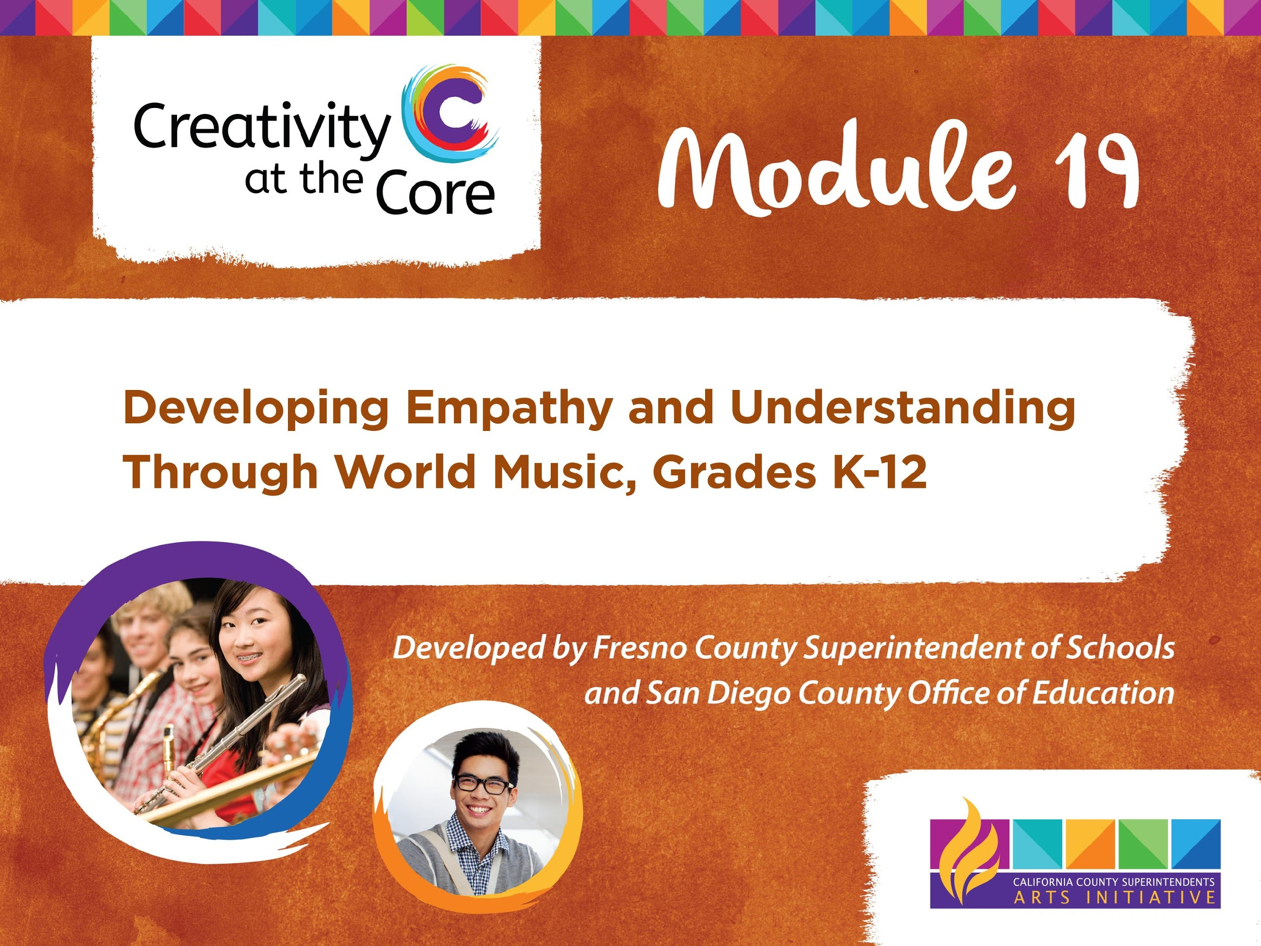

Slide 2
LEARNING OUTCOMES
Demonstrate appropriate use of seven elements of music
Demonstrate understanding of empathy
Demonstrate understanding of the role music plays in our lives
Demonstrate the role music plays in the lives of people living in South Africa

Slide 3
Czechoslovakia
Czechoslovakia, Boom Sha Boom
Yugoslavia, Boom Sha Boom
Let’s get the rhythm of the hands;
we got the rhythm of the hands
Let's get the rhythm of the feet;
we got the rhythm of the feet.
Let's get the rhythm of the eyes;
we got the rhythm of the eyes.
Let's get the rhythm of the hips;
we got the rhythm of the hips,
Let’s get the rhythm of the free form dance.

Slide 4
Lesson 1 Elements of Music
Beat
The steady pulse of music

Slide 5
Lesson 1 Elements of Music
Rhythm
The pattern of short and long sounds and silences that fit within a steady beat. It is how we multiply or divide the beat to create interesting patterns.

Slide 6
Lesson 1 Elements of Music
Tempo
The speed of the beat
(fast, medium, or slow)

Slide 7
Lesson 2 Elements of Music
Pitch
The highness or lowness of sounds
(high, medium, or low)

Slide 8
Respectful Listening Guide
Always Be Kind
Be Silent
Check your Body Language

Slide 9
South Africa
Official Languages of South Africa: Afrikaans, English, Ndebele, Northern Sotho, Sotho, Swazi, Tsonga, Tswana, Venda, Xhosa, Zulu
Travel to South Africa: airplane, boat
Notes:
Please add facts relative to other appropriate content standards

Slide 10
South Africa
Capitals of South Africa:
Pretoria (Executive)
Bloemfontein (Judicial)
Cape Town(Legislative)
Animals living in South Africa: elephant, lion, rhino, buffalo, leopard
Notes:
Please add facts relative to other appropriate content standards

Slide 11
Che-Che Kule
Che-che kule
Che kofisa
Kofisa langa
Langa tilanga
Khum a-le-le
Khum a-le-le

Slide 12
“Shosholoza”
Shoh-shoh-loh-zah
Shoh-shoh-loh-zah
Kooh-leh-zoh ntah-sah ma-mah
Kooh-leh-zoh ntah-bah
Stih-meh-lah see-pooh-meh South Africa
Weh-n ooh-yah-bah-leh-kah
Weh-n ooh-yah-bah-leh-kah
Kooh-leh-zoh ntah-sah ma-mah
Kooh-leh-zoh ntah-bah
Stih-meh-lah see-pooh-meh South Africa

Slide 13
Lesson 3 Elements of Music
Duration
The length of a sound
(short or long)

Slide 14
Lesson 3 Elements of Music
Dynamics
The loudness or softness of a sound
(high, medium, or low)

Slide 15
Lesson 3 Elements of Music
Timbre
The quality or tone color of a sound. It distinguishes one instrument sound from another.

Slide 16
