Slide 1
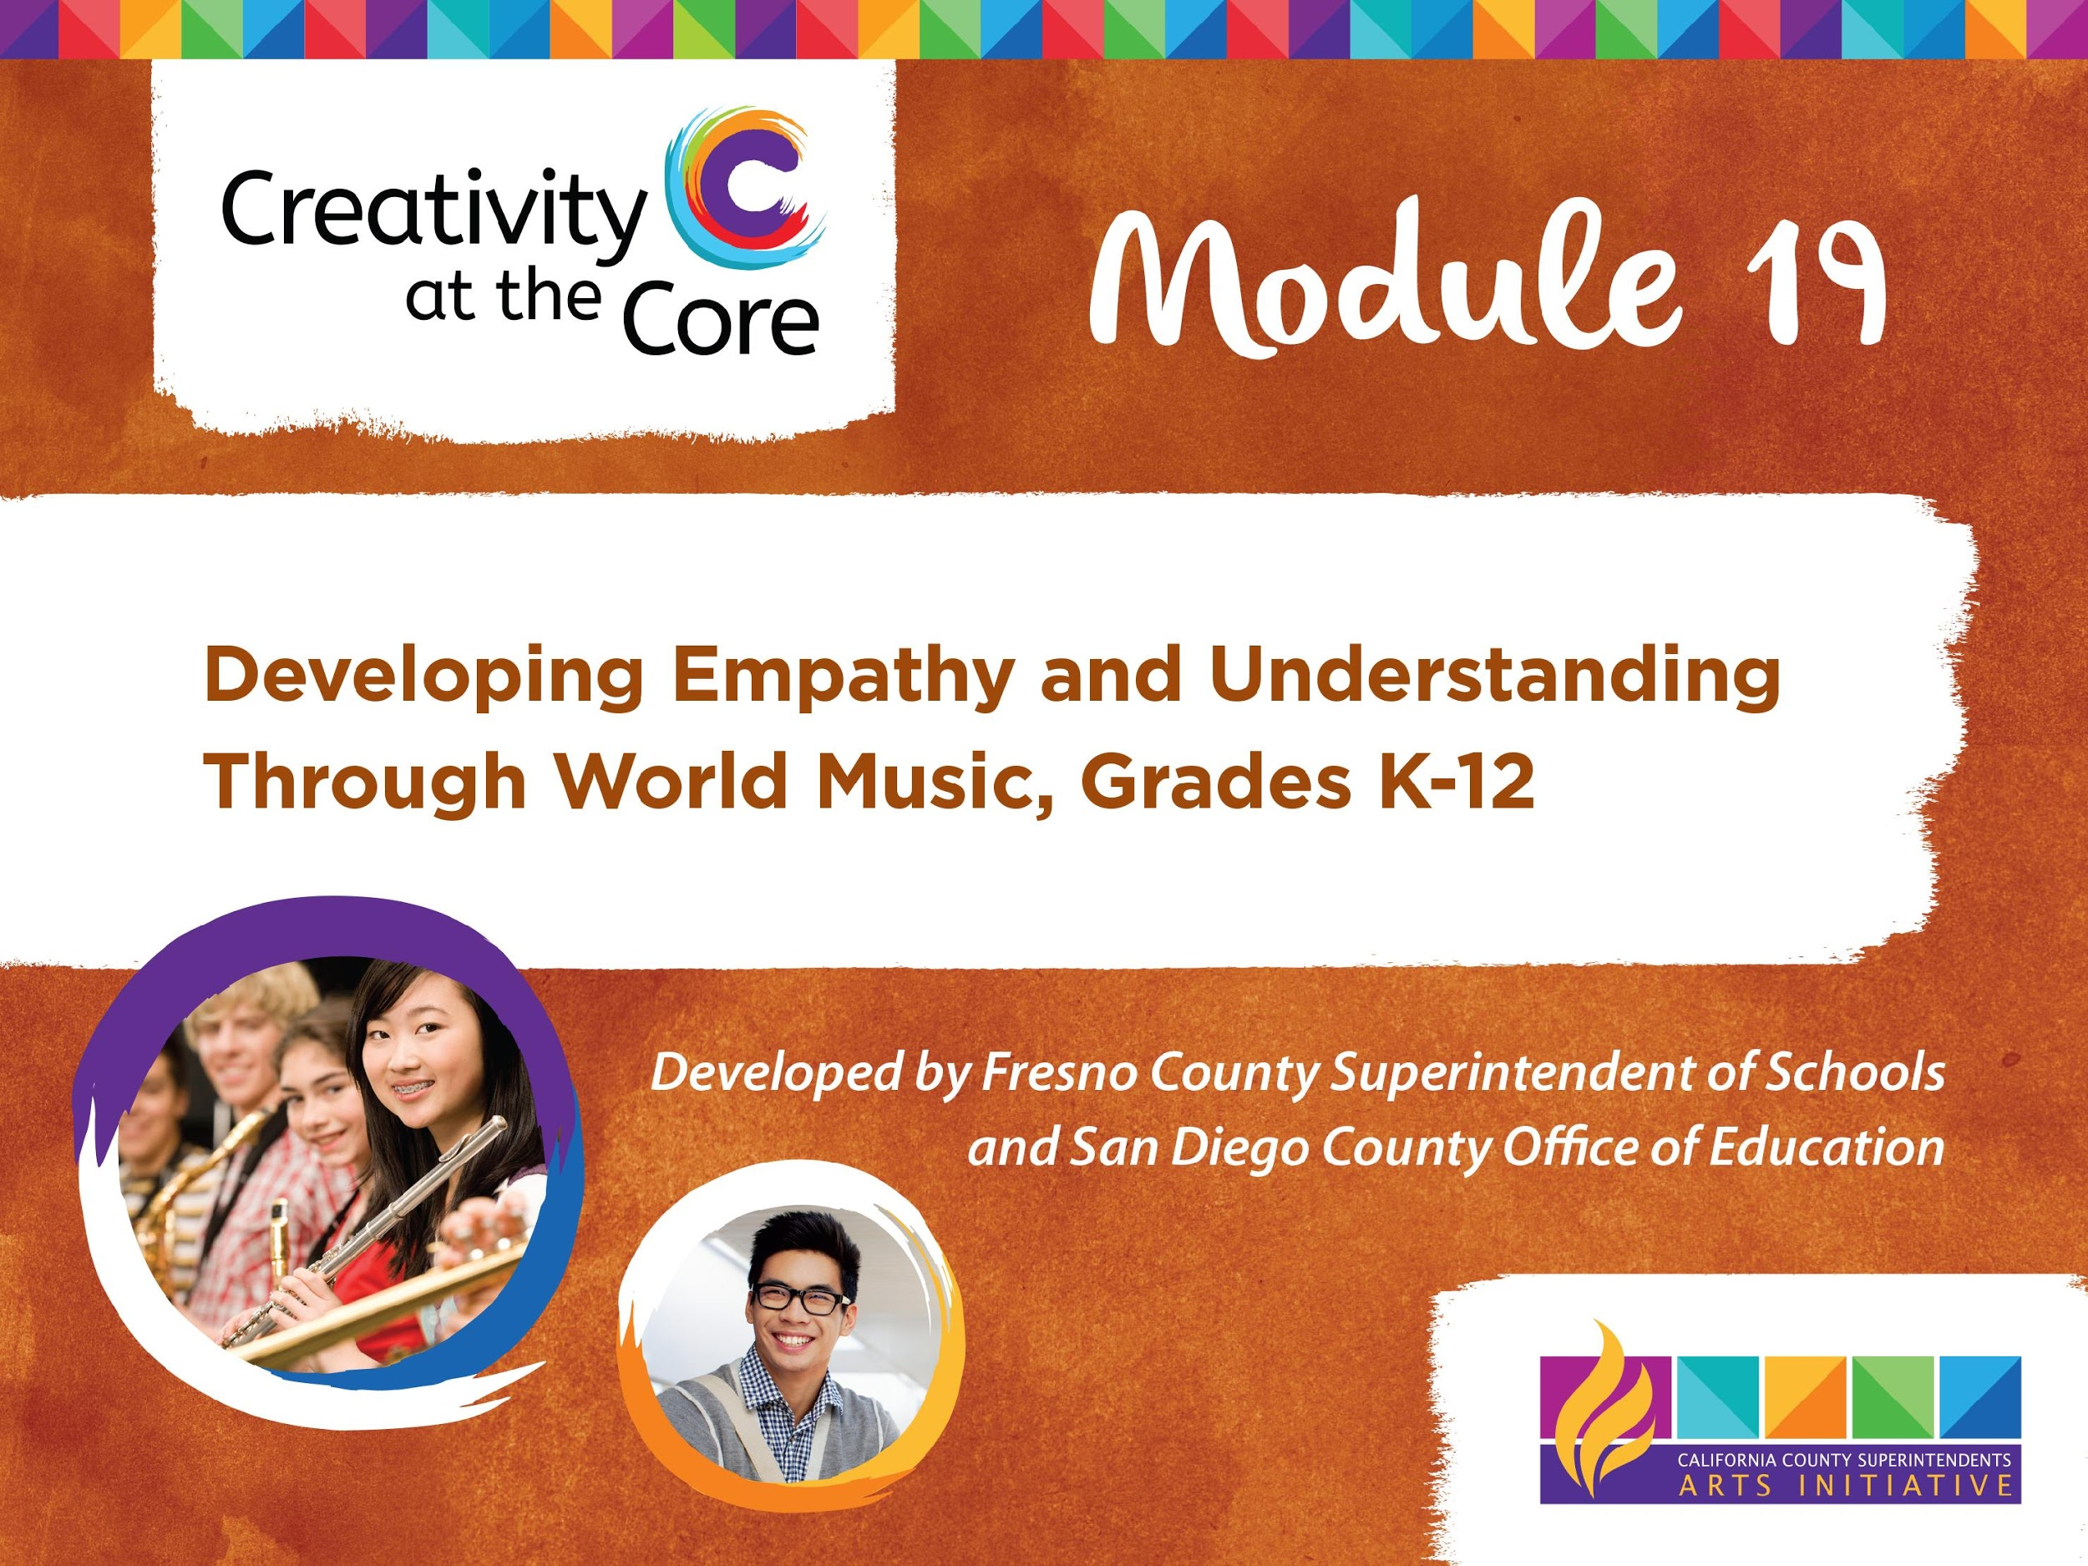

Slide 2
LEARNING OUTCOMES
Demonstrate appropriate use of six elements of music
Demonstrate understanding of empathy
Demonstrate understanding of the role music plays in our lives
Demonstrate the role music plays in the lives of people living in Brazil

Slide 3
Bubble Gum, Bubble Gum
Bubble Gum,
Bubble Gum,
In a dish.
How many pieces
Do you wish?

Slide 4
Lesson 1 Elements of Music
Beat
The steady pulse of music

Slide 5
Lesson 1 Elements of Music
Tempo
The speed of the beat
(fast, medium, or slow)

Slide 6
Lesson 2 Elements of Music
Pitch
The highness or lowness of sounds
(high, medium, or low)

Slide 7
Respectful Listening Guide
Always Be Kind
Be Silent
Check your Body Language

Slide 8
Brazil
Official Language of Brazil: Portuguese
Travel to Brazil: airplane, boat
Animals living in Brazil: jaguar, sloth, armadillo, tapir
Notes:
Please add facts relative to other appropriate content standards

Slide 9
Lesson 3 Elements of Music
Duration
The length of a sound
(short or long)

Slide 10
Lesson 3 Elements of Music
Dynamics
The loudness or softness of a sound
(high, medium, or low)

Slide 11
Lesson 3 Elements of Music
Timbre
The quality or tone color of a sound. It distinguishes one instrument sound from another.

Slide 12
