Slide 1
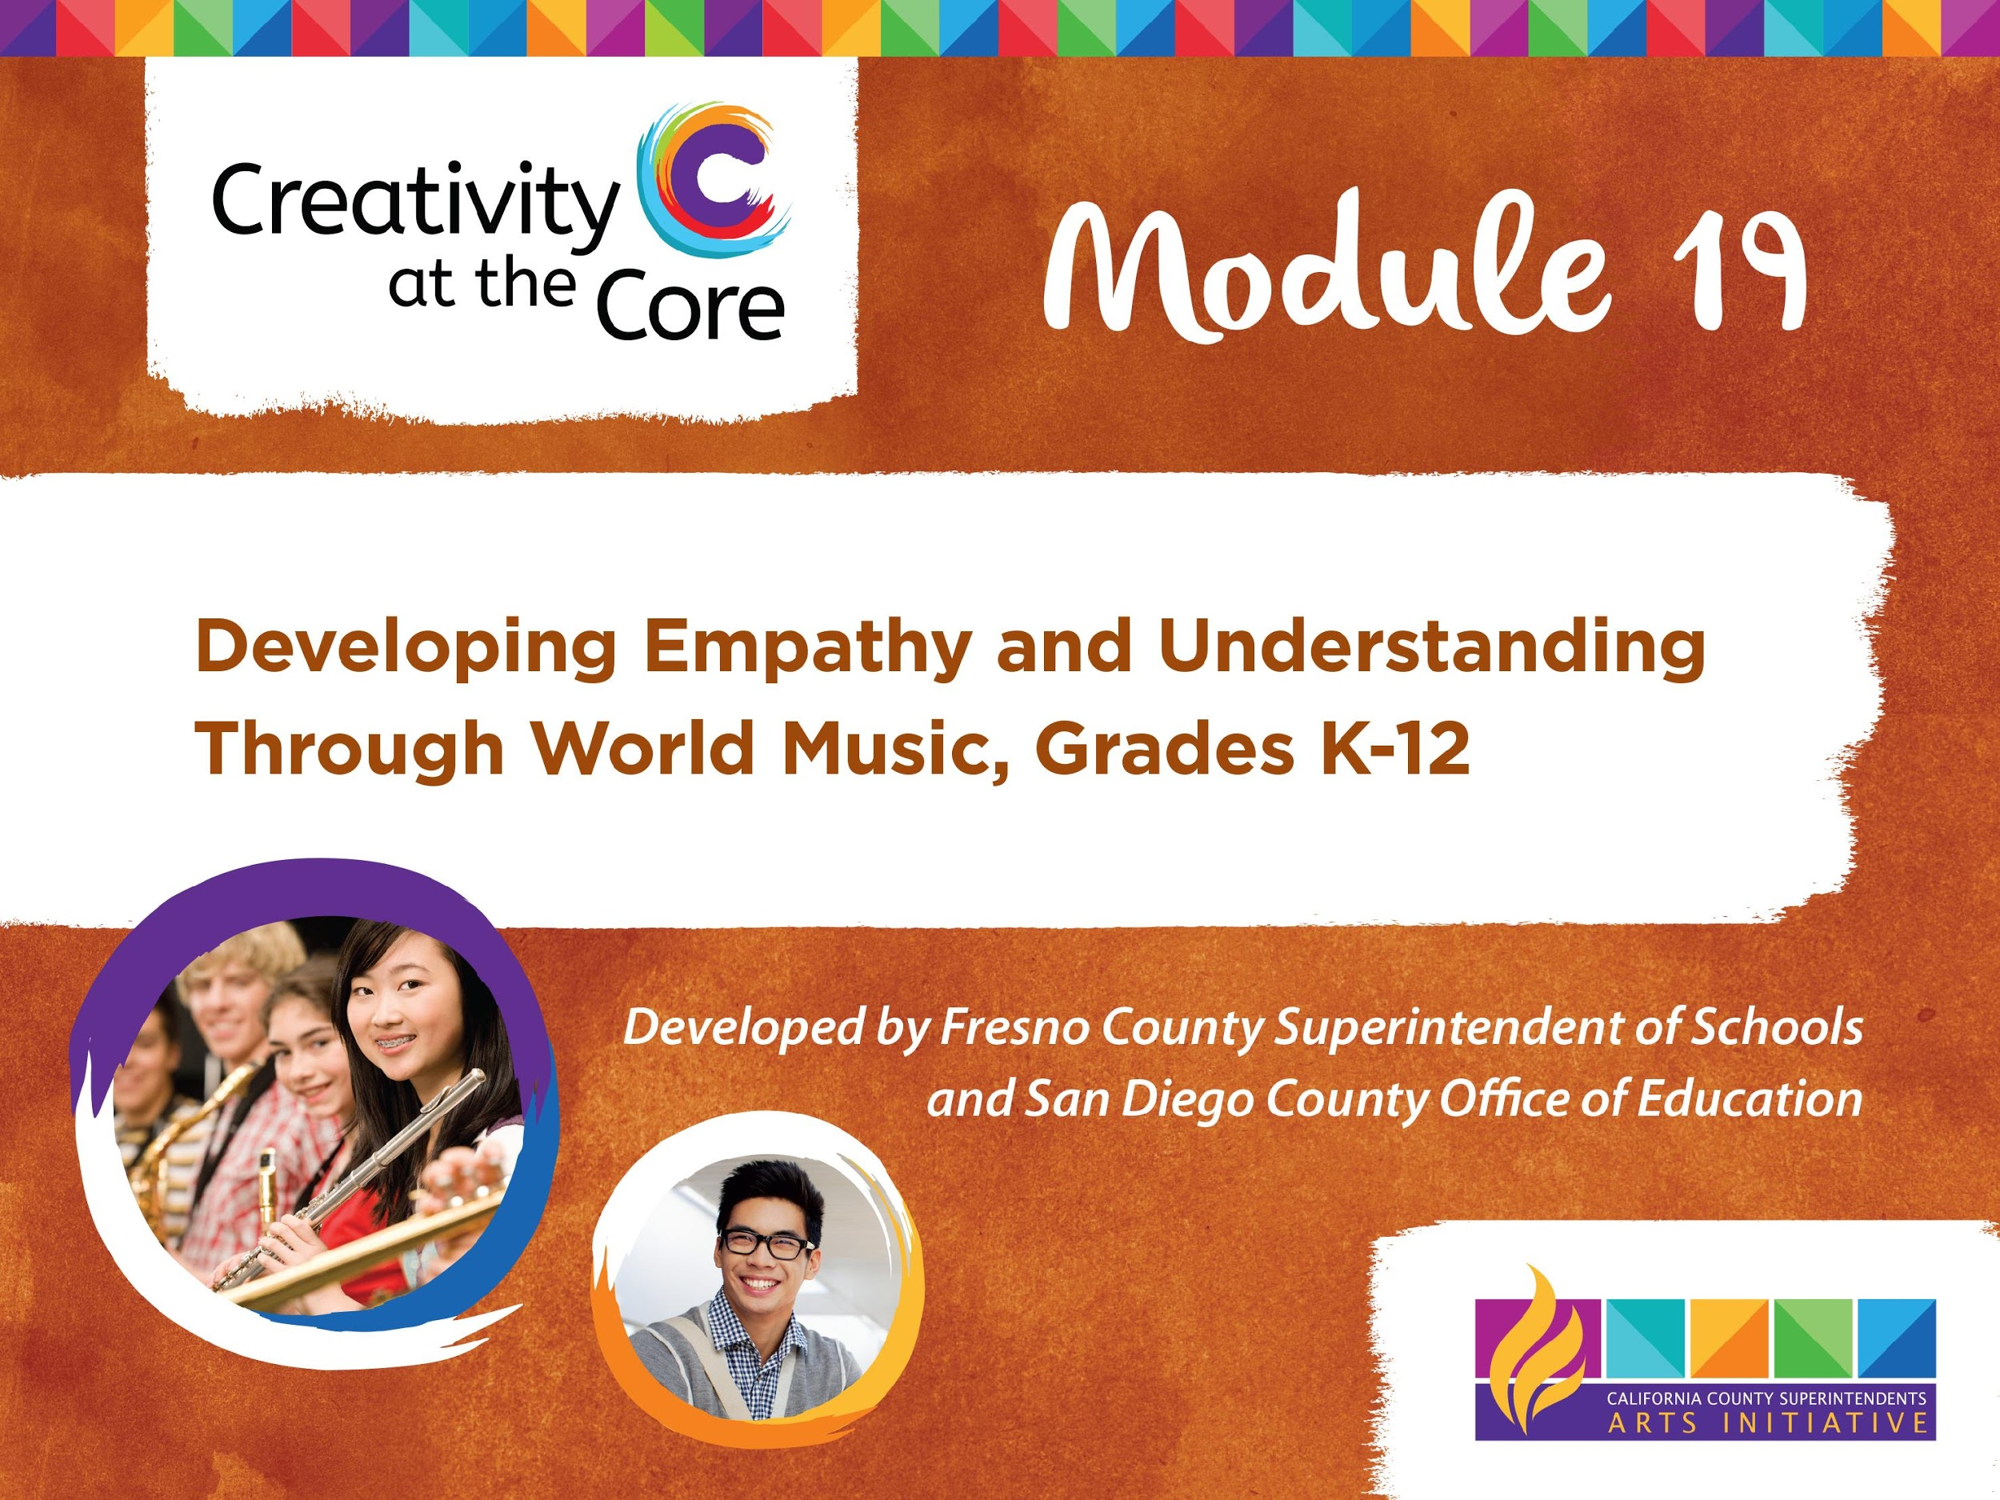

Slide 2
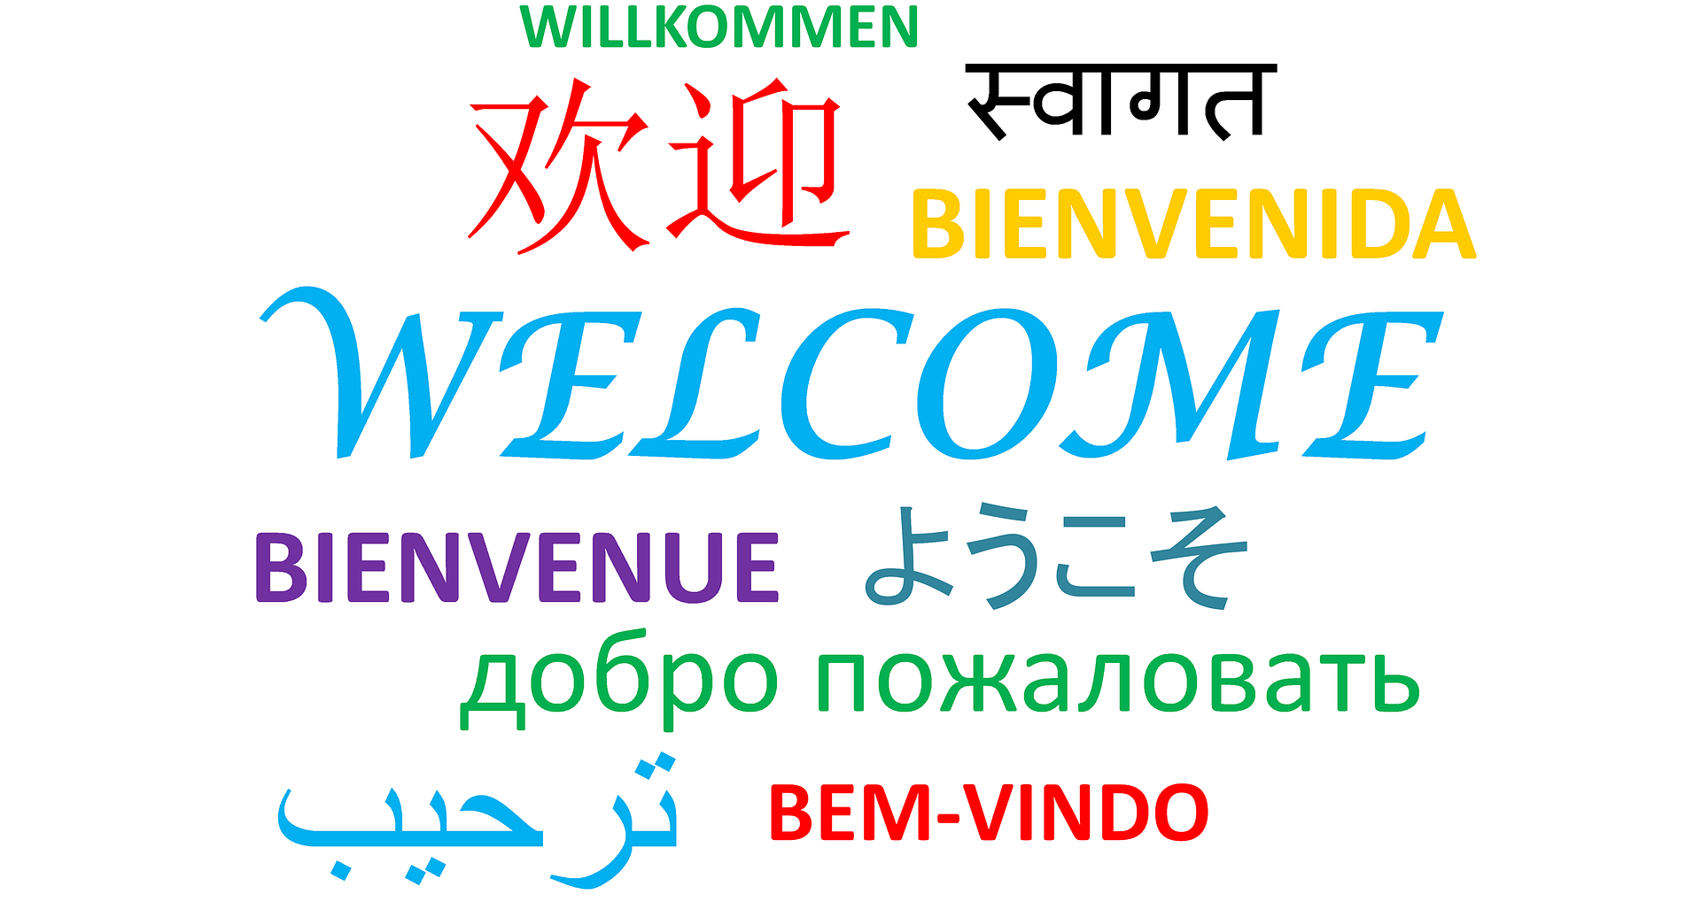

Slide 3

WHO’S IN THE ROOM?

Slide 4
PURPOSE
Provide resources for music and general ed classroom teachers to use music to broaden student’s world view
Reinforce the need for discipline specific music and arts instruction AND integrated arts instruction to benefit the whole child
Explore the lives of people in other parts of the world through music
Introduce and reinforce key music standards

Slide 5
Czechoslovakia
Czechoslovakia, Boom Sha Boom
Yugoslavia, Boom Sha Boom
Let’s get the rhythm of the hands;
we got the rhythm of the hands
Let's get the rhythm of the feet;
we got the rhythm of the feet.
Let's get the rhythm of the eyes;
we got the rhythm of the eyes.
Let's get the rhythm of the hips;
we got the rhythm of the hips,
Let’s get the rhythm of the free form dance.

Slide 6
ELEMENTS OF MUSIC
BEAT
RHYTHM
TEMPO
PITCH
DYNAMICS
TIMBRE

Slide 7
Elements of Music
BEAT
The steady pulse of music

Slide 8
Elements of Music
RHYTHM
The pattern of short and long sounds and silences that fit within a steady beat. It is how we multiply or divide the beat to create interesting patterns.

Slide 9
Elements of Music
TEMPO
The speed of the beat
(fast, medium, or slow)

Slide 10
Elements of Music
PITCH
The highness or lowness of sounds
(high, medium, or low)
Samba Whistle Demonstration
Tuba Demonstration

Slide 11
Elements of Music
DYNAMICS
The loudness or softness of a sound
(high, medium, or low)
Dynamics Demonstration

Slide 12
Elements of Music
TIMBRE
The quality or tone color of a sound. It distinguishes one instrument sound from another.
Timbre Demonstration

Slide 13
ELEMENTS OF MUSIC
BEAT
RHYTHM
TEMPO
PITCH
DYNAMICS
TIMBRE

Slide 15
WHAT IS EMPATHY?
How do YOU define the term?
(share with your elbow partner)

Slide 16
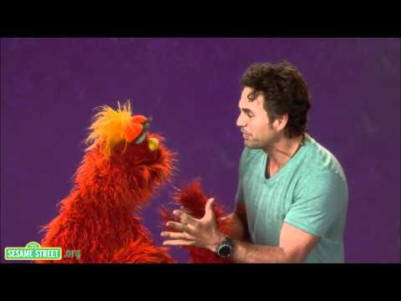
WHAT IS EMPATHY?
Notes:
video link: https://www.youtube.com/watch?v=9_1Rt1R4xbM&t=1s

Slide 17
EMPATHY AND MUSIC?
Music-making uses many key elements for increasing empathy.
Educators can utilize music relating to the theme of empathy.
Students can compose songs with lyrics related to empathy, kindness, or compassion.

Slide 18
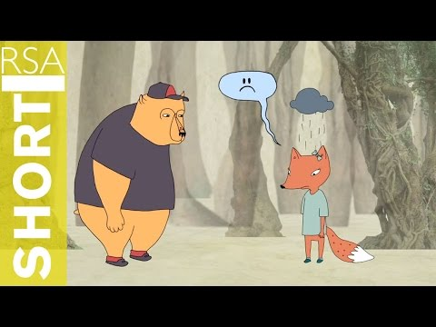
THE FINAL WORD ON EMPATHY
Notes:
video link: https://www.youtube.com/watch?v=1Evwgu369Jw&t=2s

Slide 19

REFLECTION
What about the video stood out to you?
Did you learn anything new from the video?
What challenged or reinforced the definition of empathy you shared at the start of this section?

Slide 20
ELEMENTS OF MUSIC
BEAT
RHYTHM
TEMPO
PITCH
DYNAMICS
TIMBRE

Slide 22
South Africa
Official Languages of South Africa: Afrikaans, English, Ndebele, Northern Sotho, Sotho, Swazi, Tsonga, Tswana, Venda, Xhosa, Zulu
Notes:
Please add facts relative to other appropriate content standards

Slide 23
GUMBOOT DANCE
Clap - Slap of the Boot - Stomp
(4 times)
Slide - Slap of the Boot - Stomp
(4 times)

Slide 24
Music Around Us
Lullaby
Sporting Event
Parade

Slide 25
Music in South Africa
Lullaby
Sporting Event
Parade
Notes:
Optional Extension video: https://www.youtube.com/watch?v=NTc7JwKnBD0

Slide 26
ELEMENTS OF MUSIC
BEAT
RHYTHM
TEMPO
PITCH
DYNAMICS
TIMBRE

Slide 28
Creating a Soundscape
Choir Creates a Rainstorm

Slide 29
FINAL REFLECTION
How did you use the elements of music to convey images, feelings, or emotion in your soundscape performance?
What things did you learn about the people and music of South Africa that are similar to your experiences? Different?
What is empathy and why is it important to you?

Slide 30
