Slide 1
Notes:
1. Welcome participants to the session. Introduce yourself and provide some background as to why you are making the presentation (slide 1).

Slide 2
What is in Module 20?
List of Contents
Scripted PowerPoint
Presentation Template
Content Outlines (4)
32 Handouts
Videos of Music instruction: whole and portions
    Kindergarten
    2nd Grade
    5th Grade
Citations
Lesson plan Development

Slide 3
List of Contents
Find the hyperlink marked List of Contents or look at the right hand side of the webpage for all of pieces of this module.
Image source

Slide 4
Scripted PowerPoint
The PowerPoint is scripted to assist in facilitation of the professional development.
The PowerPoint is cross-referenced with the content outlines in which activities and handouts are detailed. It describes precisely how to lead each of the activities.

Slide 5
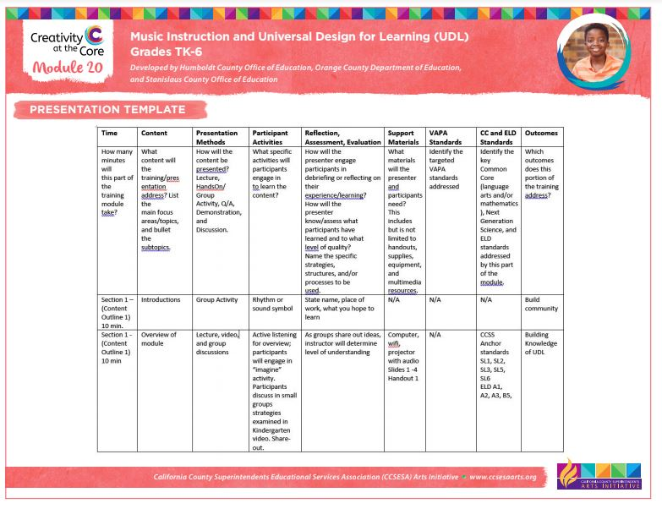
Presentation Template
The Presentation Template is a quick reference guide to standards, activities, handouts, and timing of the professional development.

Slide 6
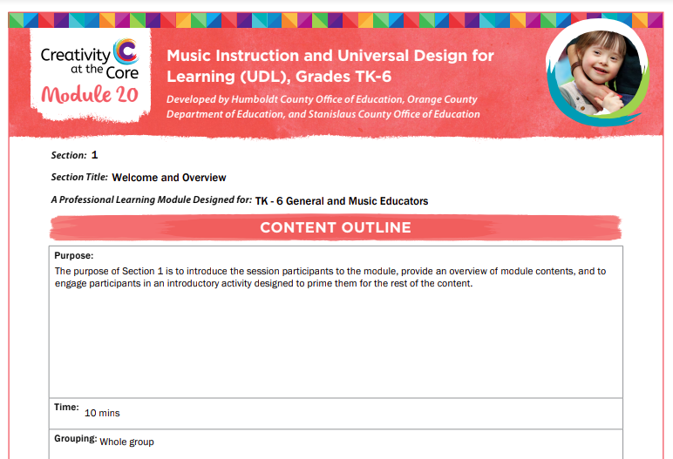
Content Outlines
The four content outlines describe the activities in detail, aligned with PowerPoint slides and handouts.

Slide 7
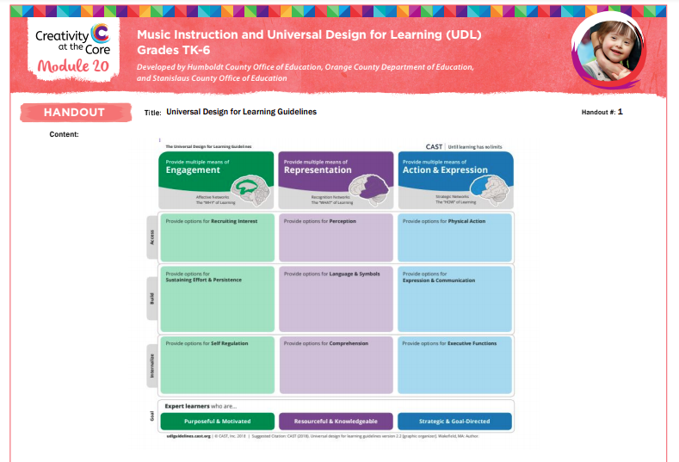
Handouts
The 32 handouts are numbered and listed on the PowerPoint, in the content outlines, and Presentation template.

Slide 8

Videos of Music Instruction
The Videos have been embedded in the PowerPoint, additionally, they are located on the right hand side of the module webpage. They show whole lesson instruction as well as portions. You will want to preview all of the videos to see how it best is used in your professional development.

Slide 9
Citations
Research, Standards, and Contributors are cited in these hyperlinks, found on the right side of the webpage.
Please contact any of the Contributors for more information or clarification.

Slide 10
UDL Music Lessons – Solfege, Rhythm, Perform
General Classroom teachers should group by grade level:
Kindergarten (TK – 1st)
2nd grade (2nd – 4th grades) or
5th grade (5th – 6th grades)
3 breakout rooms necessary for this
Music teachers should do all 3 lessons (triple your Professional Development Schedule)

Slide 11
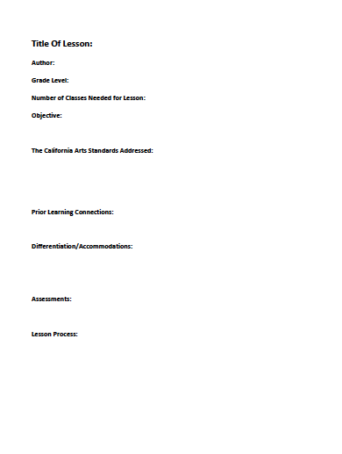
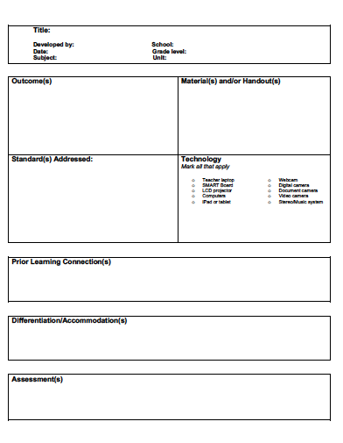
UDL Lesson Templates for Designing Lessons
Notes:
Explain to the participants that there are lots of templates available to write a UDL lesson. Ask them to turn to the UDL templates in their handout. Have them create lessons using UDL strategies. They can be in the arts or in another content area.

Slide 12



Questions?

