Slide 1
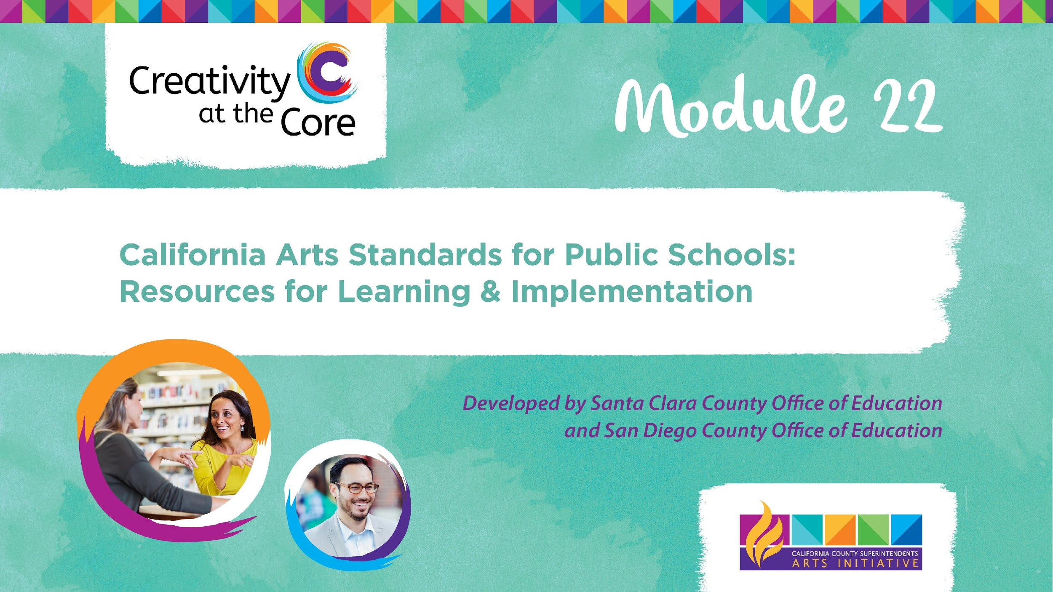

Slide 2
Welcome
&
Introductions
Notes:
Set up tables, chairs, materials. Add presenter names and organizations. Have on the tables: Pens, table boxes, computer, projector, screen, audio connection(add other materials needed here)
Community building

Slide 3
Group Introduction
Who’s in the room?
Name
Role
Location
Favorite Art Form
Notes:
Welcome to this Intro to the CAS
*Introductions - Who’s in the Room? Please share your name, role, location, and one word about the importance of the arts.

Slide 4
Purpose of the Module
This Module will provide educators with an overall understanding of the California Arts Standards structure and purpose as well as the opportunity to do a deep study into one or more arts disciplines.
Notes:
*Setting the stage for the session/day
Understand:
The structure of the California Arts Standards
The purpose of the California Arts Standards
What is new about the California Arts Standards

Slide 5
Overview of Module
You will become familiar with:
The structure of the California Arts Standards
The purpose of the California Arts Standards
What is new about the California Arts Standards

Slide 6
When were the new California Arts Standards adopted?
September 10, 2018
January 9, 2019
February 2, 2019
October 31, 2018
Notes:
Respond to the prompts on the slide with an elbow partner then share your responses with the larger group.

Slide 7
What arts disciplines do the new California Arts Standards cover?
Dance, Music, Theatre, and Visual Art
Dance, Media Arts, Music, Theatre, and Visual Art
Dance, Music, Drama, and Invisible Art
Caricature Drawing, Square Dancing, Musical Chairs and Tableau
Notes:
Respond to the prompts on the slide with an elbow partner then share your responses with the larger group.

Slide 8
What is the official title of the new California Arts Standards?
The California Visual & Performing Arts Standards
The California Arts Standards for Public Schools, Prekindergarten Through Grade Twelve
The 21st Century California Standards for The Arts
National Core Arts Standards
Notes:
Respond to the prompts on the slide with an elbow partner then share your responses with the larger group.

Slide 9
How familiar are you with the new California Arts Standards?
“There are Standards? For the Arts?”
I know they exist, but I’ve not seen them much.
I have read through the standards for my content area.
I feel like I could give this presentation.
Notes:
Respond to the prompts on the slide with an elbow partner then share your responses with the larger group.

Slide 10
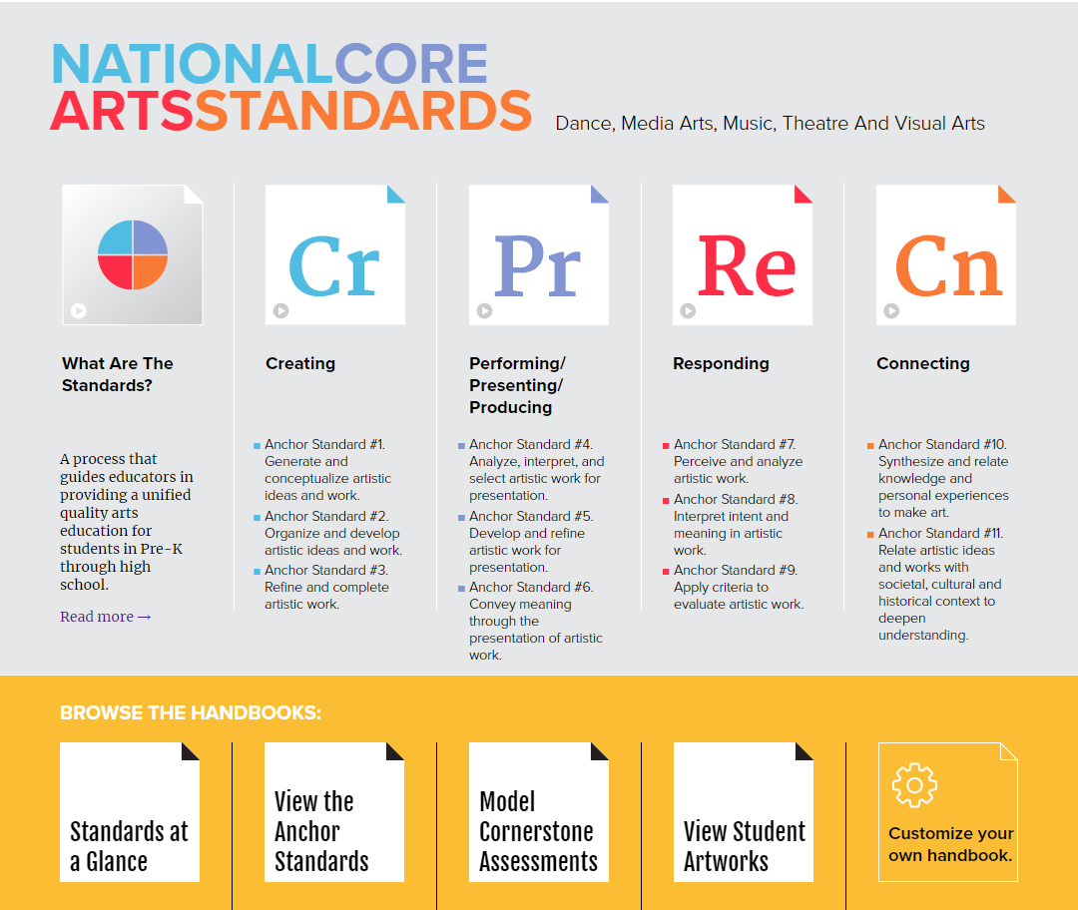
The National Core Arts Standards (NCAS) “shall serve
as the basis for deliberations.”
Notes:
The legislation (AB 2862) that initiated the standards revision specified that the revision must be based on the National Core Arts Standards (EC Section 60605.13). The 2019 California Arts Standards are similar and in some ways identical to the NCAS. The standards were adopted by the State Board of Education on January 9, 2019.

Slide 11
Philosophical Foundations & Lifelong Goals
Means to Wellbeing
Communication
The Arts
as ...
Community Engagement
Creative Personal Realization
Culture, History, & Connectors
Profession
Notes:
The standards are grounded in the National Core Arts Standards (NCAS) vision of artistic literacy - the knowledge and understanding required to participate authentically in the arts. Fluency in the language of the arts is the ability to create, perform/produce/present, respond, and connect through symbolic and metaphoric forms that are unique to the arts. An artistically literate person is able to transfer arts knowledge, skills, and capacities to other subjects, settings, and contexts.

Slide 12
Activity
Philosophical Foundations and Lifelong Goals
Read your card and reflect
Find a group of SIX representing each of the Philosophical Foundations
Share your card and your reflection with the group
Notes:
Use Philosophical Foundations & Lifelong Goals Cards/Manipulatives
CAS are grounded in the NCAS vision of Artistic Literacy
*Jigsaw reading of the 6 Foundations and Goals
*What might learning look and sound like in a classroom where instruction is based on the Foundation and designed to move students toward the Goal?
*Share with an elbow partner
*Whole group share out for each of the 6

Slide 13
Alternate Activity
Philosophical Foundations - A Closer Look
1.Read your philosophical foundation and lifelong goal.
2.Reflect: What might learning look and sound like in a classroom where instruction is based on the foundation and designed to move students towards the goal?
3.Share your thoughts with the group.
Notes:
Use Philosophical Foundations & Lifelong Goals Cards/Manipulatives

Slide 14
Parts of the Arts Standards
1
Artistic Processes (4)
1
2
Anchor Standards (11)
3
Enduring Understandings & Essential Questions
1
4
Process Components (verbs)
5
Performance Standards (discipline specific)
Notes:
Here are the 5 components that make up the Arts standards.

Slide 15
Artistic Processes
1
Cr | Pr | Re | Cn
Creating - Conceiving and developing new artistic ideas and work | Performing - Realizing artistic ideas and work through interpretation and presentation. Presenting - Interpreting and sharing artistic work. Producing - Realizing and presenting artistic idea and work | Responding - Understanding and evaluating how the arts convey meaning. | Connecting - Relating artistic ideas and work with personal meaning and external context.
Notes:
The standards are based on the artistic processes of creating; performing/ producing/presenting; responding; and connecting. These artistic processes are the cognitive and physical actions by which arts learning and making are realized. Each of the arts disciplines incorporates the artistic processes which define and organize the link between the art and the learner.

Slide 16
Anchor Standards
2
Cr Creating | Generate and conceptualize artistic ideas and work. Organize and develop artistic ideas and work. Refine and complete artistic work.
Pr Performing Presenting Producing | Select, analyze and interpret artistic work for presentation. Develop and refine artistic techniques and work for presentation. Convey meaning through the presentation of artistic work.
Re Responding | Perceive and analyze artistic work. Interpret intent and meaning in artistic work. Apply criteria to evaluate artistic work.
Cn Connecting | Synthesize and relate knowledge and personal experiences to make art. Relate artistic ideas and works with societal, cultural and historical context to deepen understanding.
Notes:
Each artistic process branches into either two or three anchor standards. Anchor standards describe the general behaviors, artistic skills and habits of mind that teachers expect students to demonstrate throughout their education in the arts. These anchor standards are parallel across arts disciplines and grade levels and serve as the tangible educational expression of artistic literacy.

Slide 17

Enduring Understandings & Essential Questions
3
Enduring Understandings
Important Ideas
Core Processes
What students should understand
Help make connections
Essential Questions
Guide student inquiry into the Enduring Understandings
Notes:
Enduring understandings and essential questions focus on the big ideas and important understandings in arts education. Essential questions and enduring understandings work together to support an inquiry-based approach to arts education, an approach emphasized in college and career ready standards across all the content areas.
Enduring understandings are statements summarizing important ideas and core processes that are central to a discipline and have lasting value beyond the classroom. They synthesize what students should come to understand as a result of studying a particular content area. Moreover, they articulate what students should value about the content area over the course of their lifetimes. Enduring understandings also enable students to make connections to other disciplines beyond the arts. A true grasp of an enduring understanding is demonstrated by the student’s ability to explain, interpret, analyze, apply, and evaluate its core elements.
Essential questions guide students’ inquiry into these enduring understandings. Reflecting differences in traditions and instructional practices between the arts, the specific enduring understandings and essential questions addressed by their standards also vary.

Slide 18
Enduring Understanding Example
Creating - Anchor Standard 1: Generate and conceptualize artistic ideas and work
Dance | Media Arts | Music | Theatre | Visual Arts
Choreographers use a variety of sources as inspiration and transform concepts and ideas into movement for artistic expression. | Media arts ideas, works, and processes are shaped by the imagination, creative processes, and by experiences, both within and outside of the arts. | The creative ideas, concepts, and feelings that influence musicians’ work emerge from a variety of sources. | Theatre artists rely on intuition, curiosity, and critical inquiry. | Creativity and innovative thinking are essential life skills that can be developed.
Notes:
Here are samples for Creating Standard 1 in each of the arts disciplines.

Slide 19

Process Components
4
Process component verbs describe the actions artist-learners do to complete a task in each grade-by-grade sequence of the content area standards.
Notes:
Process components are the actions (expressed through verbs such as imagine, plan and make, evaluate, refine, present) that artists carry out as they complete each artistic process. These process components accompany clusters of performance standards. Students’ ability to carry out these actions empowers them to engage in the artistic process independently.

Slide 20
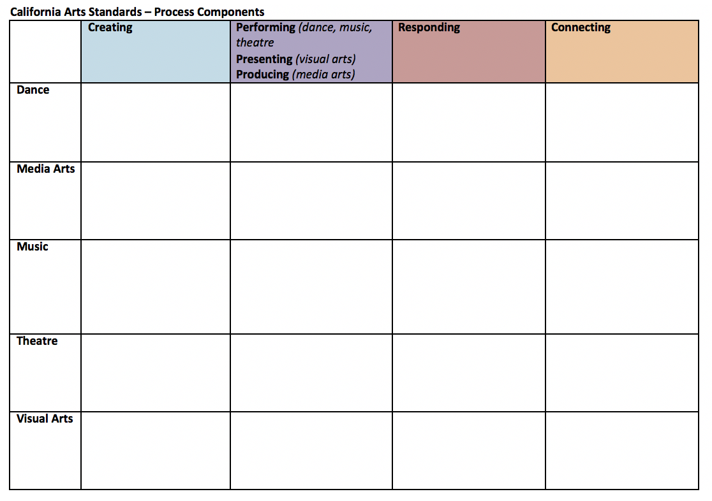
Process Component Verbs
Complete this Chart
Notes:
*Artistic Process Components
*Give each participant a copy of the blank process component chart
*Ask the group to fill in the chart with the process component verbs
*What similarities do you notice across the 5 disciplines? Differences?
*Discuss findings

Slide 21
Process Component Verbs
CREATING
Dance | Explore Plan Revise
Media Arts | Conceive Develop Construct
Music | Imagine Plan & Make Evaluate & Refine Present
Theatre | Envision Conceptualize Develop Rehearse
Visual Arts | Imagine, Plan & Make Investigate Reflect, Refine & Revise
Notes:
What similarities do you notice across the 5 disciplines? Differences?

Slide 22
Process Component Verbs
PERFORMING (dance, music, theatre) PRESENTING (visual arts) PRODUCING (media arts)
Dance | Express Embody Present
Media Arts | Integrate Practice
Music | Select, Analyze Interpret Rehearse, Evaluate & Refine Present
Theatre | Select Prepare Share Present
Visual Arts | Select, Analyze Prepare Present
Notes:
What similarities do you notice across the 5 disciplines? Differences?

Slide 23
Process Component Verbs
RESPONDING
Dance | Analyze Interpret Critique
Media Arts | Perceive Interpret Evaluate
Music | Select Analyze Interpret Evaluate
Theatre | Reflect Interpret Evaluate
Visual Arts | Perceive Perceive, Analyze Interpret Evaluate
Notes:
What similarities do you notice across the 5 disciplines? Differences?

Slide 24
Process Component Verbs
CONNECTING
Dance | Synthesize Relate
Media Arts | Synthesize Relate
Music | Synthesize Relate
Theatre | Empathize Interrelate Research
Visual Arts | Synthesize Relate
Notes:
What similarities do you notice across the 5 disciplines? Differences?

Slide 25





FIVE Artistic Disciplines
Dance | Media Arts | Music | Theatre | Visual Arts
Notes:
*Performance standards are the substantive portion of the California Arts Standards.
*They are discipline-specific (dance, media arts, music, theatre, visual arts), grade-by-grade articulations of student achievement in the arts PK–8 and at three proficiency levels in high school (Proficient, Accomplished, and Advanced).

Slide 26
Performance Standards
5
Proficient | Accomplished | Advanced
A level of achievement attainable by most students who complete a high- school level course in the arts (or equivalent) beyond the foundation of quality PK–8 instruction. | A level of achievement attainable by most students who complete a rigorous sequence of high-school level courses (or equivalent) beyond the Proficient level. | Achievement at this level is indisputably rigorous and substantially expands students’ knowledge, skills, and understandings beyond the expectations articulated for Accomplished level.
Notes:
The three high school proficiency levels are flexible enough to accommodate varying degrees of achievement by students during high school, including those who explore a wide range of artistic pursuits and experiences, as well as those who build on their PK–8 foundation by pursuing deeper engagement in one arts discipline.
For detailed description, refer to page 10 of the Arts Standards Introduction Chapter.

Slide 27
Performance Standards - MUSIC 🎵
5
FIVE Variety of Music Courses
Added Levels
PK-8
Technology (HS)
Composition and Theory (HS)
Ensembles
Harmonizing Instruments
In addition to the High School levels of
Proficient
Accomplished
Advanced
Music Adds
Novice: fifth-grade level
Intermediate: eighth-grade level
Notes:
Ensembles and Harmonizing Instruments encompass five proficiency levels and are used by elementary, middle, and high schools. There are an added two preparatory strands.

Slide 28
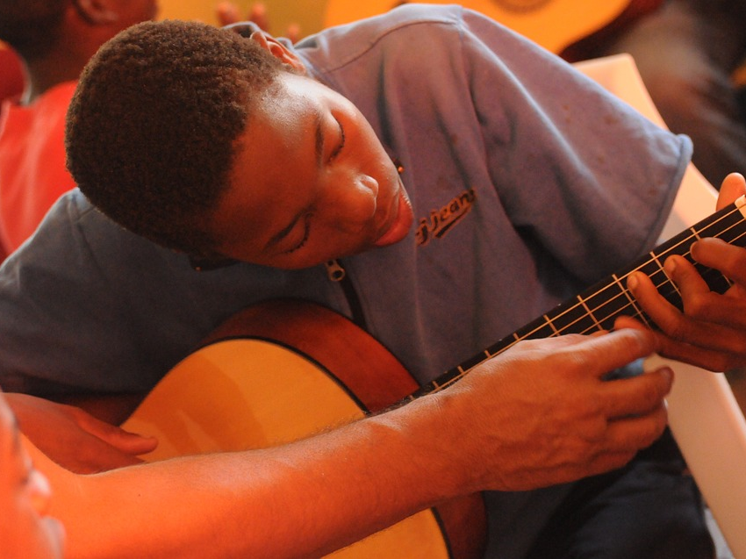
Considerations for Music
Considerations for Music:
FIVE subsets of Standards
PK–8
Composition and Theory
Technology
Harmonizing Instruments*
Ensembles*
  * additional levels of: Novice & Intermediate
Notes:
*Special considerations for Music:
5 different courses
Addition of Novice and Intermediate levels

Slide 29
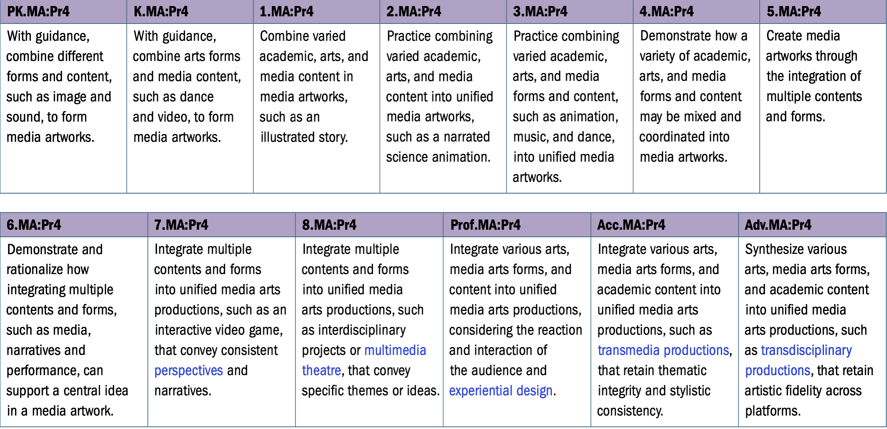
Performance Standards
5
Media Arts: Producing -
Anchor Standard 4
Notes:
Performance standards are the substantive portion of the California Arts Standards. They are discipline-specific (dance, media arts, music, theatre, visual arts), grade-by-grade articulations of student achievement in the arts PK–8 and at three proficiency levels in high school (Proficient, Accomplished, and Advanced). The performance standards translate the anchor standards, enduring understandings, and essential questions into measurable learning goals by describing more specifically what students should know and be able to do in each arts discipline by the end of a school year or course.
Here is an example from Media Arts

Slide 30
Coding of the Standards
The sub-part of the performance standard (a)
The discipline (theatre)
5.TH:Cr2.a
The grade level (five)
The artistic process (creating)
The anchor standard (two)
Notes:
*Coding of the Standards: This is a description of each part of the coding of the standards.

Slide 31
Similarities & Differences
Parts | Dance | Media Arts | Music | Theatre | Visual Arts
4 Artistic Processes | Creating, Performing, Responding, Connecting | Creating, Producing, Responding, Connecting | Creating, Performing, Responding, Connecting | Creating, Performing, Responding, Connecting | Creating, Presenting, Responding, Connecting
11 Anchor Standards | Same for all | Same for all | Same for all | Same for all | Same for all
EUs & EQs | Different for each | Different for each | Different for each | Different for each | Different for each
Process Components | Different for each | Different for each | Different for each | Different for each | Different for each
Performance Standards | Different for each | Different for each | Different for each | Different for each | Different for each
Notes:
This has been a helpful visual for many…
*Shared Artistic Processes
*11 Anchor Standards
*Performance Standards
*Similarities and Differences

Slide 32
Questions?
Notes:
What questions do you have so far? Please write each response on a sticky note (in person) or on the padlet: https://padlet.com/
You’ll need to create an account and sign in to use this feature.

Slide 33
Arts Lesson
Developing Literacy in the Arts:
discovering the expressive elements
understanding the basic concepts
knowing the terminology that is used for comprehension
developing the skills necessary to produce a work of art
being able to reflect, critique, and connect personal experience to the work of art
Arts Texts
Performance (live or archived)
Music or lab notation
Lighting plot, stage notes, music scores
Critique or reviews
Artistic statements
Interviews
Biographies
Informational text about the aesthetics and historical or cultural context of the art work

Slide 34
Arts Lesson
Discussion:
Select one question from the following list to focus on while you are viewing the text
Take notes to enable you to participate in a conversation about your response to the text

Slide 35
Arts Lesson
Discussion Questions:
How does the artist generate creative ideas and make creative decisions?
How is deeper meaning of the work made by personally connecting it to: social, historical, or cultural contexts, connection to the genre, interests or personal worldview?
What does the artist want the audience to know, believe, do or experience? What is their purpose?
What sources or experiences were the inspiration for the work?

Slide 36
Arts Lesson
Experience a Text
Music videos: https://www.youtube.com/watch?v=mDZG-BM3AoI
https://www.youtube.com/watch?v=V5T46f-YNAA
Dance videos: https://www.youtube.com/watch?v=PqJ1KI9Eawc
Theater videos: https://www.youtube.com/watch?v=IL316wKu5ho and
https://www.youtube.com/watch?v=FQ-viSPMR0A
Visual Arts: https://bit.ly/2zw4utD
Media Arts: : https://bit.ly/3g8mABM and https://bit.ly/3g9sQcv
Notes:
You may insert a particular performance you curate or add links of the performances in the Annotated Agenda here.

Slide 37
Arts Lesson
Discuss the Text
Please share the discussion question you selected and why you chose it.
Please share your response to the question.

Slide 38
BREAK
Notes:
Insert an image of your choice here.

Slide 39
What’s New
Arts Standards
Media Arts added as the 5th arts discipline
Inquiry based and connections to other content areas
Emphasis on process
Accessible standards
Notes:
*Name changed to the Arts standards (previously the VAPA standards)
*Media Arts added as the 5th arts discipline
*Inquiry
*Process emphasis
*UDL “Open”

Slide 40
What’s New
Inquiry based and connections to other content areas
What elements of Inquiry existed in the Literacy lesson?
What opportunities exist to add elements of Inquiry into the Literacy lesson?
Notes:
The Literacy lesson provided an opportunity for inquiry rather than direct instruction and it provided the opportunity to connect with other content areas.

Slide 41
What’s New
Emphasis on process
How could the process of learning from the Literacy lesson be demonstrated?
What challenges exist in demonstrating the learning process rather than a final product? Discuss for each of the 5 arts disciplines.
Notes:
Emphasis on Process AND Product
refer to page 2-3 for language, if needed
What’s new?
1.Process emphasis—Create component may be more challenging for some disciplines.
How could the process of learning from the Literacy lesson be demonstrated?
What challenges exist in demonstrating the learning process rather than a final product? Discuss for each of the 5 arts disciplines.

Slide 42
What’s New
Accessible standards
Notes:
UDL

Slide 43
What’s New
What is UDL?
“Universal Design for Learning (UDL) is a research-based framework for improving student learning experiences and outcomes through careful instructional planning focused on the varied needs of all students, including students with disabilities, advanced and gifted learners, and English learners. The principles of UDL emphasize providing multiple means of representation, action and expression, and engagement and options for various cognitive, communicative, physical, meta-cognitive, and other means of participating in learning and assessment tasks. ”
- CAS Introduction, page 19
Notes:
UDL: What is UDL?
Ask volunteer(s) to read the paragraph from CAS Intro, page 19
*What stands out to you?
*What questions do you have?

Slide 44
What’s New
UDL is an approach that is:
Essential for Some, Good for All
https://www.youtube.com/watch?v=pGLTJw0GSxk
Notes:
What is UDL?
Share the David Rose video
UDL Guidelines
Handout copy of UDL Guidelines
Refer back to the Literacy lesson from earlier.
*What guidelines did you observe during the lesson?
*Which guidelines were not addressed?
*What opportunities exist to include additional guidelines in the lesson in the future?
Look at the Artistic Processes and Anchor Standards alongside the UDL Guidelines
*What connections do you see between the 2 documents?

Slide 45
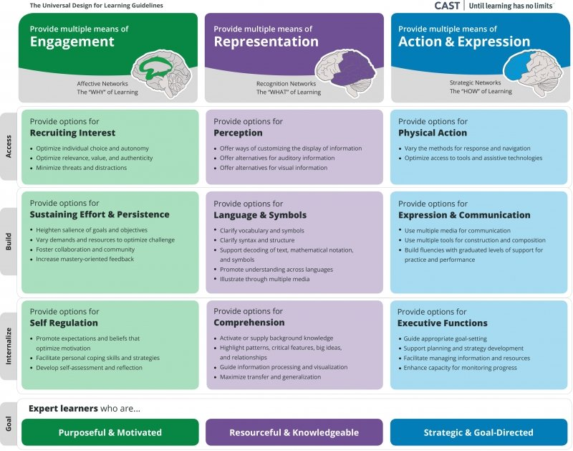
What’s New
Universal Design for Learning Guidelines

Slide 46
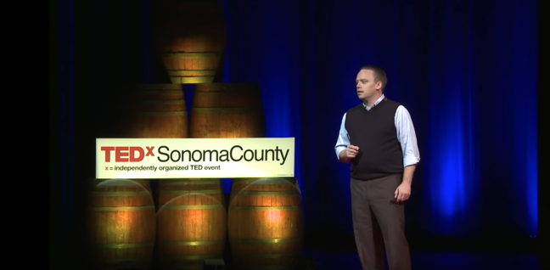
What’s New
The Myth of Average: Todd Rose
Notes:
-5:36 (part of 18 minute talk)
https://www.youtube.com/watch?v=4eBmyttcfU4&feature=youtu.be&t=23
The Myth of Average
View the video
Discuss the Myth of Average in partners and as a whole group

Slide 47
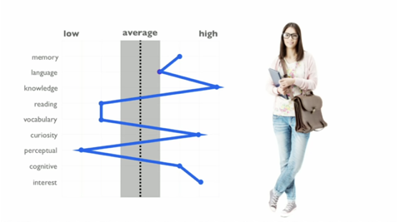

What’s New
Myth of Average in Education
Notes:
Show this while participants are viewing the video if in person.

Slide 48

What’s New

Slide 49
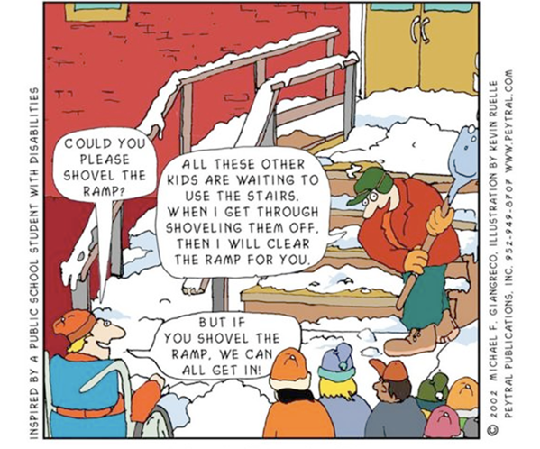
What’s New

Slide 50

What’s New
Copernican Shift
Notes:
Motion of Sun (yellow), Earth (blue), and Mars (red) according to heliocentrism (left) and to geocentrism (right), before the Copernican Revolution. Note the retrograde motion of Mars on the right.
(To create a smooth animation, Mars' period of revolution is depicted as exactly 2 years instead of 1.88. The orbits are depicted as circular in the heliocentric case.)

Slide 51
What’s New
Copernican Shift
“When students encounter difficulty, the curriculum – not the learner – is assumed to be inadequate to meet the varied and diverse needs of learners. This replaces the old practice of jumping to label learners as ‘disabled’ or ‘challenged’ when they encounter difficulty with a curriculum that offers limited paths to success.”
Universal Design for Learning: Theory and Practice by Anne Meyer, David H. Rose, and David Gordon
Notes:
“Copernican Shift
1530 Polish Astronomer Nicolaus Copernicus finished drafting his theory that the sun, rather than the earth, stood at the center of the universe.” (UDL page 127)
“When students encounter difficulty, the curriculum – not the learner – is assumed to be inadequate to meet the varied and diverse needs of learners. This replaces the old practice of jumping to label learners as ‘disabled’ or ‘challenged’ when they encounter difficulty with a curriculum that offers limited paths to success.” (UDL 129)

Slide 52
What’s New
California Education Code Section 33080,
Purpose of the Educational System
“Each child is a unique person, with unique needs, and the purpose of the education system of this state is to enable each child to develop all of his or her own potential.”

Slide 53

Activity #1
CAS Scavenger Hunt
In discipline-based groups,
Examine the standards.
Locate parts 1-5.
Identify patterns in the standards.
Share 3-5 insights with your colleagues.
Notes:
Divide participants into groups representing the 5 different arts disciplines
Examine the standards.
Locate the 5 parts (artistic processes, anchor standards, enduring understandings and essential questions, process components, performance standards)
Identify patterns in the standards. Put up next slide (Parts of Standards) for participants to refer to. Do this activity when participants have a copy of the standards to refer to physically or digitally. Chart and share 3-5 insights from your discipline group.

Slide 54
Parts of the Arts Standards
1
Artistic Processes (4)
1
2
Anchor Standards (11)
3
Enduring Understandings & Essential Questions
1
4
Process Components (verbs)
5
Performance Standards (discipline specific)
Notes:
For CAS Scavenger Hunt activity on Slide #39

Slide 55

Activity #2
Creative Share-Out
In discipline-based groups,
Create a collaborative art piece in your discipline that shares insights and patterns.
Present to your peers through a 1 minute theater, dance, music, media, or visual art piece.
Share analysis in 1 minute for your peers on how your art piece used the new standards.
1 minute Q & A from audience.
Notes:
Teaching artist version
Work with your discipline group to create a collaborative art piece in your discipline that shares your insights and patterns.
Present to the whole group through a one minute dance, media arts, music, theatre, or visual art piece.
Share an analysis in one minute for your peers on how your art piece used the new standards.
The whole group can ask questions for one minute.

Slide 56
Activity #3
Creating Your Own Lesson Plans
Now that you have an understanding of the new California Arts Standards, create two (2) lessons in one of the five arts content areas - music, dance, theater, visual arts, or media arts. Incorporate the new standards and use the Universal Design for Learning Guidelines for designing and delivering that instruction.

Slide 57
What’s Next?
What actions can you take to build awareness around the new arts standards?
What actions can you take to implement the new arts standards?
Notes:
Ask participants to determine what actions they can take to build awareness around the new CAS
Chart ideas as a group
Gallery Walk or padlet

Slide 58
Reflection
What are you most excited about from the work today?
What questions do you have?
What support are you looking for to allow you to effectively implement the standards?
Notes:
Participants complete the reflection form

Slide 59

Closing Slide

