Slide 1
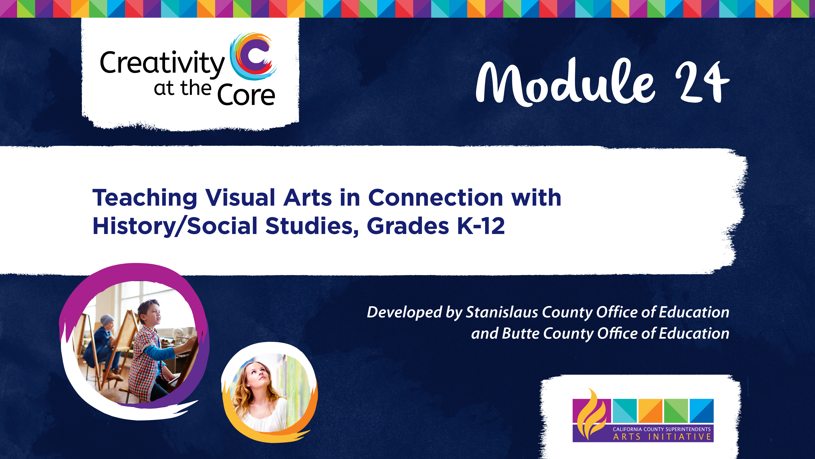

Slide 2
Welcome
Welcome to Module 24: Integrating History/Social Science and Visual Arts
Designed to enhance both the quality of Visual Arts and History/Social Science learning, this module provides a model for integrating Visual Arts and History Social Science, and provides six integrated units that meet the rigor of Visual Art and History/Social Science standards.

Slide 3
Module Outcomes
The primary outcome for Module 24 is to encourage Visual Art educators, History Social/Science educators, general classroom educators, administrators, and professional development facilitators to integrate History/Social Science, and by extension other academic subjects, through the creation of six Visual Art and History/Social Science integrated units of study.

Slide 4
A Teaching Partnership: Visual Art and History/Social Science
It’s a Great Fit Because….
History should not serve as a mere background to a work of art – “something which is essentially absent from the work of art and its production, but which occasionally makes an appearance” – but “Artists respond to the values and ideas of the artistic community, which in turn are altered by change in the general values and ideas of society, which in turn are determined by historical conditions.”
– T.J.Clark, Art Historian
Notes:
T.J. Clark Image of the People, pp. 9-21.

Slide 5
A Teaching Partnership: Visual Art and History/Social Science
It’s a Great Fit Because….
“A piece of art can provide a window into a historical time period for students.”
- Ron Litz, How to Use Art to Teach History
“Having students engage with, use, and create art (in any form) provides a concrete way for students to connect to social studies content and concepts in innovative, creative, and purposive ways. This integration creates context when there was none, generates relevance when students could not find any, and constructs connections out of the disconnected.”
Joyce H. Burstein and Greg Knotts
Integrating Art and History:
A Model for the Middle School Classroom
Notes:
https://www.socialstudies.org/system/files/publications/articles/yl_230120.pdf
https://www.edutopia.org/article/how-use-art-teach-history

Slide 6
Materials Needed
The materials and supplies needed for this module vary according to each part of the module. At the beginning of each module presentation there is a list of materials to complete that part of the module and/or integrated unit.

Slide 7
Module Users
Module 24 was designed for:
Visual Arts Teachers
History/Social Science Teachers
General Education Teachers
Administrators
Professional Development Facilitators

Slide 8
Module Users
For the individual teacher, this module provides step by step guidance on lesson planning as well as grade specific model units.
For the administrator, this module demonstrates how the process of integration works and provides exemplary units at a range of grade levels that illustrate the advantages of the integrated approach.
For use as professional development, this module provides all the information and materials need to conduct a full day workshop on the topic.

Slide 9
Module Presentation Chart
Presentation Chart
The module presentation chart provides an overview of this module.
This chart details key content, presentation methods, participant activities, resources and research to be addressed throughout the module.
The presentation chart is located under the Downloads section on the right.

Slide 10
Parts of the Module
This module is divided into seven parts. The first part provides a model for integrating Visual Art and History/Social Science. The remaining six parts are models of grade-level aligned units integrating Visual Art and History Social Science.
Part I: Unpacking Visual Art and History/Social Science Integration
Grade 2 Unit - Cityscapes and Landscapes
Grade 3 Unit - Making Civic Monuments Personal
Grade 5 Unit - Native American Ledger Art
Grade 6 Unit - Creating a Memorial Inspired by Hatshepsut
Grade 8 Unit - Documenting Community
Grade 10 Unit - Through the Lens of Ai Weiwei’s Art

Slide 11
Part I: Unpacking Visual Art and History/Social Science Integration
The purpose of this part is to define integration, provide a model of how to integrate Visual Art and History/Social Science, and provide resources for Visual Art and History/Social Science integration.
Handouts for this section include:
  Visual Art and History/Social Science Integration Resources Handout
  Tips for Teaching Visual Art Handout
  Talking to Students About Art Handout

Slide 12
Model Units of Integration
The next six parts of Module 24 are models of grade-level aligned units integrating Visual Art and History/Social Science. Each unit includes a unit overview handout, a unit presentation slide deck, key questions unpacking each subject, skill building activities, and unit assessments. While the units are organized by grade level, most can be modified to fit any grade level.
Grade 2 Unit - Cityscapes and Landscapes
Grade 3 Unit - Making Civic Monuments Personal
Grade 5 Unit - Native American Ledger Art
Grade 6 Unit - Creating a Memorial Inspired by Hatshepsut
Grade 8 Unit - Documenting Community
Grade 10 Unit - Through the Lens of Ai Weiwei’s Art

Slide 13
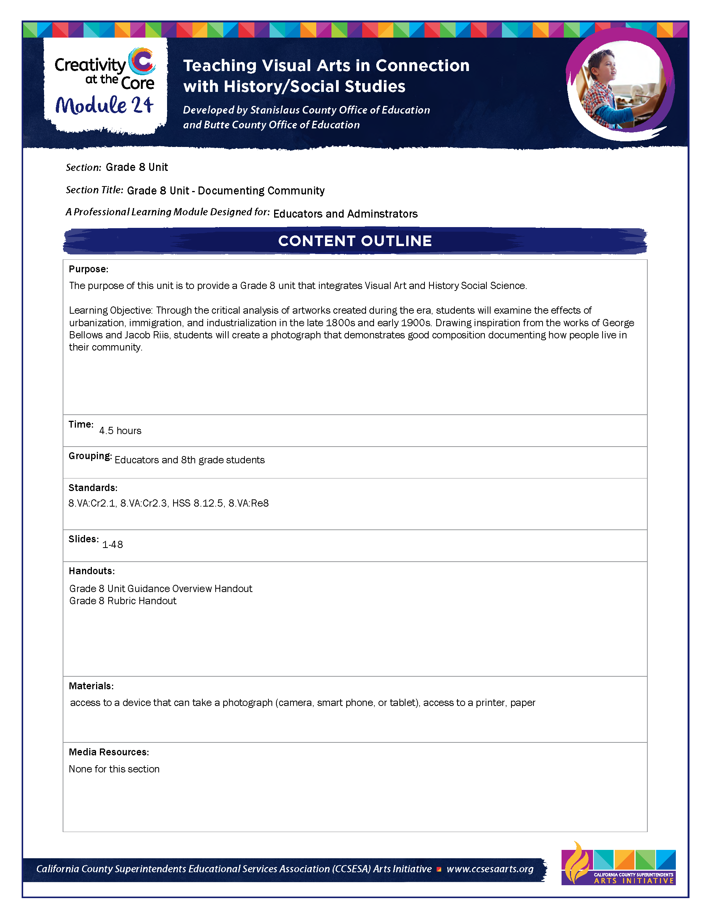
Content Outlines
The Content Outlines detail specific objectives and activities of each section.
The Content Outlines for each part are located under Downloads.

Slide 14
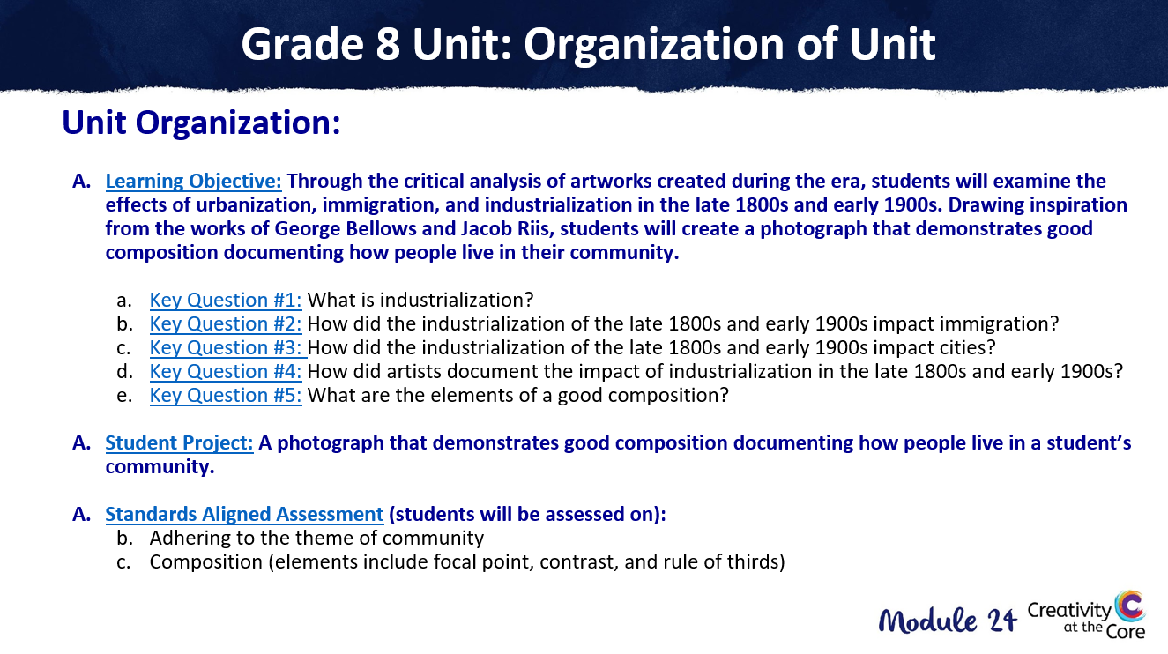
Unit Presentation
Each standards-aligned unit has a Unit Presentation. This is a PowerPoint slide deck that walks educators through each nuanced piece of the unit.
The Unit Presentations for each unit are located under Downloads.

Slide 15
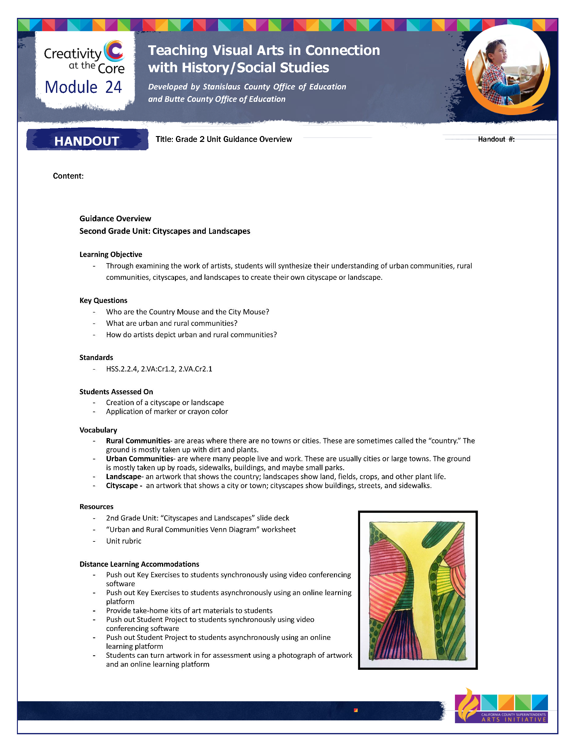
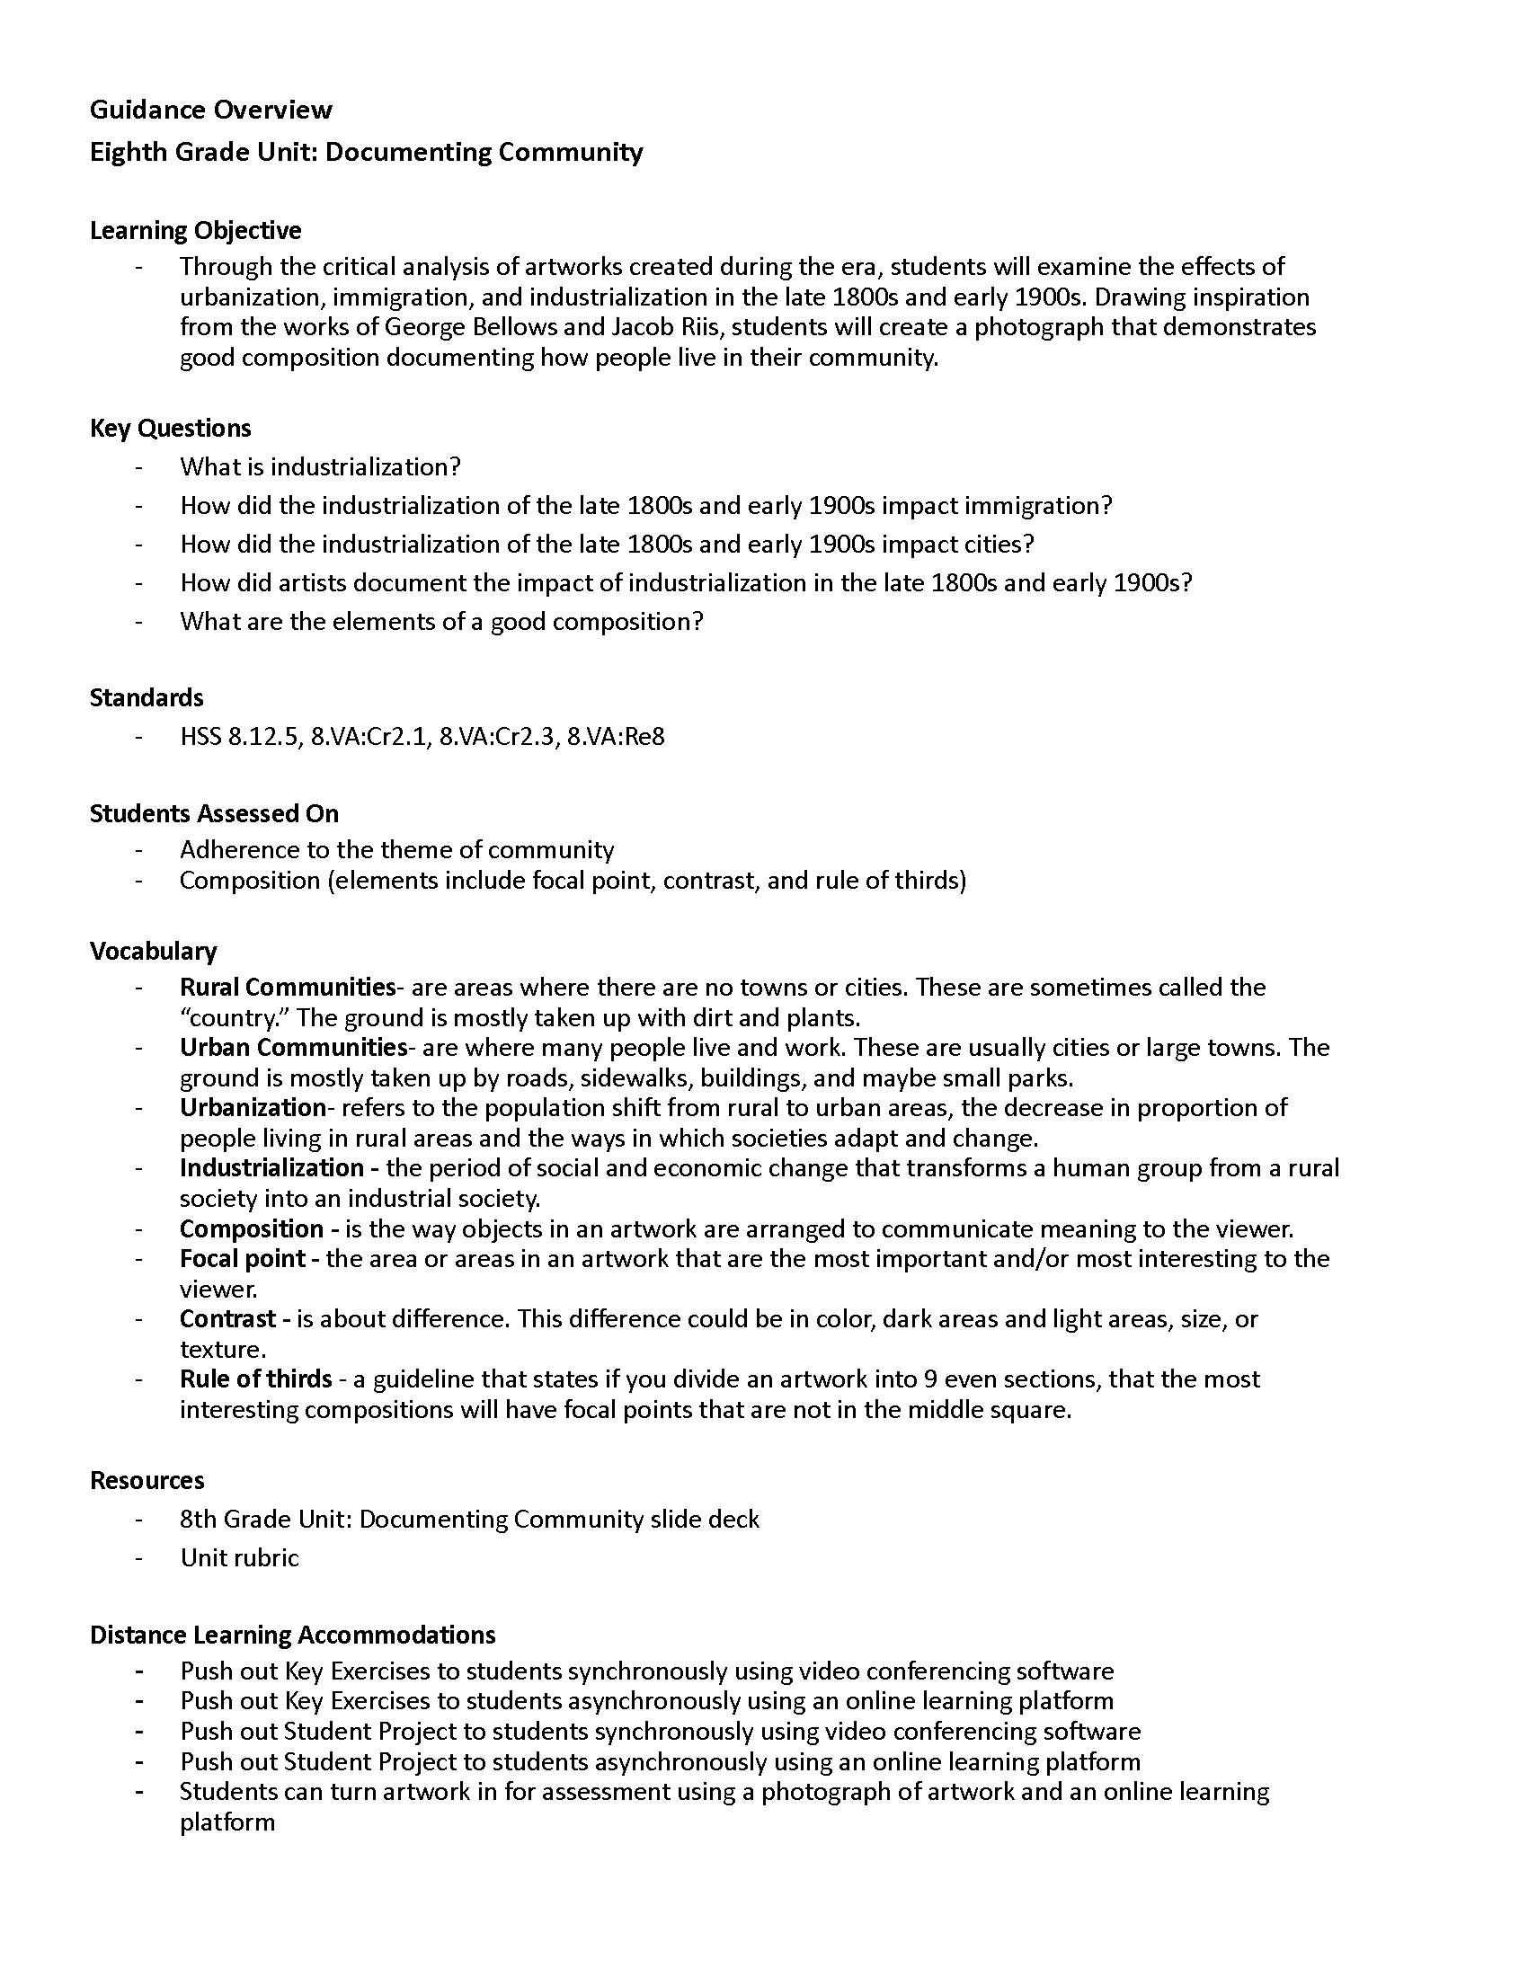
Handouts
Each standards-aligned unit has a Handout Packet. The Handout Packet includes a unit Guidance Overview, unit rubric, and other support materials.
The Handout Packets for each unit are located under Downloads.

Slide 16
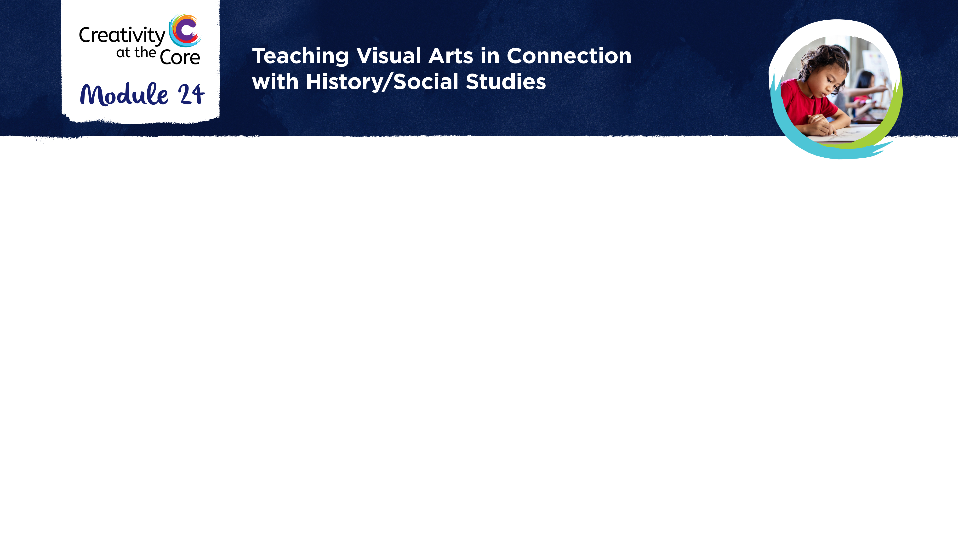
Closing Slide

