Slide 1


Slide 2
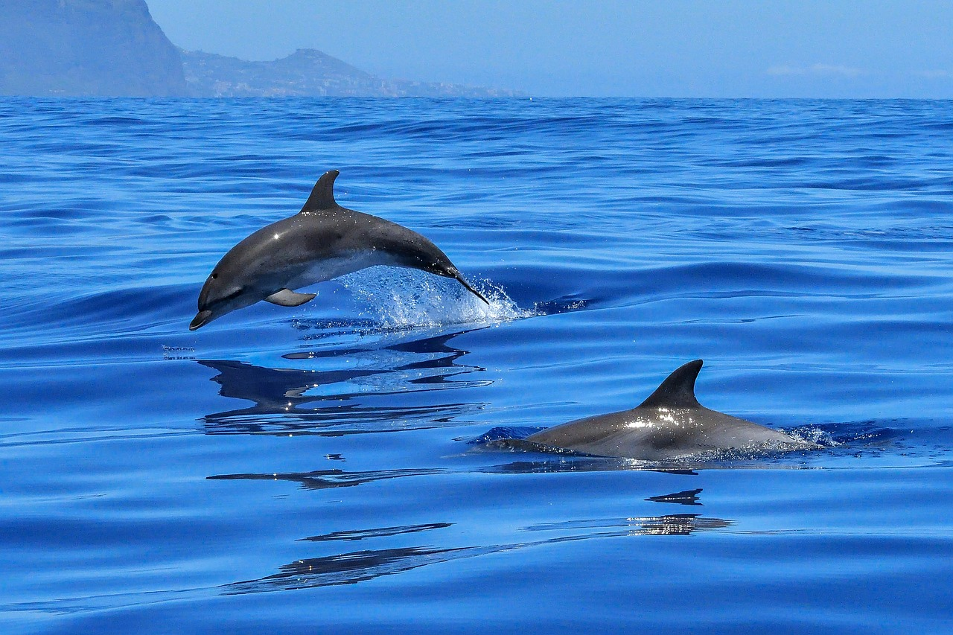
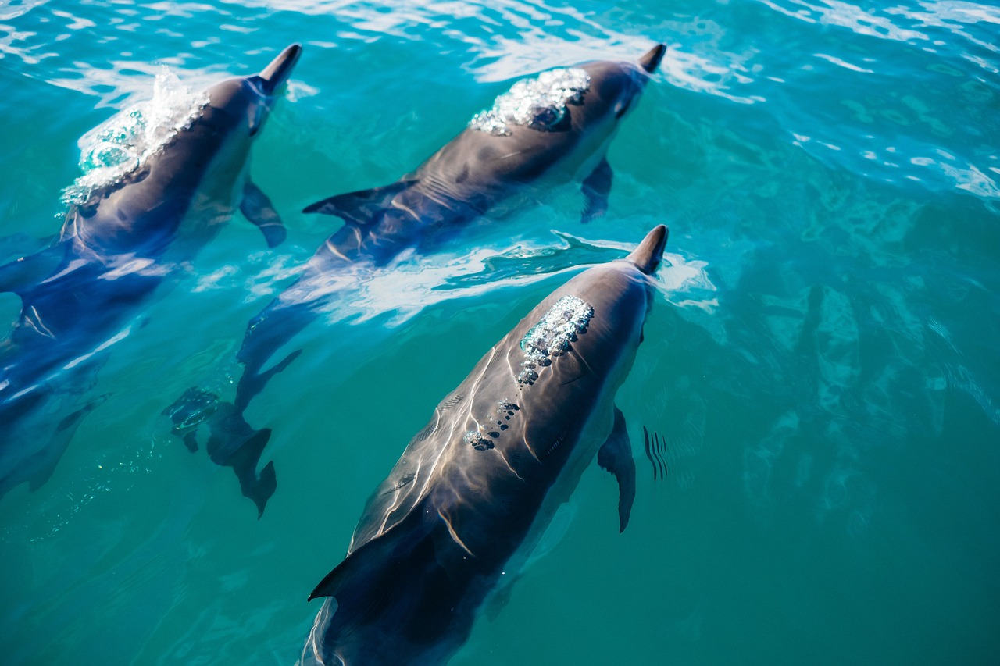
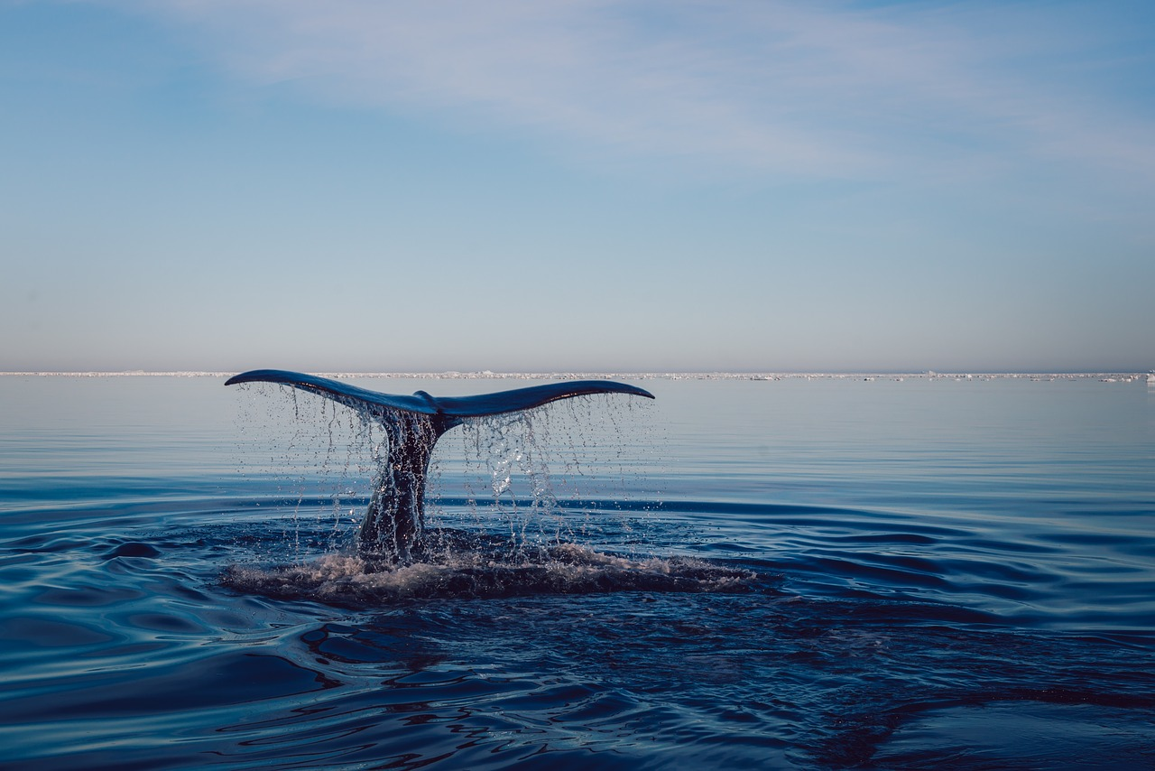
Dolphins Here, There, and Everywhere
By Rima Haroun, Hana Haroun, and Norma H. Gómez-Michel,
San Diego County Office of Education, 2020
Grade 6 | Communication
Designated ELD
Student Handout
Dolphins Poem

Slide 3
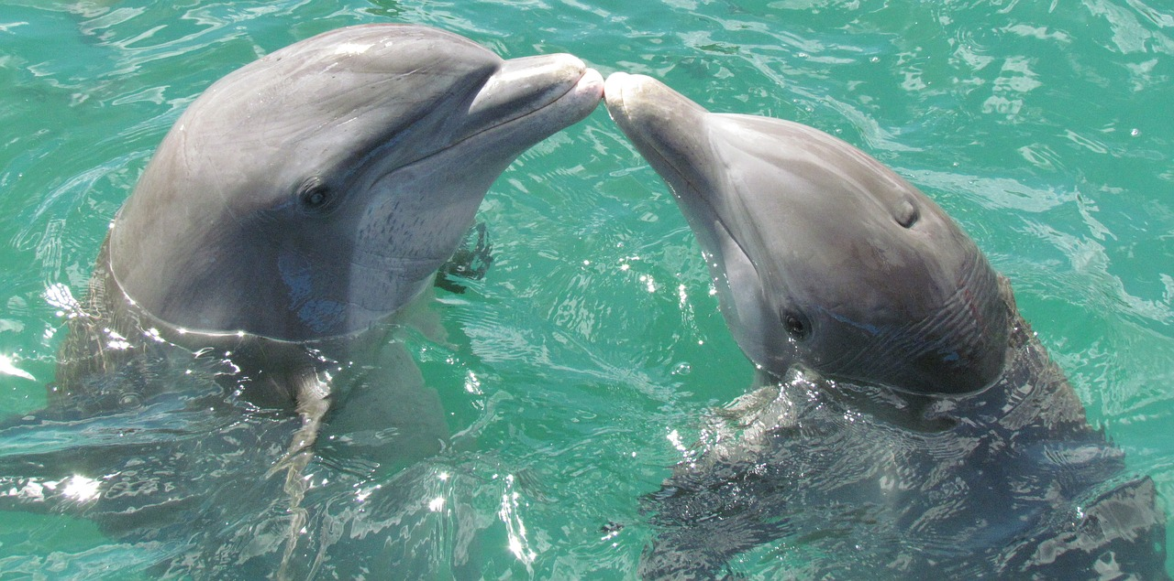
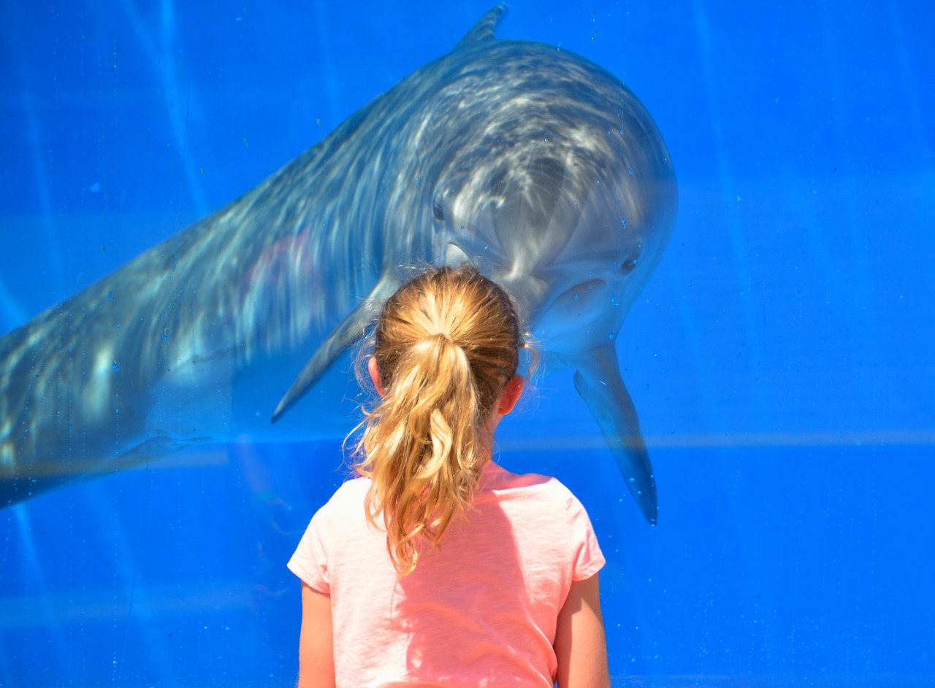
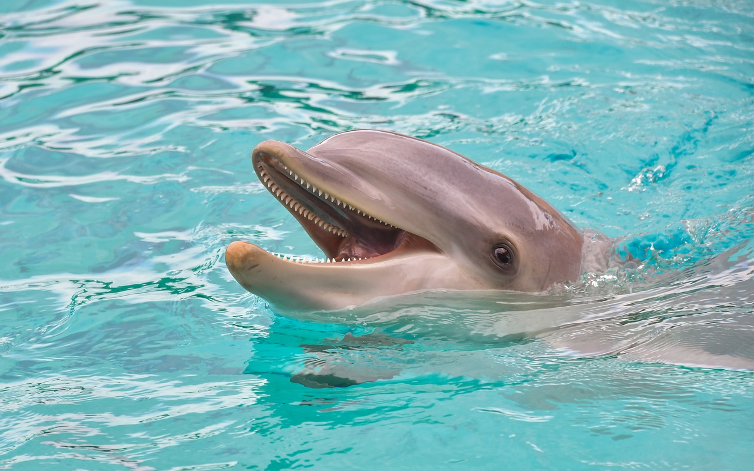
Dolphins here, dolphins there,
Dolphins, dolphins everywhere!
Grade 6 | Communication
Designated ELD
Student Handout
Dolphins Poem

Slide 4
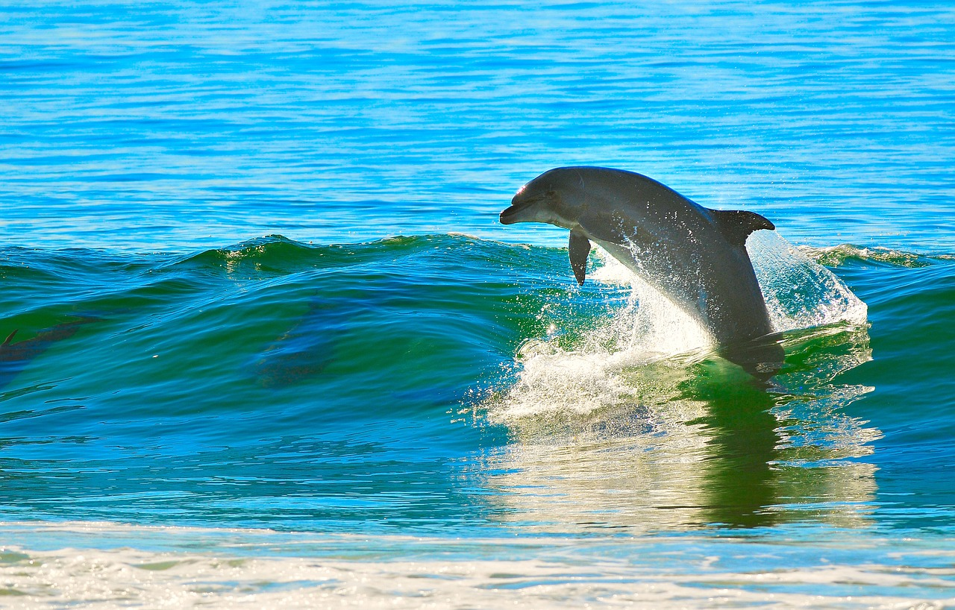
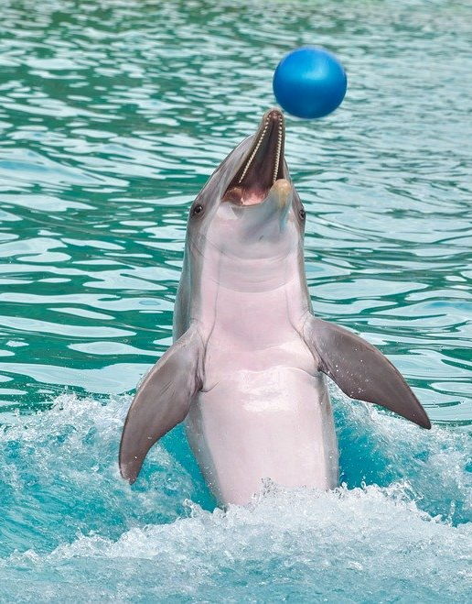
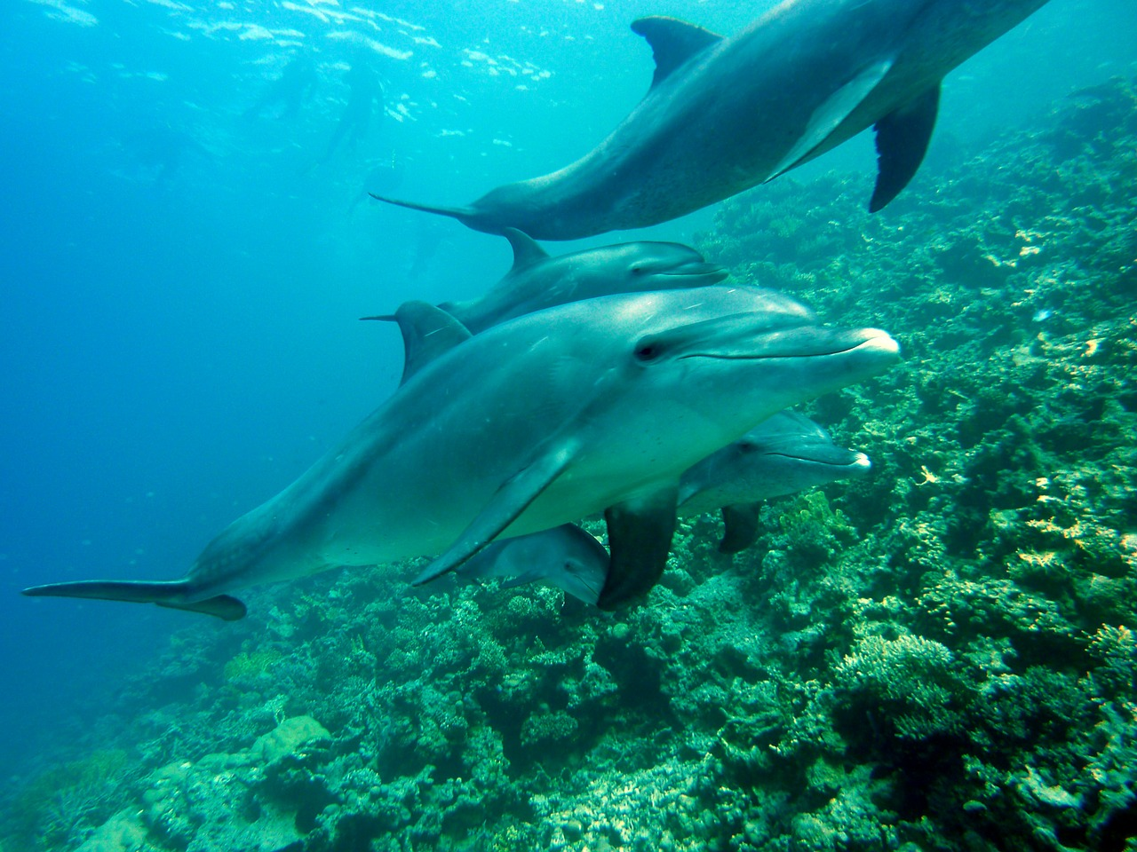
Aquatic dolphins surfing naturally,
Adventurous dolphins playing happily,
Hungry dolphins hunting strategically,
And social dolphins communicating regularly.
Grade 6 | Communication
Designated ELD
Student Handout
Dolphins Poem

Slide 5
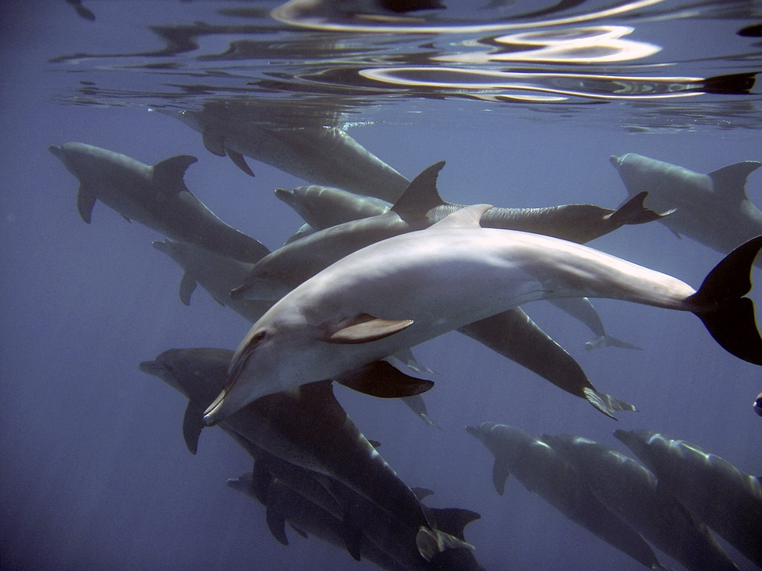
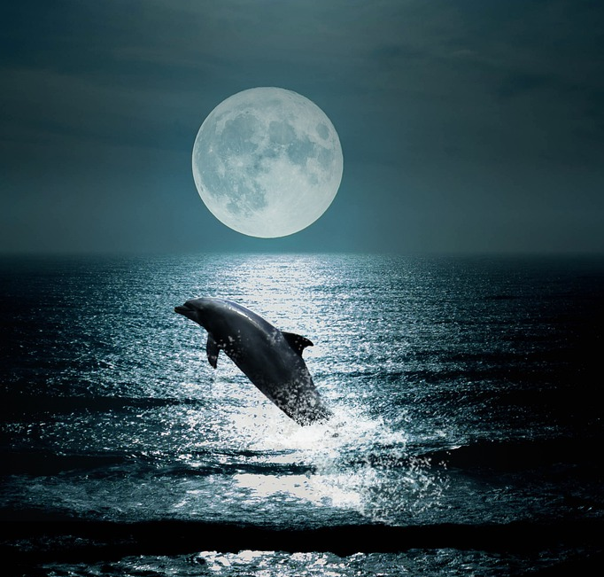
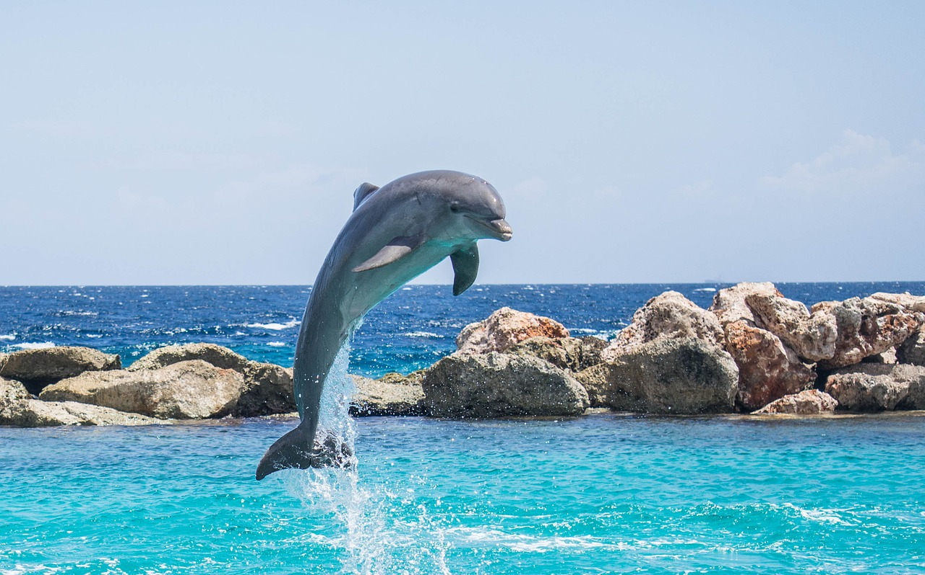
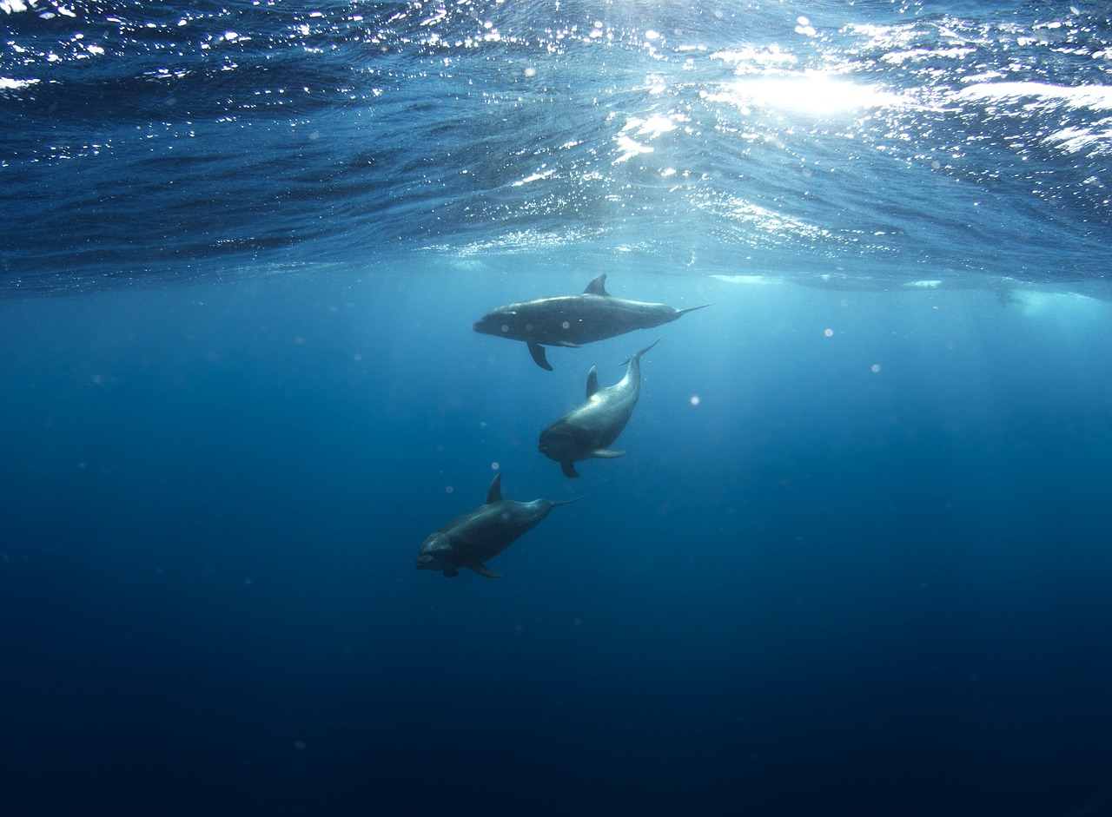
Dolphins with their pod at daybreak,
Dolphins in oceans around the world,
Dolphins in offshore waterways at dusk,
And dolphins below the ocean waves.
Grade 6 | Communication
Designated ELD
Student Handout
Dolphins Poem

Slide 6
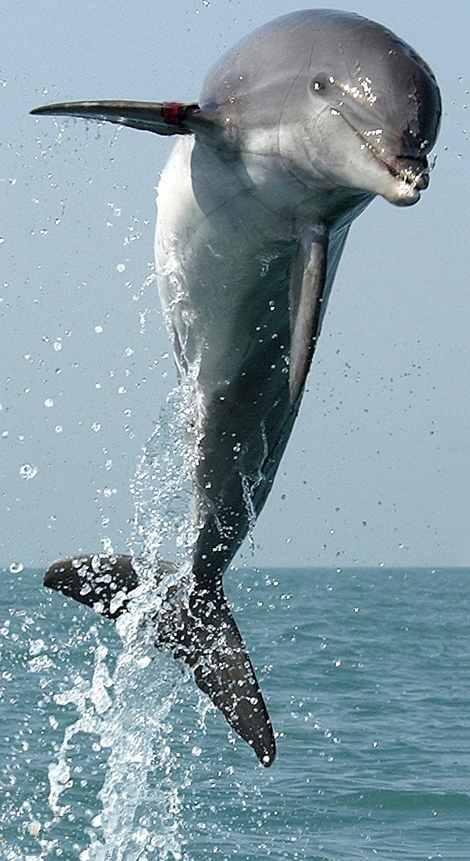
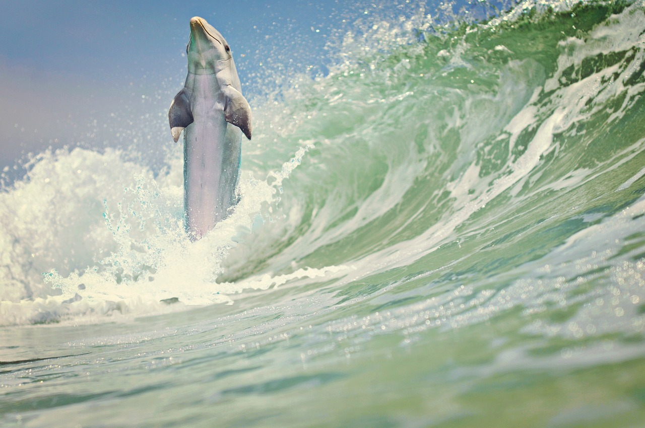
Dolphins here, dolphins there,
Dolphins, dolphins everywhere.
Dolphins! Dolphins! Dolphins!
Grade 6 | Communication
Designated ELD
Student Handout
Dolphins Poem

