Slide 1
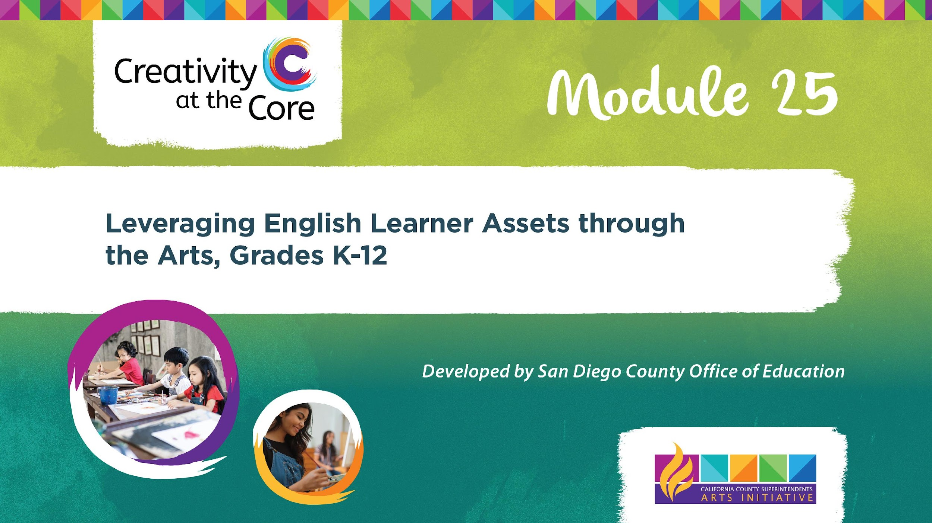

Slide 2
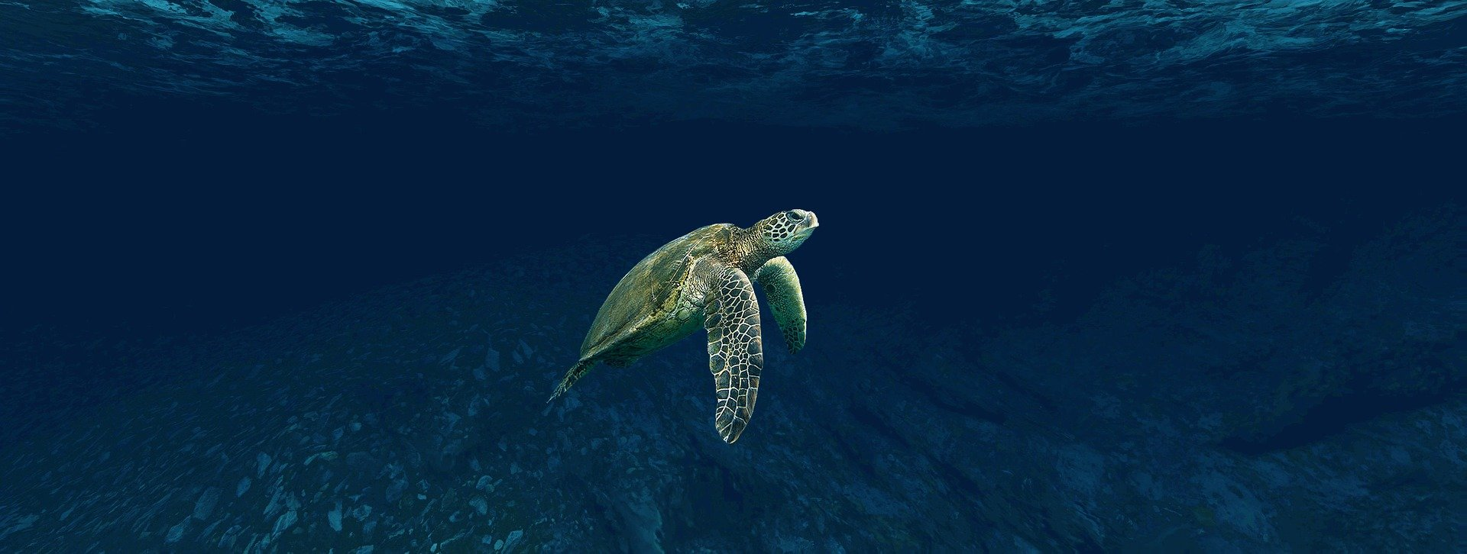
The Turtlers’ Alphabet: A Caymanian Folk Song
Notes:
Image source: Pixabay

Slide 3
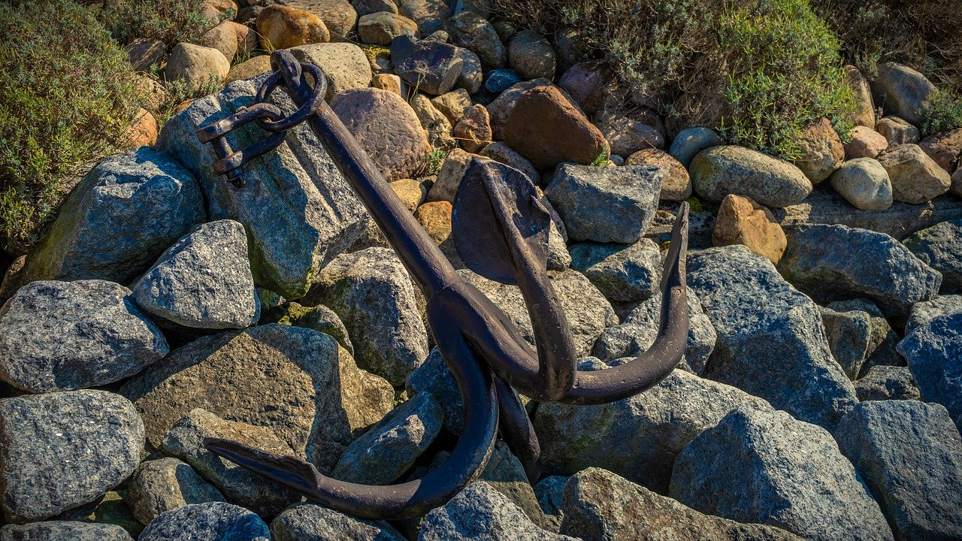
A is for Anchor the Cayman boys weigh
Notes:
Image source: Pixabay

Slide 4
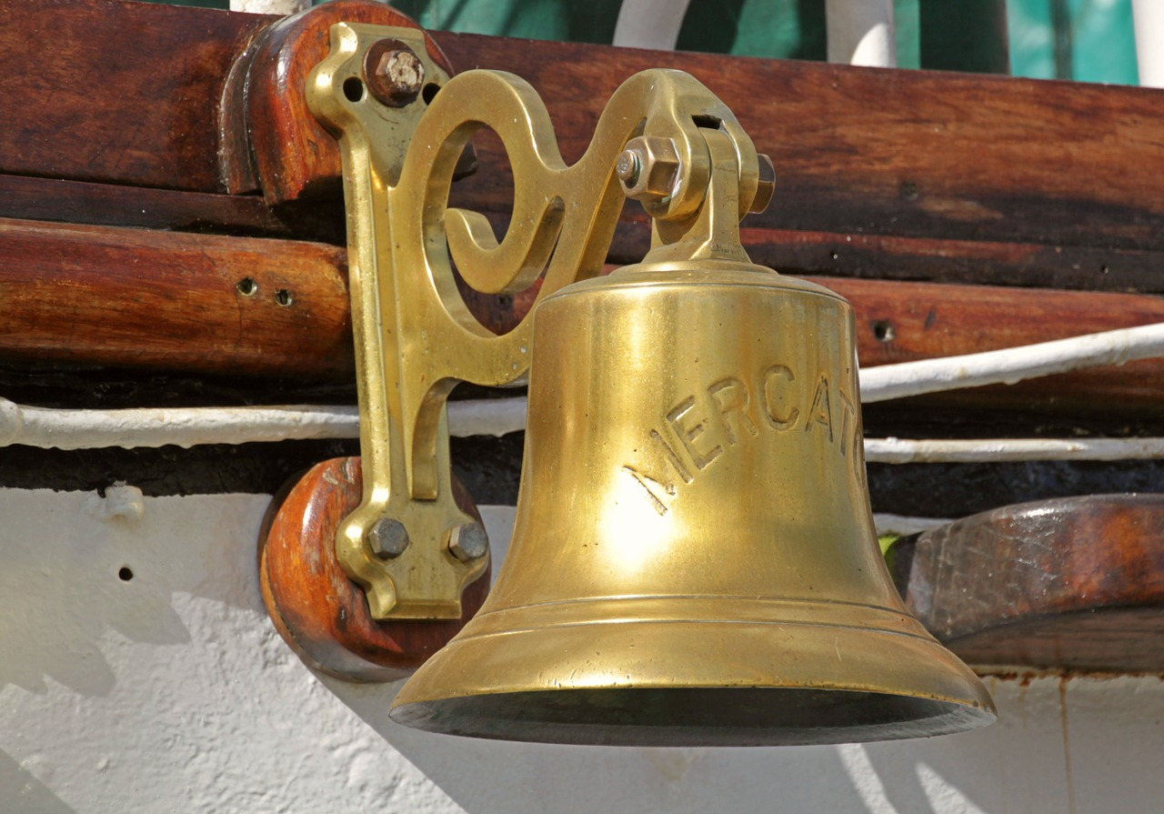
B is for Bobell that steers them away
Notes:
Image source: Pixabay

Slide 5

C is for Compass that always points right
D is for Danger we fear in the night
Notes:
Image source: Pixabay

Slide 6
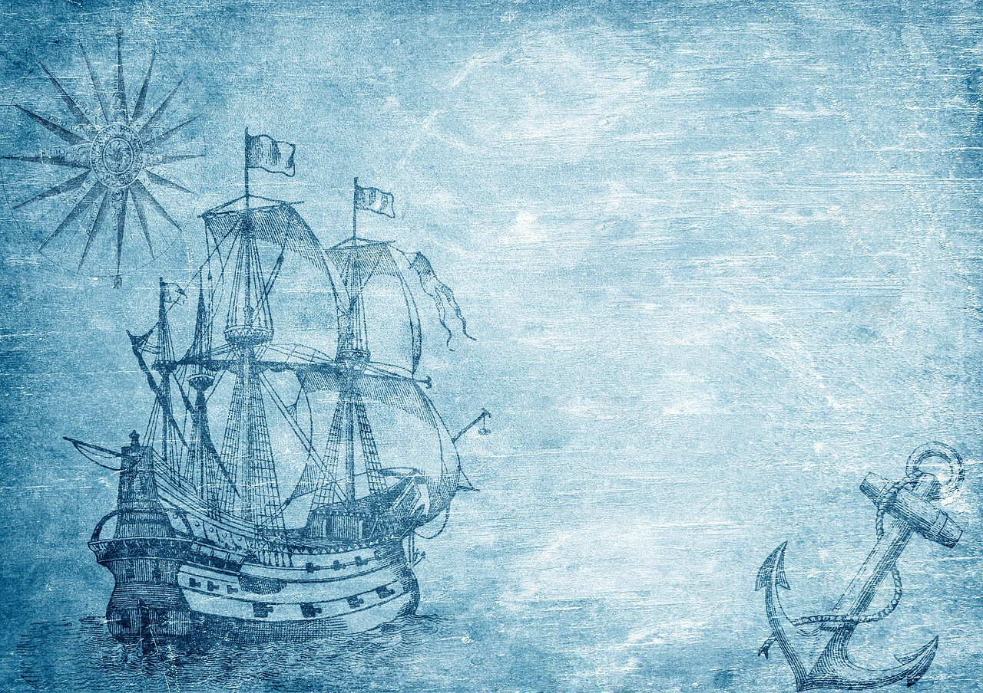
So wet and so tired and hungry are we
There’s no one who suffers like a turtler at sea

Slide 7
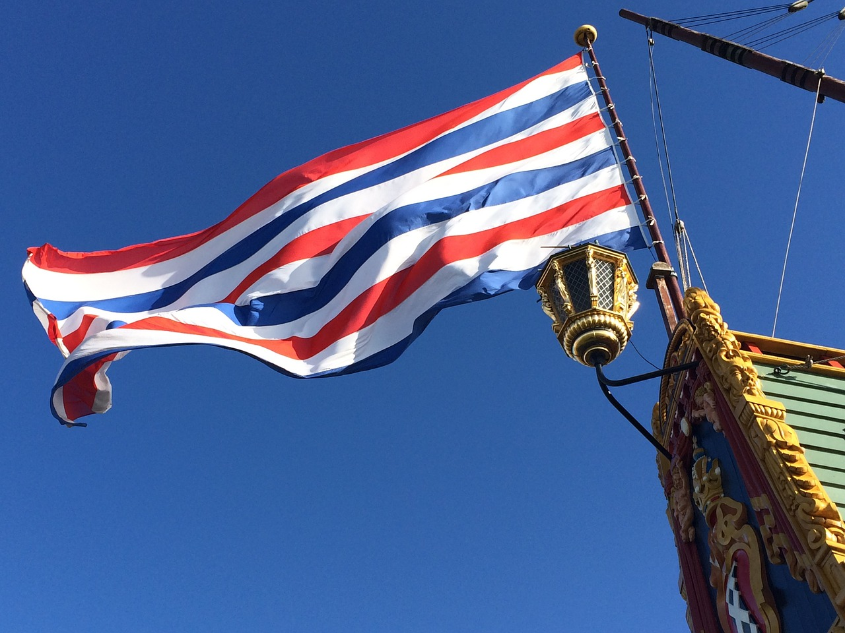
E is for Ensign we always fly high
F is for Farewell that
makes the girls cry
Notes:
Image source: Pixabay

Slide 8
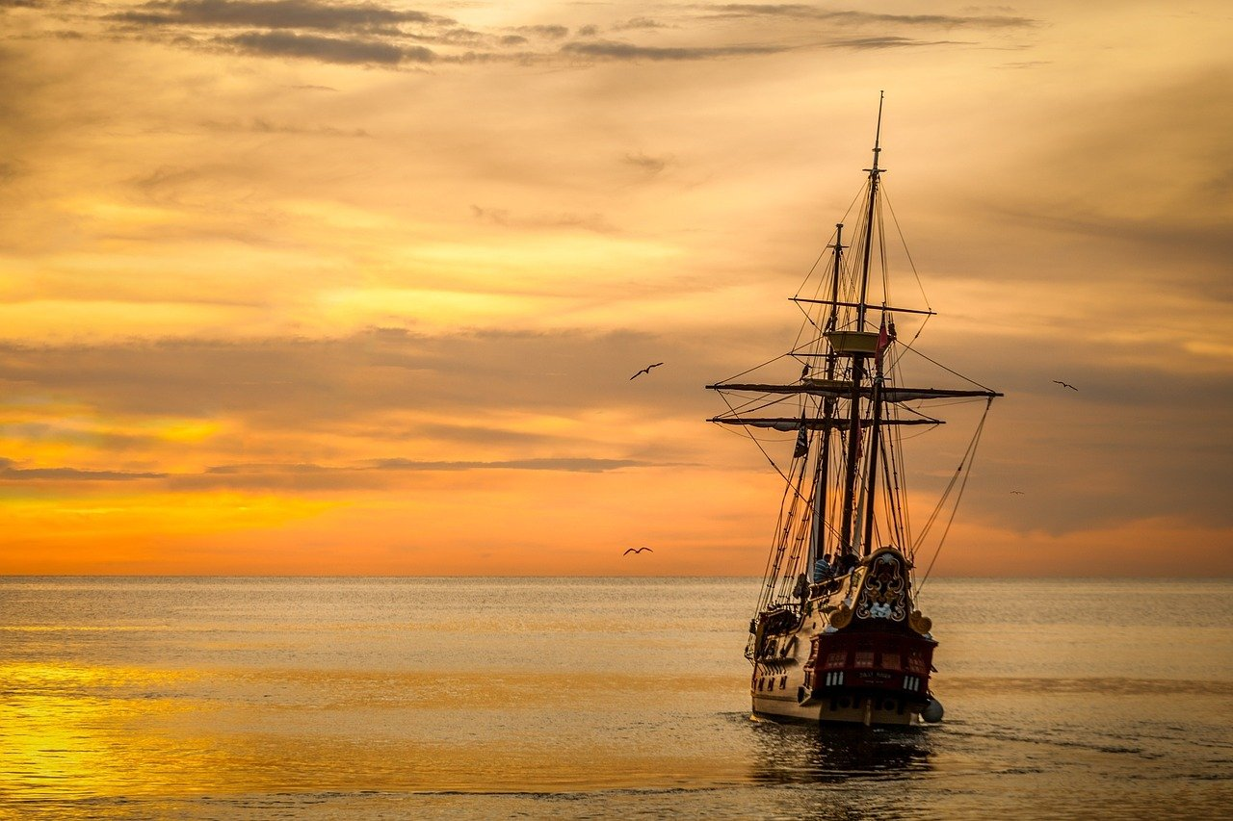
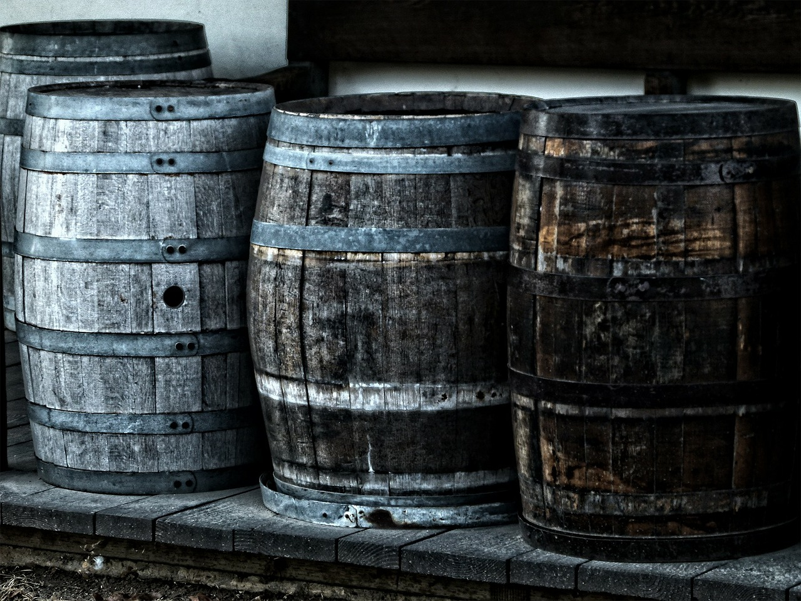
G is for Galley, our breads are secure
Notes:
Image source: Pixabay

Slide 9
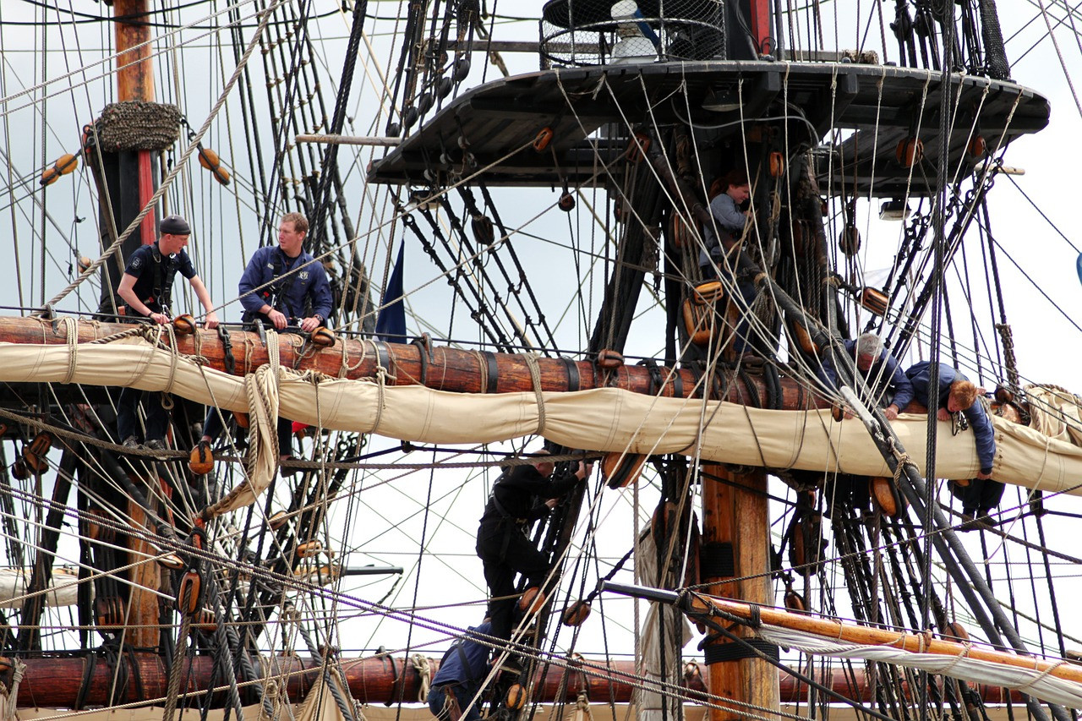
H is for Halyard that makes our hands sore
Notes:
Image source: Pixabay

Slide 10
So wet and so tired and hungry are we
There’s no one who suffers like a turtler at sea

Slide 11

I is for Interest the turtle procure
J is for Judgement we use on our oars
Notes:
Image source: Pixabay

Slide 12
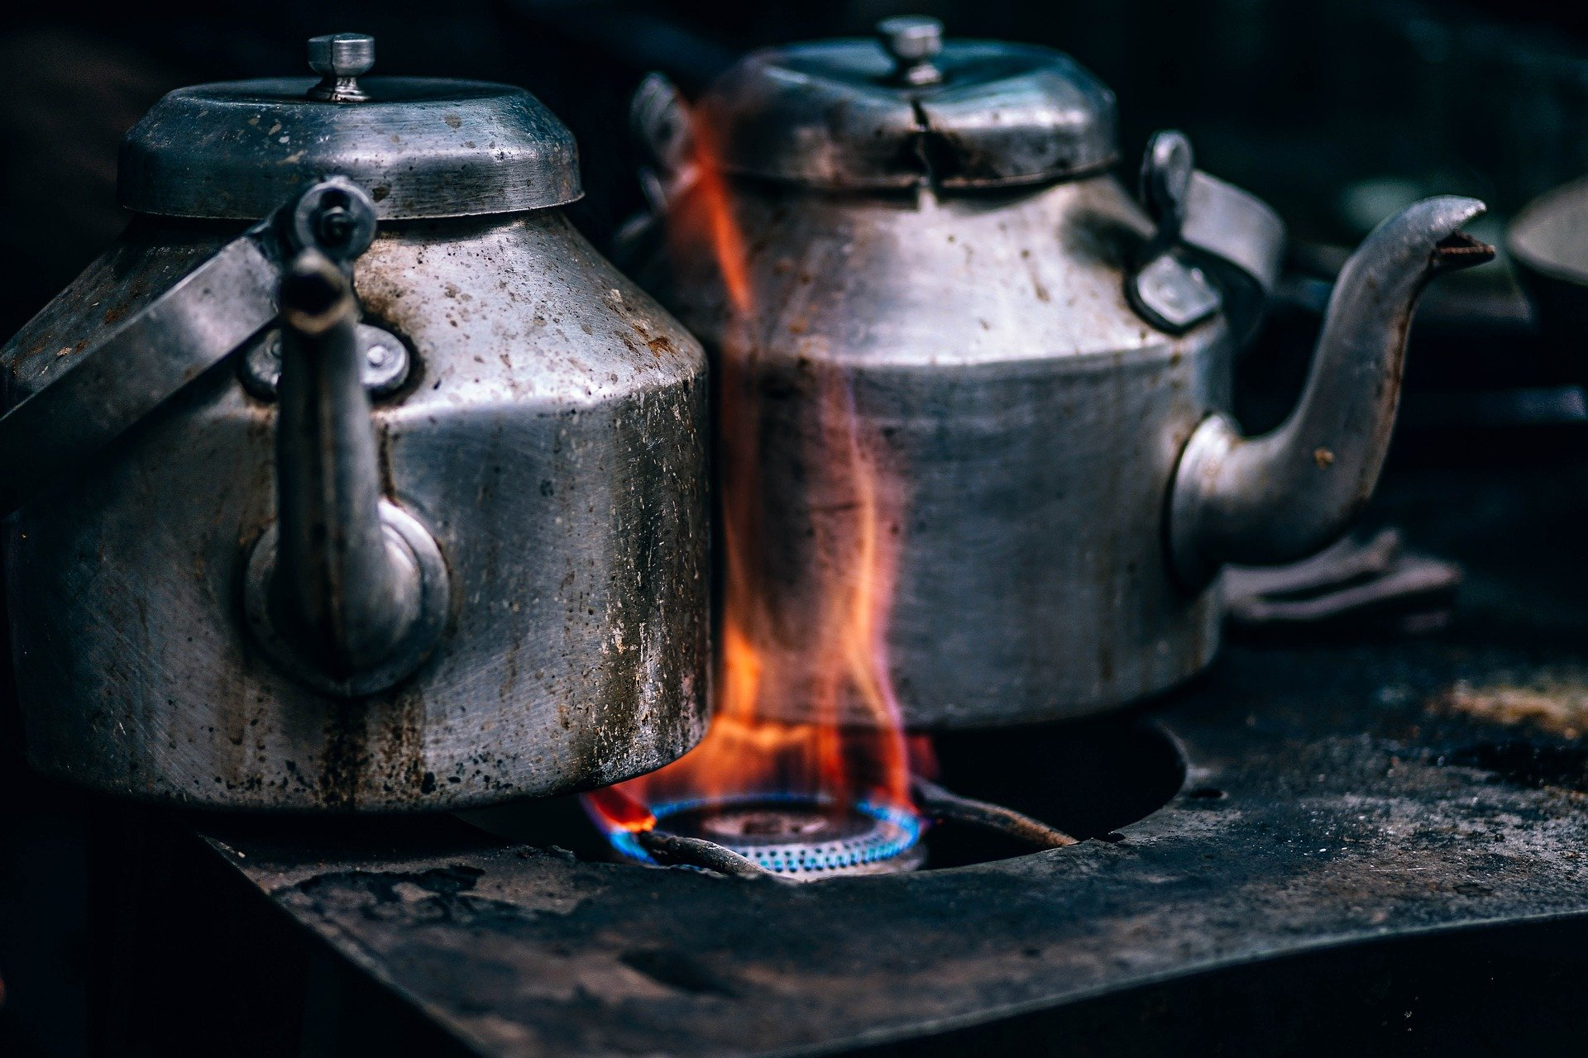
K is for Kettle when we boil our tea
L is for Lookout we keep on our lee.
Notes:
Image source: Pixabay

Slide 13
So wet and so tired and hungry are we
There’s no one who suffers like a turtler at sea

