Slide 1
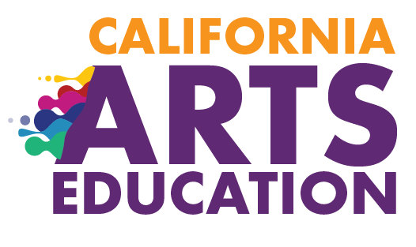



Chapter 9:
Implementing Effective Arts Education
EXCERPT: This excerpt (Slides 14–25) is provided for use with the Informed Decision-Making Inquiry on the California Arts Education Framework Resources for Implementation website located at https://www.calartsedframework.org/. The full slide deck can be accessed at https://www.cde.ca.gov/ci/vp/cf/.
2020 Arts Education Framework for California Public Schools, Transitional Kindergarten Through Grade Twelve
California Department of Education
Tony Thurmond, State Superintendent of Public Instruction
Notes:
Chapter 9: Implementing Effective Arts Education
This presentation deck includes content from chapter 9 of the 2020 Arts Education Framework for California Public Schools, Transitional Kindergarten Through Grade Twelve (Arts Framework).
The content was selected and refined in collaboration with leaders from California County Superintendents Educational Services Association (CCSESA) Statewide Arts Initiative and The California Arts Project (TCAP).
The slides are mostly self-explanatory, but in some places the slide notes contain clarifying talking points, possible reflection questions, or notes that may be useful for anyone facilitating a group.
The presentation deck
is meant to be a resource for educators and education partners to use to guide their reading of the Arts Framework;
is designed to use for self- or group study; and
captures highlights and provides entry points to the chapter, but the slides and the notes are not meant to be exhaustive and represent all content in the chapter.
The slides and notes are not intended to be a substitute for reading the chapter.
The slide notes also reference chapter pages from which the slide content originates.
Educators may download and modify the presentation for personal use.
The content may be used as a base for workshops and presentations.
Please contact the Curriculum Framework and Instructional Resources Division at cfird@cde.ca.gov with any questions about the content or use the presentation deck.

Slide 2
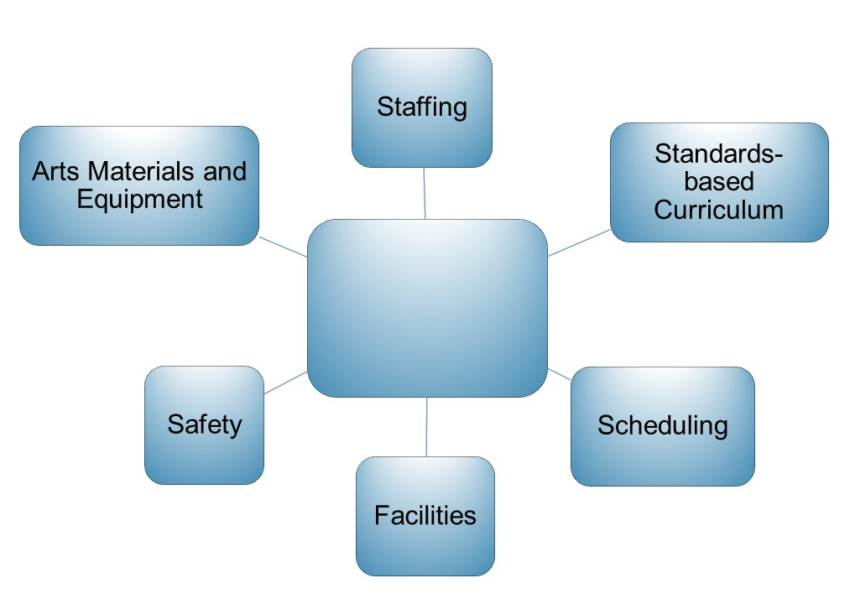

Fundamental Components of Arts Education
Notes:
Fundamental Components of Arts Education
The four national professional arts education associations have each developed Opportunity to Learn Standards (OTLS) related to these components.
These components form the basics of any arts education program.
Using these components to develop and evaluate district plans such as Local Control Accountability Plans (LCAPS) can help improve arts education programs and provide a roadmap to ensure every California student has access to a sequential, standards-based, effective TK–12 arts education.
The next 11 slides provide additional detail on each component.
Additional, discipline-specific discussion is provided in the discipline chapters 3–7.
Chapter Page: 14

Slide 3

STANDARDS-BASED CURRICULUM
Guides Arts Instruction
Curriculum, or course of study, is the content and plan for instruction. It is made up of the instructional resources, methods, and assessments needed to help students develop critical skills and knowledge. Along with high-quality and effective instruction, curriculum is an essential element that enables students to learn and thrive.
See CDE Curriculum web page at https://www.cde.ca.gov/qs/ci/
Notes:
Standards-Based Curriculum Guides Arts Instruction
Effective curriculum articulates the sequence of instruction and student learning expectations for all students.
Teachers, individually or collaboratively, use, develop new, and revise the curriculum and use the principles of Universal Design for Learning (UDL) to design specific classroom units of instruction and assessments that give all students equal opportunities to succeed.
In LEAs that include cross-disciplinary approaches, the curriculum may also provide teachers guidance for integrated instruction that includes the arts.
While the benefits of strategic and well-crafted arts integration are known, integration should not supersede or replace discrete arts education.
Chapter Pages: 16–19

Slide 4
Standards-Based Curriculum
Articulates the Sequence of Instruction and Learning Expectations. It
provides general guidance on diverse student learning needs and suggestions for accommodations and modifications;
attends to the range of novice through advanced learners;
provides a basis for formative and summative classroom assessment; and
is grounded in the appropriate disciplinary pedagogies and methodologies.
Notes:
Standards-based Curriculum
Possible brainstorm and discussion—what are some investigative questions that could help you gather data about the arts curriculum, learning expectations, and assessment in your district?
Chapter Pages: 16–19

Slide 5
SCHEDULING
Considerations for Elementary
  Discrete instruction in each arts discipline builds foundational arts literacy, language, knowledge, and skills.
  Careful scheduling and planning of services ensures students are not missing arts learning time.
  Single-subject teachers may be assigned to work in multiple schools.
Notes:
Scheduling Considerations for Elementary
In elementary, include time for discrete instruction in each arts discipline to build foundational literacy, language, knowledge, and skills.
In districts where it is not possible to add single subject credentialed arts teachers to support multiple subject teachers, professional learning is needed to make arts education equitably accessible to all of California’s students.
Section 60811.8 of the California Education Code prohibits denial to English learners of equal participation in courses that are required to meet state or local graduation requirements and courses required for middle school grade promotion.
See page 18 for a list of additional considerations for administrators when teachers are assigned to more than one school.
Possible brainstorm and discussion—what are some investigative questions that could help you gather data about scheduling in your district?
Chapter Pages: 19–20

Slide 6
SCHEDULING
Considerations for Secondary
Middle School
  Students have access courses in all arts disciplines to continue to deepen learning in one arts discipline or possibly continue study in multiple arts disciplines.
High School
  Students have access to opportunities to take yearlong courses in one or more arts disciplines and advanced courses in each year.
  Counselors and teachers are knowledgeable about requirements needed for postsecondary education and/or careers in the arts.
  Master scheduling should provide access to advanced course of study in the arts every year.
Notes:
Scheduling Considerations for Secondary
As required subjects in California Education Code, in the middle grades students need access to courses in all arts disciplines.
They may continue to deepen learning in one arts discipline or may continue study in multiple arts disciplines.
In high school, effective scheduling provides students access to opportunities to take yearlong courses in one or more arts disciplines and advanced courses in each year.
Scheduling at this level should provide students interested in pursuing postsecondary arts learning or arts careers after high school with opportunities for advanced learning through discipline-specific sequenced and articulated arts courses.
Students should have access to advanced courses of study in the arts every year.
Careful master scheduling of courses by counselors who are knowledgeable about requirements needed for postsecondary or careers in the arts help ensure that all students have access to courses that fulfill their high school requirements, meet the freshman admission to the University of California and the California State University, and provide preparation for entry-level careers or postsecondary learning in the arts.
See page 19 for snapshot with an example of LEA including the arts in the master schedule conversations.
Chapter Pages: 19–20

Slide 7
STAFFING
Teachers Assigned to More than One School
To support teachers, administrators can ensure
adequate and protected time to teach beyond one short block of time;
dedicated classrooms designed for safe learning in the arts;
a secure place for storage and sufficient supplies, equipment, and resources for each student to use for arts learning;
access to appropriate and needed technologies for teaching and for student learning and creating; and
time to collaborate and build relationships with school site administration, staff, and parents.
Notes:
STAFFING: Teachers Assigned to More than One School
Chapter Pages: 23–24

Slide 8
STAFFING
Administrators and Other Personnel
Administrators and other personnel include district superintendents, arts coordinators, resource teachers, counselors, and support staff who
are informed and knowledgeable about arts education to provide necessary and effective administrative and fiscal support;
provide leadership and professional support to arts educators;
advocate for high-quality arts education and understand the structure, differing needs, and nature of authentic learning in each arts discipline; and
administrators are attentive to student-to-teacher ratios in arts classes in order to provide a safe learning environment for students to achieve the standards.
Notes:
STAFFING: Administrators and Other Personnel
Possible brainstorm and discussion—what are some investigative questions that could help you gather data about staffing for arts instruction in your district?
Chapter Pages: 23–24

Slide 9
STAFFING
Qualified Teachers
Arts educators include multiple subject, single subject, and career technical education teachers who are
recognized and respected as part of the school community and equal contributors to students’ well-rounded education;
supported like teachers of other content areas, with resources and materials necessary to teach the arts, and with ongoing professional learning; and
included and invited to contribute as equal members in district and school efforts, initiatives, and decisions.
Notes:
STAFFING: Qualified Teachers
Chapter Pages: 23–24

Slide 10
FACILITIES
Spaces for Arts Instruction
Authentic learning in the arts requires dedicated, appropriate spaces for instruction that provide safe environments for students to learn; create; revise; and produce, perform, or present their work. This means
  Facilities built and maintained to provide teaching, learning, and performing environments that are physically safe
  Spaces that enable a creative, inclusive environment offer a foundation for students to authentically learn and safely thrive in the arts
*While not all schools can provide studio-like spaces, with a few strategic modifications, classrooms can be effective arts teaching environments.
Notes:
FACILITIES: Spaces for Arts Instruction
Regularly scheduled access to venues for student performances, productions, and presentations of student artworks provides students with authentic experiences and learning within the arts.
Priority scheduling of such school and district spaces should be given to arts educators first, before outside groups or others wishing to utilize these specialized educational venues.
Chapter Page: 25

Slide 11
FACILITIES
Attributes That Support Arts Learning
Space for safe individual, small, and large group movement (theatre and dance)
Space to accommodate individual, small group, and collaborative art making and presentation (visual arts, media arts, technical theatre)
Access to water, proper ventilation, space for safe use of tools, and cleaning and storage areas (visual arts).
Room for individual, ensemble, and whole group practice and rehearsal while protecting the hearing of teachers and students (music)
Lighting, sound, climate control, and security for classrooms and performance/presentation venues (all)
Suitable space, power, and appropriate internet connections for multiple computers and other electronic equipment (all)
Notes:
Facilities Attributes That Support Arts Learning
When districts or school construct new or refurbish facilities for arts learning, visual, performing, and media arts educators should be consulted and included on planning committees.
Possible brainstorm and discussion—what are some investigative questions that could help you gather data about facilities for arts learning in your district?
Chapter Page: 25

Slide 12
SAFETY
Teachers and students
Should know, understand, and adhere to safety guidelines and codes in classrooms and performance venues
Should follow safety guidelines in art making practices to protect themselves and others
Are trained for safe use and handling of tools, facilities, artistic supplies, equipment, and materials
Can access appropriate and well-maintained safety apparel and equipment
Know the location of safety kits and fire extinguishers in classrooms and creative-making spaces and are trained in their use
Follow fire, stage, and shop safety protocol outlines in guidelines from the Occupational Safety and Health Administration
Notes:
SAFETY
Occupational Safety and Health Administration (OSHA) guidelines can be found at https://www.cde.ca.gov/ls/fa/hs/. Additional safety measures related to COVID-19 may also be needed.
Chapter Pages: 26–27

Slide 13
ARTS MATERIALS AND EQUIPMENT
Technology—Students have access to and choices of technologies to engage in emerging and contemporary art practices, explore multiple approaches to developing portfolios, engage in collaboration and access to additional instructional supports as needed.
Funding—District and school budgets support equal access to necessary arts education-related expenditures and instructional materials, and provide for ongoing maintenance of tools, equipment, and technology.
Safety—Students have access to safe and healthy arts materials and equipment.
California Guidance—Instructional materials follow Education Code sections 60040–60045 and 60048 as well as the State Board of Education guidelines in Standards for Evaluating Instructional Materials for Social Content, 2013 Edition and Chapter 10: Instructional Materials of the framework.
Notes:
Authentic and Appropriate Arts Materials and Equipment
Possible brainstorm and discussion—what are some investigative questions that could help you gather data about safety, equipment, and materials for arts instruction in your district?
Chapter Pages: 27–29

