Slide 1
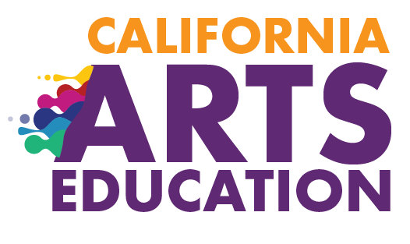



Chapter 9:
Implementing Effective Arts Education
EXCERPT: This excerpt (Slides 32–42) is provided for use with the Informed Decision-Making Inquiry on the California Arts Education Framework Resources for Implementation website located at https://www.calartsedframework.org/. The full slide deck can be accessed at https://www.cde.ca.gov/ci/vp/cf/.
2020 Arts Education Framework for California Public Schools, Transitional Kindergarten Through Grade Twelve
California Department of Education
Tony Thurmond, State Superintendent of Public Instruction
Notes:
Chapter 9: Implementing Effective Arts Education
This presentation deck includes content from chapter 9 of the 2020 Arts Education Framework for California Public Schools, Transitional Kindergarten Through Grade Twelve (Arts Framework).
The content was selected and refined in collaboration with leaders from California County Superintendents Educational Services Association (CCSESA) Statewide Arts Initiative and The California Arts Project (TCAP).
The slides are mostly self-explanatory, but in some places the slide notes contain clarifying talking points, possible reflection questions, or notes that may be useful for anyone facilitating a group.
The presentation deck
is meant to be a resource for educators and education partners to use to guide their reading of the Arts Framework;
is designed to use for self- or group study; and
captures highlights and provides entry points to the chapter, but the slides and the notes are not meant to be exhaustive and represent all content in the chapter.
The slides and notes are not intended to be a substitute for reading the chapter.
The slide notes also reference chapter pages from which the slide content originates.
Educators may download and modify the presentation for personal use.
The content may be used as a base for workshops and presentations.
Please contact the Curriculum Framework and Instructional Resources Division at cfird@cde.ca.gov with any questions about the content or use the presentation deck.

Slide 2
Q3—How does professional learning support effective and equitable arts learning?
Notes:
How does professional learning support effective and equitable arts learning?
What are the roles?
What are the qualities?
What are some models?
Chapter Pages: 38–55

Slide 3
Professional Learning for Leaders—a Leading Factor in Student Success
School leaders and teachers who understand the what and the why of arts education are better able to provide effective leadership. Professional learning content for leaders
  highlights the overlapping and expanded literacy development students gain through the arts;
  includes insights into effective teaching in the arts; and
  provides illustrations of the benefits gained by all students from a sequential, standards-based arts education.
Notes:
Professional Learning for Leaders—a Leading Factor in Student Success
Professional learning is a critical ongoing part of every administrator’s and teacher’s career and a leading factor in student success in any content area.
School leaders and teachers who understand the what and the why of arts education are better able to provide effective leadership.
Administrators and teachers need professional learning that includes an overview on quality indicators of standards-based arts education that supports them in gaining an understanding of the intent and goals of the California Arts Standards and Framework.
Administrators and other school leaders who understand the aspects listed on the slide can articulate a vision for arts education and lead in ways that create conditions for and support quality arts learning.
Chapter Pages: 38–39

Slide 4
Professional Learning for Teachers—an Investment in Student Success
Arts teachers’ benefit when professional learning is targeted to their role, their needs, and their students’ needs. Professional learning content for teachers
  builds multiple subject teachers’ capacity to provide standards-based arts education;
  is relevant and discipline-specific for single subject arts teachers;
  fosters opportunities for arts teachers to collaboratively address problems of practice and acquire new skills and strategies; and
  is informed by best practices and current research in arts education.
Notes:
Professional Learning for Teachers—an Investment in Student Success
An investment of time and allocation of resources for professional learning is necessary.
Chapter Pages: 38–39

Slide 5
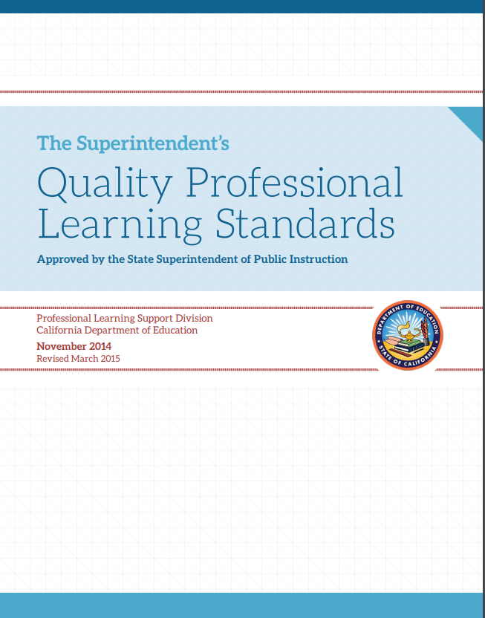
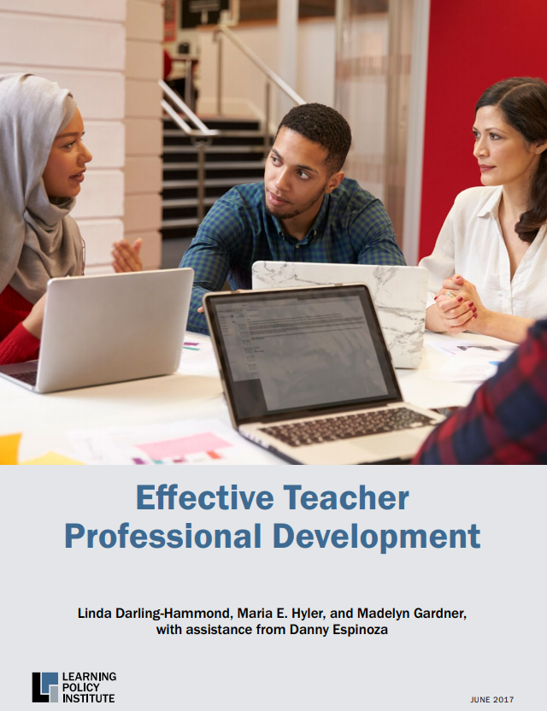
Qualities of Effective Professional Learning Models
The Quality Professional Learning Standards (QPLS) describe characteristics of professional learning that are “…most likely to support educators in building individual and collective capacity to meet professional, school, and student performance expectations.”
The Learning Policy Institute (LPI) report Effective Teacher Professional Development identifies effective design elements for professional learning design.
Notes:
Qualities of Effective Professional Learning Models
Two documents, Effective Teacher Professional Development Report and Quality Professional Learning Standards, provide insight into effective professional learning models and related attributes that are useful for arts education.
The LPI’s seven elements, combined with California Department of Education’s QPLS, articulate effective professional learning attributes that should be present to support arts educators and administrators.
The design elements and standards are useful guides for administrators to guide the design or selection of professional learning.
Teachers may find the elements and standards descriptions useful when selecting professional learning activities to meet their needs and enhance their practice.
Chapter Pages: 40–42

Slide 6
Elements of Effective Professional Learning
According to the LPI report, seven effective design elements present in most effective professional learning include the following:
  Focus on content
  Active learning utilizing adult learning theory
  Collaboration, typically in job-embedded contexts
  Models and modeling of effective practice
  Coaching and expert support
  Opportunities for feedback and reflection
  Sustained over time
Notes:
Elements of Effective Professional Learning
The authors of the report define effective professional development as ”structured professional learning that results in changes in teacher practices and improvements in student learning outcomes.”
The LPI report can be downloaded at https://learningpolicyinstitute.org/product/effective-teacher-professional-development-report.
Chapter Pages: 40–42

Slide 7
Characteristics of Quality Professional Learning
The QPLS identify seven interdependent characteristics of professional learning to guide systems of professional learning:
  Rooted in student and educator needs based on data
  Focused on content and pedagogy
  Designed to ensure equitable outcomes
  Designed and structured to be ongoing, intensive, and embedded in practice
  Collaborative with an emphasis on shared accountability
  Supported by adequate resources
  Coherent and aligned with other standards, policies, and programs
Notes:
Characteristics of Quality Professional Learning
The QPLS can be downloaded at https://www.cde.ca.gov/pd/ps/qpls.asp.
Chapter Pages: 40–42

Slide 8
Reflection on the Qualities of Effective Professional Learning
To what degree/how often does arts professional learning you design, or experience, align with these elements and characteristics?
What are the most challenging elements and characteristics to include?
How can these challenges be addressed?
Notes:
Reflection on the Qualities of Effective Professional Learning
An additional question for administrators to consider is—what professional learning do you need, as an instructional leader to, support and strengthen arts education and programming for students and teachers at your site or district?
Chapter Pages: 40–42

Slide 9
Professional Learning for Administrators, School, and District Leaders
Leaders and personnel assigned responsibility for arts education benefit from arts education-focused professional learning.
Leaders may have disciplinary expertise or experience in one of the arts content areas, but not all.
Engagement in Professional Learning Communities (PLCs) focused on arts education can be effective to foster collaborative professional learning.
PLCs can be regional or district-based and organized through partnerships or collaborations with established arts education agencies.
Notes:
Professional Learning for Administrators, School, and District Leaders
Professional learning is a necessary support for administrators and counselors assigned to be responsible for arts education.
Those supporting arts education may not be fully prepared, knowledgeable about current arts education policies, or empowered to facilitate change.
School board members and counselors also play critical roles in supporting, creating policies, and implementing practices that provide or prohibit students’ access to arts education.
Given the multiple demands on their time, engagement in regional or local networks (PLCs) that meet for a few hours monthly or a full day quarterly offer opportunities for ongoing support.
The addition of an outside arts education expert to help facilitate the PLC, provide guidance, and offer information has been found to be an effective approach
Chapter Pages 42–44

Slide 10
Professional Learning Needs: Multiple and Single Subject Teachers
For Multiple Subject Teachers
For Single Subject Teachers
Builds content knowledge, language, skills, and pedagogical content knowledge in the five arts disciplines
Boosts confidence and ability to provide discrete, sequential arts learning experiences
Increases capacity to design and implement effective integrated arts learning experiences
Provides continued growth in contemporary arts practices, new technologies, new skill development, etc.
Provides opportunity for collaboration related to standards, assessment, and instructional design
Addresses the content and the arts subject area taught
Notes:
Professional Learning Needs: Multiple and Single Subject Teachers
In some districts an arts teacher may be the only teacher in their subject area on their campus, and professional learning with same subject area arts teachers that crosses school sites can be useful for collaborative professional learning.
Professional Learning Communities (PLCs) can be organized in a variety of ways, such as by grade level (vertical and horizontal), disciplines, and by teaching contexts (such as within a pathway, multiple schools, or self-contained classrooms) to mediate teacher isolation.
The PLC groupings should be ongoing, learning focused, inquiry based, and action orientated to achieve improved student learning.
See pages 49–51 for a summary of DuFour’s big ideas of professional learning communities, examples, and a Snapshot Focus on Practice, which provides an example of a regional professional learning community structure for the arts focused on problems of practice.
Chapter Pages: 44–55

Slide 11
Resources for Professional Learning
The California Arts Project https://csmp.ucop.edu/tcap
California County Superintendents Arts Statewide Initiative https://ccsesaarts.org/
California Art Education Association https://www.caea-arteducation.org/
California Dance Education Association https://www.cdeadance.org/
California Educational Theatre Association http://cetoweb.org/ceta/
California Music Educators Association https://www.calmusiced.com/
Notes:
Resources for Professional Learning

