Slide 1
8th Grade Arts & Science
Music & Sound Learning Sequence
Created using the SDCOE Distance Learning Units of Study Communication Units
C.Cochrane and P.Crooks

Slide 2

Part 1: Explore Sound
What is sound?
Think about what you have learned about sound in the past and how you experience sound in your daily life. What is sound? Jot down your initial ideas in your notebook.

Slide 3
Observing Sound
Spend a few moments noticing and listening to all the sounds around you.
Record some of your observations, thoughts, and wonderings in your notebook. What sounds are you hearing? How would you describe each sound that you hear? Which of the sounds evoke a pleasant mood? Which ones feel more harsh? Are the sounds loud or soft?

Slide 4

Think, Puzzle, Explore
What do you think you know about sound?
What questions or puzzles do you have about sound?
How might you explore your puzzles about sound?
Puzzles are things you are wondering about.

Slide 5
How do humans make sound?
Let’s take a few minutes to explore how our bodies can make vocal sounds.
Say “Ahhhhh…” loudly.
Observe all that your body has to do to make the sound. Share your thoughts with a partner. How is your body able to make vocal sounds? Record your thoughts in your notebook. Use pictures, if that helps explain your thinking.
Now whisper “Ahhhhh…”.
What did your body do to change the sound? Share your thinking with a partner and add any new thinking to your notebook.

Slide 6
Initial Reflection
My Personal Reflection Table
 | Things I know for sure... | Things I think I know but am not completely sure... | Things I wonder about or would like to know more about...
What sound is
How sounds are transmitted, or sent, from a source to a receiver
How sound waves create music

Slide 7

Part 2: Create and Experience Sound
How do humans experience sound and music?

Slide 8

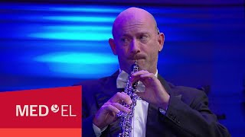
Experiencing Music with Hearing Loss
Watch these videos to learn about how people with hearing loss experience music.
Dancer Shaheem Sanchez.
As you watch the first video, listen for Shaheem’s description of how he hears music and what he tells us about sound. Think about how his ideas about music are the same or different from your ideas.
Musician Russell.
As you watch the second video, listen for Russell’s description of how wearing a cochlear implant helps him hear music and what he tells us about sound. Think about how his ideas about music are the same or different from your ideas.

Slide 9
Responding & Connecting
Based on what you watched, respond to the following questions in your notebook:
How does Shaheem hear music? What does he tell us about sound?
What does Shaheem say about music that is the same or different that your thoughts? How is your experience with music similar or different than Shaheem’s?
How does Russell hear music? What does he tell us about sound?
What does Russell say about music that is the same or different that your thoughts? How is your experience with music similar or different than Russell’s?

Slide 10
Writing Scientific Questions
Write 3-4 scientific questions. Use these Scientific Question Starters or come up with your own.
How is ______________ changing?
How does changing ___________ affect ________________?
How do __________ and __________ change over time?
How does the structure of ___________ change _______________?
What is the relationship between __________ and __________?

Slide 11
Same Different Connect Engage
Same - In what ways might this person and you be similar?
Different - In what ways might the person and you be different?
Connect - In what ways might the person and you be connected as human beings?
Engage - What would you like to ask, say, or do with the person if you had the chance?

Slide 12
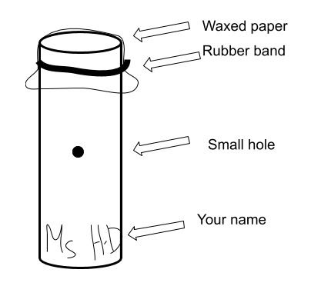
Make a Kazoo
The kazoo needs three parts:
Tube (possible materials - index cards, card stock, pre-made tube, could make different lengths)
Membrane (possible materials - wax paper, parchment paper, aluminum foil, tissue paper). This is held in place with a rubber band.
Hole in the tube (possible variations – different sized holes, different placement of the hole on the tube)
Once you have finished making your kazoo, remember to write your name on it.
Example kazoo with simple materials
(Source: #ProjectPhenomena)

Slide 13
Explore making sound using a kazoo
Use your kazoo to make different sounds.
Answer the following questions in your notebook:
What do you have to do to make sounds with the kazoo?
What does the kazoo do to make sound?
Do you have to have a hole in the kazoo? Why or why not?
What are you wondering about? What questions do you have?

Slide 14
Curiosity Check-in
How is music a part of your life? What genres of music do you enjoy most? Do you play any instruments? If so, which one(s)?
Do you enjoy listening to other sounds such as naturescapes or ambient noise? How do these sounds make you feel? When do you like to listen to them?

Slide 15
Part 3: Elements of Music
What are the elements of music and how are they used by composers and performers?

Slide 16

Elements of Music
Composers and performers use the elements of music in specific ways to create the message they want to communicate.
The elements of music are the basic characteristics of sound (pitch, rhythm, harmony, dynamics, timbre, texture, form, and style/articulation) that are manipulated to create music.
Source: nounproject.com

Slide 17
Explore dynamics, pitch, rhythm, tempo, and timbre
Use your kazoo to explore each element. Pause to write a definition for each element in your notebook.
Explore dynamics. How can you make loud or soft sounds with the kazoo?
Explore pitch. Does your kazoo have a high or low sound? How could you change the pitch of your kazoo?
Explore rhythm. Create a pattern of short and long sounds and silences.
Explore tempo. Repeat your pattern at different speeds.
Explore timbre. What do you think of the quality or tone color of the sound produced by your simple kazoo? How might using different materials affect the timbre of your kazoo? Have you tried covering the open end of the kazoo? What happens when you do this?

Slide 18
Elements of Music - Definitions
We are going to use the following definitions for purposes of this module:
Dynamics are the loudness or softness of a sound.
Pitch is the highness and lowness of sounds.
Rhythm is the pattern of short and long sounds and silences that fit within a steady beat. It is how we multiply or divide the beat to create interesting patterns.
Tempo is the speed of the beat or music: fast, medium, slow.
Timbre is the quality or tone color of a sound; it is what makes one instrument or sound different from another.
Please add any details from these definitions you may not have included to your own definitions of each of the five elements of music.

Slide 19
Practice Listening for the Elements of Music
Listen to each of the pieces of music from this list.
Describe the dynamics, pitch, rhythm, tempo, and timbre.
“Asi” (Salsa) the song ends at 2:34
Song title not available (Flamenco)
Song title not available (Bluegrass Clogging)
“Panta Rhei” The Young People’s Chorus

Slide 20
Practice Listening for the Elements of Music
Review your notes for each of the pieces of music.
How did the composers and performers utilize the elements of music in the same ways or in different ways? What language did you hear in the pieces of music with lyrics? Are these languages you can understand? How did that impact your listening experience?
Share your observations with a partner or small group.

Slide 21
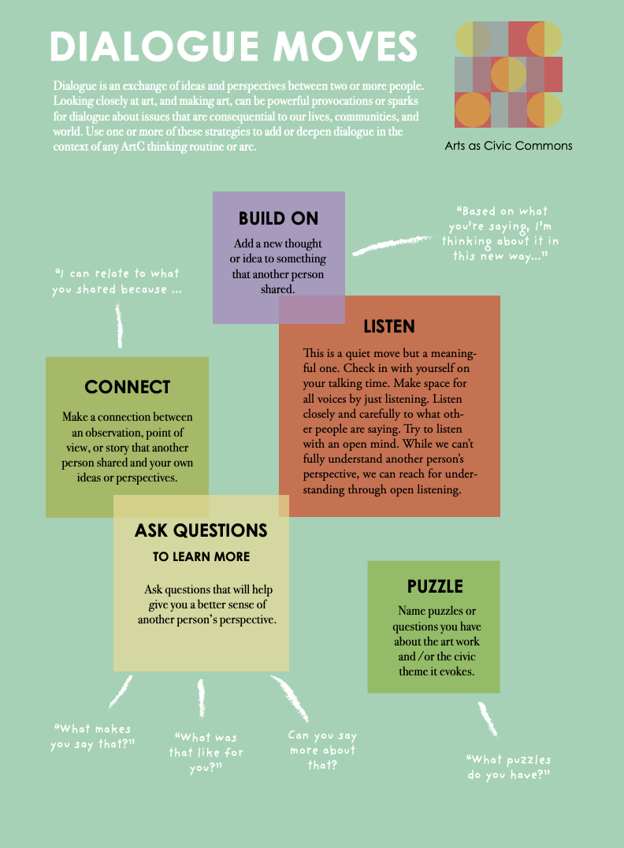
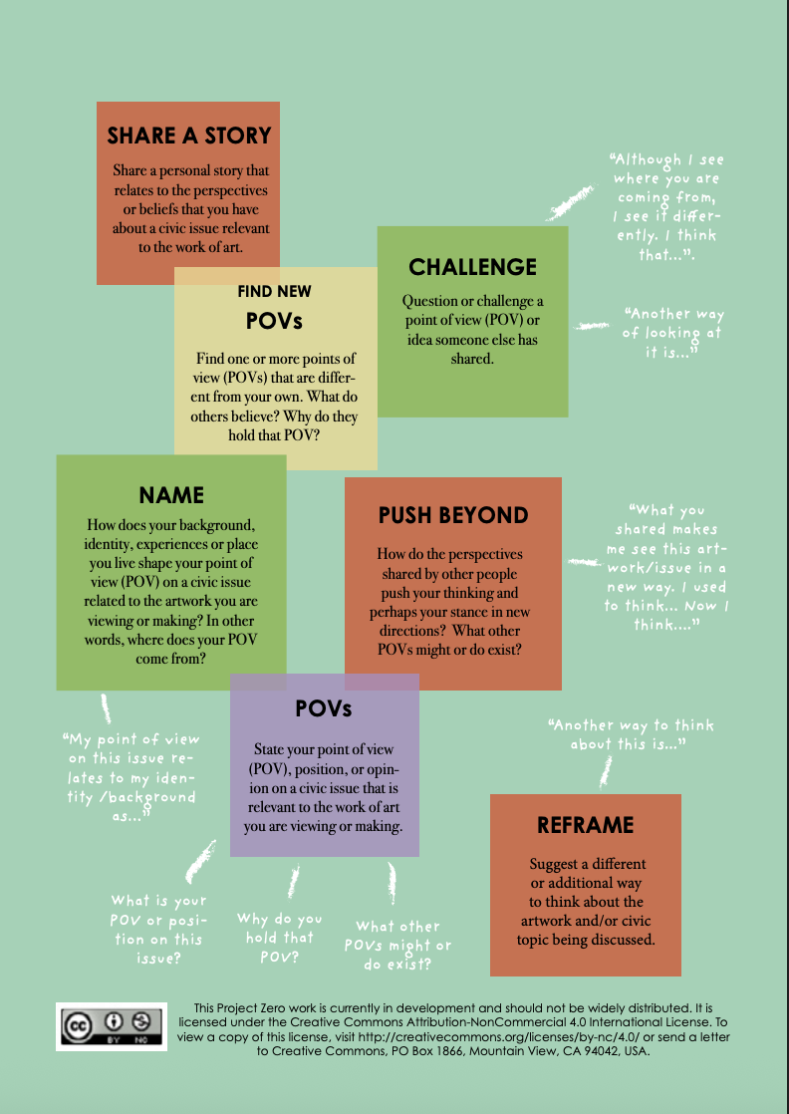
Dialogue Moves
Notes:
OPTIONAL SLIDE if you want to introduce the Dialogue Moves from Project Zero.
https://pz.harvard.edu/sites/default/files/Dialogue%20Moves.pdf

Slide 22
Listening: Ten Times Two
1. Listen to a piece of music quietly. Let your ears wander and take in as much as possible.
2. List 10 words or phrases about any aspect of what you hear.
3. Repeat steps 1 & 2: Listen again and try to add 10 more words or phrases to your list.
Notes:
OPTIONAL SLIDE if you want to introduce the Listening: Ten Times Two, a routine for making careful observations about music. from Project Zero.
https://pz.harvard.edu/sites/default/files/Listening%20-%20Ten%20Times%20Two_0.pdf

Slide 23
Part 4: The Power of Music
How is music impactful and emotional?

Slide 24
The Power of Music
Composers and performers use music to express ideas and emotions. At times, an especially powerful song is passed on through generations and can take on new meaning for the performers and the audience.
Read the “We Shall Overcome - The story behind the song” article about a song with roots that can be traced back to the 1700’s and is still being performed throughout the world today. Listen to two audio recordings:
Pete Seeger - “We Shall Overcome” - embedded in the article
Martin Luther King 1964

Slide 25
Responding the Music and text
From the reading:
Why did Lucille Simmons change the lyrics of the song from “I Shall Overcome” to “We Shall Overcome”? How does changing one word of a song change the meaning?
From the songs:
What instrument did Pete Seeger play to accompany his singing of “We Shall Overcome” on September 2, 1957?
How would you describe the dynamics, pitch, rhythm, tempo, and timbre in his performance of “We Shall Overcome”?
How did Martin Luther King use the lyrics of the song “We Shall Overcome” in the second recording? How did this impact the meaning of the song?
Did performances of this song spread beyond the United States?
Connecting to the songs:
Have you heard this song before?
What meaning does this song have for your life?

Slide 26
Curiosity Check-in
What songs are important in your life? What meaning do the songs have for your life? Do you know when the songs were created? What do you know about the history of the songs?

Slide 27
Part 5: Sound Simulation
What does sound look like?

Slide 28
Looking at Sound
Capture your initial ideas about what sound looks like in your notebook. Record your thoughts using pictures and about three to five sentences.
Use the Sound Exploration directions and response sheet as you explore sound waves using the phET Sound Simulation.

Slide 29
pHET Simulation Part 1
Complete Sound Waves Exploration - pHET Simulation Part 1.
Share your observations with your partner.
Discuss:
How sound is produced
The role particles play in sound
What makes sound waves
How a sound wave moves
How particles change as a sound wave is made and moves

Slide 30
pHET Simulation Part 2
Complete Sound Waves Exploration - pHET Simulation Part 2
Share your observations with your partner.
Discuss:
The relationship between frequency and sound
The relationship between amplitude and sound

Slide 31
Revisit Your Initial Ideas
Revisit your initial ideas regarding “What does sound look like?” and add to your thinking:
How would you now describe what sound looks like?
What is the relationship between sound, air particle movement, and the forces involved?

Slide 32
Class Discussion
How can we use our thinking about the relationship between sound, air particle movement, and the forces involved to explain how Shaheem Sanchez and Russell feel/hear music?

Slide 33
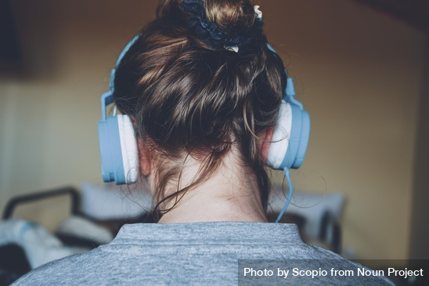
Part 6: Perception Range
How do our ears hear sound?

Slide 34
Sound Perception
Use the Signal Generator to test others’ perception of sound by giving them a hearing test.
Complete these steps:
Test the volume on your computer by playing a sound, song, or video. The volume should be at a comfortable level (not too loud or soft).
Try to remove as many background sounds and noises in the room where you are performing your experiment as possible, including sounds from electronics and talking.
Go to the signal generator. Lock the amplitude at the halfway point on the signal generator.
Have the person you are testing wear headphones connected to the computer. You should have them sit so they are facing away from the computer screen.
Play the lowest frequency sound possible from the signal generator. Slowly raise the frequency up from the bottom.
Have the person you are testing raise their hand when they hear a sound.
Record the lowest frequency the person first hears.
Play the highest frequency sound possible from the signal generator. Slowly lower the frequency down from the top.
Have the person you are testing raise their hand when they hear a sound.
Record the highest frequency the person first hears.
Record the name and age of the person tested.
Continue testing other people using steps 4-11.

Slide 35
Notebook Responses
After conducting the hearing tests, answer the following questions in your notebook:
Did everyone hear the same lowest frequency sound? If not, what was the range of lowest frequency sounds heard?
Did everyone hear the same highest frequency sound? If not, what was the range of highest frequency sounds heard?
Why do you think we all hear at different frequency ranges?
Do we continue to hear the same frequencies for our whole lives? Explain your thinking. Do you have any data which confirms your explanation?

Slide 36
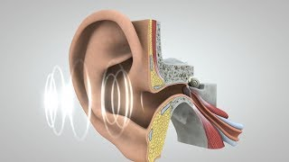
How Do Our Ears Hear Sound?
Watch the Journey of Sound to the Brain video to learn more about how sounds make their way from a source to your brain. As you watch the video, think about what you know about waves and sound and how it can help you understand how the ear works. Also think about the different structures in the ear and how they function to help someone hear.
In your notebook:
make a sketch of the ear and label the structures (be sure to include the cochlea)
explain and show how the ear uses the motion and energy of air particles to transfer sounds from the air to the brain
note where low and high frequency sounds are heard
record the steps in the process of converting sound waves to electronic signals

Slide 37

Hearing Explained
Think back to the hearing tests you conducted. Based on your sketch of the ear and notes, explain why some people hear different frequency ranges.
Watch this short Universe Unboxed: Kazoo Science! episode of SciShow. Listen to Hank Green’s explanation. Add any new ideas you hear to your own explanation.

Slide 38
Curiosity Check-in
How did you feel when you were listening to different frequencies of sound? Were there high level or low level frequency sounds that irritated your sense of hearing? What frequency level of sounds did you find the most pleasant? What did these sounds remind you of?

Slide 39
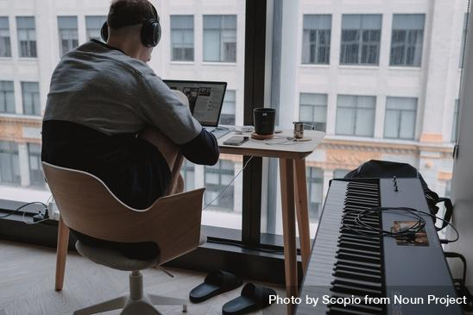
Part 7: Create Your Own Arrangement
How do musicians create arrangements?

Slide 40
Explore “Ode to Joy”
It’s time to sing or play a melody. We are going to learn part of the melody line from a piece of music called “Ode to Joy” by Ludwig van Beethoven.
Explore this recording of “Ode to Joy” and record what you notice about the elements of music in the piece.
Please describe the dynamics, pitch, rhythm, tempo, and timbre. (Refer back to the definitions in your notebook if you need a refresher on the elements of music.)
Does this music express an idea or an emotion?
How would you describe the idea or emotion?

Slide 41

Comparing Arrangements
Explore this recording of “Ode to Joy” and record what you notice about the elements of music in the piece.
Discuss with a partner. What is different between this arrangement and the first one you heard?

Slide 42
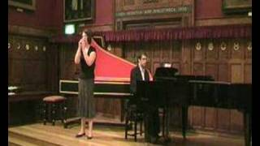

More “Ode to Joy”
Explore either one or both of these videos showing a piano and kazoo duet or a guitar and kazoo duet of “Ode to Joy”. Feel free to join in with your own kazoo.
How does hearing “Ode to Joy” on a simple instrument, the kazoo, compare to the more complex arrangements you listened to previously?

Slide 43
Dynamics
Now that you’ve learned to sing or play the melody line for “Ode to Joy” it is time for you to create your own arrangement for the piece of music.
Let’s start with adding dynamics to the piece. Experiment with different dynamic levels. Once you have something you like, write the dynamic levels in the piece of music.
You can use your own symbols or you can use these traditional symbols:
Very soft = pianissimo = pp
Soft = piano = p
Medium soft = mezzo piano = mp
Medium loud = mezzo forte = mf
Loud = forte = f
Very loud = fortissimo = ff
Gradually increase the volume = crescendo = cresc.
Gradually decrease the volume = decrescendo = decresc.

Slide 44
Tempo
Next, let’s experiment with the tempo.
Try playing the piece at different speeds: slow (Andante), medium (Moderato), fast (Allegro). What happens if you slow down (ritardando) or speed up (accelerando) during the piece?
Once you have something you like, write the tempo markings in the piece of music. You can use your own symbols or you can use the following traditional symbols:
Slow = Andante
Medium = Moderato
Fast = Allegro
Gradually slowing down = ritardando = rit.
Gradually getting faster = accelerando = accel.

Slide 45
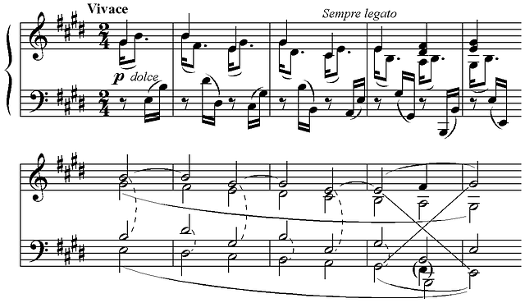
Sample
An example of how to write a tempo marking and dynamics:
(Source: pixabay.com)

Slide 46
Rhythms
Now, let’s experiment with rhythms. One great thing about improvisation is that there is no right or wrong way to improvise, unless you choose not to participate.
Let’s return to our music for “Ode to Joy” and think about how you can change the rhythms in the piece. Experiment with different rhythms in the first four measures of the song.
Once you have something you like, find a way to write it down. Then go ahead and experiment with different rhythms for the remaining 12 measures of the piece and write down your final rhythmic choices.
use standard or iconic notation to write down their rhythms

Slide 47

Thinking About the Experiences of Others
Now let’s think about how others experience “Ode to Joy”. Watch How deaf people experience Beethoven's Ninth Symphony | Music Documentary to see how Paul Whittaker helps people with hearing loss “Feel the Music”.

Slide 48
Partner Discussion
After watching the video, discuss the following questions with a partner:
What assumptions did you have about how deaf people experience music before watching this documentary? How did the documentary challenge or confirm those assumptions?
How does the documentary broaden your understanding of the concept of "listening" to include more than using your sense of hearing?
Thinking of the elements of music, why is Beethoven's Ninth Symphony, particularly the "Ode to Joy", a powerful piece to explore the theme of accessibility in music?
Considering the technological advancements shown in the documentary, how might these technologies change the future of accessibility in the arts, not just for music but for other art forms as well? What role do you think artists, venues, and the broader music community have in promoting accessibility and inclusivity in the arts? How could you include these in your arrangement to make it more inclusive?
How can the insights gained from this documentary be applied to other areas of life and create a more inclusive society for individuals with disabilities?

Slide 49
Curiosity Check-in
Now that you’ve been working as an arranger, what do you think about having the freedom to create your own version of a piece of music? Did you enjoy the process? Why or why not? What else would you like to try out? How could you make your arrangement more inclusive?

Slide 50
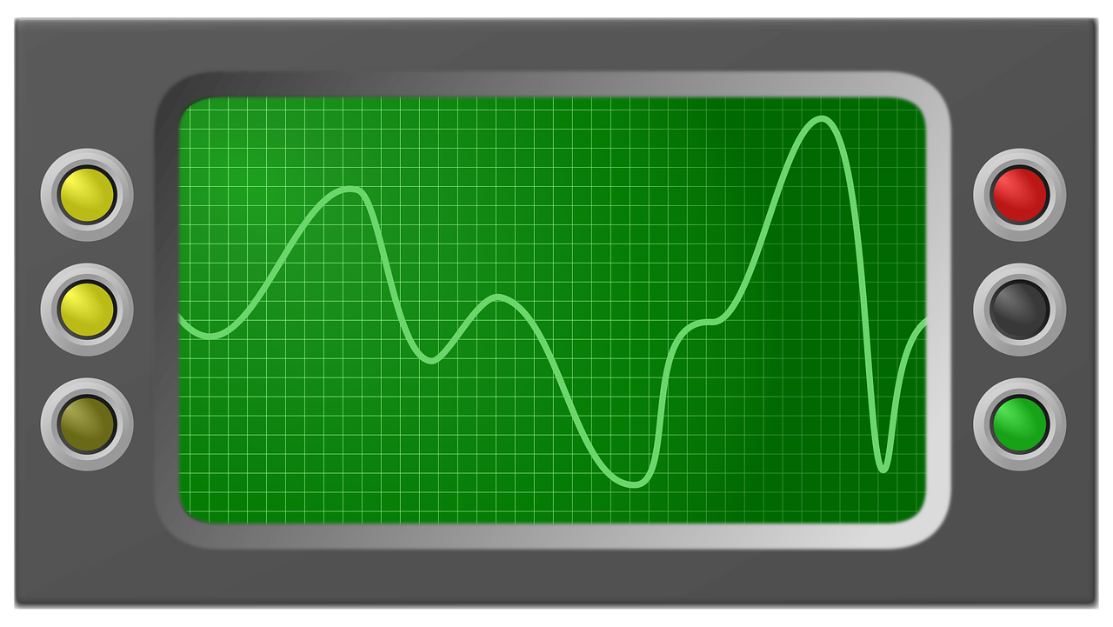
Part 8a: Oscilloscope Exploration
What patterns appear in the visualization of sound?

Slide 51
Understanding Microphones
Your computer detects sound through a microphone. To learn more about how a microphone works, read How Do Microphones Work?.
After reading the article, refer back to the speaker-ear model you created. Discuss your thoughts with a partner:
Which part of the speaker-ear model does the microphone most closely mimic? Why?

Slide 52
Oscilloscope
Next, we will explore sound with an oscilloscope. An oscilloscope is an electronic instrument that visually displays electrical signals, allowing for the analysis of the properties of waves, such as their speed, amplitude, frequency, and period.
Use an oscilloscope to explore a variety of noises and record them on the oscilloscope. Watch this short video tutorial to learn how to use this tool.

Slide 53
Explore the Oscilloscope
Explore the Oscilloscope. Click the red circle to begin recording, click the square icon to stop recording, and click the triangle button will play back your recording. Record some of these suggestions:
  whistle
  sing a note
  bang on a table
  spin a coin
  create vowel sounds like “ahhh” or “ooooo”
  create consonant sounds like “shhh” or “ch”
  say your name
  hum a song
  play Ode to Joy on your kazoo
  play an additional piece of music

Slide 54
Group Discussion
Discuss the following questions in your group. Use your oscilloscope recording to compare each other's sounds if needed.
How is sound represented by this visualization similar and different from the pHET sound wave simulation and the signal generator?
  What do short sounds look like and what do long sounds look like?
  What do high-pitch and low-pitch sounds look like?
  What do loud and quiet sounds look like?
  What does talking look like?
  What does humming look like?
  Does whistling one note look the same as playing one note on your kazoo?
  What happens when you zoom in on a segment of the oscilloscope?

Slide 55
Connect, Extend, Challenge
How are the ideas and information connected to what you already know?
What new ideas did you get that broadened your thinking or extended it in different directions?
What challenges or puzzles emerge for you?

Slide 56
Part 8b: Sound Visualization Extension
What other tools help us visualize sound?

Slide 57
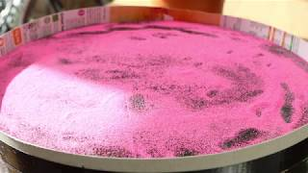
Tonoscope
Watch Visualising Sound: Using a Tonoscope to see vibrations on a surface to see the visual patterns created by different frequencies.
What questions do you have about the similarities and differences between a tonoscope and an oscilloscope?

Slide 58
Tonoscopes versus Oscilloscopes
How is a tonoscope the same as the oscilloscope? How is it different?
Tonoscopes are often used for observing the "form" of sound (Cymatics) while an oscilloscope measures voltage variations over time, showing waveforms (amplitude on the y-axis, time on the x-axis).

Slide 59
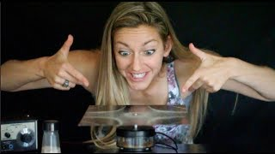
Chladni Plates
Watch Singing plates - Standing Waves on Chladni plates to learn with Physics Girl and take a deeper dive into how the physics of waves help explain the patterns we see.
Jot your ideas in your notebook. What are you curious about? What questions do you still have about the ways we can visual sound?

Slide 60
Part 9: Prepare for a Musical Performance
How do you know your piece of music is ready to perform for an audience?

Slide 61
Getting Ready to Perform - Reflection
As a musician, it is likely a performance is set for you on a calendar that was created by someone else. This is generally how performances work, but how do you know the music is actually ready to perform for an audience? If it was up to you to decide when a piece of music is ready how would you make that decision?
Write your response in your notebook.

Slide 62
Create a Getting Ready to Perform Checklist
Work in a small group to create a checklist you could use to determine when a piece of music is ready to share with an audience.

Slide 63
Finalize Our Getting Ready to Perform Checklist
Before you finalize your group list, think about your audience.
Watch Learning to Dance While Deaf | The Express Way with Dulé Hill to revisit how Shaheem Sanchez and other people with disabilities may experience your performance.
After watching the video, review your checklist. What can you add to ensure your piece of music is ready to share with an inclusive audience?
Share your list with the larger group. Create one checklist the entire class can use.

Slide 64
Using Our Getting Ready to Perform Checklist
Return to your arrangement of “Ode to Joy”. Use the checklist your class created to determine if it is ready to perform for an audience. If it is not ready, what would you need to do to get it ready and how long do you think that would take? You are going to be asked to perform your arrangement in the next section so take the time you have available to have your piece as ready as possible.

Slide 65
Getting to Know the Composer
Part of preparing a piece of music is knowing more about the composers’ expressive intent.
Read The Genius of Beethoven. What did you learn about Beethoven’s life? How do you think this shaped the music he composed? Jot your thoughts in your notebook.
Notes:
The article, “The Genius of Beethoven” is in the resource folder.

Slide 66
Watch this video performance of a section of Beethoven’s 9th Symphony.
Do you hear the melodic line you’ve been playing or singing and arranging?
How does it sound different from your performance?
What changes to the elements of music did Beethoven make each time the melody is repeated?

Slide 67
Rehearse both the original version of “Ode to Joy” as well as your arrangement. You will want to play both versions for the audience. Use your checklist as you rehearse.

Slide 68
TAG Feedback
It is always important to get feedback before a performance.
Sing or play the original version of “Ode to Joy” as well as your arrangement for a partner or small group.
Each group member will use the TAG feedback protocol to,
Tell something they notice about the performance,
Ask a question about the performance, and
Give a suggestion about the performance to assist you with having the best performance possible.

Slide 69
TAG Protocol
TAG Feedback protocol
Tell something they notice about the performance
Ask a question about the performance
Give a suggestion
Repeat this feedback protocol until each member of the group has shared their performance in the small group and received feedback.
Write down the feedback you receive and incorporate it into your rehearsals for your final performance.

Slide 70
Thinking about Sound
Think of each of the performances you listened to.
How did the sound travel from the performer to your ears?
Create a model of the sound travel - use words, numbers, and pictures to record your thinking in your notebook.

Slide 71
Thinking about the Elements of Music
Think of each of the performances you listened to.
Use the elements of music to describe the piece you enjoyed the most.
Record your thinking about pitch, rhythm, harmony, dynamics, timbre, texture, form, and style/articulation in your notebook.

Slide 72
Part 10: Perform Music
How do you, as an arranger and performer, communicate with the audience?

Slide 73
Audience Etiquette
Before we begin, let’s determine audience etiquette.
As a class, determine how you, as the audience, will act while you are watching and listening to one another perform.
Will you move to the music during the performance?
Will you sit still and in silence until the music stops and then clap for each performer?
Will you hum along with the performer(s)?
Will you join in the performance with your own kazoos?
What else can you think of?

Slide 74

Performance Time
It is now time to perform your arrangement for an audience.
Source: pixabay.com

Slide 75
Reflect on your Performance
After your performance, think about how you used the elements of music to create your own arrangement of “Ode to Joy” to convey your own expressive intent.
Use the following questions to guide your reflection:
How would you describe your performance of “Ode to Joy”? Look back at your performance checklist and use it as a guide for your responses.
How did the audience respond to your performance? How did you feel sharing the arrangement you created of “Ode to Joy”?
How can you make arranging and improvisation a regular part of your practice routine?
What have you learned about expressive intent?
How will you use what you have learned to prepare for future performances?
Jot your reflection notes in your notebook.

Slide 76
Curiosity Check-in
What did you notice about yourself when you were performing? Did you enjoy performing? Why or why not? What other types of performances (ie. recitals, sports/games, speeches) have you participated in in the past? How were the experiences similar or different from your performance today?

Slide 77
Part 11: Spectrogram Exploration
How else can we visualize sound?

Slide 78
Explore the Spectrogram - Part 1
Experiment using a spectrogram to visualize and analyze different sounds.
Make a loud “ahhhh” sound and a quiet “ahhhh” sound of the same pitch.
What do you notice?
What does the spectrogram show?
Make a low-pitch sound, then a high-pitch sound.
What do you notice?
What does the spectrogram show?
How does the spectrogram change when the pitch changes?

Slide 79
Explore the Spectrogram - Part 2
Complete the Spectrogram Exploration sheet with a partner.
When you get to question #6, consider playing your performance of, “Ode to Joy”. What do you see on the spectrogram when you perform the song?

Slide 80
Spectrogram Reflection
After working with your partner, answer the following questions in your notebook:
How does the spectrogram visualize frequency?
How does the spectrogram visualize amplitude?
What is being measured on the spectrogram?
What does it tell you about the nature of sound?
How we can use the spectrogram to visualize music with multiple sounds compared to a single note?

Slide 81
Claim, Support, Question
Class Discussion • Thinking routine for reasoning with evidence
Drawing on our spectrogram exploration and your prior knowledge and experience:
• Make a claim about the data a spectrogram provides.
• Identify evidence that supports your claim.
• Ask a question related to your claim or the supports. What isn’t explained yet?

Slide 82
Spectrogram Exploration - Part 3
Work with a partner. Open the Spectrogram. Play a couple different pieces of music and analyze the visualization of sound that you observe.
Consider playing the pieces we have listened to earlier in the unit:
“Asi” (Salsa) the song ends at 2:34
Song title not available (Flamenco)
Song title not available (Bluegrass Clogging)
“Panta Rhei” The Young People’s Chorus
“We Shall Overcome” embedded in the article
Discuss the following questions:
How are the sounds in each piece of music represented on the spectrogram?
What colors do you see? What do the colors mean? Which elements of music or visualized by the colors?
How are the pieces visually similar or different?
How does seeing the sound help you experience the music? Do the visual similarities and differences seem to match the similarities and differences you hear in the songs? How so?

Slide 83
New Technologies
Experiencing music is often thought of as an auditory experience, something we only do with our sense of hearing. Tools like a spectrogram and oscilloscope help us see the music. Watch these videos to see how new technologies are helping deaf people experience music through the sense of touch (feeling) and sight (seeing).
Watch How a Deaf Musician Is Helping Others “See With Sound” or Audiolux One: Sound Reactive Visuals to learn about Myles de Bastion and the Audiolux technology he has developed that creates sound reactive visual displays.
Next watch, The Sound Shirt | Junge Symphoniker Hamburg to learn about experiencing music through touch sensations.

Slide 84
New Technologies - Partner Talk
After watching the videos, discuss the following questions with a partner:
How are these technologies helping musical performances become more accessible?
After learning about Audiolux:
What are some of the ways in which audio elements like rhythm, pitch, and amplitude are represented visually?
How can more inclusive spaces, such as classrooms and music venues, be created to ensure everyone has access to and can enjoy music?
After learning about the Sound Shirt:
What reactions did you see in the video from those wearing the shirt? What do these reactions tell us about the impact of the Sound Shirt?
How does this approach compare to simply feeling vibrations through the floor or through a conventional speaker?
Beyond concerts, what other applications could the Sound Shirt or similar haptic technology have?

Slide 85
Part 12: Cochlear Implants
How do the sound patterns in music get transferred to a cochlear implant?

Slide 86
How we Hear Sound - Part 1
A mixture of pure tones make up complex musical sounds. This is why the human cochlea needs thousands of neurons to truly transmit music to the brain.
Rewatch the Journey of Sound to the Brain video and watch Two-Minute Neuroscience: The Cochlea to see how structures in the ear, especially the basilar membrane and cochlea, function to transmit sound waves to electrical signals for the brain to process.

Slide 87
Cochlear Implants - Reading
Read the article, What Are Cochlear Implants?, to learn about cochlear implants and the types of signals perceived by someone with an implant versus someone without.
Be sure to watch the short video included in the article. If you would like the article read aloud to you, click on the Listen button at the top of the page.

Slide 88
Cochlear Implants - Discussion
Only a limited number of signals can be sent by an implant compared to the thousands of neurons sending signals in the ear basilar membrane.
Discuss the differences between the sounds heard through a cochlear implant and normal hearing.
How might skipping the cochlea and sending the signal directly to the auditory nerve impact the sounds being heard by a person?
In your earlier reading, you learned that Beethoven experienced gradual hearing loss throughout his life. How would using a Cochlear implant impact the way Beethoven experienced music?

Slide 89
How Else and Why?
A thinking routine for cultivating a disposition to communicate across difference.
What I want to say is...
How else can I say this? And why?
How else can I say this? And why?
Repeat the questions and respond as many times as needed, until we feel our language would not be unintentionally offensive to others.

Slide 90
Part 13: Unit Reflection
Music and sound are not just topics you learn at school, they are around you every day. In fact, they may even be inspiration for a future career.
Explore the Wavemakers — Listening to Waves videos, a series of mini documentaries that feature young people in a STEM career path related to sound or waves.
Watch at least two videos and jot your responses in your notebook:
Which Wavemakers did you connect to?
What about the person or their job did you find most interesting?
What questions would you want to ask them next?

