Slide 1
California Arts Education Framework Chapter 8 Transcending Disciplinary Boundaries - Arts Integration

Slide 2
California Arts Education Framework Chapter 8 Transcending Disciplinary Boundaries - Arts Integration

Slide 3

“Arts education inspires, positively impacts student learning, and when integrated provides pathways for learning that transcends discipline boundaries.”
Notes:
-CA Arts Ed Framework Page 623
*images from the Noun Project https://thenounproject.com/

Slide 4
What examples can you provide of
arts education positively impacting
your life or the lives of others?
Notes:
*images from the Noun Project https://thenounproject.com/

Slide 5
What is Arts Integration?
How would you define arts integration at this time?
Record your thoughts and save them.

Slide 6
What is Arts Integration?
“The California Arts Education Framework defines ‘arts-integrated instruction’ as co-equal instruction in which students are learning and being assessed equally in one of more arts disciplines through the arts standards’ four artistic processes and one or more other subject areas.”
-CA Arts Ed Framework page 623
Notes:
Page 623
What stands out to you about this definition?
How does it align to the definition you shared a couple of minutes ago?
What surprises you? What questions does it create for you?

Slide 7

What is Arts Integration?
“Making Connections”
“Connections . . . provides students opportunities to find relevancy and move beyond superficial learning.”
-CA Arts Ed Framework page 629
Notes:
Integrated curriculum in its simplest conception is making connections.
Page 629
*images from the Noun Project https://thenounproject.com/

Slide 8
What is Arts Integration?
What types of connections currently engage your students?
What types of connections support learning with your current students?
Notes:
*images from the Noun Project https://thenounproject.com/

Slide 9
Arts Enhancement
An Arts Enhanced Activity is an Arts activity that acts as a mechanism to engage students without instruction in the arts discipline itself. It uses the arts as a tool to assist in learning a different content area/subject.
-adapted from CA Arts Ed Framework pages 657-658
Notes:
Adapted from information on pages 657-658

Slide 10
Arts Integration and Discrete Arts Education
Students benefit when:
they have access to learning in each of the 5 arts disciplines: dance, media arts, music, theatre, and visual arts.
the arts disciplines are integrated with one another.
the arts disciplines are integrated with another content area.
-adapted from CA Arts Ed Framework page 624
Notes:
Pg 624

Slide 11
Arts Integration and Discrete Arts Education
“Arts integration is beneficial to student learning, but according to Hardiman et al., ‘Arts integration should not replace [discrete] arts education’ (2019).”
-CA Arts Ed Framework page 623
Notes:
Pg 623

Slide 12
Honoring Foundational Cultrual Arts Schemas
“In some societies and cultures, especially in music and dance traditions, the arts are not always conceptualized or practiced as separate arts disciplines as in the California Arts Standards.”
“It is important for educators to understand and honor the foundational cultural arts schemas when addressing cultural art forms.”
-CA Arts Ed Framework page 628
Notes:
For example, in many cultures music and dance are intertwined so much so that the language doesn’t have a separate word for music and a separate word for dance.
Page 628

Slide 13

Successful Arts Integration
“To integrate successfully, the convergence of content areas must authentically connect the learning objectives in all subjects.”
-CA Arts Ed Framework page 627
Notes:
Page 627
*images from the Noun Project https://thenounproject.com/

Slide 14

Successful Arts Integration
What opportunities can you think of where 2 or more content areas authentically connect?
Notes:
*images from the Noun Project https://thenounproject.com/

Slide 15
Successful Arts Integration
“To deepen and expand students’ learning through co-equal arts integration, the intersection of the content areas authentically connects while addressing, assessing, and forwarding learning objectives equally in all subjects.”
-CA Arts Ed Framework page 623
Notes:
“Using their own experiences and knowledge, young artists can explore themes across all aspects of their world and interests - literature, sciences, history, environment, and personal and social issues.” (CA Arts Ed Framework page 623)
Page 623
*images from the Noun Project https://thenounproject.com/

Slide 16
Successful Arts Integration
How have you experienced integrated instruction where each of the content areas was authentically connected while addressing, assessing, and forwarding learning objectives equally in all subjects?
Notes:
*images from the Noun Project https://thenounproject.com/

Slide 17
Successful Arts Integration
What challenges and opportunities can you anticipate in designing integrated learning experiences where each of the content areas is authentically connected while addressing, assessing, and forwarding learning objectives equally in all subjects?
Notes:
*images from the Noun Project https://thenounproject.com/

Slide 18




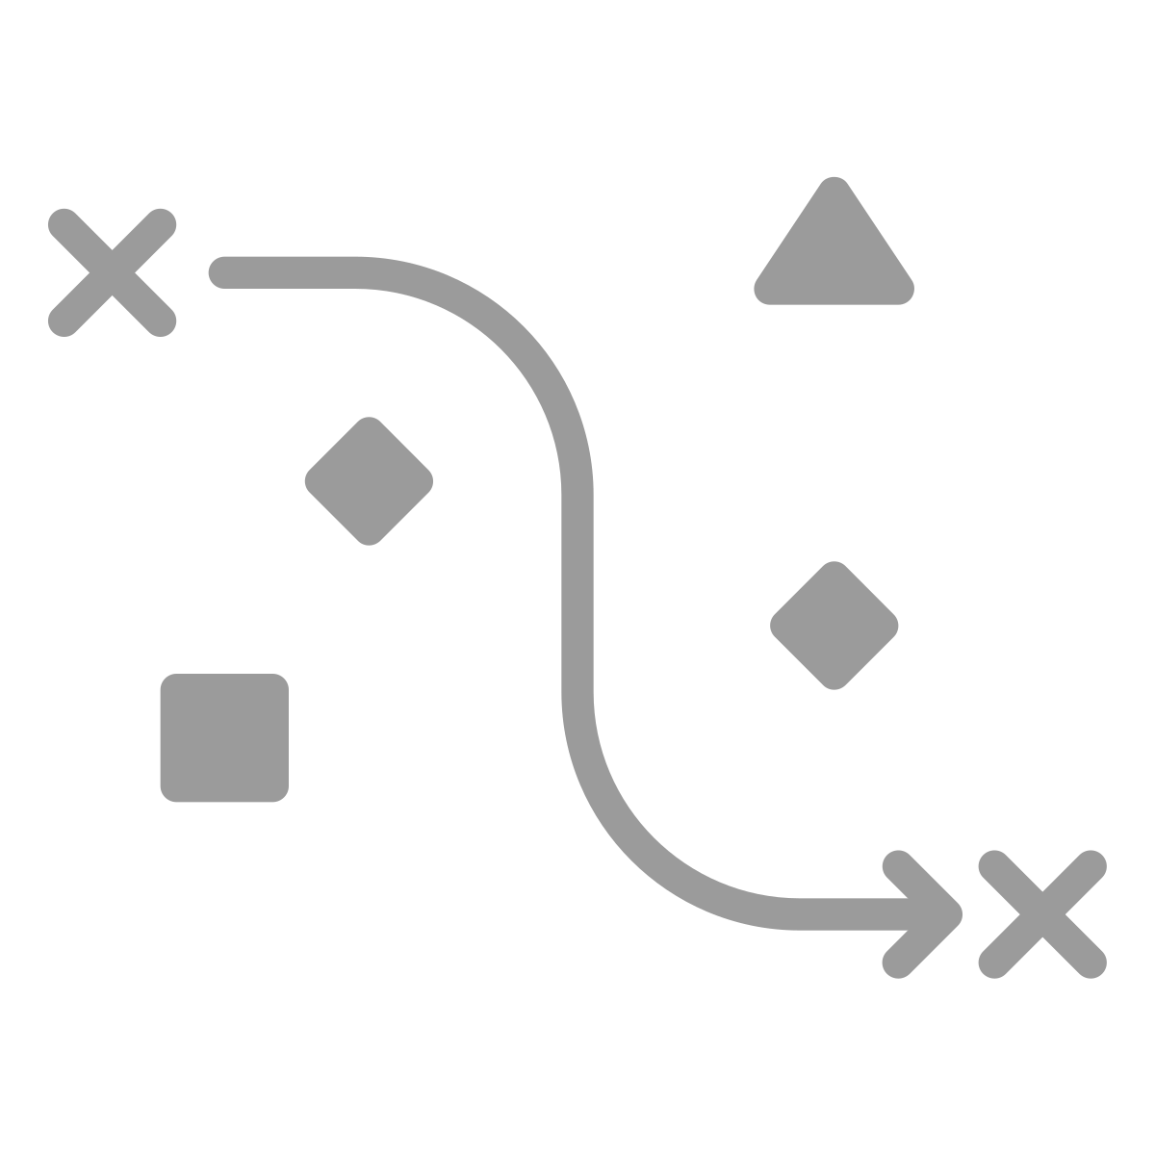
Instructional Design
Thoughtful selection of the corresponding standards in each content area
Clearly identified learning goals for each content area
  All lessons within the unit of study will not necessarily include each content area being integrated.
Assessment opportunities identified for each learning goal
Choice of effective integration approach
  Multidisciplinary, Interdisciplinary, or Transdisciplinary
-adapted from CA Arts Ed Framework page 627
Notes:
Chapter 8 of the CA Arts Education Framework outlines an instructional design strategy to create co-equal arts integrated learning experiences.
Page 627
*images from the Noun Project https://thenounproject.com/

Slide 19

Instructional Design Standards
Sequential, standards-based arts learning and instruction designed with the CA Arts Standards
https://www.cde.ca.gov/be/st/ss/vapacontentstds.asp
Content standards for each additional content area
https://www.cde.ca.gov/be/st/ss/
-adapted from CA Arts Ed Framework page 627
Notes:
CA Arts Standards https://www.cde.ca.gov/be/st/ss/vapacontentstds.asp and the content standards for each additional content area https://www.cde.ca.gov/be/st/ss/
*images from the Noun Project https://thenounproject.com/

Slide 20

Notes:
CA Arts Standards https://www.cde.ca.gov/be/st/ss/vapacontentstds.asp

Slide 21
Parts of the California Arts Standards
Artistic Process
Anchor Standards
Enduring Understandings and Essential Questions
Artistic Process Components
Performance Standards
Notes:
CA Arts Standards https://www.cde.ca.gov/be/st/ss/vapacontentstds.asp

Slide 22
The Four Artistic Processes
Creating (Cr) Conceiving and developing new artistic ideas and work. | Performing (Pr) (dance, music, theatre) Realizing artistic ideas and work through interpretation and presentation. Presenting (Pr) (visual arts) Interpreting and sharing artistic work. Producing (Pr) (media arts) Realizing and presenting artistic ideas and work. | Responding (Re) Understanding and evaluating how the arts convey meaning. | Connecting (Cn) Relating artistic ideas and work with personal meaning and external context.
Notes:
All 4 artistic processes “provide intersecting points for integration with other disciplines to cross curricular boundaries and deepen students’ understanding.” Add this to front matter and code where each of these take place in the learning sequences provided (4th grade example).
Pges 626, 627, 629

Slide 23
Artistic Processes | Anchor Standards: Students will…
Cr (Creating) | 1. Generate and conceptualize artistic ideas and work. 2. Organize and develop artistic ideas and work. 3. Refine and complete artistic work.
Pr (Performing, Presenting, Producing) | 4. Analyze, interpret, and select artistic work for presentation. 5. Develop and refine artistic work for presentation. 6. Convey meaning through the presentation of artistic work.
Re (Responding) | 7. Perceive and analyze artistic work. 8. Interpret intent and meaning in artistic work. 9. Apply criteria to evaluate artistic work.
Cn (Connecting) | 10. Synthesize and relate knowledge and personal experiences to make art. 11. Relate artistic ideas and works with societal, cultural, and historical context to deepen understanding.
Notes:
Each artistic process branches into either two or three anchor standards. Anchor standards describe the general behaviors, artistic skills and habits of mind that teachers expect students to demonstrate throughout their education in the arts. These anchor standards are parallel across arts disciplines and grade levels and serve as the tangible educational expression of artistic literacy.
CA Arts Standards page 8

Slide 24





The 5 Arts Disciplines
Dance | Media Arts | Music | Theatre | Visual Arts
Notes:
“While the new standards inform teaching and learning in the artistic disciplines of dance, music, theatre, and visual arts, they also reflect the significance of new standards for media arts. Media arts standards are intended to address the diverse forms and categories of media arts as a distinct, stand-alone discipline, including photography, digital imaging, video, animation, sound production, web design, graphic design, virtual design, interactive design, multimedia, virtual reality, and emerging forms. Media arts standards are also intended to be used in other disciplines.” CA Arts Standards page 5
*images from the Noun Project https://thenounproject.com/

Slide 25

Instructional Design Learning Goals
“Teachers identify the type of approach that fosters student agency and fits the learning objectives/goals for students in the content areas being integrated.”
Teachers need to know their students AND have clear learning goals/objectives that are in alignment with each other.
-adapted from CA Arts Ed Framework page 629
Notes:
Chapter 8 page 629
*images from the Noun Project https://thenounproject.com/

Slide 26
Instructional Design Learning Goals
“Teachers must have a good understanding of where the students are, and where they are meant to be—and the more transparent they make this status for the students, the more students can help to get themselves from the points at which they are to the success points, and thus enjoy the fruits of feedback” (Hattie 2012).”
-CA Arts Ed Framework page 64
Notes:
Chapter 2, page 64
*images from the Noun Project https://thenounproject.com/

Slide 27
Instructional Design Assessments
Aligned to the learning goals and standards
Authentic
Determine how students will demonstrate progress towards learning goals
Shared with students so they can track their own progress
-Adapted from CA Arts Ed Framework pages 627-629
Notes:
Page 627, 628, 629
*images from the Noun Project https://thenounproject.com/

Slide 28
Instructional Design
Choose an Integration Approach:
Multidisciplinary
Interdisciplinary
Transdisciplinary
Notes:
Chapter 8 of the Framework includes 3 of the integration approaches from Drake & Burns
Pages 629
*images from the Noun Project https://thenounproject.com/

Slide 29
Instructional Design: Choose an Integration Approach
Multidisciplinary
This approach focuses on a connecting theme common to each discipline.
Teachers using this model identify and employ the selected discipline standards to organize instruction and connect to the common theme.
-Adapted from CA Arts Ed Framework page 629 and 645
Notes:
Pages 629, 645
*images from the Noun Project https://thenounproject.com/

Slide 30
Instructional Design: Choose an Integration Approach
Interdisciplinary
This approach focuses on common big ideas or concepts that can connect, transcend, and support transfer of learning across content areas.
  Secondary teachers collaborate to organize instruction around common aspects of their content found within their respective standards.
-Adapted from CA Arts Ed Framework page 629 and 645
Notes:
Examples of big ideas or concepts can include literacy, thinking skills, numeracy, research skills, communication, etc. (Drake and Burns page 12)
Pages 629, 630, 645, 646
Search the CA standards: https://www2.cde.ca.gov/cacs/
*images from the Noun Project https://thenounproject.com/

Slide 31
Instructional Design: Choose an Integration Approach
Transdisciplinary
This approach is focused on grounding student learning through real-life contexts. It is centered around student questions and concerns that lead to acquisition of life skills.
-Adapted from CA Arts Ed Framework page 630 and 655
Notes:
One example is Project-Based Learning (Drake & Burns page 13-14)
Pages 630, 655
*images from the Noun Project https://thenounproject.com/

Slide 32
Instructional Design: Choose an Integration Approach
 | Multidisciplinary | Interdisciplinary | Transdisciplinary
Approach | Organized around a common theme. | Common big ideas or concepts connect, transcend, and support transfer of learning across disciplines. | Developed through student engagement in relevant, real-life community or school-based projects.
Instructional Planning | Teachers choose standards from selected disciplines. | Teachers collaborate to choose educational concepts or common big ideas across content areas. | Students are co-planners alongside teacher. Focus on students’ questions, concerns, and acquisition of life skills.
Student Engagement | Educators are facilitators and resources for student learning. | Students gain skills across disciplines to foster high-level thinking and deeper comprehension. | Focus on students’ questions and solving problems. Students gain experience in applying knowledge and interdisciplinary skills.
Assessment | Assessment may result in a culminating task that integrates all disciplines taught. | Assessment addresses interdisciplinary concepts, addressing each of the selected disciplines. | Assessment focuses on growing skills and understanding of cross-cutting concepts in a real world application.
-Adapted from CA Arts Ed Framework Chapter 8
Notes:
Create a pdf of this chart to download and share
https://drive.google.com/file/d/1xFY-ghQfkx0CANchWlbdG0WSmNbaY5Re/view?usp=sharing
Pages 629, 630, 632, 636, 643, 645, 646, 648, 649, 654, and 655

Slide 33

Arts Integration Logistics (1 of 2)
Effective, co-equal arts integration requires:
Professional learning (knowledge, confidence).
Time (to learn, plan, gather resources, reflect).
Resources,
  Support from Single-Subject Arts teachers on campus or in district.
  Support from artists from local arts institutions,
  Appropriate materials, supplies, and spaces
-Adapted from CA Arts Ed Framework Chapter 8
Notes:
See Chapter 9 of the CA Arts Education Framework for information on what is needed.
See Chapters 3-7 of the CA Arts Education Framework for detailed information specific to each of the five arts disciplines.
Pages 627, 628, 631, 632, 633, 634, 635, 636, 640, 645, 646, 647, 655, 657
*images from the Noun Project https://thenounproject.com/

Slide 34
Arts Integration Logistics (2 of 2)
Effective, co-equal arts integration requires:
Thoughtful planning,
  Attention to the individual standards and learning goals.
  Effective assessment strategies and tools for each integrated content area.
  Understanding and selection of effective and appropriate approaches to integration.
  Sequencing of instruction in all integrated areas.
-Adapted from CA Arts Ed Framework Chapter 8
Notes:
Pages 627, 631, 632, 645, 656, 659
*images from the Noun Project https://thenounproject.com/

Slide 35
Arts Integration Logistics: Elementary Educators
“In whatever integrated approach or model elementary teachers choose, it is critical to identify clear co-equal learning goals, develop and implement effective assessments of all content areas being integrated, and plan the sequence of learning in all the content areas to ensure student success.”
-CA Arts Ed Framework page 645
Notes:
Page 645
*images from the Noun Project https://thenounproject.com/

Slide 36
Arts Integration Logistics: Secondary Educators
“Arts integration at the secondary level provides avenues for students to build upon their elementary learning, deepen conceptual understandings, refine artistic practices, and bridge the compartmentalized learning that often exists within single-subject courses.”
-CA Arts Ed Framework page 645
Notes:
Page 645
*images from the Noun Project https://thenounproject.com/

Slide 37
Universal Design for Learning
“Ensuring students can access standards-based integrated instruction requires carefully planned units or lessons using Universal Design for Learning principles and guidelines that support and accommodate the diversity and variability of all learners.”
-CA Arts Ed Framework page 628
Notes:
Page 628

Slide 38
Universal Design for Learning
UDL is a framework that improves and optimizes teaching and learning for all people. It aims to change the design of the environment rather than to change the learner. When environments are intentionally designed to reduce barriers, all learners can engage in rigorous, meaningful learning.
-SDCOE@ https://www.sdcoe.net/educators/universal-design-for-learning
Notes:
https://www.sdcoe.net/educators/universal-design-for-learning

Slide 39
Universal Design for Learning
Acknowledges student have variability and promotes designing instruction that leverages that variability
Designs to increase educational equity from the start by removing barriers
Teachers to the spectrum of learners
Is a mindset (all can succeed) and a skillset (of removing barriers)
-SDCOE@ https://www.sdcoe.net/educators/universal-design-for-learning
Notes:
https://www.sdcoe.net/educators/universal-design-for-learning

Slide 40
Universal Design for Learning
“Through the UDL framework, the needs of all learners are identified, and instruction is designed specifically to address student variability at the first point of instruction. This evidence-based instructional planning supports students’ full inclusion in (every arts discipline) and reduces the need for follow-up instruction.”
-CA Arts Ed Framework page 162, 262, 358, 468, 588
Notes:
Additional resources on UDL can be found in the CA Arts Ed Framework:
Page 58: “The standards embody the principles of instructional design that begins with the outcome in mind—often called backward design—and Universal Design for Learning (UDL). Backward design focuses on what students will know and be able to do and how they will demonstrate it; UDL focuses on providing instruction that recognizes and removes barriers to learning for all students. When developing instruction using backward design, principles of UDL, and the content, skills, and processes of the arts disciplines, the arts standards become a powerful tool for teaching and learning.”
Page 59: Applying UDL principles when planning standards-based arts instruction is vital to ensure content is accessible for all students.
Page 88: Universal Design for Learning (UDL) provides guidelines for creating supportive learning environments.
Page 89: Through UDL, teachers can create an instructional context that accounts for the needs of each student.
Page 121: The process of reflecting provides options for students to self-regulate their own learning as they engage in their classroom experiences, and is a fundamental component in the Universal Design for Learning (UDL) guidelines (CAST 2018). When students develop skills to self-regulate, they can assess their own growth and gain the self-discipline and resilience necessary for learning dance. These self-reflective skills and habits learned through dance education can transfer to other areas of their lives.
Pages 161-162, 261-262, 358, 468, 588: “Universal Design for Learning (UDL) is a research-based framework for improving student learning experiences and outcomes through careful instructional planning focused on the varied needs of all students, including students with visible and nonvisible disabilities, advanced and gifted learners, and English learners. The principles of UDL emphasize providing multiple means of representation, action and expression, and engagement and options for various cognitive, communicative, physical, metacognitive, and other means of participating in learning and assessment tasks. Through the UDL framework, the needs of all learners are identified, and instruction is designed specifically to address student variability at the first point of instruction. This evidence-based instructional planning supports students’ full inclusion in every arts discipline and reduces the need for follow-up instruction.”

Slide 41
Universal Design for Learning
Additional UDL resources are available throughout the CA Arts Education Framework.
https://www.cde.ca.gov/ci/vp/cf/
Notes:
Additional resources on UDL can be found in the CA Arts Ed Framework:
Page 58: “The standards embody the principles of instructional design that begins with the outcome in mind—often called backward design—and Universal Design for Learning (UDL). Backward design focuses on what students will know and be able to do and how they will demonstrate it; UDL focuses on providing instruction that recognizes and removes barriers to learning for all students. When developing instruction using backward design, principles of UDL, and the content, skills, and processes of the arts disciplines, the arts standards become a powerful tool for teaching and learning.”
Page 59: Applying UDL principles when planning standards-based arts instruction is vital to ensure content is accessible for all students.
Page 88: Universal Design for Learning (UDL) provides guidelines for creating supportive learning environments.
Page 89: Through UDL, teachers can create an instructional context that accounts for the needs of each student.
Page 121: The process of reflecting provides options for students to self-regulate their own learning as they engage in their classroom experiences, and is a fundamental component in the Universal Design for Learning (UDL) guidelines (CAST 2018). When students develop skills to self-regulate, they can assess their own growth and gain the self-discipline and resilience necessary for learning dance. These self-reflective skills and habits learned through dance education can transfer to other areas of their lives.
Pages 161-162, 261-262, 358, 468, 588: “Universal Design for Learning (UDL) is a research-based framework for improving student learning experiences and outcomes through careful instructional planning focused on the varied needs of all students, including students with visible and nonvisible disabilities, advanced and gifted learners, and English learners. The principles of UDL emphasize providing multiple means of representation, action and expression, and engagement and options for various cognitive, communicative, physical, metacognitive, and other means of participating in learning and assessment tasks. Through the UDL framework, the needs of all learners are identified, and instruction is designed specifically to address student variability at the first point of instruction. This evidence-based instructional planning supports students’ full inclusion in every arts discipline and reduces the need for follow-up instruction.”

Slide 42
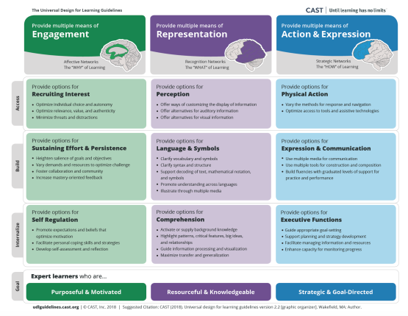
Universal Design for Learning
-CAST@ https://www.cast.org/impact/universal-design-for-learning-udl
Notes:
https://www.cast.org/impact/universal-design-for-learning-udl

Slide 43
Is it Arts Integration?
Have standards been selected for two or more content areas?
Are there co-equal learning goals/objectives connected to each content area?
What standards are being assessed?
  Integrated instruction can include standards in other content areas without assessing them.
-Adapted from CA Arts Ed Framework Chapter 8
Notes:
The questions listed here will get you started on the journey of determining whether lessons, resources, or materials are integrated.

Slide 44
Is it Arts Integration?
Can you determine which approach to arts integration is being used?
  Multidisciplinary, Interdisciplinary, or Transdisciplinary
Do you see a clear sequence of instruction?
What opportunities exist for student engagement?
-Adapted from CA Arts Ed Framework Chapter 8
Notes:
The questions listed here will get you started on the journey of determining whether lessons, resources, or materials are integrated.

Slide 45
Arts Enhancement
An Arts Enhanced Activity is an Arts activity that acts as a mechanism to engage students without instruction in the arts discipline itself. It uses the arts as a tool to assist in learning a different content area/subject.
-adapted from CA Arts Ed Framework pages 657-658
Notes:
Examples of using the arts as a mechanism to engage students using a song to learn state capitals or the periodic table of elements, or the water cycle, illustrating a story, coloring a map without purpose, etc.

Slide 46
Moving Arts Enhancement to Arts Integration
How could you take an arts enhanced activity or lesson and move it to arts integration?
Remember, Arts Integration is about making connections.
-Adapted from CA Arts Ed Framework Chapter 8
Notes:
Record your thoughts to keep and share them with a partner or small group.

Slide 47
Moving Arts Enhancement to Arts Integration
Review the CA Arts Standards at a specific grade level to discover connections.
Consider the Multidisciplinary, Interdisciplinary, and Transdisciplinary approaches.
Determine how you can access your students’ interests.
-Adapted from CA Arts Ed Framework Chapter 8
Notes:
The ideas listed on this slide are provided as ideas to transform an arts enhanced activity into arts integration.

Slide 48
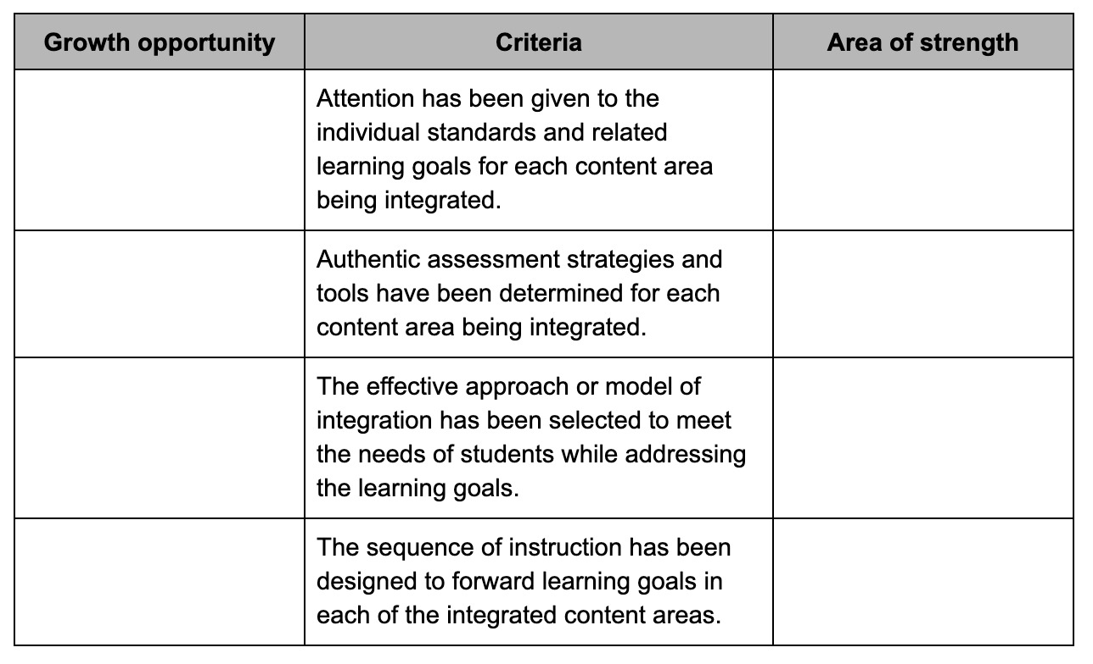
Moving Arts Enhancement to Arts Integration
Notes:
Entire Chapter

Slide 49
Arts Integration Summary
“Students need thoughtful, well-planned, and implemented instruction that connects their learning across many subjects and prepares them for life in a global, interconnected world. It is critical to understand that integrating content areas in a co-equal approach is not a replacement for specific discrete instruction in any content area. When choosing a model of co-equal integration, the purpose must be clear and the model aligned purposely. The goal should be authentic and co-equal student learning in each content area addressed.”
-CA Arts Ed Framework page 656
Notes:
656
What responses do you have to this quote? Capture your thoughts and share them with a partner.

Slide 50

Reflection and Next Steps
Reflect on your arts integration learning experience. Record your responses and share with a partners.
What are your next steps to strengthen your integration practices? What resources will you need to move forward?
What support will you need? Who can you reach out to for support or collaboration in this journey?
Notes:
Complete this reflection and capture your next steps. Add your next steps to your calendar to help ensure they take place.
*images from the Noun Project https://thenounproject.com/

