Slide 1
High School Music & Computer Science
Integrated Unit
Learning Sequence #2

Slide 2

Unintended Impacts:
Did the Technology Industry Wreck the Music Industry or Save it?
As you learn more about writing computer code in this unit, we’ll also be looking at how the consumption of cultural and entertainment media has changed; specifically in the music field.
(Source: Wikimedia Commons)
2

Slide 3

Prelude
You may or may not be surprised at the intersection of computing technologies and an art form that has existed since the dawn of humankind. We’ll examine and discuss this intersection in technical, sociological, and personal ways. In this learning sequence we’ll look at the structure of how we listen to music and the way that has changed over time. We’ll look at the technical innovations which brought music listening to computer platforms and we’ll also explore the structure of the computer technology industry [namely internet related companies] and the unplanned consequences of when those industries collided. We’ll explore these ideas as we learn more deeply about writing computer code and programming through the following questions:
How do you connect to music?
How has music been heard in the past?
What did technology bring to music?
Did the technology industry wreck the music industry or save it?
(Source: “Wurundieri Tribe” Jacqueline Suttin under CC v3.0)
3

Slide 4

Connecting to and Experiencing Music
Many people connect with music in a very personal way. Artists tell stories and evoke emotions in us that feel unique and fit into the story of our lives. There are many different ways to experience music and each one has its own subtle differences to the others.
(Source: Piasels)
4

Slide 5
Your Music Story (1)
Take some time to write thoughtful answers to the following questions:
What is your favorite song lately? Who is the artist(s) that performs that song? What do you know about them?
How is it that you’ve heard that song? Did you hear it on the radio? Did you discover it on Spotify? Did an adult play it for you?
What about the song do you like? Is it the lyrics? The way the melody moves? The rhythm? What about that element speaks to you?
How does the song make you feel?
Do you know of other artists that are similar to this one? What about their music reminds you of the first artist you wrote about?
5

Slide 6
Your Music Story (2)
Take some time to write thoughtful answers to the following questions:
Ask a trusted adult in your life (someone like your teacher, your parents, even better yet, your grandparents) how they discovered music when they were young. Ask them the following questions and note their responses:
  How did they discover music when they were young?
  Do they recall a favorite song? Who was the artist? Were they popular? Why?
  What about that song was special? Was it the lyrics? The melody? The rhythm? What made that element so special?
  How much did music cost when they were young?
How is the adults’ story of their youth similar to yours? How is it Different?
Share with the class (or post online in the manner your teacher tells you) your current favorite song and why. Then, tell some of the stories you learned about one the adults in your life.
6

Slide 7
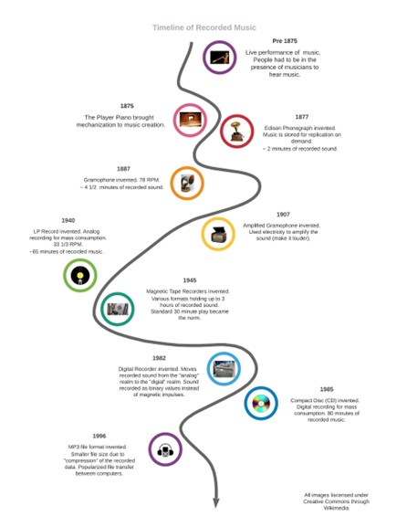
How has music been heard in the past? (1)
Read this Britannica Sound Recording article about audio recordings.
Also, read Britannica CD-ROM article about computers and CD’s. Make notes of information you think is important. You may also find this timeline helpful after you read.
(Source: M. Lantsberger, personal collection)
7
Notes:
https://school.eb.com/levels/middle/article/sound-recording/273007
https://school.eb.com/levels/middle/article/CD-ROM/1430

Slide 8
How has music been heard in the past? (2)
After you’ve read the article, record your answers to the following questions. Feel free to return to the articles to review information if you need to.
In a general way, describe the difference between analog and digital recordings.
Early digital recordings were sold on CD’s starting in the 1980’s. Why weren’t those recordings sold on the internet?
Computer programs, or applications (Apps), used to be sold to people on CD’s just like music! What do you think the experience looked like if you couldn’t “download” an App? Is there a trusted adult you could ask about this? Ask them!
For that matter, what do you think the experience looked like if you couldn’t “download” a song? Is there a trusted adult you could ask about this? Ask them!
How are those experiences different from what you experience today?
It seems that digital recordings and the invention of the personal computer happened at similar times. With your understanding of how computers work, do you think there is much difference in how a CD holds audio information and how it holds text, pictures, or programs? Why or why not?
Share your responses with the class or in a small group.
8

Slide 9
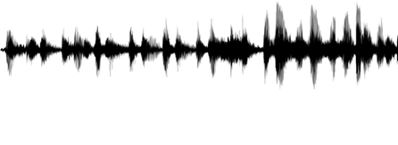
Part 2: What did Technology bring to Music?
You’ve recently thought about how technologies changed the way people listen to music over time. As computer scientists, you’re likely interested in how the digital recordings are captured. Further, how is that data actually stored within a system! The screenshot is of an audio file and what it can look like when represented visually in a software tool. The waveform shown below is a mono digital recording of a drum kit and lasts about 15 seconds.
You’ve been learning about data abstraction lately in your class. Most notably about data representation (how we use numerical values to represent particular meaning) and abstract data types. Examples of these types may be like a list containing many values or if you’ve worked in Scratch, it’s the idea of a Sprite which can hold many different values within itself.
(Source: M. Lantsberger, personal collection)
9

Slide 10
How Sound is Recorded (1)
Read How Analog and Digital Recording Works and make notes about information you think is important. The beginning may seem like a review, but it contains important understandings so read it carefully! As you read, remember to think like a computer scientist and consider:
What data do we have here?
How could that be stored in a computer system using variables?
If this digital data is stored in a file (like a .wav or .aiff) how might we organize the variables holding the data?
Create a “How sound is recorded” journal entry taking notes about information you think is important.
10
Notes:
https://electronics.howstuffworks.com/analog-digital.htm

Slide 11
The Encoding Process (1)
Some extra information which may not be clear from the article is how this data is transferred back into sound we can hear?
The encoding process is reversed!
The digital data is converted back into electrical impulses which are then amplified (given extra power) to move the cone on a loudspeaker, often just called a speaker.
11

Slide 12
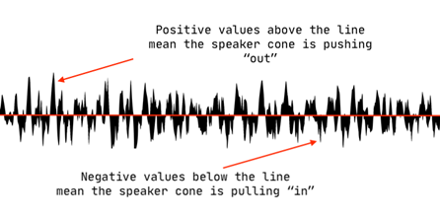
The Encoding Process (2)
The screenshot below is the same waveform shown earlier. However, we’re only looking at about ¾ of one second of information. We’ve “zoomed in” on the timeline. The center red line (a.k.a. The Zero Line) is when the speaker cone is at rest, or in the neutral position. This is the same position the cone would be at when there is no sound being played at all. The cone driver (a magnet) pushes out and pulls in from neutral with the same action you “see” in the waveform above. This is why a speaker seems to be “bouncing” when music is played through it, especially when loud!
(Source: M. Lantsberger, personal collection)
12

Slide 13
How Sound is Recorded (2)
Record your answers to the following questions below the notes you’ve made in your “How Sound Is Converted” journal entry. Feel free to return to the article to review information if you need to.
In your own words, describe sampling rate and sampling precision. How do changes in these qualities affect the result of audio capture?
For a computer to keep this sampled audio data in RAM, how would you organize it? What names (or identifiers) would you use for the variables and what would be stored there?
We’re told that CD’s can hold 74 minutes of stereo audio content. How many megabytes (MB) of information is that? What are some of the differences in audio files which could alter the number of minutes a CD could hold?
How many MB of storage would a 4 ½ minute song require?
By way of comparison, a small, typical, .jpeg graphic you see on an internet page is between 5 and 10 KB. How many times bigger do you think our 4 ½ minute audio sample would be?
Ask a trusted adult if they can recall when they first started listening to music on a computer (if they have)?
Share your responses with the class or in a small group
13
Notes:
https://electronics.howstuffworks.com/analog-digital.htm

Slide 14

Part 3: How’s That Sound to You?
As digital recording progressed, many people noticed a difference in sound quality between analog and digital sounds. If you’ve ever listened to the same song on a vinyl record and on a CD you may have noticed differences yourself! These differences sparked passionate debate in the music and recording industries and amongst avid music fans. Some people noticed differences, others didn’t.
(Source: “howz the sound?” Licensed under CC0)
14

Slide 15
The Debate over Vinyl and CD Sound Quality
Listen to the broadcast Why Vinyl Sounds Better Than CD, Or Not to hear audio professionals discussing this debate. The transcript of the conversation is below the audio player found at the top of the page. Listen up to the 14:30 minute mark only.
Make notes of information you think is important
After you’ve heard the broadcast, add your answers to the questions on the next slide below the notes you’ve made in your “How Sound Is Converted” journal entry. Feel free to return to the broadcast to review information if you need to.
15
Notes:
https://www.npr.org/2012/02/10/146697658/why-vinyl-sounds-better-than-cd-or-not

Slide 16
The Debate over Vinyl and CD Sound Quality (2)
Have you ever heard the same song on a vinyl record and then in digital format? Did you hear any difference? What was that difference and describe the experience.
Ask a trusted adult if they’ve had any experience with this comparison. Write about that.
Tell something that was said in the broadcast which caught your attention or was a new idea to you. Tell about the person who said it, what they said, and why that statement resonated with you.
How do you view yourself? Do you “consume” music while engaged in a variety of activities? In what circumstances do you do this? Or is listening to music a “ritual” for you? Meaning you find a time and space to listen as well as look over associated artwork or lyrics while you’re listening. Are you a “ritual” listener or a “consumer”? Are you both at different times?
With what you’ve heard, how do you think audio professionals made the decision of what sampling rate and sampling precision was “good enough” to maintain audio quality (a.k.a. fidelity)?
Share your responses with the class or in a small group
16

Slide 17
A Little Smaller Would be Better…
Could you hold the above record (or CD’s for that matter) in your jacket pocket? With what you’ve learned about raw audio files (.wav and .aiff) and their size you can likely guess that audio files needed to evolve. As the internet started to grow in the mid to late 90’s, music creators found a problem with the fast-changing system. Their files were too big to transport easily and move across the internet! A way to compress or reduce the size of the file and still maintain CD quality was needed and the .mp3 file format was born.
Read How the Phonograph Revolutionized Sound Recording to get some history of the .mp3 file format. Make notes of information you think is important.
17
Notes:
https://science.howstuffworks.com/innovation/everyday-innovations/invented-mp3s.htm

Slide 18
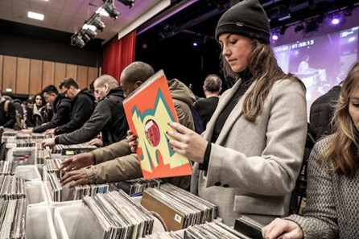
The Debate over Vinyl and CD Sound Quality (3)
Listen to the remainder of the earlier broadcast to hear audio professionals discussing this debate. The transcript of the conversation is below the audio player found at the top of the page. Listen after the 14:30 minute mark to the end. Make notes of information you think is important.
(Source: “Unnamed” Pixabay)
18
Notes:
https://www.npr.org/2012/02/10/146697658/why-vinyl-sounds-better-than-cd-or-not

Slide 19
The mp3 File Format
After you’ve read the article and heard the final part of the broadcast, record your answers to the following questions. Feel free to return to the article and broadcast to review information if you need to.
Describe some of the ways which audio files are “compressed” using the mp3 codec. You don’t have to give exact math formulas, but write generally about why these files came to be known as “lossy”.
Patent laws help developers of a process or methodology get compensation for what they developed. This file format was developed (and licensed) by many people. Reread the “Microsoft’s Big Payout” text box. This is clearly a complex situation! Describe in your own words the nature of this legal conflict.
The mp3 file format was well designed for use across the internet. What made it wildly popular with music consumers and why?
Reread the “Author’s Note” at the end of the article. Consider a “ritual” type of listener of music (introduced in the previous section) and how they value the experience of listening. Do you know what a b-side is? If so, tell about that and why it could be important to a “ritual” listener. If not, what do you think it might be?
According to this author, why might you be confused by the previous question?
Share your responses with the class or in a small group
19

Slide 20

Part 4: Did the Technology Industry Wreck the
Music Industry or Save it?
For many years, artists and the recording industry earned their living from producing music recordings, creating copies of them, and selling them to people. This was the structure of the entire industry. Whether those sales were through analog LP recordings or digital CD recordings, artists and record companies are the only individuals who legally have the right to copy their work for sale. This is known as a copyright and the entire recording industry grew and thrived with this arrangement.
(Source: CD’s by Petr Kratochvil in the Public Domain)
20

Slide 21
The Structure of a Whole Industry
In the technology industry, programmers and software companies also are copyright holders. The structure of this industry, like the music industry, exclusively sold software products which they developed.
Sales from the products of these two industries are what support the growth, expansion, an improvement of future products as well as development of the talented people who create them.
21

Slide 22
The Structure of a Whole Industry (2)
Think about the following questions and share your thoughts with a partner or the class
Why do you think that music and software creators feel that copyright is an important legal idea? What is their benefit?
Name the different ways you listen to music. Is there a price you pay for those listening experiences? It may not be just money!
Name the different ways you use devices and the Apps on them. Is there a price you pay for those computing experiences?
Do you think it’s fair for creators to charge some kind of fee for the products they create? Why or why not?
22

Slide 23
Data is Data
One way that musicians survive and thrive is through the sale of their art. When physical copies of their work were sold, the money trail was easy to track, although some would say intentionally made complicated by the recording industry. Digital distribution has made that accounting more complex.
23

Slide 24

Metadata: Not Yet Standardized
One of the issues here is metadata. As we’ve learned, songs and sounds are captured as digital data in computer systems. The sound files are 1’s and 0’s, just like text or any other information in a digital system. With file formats like .mp3 and .mp4, it's simple to add more information to the file such as who the artist is, what the title of the work is, and who produced it. This metadata is how you see the name of the artist and the title of the song on your music player or your computer. However, this data hasn’t been standardized yet!
(Source: Pixabay)
24

Slide 25
The Problem of Metadata
Read Metadata is the biggest little problem plaguing the music industry to get further insights into the problem this can pose for the music industry. Make notes of information you think is important.
After you’ve read the article, record your answers to the following questions in the journal space you’ve already reserved. Feel free to return to the article and broadcast to review information if you need to.
Discuss the context and nature of 2 different metadata problems raised in this article.
Who is to blame for these two problems?
Do you think the issues are the result of intentional actions or inactions?
What solutions would you pose to solve these problems?
Share your responses with the class or in a small group
25
Notes:
https://cacountyarts.org/wp-content/uploads/Metadata-is-the-biggest-little-problem-plaguing-the-music-industry-_-The-Verge.pdf

Slide 26

Part 5: And Then, Everything Changed…
In the 90’s many people started asking questions about the products they purchased. They felt music was expensive to buy on CD. They felt that software was VERY expensive to purchase. In the late 90’s a new idea, the internet, was becoming more available to a larger group of people. A young, 18 year old college student had an idea which impacted both the music and technology industries.
(Source: Napster logo by Napster licensed under the Creative Commons Attribution-Share Alike 4.0 International)
26

Slide 27
Napster Brings Industry Changes
Be prepared to take notes as you watch the documentary on Napster. The video is about how the music industry changed in recent history. The video will be paused at certain times (listed on this handout) for you to answer some questions and/or record your thoughts.
27
Notes:
https://www.youtube.com/watch?v=CKrdsGdLVQ8
https://cacountyarts.org/wp-content/uploads/Napster-Documentary-Questions.pdf

Slide 28
Part 6: Understanding Unplanned Consequences
We’ve been looking at the story of how structures that exist in the world around us can be truly challenged by a new idea.
Take a few minutes to review your thoughts and answers to the previous activities about structures in the music recording industry and what you’ve learned about data and how it’s represented in the digital realm. Focus on what you’ve learned which was new.
28

Slide 29
Reflection on New Learning
Think about the following questions and share your thoughts with a partner or the class
Do you think Shawn Fanning intended to change an entire industry when he thought of his big idea?
Clearly the structure of the music industry changed. What do you think was good about that?
What do you think was bad about that?
In your opinion, should people consider what bad things might happen before they pursue their own “big idea”? Why is that important?
Discuss how data representation and Abstract Data Types play a role in music technology.
What was a new thing you learned in this Unit which surprised you? Why?
What is something you still wonder about our learnings in this Unit?
Write down new things you’ve learned and your thoughts about them.
29

Slide 30
Self Reflection
Reflect on your thinking, learning, and work throughout this learning sequence.
What were you most proud of?
Where did you encounter struggles, and what did you do to deal with it?
What about your thinking, learning, or work brought you the most satisfaction? Why?
How were you curious throughout the learning sequence?
What new skills and/or information did you learn?
30

