Slide 1
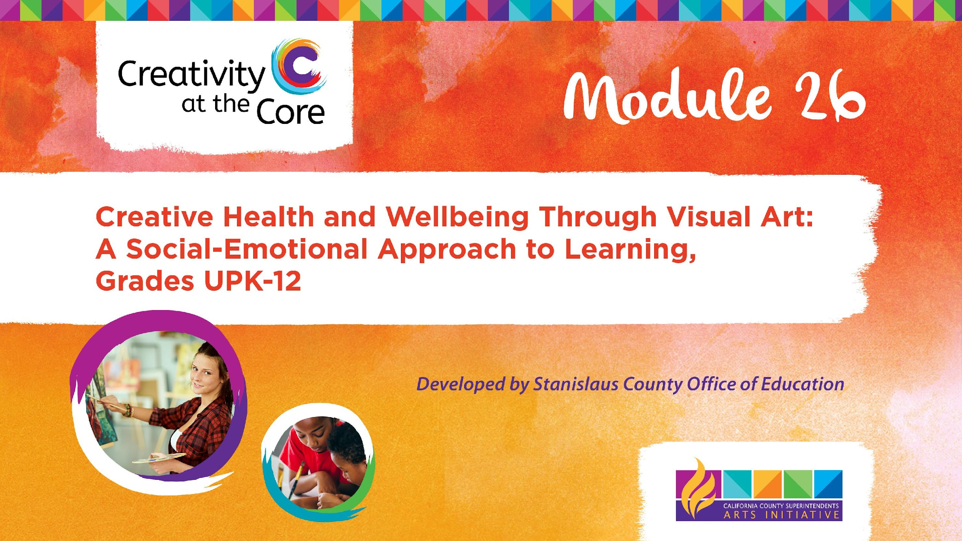
Educator Project: Mandala for Self-Discovery​

Slide 2
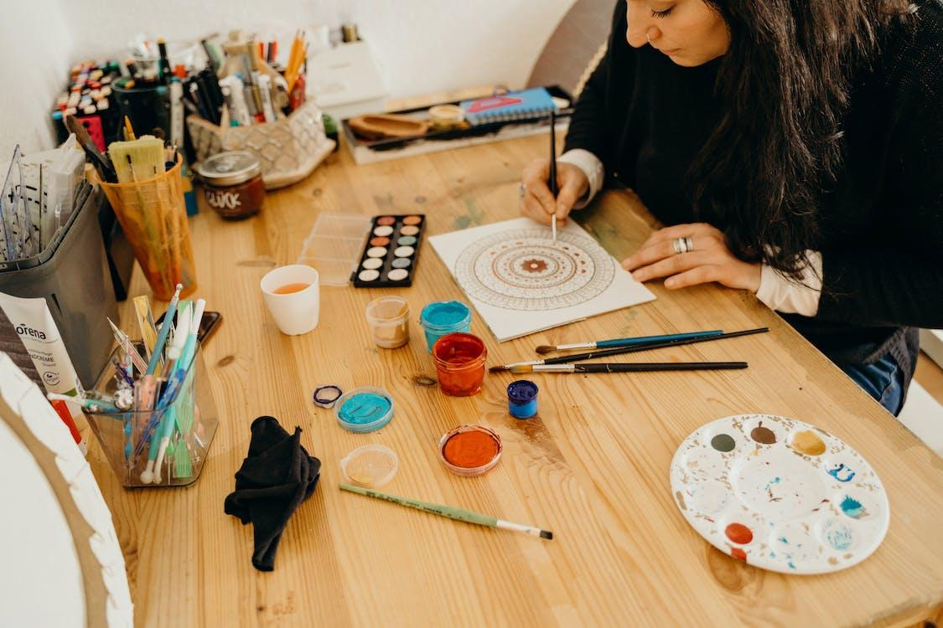
Educator Project: Mandala for Self-Discovery
Learning Outcomes
Create a personal mandala.
Notes:
https://www.pexels.com/photo/woman-in-black-sweater-painting-on-white-paper-in-the-table-7182282/

Slide 3
Educator Project: Mandala for Self Discovery
SEL Core Competencies Addressed
Self-Awareness
Self-Management

Slide 4
Educator Project: Mandala for Self Discovery
Materials Needed
Follow your intuition about what materials are best for you; suggestions include:
Pencil and paper
Colored pencils, pastels, crayons, markers, chalks, pastels, charcoal
Paints, watercolors, tempera, colored inks
Collage materials: magazines, fabrics, photos, found objects, images, paper, construction paper, scissors, glue
Notes:
https://www.flickr.com/photos/naivepaintings/42406671740/in/photolist-27Bkh5L-29gE9mu-hotT5g-QoxxVP-bmUai3-Qoxvcc-z57iCR-29gE9w9-27BkiDs-29gE9q7-2aewtY2-5kETh8-28Z3Vxa-cMnA7W-2991vqS-29gE9id-29gE8CL-e9uJ5Z-iMeym-e9AoWs-NeEaxy-e9AopE-cMnA3s-2aewtZK-e9Ao8j-2aewu7i-2991vuE-5W4pis-dB1EZ4-29gE8WG-63u5np-cMnAd7-29gE9f7-28Z3WnB-29gE9y3-62Yv2h-89gGyg-2991vu9-z9QsV3-zrreY2-2kSoH9H-597YKq-cMnAn3-2aewu5z-AsNZTr-cMnzG5-2991vvw-cMnAgW-23GF4Ww-7k6oW4

Slide 5
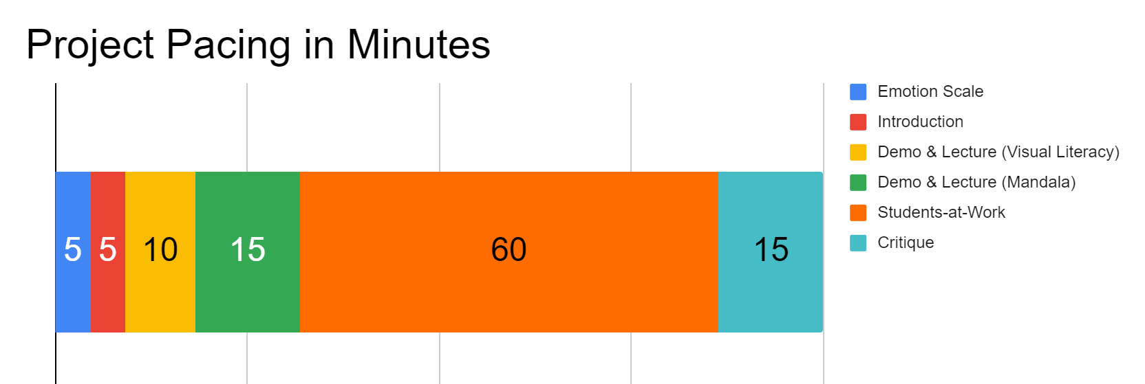
Project Pacing
For the Students-at-Work block: The timing is really up to you, the artist.
Pacing structure follows the guidance of the Studio Habits of Mind framework.

Slide 6
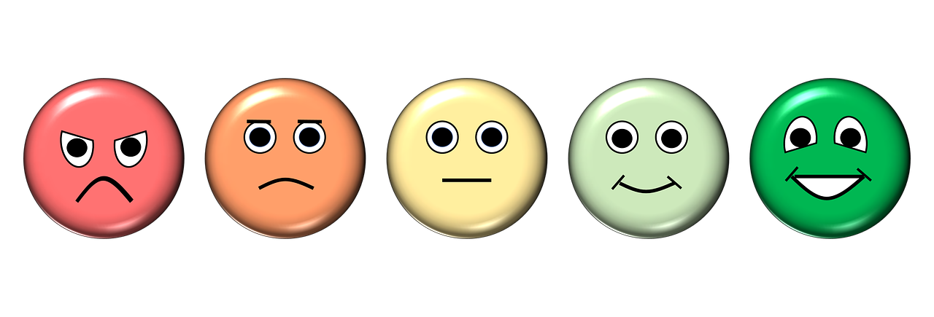
How are you feeling right now?
Notes:
https://pixabay.com/illustrations/emotion-scale-emoji-icon-feedback-3404484/

Slide 7
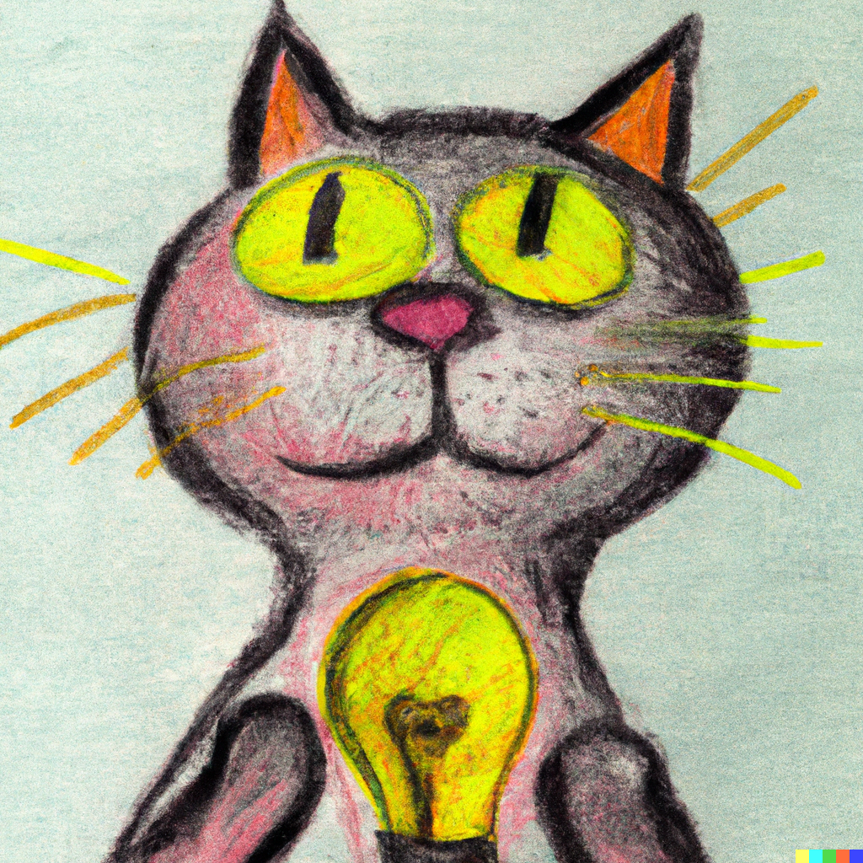
Introduction
Goals for this creative experience:
Be present not perfect
Use positive language to talk about what you and others create
Feel better than when you started
Notes:
Artwork generated in Dall-E AI based on a prompt by Amy Bultena

Slide 8
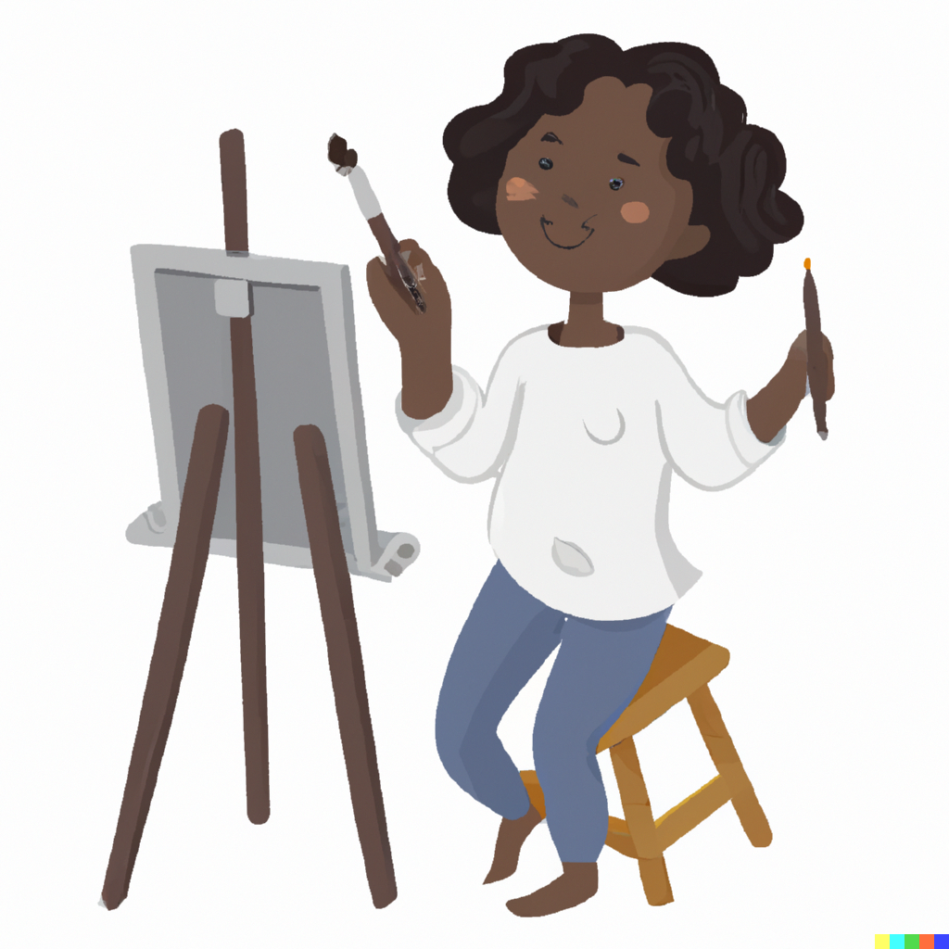
Introduction
It’s science!
Did you know that art is scientifically proven to make us feel better?
Notes:
Artwork generated in Dall-E AI based on a prompt by Amy Bultena

Slide 9
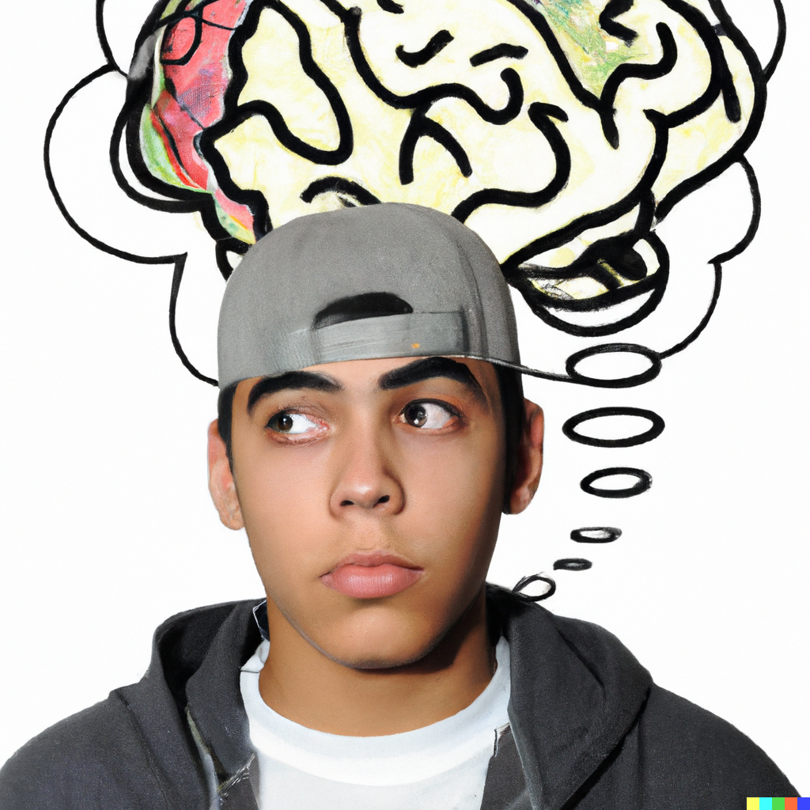
Introduction
We are going to create art to help us:
Feel better
Think about ourselves
Notes:
Artwork generated in Dall-E AI based on a prompt by Amy Bultena

Slide 10
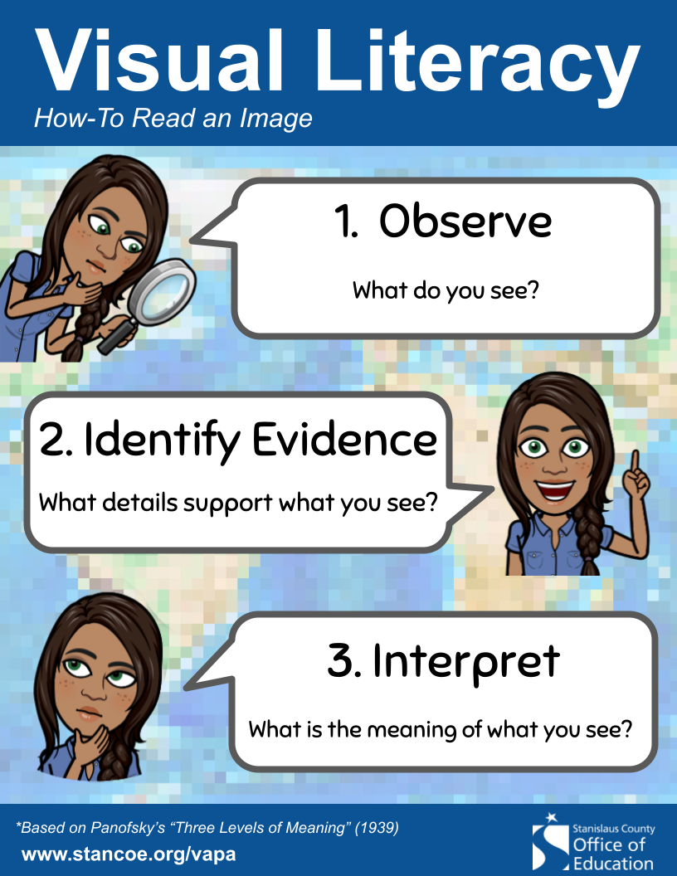
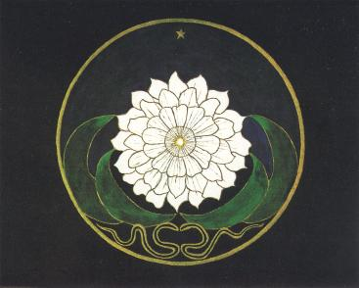
Demo & Lecture: Visual Literacy
Notes:
Image from Alchemical Studies, The Collected Works of C.G. Jung, 1967
https://commons.wikimedia.org/wiki/File:Mandala_Golden_Flower_Jung.JPG

Slide 11
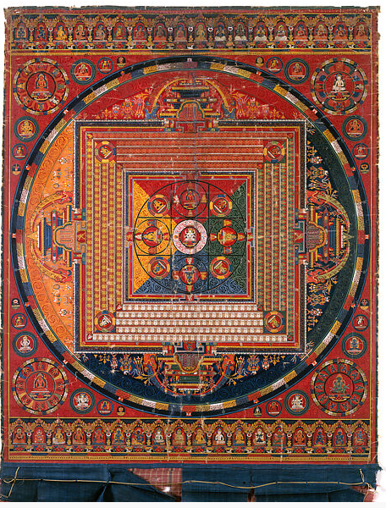
Demo & Lecture: Mandala
Mandala, or sacred circles, originated in Eastern spiritual traditions as veneration of the primordial Mother Goddess.
Mandala evolved with the development of Hinduism, Buddhism, Taoism, and other spiritual practices.
Vajradhatu (Diamond Realm) Mandala, Central Tibet, 14th Century
Notes:
https://commons.wikimedia.org/wiki/File:Mandala_of_Vajradhatu.JPG
information in this power point
taken from a presentation by
Susanne Fincher, ATR-BC, LPC and
Diana Gregory, PhD
2008 AATA National Conference
Cleveland, OH

Slide 12
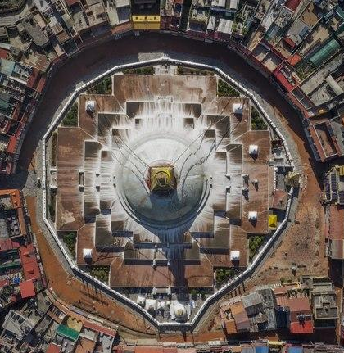
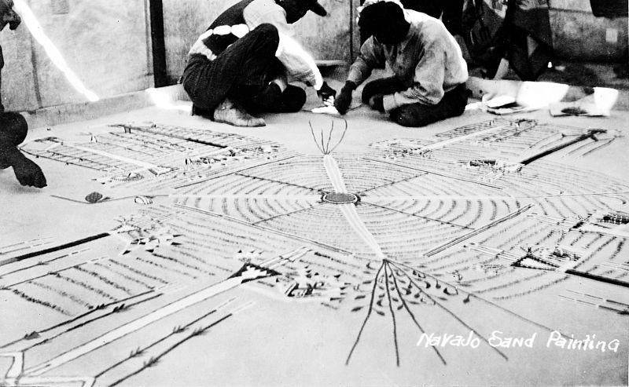
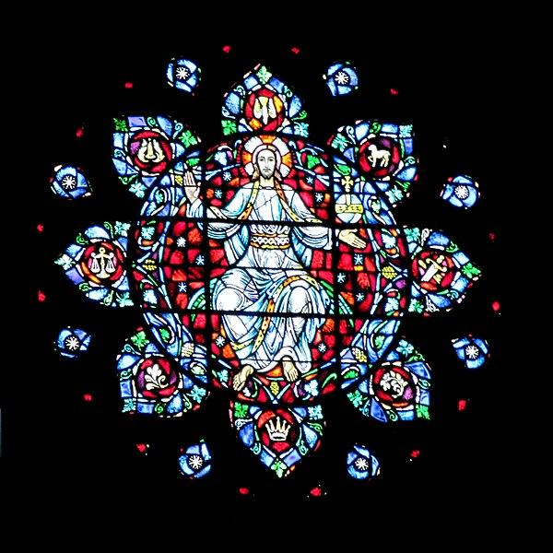
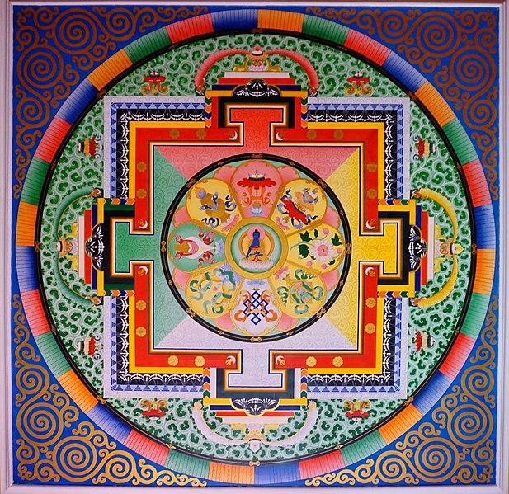
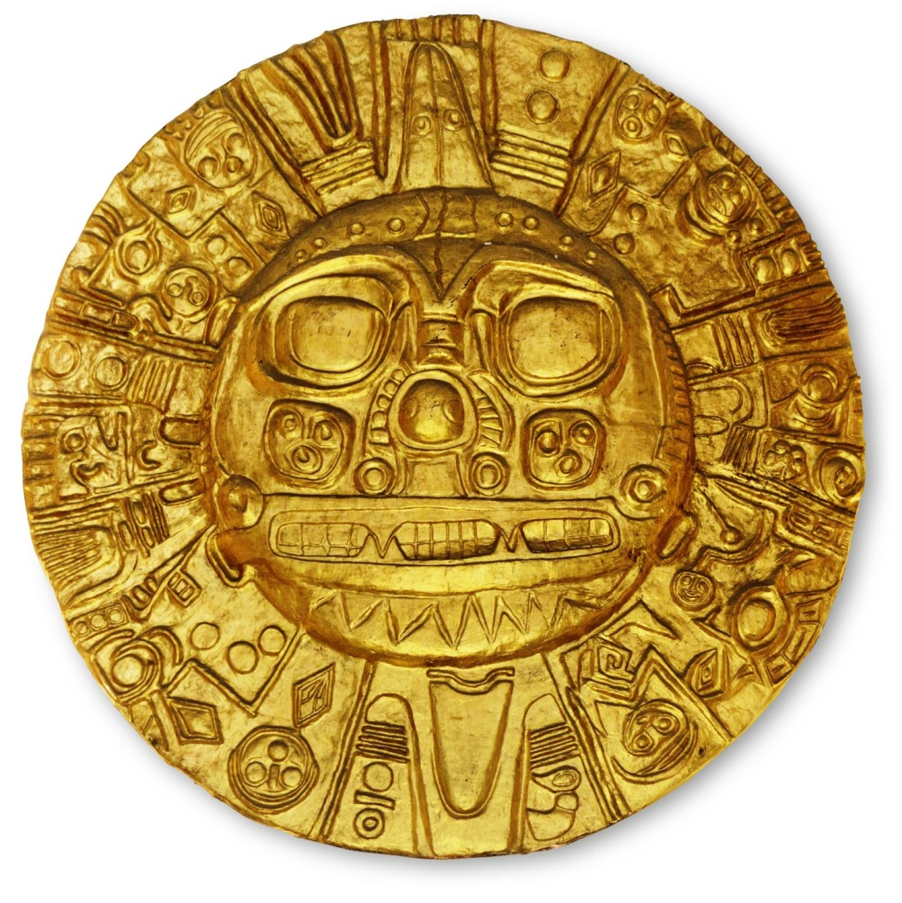
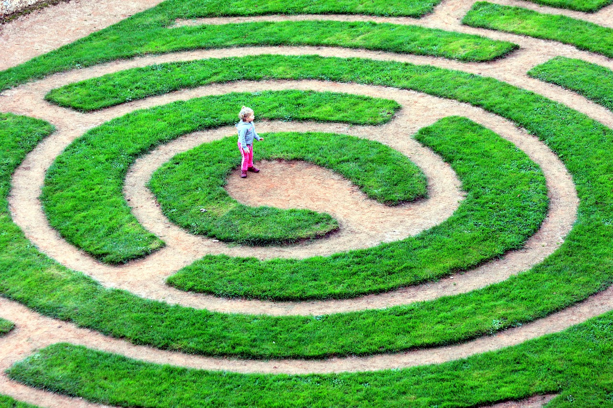
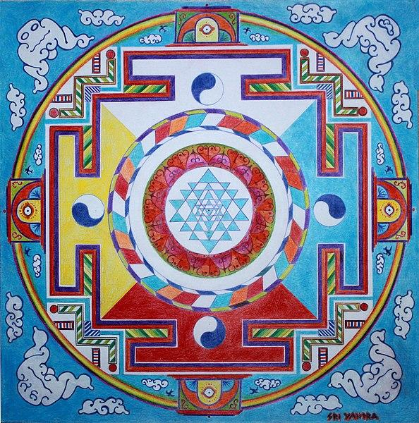
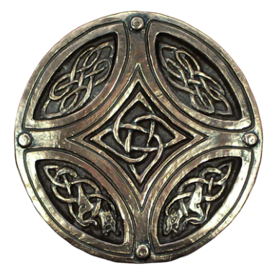
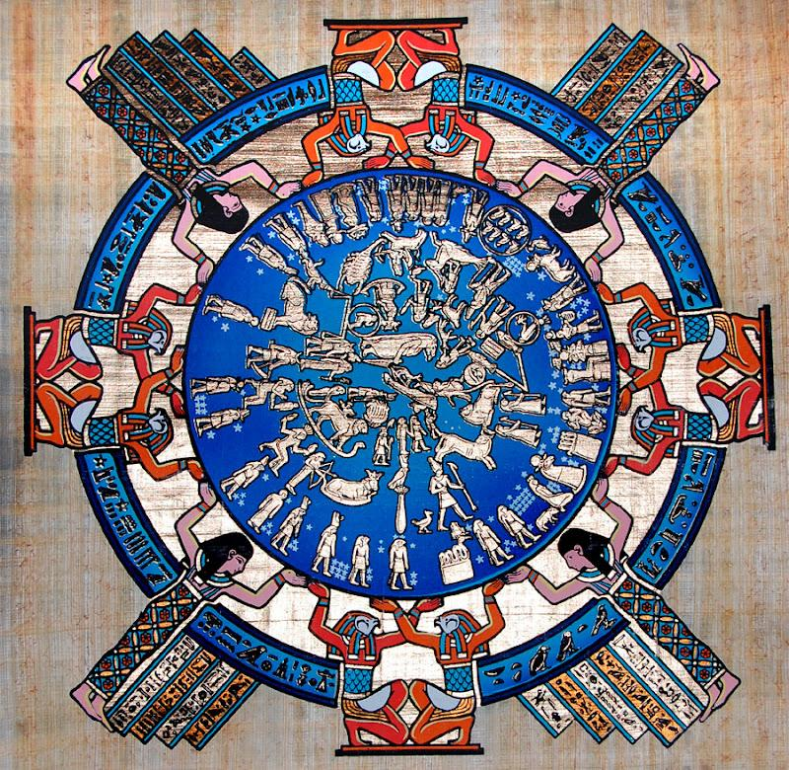
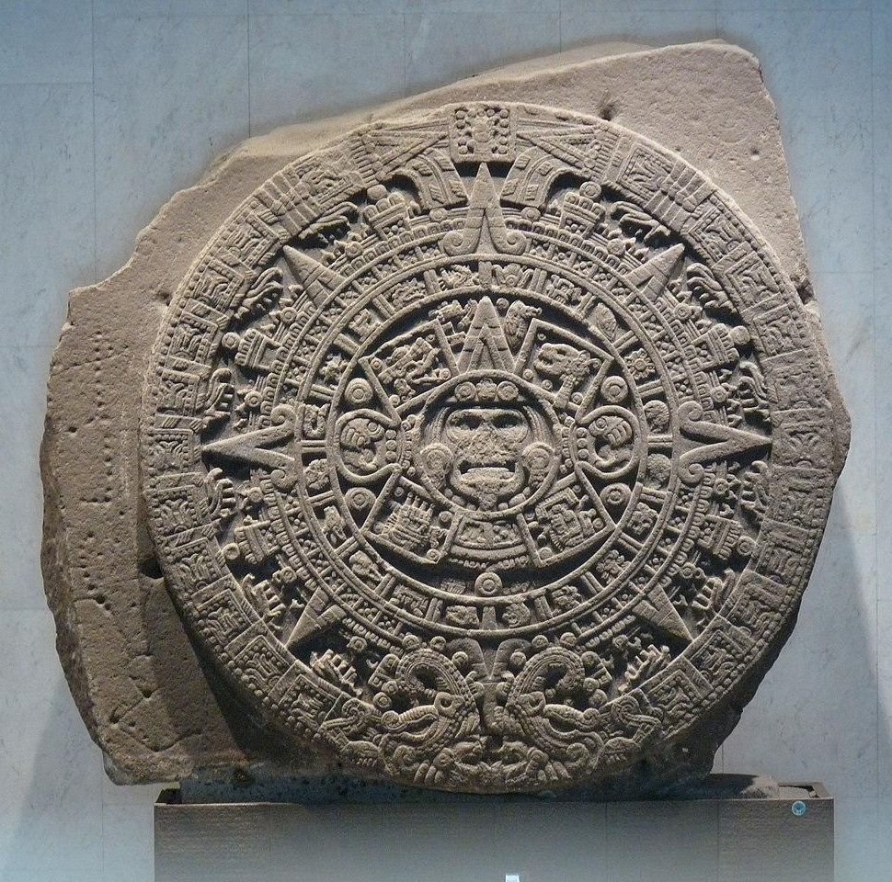
Demo & Lecture: Mandala
People in almost every culture create mandalas.
Aerial View of Boudha Stupa
Navajo Sand Painting
European Church Window
Buddhist Sand Painting
Incan God Medallion
Hindu Sri Yantra
Labyrinth
Circle Celtic Knot
Egyptian Calendar
Aztec Calendar
Notes:
https://commons.wikimedia.org/wiki/File:049_Ceiling_Medicine_Buddha_Mandala_(39096080312).jpg
https://en.wikipedia.org/wiki/Aztec_calendar#/media/File:Monolito_de_la_Piedra_del_Sol.jpg
https://en.wikipedia.org/wiki/File:AERIAL_BOUDHA_VIEW.tif
https://commons.wikimedia.org/wiki/File:Hedge_maze_in_Parque_S%C3%A3o_Roque_da_Lameira_2.jpg
https://pixabay.com/photos/labyrinth-charters-green-child-4913643/
https://commons.wikimedia.org/wiki/File:Navajo_sand-painting,_negative_made_from_postcard_Wellcome_M0010862.jpg
https://commons.wikimedia.org/wiki/File:2021_Henrique_Matos_Mandala_Sri_Yantra_02.jpg

Slide 13
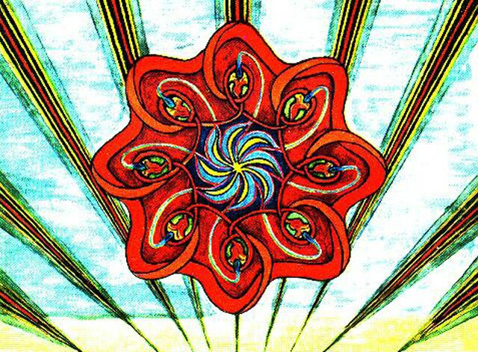
Demo & Lecture: Mandala
C. G. Jung acknowledged his indebtedness to Eastern thought in the formulation of his map of the psyche.
Especially his discovery of the Self, the central orientation point of the individual psyche.
Self - designated the totality of man [sic], the sum total of his conscious and unconscious contents.
Mandala painted by a client of Jung.
Notes:
Image from Alchemical Studies, The Collected Works of C.G. Jung, 1967
Information in this power point taken from a presentation by Susanne Fincher, ATR-BC, LPC and Diana Gregory, PhD
2008 AATA National Conference, Cleveland, OH.

Slide 14
Demo & Lecture: Mandala
C. G. Jung was a psychiatrist and psychoanalyst; his work had a great impact on psychiatry, anthropology, archaeology, literature, philosophy, psychology, and religious studies.
Jung identified the Self as one of the major concepts in analytical psychology.
Jung utilized mandala in therapy to help express both the conscious and the unconscious Self.
Mandala painted by a client of Jung.
Notes:
Image from Alchemical Studies, The Collected Works of C.G. Jung, 1967
https://commons.wikimedia.org/wiki/File:Mandala_Golden_Flower_Jung.JPG

Slide 15
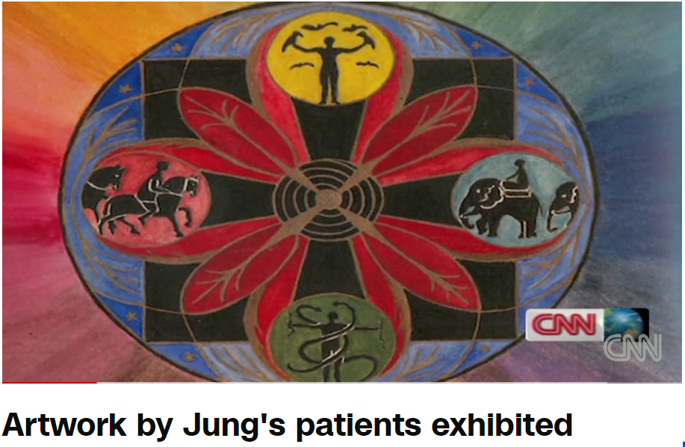
Demo & Lecture: Mandala
Watch, Artwork by Jung’s Patients Exhibited
(3:09 mins)
Notes:
https://www.cnn.com/videos/living/2012/02/19/pkg-sacred-circles.cnn

Slide 16

Demo & Lecture: Mandala
Mandalas - complex symbols that represent the ideal alignment of physical, cosmic, and spiritual realities
Express the ideal synchrony of planes of existence
Give expression to individual experiences of blissful states
Personal identity is both rooted in and sustained by transpersonal reality that is perfect harmony ordered by cosmic rhythms
Notes:
Information in this power point taken from a presentation by Susanne Fincher, ATR-BC, LPC and Diana Gregory, PhD
2008 AATA National Conference, Cleveland, OH.

Slide 17
Project Overview
You are going to create a personal mandala.

Slide 18
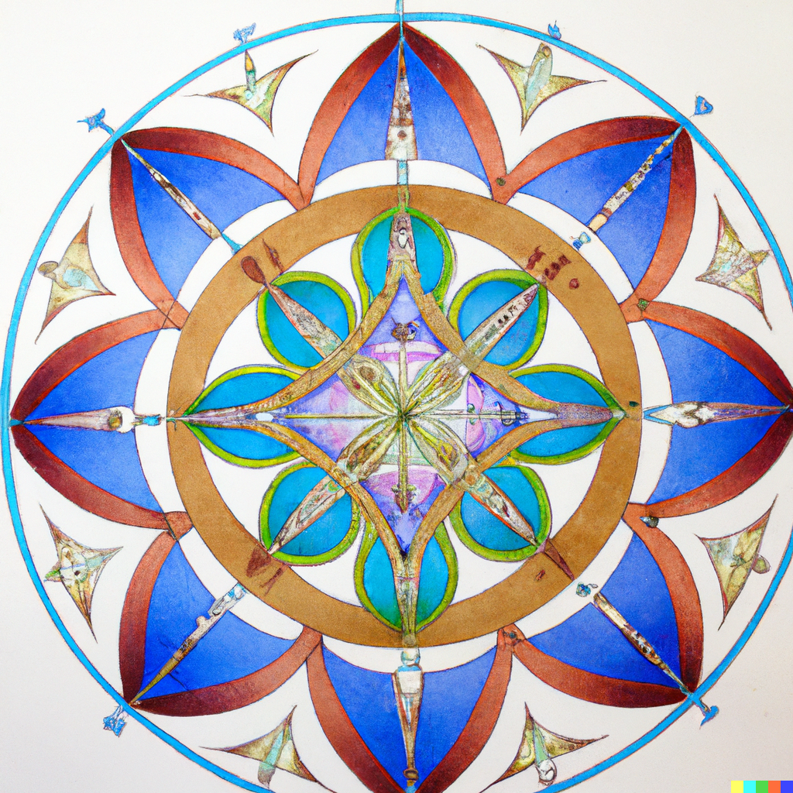
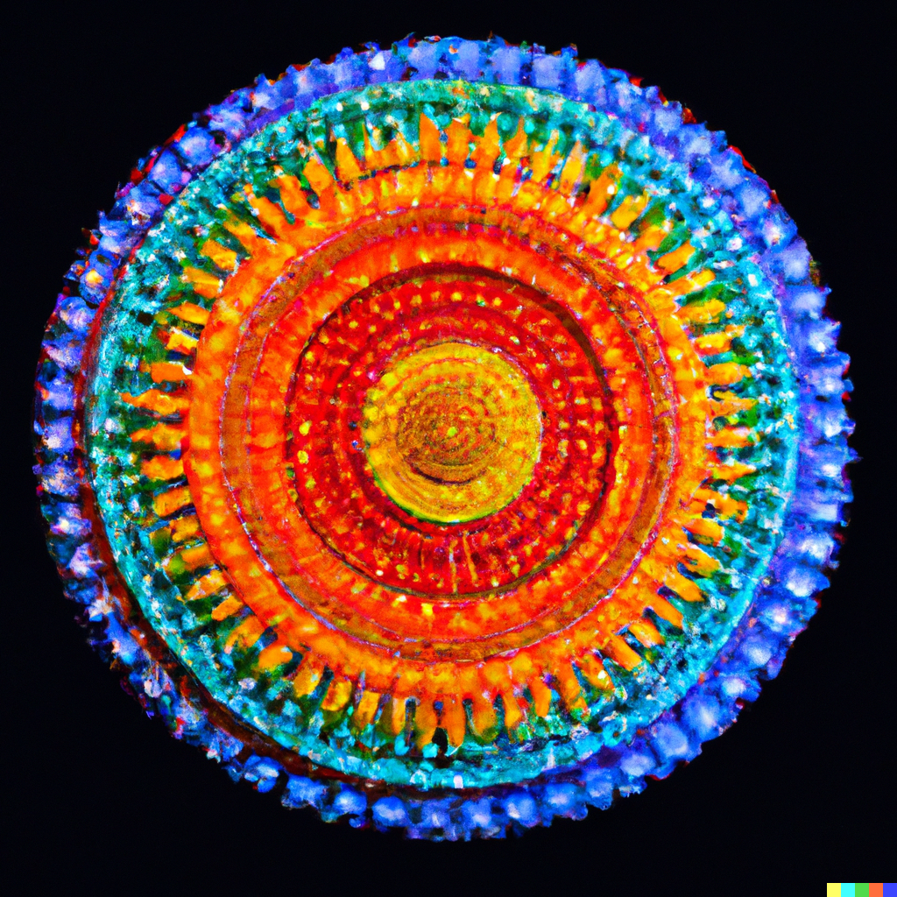
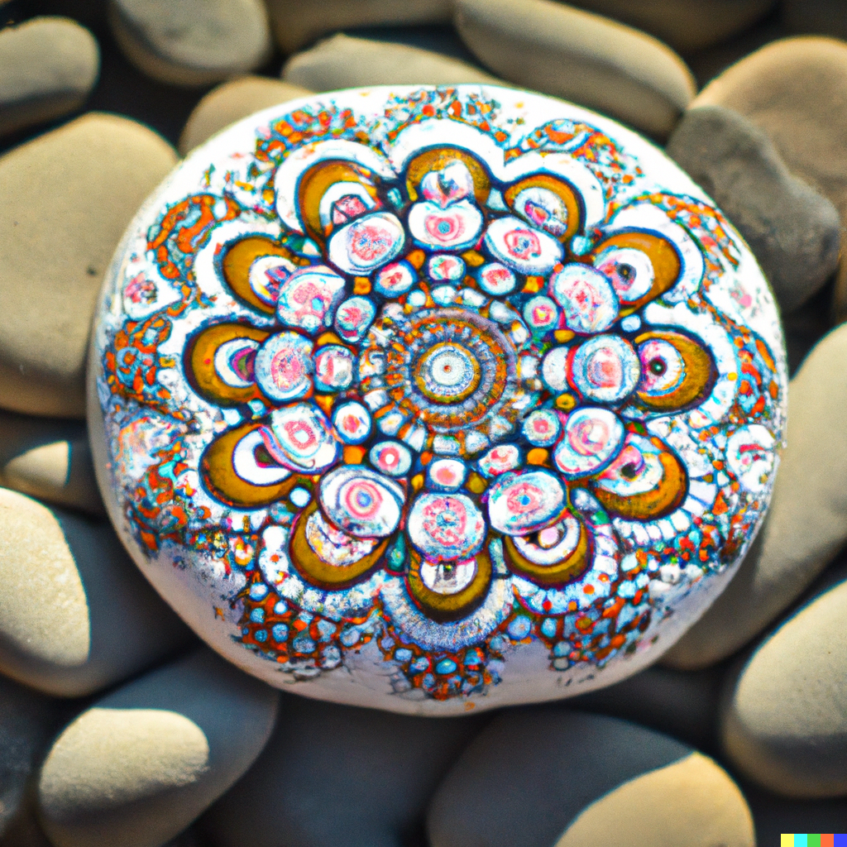
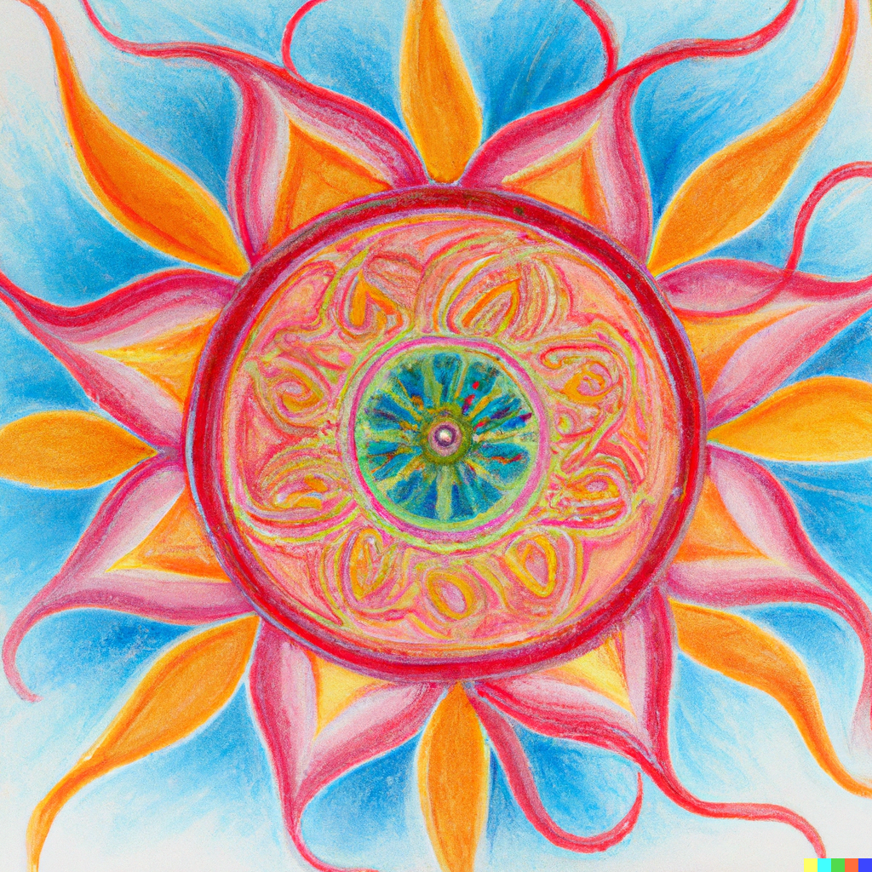
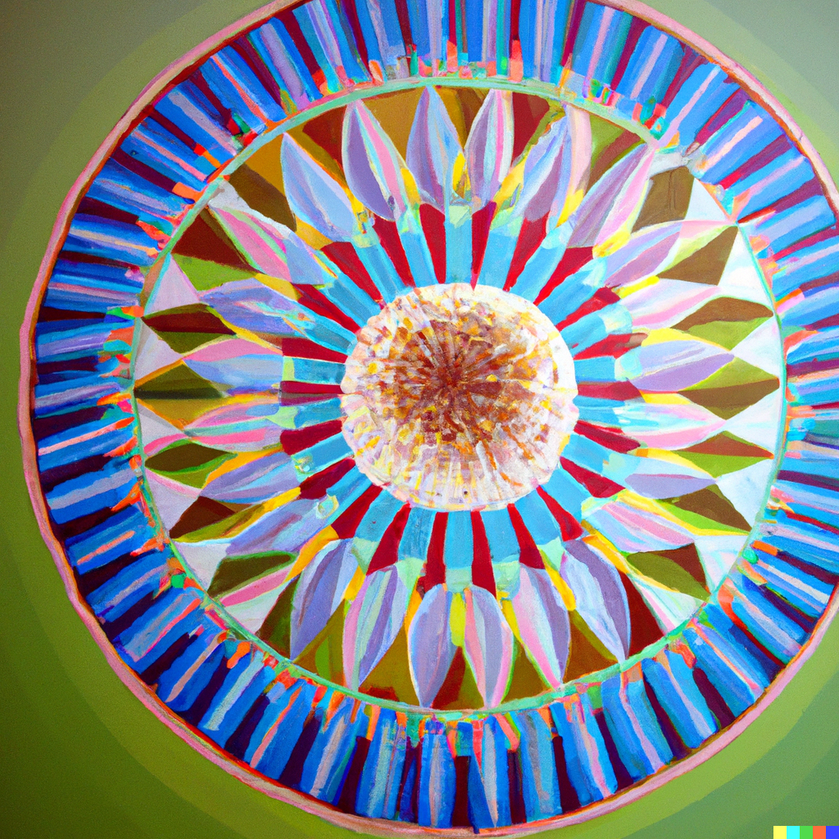
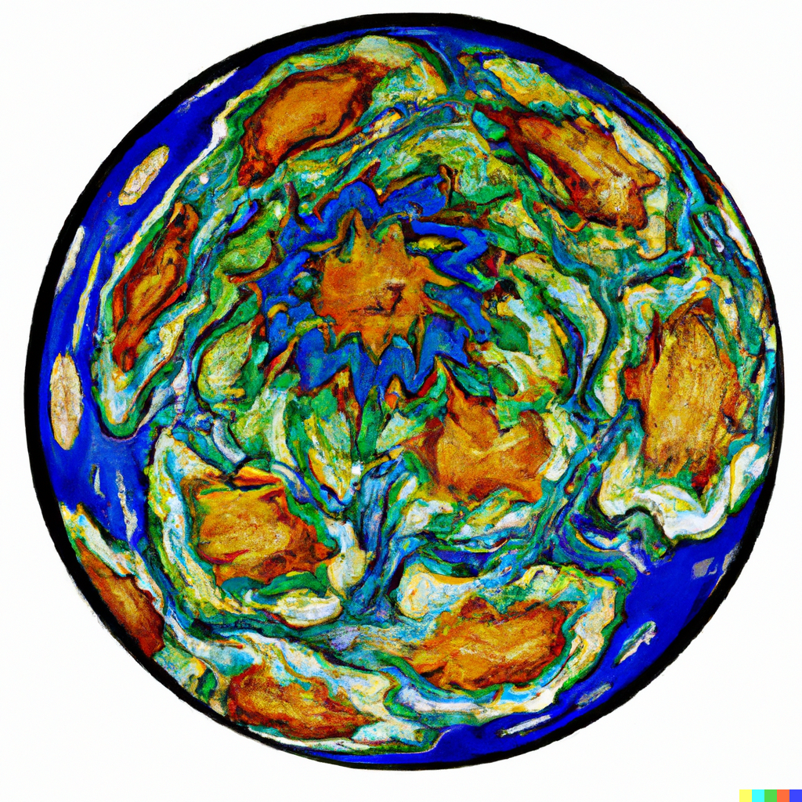
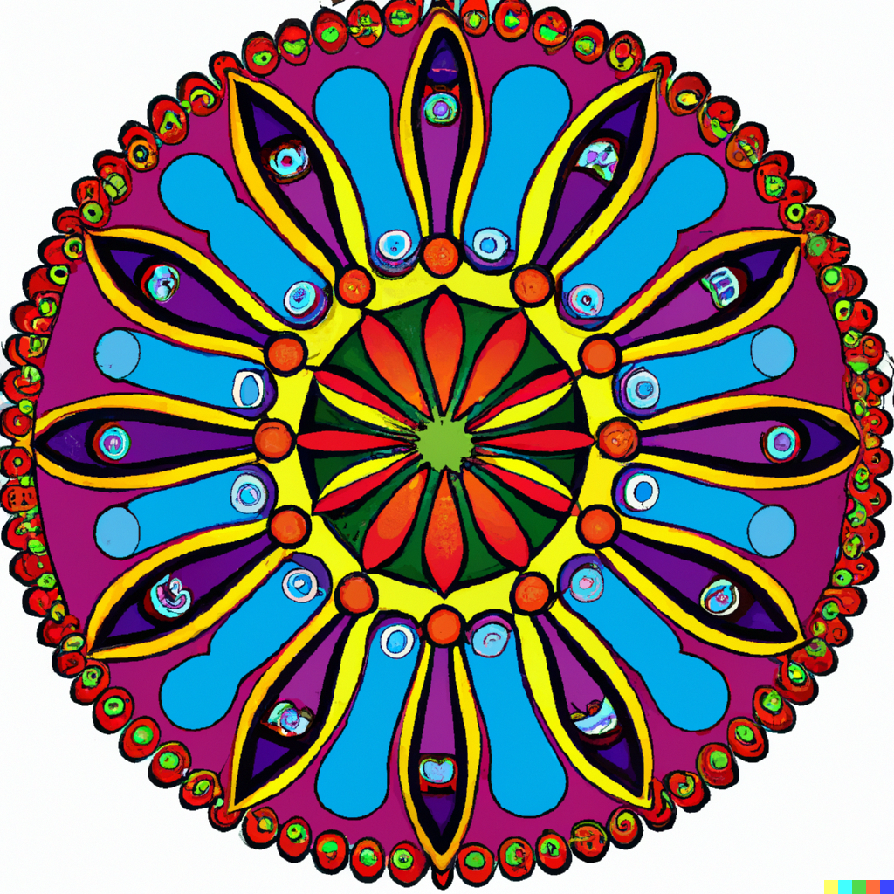
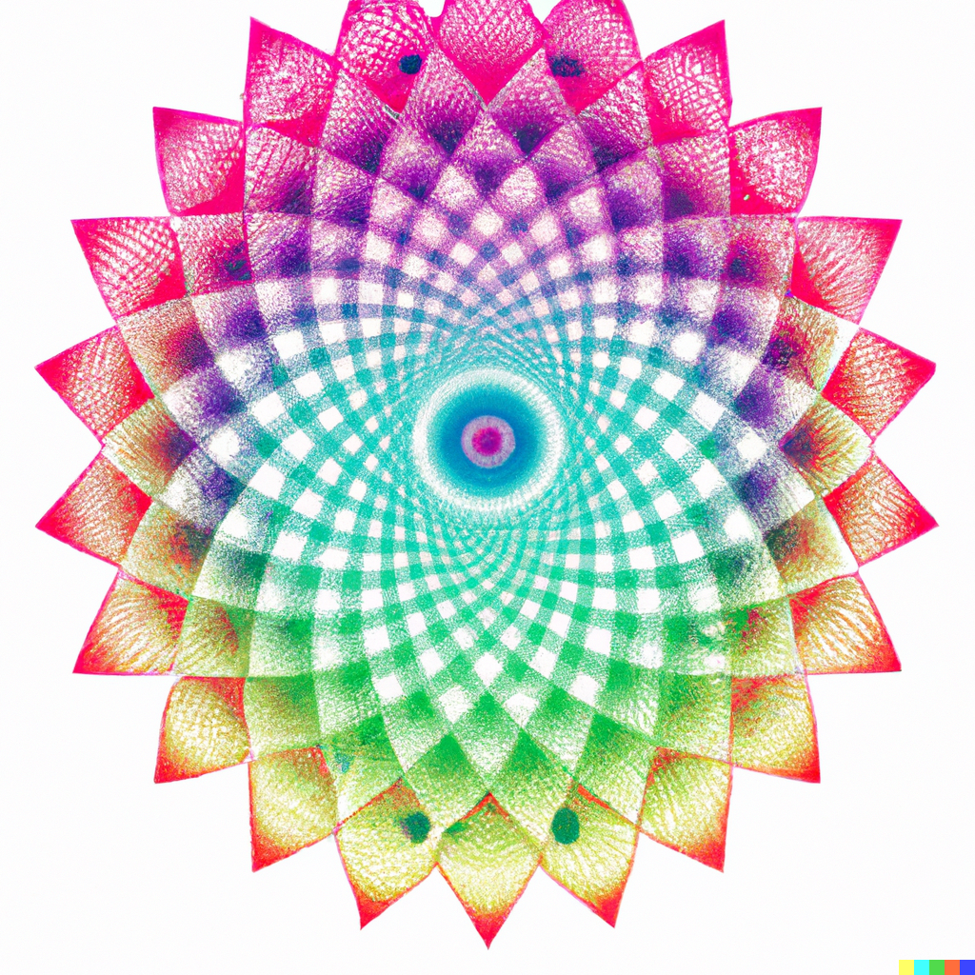
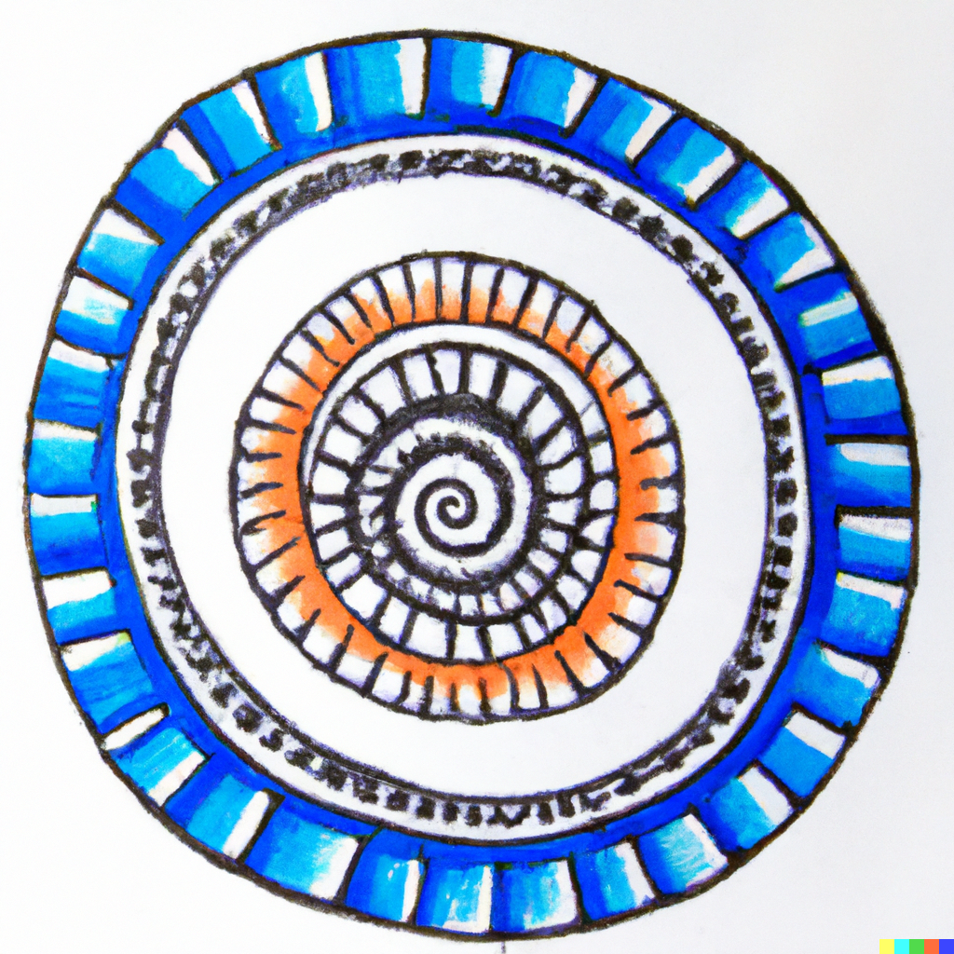
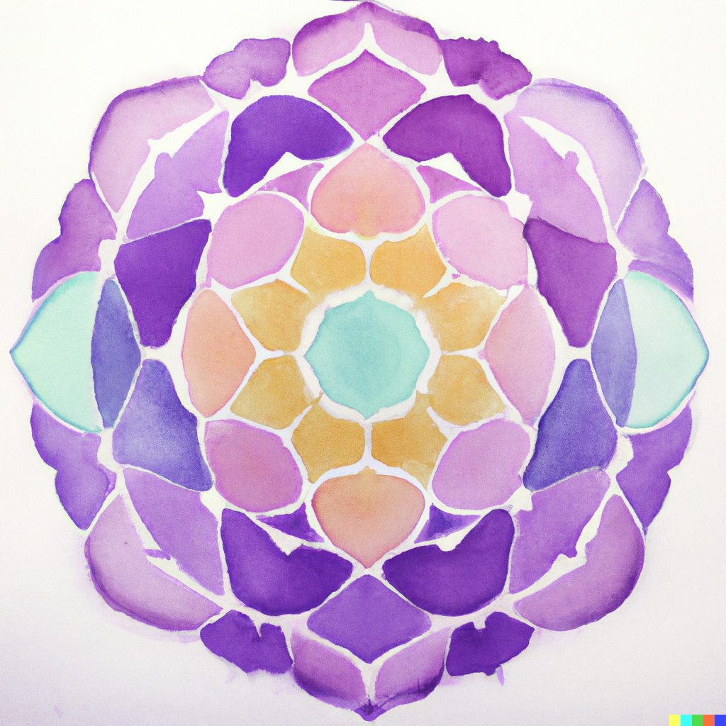
Demo & Lecture: Mandala
Mandalas can be geometric or free-form; simple or complex.
There is no right or wrong way to create a mandala.
The purpose is to focus on the process of creation, and how you feel.
Notes:
Mandala images generated using DALL-E AI based on a prompt by Amy Bultena

Slide 19
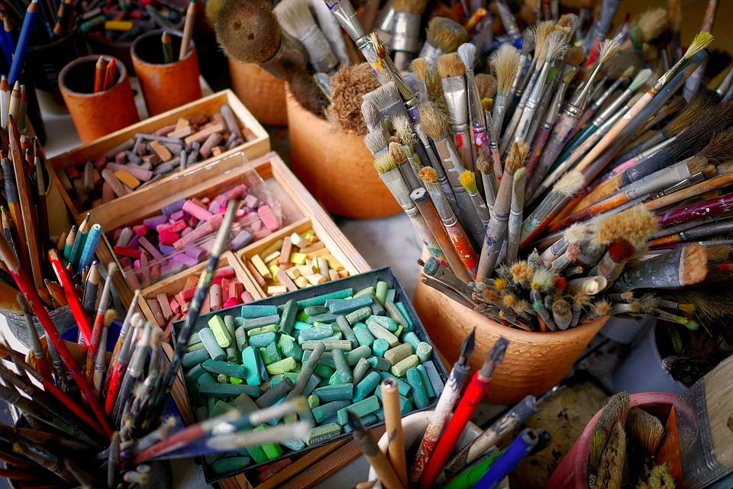
Students-at-Work
Before you begin, assemble your artmaking materials and journaling supplies.
Follow your intuition about what materials are best for you; suggestions include:
Pencil and paper
Colored pencils, pastels, crayons, markers, chalks, pastels, charcoal
Paints, watercolors, tempera, colored inks
Collage materials: magazines, fabrics, photos, found objects, images, paper, construction paper, scissors, glue
Notes:
https://www.maxpixel.net/Art-Materials-Colorful-Chalks-Brushes-Art-Supplies-2927793

Slide 20
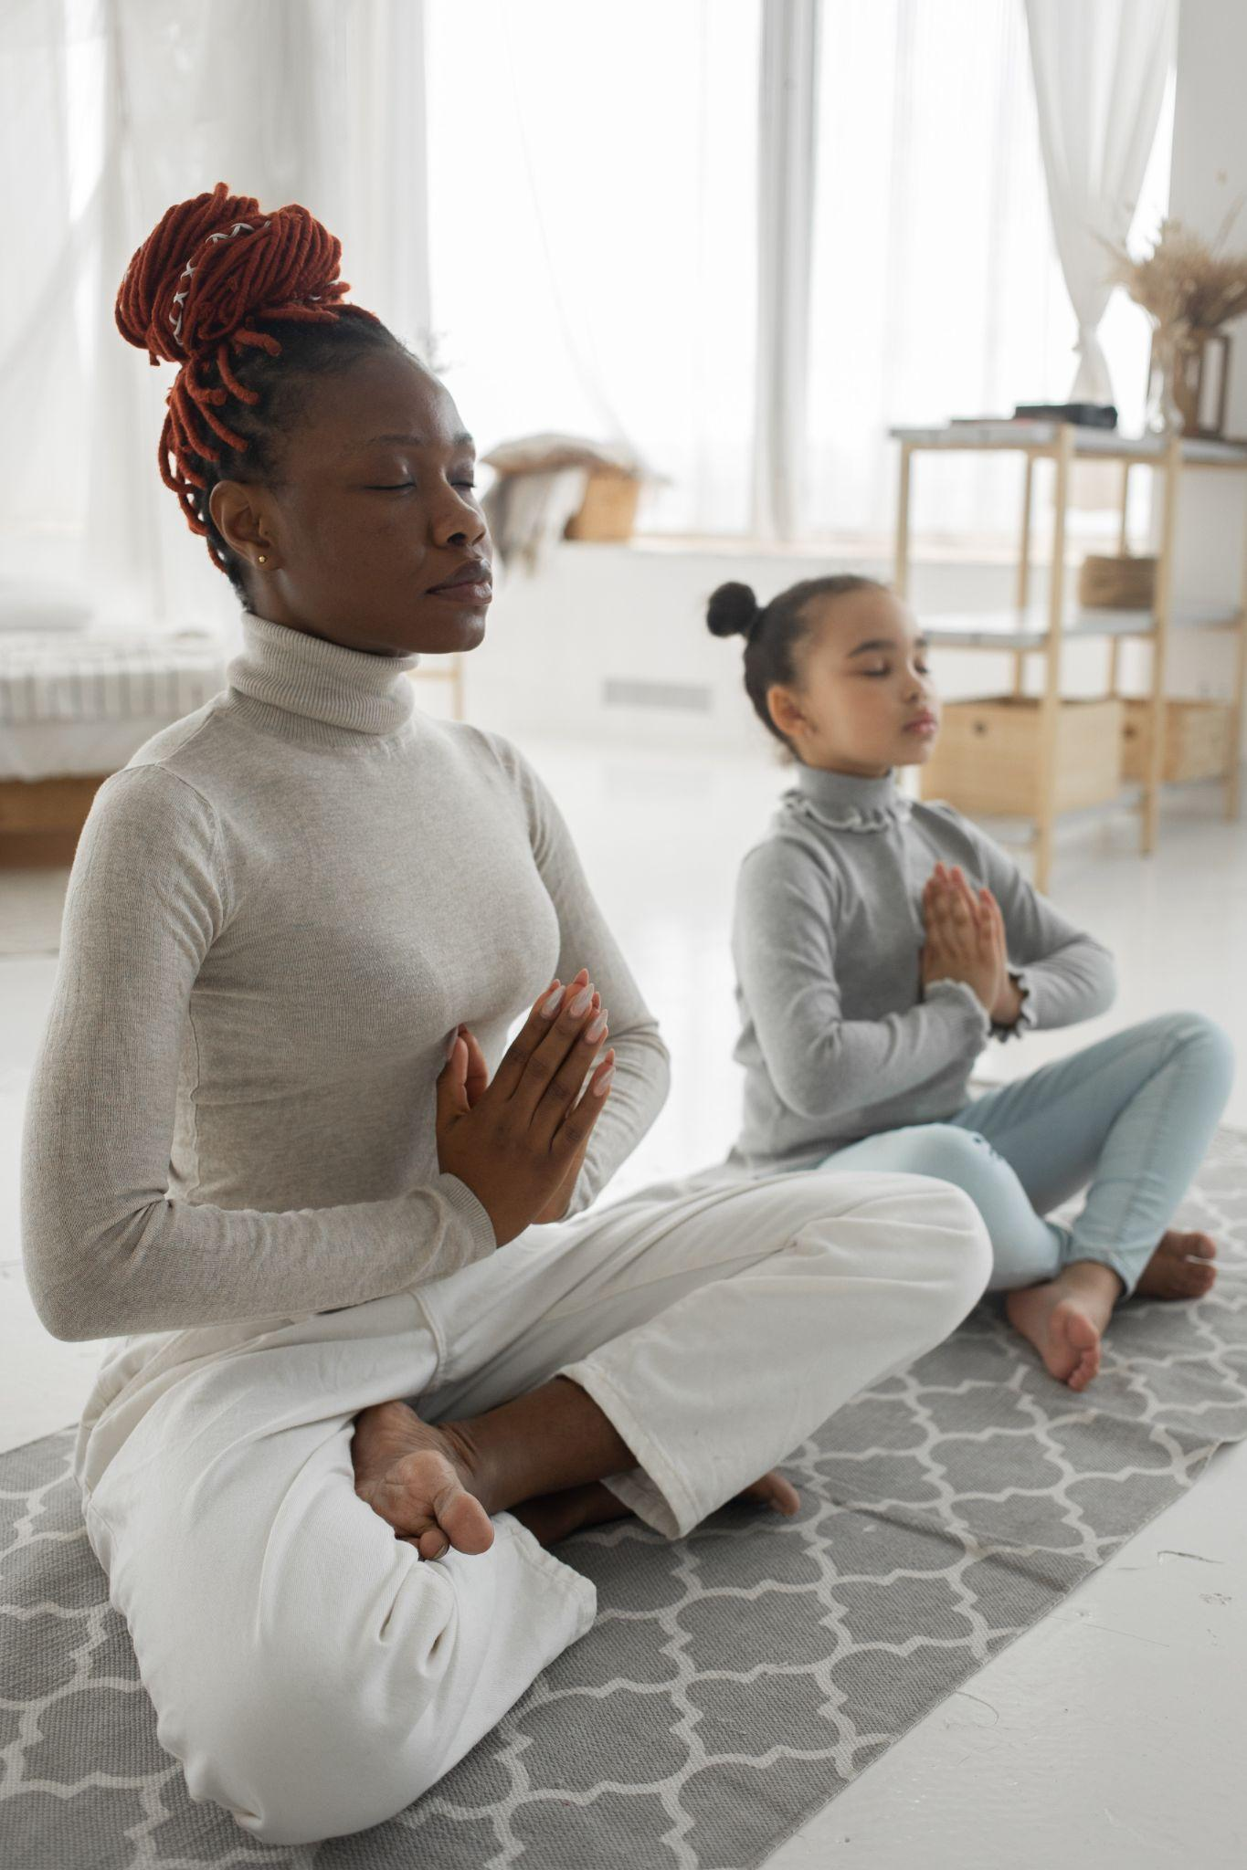
Students-at-Work
Now that you have your treasures gathered around you, find a quiet spot.
Breathing Activity
Follow your breath; notice the in and out rhythm of your breathing.
Take a couple of deep breaths and let them out slowly.
Try to see what your thoughts are, see how you feel, and relax.
Notes:
https://www.pexels.com/photo/relaxed-black-woman-with-little-daughter-practicing-lotus-pose-at-home-7353048/

Slide 21
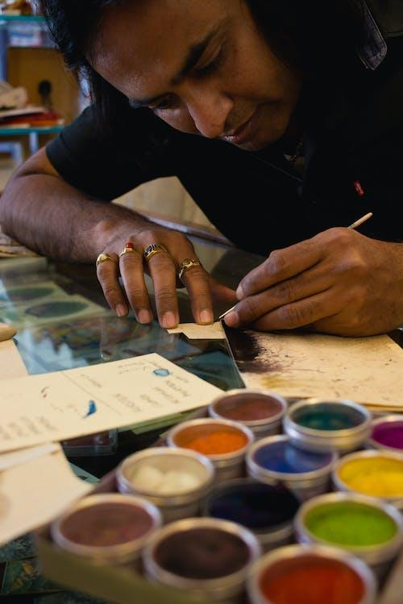
Students-at-Work
When you are ready, begin your mandala.
There is no right or wrong way, what you create is yours.
When you are ready to stop, do so.
Look at your work; turn it in every direction and decide which way is up.
Mark the drawing with an up arrow to indicate the direction.
Notes:
https://www.pexels.com/photo/man-drawing-on-paper-2302807/

Slide 22
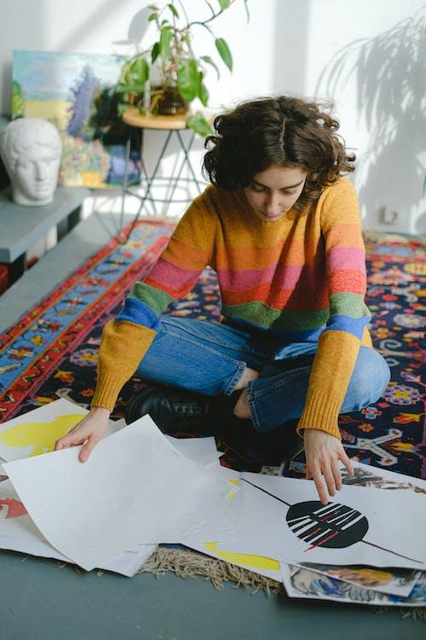
Critique
Now, take some time and let your thoughts about what you see come forward.
If you want, write down any connections or ideas.
Give your work a title and put it someplace where you can see it.
Over the next few days, see if there is another mandala that wants to emerge. If so, let that process begin.
Notes:
https://www.pexels.com/photo/lady-looking-at-paintings-while-sitting-on-floor-in-studio-5641866/

Slide 23
How are you feeling after making your artwork?
Do you feel better, worse, or the same? Why?
Notes:
https://pixabay.com/illustrations/emotion-scale-emoji-icon-feedback-3404484/

Slide 24

Closing Slide

