Slide 1

Grades 1 – 2 Project: Positive Word Portraits​

Slide 2
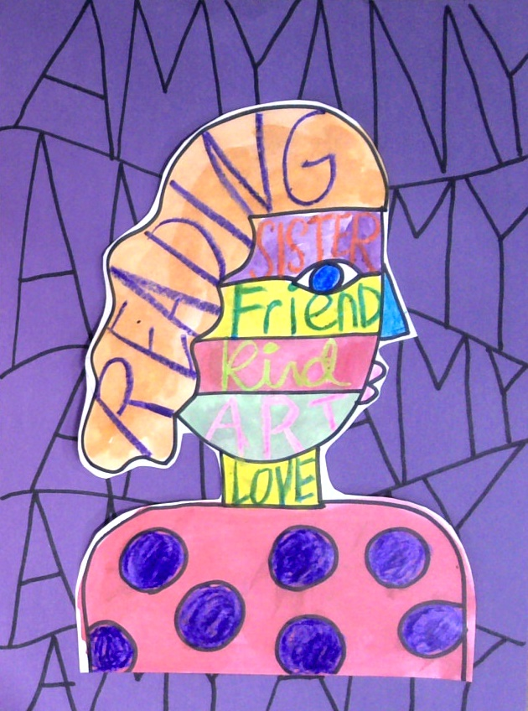
Grades 1 – 2 Project: Positive Word Portraits
Learning Outcomes
Create a self-portrait in profile that uses positive, descriptive language about the self.

Slide 3
Grades 1 – 2 Project: Positive Word Portraits
SEL Core Competencies Addressed
Self-Awareness
Visual Art Standards
1.VA:Cr2.1 - Explore uses of materials and tools to create works of art.
2.VA:Cr2.1 - Experiment with various materials and tools to explore personal interests in a work of art or design.

Slide 4
Grades 1 – 2 Project: Positive Word Portraits
Materials Needed
8.5 x 11 inch white cardstock
9 x 12 inch multi colored construction paper
Black permanent marker
Crayons
Watercolor paint
Paint brush
Glue
Scissors

Slide 5
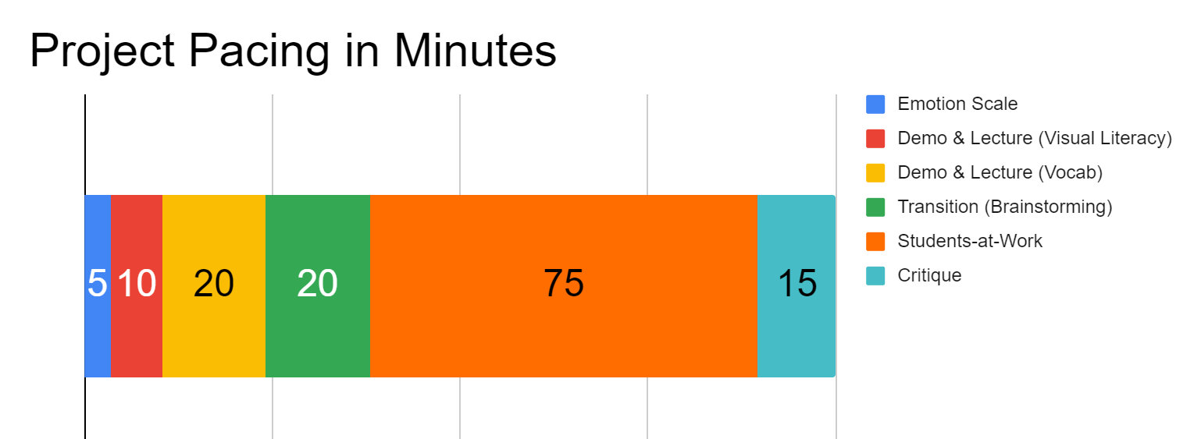
Project Pacing
Pacing structure follows the guidance of the Studio Habits of Mind framework.

Slide 6
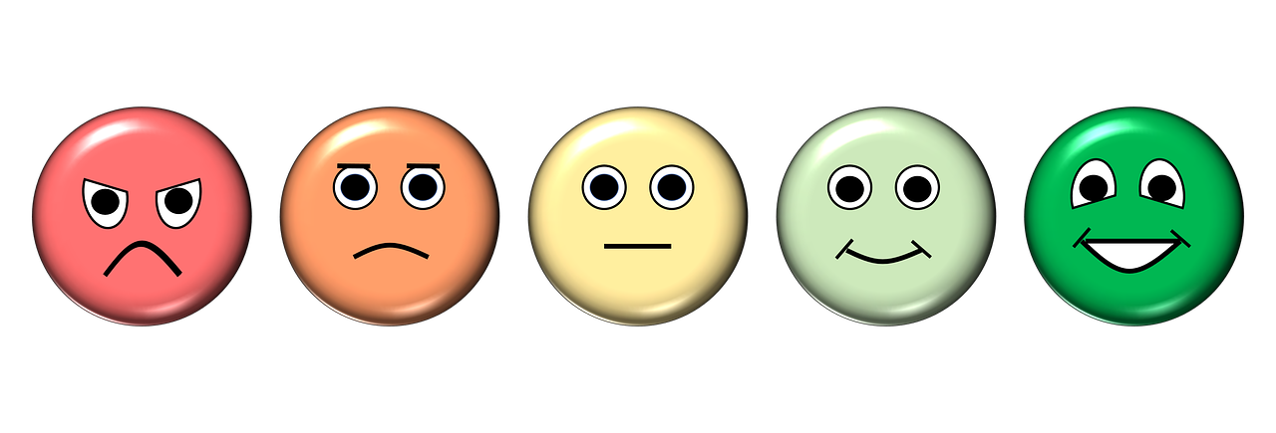
How are you feeling right now?
Notes:
https://pixabay.com/illustrations/emotion-scale-emoji-icon-feedback-3404484/

Slide 7
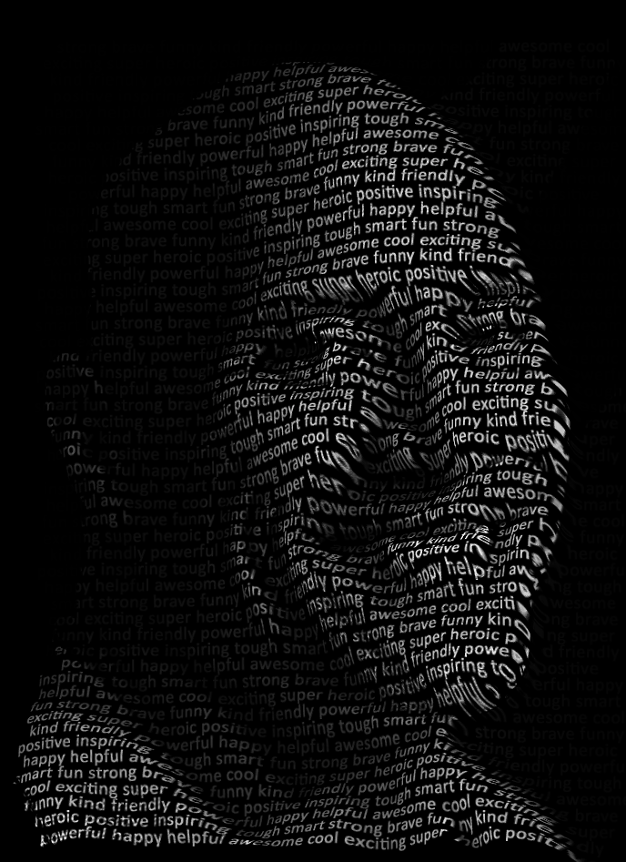
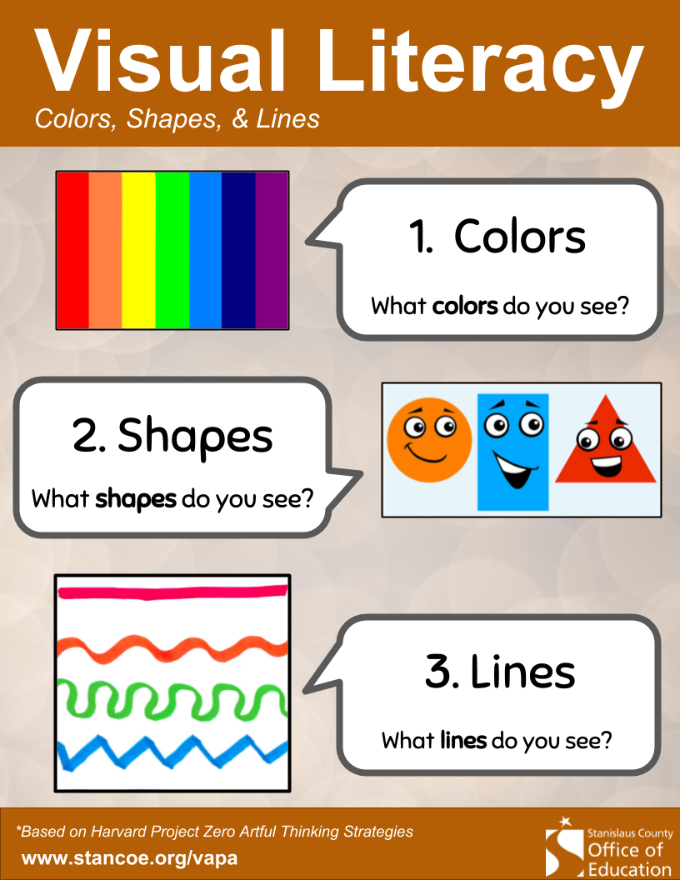
Demo & Lecture: Visual Literacy
Notes:
Artwork by Amy Bultena, used with permission from the artist

Slide 8
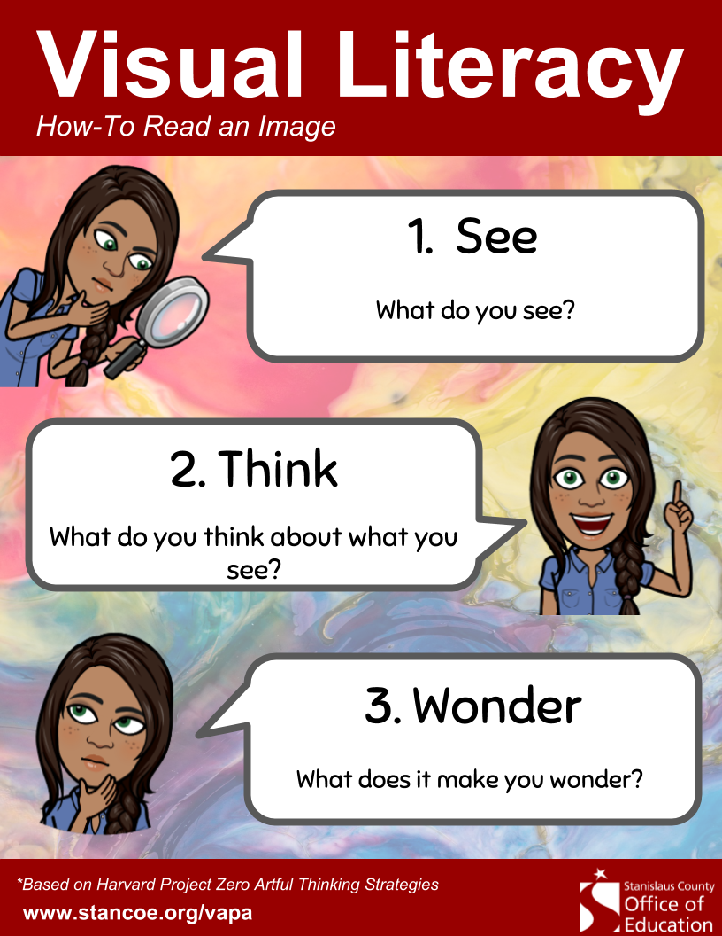
Demo & Lecture: Visual Literacy
Notes:
Artwork by Amy Bultena, used with permission from the artist

Slide 9
Project Overview
Let’s make a portrait of ourselves.
Let’s use positive words that describe ourselves in the artwork.

Slide 10
Demo & Lecture: Vocabulary
Before we create our artwork, we need to know some vocabulary words.
What is a portrait?
What is a self-portrait?

Slide 11
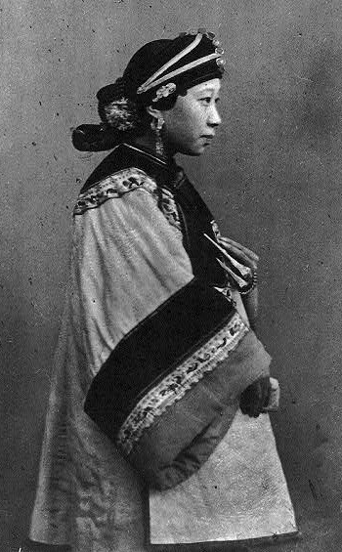
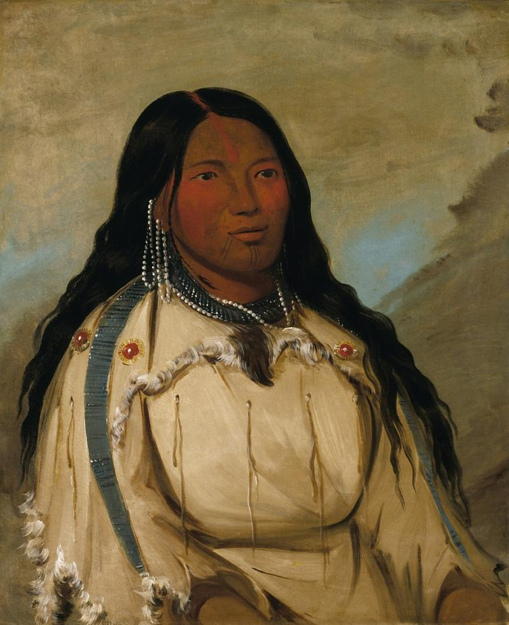
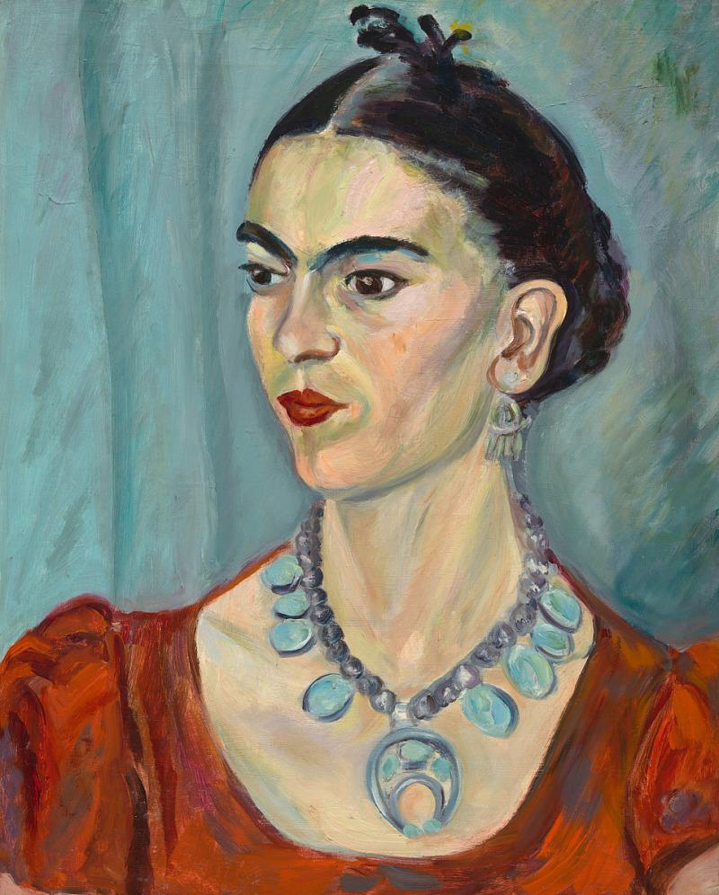
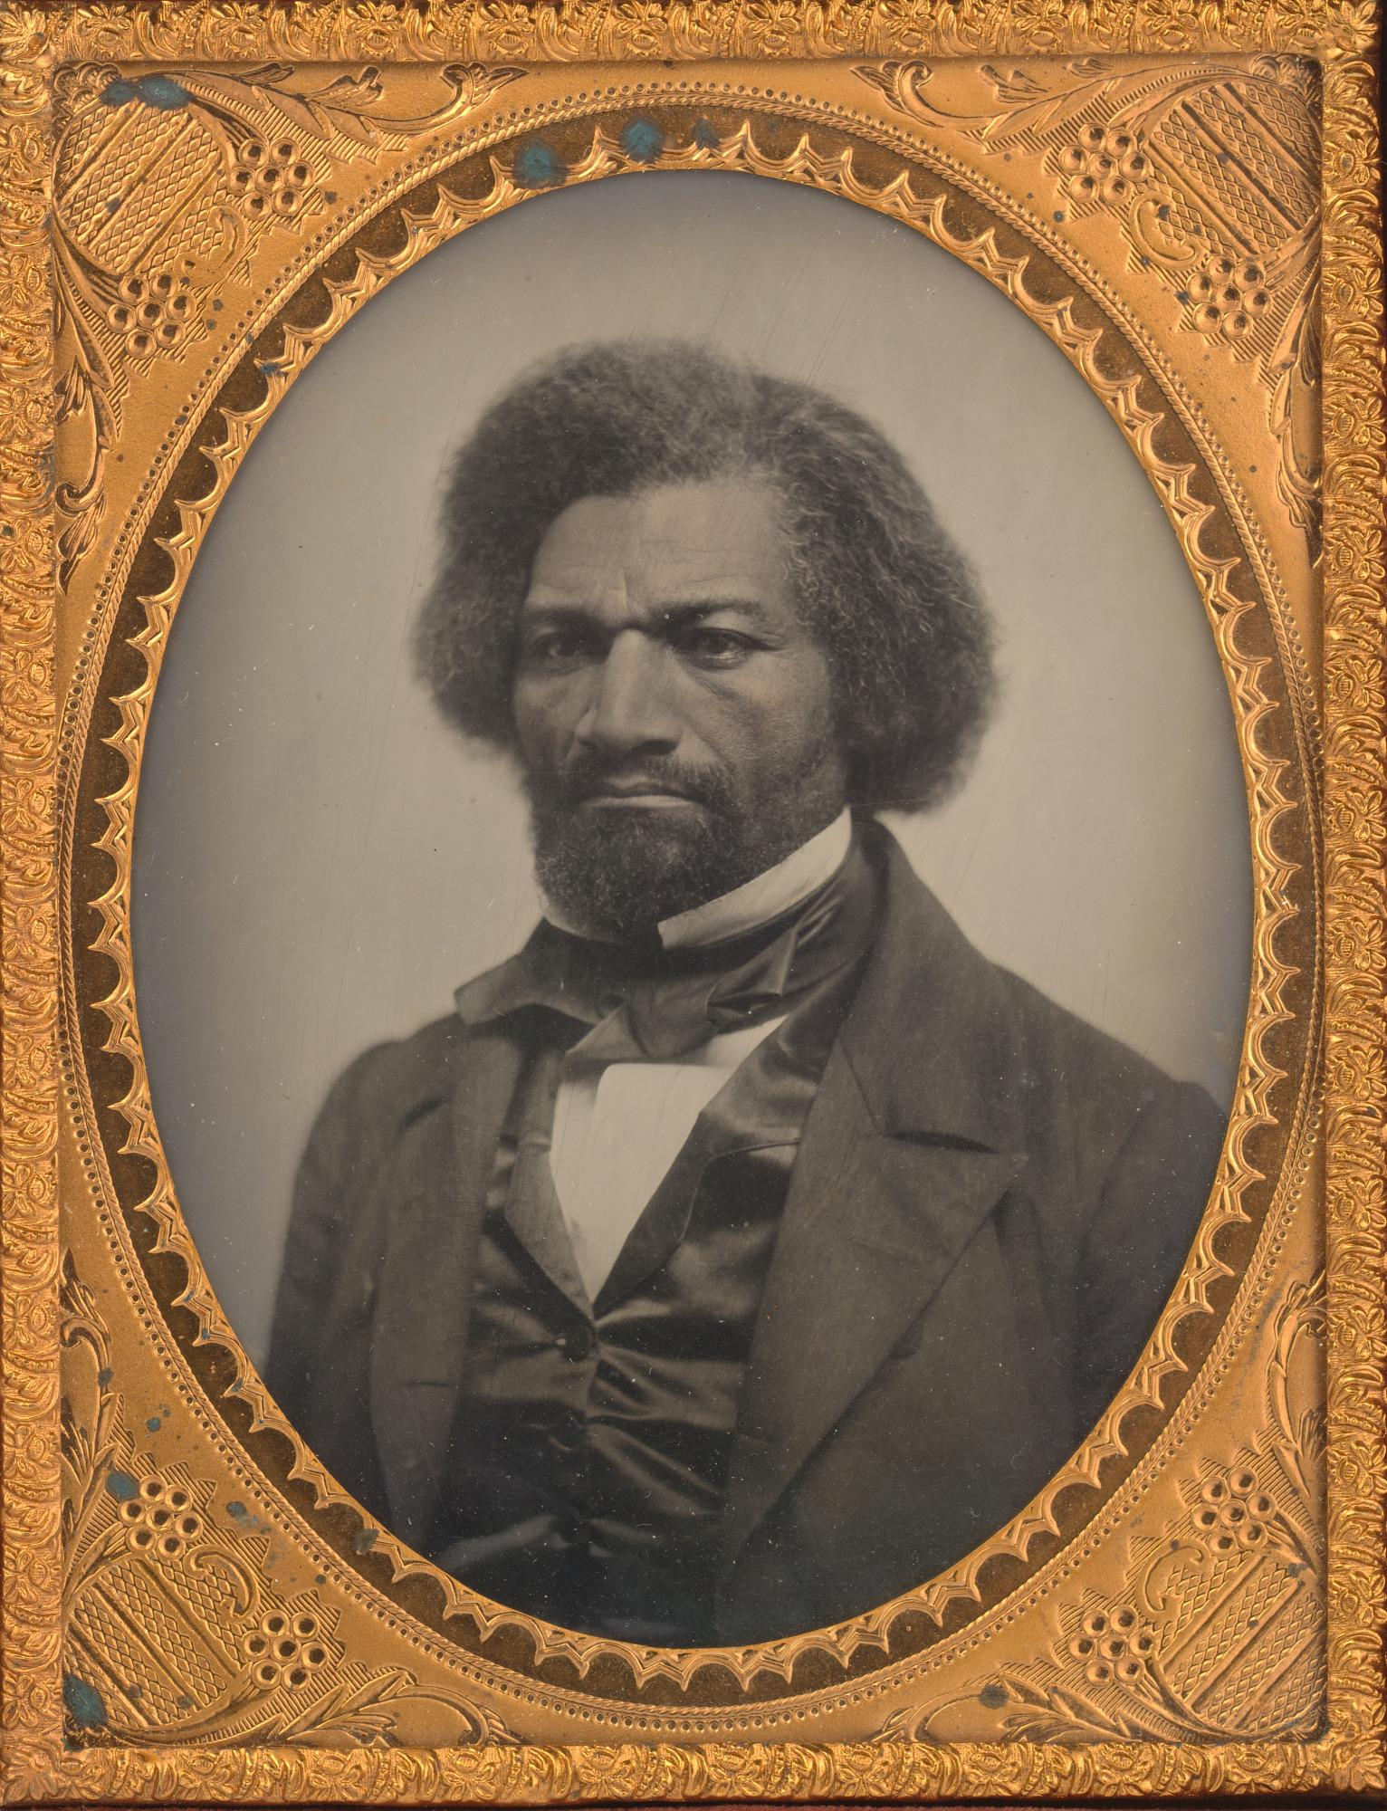
Demo & Lecture: Vocabulary
A portrait is a picture of a person.
Chinese Woman
John Thomson
1870
Tow-ee-ka-we, a Cree Woman
George Catlin
1872
Frida Kahlo
Magda Pach
1950
Frederick Douglass
Unidentified Artist
1856
Notes:
https://npg.si.edu/object/npg_NPG.74.75
https://www.si.edu/object/frida-kahlo:npg_NPG.2015.136
https://www.si.edu/object/tow-ee-ka-wet-cree-woman:saam_1985.66.178
https://www.loc.gov/pictures/resource/cph.3b12164/

Slide 12
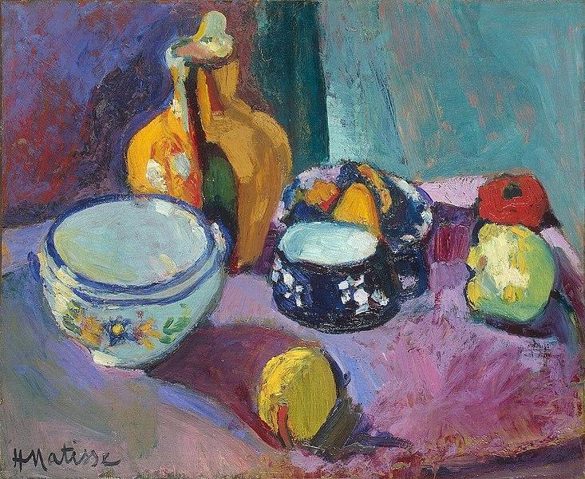
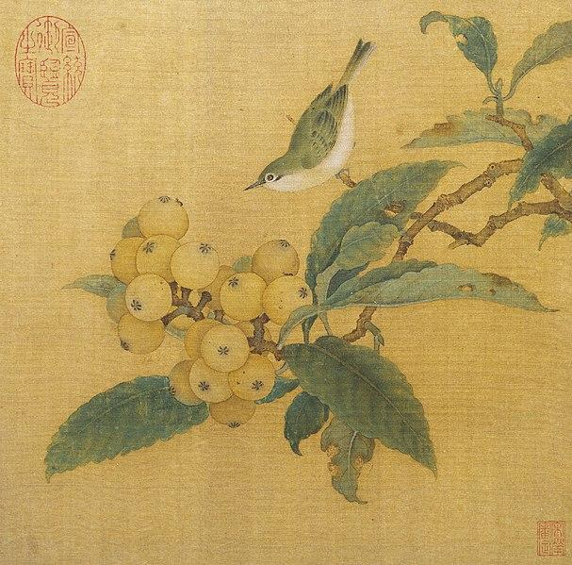
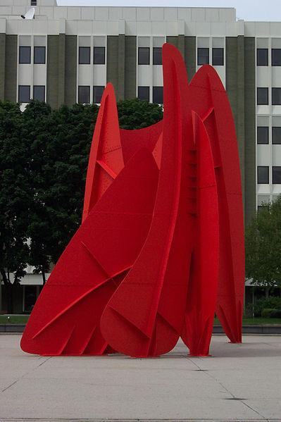
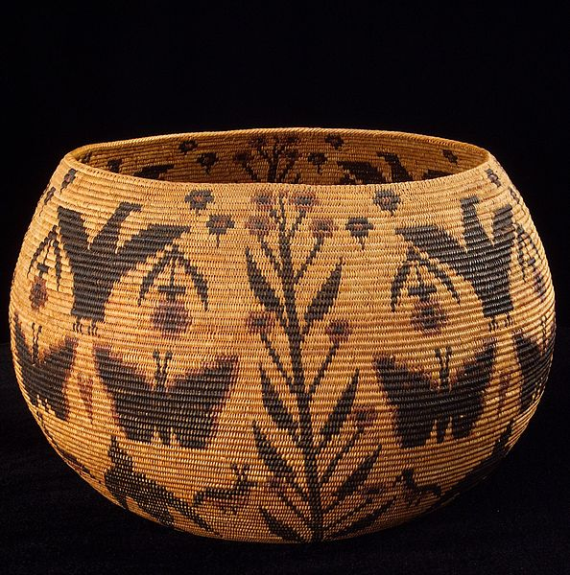
Can you find the portraits below?
Notes:
https://en.wikipedia.org/wiki/File:LaGrandeVitesse1969.jpg
https://en.wikipedia.org/wiki/File:Matisse_-_Dishes_and_Fruit_(1901).jpg
https://en.wikipedia.org/wiki/File:Lucy_Telles_basket.jpg
https://en.wikipedia.org/wiki/File:Loquats_and_Mountain_Bird.jpg

Slide 13
Which of these images are not portraits?
Notes:
https://en.wikipedia.org/wiki/File:LaGrandeVitesse1969.jpg
https://en.wikipedia.org/wiki/File:Matisse_-_Dishes_and_Fruit_(1901).jpg
https://en.wikipedia.org/wiki/File:Lucy_Telles_basket.jpg
https://en.wikipedia.org/wiki/File:Loquats_and_Mountain_Bird.jpg

Slide 14
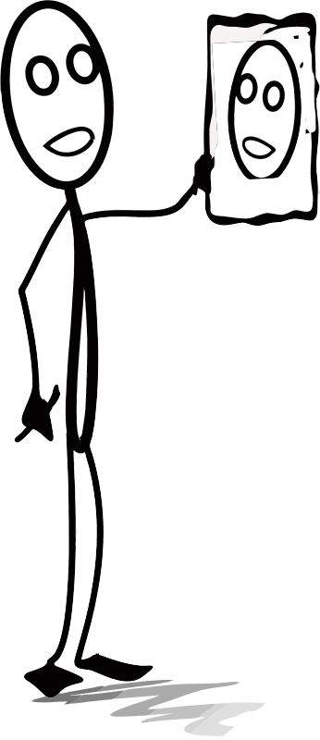
Demo & Lecture: Vocabulary
A self-portrait is an artwork an artist makes that shows themselves.
Have you ever drawn a picture of yourself?
You’re an artist! You made a self-portrait!
Notes:
https://openclipart.org/detail/283821/michael1952-AL-drawing.png

Slide 15
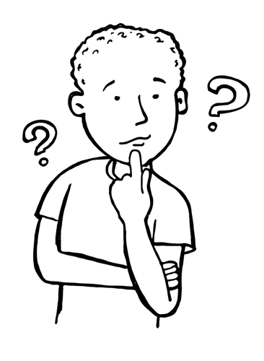
Transition: Brainstorming Positive Words
As a whole class, brainstorm positive words that you can use to describe yourselves.
Write the list where the whole class can see it.
Notes:
https://publicdomainvectors.org/en/free-clipart/Thinking-boy-vector-image/10492.html

Slide 16

Transition: Writing Positive Words
We are going to use positive words about ourselves in our self portrait.
Get out a scratch sheet of paper.
On the paper, write down six words that describe you.
Notes:
https://commons.wikimedia.org/wiki/File:Writing.svg

Slide 17
Begin the Project
Now we are ready to make a self-portrait using positive words about ourselves.

Slide 18
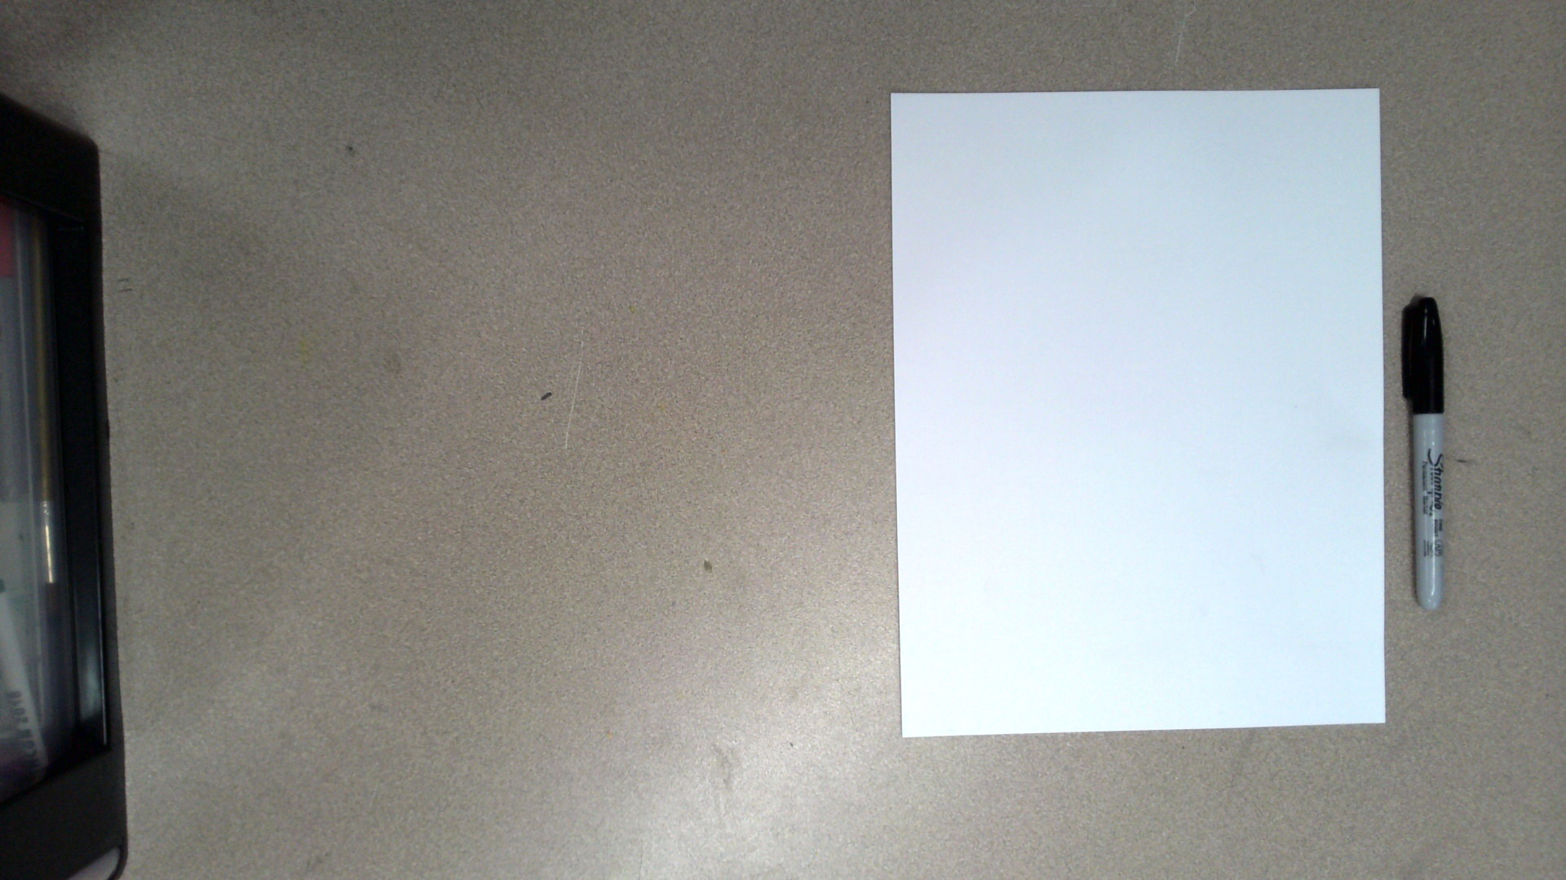
Get our a sheet of white paper and a permanent marker.
Place the paper in front of yourself portrait style or vertically.

Slide 19
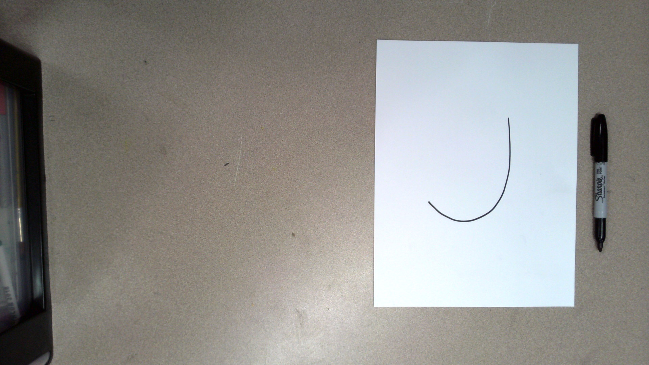
Draw a curved line like this. This will be the shape of our head.

Slide 20
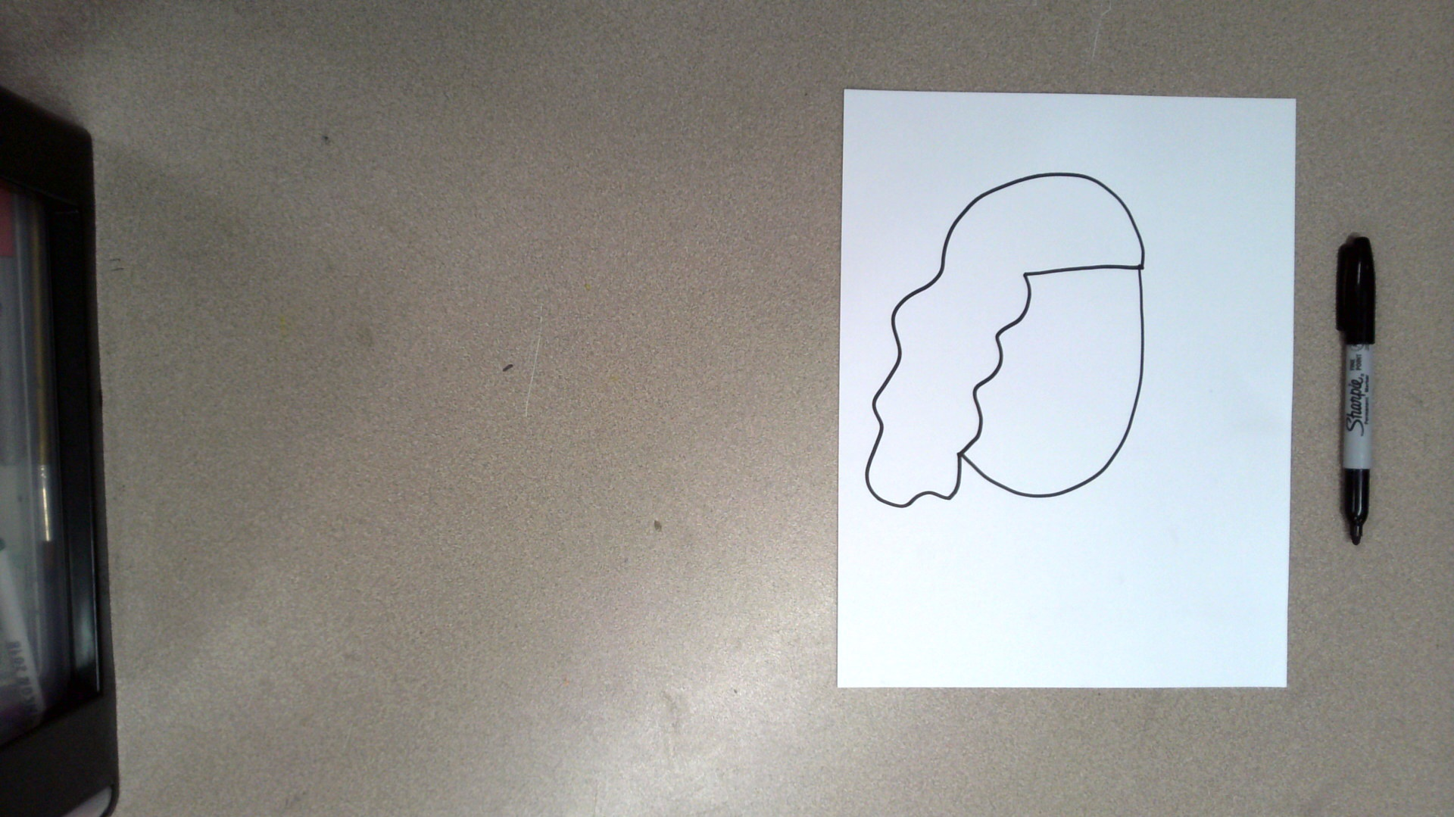
Give your head some hair.
Be sure to draw the shape of the hair, and not the individual lines of hair.
The next slide has examples of different hairstyles.

Slide 21
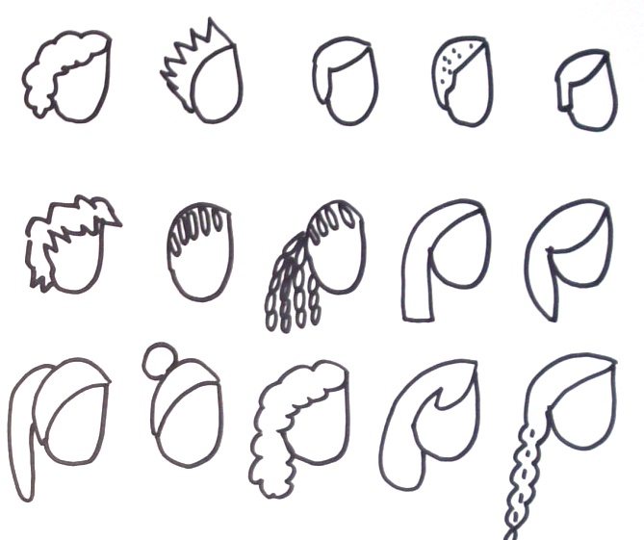
Here are some sample hairstyles. You can also draw a hairstyle that is not here.
The point is to draw a hairstyle that resembles your own hair because this is a self-portrait.
Notes:
image by Amy Bultena

Slide 22
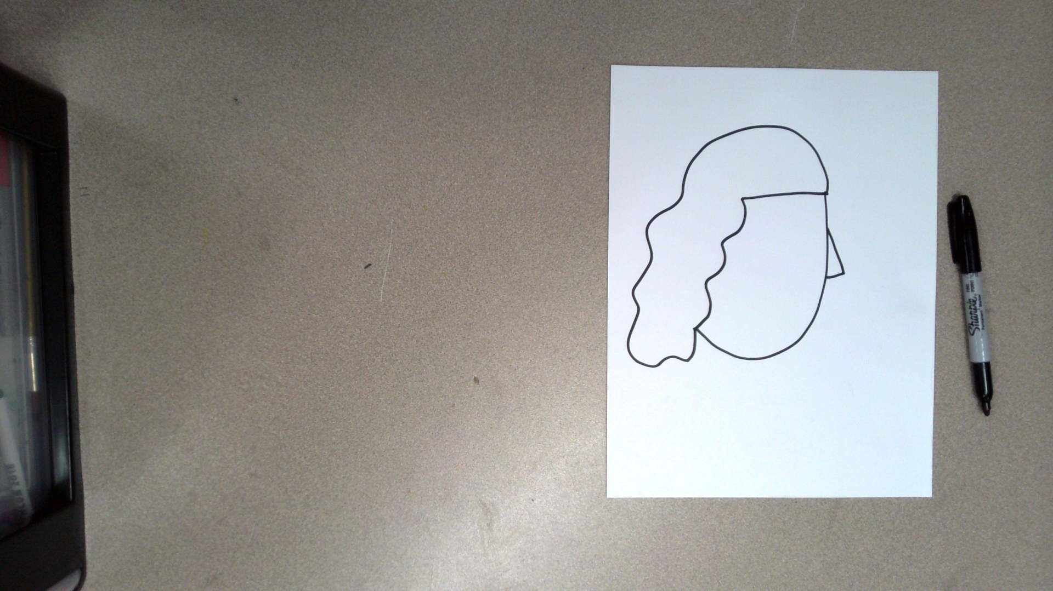
Draw your self-portrait a nose.

Slide 23
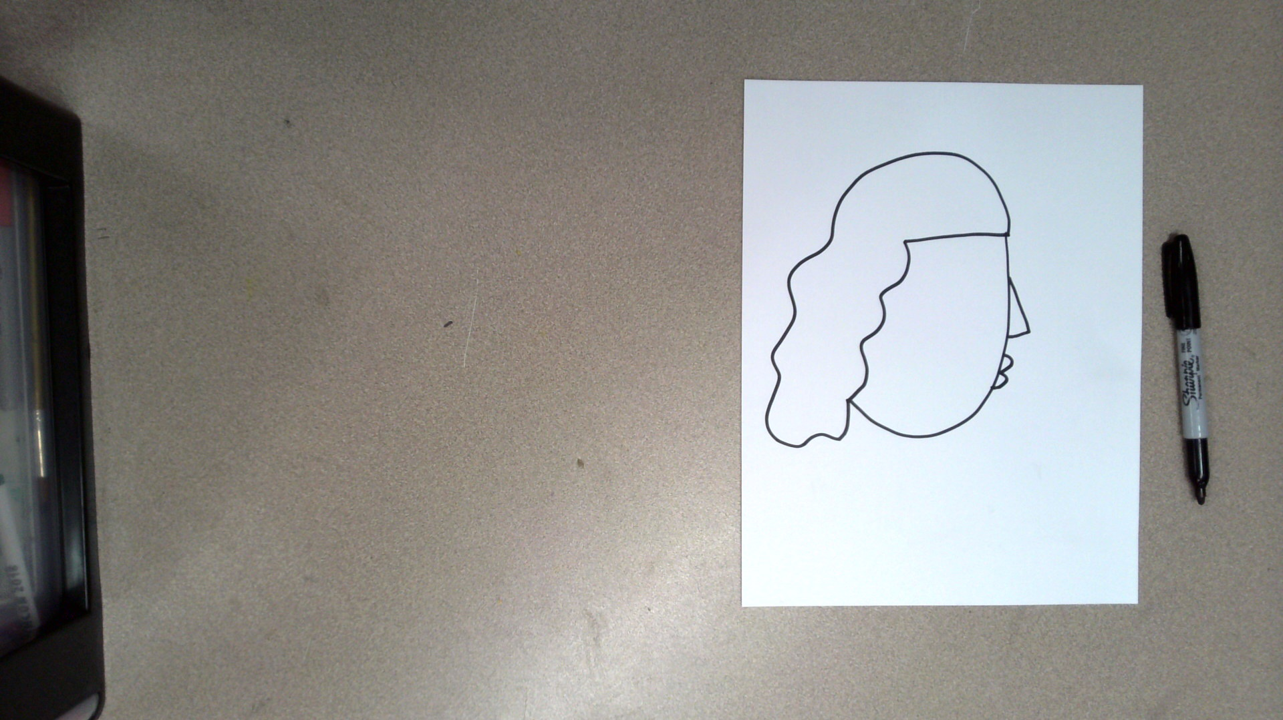
Draw your self-portrait a mouth.

Slide 24
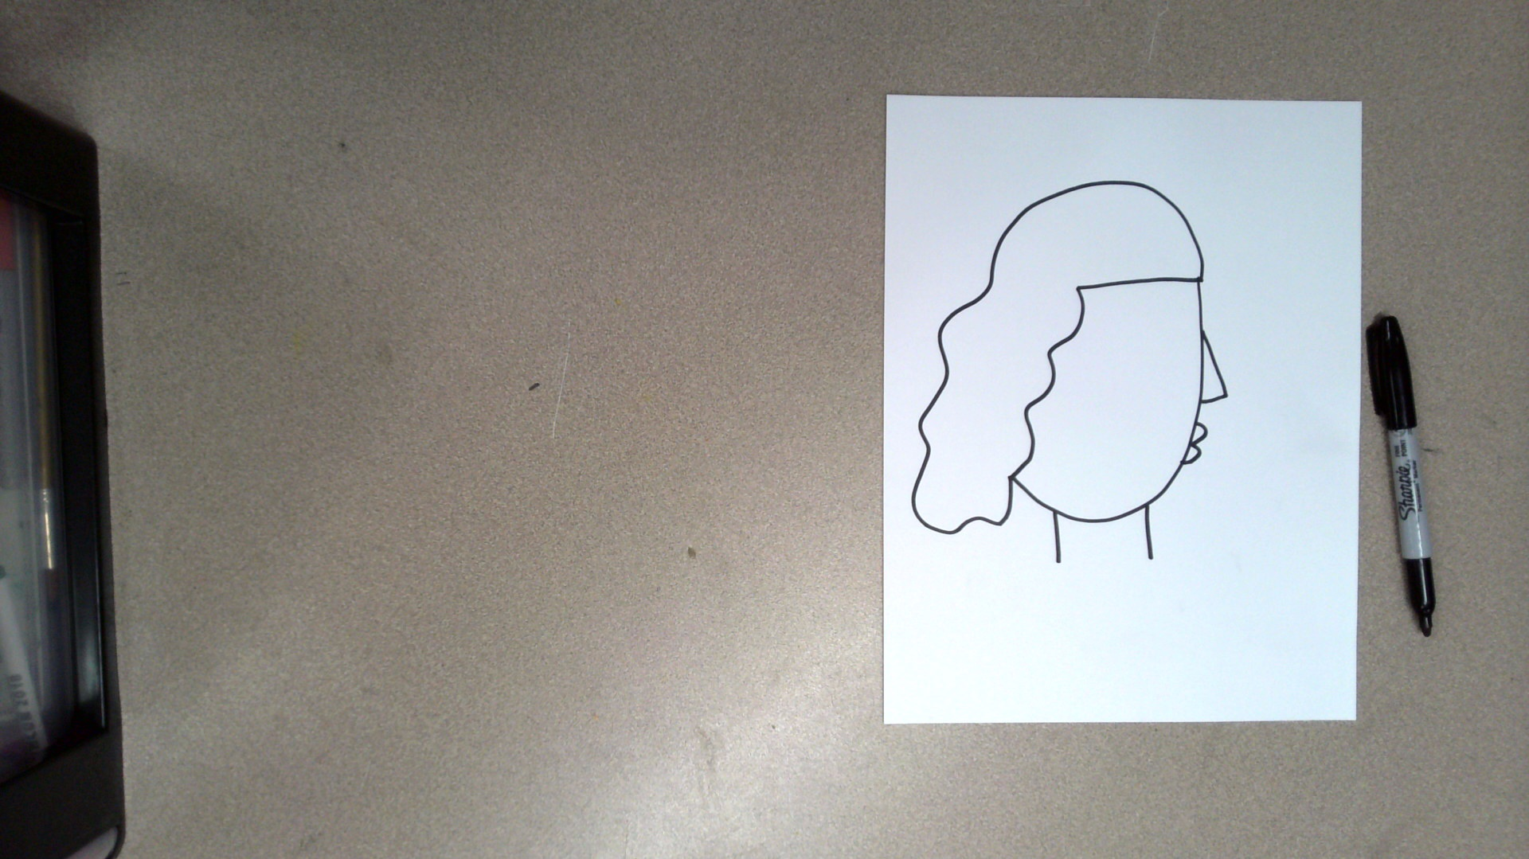
Draw your self-portrait a neck.

Slide 25
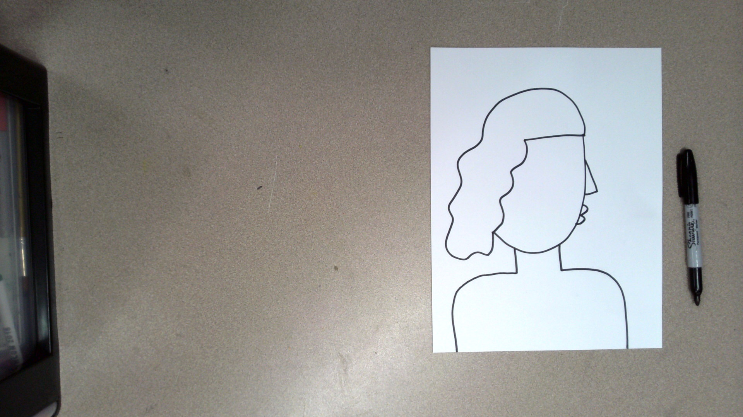
Draw your self-portrait shoulders.

Slide 26
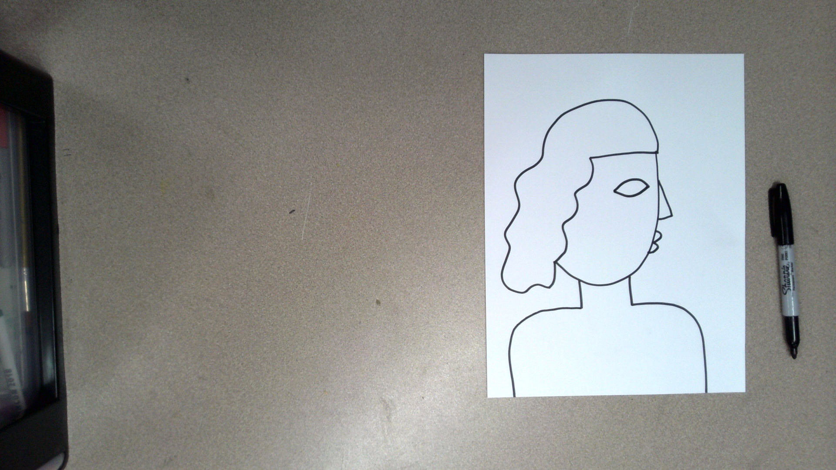
Draw your self-portrait an eye.

Slide 27
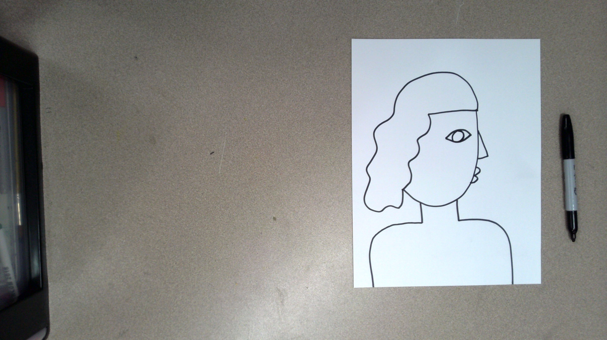
Draw your self-portrait an eye.

Slide 28
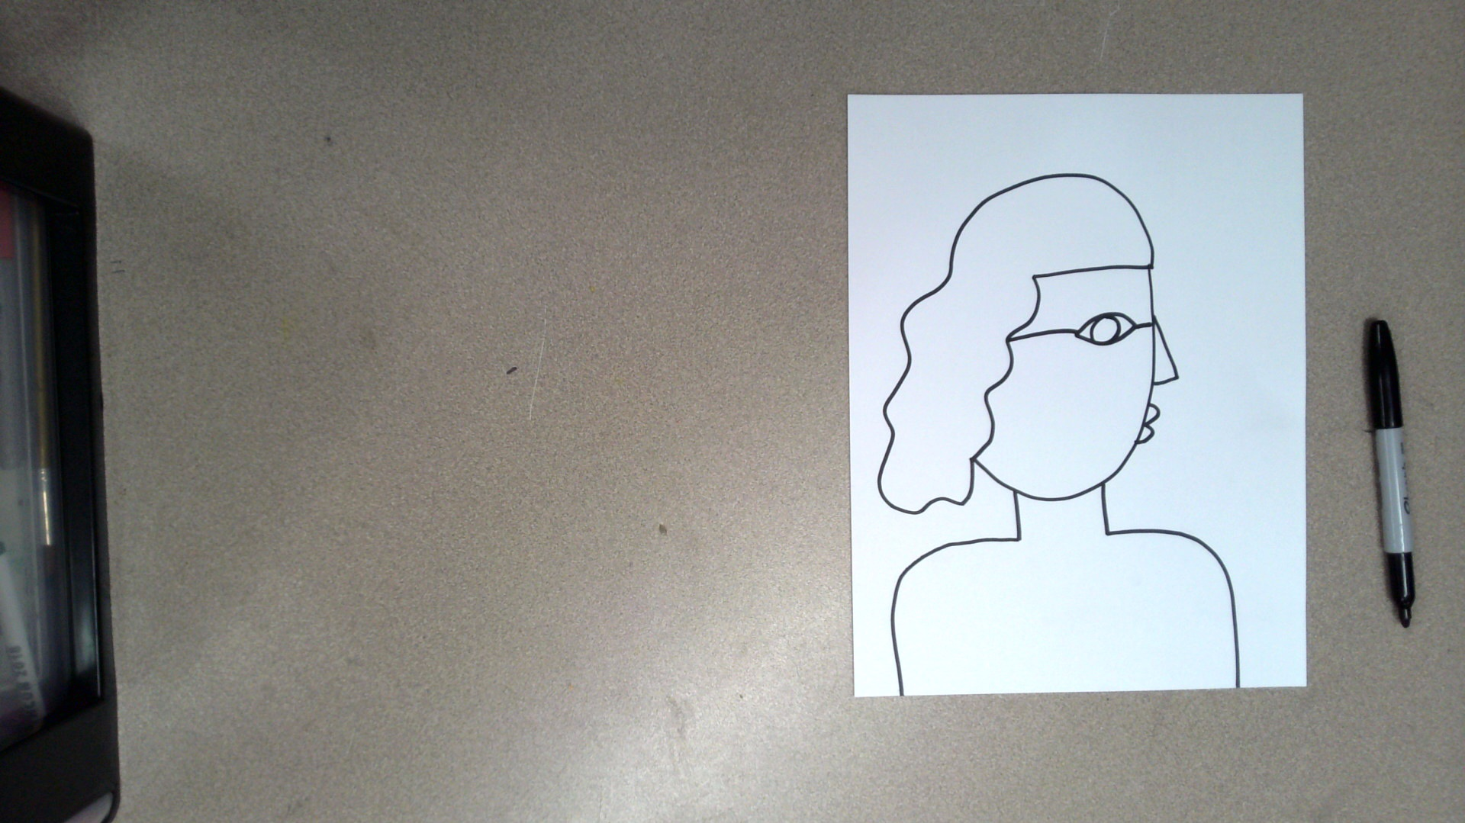
Draw a horizontal line through your face that lines up with the eye.

Slide 29
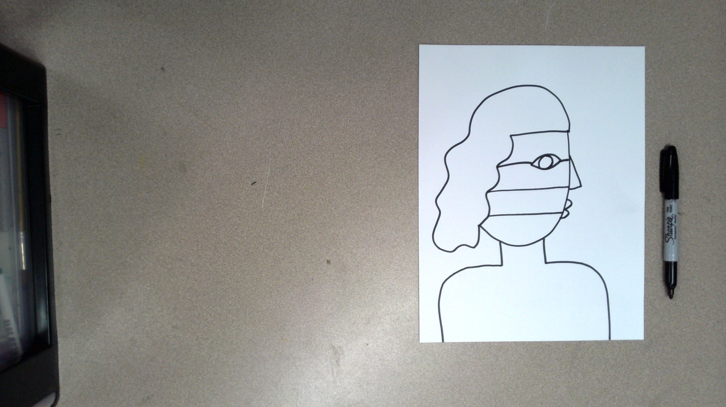
Draw two more horizontal lines through your face.

Slide 30
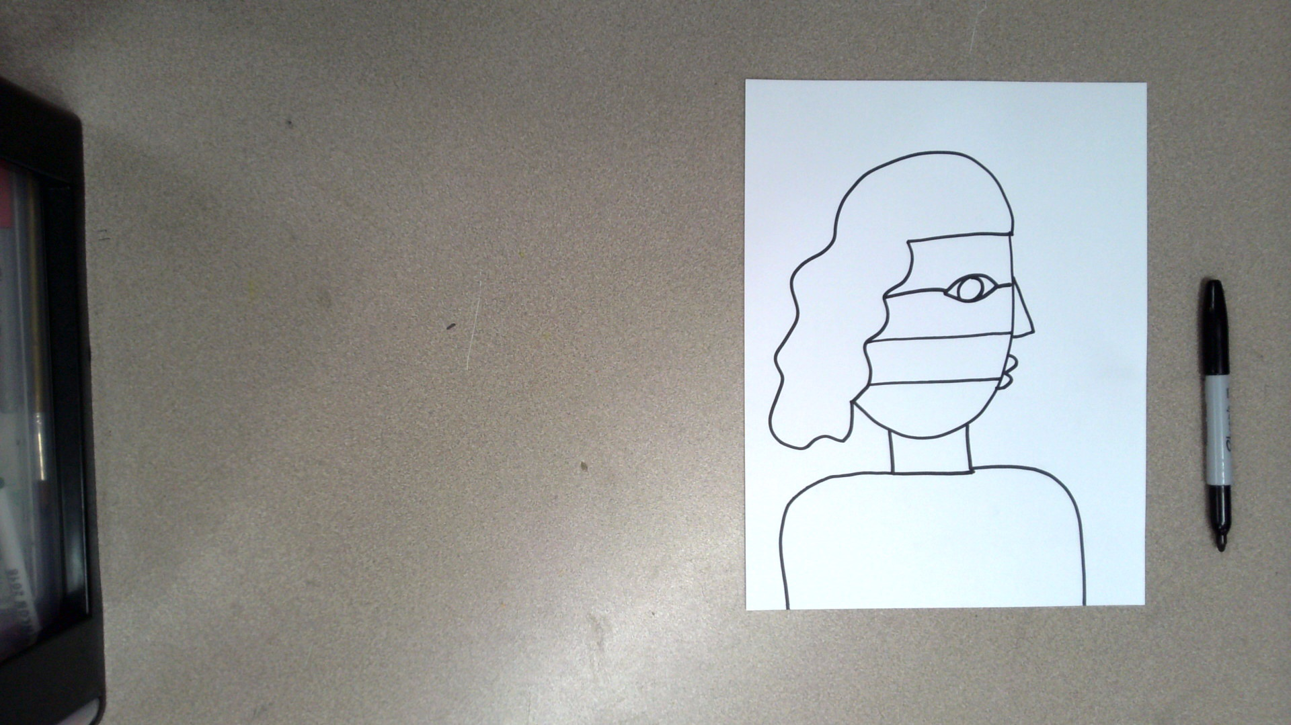
Draw a collar for your shirt.

Slide 31
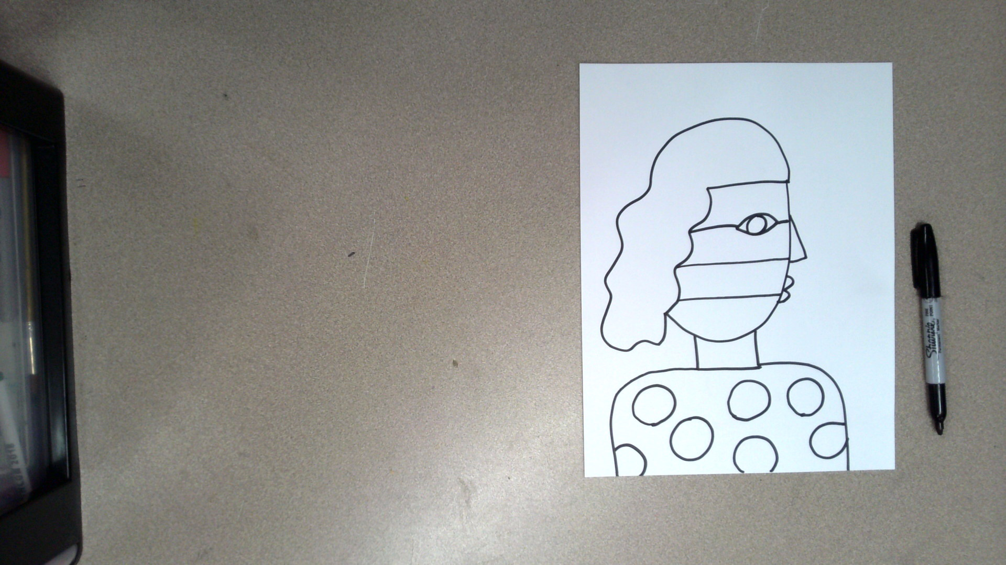
Decorate your shirt with a design or pattern.

Slide 32
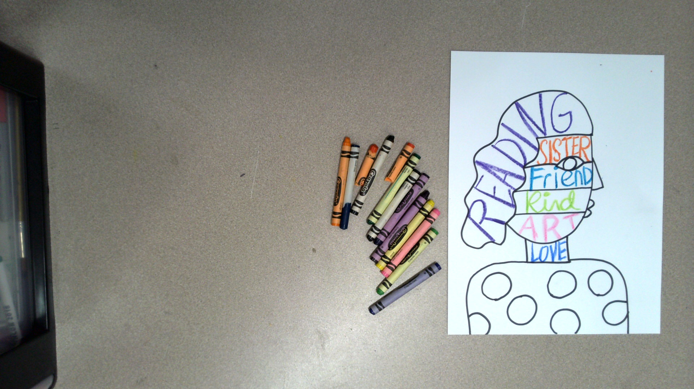
Using crayons write positive words about yourself on the face, hair, and neck.
Make sure the letters touch the top and bottom of the lines.
Make sure to draw thick and waxy with the crayon. This means you may need to trace the word a few times.

Slide 33
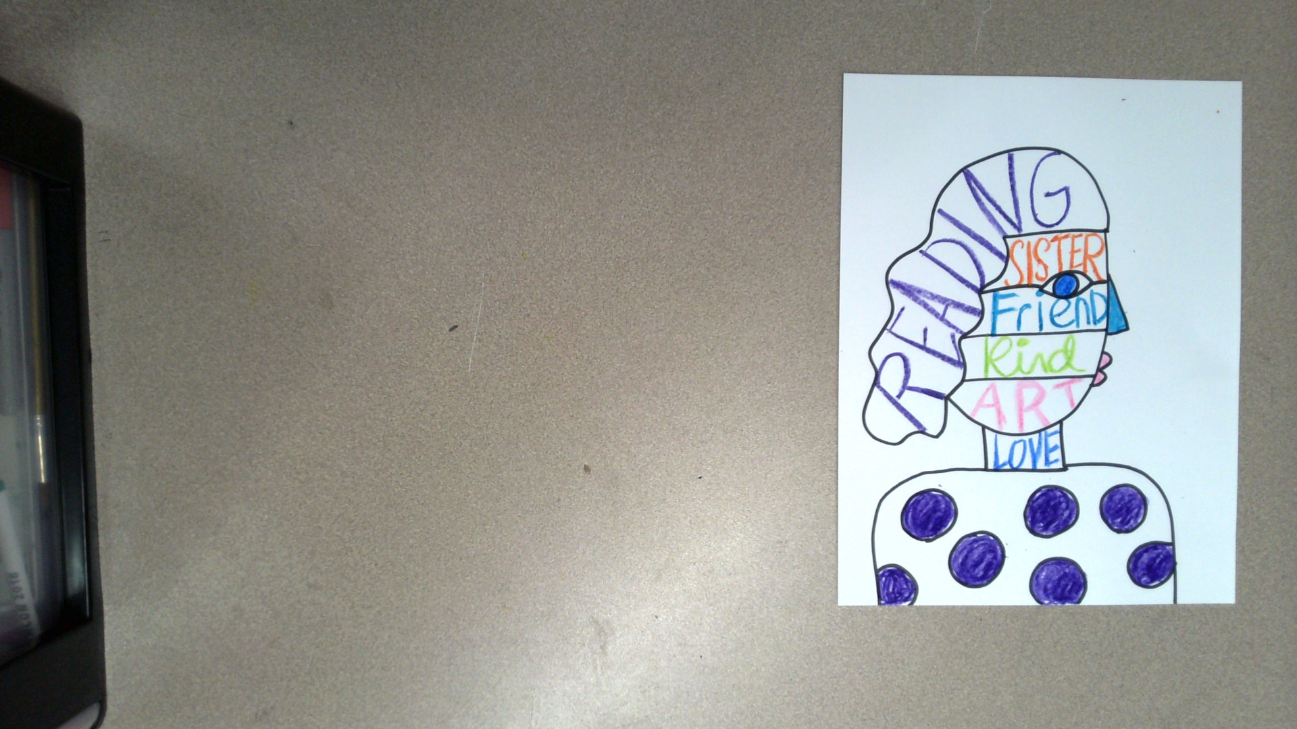
Using crayons, color the design or pattern on your shirt.

Slide 34
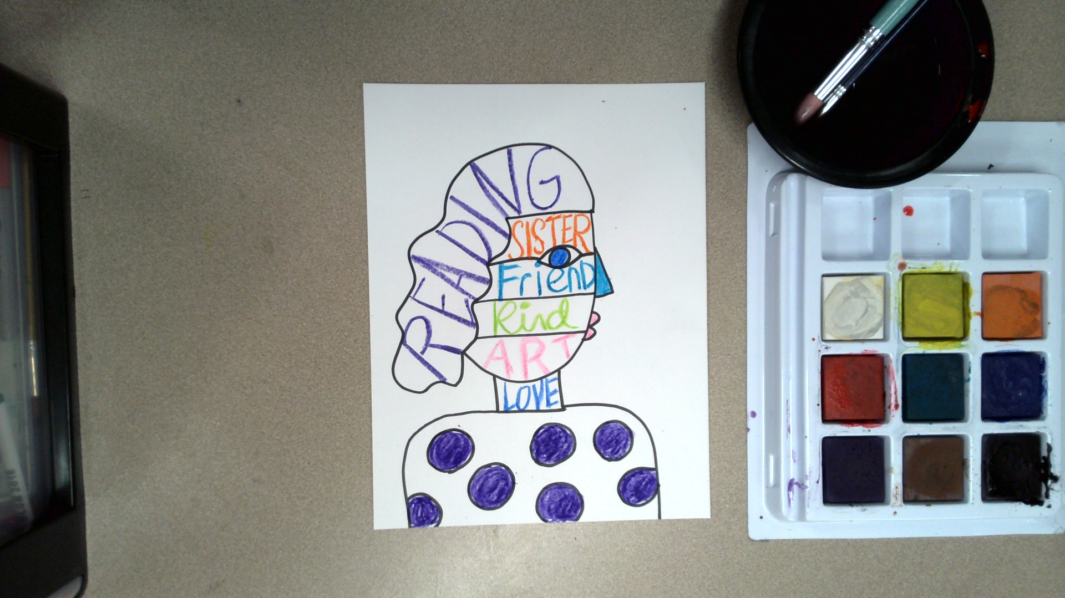
Get out:
Watercolor paint or cake tempera paint
Water
Paintbrushes

Slide 35
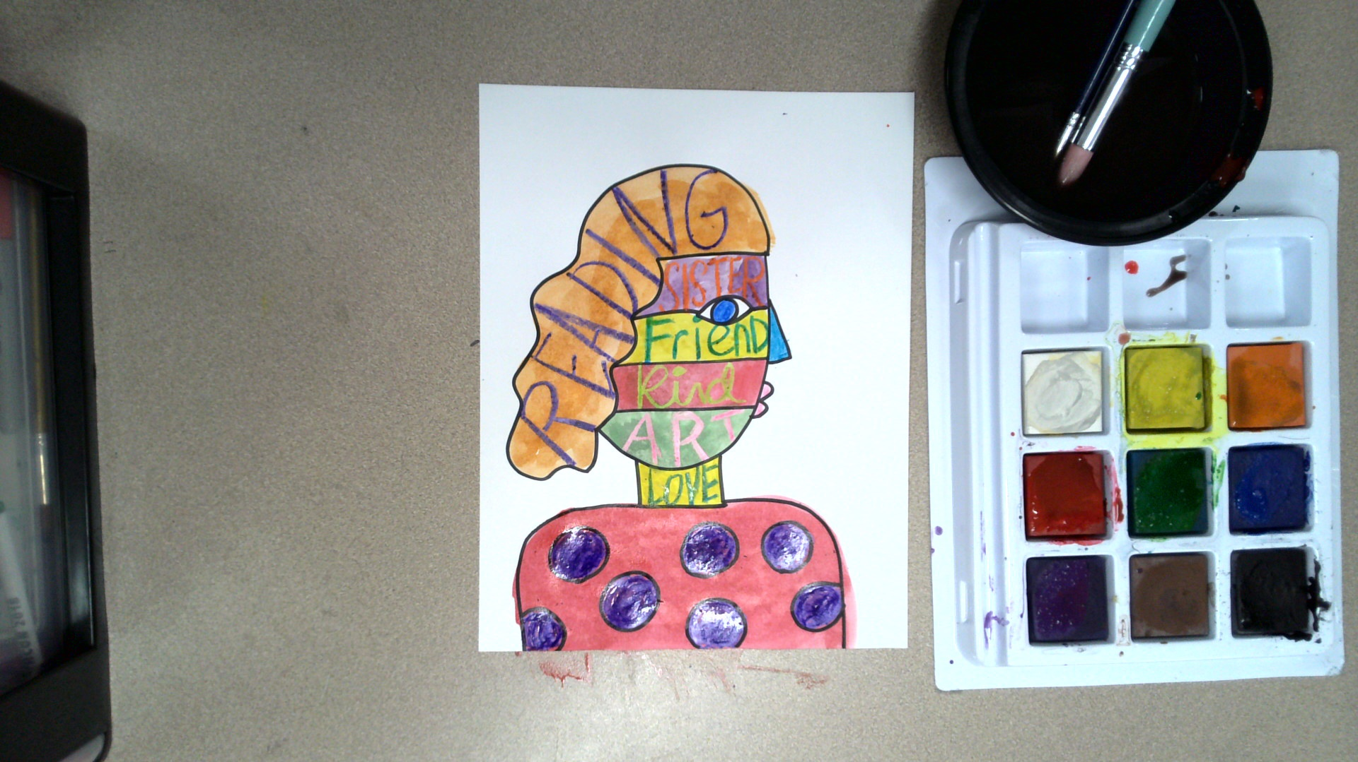
Lightly paint your self-portrait.
You do not want to paint too thickly because then the positive words won’t show up.

Slide 36
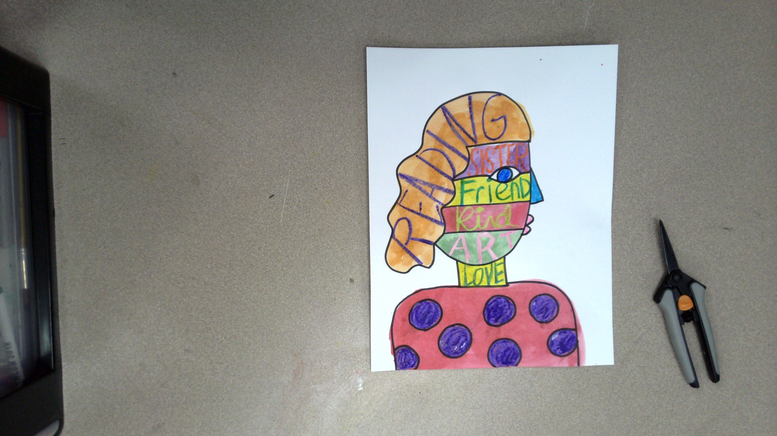
Allow your self-portrait to dry.
Then, get out a pair of scissors.

Slide 37
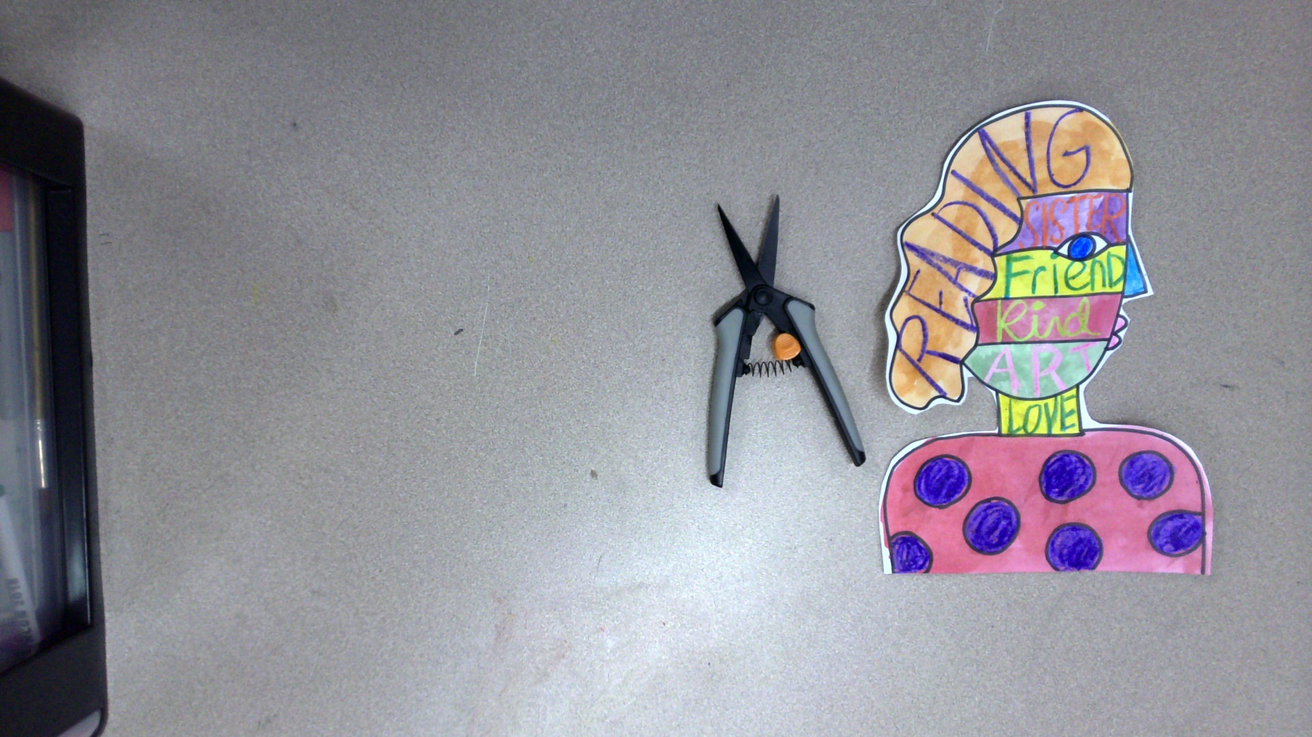
Cut out your portrait. It’s okay to leave a white border.

Slide 38
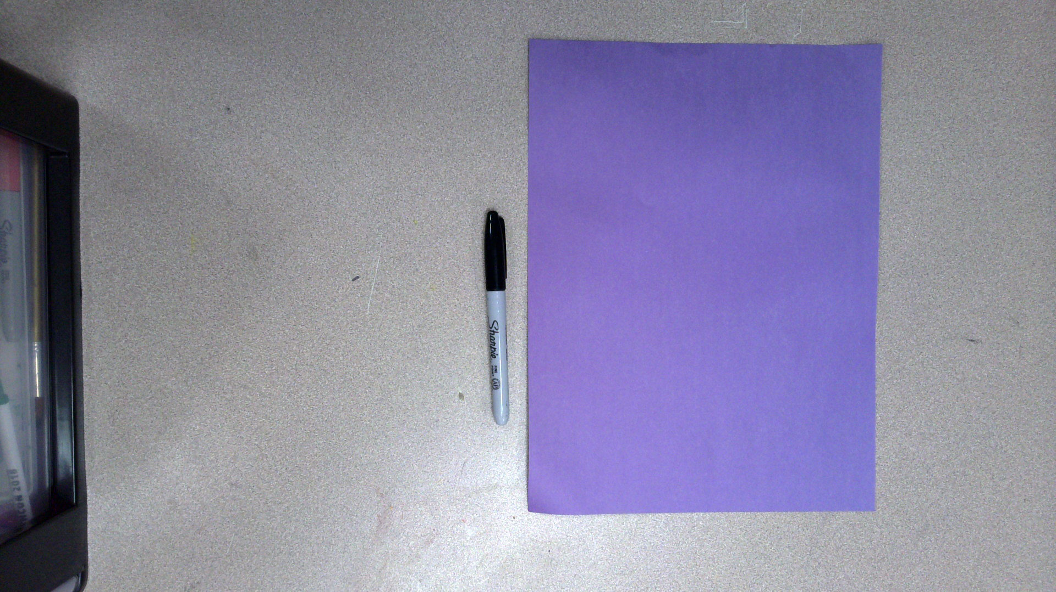
Get out a sheet of colored construction paper (it can be any color), and a marker.
Place the paper in front of your portrait style or vertically.

Slide 39
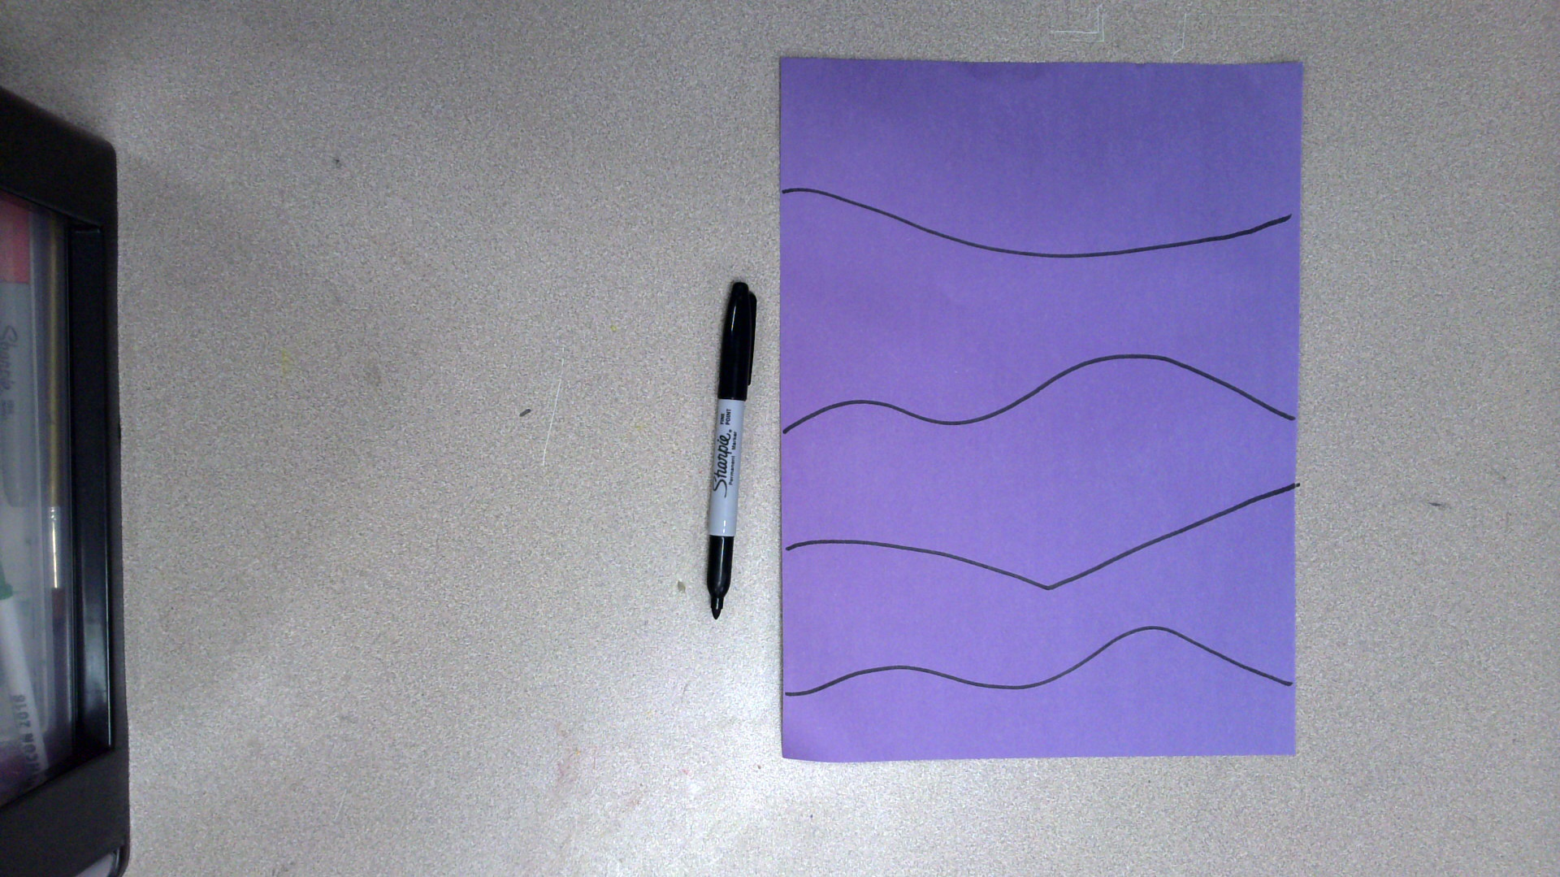
Draw four somewhat evenly spaced lines across your paper.
The lines can be curvy.

Slide 40
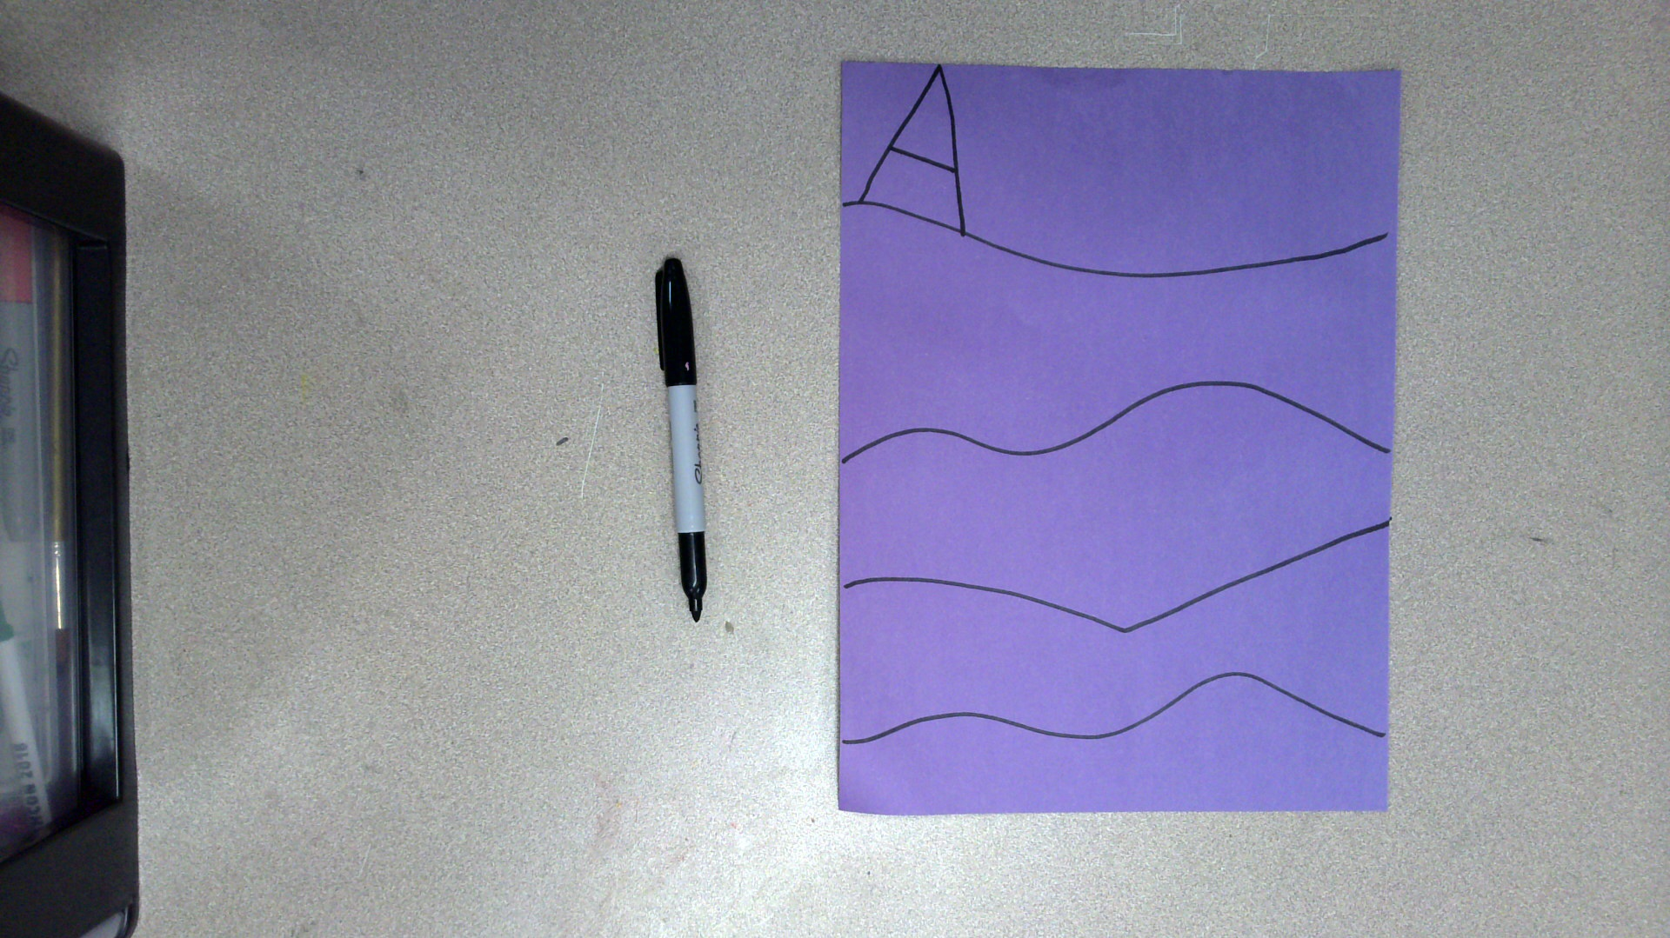
Draw the first letter of your first name.
Make sure the letter touches both the top of the paper and the line.

Slide 41
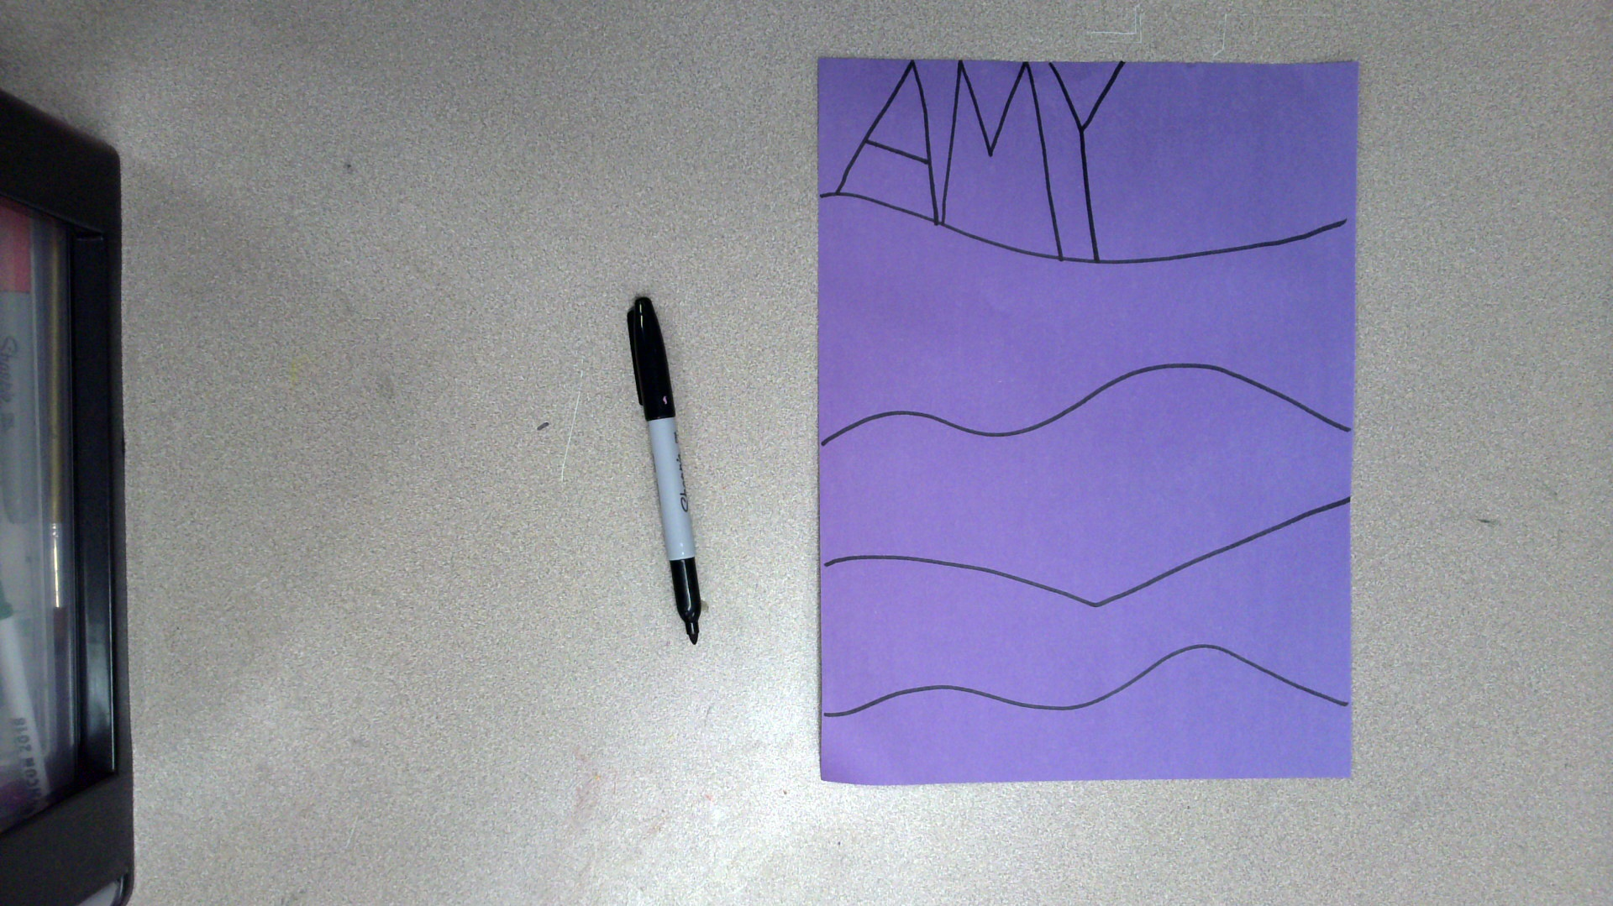
Draw the rest of the letters in your name.
Make sure the letters touch the top of the paper and the line.

Slide 42
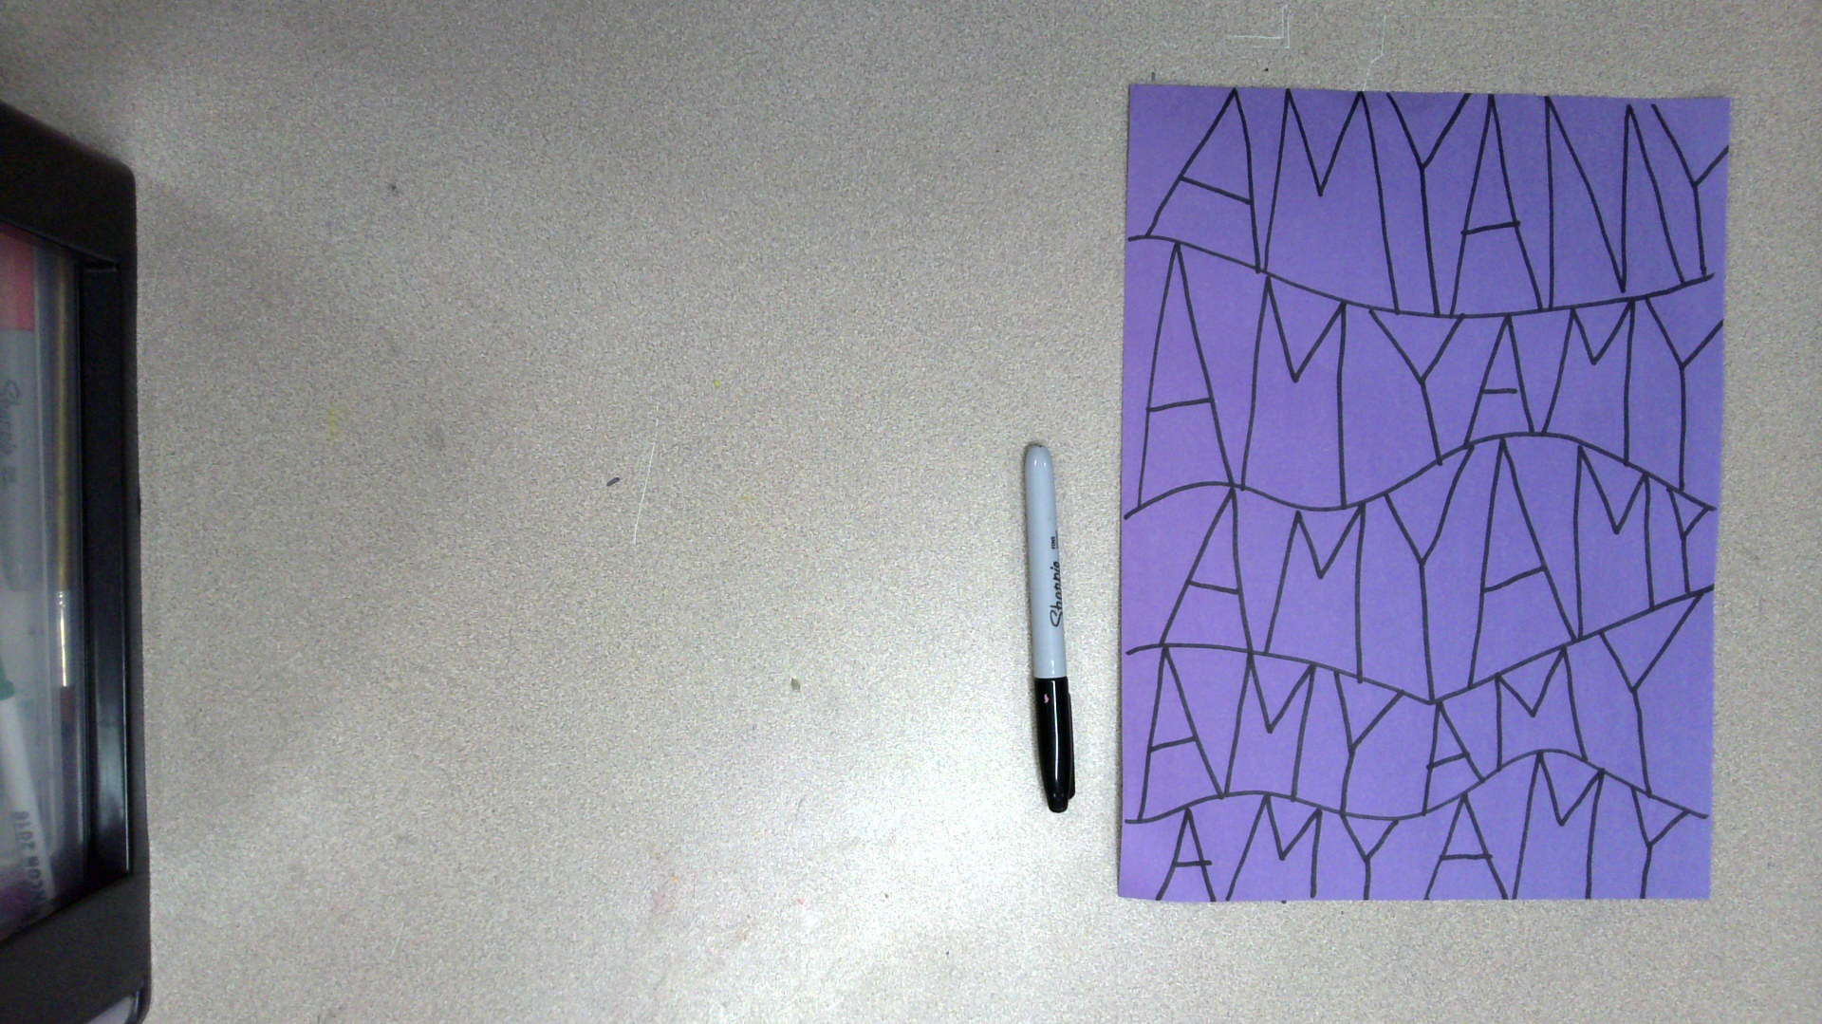
Repeat your name until you have covered the entire paper.

Slide 43
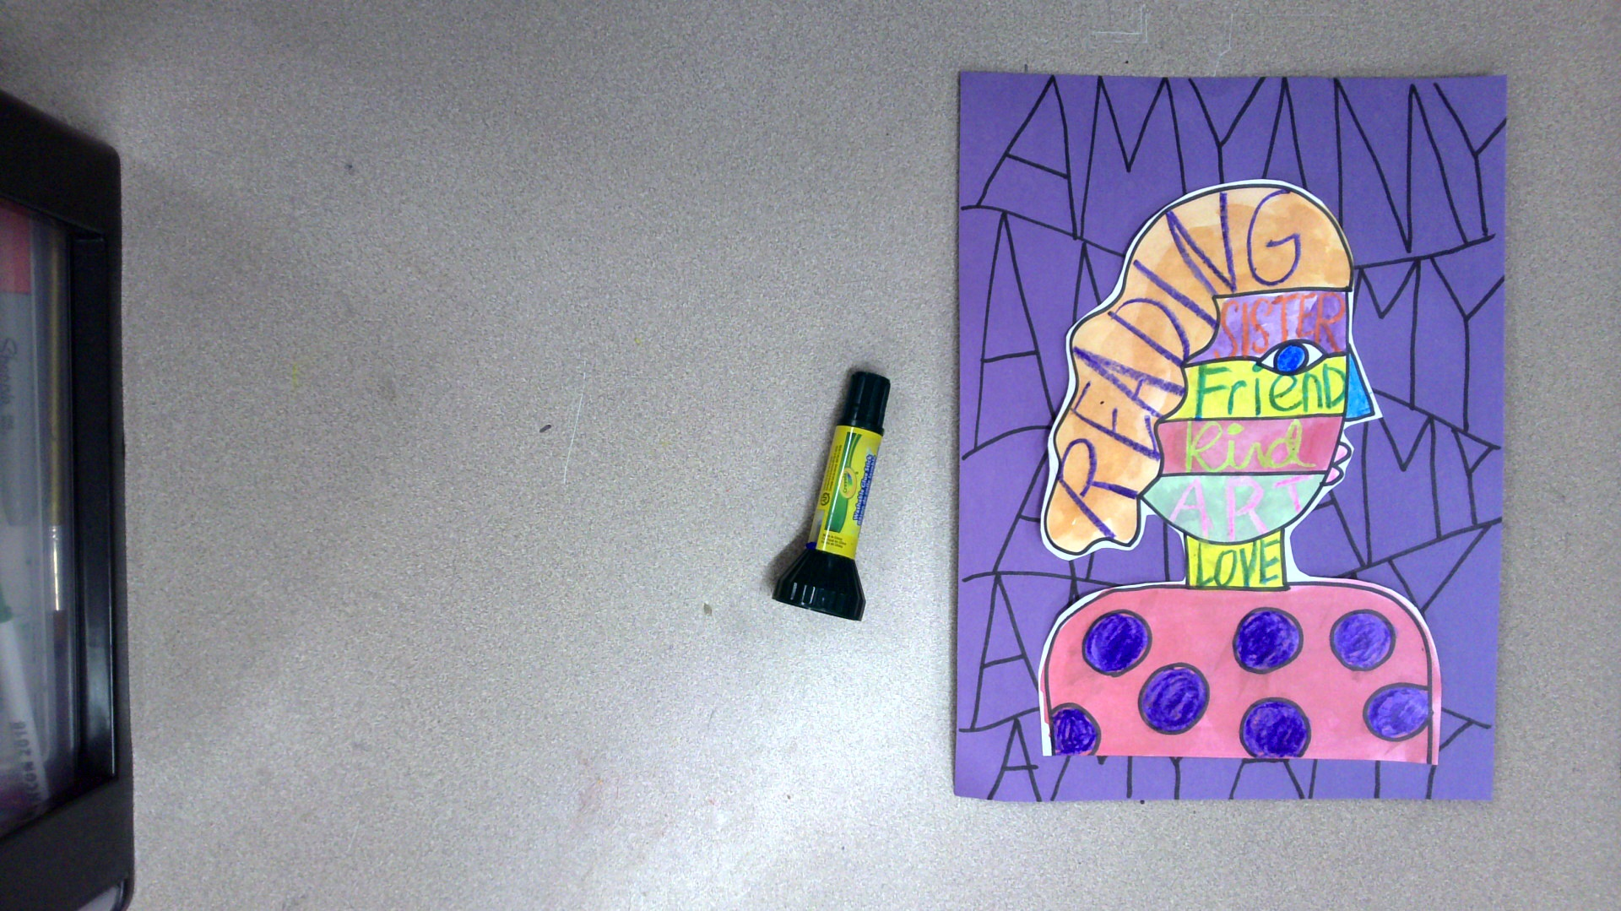
Glue your self-portrait to the colored construction paper.

Slide 44
Critique
With a partner, discuss the positive words you picked and how they describe you.
Listen as your partner discusses the words they chose and how they describe them.

Slide 45
How are you feeling after making your artwork?
Do you feel better, worse, or the same? Why?
Notes:
https://pixabay.com/illustrations/emotion-scale-emoji-icon-feedback-3404484/

Slide 46

Closing Slide

