Slide 1
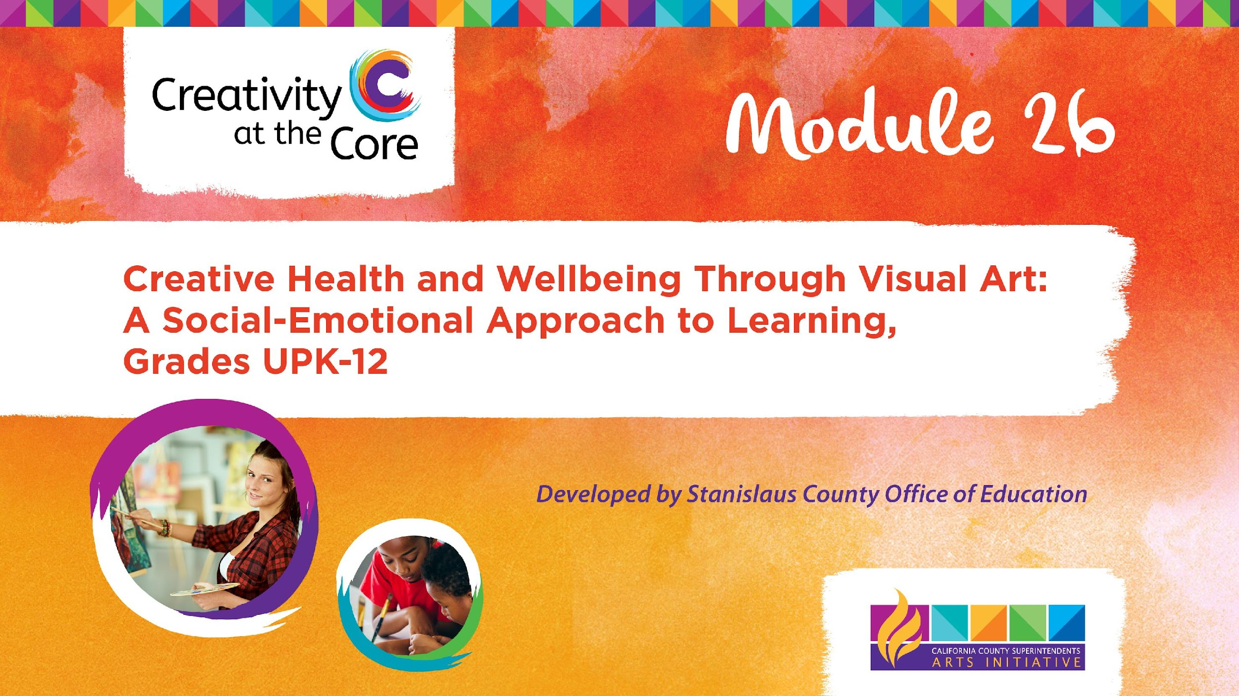
Grades 3 – 5 Project: Fauvist Self-Portrait​

Slide 2
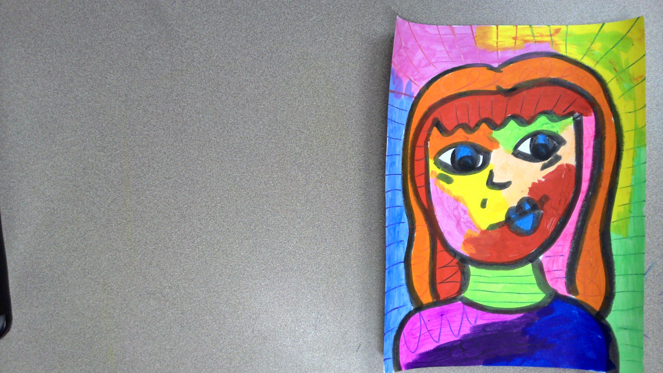
Grades 3 – 5 Project: Fauvist Self-Portrait
Learning Outcomes
Create a fauvist self-portrait depicting an emotion.

Slide 3
Grades 3 – 5 Project: Fauvist Self-Portrait
SEL Core Competencies Addressed
Self-Awareness
Self-Management
Visual Art Standards
3.VA:Cr2.1- Create personally satisfying artwork using a variety of artistic processes and materials.
4.VA:Cr2.1 - Explore and invent art-making techniques and approaches.
5.VA:Cr2.1 - Experiment and develop skills in multiple art-making techniques and approaches through practice.

Slide 4
Grades 3 – 5 Project: Fauvist Self-Portrait
Materials Needed
8.5 x 11 inch white cardstock
Tempera stick paint
Colored pencils

Slide 5
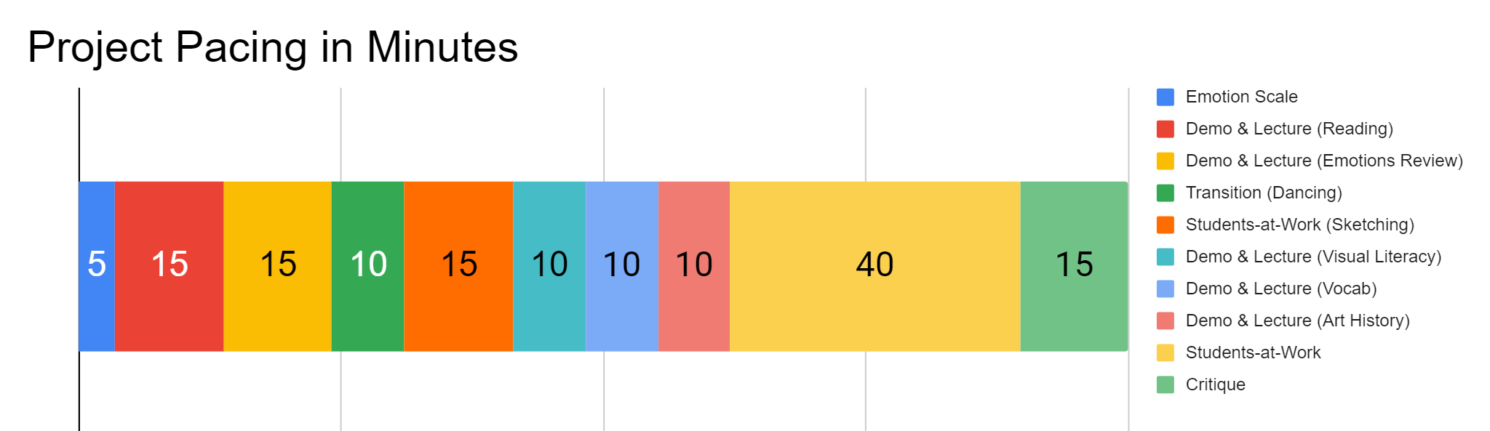
Project Pacing
Pacing structure follows the guidance of the Studio Habits of Mind framework.

Slide 6
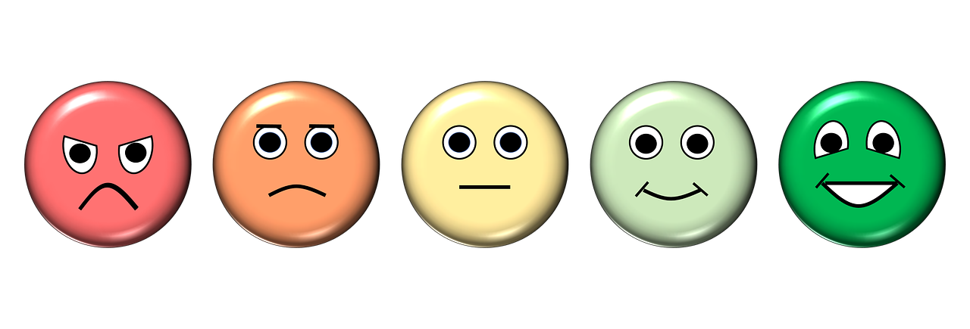
How are you feeling right now?
Notes:
https://pixabay.com/illustrations/emotion-scale-emoji-icon-feedback-3404484/

Slide 7
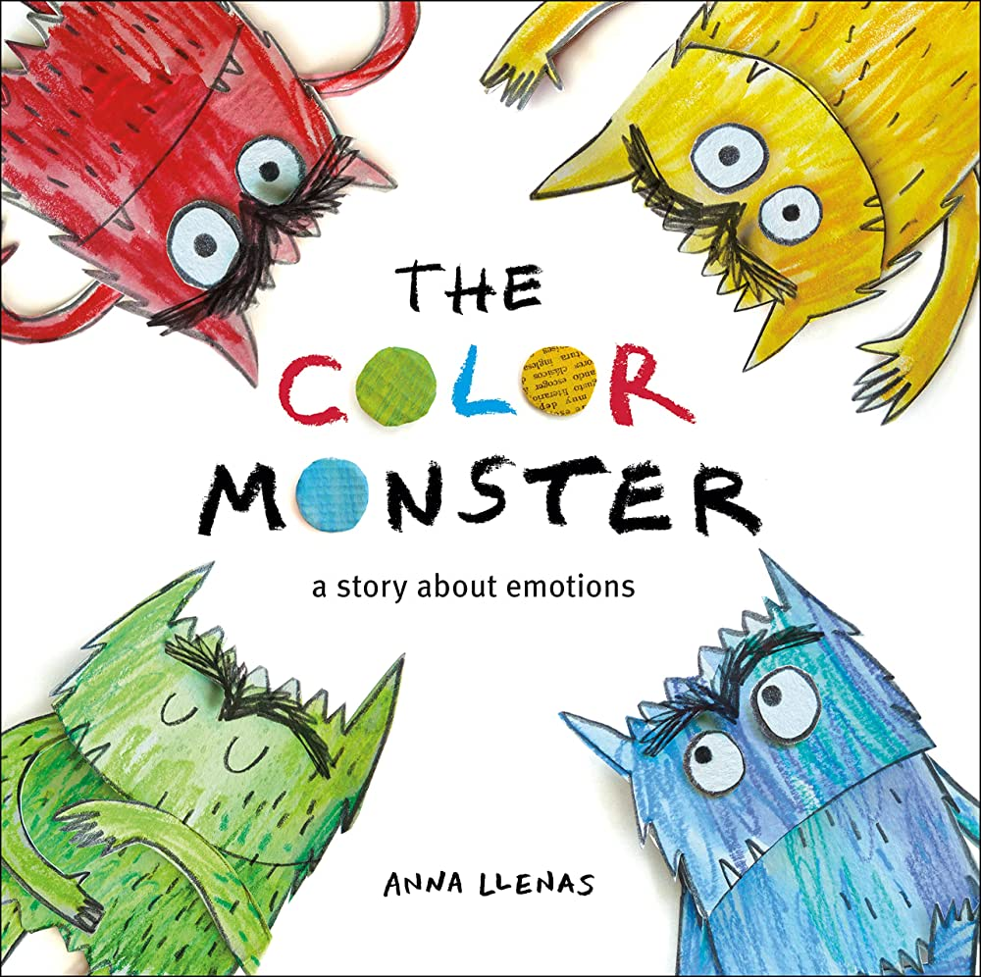
Demo & Lecture: Reading
Suggested but not required reading:
The Color Monster
by Anna Llenas
As you read the book, pause at each emotion. Ask students to make a facial expression that matches the emotion.

Slide 8
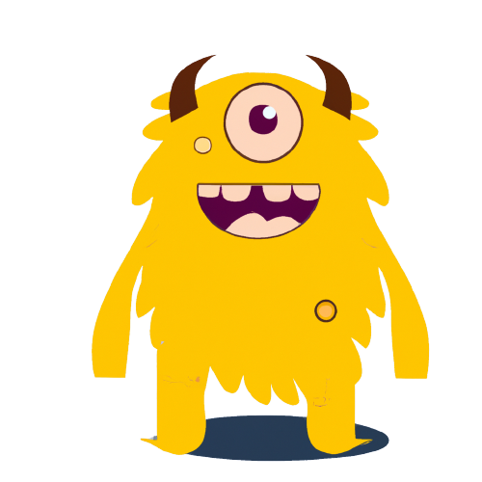
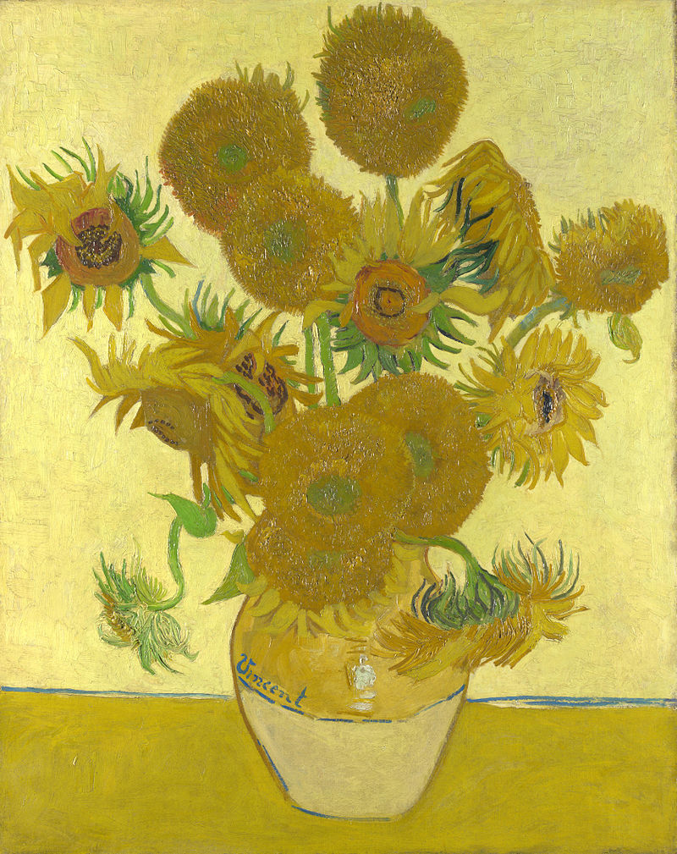

Demo & Lecture: Emotions Review
Sunflowers
Vincent Van Gogh
1888
What emotion is this?
Can you make a face showing this emotion?
Notes:
Monster image generated by DALL-E2 AI based on a prompt by Amy Bultena
https://www.pexels.com/photo/black-happy-man-smiling-near-modern-building-6930504/
https://en.wikipedia.org/wiki/Sunflowers_(Van_Gogh_series)#/media/File:Vincent_Willem_van_Gogh_127.jpg

Slide 9
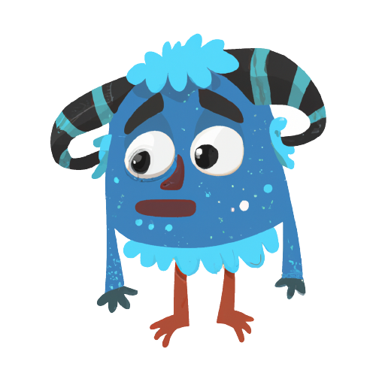
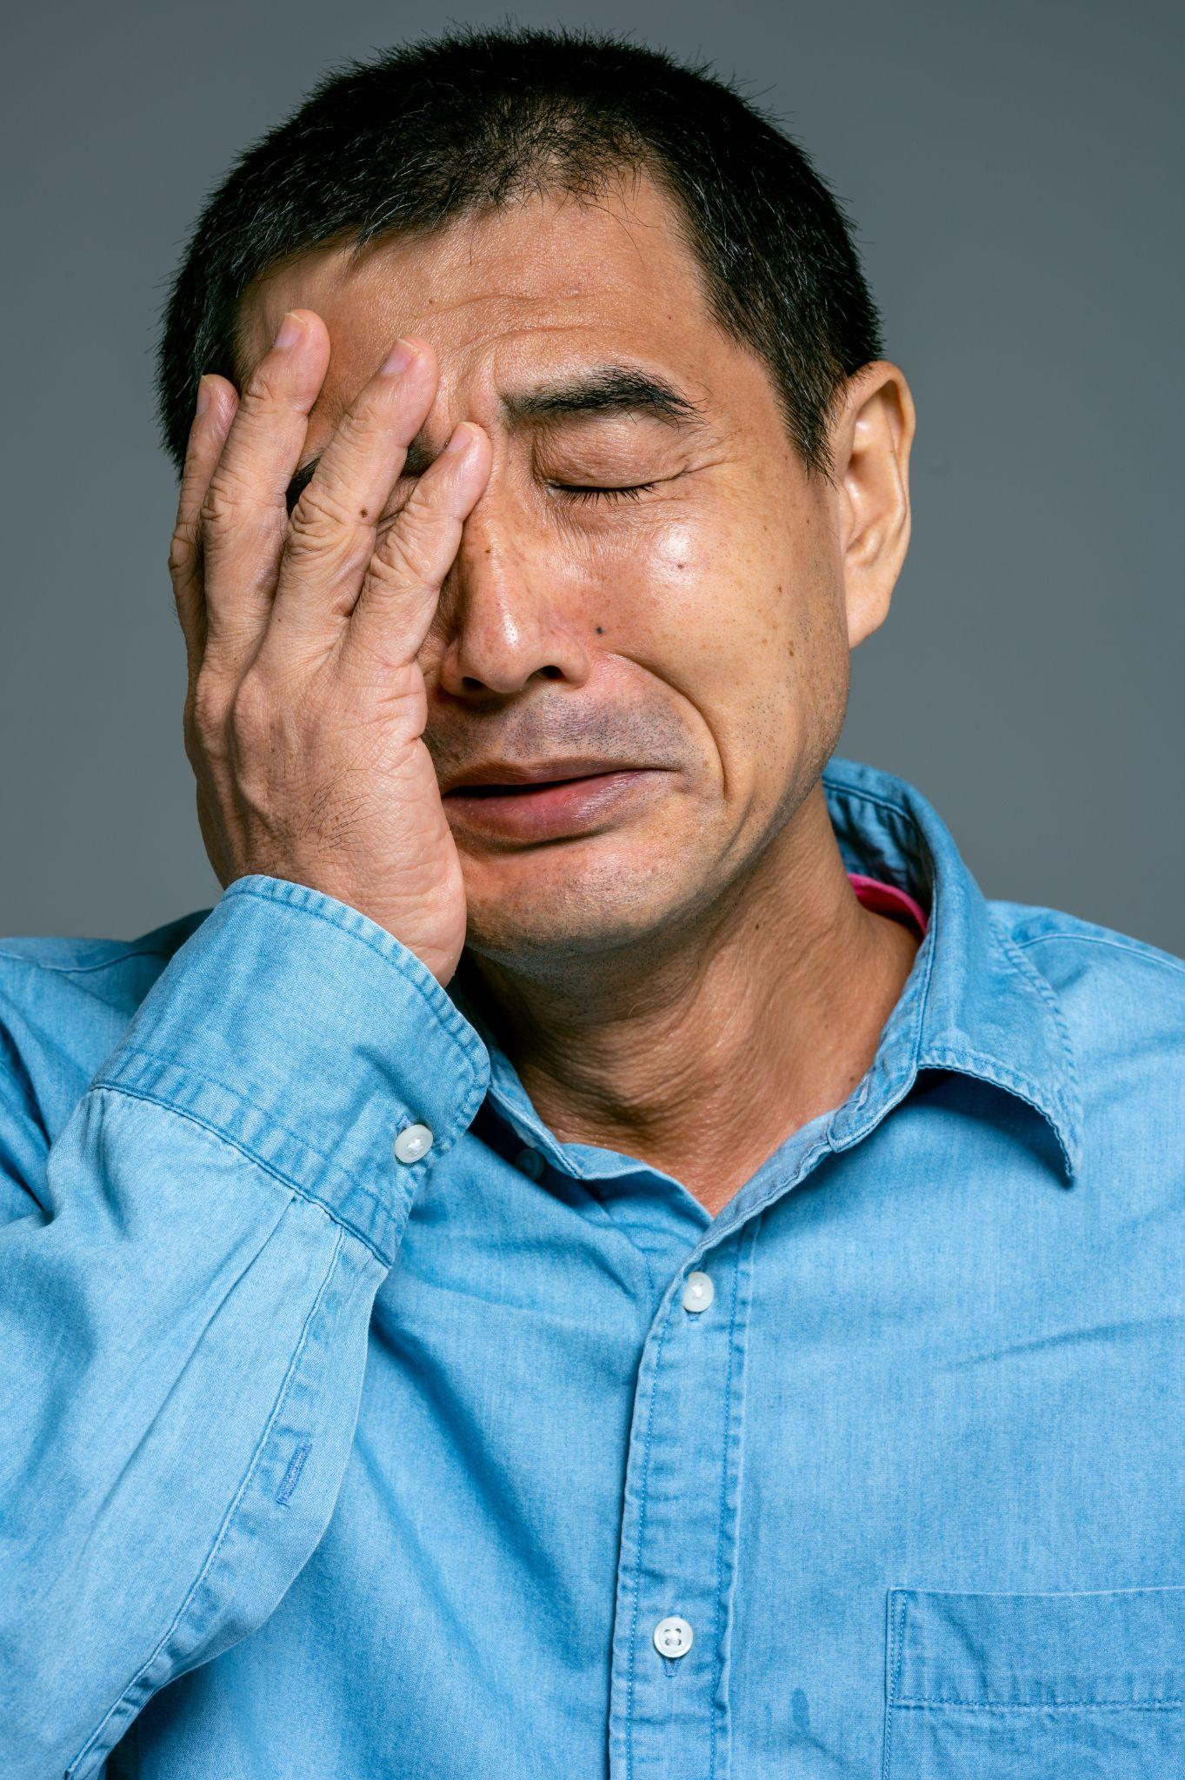
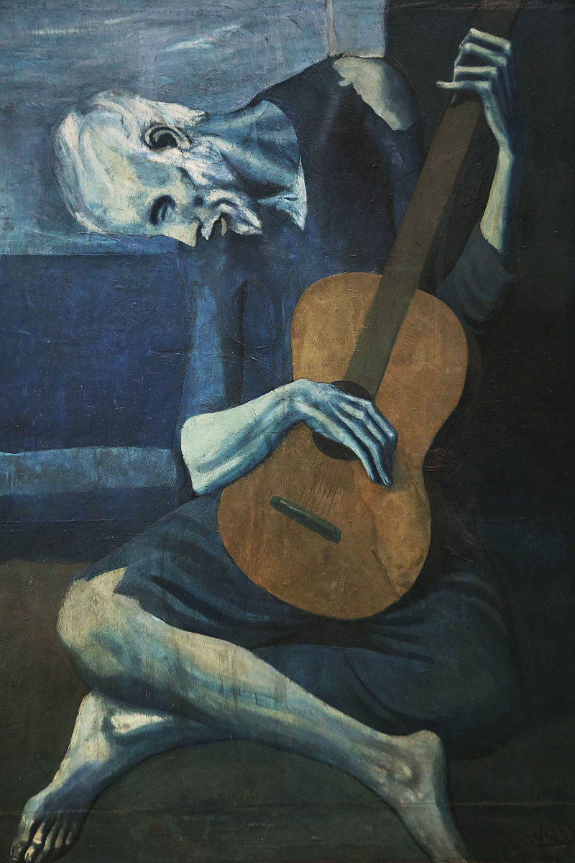
Demo & Lecture: Emotions Review
The Old Guitarist
Pablo Picasso
1903
What emotion is this?
Can you make a face showing this emotion?
Notes:
Monster image generated by DALL-E2 AI based on a prompt by Amy Bultena
https://www.pexels.com/photo/man-in-blue-button-up-shirt-crying-4584111/
https://en.wikipedia.org/wiki/The_Old_Guitarist#/media/File:Old_guitarist_chicago.jpg

Slide 10


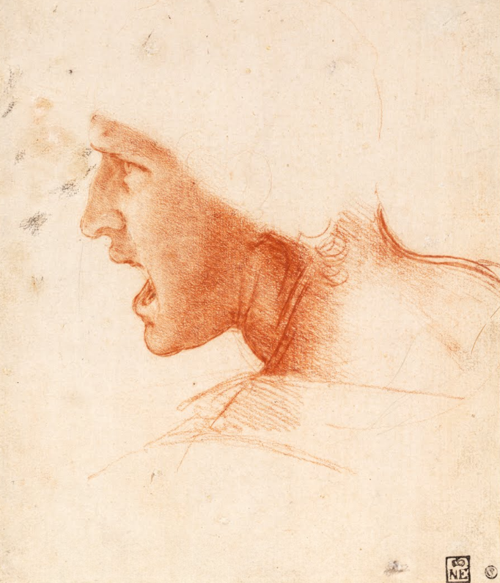
Demo & Lecture: Emotions Review
Study for the Head of Soldier in Battle
Leonardo da Vinci
1504
What emotion is this?
Can you make a face showing this emotion?
Notes:
Monster image generated by DALL-E2 AI based on a prompt by Amy Bultena
https://pixabay.com/photos/anger-angry-bad-burn-dangerous-18658/
https://artsandculture.google.com/asset/recto-study-for-the-head-of-a-soldier-in-the-battle-of-anghiari-leonardo-da-vinci/agGehq9rnyX-vw?hl=en

Slide 11
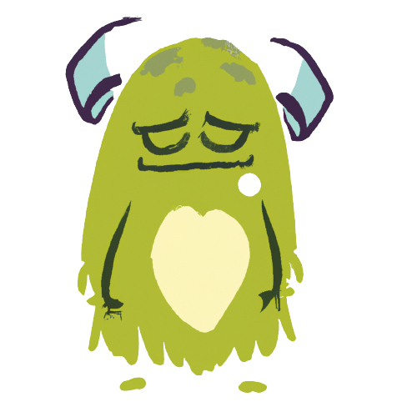
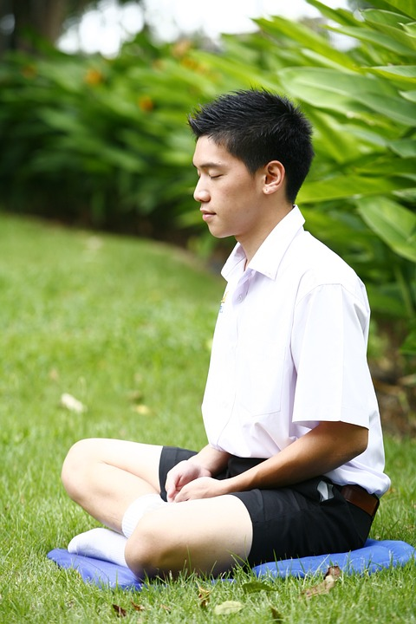
Demo & Lecture: Emotions Review
Water Lilies and Japanese Bridge
Claude Monet
1898
What emotion is this?
Can you make a face showing this emotion?
Notes:
Monster image generated by DALL-E2 AI based on a prompt by Amy Bultena
https://pixabay.com/photos/meditation-buddhist-boy-meditate-481246/
https://commons.wikimedia.org/wiki/File:Water-Lilies-and-Japanese-Bridge-(1897-1899)-Monet.jpg

Slide 12

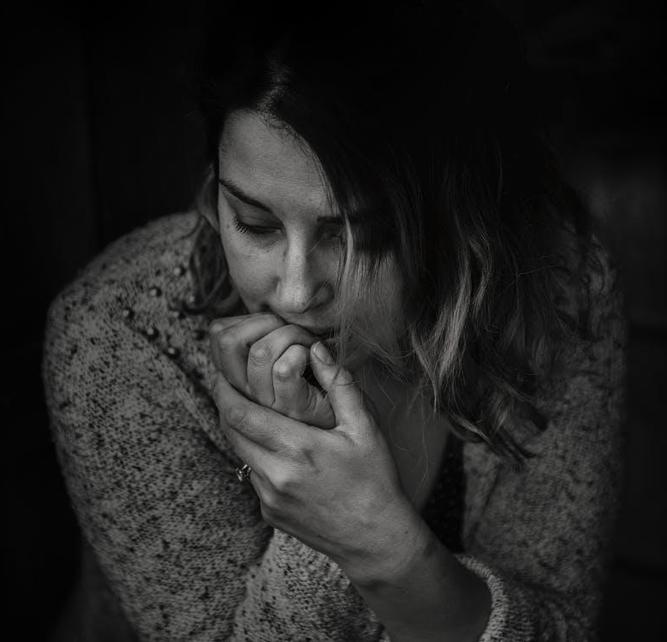
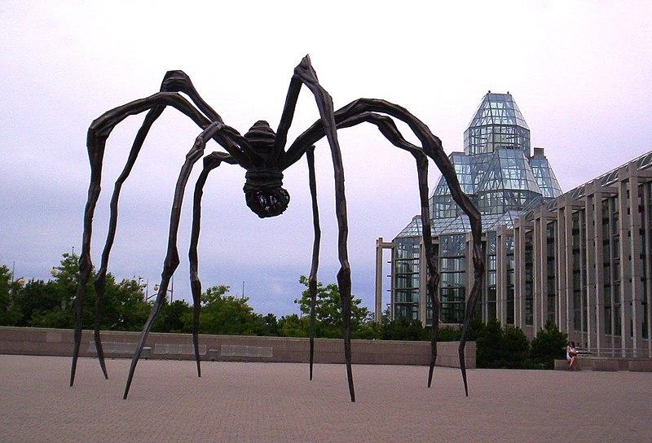
Demo & Lecture: Emotions Review
Maman
Louise Bourgeois
2005
What emotion is this?
Can you make a face showing this emotion?
Notes:
Monster image generated by DALL-E2 AI based on a prompt by Amy Bultena
https://www.pexels.com/photo/greyscale-photography-of-woman-wearing-long-sleeved-top-736843/
https://www.atlasobscura.com/places/maman

Slide 13


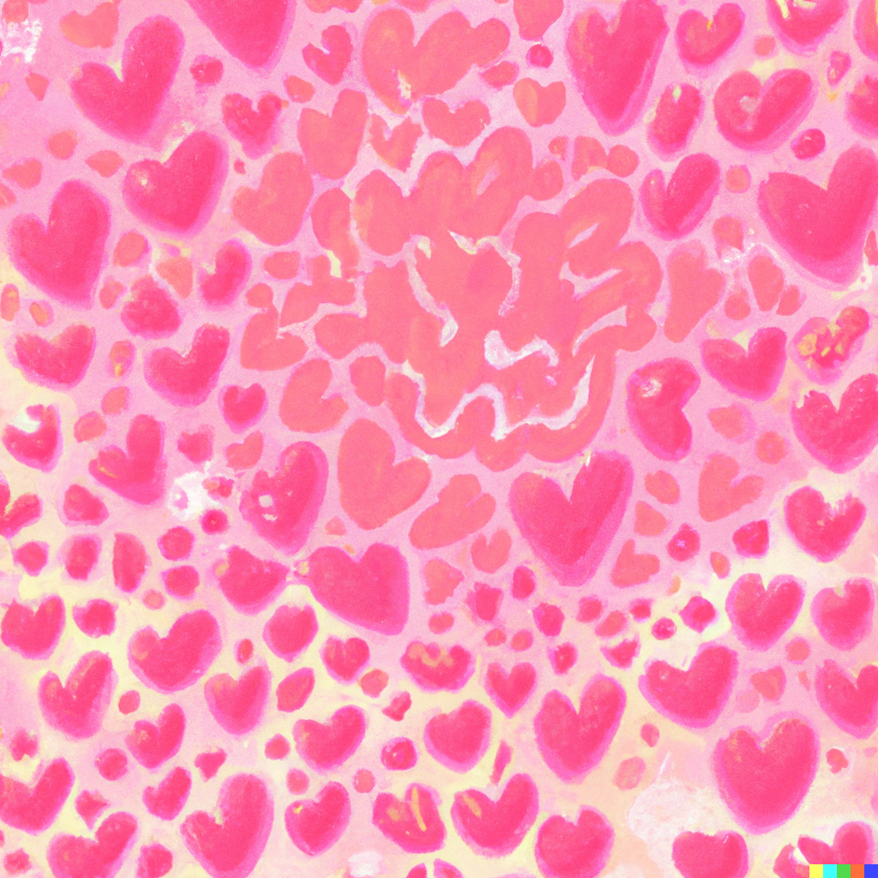
Demo & Lecture: Emotions Review
What emotion is this?
Can you make a face showing this emotion?
Notes:
Monster image generated by DALL-E2 AI based on a prompt by Amy Bultena
Heart artwork image generated by DALL-E2 AI based on a prompt by Amy Bultena
https://pixabay.com/photos/valentines-day-valentine-hearts-1947567/

Slide 14
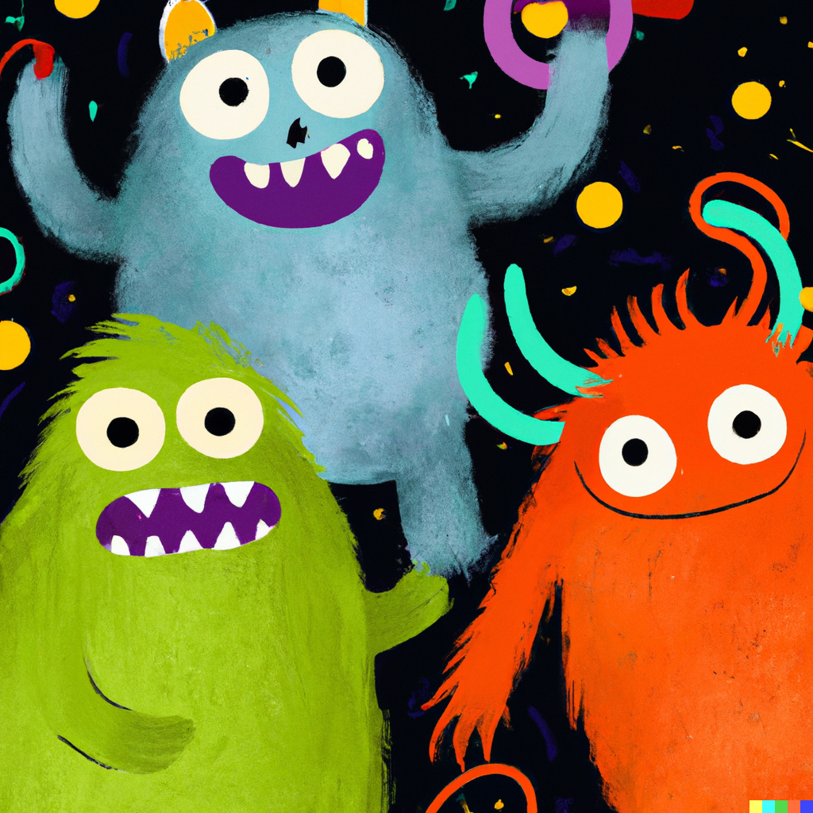
Transition: Emotions Dancing
Emotions Hokey Pokey
Students stand in a circle
Sing the Hokey Pokey song
Instead of placing a body part in and out, students place an emotion in and out (example: “Put your happy face in; put your happy face out!”
Notes:
Monster image generated by DALL-E2 AI based on a prompt by Amy Bultena

Slide 15
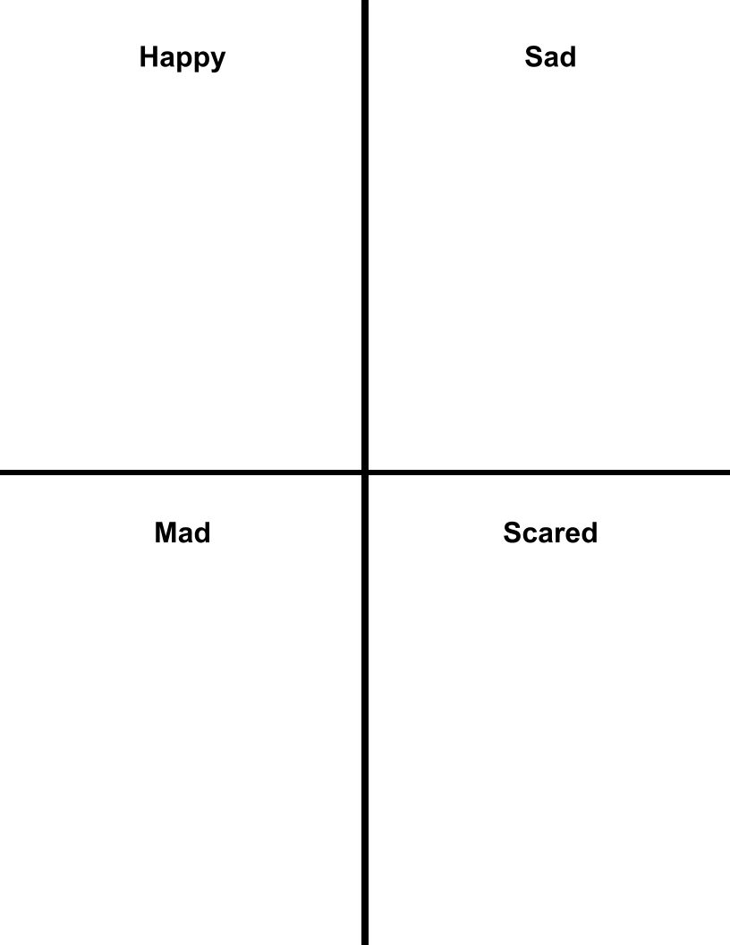
Students-at-Work: Sketching
Let’s practice drawing emotions.
Each student needs a pencil or crayon
Provide students with a sheet of paper sectioned into fourths

Slide 16
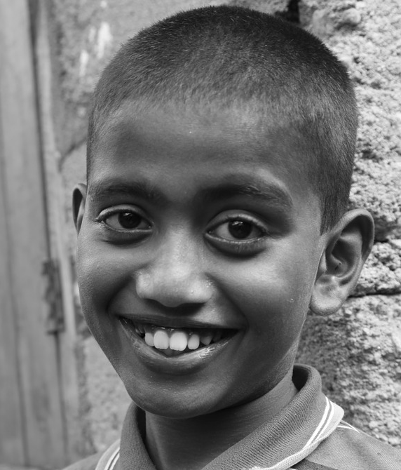

Students-at-Work: Sketching
What emotion is this?
Notes:
https://www.wallpaperflare.com/smiley-face-basic-emoticon-eyes-icons-illustrations-happy-wallpaper-wlnao
https://www.pxfuel.com/en/free-photo-qjuzs

Slide 17
Students-at-Work: Sketching
Can you make this face?

Slide 18
Students-at-Work: Sketching
Practice drawing this face.

Slide 19
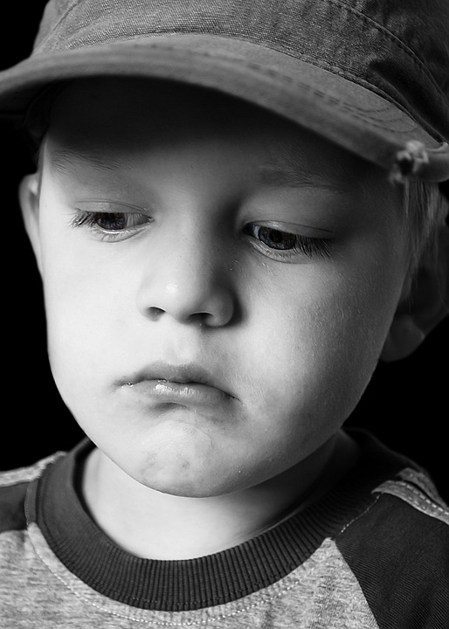

Students-at-Work: Sketching
What emotion is this?
Notes:
https://www.publicdomainpictures.net/en/view-image.php?image=25535&picture=sad-child
https://www.maxpixel.net/Message-Yellow-Emoji-Upset-Sad-Face-Bored-5843434

Slide 20
Students-at-Work: Sketching
Can you make this face?

Slide 21
Students-at-Work: Sketching
Practice drawing this face.

Slide 22
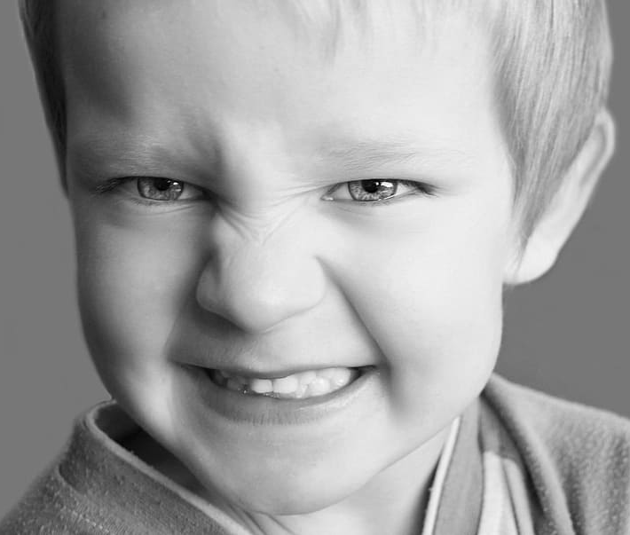

Students-at-Work: Sketching
What emotion is this?
Notes:
https://www.wallpaperflare.com/search?wallpaper=angry+kid
https://commons.wikimedia.org/wiki/File:%D0%A1%D0%BC%D0%B0%D0%B9%D0%BB%D0%B8%D0%BA-%D0%B7%D0%BB%D0%BE%D0%B9.svg

Slide 23
Students-at-Work: Sketching
Can you make this face?

Slide 24
Students-at-Work: Sketching
Practice drawing this face.

Slide 25
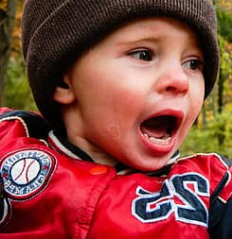

Students-at-Work: Sketching
What emotion is this?
Notes:
https://www.pikist.com/free-photo-varkx
https://pixabay.com/illustrations/emoji-scared-emoticon-expression-2009487/

Slide 26
Students-at-Work: Sketching
Can you make this face?

Slide 27
Students-at-Work: Sketching
Practice drawing this face.

Slide 28
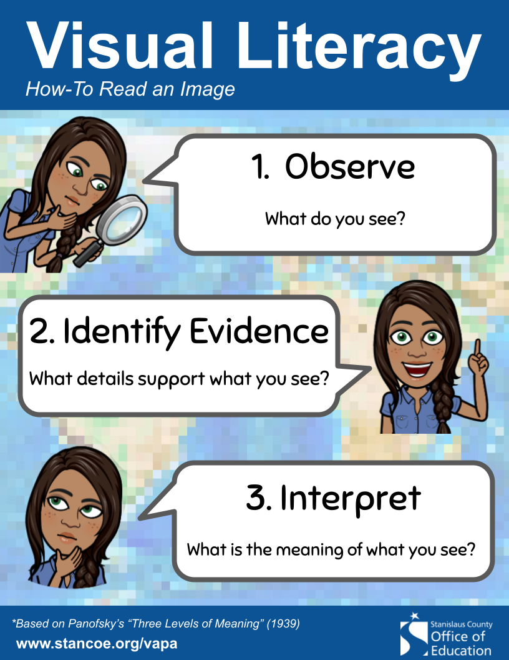
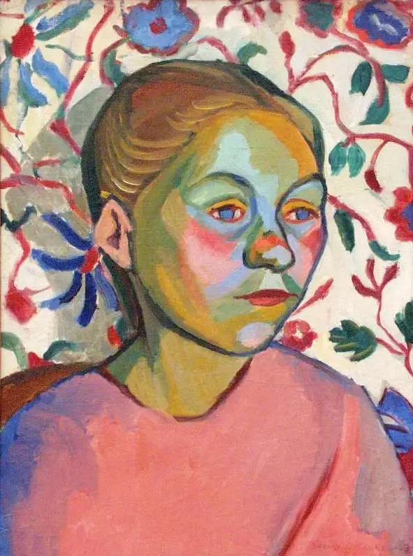
Visual Literacy
Finnish Woman
Sonia Delaunay
1907-08
Notes:
https://medium.com/counterarts/the-fauvist-portrait-7d4cd91e3324

Slide 29
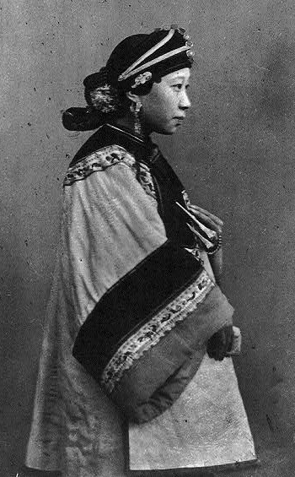
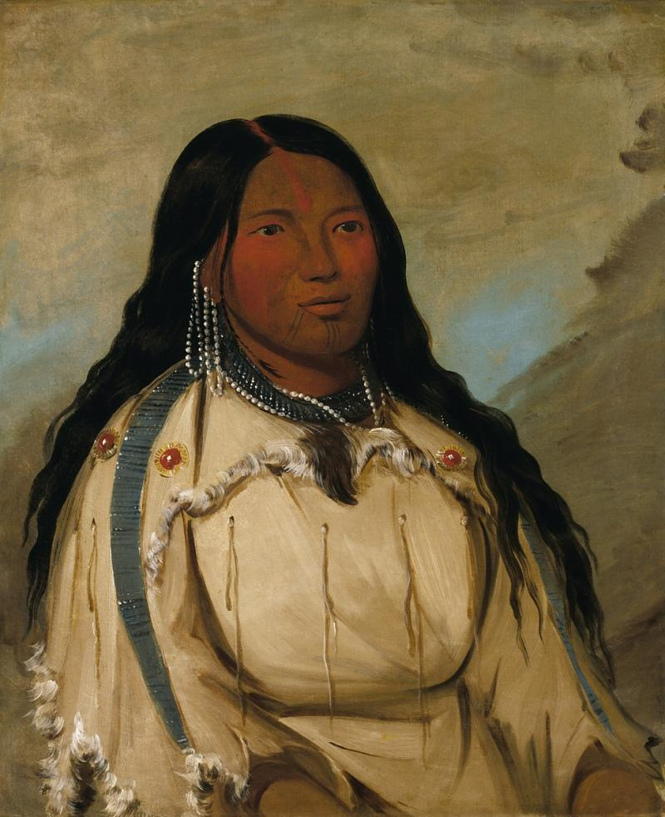
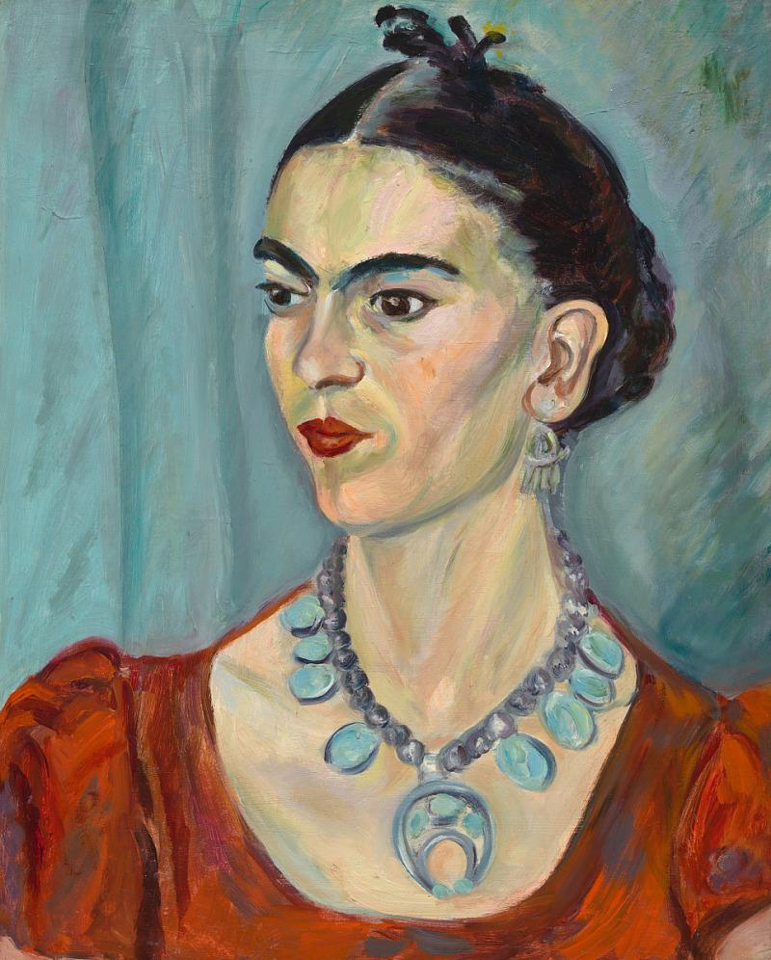
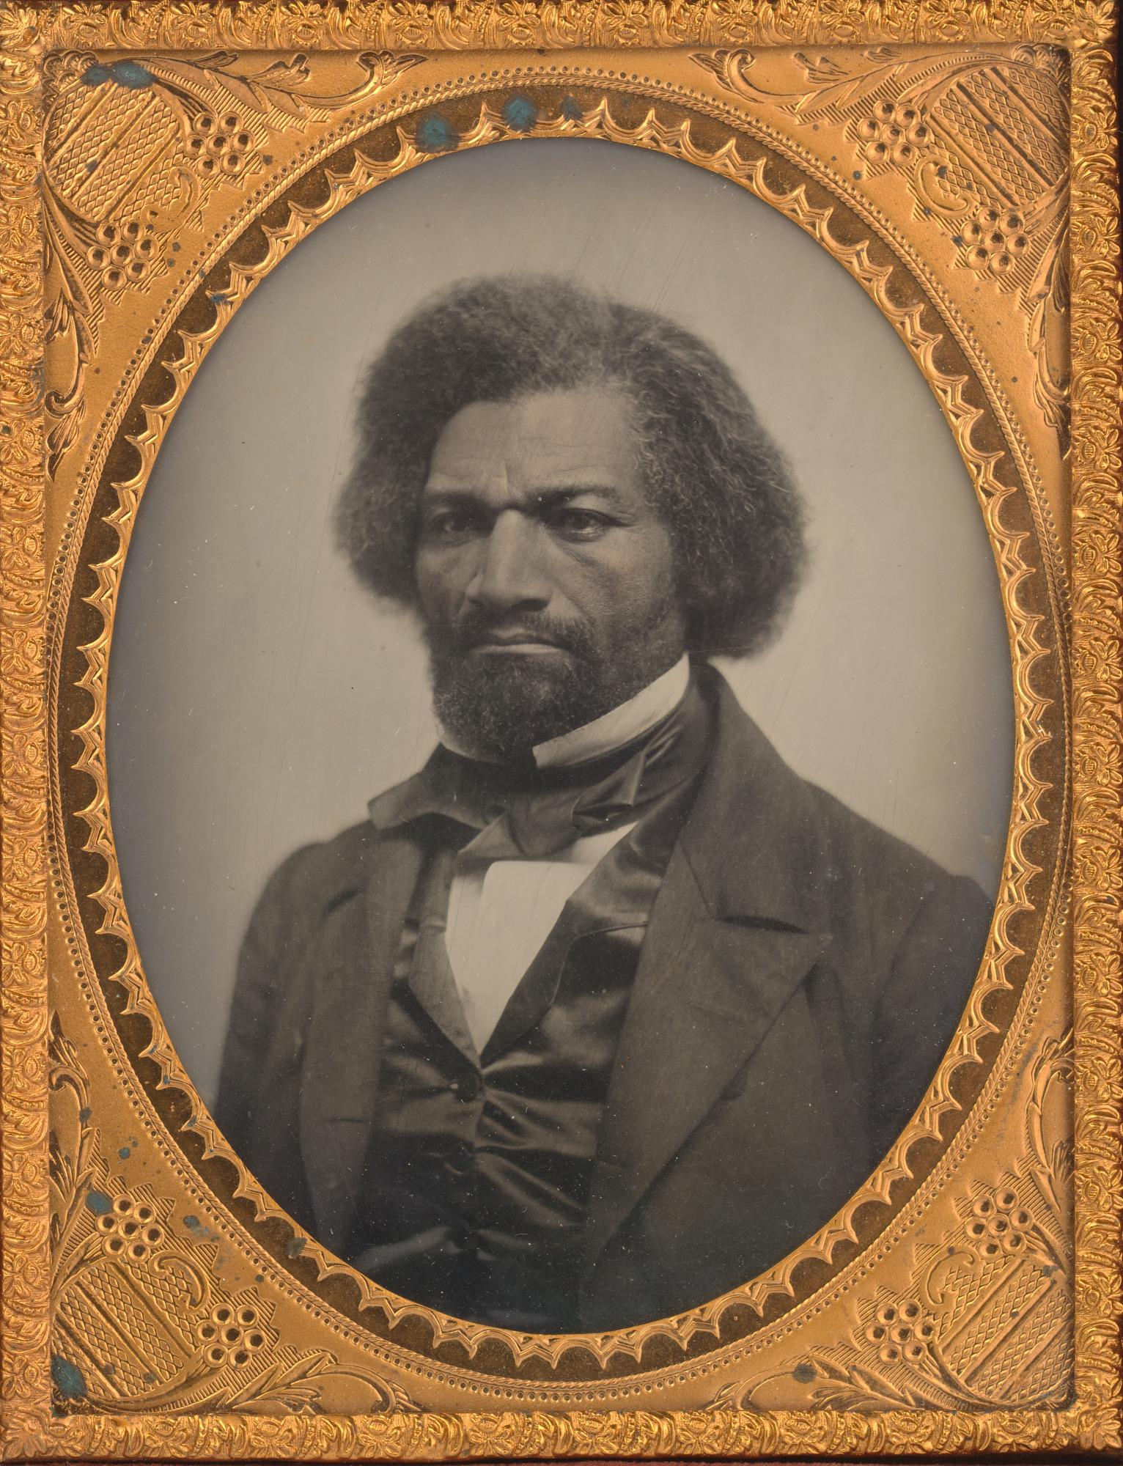
Demo & Lecture: Vocabulary
A portrait is a picture of a person.
Chinese Woman
John Thomson
1870
Tow-ee-ka-we, a Cree Woman
George Catlin
1872
Frida Kahlo
Magda Pach
1950
Frederick Douglass
Unidentified Artist
1856
Notes:
https://npg.si.edu/object/npg_NPG.74.75
https://www.si.edu/object/frida-kahlo:npg_NPG.2015.136
https://www.si.edu/object/tow-ee-ka-wet-cree-woman:saam_1985.66.178
https://www.loc.gov/pictures/resource/cph.3b12164/

Slide 30
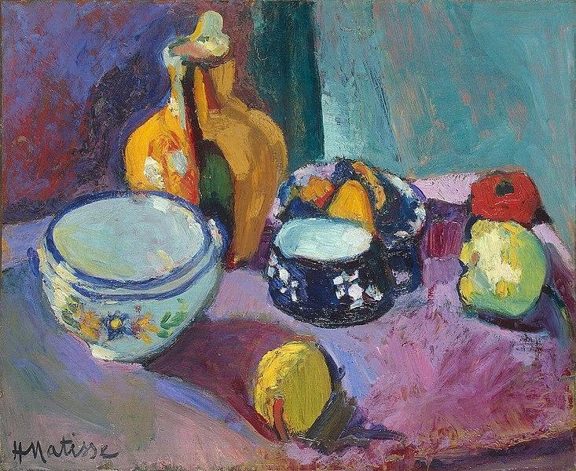
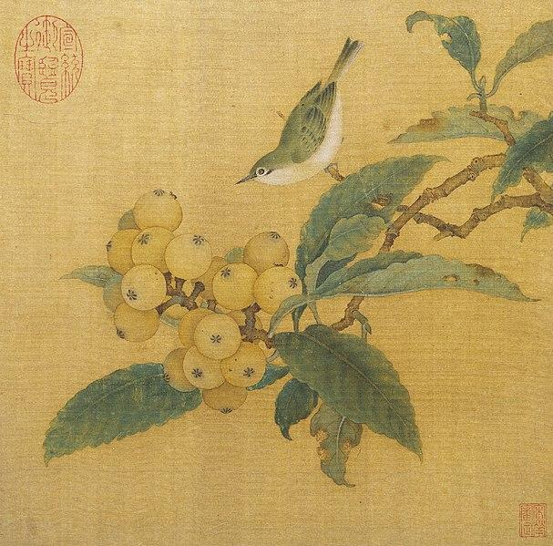
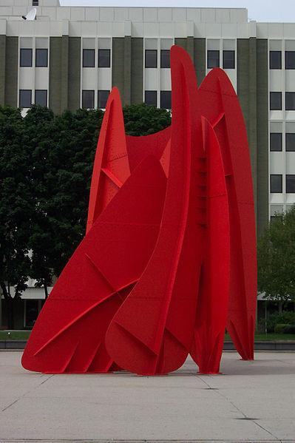
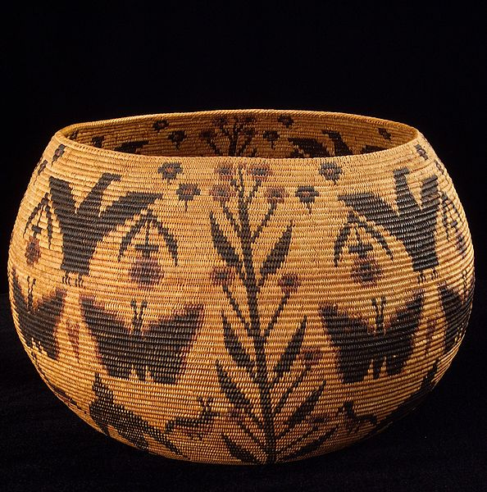
Can you find the portraits below?
Notes:
https://en.wikipedia.org/wiki/File:LaGrandeVitesse1969.jpg
https://en.wikipedia.org/wiki/File:Matisse_-_Dishes_and_Fruit_(1901).jpg
https://en.wikipedia.org/wiki/File:Lucy_Telles_basket.jpg
https://en.wikipedia.org/wiki/File:Loquats_and_Mountain_Bird.jpg

Slide 31
Which of these images are not portraits?
Notes:
https://en.wikipedia.org/wiki/File:LaGrandeVitesse1969.jpg
https://en.wikipedia.org/wiki/File:Matisse_-_Dishes_and_Fruit_(1901).jpg
https://en.wikipedia.org/wiki/File:Lucy_Telles_basket.jpg
https://en.wikipedia.org/wiki/File:Loquats_and_Mountain_Bird.jpg

Slide 32
Demo & Lecture: Art History
Is this artwork, Finnish Woman, a portrait?
Why or why not?
Finnish Woman
Sonia Delaunay
1907-08

Slide 33
Demo & Lecture: Art History
This artwork, Finnish Woman, is considered a fauvist artwork.
What do you think Fauvism is?
Finnish Woman
Sonia Delaunay
1907-08

Slide 34
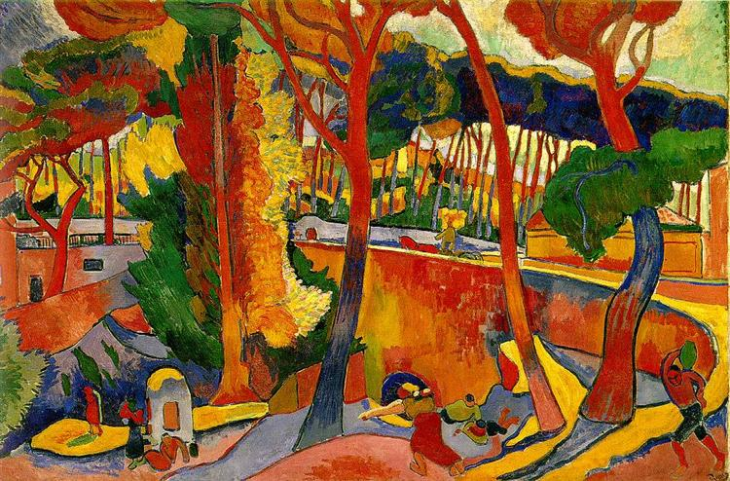
Demo & Lecture: Art History
Fauvism is a style of artwork.
Fauvist artworks:
Use all sorts of colors; they don’t have to be based on reality.
Use thick paint.
Have heavy lines.
Use colors that sometimes clash.
Notes:
https://www.wikiart.org/en/andre-derain/estaque-1905

Slide 35
Demo & Lecture: Art History
How do we know this artwork, Finnish Woman, is a Fauvist artwork?
Use all sorts of colors; they don’t have to be based on reality.
Use thick paint.
Have heavy lines.
Use colors that sometimes clash.
Finnish Woman
Sonia Delaunay
1907-08

Slide 36
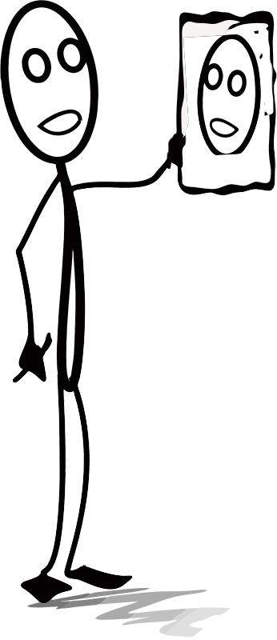
What is a self-portrait?
A self-portrait is an artwork an artist makes that shows themselves.
Have you ever drawn a picture of yourself?
You’re an artist! You made a self-portrait!
Notes:
https://openclipart.org/detail/283821/michael1952-AL-drawing.png

Slide 37
Project Overview
Let’s create a fauvist self-portrait showing an emotion.
Think about what emotion you will show.

Slide 38
Fauvism Review
Use all sorts of colors; they don’t have to be based on reality.
Use thick paint.
Have heavy lines.
Use colors that sometimes clash.

Slide 39
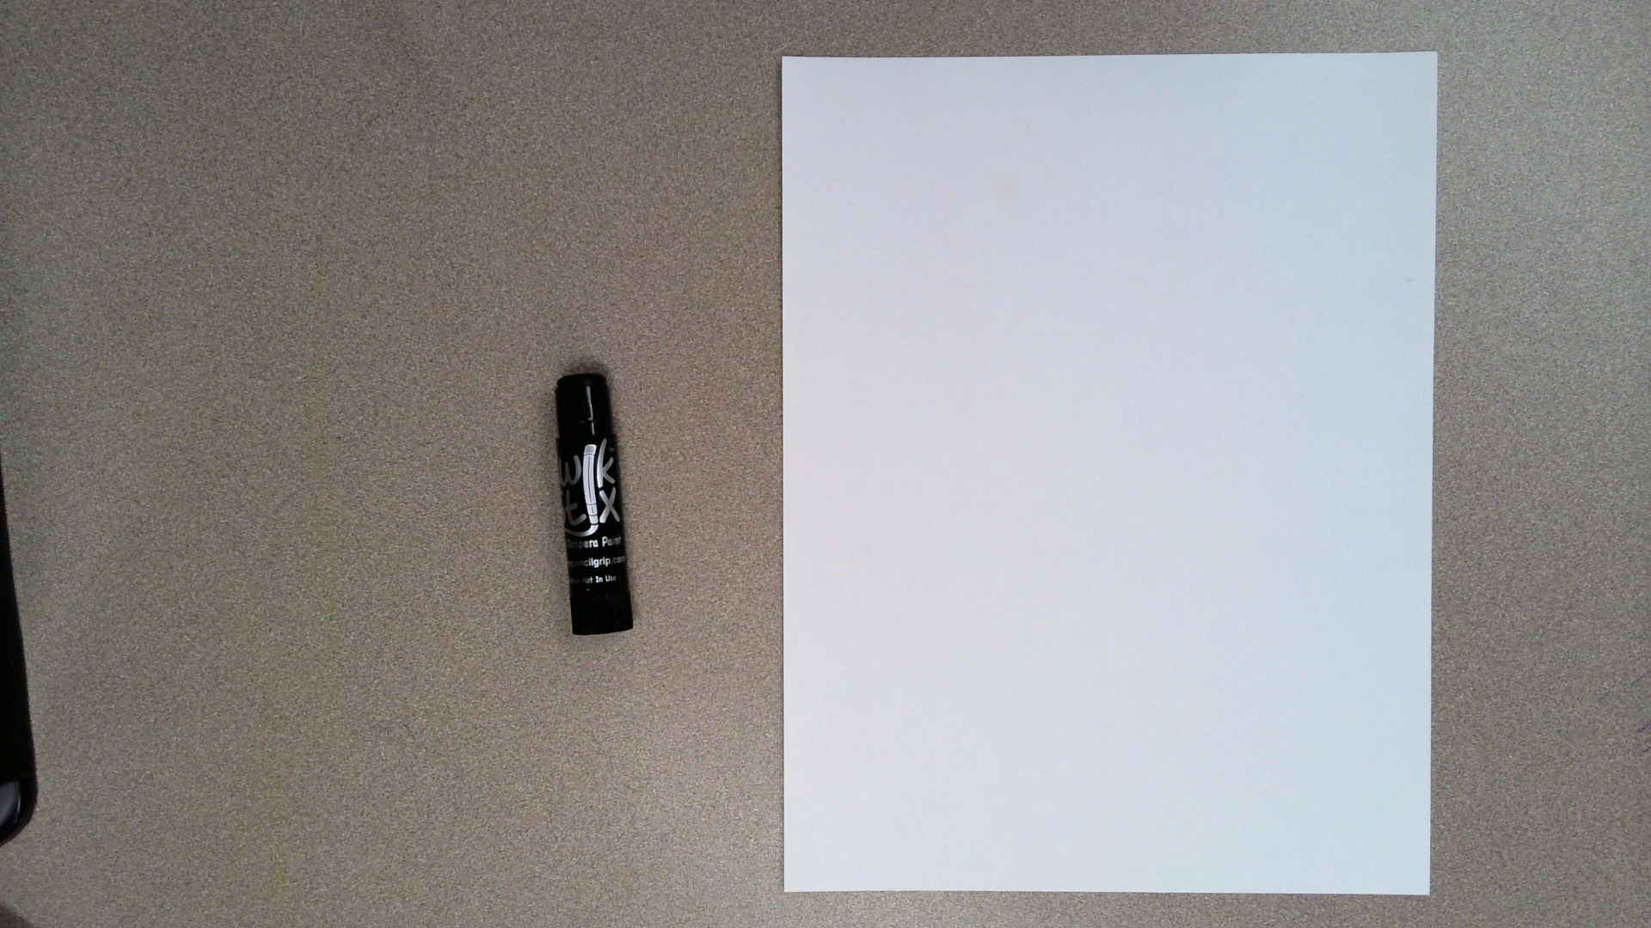
Begin with a white sheet of cardstock placed in front of your vertically.
Get out a dark colored kwik stick.

Slide 40
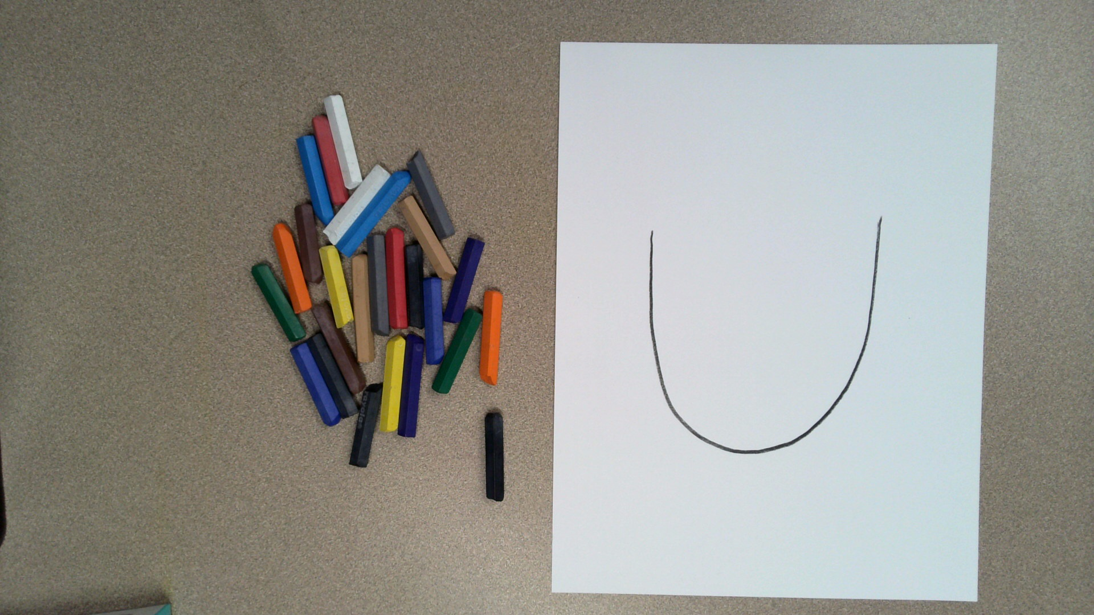
Draw a large u-shape.
This will be the bottom of your face.

Slide 41
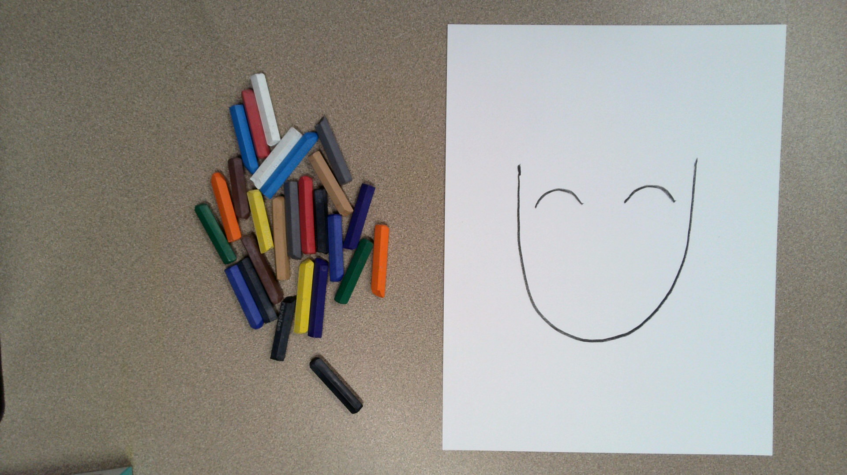
Draw two curved lines.
These will be the tops of your eyes.

Slide 42
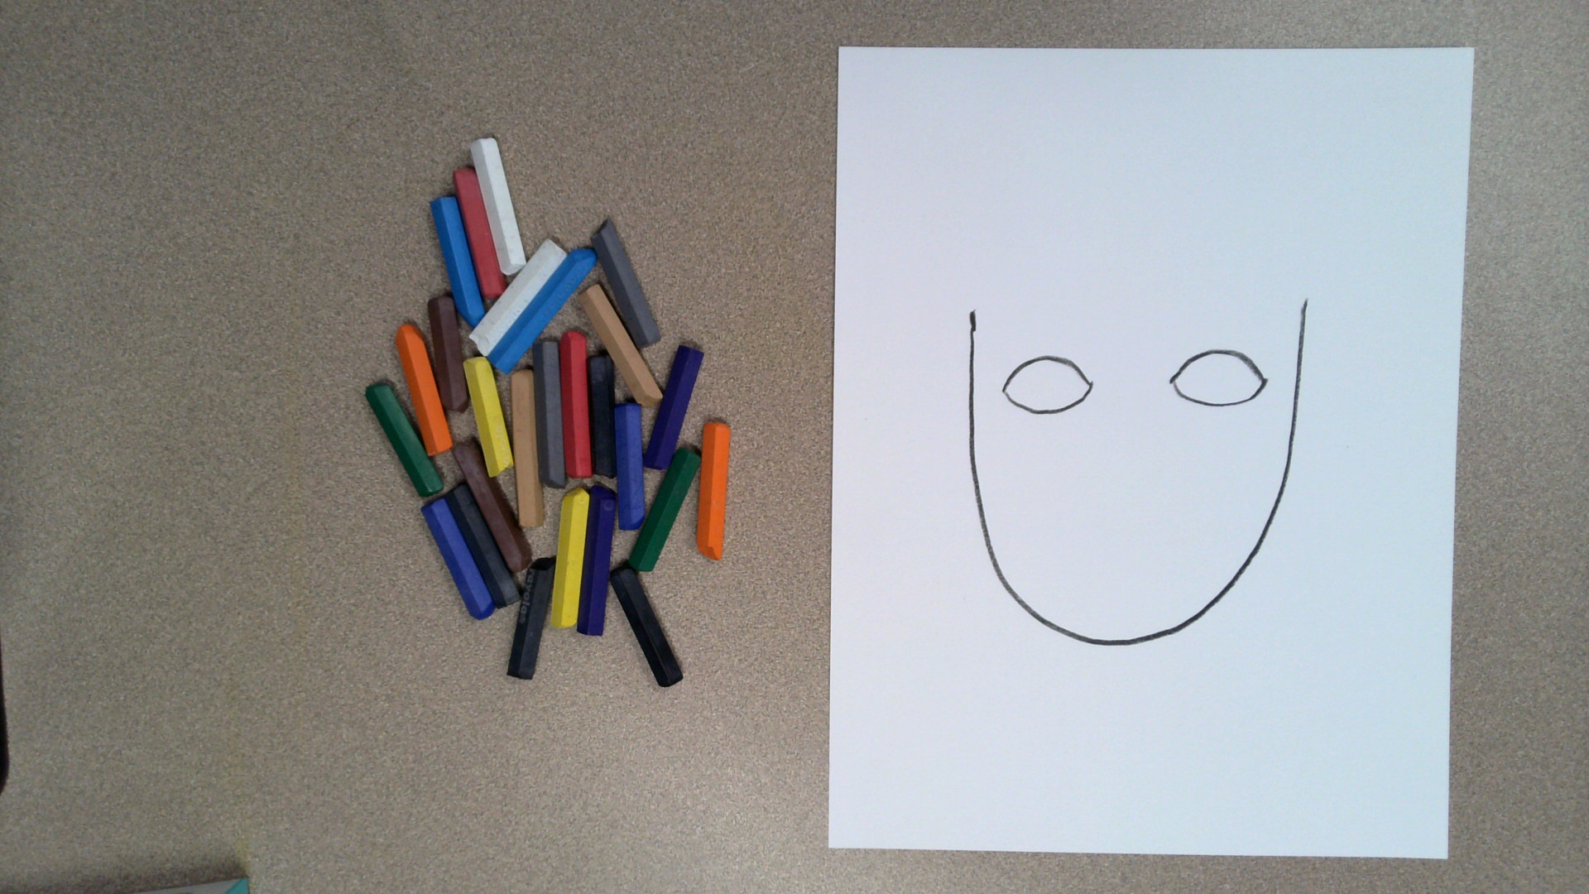
Draw two curved lines for the bottom of your eyes.

Slide 43
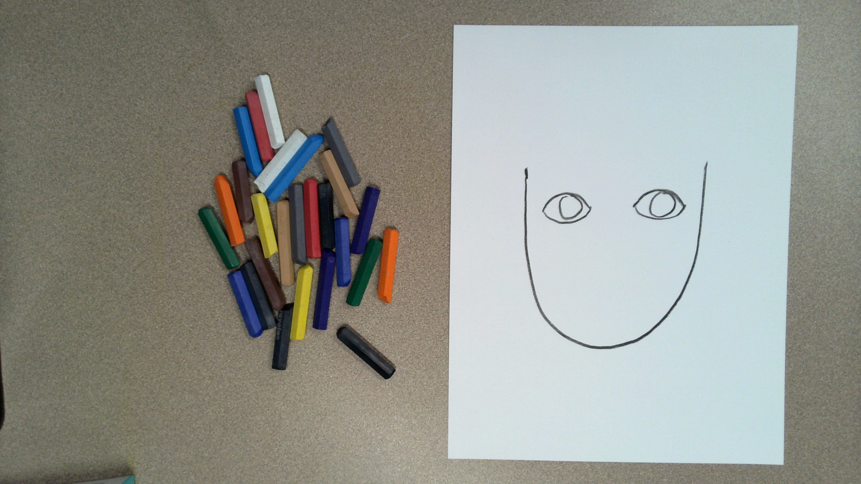
Draw two circles inside your eyes.

Slide 44
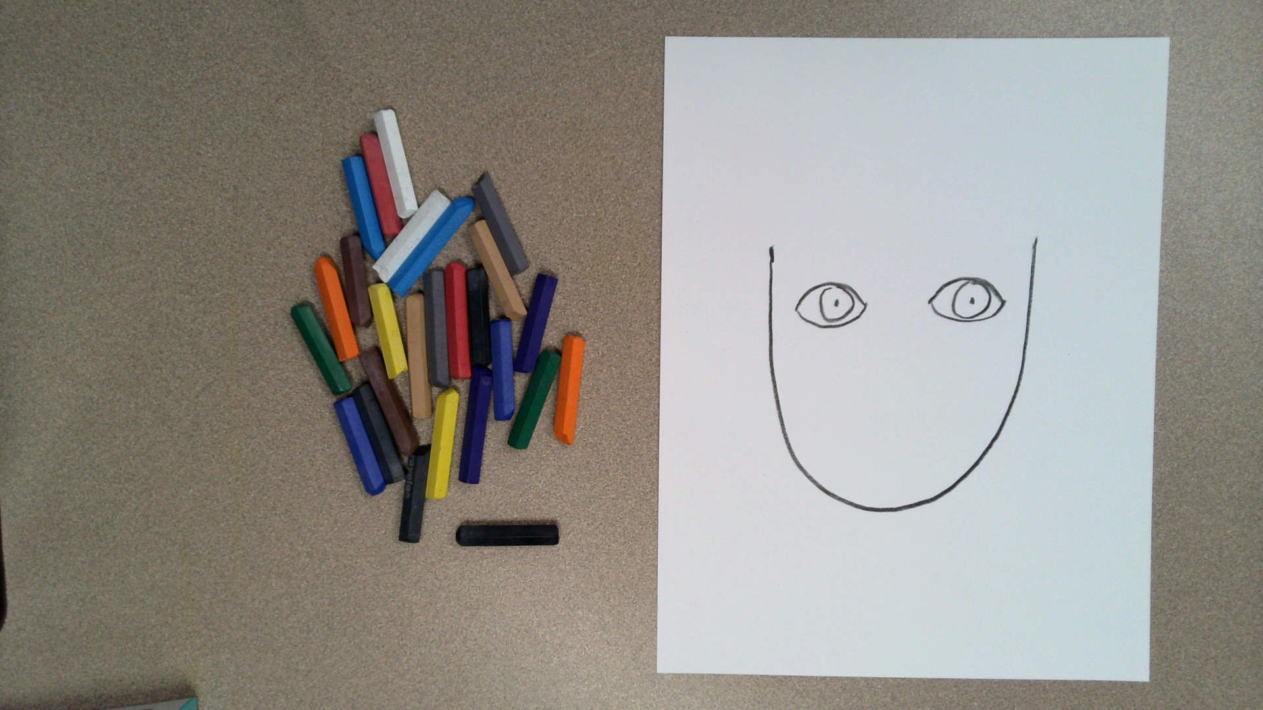
Draw a tiny dot in the center of both your eyes.

Slide 45
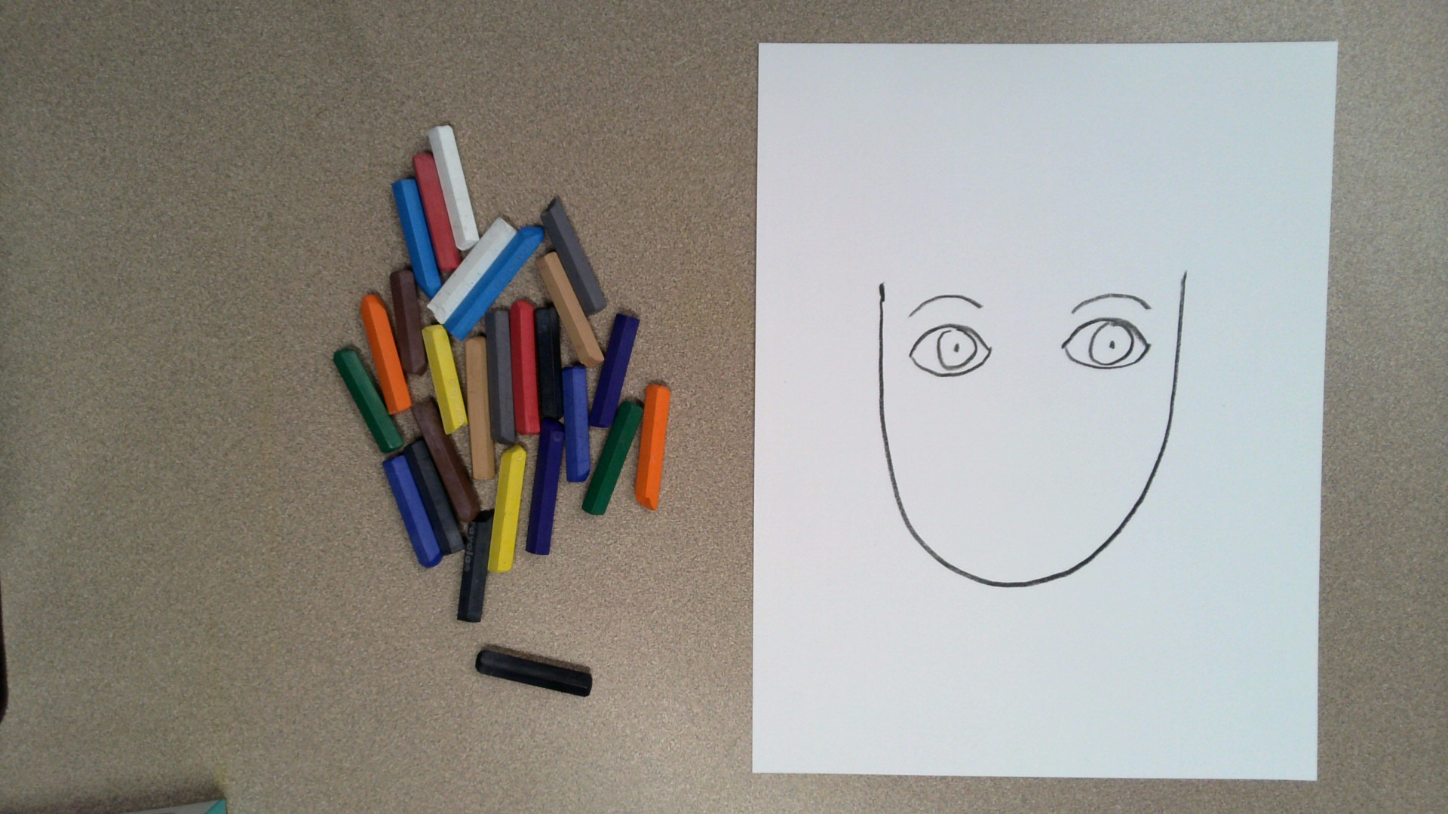
Draw two eyebrows.

Slide 46
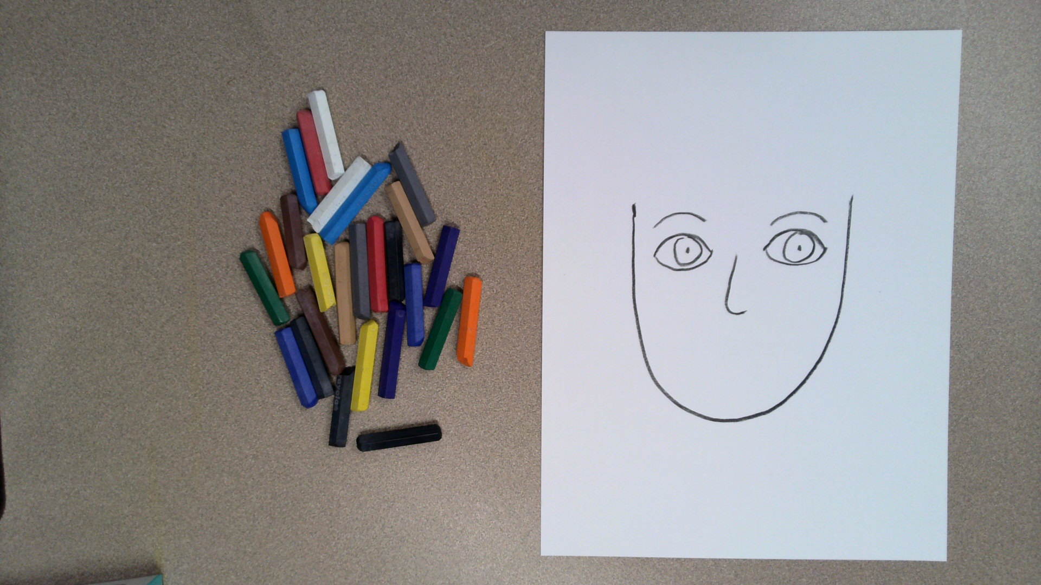
Draw a nose.
Any kind of nose you want to draw is okay.

Slide 47
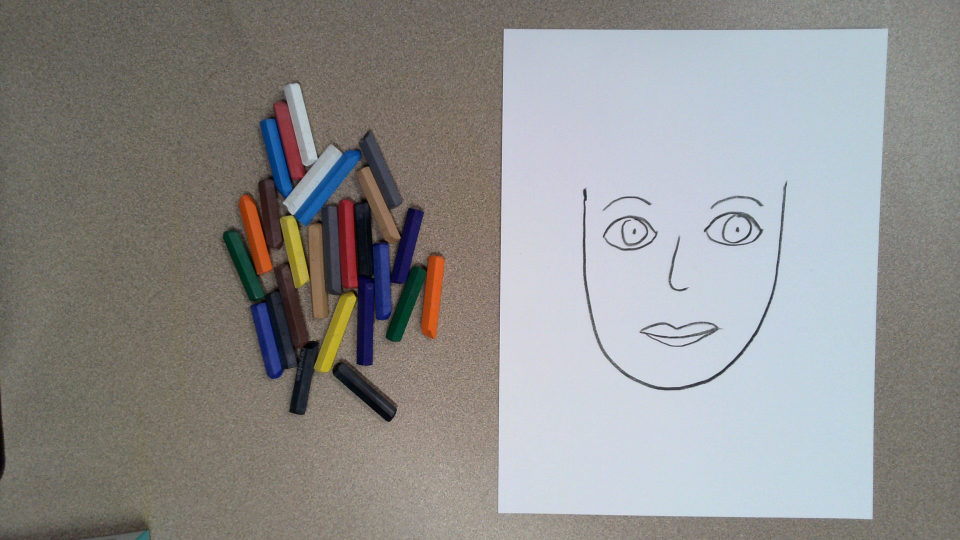
Draw a mouth.
Before you draw, consider if you are happy, scared, sad, or mad.

Slide 48
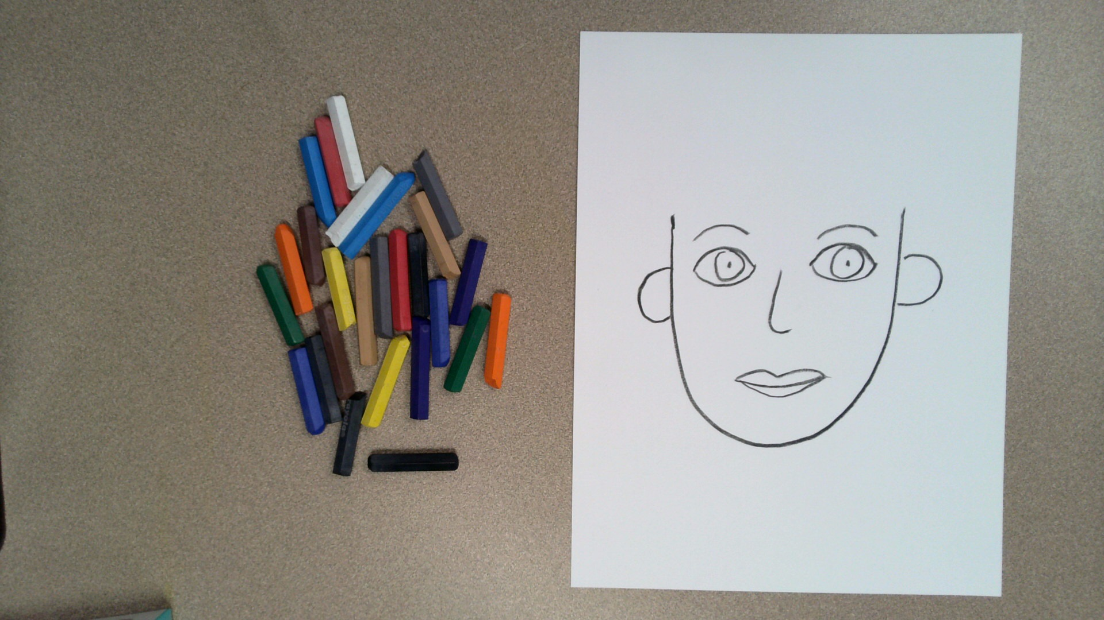
Draw two ears.

Slide 49
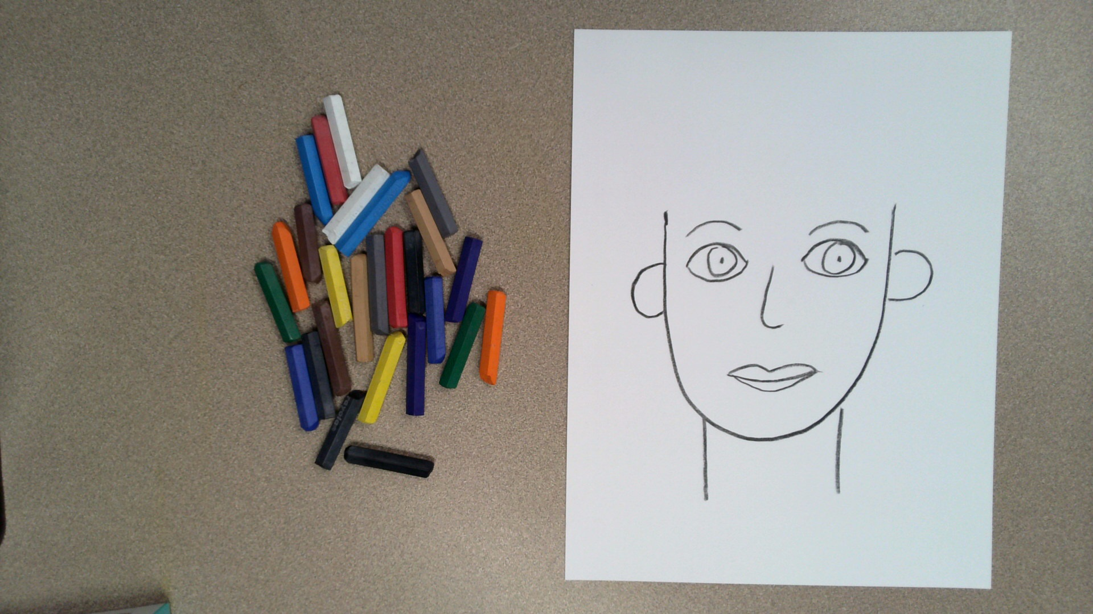
Draw two lines for your neck.

Slide 50
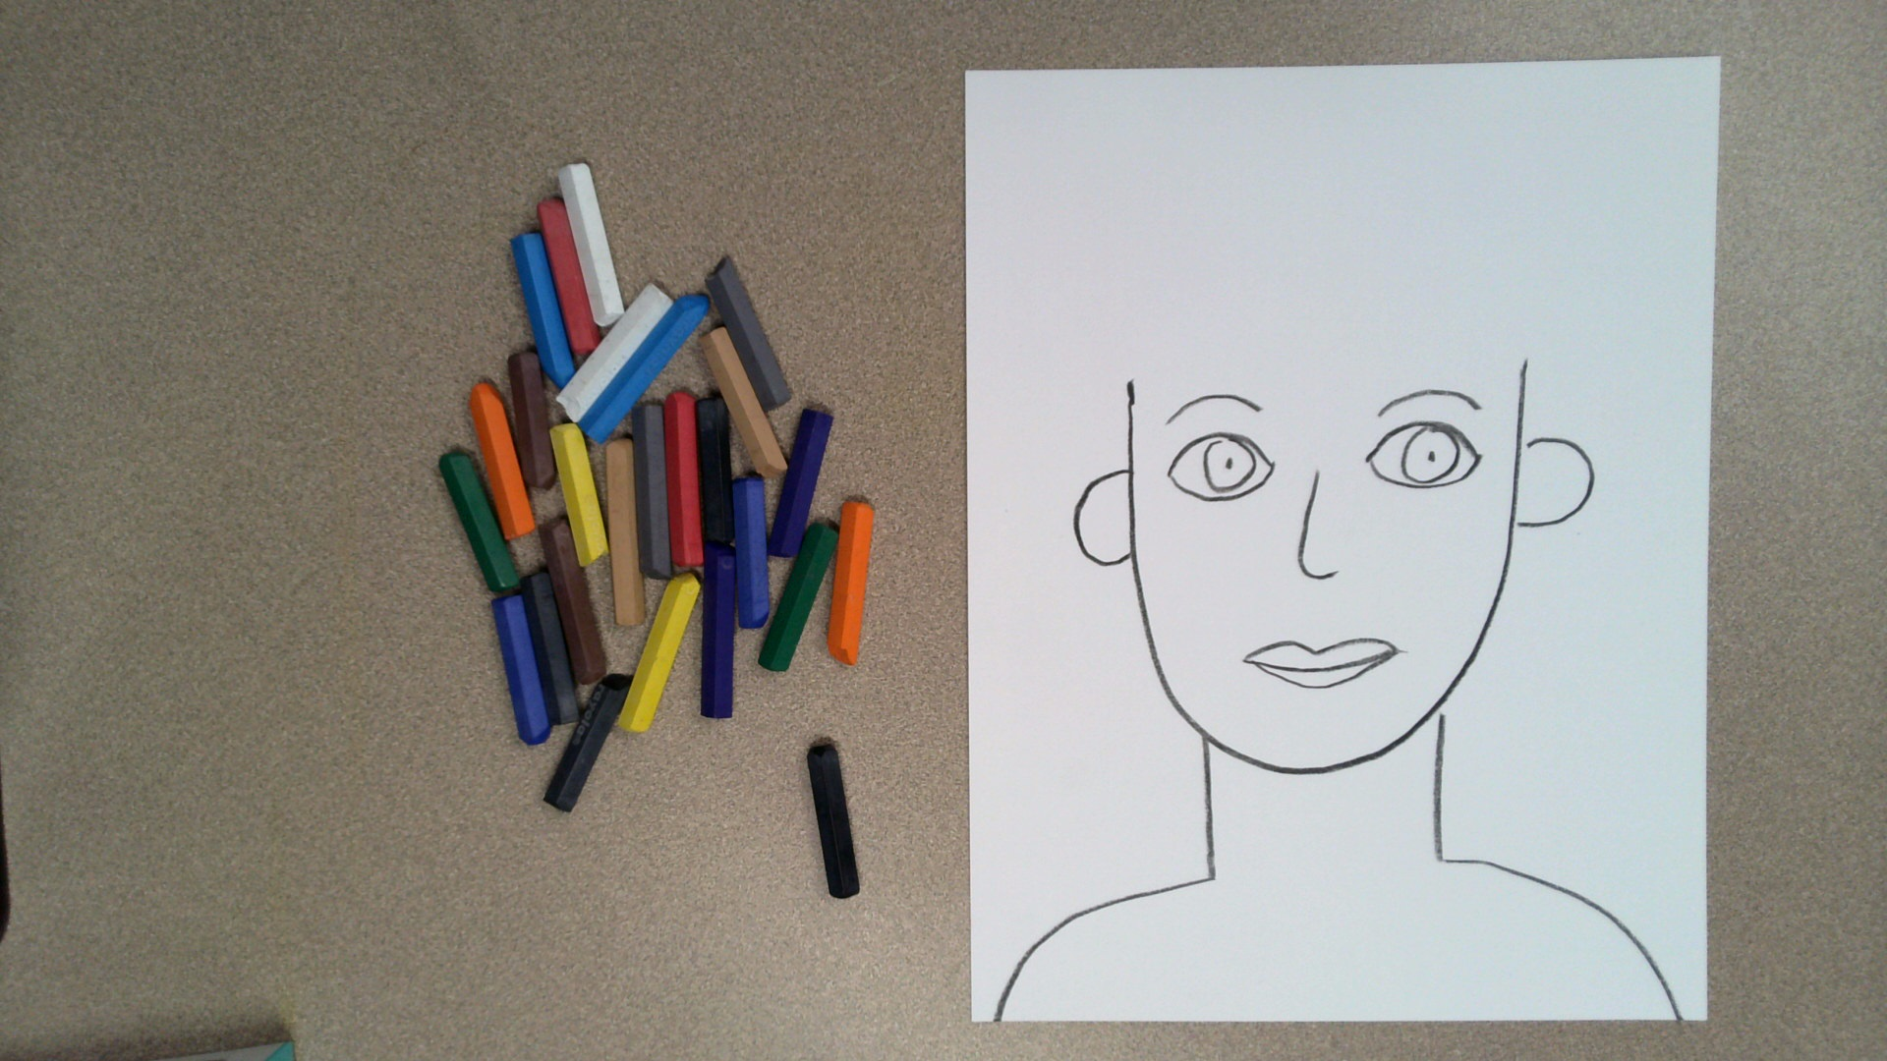
Draw two shoulders.

Slide 51
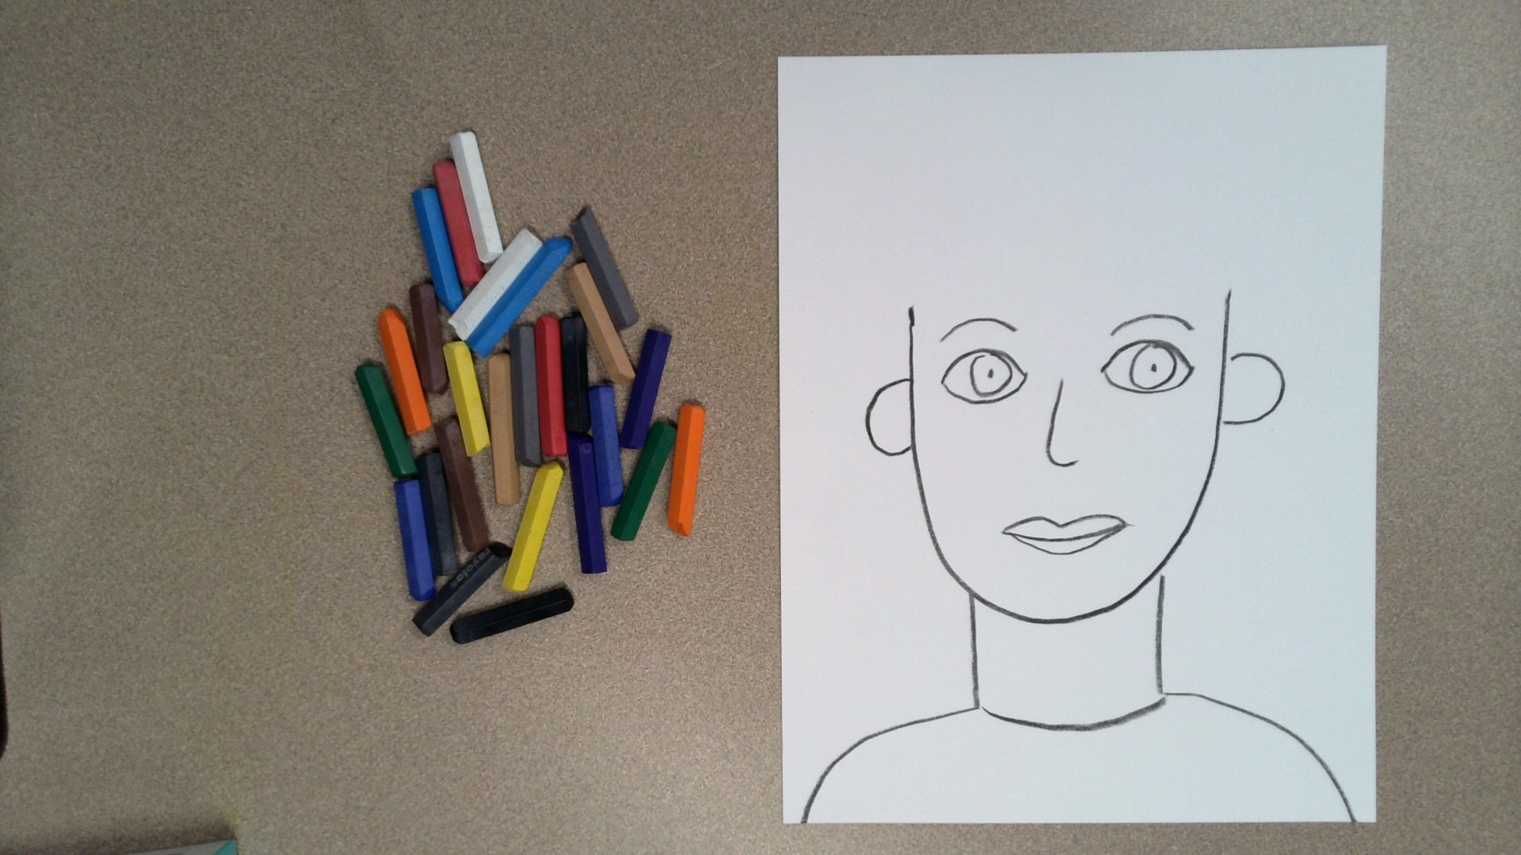
Draw a line to show the neck of your shirt.

Slide 52
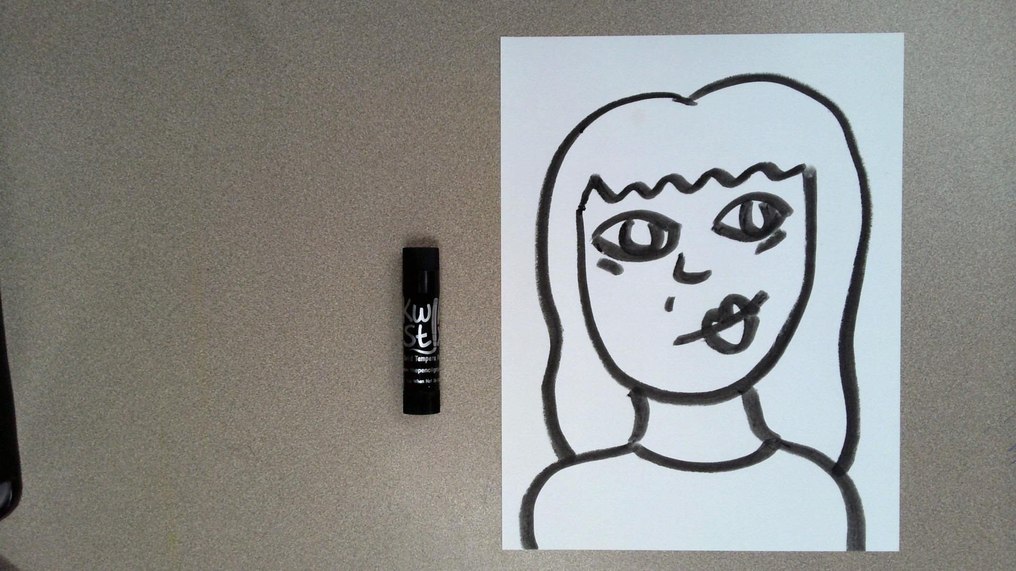
Draw a self-portrait.
Keep it simple.
Think about what emotion you are going to show.

Slide 53
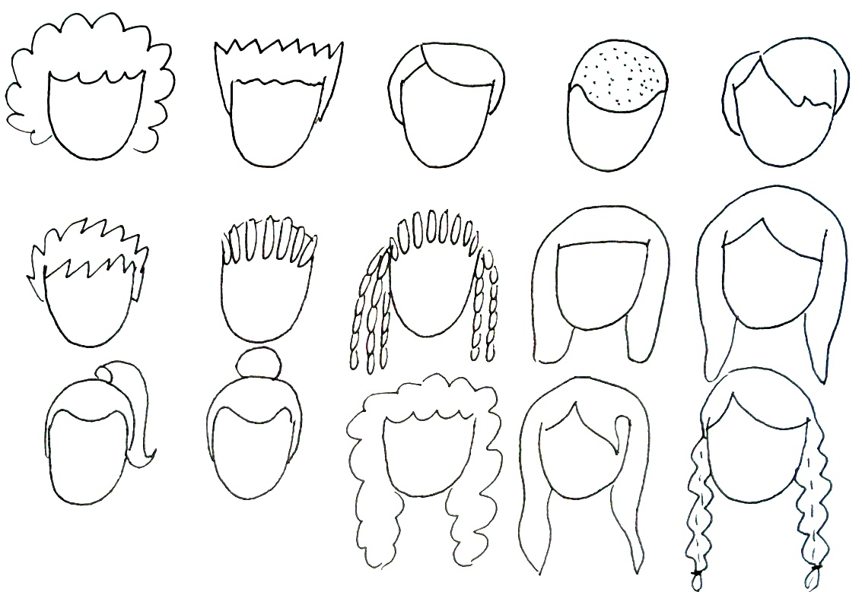

Slide 54
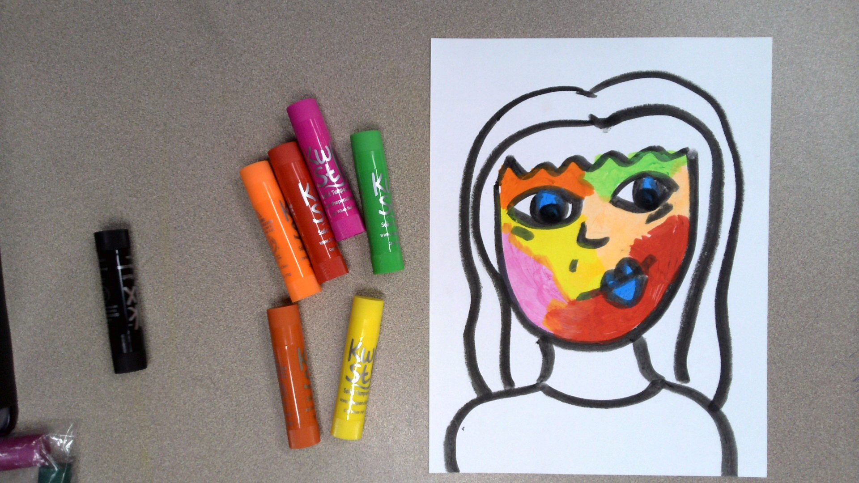
Color your face.
Remember, fauvists use all sorts of colors; they don’t have to be based on reality.

Slide 55

Color the rest of your portrait.
Remember, fauvists use all sorts of colors; they don’t have to be based on reality.

Slide 56

Color your background.
Remember, fauvists use all sorts of colors; they don’t have to be based on reality.

Slide 57

Get out the colored pencils.

Slide 58
Add designs and patterns to your self-portrait using the colored pencils.

Slide 59
Critique
With a partner, discuss your artwork.
Describe the emotion you created.
Describe how your artwork is fauvist.
Share one thing about your artwork that you like.
Listen as your partner talks about their artwork.
Share one think about your partner’s artwork that you like.

Slide 60
How are you feeling after making your artwork?
Do you feel better, worse, or the same? Why?
Notes:
https://pixabay.com/illustrations/emotion-scale-emoji-icon-feedback-3404484/

Slide 61

Closing Slide

