Slide 1
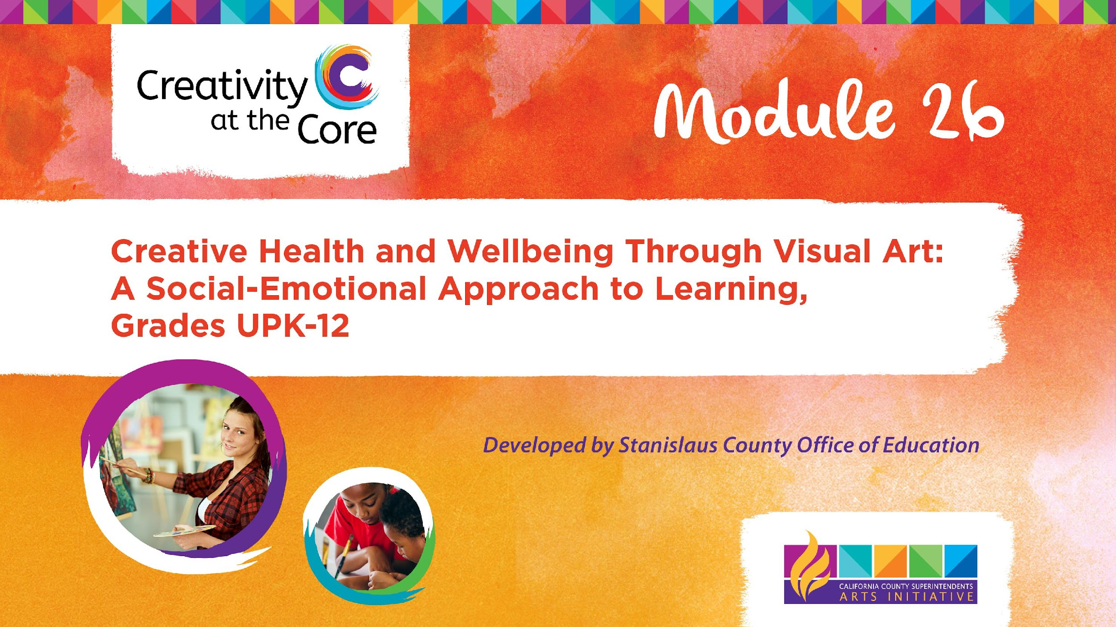
Grades 3 – 5 Project: Worry Monsters​

Slide 2
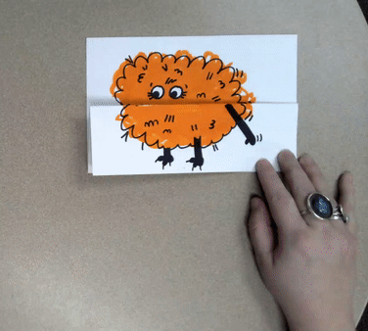
Grades 3 – 5 Project: Worry Monsters
Learning Outcomes
Create a worry monster that helps “gobble” up student worries.

Slide 3
Grades 3 – 5 Project: Worry Monsters
SEL Core Competencies
Addressed
Self-Awareness
Self-Management
Visual Art Standards
3.VA:Cr2.1- Create personally satisfying artwork using a variety of artistic processes and materials.
4.VA:Cr2.1 - Explore and invent art-making techniques and approaches.
5.VA:Cr2.1 - Experiment and develop skills in multiple art-making techniques and approaches through practice.

Slide 4
Grades 3 – 5 Project: Worry Monsters
Materials Needed
8.5 x 11 in white cardstock
Black permanent marker
Colored markers

Slide 5
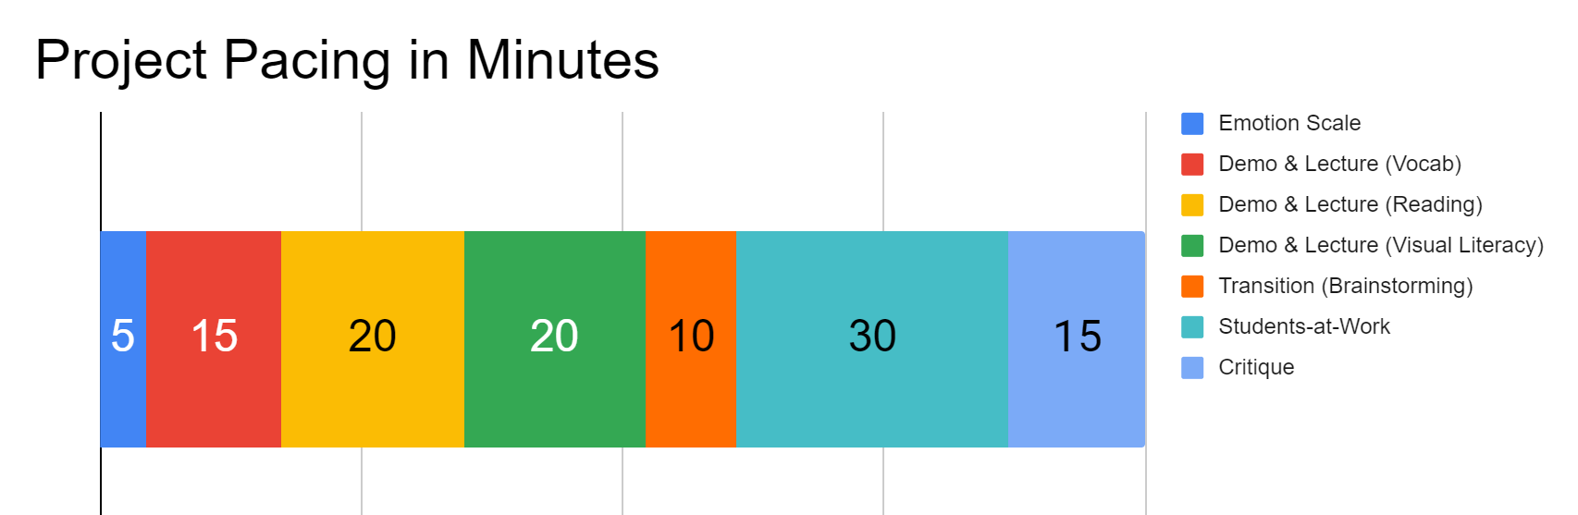
Project Pacing
Pacing structure follows the guidance of the Studio Habits of Mind framework.

Slide 6
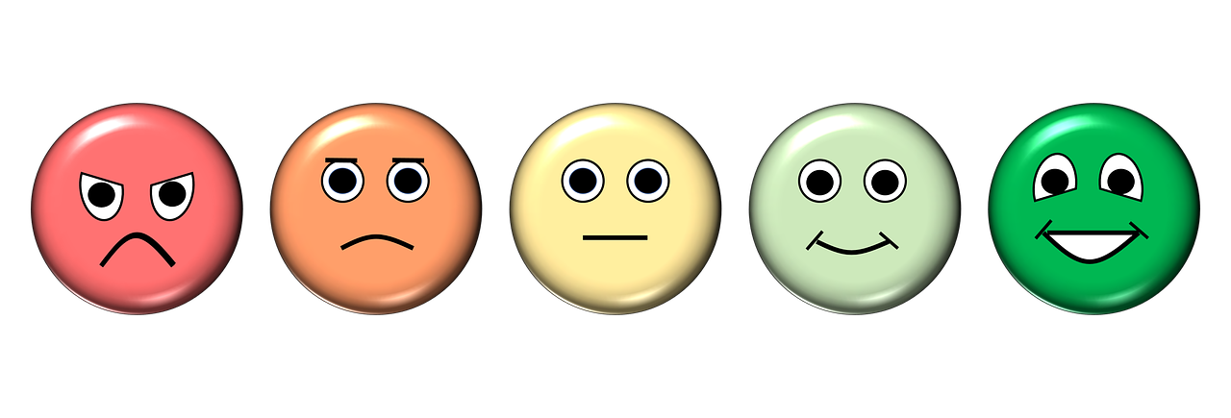
How are you feeling right now?
Notes:
https://pixabay.com/illustrations/emotion-scale-emoji-icon-feedback-3404484/

Slide 7
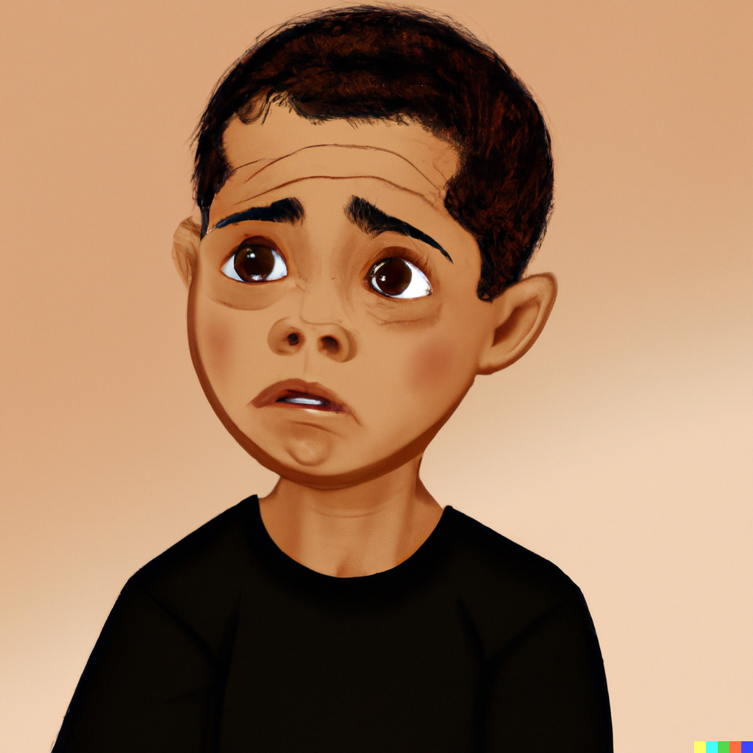
Demo & Lecture: Vocabulary
Have you ever heard the word worry before?
What do you think worry means?
Notes:
Image generated by DALL-E 2 AI based on a prompt by Amy Bultena

Slide 8
Demo & Lecture: Vocabulary
Worry is when you feel bothered or upset about something.
It’s like having a little voice in your head that keeps thinking about things that might go wrong or make you feel scared or sad.
Notes:
Image generated by DALL-E 2 AI based on a prompt by Amy Bultena

Slide 9
Demo & Lecture: Vocabulary
You might worry about school, like getting good grades or making friends.
You might worry about things happening with your grown-ups.
You might worry about if you’ll do well in activities you enjoy.
What are some things that you worry about?
Notes:
Image generated by DALL-E 2 AI based on a prompt by Amy Bultena

Slide 10
Demo & Lecture: Vocabulary
Worrying is a natural feeling that everyone experiences sometimes, and it’s okay to feel this way.
Notes:
Image generated by DALL-E 2 AI based on a prompt by Amy Bultena

Slide 11
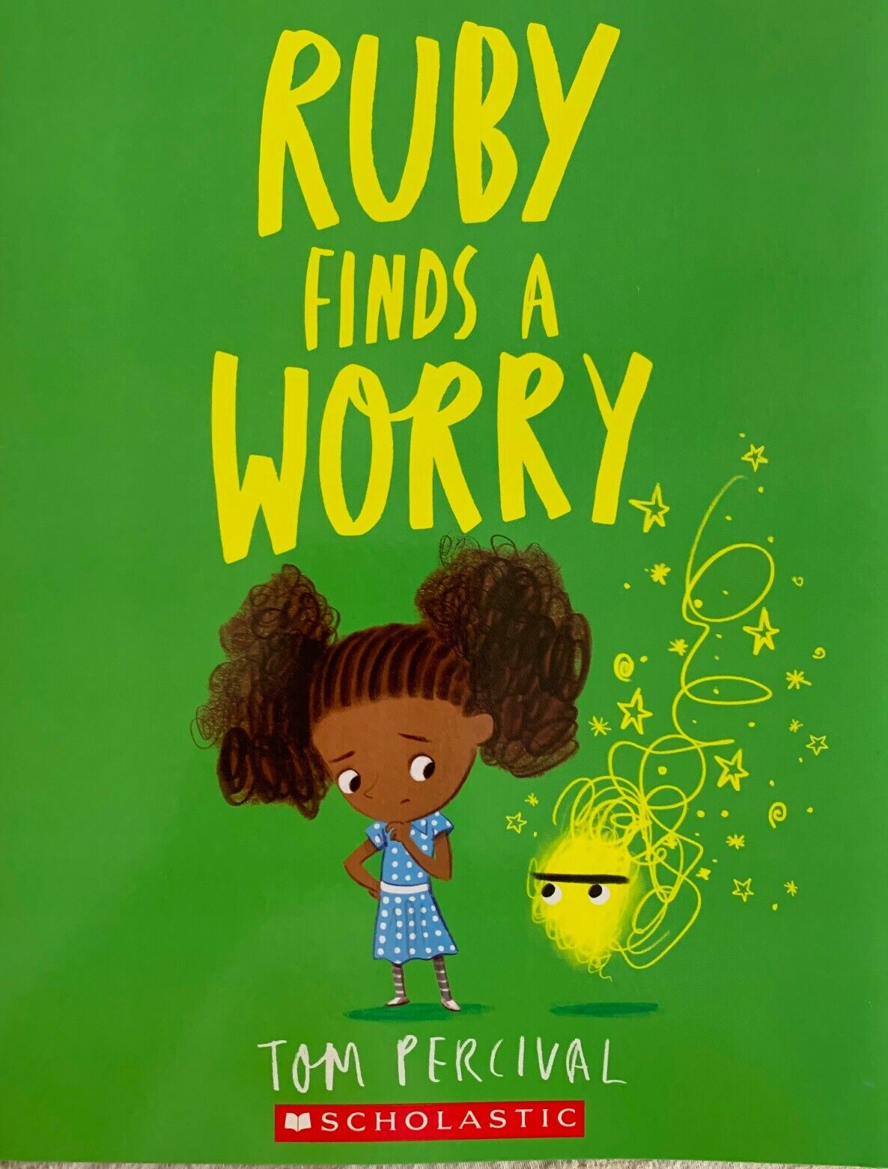
Demo & Lecture: Reading
Suggested but not required reading:
Ruby Finds a Worry
by Tom Percival
Questions:
What happens with Ruby’s worry?
How do Ruby and the boy get rid of their worries?

Slide 12
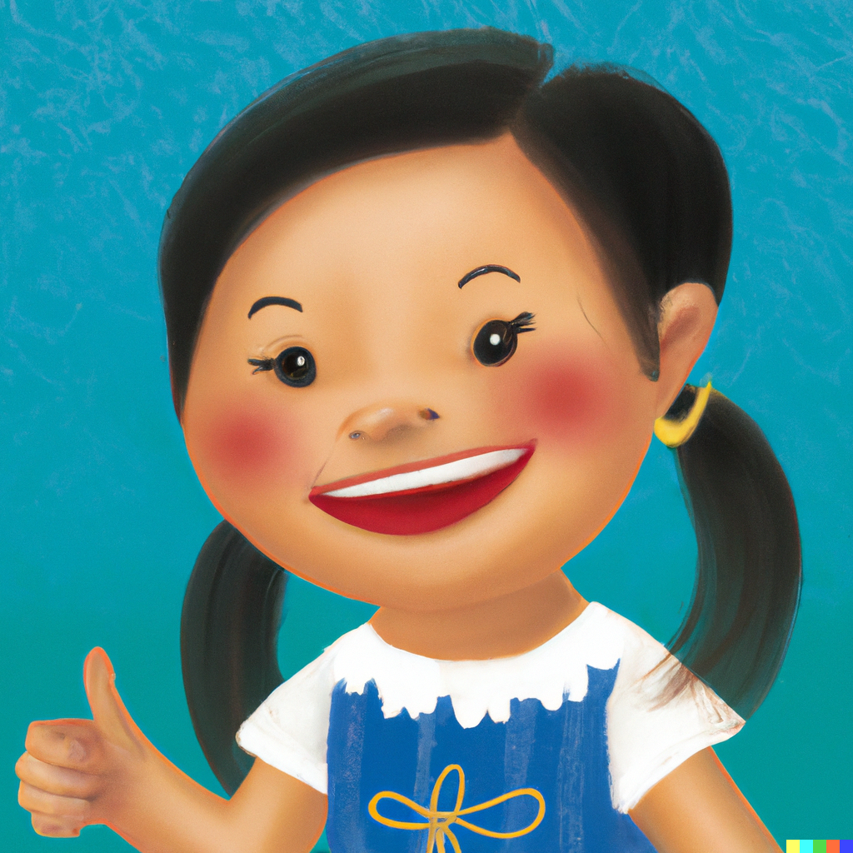
Getting Rid of Worry
The best way to get rid of a worry is to talk to someone you trust like your grown-ups, a sibling, a teacher, or a friend.
They can listen to you and help you understanding your feelings, and they can help you feel better.
Notes:
Image generated by DALL-E 2 AI based on a prompt by Amy Bultena

Slide 13
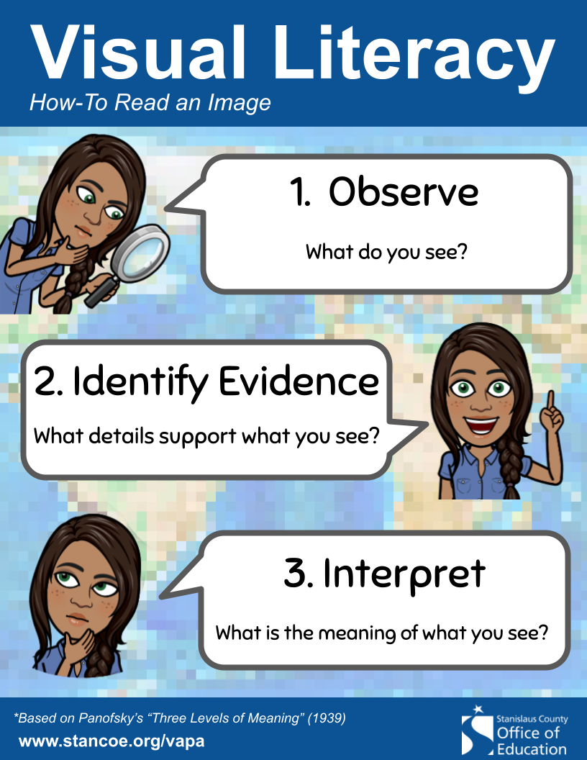
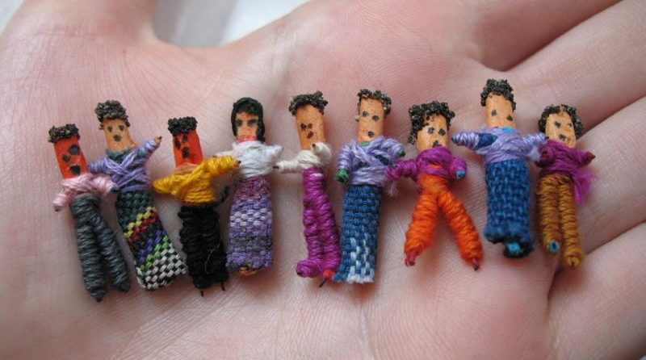
Demo & Lecture: Visual Literacy
Notes:
https://en.wikipedia.org/wiki/File:Worry_dolls.jpg

Slide 14
Demo & Lecture: Visual Literacy
These are worry dolls or Muñeca quitapena.
They are made by the indigenous people of Guatemala.
Have you ever seen a worry doll before?
What do you think they do?
Notes:
https://en.wikipedia.org/wiki/File:Worry_dolls.jpg

Slide 15
Demo & Lecture: Visual Literacy
Worry dolls are given to children.
Children tell their worries to the doll, and then hide it under their pillow at night.
It is believed that the doll takes the worries away in the night.
Notes:
https://en.wikipedia.org/wiki/File:Worry_dolls.jpg

Slide 16
Demo & Lecture: Visual Literacy
Worry dolls are mostly handmade.
They are made from wire, wool, and leftover fabrics. Their clothing is similar to the traditional clothing of the Maya people who are indigenous to Guatemala.
They range in size from 1/2 inch to 2 inches.
Notes:
https://en.wikipedia.org/wiki/File:Worry_dolls.jpg

Slide 17

Transition: Brainstorming
What are some things that make you worry?
Notes:
https://publicdomainvectors.org/en/free-clipart/Thinking-boy-vector-image/10492.html

Slide 18
Transition: Brainstorming
What are some things you can do to get rid of your worries?
Notes:
https://publicdomainvectors.org/en/free-clipart/Thinking-boy-vector-image/10492.html

Slide 19
Project Overview
Let’s create a worry monster.
Worry monsters eat worries.
Your monster will gobble up all of your worries.

Slide 20
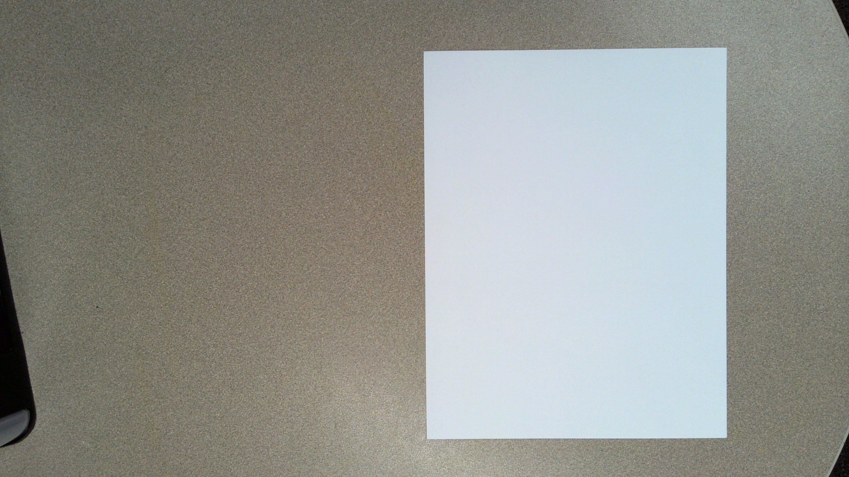
Place a white sheet of paper in front of you vertically.

Slide 21
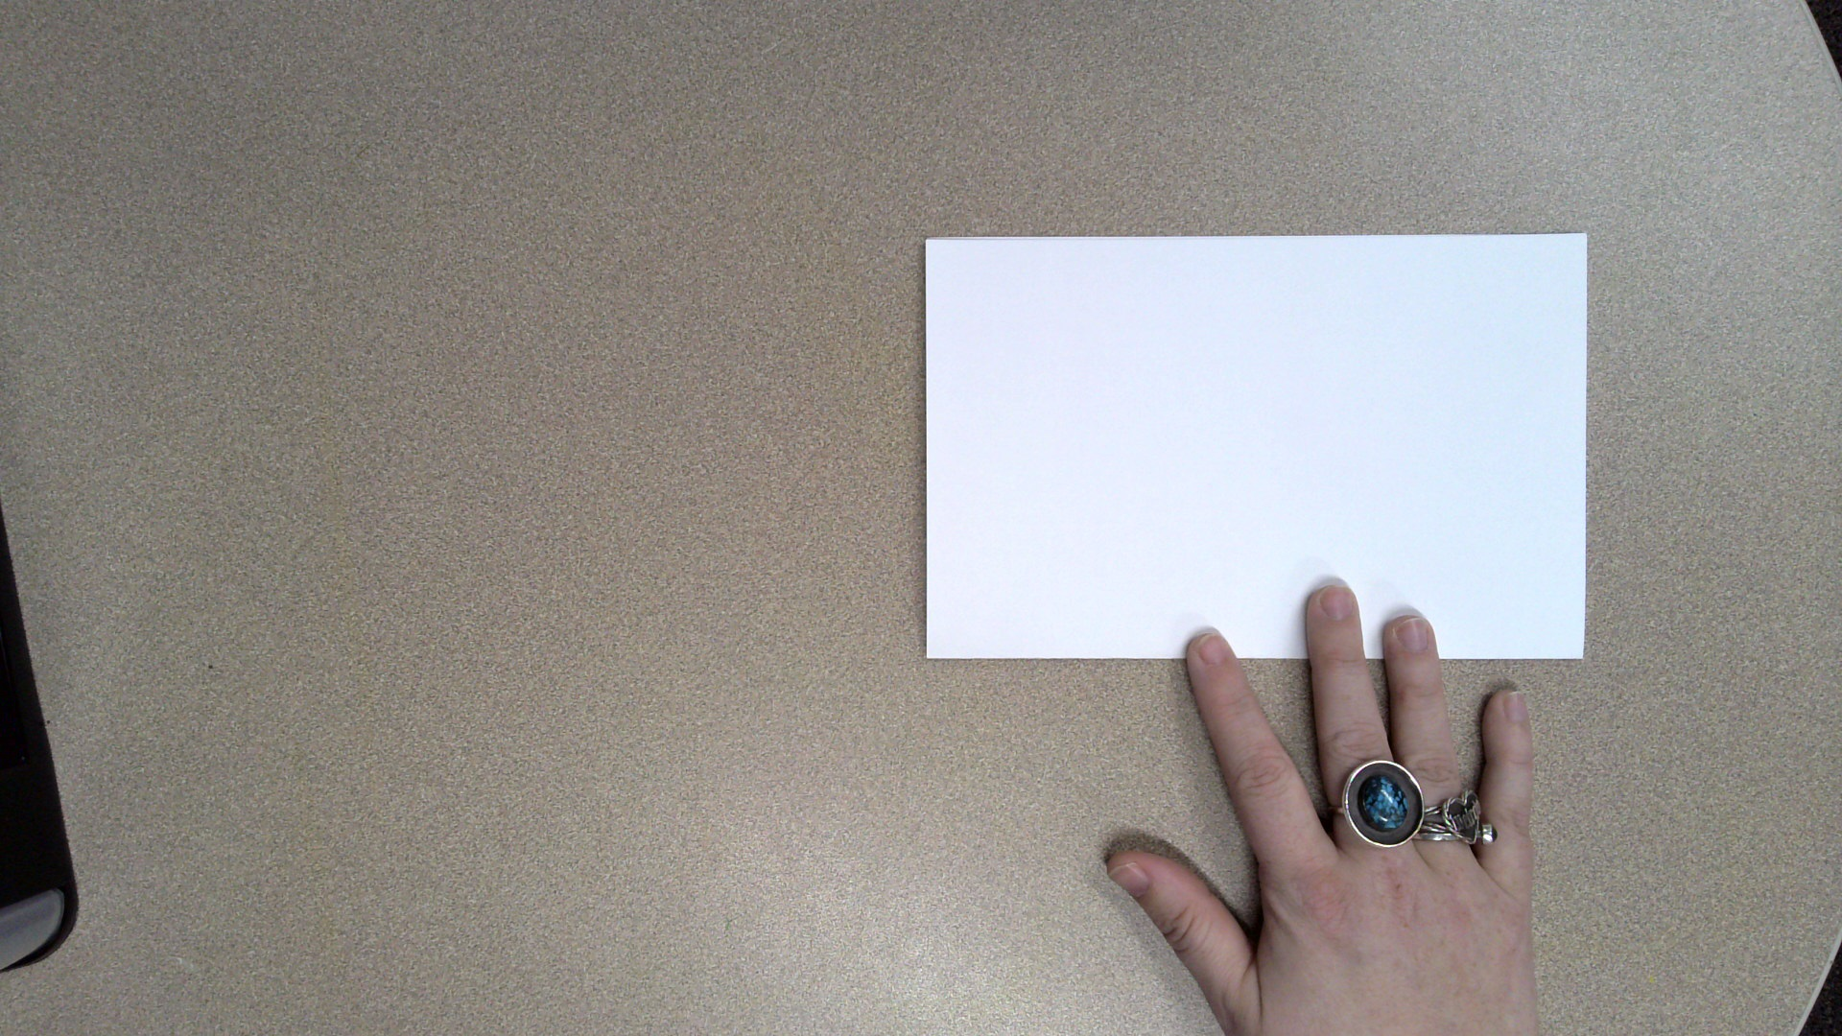
Fold the paper in half.
Folded edge

Slide 22
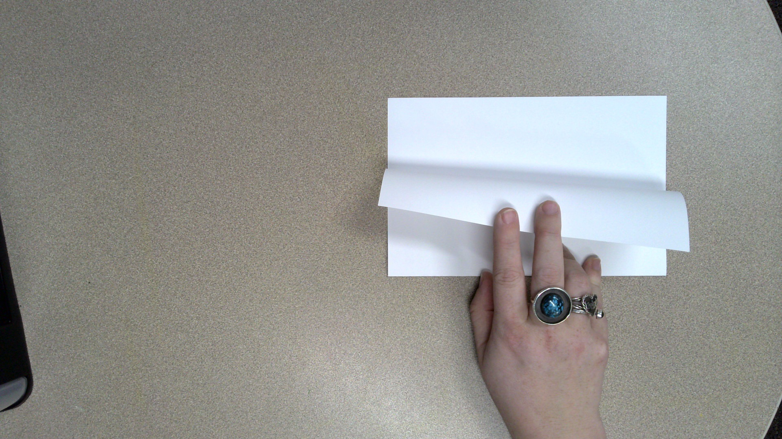
Fold the top piece down to the bottom.
Folded edge

Slide 23
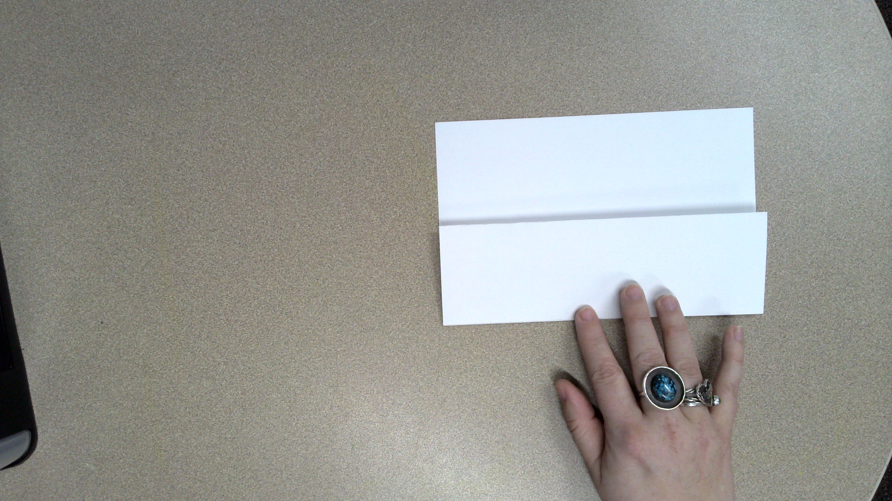
Fold the top piece down to the bottom.
Folded edge

Slide 24
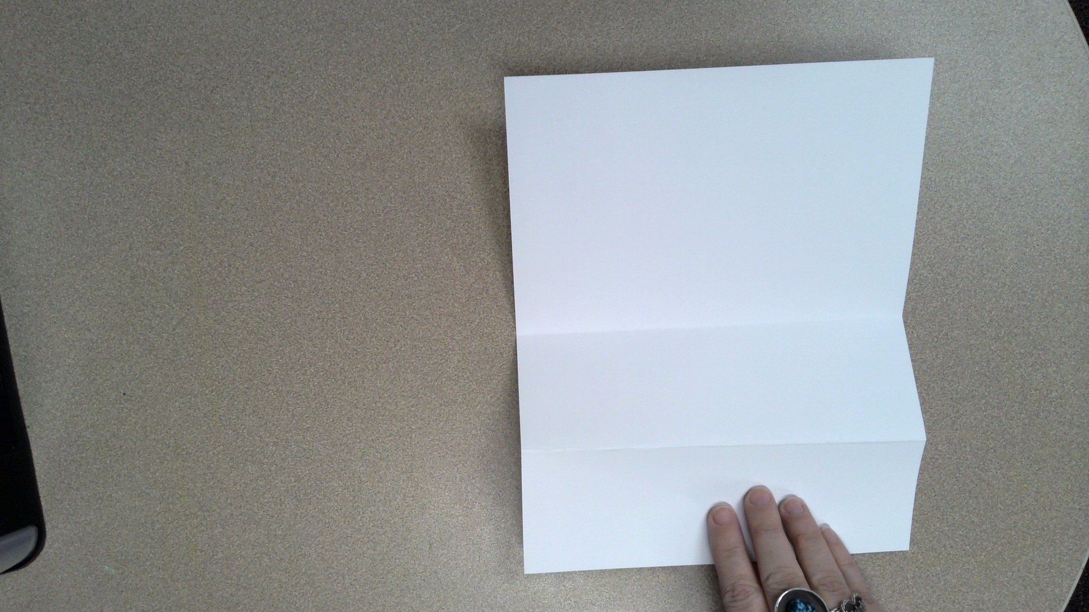
Unfold the paper.

Slide 25
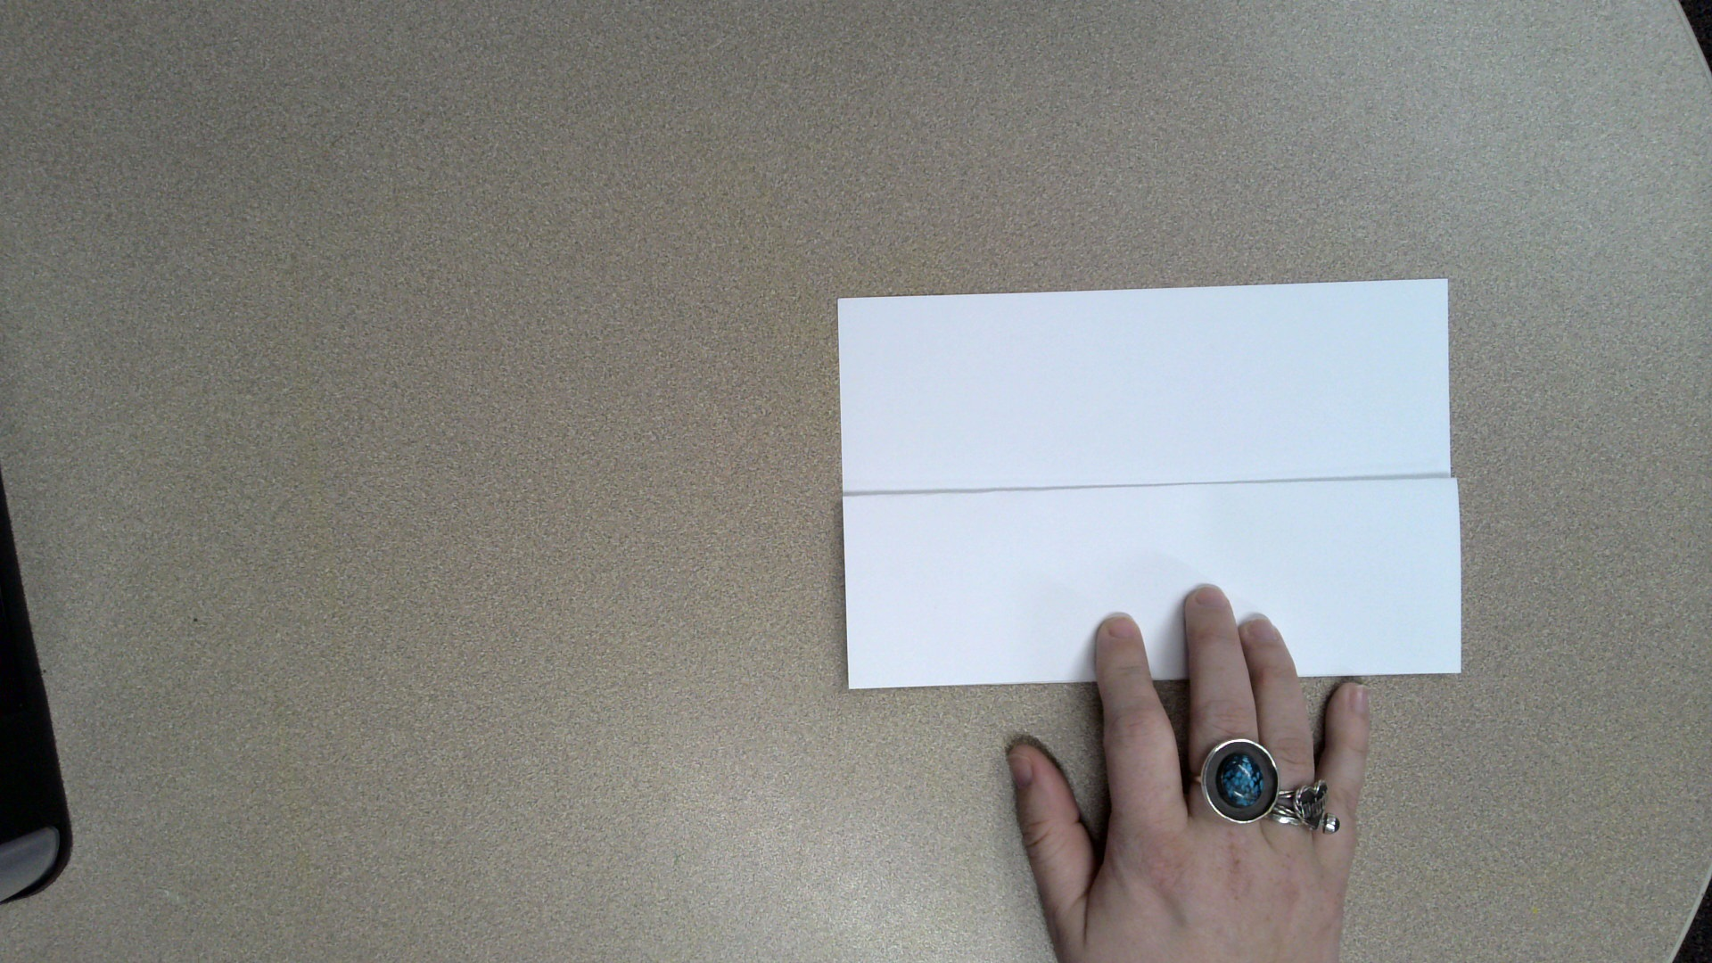
Practice folding the paper back up.

Slide 26
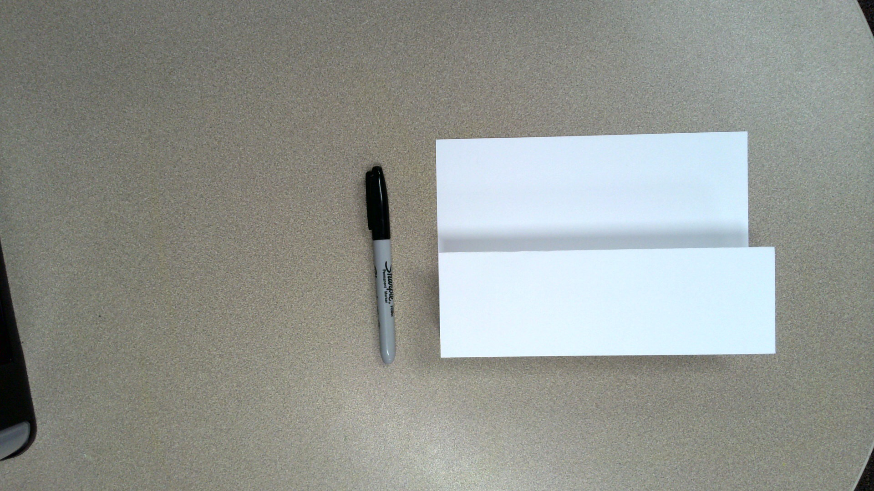
Fold the paper back down.
Get out a black marker.

Slide 27
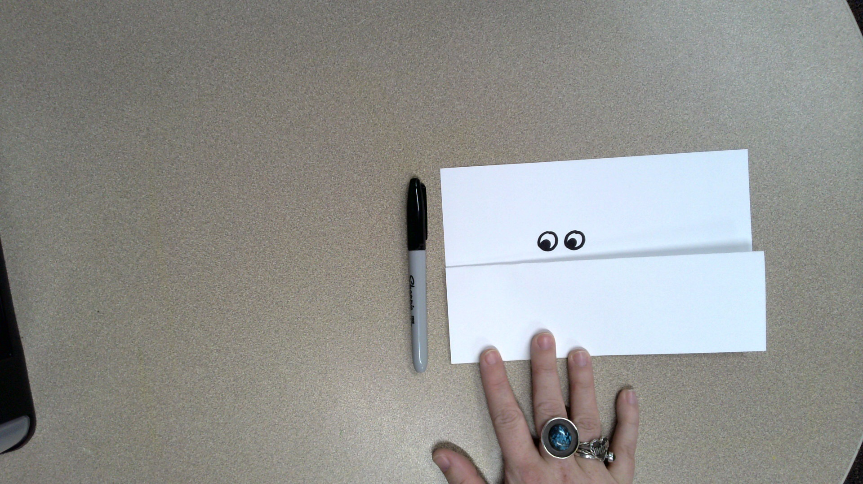
Draw 2 eyes for your worry monster.
The eyes can look however you want.

Slide 28
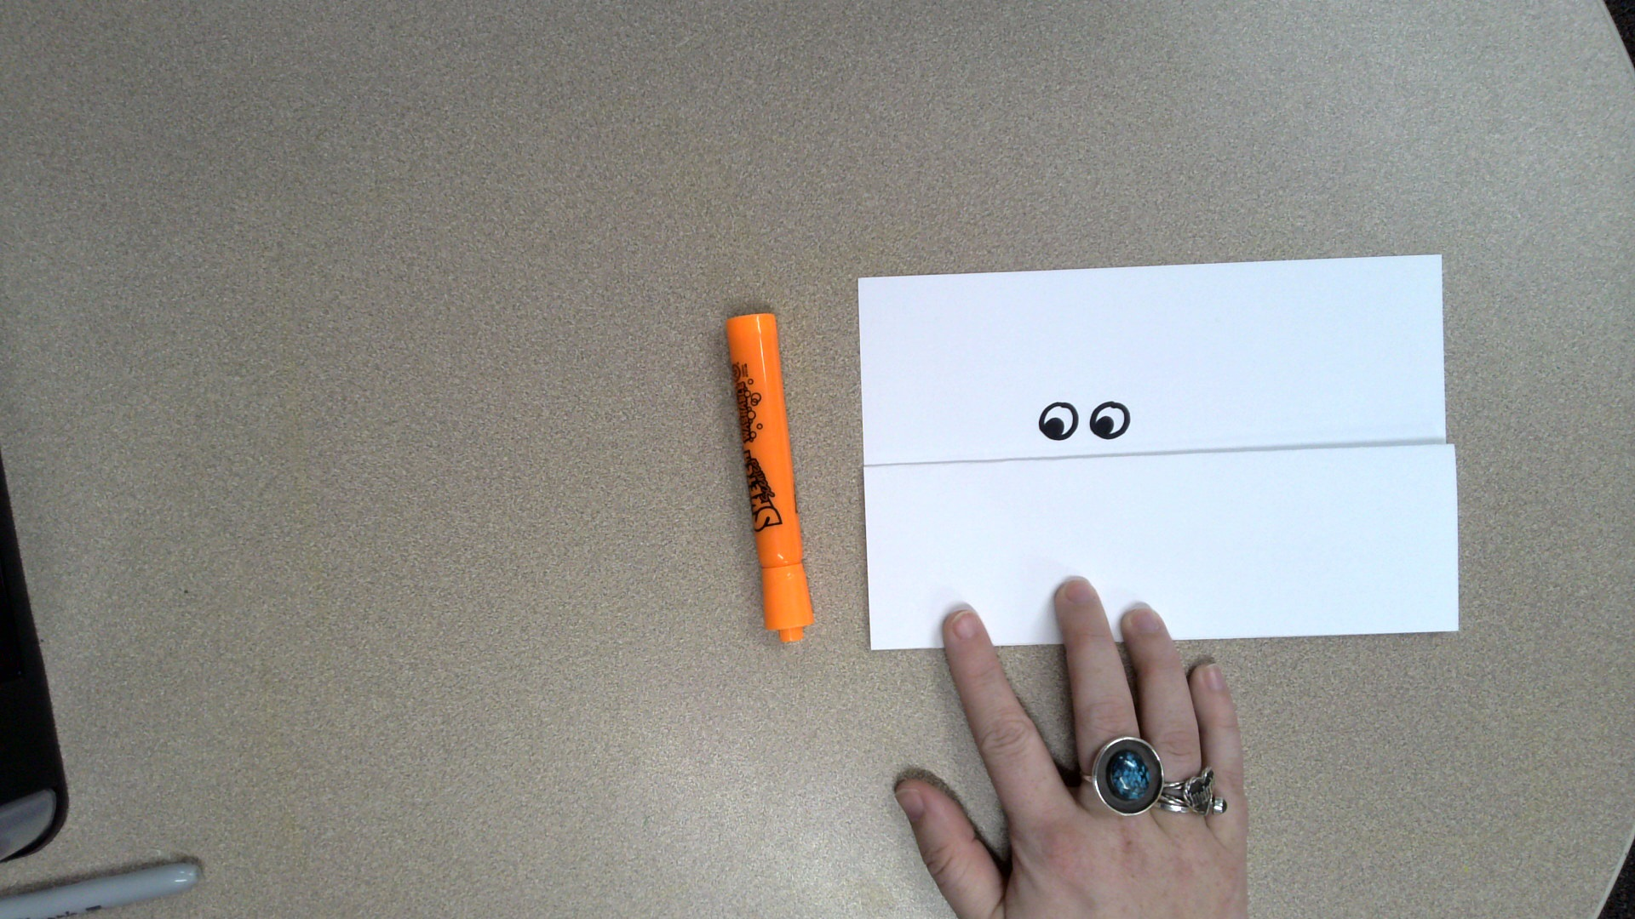
Pick out a color for your worry monster.
You can pick any color you want.

Slide 29
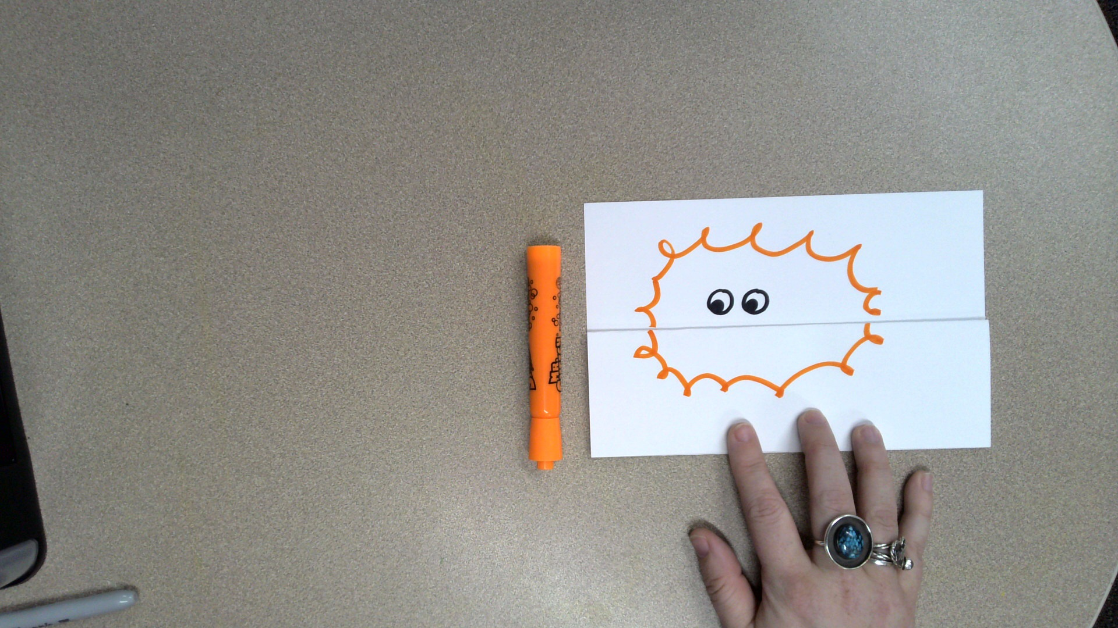
Draw a body for your worry monster.
Perfection is not needed.

Slide 30
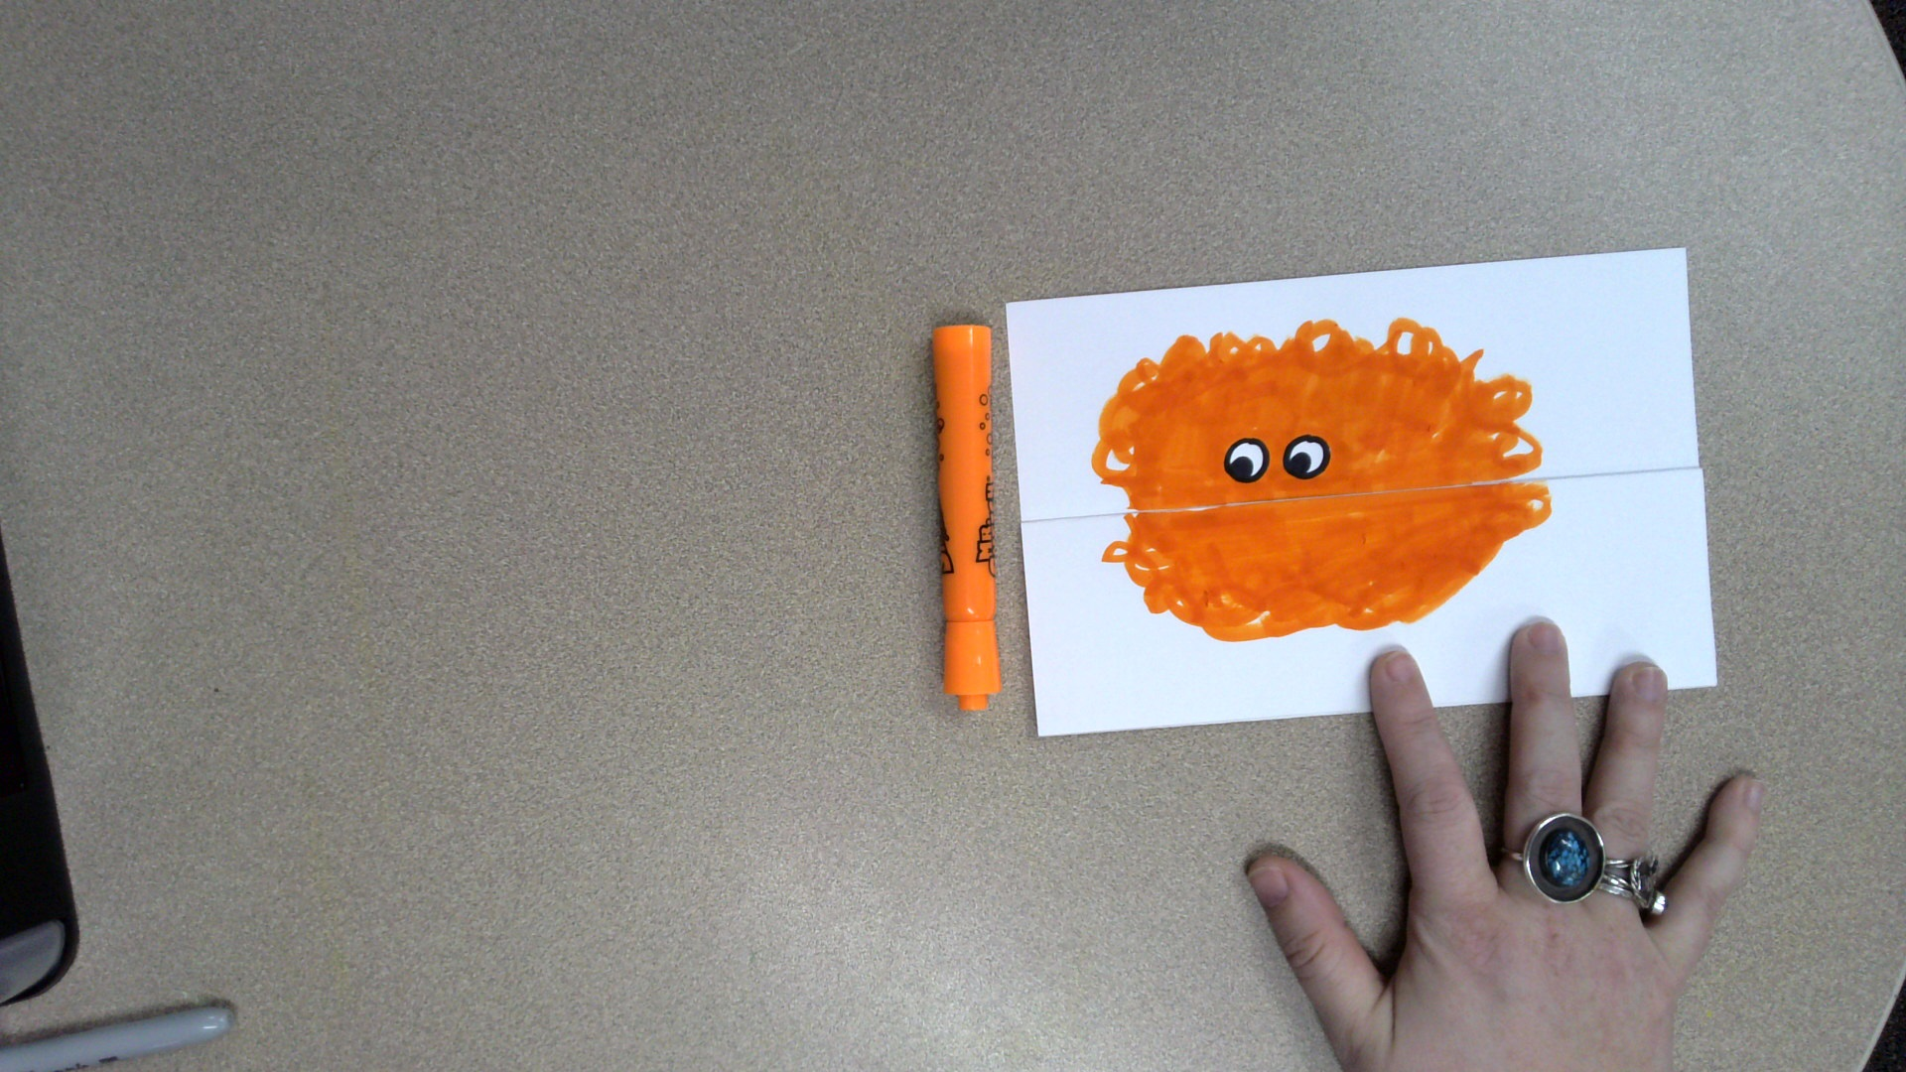
Keep the paper folded.
Color in your worry monster.
Leave the edges kind of messy.

Slide 31
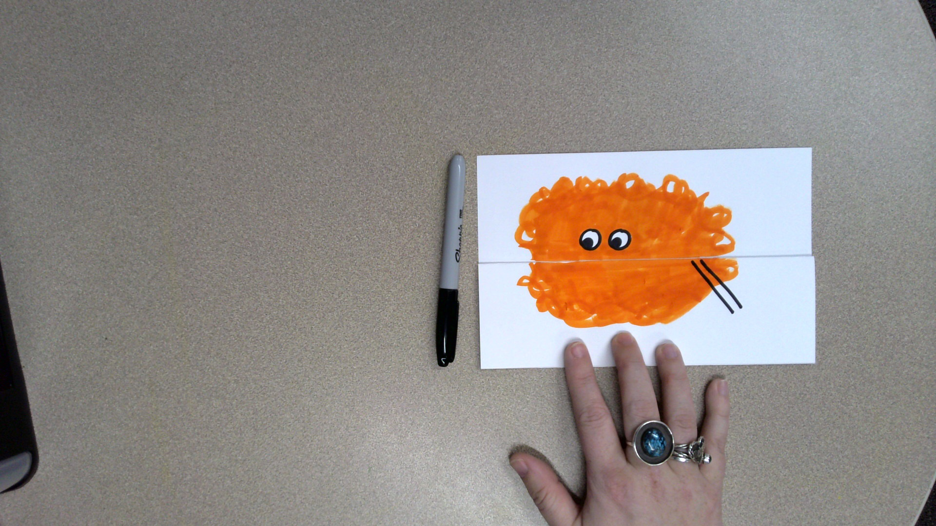
Let’s give your worry monster an arm.
Draw two lines like this.
The arm can go in any direction you want.

Slide 32
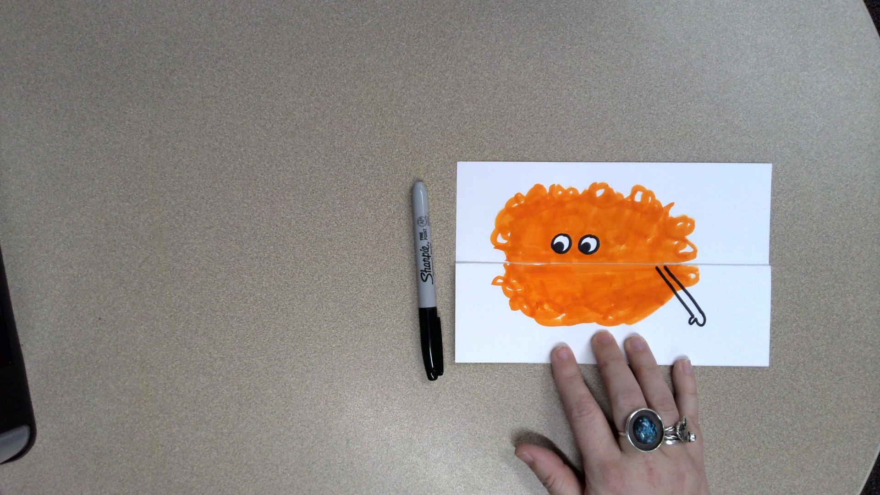
Draw a hand or paw for your worry monster.

Slide 33
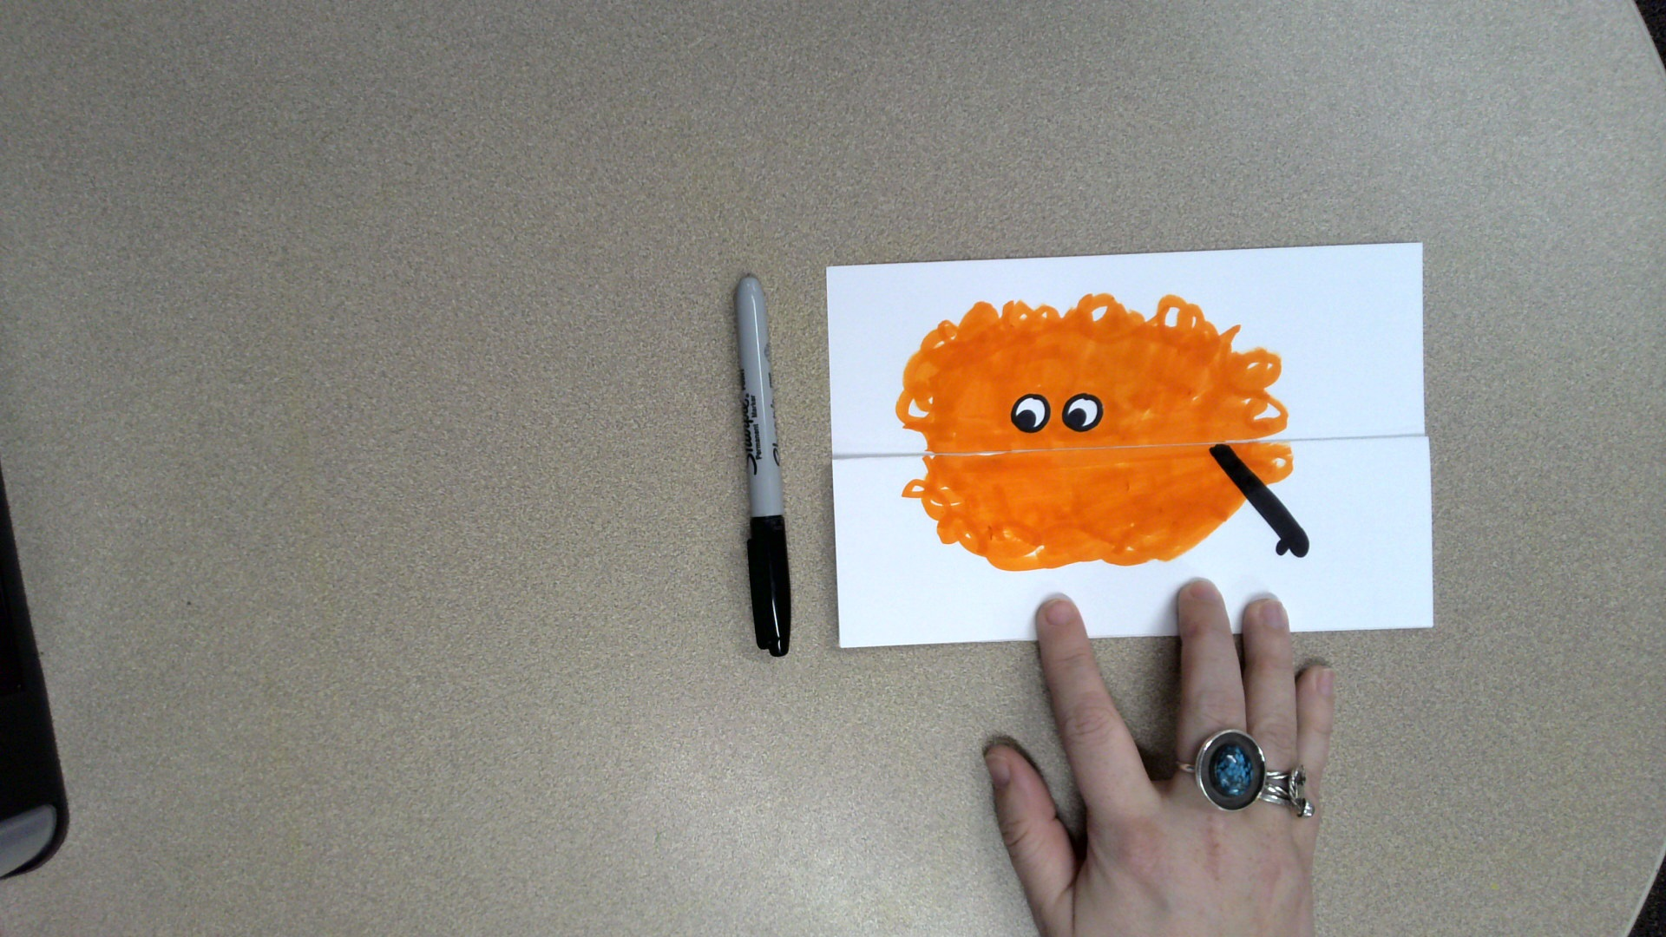
Color in your worry monster’s arm with black marker.

Slide 34
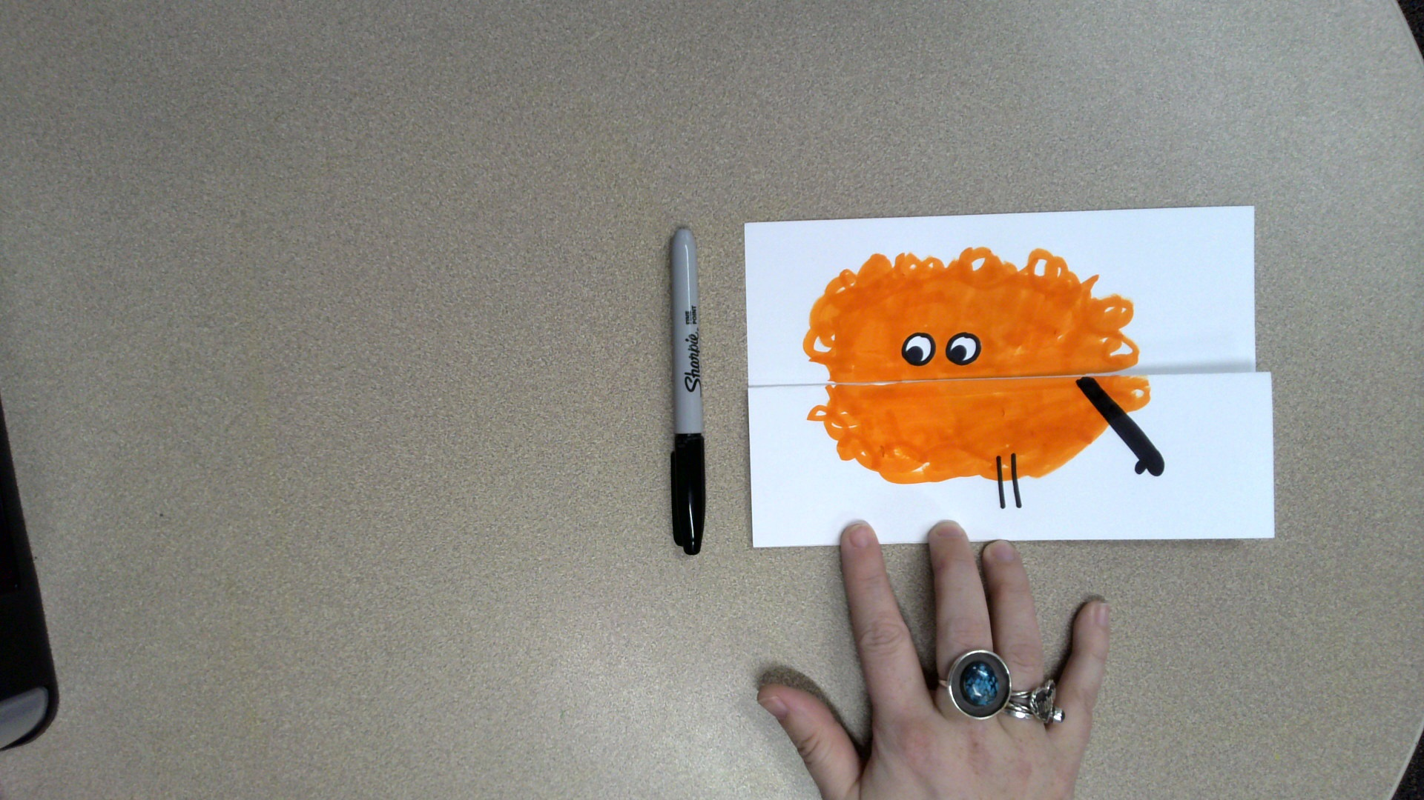
Let’s give your worry monster legs.
Draw 2 parallel lines like this.

Slide 35
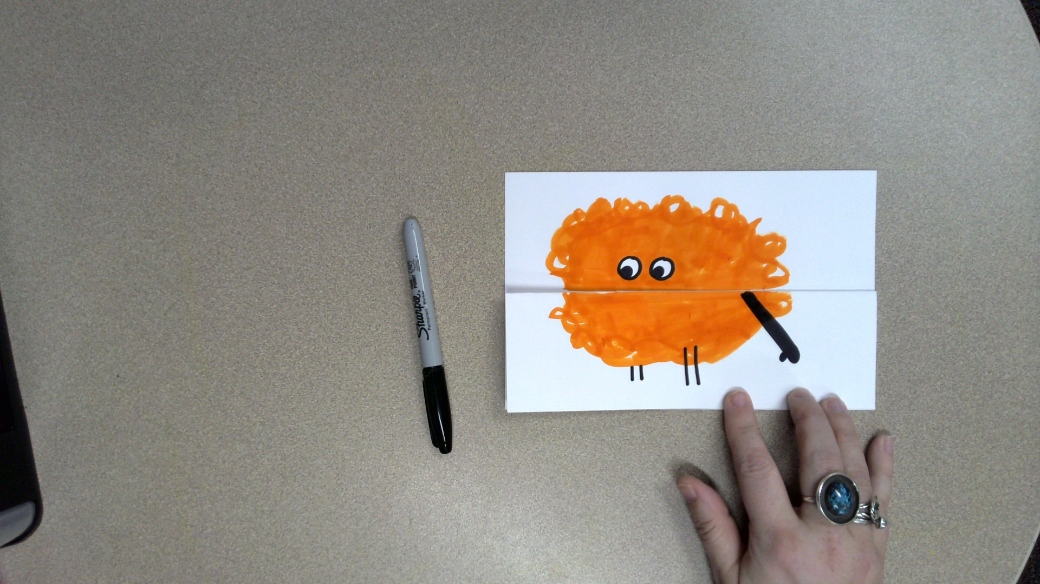
Draw 2 more parallel lines like this.

Slide 36
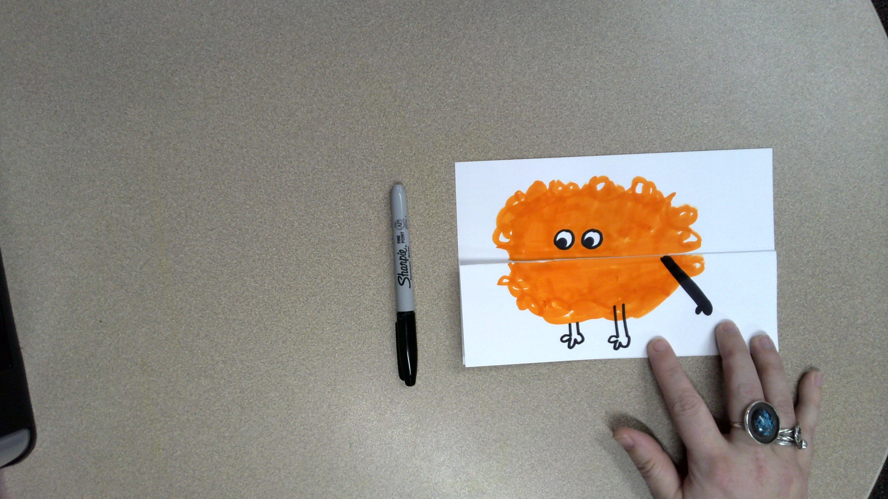
Give your worry monster feet or paws.
They can look however you like.

Slide 37
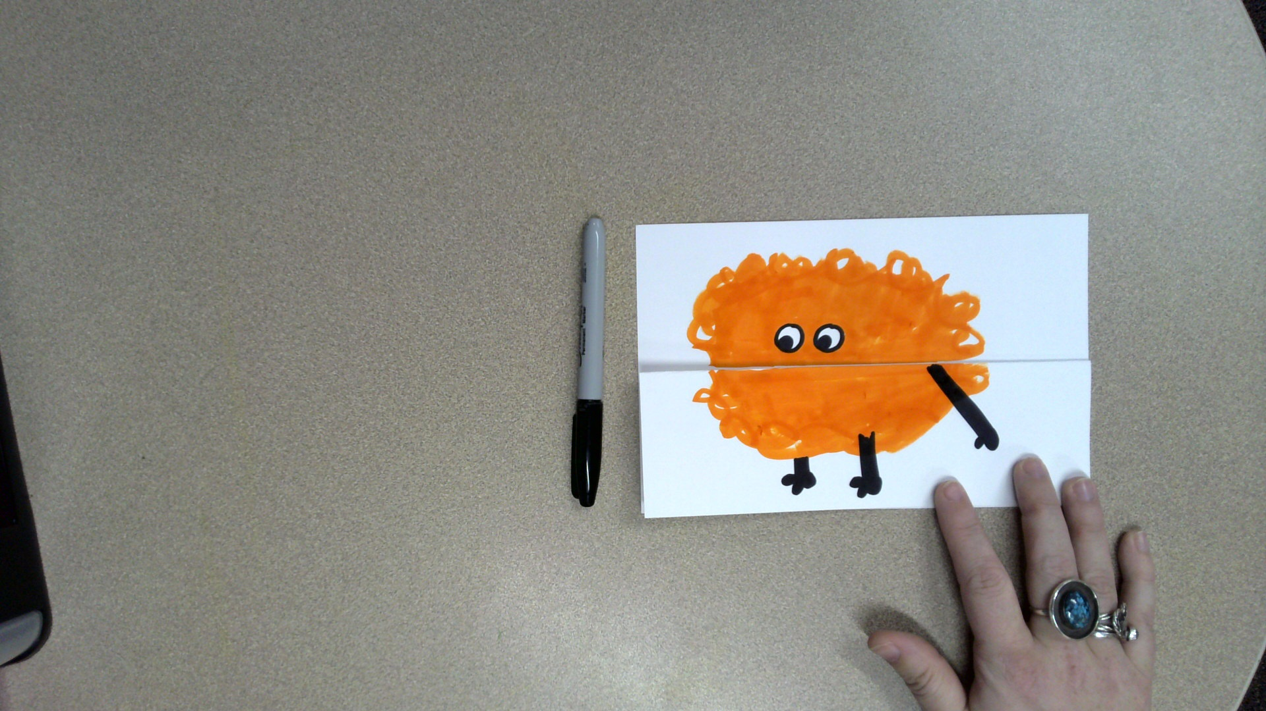
Color in the legs with black marker.

Slide 38
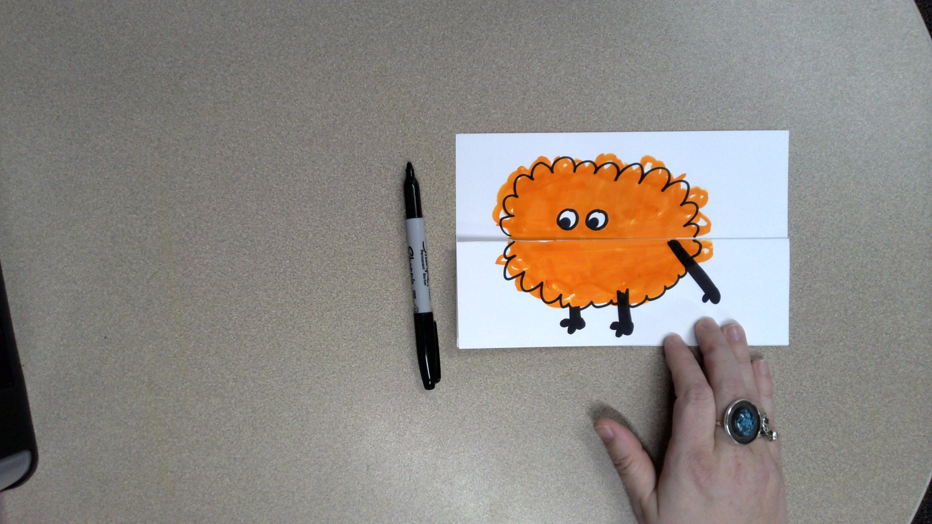
Use the black marker to outline your worry monster’s body.
Don’t worry about perfection.

Slide 39
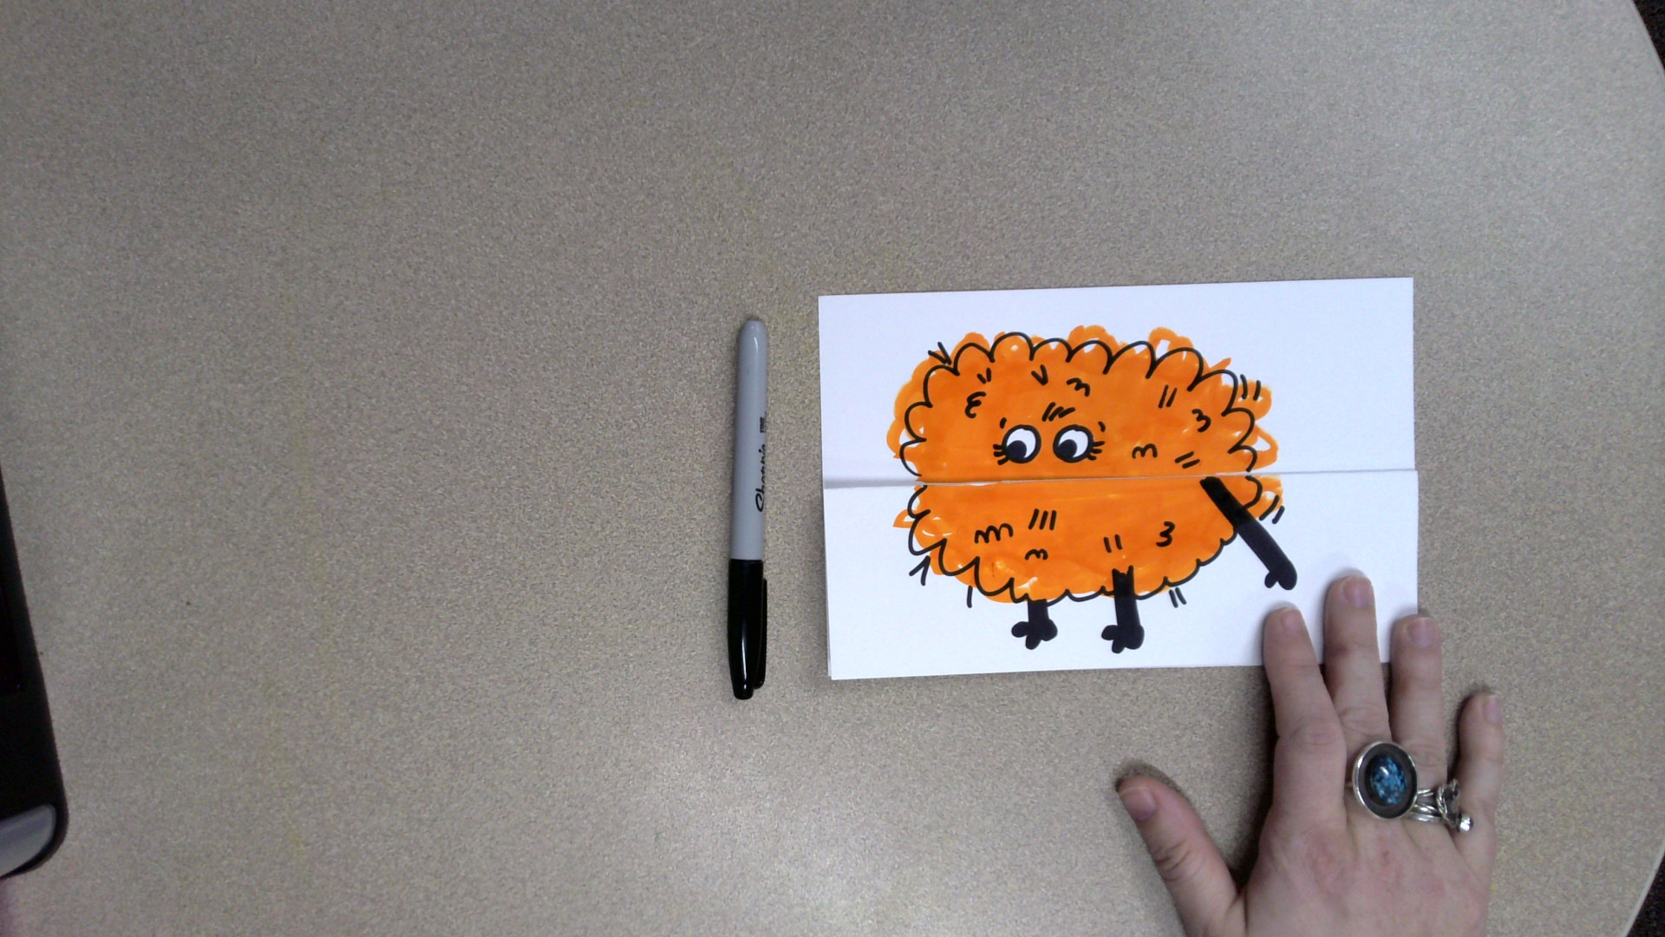
Add details with the black marker to make your worry monster look fuzzy or furry.

Slide 40
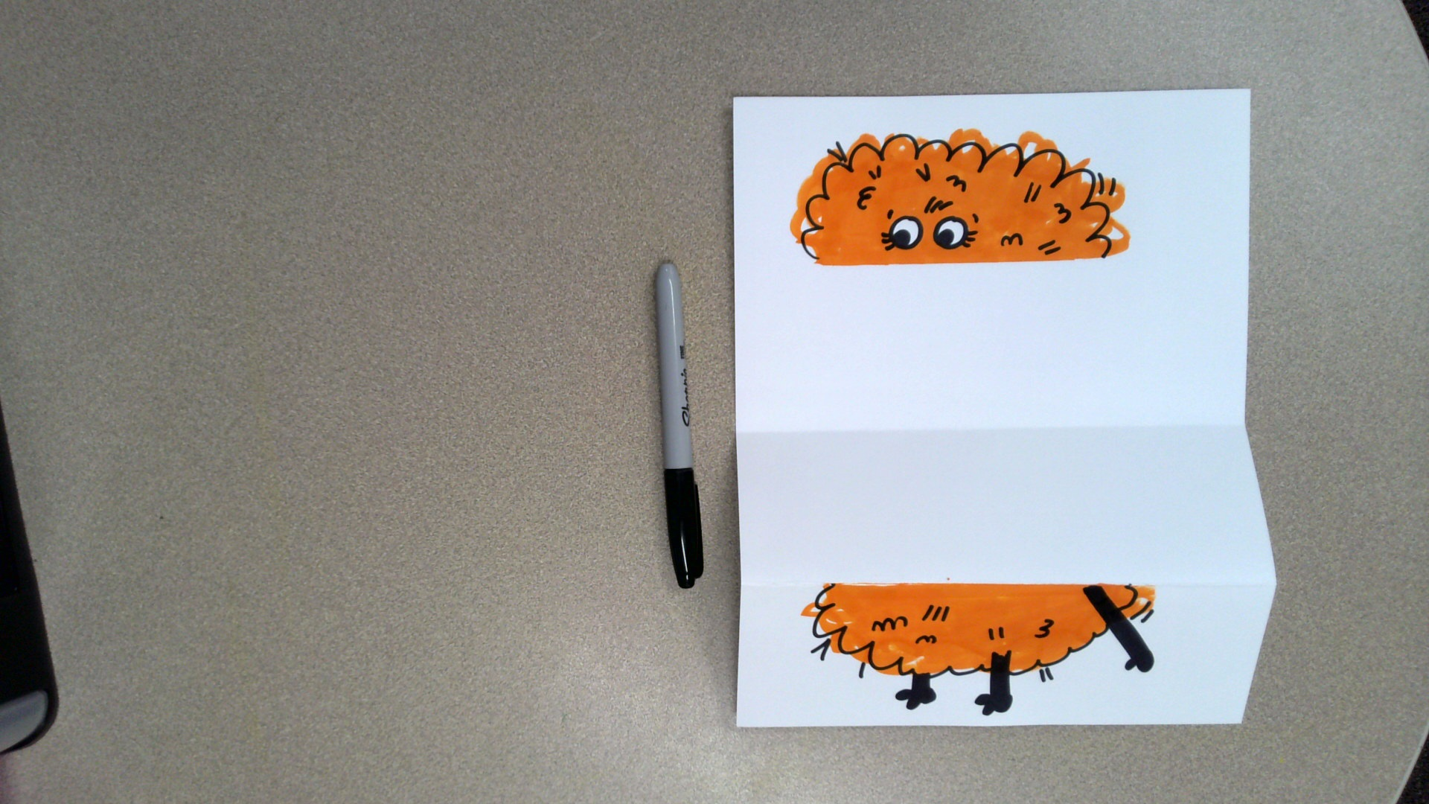
Let’s draw the inside of your worry monster’s mouth.
Unfold your paper.

Slide 41
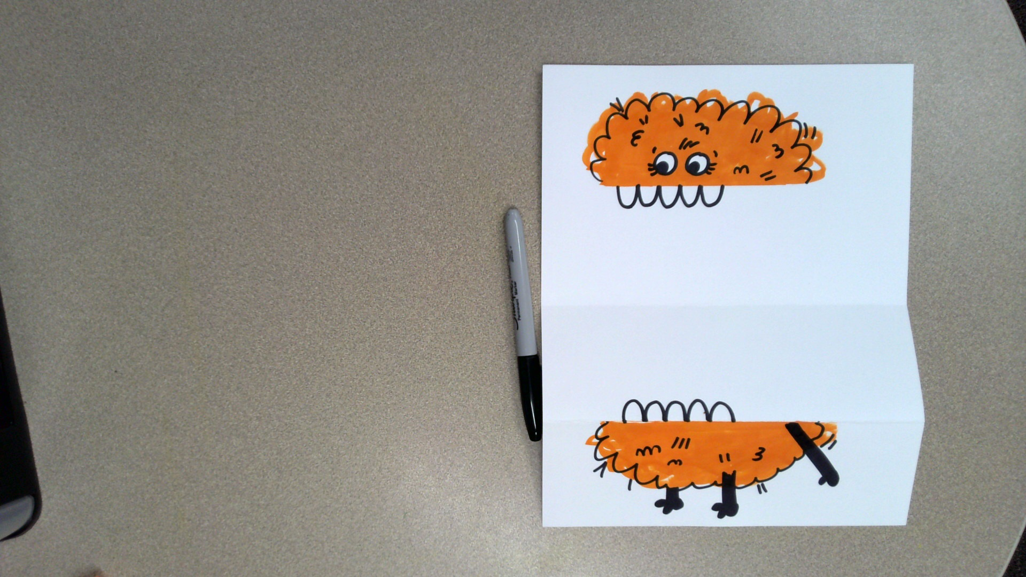
Draw your worry monster’s teeth on the top and the bottom.
The teeth can be rounded or sharp.
Don’t go all the way to the edge of your monster.

Slide 42
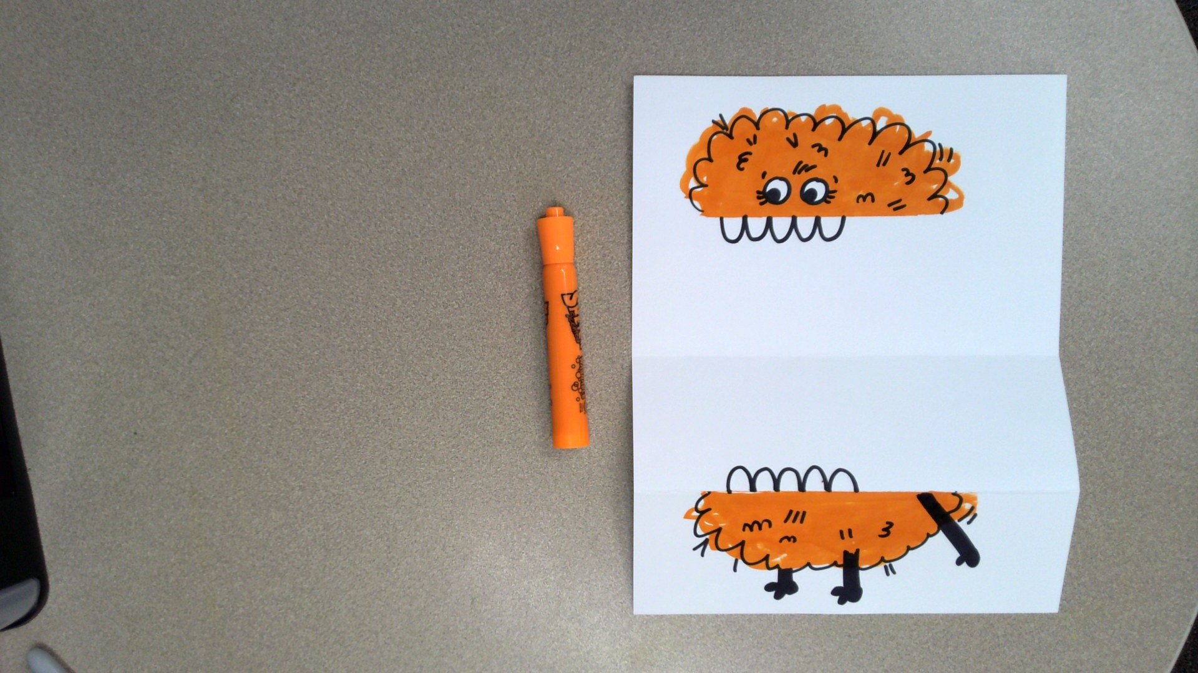
Get out the marker that is the same color as your worry monster.

Slide 43
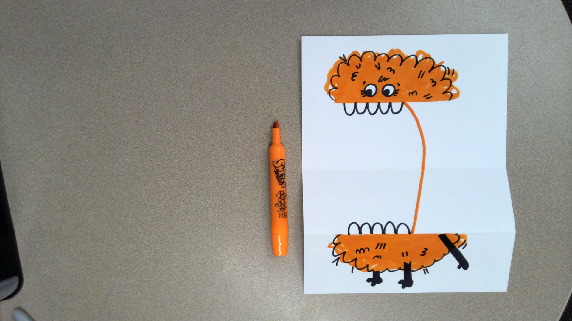
Draw a curved line like this.

Slide 44
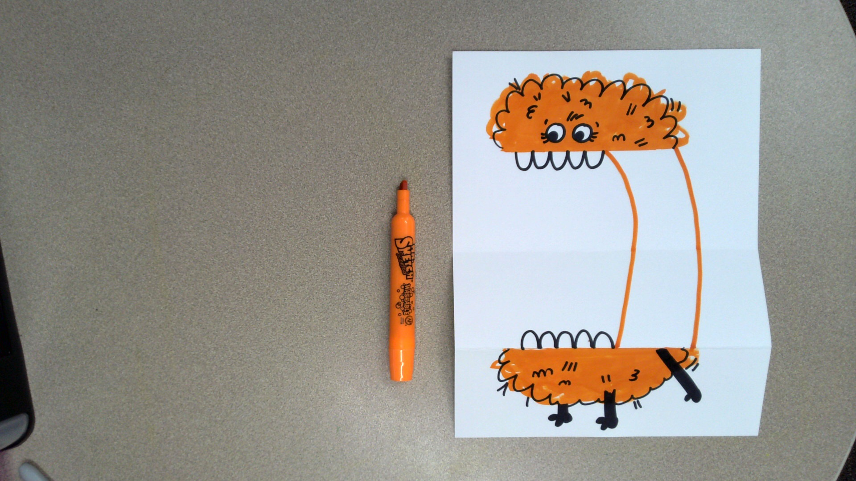
Draw another curved line like this.
This is the back of your worry monster’s body.

Slide 45
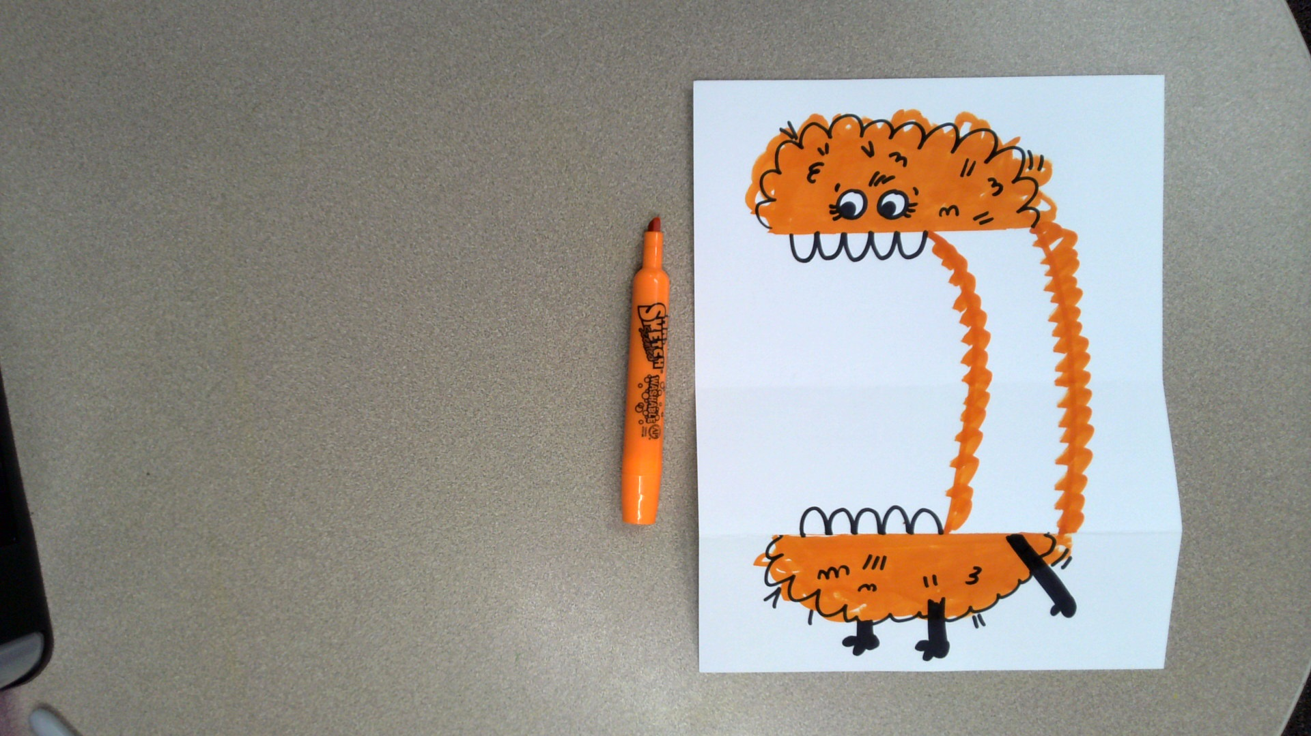
Make the lines kind of messy like this.

Slide 46
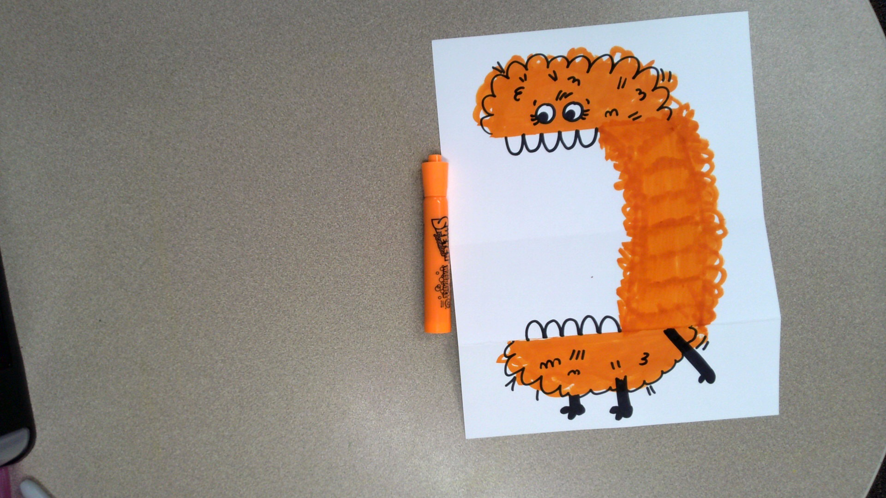
Color in the space you created.
Perfection is not needed.

Slide 47
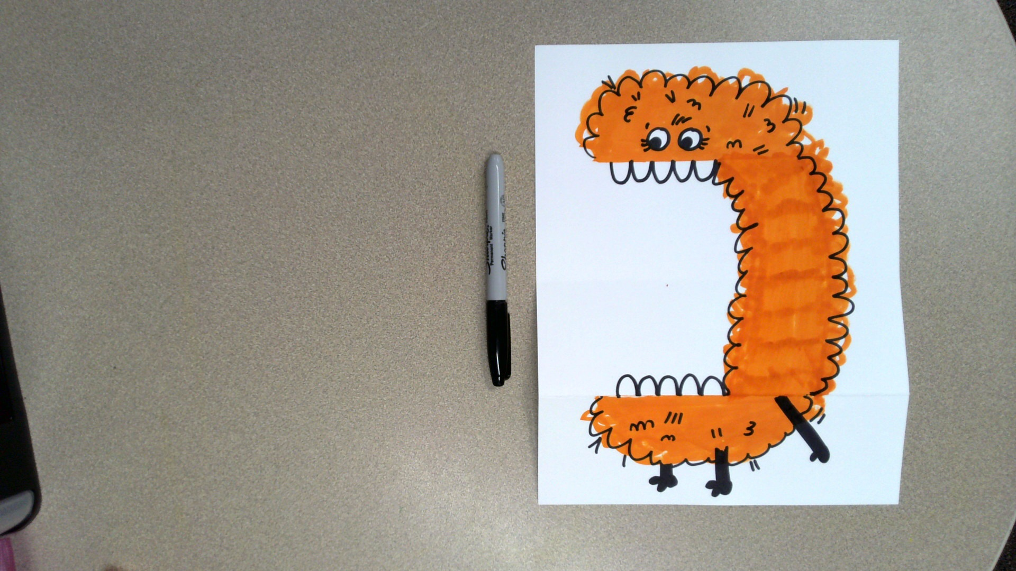
Outline the rest of your worry monster’s body with black marker.
Perfection is not needed.

Slide 48
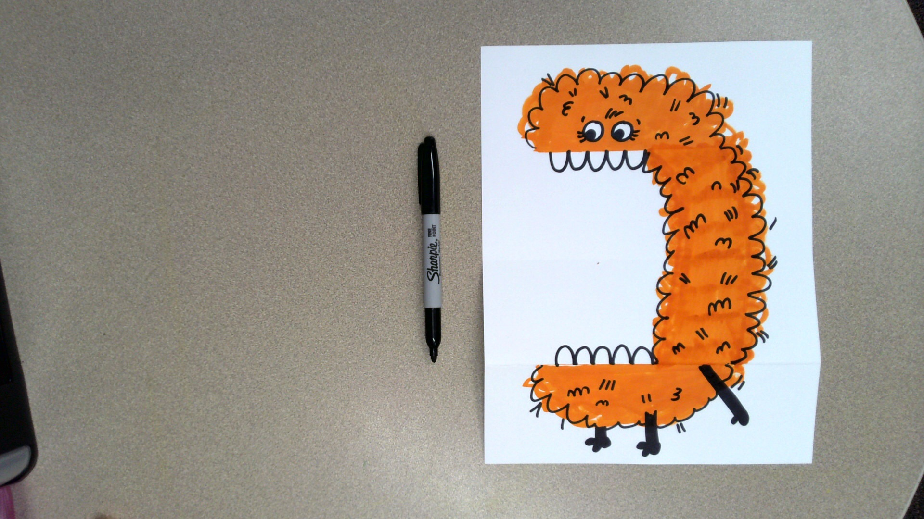
Add details to make your worry monster look furry or fluffy.

Slide 49
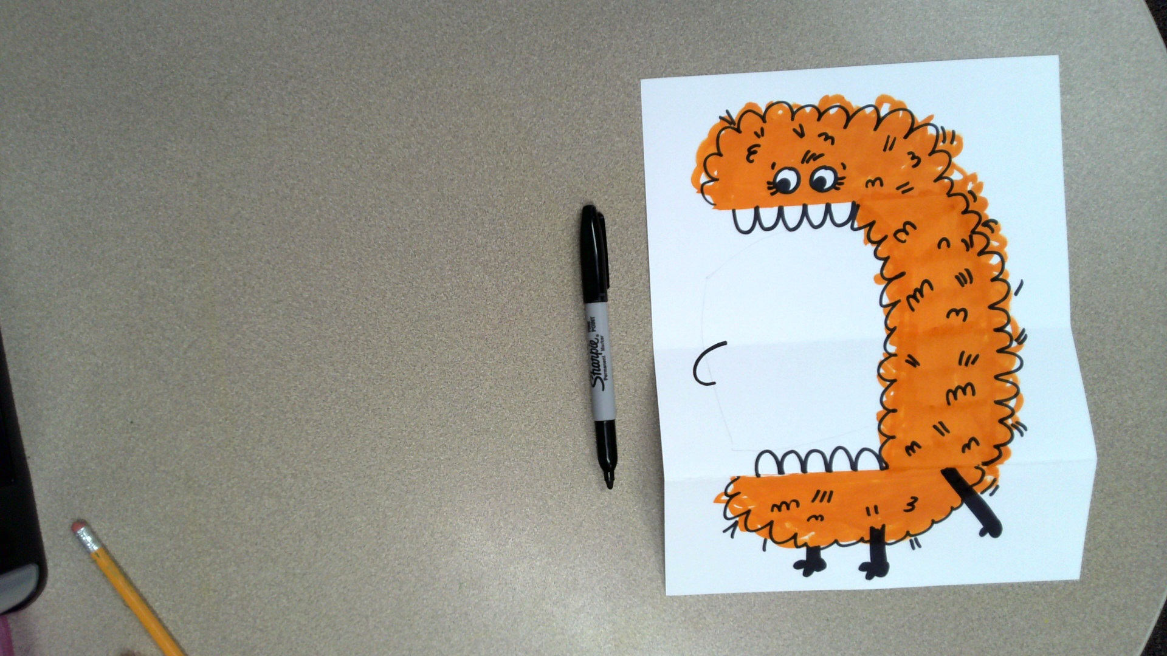
Let’s draw an arm.
This arm will be shoving all of your worry into the monster’s mouth.
Draw a curved line like this.

Slide 50
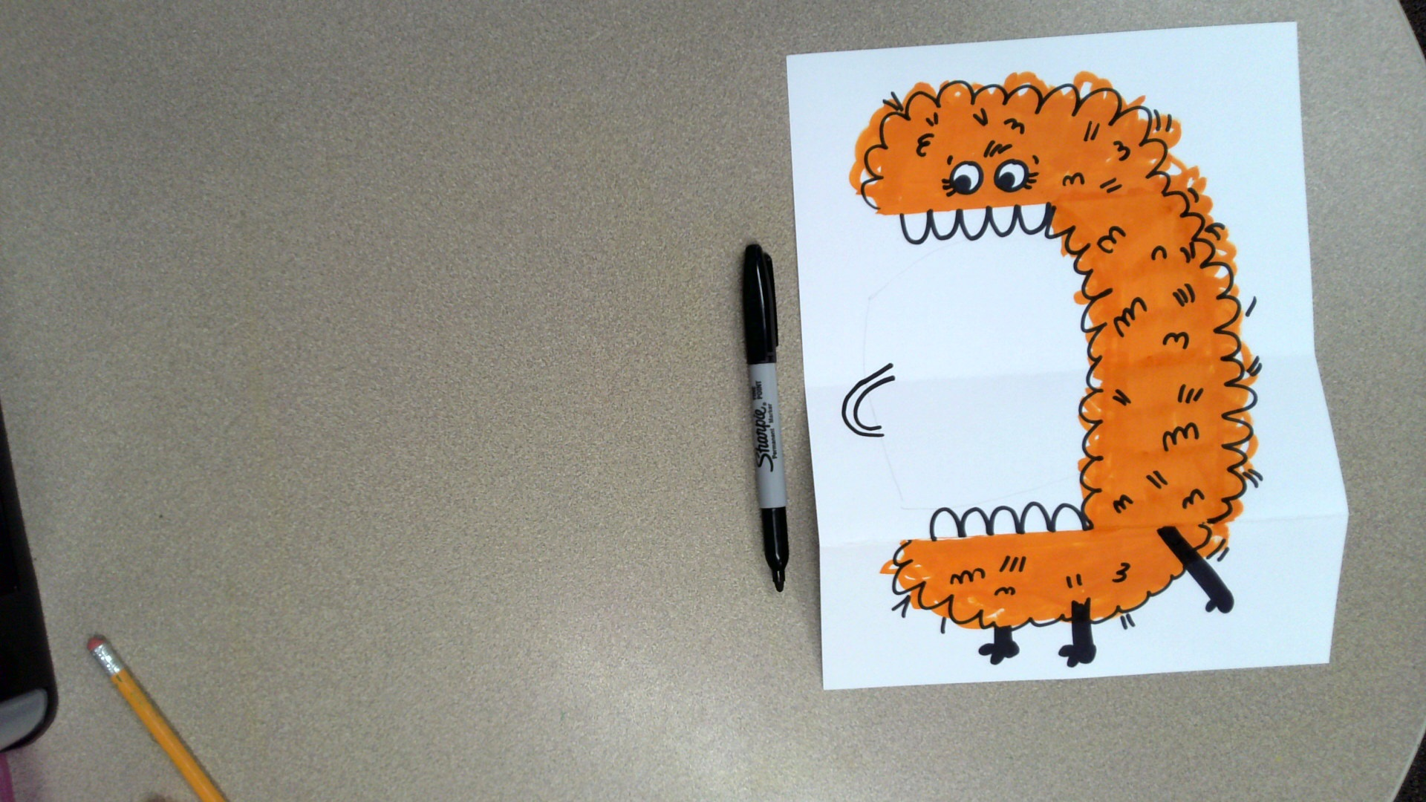
Draw another curved line that is parallel to the first one.

Slide 51
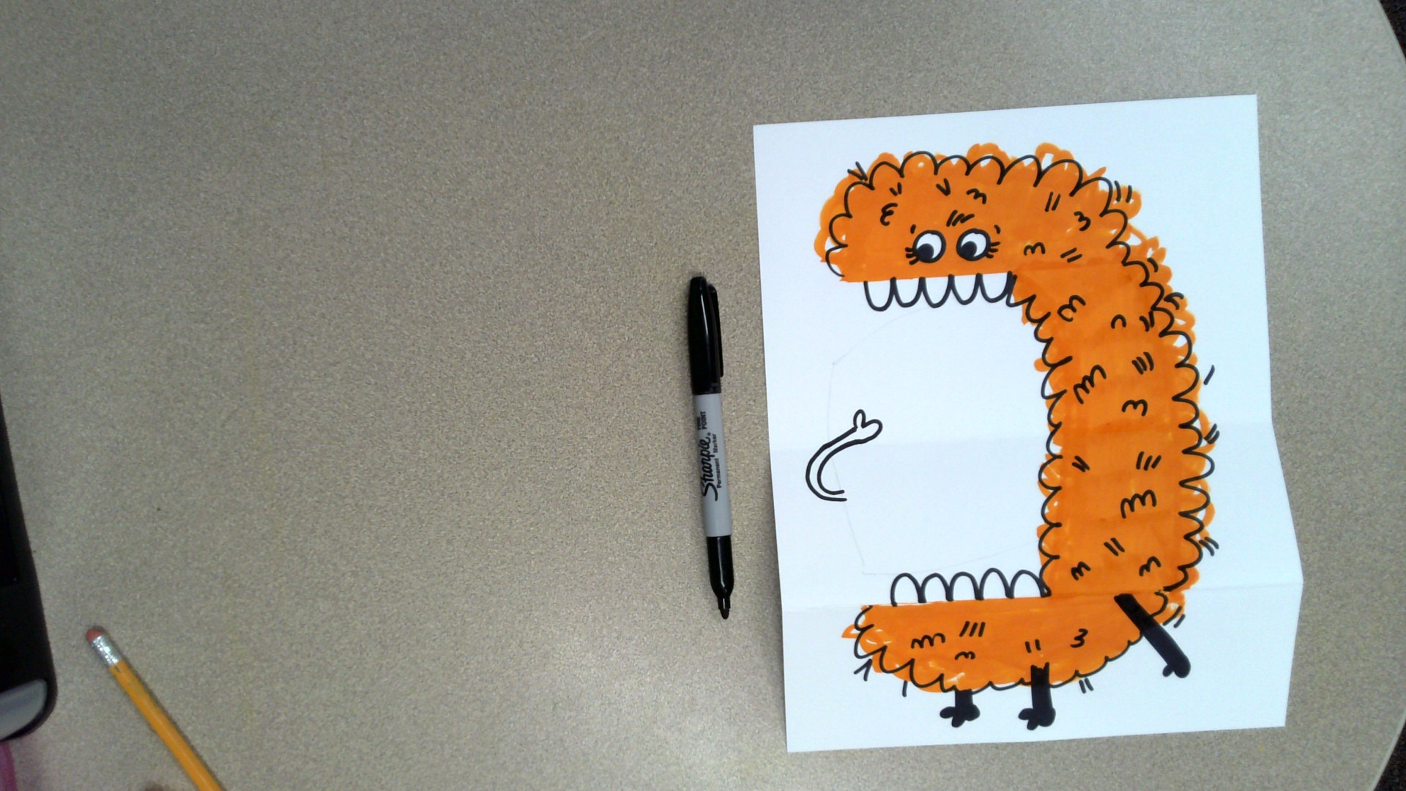
Draw a paw or hand for the arm.

Slide 52
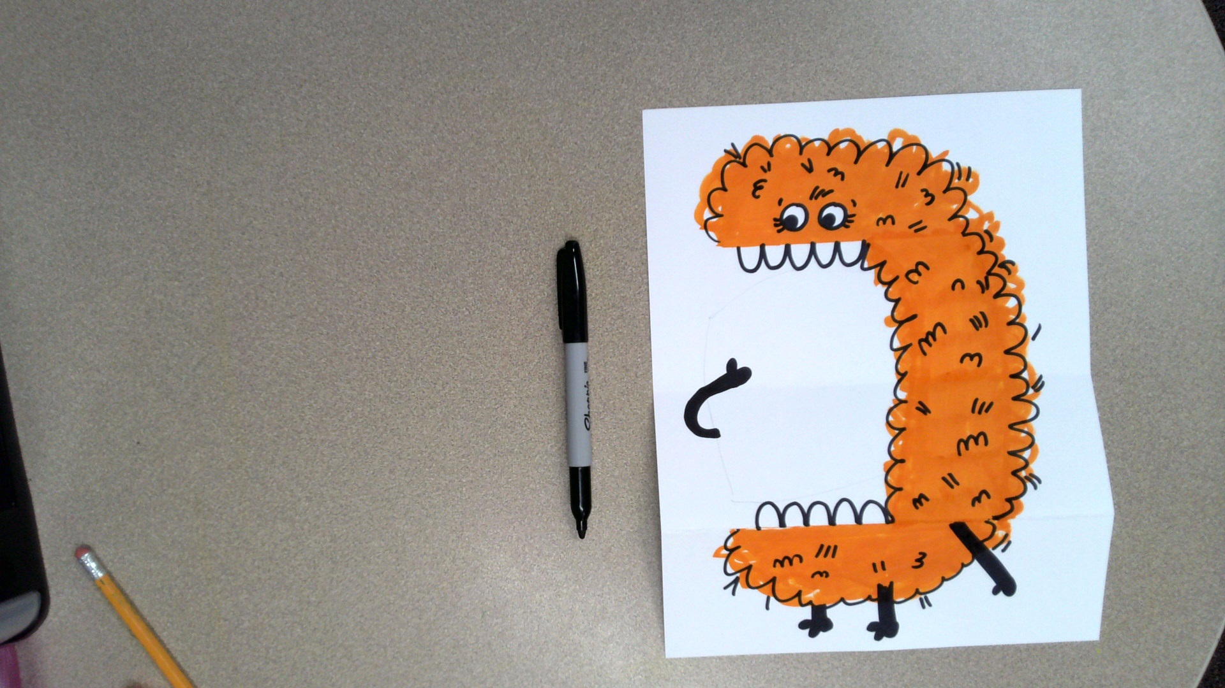
Color in the arm you just drew black.

Slide 53
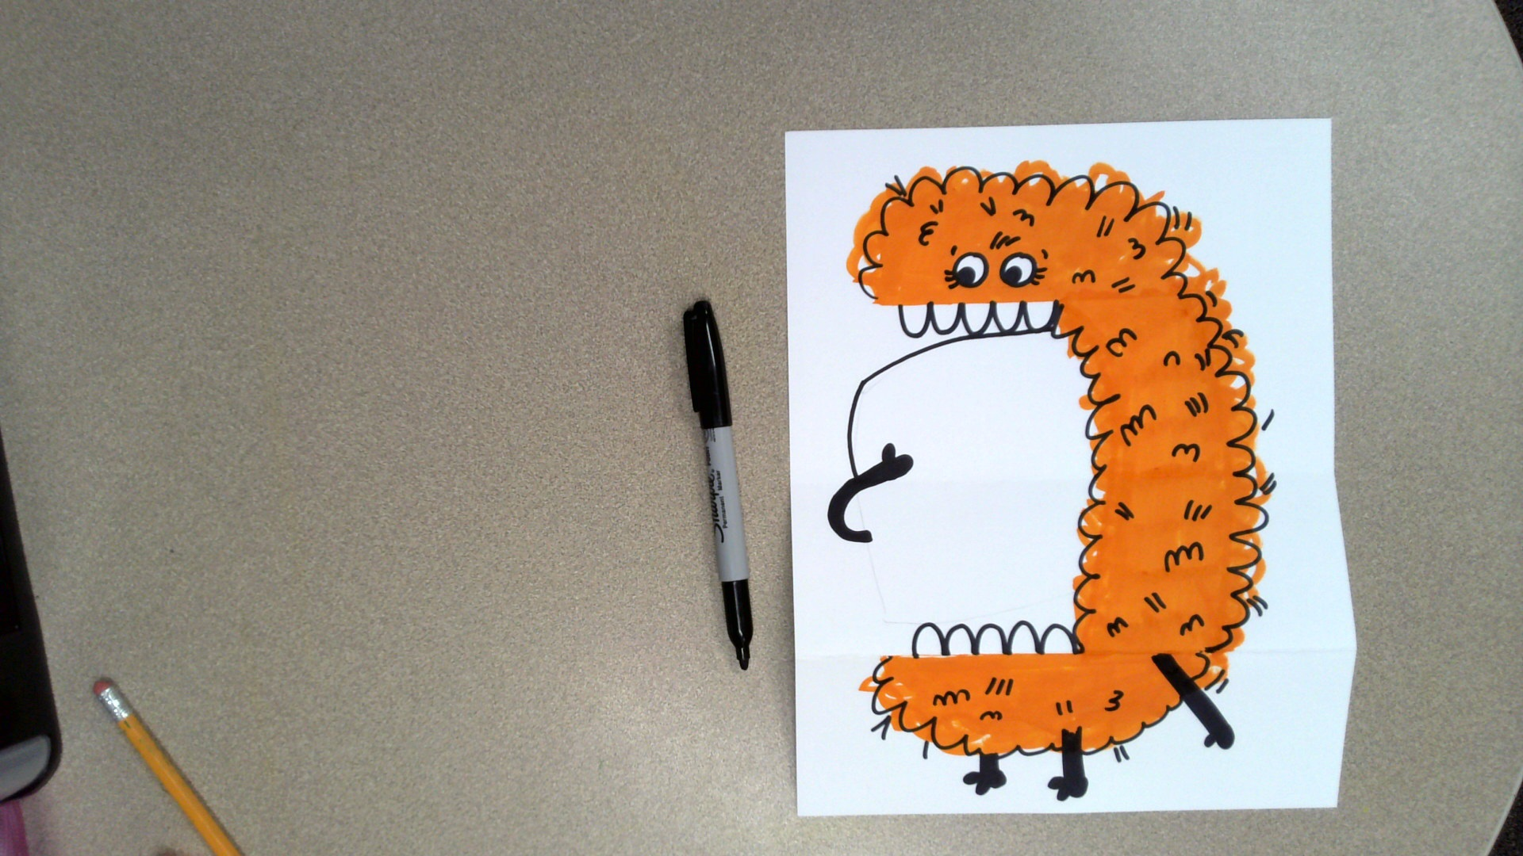
Let’s create a place for all that worry to go.
Draw a curved line like this.

Slide 54
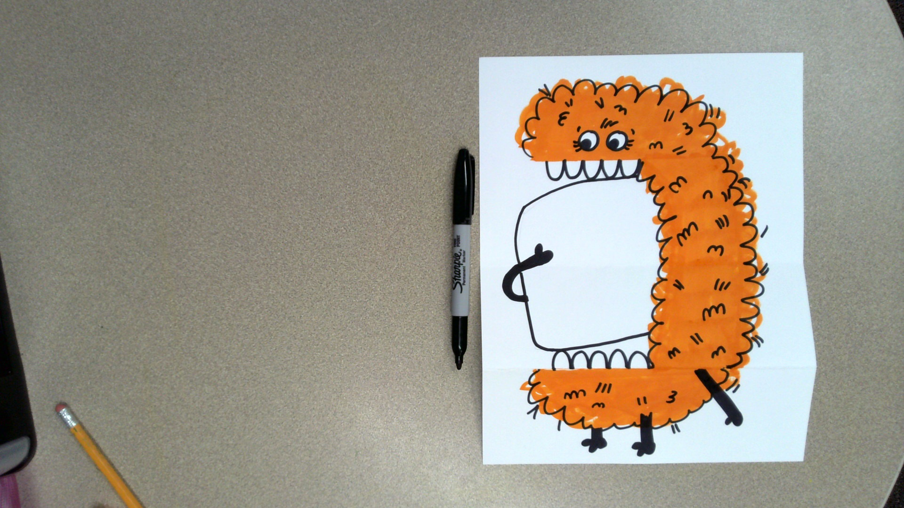
Draw another curved line like this.

Slide 55
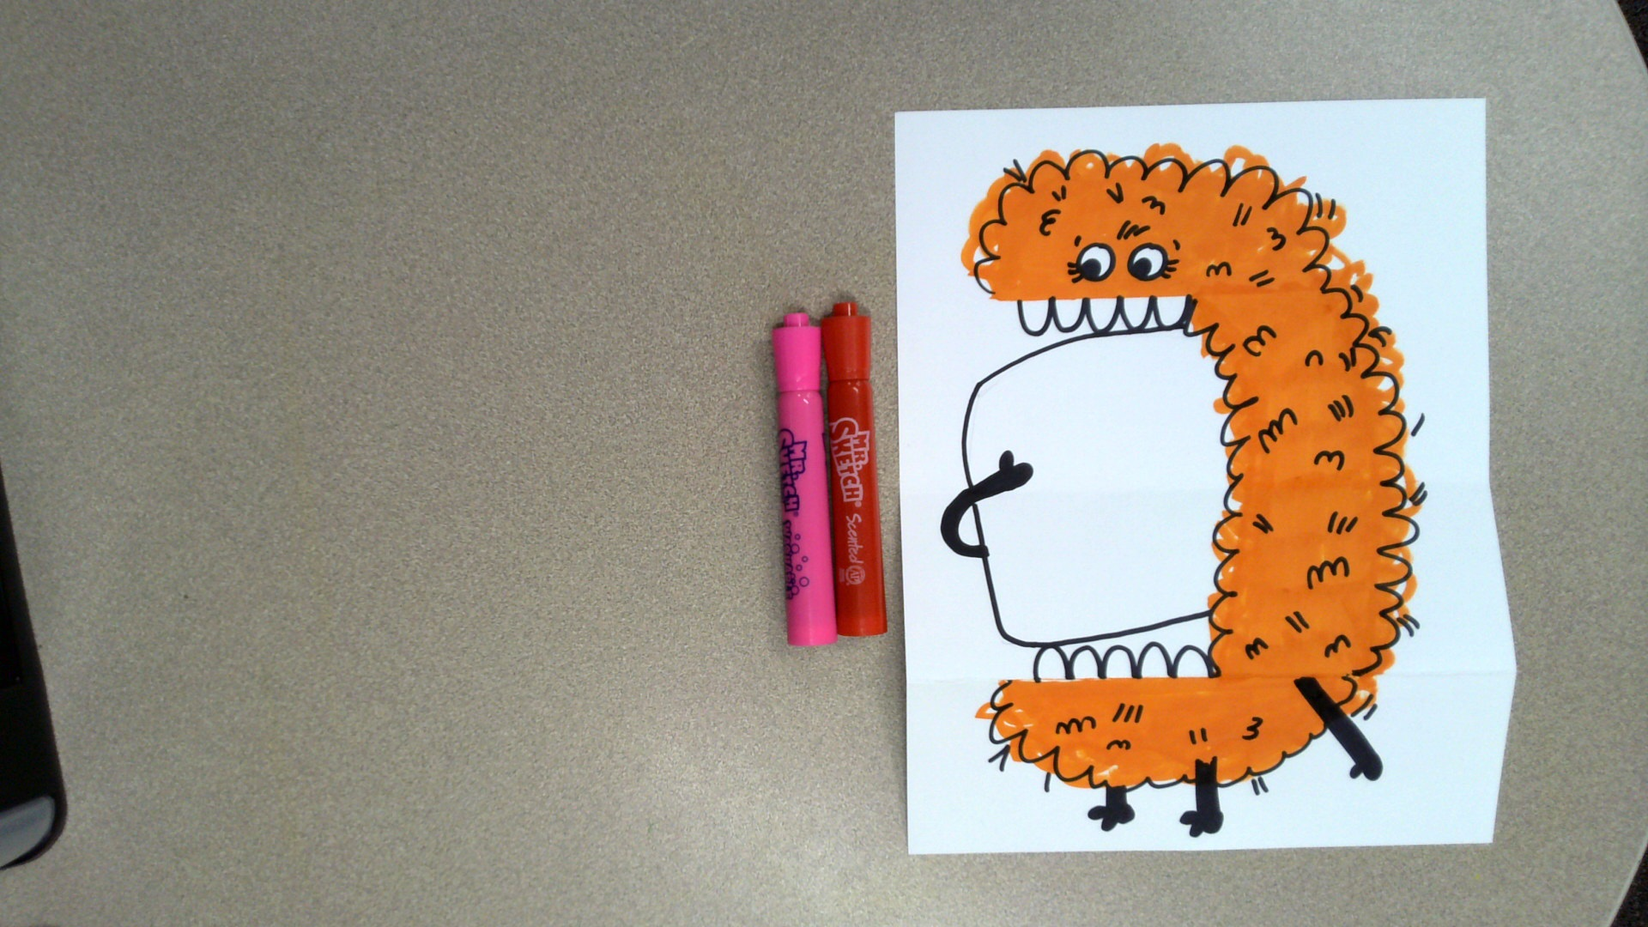
Let’s create the rest of your worry monster’s mouth.
Pick a color for the inside of the mouth. It can be any color you like.

Slide 56
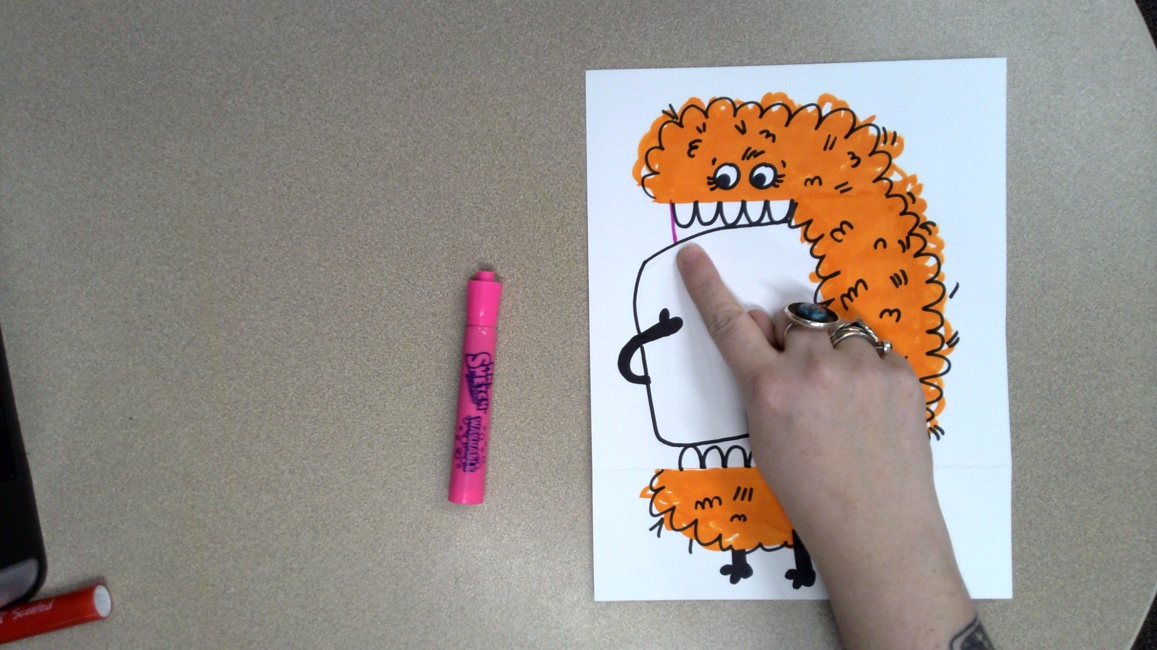
Using the color you chose, draw a line like this.

Slide 57
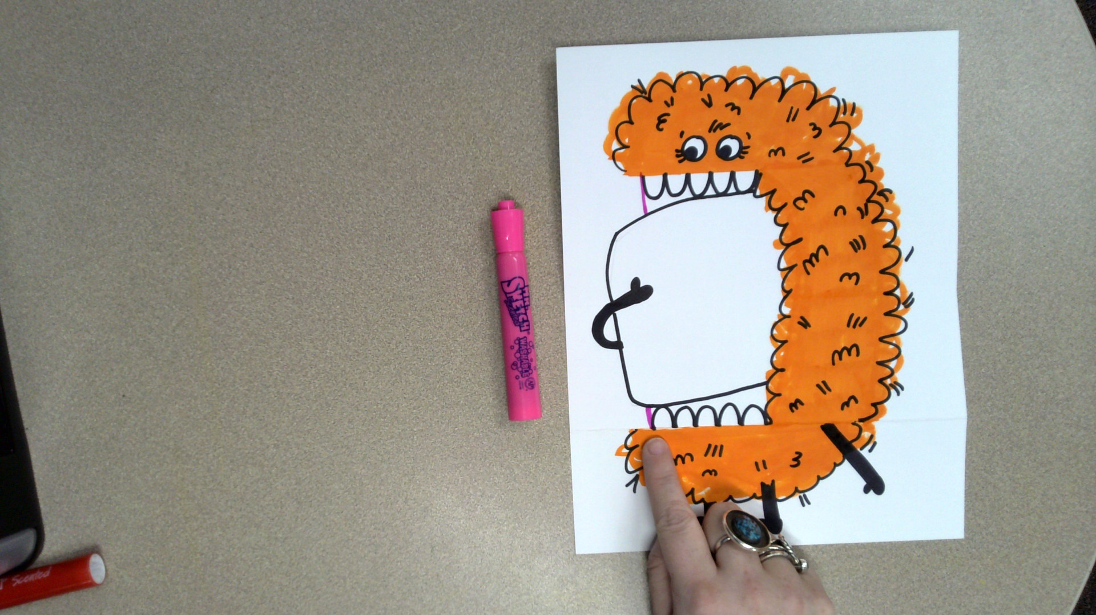
Draw another line like this.

Slide 58
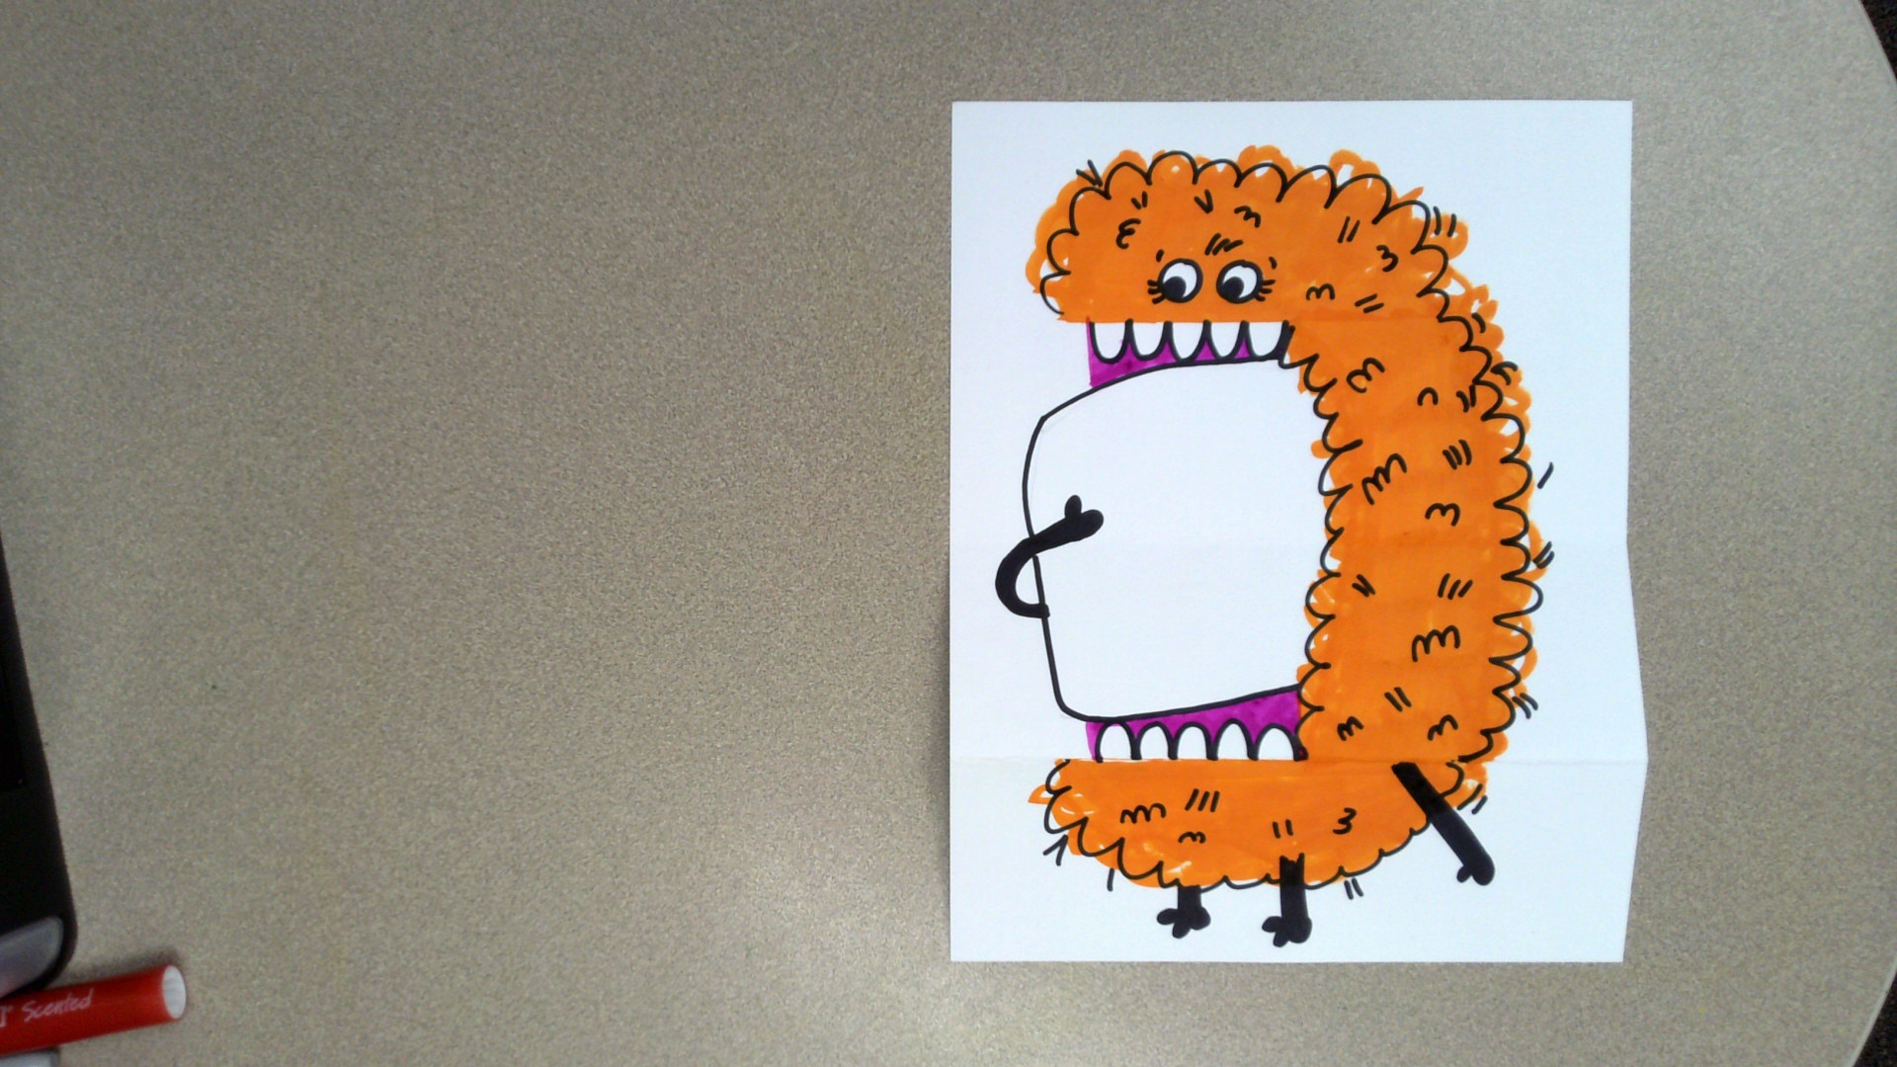
Color in the rest of the spaces that make up the mouth.

Slide 59
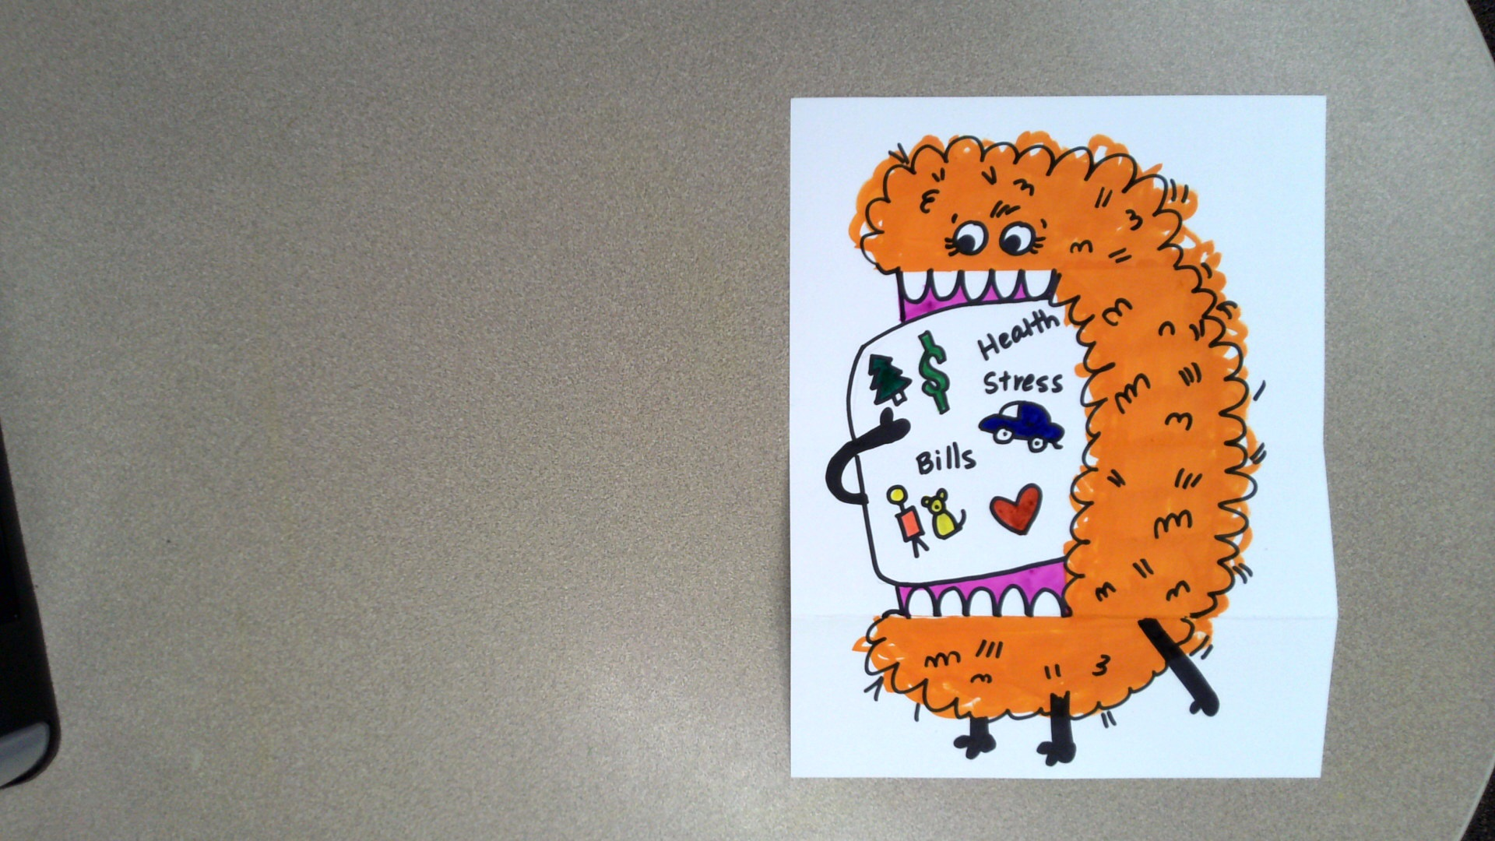
Draw and/or write all of the things that worry you inside your monster’s mouth.
Take your time.
Making marks is part of the process that relieves worry the most.

Slide 60
Critique
Ruby taught us that talking about our worries helps them to go away.
Share with a friend the worries that your monster is gobbling up.

Slide 61
How are you feeling after making your artwork?
Do you feel better, worse, or the same? Why?
Notes:
https://pixabay.com/illustrations/emotion-scale-emoji-icon-feedback-3404484/

Slide 62
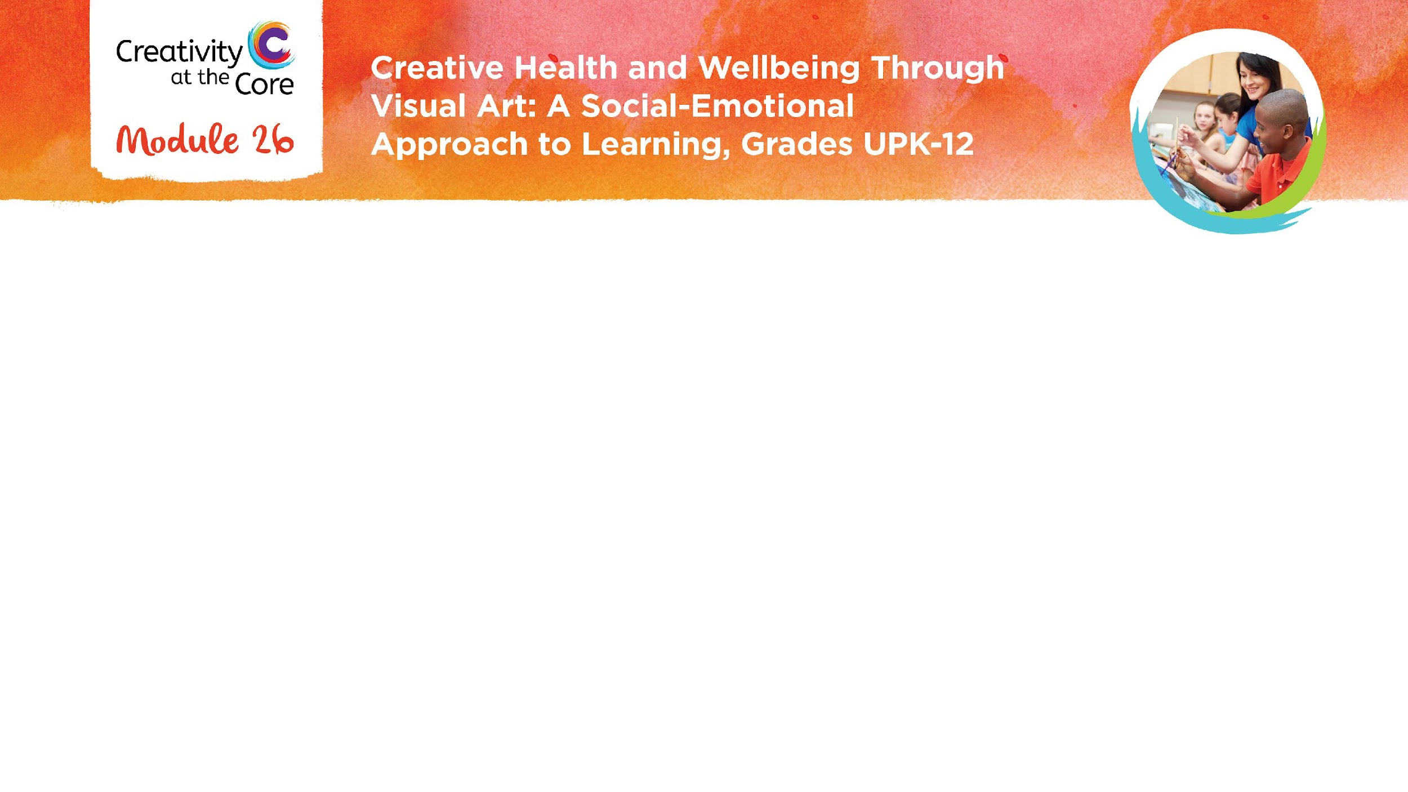
Closing Slide

