Slide 1
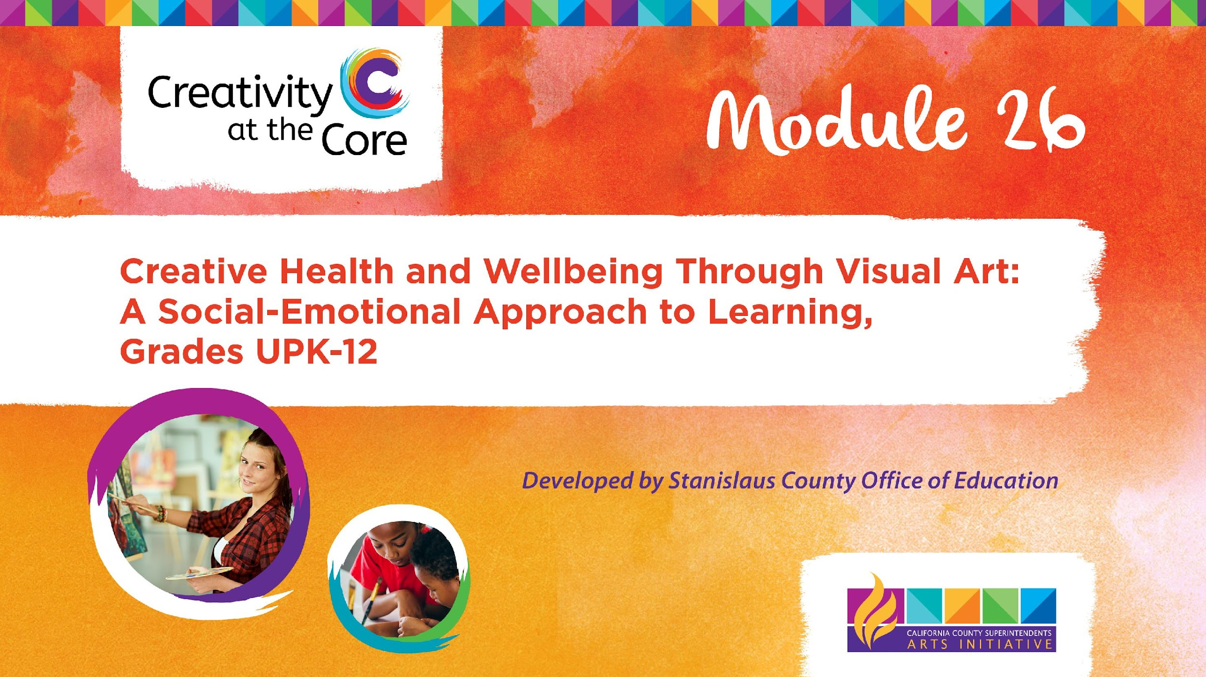
Grades 6 – 8 Project: Fragmented Icons

Slide 2
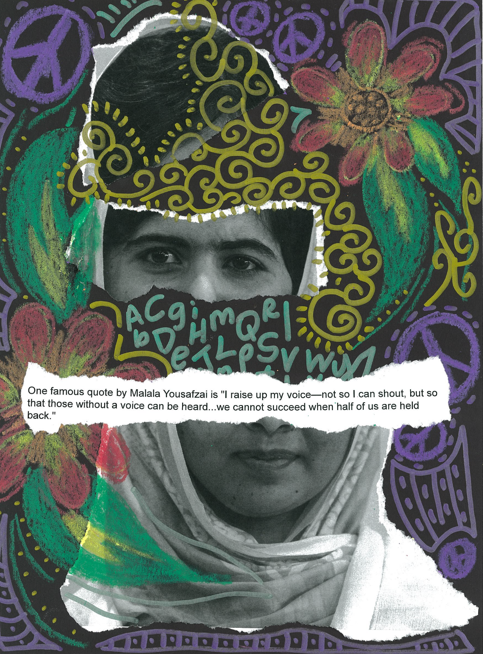
Grades 6 – 8 Project: Fragmented Icons
Learning Outcomes
Create a torn-paper collage about a person you admire.

Slide 3
Grades 6 – 8 Project: Fragmented Icons
SEL Core Competencies Addressed
Self-Awareness
Self-Management
Social Awareness
Visual Art Standards
6.VA:Cr2.1 - Demonstrate openness in trying new ideas, materials, methods, and approaches in making works of art and design.
7.VA:Cr2.1 - Demonstrate persistence in developing skills with various materials, methods, and approaches in creating works of art or design.
8.VA:Cr2.1 - Demonstrate willingness to experiment, innovate, and take risks to pursue ideas, forms, and meanings that emerge in the process of artmaking or designing.

Slide 4
Grades 6-8 Project: Fragmented Icons
Materials Needed
9 x 12 inch black paper
8.5 x 11 inch copy paper
Glue sticks
Items that mark well on dark paper:
Metallic markers
Construction paper crayons
Gel pens
Gel crayons

Slide 5
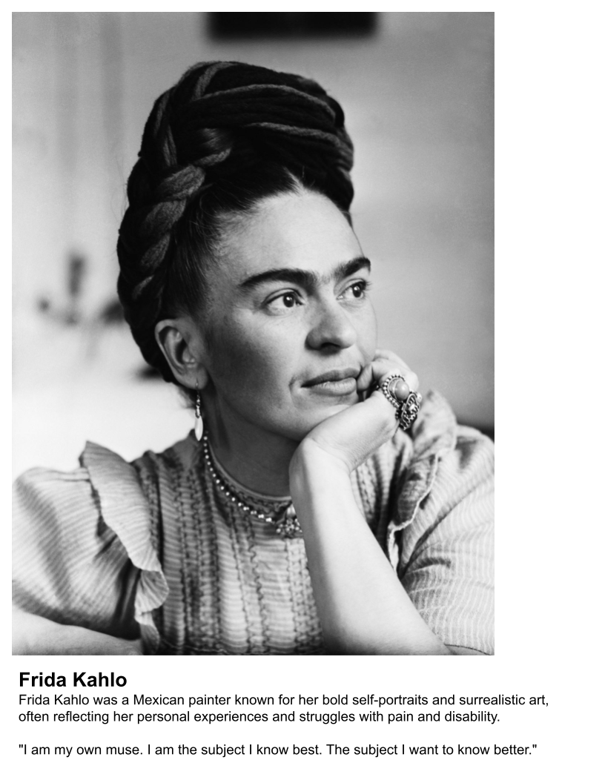
Prepping for Studio Time
Survey your students to see who they would like for their icon collages to be about.
Find images of the icons and place them into an 8.5 x 11 inch format.
As you have time - place the name of the icon on the sheet along with a two-three sentence bio about the icon and a quote by the icon.
Example of an icon sheet that will be provided to a student for artmaking.

Slide 6
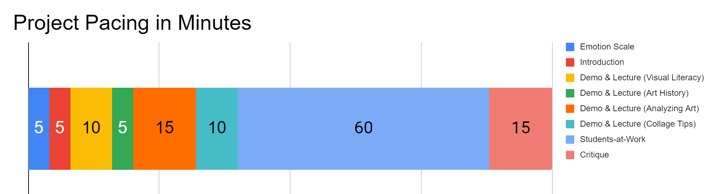
Project Pacing
Pacing structure follows the guidance of the Studio Habits of Mind framework.

Slide 7
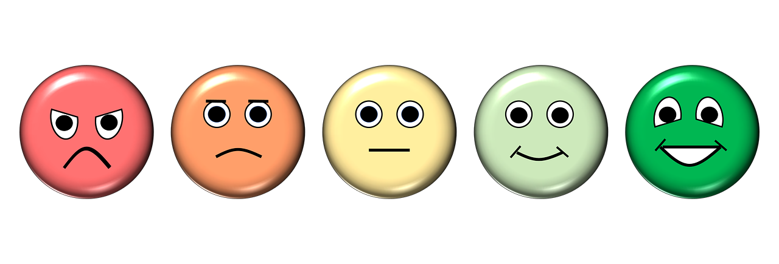
How are you feeling right now?
Notes:
https://pixabay.com/illustrations/emotion-scale-emoji-icon-feedback-3404484/

Slide 8
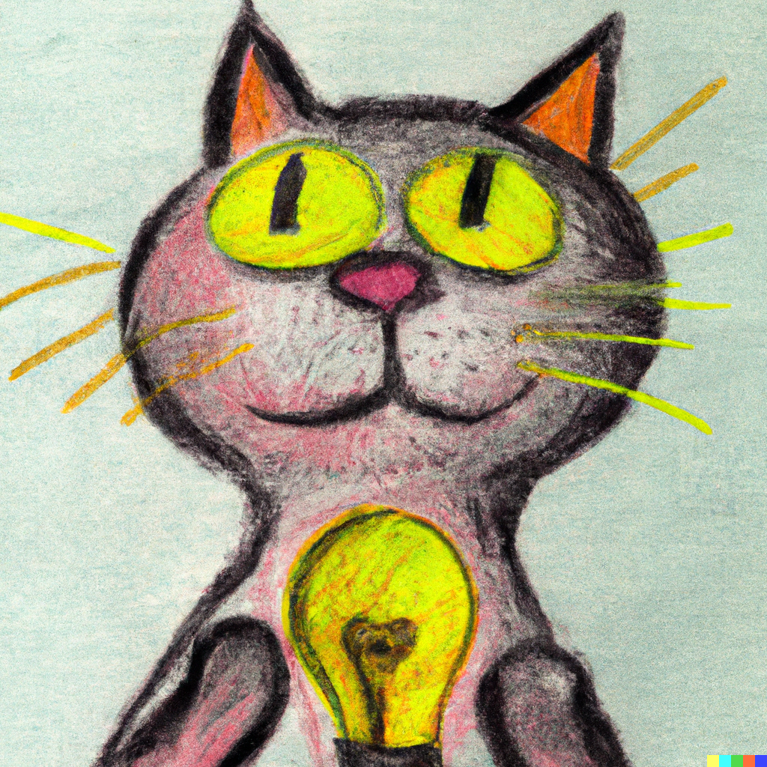
Introduction
Goals for this creative experience:
Be present not perfect
Use positive language to talk about what you and others create
Feel better than when you started
Notes:
Artwork generated in Dall-E AI based on a prompt by Amy Bultena

Slide 9
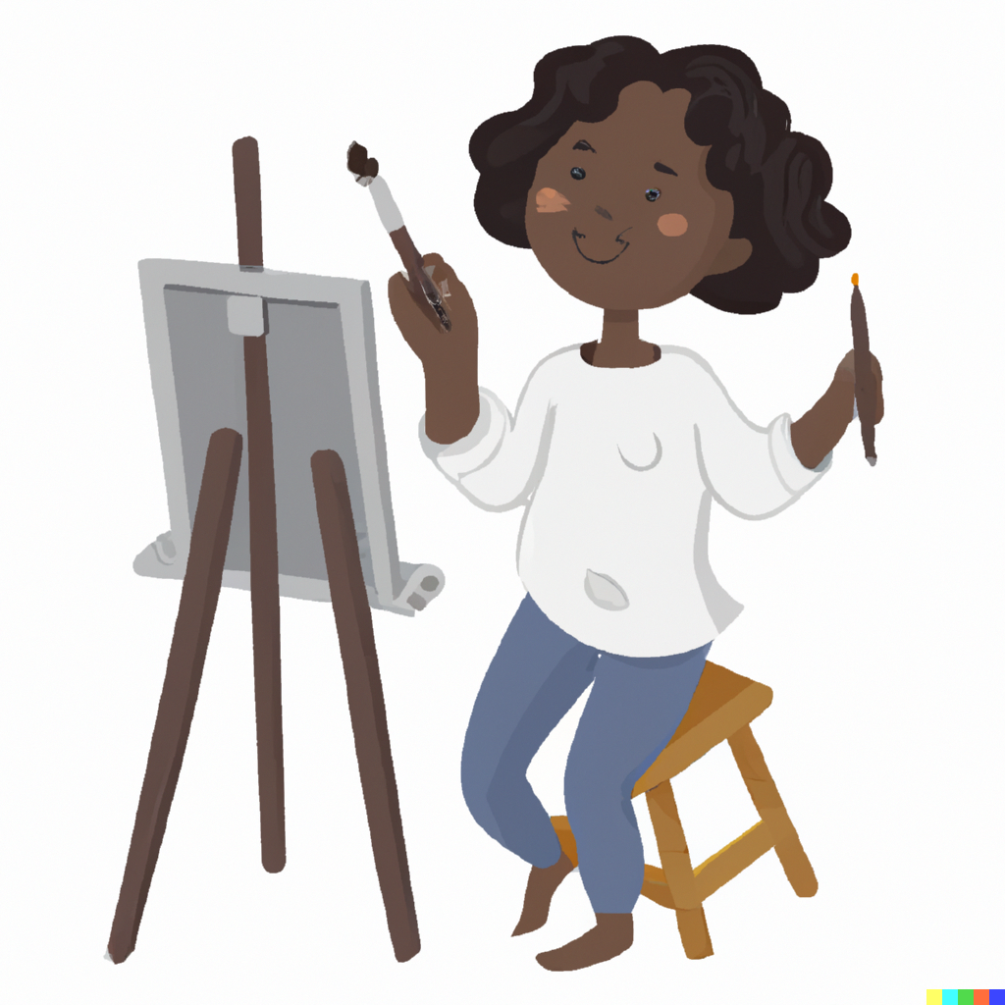
Introduction
It’s science!
Did you know that art is scientifically proven to make us feel better?
Notes:
Artwork generated in Dall-E AI based on a prompt by Amy Bultena

Slide 10
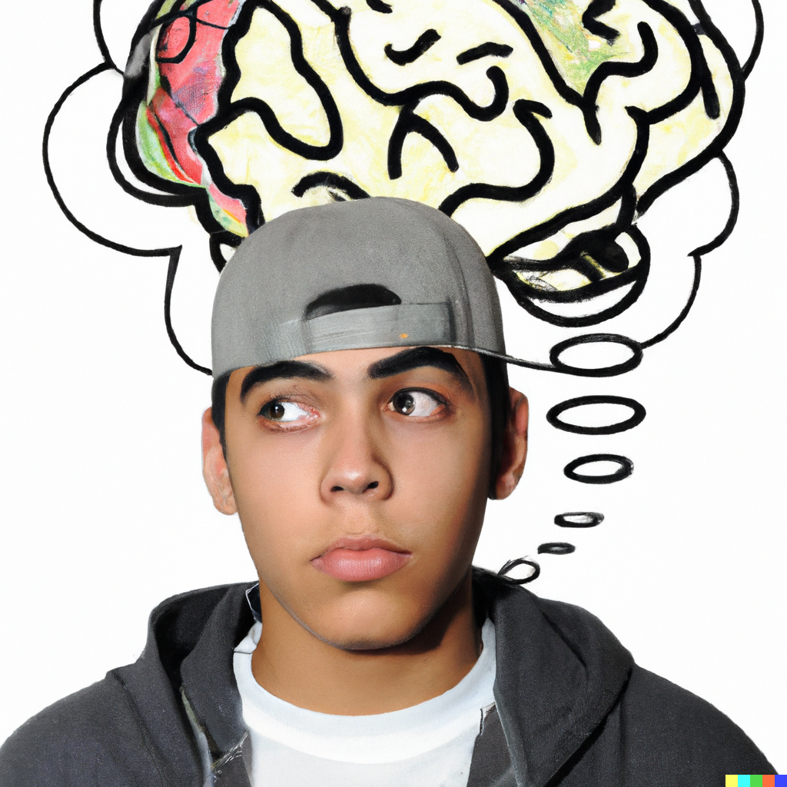
Introduction
We are going to create art to help us:
Feel better
Think about ourselves
Notes:
Artwork generated in Dall-E AI based on a prompt by Amy Bultena

Slide 11
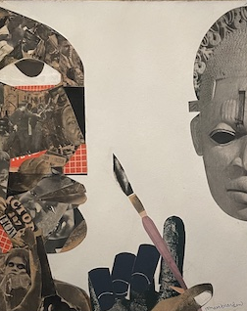
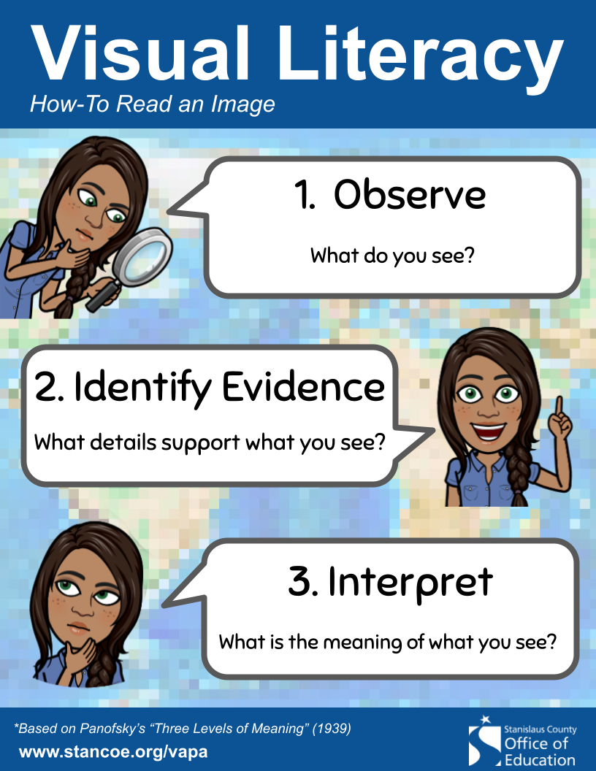
Demo & Lecture: Visual Literacy
Notes:
https://en.wikipedia.org/wiki/Romare_Bearden#/media/File:The_Black_American_in_Search_of_His_Identity_1969_Romare_Bearden.jpg

Slide 12
Demo & Lecture: Visual Literacy
The Black American in Search of His Identity, Romare Bearden, 1969
Notes:
https://en.wikipedia.org/wiki/Romare_Bearden#/media/File:The_Black_American_in_Search_of_His_Identity_1969_Romare_Bearden.jpg

Slide 13
Demo & Lecture: Art History
This is an artwork by artist Romare Bearden.
This type of artwork is called a collage.
Collage is a technique where you create a new picture by cutting, tearing, and pasting different materials to a surface make a new image.

Slide 14
Demo & Lecture: Art History
Romare Bearden is an American artist.
He is known for creating collages.
Bearden's collages often portray African American life, history, and culture, telling stories and expressing important messages.
His artworks celebrate the beauty and diversity of his community while also addressing social issues and promoting equality and understanding.

Slide 15
Demo & Lecture: Analyzing Art
Geteiltes Selbst, Annegret Soltau, 2019
Mischa Barton for Bebe, David Adey, 2008
Candy Coated, Derek Gores, 2020
Der Strauß, Hannah Höch, 1965
Frida, Loui Jover, 2018
Sonia Delaunay, Fabian Emmanuel, date unknown
Collages, Kacey Kal, date unknown
Nikola Tesla, Michel Keck, date unknown
Wild Souls, FOG, 2021
Redacted, Kendrick Daye, 2023
Collages, Veerle Symoens, dates unknown
Daughters of Memory Series, Aaron Marin, dates unknown
You Only See Me, Kayla May, 2019
Based on the interests of those in your classroom, choose 1-2 of the following contemporary collages.
Discuss how the artist is telling a story through the imagery used.

Slide 16
Project Overview
Today, you are going to create a collage about someone you admire; an icon.
Let’s look at some examples.

Slide 17
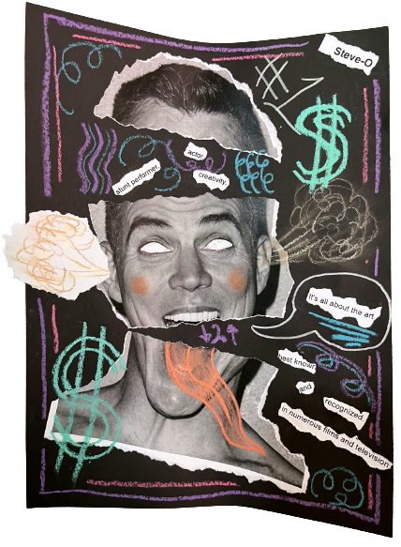
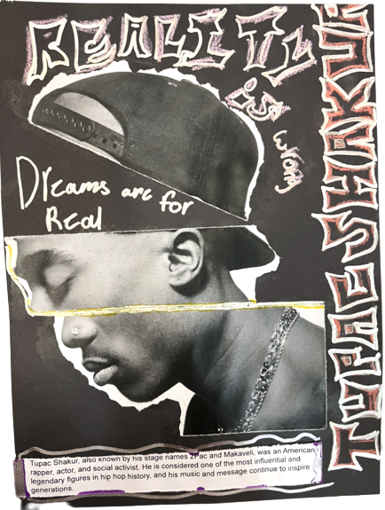
Demo & Lecture: Collage Tips
Notice how the students included imagery that helps to identify their icon.
Remember, it is important to be present; do not worry about being perfect.
Notes:
Artwork Amy Bultena

Slide 18
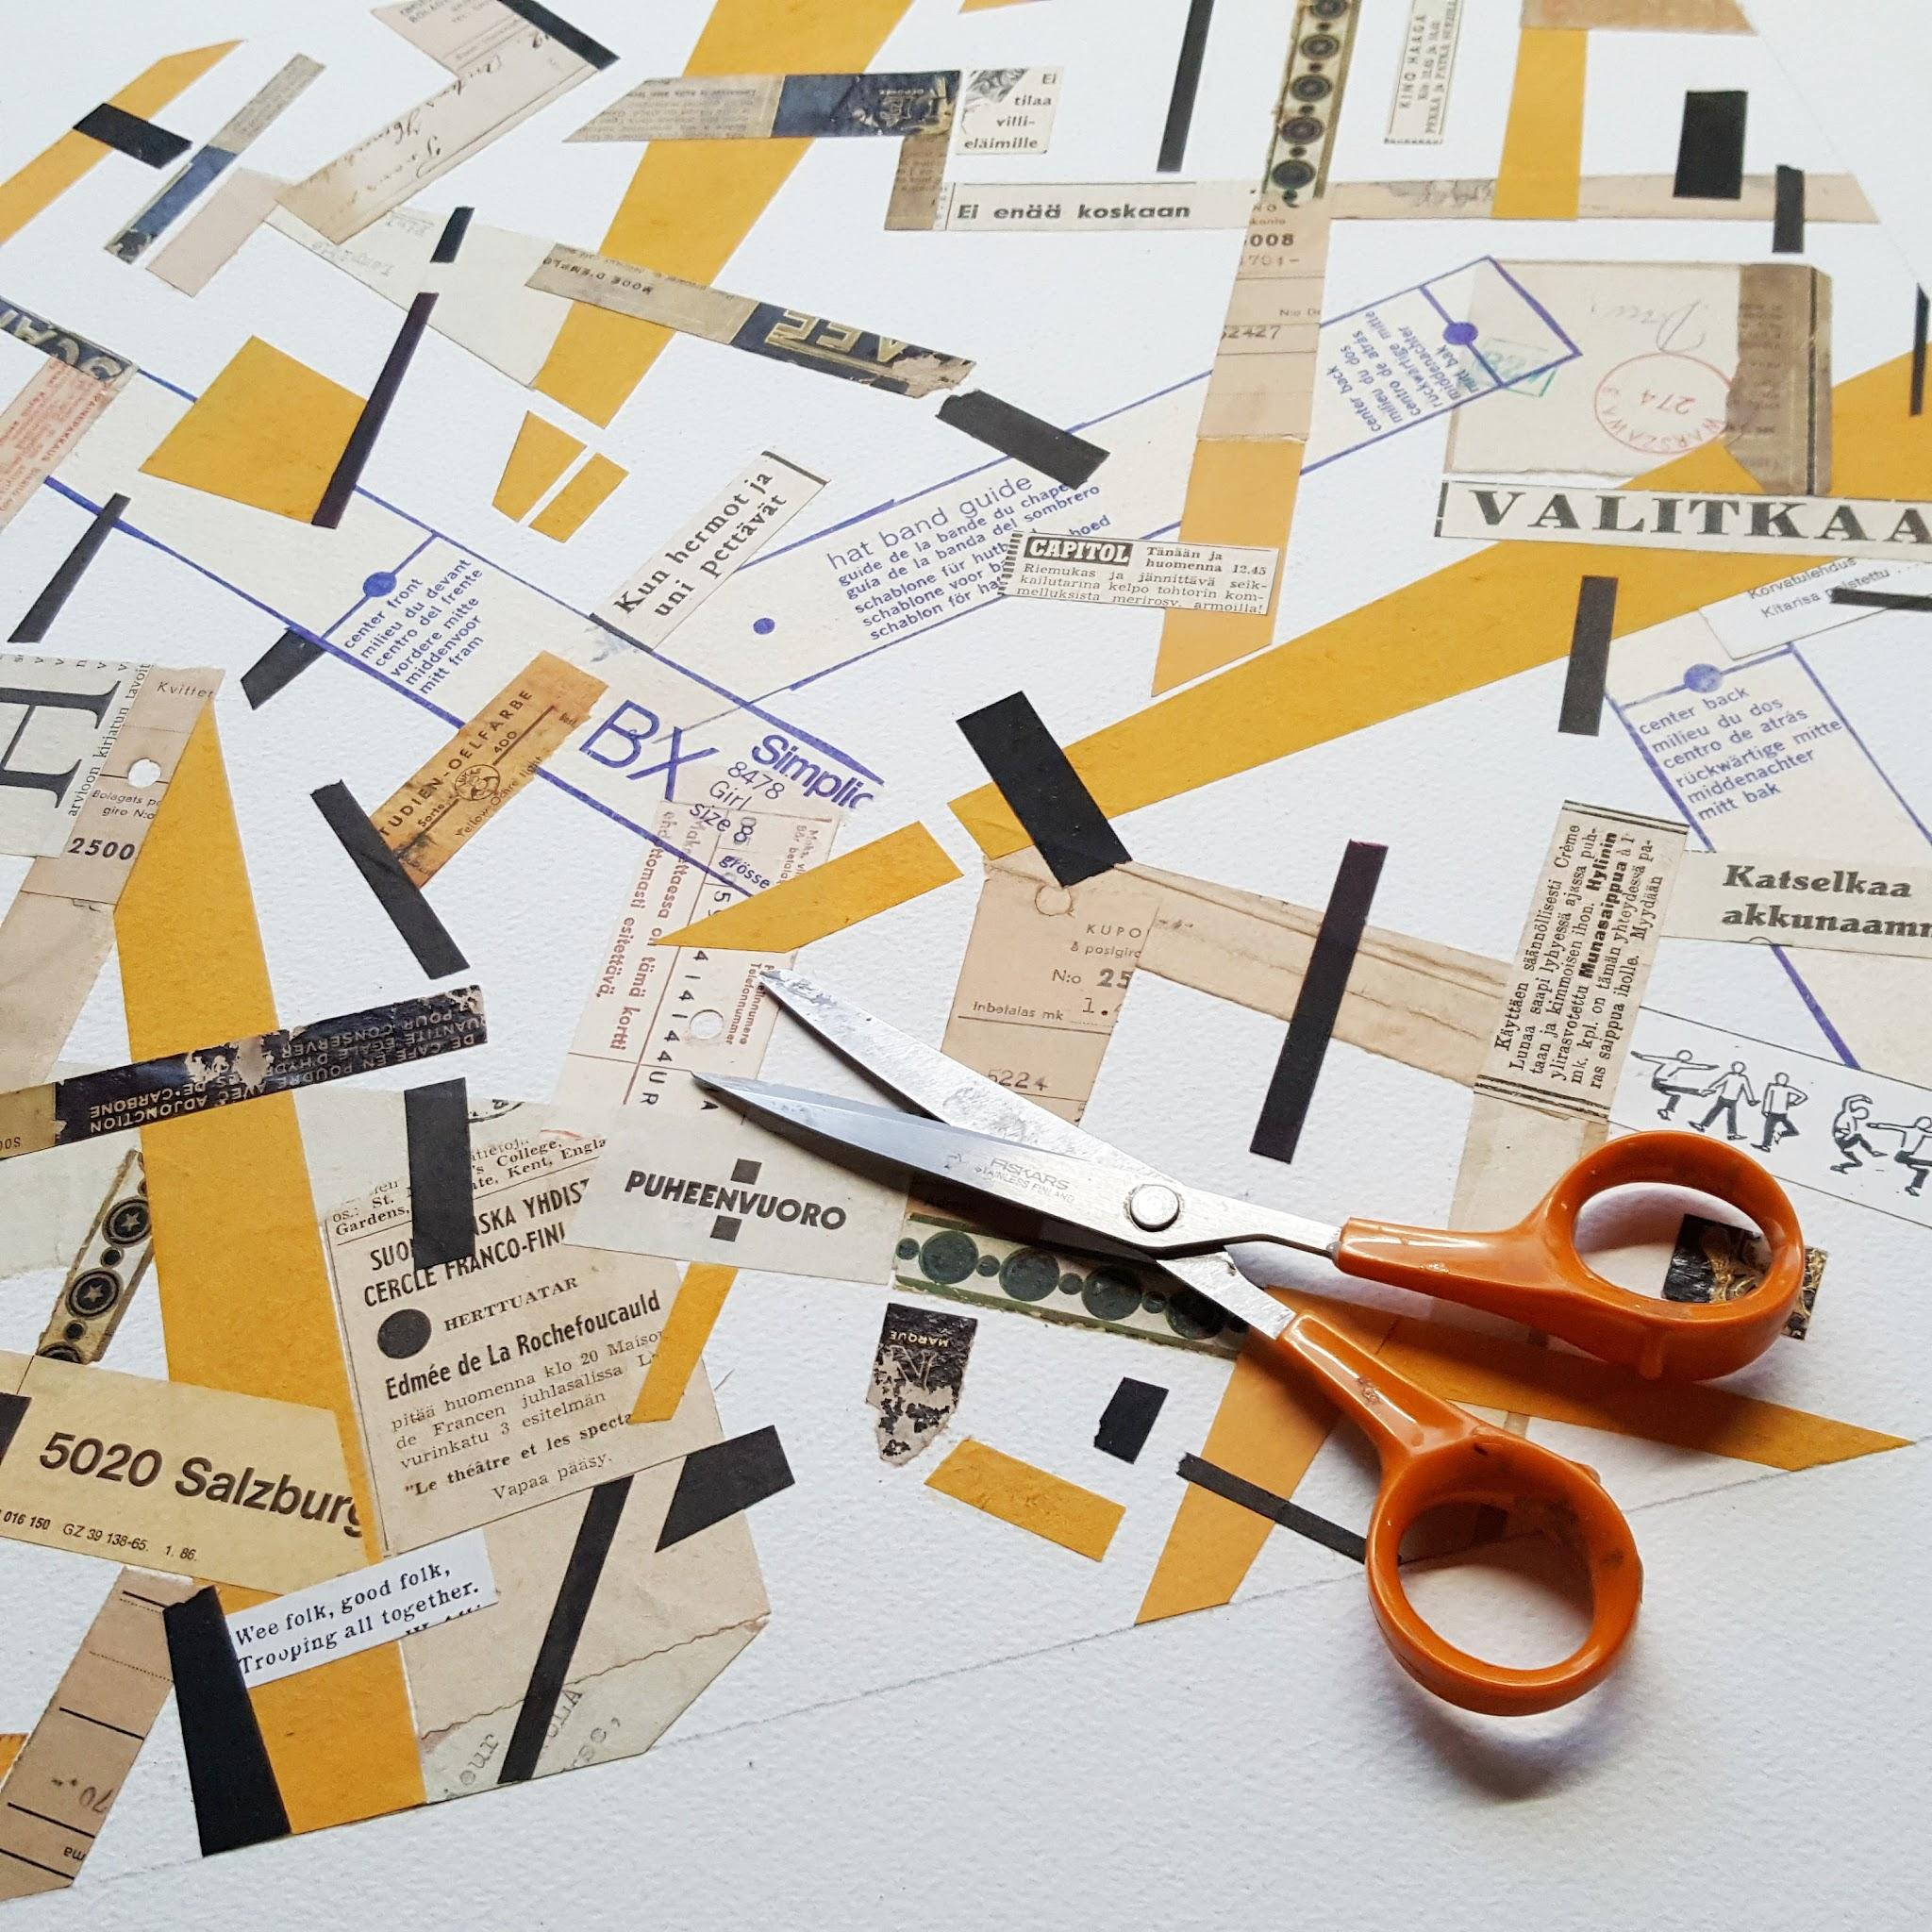
Demo & Lecture: Collage Tips
Cluster items
Overlap items
Create a scene
Mimic or copy items
Arrange items to make a shape
Create a dynamic background
Create different textures
Have elements that pop up
Tear away pieces to reveal items
Combine items in unique arrangements
Outline items
Tear into strips
Notes:
https://commons.wikimedia.org/wiki/File:Making_a_paper_collage.jpg

Slide 19
Students-at-Work: Getting Started
Let’s talk about how to get started with your collage.

Slide 20
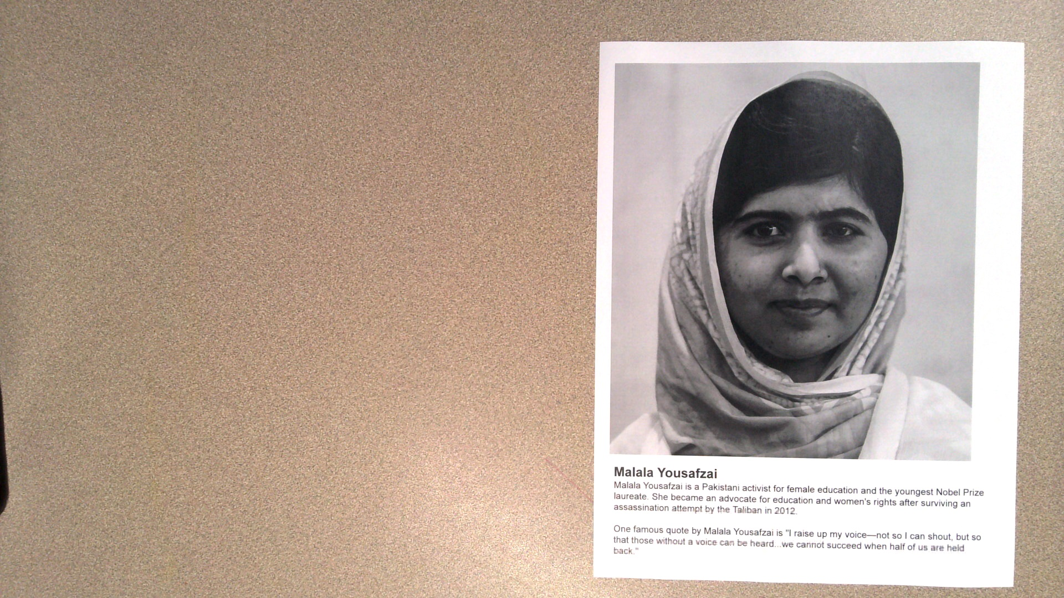
Select an icon.

Slide 21
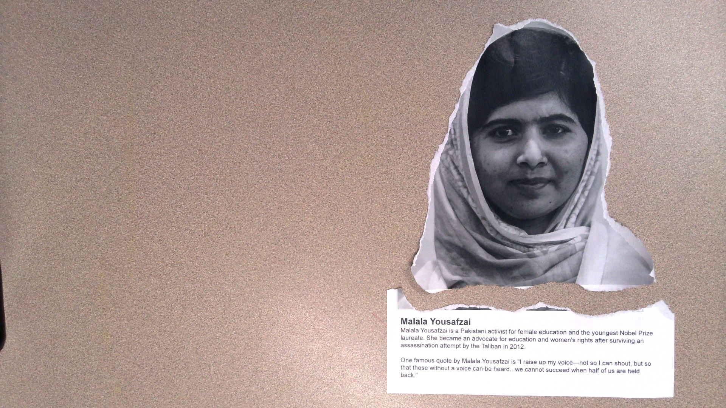
Gently and slowly tear the text away from the portrait.

Slide 22
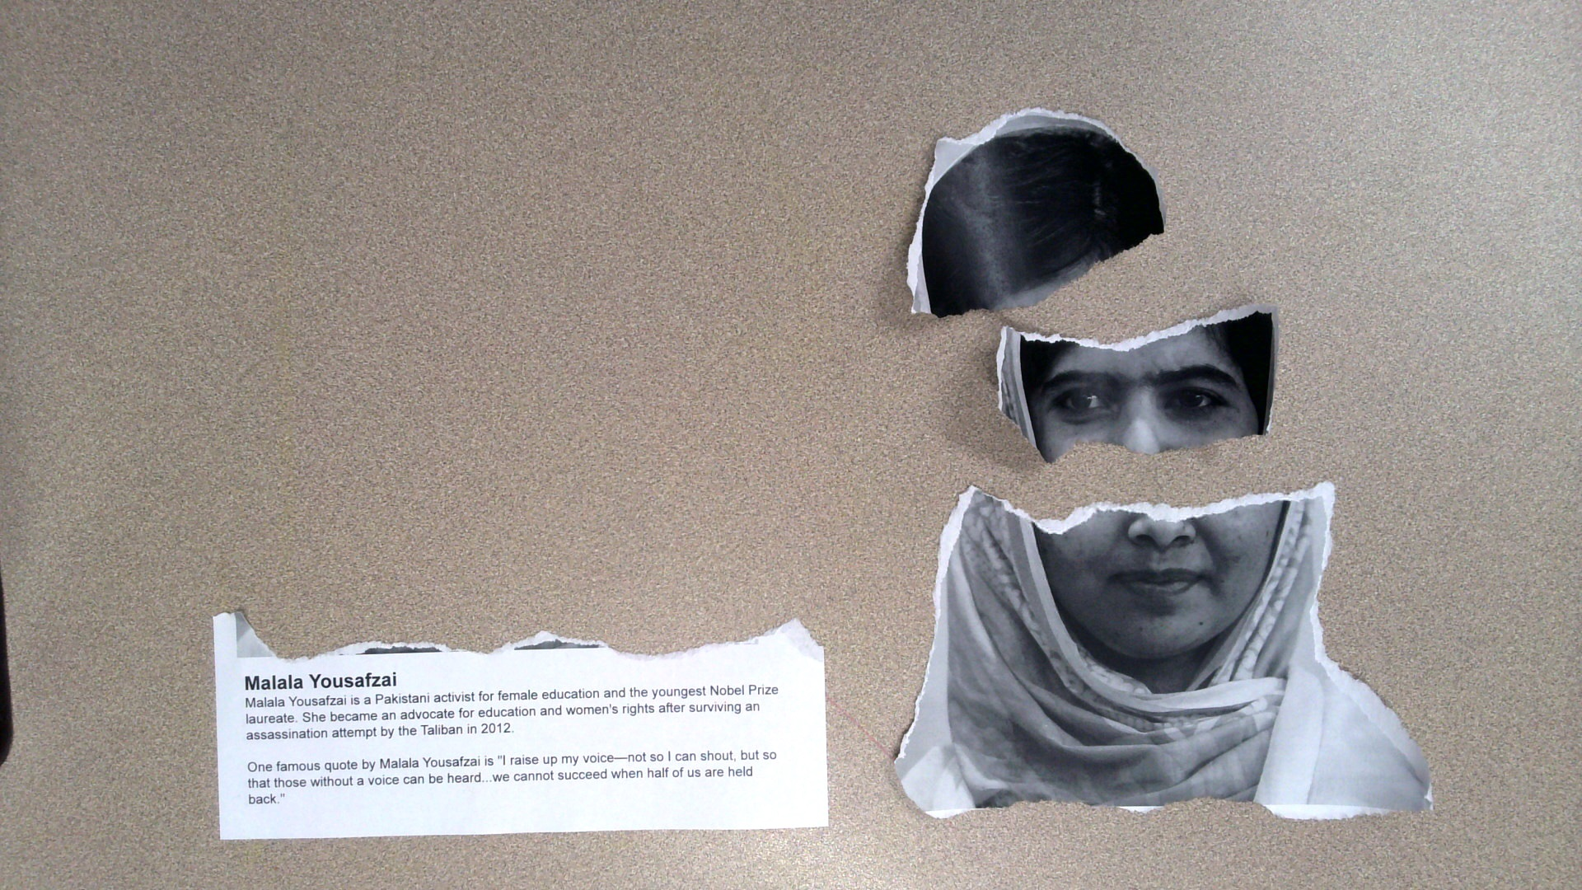
Brainstorm about how you would like to fragment your icon’s face.
How you do this is up to you.

Slide 23
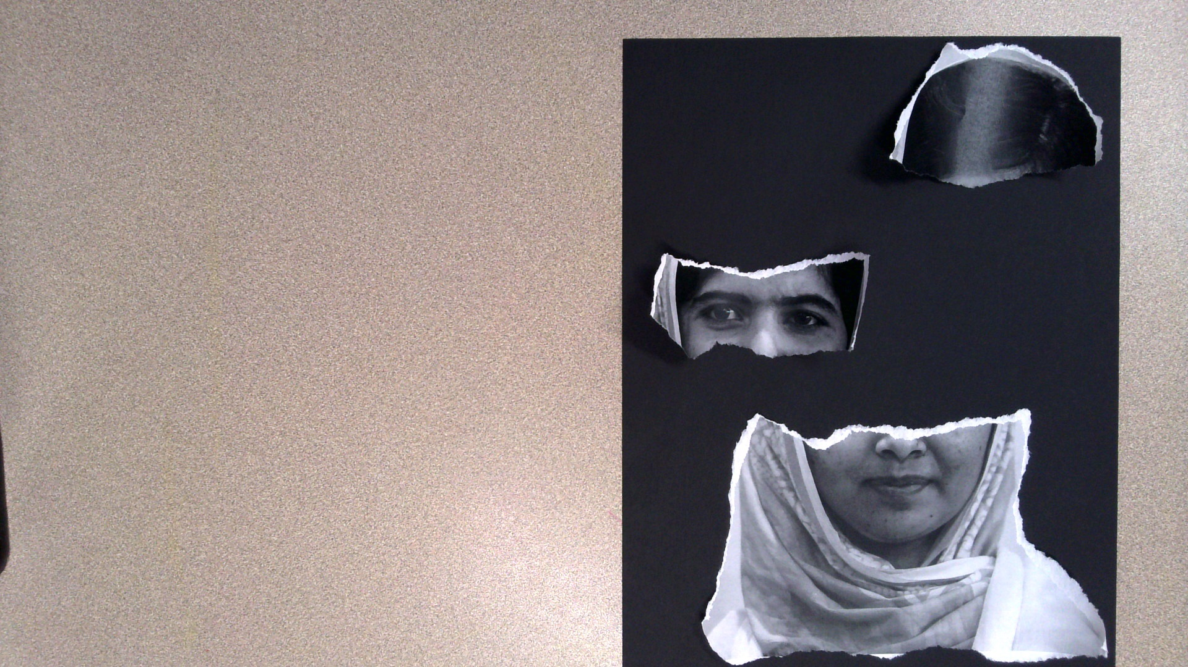
Practice how you would like to arrange the pieces on your black paper.
Your first choice may not be your favorite choice.

Slide 24
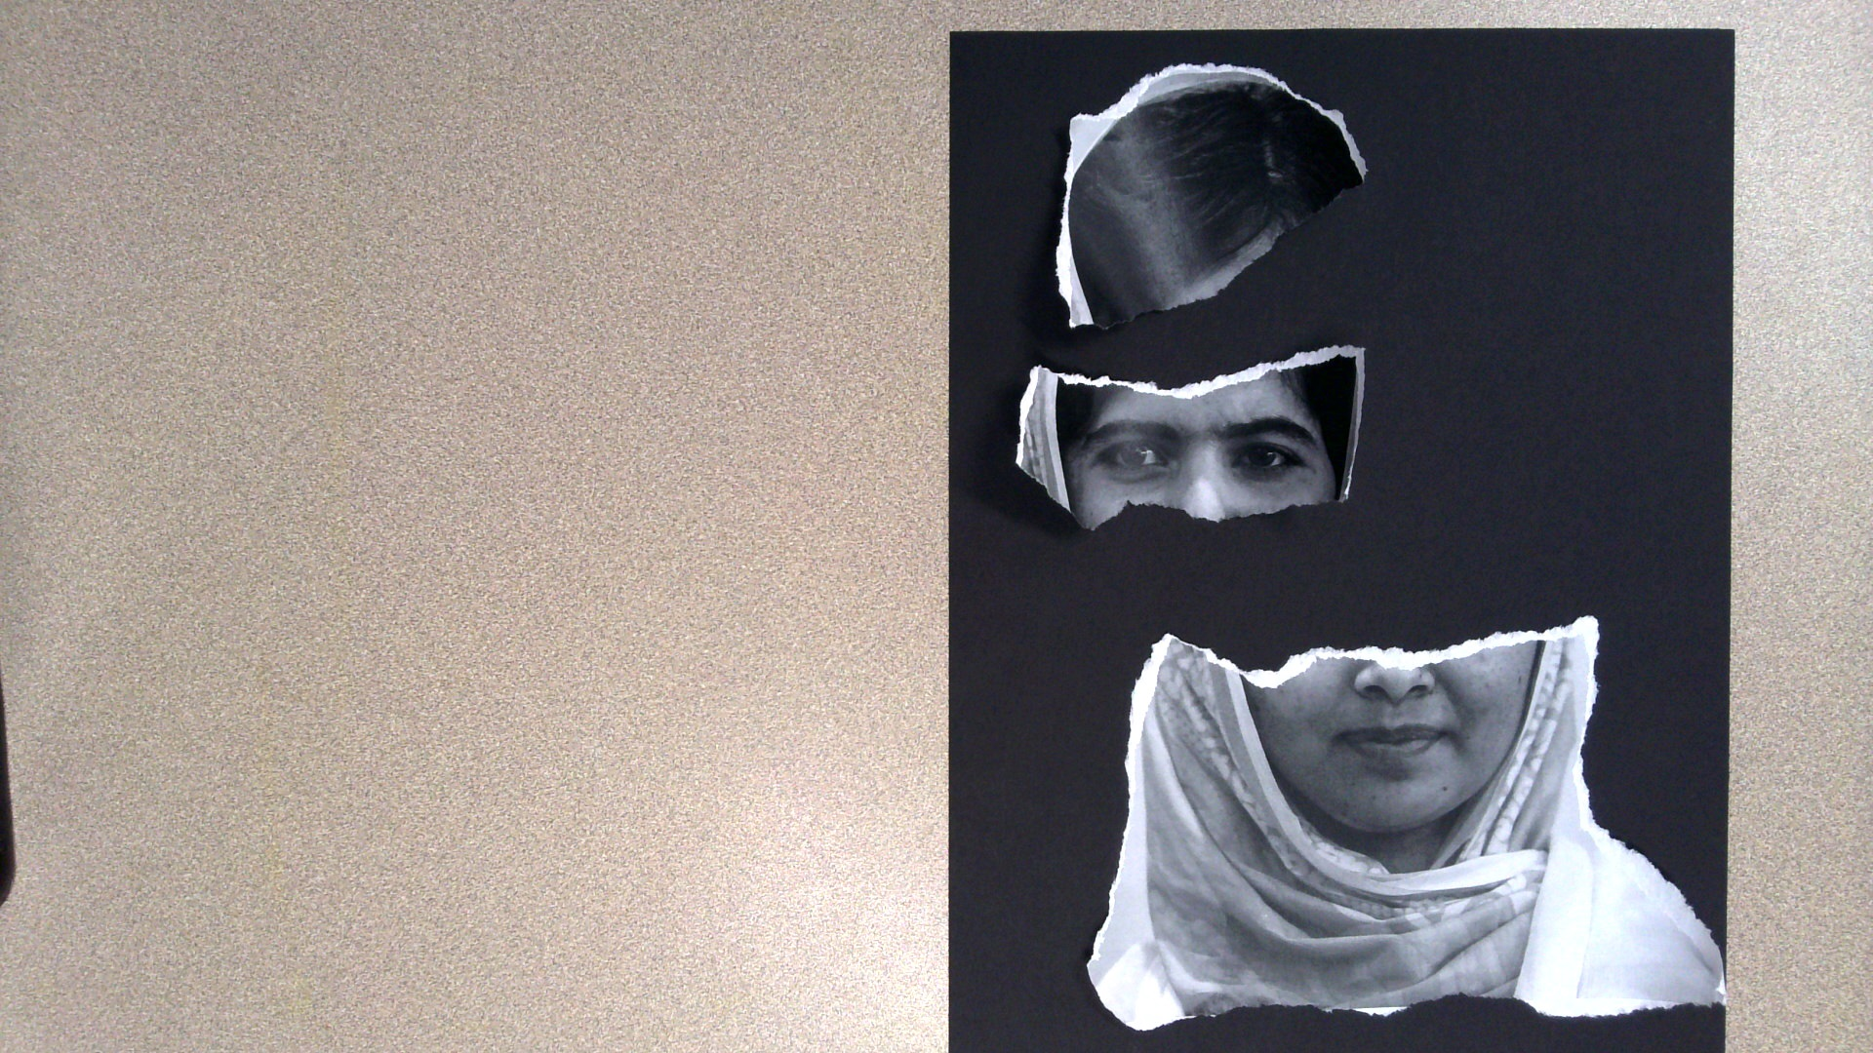
Here I am practicing a second way to arrange my pieces.

Slide 25
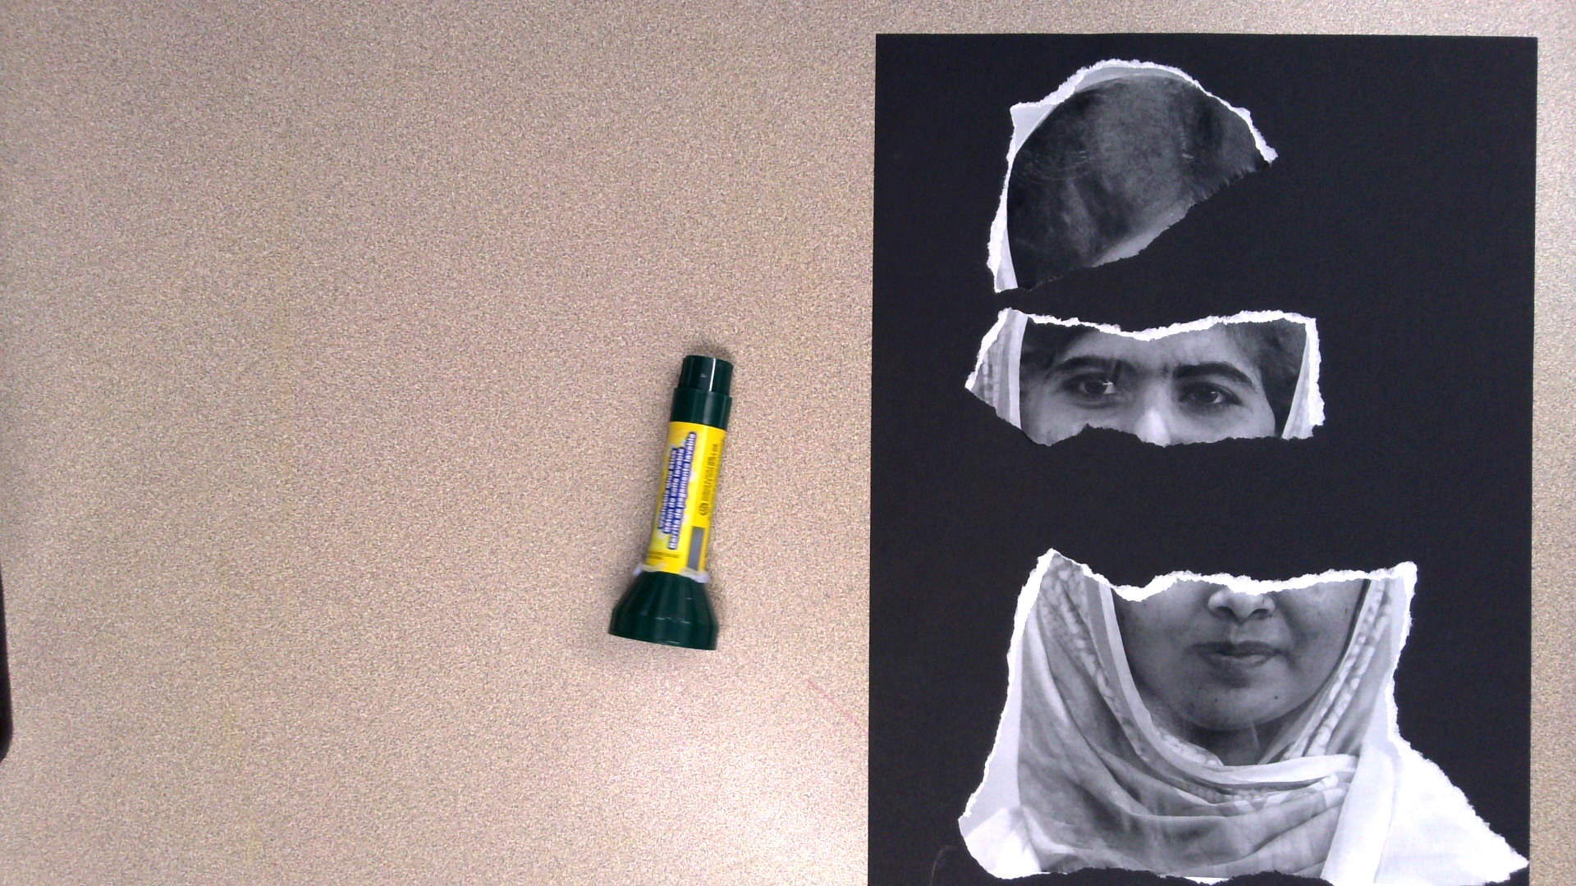
Glue down the icon pieces.

Slide 26
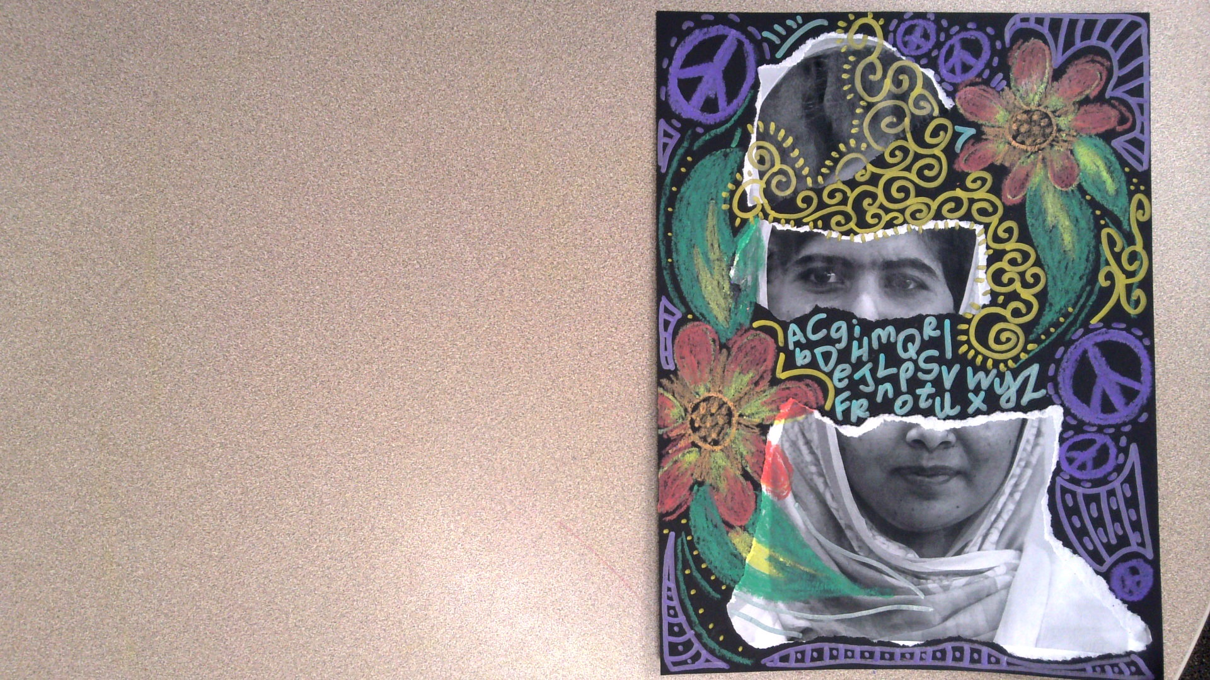
Add designs to your artwork.
Think about what types of colors, shapes, and symbols you want to associate with your icon.

Slide 27
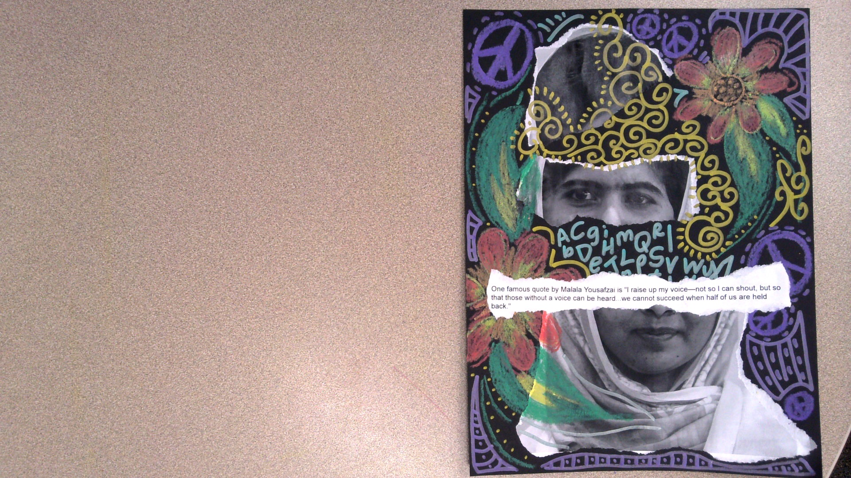
If you would like, add a quote by your icon.
You can write this, or glue down the provided text.

Slide 28
Critique
Look at your artwork. What do you like the most? What do you like the least? What would you change?
Share your artwork with a friend. Discuss why you chose this icon. Explain why you made the artistic choices evident in your work.
Listen as your friend shares about their artwork.

Slide 29
How are you feeling after making your artwork?
Do you feel better, worse, or the same? Why?
Notes:
https://pixabay.com/illustrations/emotion-scale-emoji-icon-feedback-3404484/

Slide 30
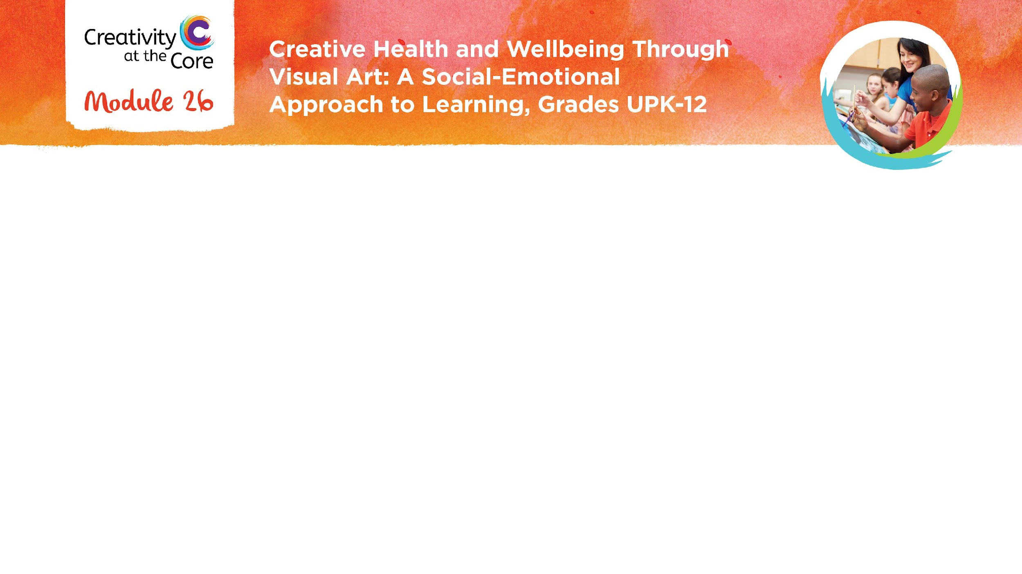
Closing Slide

