Slide 1
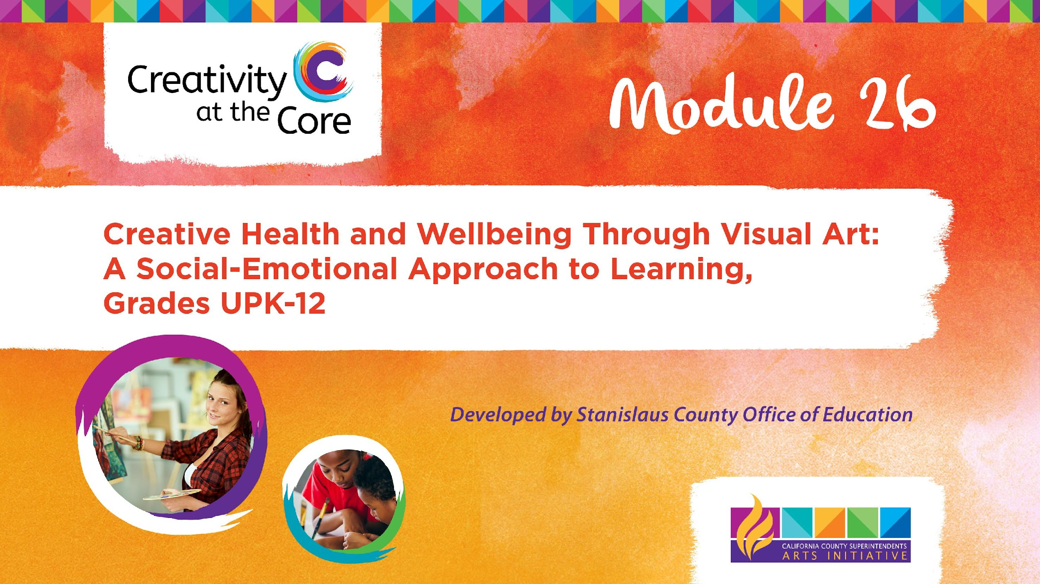
Grades 6 – 8 Project: My Story Mandala​

Slide 2
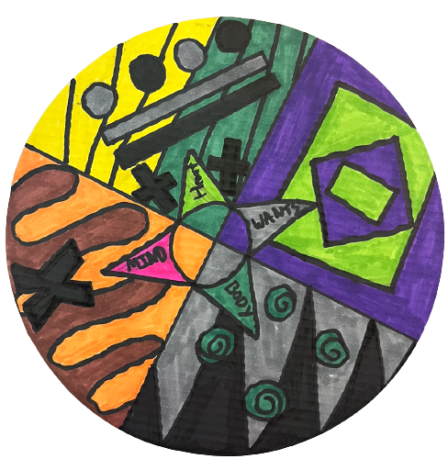
Grades 6 – 8 Project: My Story Mandala
Learning Outcomes
Create a mandala that expresses a story about the self, using only shapes, lines, and color.

Slide 3
Grades 6 – 8 Project: My Story Mandala
SEL Core Competencies Addressed
Self-Awareness
Self-Management
Visual Art Standards
6.VA:Cr2.1 - Demonstrate openness in trying new ideas, materials, methods, and approaches in making works of art and design.
7.VA:Cr2.1 - Demonstrate persistence in developing skills with various materials, methods, and approaches in creating works of art or design.
8.VA:Cr2.1 - Demonstrate willingness to experiment, innovate, and take risks to pursue ideas, forms, and meanings that emerge in the process of artmaking or designing.

Slide 4
Grades 6 – 8 Project: My Story Mandala
Materials Needed
8-inch diameter cardboard cake round (white)
Colored markers (permanent markers preferred)
Rulers (optional)

Slide 5
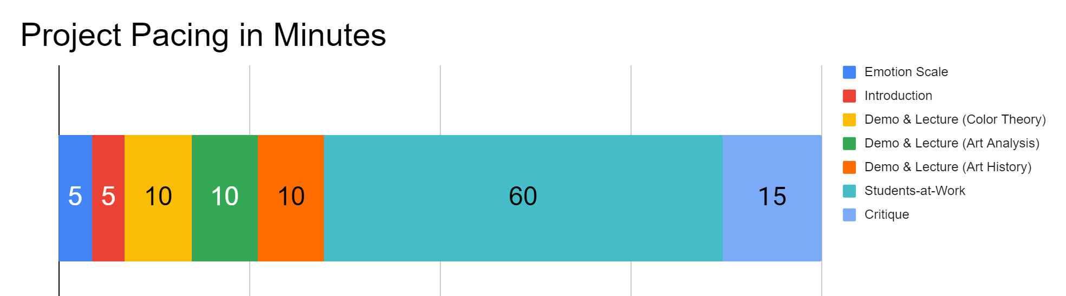
Project Pacing
Pacing structure follows the guidance of the Studio Habits of Mind framework.

Slide 6
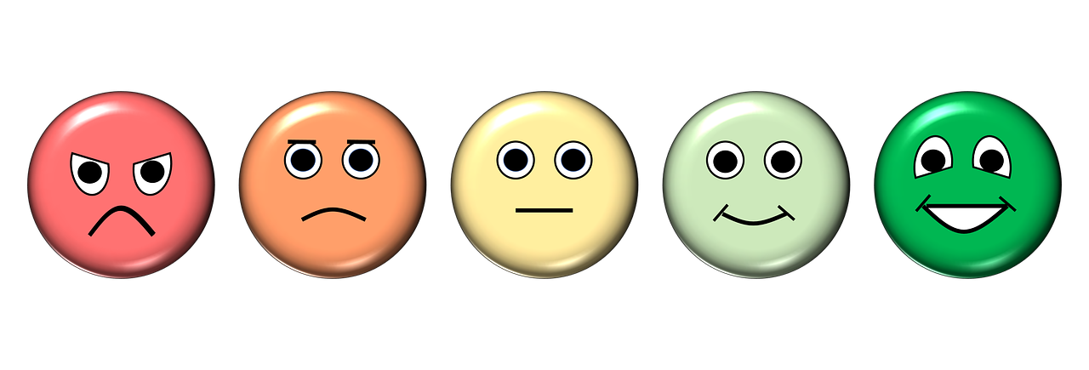
How are you feeling right now?
Notes:
https://pixabay.com/illustrations/emotion-scale-emoji-icon-feedback-3404484/

Slide 7
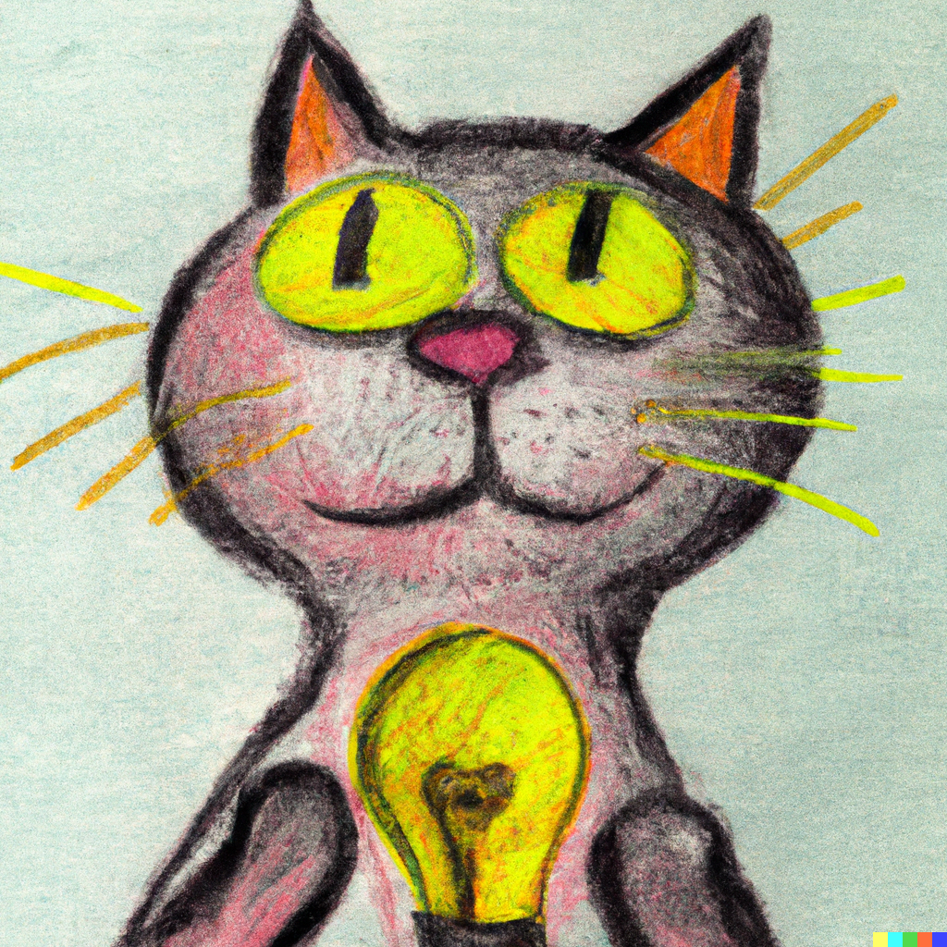
Introduction
Goals for this creative experience:
Be present not perfect
Use positive language to talk about what you and others create
Feel better than when you started
Notes:
artwork generated in Dall-E AI based on a prompt by Amy Bultena

Slide 8
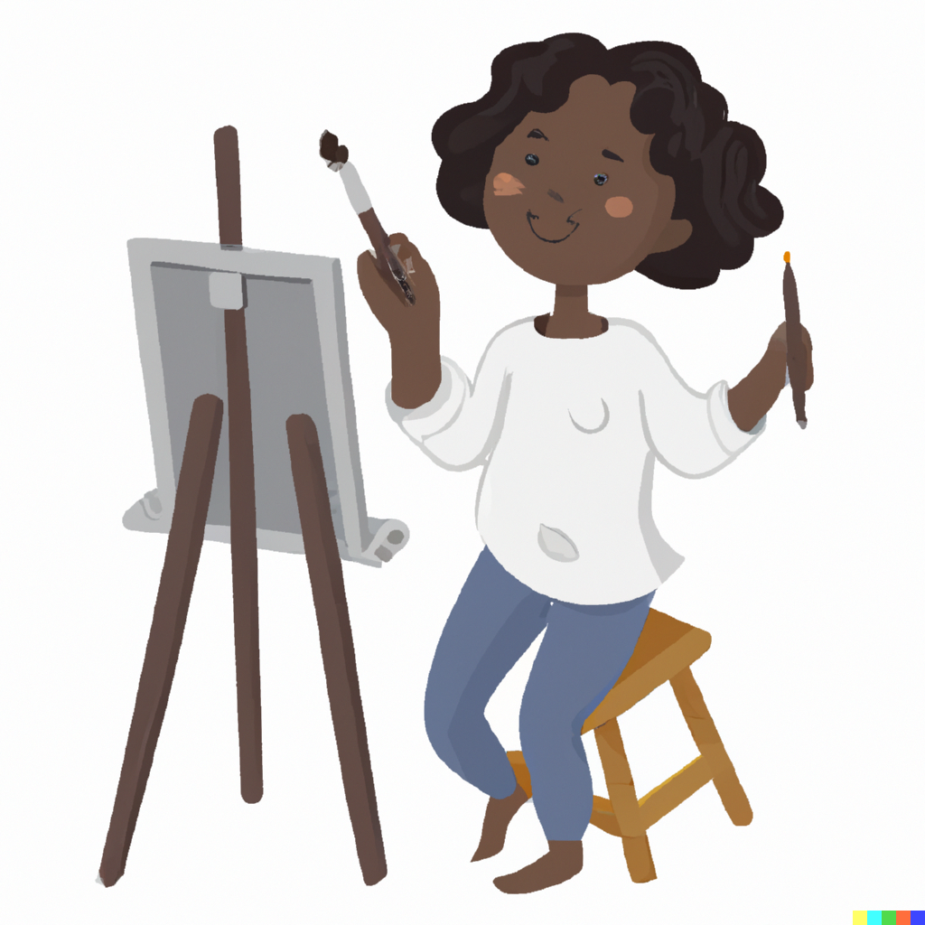
Introduction
It’s science!
Did you know that art is scientifically proven to make us feel better?
Notes:
artwork generated in Dall-E AI based on a prompt by Amy Bultena

Slide 9

Introduction
We are going to create art to help us:
Feel better
Think about ourselves
Notes:
artwork generated in Dall-E AI based on a prompt by Amy Bultena

Slide 10
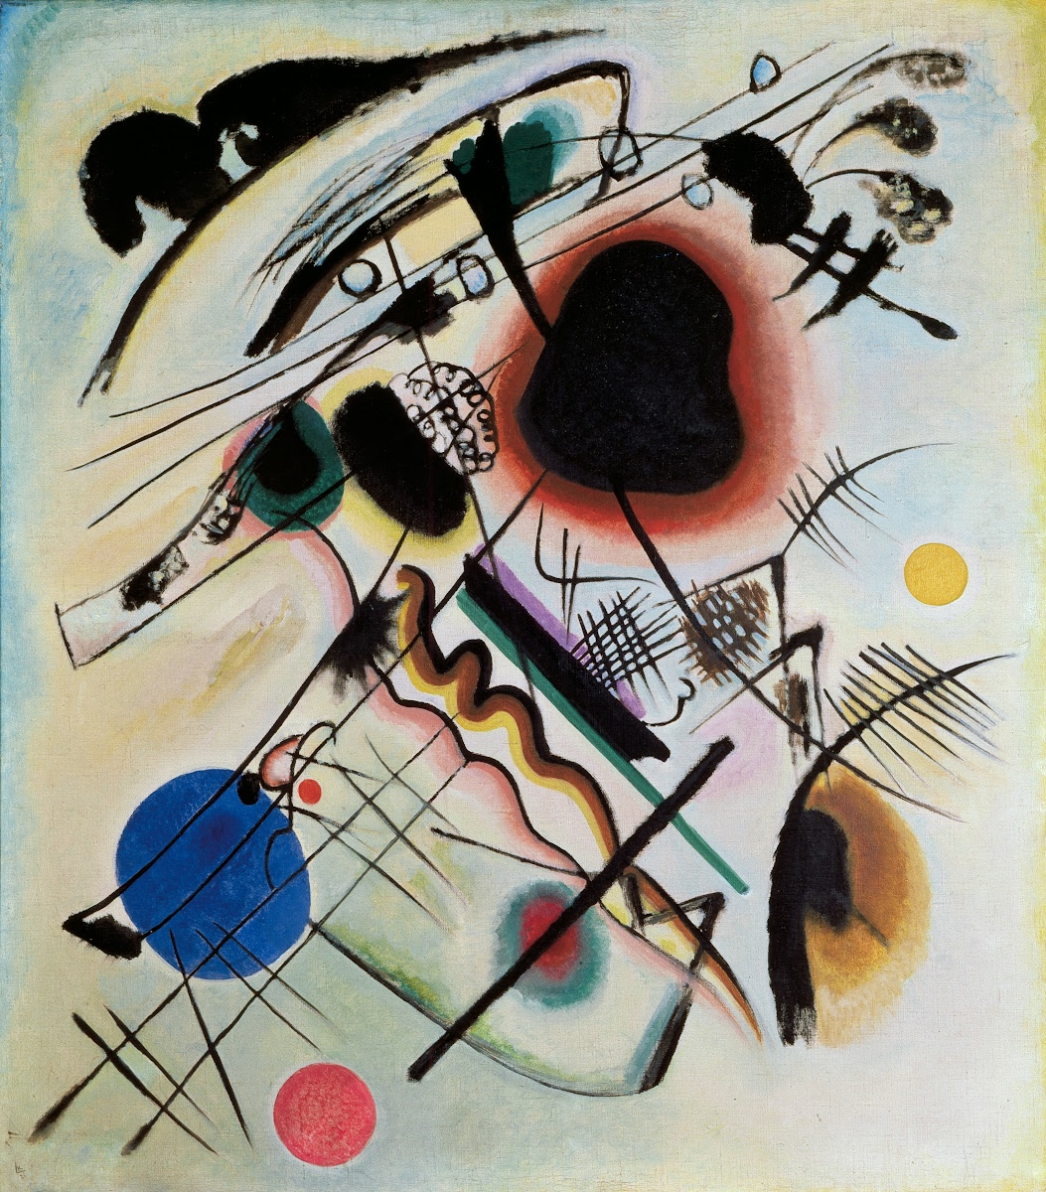
Demo & Lecture: Color Theory
Art often shares emotions.
Artists tell stories using colors, shapes, and lines.
Colors, shapes, and lines can share emotions.
Black Spot
Wassily Kandinsky
1921
Notes:
https://artsandculture.google.com/asset/black-spot-wassily-kandinsky/6AGAlOL7ZY7W0Q?hl=en

Slide 11
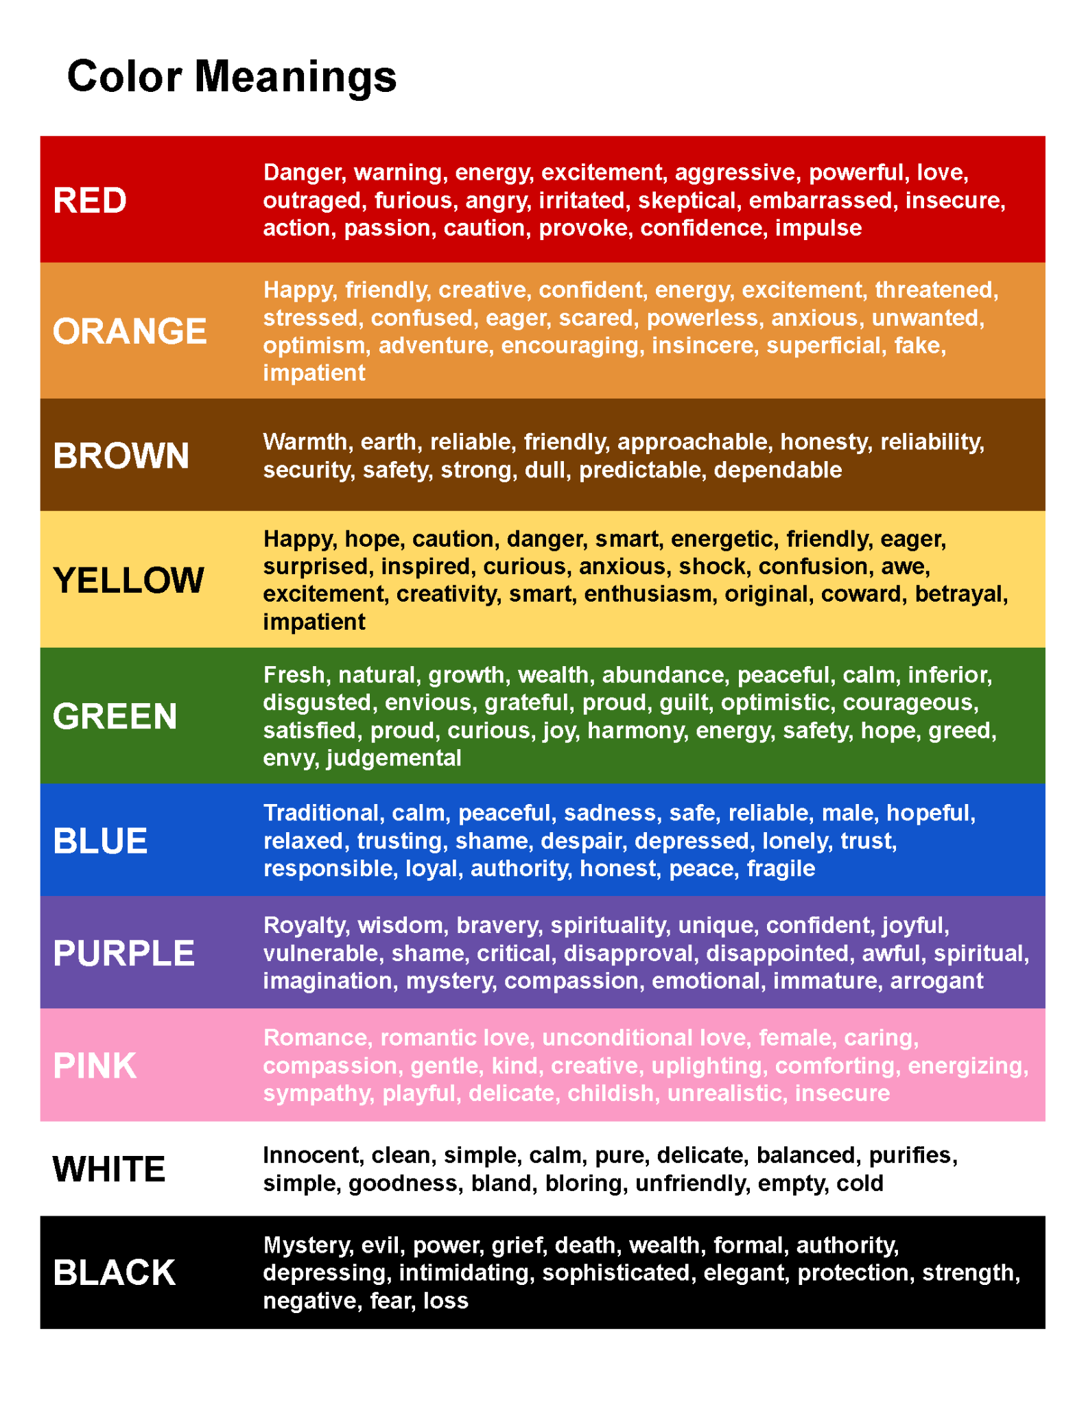

Slide 13
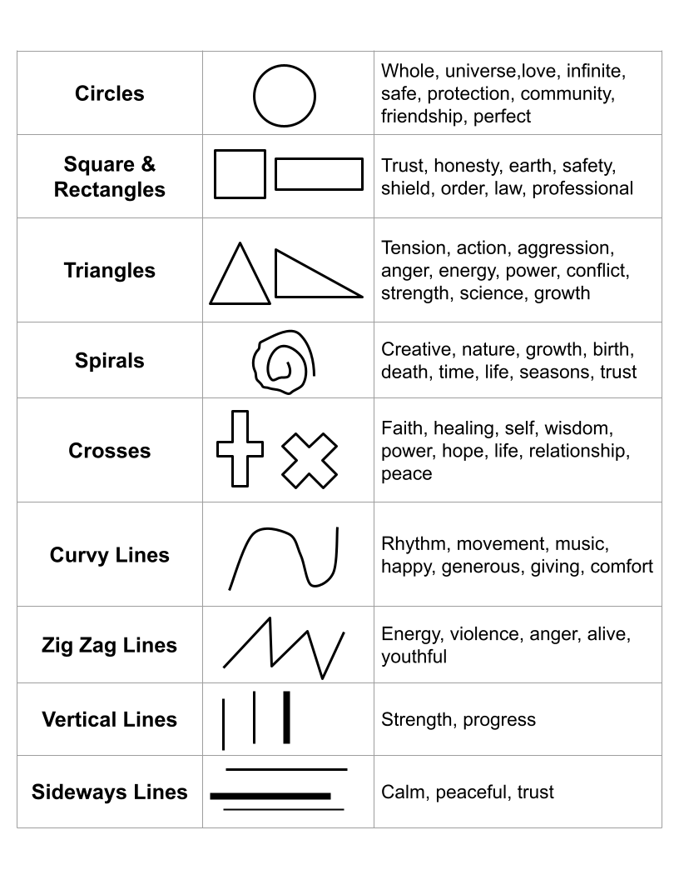

Slide 15
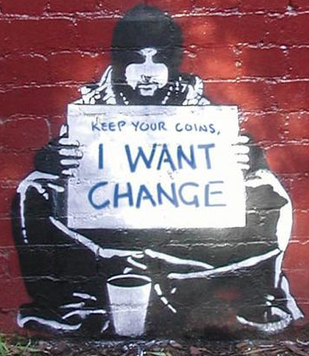
Demo & Lecture: Analyzing Art
This is a very famous piece of graffiti by the artist Banksy.
How does Banksy use colors to tell a story?

Slide 16
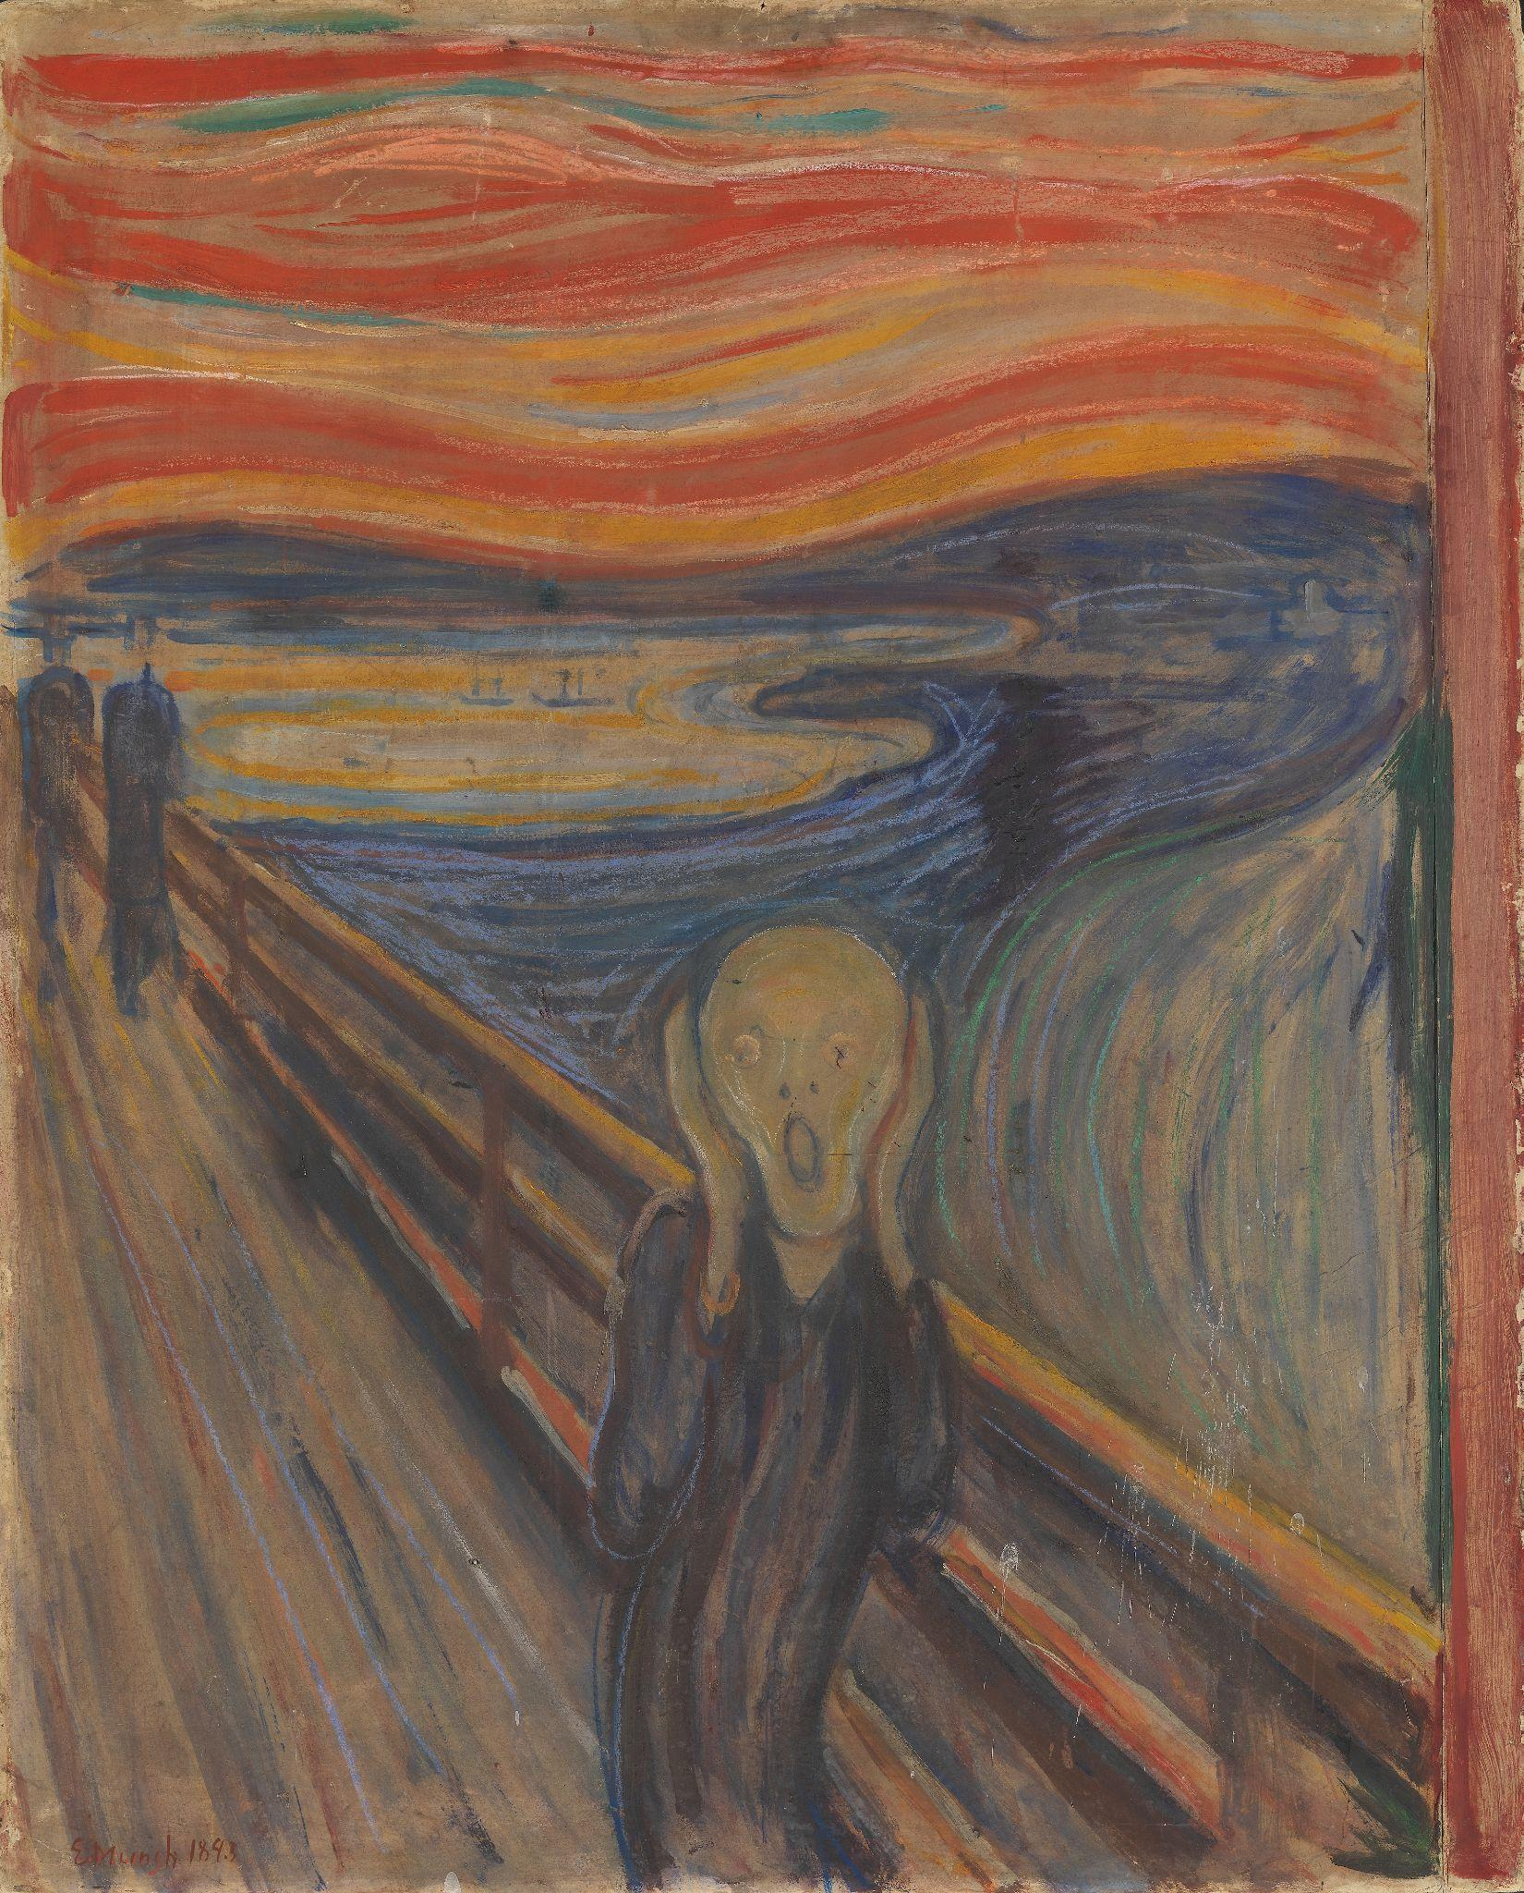
Demo & Lecture: Analyzing Art
This is a painting by artist Edvard Munch
How is Edvard using colors and lines to tell a story?
Notes:
https://upload.wikimedia.org/wikipedia/commons/c/c5/Edvard_Munch%2C_1893%2C_The_Scream%2C_oil%2C_tempera_and_pastel_on_cardboard%2C_91_x_73_cm%2C_National_Gallery_of_Norway.jpg

Slide 17
Demo & Lecture: Analyzing Art
Wake Up, Elizabeth Murray, 1981
Talking with Coatlicue, Eamon Ore Giron, 2017
Build Me a Platform, High in the Trees, Nathalie Miebach, 2017
And Now I See You, Samantha Keely Smith, 2023
Fresca y Atrevida (Bold and Outspoken), Liz Flores, 2022
Chadwick Boseman, Victoria Villasana, 2020
Feel, Jason Limon, 2022
Red Bandana on Green Suit, Kwame Kye Quaicoe, 2020
Our Colour, Liz West, 2016
Portrait with a Lemon Yellow Outline, Agnes Grochulska, 2020
Based on the interests of those in your classroom, choose 1-2 of the following contemporary artworks.
Discuss how you think the artist is using lines and colors to tell a story.

Slide 18
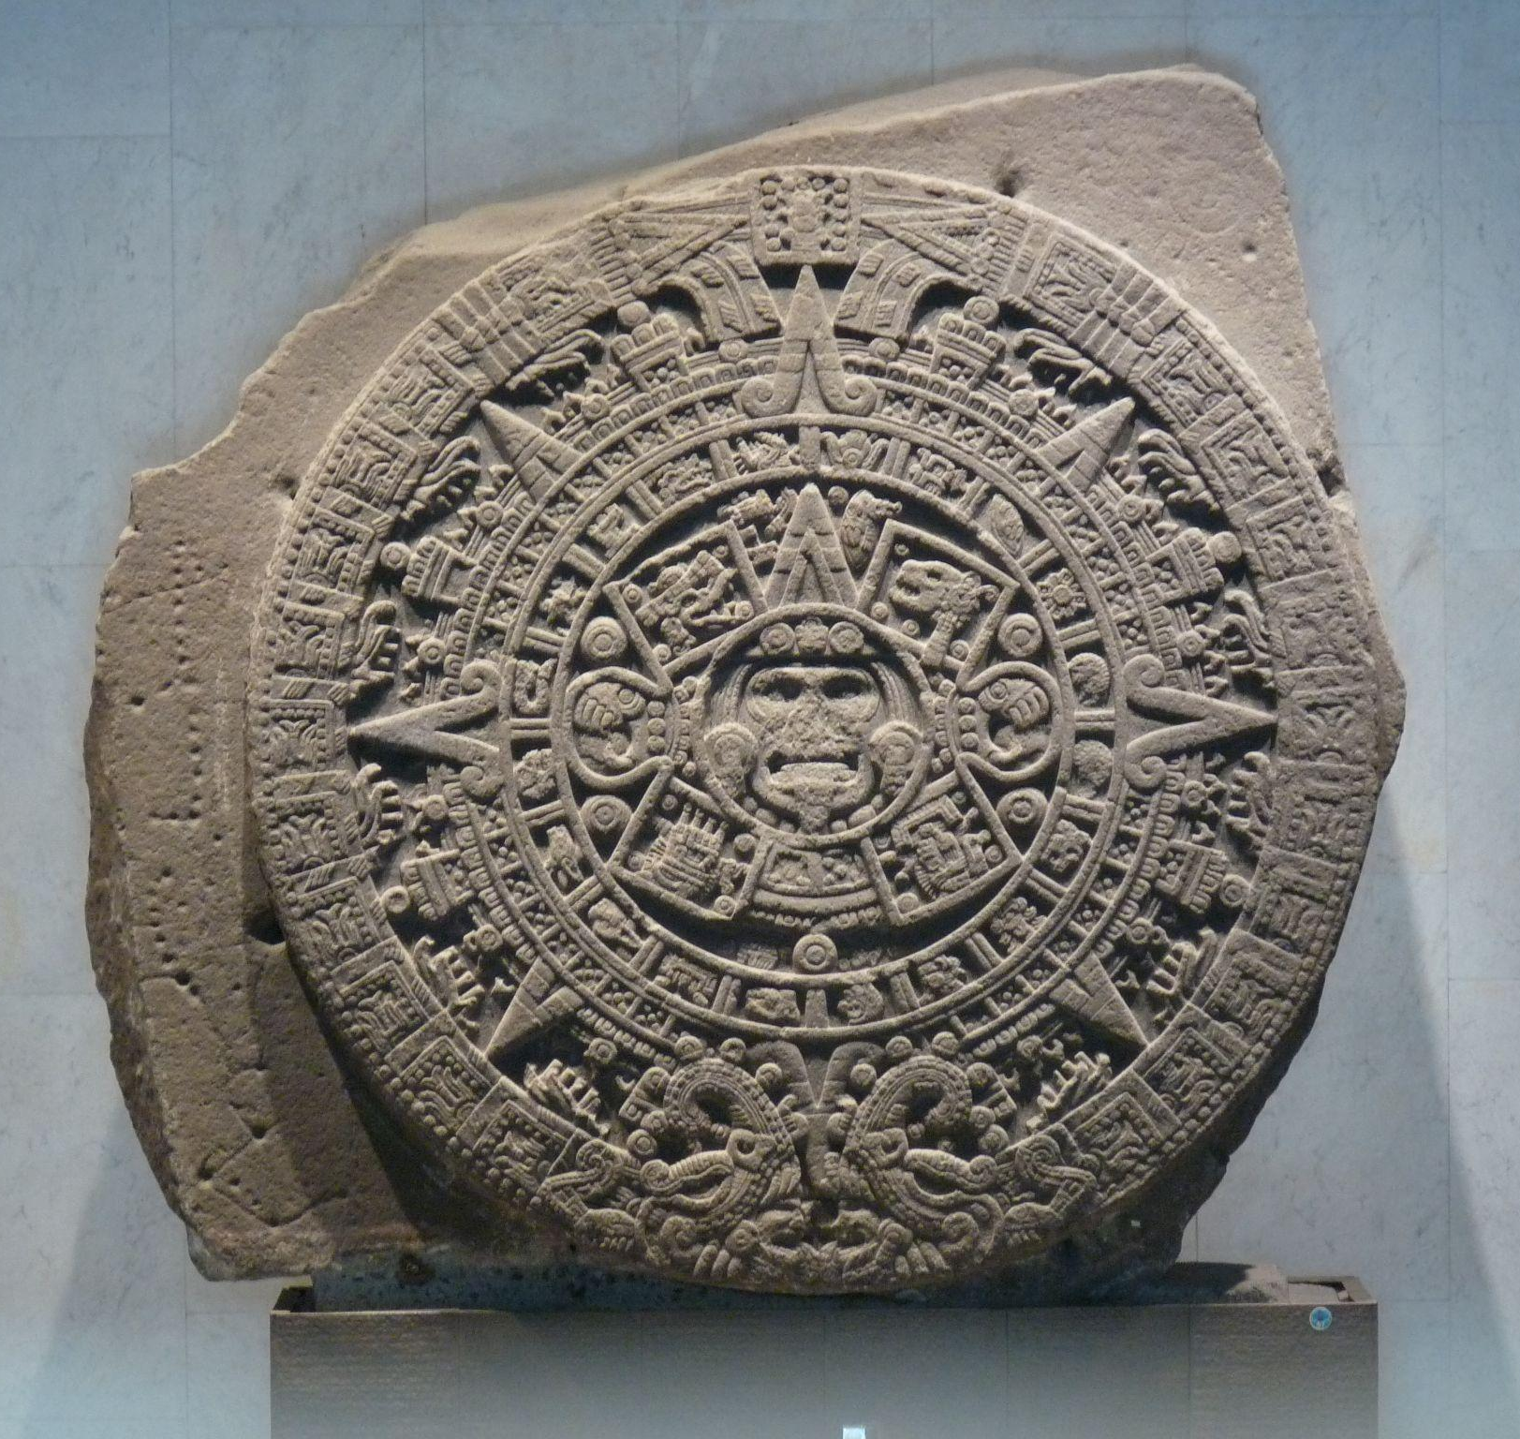
Demo & Lecture: Art History
You are going to create an artwork today that tells a story about yourself using colors, shapes, and lines.
The type of art you will be making is a called a mandala.
Have you ever heard this word before? Do you know what a mandala is?
Aztec Calendar Sun Stone
Notes:
https://en.wikipedia.org/wiki/Aztec_calendar#/media/File:Monolito_de_la_Piedra_del_Sol.jpg

Slide 19
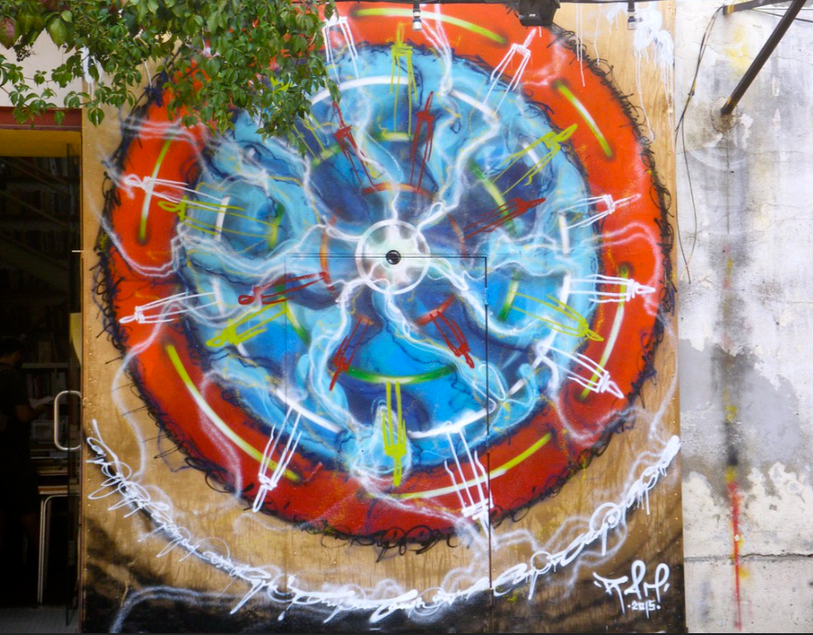
Demo & Lecture: Art History
Mandala is a sanskrit term that means “circle.”
A mandala is an artwork made from a circle.
Mandala Graffiti in Lisbon, Portugal
Notes:
https://www.flickr.com/photos/punktoad/22539307747/in/photolist-9Ku27s-7syiA4-2jN9oho-GJ2mVQ-rj7FKQ-86LBeD-AkHQWg

Slide 20
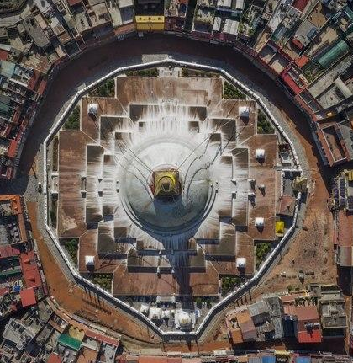
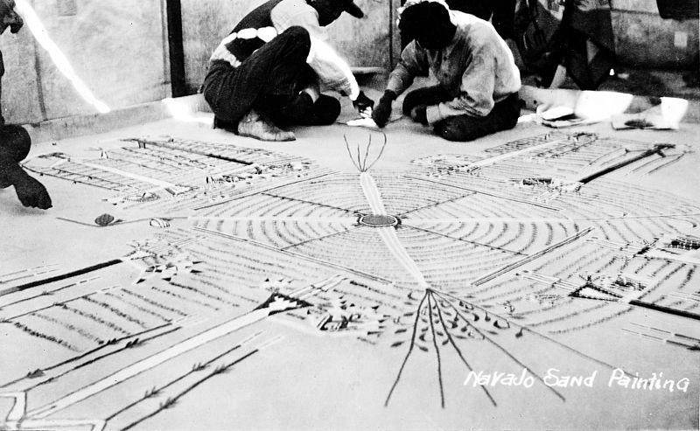

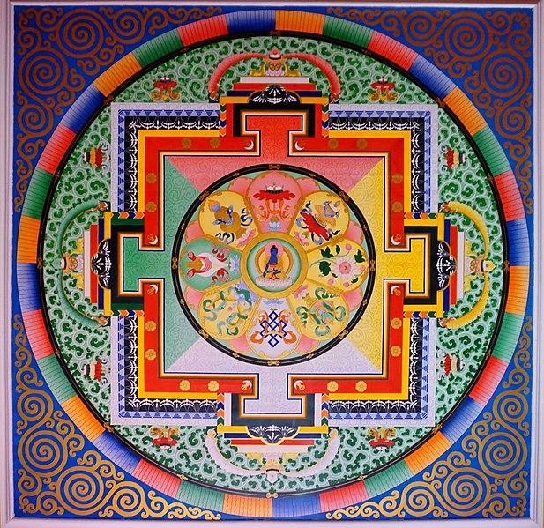
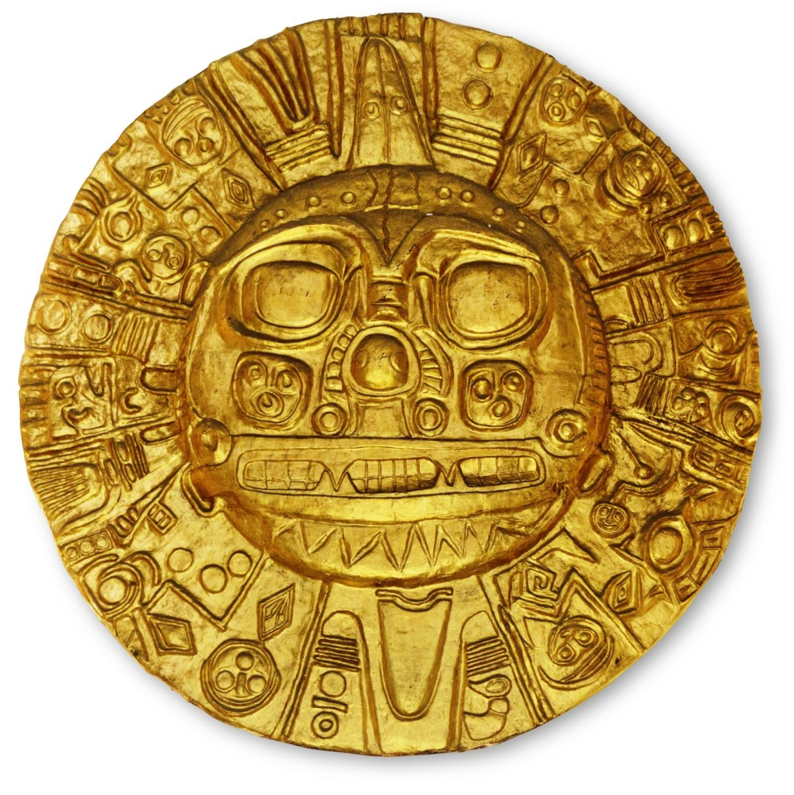
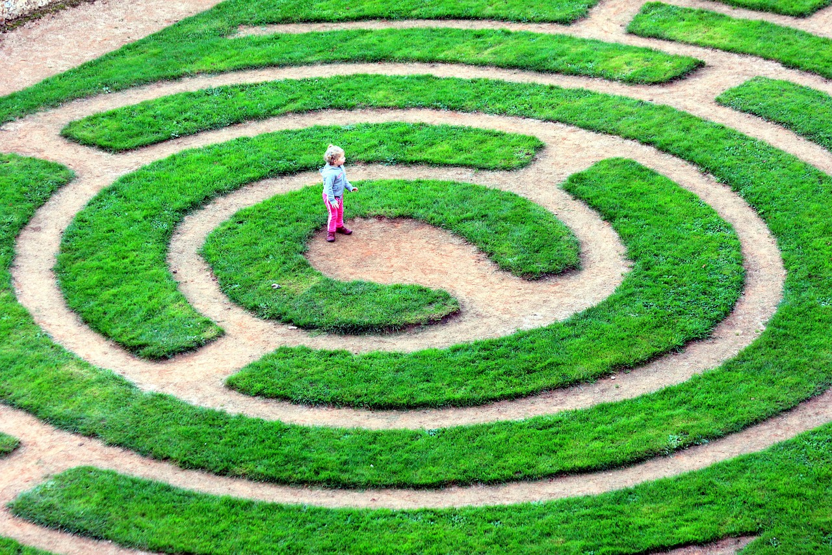
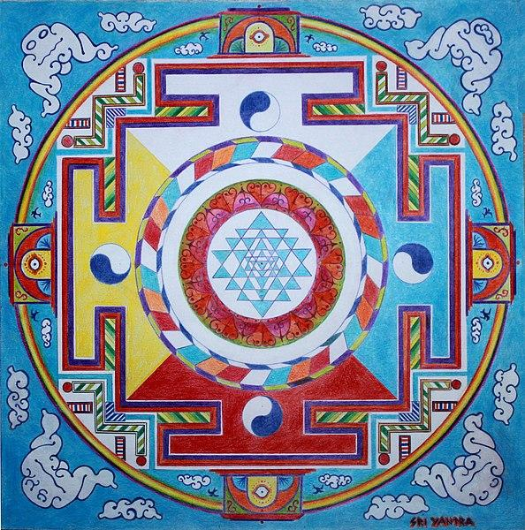
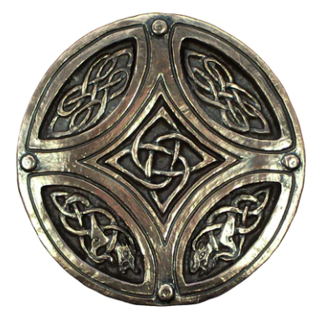
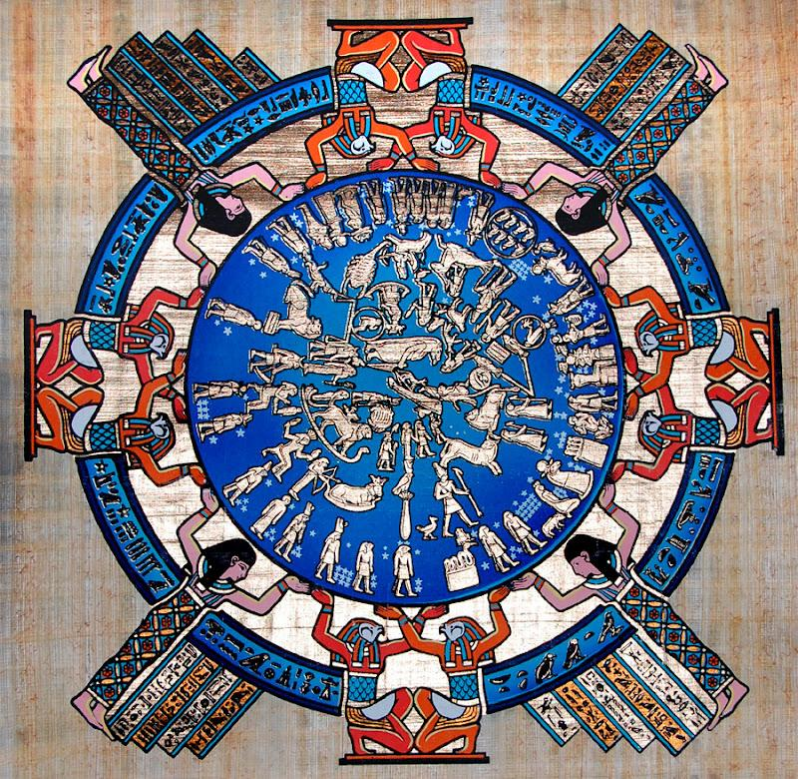

Demo & Lecture: Art History
People in almost every culture create mandalas.
Aerial View of Boudha Stupa
Navajo Sand Painting
European Church Window
Buddhist Sand Painting
Incan God Medallion
Hindu Sri Yantra
Labyrinth
Circle Celtic Knot
Egyptian calendar mandala
Aztec Calendar
Notes:
https://commons.wikimedia.org/wiki/File:049_Ceiling_Medicine_Buddha_Mandala_(39096080312).jpg
https://en.wikipedia.org/wiki/Aztec_calendar#/media/File:Monolito_de_la_Piedra_del_Sol.jpg
https://en.wikipedia.org/wiki/File:AERIAL_BOUDHA_VIEW.tif
https://commons.wikimedia.org/wiki/File:Hedge_maze_in_Parque_S%C3%A3o_Roque_da_Lameira_2.jpg
https://pixabay.com/photos/labyrinth-charters-green-child-4913643/
https://commons.wikimedia.org/wiki/File:Navajo_sand-painting,_negative_made_from_postcard_Wellcome_M0010862.jpg
https://commons.wikimedia.org/wiki/File:2021_Henrique_Matos_Mandala_Sri_Yantra_02.jpg

Slide 21
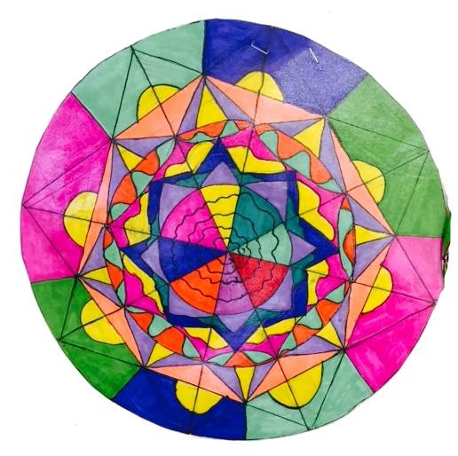
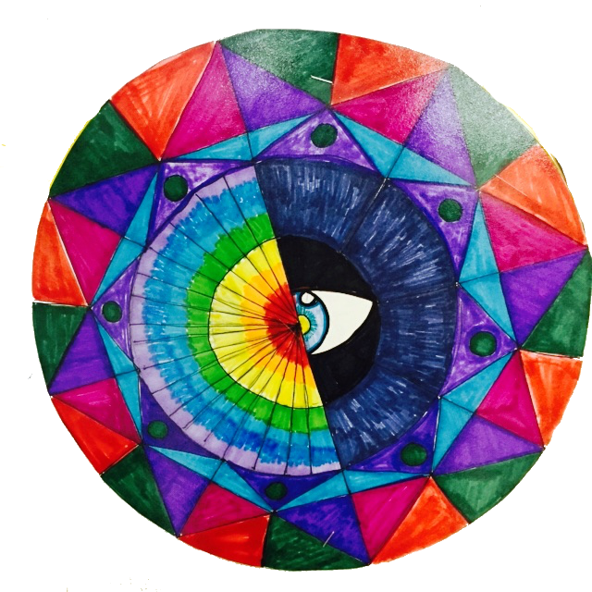
Demo & Lecture: Art History
Many people create mandalas to help them express feelings.
The mandala has special meanings for the person or people who create it.
The patterns, shapes, and colors they use represent their feelings and thoughts.
Notes:
Artwork Amy Bultena

Slide 22
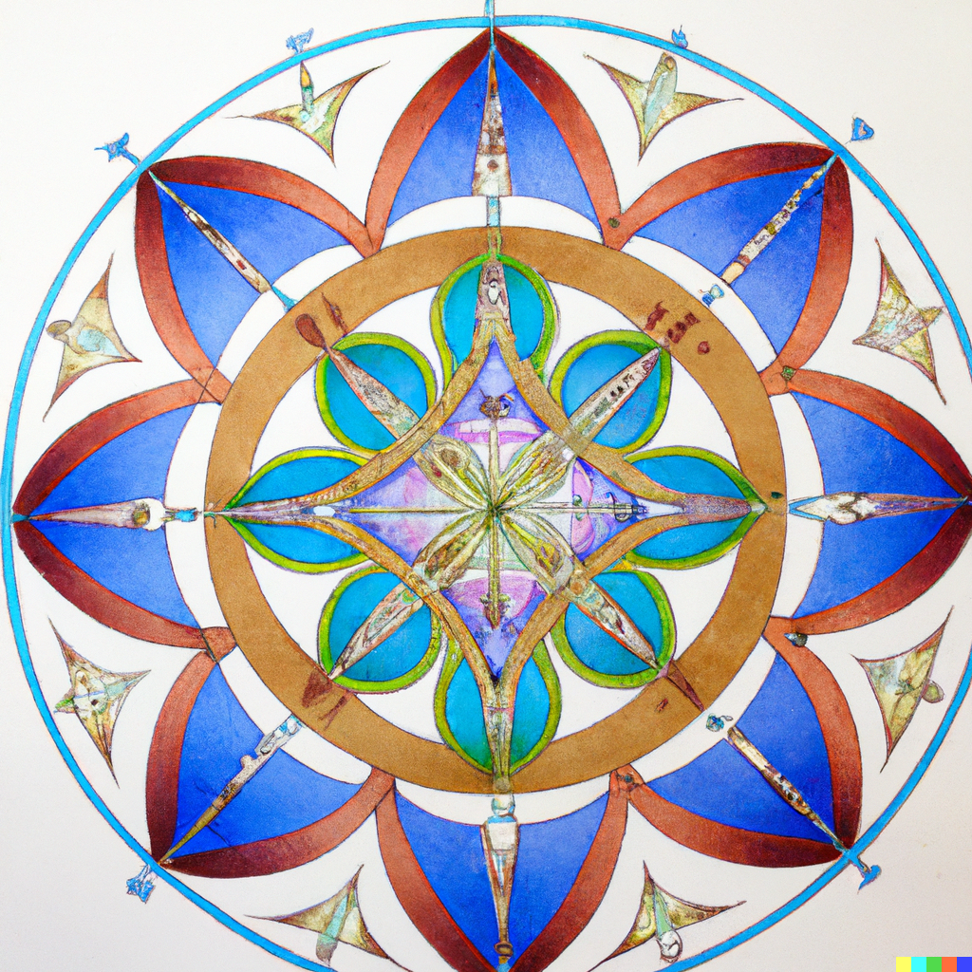
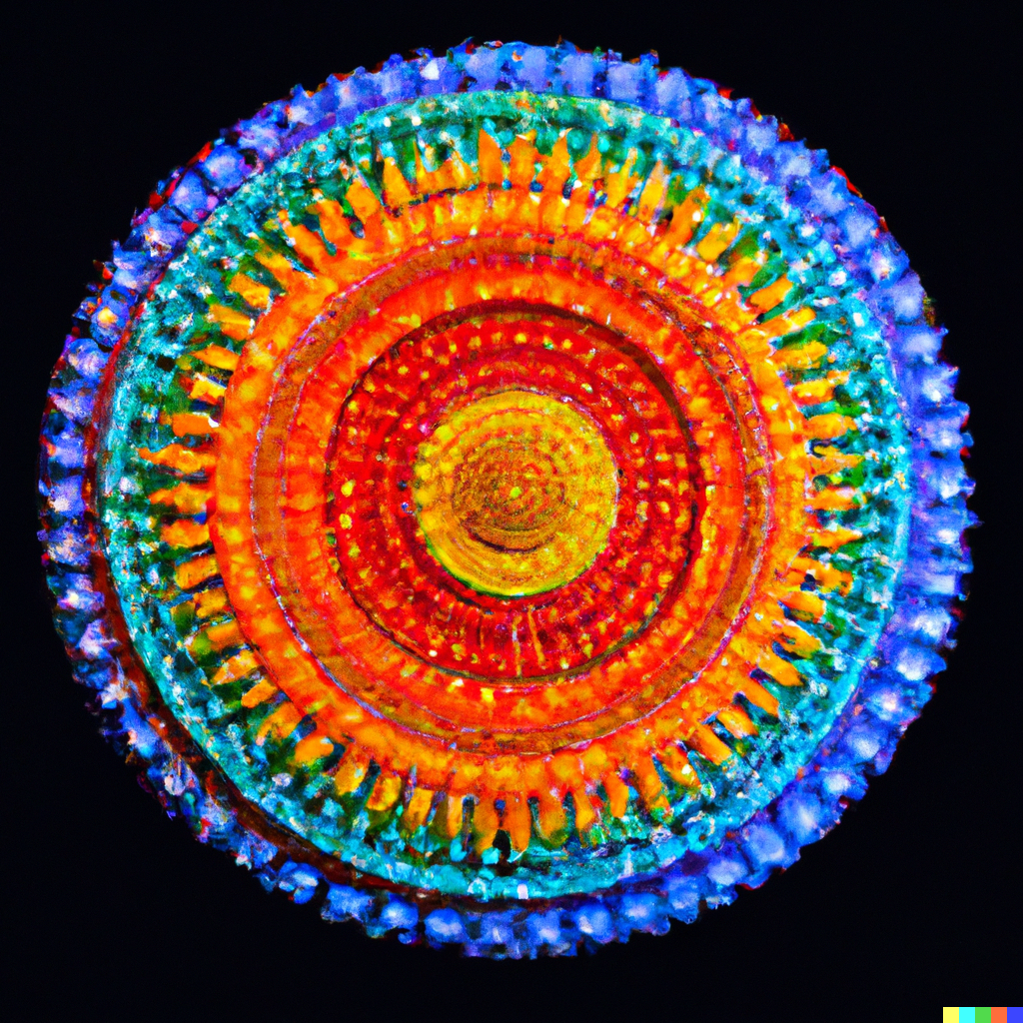
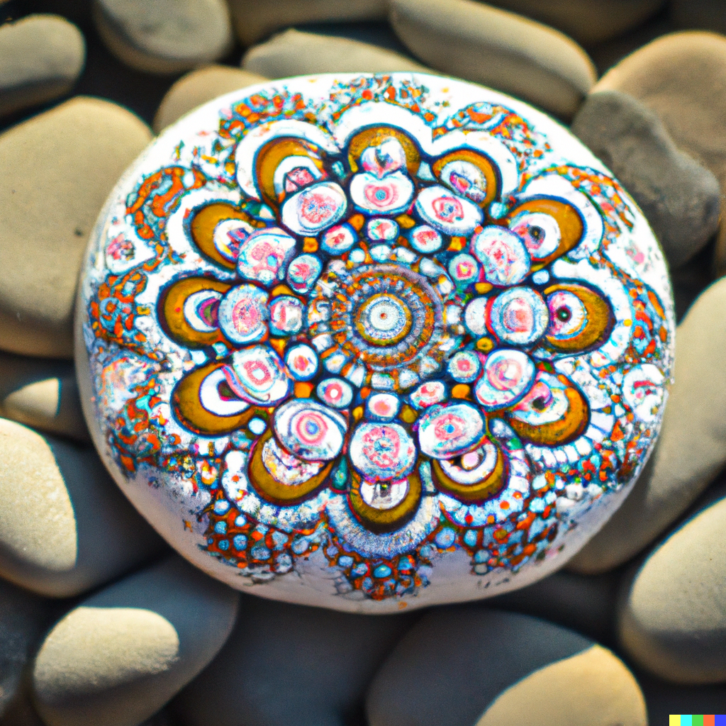
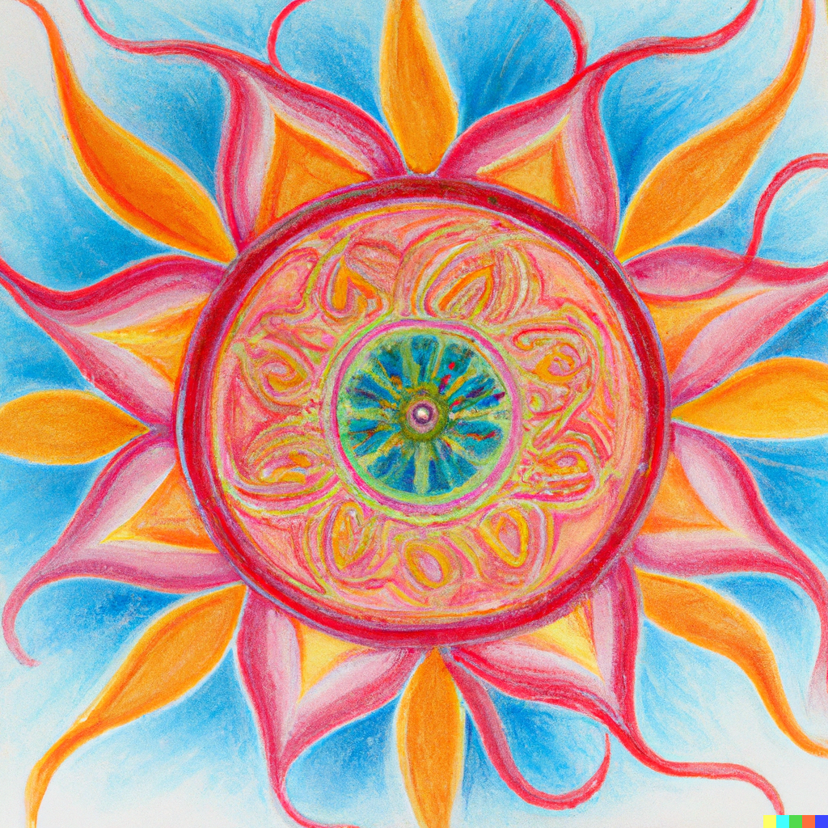
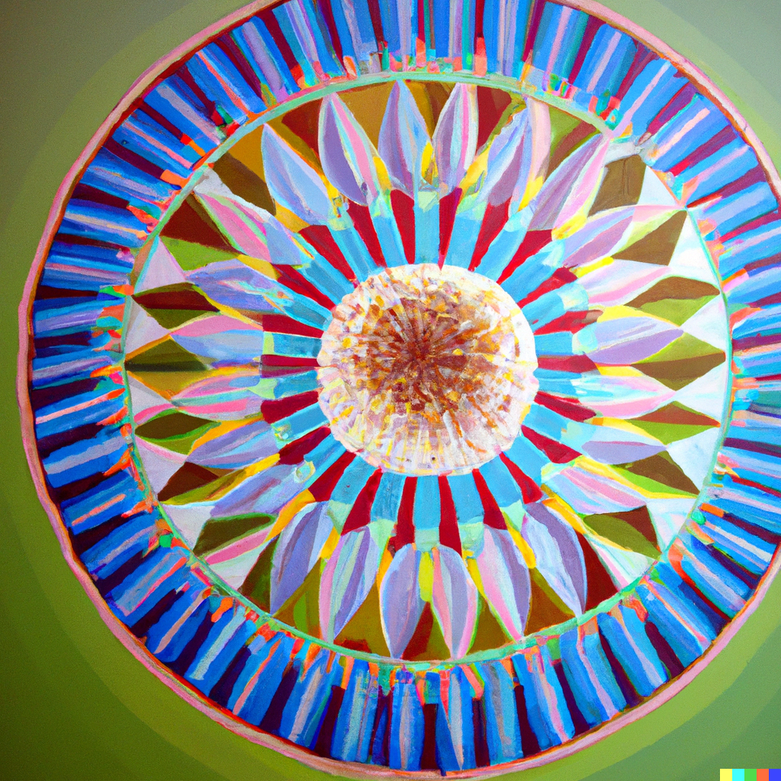
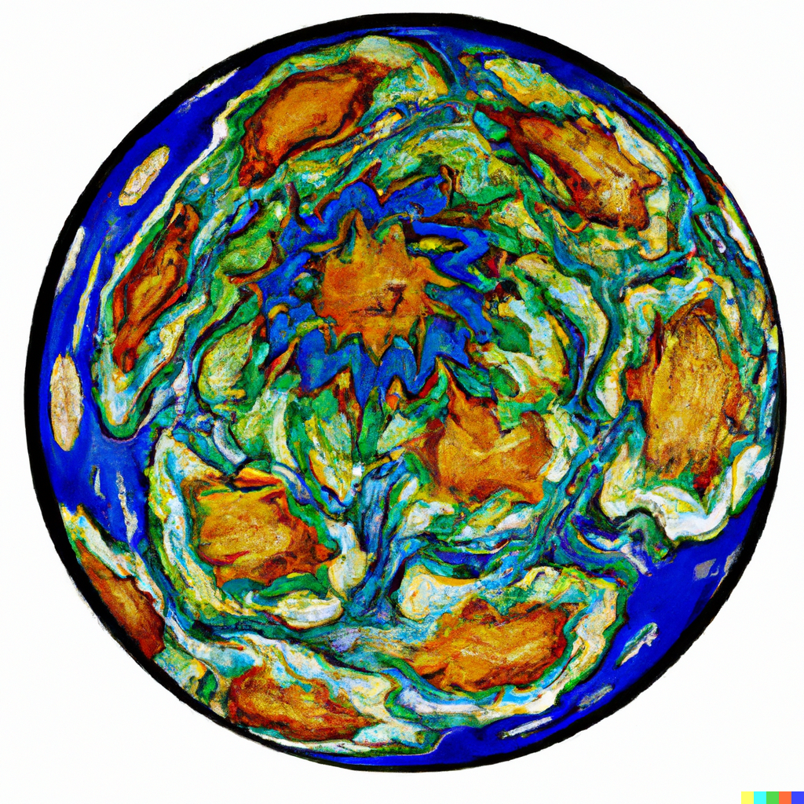
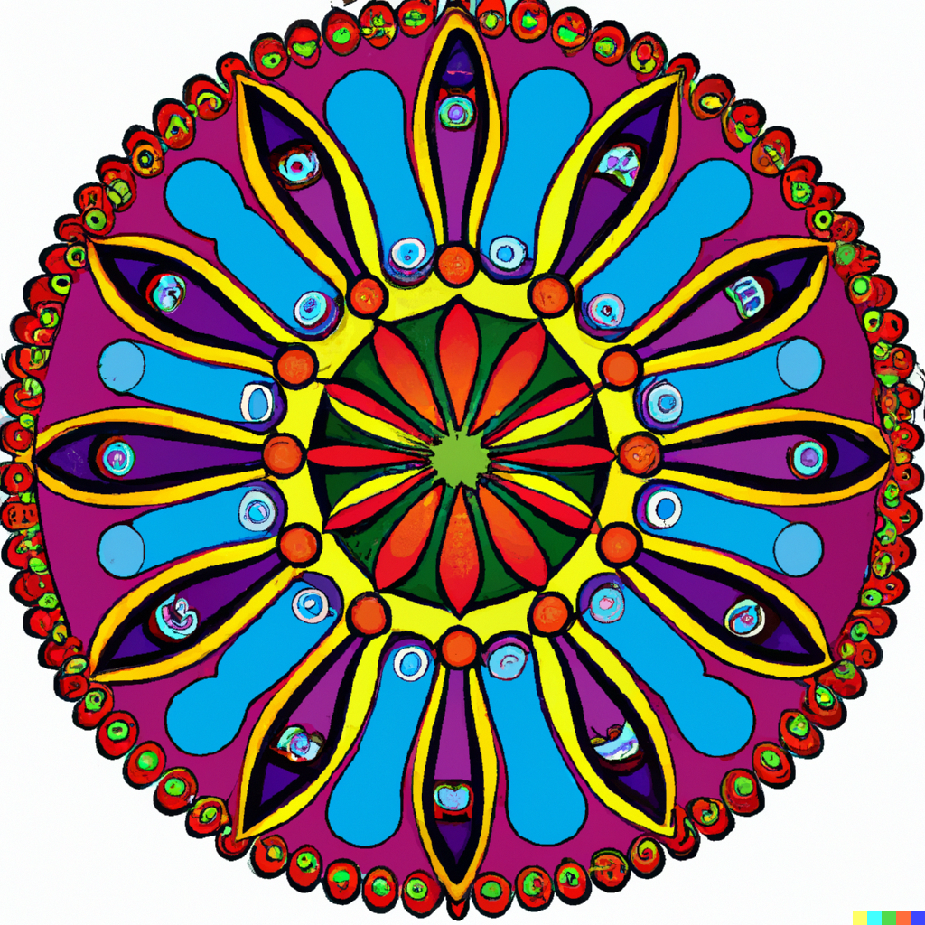
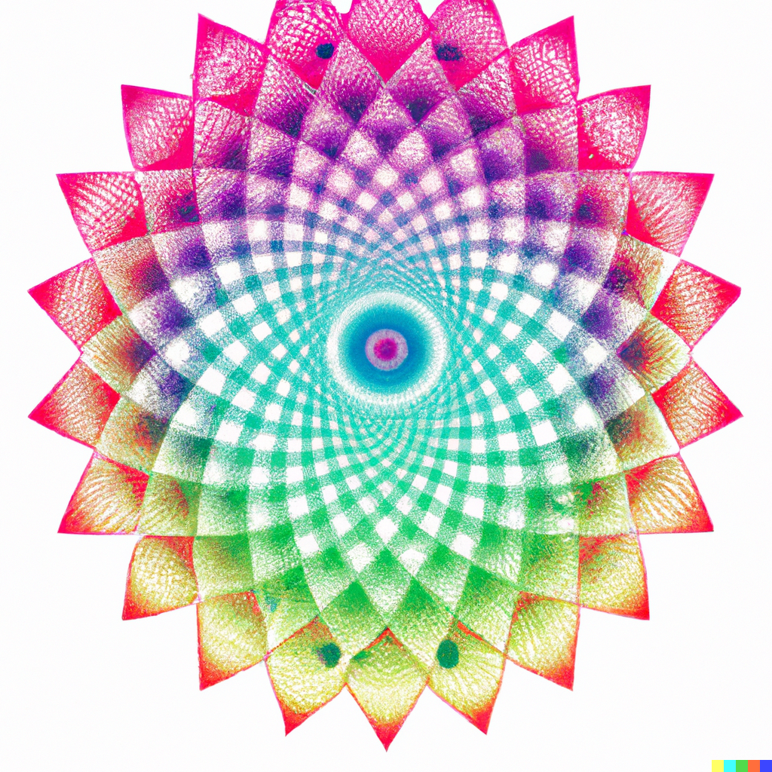
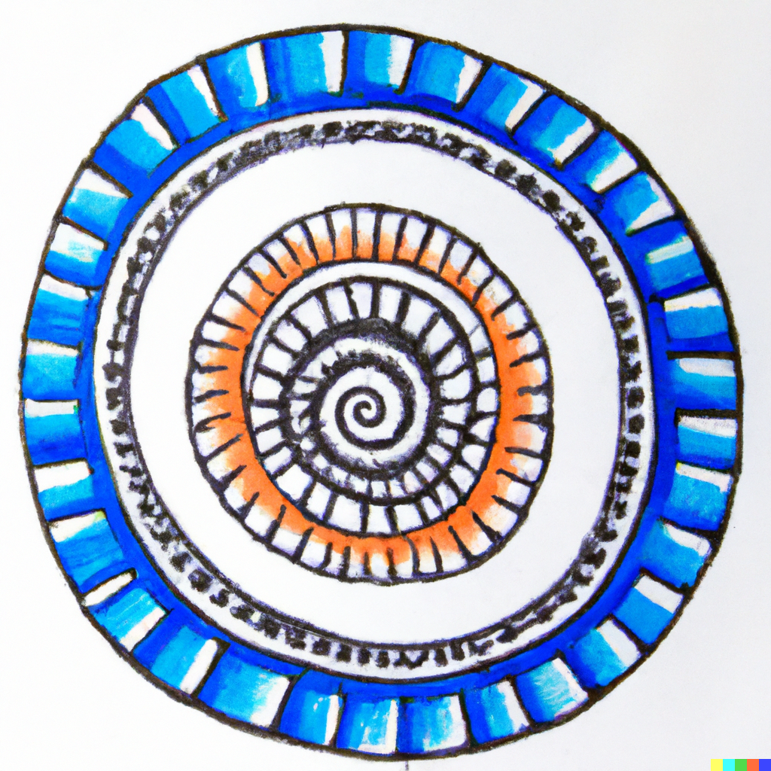
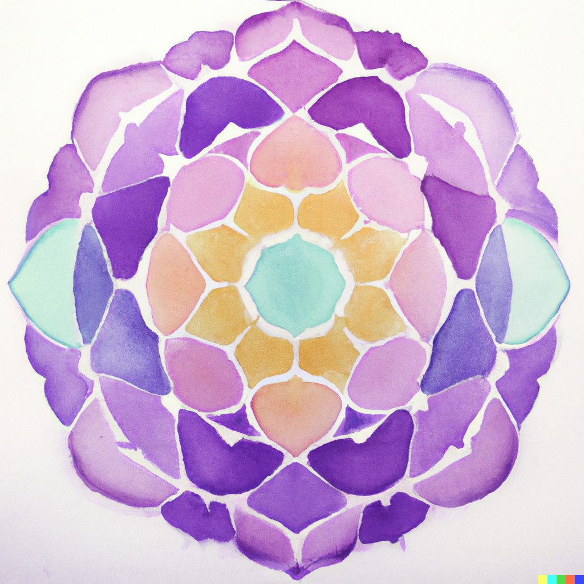
Demo & Lecture: Art History
Mandalas can be geometric or free-form; simple or complex.
There is no right or wrong way to create a mandala.
The purpose is to focus on the process of creation, and how you feel.
Notes:
Mandala images generated using DALL-E AI based on a prompt by Amy Bultena

Slide 23
Project Overview
You are going to share a story about yourself using color, shapes, and lines to create a mandala.
I am going to help you get started.

Slide 24
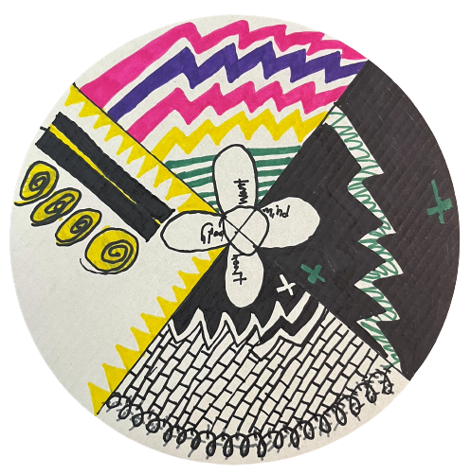
Students-at-Work: Getting Started
Your mandala is going to be about your:
Heart
Mind
Body
Wants
Take one minute, breath deeply, and think about how you feel in heart, mind, and body.

Slide 25
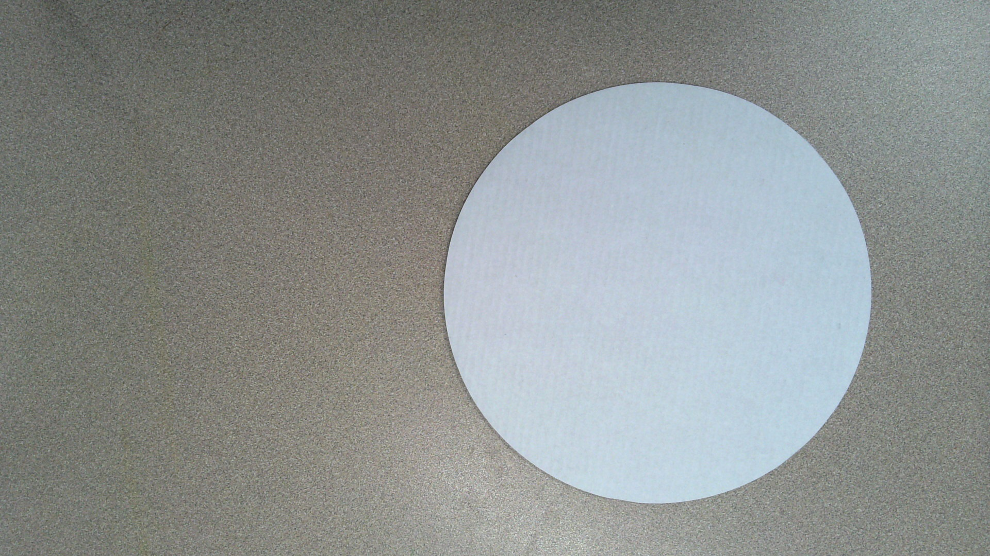
Place your circle in front you.

Slide 26
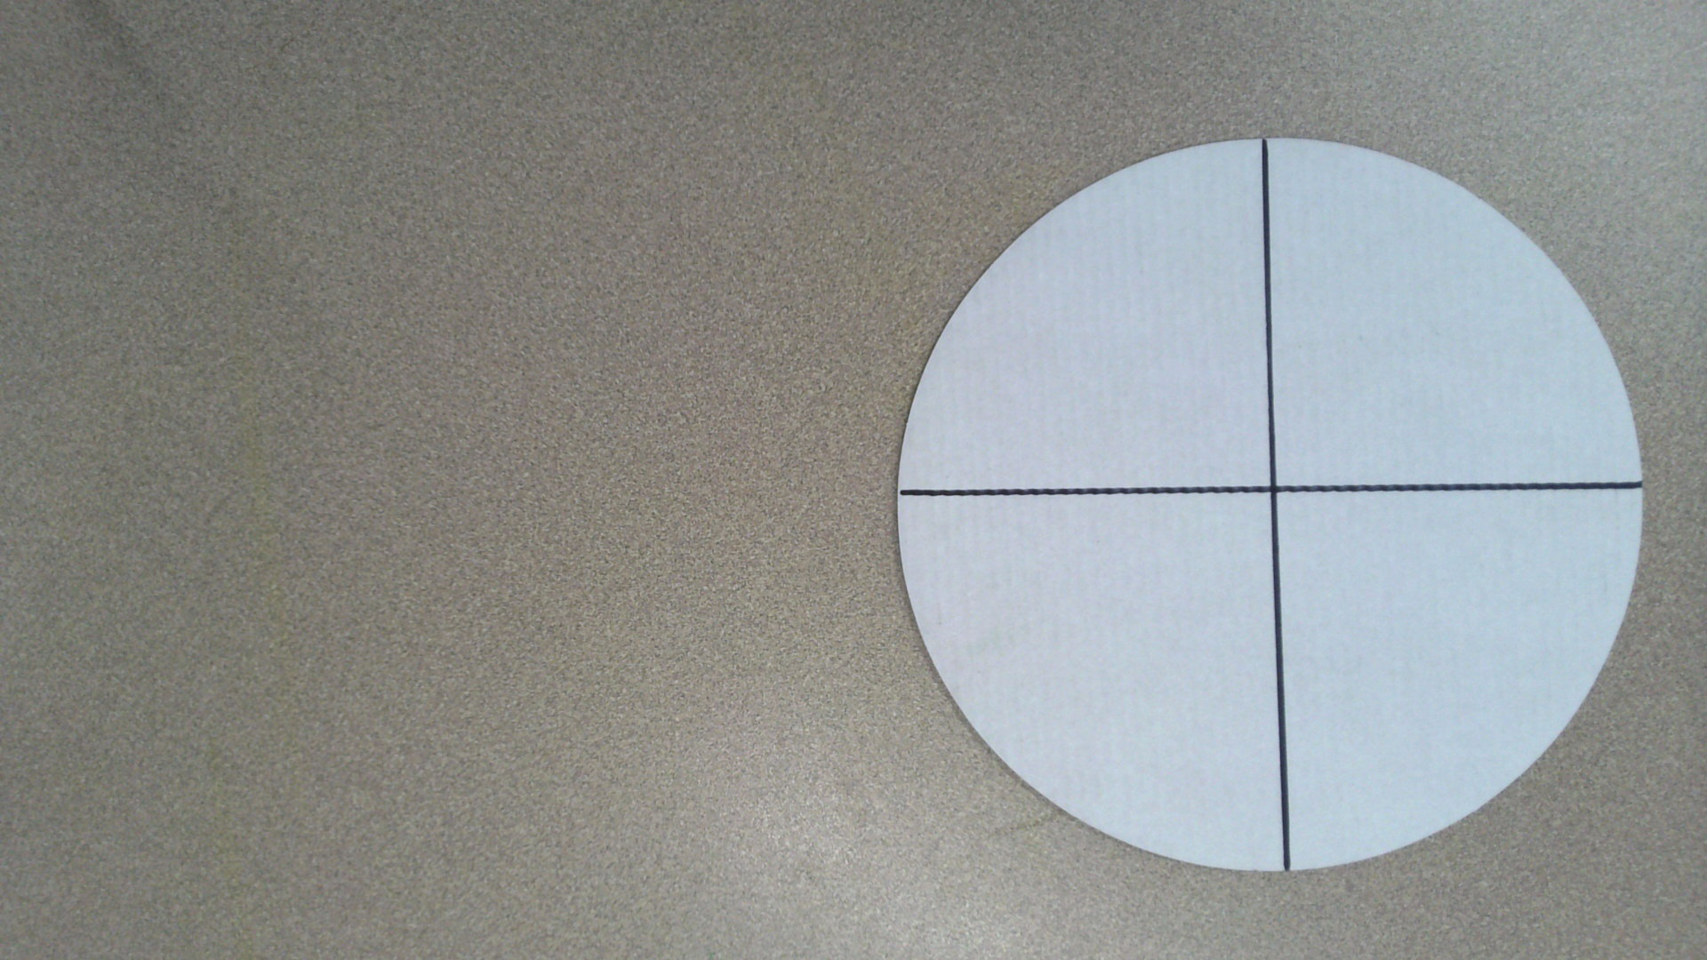
Using a ruler, draw a “plus sign” through the middle of the circle.

Slide 27
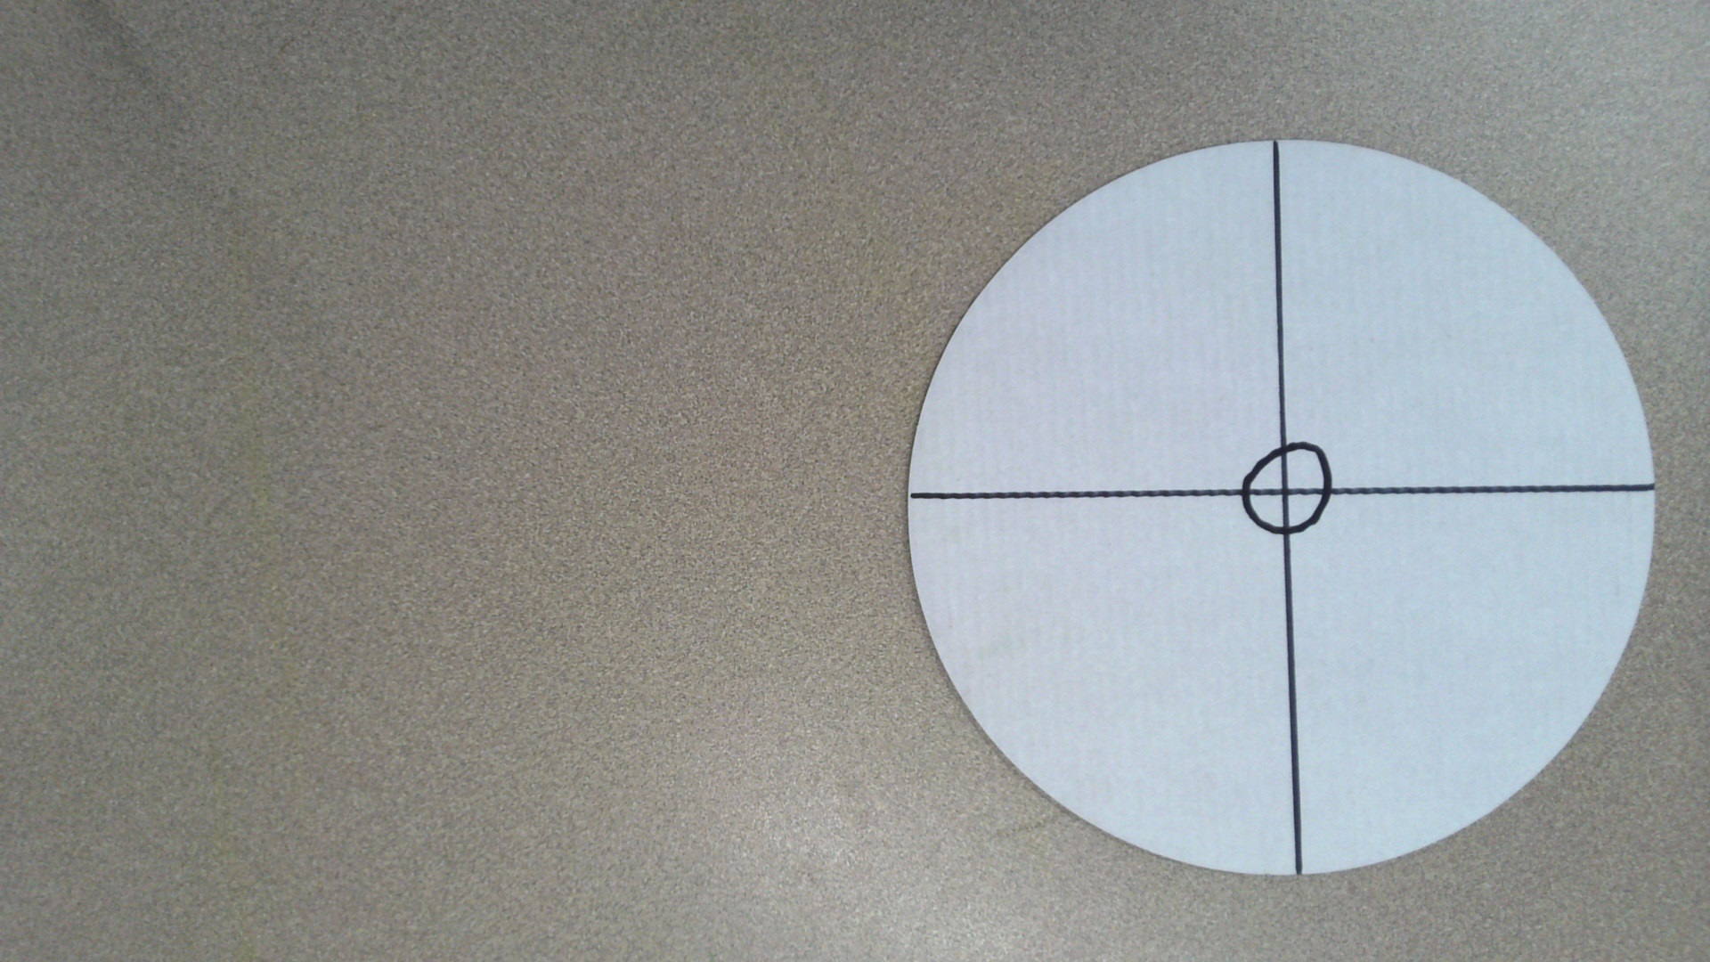
Draw a small circle around the midpoint.
This small circle represents the center of you.

Slide 28
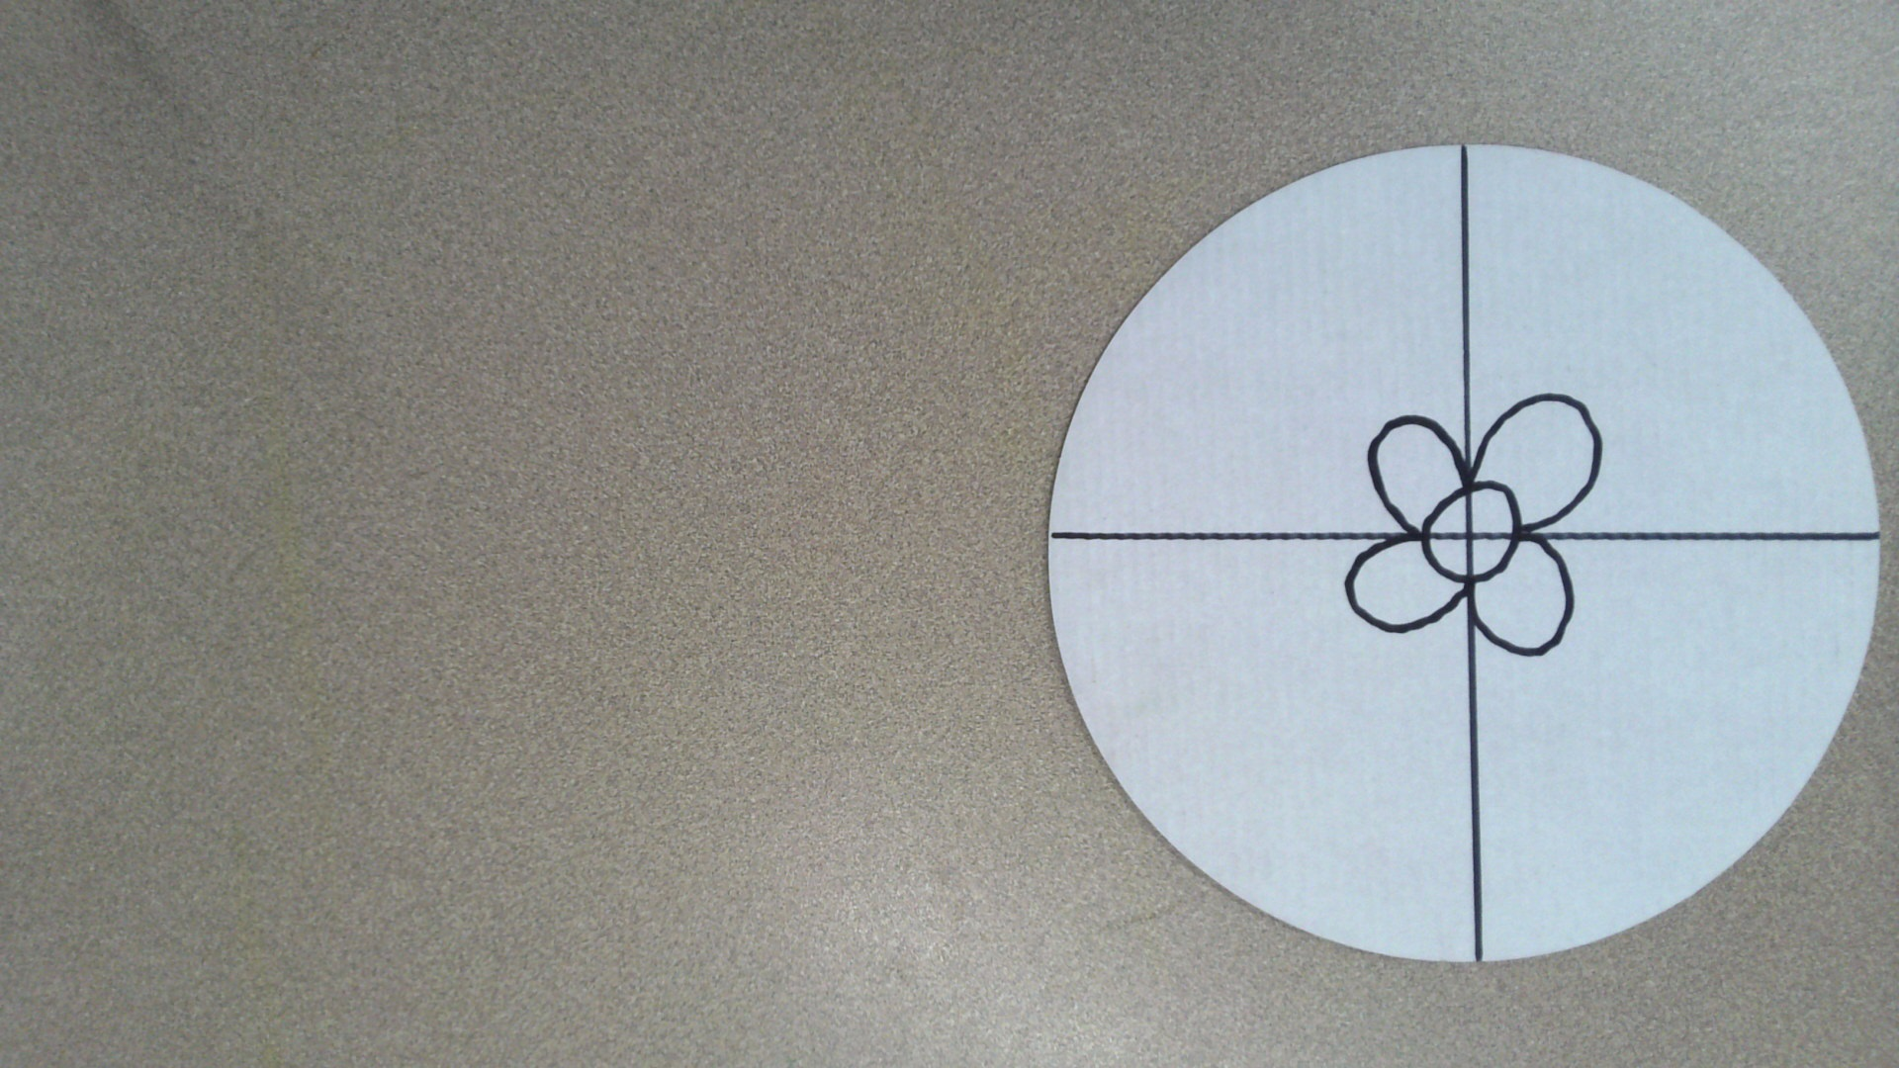
Now, give each pie slice a “leaf.”
You can shape the leaves however you like.

Slide 29
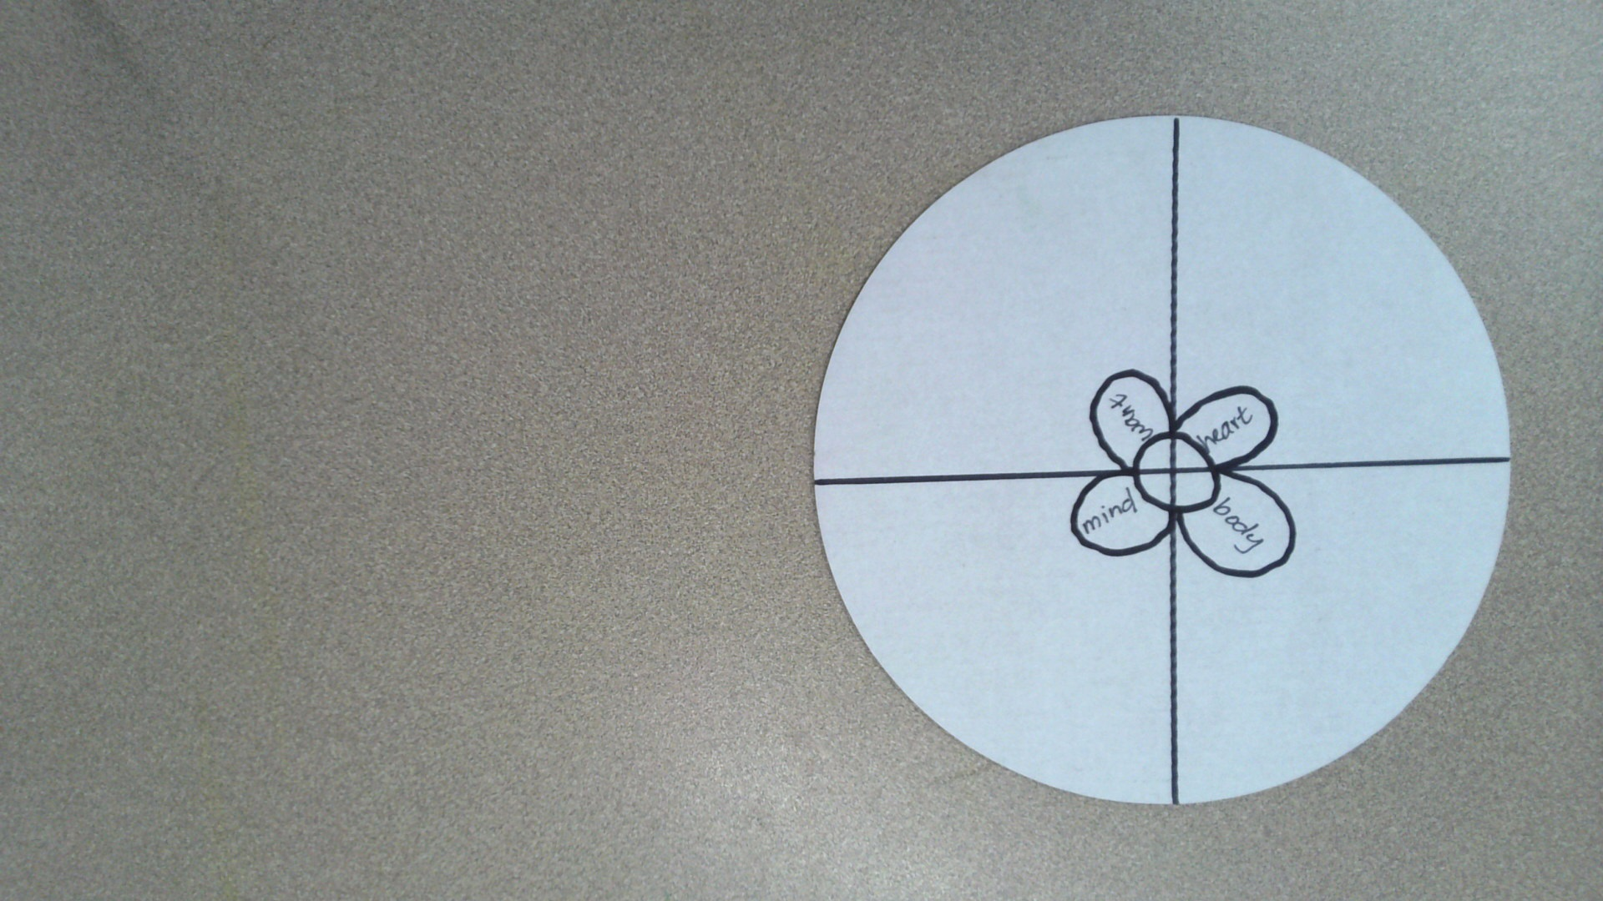
Each leaf represents a different part of your story:
Mind
Body
Heart
Wants

Slide 30
Tell a story about the different parts of you using colors, shapes, and lines.
Mind
Body
Heart
Wants
You must create only using colors, shapes and lines. No hearts, peace signs, or dollar signs etc.

Slide 31
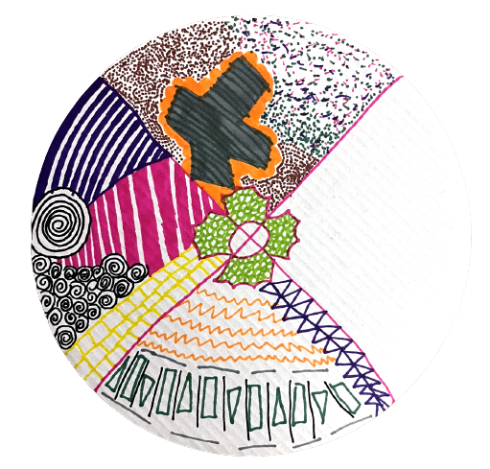
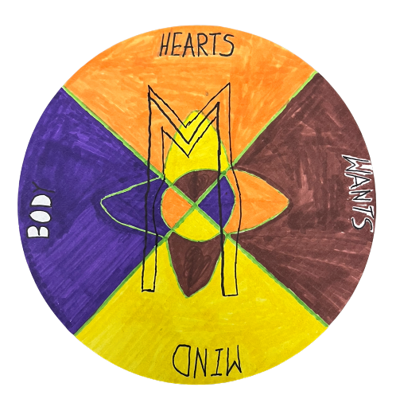
Student Examples
Notice how these students only used colors, shapes, and lines to tell a story in their mandala.
Remember, it is important to be present; do not worry about being perfect.
Notes:
Artwork Amy Bultena

Slide 32
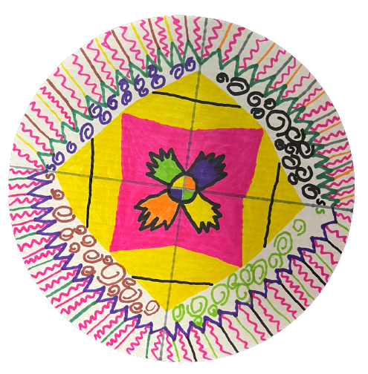
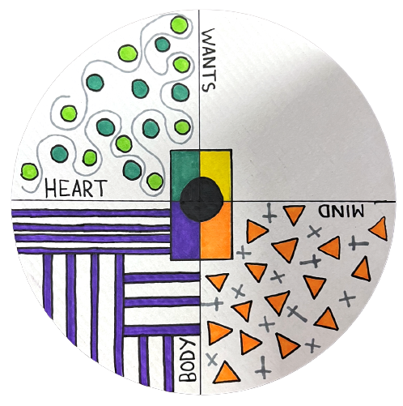
Student Examples
Notice how these students only used colors, shapes, and lines to tell a story in their mandala.
Remember, it is important to be present; do not worry about being perfect.
Notes:
Artwork Amy Bultena

Slide 33
Tell a story about the different parts of you using colors, shapes, and lines.
Mind
Body
Heart
Wants
You must create only using colors, shapes and lines. No hearts, peace signs, or dollar signs etc.

Slide 35
Critique
Look at your mandala. What story is your mandala telling.
How did creating your mandala feel? What did you like? What did you dislike?

Slide 36
How are you feeling after making your artwork?
Do you feel better, worse, or the same? Why?
Notes:
https://pixabay.com/illustrations/emotion-scale-emoji-icon-feedback-3404484/

Slide 37

Closing Slide

