Slide 1
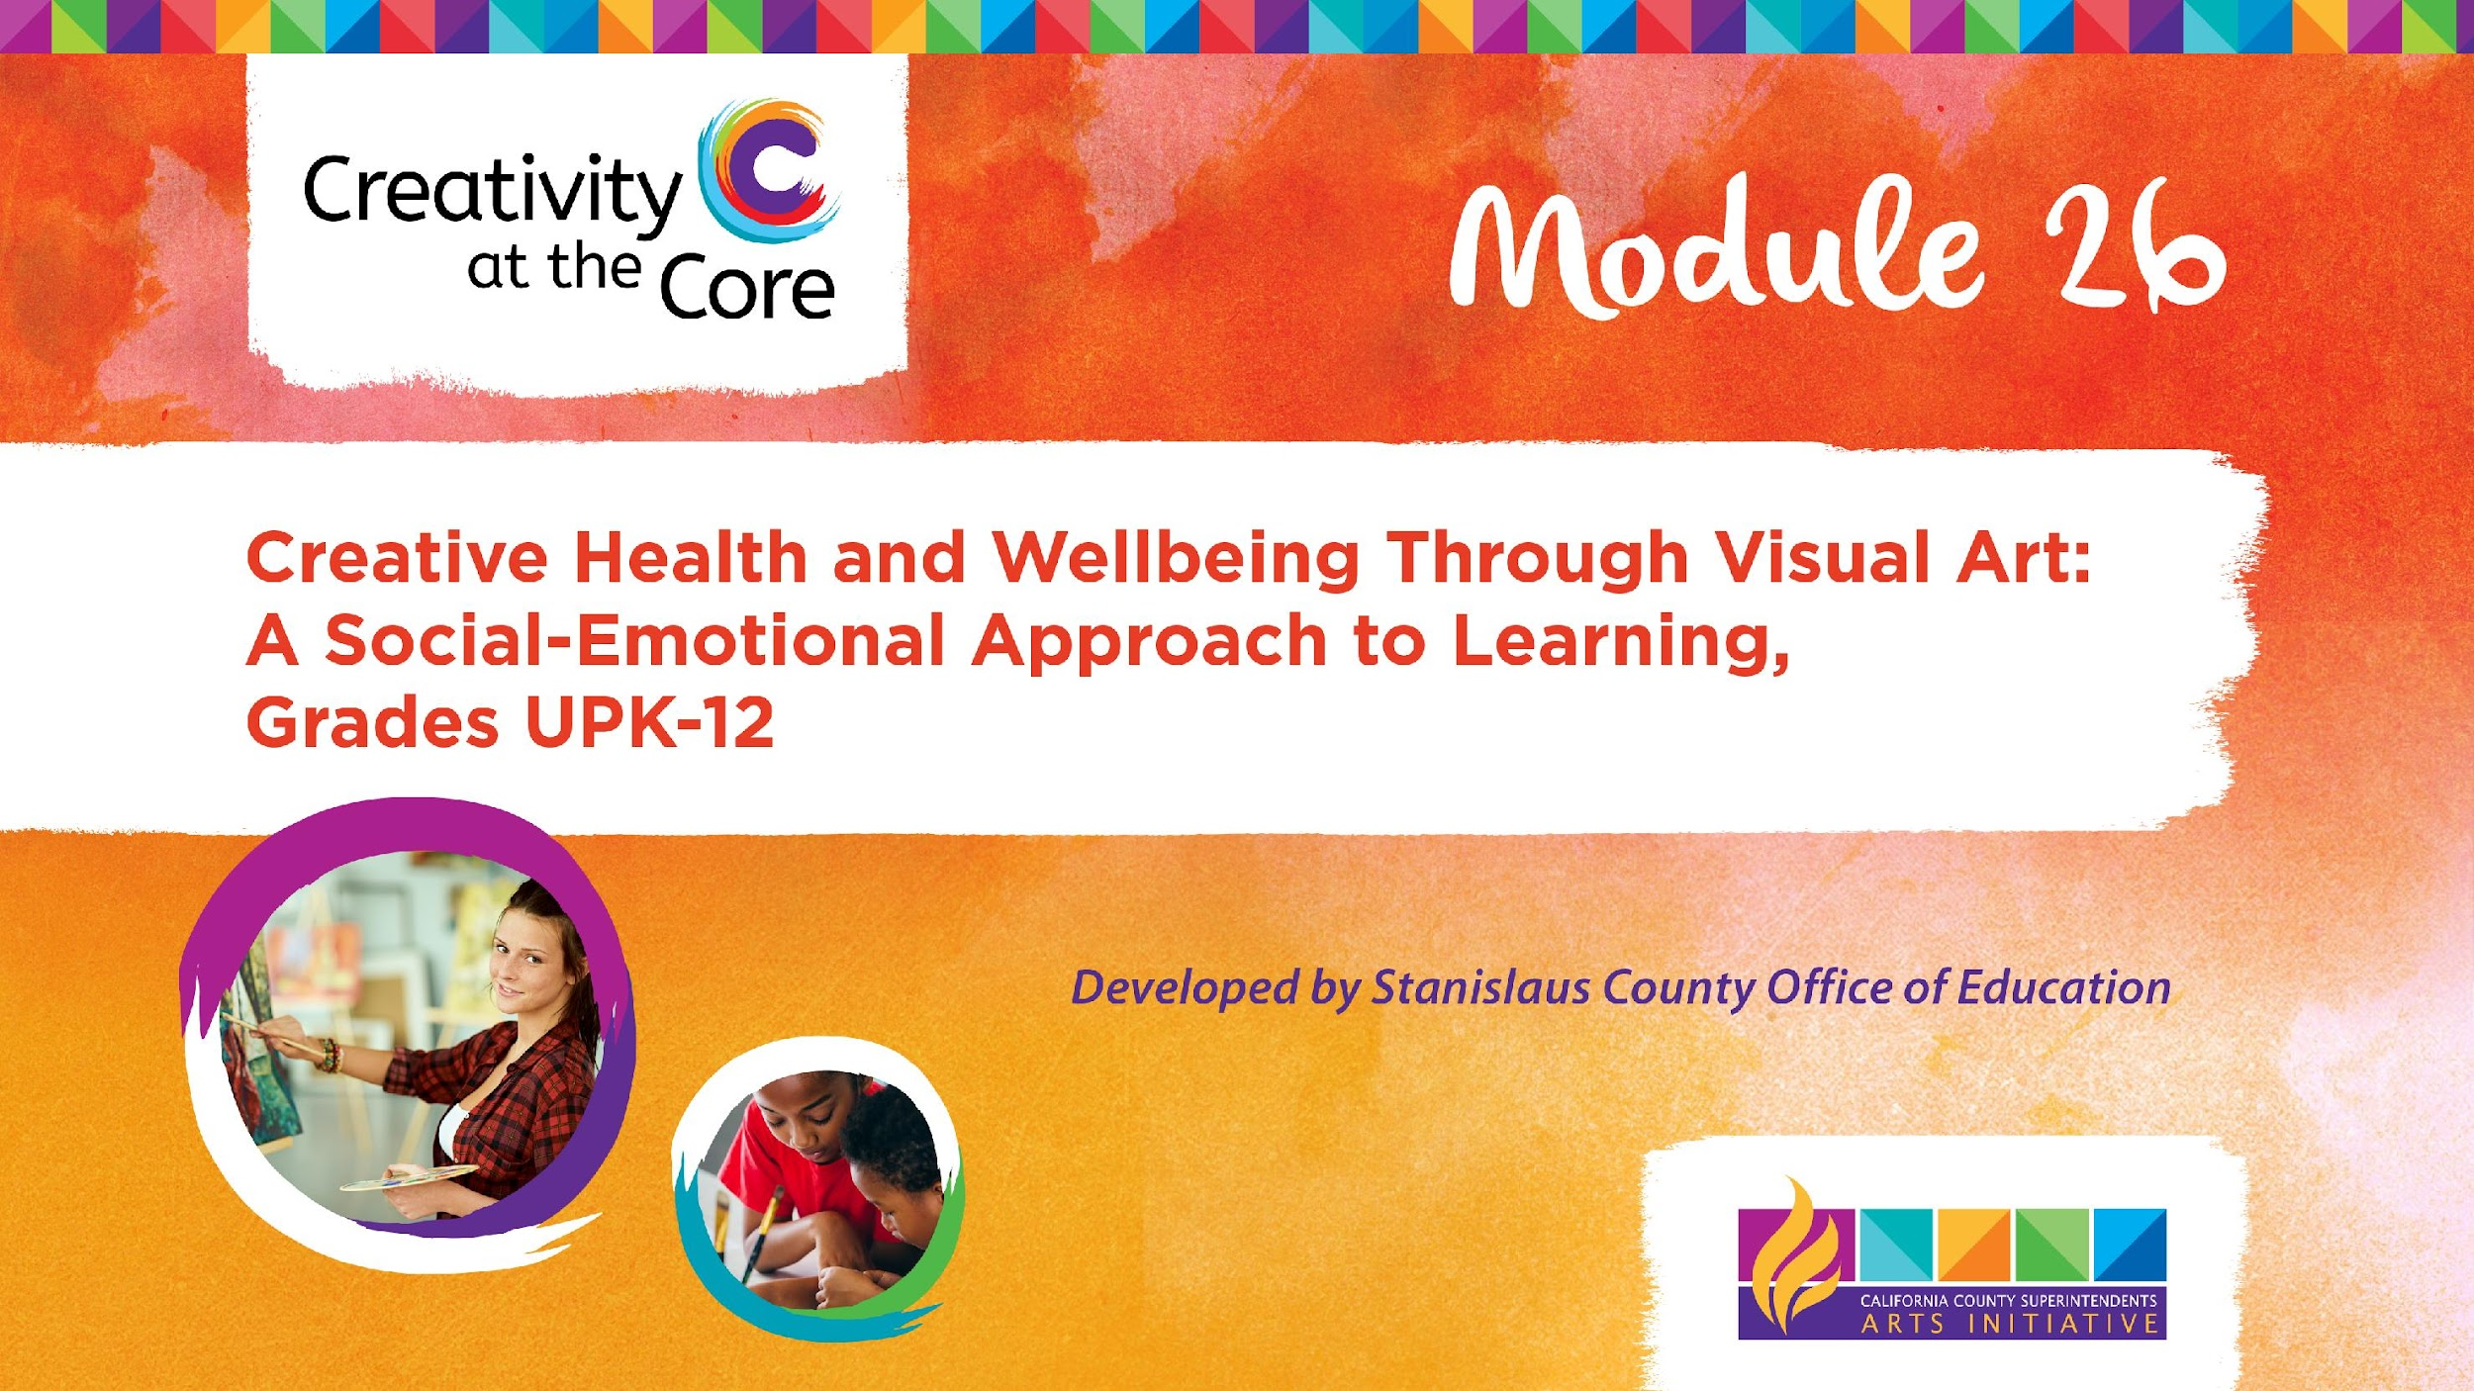
Grades 9 – 12 Project: Museum of Me Unfolding Book​

Slide 2
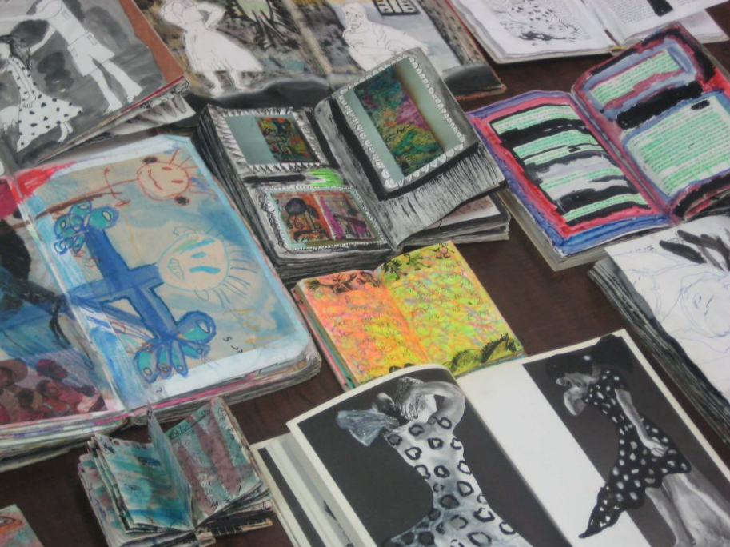
Grades 9 – 12 Project: Museum of Me Unfolding Book
Learning Outcomes
Create a three-square unfolding artist book. The book will have a minimum of four inserts. As the book unfolds students will add art about their place in the world, their identity, and their feelings.

Slide 3
Grades 9 – 12 Project: Museum of Me Unfolding Book
SEL Core Competencies Addressed
Self-Awareness
Self-Management
Visual Art Standards
Prof.VA:Cr1.2 - Shape an artistic investigation of an aspect of present-day life using a contemporary practice of art or design.
Prof.VA:Cr2.1 - Engage in making a work of art or design without having a preconceived plan.

Slide 4
Grades 9 – 12 Project: Museum of Me Unfolding Book
Materials Needed
4 sheets of square paper in various colors (recommended 12 x 12 inches)
Glue or glue sticks
Scrap paper
Assorted artmaking materials such as:
  Colored pencils
  Markers
  Watercolor paint
  Pens
  Oil pastels
  Collage materials
Notes:
https://www.flickr.com/photos/naivepaintings/42406671740/in/photolist-27Bkh5L-29gE9mu-hotT5g-QoxxVP-bmUai3-Qoxvcc-z57iCR-29gE9w9-27BkiDs-29gE9q7-2aewtY2-5kETh8-28Z3Vxa-cMnA7W-2991vqS-29gE9id-29gE8CL-e9uJ5Z-iMeym-e9AoWs-NeEaxy-e9AopE-cMnA3s-2aewtZK-e9Ao8j-2aewu7i-2991vuE-5W4pis-dB1EZ4-29gE8WG-63u5np-cMnAd7-29gE9f7-28Z3WnB-29gE9y3-62Yv2h-89gGyg-2991vu9-z9QsV3-zrreY2-2kSoH9H-597YKq-cMnAn3-2aewu5z-AsNZTr-cMnzG5-2991vvw-cMnAgW-23GF4Ww-7k6oW4

Slide 5
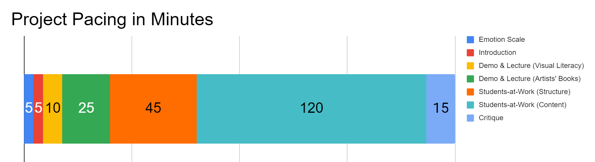
Project Pacing
For the Students-at-Work (Content) block: This is a work time that does not need to be continuous. Students can stop and return back to the work as needed and/or necessary.
Pacing structure follows the guidance of the Studio Habits of Mind framework.

Slide 6
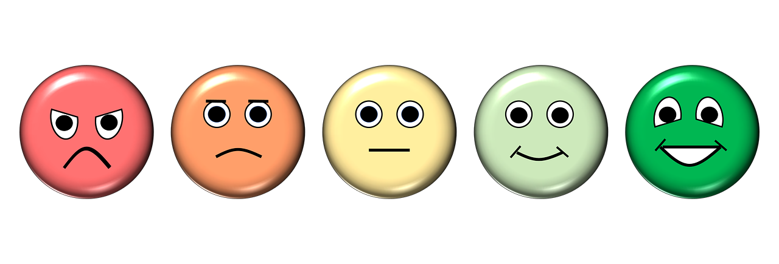
How are you feeling right now?
Notes:
https://pixabay.com/illustrations/emotion-scale-emoji-icon-feedback-3404484/

Slide 7
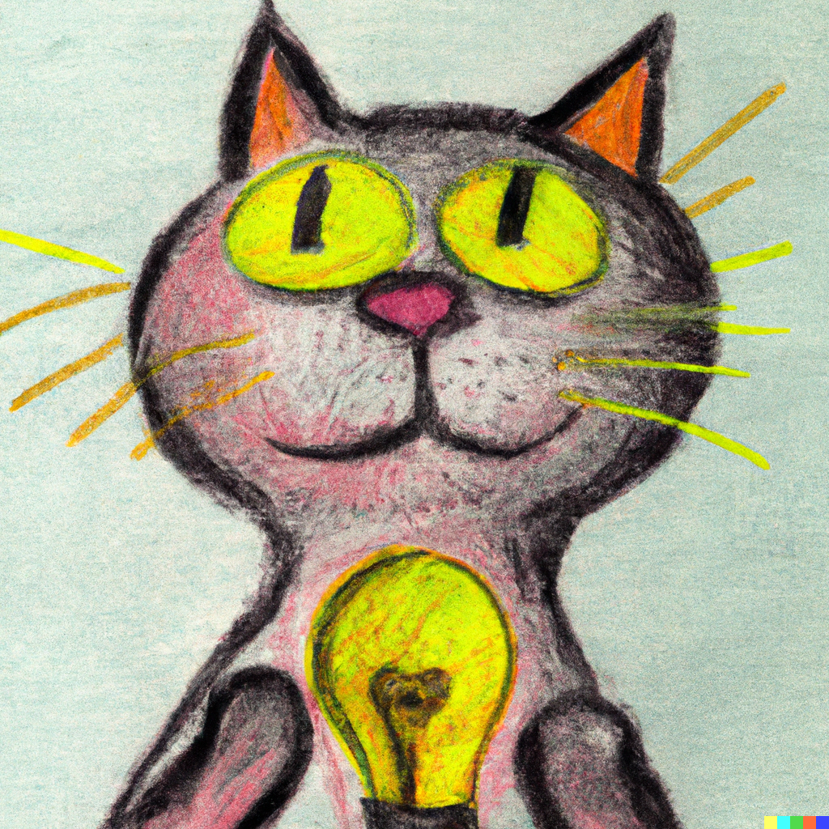
Introduction
Goals for this creative experience:
Be present not perfect
Use positive language to talk about what you and others create
Feel better than when you started
Notes:
Artwork generated in Dall-E AI based on a prompt by Amy Bultena

Slide 8
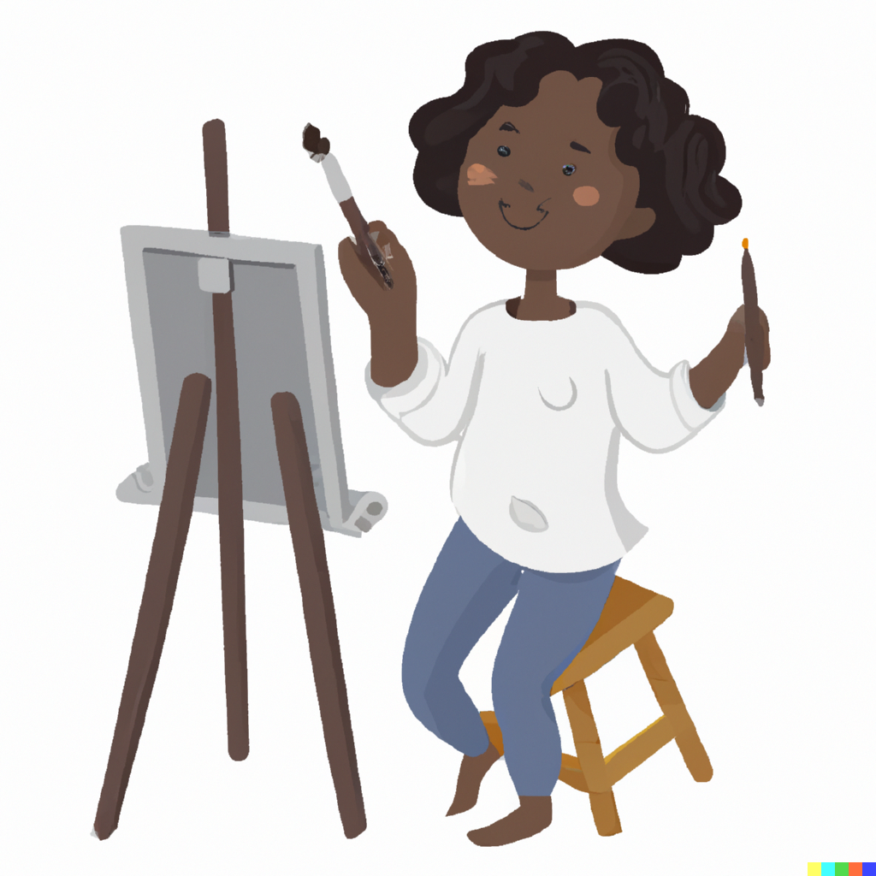
Introduction
It’s science!
Did you know that art is scientifically proven to make us feel better?
Notes:
Artwork generated in Dall-E AI based on a prompt by Amy Bultena

Slide 9
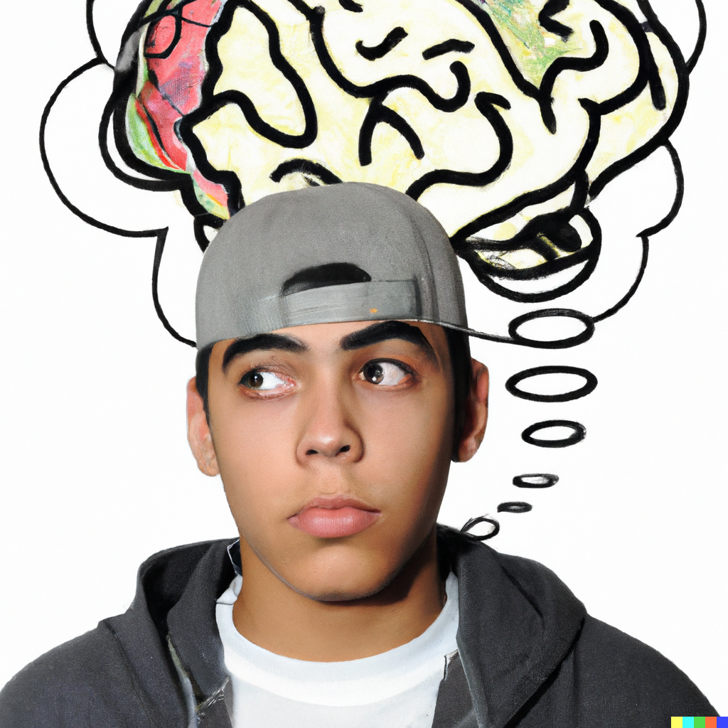
Introduction
We are going to create art to help us:
Feel better
Think about ourselves
Notes:
Artwork generated in Dall-E AI based on a prompt by Amy Bultena

Slide 10
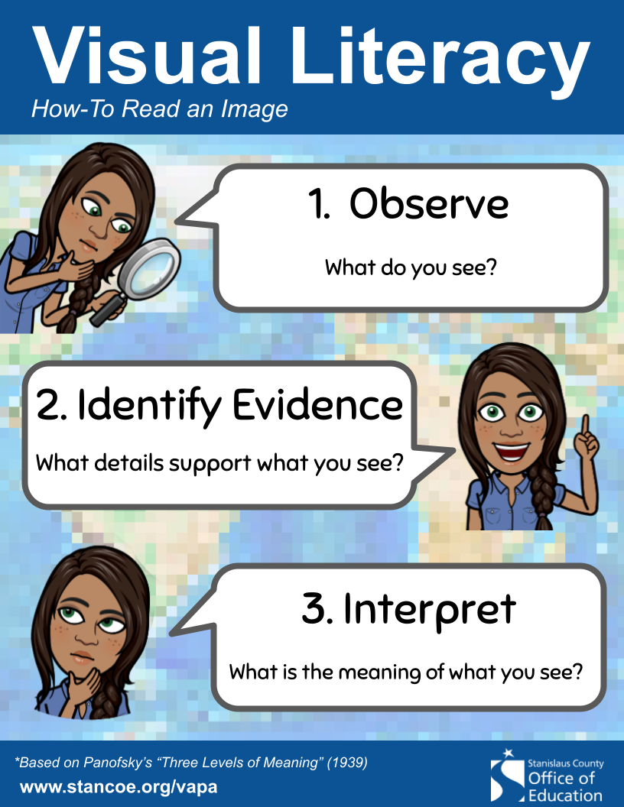
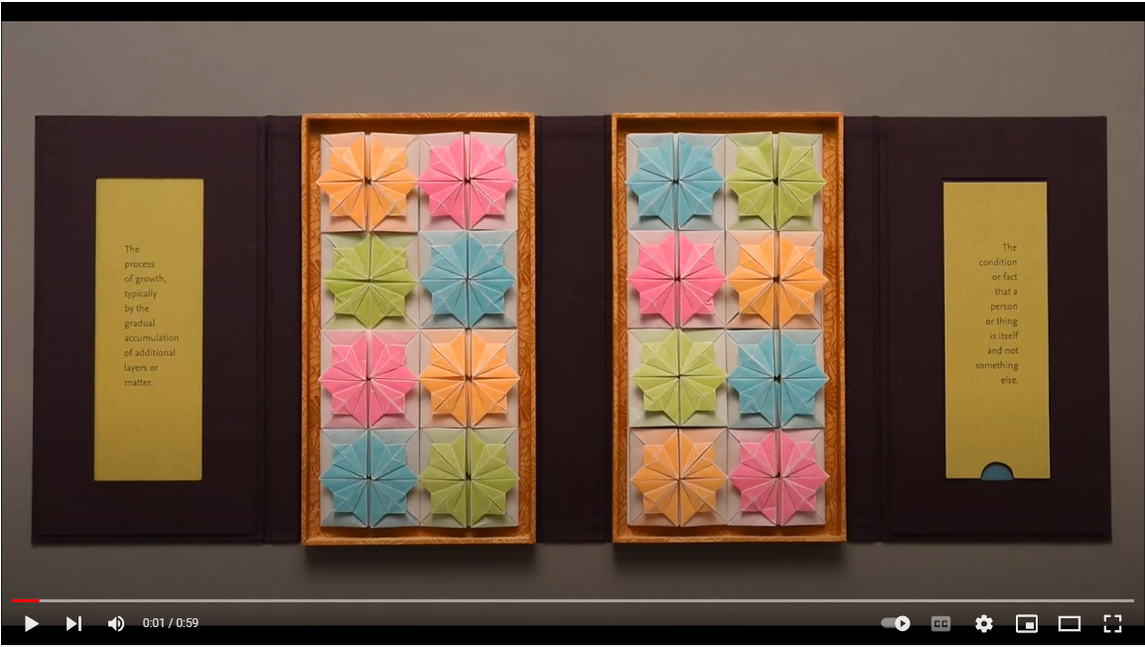
Demo & Lecture: Visual Literacy
Watch video to view artwork https://youtu.be/LGhbRjNjW0U (0:59 seconds)
Notes:
https://en.wikipedia.org/wiki/Composition_VII#/media/File:Vassily_Kandinsky,_1913_-_Composition_7.jpg

Slide 11
Demo & Lecture: Visual Literacy
This is an artist book made by Julie Chen.
The title is Accretion of Identity.
Chen explains this artwork “explores various ways in which individual identity is developed.”
Accretion of Identity, Julie Chen, 2022
Notes:
https://flyingfishpress.com/portfolio-item/the-accretion-of-identity/

Slide 12
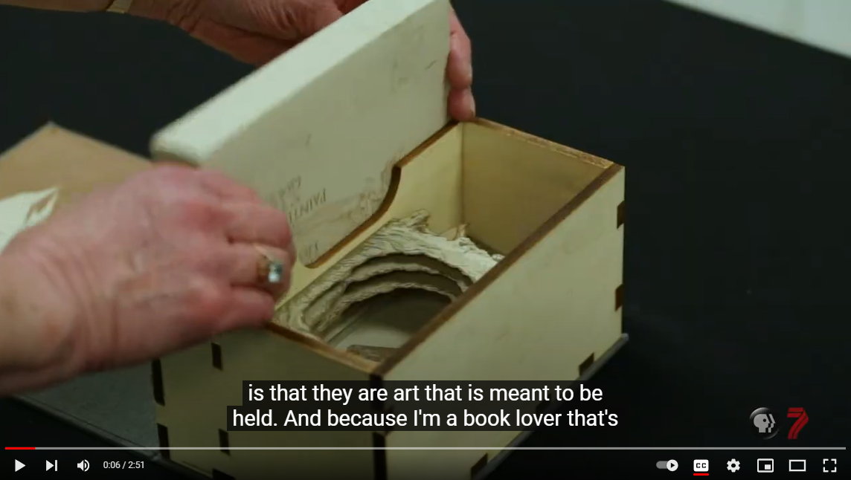
Demo & Lecture: Artists’ Books
Artists' books, also known as book arts, are special artworks that use the form of a book.
Instead of just being regular books you find in a store, these artworks are created by artists and are limited editions.
Sometimes, they're even one-of-a-kind, which means there's only one of them in the whole world.
Watch, Artists Books - PBS Utah https://youtu.be/AaynQuQyMnc (2:51 mins)

Slide 13
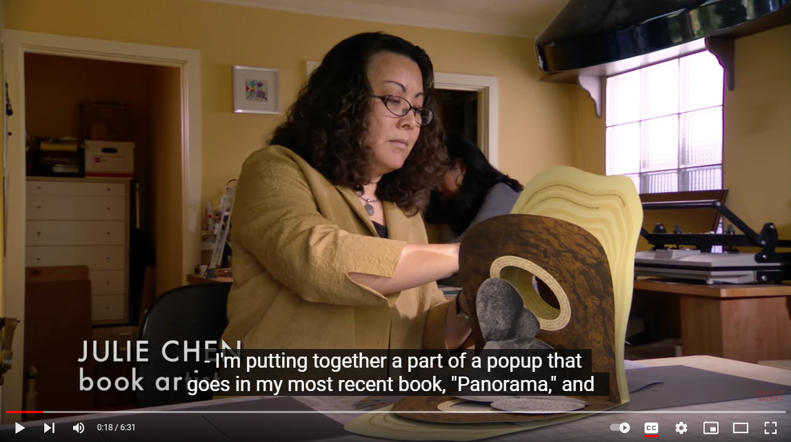
Demo & Lecture: Artists’ Books
Watch, Book Artist Julie Chen, PROCESS - Craft in America https://youtu.be/8rebvFWceFE (6:31 mins)

Slide 14
Demo & Lecture: Artists’ Books
Art History Lessons, Laura Davidson, 2005
What’s Happening With Momma? Clarissa Sligh, 1988
We Are Tiger Dragon People, Colette Fu, 2008-2013
Storm Sequence, Alisa C. Banks, 2011
Dolls of Africa, Freya Diamond, 2016
Fenway Park, Laura Davidson, 2008
Gifts From Our Elders, Kerry McAleer-Keeler, 2014
Plinitude, M.L. Van Nice, 1994
World Without End, Julie Chen, 1999
Gold Rush, Jill Timm, 2013
The Ultimate Safari, Nadine Gordimer, Aletah Masuku, Alsetah Manthosi, Dorah Ngomane, 2001
Based on the interests of those in your classroom, choose 1-2 of the following contemporary artist’s books.
Discuss how the artist is telling a story through the form of a book.

Slide 15
Project Overview
You are going to create a three-square unfolding artist book. Your book will have a minimum of four inserts. As the book unfolds you will add art about your place in the world, your identity, and your feelings.

Slide 16
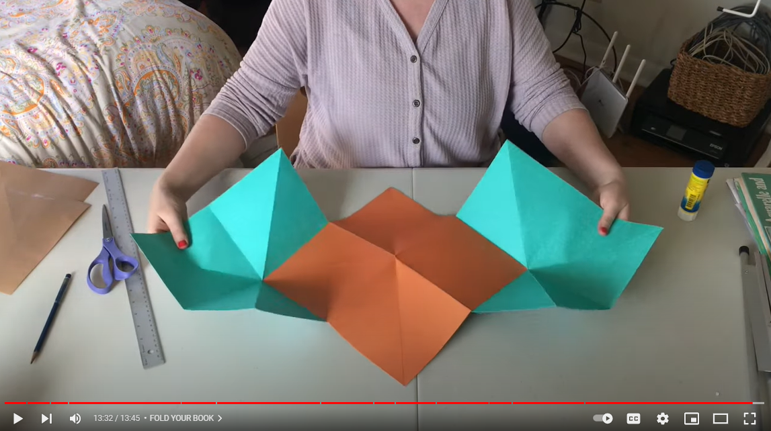
Students-at-Work: Book Structure
To begin, you need to know how to create the structure of your book (the page inserts).
Watch this video to learn how to build the structure of your book.
Your book must have at least four inserts.
How To Make An Explosion Book, https://youtu.be/B_j63YjWHlM (13:45 mins)
Pictorial, step-by-step instructions available here.
Notes:
https://discover.hubpages.com/education/three-square-unfolding-book

Slide 17
Students-at-Work: Book Contents
Now that your book has a structure, it is time to create the content.
Create artwork on surfaces of your book.
What you create should relate to your place in the world, your identity, and your feelings. There are only right answers.
Consider using different types of materials:
  Drawing materials
  Painting materials
  Collage materials
  Other materials

Slide 18
Critique
What feelings came up as your created your book?
What do the colors, shapes, and lines in your book mean to you?
If your book could talk, what would it say to you?
What title would you give your book?
How does this artwork relate to your life right now?

Slide 19
How are you feeling after making your artwork?
Do you feel better, worse, or the same? Why?
Notes:
https://pixabay.com/illustrations/emotion-scale-emoji-icon-feedback-3404484/

Slide 20
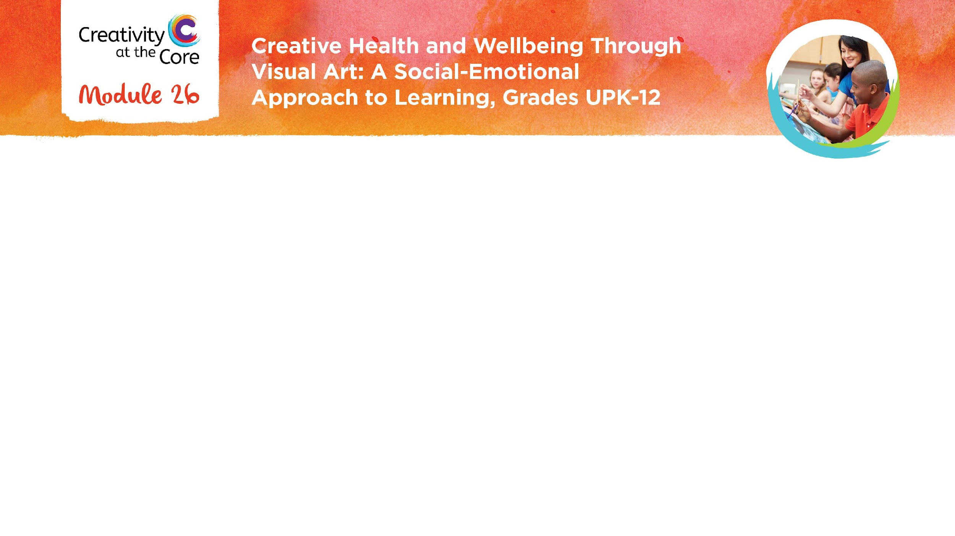
Closing Slide

