Slide 1
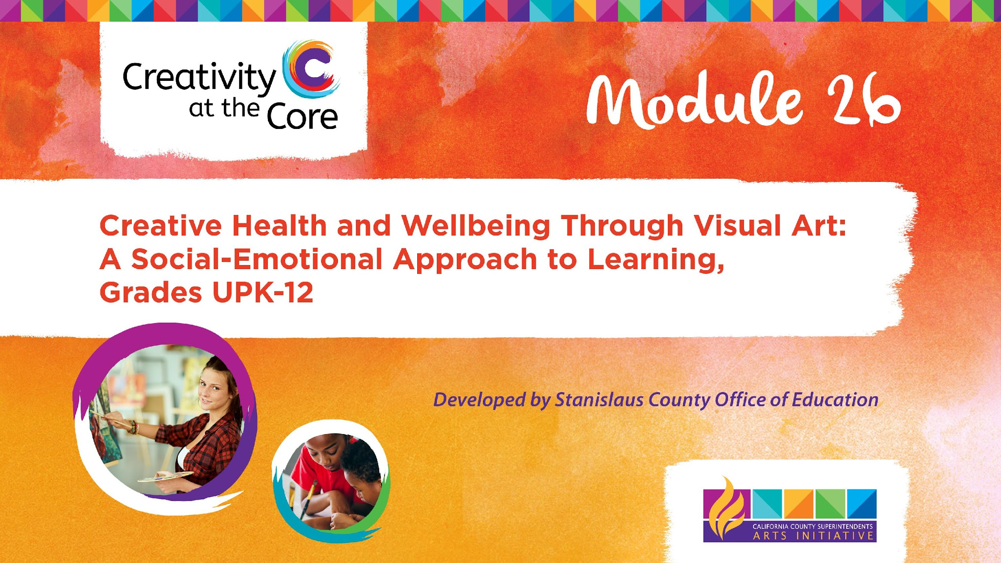
Grades 9 – 12 Project: My Color and Shape Journey​

Slide 2
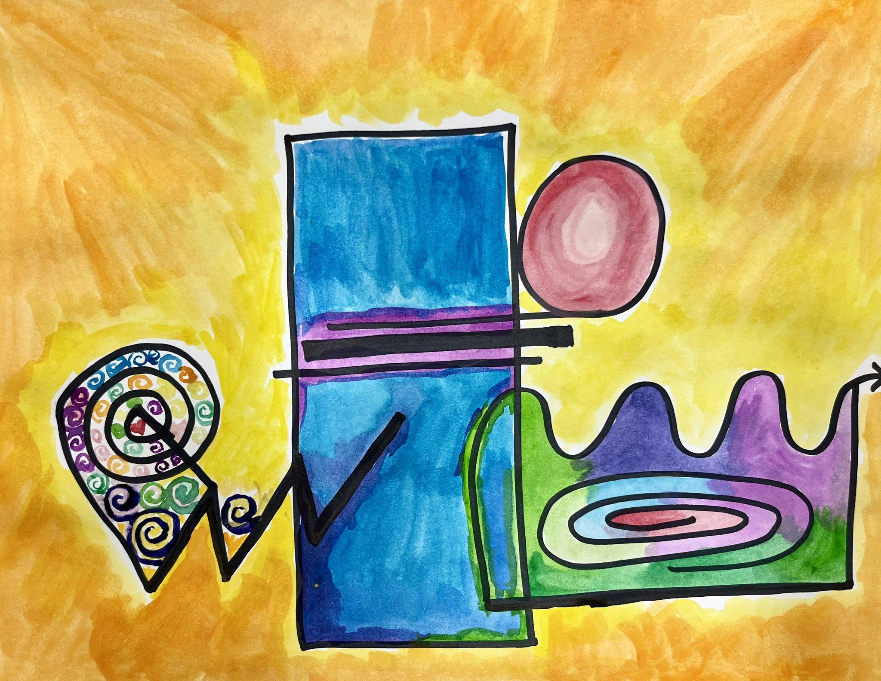
Grades 9 – 12 Project: My Color and Shape Journey
Learning Outcomes
Create an abstract artwork depicting a life journey through the use of shape, line, and color.

Slide 3
Grades 9 – 12 Project: My Color and Shape Journey
SEL Core Competencies Addressed
Self-Awareness
Self-Management
Social Awareness
Visual Art Standards
Prof.VA:Cr1.2 - Shape an artistic investigation of an aspect of present-day life using a contemporary practice of art or design.
Prof.VA:Cr2.1 - Engage in making a work of art or design without having a preconceived plan.

Slide 4
Grades 9 – 12 Project: My Color and Shape Journey
Materials Needed
Scratch paper
12 x 18 inch white paper
Black permanent marker
Paint brushes
Watercolor paint

Slide 5
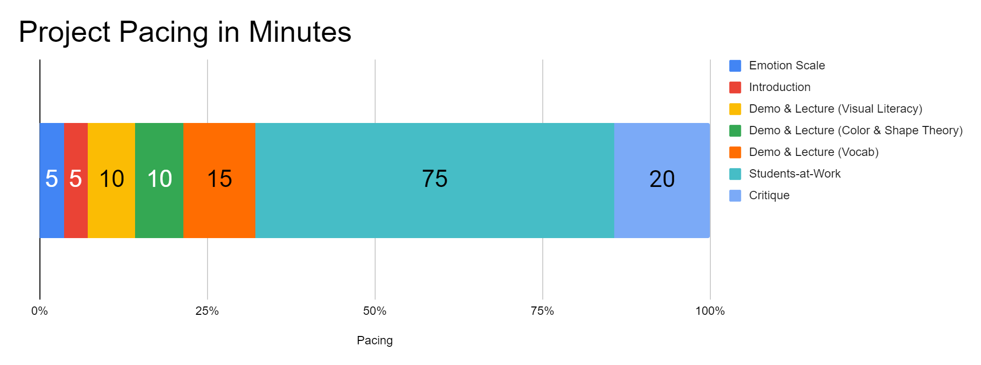
Project Pacing
Pacing structure follows the guidance of the Studio Habits of Mind framework.

Slide 6

How are you feeling right now?
Notes:
https://pixabay.com/illustrations/emotion-scale-emoji-icon-feedback-3404484/

Slide 7

Introduction
Goals for this creative experience:
Be present not perfect
Use positive language to talk about what you and others create
Feel better than when you started
Notes:
Artwork generated in Dall-E AI based on a prompt by Amy Bultena

Slide 8

Introduction
It’s science!
Did you know that art is scientifically proven to make us feel better?
Notes:
Artwork generated in Dall-E AI based on a prompt by Amy Bultena

Slide 9

Introduction
We are going to create art to help us:
Feel better
Think about ourselves
Notes:
Artwork generated in Dall-E AI based on a prompt by Amy Bultena

Slide 10
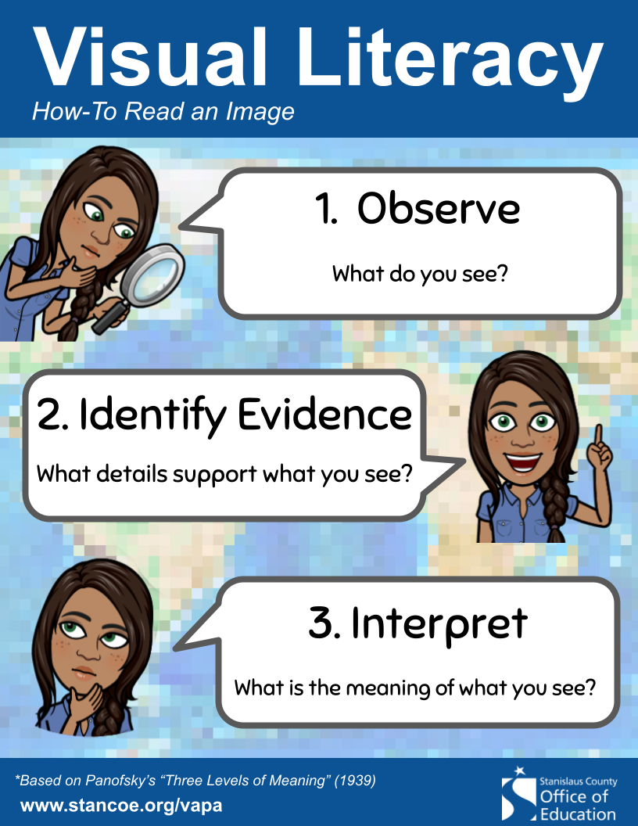
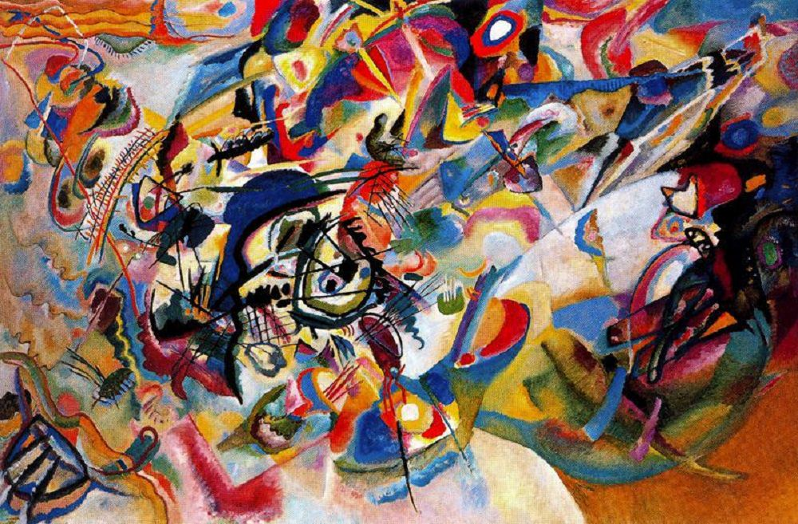
Demo & Lecture: Visual Literacy
Notes:
https://en.wikipedia.org/wiki/Composition_VII#/media/File:Vassily_Kandinsky,_1913_-_Composition_7.jpg

Slide 11
Demo & Lecture: Visual Literacy
Artists tell stories using colors, shapes, and lines.
This artwork depicts a journey from the Garden of Eden, to the Great Flood, to the Resurrection..
Composition 7, Wassily Kandinsky,1913
.

Slide 12
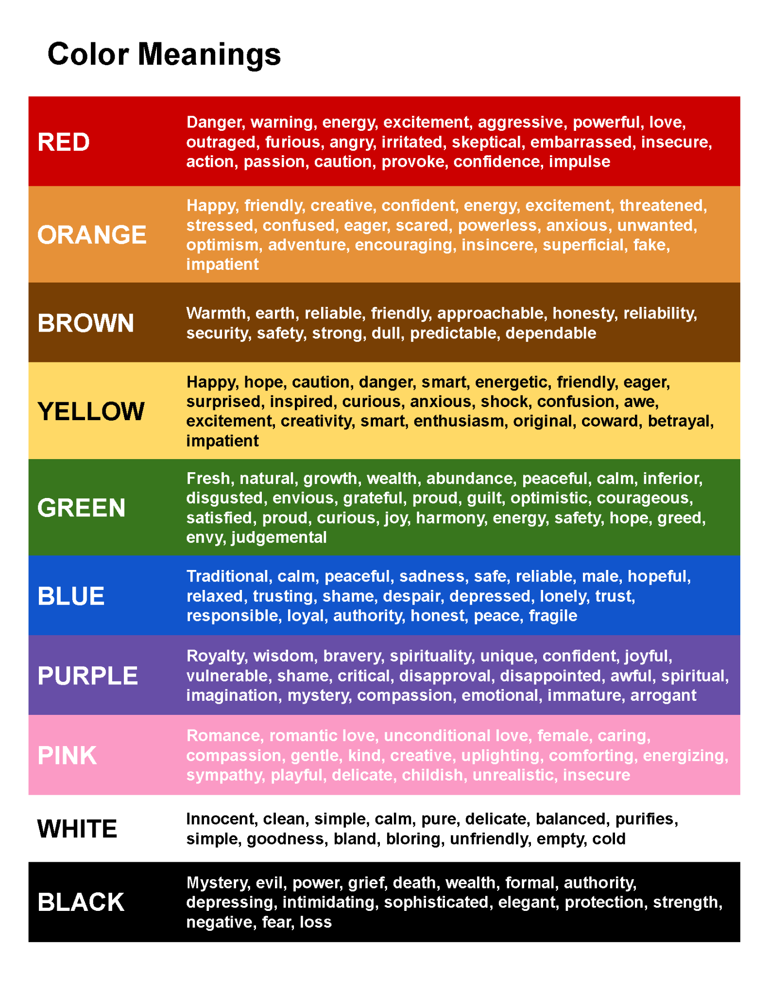

Slide 14
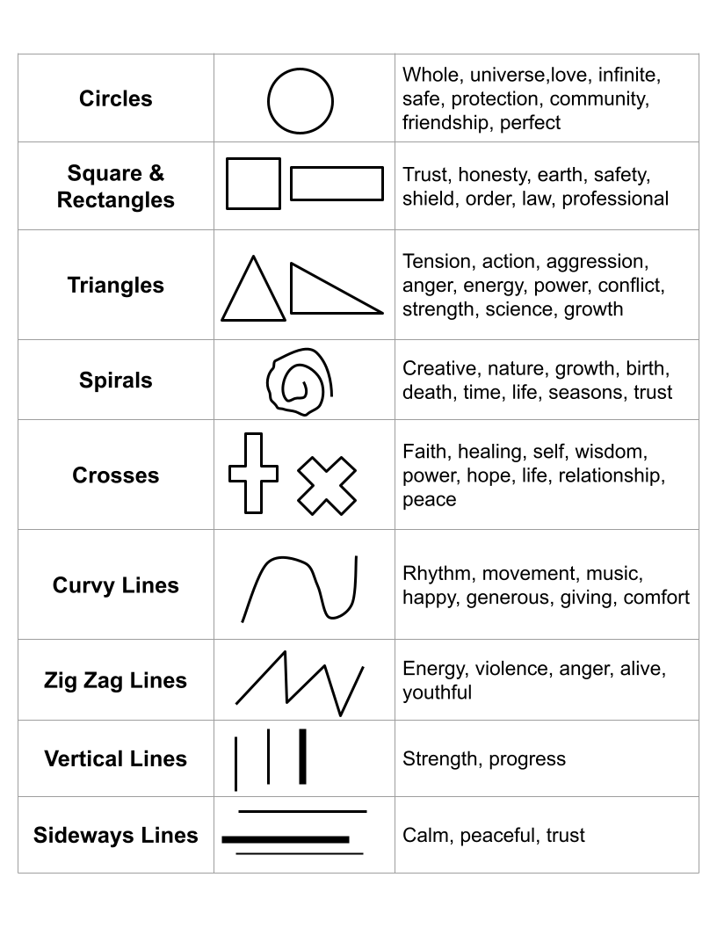

Slide 16
Project Overview
You are going to create an artwork about your life journey (past, present, & future).
This artwork will be abstract.
Do you know what abstract means?
Student artwork showing shapes representing their past, present, and future.

Slide 17
Demo & Lecture: Vocabulary
Abstract art is a style of art that doesn’t try to show things like people, objects, or places in a realistic way.
Uses shapes, lines, and colors like a language to create a feeling or mood
Looks different to different people, and it lets you use your imagination to see and feel different things
Composition 7, Wassily Kandinsky,1913
.

Slide 18
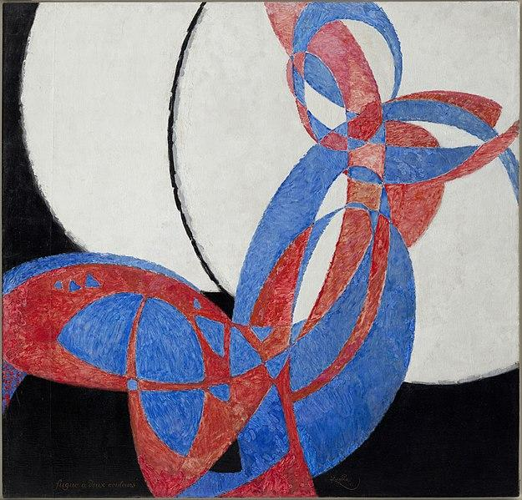
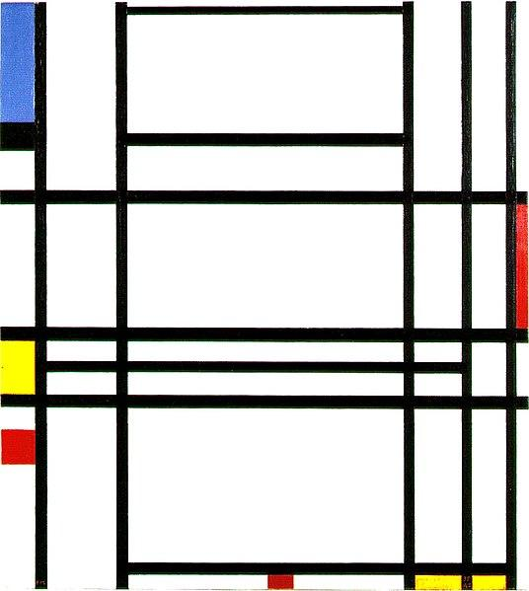
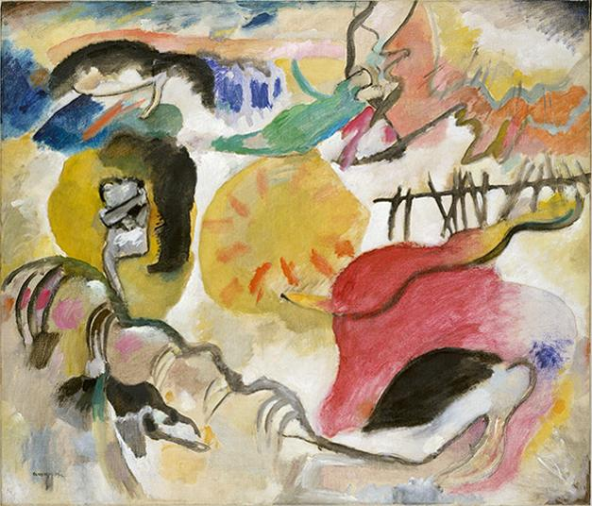
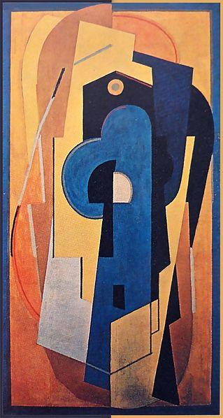
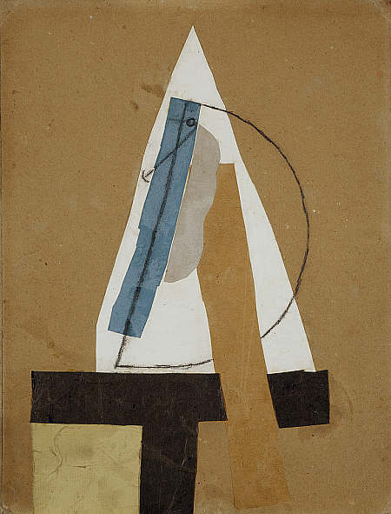
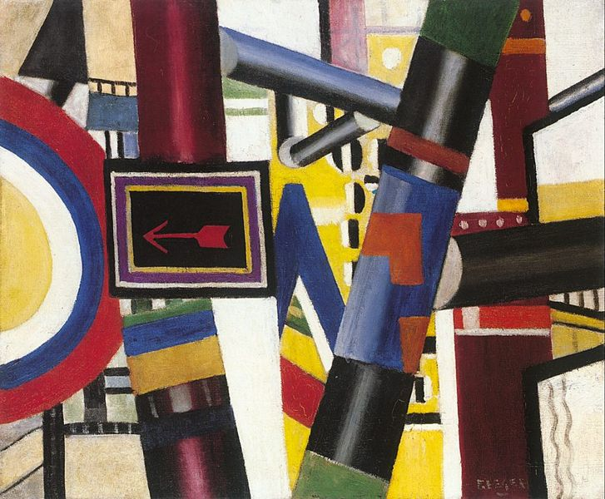
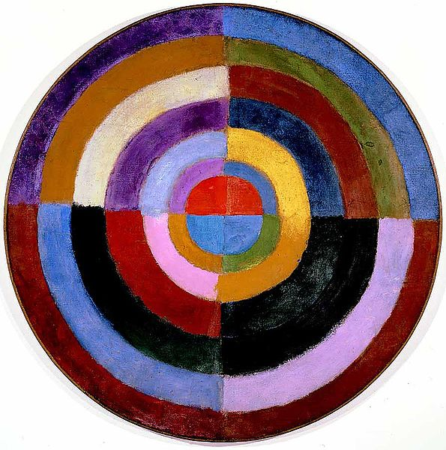
Demo & Lecture: Vocabulary
Abstract art is a style of art that doesn’t try to show things like people, objects, or places in a realistic way.
These are all abstract artworks.
Notes:
https://en.wikipedia.org/wiki/File:Robert_Delaunay,_1913,_Premier_Disque,_134_cm,_52.7_inches,_Private_collection.jpg
https://en.wikipedia.org/wiki/File:Franti%C5%A1ek_Kupka,_1912,_Amorpha,_fugue_en_deux_couleurs_(Fugue_in_Two_Colors),_210_x_200_cm,_Narodni_Galerie,_Prague.jpg
https://en.wikipedia.org/wiki/File:Piet_Mondriaan,_1939-1942_-_Composition_10.jpg
https://en.wikipedia.org/wiki/File:Vassily_Kandinsky,_1912_-_Improvisation_27,_Garden_of_Love_II.jpg
https://en.wikipedia.org/wiki/File:Leger_railway_crossing.jpg
https://en.wikipedia.org/wiki/File:Pablo_Picasso,_1913-14,_Head_(T%C3%AAte),_cut_and_pasted_colored_paper,_gouache_and_charcoal_on_paperboard,_43.5_x_33_cm,_Scottish_National_Gallery_of_Modern_Art,_Edinburgh.jpg
https://en.wikipedia.org/wiki/File:Albert_Gleizes,_1921,_Composition_bleu_et_jaune_(Composition_jaune),_oil_on_canvas,_200.5_x_110_cm_DSC00547.jpg

Slide 19

Students-at-Work: Getting Started
First, let’s create a shape that represents where you are now in your life journey.
Get out the Shape Sheet Handout and a black permanent marker.
This is on scratch paper, so mess ups are fine.
Notes:
https://www.wallpaperflare.com/person-holding-black-marker-person-holding-black-pen-hand-paper-wallpaper-zpywy

Slide 20
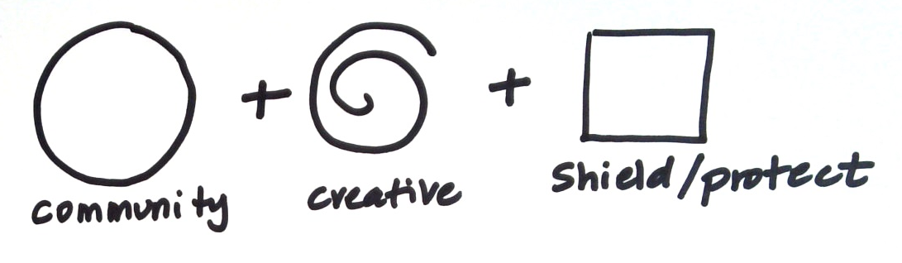
Students-at-Work
Look at the shape sheet and identify 2-4 shapes that represent you in some way.
Draw them on top 1/3 of your paper.

Slide 21
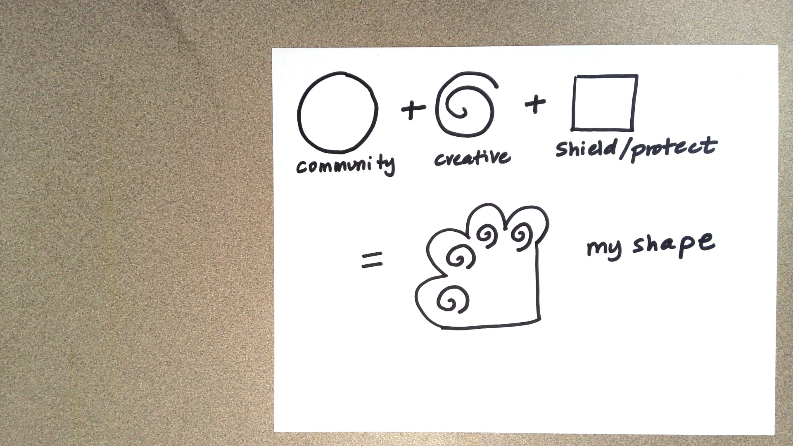
Students-at-Work
Using those shapes, create a new shape. This shape represents you right now. This is where you are in your life journey. This is your present.

Slide 22
Students-at-Work
Life Event in the Past
Think about an important life event that happened in your past.
Using the same process as before, create a shape that represents this event in your life.
Shape representing your PAST

Slide 23
Students-at-Work
Life Event in the Future
Think about an important life event that happened in your past.
Using the same process as before, create a shape that represents this event in your life.
Shape representing your FUTURE

Slide 24
Students-at-Work
Get out the large sheet of white paper (12 x 18 inches).
Combine all three life journey events (past, present and future) into one abstract artwork.
Materials
Permanent markers
Watercolor paint
Student artwork showing shapes representing their past, present, and future.

Slide 25
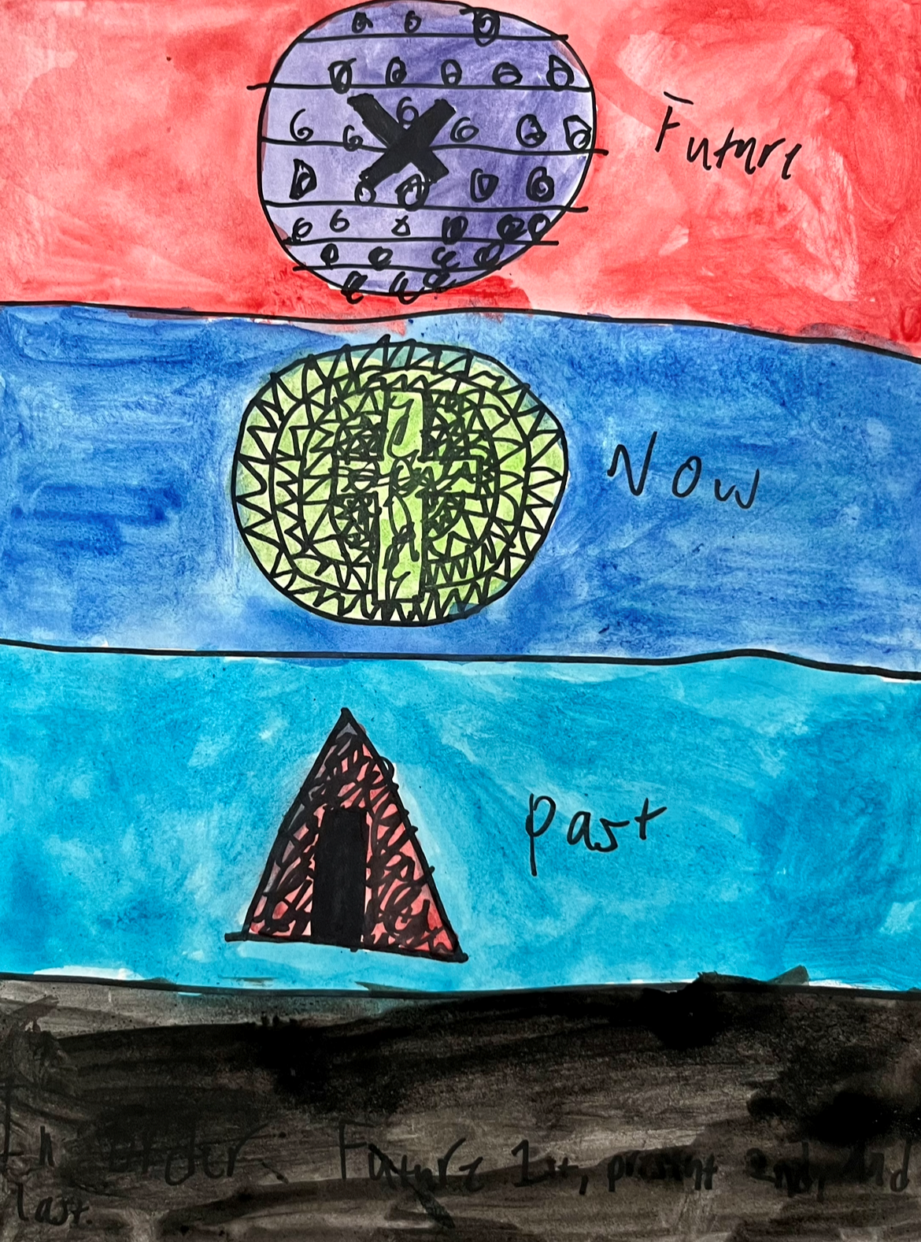
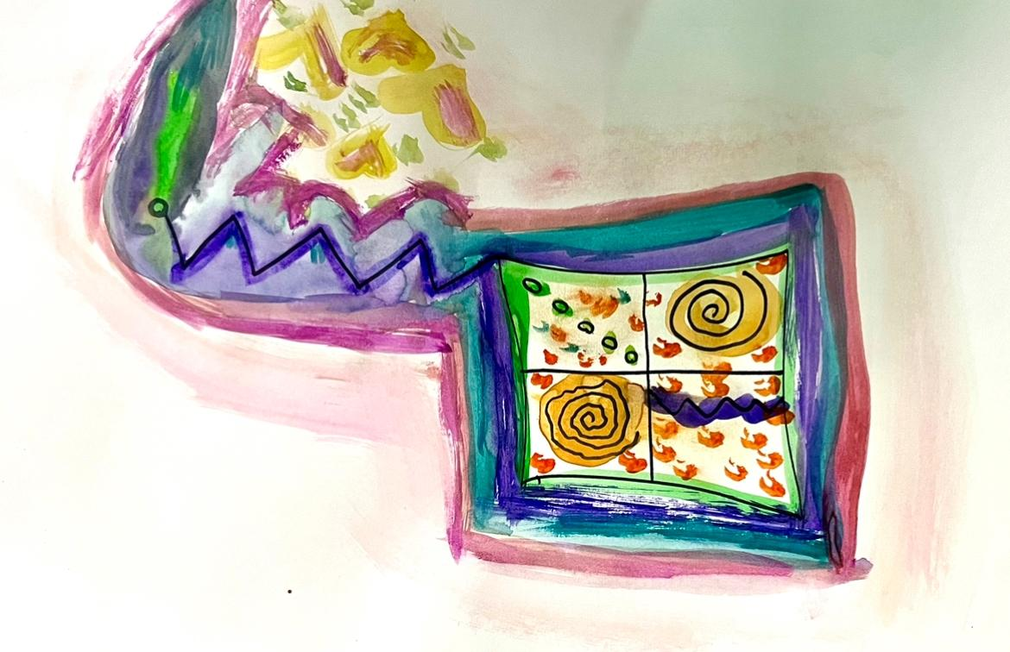
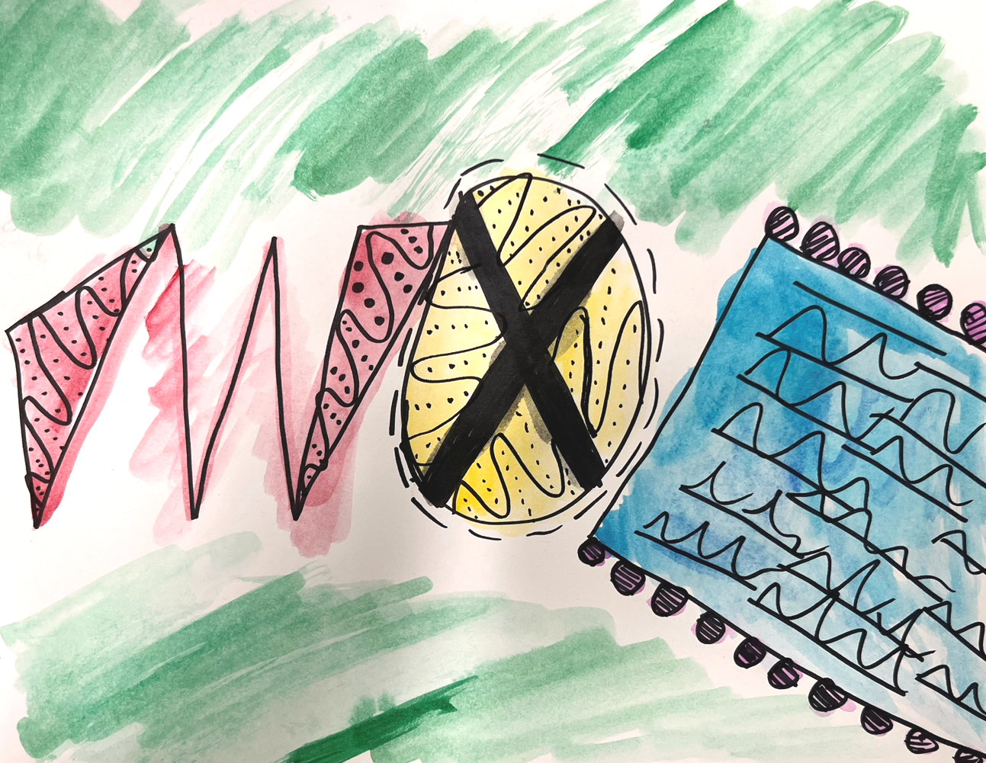
Student Examples
Notice how these students only used colors, shapes, and lines to share their journey.
Remember, it is important to be present; do not worry about being perfect.

Slide 26
Critique
Look at your artwork. How does it feel to look at your entire journey?
How did you use color and shape to tell your story?
Optional: Write a short journal entry explaining the meaning behind your artwork.
Student artwork showing shapes representing their past, present, and future.

Slide 27
How are you feeling after making your artwork?
Do you feel better, worse, or the same? Why?
Notes:
https://pixabay.com/illustrations/emotion-scale-emoji-icon-feedback-3404484/

Slide 28

Closing Slide

