Slide 1
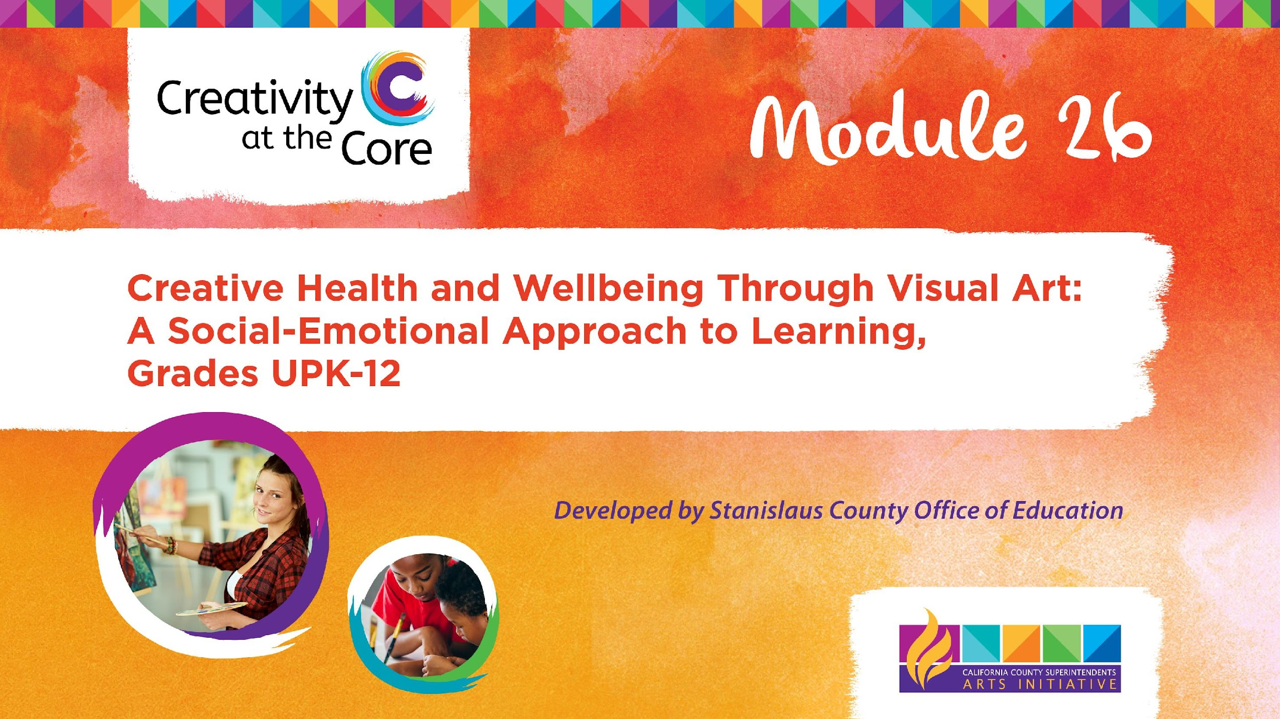
Grades UPK, TK, K Project: Marble Mandala​

Slide 2
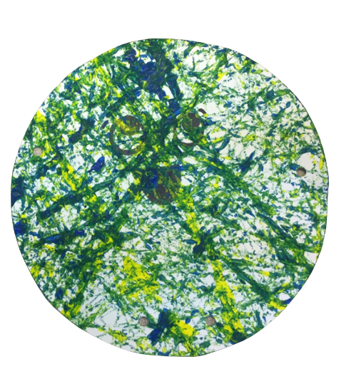
Grades UPK, TK, K Project: Marble Mandala
Learning Outcomes
Alone or in pairs, students create process-based artworks using sensory skills and tools alongside choice making based on self-awareness, self-management, and relationship skills.

Slide 3
Grades UPK, TK, K Project: Marble Mandala
SEL Core Competencies Addressed
Self-Awareness
Self-Management
Relationship Skills
Visual Art Standards
DRDP VPA 1 Visual Art - Engages with tools and materials for painting or drawing or sculpting, as a primarily sensory experience.
CA Preschool Learning Foundations (Around 60 Months) - Recognize and name materials and tools used for visual arts.
PK.VA:Cr1.2 - Engage in self-directed, creative art-making.
PK.VA:Cr2.1 - Use a variety of art-making tools.
K.VA:Cr1.1 - Engage in exploration and imaginative play with various art materials.
K.VA:Cr2.1 - Through experimentation, build skills in various media and approaches to artmaking.

Slide 4
Grades UPK, TK, K Project: Marble Mandala
Materials Needed
White paper
Cardboard lids (copy paper box lids work great)
Chopsticks
Marbles
Red liquid tempera paint
Yellow liquid tempera paint
Blue liquid tempera paint

Slide 5
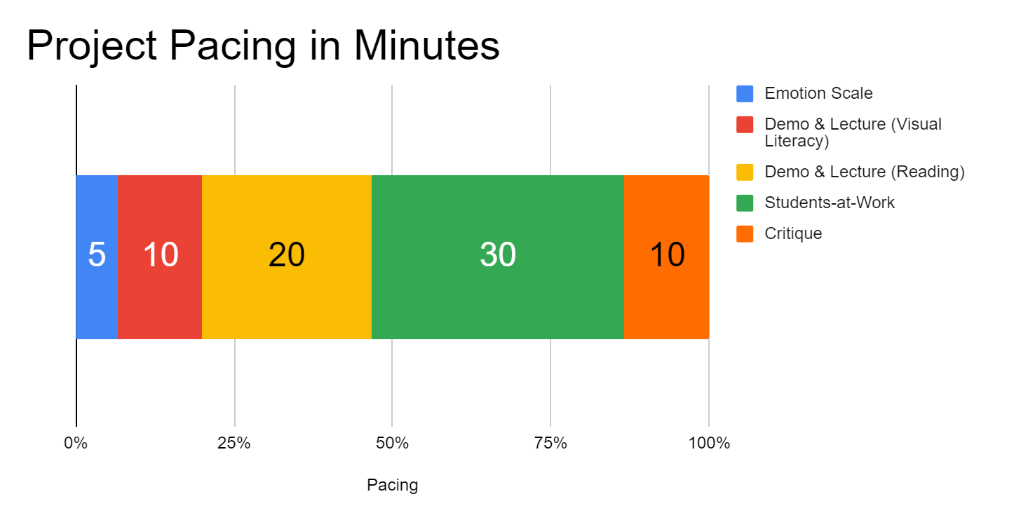
Project Pacing
Pacing structure follows the guidance of the Studio Habits of Mind framework.

Slide 6
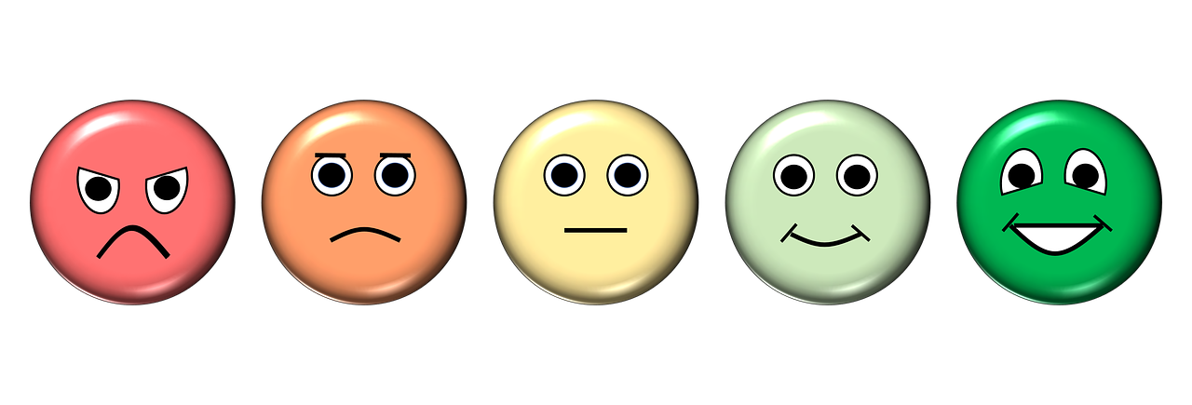
How are you feeling right now?
Notes:
https://pixabay.com/illustrations/emotion-scale-emoji-icon-feedback-3404484/

Slide 7
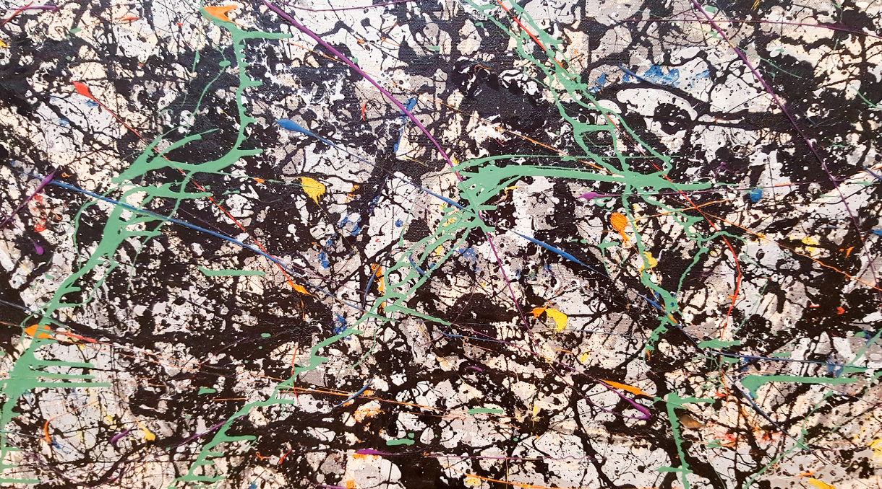
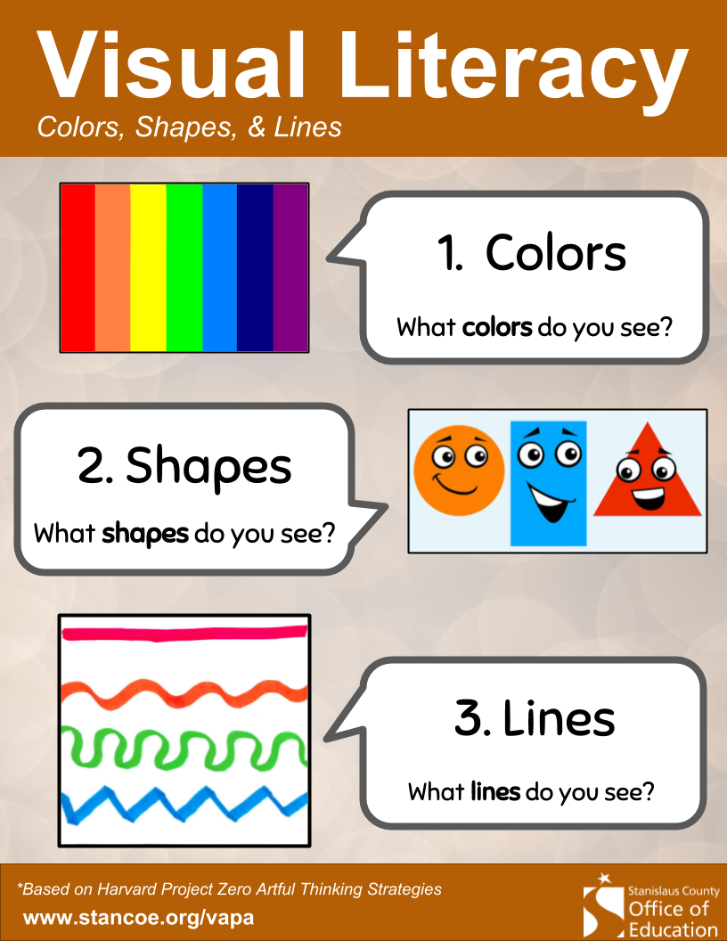
Demo & Lecture: Visual Literacy
Close up of Jackson Pollock painting, Jackson Pollock, 1947
Notes:
https://www.flickr.com/photos/edbierman/27002370216/in/photolist-H97cVb-eFrHRp-GLQxQU-T7nZf-2m8bcGz-23GdqXM-YGwT61-E9thz-adgA5-T6Zkx-spf1Nv-facre3-dzkmEt-RpZbLX-d9hGmN-CQbdC5-5THWYD-E9s4C-kQauua-T6Zqk-58bcF7-4jdUEo-2nohZrv-3PttGt-78CLxq-2nohZug-2nohZoQ-T6ZHK-irLYaY-dbLg98-E9thw-2k1UdS9-E9thy-7qytHJ-2noj6sc-2noj6ma-2jDHfJP-2nocxGi-E9tht-zJnA3x-Esfbd-Esgb4-Esfb9-4bY1ey-kHrDS-2bLKmSi-TnZ41r-NAzFM7-Rzgwqs-Esfbj/

Slide 8
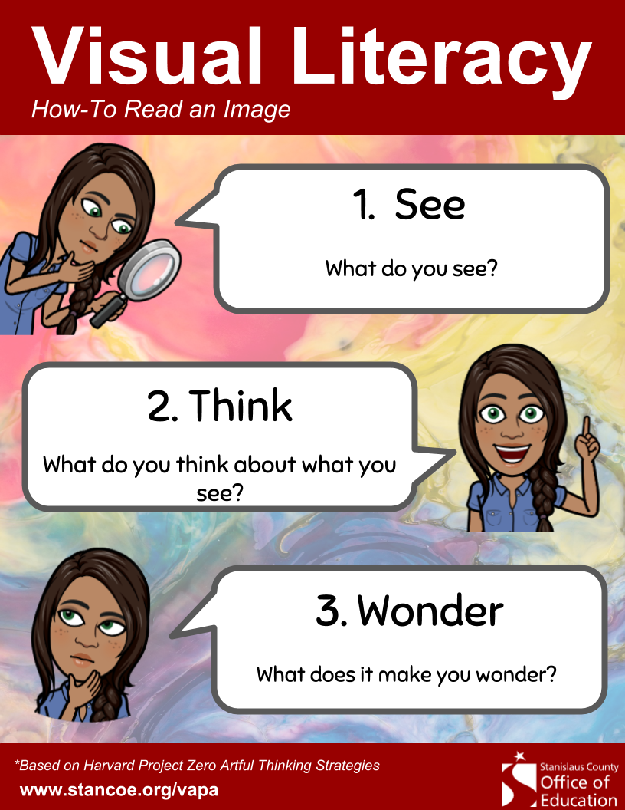
Demo & Lecture: Visual Literacy
Close up of Jackson Pollock painting, Jackson Pollock, 1947
Notes:
https://www.flickr.com/photos/edbierman/27002370216/in/photolist-H97cVb-eFrHRp-GLQxQU-T7nZf-2m8bcGz-23GdqXM-YGwT61-E9thz-adgA5-T6Zkx-spf1Nv-facre3-dzkmEt-RpZbLX-d9hGmN-CQbdC5-5THWYD-E9s4C-kQauua-T6Zqk-58bcF7-4jdUEo-2nohZrv-3PttGt-78CLxq-2nohZug-2nohZoQ-T6ZHK-irLYaY-dbLg98-E9thw-2k1UdS9-E9thy-7qytHJ-2noj6sc-2noj6ma-2jDHfJP-2nocxGi-E9tht-zJnA3x-Esfbd-Esgb4-Esfb9-4bY1ey-kHrDS-2bLKmSi-TnZ41r-NAzFM7-Rzgwqs-Esfbj/

Slide 9

Demo & Lecture: Reading
Suggested but not required reading:
Monsters Love Colors
by Mike Austin
Follow-up questions:
What is the story about?
What happens in the story?
How does the story end?

Slide 10
Project Overview
Do you think you could create some artwork using color like the monsters in Monsters Love Color did?
Let’s try it out!

Slide 11
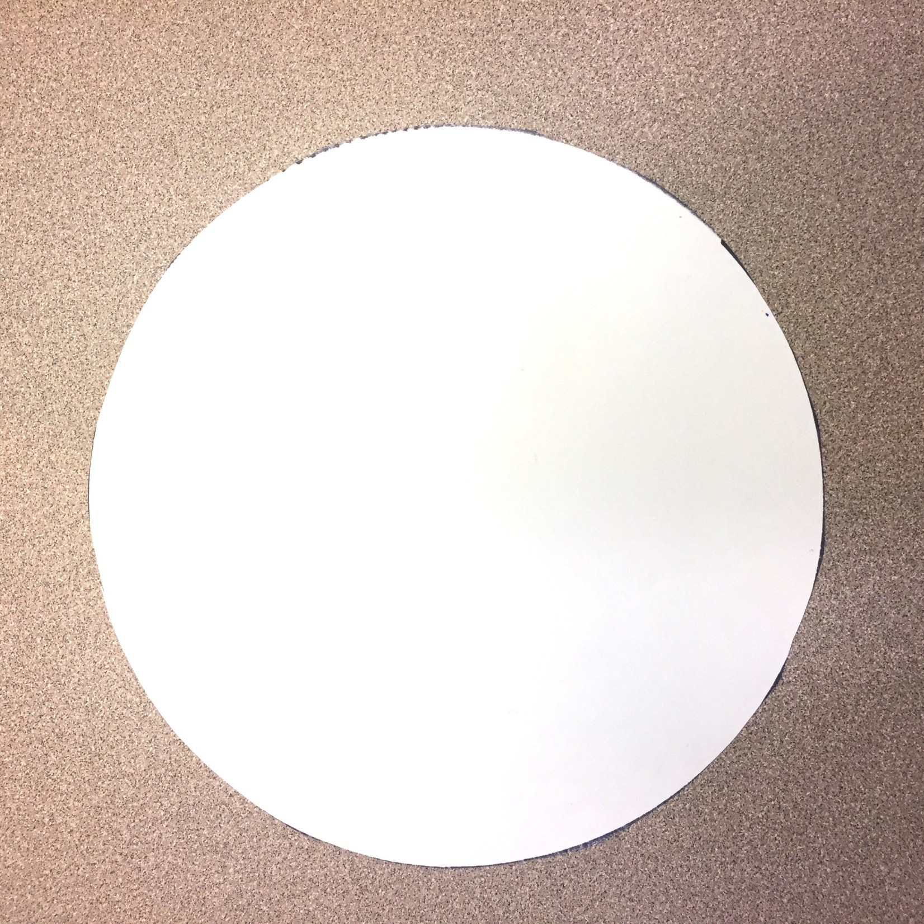
Students-at-Work
Use a sheet of paper; it could be any shape.
The example used is a circle
This is a great opportunity to use a triangle, square or rectangle. If you have multiple shapes: allow students to select their shape.

Slide 12
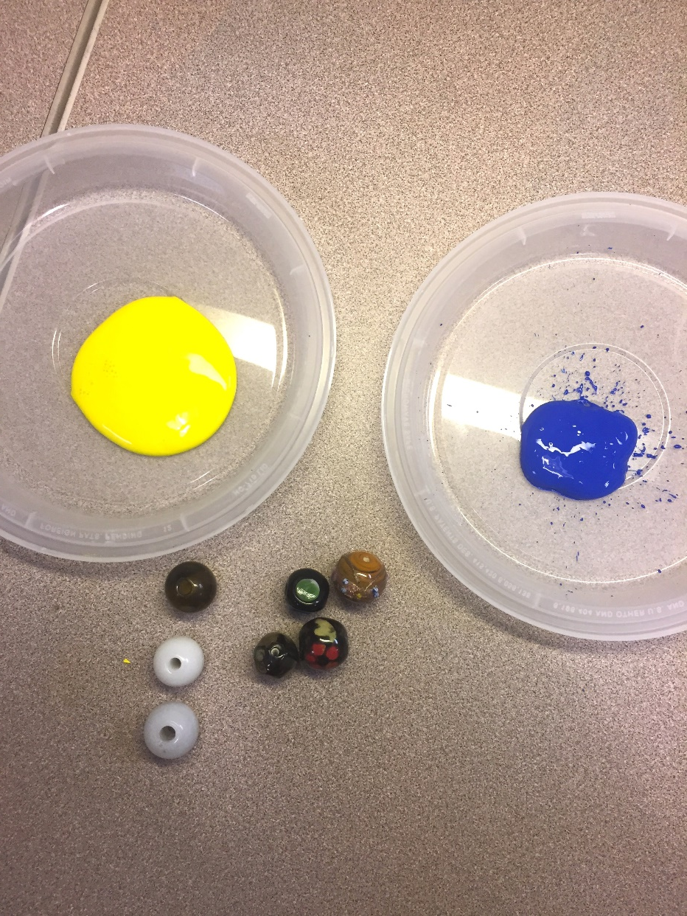
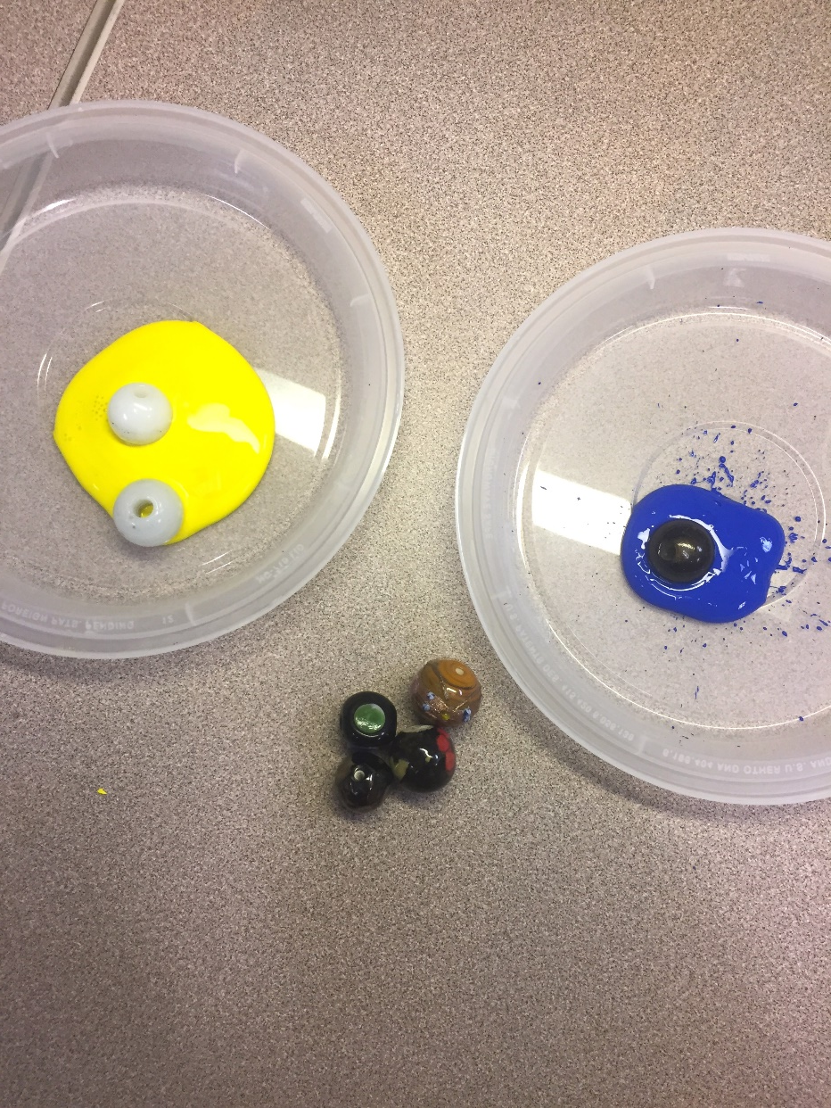
Students-at-Work
Place 2 pieces of white paper (or pre-cut shapes) into cardboard lids.
Set out liquid tempera paint in red, blue, and green.
Allow students to select ONE color and ONE marble
Students place the marble in their paint color

Slide 13
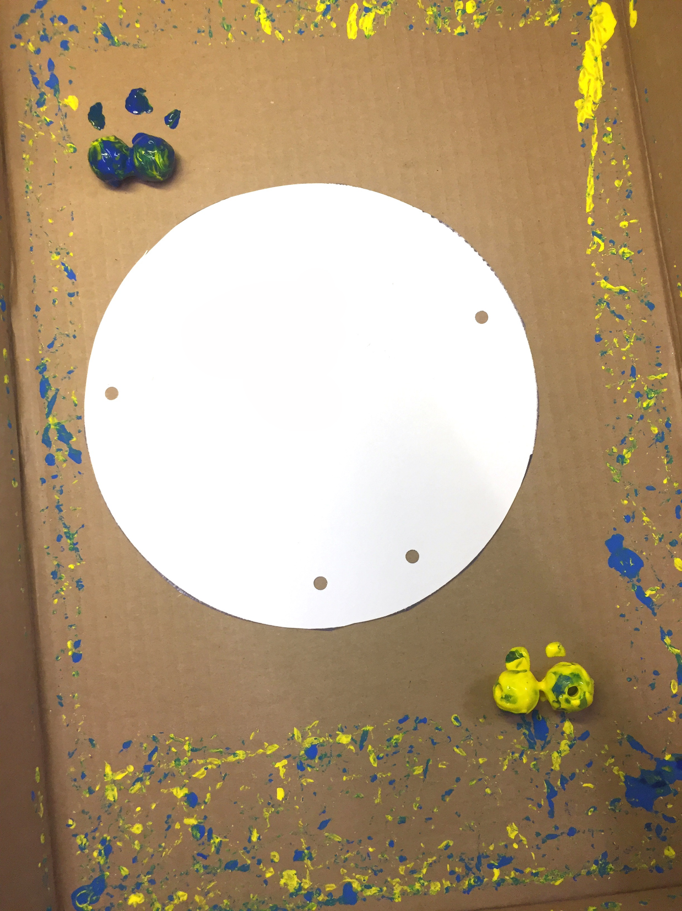
Students-at-Work
5. Students use a spoon to transfer their marble from paint to cardboard tray.
6. There should be 2 students per tray; 2 different colored marbles per tray
There should be 2 sheets of paper in the tray.

Slide 14
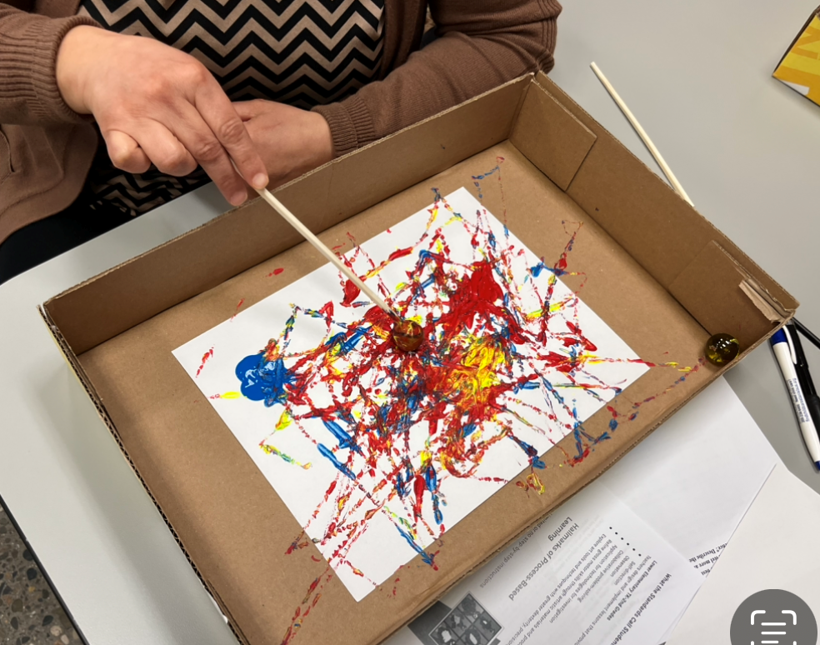
Students-at-Work
7. Each student gets 1 chopstick
8. The students use their chopsticks to move their paint-covered marbles around the tray.
9. Students make observations about what happens to the colors as they move the marbles.

Slide 15
Students-at-Work
Allow to dry to overnight.
While drying (or next day) reflect on art-making with students (see next slide).

Slide 16
Critique
How did you make your art?
Was it hard to keep the marble in the tray? What did you do to keep the marble in the tray?
How did you and your partner work together?
What colors did you use?
What happened to the colors as you used them?
What did you like the most?
What did you like the least?
How did making art make you feel?
If your art could talk what would it say?

Slide 17
How are you feeling after making your artwork?
Do you feel better, worse, or the same? Why?
Notes:
https://pixabay.com/illustrations/emotion-scale-emoji-icon-feedback-3404484/

Slide 18

Closing Slide

