Slide 1
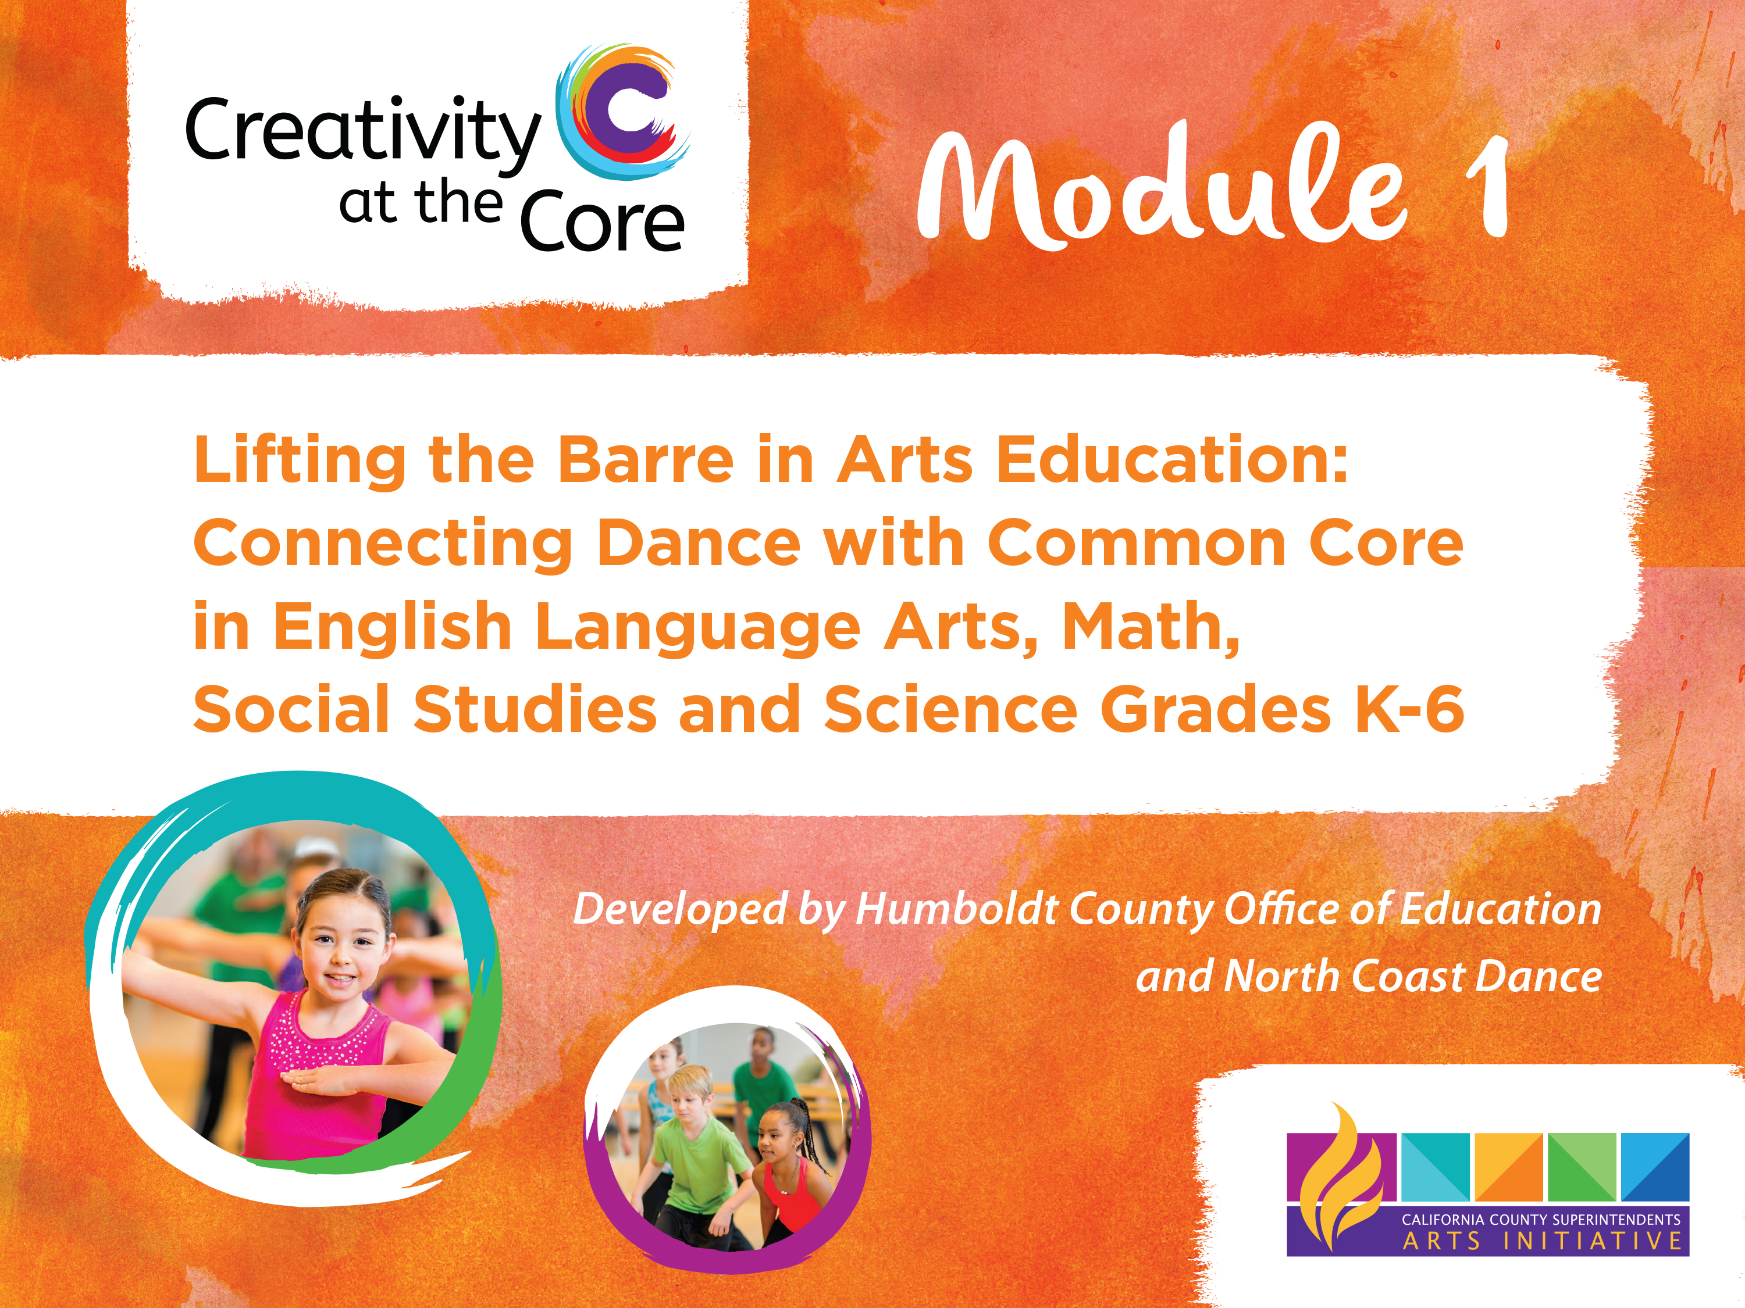
Notes:
TUTORIAL!

Slide 2



Tutorial
Equipping K-6 teachers with an understanding of Common Core and Dance Standards to promote Arts Integration.
Educators can either self-pace through this training module or download it and present it to other educators over a 12 hour period.
Notes:
Presentation configurations: Staff meetings, PLC’s, and/or Professional Development workshops.
The entire length is 12 hours, but can be “chunked” in as few as 2 days or 12 days of 1 hour each.

Slide 3

Creativity at the Core Website
www.cacountyarts.org
Notes:
Take them with this hyperlink to the website.

Slide 4
Qualifications of the Presenters:
Ideally, there would be 2 presenters
Knowledgeable in CA Standards, including Common Core and Visual & Performing Arts.
Dance teacher (with or without credential), who is familiar with dance standards, and knowledgeable in a dance genre.
Notes:
Ballet dancer is not required. In fact, because ballet is used in the demo videos, a juxtaposition of another dance genre is PREFERRED.

Slide 5
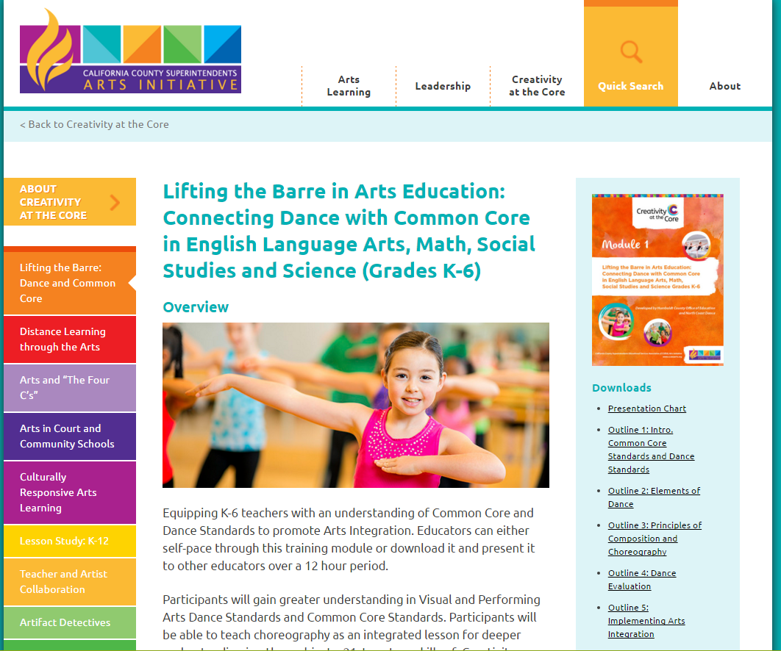
Lifting the Barre in Arts Education
Notes:
Show them the modules, this is module 1.

Slide 6
Module 1 Standards Covered
Common Core State Standards (CCSS)
Visual & Performing Arts (VAPA) – Dance
English Language Development (ELD) Standards
Next Generation Science Standards (NGSS)

Slide 7
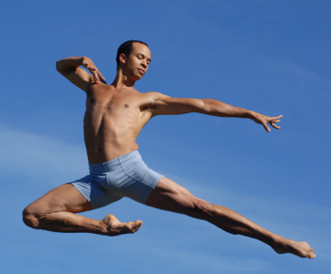
CA Dance Standards Strands
Artistic Perception
Creative Expression
Historical & Cultural Context
Aesthetic Valuing
Connections & Applications
Link to California Dance Standards
Dance photo here
Download the standards at https://www.cde.ca.gov/be/st/ss/vapacontentstds.asp
Notes:
Preload iPads with website.
Discuss Dance Standards
Note: All VAPA standards have these 5 strands

Slide 8

English / Language Arts Common Core Standards
English / Language Arts Common Core Standards
http://estandards
College & Career Readiness Anchor Standards (CCR)
Notes:
Show estandards

Slide 9
How to
talk about dance
How to talk about dance
How does dance relate to:
English/Language Arts
Math
Next Generation Science Standards
Notes:
Ask: How to use the structure of dance to reinforce structures in other subjects?
Why is it important to break down the concepts ot the smallest parts?

Slide 10
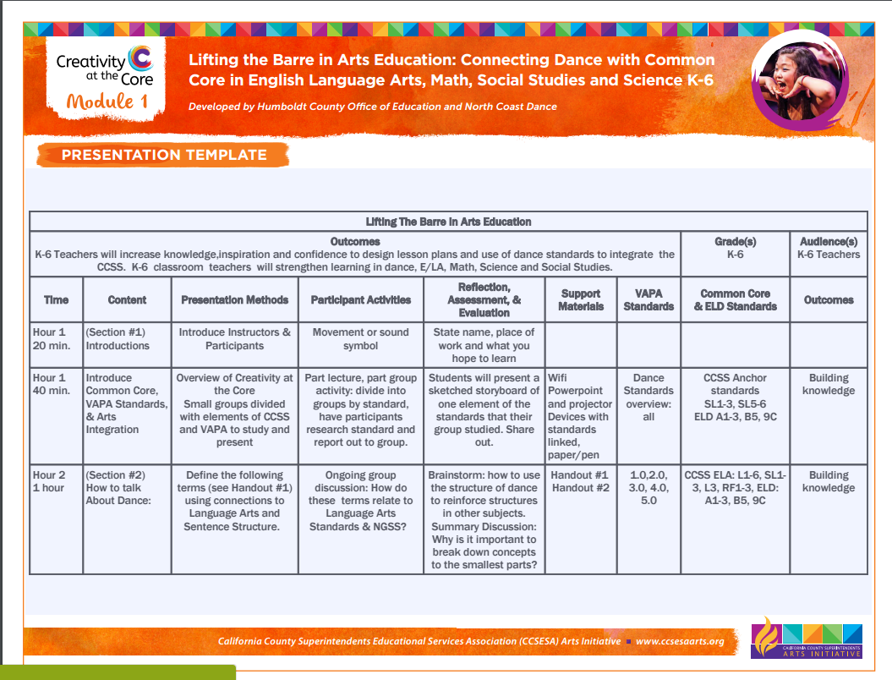
Presentation Chart:
The chart unpacks the module. You will want to read this first. It has each section broken down by hour, objective, standards covered and outcome.

Slide 11
Content Outline
The following outlines can be used to break down your training. These are all available under Downloads.
Introduction, Common Core Standards and Dance Standards
Elements of Dance
Choreography and Principles of Composition
Dance Evaluation
Implementing Arts Integration

Slide 12
Culturally & Linguistically Responsive Arts Education:
What is particularly responsive about this module is that it
a: teaches a new vocabulary that puts each student on the same playing field (English Learner and English-speaker alike)
and b: is heavily reliant on demonstration and kinesthetic learning.
If the presenters take the recommended suggestion of using an additional dance teacher in a genre, it would be best for them to select a dance genre that is appropriate for the students they teach and COMPARING it to the ballet in the demo videos.
Notes:
For example, if one is teaching in a Jewish community, learning Jewish dances.
If one is teaching in a Latino community, salsa or tango instruction.
If one is presenting in an Indigenous People’s community, inviting a dance teacher to teach a secular dance would be highly favorable.

Slide 13

PowerPoint
A training PowerPoint is included with the embedded videos per slide and presenter notes. Presenter notes are also in the download.

Slide 14
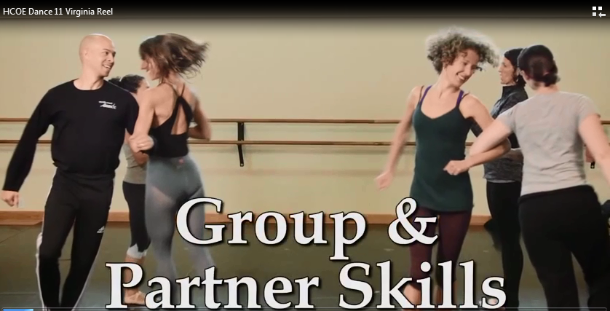
Dance Element #1 - Movement
How to use the videos:
Play video clip 11 Virginia Reel
Group/partner skills
Skills that require cooperation, coordination, and dependence, including imitation, lead and follow, echo, mirroring, and call and response.
Notes:
Videos are embedded within the module, showing examples with voice overs of dance vocabulary. Example 11:
Virginia Reel - Video clip and handout 3
Ask: what other concepts does Virginia Reel teach?

Slide 15
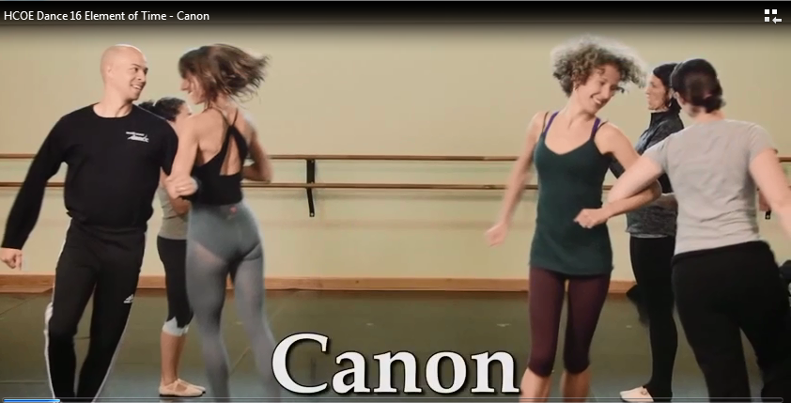
Dance Element #3 - Time
Dance Element #3 – Time
Play video clip 16
Variation 1:
Do the wave (in canon).
Canon
A passage, movement sequence, or piece of music in which the parts are done in succession, overlapping one another.
Notes:
Handout 2 - activity 8

Slide 16
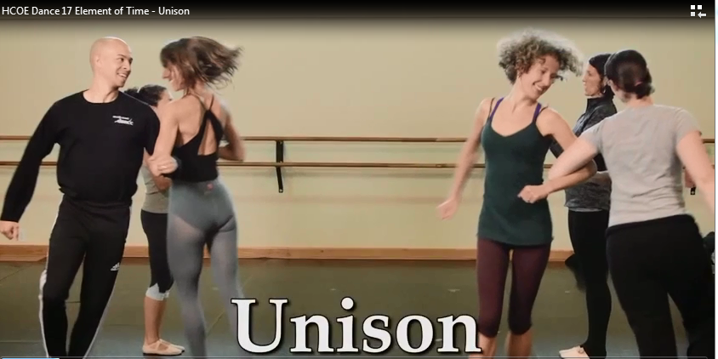
Dance Element #3 - Time
Dance Element #3 – Time
Play video clip 17
Variation 2: Everyone does the “wave” movement at the same time (in unison).
Unison
Dance movement that takes place at the same time in a group.
Notes:
Handout 2 - variation 2 of activity 8

Slide 17
Handouts and Resources
The Content Outline indicates where each handout, resource, music selection and video will be used.
a. Handout 1: Glossary of Dance Terms
b. Handout 2: Dance Activities
c. Handout 3: Movement Problems
d. Handout 4: Dance Rubric
Notes:
All of this can be found on the CCSESA Creativity at the Core website

Slide 18
Learning Activity Example:
Dance Standards
Choreography: 1.3, 1.4, 1.5, 4.1, 4.3, 5.1
Dance Element #1: Axial versus Locomotor
Next Generation Science Standards
ESS1- Earth’s Place in the Universe
Student will demonstrate understanding of Earth’s solar system through dance.
Student will demonstrate understanding of the principles of Choreography and the elements of Axial and Locomotor motion.
Notes:
Demonstrate with teaching artist or embedded video the terms axial and locomotor movements. Have students choreograph with a beginning, middle and end their understanding of the Earth’s solar system. Let them create anything! We’ve had students do the big band to entropy. We’ve had the international space station and comets fly through. We’ve had students choreograph the moon landing. Record their drafts and final performances. Practice giving feedback and facilitate peer review

Slide 19
Tips:
You will want to print all of the downloads and review the powerpoint.
Check that the videos and mp3’s work.
Familiarize yourself with the module.
Make sure you have tables for participants to put their materials and plenty of space for dancing.
A large room is necessary, a dance floor is ideal.

Slide 20
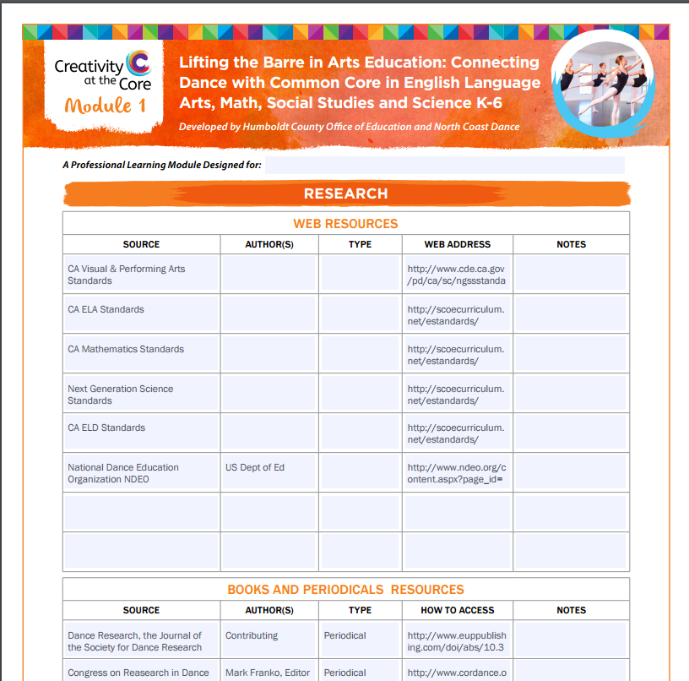
Research:
In the Research document you will find web, book, and periodical resources.
Notes:
Download on the CCSESA Website.

Slide 21
Standards:
Read about the Common Core Plus standards in the Standards document under Downloads, or in this PowerPoint slides 6-8.
Notes:
Web links are included.

Slide 22
Dance Evaluation
How do we assess dance?
Is it subjective?
Create Rubric with elbow partner
Share out
Notes:
Check out the rubric on the website. Practice assessing
Q&A

Slide 23

Credits
Stacy Young, VAPA Learning Specialist & Region 1 Lead, Humboldt County Office of Education
Gina Grebe, Education Coordinator, North Coast Dance
Ikolo Griffin, Artistic Director 2014, North Coast Dance
Kris Marquez, Executive Director, North Coast Dance
Ben Bettenhausen, Mahalo Video
and Justin Ross, Pianist

Slide 24

Thank you

