Slide 1
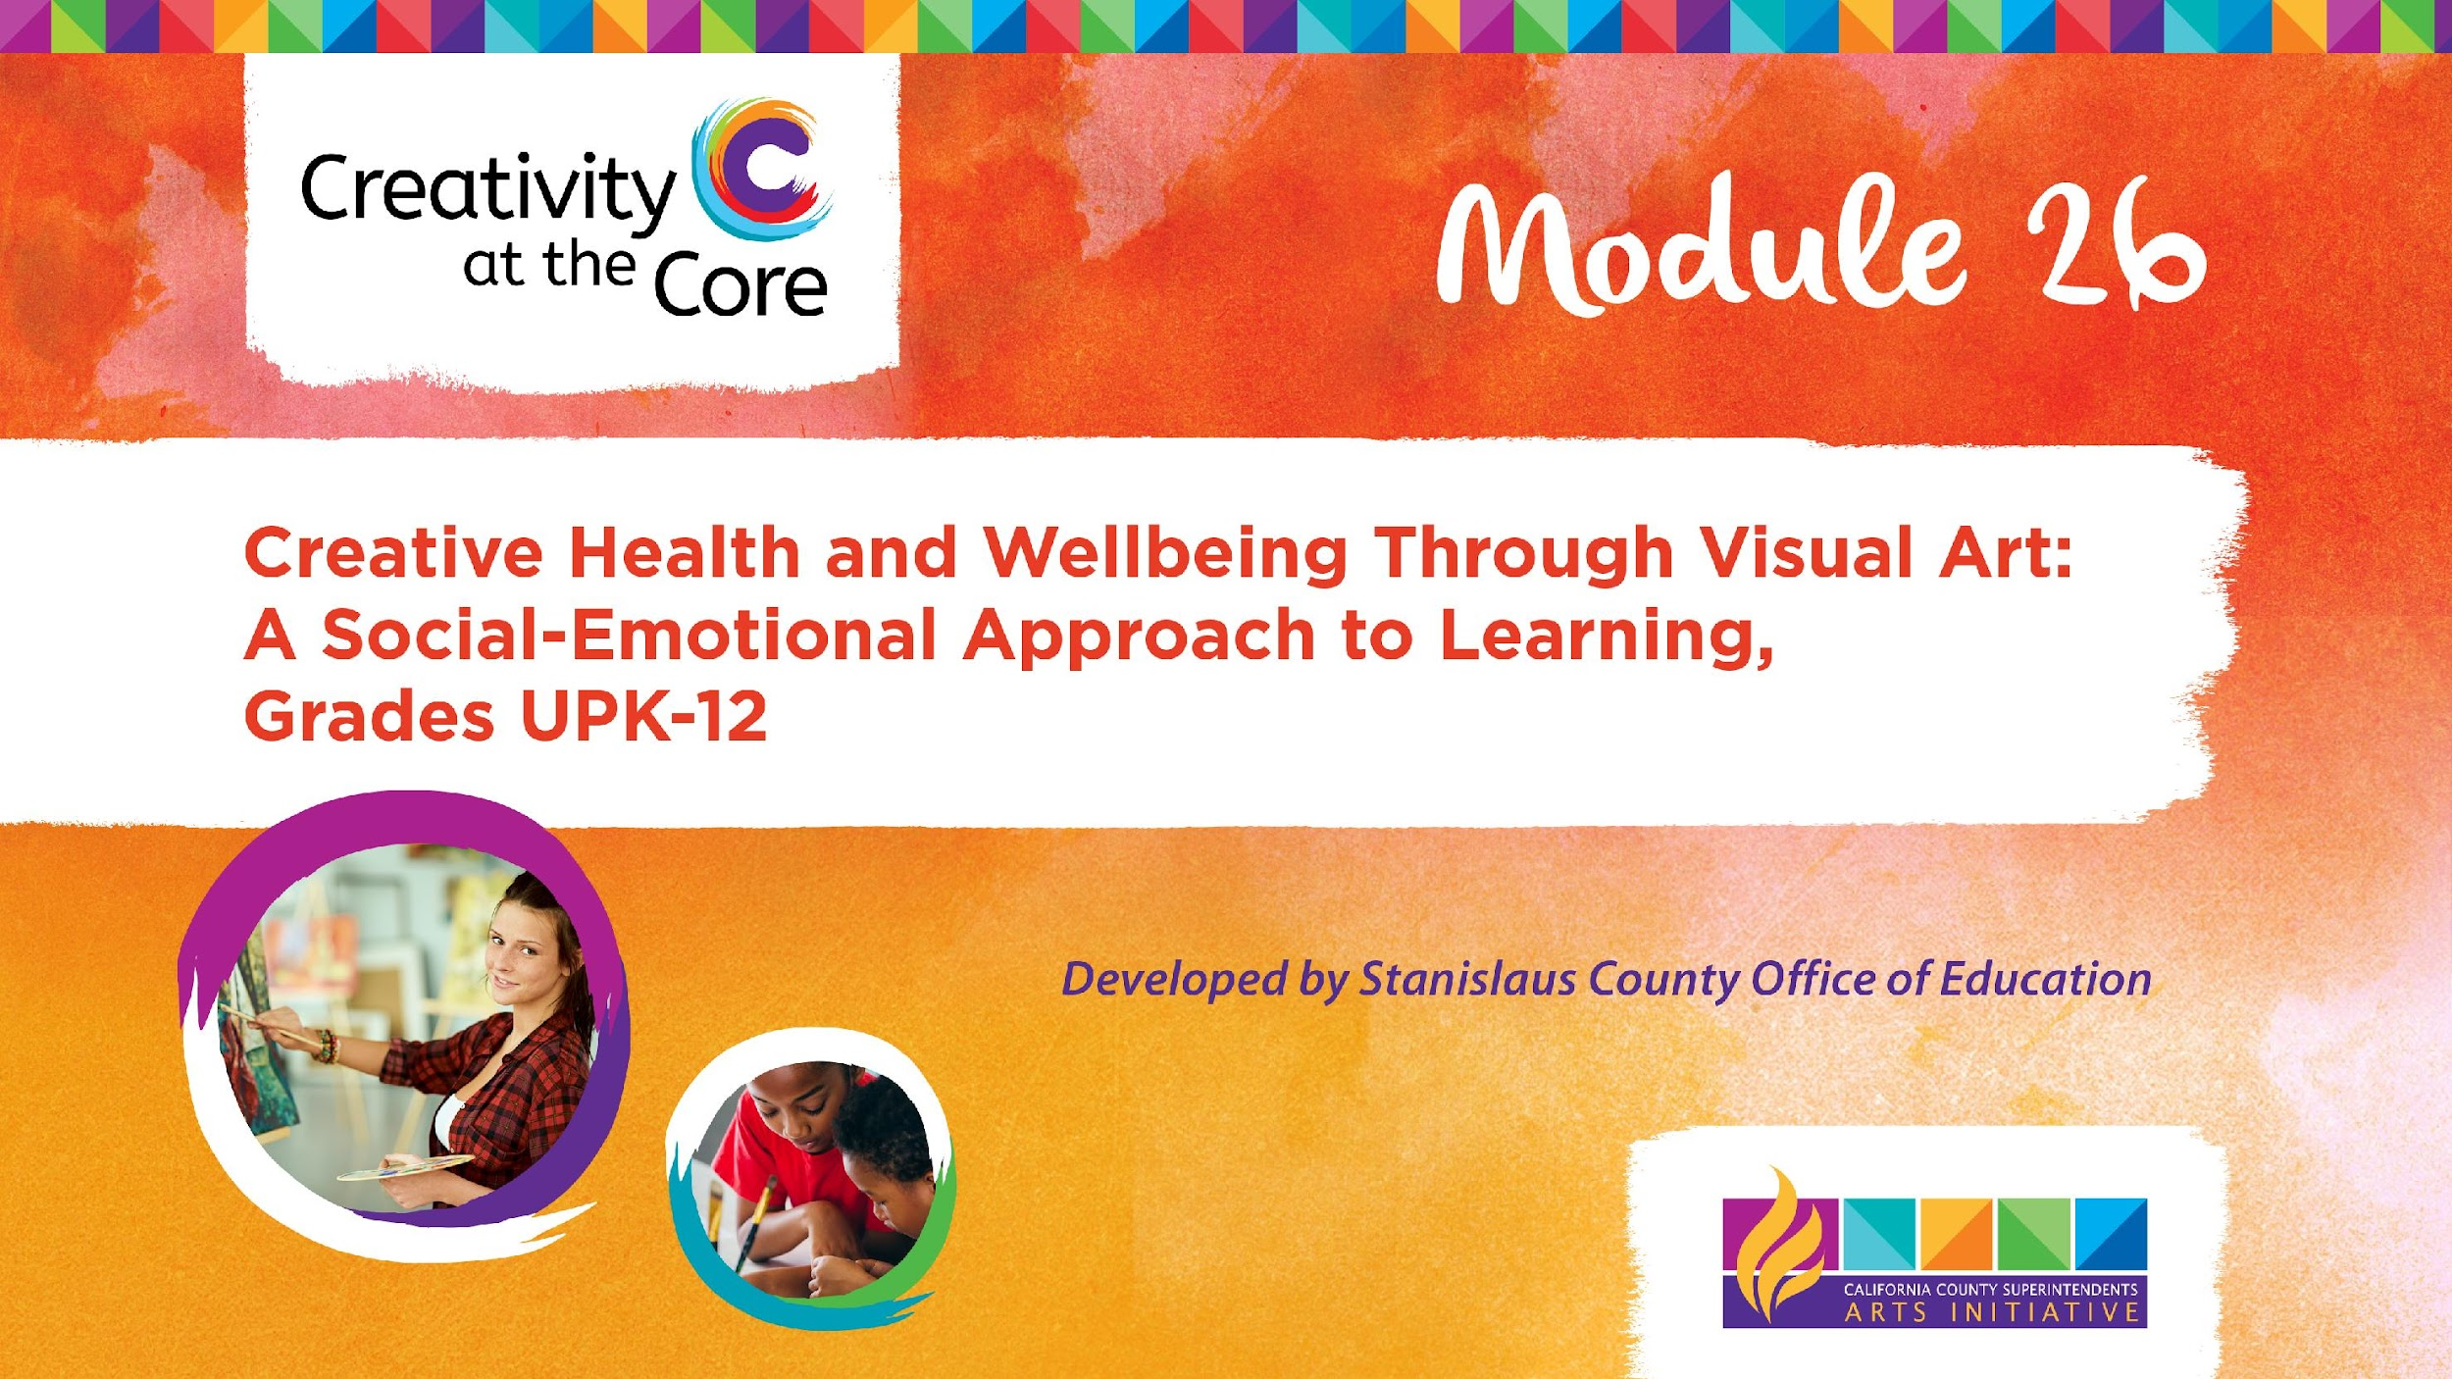
Part I: Unpacking Creative Health, SEL, Visual Art for Facilitators and Educators

Slide 2
Module Description
The objective of this module is to equip educators and administrators from Universal Pre-Kindergarten to 12th grade with the necessary skills, tools, knowledge, and self-confidence to promote students' creative health and well-being through visual arts. This includes incorporating mindfulness and respecting the diverse cultures, communities, and identities found in today's culturally-responsive classrooms. Drawing upon the principles outlined in the Studio Habits of Mind, this module offers ten California Arts standards and SEL core competencies aligned visual art projects for students in grades UPK-12th, and one visual art project for educators. These resources are designed to foster the creative well-being of both educators and students alike.

Slide 3
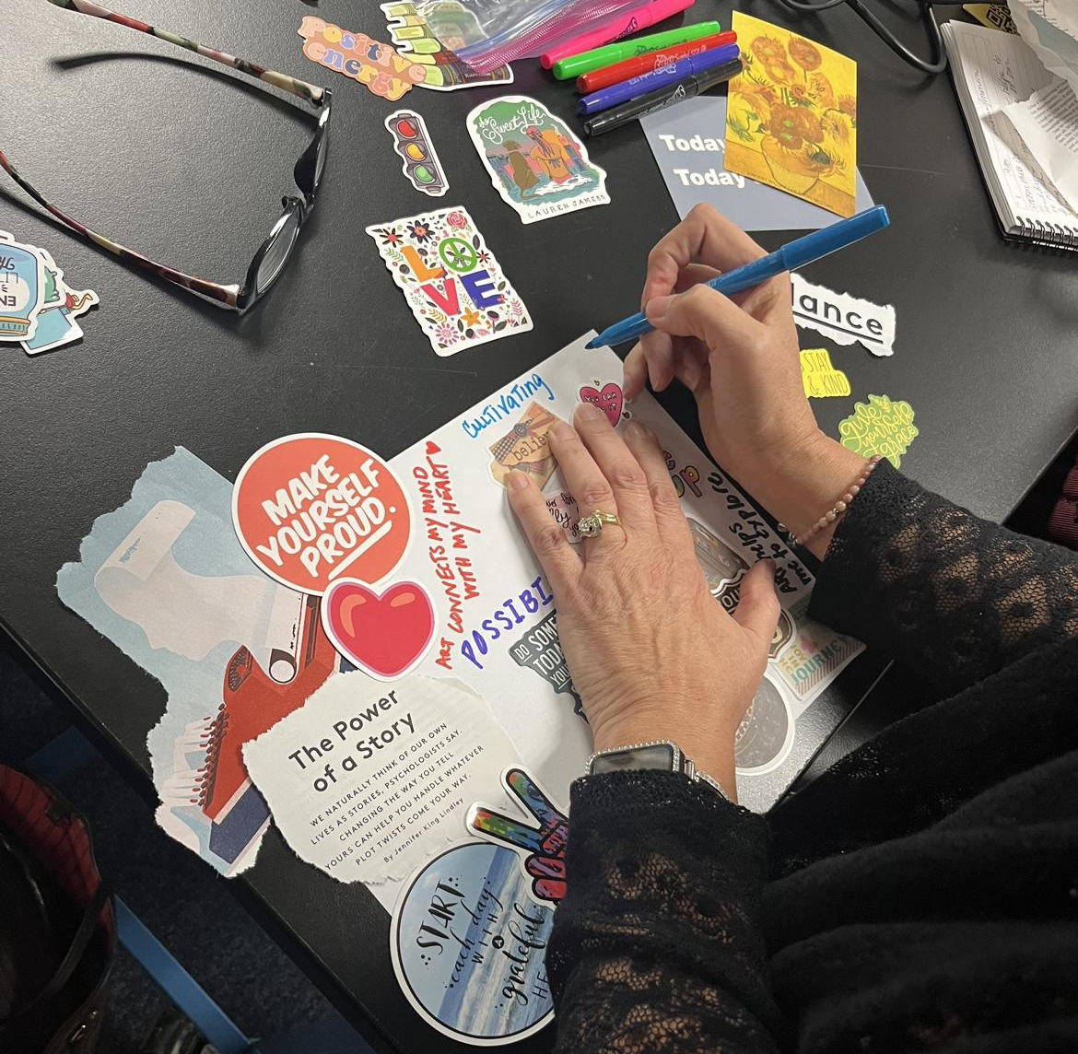
Module Outcome
The intended outcome of this module is to increase educator and administrator self-confidence and efficacy in the support of their own creative health and well being, and in doing-so increase their ability to develop and support the creative health and well being of their students.
Notes:
image: Amy Bultena

Slide 4

Agenda
Introduction
Safe Space Activity
Social-Emotional Learning Foundations
Creative Health Definition
Visual Art and Mental Health
Trauma-Informed Art Strategies
Studio Habits of Mind
Tips for Talking About Visual Art
Next Steps
Closing Activity
Notes:
image: Buravleva via Canva

Slide 5

Introduction
Self-expression is a powerful tool, but it’s hard to convince people that it’s important.
Notes:
Hannum, K. (2014). The healing arts. (Cover story). U.S. Catholic, 79(11), 12–17.

Slide 6
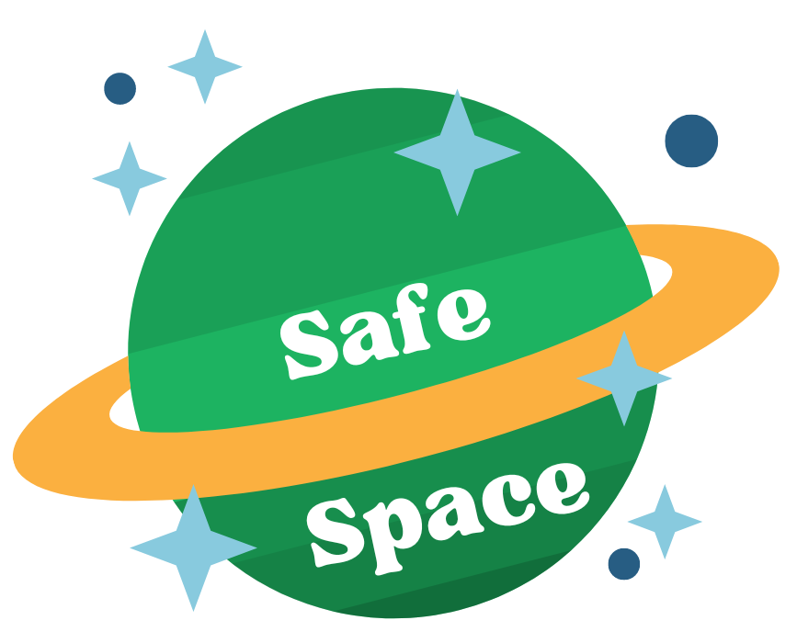
Preparing for Learning
Research shows, that we - humans - need to feel safe in order to have the most meaningful learning experiences.
The next activity is going to revolve around creating a safe place for learning.
Notes:
Graphic: Amy Bultena

Slide 7

Creating a Safe Place for Learning
Imagine a safe place where you feel protected and secure. It could be a real or made-up spot. Using a sheet of scratch paper and creative tools, draw your safe place.
You can describe it using words, pictures, shapes, or colors. If you're having trouble, think of any place that makes you feel safe. Remember, there are no right or wrong answers. Just let your imagination guide you.
10 minutes
Notes:
https://creazilla.com/nodes/55424-timer-clock-emoji-clipart

Slide 8
Using Your Safe Place
Now that you have crafted a mental image of your safe space, you can utilize it as a valuable tool.
Whenever you feel stressed, scared, sad, or overwhelmed by negative emotions, simply bring your safe space to mind and take a series of slow, deep breaths. This practice will aid in calming and grounding yourself.
Additionally, you might consider displaying your safe space artwork in a prominent location where it can serve as a visual prompt to utilize this tool whenever necessary.
Notes:
image: Amy Bultena

Slide 9
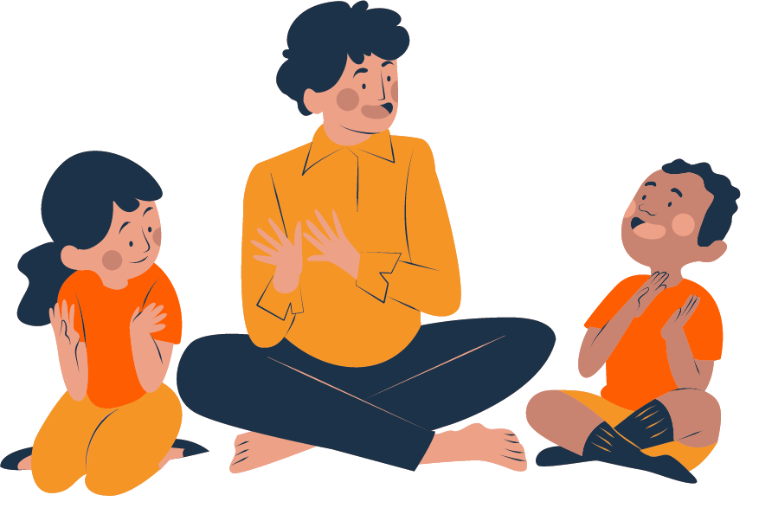
What is Social-Emotional Learning?
Social emotional learning (SEL) refers to the process of developing and understanding our emotions, thoughts, and social skills.
Notes:
Image: sparklestroke on canva

Slide 10
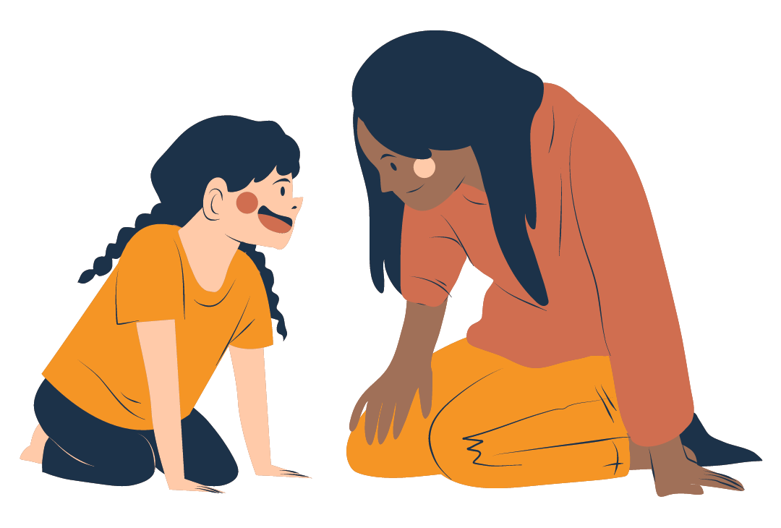
Why is SEL important?
Students who are equipped to manage personal problems are better able to navigate the pressures of adult life.
SEL participation leads to an 11 percentile increase in overall grades.
SEL increases prosocial behaviors, improves student attitudes toward school, and reduces depression and stress.
Notes:
Durlak, J. A., Domitrovich, C. E., Weissberg, R. P., & Gullotta, T. P. (Eds.). (2016). Handbook of Social and Emotional Learning Research and Practice. Guilford Press
Image: sparklestroke on canva

Slide 11
How does California define SEL?
Social and Emotional Learning reflects the critical role of positive relationships and emotional connections in the learning process and helps students develop a range of skills they need for school and life. SEL skills include the ability to:
Set and achieve positive goals
Feel and show empathy for others
Establish and maintain positive relationships
Make responsible decisions
Understand and manage emotions
Notes:
California Department of Education

Slide 12
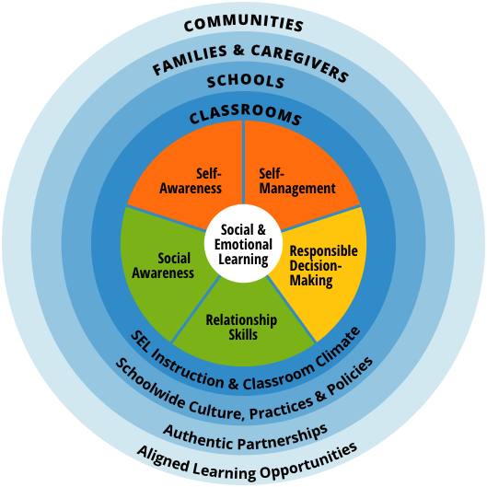
SEL Competencies
This module utilizes the five SEL competencies as outlined by CASEL.
Self-Awareness
Self-Management
Responsible Decision-Making
Relationship Skills
Social Awareness
Notes:
Collaborative for Academic, Social, and Emotional Learning (CASEL)
Collaborative for Academic, Social, and Emotional Learning CASEL (1994). CASEL Wheel [Graphic]. CASEL.
https://casel.org/fundamentals-of-sel/what-is-the-casel-framework/

Slide 13
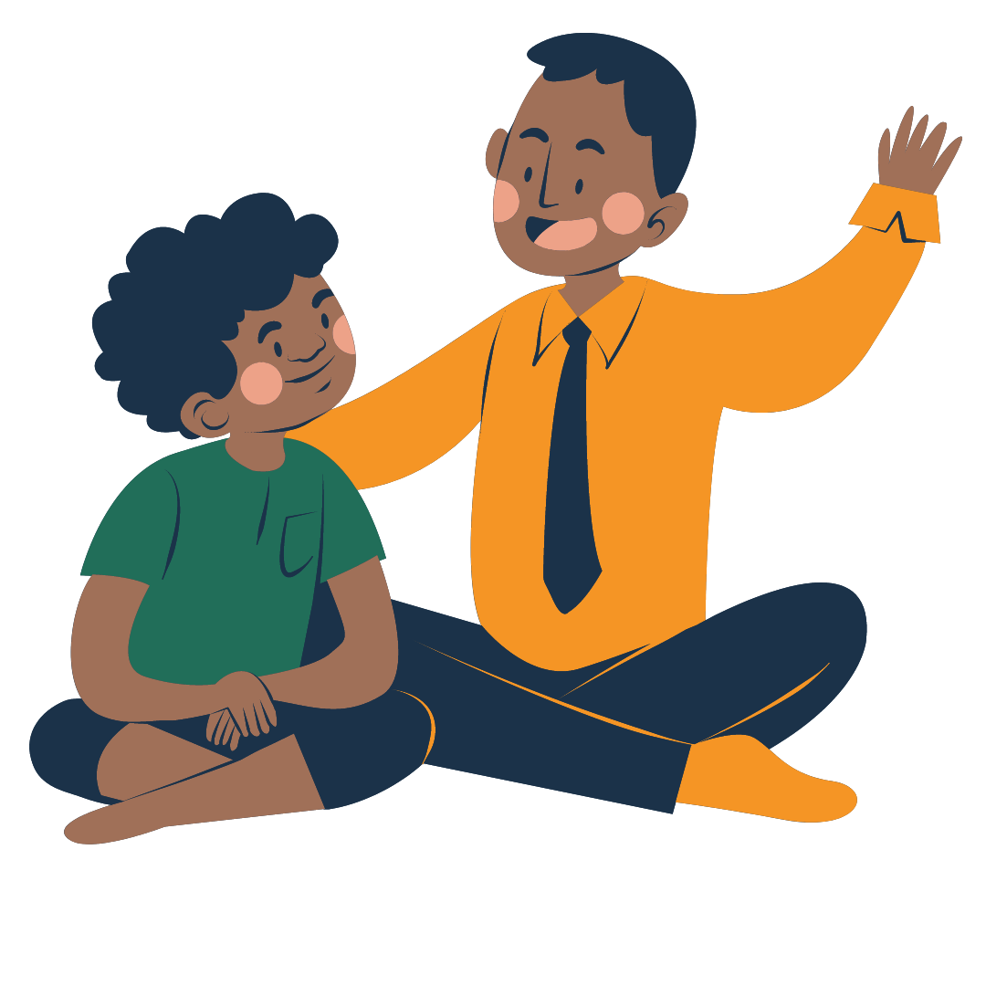
Educator Training in Providing SEL is Critical
A June 2020 report found that:
94% of teachers feel students increasingly need more social and emotional support
77% of teachers are concerned about student social emotional well being
7% of teachers feel prepared to address the social-emotional needs of students
Notes:
Houghton Mifflin Harcourt. (2020). (rep.). HMH 6th Annual Educator Confidence Report.
Image: sparklestroke on canva

Slide 14
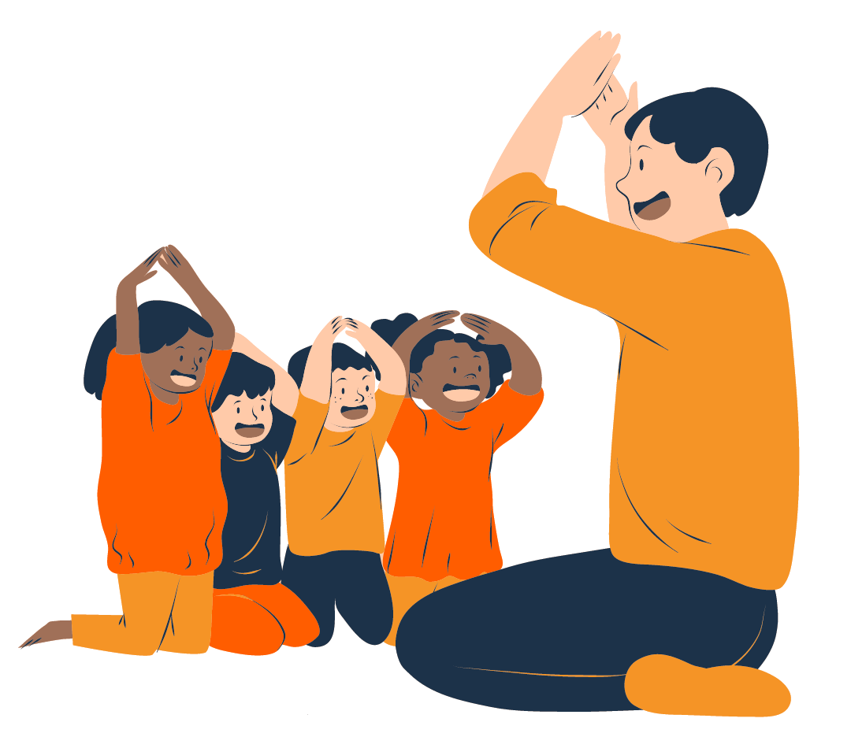
Isn’t all teaching SEL?!
Although social learning is present in various aspects of K-12 education, it doesn't consistently and effectively support students in understanding their emotions, thoughts, and social skills.
Research shows that “for SEL to be effective, it must be taught and embedded in the curriculum.”
Notes:
Morrison, R., & Elias, M.J. Social emotional learning and the arts. New Jersey School Boards Association Leader, 51(2).
Image: sparklestroke on canva

Slide 15
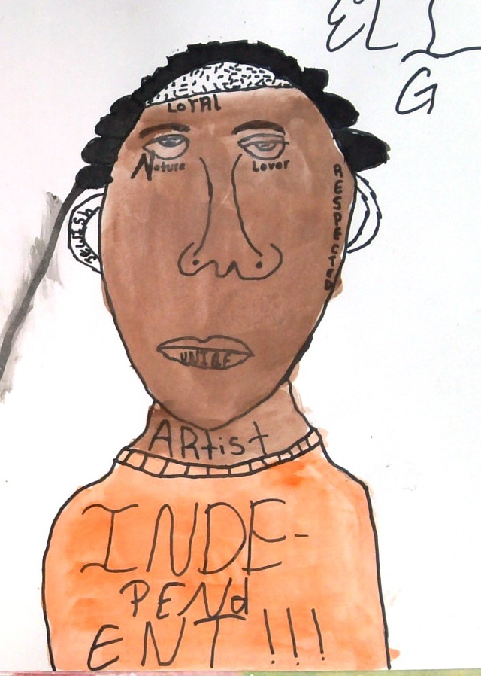
What is Creative Health?
Creative Health is a concept that recognizes the powerful benefits the arts provide to our overall health and wellbeing.
based on peer-reviewed scientific research
combination of arts, creativity, culture, and public health
“This art chilled me out. I was mad, but this helped me calm down.”
Notes:
All-Party Parliamentary Group on Arts, Health and Wellbeing Inquiry (2017). (rep.). Creative Health: The Arts for Health and Wellbeing - The Short Report (pp. 1–13).

Slide 16
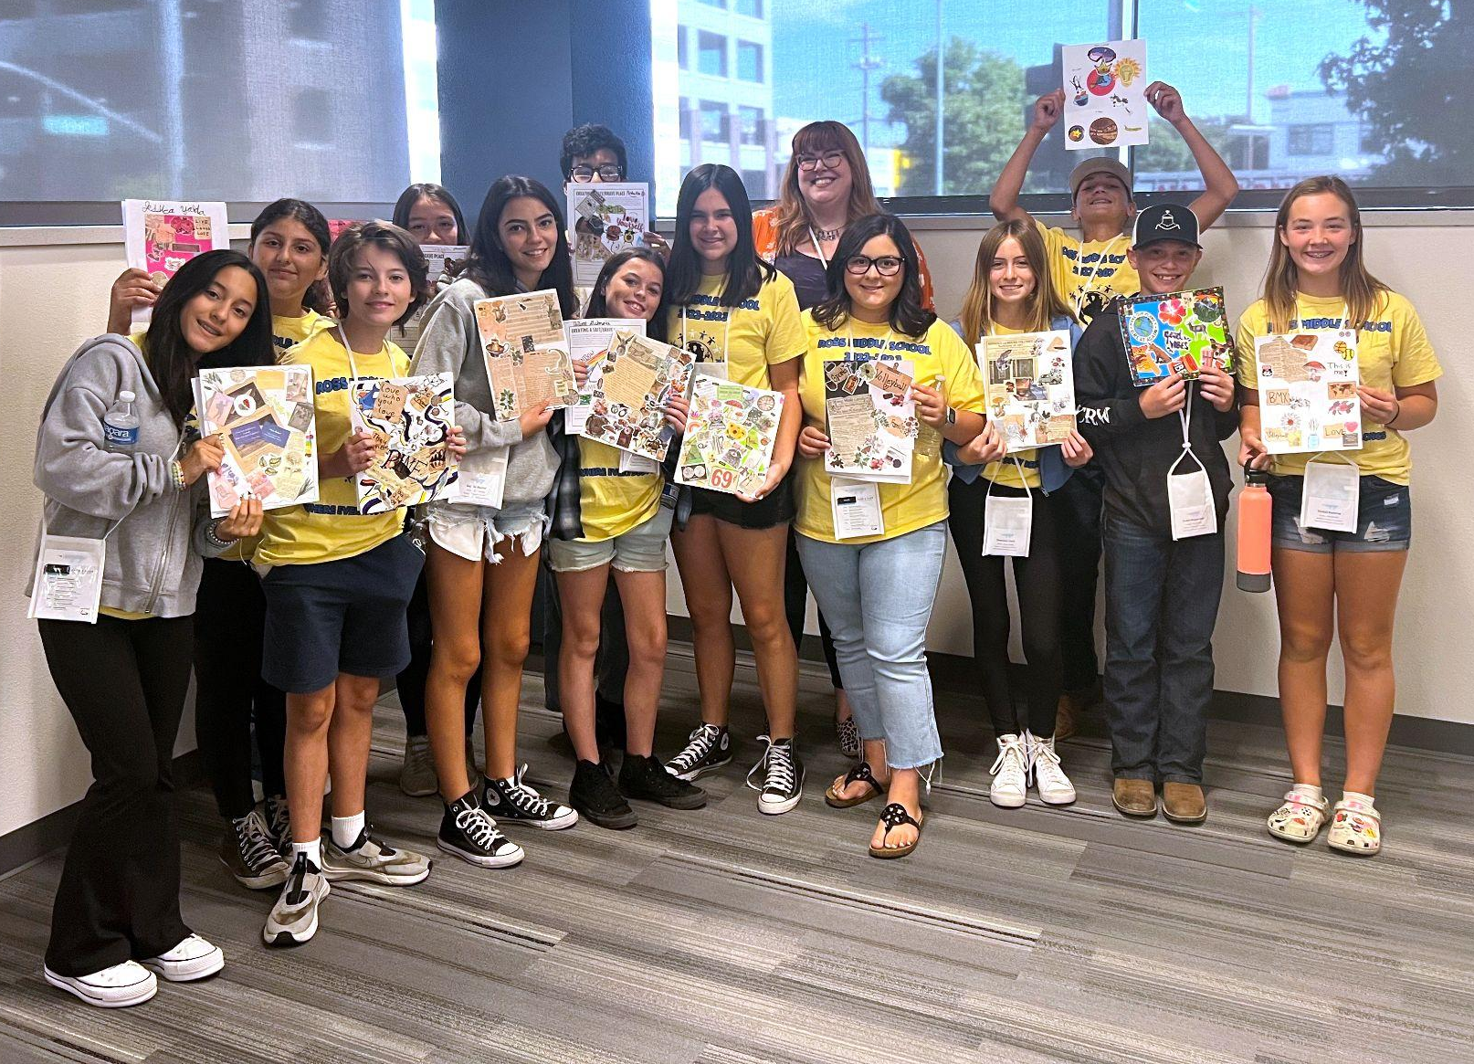
Creative Health Key Messages
The arts help keep us healthy, aid in recovery, and support long life spans.
The arts help meet major challenges facing health and social care.
The arts contribute to happy and healthy communities.
Notes:
All-Party Parliamentary Group on Arts, Health and Wellbeing Inquiry (2017). (rep.). Creative Health: The Arts for Health and Wellbeing - The Short Report (pp. 1–13).
image: Amy Bultena

Slide 17
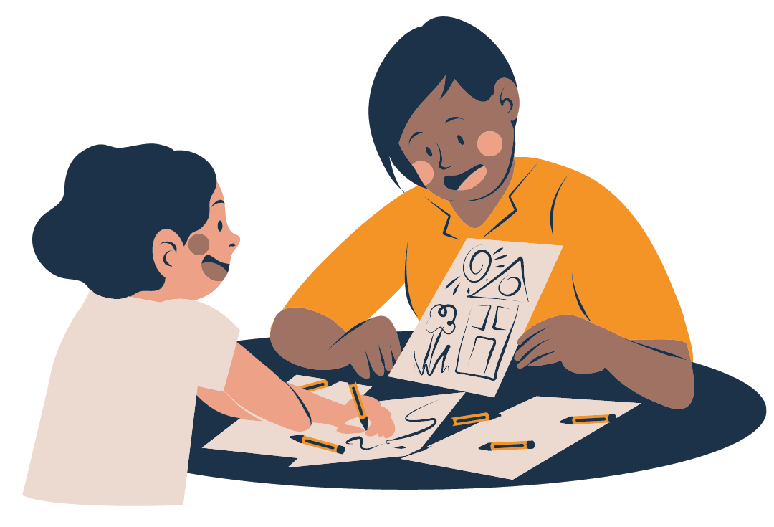
Creative Health Modalities
Any creative act can be a Creative Health modality.
Here are a few examples:
Visual Art
Media Arts
Music
Dance / Movement
Theater
Writing
Cooking & Baking
Gardening
Floral Arts
Cosplay
Fiber Arts
Calligraphy
Notes:
Image: sparklestroke on canva

Slide 18
Creative Health Modality: Visual Art
Visual Art is a vital part of Creative Health as it supports our physical, mental, and emotional wellbeing. Scientifically speaking artmaking:
Increases blood flow to the brain
Increases alpha wave brain patterns found in meditation
Increases serotonin
Decreases cortisol
Reconnects parts of the brain that are damaged due to trauma
Enhances brain function, even into old age
Offers the possibility of a longer life span
Notes:
Kay, L. (2008). Arts education pedagogy and practice with adolescent students at-risk in alternative high schools (dissertation). Northern Illinois University ProQuest Dissertations Publishing.
Malchiodi, Cathy. The Art Therapy Sourcebook. McGraw-Hill. 2006.

Slide 19
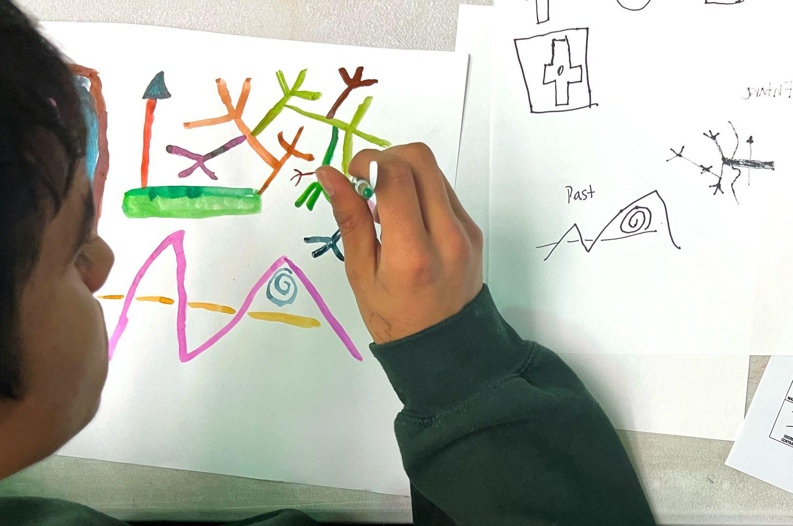
Visual Art and SEL
“Artmaking is an experience that provides a type of transcendence.
Artmaking can be used to deal with our own feelings and to share our perceptions with others.”
Notes:
Kay, L., & Losel, S. (2018). Building Relationships through Art: Understanding the Potential of Art-Making for Students Experiencing Psychological Trauma. In Art for Children Experiencing Psychological Trauma (1st ed., p. 156). essay, Routledge.
image: Amy Bultena

Slide 20
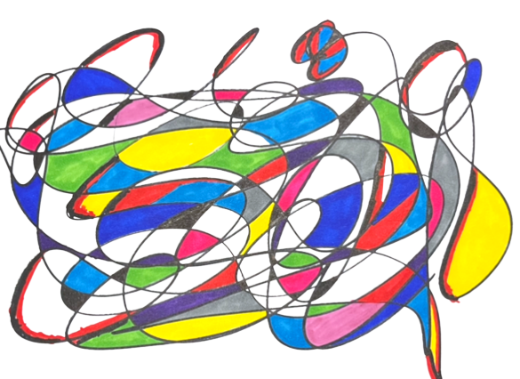
Visual Art and SEL
“Art-making provides opportunities for students to express themselves in nonverbal ways that may be hard for them to understand.”
Notes:
Kay, L., & Losel, S. (2018). Building Relationships through Art: Understanding the Potential of Art-Making for Students Experiencing Psychological Trauma. In Art for Children Experiencing Psychological Trauma (1st ed., p. 156). essay, Routledge.
image: Amy Bultena

Slide 21
Visual Art and SEL
Research shows it’s not IF an art practice will affect a social-emotional competency, but HOW it will happen.
Notes:
Farrington, C. A., Mauer, J., Aska McBride, M. R., Nagaoka, J., Puller, J. S., Shewfelt, S., Weiss, E. M., & Wright, L. (2019). (rep.). Arts Education and Social Emotional Learning Outcomes Among K-12 Students: Developing a Theory of Action (pp. 1–48). Chicago, Illinois: University of Chicago.

Slide 22
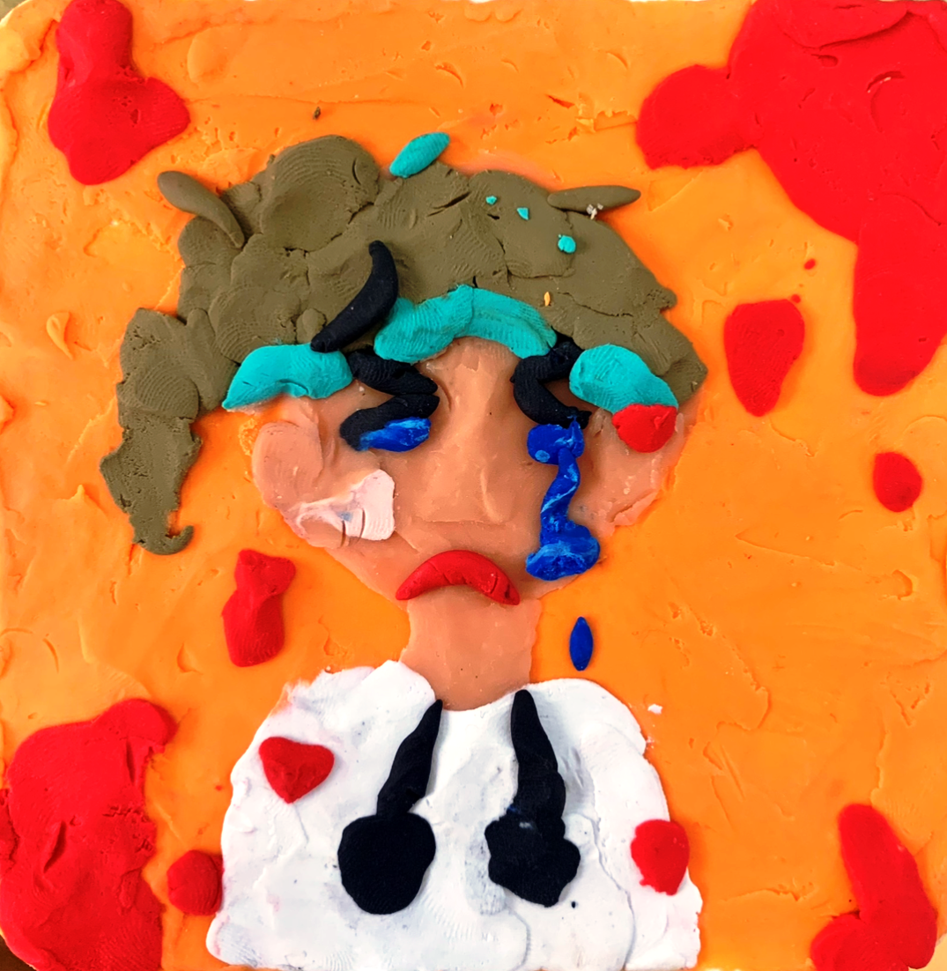
Visual Art and Trauma
Visual Art is an incredibly effective tool for supporting the processing and healing of trauma.
Our students need trauma-informed care as part of their SEL experience.
“Making this helped me express myself. I’ve been feeling sad lately so I tried to make my art look that way.”
Notes:
image: Amy Bultena

Slide 23
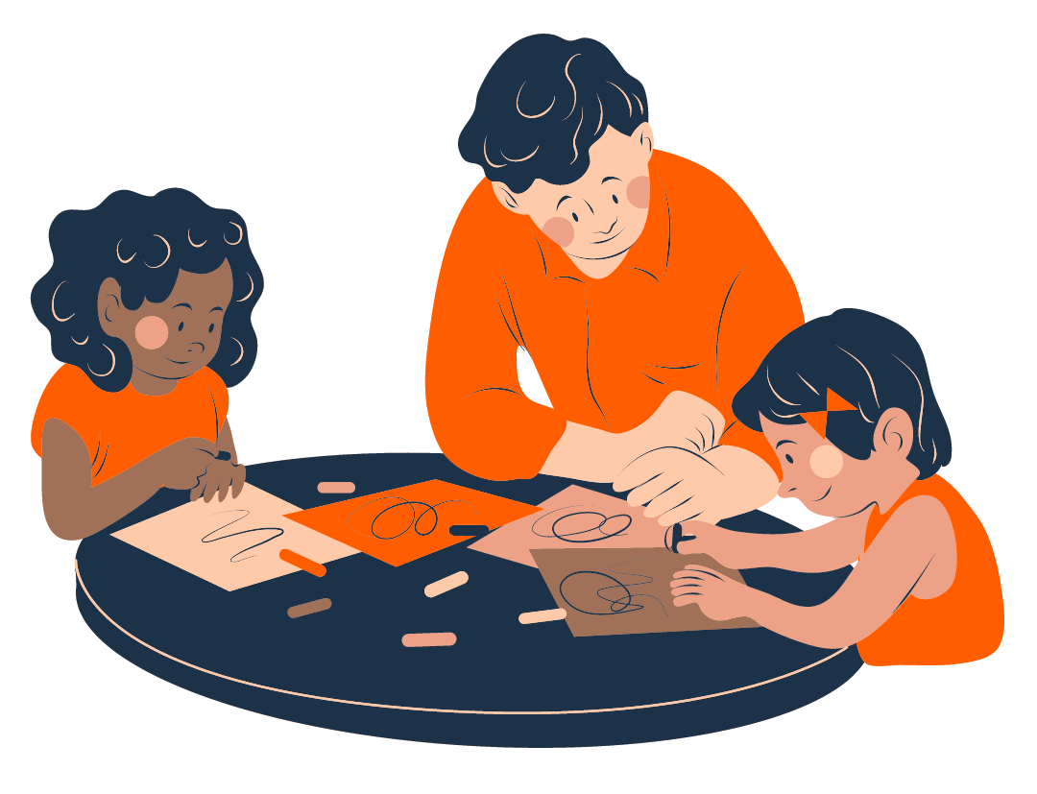
What is trauma-informed care?
Trauma-informed care is an approach to providing support that recognizes and responds to the impact of trauma on individuals' lives.
It involves understanding how trauma affects people and creating a safe and empowering environment that promotes healing and resilience.
It shifts the question from “What’s wrong with you?” to “What happened to you?”
Notes:
Image: sparklestroke on canva

Slide 24
Trauma and American Students
More than 2/3 of students report a traumatic experience before age 16
11% of students have PTSD
Students living in poverty are more likely to experience trauma
  14% of children live in poverty
  (>$30,000 / family of 4)
  50% of children living in poverty live in “extreme poverty”
  (>$13,250 / family of 4)
  More than 20% of students spend at least one year in poverty
  59.6% of California students are socioeconomically disadvantaged
Notes:
Puzzanchera, Charles, Hockenberry, Sarah, and Sickmund, Melissa. 2022. Youth and the Juvenile Justice System: 2022 National Report. Pittsburgh, PA: National Center for Juvenile Justice.
Substance Abuse and Mental Health Services Administration. (2022). Understanding child trauma. SAMHSA. Retrieved February 7, 2023, from https://www.samhsa.gov/child-trauma/understanding-child-trauma
Wolpaw, J.W., & Ford, J.D. (2004). Assessing exposure to psychological trauma and post-traumatic stress in the juvenile justice population. National Child and Traumatic Stress Network, www. NCTSNet.org
https://www.ncbi.nlm.nih.gov/pmc/articles/PMC4648521/

Slide 25
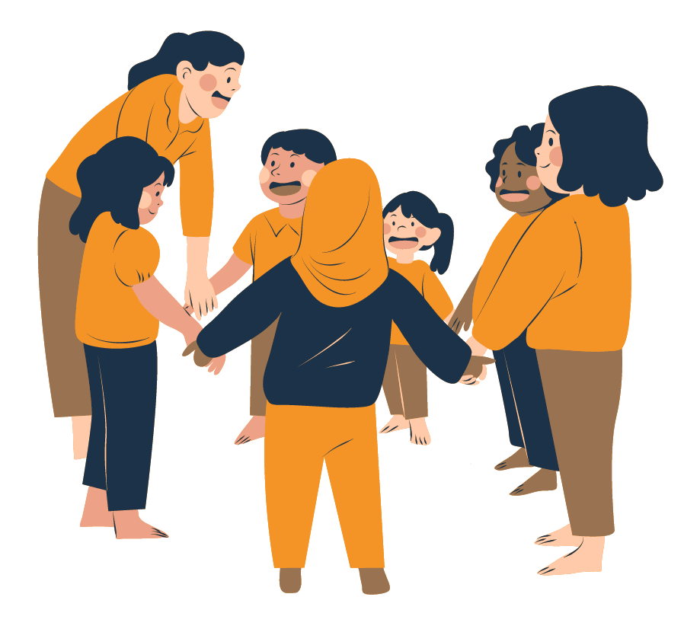
Trauma-Informed Care and Students
Trauma-informed care is universally designed.
While not all students have experienced trauma, trauma-informed care benefits all students.
Trauma-informed care should be a part of SEL programming.
Notes:
Image: sparklestroke on canva

Slide 26
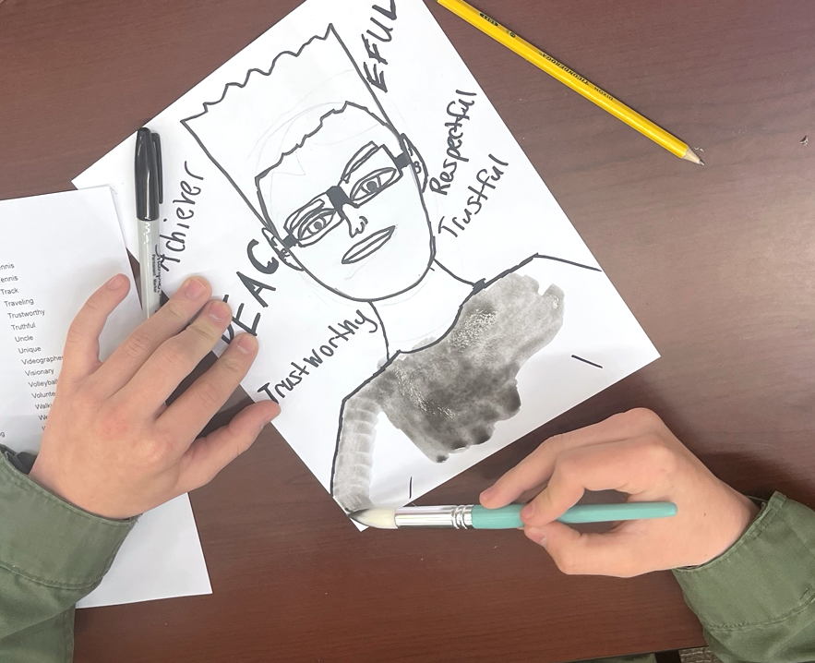
Trauma-Informed Art
Trauma-informed art refers to the use of artistic expression as an approach to processing and healing trauma.
It involves engaging in creative processes to promote healing, self-expression, and resilience.
Notes:
image: Amy Bultena

Slide 27
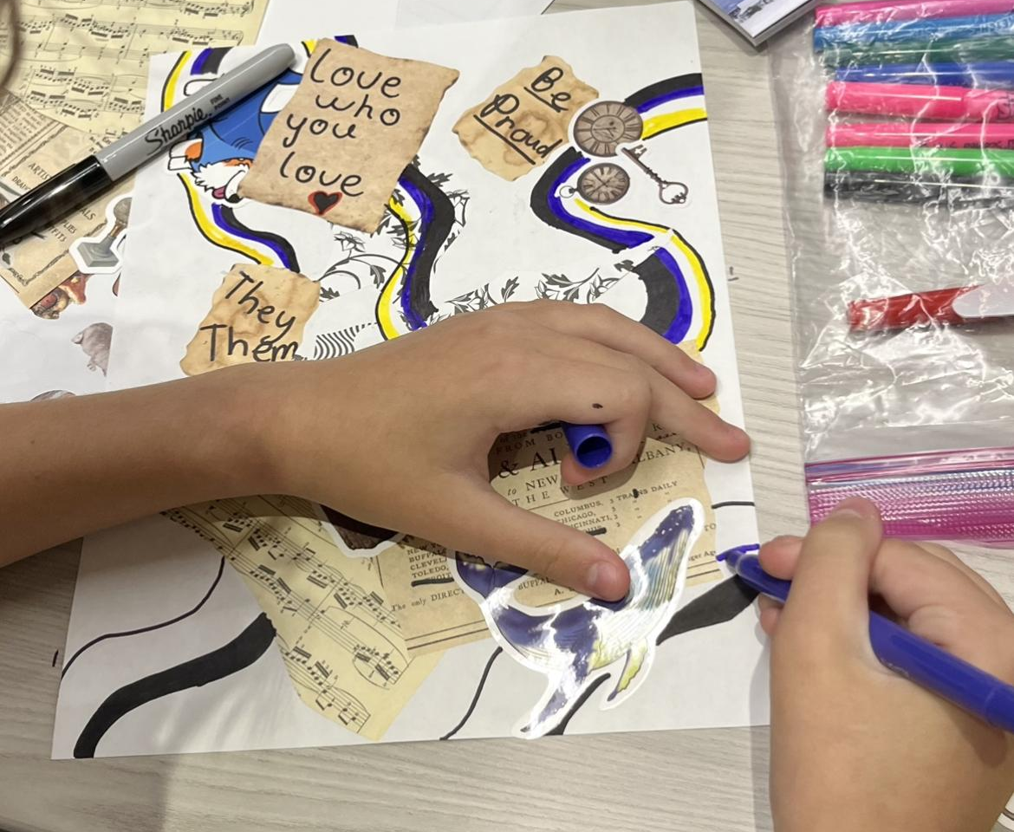
Trauma-Informed Art Strategies
Utilizing trauma-informed art strategies enables educators to design and deliver creative experiences that develop students’ SEL competencies through artmaking.
Notes:
image: Amy Bultena

Slide 28
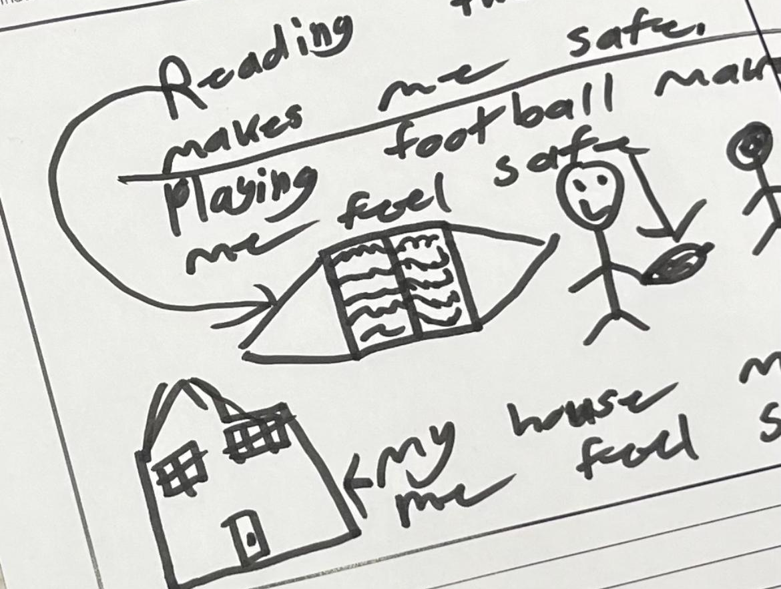
Strategy 1: Create a Safe Space for Artmaking
Research shows, that we - humans - need to feel safe in order to have the most meaningful learning experiences.
Physical safety
Emotional safety
Predictability
Consistency
SEL Competencies
Self-Management
Self-Awareness
Notes:
Image Amy Bultena

Slide 29
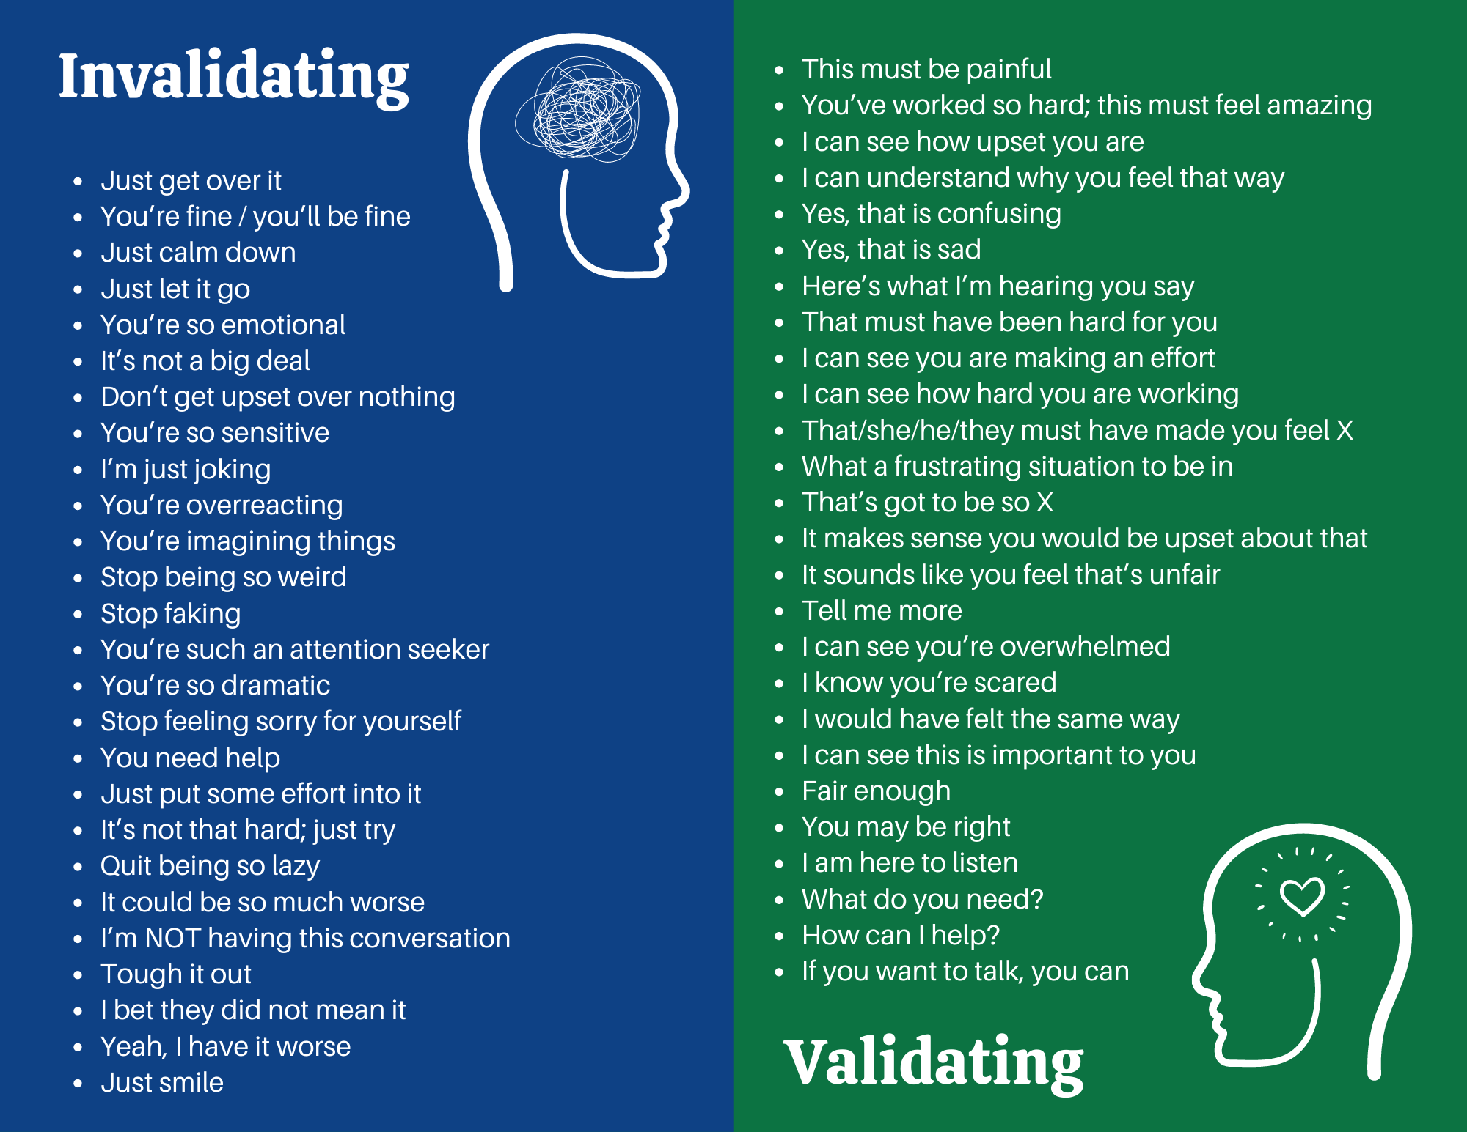
Strategy 1: Create a Safe Space for Artmaking
Validation builds relationships, trust, and safety.
Notes:
Graphic Amy Bultena

Slide 30
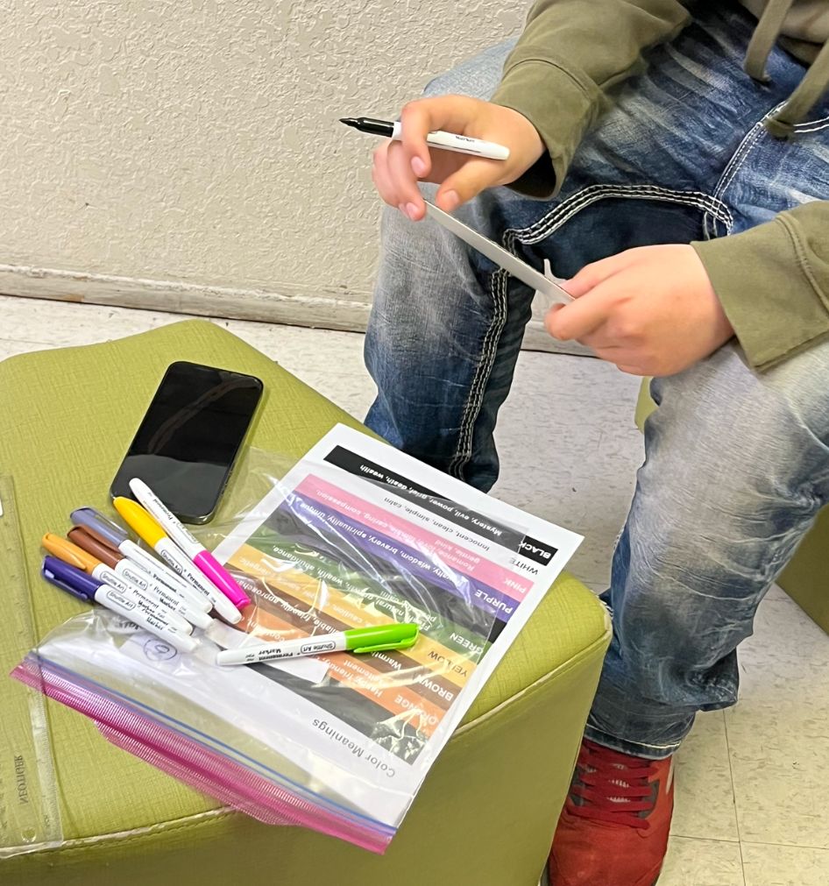
Strategy 2: View Acting Out Differently
View it differently; what are the losses?
Consider possible triggers
Be consistent with promises and follow-through
Fully explain the “why”
SEL Competencies
Self-Management
Self-Awareness
Responsible Decision-Making
Relationship Skills
Social Awareness
Notes:
Image Amy Bultena

Slide 31
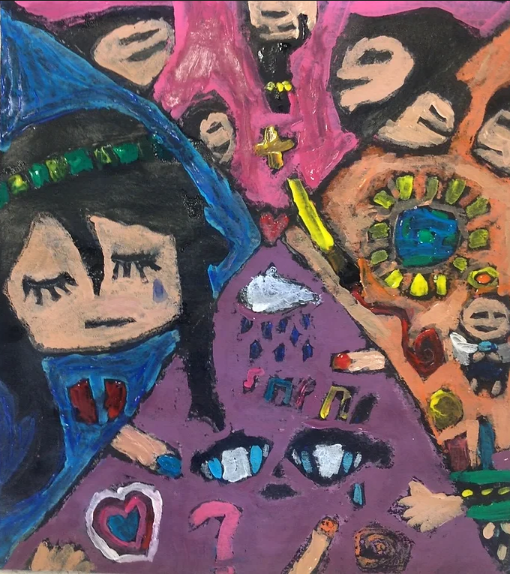
Strategy 3: Consider What Reasonable Rules Might Be Triggering
Re-traumatization is a real thing
What are the individual needs of students?
Consider who is in the space, and how their small and large worlds impact them.
SEL Competencies
Self-Management
Self-Awareness
Relationship Skills
Social Awareness
Notes:
Image Amy Bultena

Slide 32
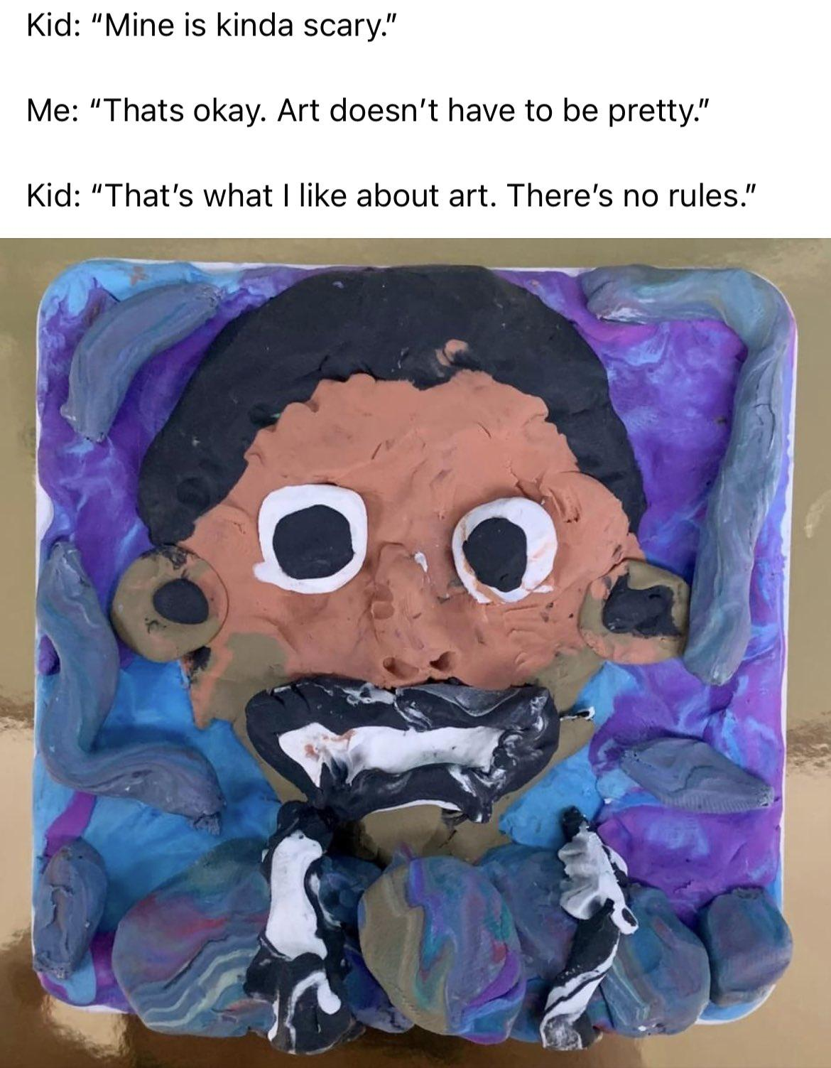
Strategy 4: Recognize that Artmaking May be New and Intimidating
Avoid being too-directive
Give flexibility to make choices (empowerment)
Lean towards abstract and non-objective art
Art doesn’t have to be something; it doesn’t have to be “pretty”
SEL Competencies
Self-Awareness
Social Awareness
Notes:
Image Amy Bultena

Slide 33
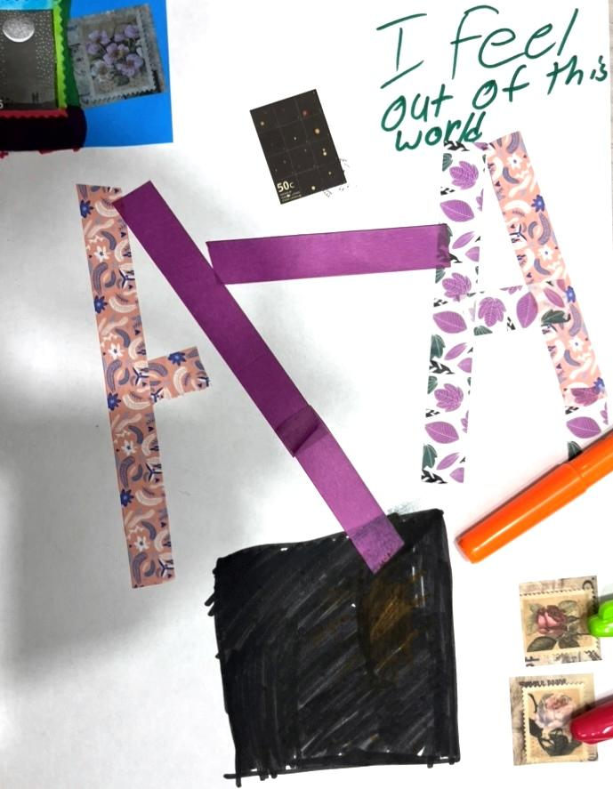
Strategy 5: Normalize Distress About Artmaking
Being present is participation
Being silent is participation
Starting over is okay
We aren’t worried about the final product
It’s okay if you don’t like your art
It’s called artWORK not artEASY
SEL Competencies
Self-Management
Self-Awareness
Responsible Decision-Making
Relationship Skills
Notes:
Image Amy Bultena

Slide 34
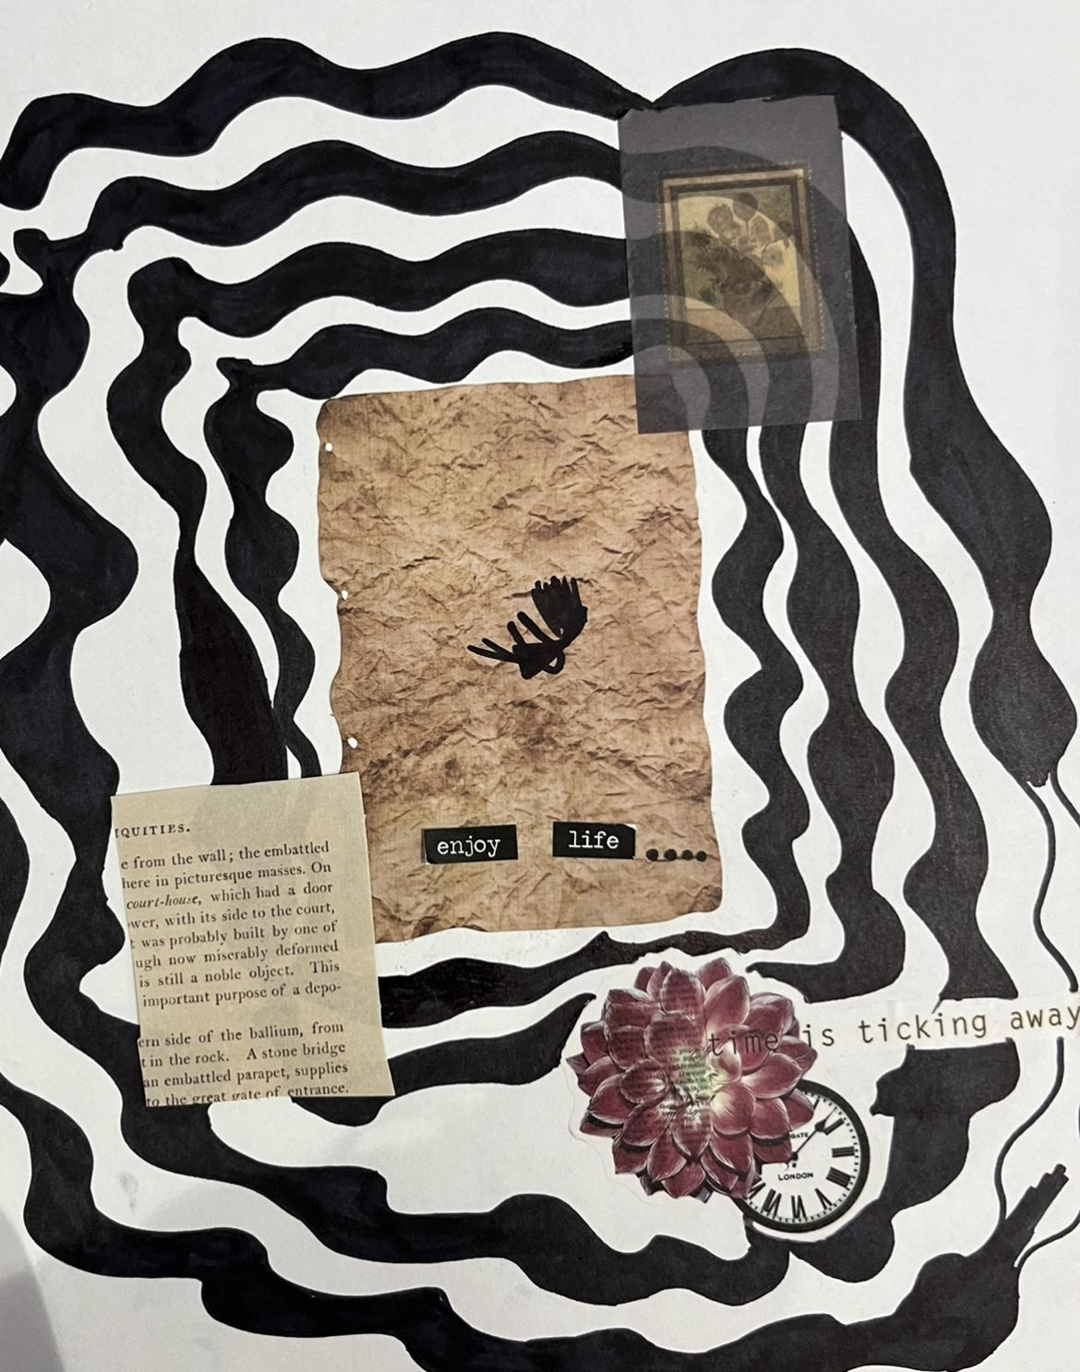
Strategy 6: Emphasize the Here and Now
Check in before, during, and after creating; how do we feel?
Invite students to create; not require
Focus on being in the moment
Emphasize current feelings and emotions
Emphasize students are in control of what they create
SEL Competencies
Self-Management
Relationship Skills
Social Awareness
Notes:
Image Amy Bultena

Slide 35
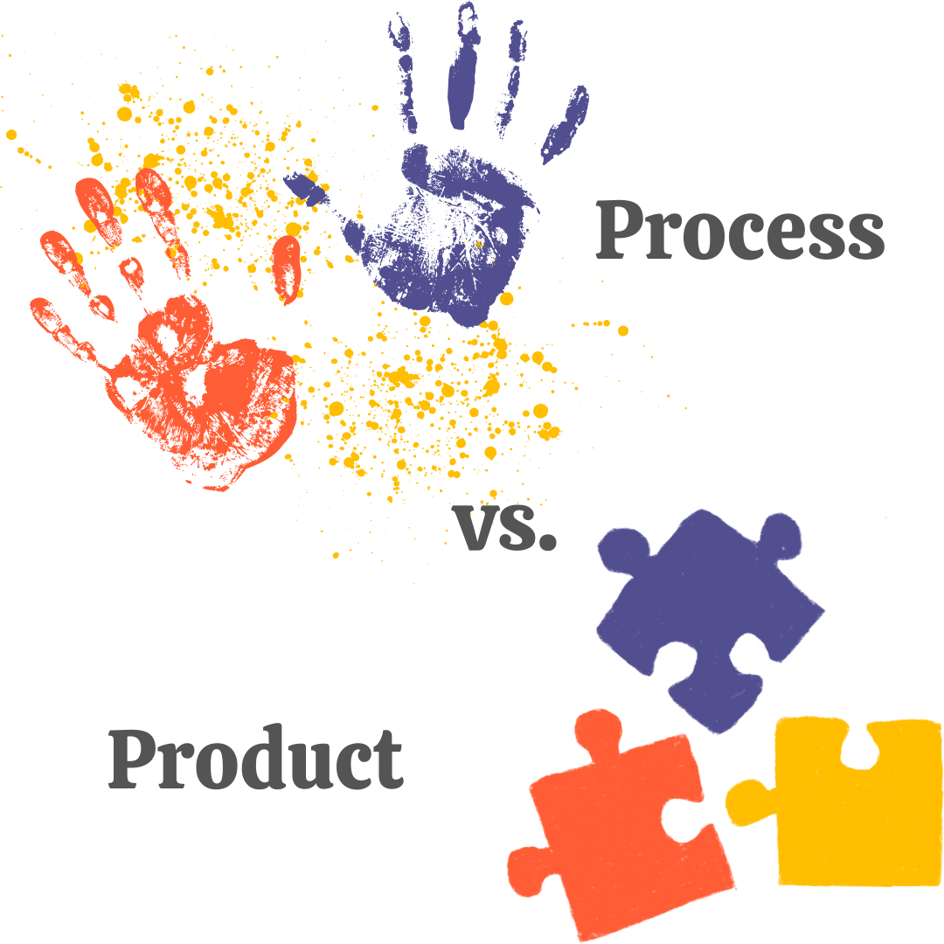
Strategy 7: Facilitate Projects That Are Open-Ended & Process-Based
Process over product
Multiple answers
Student-led
Material choices
SEL Competencies
Self-Management
Self-Awareness
Notes:
Image Amy Bultena

Slide 36
Process vs. Product
Research shows process-based lessons impact students more profoundly than product-based lessons.
We learn more when we construct our own meaning versus when meaning is constructed for us.
Notes:
Image Amy Bultena

Slide 37
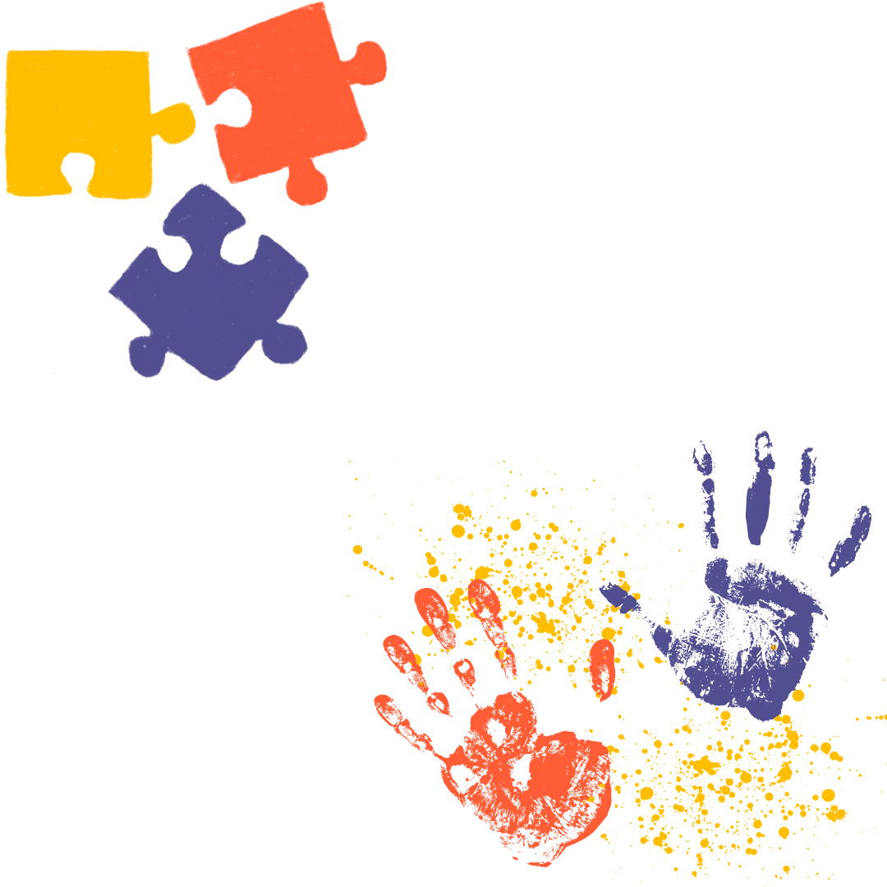
Hallmarks of Product-Based Learning
Concrete, step-by-step instructions
Students copy a teacher sample
There is a right or wrong way to proceed
Students’ finished works all look the same
The teacher might “fix” mistakes
Patterns and templates are readily available
Notes:
Image Amy Bultena

Slide 38
Hallmarks of Process-Based Learning
Limited or no step-by-step instructions
No sample to copy or follow
No right or wrong way to create (within limits)
Opportunity to explore techniques and materials
Students demonstrate understanding through creative work
Open-ended problem solving
Student creativity and choice is evident
Notes:
Image Amy Bultena

Slide 39
Strategy 8: Use a Strength-Based Approach For Materials and Processes
Materials with the most control and the least structure feel safest for artmaking.
Wet clay offers the least structure, but it can be challenging for beginners
Pencils offer the most control but may not always spark creativity for everyone
Materials with the most control and the least structure:
Collage
Felt markers
Oil pastels
Crayons

Slide 40
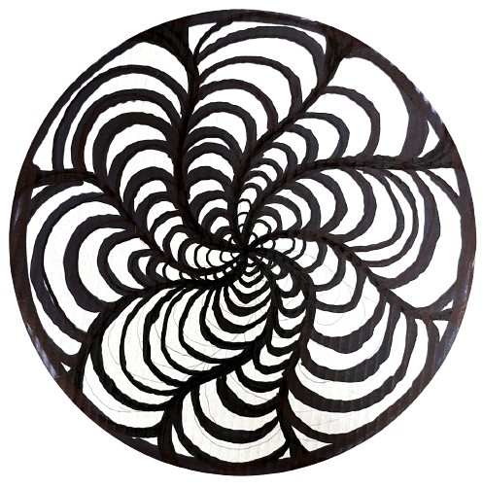
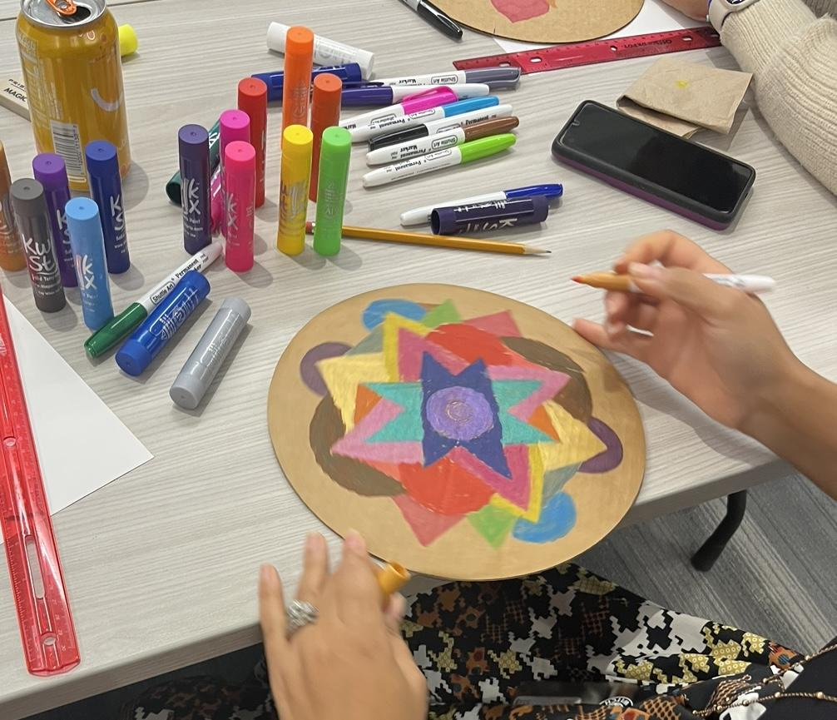
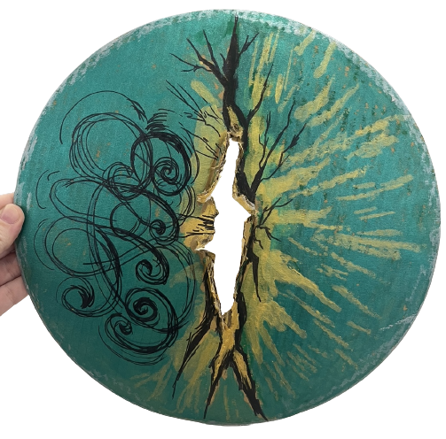
Strategy 9: Say “Yes” When Possible; Provide Opportunities for Choice Making
Encourages creativity
Validates the learner
Builds self-efficacy
Increases confidence
Provides more space for safe exploration
SEL Competencies
Self-Management
Self-Awareness
Responsible Decision-Making
Social Awareness
Notes:
Image Amy Bultena

Slide 41
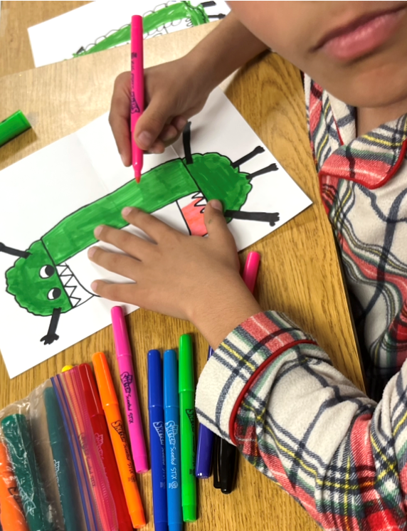
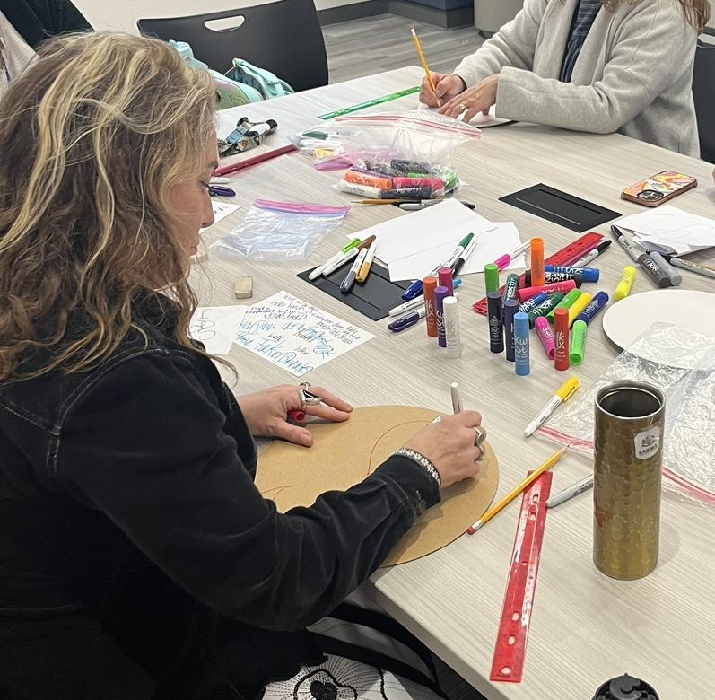
Strategy 10: Believe Everyone is an Artist
Notes:
images: Amy Bultena

Slide 42
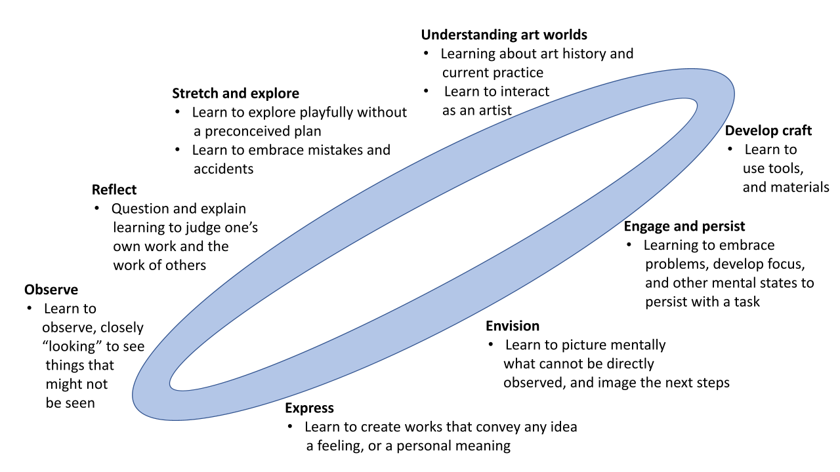
Studio Habits of Mind
A framework originating from research conducted by Lois Hetland and Ellen Winner at Harvard University’s Project Zero.
It consists of eight interconnected habits that foster creativity, critical thinking, and artistic development.
Notes:
Hetland, L., Winner, E., Vennema, S., Sheridan, K. (2013). Studio Thinking 2: The real benefits of visual arts education, p. 6.

Slide 43
Eight Studio Habits of Mind
Observe
Reflect
Stretch and Explore
Understanding Art Worlds
Develop Craft
Engage and Persist
Envision
Express
There is no ranking or hierarchical order in which the Studio Habits of Mind should be engaged.
Notes:
Hetland, L., Winner, E., Vennema, S., Sheridan, K. (2013). Studio Thinking 2: The real benefits of visual arts education, p. 6.

Slide 44

Eight Studio Habits of Mind
Notes:
Hetland, L., Winner, E., Vennema, S., Sheridan, K. (2013). Studio Thinking 2: The real benefits of visual arts education, p. 6.

Slide 45
Structuring Learning with the Studio Habits of Mind Framework
There are four components for planning the structure of a lesson utilizing the Studio Habits of Mind Framework:
Demonstration
  Information about processes, products, and assignments is delivered
  Information is useful for classwork or homework
  Conveyed quickly to reserve time for work and reflection
  Visual examples are frequent and/or extended
  Interaction occurs in varying degrees
Students-at-Work
  Students make artworks based on assignments
  Assignments specify materials, tools, and/or challenges
  Teachers observe and talk either to the whole class, individuals, or small groups
Critique
  Central structure for discussion and reflection
  A pause to focus on observation, conversation, and reflection
  Focus on student work
  Works are completed or in process
  Display is informal and temporary
Exhibition
  Many forms including physical, virtual, permanent, temporary, curated gallery style, informal and/or formal
  Develops in phases: planning, installation, exhibition, and aftermath

Slide 46
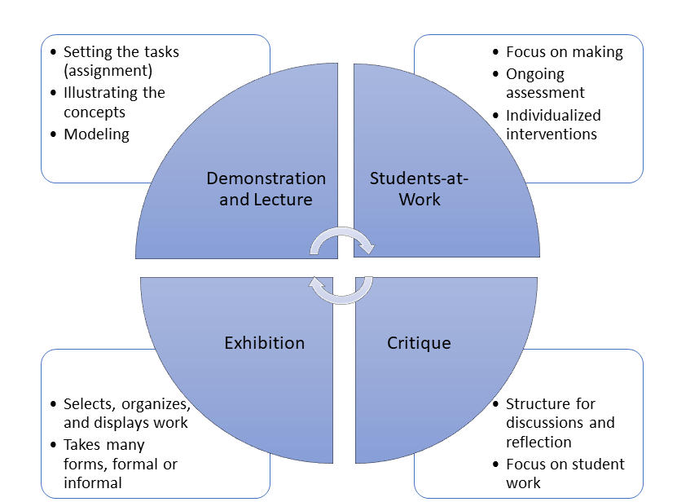
Structuring Learning with the Studio Habits of Mind Framework
The structuring of lessons using Studio Habits of Mind is not necessarily fixed, and often is a circuit.
Notes:
Hetland, L., Winner, E., Vennema, S., Sheridan, K. (2013). Studio Thinking 2: The real benefits of visual arts education.

Slide 47
Thoughts About Class Structure & Studio Habits of Mind
Thoughts about class structure
A frequent question about art in the classroom involves the activity's planning or structure. While there are many approaches in Studio Thinking 2 (2013) some typical variations are included. First is the ABA Class Shape (see Figure 1.) with a Demonstration-Lecture, then Students-at-work, followed by Critique, an approach that works well in high school classes.
Figure 1. ABA Class Shape
For younger students or for students with less skill or investment the Punctuated Class Shape (see Figure 2.) with a Transition (T), Demonstration-Lecture (D-L), Students-at-work (S-a-W), Demonstration-Lecture, Students-at-work, Critique (Crit), Transition, Critique, Demonstration-Lecture, may work better.
Figure 2. Punctuated Class Shape
Demonstration and Lecture
Students-at-Work
Critique
Exhibition
T | D-L | S-a-W | D-L | S-a-W | Crit | T | Crit | D-L | Exhibit
Notes:
Hetland, L., Winner, E., Vennema, S., Sheridan, K. (2013). Studio Thinking 2: The real benefits of visual arts education, p. 15-29.

Slide 48
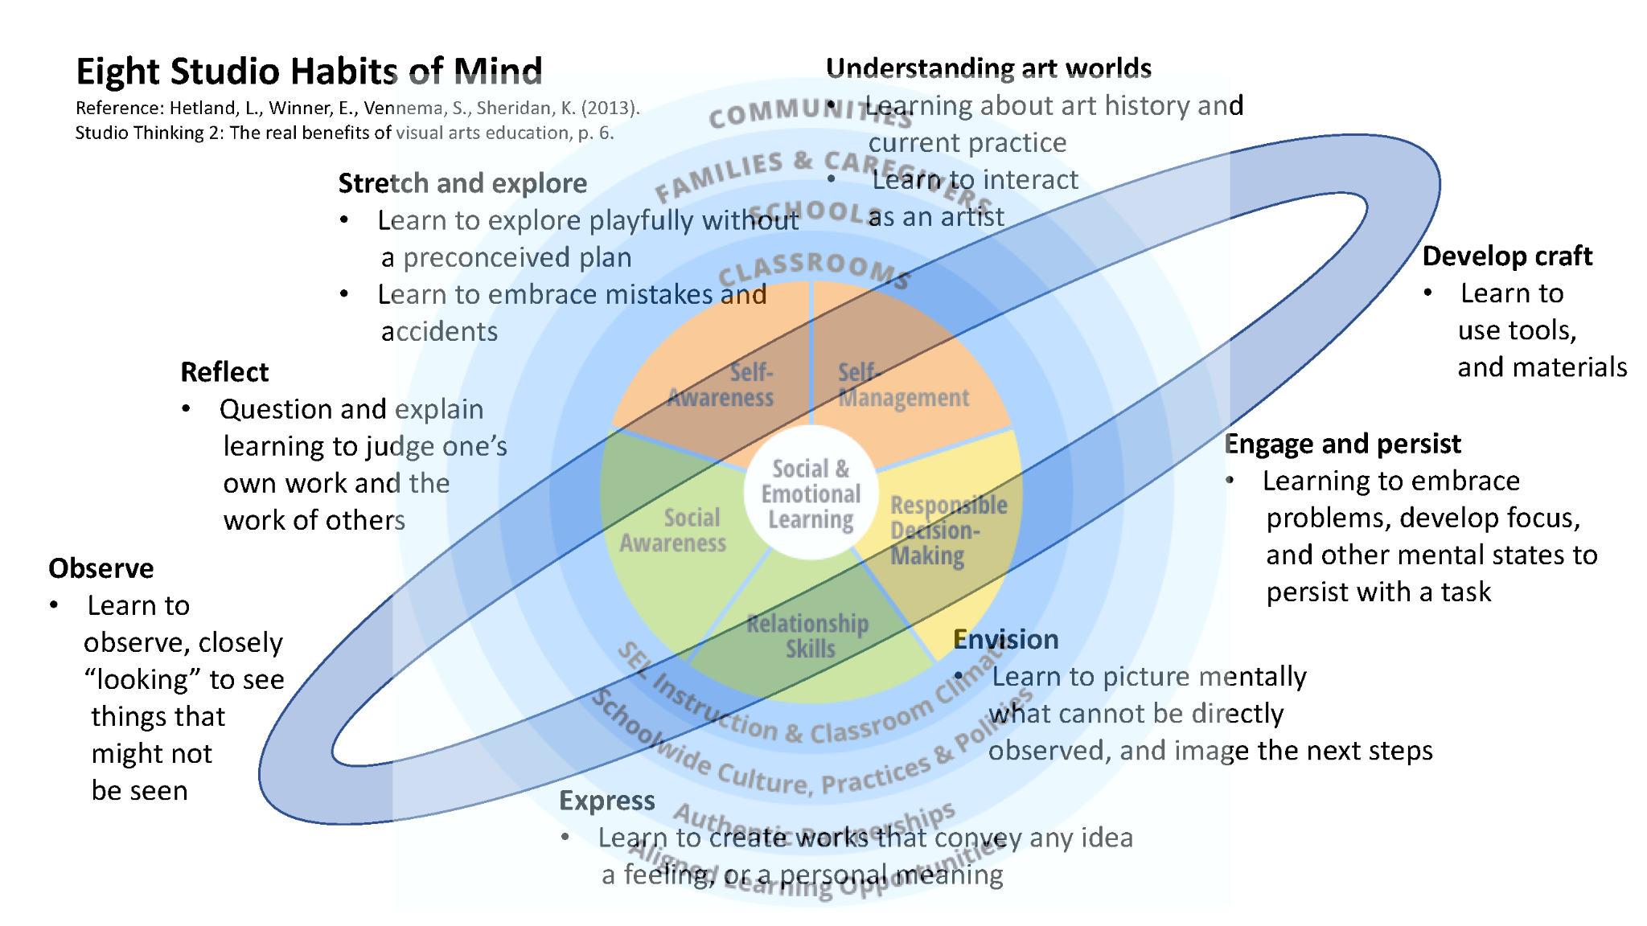
Studio Habits of Mind and SEL Competencies

Slide 49

Tips for Talking to Students About Their Art
Examine the artwork
Really look at the artwork; take longer than a quick glance.
Be specific
Avoid neutral words like “interesting” or “nice.” Use phrasing such as, “This is ____ because ____.”
Find a point of entry
What decisions were made? What skills are on display? Does the idea outweigh the execution or vice versa? Consider phrasing like, “This reminds me of ____ because ____.”
Celebrate successes
Ask thoughtful questions when you are unsure of intention. Avoid making value judgements. Preserve and celebrate student excitement by finding what is successful.
Notes:
Green, S.U. How to Critique the Art Assignment PBS Digital Studios (2014, October 09). Retrieved September 05, 2018 from http://bit.ly/2ClAr9dc

Slide 50

Tips for When Students Talk to Peers About Art
Critique is a constructive process.
Critique, or the process of providing feedback, is a constructive process that teaches students different ways of looking & thinking.
Provide opportunities for peer to peer review.
Feedback is often most informative for the person giving it. In looking at the art of others, forming an opinion, and sharing feedback, students learn a lot.
Try using the “sandwich method.”
Pair students. Each student gives a positive comment, a constructive comment, & a positive comment. Encourage students to be specific in their comments.
Notes:
Green, S.U. How to Critique the Art Assignment PBS Digital Studios (2014, October 09). Retrieved September 05, 2018 from http://bit.ly/2ClAr9dc

Slide 51
Creative Health Visual Art Lessons
The Creative Health Visual Art lessons designed for this module utilize Studio Habits of Mind and are aligned with Creative Health as they are trauma-informed and a part of social-emotional learning.
As you use the lesson slide decks you will find:
Usage of the Studio Habits of Mind framework
Lesson structuring following the Studio Habits of Mind framework
Alignment to SEL competencies
Alignment to California Visual Arts Standards

Slide 52
Creative Health Visual Art Lessons
Utilizing the Studio Habits of Mind framework, this module has 11 projects integrating Visual Art alongside trauma-informed strategies.
1 project for Educators
2 projects for UPK, TK, and Kindergarten
2 projects for 1st & 2nd Grades
2 projects for 3rd-5th Grades
2 projects for 6th-8th Grades
2 projects for 9th-12 Grades

Slide 53
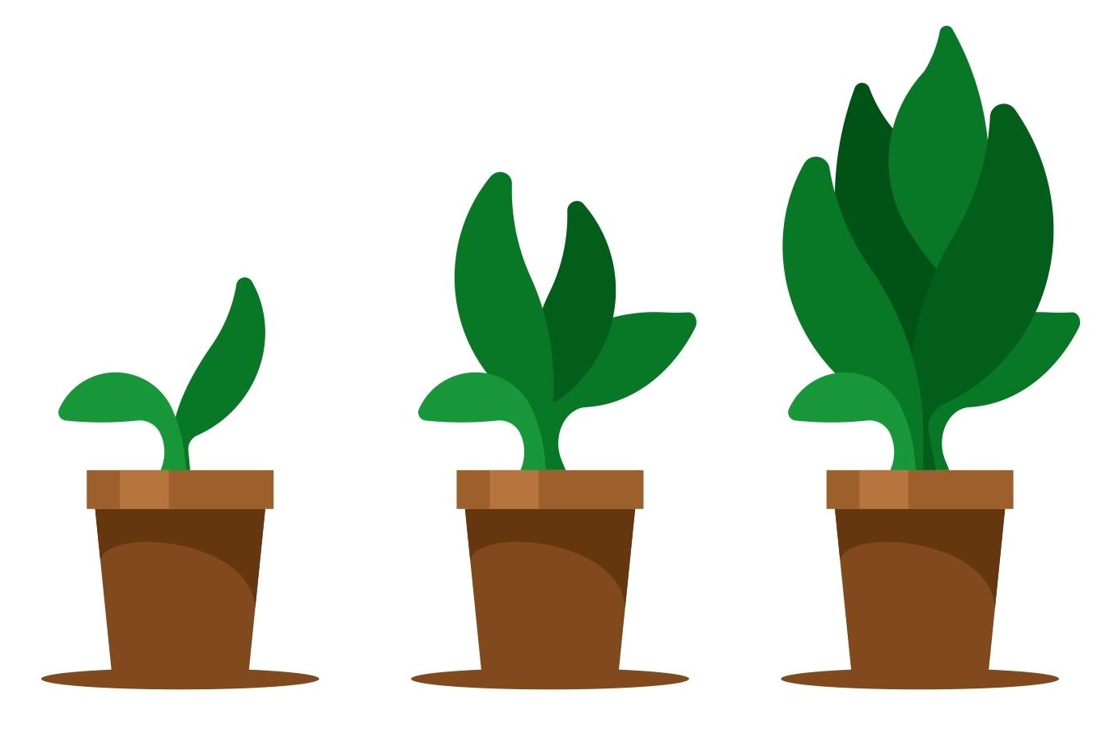
Recommendations for Next Steps
Try out the Lesson for Educators
View the the Visual Art Lessons for Students
Try out a Visual Art Lesson with a group of your students
Notes:
https://free-vectors.net/nature/plant-growth-stages

Slide 54
Closing: Expressive Visualization
Play some calming music
Find a comfortable position and close your eyes
Take three slow, deep breaths
Visualize yourself in your safe space
What does your safe space look like, sound like, and feel like? Embrace your senses and embrace the details
Exist in your safe space for a minute
Take three slow, deep breaths
If you feel comfortable, share your experience with an elbow partner
3 minutes
Notes:
https://creazilla.com/nodes/55424-timer-clock-emoji-clipart

Slide 55
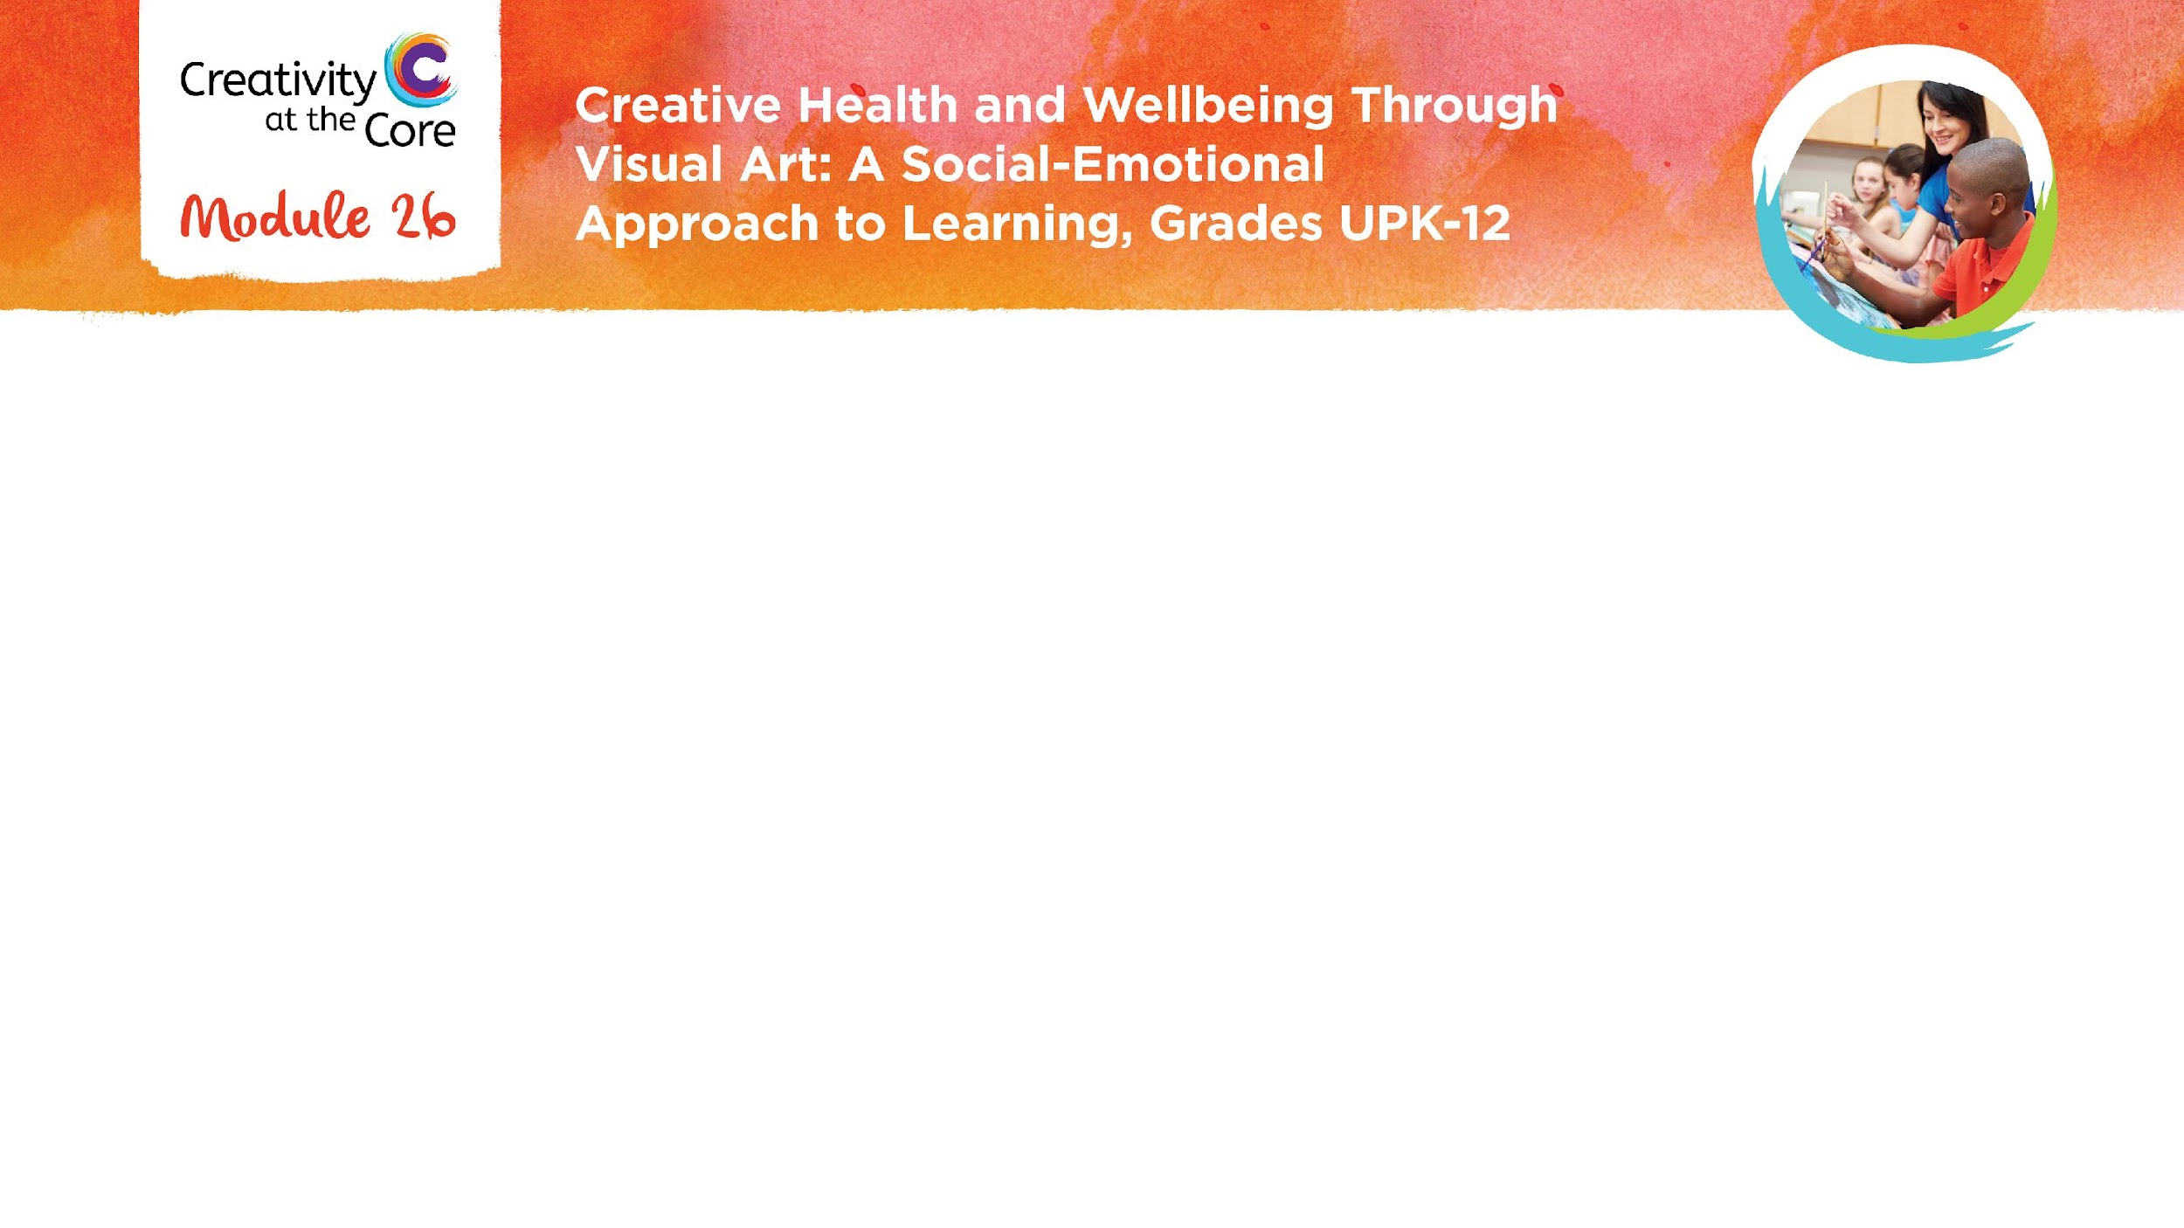
Closing Slide

