Slide 1
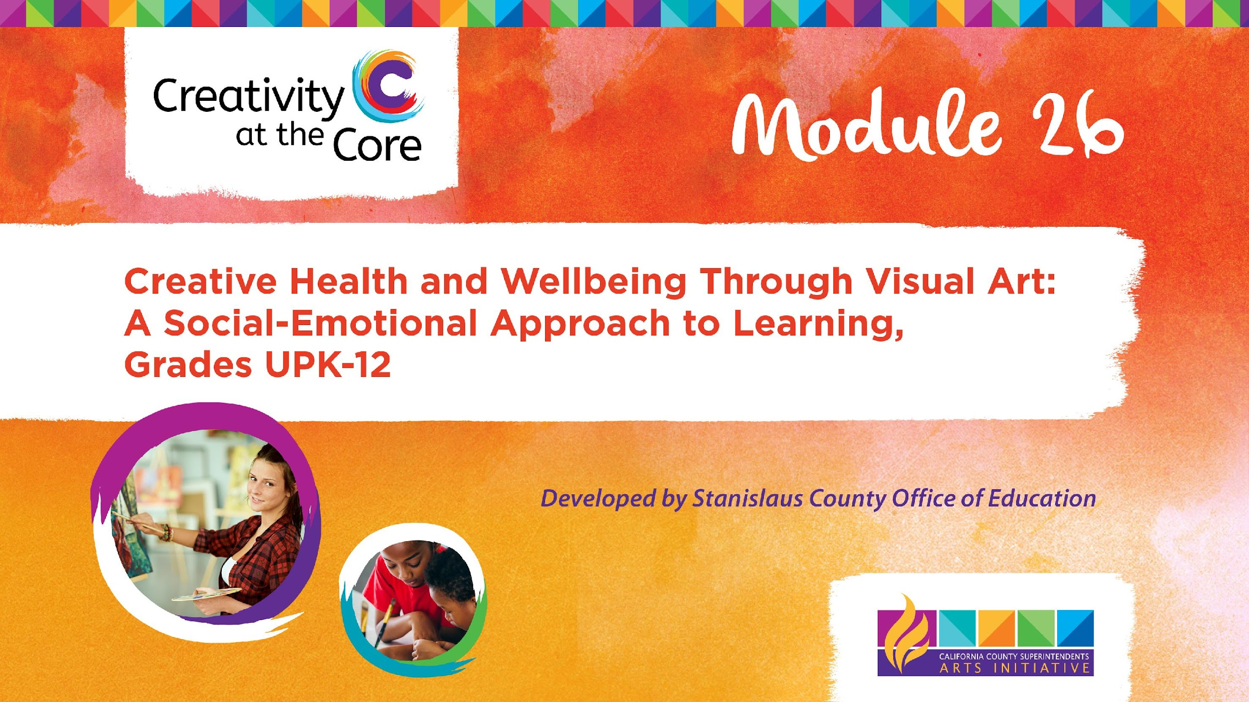
Module 26: Tutorial

Slide 2
Module Description
The objective of this module is to equip educators and administrators from Universal Pre-Kindergarten to 12th grade with the necessary skills, tools, knowledge, and self-confidence to promote students' creative health and well-being through visual arts. This includes incorporating mindfulness and respecting the diverse cultures, communities, and identities found in today's culturally-responsive classrooms. Drawing upon the principles outlined in the Studio Habits of Mind, this module offers ten visual art projects aligned to California Arts standards and SEL core competencies for students in grades UPK-12, and one visual art project for educators. These resources are designed to foster the creative well-being of both educators and students alike.

Slide 3
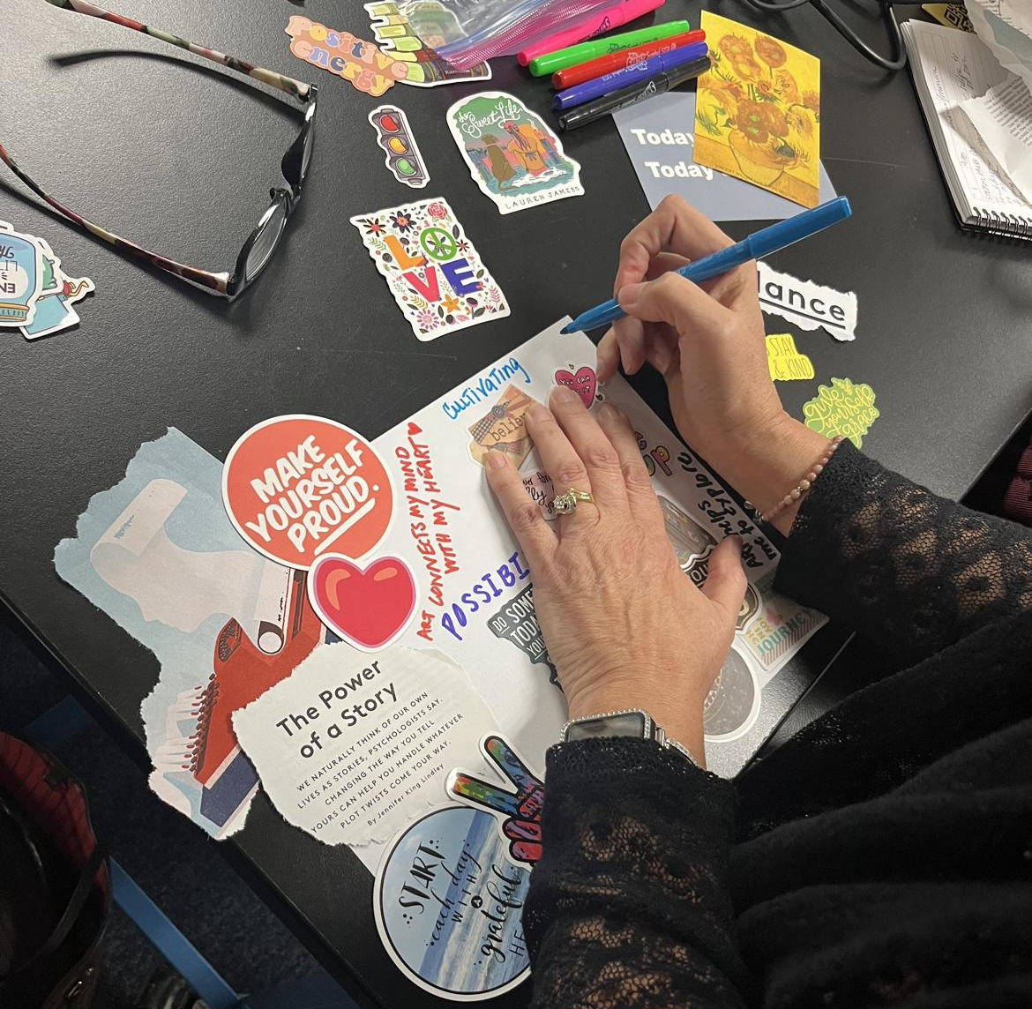
Module Outcome
The intended outcome of this module is to increase educator and administrator self-confidence and efficacy in the support of their own creative health and well being, and in doing-so increase their ability to develop and support the creative health and well being of their students.
Notes:
image: Amy Bultena

Slide 4
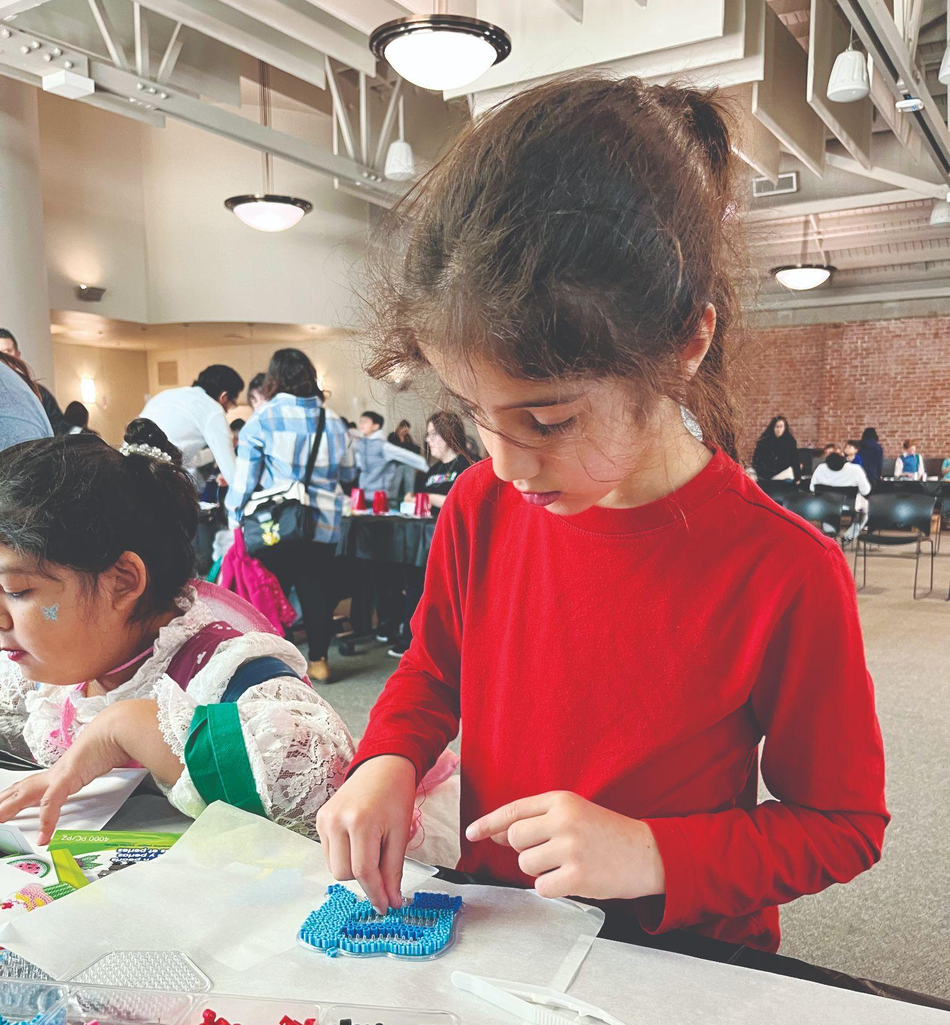
Materials Needed
Module 26 contains 10 CA Arts standards and SEL core competencies aligned visual art projects for students in grades UPK-12, and one visual art project for educators.
The materials needed for each visual art project vary, and a list of materials can be found on Slide 4 of each project’s presentation slide deck.
Notes:
image Amy Bultena

Slide 5
Module Users
Module 26 is for:
General Education & Visual Art Teachers of Grades UPK-12
  For the individual teacher, Module 26 provides step by step guidance for facilitating 10 CA Arts standards and SEL core competencies aligned Visual Art projects for students in grades UPK-12.
Administrators
  For the administrator, this Module 26 demonstrates the importance and effectiveness of Creative Health and provides exemplary projects at a full range of grade levels that illustrate the advantages utilizing Visual Art to support student SEL.
Professional Development Facilitators
  For use as professional development, Module 26 provides all the information and materials needed to conduct a full day workshop on the topic.

Slide 6
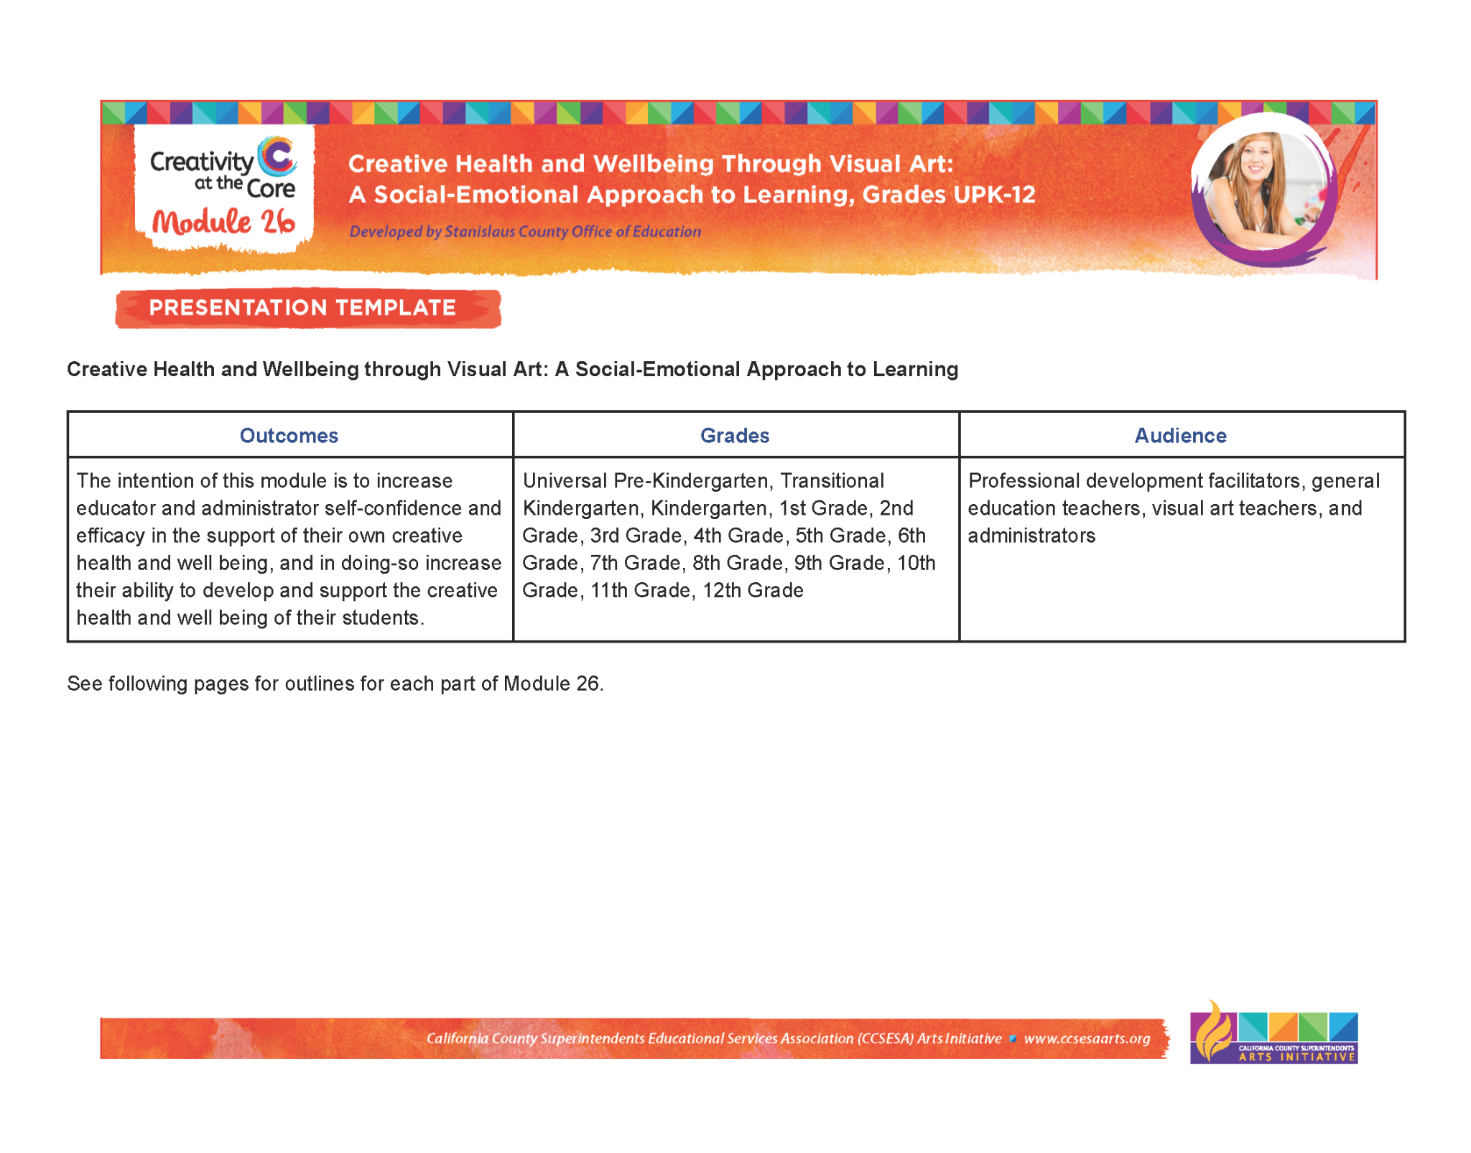
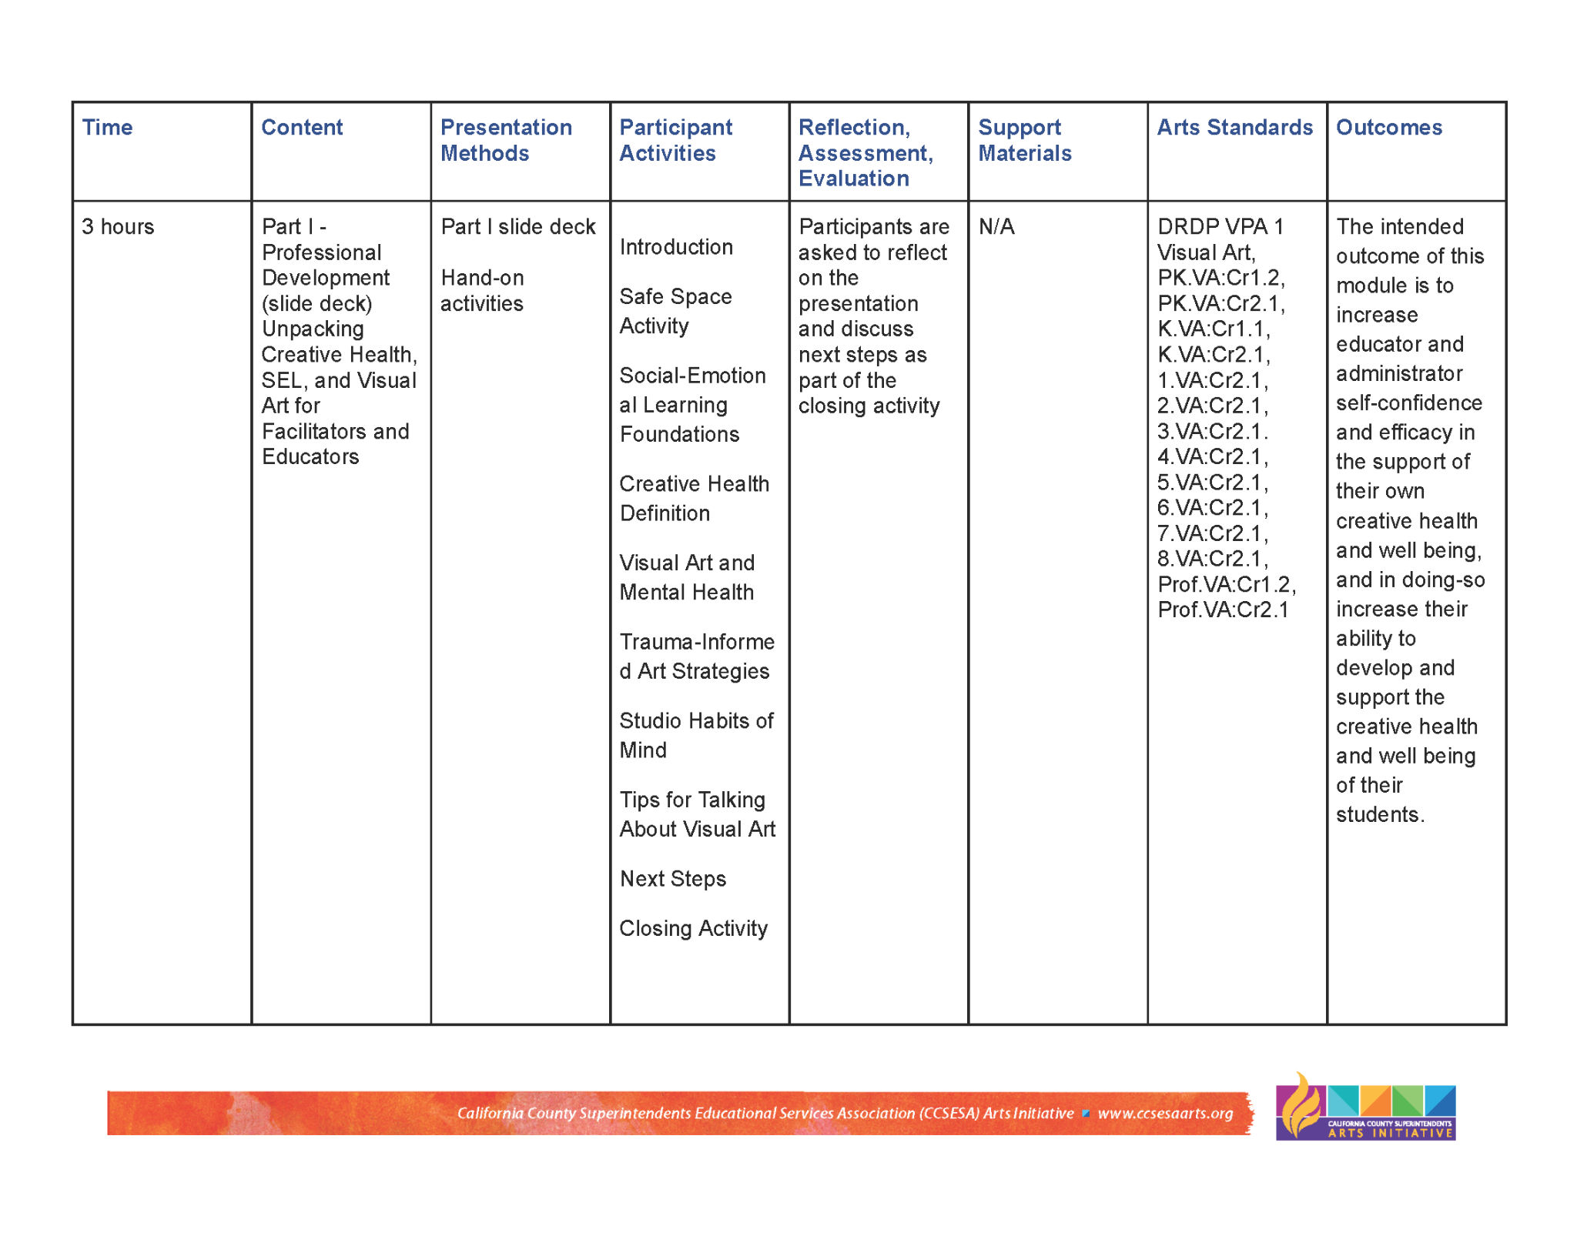
Module Presentation Chart
The module Presentation Chart provides an overview of this module.
This chart details key content, presentation methods, participant activities, resources and research to be addressed throughout the module.
The Presentation Chart is located under the Downloads section on the right.

Slide 7
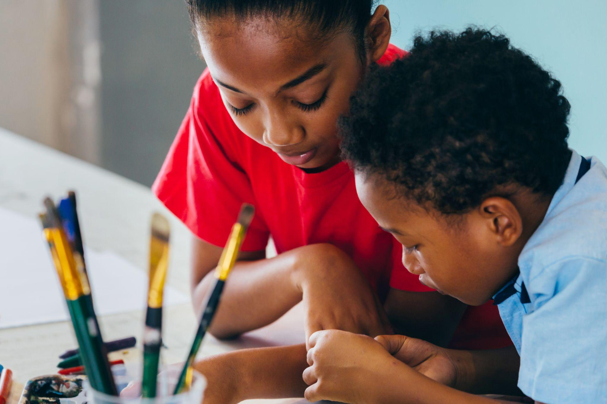
Parts of the Module
Module 26 is divided into two parts:
Part one is a presentation unpacking creative health, SEL, and visual art for facilitators and educators.
Part two consists of 10 CA Arts standards and SEL core competencies aligned visual art projects for students in grades UPK-12, and one visual art project for educators.

Slide 8
Part One of the Module: Unpacking
Part One: Unpacking Creative Health, SEL, and Visual Art for Facilitators and Educators
The purpose of this part is to define creative health, define Studio Habits of Mind, outline the science behind utilizing visual art to support student SEL, and provide strategies for how educators can use visual art activities to support student wellness.
Part One consists of a presentation slide deck entitled Unpacking Creative Health, SEL, and Visual Art for Facilitators and Educators.

Slide 9
Part Two of the Module: Projects
Part Two: Utilizing the Studio Habits of Mind framework, this module has 11 projects integrating visual art alongside trauma-informed strategies.This part of the module provides hands-on visual art projects that any teacher can facilitate to support student SEL.
1 project for Educators
2 projects for UPK, TK, and Kindergarten
2 projects for 1st & 2nd Grades
2 projects for 3rd-5th Grades
2 projects for 6th-8th Grades
2 projects for 9th-12 Grades

Slide 10
Part Two of the Module: Projects
The creative health visual art projects designed for this module utilize Studio Habits of Mind and are aligned with creative health as they are trauma-informed and a part of social-emotional learning.
As you use the project slide decks you will find:
Usage of the Studio Habits of Mind framework
Lesson structuring following the Studio Habits of Mind framework
Alignment to SEL competencies
Alignment to California Visual Arts Standards

Slide 11
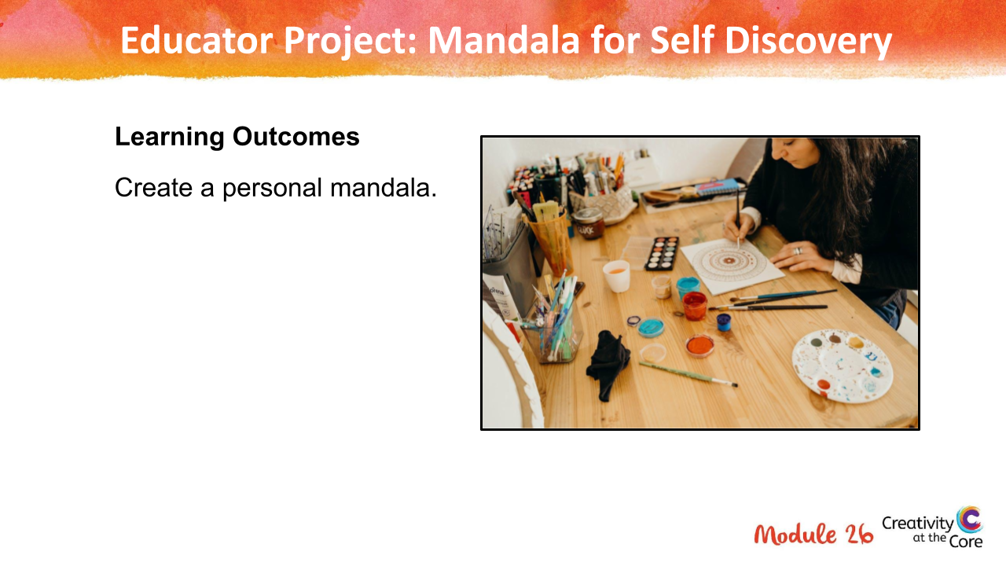
Educator Project

Slide 12
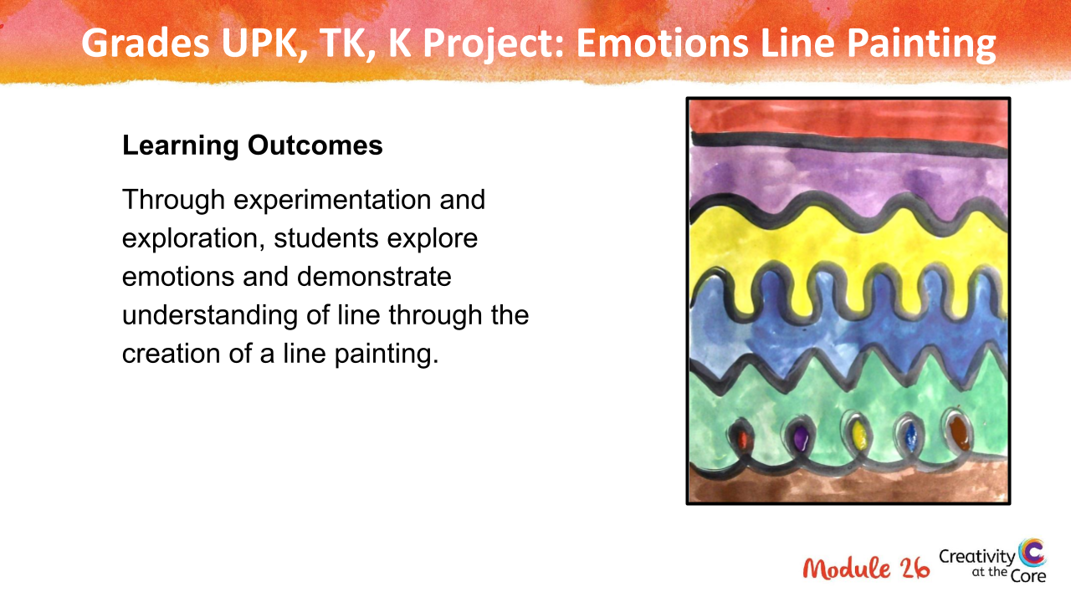
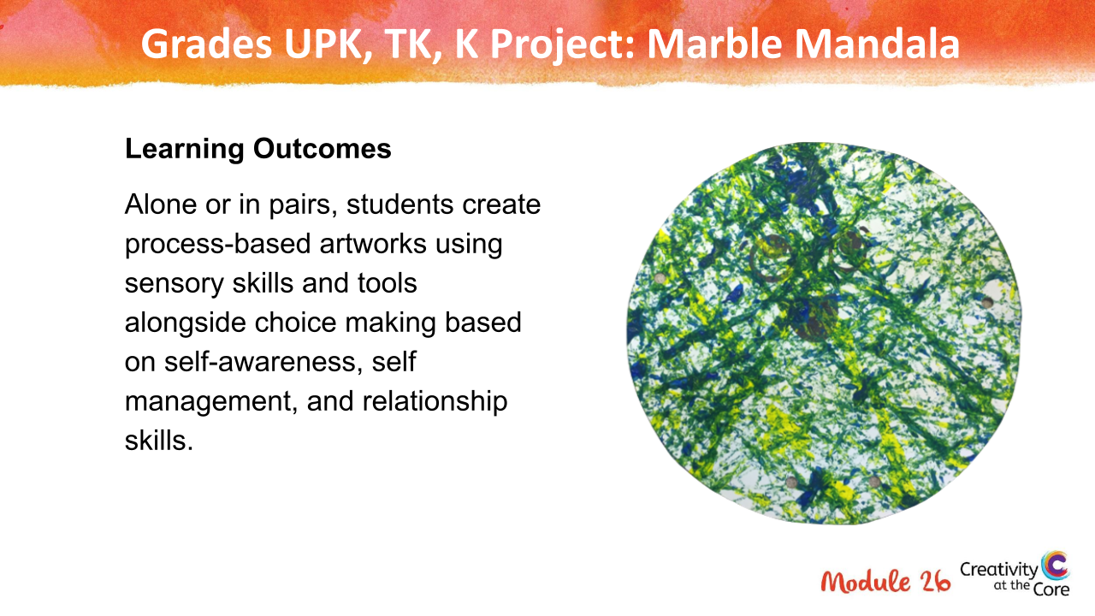
UPK, TK, and Kindergarten Projects

Slide 13
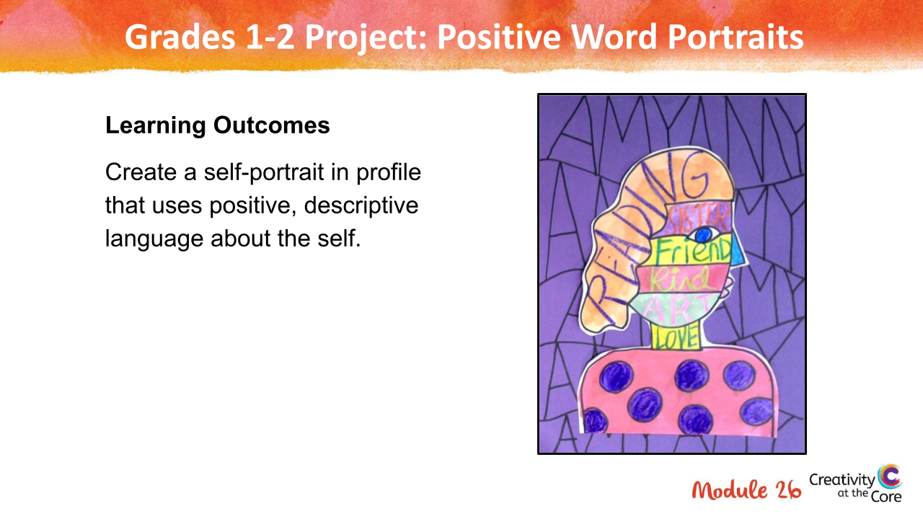
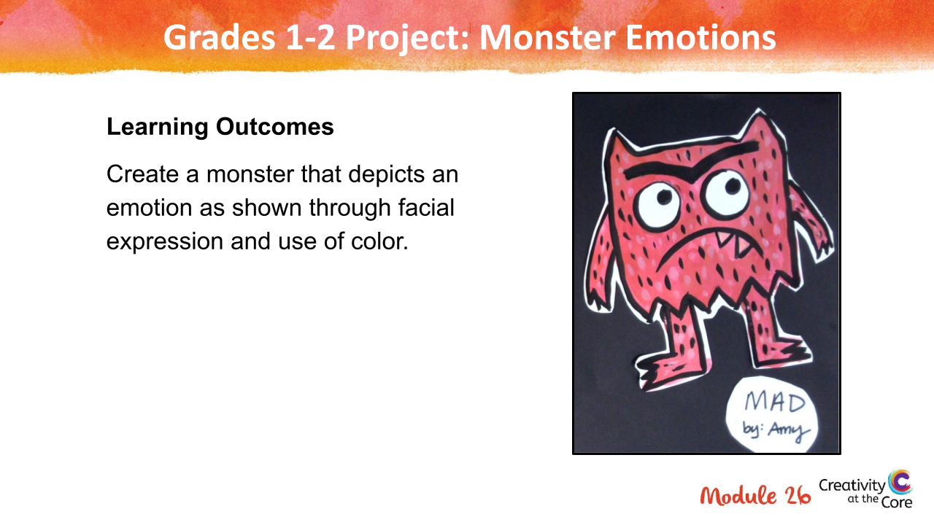
Grades 1-2 Projects

Slide 14
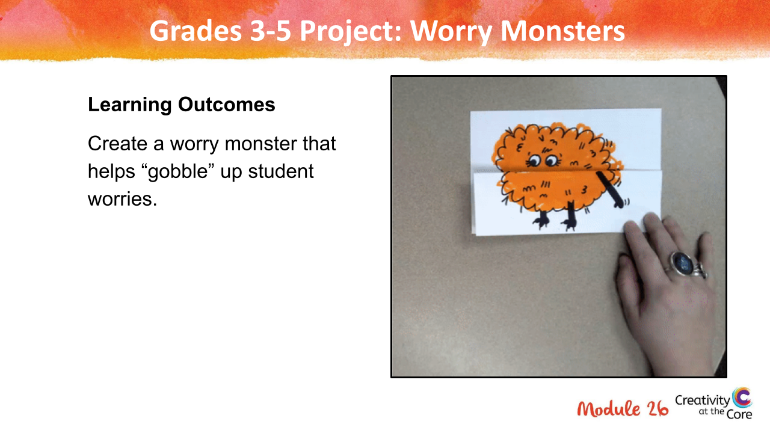
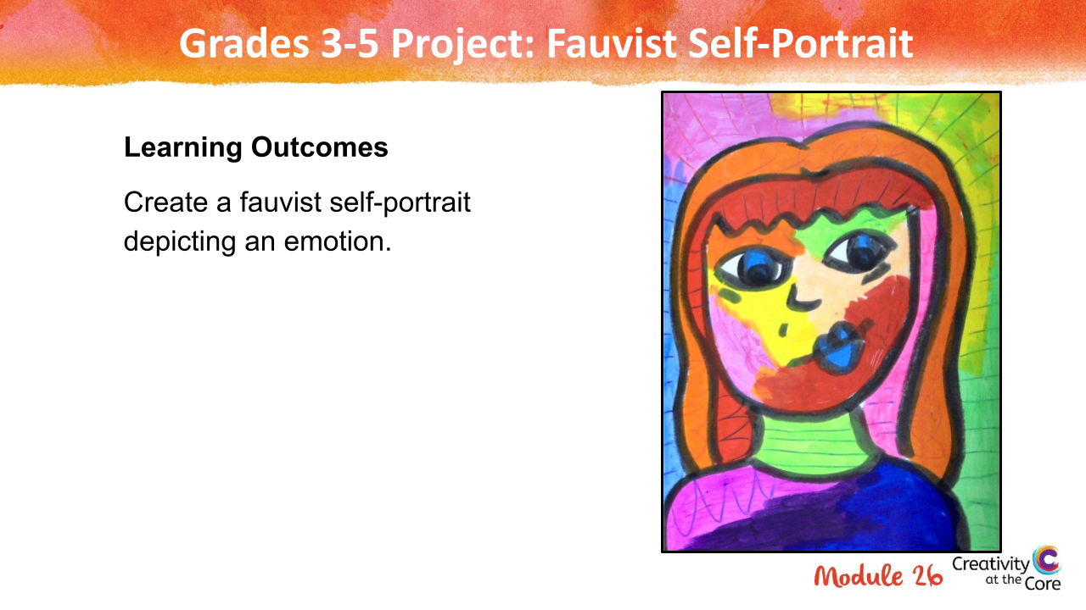
Grades 3-5 Projects

Slide 15
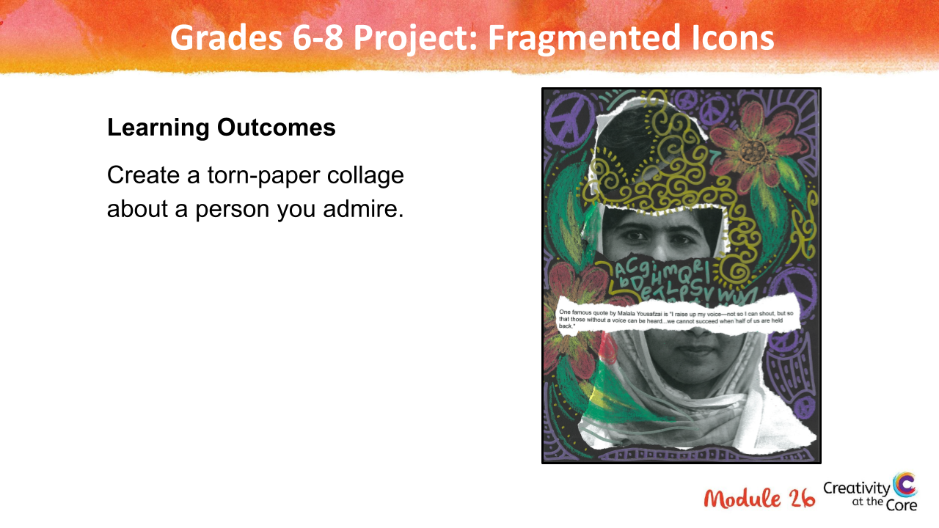
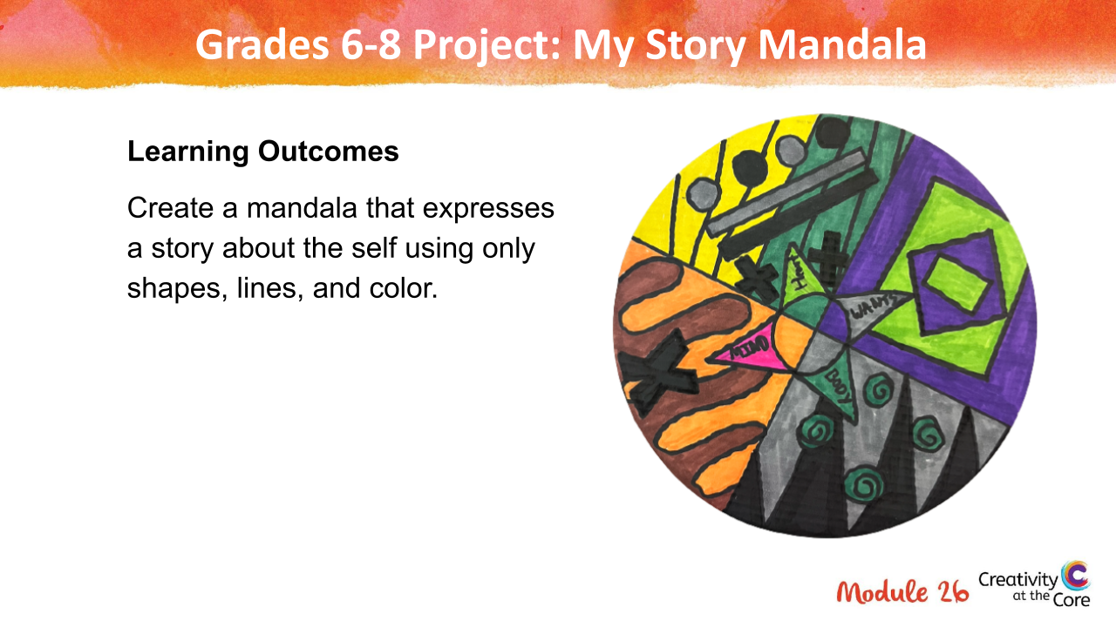
Grades 6-8 Projects

Slide 16
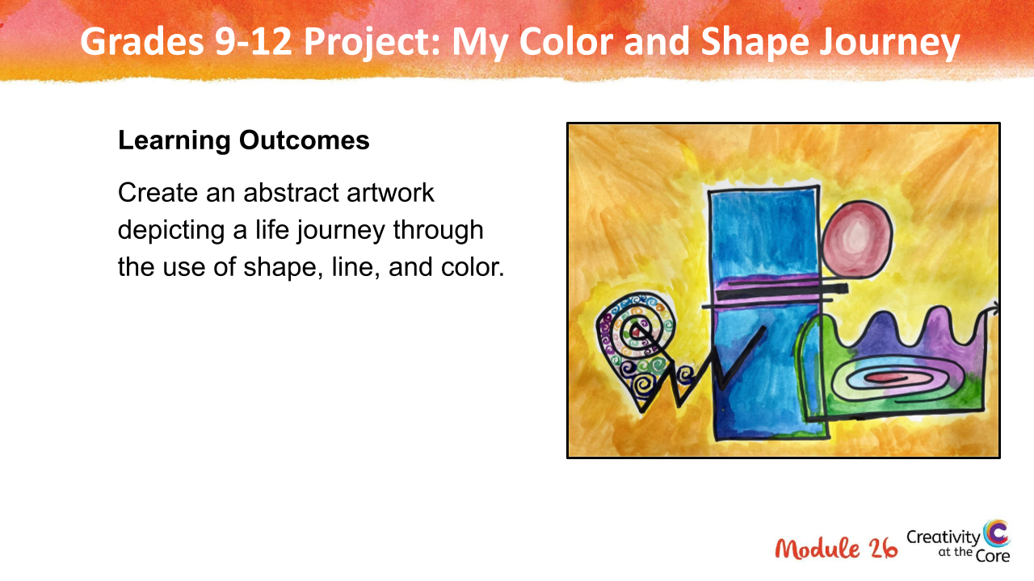
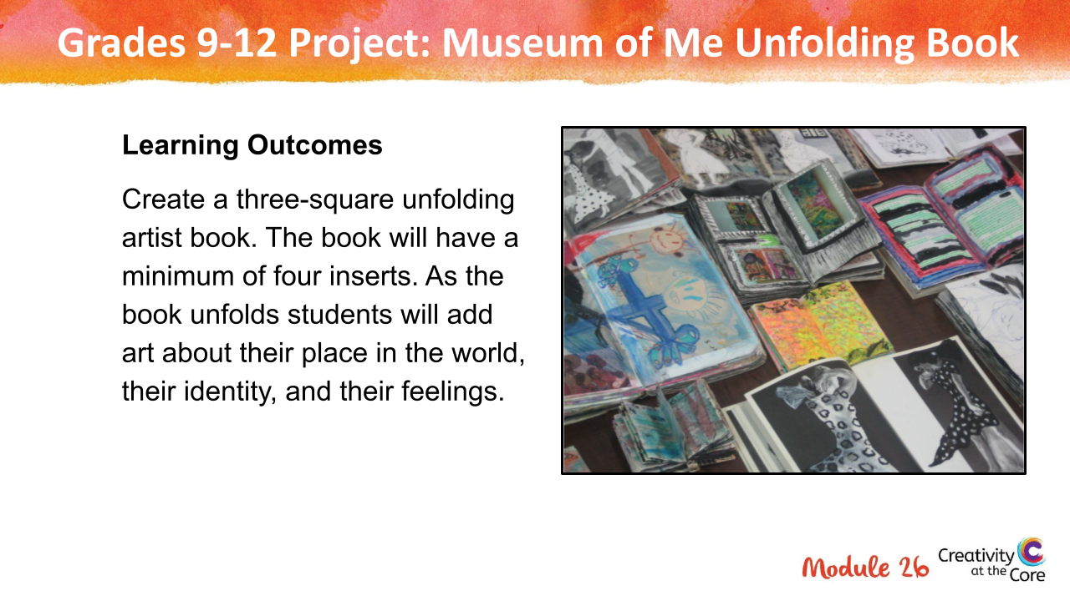
Grades 9-12 Projects

Slide 17
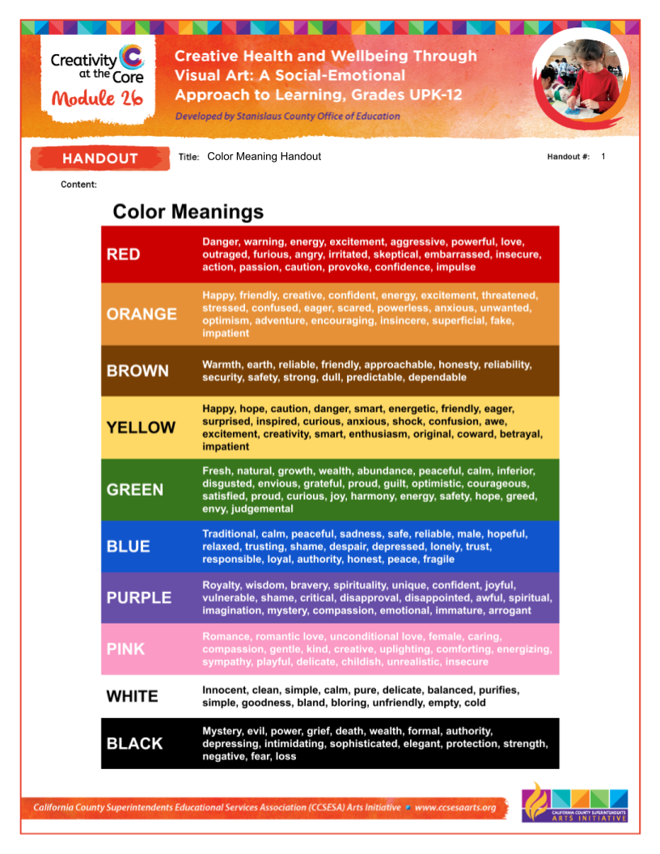
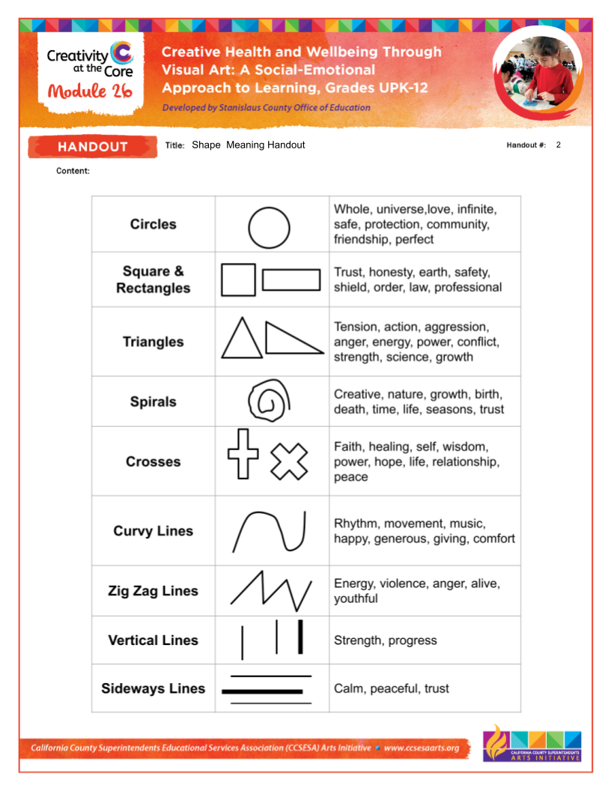
Handouts
A few of the projects offer a handout to support student exploration and learning.
All handouts are located under Downloads on the right.

Slide 18
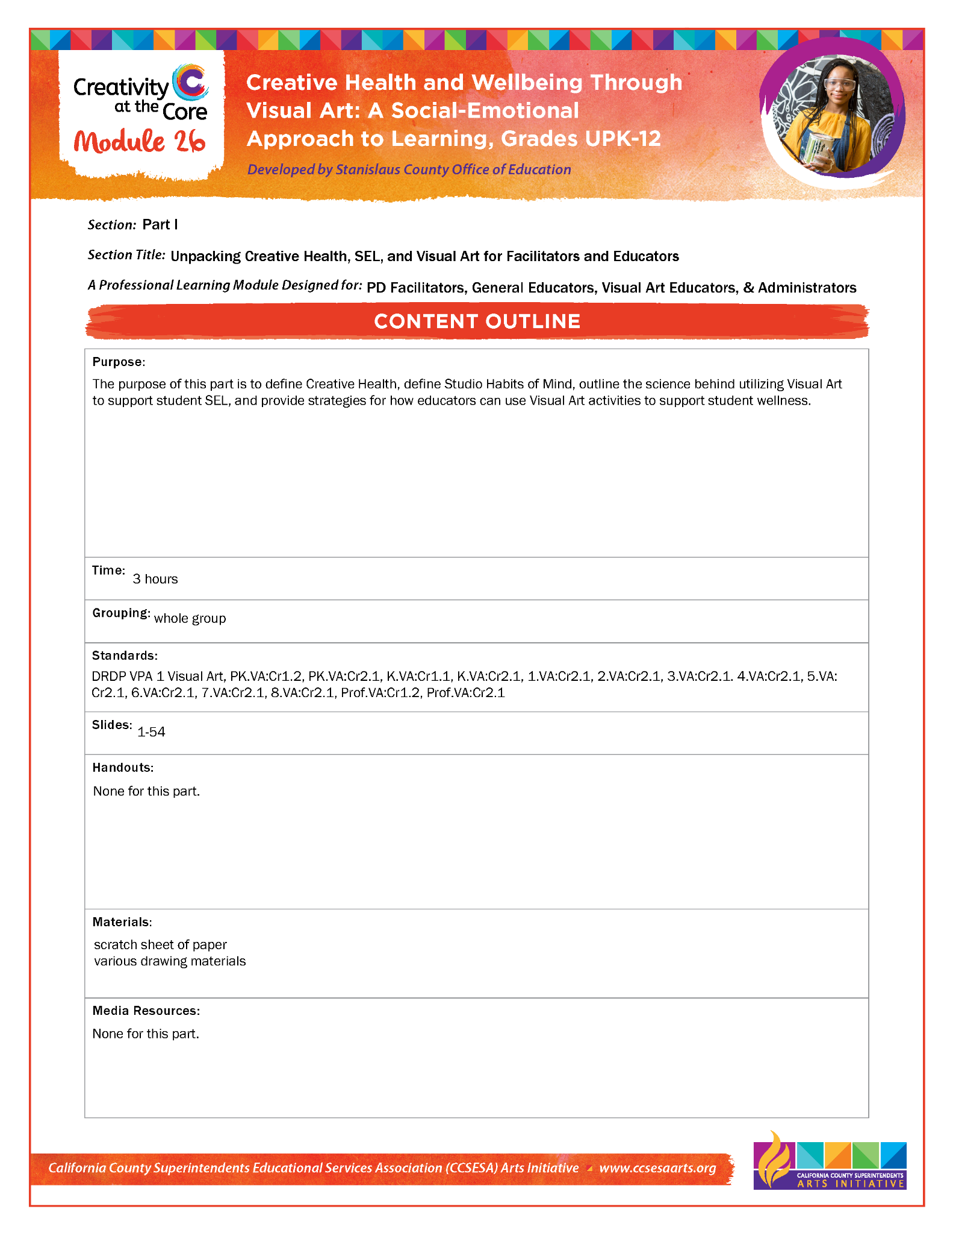
Content Outlines
The Content Outlines detail specific objectives and activities of each section.
The Content Outlines for each part are located under Downloads on the right.

Slide 19
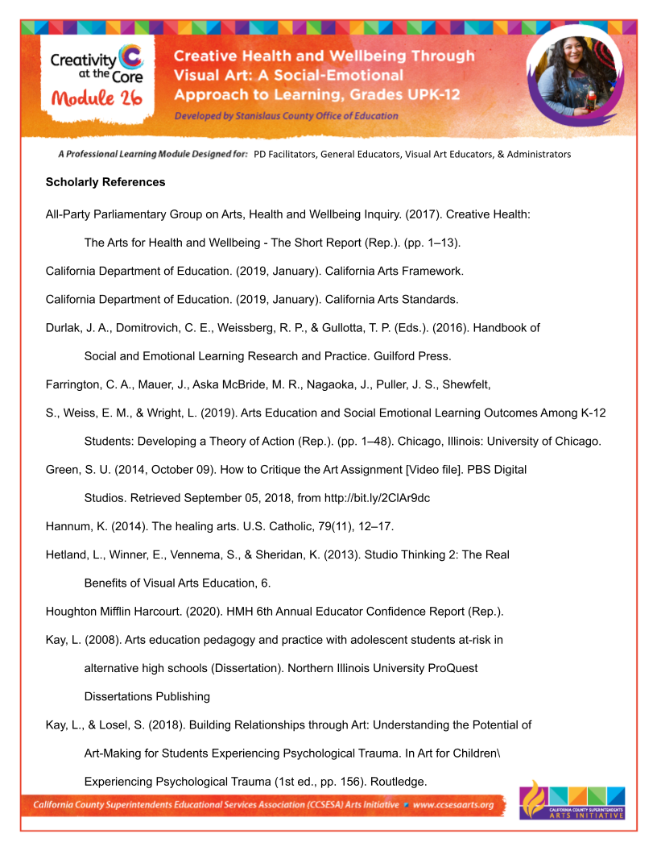
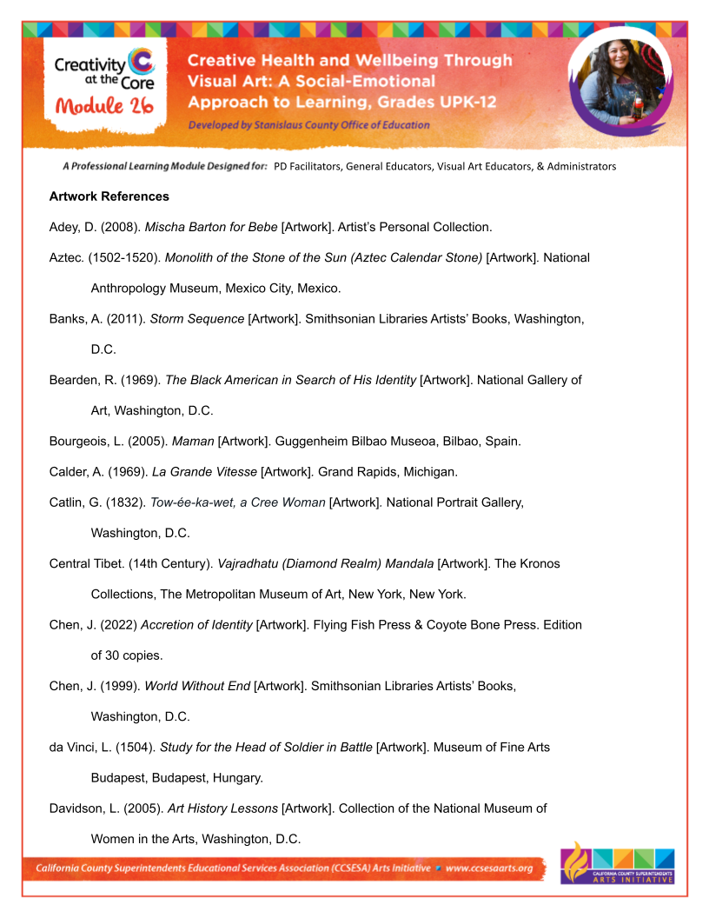
Research
In the Research document, you will find web, journal, artwork, and other research resources used for Module 26.
The Research document is located under Downloads on the right.

Slide 20
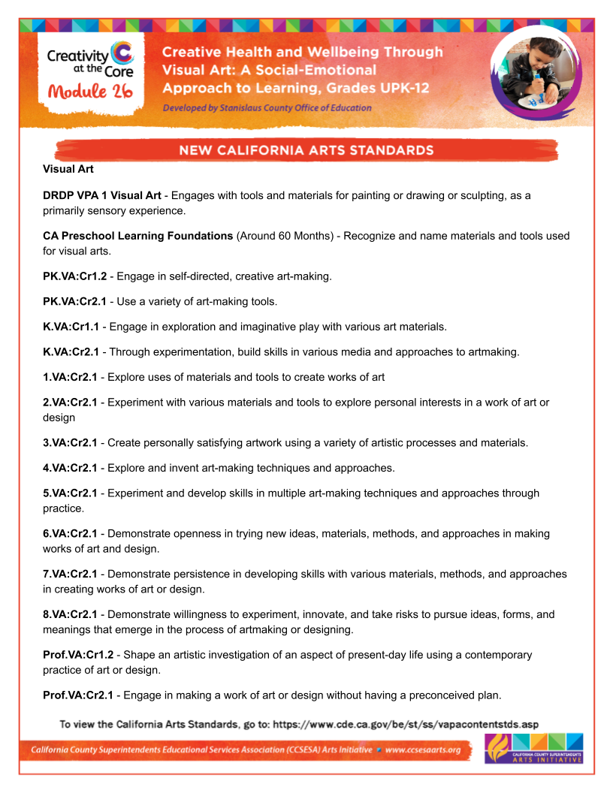
Standards
In the Standards document, you will find all standards used for Module 26.
The Standards document is located under Downloads on the right.

Slide 21
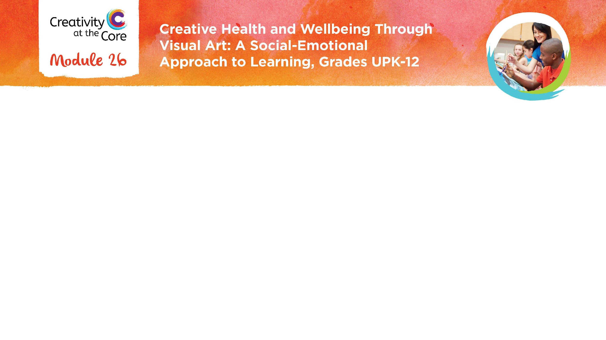
Closing Slide

