Slide 1
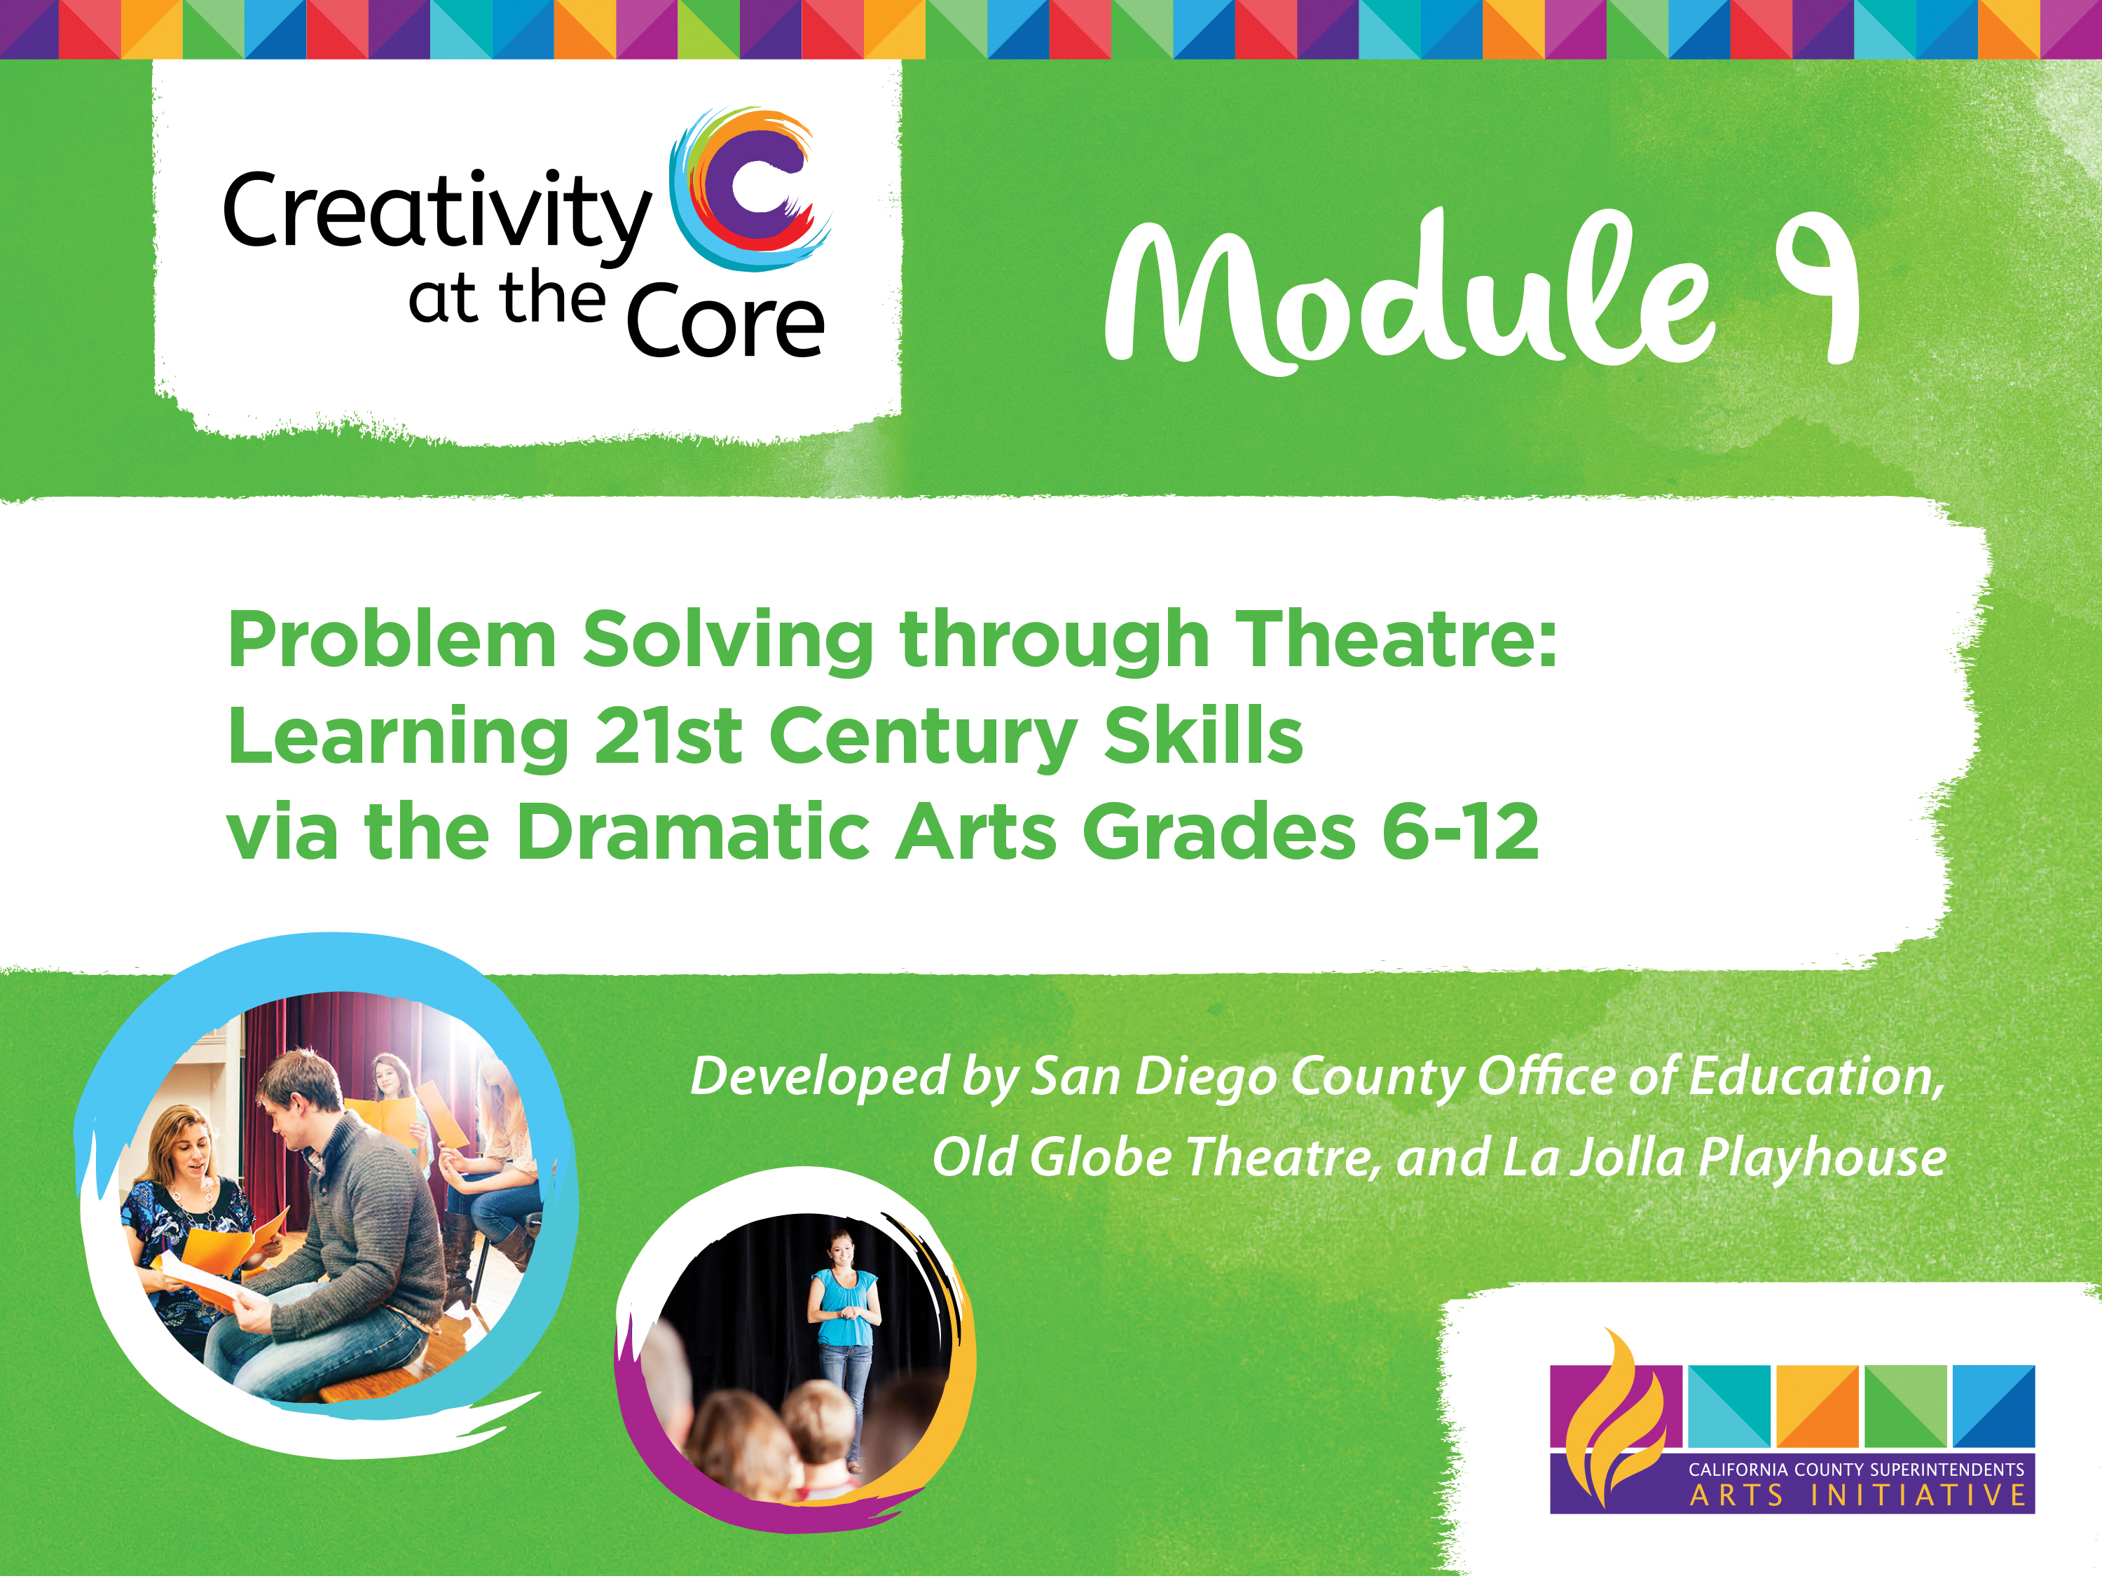

Slide 2
Module 9 Tutorial
Welcome to Problem Solving with Theatre!
Please use this tutorial to learn more about implementing professional learning Module 9 in your classroom, school district, or county. Once you have completed this tutorial, please spend time exploring the components of the module found on this website.

Slide 3
Module 9 Tutorial
Module 9 Objective:
Equip grades 6-12 teachers with an understanding of problem solving through theatre using 21st Century Skills

Slide 4
Module 9 Tutorial
Module 9 was developed over two years through a unique partnership between the Visual and Performing Arts (VAPA) Department of the San Diego County Office of Education, The Old Globe Theatre and La Jolla Playhouse. The module itself has been divided into two parts which each focus on different ways of using Theatre to address problem solving in the classroom. These two parts may be utilized independently or in conjunction as they explore the topic through slightly different lenses and therefore allow for different levels of implementation.

Slide 5
Part I
Part I – Developed in partnership between the VAPA Department of the San Diego County Office of Education and The Old Globe Theatre.
This portion of the module was programmed with the intent of serving as a blueprint for school administrators and classroom teachers to utilize during professional development sessions or teacher prep time. It lays out a clear series of exercises and activities which guides participants through the process of discussion and discovery of specific issues or concerns that are being faced by teachers and students in their classrooms. Part I was designed to allow for significant open discussion and dialog through which participants are invited to share their pressing concerns regarding areas of conflict they are experiencing in their classrooms and taking advantage of the larger group to brainstorm effective avenues of inquiry that may assist those individuals in developing a plan to address their specific predicaments and use Theatre activities and practices to promote problem solving with their students.

Slide 6
Part II
Part II – Developed in partnership between the VAPA Department of the San Diego County Office of Education and La Jolla Playhouse.
While Part I of this module was designed to be an entry point to begin the conversation of how Theatre may be used to address problem solving in schools, Part II of the module focuses on practical methods that may be used in the classroom to explore the topic. This portion of the module is intended to be classroom-ready by providing teachers with four units they may use with their students. Each unit explores a different “C” in the list of identified 21st century skills necessary for students to be successful in their future: Creativity, Collaboration, Communication and Critical Thinking. The four units are intended to be sequential with each unit serving as a base upon which the content of the following unit may be built.

Slide 7
Why 21st Century Skills?
Critical Thinking can be used to address any social issue.
Creativity is about free thinking and not self censoring ideas.
The drama activities in these units are about flexing problem solving muscles and not giving participants the answers.
21st Century Skills empower students to:
  Think quickly on their feet
  Look at the way others can assist them
  Look at how they can assist others
  Read body language of what is not being said
  Look critically at an issue or problem and see multiple sides
  Empathize with others

Slide 8
Why Theatre?
Theatre is a pure creative form of expression that examines the human condition and teaches empathy.
Theatre is a collaborative art form that requires all participants work together in order to be successful.
As the Theatre experience is an ephemeral one, each participant in the creative process must be in consistent communication to ensure everyone is on the same page and working towards a common goal.
Successful theatre artists are masters of critical thinking and problem solving.

Slide 9
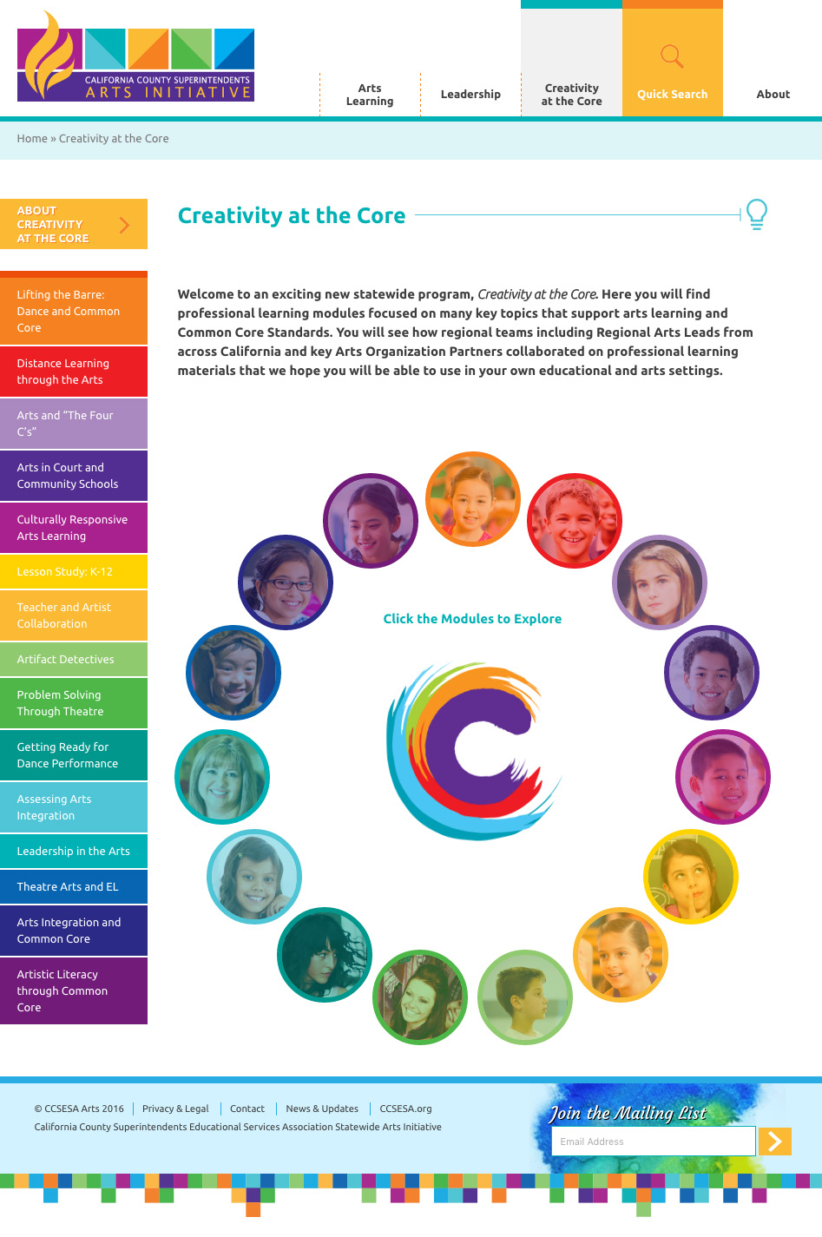
Creativity at the Core Website
www.ccsesaarts.org

Slide 10
Qualifications of Presenters
Ideally, there would be two presenters:
  Educator or Administrator knowledgeable in Standards, including Common Core Standards for the Technical Subjects, California Visual and Performing Arts Standards, National Core Arts Standards, English Language Development Standards.
  Theatre teacher (with or without a credential) who is familiar with theatre standards and knowledgeable in the facilitation of performance based theatre activities and exercises.

Slide 11
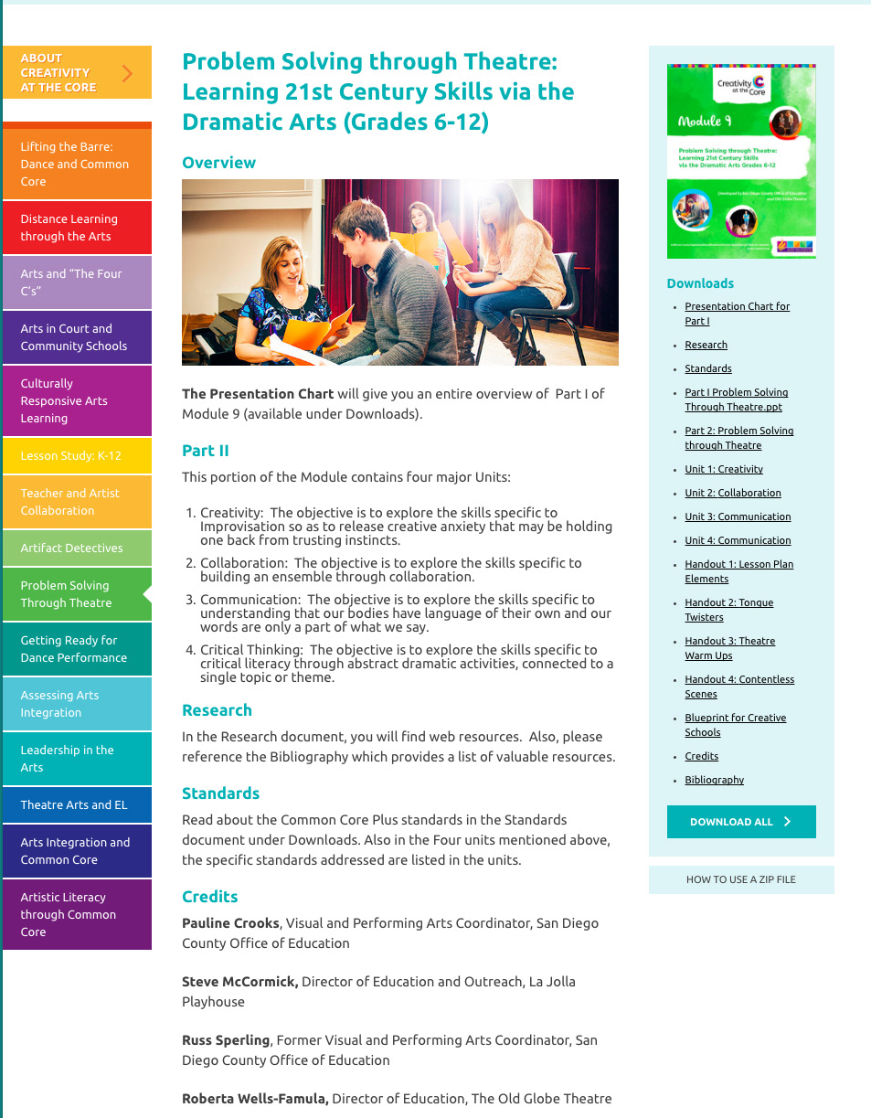
Module 9: Problem Solving through Theatre

Slide 12
Standards
Common Core Standards
California Visual and Performing Arts Standards
National Core Arts Standards
English Language Development Standards

Slide 13
Common Core Standards
Link to Common Core Standards for Technical Subjects:
http://www.corestandards.org/ELA-Literacy/RST/11-12/

Slide 14
California Theatre Standards
Link to California Standards for the Visual and Performing Arts: Theatre
https://www.cde.ca.gov/be/st/ss/documents/finalelaccssstandards.pdf

Slide 15
National Core Arts Standards
http://www.nationalartsstandards.org/

Slide 16
English Language Development Standards
http://www.cde.ca.gov/sp/el/er/eldstandards.asp

Slide 17
Presentation Chart
Part I Presentation Chart
Notes:
Please see the Part I Presentation Chart for a detailed summary of Part I of Module 9

Slide 18
PowerPoint
A PowerPoint presentation exists for both Part I and Part II of Module 9. The PowerPoint presentation contain notes for the presenter, videos, photos and other useful information.

Slide 19
Handouts and Resources
The handouts for each
Unit in Part II can be
found on the right-hand
side of the page.

Slide 20
Handouts and Resources
The resources for Part II
are located on the
right-hand side of the page.

