Slide 1
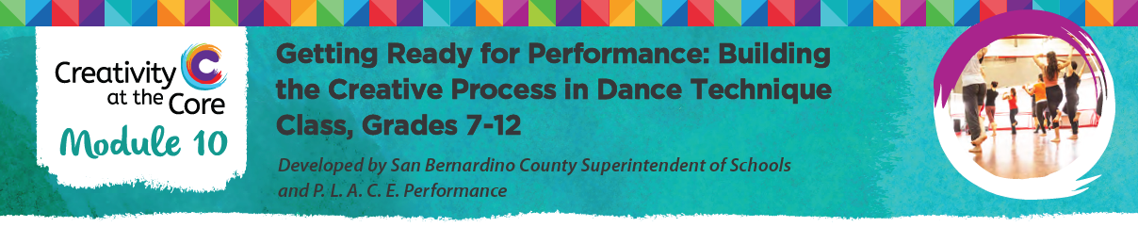
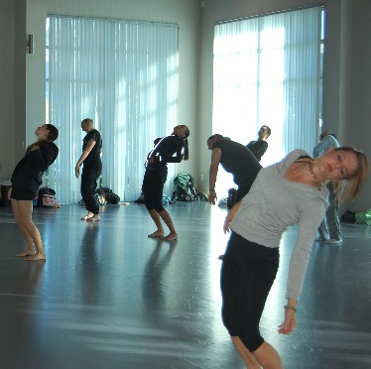
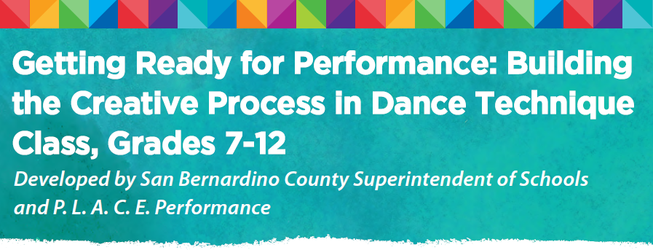

Slide 2

Audience
This module has been specifically designed for the single-subject dance educator who teaches technique class in their school setting.
This module has been developed for grades 7 – 12
Recommended Length: Full Day (6 hours)
Alternative Length: ½ Day Segment (3 hours)
Possible Contexts:
District or County Office Professional Development
Teacher/Artist Professional Development

Slide 3
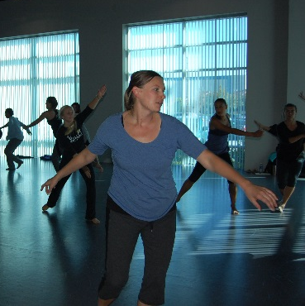
This module…
…
Reinforces the mindfulness that the dancer brings to the technique class, inclusive of:
physical awareness
cognitive reflection
insights from feelings

Slide 4
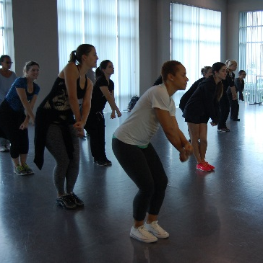
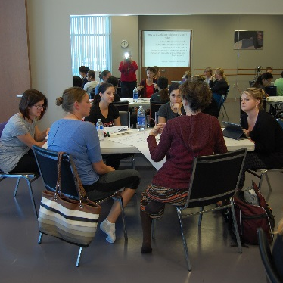

According to Martha Eddy*
“When the dancing body is approached from a holistic perspective, which involves experiential inquiry inclusive of physical awareness, cognitive reflection, and insights from feelings, the dancing is somatic.”
*Journal of Dance Education, (2002) 2(4), 119-127.

Slide 5
Purpose
The goal of this module is to enable dance educators to understand the importance of building the creative process into the dance technique class.
This module will engage participants in creative processes that open the mind and body of the dancer to listen within and interpret the movement in the moment using their own “voice”.

Slide 6
Purpose (contd.)
The use of somatic processes will allow the participant to be aware of their senses and prepare the body and mind for learning within the technique class.
Participants in this module are asked to listen to their own bodies and assess what their body wished to express as they replicate the movement given to them by the technique class presenter.

Slide 7
Rationale
CA State Standards for English Language Arts and Literacy in History/Social Studies, Science, and Technical Subjects call for students to be college and career ready in reading, writing, speaking, listening and language.
Students are asked to develop competencies in seven areas (next slide) as they progress through the K-12 system.
These competencies manifest themselves in the introductory document that “offers a portrait of a student who meets the standards”.

Slide 8
The 7 Capacities of a Literate Individual in the
CA Common Core State Standards that enable students to be college and career ready require that:
They demonstrate independence.
They build strong content knowledge.
They respond to the varying demands of audience, task, purpose, and discipline.
They comprehend as well as critique.
They value evidence.
They use technology and digital media strategically and capably.
They come to understand other perspectives and cultures.

Slide 9
Rationale (contd.)
This module provides participants tools that they can apply to engage in processes they would use with their students within the technique class to develop these competencies.
Specifically, demonstrating independence through the use of strong content knowledge, as well as addressing and responding to the demands of audience, task, purpose and discipline/genre/style.

Slide 10
Standards
This module is designed for the dance educator, not for the non-arts educator.
The standards selected are pulled from:
  CA Dance Standards, grades 7 – 12
  National Core Arts Standards in Dance
  CA Content Literacy Standards for Technical Subjects, grades 6 – 12
This module reinforces content literacy in dance as articulated through the need for college and career readiness in preparing students for participating in dance beyond high school.

Slide 11
Qualifications of the Presenter
The module is developed around one or two technique classes provided to dance educators.
The technique class presenters should be well-versed in the dance genre/style of the class being delivered.
The presenter(s)/facilitator(s) should also be well-versed in:
  Dance education
  CA Dance State Standards
  CA Content Literacy Standards for Technical Subjects
  CA English Language Development Standards
  National Core Arts Standards in Dance

Slide 12
Tools for the presenter(s) / facilitator(s)
The slides that follow will cover these tools:
Presentation Chart
Content Outlines
PowerPoint Slides
Research and Resources
Article
Handout
Note: These are all available under “Downloads”.

Slide 13
Presentation Chart
Tools:
The presentation chart provides the facilitator/presenters with an overview of the module and a timeline for possible activities.
Each time frame can be adapted to meet the needs of the presentation length (Full Day or ½ Day Segment).
The support materials column corresponds to the Content Outlines and PowerPoint slides given in the module.

Slide 14
Content Outlines
Tools:
The content outlines provide another view of the module Presentation Chart information to allow the presenter(s)/facilitator(s) the opportunity to “chunk” the contents into various time frames and constraints.
Suggestion for use:
The technique class genres/styles can be substituted with any dance genre/style dependent on the expertise of the technique class presenter.

Slide 15
Tools:
Content Outlines (contd.)
Content Outlines for the following sections can be used to break down your training.
Section 1: Welcome and Introductions
Section 2: AM Technique Class
Section 3: Deconstructing the AM Class
Section 4: PM Technique Class
Section 5: Classroom Translation and Final Reflection
These are all available under “Downloads”

Slide 16
Tools:
PowerPoint Slides
The PowerPoint slides are referenced in both the Presentation Chart and the Content Outlines for guiding the facilitator.
The notes that are found on the various slides can be used by the facilitator to guide the conversations and keep the focus of the module.

Slide 17
Tools:
Research and
Resources
Further research on Somatic Dance Education can be found in the “Research” template of the module, available under “Downloads”.
The Books and Periodicals Resources section lists the various items that can be referenced.
In addition, a local university dance educator may have expertise in somatic approaches to movement education.

Slide 18
Tools:
Article
The article suggested in the module is called: Developing Listening Bodies in the Dance Technique Class, by Rebecca Enghauser.
Read the article first to understand the somatic processes that can be used in one or more of the technique classes offered as part of the module.
Consider one or more of the five processes from the article that the technique class presenter may be familiar with or drawn to that may be applied within the class offered. This could be a process that the presenter wishes to learn to expand his or her own understanding of somatic approaches or a process that may seem natural to that particular genre/style of dance.
The presentation charts/content outlines indicate where in the module to use the article for facilitating a dialogue around somatic approaches and the unpacking of the dance technique class or classes.

Slide 19
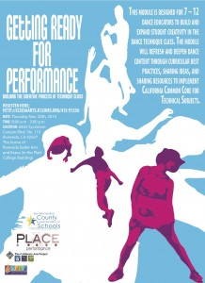
Tools:
Handout
A flyer from a previous workshop is provided for reference.

Slide 20
Credits
Armalyn De La O
Visual and Performing Arts Coordinator, San Bernardino County Superintendent of Schools, 601 North E Street, San Bernardino, CA 92415
Sue Roginski
Dance Artist and Educator, P.L.A.C.E. Performance, 4746 Sunnyside Dr., Riverside, CA 92506
Other Education and Arts Contributors
Nicole Robinson
Teacher Leader, RIMS California Arts Project
C.J. Logel
Dance Artist/Choreographer, P.L.A.C.E. Performance
Rosa Rodriguez Frazier
Dancer/Choreographer/Educator, AB Miller Dance Conservatory
Brandon J
Choreographer and Educator, ENVY Dance Company
Tracy Tom-Hoon
Dance Artist and Choreographer, P.L.A.C.E. Performance

Slide 21
