Slide 1
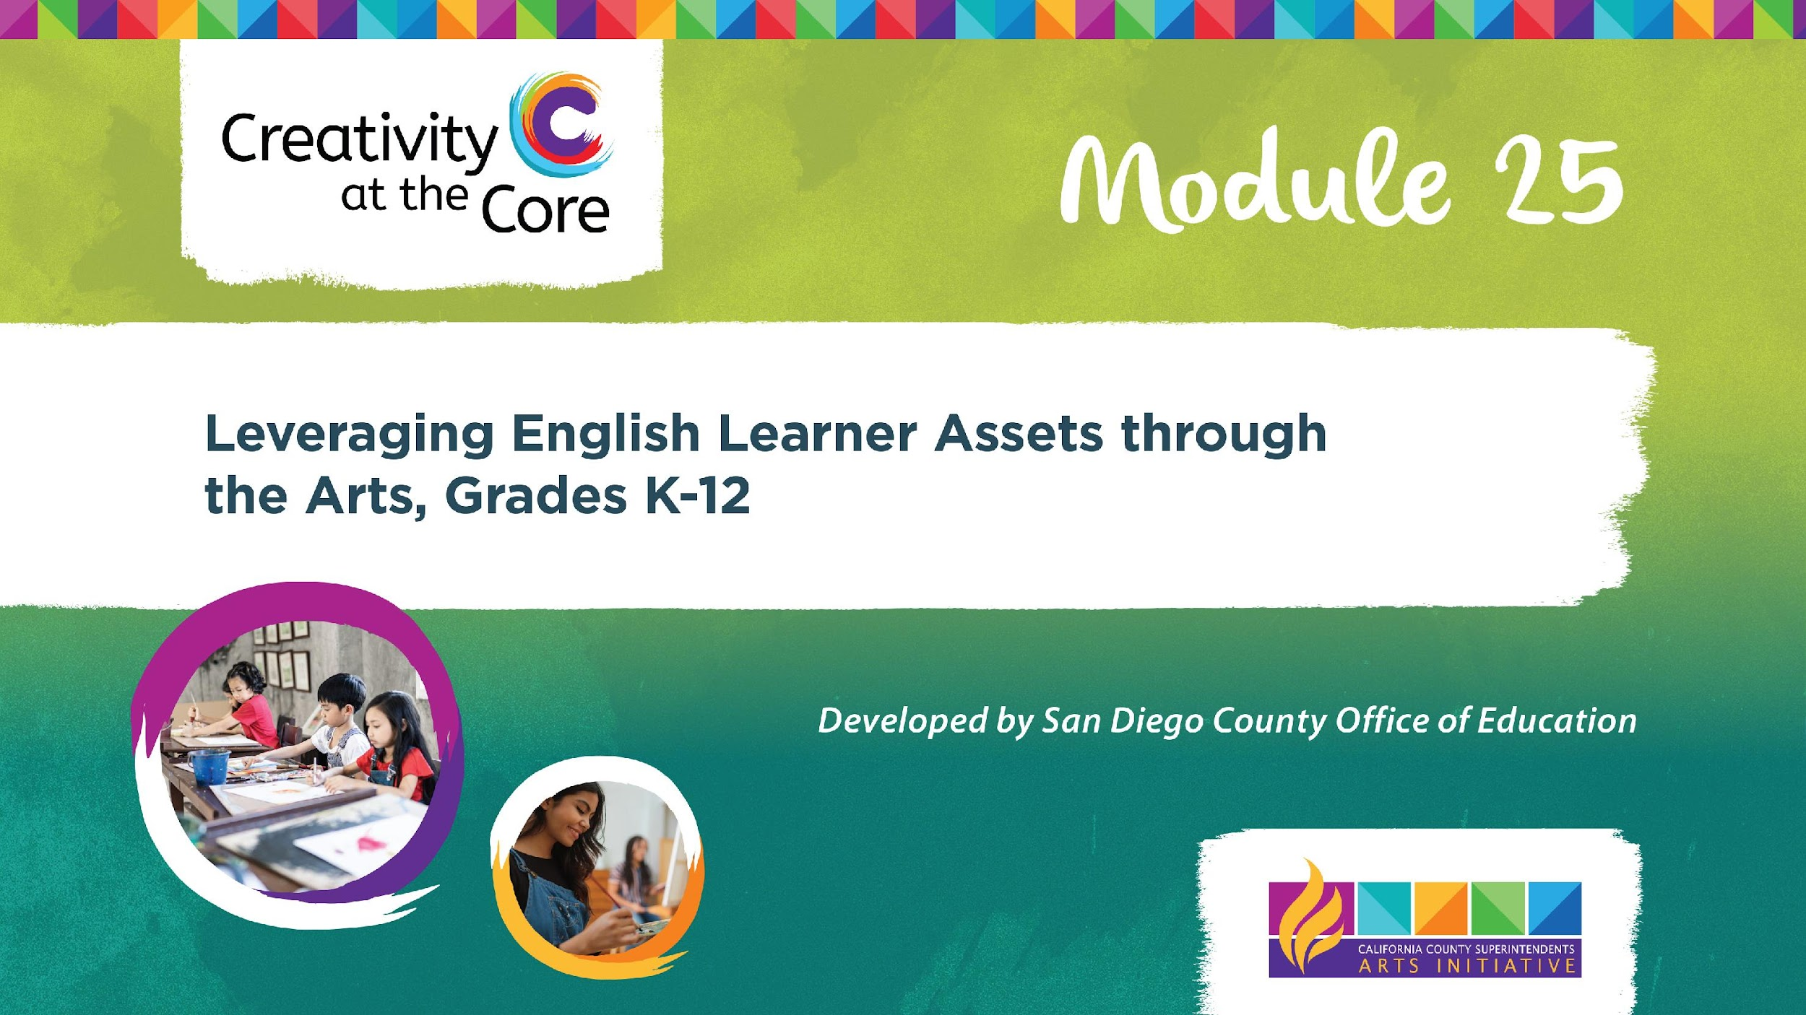
Notes:
Section 1: Liberatory Design
Welcome, Introductions

Slide 2

Purpose
Provide resources for both ELD educators and arts educators to support all students
Provide tools to show how to develop curriculum that leverages the assets English Learners bring to the school community
Explore all five arts disciplines (dance, media arts, music, theatre, and visual arts), science, and ELA
Notes:
Purpose of Creativity at the Core professional learning Module 25
Provide resources for both ELD educators and arts educators to support all students
Provide tools to show how to develop curriculum that leverages the assets English Learners bring to the school community
Explore all five arts disciplines (dance, media arts, music, theatre, and visual arts), science, and ELA

Slide 3

Introduce yourself
Name
Location
Position
Share the story behind your name
The Story Behind Your Name
Notes:
The Story Behind Your Name (Inclusion activity)
Please introduce yourself by sharing your name, location, and position.
Share the story behind your name with your group of 2 or 3 people - limit of 2 minutes per person

Slide 4


Our mission is to dramatically improve educational experiences, outcomes, and life options for students and families who have been historically underserved by their schools and districts.
Notes:
Equity
The work we are about to enter into comes from the National Equity Project.
This is the mission of the National Equity Project: To dramatically improve educational experiences, outcomes, and life options for students and families who have been historically underserved by their schools and districts.

Slide 5
Connecting to Your “WHY”
Given your identity,
your experiences, and your role,
what is your
equity why?
Notes:
Before we dive in, let’s take a moment to connect with our why. Given your identity, your experiences, and your role, what is your equity “WHY”?
You have 5 minutes to reflect, write down, and share your equity “WHY”.
This could be shared in the chat, on a document such as a jamboard, or on paper sticky notes.

Slide 6
History is a series of design decisions.
All systems produce what they are designed to produce.
Everything is by design.
We are ALL designers.
Educators as Designers
Notes:
Liberatory Design
As educators, we are all designers. Everything we plan is by design. And we redesign minute by minute sometimes to make sure we are meeting the needs of our students. As we design, we need to ensure that we are designing lessons equitably so all students have access to grade-level appropriate content.

Slide 7



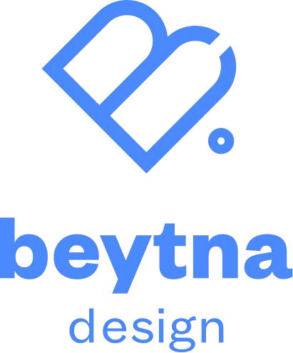

What do we mean by “liberatory” design?
Liberatory Design is an approach to addressing complex equity challenges.
It’s a process & practice to…
Create designs that help liberate and increase opportunity for those most impacted by oppression
Transform power by shifting the relationships between those who hold power to design and those impacted by these designs
Generate liberatory learning and increased agency for those involved in the design work
Notes:
What do we mean by “liberatory design”?
It is an adapted design thinking process that includes steps we believe are essential to practice design for equity.
Liberatory design is an approach to addressing complex equity challenges.
It’s a process and practice to
Create designs that help liberate and increase opportunity for those most impacted by oppression.
Transform power by shifting the relationships between those who hold power to design and those impacted by these designs
Generate liberatory learning and increased agency for those involved in the design work

Slide 8
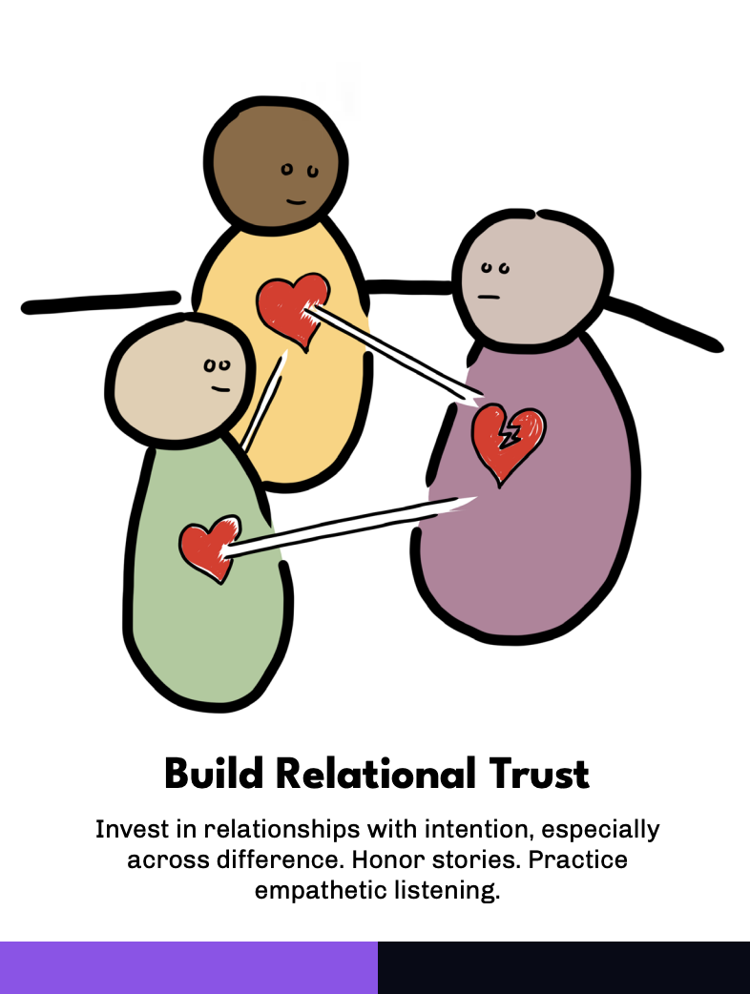
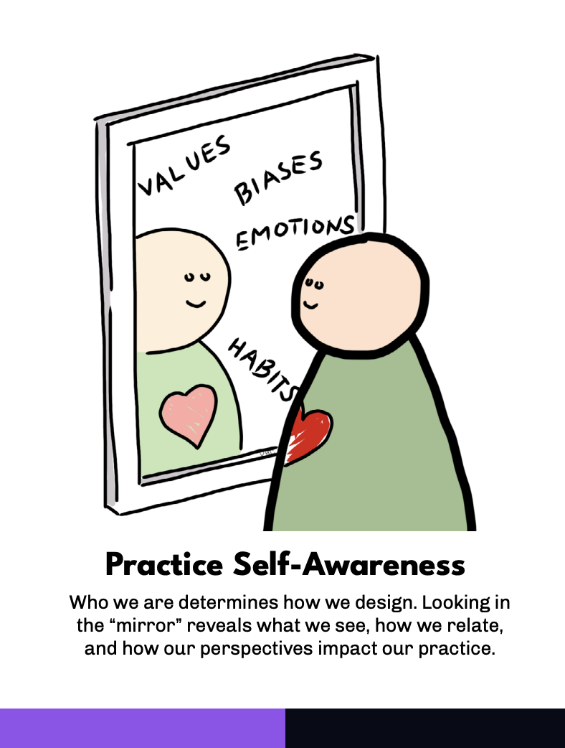
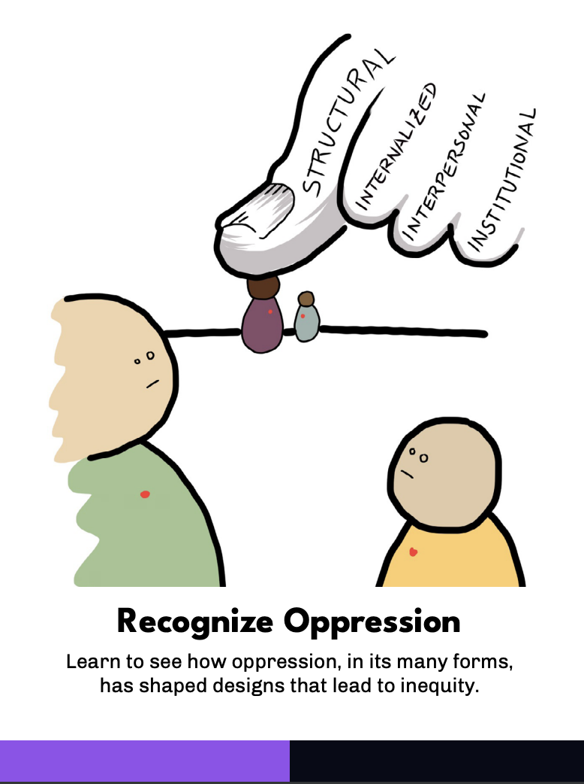
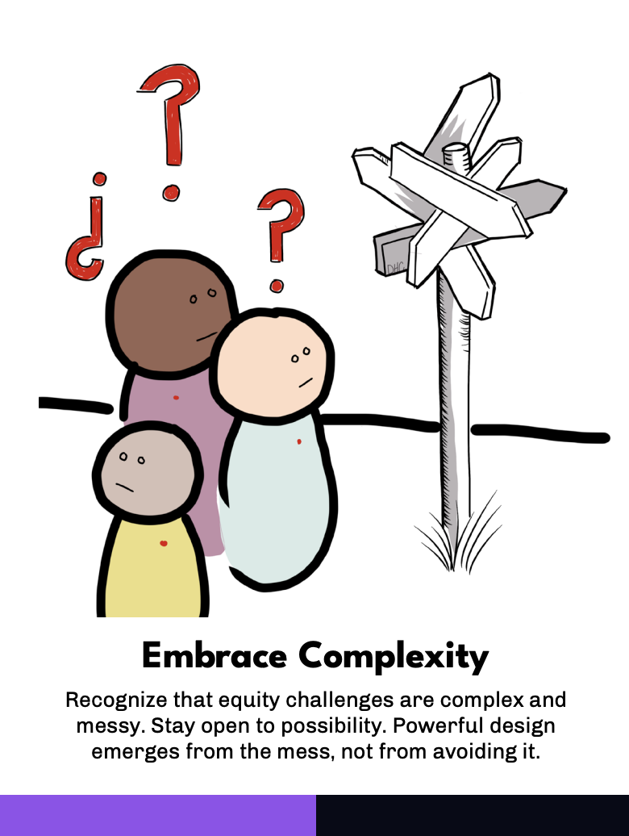
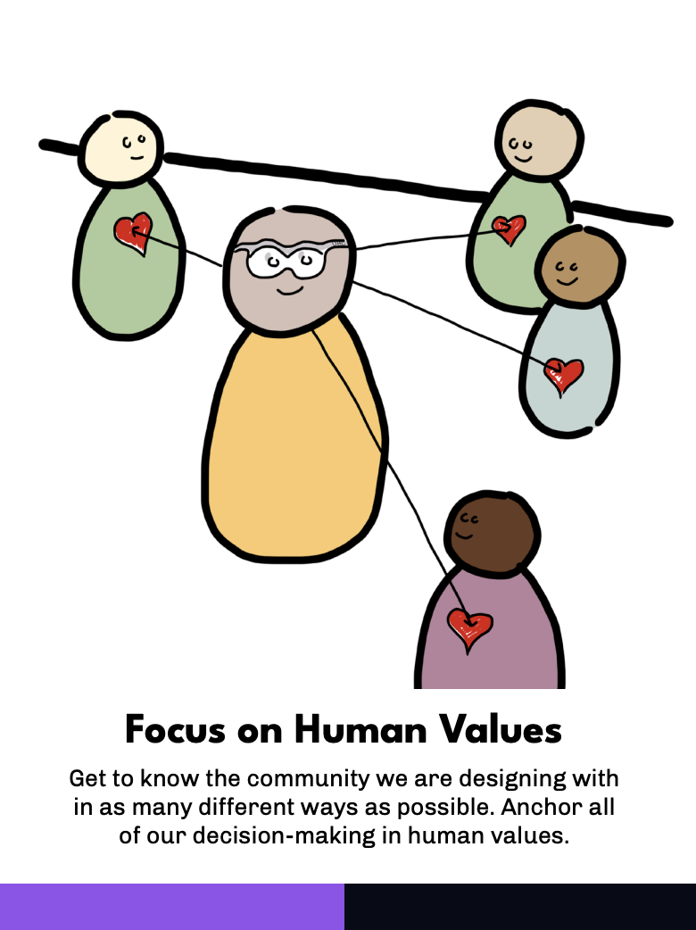
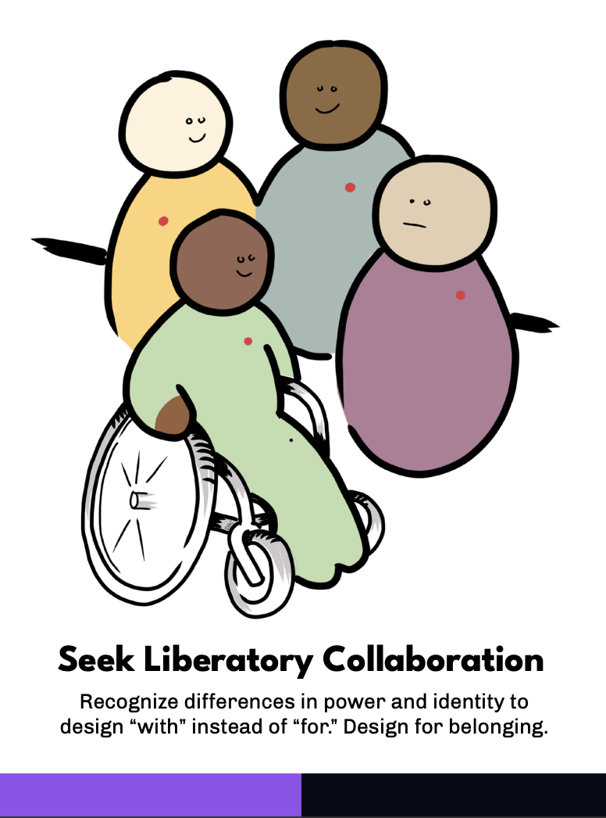
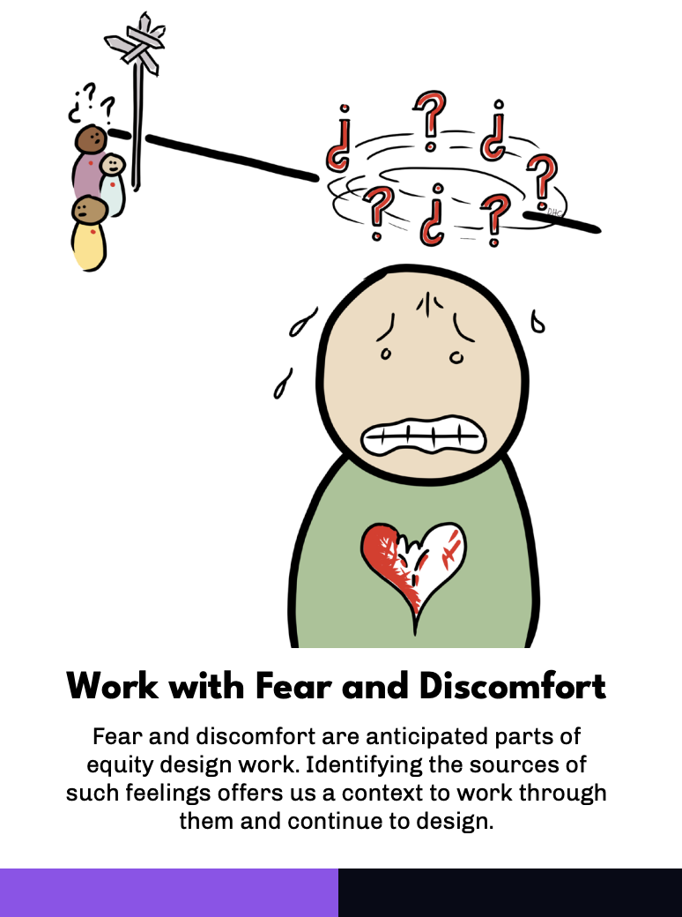
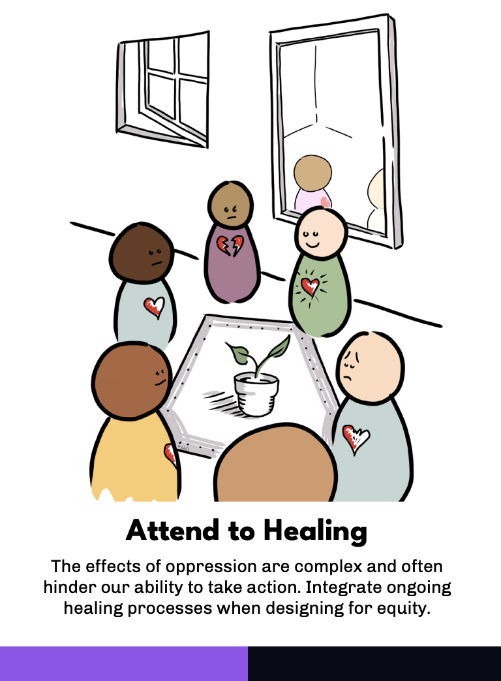
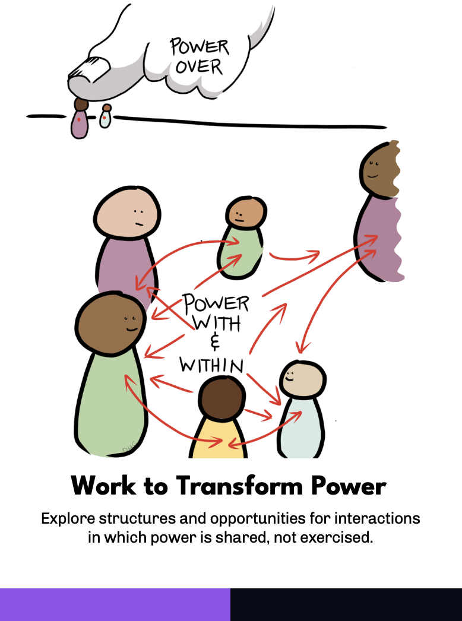
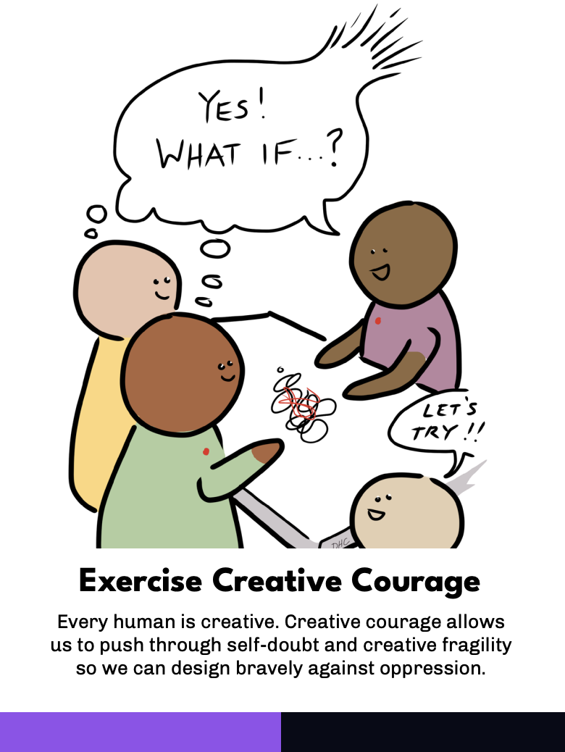
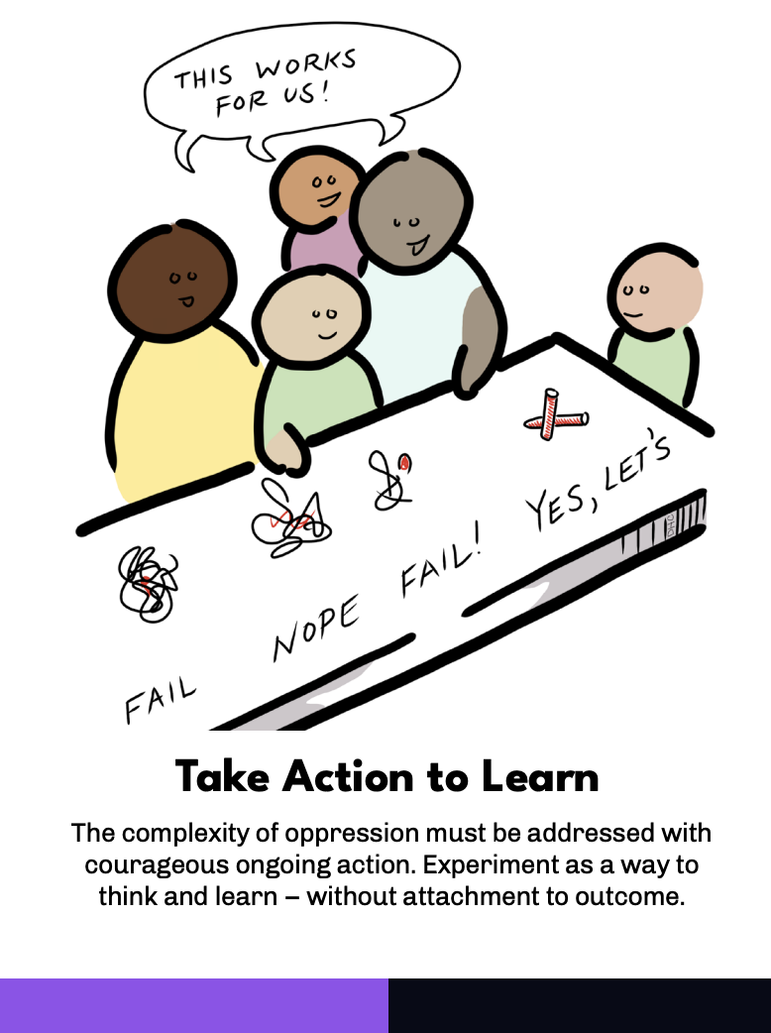
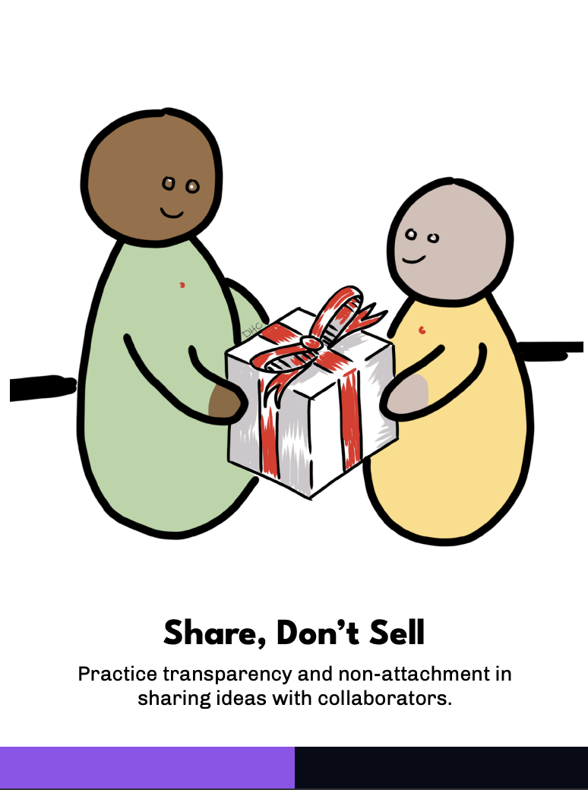
LIBERATORY DESIGN MINDSETS
NEP Liberatory Design Website
Liberatory Design Card Deck
Notes:
Liberatory Design Mindsets
To practice Liberatory Design authentically, it is important to carry certain mindsets in all the work you do to design for diversity, inclusion, equity, and ultimately, liberation.
Here are the 12 mindsets: Build Relational Trust, Practice Self-Awareness, Recognize Oppression, Embrace Complexity, Focus on Human Values, Seek Liberatory Collaboration, Work With Fear and Discomfort, Attend to Healing, Work to Transform Power, Exercise Creative Courage, Take Action to Learn, and Share, Don’t Sell

Slide 9
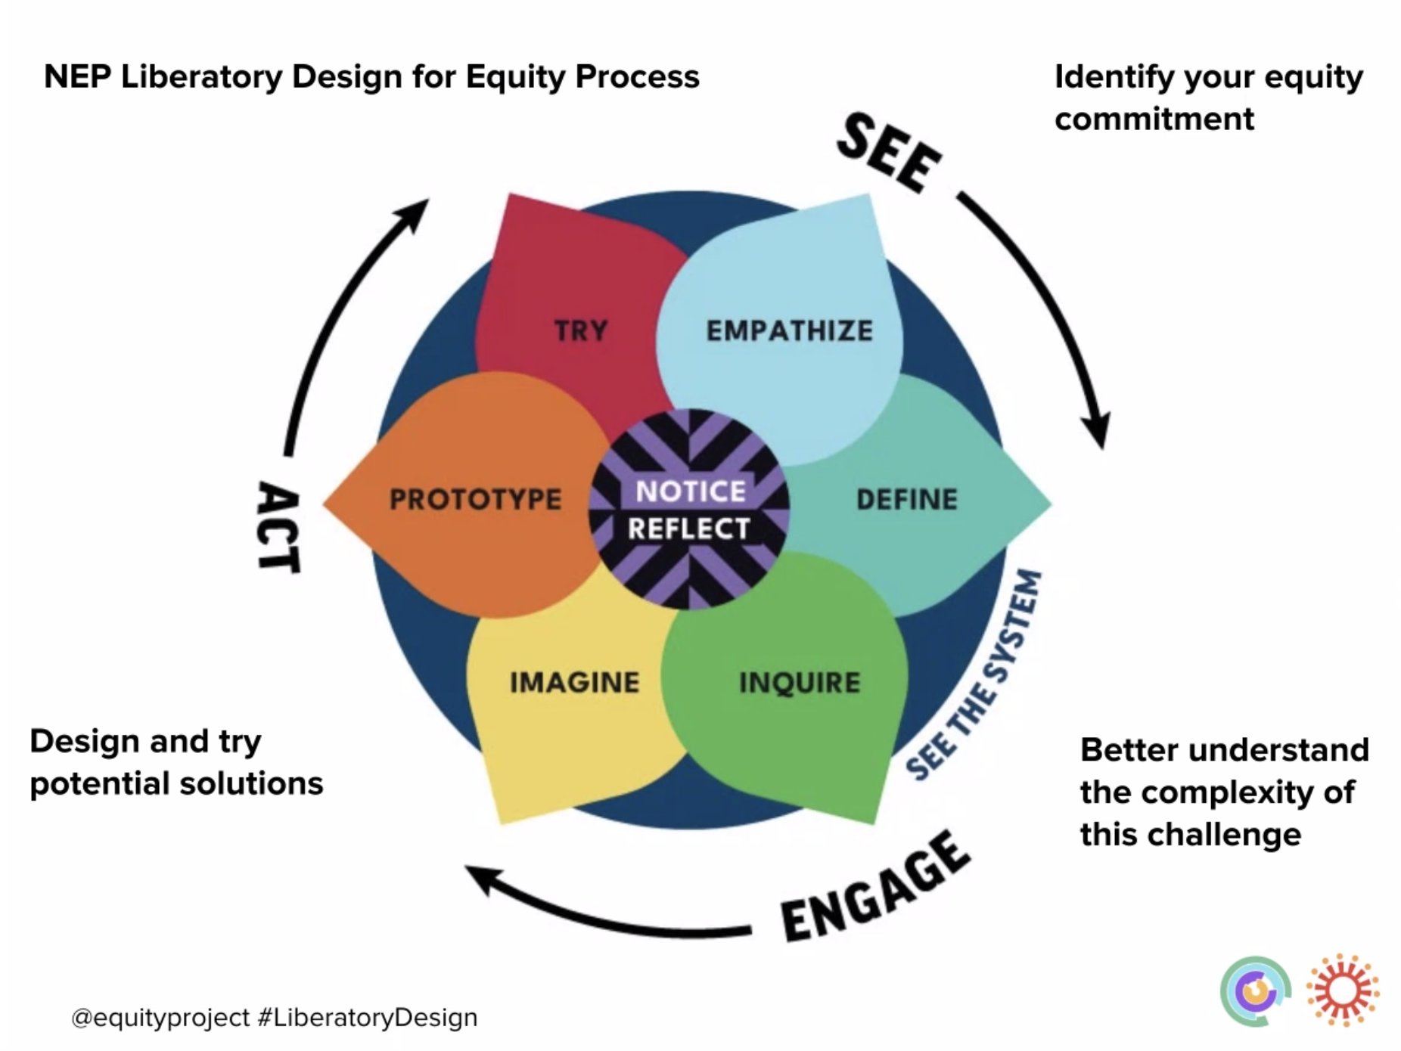
LIBERATORY DESIGN MODES
NEP Liberatory Design Website
Notes:
Liberatory Design Modes
This adapted design thinking process includes steps we believe are essential to practice design for equity. The goal is to provide a design process that develops one’s self-awareness as an equity-centered designer.
What makes Liberatory Design unique is the introduction of two new design modes, Notice and Reflect, within the design thinking process; they are not linear in the design stages, they should be practiced within and in-between each stage of the traditional design thinking model.
The Notice phase helps designers develop a self and social-emotional awareness before entering any context or practice of empathy. This phase focuses on you, the designer, in order to build a practice of self-awareness of your own identity, values, emotions, biases, assumptions and situatedness. From there, begin to reveal your authentic self, accept and build from all you don’t know so you can empathize with humility, curiosity and courage. Noticing what one brings to any person and context allows for authentic human centered design, not “you” centered design.
The Reflect phase of the process is ongoing and transparent throughout the design thinking process. It allows you and your team the time to notice, focus and reflect on your actions, emotions, insights and impact as designer(s) and human(s) within your user's context. We suggest you Reflect using an Equity Pause, a process step coined by EquityXDesign. An Equity Pause is a time to share our learning and see what we can do better next time in the service of equity and inclusion.

Slide 10
LIBERATORY DESIGN MINDSETS
Equity is both a goal and a process.
Addressing equity and inequity requires new mindsets and intentions
Notes:
Liberatory Design Mindsets
Equity is both a goal and a process. Addressing equity and inequity requires new mindsets and intentions.
To practice Liberatory Design authentically, it is important to carry certain mindsets in all the work you do to design for diversity, inclusion, equity and ultimately, liberation.

Slide 11
LIBERATORY DESIGN MINDSETS
What stands out? What resonates? Thinking about your role as a teacher of emerging bilinguals, what might be important?
Notes:
Liberatory Design Mindsets Dialogue
Review the Liberatory Design Mindsets
What stands out?
What resonates?
Thinking about your role as a teacher of emerging bilinguals, what might be important?
Share your thoughts with a partner or small group.

Slide 12
Notes:
Section 2: English Learner Roadmap

Slide 13
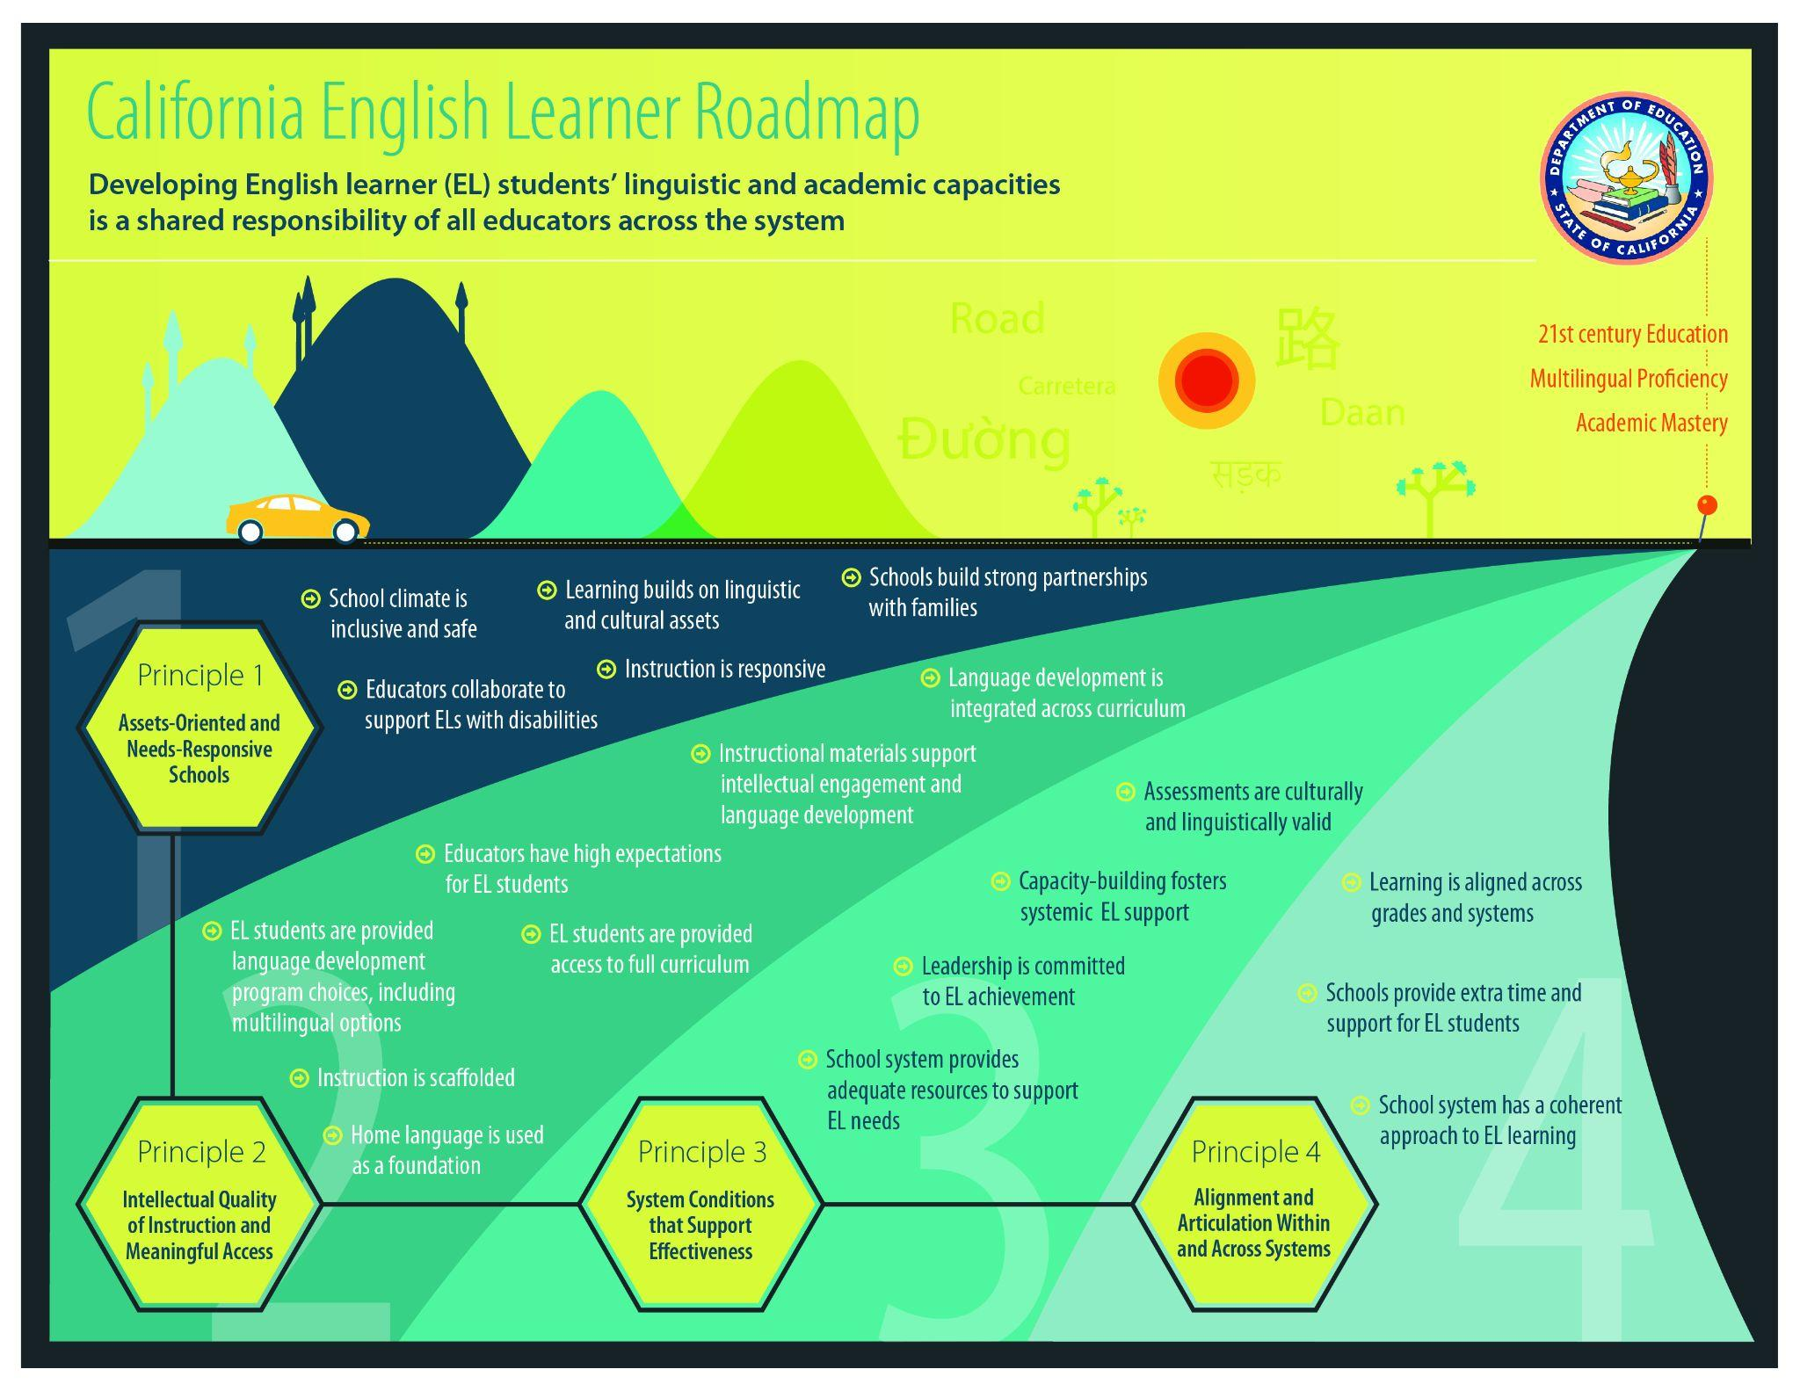
Aligned to the English Learner Roadmap Policy
Notes:
CA English Learner Roadmap
This module directly aligns to the four principles in the EL roadmap policy, which are research-based and guide all levels of the system toward a coherent, aligned set of practices, services, relationships, and approaches.
https://californianstogether.org/english-learner-roadmap-toolkits/

Slide 14




4 EL Roadmap Principles
Discover the 4 Principles
Principle One: Assets-Oriented and Needs Responsive Schools
Principle Two: Intellectual Quality of Instruction and Meaningful Access
Principle Three: System Conditions that Support Effectiveness
Principle Four: Alignment and Articulation Within and Across Systems
Notes:
4 EL Roadmap Principles
Principle 1: “Pre-schools and schools are responsive to different EL strengths, needs and identities, and support the socio-emotional health and development of English learners. Programs value and build upon the cultural and linguistic assets students bring to their education in safe and affirming school climates. Educators value and build strong family, community, and school partnerships.”
Principle 2: “English learners engage in intellectually rich, developmentally appropriate learning experiences that foster high levels of English proficiency. These experiences integrate language development, literacy, and content learning as well as provide access for comprehension and participation through native language instruction and scaffolding. English learners have meaningful access to a full standards-based and relevant curriculum and the opportunity to develop proficiency in English and other languages.”
Principle 3: “Each level of the school system (state, county, district, school, pre-school) has leaders and educators who are knowledgeable of and responsive to the strengths and needs of English learners and their communities, and utilize valid assessment and other data systems that inform instruction and continuous improvement; resources and tiered support is provided to ensure strong programs and build the capacity of teachers and staff to build on the strengths and meet the needs of English learners”
Principle 4: “English learners experience a coherent, articulated and aligned set of practices and pathways across grade levels and educational segments beginning with a strong foundation in early childhood and continuing through to reclassification, graduation and higher education. These pathways foster the skills, language(s), literacy and knowledge students need for college- and career-readiness and participation in a global, diverse multilingual 21st century world.”
This module focuses on Principles 1 and 2

Slide 15
Principle One: Assets-Oriented and Needs Responsive Schools
EL Roadmap Principle 1
Elements:
Languages and cultures are assets
Recognizing that there is no single EL profile
School climates are affirming, inclusive and safe
Schools value and build strong family and school partnerships
Schools and districts develop a collaborative framework for identifying ELs with disabilities
Notes:
EL Roadmap Principle 1
Assets-Oriented and Needs Responsive Schools
Please read the Elements:
Languages and cultures are assets
Recognizing that there is no single EL profile
School climates are affirming, inclusive and safe
Schools value and build strong family and school partnerships
Schools and districts develop a collaborative framework for identifying ELs with disabilities
Which element is resonating with you at the moment?

Slide 16
Principle Two: Intellectual Quality of Instruction and Meaningful Access
EL Roadmap Principle 2
Elements:
Integrated and Designated English Language Development (ELD)
Intellectually Rich, Standards-based Curriculum
High Expectations
Access to the Full Curriculum
Use of Students' Home Languages
Rigorous Instructional Material
Programmatic Choice
Notes:
EL Roadmap Principle 2
Intellectual Quality of Instruction and Meaningful Access
Please read the Elements:
Integrated and Designated English Language Development (ELD)
Intellectually Rich, Standards-based Curriculum
High Expectations
Access to the Full Curriculum
Use of Students' Home Languages
Rigorous Instructional Material
Programmatic Choice
Which element is resonating with you at the moment?

Slide 17

Review the EL Roadmap,
focusing on principles 1 and 2
How can you use this tool to help inform your instruction to best meet the needs of your English Learners?
Dialogue
Notes:
EL Roadmap Dialogue
Review the EL Roadmap, focusing on Principles 1 and 2
How can you use this tool to help inform your instruction to best meet the needs of your English Learners?
Share your thoughts with a partner or small group

Slide 18




Self-Assessment for Classroom Teachers...
1
2
3
Elementary
Middle School
High School
Notes:
EL Roadmap Teacher Toolkit
Please select the toolkit that best fits your role:
Elementary school
Middle school
High school
How can you use this toolkit to help inform your instruction to best meet the needs of your English Learners?
Share your thoughts with a partner or small group

Slide 19
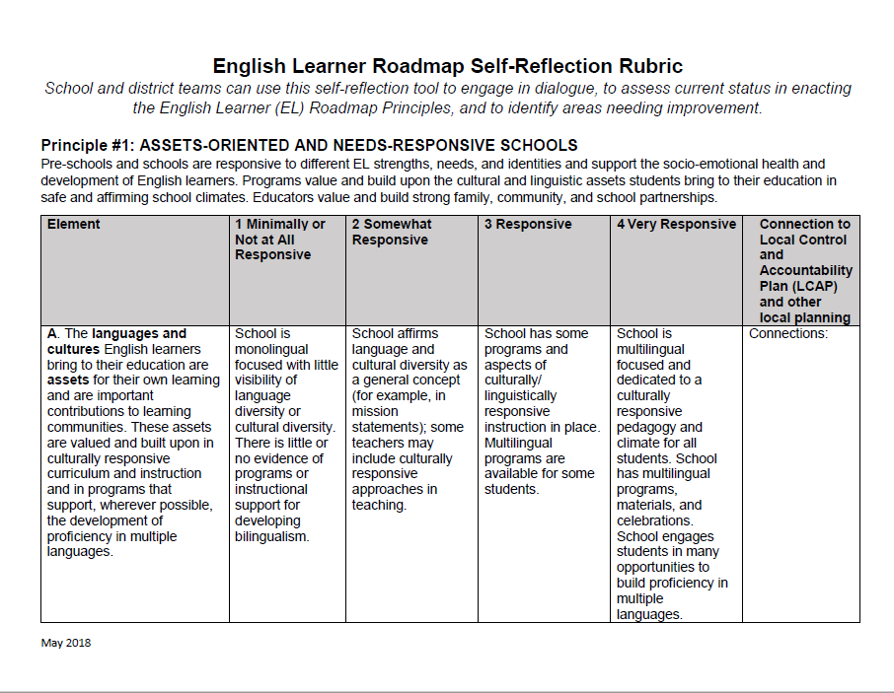
Self-Reflection Rubric
Rubric Purpose:
Schools, districts, and programs are able to reflect on their EL policies, programs, and practices based on a clearly outlined rubric for the purpose of guiding and prioritizing planning and improvement.
Available on the CA EL Roadmap Resources web page as a handout.
https://www.cde.ca.gov/sp/ml/rmresources.asp
Notes:
Site-Level Self-Reflection Rubric
This rubric exists to ensure schools, districts, and programs are able to reflect on their EL policies, programs, and practices based on a clearly outlined rubric for the purpose of guiding and prioritizing planning and improvement.
This rubric is available on the CA EL Roadmap Resources web page as a handout.

Slide 20
Self-Reflection Activity
In Groups:
Focus on one principle
Read through that entire section of the rubric for your principle, marking where you think your classroom, grade level, subject area or course team, school, and/or district/charter is in each area from your perspective and role
Be prepared to share with colleagues
Notes:
Self-Reflection
Focus on one of the Principles from the EL Roadmap
Read through that entire section of the rubric for your selected principle, marking where you think your classroom, grade level, subject area or course team, school, and/or district/charter is in each area from your perspective and role.
Be prepared to share your responses with colleagues.

Slide 21
Reflection...
1
2
3
4
How do you attend to the language and cultures of your ELs, highlighting their assets?
How do you attend to needs- responsive instructional practices to meet the needs of your students?
How do you attend to the various EL typologies in your setting?
How do you show value and build strong family and school partnerships?
Notes:
EL Roadmap Principles Reflection - Please answer one of these questions and share your response.
How do you attend to the language and cultures of your ELs, highlighting their assets?
How do you attend to needs-responsive instructional practices to meet the needs of your students?
How do you attend to the various EL typologies in your setting?
How do you show value and build strong family and school partnerships?

Slide 22

Reflection
What squares with your thinking?
3
new ideas
What is circling around in your head?
Notes:
Reflection
Note your responses to each of the three prompts:
What squares with your thinking so far?
3 new ideas
What is circling around in your head?

Slide 23
Notes:
Section 3: Artistic Literacy and Equity

Slide 24
LIBERATORY DESIGN MINDSETS
Select one of the Liberatory Design Mindsets to focus on as you continue your learning today.
Notes:
Please select one of the Liberatory Design Mindsets to focus on as we continue our time together.

Slide 25
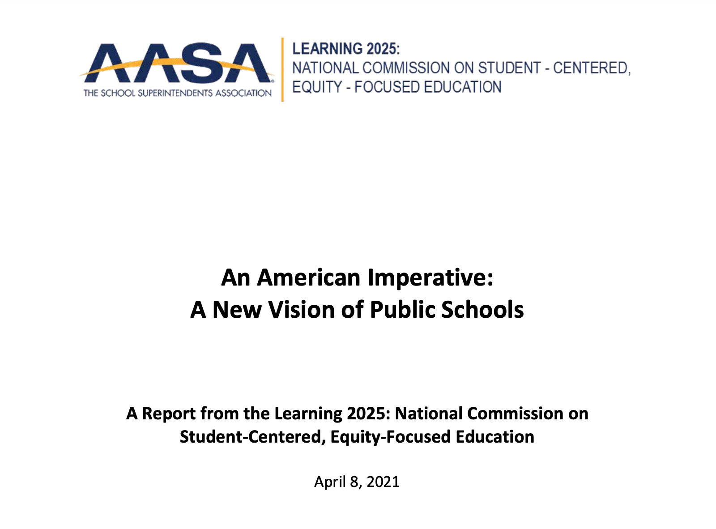
A Holistic Redesign of Public Schools by 2025
Read page Roman Numeral iv.
What are you currently doing to support this vision?
Link to report
Notes:
Holistic Redesign of Public Schools by 2025
Everything you have learned about the California English Learner Roadmap supports this new vision for American schools that needs to come into effect by 2025.
Let's take a look at this new vision.
Please read page Roman numeral iv.
As you read, we invite you to reflect on the following:
What are you currently doing to support this vision?
You have 10 minutes for a quick read and group discussion.
Please be prepared to share what you discussed with the whole group.

Slide 26
Why the Arts?
“The arts are a major area of human cognition,
one of the ways in which we know about the world
and express our knowledge. Much of what is said
in the arts cannot be said in another way.
To withhold artistic means of understanding is as
much a malpractice as to withhold mathematics . . .
Since schools traditionally develop only linguistic and logical/mathematical skills they are missing an enormous opportunity to develop the whole child.”
-Dr. Howard Gardner - Harvard Graduate School of Education
Notes:
Why the Arts?
Ask a volunteer to read this quote
How does this quote connect with the equity “WHY” you shared earlier?
Make any revisions to your equity “WHY” based on everything you’ve experienced in this session so far.

Slide 27
Why the Arts?
The Arts Teach Valuable Skills and Develop Students in Unique Ways
The Arts:
Connect students to themselves and each other
Transform the environment for learning
Connect learning experiences to the world
Reach students who are not otherwise being reached
Provide new challenges for those students already considered successful
Notes:
Why the Arts?
The Arts Teach Valuable Skills and Develop Students in Unique Ways. The Arts:
Connect students to themselves and each other
Transform the environment for learning
Connect learning experiences to the world
Reach students who are not otherwise being reached
Provide new challenges for those students already considered successful
How do these statements fit with your equity “WHY”?
Share your equity “WHY” with a partner or small group.
What similarities do you notice?
What differences do you notice?

Slide 28
Philosophical Foundations and Lifelong Goals
The Arts as Communication
The Arts as Creative Personal Realization
The Arts as Culture, History, and Connectors
The Arts as Means to Wellbeing
The Arts as Community Engagement
The Arts as Profession
Notes:
Philosophical Foundations and Lifelong Goals
The California Arts Standards (CAS) are built on these 6 Philosophical Foundations and Lifelong Goals: The Arts as . . .
Communication
Creative Personal Realization
Culture, History, and Connectors
Means to Wellbeing
Community Engagement
Profession
Read through the philosophical foundations and lifelong goals (the next six slides).
Choose one that resonates with you.
Consider the following prompts:
What does this currently look like with your students?
What could this look like for students if all barriers were removed?
Share your thoughts with a partner or small group

Slide 29
The Arts as Communication
Philosophical Foundation | Lifelong Goal
In today’s multimedia society, the arts are the media, and therefore provide powerful and essential means of communication. The arts provide unique symbol systems and metaphors that convey and inform life experience (i.e., the arts are ways of knowing). | Artistically Literate Citizens use a variety of artistic media, symbols, and metaphors to independently create and perform work that expresses and communicates their own ideas and are able to respond by analyzing and interpreting the artistic communications of others.
Notes:
The Arts as Communication

Slide 30
The Arts as Creative Personal Realization
Philosophical Foundation | Lifelong Goal
Participation in each of the arts as creators, performers, and audience members (responders) enables individuals to discover and develop their own creative capacity, thereby providing a source of lifelong satisfaction. | Artistically Literate Citizens find at least one arts discipline in which they develop sufficient competence to continue active involvement in creating, performing, and responding to art as an adult.
Notes:
The Arts as Creative Personal Realization

Slide 31
The Arts as Culture, History, and Connectors
Philosophical Foundation | Lifelong Goal
…Understanding artwork provides insights into individuals’ own and others’ cultures and societies, while also providing opportunities to access, express, and integrate meaning across a variety of content areas. | Artistically Literate Citizens know and understand artwork from varied historical periods and cultures, and actively seek and appreciate diverse forms and genres of artwork of enduring quality and significance. They also seek to cultivate habits of searching for and identifying patterns to understand relationships among the arts and between the arts and other content knowledge.
Notes:
The Arts as Culture, History, and Connectors
The philosophical foundation was excerpted to fit the slide. The full quote is provided below.
Full Quote:
The Arts as Culture, History, and Connectors. Throughout history the arts have provided essential means for individuals and communities to express their ideas, experiences, feelings, and deepest beliefs. Each discipline shares common goals but approaches them through distinct media and techniques. Understanding artwork provides insights into individuals’ own and others’ cultures and societies, while also providing opportunities to access, express, and integrate meaning across a variety of content areas. Artistically literate citizens know and understand artwork from varied historical periods and cultures, and actively seek and appreciate diverse forms and genres of artwork of enduring quality and significance. They also seek to cultivate habits of searching for and identifying patterns to understand relationships among the arts and between the arts and other content knowledge.

Slide 32
The Arts as a Means to Wellbeing
Philosophical Foundation | Lifelong Goal
Participation in the arts as creators, performers, and audience members (responders) enhances mental, physical, and emotional wellbeing. | Artistically Literate Citizens find joy, inspiration, peace, intellectual stimulation, meaning, and other life-enhancing qualities through participation in all of the arts.
Notes:
The Arts as a Means to Wellbeing

Slide 33
The Arts as Community Engagement
Philosophical Foundation | Lifelong Goal
The arts provide means for individuals to collaborate and connect with others in an enjoyable inclusive environment as they create, prepare, and share artwork that bring communities together. | Artistically Literate Citizens seek artistic experiences and support the arts in their local, state, national, and global communities.
Notes:
The Arts as Community Engagement

Slide 34
The Arts as Profession
Philosophical Foundation | Lifelong Goal
Professional artists weave the cultural and aesthetic fabric of communities and cultivate beauty, enjoyment, curiosity, awareness, activism and personal, social, and cultural connection and reflection. This fabric strengthens communities, enhances the lives of individuals, and inspires the global community. | Artistically Literate Citizens appreciate the value of supporting the arts as a profession by engaging with the arts and by supporting the funding of the arts. Some artistically literate individuals will pursue a career in the arts, thereby enriching local, state, national, and global communities and economies.
Notes:
The Arts as Profession

Slide 35
Artistically Literate Individuals . . .
acknowledge and appreciate the relationship between the arts disciplines and other content areas and seek to develop, express, and integrate meaning across content areas
value the arts as a means of expression and the significance of civic engagement in communities
understand that each arts discipline has a unique and evolving language and use it to convey and interpret meaning
collaborate and connect with others to create, prepare, and share artwork that brings communities together
have the capacity to transfer arts knowledge and skills to multiple situations and settings, both in and outside the school environment
Notes:
Artistic Literacy
The goal of a sequential, standards-based, comprehensive arts education in CA is to develop artistic literacy.
Artistic literacy is the ability to understand, create, perform/present/produce, respond, and connect through the arts and transfer knowledge and skills learned from authentic experiences in the arts that transcend historical, cultural, and societal contexts.
Please take a minute to read these statements about Artistically Literate Individuals.
What aspects of artistic literacy as described here stand out to you?
What resonates?
Does anything surprise you?
Share your thoughts with a partner or group

Slide 36
Comprehensive Arts Education Programs
For students to develop into artistically literate, creative, and capable individuals, it is essential that arts instruction is sequential, standards-based, comprehensive, and prioritized
This means standards-based, sequential instruction for all students
  in all five arts disciplines (dance, media arts, music, theatre, visual arts)
  during the regular school day
  each year from TK through grade twelve.
Notes:
Comprehensive Arts Education Programs
For students to develop into artistically literate, creative, and capable individuals, it is essential that arts instruction is sequential, standards-based, comprehensive, and prioritized
For ALL students
In all 5 arts disciplines
During the regular school day
Each year from TK-grade 12

Slide 37
Using the Arts Ed Framework to Support English Learners
Notes:
The statements on the next 5 slides are from the arts discipline specific chapters of the new California Arts Education Framework
Please read through the statements (the next five slides).
Choose one that resonates with you.
Consider the following prompts:
What does this currently look like with your students?
What connections do you see to the statements and your Equity Why and the Liberatory Design Mindsets?
Share your thoughts with a partner or small group

Slide 38
Dance
“Since dance is kinesthetic, all students can actively participate, at every language proficiency level.”
“The collaborative and creative nature of dance and choreography provide authentic opportunities for students to practice speaking in their new language and learning from peers.”

Slide 39
Media Arts
“Students who are English learners are offered opportunities in learning media arts that are not always English language dependent but support language development when instruction is intentionally designed.”
“Students benefit from having many ways to access the language of media arts for communication, comprehension, and expression, as well as the language to negotiate its operational processes and technical systems.”

Slide 40
Music
“Music itself has the power to be its own language. Learning in music can level the playing field allowing all students to be beginners as they explore singing voices, terminology, and skills together. Learning this new musical language can have a huge impact on student’s sense of success and belonging.”

Slide 41
Theatre
“Creative drama and theatre provide a variety of contexts for language use; thus, by the very nature of the discipline, theatre supports and augments language development in all students.”
“Theatre puts language in context that illuminates the way a given communication functions. Theatre allows a participant to become or to talk as a character in a given context, communicating a specific intent, and thus practice language in an authentic way. Theatre offers ELs the opportunity to explore, experiment, and practice with language. The authentic context requires an examination of tone and exploration into the nuances of communication. In this way, theatre provides contexts that simultaneously extend students’ use of language while protecting them from feelings of linguistic inadequacy. This applies not just to speaking and listening, but to reading and writing as well (Fleming 2017).”

Slide 42
Visual Arts
“Students who are English learners are offered opportunities in learning visual arts that are not English language dependent. Through the expressive and communication elements of visual arts that are not always dependent of text, students can create, produce, access, and engage in the content.”
“Teaching visual arts is a visual process, as such students who are English Learners (ELs) are supported and benefit from visual arts learning. While the visual aspects lend authentic access to visual arts learning, ELs gain from teaching that supports their overall growth in the academic, technical, responsive language of visual arts in English.”

Slide 43
A Holistic Redesign of Public Schools by 2025
Read page Roman Numeral iv.
What is your prediction of how leveraging English Learner assets through the arts will impact instructional practices to make this vision a reality?
Link to report
Notes:
Holistic Redesign of Public Schools by 2025
Let's revisit this vision now through the lens of artistic literacy and the CA Arts Education Framework.
The CA Arts Education Framework supports this new vision for American schools that needs to come into effect by 2025.
Please reread page Roman numeral iv.
As you read, we invite you to reflect on the following:
What is your prediction of how leveraging English Learner assets through the arts will impact instructional practices to make this vision a reality?
You have 10 minutes for a quick review and for your discussion.
Please be prepared to share what you discussed with the whole group.

Slide 44
LIBERATORY DESIGN MINDSETS
Reflect on your learning today through the lens of the Liberatory Design Mindset you chose as a focus. What connections did you notice? What questions do you still have?
Notes:
Please consider the Liberatory Design Mindset you selected as a focus throughout this section.
What connections did you notice?
What questions do you have?

Slide 45
Reflection
What squares with your thinking?
3
new ideas
What is circling around in your head?
Notes:
Reflection
Note your responses to each of the three prompts:
What squares with your thinking so far?
3 new ideas
What is circling around in your head?

Slide 46
Notes:
Section 4: Instructional Practice and Design

Slide 47
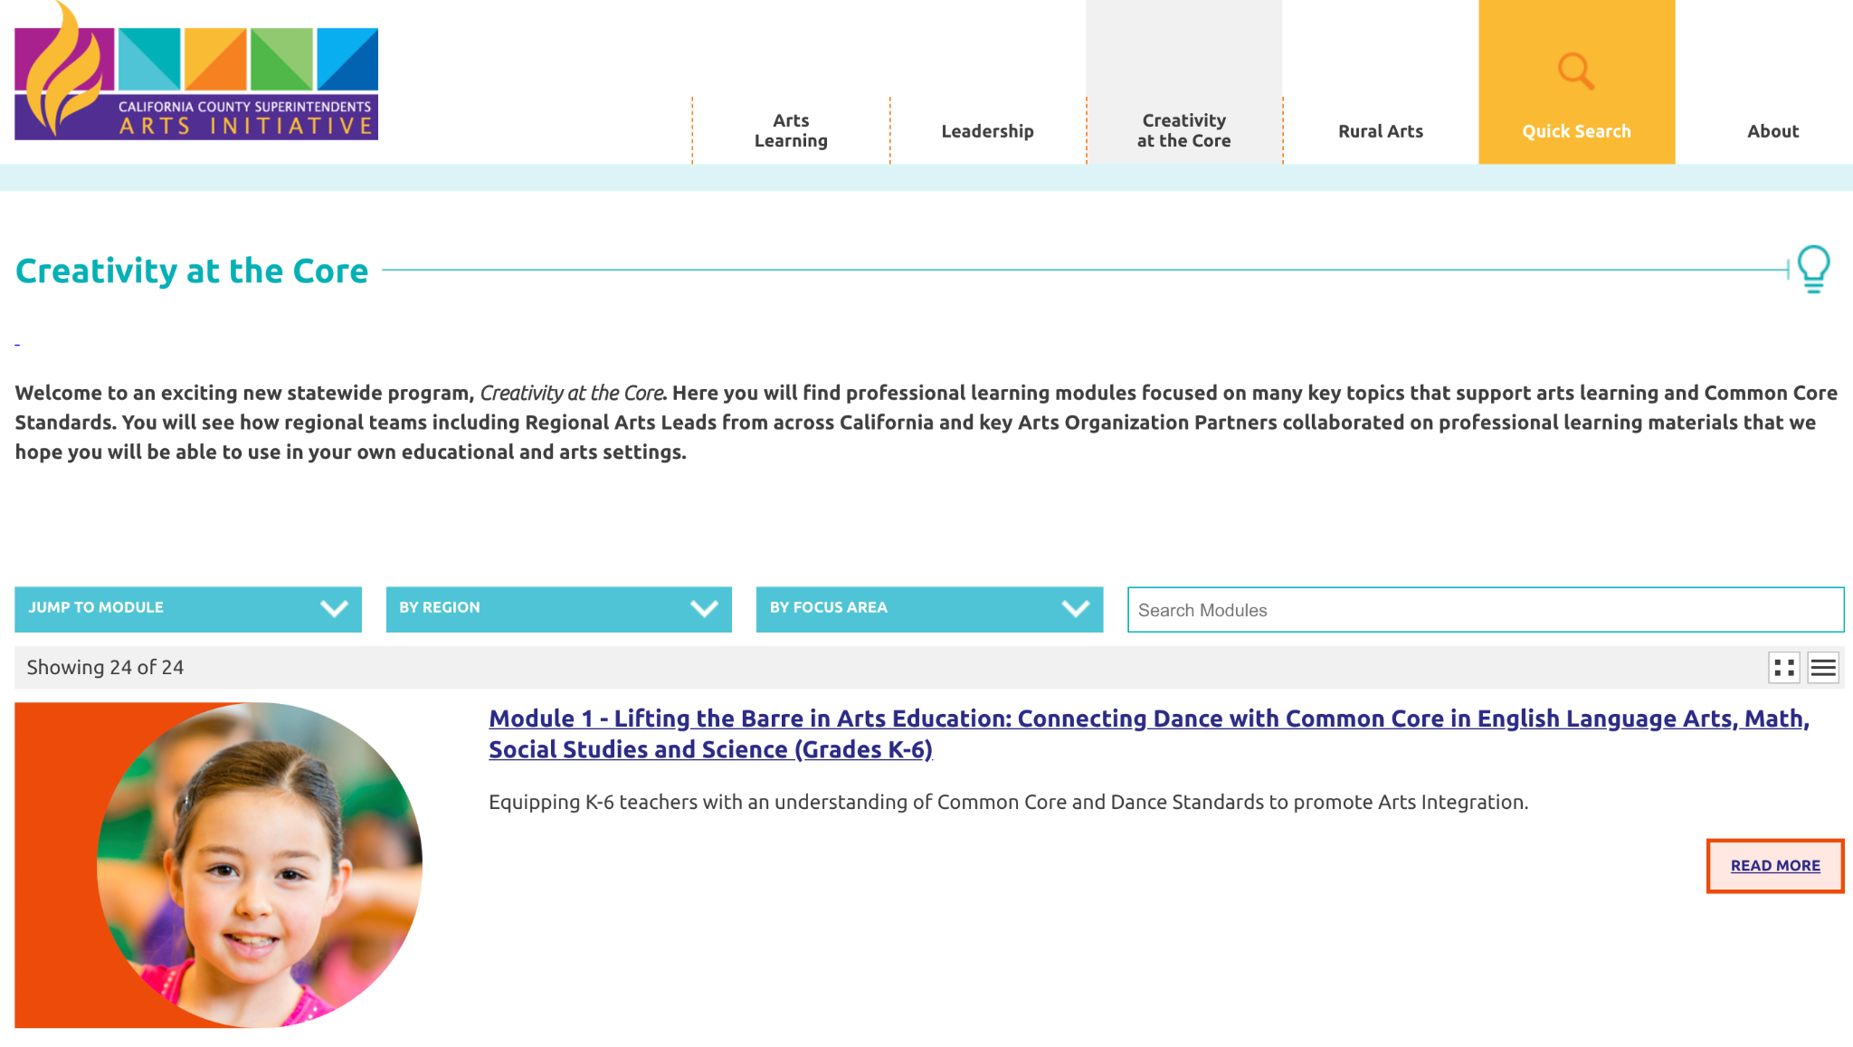
Creativity at the Core
Notes:
Module 25 Resources
This is the 25th Module created for the CCSESA Creativity at the Core professional learning
The materials in the modules can be presented to a group or used for self-guided professional learning

Slide 48
Instructional Design and Practice
Curriculum Module Development Considerations:
Determination of essential learnings
Development of deep learning goals
Incorporation of common lesson design elements
Elimination of barriers for students to learn
Providing support and flexibility for teachers
Integration across three or more content areas
Notes:
Instructional Design and Practice
The curriculum you are about to explore was created using a designated ELD module previously created with ELD, ELA, and Science standards. The curriculum was then expanded to include one or two of the five arts disciplines.
6th grade includes theatre
7th grade includes media arts and visual arts
8th grade includes dance and music
This inclusion of the arts was done to demonstrate arts integration and can be used as a model for you as you create and expand curriculum for your students.
The curriculum was designed by
determining essential learnings
developing deep learning goals
incorporating common lesson design elements
eliminating barriers for students to learn while providing support and flexibility for teachers

Slide 49

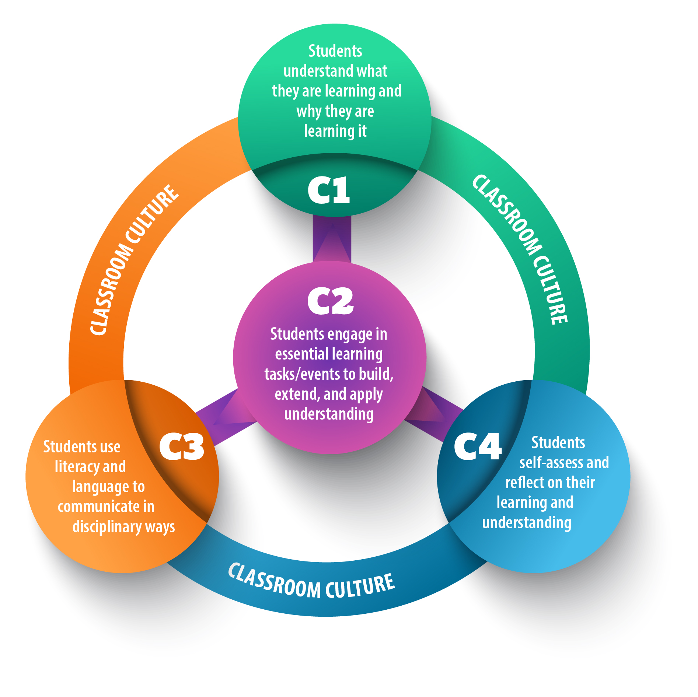
Lesson Design Principles - Components of Student Learning
There are four components of student learning that are shared across content areas and embedded in all lessons:
Students understand what they are learning and why they are learning it
Students engage in learning tasks/events to build, extend, and apply understanding
Students use language and literacy to communicate in disciplinary ways
Students self-assess and reflect on their learning and understanding
Notes:
Lesson Design Principles
The curriculum was designed using four Components of Student Learning as defined by the Curriculum and Instruction Department at the San Diego County Office of Education
The four components of student learning are shared across content areas and embedded in all lessons:
Students understand what they are learning and why they are learning it
Students engage in learning tasks/events to build, extend, and apply understanding
Students use language and literacy to communicate in disciplinary ways
Students self-assess and reflect on their learning and understanding

Slide 50
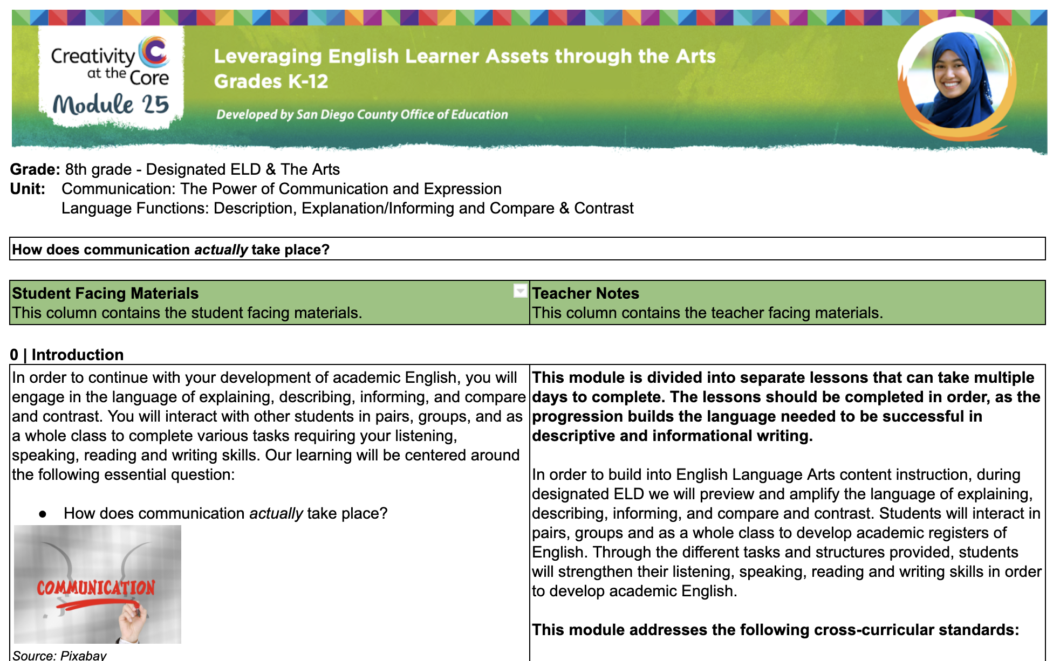
What is in a Curriculum Module?
Notes:
What is in a Curriculum Module?
Modules
Student materials are on the left and Teacher materials are on the right
Each module is made up of submodules
Submodule 0 is the introduction and contains
Guiding Questions
Teacher materials include
Information about the design
Descriptions of all activities and links to resources for students and teachers

Slide 51
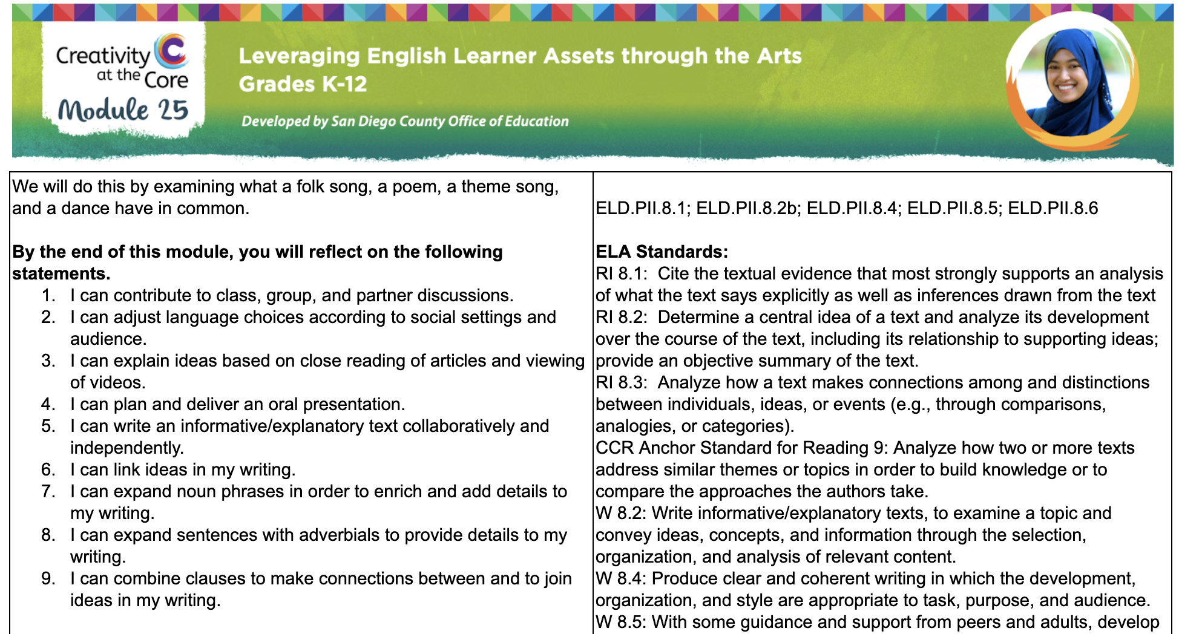
What is in a Curriculum Module?
Notes:
What is in a Curriculum Module?
Student materials are on the left and Teacher materials are on the right
Each module is made up of submodules
Submodule 0 is the introduction and contains
List of Language Objectives
Teacher materials include
List of Content Standards
Descriptions of all activities and links to resources for students and teachers

Slide 52
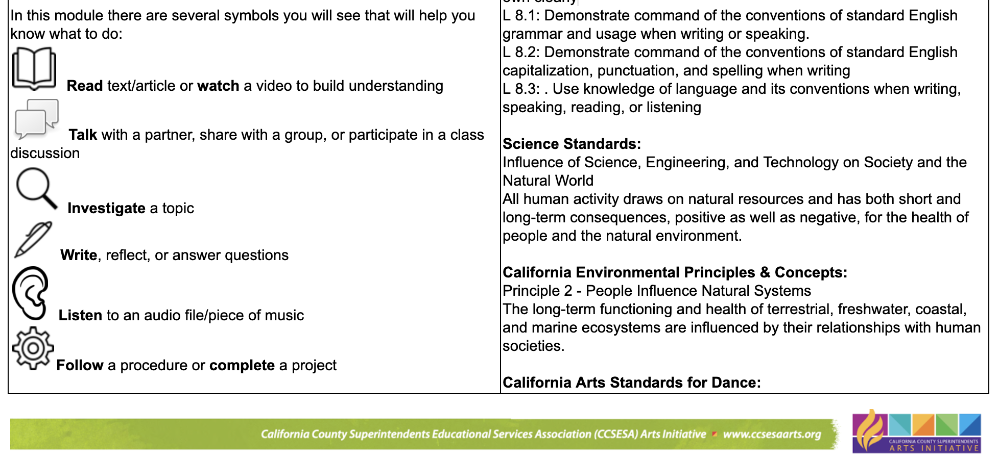
What is in a Curriculum Module?
Notes:
What is in a Curriculum Module?
Student materials are on the left and Teacher materials are on the right
Each module is made up of submodules
Submodule 0 is the introduction and contains
Student Action Symbols
List of materials needed
Teacher materials include
List of Content Standards
Descriptions of all activities and links to resources for students and teachers

Slide 53
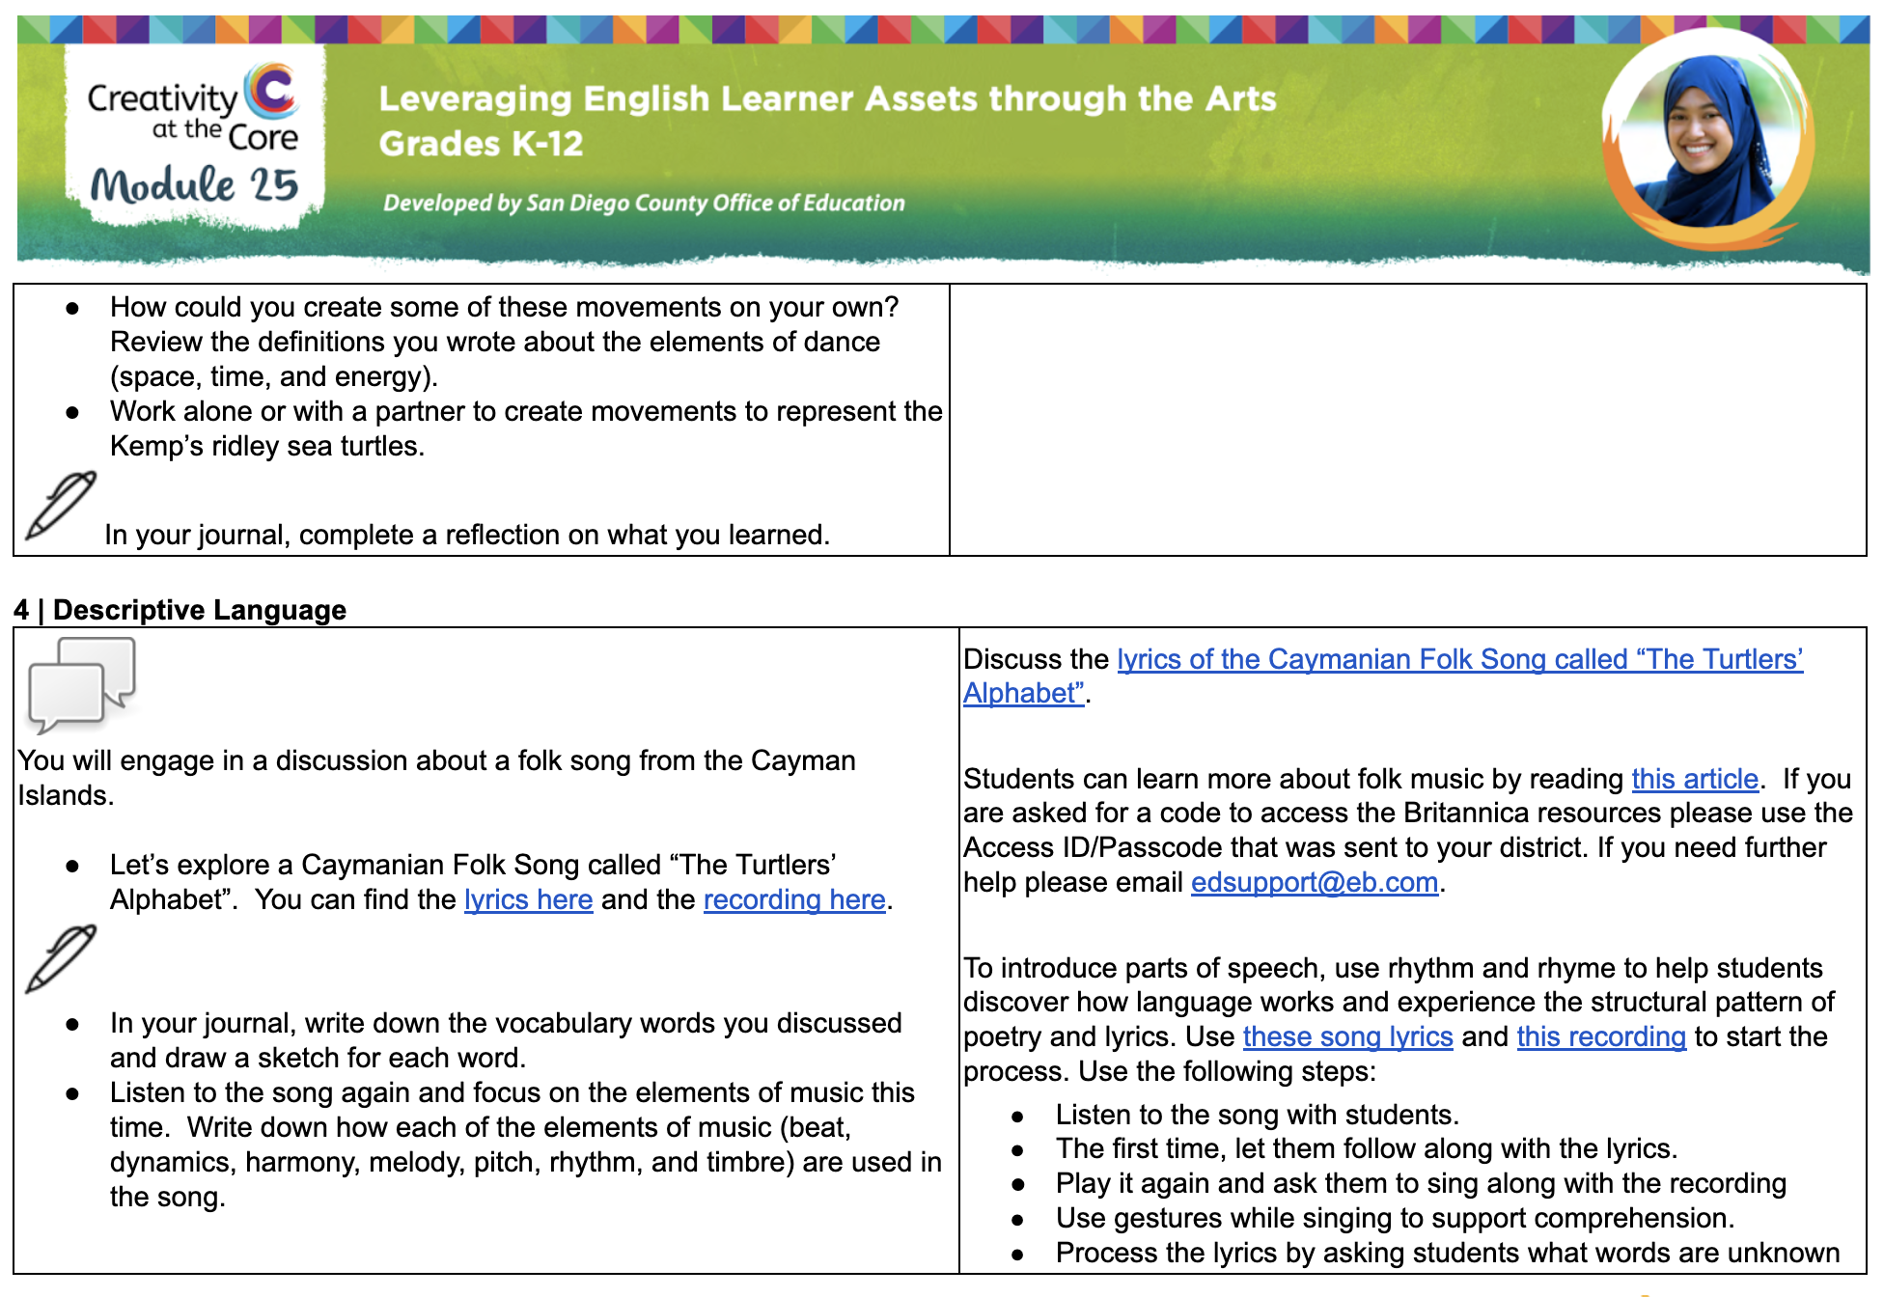
What is in a Curriculum Module?
Notes:
What is in a Curriculum Module?
Student materials are on the left and Teacher materials are on the right
Descriptions of all activities and links to resources for students and teachers

Slide 54
LIBERATORY DESIGN MINDSETS
Select one of the Liberatory Design Mindsets to use as a lens through which you view the curriculum.
Notes:
Explore a Unit
Select one of the Liberatory Design Mindsets to use as a lens through which you view the curriculum

Slide 55
Time to Explore!
Notes:
Explore a Unit
Open one of the Curriculum Modules and explore
6th Grade - Designated ELD, ELA, Theatre
7th Grade - Designated ELD, ELA, Science, Media Arts, Visual Arts
8th Grade - Designated ELD, ELA, Science, Dance, Music

Slide 56
Reflection
What squares with your thinking?
3
new ideas
What is circling around in your head?
Notes:
Reflection
Consider all you have experienced around Liberatory Design Mindsets, English Learner Roadmap, Artistic Literacy, California Arts Standards, California Arts Education Framework, and the Curriculum Modules.
Note your responses to each of the three prompts:
What squares with your thinking so far?
3 new ideas
What is circling around in your head?

Slide 57
Thank you!
Notes:
Thank you for participating in this professional learning module.

