Slide 1
High School Music & Computer Science
Integrated Unit

Slide 2

How has Technology Impacted the Music Industry?
Have you ever stopped to consider how evolving technologies impact the music you listen to each day? Create a list of all of the types of music you prefer to experience, compose, or perform and the settings where you hear music.
(Source: Pixabay)
2
Notes:
Have you ever stopped to consider how evolving technologies impact the music you listen to each day? Create a list of all of the types of music you prefer to experience, compose, or perform and the settings where you hear music.
Music can play many roles in our lives. According to the California Arts Education Framework, “Musically literate citizens appreciate the value of supporting music as a profession by engaging with music and by supporting the funding of music. Many individuals who have discovered the joy, depth of knowledge, and creative connections will pursue a career in music, thereby enriching local, state, national, and global communities and economies.”

Slide 3
Preferences for Selecting and Accessing Music
Consider the following questions and note your responses:
What are some of the ways you listen to music?
How do you learn about new music you might like to hear? (Or perform?)
Do you create playlists? Do you use playlists created by others?
Have you ever recorded your own music? What technology did you use? Did you share it? If so, how?
When you start listening to music you have not heard before, how quickly do you decide whether to continue listening or not?
What are the differences between listening to live music and listening to recorded music?
3

Slide 4
Lesson Goals
As we delve into music in the digital evolution our goals for this lesson are to:
Explore how artistic intent and personal context impact how we experience music.
Discover how music has been accessed over time.
Learn how changes in technology have impacted the music recording industry.
4

Slide 5
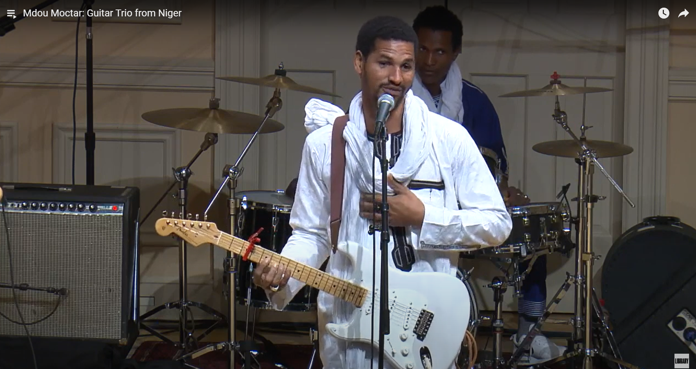
How do Artistic Intent and Personal Context Impact how we Experience Music?
Watch and listen to this video of a guitar trio from the West African country of Niger
5
Notes:
https://www.youtube.com/watch?v=EsKtyfbL7ik&list=PL8613B74E164140F8&index=48&t=273s
Start at 4:46 and end at 11:16.

Slide 6
Interpreting Music
How are the elements of music used in this piece? Focus on rhythm, tempo, pitch, dynamics, and timbre first and then reflect on the melody, harmony, form, style and articulation.
What meaning or feelings are being conveyed in this performance?
Do you think everyone who hears this piece has the same experience? Why or why not?
How is the way you are interpreting this music connected to your personal experiences, interests, or preferences?
Would you choose to listen to this piece of music on your own in the future? Why or why not?
Record your responses then share with a partner or small group
6

Slide 7
Selecting Music
How do you select music to experience or perform?
What tools do you use to browse and then obtain the music?
Have you always used the same tools or have you tried different tools over time?
Ask a trusted adult how they select the music they experience and how this has changed over time.
7

Slide 8
Elements of Music
Pitch
Melody
Harmony
Tempo
Rhythm
Dynamics
Timbre
Form
Select five or six contrasting pieces of music that are important to you. Find a recording of each of the pieces of music to share.
Listen to the pieces of music as many times as needed to describe how each of these elements of music are used
8

Slide 9
Compare how the elements of music are used in each of the pieces
What is the same about how the elements of music are used and what is different? If you notice too many similarities, you may need to change one of the pieces you chose so you have enough contrast between the two for this project.
What emotional response or feeling do you have when listening to each of the songs you selected?
What would happen if one of the elements of music was changed in each of the songs? Would that change how you feel about the music?
Save your notes and list of songs for use later in the learning sequence
9

Slide 10
Read the article Sound Recording
Describe the difference between analog and digital recordings.
Early digital recordings were sold on CD’s starting in the 1980’s. Why weren’t those recordings sold on the internet?
Computer programs, or applications (Apps), used to be sold to people on CD’s just like music. Can you imagine what the experience would be like if you couldn’t “download” an App? Ask a trusted adult about this experience.
What do you think the experience looked like if you couldn’t “download” a song? Ask a trusted adult about this experience.
How are those experiences different from what you are able to do today?
How has the experience of recording music changed for musicians over time?
How did musicians continue recording music during the global COVID-19 pandemic?
Have conversations about your responses with a partner or small group
10

Slide 11
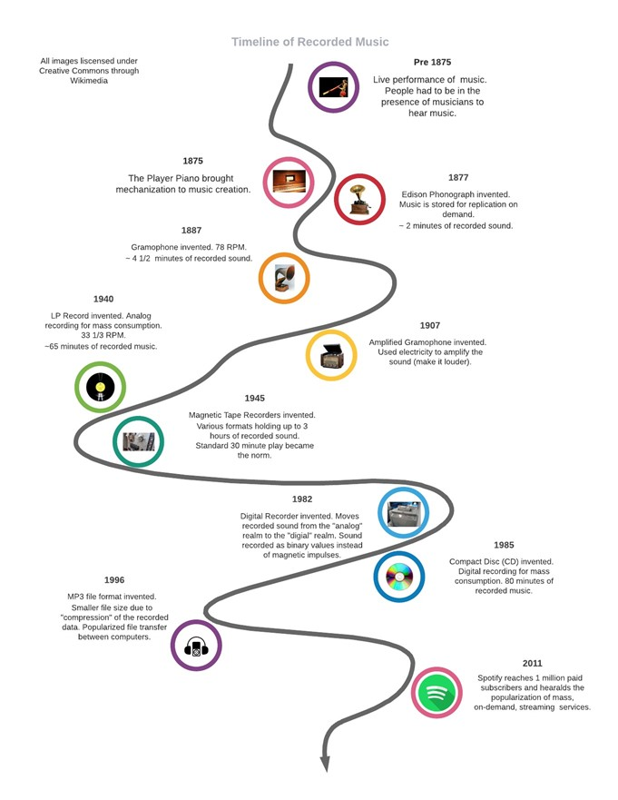
Timeline of Recorded Music
What do you notice?
What questions do you have?
Share your responses with a partner
(Source: M. Lantsberger, personal collection)
11

Slide 12
How do Artistic Intent and Personal Context Impact how we
Experience Music?
Select one of the following articles to read and write down 5-6 important facts to share with the class.
Player Piano article
Before Spotify: The Player Piano article and two videos
Stanford’s New Player Piano Collection Brings Sounds of History to Life article and video
12
Notes:
https://school.eb.com/levels/high/article/player-piano/60378
https://www.wqxr.org/story/spotify-player-piano-organ/
https://news.stanford.edu/news/2014/october/player-piano-collection-101314.html

Slide 13
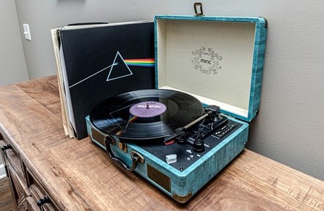
How has Music been Accessed Over Time?
Refer to the timeline to 1877 and the invention of the phonograph.
Watch From the Telephone and Telegraph Comes the Phonograph and read the article Phonograph.
What does the word “phonograph” mean in Ancient Greek?
What do you think it would have been like to be present when Edison’s first successful recording of a nursery rhyme was recorded and played back again?
How does a phonograph reproduce sound?
Have you seen records of any size before? What do you think the benefits could be of the 78-RPM, the 33 ⅓ RPM, and the 45-RPM?
(Source: Pixabay)
13
Notes:
https://ca.pbslearningmedia.org/resource/amex27-soc-edphonograph/wgbh-american-experience-edison-from-the-telephone-and-telegraph-comes-the-phonograph/
https://school.eb.com/levels/high/article/phonograph/59766

Slide 14
The Gramophone
Let’s take a closer look at the 78-RPM records, created in 1887 by Emile Berliner.
Review one of the sources below and take notes on the characteristics of a 78-RPM record, including benefits and challenges.
  For the record: Emil Berliner and the gramophone
  The Gramophone: Early Sound Recording Devices
  Emil Berliner
14

Slide 15

The Impacts of Changes in Technology
As you view the materials, note the impacts these changes in technology have on listeners, performers, and the music industry. Be sure to include any details you have from personal experience with records. Ask a trusted adult to share their experience listening to records. What do they see as benefits and challenges to owning and listening to records?
Share your responses with a partner or small group
(Source: Pixabay)
15

Slide 16
Magnetic Recordings
Let’s explore what happened with the invention of the magnetic tape recorder.
Read the article Magnetic Recording and take notes on the recording industry before and after the invention of magnetic tape, including the benefits and challenges of each format.
As a musician, do you think you would prefer to have a recording session with records or magnetic tape? Please explain your selection.
Share your responses with a partner or small group
16
Notes:
https://school.eb.com/levels/high/article/magnetic-recording/50029

Slide 17
Cassette Tapes
Read The Rise and Renaissance of the Cassette Tape to learn more about the invention of the cassette tape and take notes. What were the benefits and challenges of cassette tapes?
Share your responses with a partner or small group
17
Notes:
https://www.nypl.org/blog/2023/06/12/rise-and-renaissance-cassette-tape

Slide 18
Compact Discs and CD Roms
In 1982 the digital recorder was invented. This moved recorded sound from the “analog” realm to the “digital” realm. Sound recorded as binary values instead of magnetic impulses.
Read the articles Compact Disc, and CD-Rom about computers and CD’s. Make notes of information you think is important
What benefits and challenges of compact discs did you identify?
Share your responses with a partner or small group
18
Notes:
https://school.eb.com/levels/high/article/compact-disc/25003
https://school.eb.com/levels/middle/article/CD-ROM/1430

Slide 19

Storing Audio Files
You’ve recently thought about how technologies changed the way people listen to music over time. You’re likely interested in how the digital recordings are captured. Further, how is that data actually stored within a system! The screenshot below is of an audio file and what it can look like when represented visually in a software tool. The waveform shown is a mono digital recording of a drum kit and lasts about 15 seconds.
(Source: M. Lantsberger, personal collection)
19

Slide 20
How Analog and Digital Recording Works
Read How Analog and Digital Recording Works and take notes on information you think is important to remember.
Some extra information which may not be clear from the article is how this data is transferred back into sound we can hear? Well, the encoding process is reversed! The digital data is converted back into electrical impulses which are then amplified (given extra power) to move the cone on a loudspeaker, often just called a speaker.
20
Notes:
https://electronics.howstuffworks.com/analog-digital.htm

Slide 21
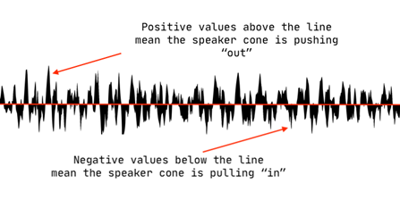
Looking Closer at the Speaker Cone
The screenshot below is the same waveform shown earlier. However, we’re only looking at about ¾ of one second of information. We’ve “zoomed in” on the waveform. The center red line (a.k.a. The Zero Line) is when the speaker cone is at rest, or in the neutral position. This is the same position the cone would be at when there is no sound being played at all. The cone driver (a magnet) pushes out and pulls in from neutral with the same action you “see” in the waveform above. This is why a speaker seems to be “bouncing” when music is played through it, especially when loud.
21

Slide 22
Analog and Digital Recording
What did you learn about
how analog and digital recording work?
Share your responses with a partner or small group
22

Slide 23
Music Appreciation Presentation
Return to your list of 5 or 6 songs you made previously.
What is each song about?
Why is each piece of music important to you?
Do you remember the first time you heard each piece?
Describe the setting, who else was present, and how you were listening to the song.
What other details would you like to share about the songs?
What do you know about each of the songs? Do some research on your pieces of music and find answers to as many of the following questions as possible:
Who composed the music and when?
What was the reason or occasion for the creation of each piece?
What was going on in the world or the place where the composers lived at the time the pieces were written?
What are the pieces of music about?
23

Slide 24
Music Appreciation Presentation
You are going to use your research information to create a new presentation to persuade others to appreciate two of the pieces of music you have selected. Check the one-point rubric again to make sure you are covering each of the criteria.
Share your list and your responses to the questions with a partner or small group and collect their feedback on the draft of your presentation.
Consider the feedback you received on the presentation you shared. What changes could you make to your presentation based on this feedback? Try making the changes to your presentation. What do you think about the changes? Look at the criteria on the one-point rubric as needed.
24

Slide 25

The MP3
On the timeline, refer to the year 1996 and the invention of the MP3.
Read or listen to these articles about the creation of the MP3 format and take notes on important details you want to remember.
MP3 (from Britannica School)
For Better or Worse, MP3s are the Format of Choice
(Source: Pixabay)
What do you see as benefits and challenges of the MP3 format?
Share your responses with a partner or small group.
25
Notes:
https://school.eb.com/levels/high/article/MP3/471619
https://www.npr.org/sections/therecord/2011/03/18/134598010/for-better-or-worse-mp3s-are-the-format-of-choice

Slide 26
Sound Quality
As digital recording progressed, many people noticed a difference in sound quality between analog and digital sounds. If you’ve ever listened to the same song on a vinyl record and on a CD you may have noticed differences yourself. These differences continue to spark passionate debate in the music and recording industries and amongst avid music fans. Some people notice differences, while others don’t.
26

Slide 27
Debates About Sound Quality
Listen to the first 14:27 minutes of Why Vinyl Sounds Better Than CD, Or Not to hear audio professionals discussing this debate. The transcript of the conversation is below the audio player found at the top of the page.
Take notes about both the challenges and benefits of analog and digital recordings as you listen to the broadcast or read the transcript. Respond to the following prompts:
What is dynamic range in audio recording? What is dynamic compression? What is an advantage of reducing the dynamic range of a recording?
What do you notice about the two audio examples around the eight minute mark? Can you tell the difference between the analog and digital recordings? What do you notice?
27

Slide 28
Debates About Sound Quality (continued)
Listen to the remainder of Why Vinyl Sounds Better Than CD, Or Not . Continue taking notes about both the challenges and benefits of analog and digital recordings responding to the following prompts:
How would you describe the differences between LP Records, CDs, MP3s and AACs in your own words?
Are you able to notice any differences in the recordings played starting around the eighteenth minute of the broadcast?
How would you explain bit rate and sample rate in your own words?
Were you surprised to hear the recording of what was missing from the compressed MP3 recording?
How do you listen to music? Are you using a device connected to the internet to listen? Do you tend to use headphones or earbuds to listen to music or do you use another type of speaker system? Does the music sound different depending on what type of device you use for listening?
Share your responses with a partner or small group.
28
Notes:
https://www.npr.org/2012/02/10/146697658/why-vinyl-sounds-better-than-cd-or-not

Slide 29
Part 4: How has Technology Impacted the Music Recording Industry?
For many years, artists and the recording industry earned their living from producing music recordings, creating copies of them, and selling them to people. This was the structure of the entire industry. Whether those sales were through analog LP recordings or digital CD recordings, artists and record companies are the only individuals who legally have the right to copy their work for sale. This is known as a copyright and the entire recording industry grew and thrived with this arrangement.
As a musician, it is important to be aware of copyright law. Read the articles below and take notes on important points to remember.
Britannica School: Copyright
U.S. Copyright Office: What Musicians Should Know about Copyright
29
Notes:
https://school.eb.com/levels/middle/article/copyright/273805
https://www.copyright.gov/engage/musicians/

Slide 30
Artificial Intelligence and Copyright law
Read AI created a song mimicking the work of Drake and The Weeknd. What does that mean for copyright law? from Harvard Law Today to learn more about the complexities of creating music, Artificial Intelligence (AI), and copyright law.
  Take notes about the experiences of each of the parties involved in the dispute.
  What ideas do you have to keep the use of AI from turning into a legal battle?
30
Notes:
https://hls.harvard.edu/today/ai-created-a-song-mimicking-the-work-of-drake-and-the-weeknd-what-does-that-mean-for-copyright-law/

Slide 31

Reflecting on Artificial Intelligence and Copyright Law
Consider the following questions and record your responses:
Why do you think the music industry believes copyright is an important legal idea? What are the benefits and challenges involved?
Name the different ways you listen to music. Is there a price you pay for those listening experiences?
Do you think it’s fair for creators to charge some kind of fee for the music they create? Why or why not?
What do you think about the idea of feeding music to an AI for the purpose of creating a new piece of music?
Share your responses with a partner or small group.
(Source: Pixabay)
31

Slide 32
The Creation of File Sharing
Returning to the timeline, take a closer look at the 1990s. Watch the documentary about Napster (long version or short version) to learn about the creation of file sharing. Respond to the following prompts:
Who created the file sharing service called Napster? What was remarkable about this?
What was important about the service?
How did this change how people were able to access music?
How did this change how musicians could distribute their music?
What were the benefits and challenges of Napster? Note the perspective of the music recording industry and the creators of Napster.
Do you use any streaming services to access music? Which one(s)? What are the benefits and challenges of these services today?
What parallels do you see with TV and Film streaming services today?
Share your responses with a partner or small group.
32
Notes:
Napster Documentary: Culture of Free: Teachers can preview and then share either this version of the video (12:28) or this version of the video
(3:36) with students depending on time and the details most important and appropriate for students.

Slide 33
How Streaming Apps are Changing the Way We Listen to Music
The final point on the timeline begins in 2011 with the creation of another streaming service called Spotify.
Watch the PBS video How Streaming Apps are Changing the Way we Listen to Music and note the benefits and challenges of streaming music through services like Spotify. Be sure to include the perspective of listeners and musicians.
Share your responses with a partner or small group.
33
Notes:
https://www.pbs.org/video/how-we-listen-1675628096/ (5:39)

Slide 34
How has Technology Impacted the Music Recording Industry?
Across this learning sequence we have learned how advances in technology have impacted musicians and the music industry, both positively and negatively.
One additional impact of the technology involved in streaming services is the way artists are paid for their work. When physical copies of recordings were sold, the money trail was easier to track. Distributing music recordings digitally has made the tracking much more complex.
34

Slide 35
Metadata and Compensation for Recording Artists
Read Metadata is the Biggest Little Problem Plaguing the Music Industry to learn how issues with metadata are causing challenges in properly paying the musicians and artists involved in putting together a recording. Take notes on the challenges and other information you think is important and respond to the following prompts:
What are the two different metadata problems you read about in the article?
Who is at fault for the problems? Do you think the problems were created intentionally or due to inaction?
What solutions would you suggest to solve the problems?
Share your responses with a partner or small group.
Together, explore ways to solve this challenge to ensure recording artists are properly compensated for their work.
35
Notes:
https://cacountyarts.org/wp-content/uploads/Metadata-is-the-biggest-little-problem-plaguing-the-music-industry-_-The-Verge.pdf

Slide 36
The Impact of Streaming Services on the Recording Industry
The creation of streaming services such as Spotify has had other impacts on musicians and the recording industry. Watch this video from PBS to learn how Spotify is changing music. Take notes on information you think is important and respond to the following prompts about the streaming service:
What is different about the business model?
How do bands reach millions of listeners?
Why would musicians change the structure of their songs for the service?
What other examples did you hear of musicians changing their music to fit the technology that we studied earlier in this module?
How long does a listener have to listen to a song on Spotify for the artists to get paid?
What changes are being seen in the number of songs on each album?
What changes are being seen in the length of each song?
Describe the Spotify “sound” in your own words.
Share your responses with a partner or small group.
36
Notes:
https://ca.pbslearningmedia.org/resource/what-is-the-spotify-sound-video/sound-field/#.X9wB3-lKjxo

Slide 37
Music Appreciation Presentation
Time to share your revised presentation with the class! Take notes while you are listening to the presentations of your classmates. Refer to your notes about empathy as needed.
Record 3 details each presenter shares about each of their songs.
Have you heard any of these songs before?
Would you want to listen to the entire recording of any of these pieces of music? Why or why not?
What emotional response or feeling do you have when listening to each of the songs?
Did you enjoy listening to the pieces of music? Why or why not?
If you were to produce a new recording of any of the pieces you heard, would you make any changes? If so, what changes would you suggest?
Do you appreciate the pieces of music regardless of whether you like them or not? Why or why not?
37

Slide 38
Self Reflection
How did you feel about the process of trying to persuade others to appreciate the pieces of music you selected?
Was anything different about the research and presentation process this time?
Complete the one-point rubric based on your presentation.
38

Slide 39
Additional Reflection
Consider all you have learned about the evolution of technology and the intersection with the history of music. Respond to the following questions:
Do you see any patterns across all the points in the timeline and the impact of technology on listeners, musicians, and the music industry?
What impact has the global COVID-19 pandemic had on the music we experience, create, and perform?
What do you think will happen next?
What impact does this new information have on how you experience, create, and perform music?
Share your responses with a partner or small group.
39

Slide 40
Reflection on Learning
Reflect on your thinking, learning, and work throughout this learning sequence.
What were you most proud of?
Where did you encounter struggles, and what did you do to deal with it?
What about your thinking, learning, or work brought you the most satisfaction? Why?
How were you curious throughout the learning sequence?
What new skills and/or information did you learn?
40

