Slide 1
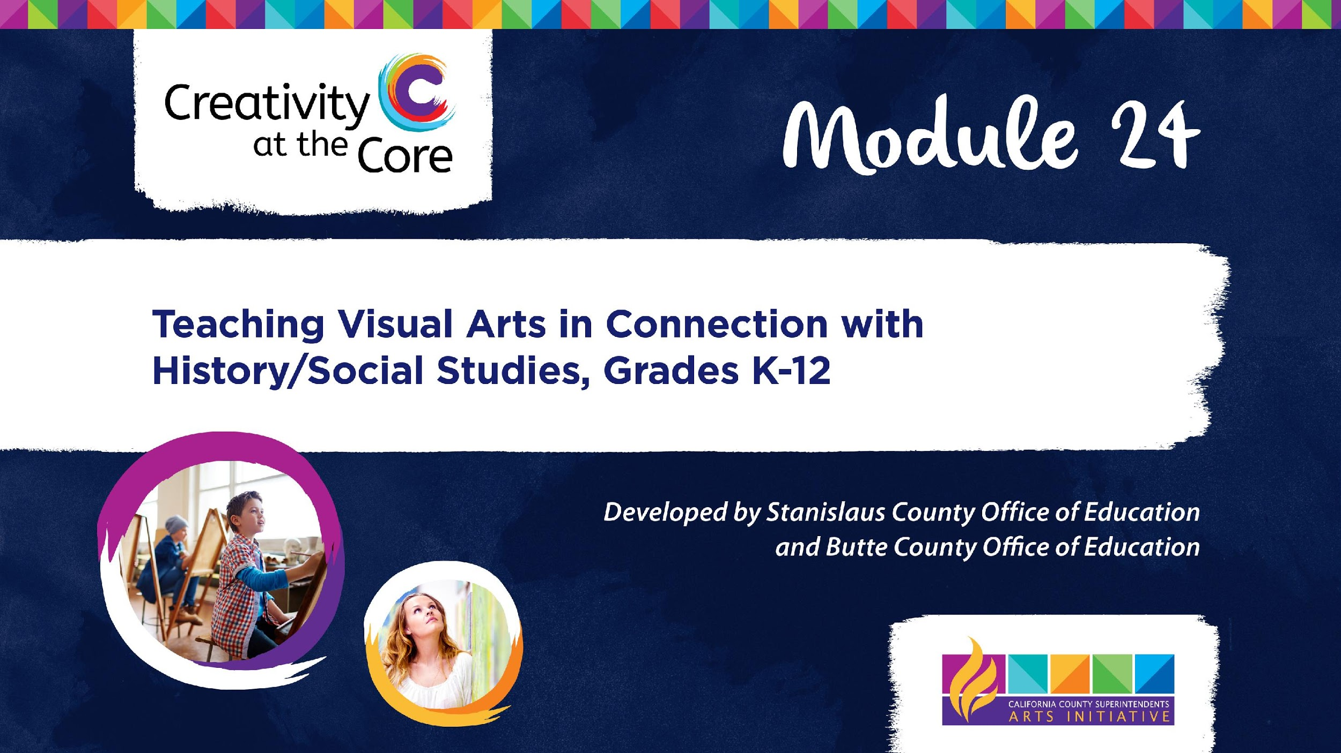

Slide 2
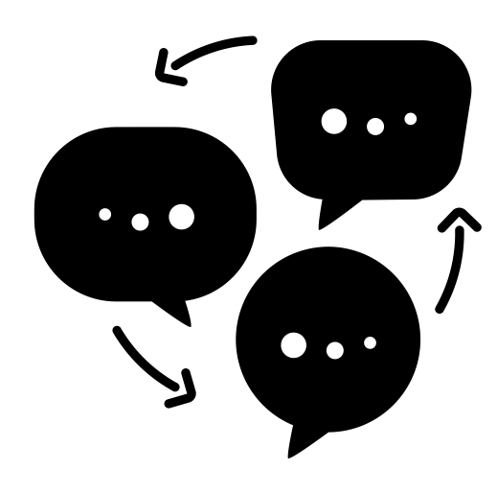
Discussion Point
Discussion Point
How do you feel about teaching the arts?
Notes:
discussion by Victoruler from the Noun Project
https://thenounproject.com/search/?q=discussion&i=2509960

Slide 3
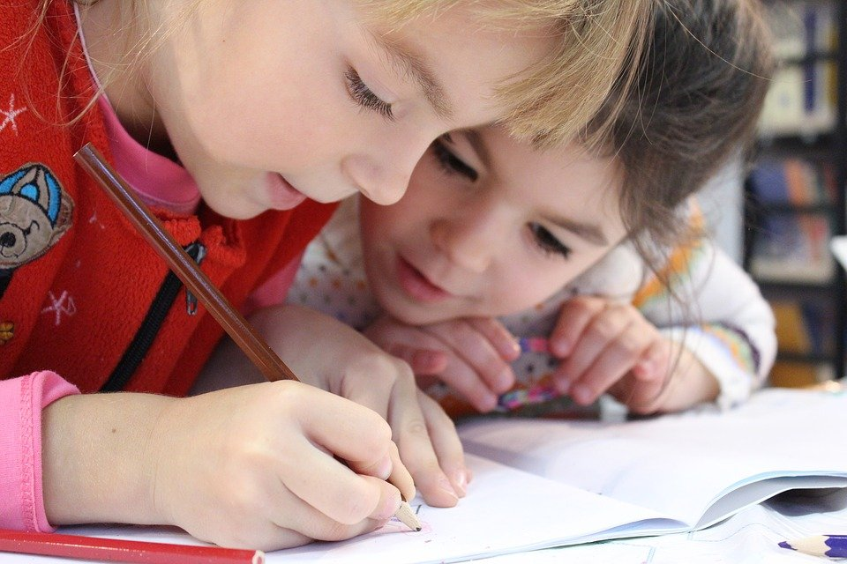
California Arts Framework & Arts Integration
Chapter 8: Transcending Disciplinary Boundaries - Arts Integration
“Arts Integration inspires, positively impacts student learning and when integrated, provides pathways for learning that transcends discipline boundaries” (lines 15-17).
“The Arts Framework defines arts integrated instruction as co-equal instruction in which students are learning and being assessed equally in one or more arts disciplines through the Arts Standards’ four artistic processes and one or more other subject areas” (lines 18-20).
Notes:
https://www.cde.ca.gov/ci/vp/cf/
https://pixabay.com/photos/kids-girl-pencil-drawing-notebook-1093758/

Slide 4
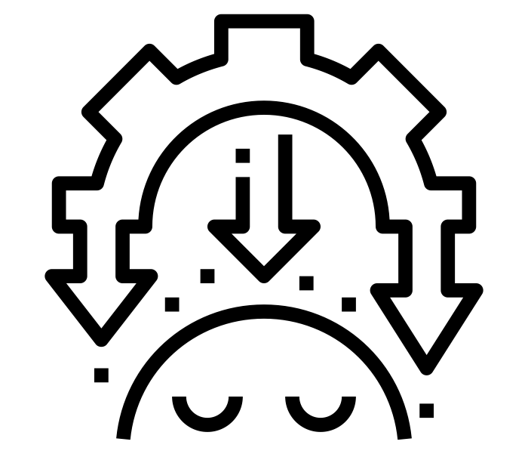
What is integrated learning?
Integrated learning recognizes that disciplines do not exist in isolation from one another.
Integrated learning helps students make connections across disciplines in hopes of building more authentic understanding.
In integrated learning, students learn about two or more disciplines at the same time.
In integrated learning, approximate equal time is devoted to the learning of each discipline.
Integrated learning is often more engaging and authentic that non-integrated learning.
Notes:
integration by Nithinan Tatah from the Noun Project
https://thenounproject.com/search/?q=integration&i=2207566

Slide 5
Discussion Point
Discussion Point
Have you used integration before in your classroom? What are your thoughts on integrated learning?
Notes:
discussion by Victoruler from the Noun Project
https://thenounproject.com/search/?q=discussion&i=2509960

Slide 6
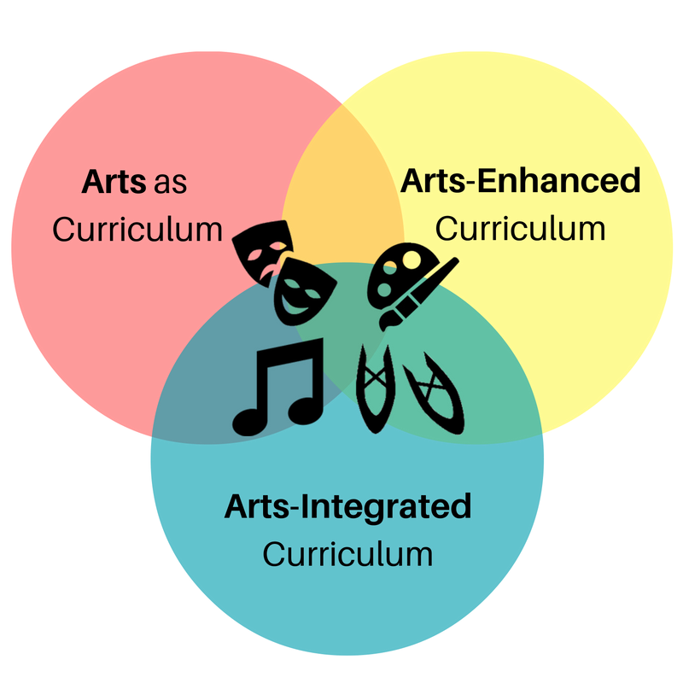
Three Types of Art Integration
There are three types of Arts Integration in schools:
Arts as Curriculum
Arts-Enhanced Curriculum
Arts-Integrated Curriculum
Notes:
image: Amy Bultena
https://www.kennedy-center.org/education/resources-for-educators/classroom-resources/articles-and-how-tos/articles/collections/arts-integration-resources/what-is-arts-integration/

Slide 7


Arts-Enhanced Curriculum
Arts-Enhanced Curriculum is when “the arts are used as a device or strategy to support other curriculum areas, but no objectives in the art form are explicit.”
In Arts-Enhanced Curriculum:
The arts are used to engage students in learning content
The arts are relegated to directed activities and/or crafts
Teachers need little to no training in the art form being used
The arts are often mistaken for Arts-Integrated Curriculum
I found the
cutest craft
Notes:
https://www.kennedy-center.org/education/resources-for-educators/classroom-resources/articles-and-how-tos/articles/collections/arts-integration-resources/what-is-arts-integration/

Slide 8
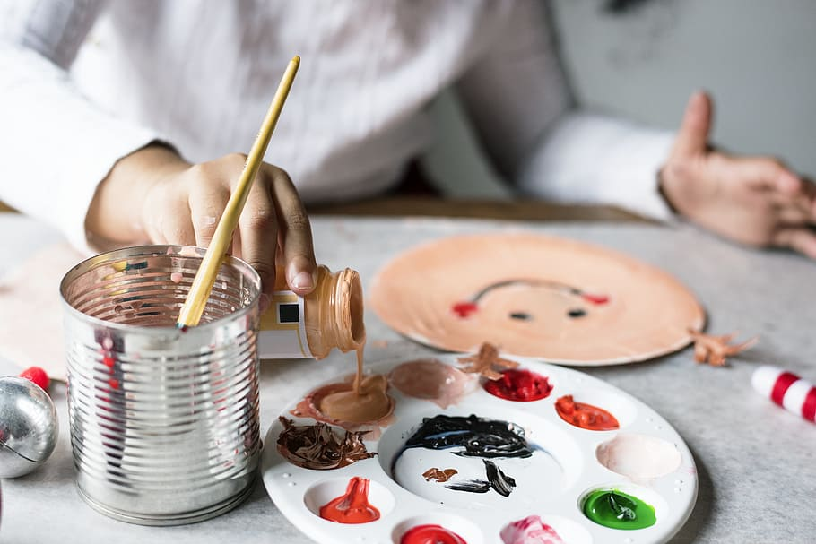
Arts as Curriculum
In Arts as Curriculum, a school has a dedicated class, time, and teacher for Dance, Drama, Music and/or Visual Art.
In Arts as Curriculum:
Students develop knowledge and skills in a specific art form
Learning is guided by state and/or national arts standards
Students attend a dedicated class devoted to the art form
Notes:
https://www.kennedy-center.org/education/resources-for-educators/classroom-resources/articles-and-how-tos/articles/collections/arts-integration-resources/what-is-arts-integration/
https://www.pxfuel.com/en/free-photo-olcze

Slide 9
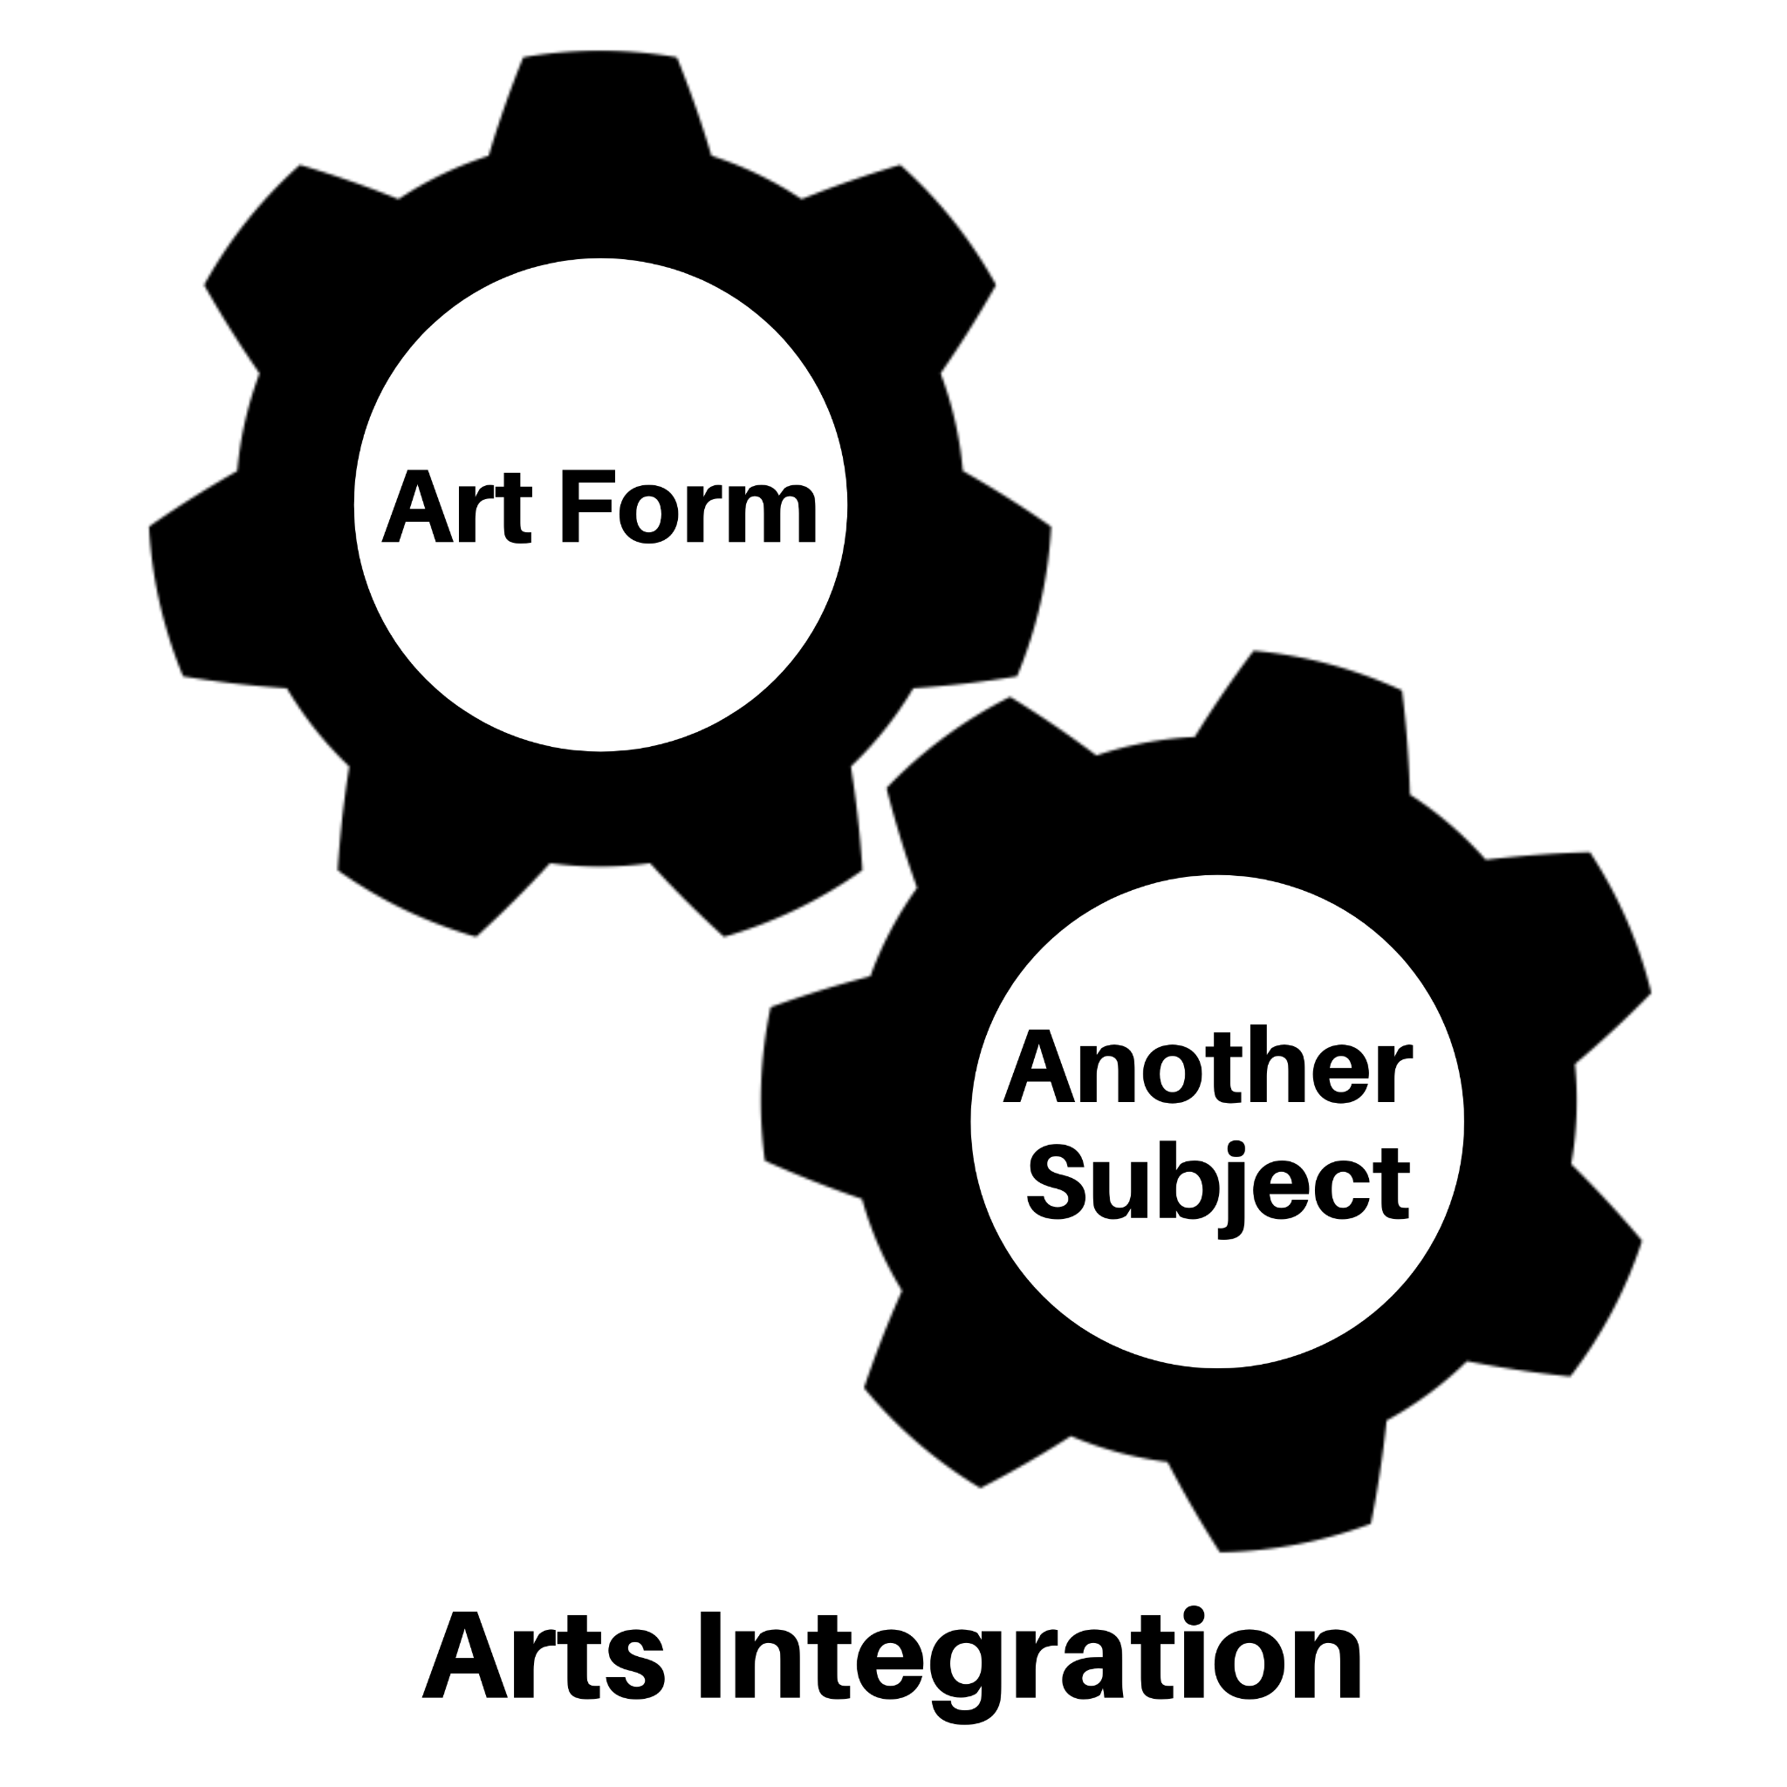
Arts-Integrated Curriculum
In Arts-Integrated Curriculum, the arts become the approach to teaching and the vehicle for learning.
In Arts-Integrated Curriculum:
Students meet dual learning objectives when they engage in the creative process to explore connections between an art form and another subject area to gain greater understanding in both.
Teachers need to engage in professional development in order to learn about arts standards and how to connect the arts to the curriculum they teach.
Both disciplines being integrated are assessed.
Notes:
https://www.kennedy-center.org/education/resources-for-educators/classroom-resources/articles-and-how-tos/articles/collections/arts-integration-resources/what-is-arts-integration/
image: Amy Bultena

Slide 10

Arts Integration Relies on Constructivism
Constructivism is a theory about how people learn based on observation and scientific study.
In constructivist theory people create their own understanding through experiences and through reflecting on experiences.
Constructivist theory in the classroom:
Encourages active techniques like experiments and real-world problem solving
Encourages consistent reflection on learning
In ideal conditions, the students learn how to learn
Notes:
https://pixabay.com/illustrations/mentor-mentoring-teaching-learning-4205038/

Slide 11
Pedagogical Research Supports Arts Integration
“The arts and regular classroom curricula naturally complement one another.”
[W]hen the arts become a vehicle for learning classroom content, the whole child is involved. Children are immersed intellectually, emotionally, physically, and therefore rigorously in the learning experience.”
3rd Grade Writing Standard
W 3.3 Write narratives to develop real or imagined experiences or events using effective technique, descriptive details, and clear event sequences
_____________________________________________
3rd Grade Visual Arts
3.VA.Cr1.1 Elaborate on an imaginative ideas.
Notes:
Lynch, P. (2015). Making meaning many ways: An exploratory look at integrating arts with classroom curriculum. Art Education, 60(4), 33-38

Slide 12
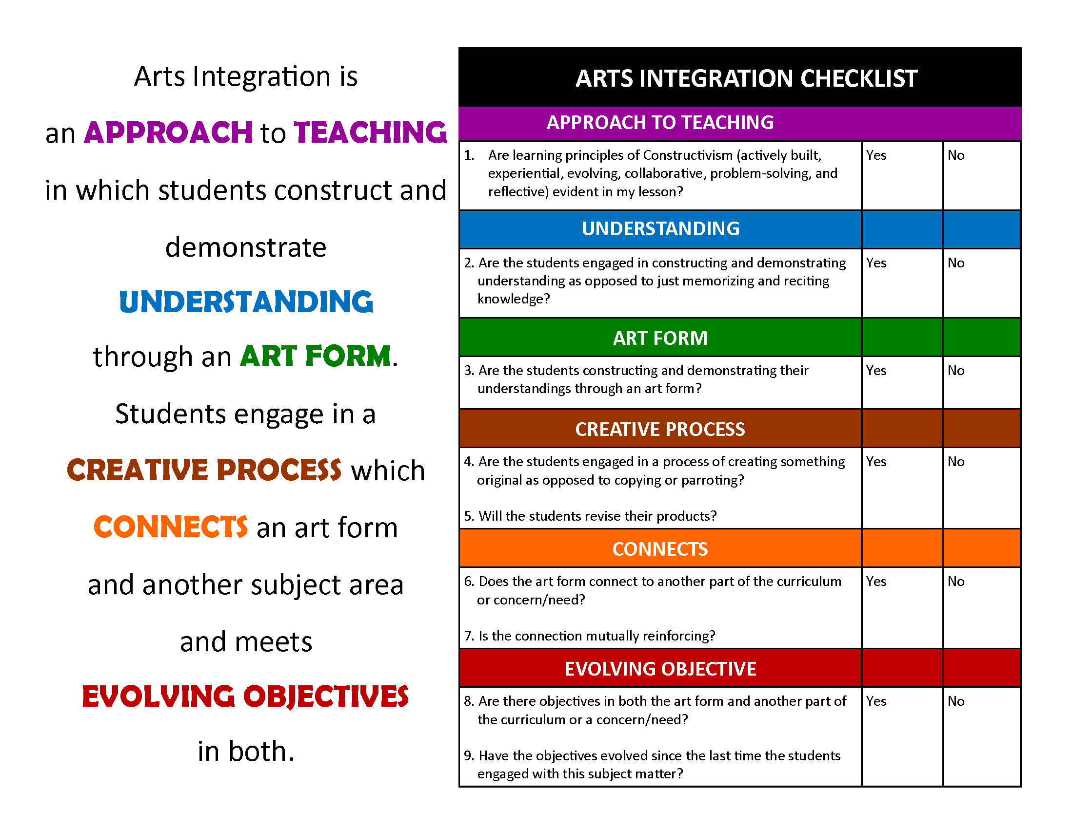
Arts Integration Definition
Notes:
https://www.kennedy-center.org/education/resources-for-educators/classroom-resources/articles-and-how-tos/articles/collections/arts-integration-resources/what-is-arts-integration/

Slide 13
Discussion Point
Discussion Point
What are your initial thoughts about the definition of arts integration?
Notes:
discussion by Victoruler from the Noun Project
https://thenounproject.com/search/?q=discussion&i=2509960

Slide 14
Breaking Down the Arts Integration Checklist
The Kennedy Center definition of Arts Integration provides a checklist for teachers.
The following slides will examine each item on the checklist.
Notes:
https://www.kennedy-center.org/education/resources-for-educators/classroom-resources/articles-and-how-tos/articles/collections/arts-integration-resources/what-is-arts-integration/

Slide 15
Arts Integration Definition: Approach to Teaching
Remember, in constructivism people construct their own understanding:
Through experiences
Through reflecting on experiences
Through “learning to learn”
Notes:
https://www.kennedy-center.org/education/resources-for-educators/classroom-resources/articles-and-how-tos/articles/collections/arts-integration-resources/what-is-arts-integration/

Slide 16
Arts Integration Definition: Understanding
Discussion Point
What does “constructing and demonstrating understanding” look like?
Notes:
https://www.kennedy-center.org/education/resources-for-educators/classroom-resources/articles-and-how-tos/articles/collections/arts-integration-resources/what-is-arts-integration/
discussion by Victoruler from the Noun Project
https://thenounproject.com/search/?q=discussion&i=2509960

Slide 17
Arts Integration Definition: Art Form
Product-Based Learning
Close-ended
Directed
Heavily structured
Heavily modeled
Less student choice
Less student creativity
Process-Based Learning
Open-ended
Exploratory
Unique
Individual
High student choice
High student creativity
Notes:
https://www.kennedy-center.org/education/resources-for-educators/classroom-resources/articles-and-how-tos/articles/collections/arts-integration-resources/what-is-arts-integration/

Slide 18
Discussion Point
Discussion Point
How could/does knowledge of process vs. product impact your teaching practice?
Notes:
discussion by Victoruler from the Noun Project
https://thenounproject.com/search/?q=discussion&i=2509960

Slide 19
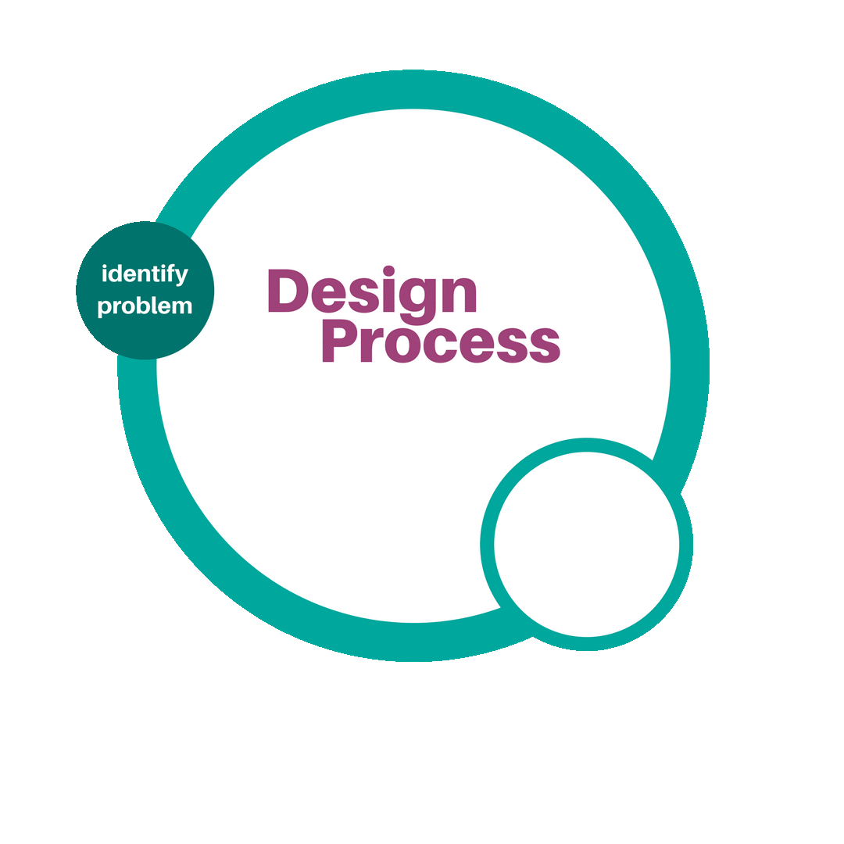
Arts Integration Definition: Creative Process
Notes:
https://www.kennedy-center.org/education/resources-for-educators/classroom-resources/articles-and-how-tos/articles/collections/arts-integration-resources/what-is-arts-integration/
image: Amy Bultena

Slide 20
Arts Integration Definition: Connects
Notes:
https://www.kennedy-center.org/education/resources-for-educators/classroom-resources/articles-and-how-tos/articles/collections/arts-integration-resources/what-is-arts-integration/
image: Amy Bultena

Slide 21
Arts Integration Definition: Evolving Objective
Objectives evolve and unfold over time as students’ experiences and understandings develop.
As students master each objective, they are ready to take on the next, more challenging ones.
Notes:
https://www.kennedy-center.org/education/resources-for-educators/classroom-resources/articles-and-how-tos/articles/collections/arts-integration-resources/what-is-arts-integration/

Slide 22
Discussion Point
Discussion Point
What challenges do teachers face when it comes to writing and implementing arts integrated lessons?
Notes:
discussion by Victoruler from the Noun Project
https://thenounproject.com/search/?q=discussion&i=2509960

Slide 23
How Do You Write an Arts Integrated Lesson?
The definition for Arts Integration is deep and thorough; it can be intimidating.
Don’t let the definition of Arts Integration intimidate you.
You can write arts integrated lessons.
The following slides will walk you through one process for creating an arts integrated lesson.
Notes:
image: Amy Bultena

Slide 24

Lesson Inspiration Resources
The internet and social media are great places to begin searching for arts integrated lesson inspiration.
Image searches, image-pinning sites, and social media yield vast collections of mostly arts-enhanced project ideas.
There are very few websites that offer true arts integration lessons and/or lesson inspiration.
In short, use search engines, blogs, image-pinning sites, and social media for project inspiration, but don’t let that inspiration be your ending place.
Notes:
https://commons.wikimedia.org/wiki/File:Applications-internet.svg

Slide 25

Arts Integration Lesson Writing: Real Talk
There are many moving parts to executing an arts integrated lesson plan, and some of those parts are:
The knowledge of the teacher
The abilities and interests of the students
Access to materials and funding for materials
Learning environment of the classroom
The best arts integrated lessons are written by the teacher who will be teaching the lesson.
That means YOU write the best arts integrated lessons.
Notes:
https://www.publicdomainpictures.net/en/view-image.php?image=155227&picture=light-bulb

Slide 26
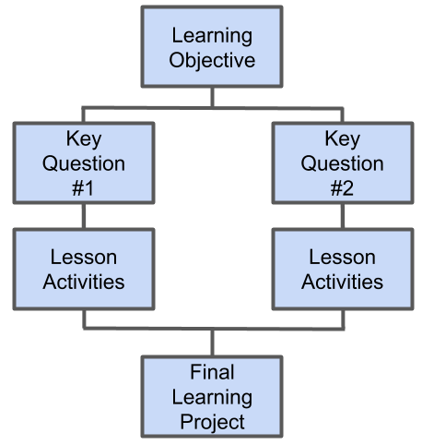
Integrated Lesson Model
Begin with the learning objective.
Consider what key questions students need to answer to meet the learning objective. The key questions often relate to the content areas being integrated. There can be many or few key questions.
Consider what lesson activities students need to perform in order to answer the key questions.
What lesson activities will students need to perform in order to have the knowledge to create the final learning project? The final learning project should directly link back to the learning objective.

Slide 27
Discussion Point
Discussion Point
What are your thoughts on the integrated learning model? What questions do you have?
Notes:
discussion by Victoruler from the Noun Project
https://thenounproject.com/search/?q=discussion&i=2509960

Slide 28
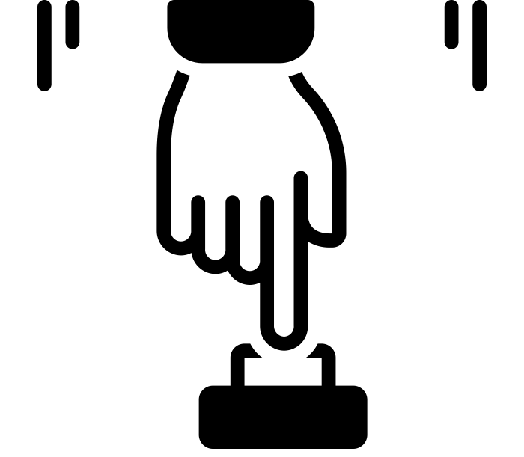
Arts Integrated Lesson: How to Begin
Examine the standards of an art discipline and another content area to see which standards are interrelated.
Examine content area standards and research where there might be entry points to connect an art discipline.
Examine art discipline standards and research where there might be entry points to connect to another content area.
Decide to integrate an art discipline alongside another content area. Then look for ways in which the two subjects could be integrated with one another.
Over the course of the next slides, we will examine how to integrate an art discipline, Visual Art, with another content area, History/Social Science.
Notes:
begin by priyanka from the Noun Project
https://thenounproject.com/search/?q=begin&i=3859258

Slide 29
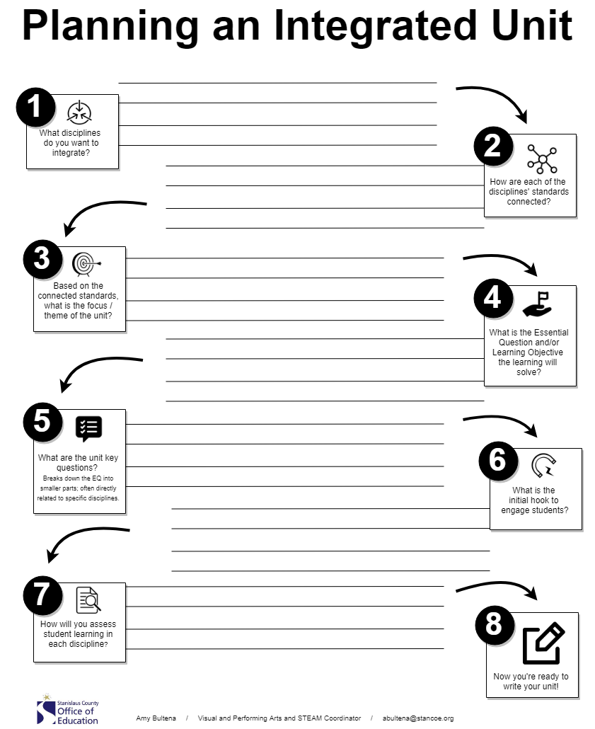
Writing an Arts Integrated Lesson: Visual Art and History/Social Science
This worksheet will guide you through the process of planning for an integrated lesson plan.
Over the course of the next slides, we will use this worksheet to plan for a Visual Art and History Social/Science integrated lesson.

Slide 30
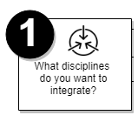
Visual Art and History Integration: Step 1
For this integrated lesson, the disciplines being integrated are:
Visual Art
History Social Science

Slide 31
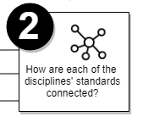
Visual Art and History Integration: Step 2
3.VA:Cr2.1 Create a personally satisfying artwork using a variety of artistic processes and materials. (we are going to focus on the materials portion of the standard - painting technique)
HSS 3.4.3 Know the histories of important local and national landmarks, symbols, and essential documents that create a sense of community among citizens and exemplify cherished ideas (e.g., the U.S. flag, the bald eagle, the Statue of Liberty, the U.S. Constitution, the Declaration of Independence, the U.S. Capital).
These standards can connect to one another through the students creating a personally satisfying artwork using a variety of artistic processes and materials that demonstrates knowledge of important local and national landmarks.

Slide 32
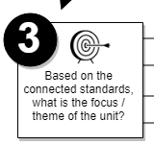
Visual Art and History Integration: Step 3
The focus for this unit will be creating a personally satisfying artwork about a local and/or national landmark.

Slide 33
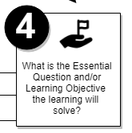
Visual Art and History Integration: Step 4
Unit Learning Objective:
Students will synthesize their understanding of the symbolism and iconography of the Statue of Liberty and Pacita Abad’s L.A. Liberty to create a self-portrait using personal symbols that is inspired by the Statue of Liberty and L.A. Liberty.

Slide 34
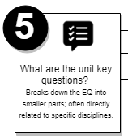
Visual Art and History Integration: Step 5
Key Questions:
What is a symbol?
What is the Statue of Liberty’s symbolism?
What is a self-portrait?
How can I use symbols in artwork?

Slide 35
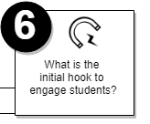
Visual Art and History Integration: Step 6
Initial Hook:
Students will use visual literacy to examine a photograph of the Statue of Liberty.

Slide 36
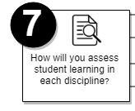
Visual Art and History Integration: Step 7
Assessment will take place via a rubric with the following dimensions:
Symbolism of the Statue of Liberty
Creating symbolism in personal artwork
Construction of a self-portrait

Slide 37
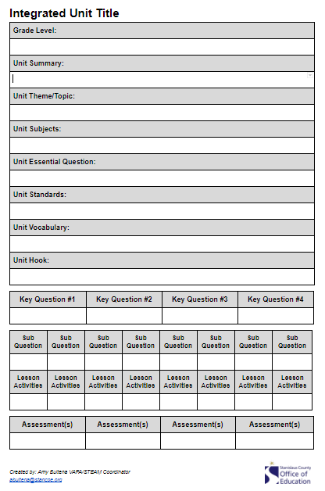
Visual Art and History Integration: Writing the Lesson
At the completion of the “Planning an Integrated Unit” worksheet, you have all of the major components needed to write an arts integrated lesson.
Here is a integrated unit lesson plan template that may be helpful as you write an arts integrated lesson.

Slide 38
Discussion Point
Discussion Point
What are your thoughts on the planning process for writing an integrated lesson? What questions do you have?
Notes:
discussion by Victoruler from the Noun Project
https://thenounproject.com/search/?q=discussion&i=2509960

Slide 39
Resources for History/Social Science
These resources support the process of integrating History/Social Science. The sites provide inspiration points, specific lessons, and student activities.
California Standards Mobile Application
California History Social Science Framework
California History-Social Science Project, UC Davis
Using Guiding Questions from California’s HSS Framework, UC Davis
Google Arts & Culture
Museums

Slide 40
Resources for Visual Art
These resources support the process of integrating Visual Art. The sites provide inspiration points, specific lessons, and student activities.
California Standards Mobile Application
California Arts Education Framework
California Art Education Association Resources for Educators
Kennedy Center for the Arts Digital Resources for Educators
Google Arts & Culture
Technology Enhanced Arts Learning online modules (T.E.A.L.)
Museums
Art Galleries

Slide 41
Resources for Images
Here are some great resources for images:
Library of Congress Prints & Photographs Online Catalog*
Smithsonian Open Access Images*
Wikimedia Commons
Google Arts & Culture
The Metropolitan Museum of Art
SFMOMA
National Gallery of Art
A note about images and copyright: The usage of copyrighted materials is permissible under educational usage for a teacher sharing materials with the students in their class. Distributing materials on the internet, even for educational purposes, may exceed the permissions under educational usage. When distributing copyrighted materials beyond the classroom, individuals should use images that are open source, in public domain, and/or have rights that allow for usage.
*indicates images that are open access

Slide 42
Cultural Appropriation Definition
Cultural appropriation “is the unauthorized adoption or theft of icons, symbols, rituals, aesthetic standards, and representations from one culture or subculture by another. Appropriation also occurs when a person of the dominant culture purports to be an expert on the experience of the dominated culture or trivializes the experiences of a member of the dominated culture.”
There is a power dynamic to cultural appropriation that is not present in cultural exchange.
In cultural appropriation, “members of a dominant culture take elements from a culture of people who have been systematically oppressed by that dominant group.”
“When teachers do not take care to respect the context of artwork from other cultures, they are telling students that it is okay to steal from another culture.”
Notes:
definition source, National Art Education Association Position Statement on Cultural Appropriation https://www.arteducators.org/advocacy-policy/articles/551-naea-position-statement-on-use-of-imagery-cultural-appropriation-and-socially-just-practices
https://everydayfeminism.com/2015/06/cultural-appropriation-wrong/
https://www.k12academics.com/education-subjects/art-education/cultural-appropriation-within-classroom

Slide 43
Cultural Appropriation Examples & Solutions
Students make totem poles
  Problem: Native Americans have been oppressed by colonization. Totem poles document ancestry, histories, peoples, and/or events of the Pacific Northwest First Nations. Students copying a totem pole appropriates the culture of Native Americans by copying an artifact without respecting the cultural reasons for which totem poles are created.
  Solution: If possible, consult with local Native American leaders; ask them to visit your class. Research the history and traditions of totem poles. Teach students about the history and uses of totem poles by First Nations in the Pacific Northwest. Task students with creating an original artwork that is about their own ancestry, history, and/or personal events.
Notes:
https://opentextbc.ca/indigenizationcurriculumdevelopers/chapter/appropriate-use-of-indigenous-content/

Slide 44
Cultural Appropriation Examples & Solutions
Students make African masks
  Problem: Africa is a continent consisting of hundred of different peoples with their own religions and cultural traditions. This project makes a generalized statement that all peoples in Africa do the same thing. Creating African masks generalizes, dilutes, and erases the many different peoples who make masks, the reasons why they make masks, the local materials used to make masks, and the aesthetics of their masks.
  Solution: Have students research the rich cultural tradition of a people or several different peoples who engage in mask making. Determine the materials used to make the mask, how the mask is made, why the mask is made, and how the mask is used. Task students to use the same materials to make a mask of their own design (not derivative of the original people’s), and have students write a report about the challenges and successes of using that material.

Slide 45
How to Avoid Cultural Appropriation
Use these questions to help you avoid cultural appropriation:
What cultural tradition and/or topic do I want to teach about?
Why am I teaching about this topic? Is it for my own purposes, or because it is relevant to my students, part of a curriculum, and/or otherwise necessary and/or important?
Am I aware of the historicity of the persons, events, and traditions present in this study? (historicity is the actuality of persons and events as opposed to myth, legend, fiction, pop culture, or urban legend)
Am I aware of any oppressed peoples represented in this lesson? Am I aware of the historicity of these peoples? Am I aware of the contemporary/current history/story of these peoples?
Have I discussed teaching this topic with other educators? Have I sought out the opinion of educators who don’t always share the same opinions as me? Have I looked online to see how other educators have approached this topic?
In what ways can I approach this lesson that respect the cultural and religious traditions of the peoples being studied?
Does the project task students with copying and thereby appropriating the work of a group of peoples? Or, does the work ask students to learn about a culture and synthesize what they learn to create something new that does not copy the work of the peoples being studied?

Slide 46
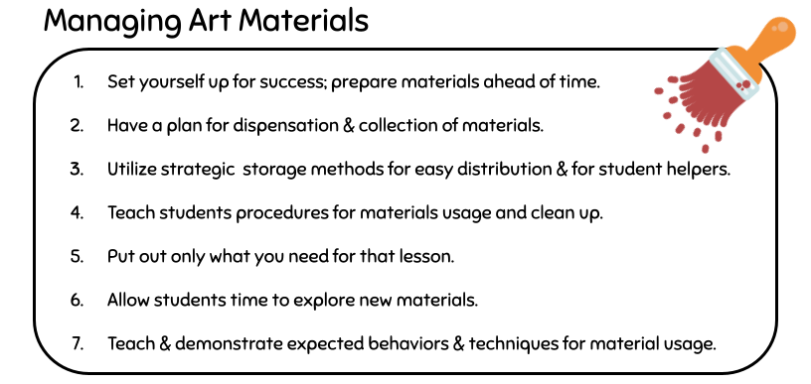
Tips for Teaching Visual Art Skills
Notes:
Adapted from Teaching Tips for Visual Arts from Fresno County Superintendent of Schools
& Tips & Tricks for Managing Materials & Behavior in the Art Classroom from Stanislaus County

Slide 47
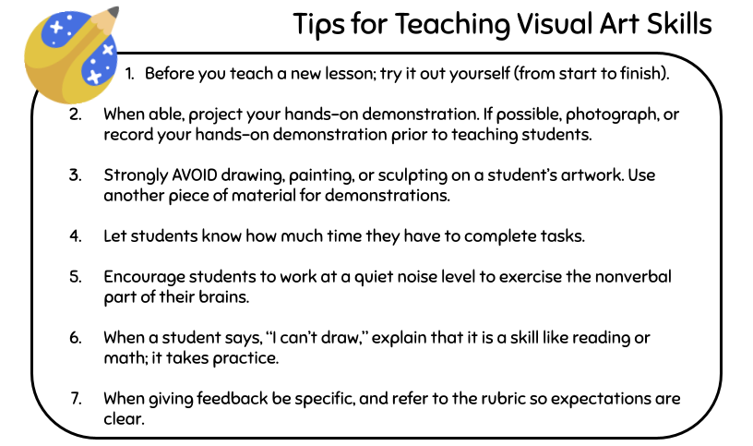
Tips for Teaching Visual Art Skills
Notes:
Adapted from Teaching Tips for Visual Arts from Fresno County Superintendent of Schools
& Tips & Tricks for Managing Materials & Behavior in the Art Classroom from Stanislaus County

Slide 48
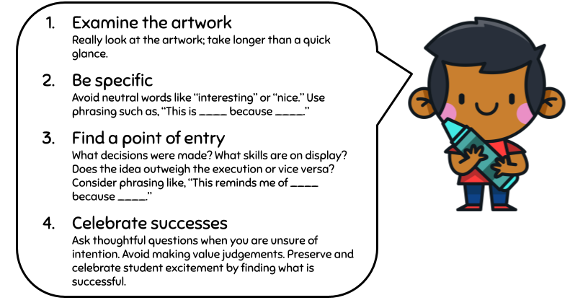
Tips for Talking to Students About Their Art
Notes:
Green, S.U. How to Critique the Art Assignment PBS Digital Studios (2014, October 09). Retrieved September 05, 2018 from http://bit.ly/2ClAr9d

Slide 49
Tips for When Students Talk to Peers About Art
Notes:
Green, S.U. How to Critique the Art Assignment PBS Digital Studios (2014, October 09). Retrieved September 05, 2018 from http://bit.ly/2ClAr9d

Slide 50

California’s Educational Code and Arts Education
Section 51210(e) mandates VAPA (Music, Dance, Theatre, & Visual Art) be included in school curriculum for students in grades 1-6.
Section 51210(g) mandates VAPA be offered to all students in grades 7-12.
Arts are a course of study and Section 51050 states, “the governing board of every school district shall enforce the courses of study.”
Notes:
https://pixabay.com/photos/wood-pencil-creativity-cross-3327316/

Slide 51
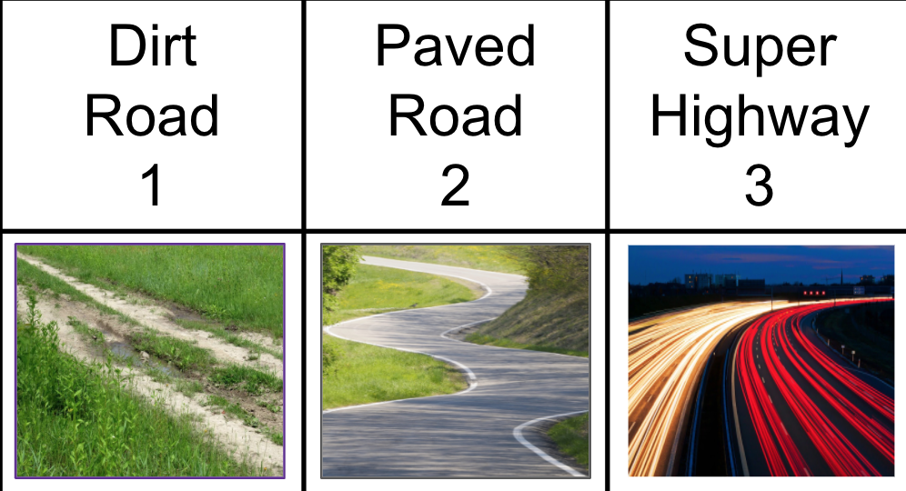
Discussion Point
Discussion Point
How do you feel about integrating the arts into your practice?
Notes:
discussion by Victoruler from the Noun Project
https://thenounproject.com/search/?q=discussion&i=2509960

Slide 52
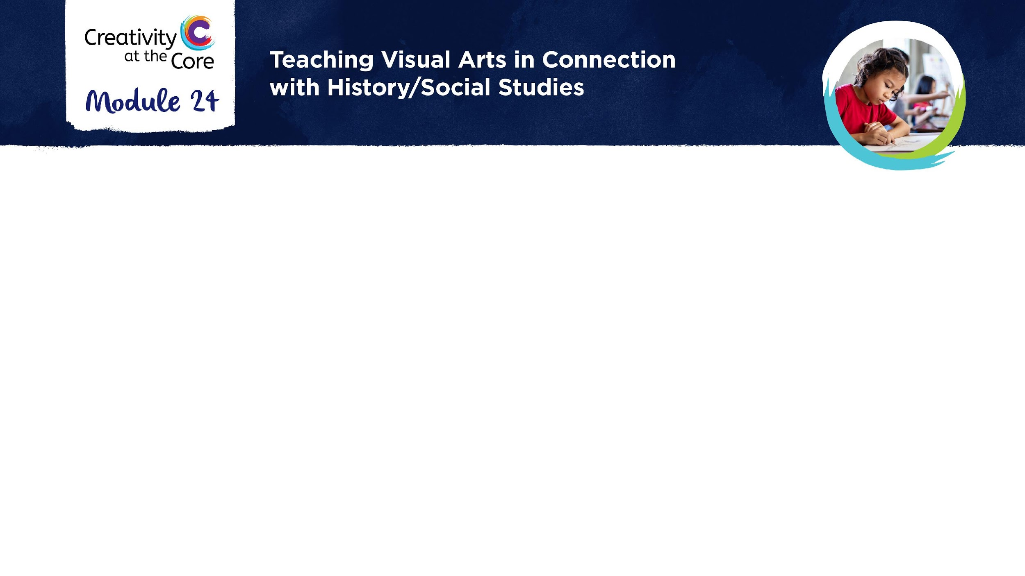
Closing Slide

