Slide 1
4th Grade Arts & Science Integrated Unit
Learning Sequence #1
Focus on Photography

Slide 2
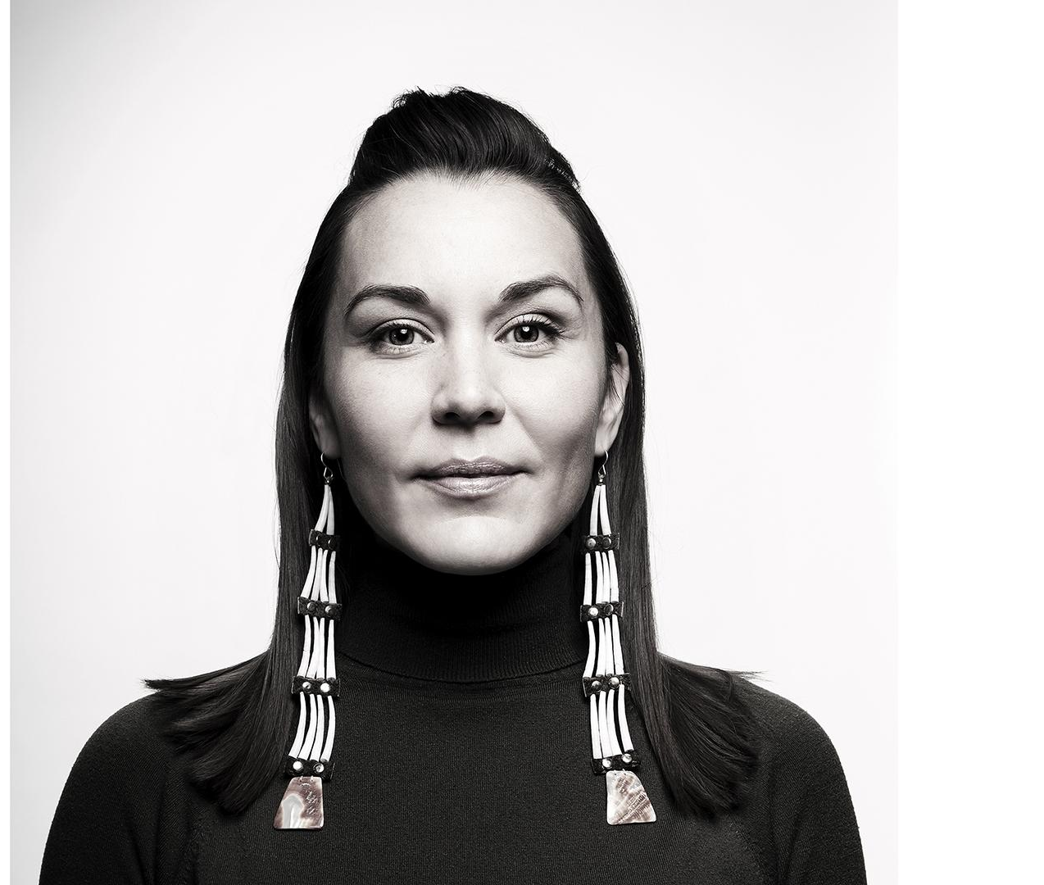
Part 1: Getting to Know the Artist - Cara Romero
Cara Romero is a contemporary photographer and member of the Chemehuevi Indian Tribe of the Chemehuevi Reservation (a branch of the Southern Paiute) of the Mojave Desert, CA.
“I was the only Native American and everyone around me was completely unaware that we existed…
And I knew almost instantly that I wanted to be able to communicate visually, through photography, modern native life.” - Cara Romero
2
Notes:
(Image Source: Cara Romero downloaded from PBS LearningMedia, https://www.pbslearningmedia.org/resource/look-and-see-who-is-in-the-photograph-gallery/craft-in-america/ (1). Rights to use this asset do not expire. Asset Copyright: © 2019 Craft in America, Inc.)

Slide 3

Chemehuevi Native American photographer Cara Romero
What did you find interesting? What did you notice? What do you wonder?
If you could meet Cara, what would you want to ask her?
How does Cara’s identity influence her art?
3
Notes:
Play the https://ca.pbslearningmedia.org/resource/look-and-see-who-is-in-the-photograph-gallery/craft-in-america/video and have students discuss the following questions.

Slide 4

My Name, My Identity
students from San José, California share the story about how they were given their name and the meaning behind it
4
Notes:
https://www.youtube.com/watch?v=AqyR9Ke8Ebg&t=5s

Slide 5
My Name, My Identity
Jot your responses to the following questions:
What is the story behind my name?
How would I describe myself? How would others describe me?
What does identity mean to me? How does my name relate to my identity?
Consider using these sentence starters:
The story behind my name is…
I describe myself as. . . Others would describe me . . .
To me, identity means…
Parts of my identity that are important to me are…
My name is related to my identity . . .
5

Slide 6
Part 2: Getting to Know the Art of Cara Romero
Whole group discussion
Why do we take photographs of people?
Do you have a favorite photo? What is the subject of the picture?
Why is this photo important to you?
6

Slide 7
Chemehuevi Native American photographer Cara Romero
Watch the video again. This time, think about these questions:
How does Cara Romero use props and/or clothing to help tell a story?
How does she combine traditional and modern elements in the photos?
7
Notes:
Play the https://ca.pbslearningmedia.org/resource/look-and-see-who-is-in-the-photograph-gallery/craft-in-america/video and have students discuss the following questions.

Slide 8
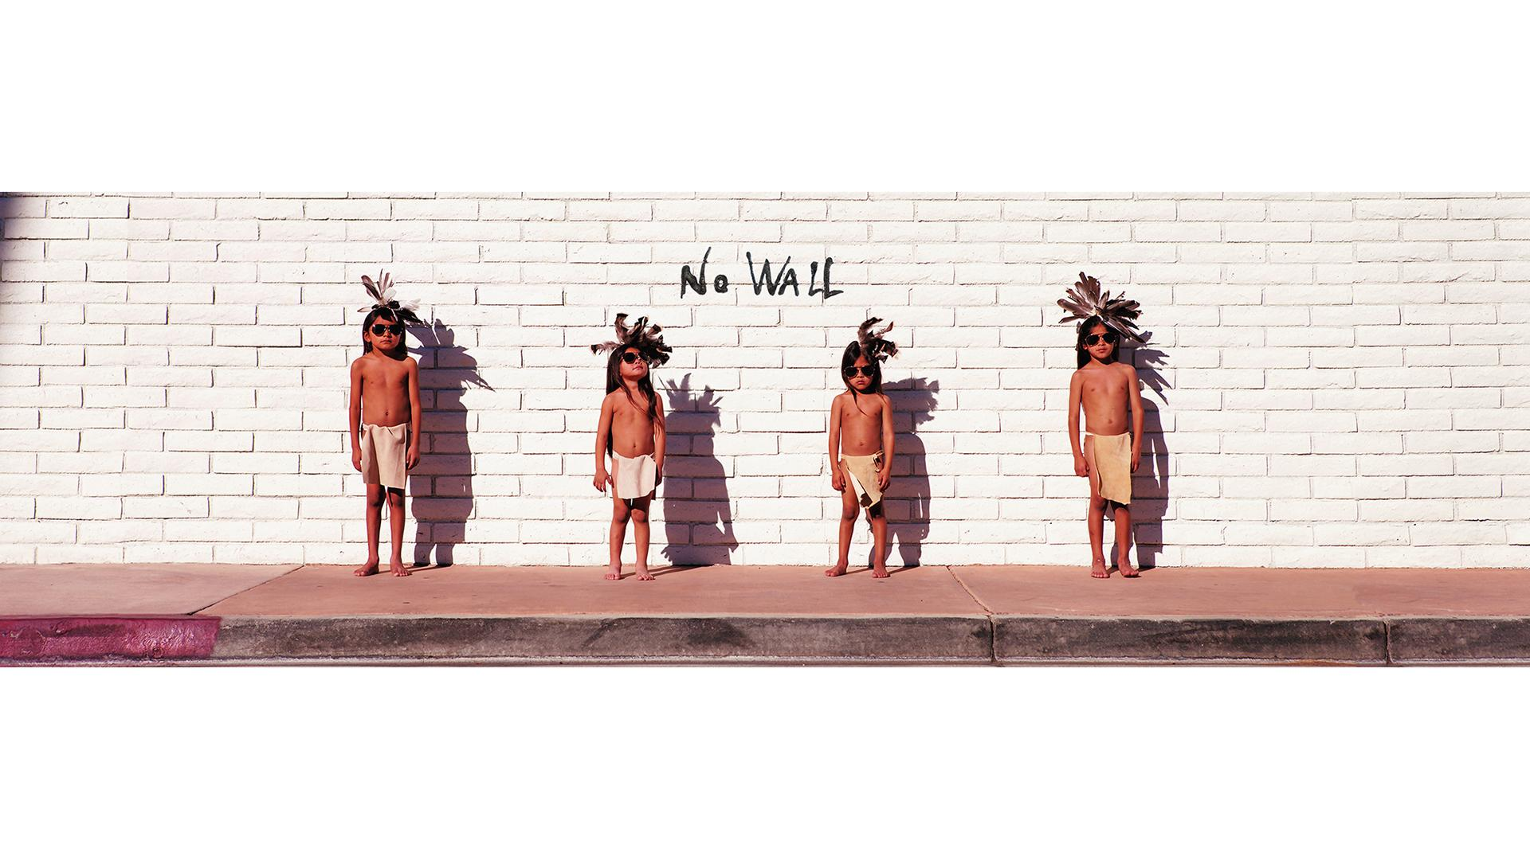
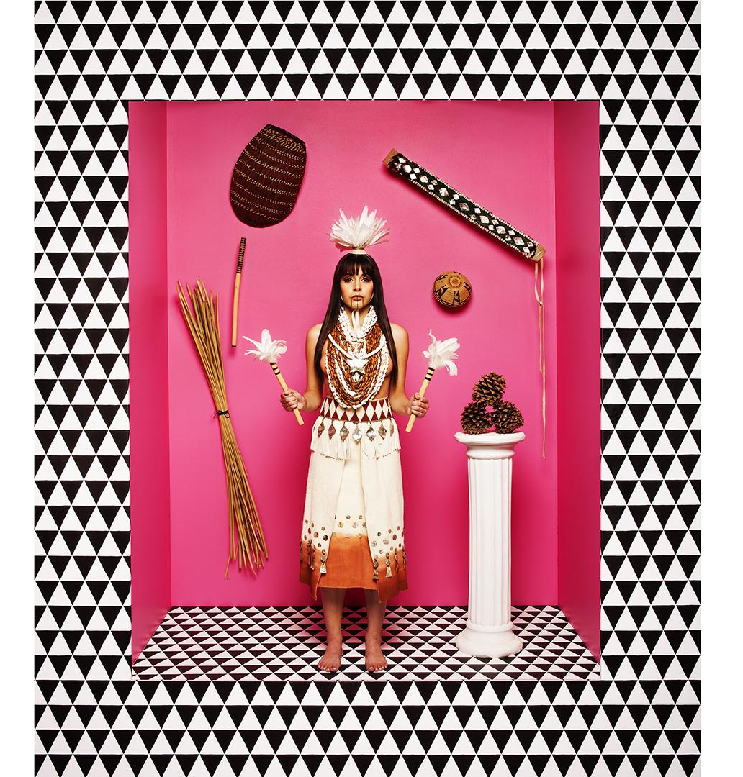
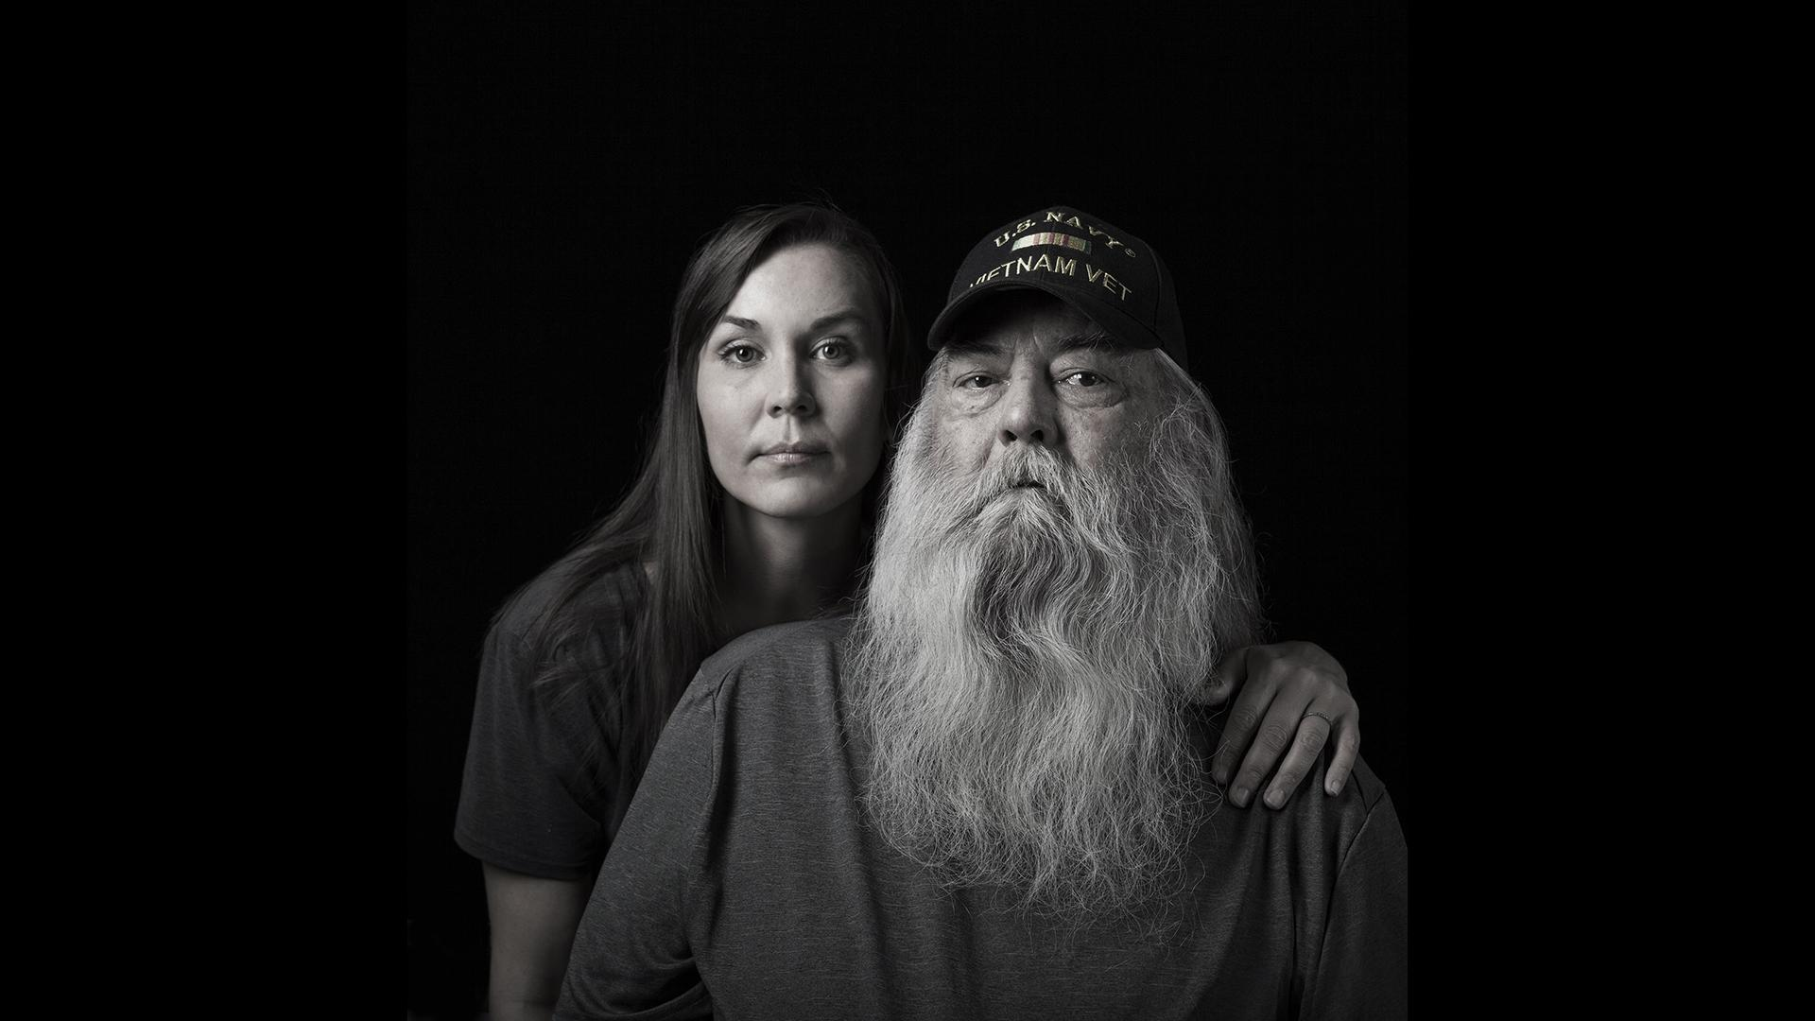
The Art of Cara Romero
No Wall (Jackrabbit, Cottontail and Spirits of the Desert series)
Cara Romero with Her Father (Portraits with Her Father series)
Naomi (First American Girls Dolls series)
Look at each image. What story do you think Cara is trying to tell in each photo. How does she use props and clothing to help tell the story?
Jot your thoughts and then share your thinking with someone else in the class.
8
Notes:
(Image Source: Cara Romero, Naomi downloaded from PBS LearningMedia, https://www.pbslearningmedia.org/resource/look-and-see-who-is-in-the-photograph-gallery/craft-in-america/. (3) Rights to use this asset do not expire. Asset Copyright: © 2019 Craft in America, Inc.)​
(Image Source: Cara Romero, No Wall, 2019 downloaded from PBS LearningMedia,https://www.pbslearningmedia.org/resource/look-and-see-who-is-in-the-photograph-gallery/craft-in-america/. (4) Rights to use this asset do not expire. Asset Copyright: © 2019 Craft in America, Inc.)​
(Image Source: Cara Romero with Her Father downloaded from PBS LearningMedia,https://www.pbslearningmedia.org/resource/look-and-see-who-is-in-the-photograph-gallery/craft-in-america/. (5) Rights to use this asset do not expire. Asset Copyright: © 2019 Craft in America, Inc.)

Slide 9
Interpreting the Art of Cara Romero
We can tell a story about someone or an event by taking a picture. Photography allows the artist to capture a moment in time. Sometimes artists like Cara Romero tell a story by staging and creating moments.
Choose one of Cara’s works of art to interpret further.
9

Slide 10
Option 1: Naomi, First American Girls Doll series
How is the character, Naomi, portrayed in the photo?
What props and clothing does Cara include in the photo?
How do the props and clothing Cara selected help tell the story?
What are you wondering? What questions do you have about the art itself? What questions would you want to ask Cara Romero?
Naomi (First American Girls Dolls series)
10

Slide 11
Option 2: No Wall, Jackrabbit, Cottontail and Spirits of the Desert series
Why was the Jackrabbit, Cottontail and Spirits of the Desert series created?
How are the characters in the photo portrayed? How do the props and clothing Cara selected help tell the story?
If the boys had not changed their clothing how would the story be different? Share your ideas about how the “Indian stuff” adds to the story.
How does Cara use technology to help tell the story?
What are you wondering? What questions do you have about the art itself? What questions would you want to ask Cara Romero?
No Wall (Jackrabbit, Cottontail and Spirits of the Desert series)
11

Slide 12
Option 3: Cara Romero with Her Father, Portraits with her father series
How are the characters in the photo portrayed?
How do the props and clothing Cara selected help tell the story?
How does her father putting on his veterans hat change the story that the photo tells? Share your ideas about what the hat adds to the story.
What are you wondering? What questions do you have about the art itself? What questions would you want to ask Cara Romero?
Cara Romero with Her Father (Portraits with Her Father series)
12

Slide 13
Sharing our Interpretations
Share your thinking with someone else that interpreted the same photo. Add new ideas from your partner to your own interpretation.
Form groups that have each of the three photos represented. Discuss the piece of art you interpreted.
What similarities do you see across the three works of art?
What differences do you see in the work you interpreted?
13

Slide 14
Curating Art to Tell a Story
Looking at photographs after they are taken allows us to experience moments in time and interpret works of art even if we weren’t there when the picture was taken.
Images can also be used to tell the story of one person. Artists and storytellers often curate, put together a group or collection, of photos to tell a story or get others to take action.
14

Slide 15
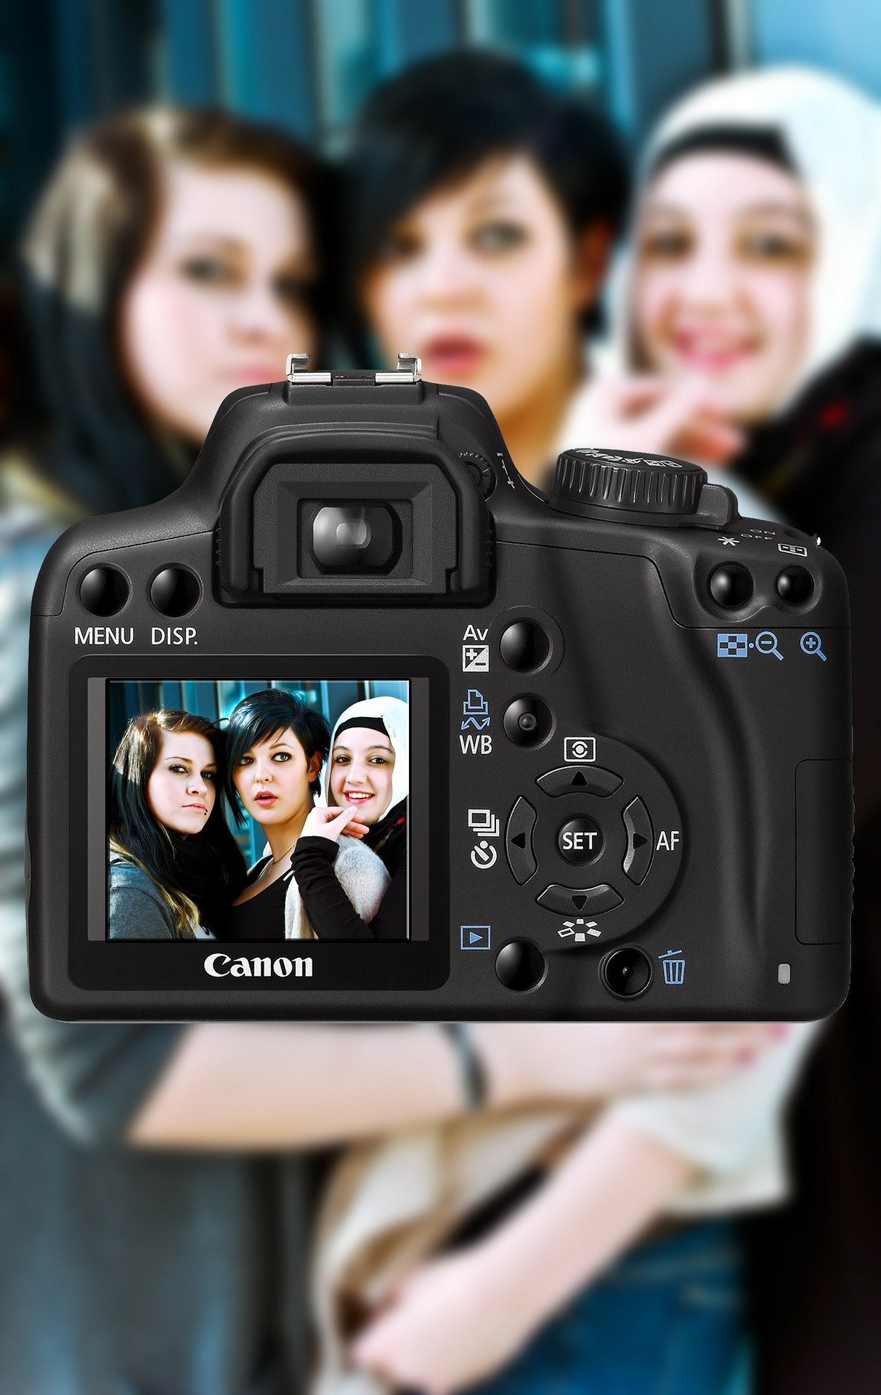
Part 3: Curating Photos to Tell a Story
How we can tell a story using photographs?
(Image Source: pixabay.com)
15

Slide 16
Curating Photos to Tell a Story
Make a list of people you are interested in learning more about. This list can include people you know personally or people you have seen or read about.
Read through the names and think about each person:
Why did you put the person on your list?
What made you write their name down?
16

Slide 17
Curating Photos to Tell a Story
Read through your list of names again and choose one person:
Whose story do you want to tell?
How do you know of this person?
What interests you most about this person?
What questions do you have about this person?
Would this person want their story told? Who might they want to tell their story?
17

Slide 18

Curating Photos to Tell a Story
Gather some photos (at least 3) of the person you selected.
These can be family photos or pictures found online (if the person is a public figure).
Look at each photo.
Why did you select each photo?
What story do the photos tell?
How do the photos you selected help tell the story? Are there props or clothing/attire in the pictures that help tell the story? Are the photos staged like the art of Cara Romero or are they candid shots?
What part of the person’s story is not told in the photos you selected?
18

Slide 19
Part 4: Telling a Story Through Photography
Cara Romero has shown us that artists can use the medium of photography to express themselves. Cameras are very common today and can be found embedded in many handheld devices such as phones and tablets.
Every time we take a picture, it doesn’t necessarily mean we have created a piece of art. However, photography is a medium that can be used in many ways to tell stories and create works of art. Some photographers, called photojournalists, take pictures at events that become the images of breaking news or used to create documentaries to tell the story of people and real life events. These photos are often candids, pictures taken without the subject's knowledge. Photojournalists often use their work to bring attention to issues of social justice.
19

Slide 20
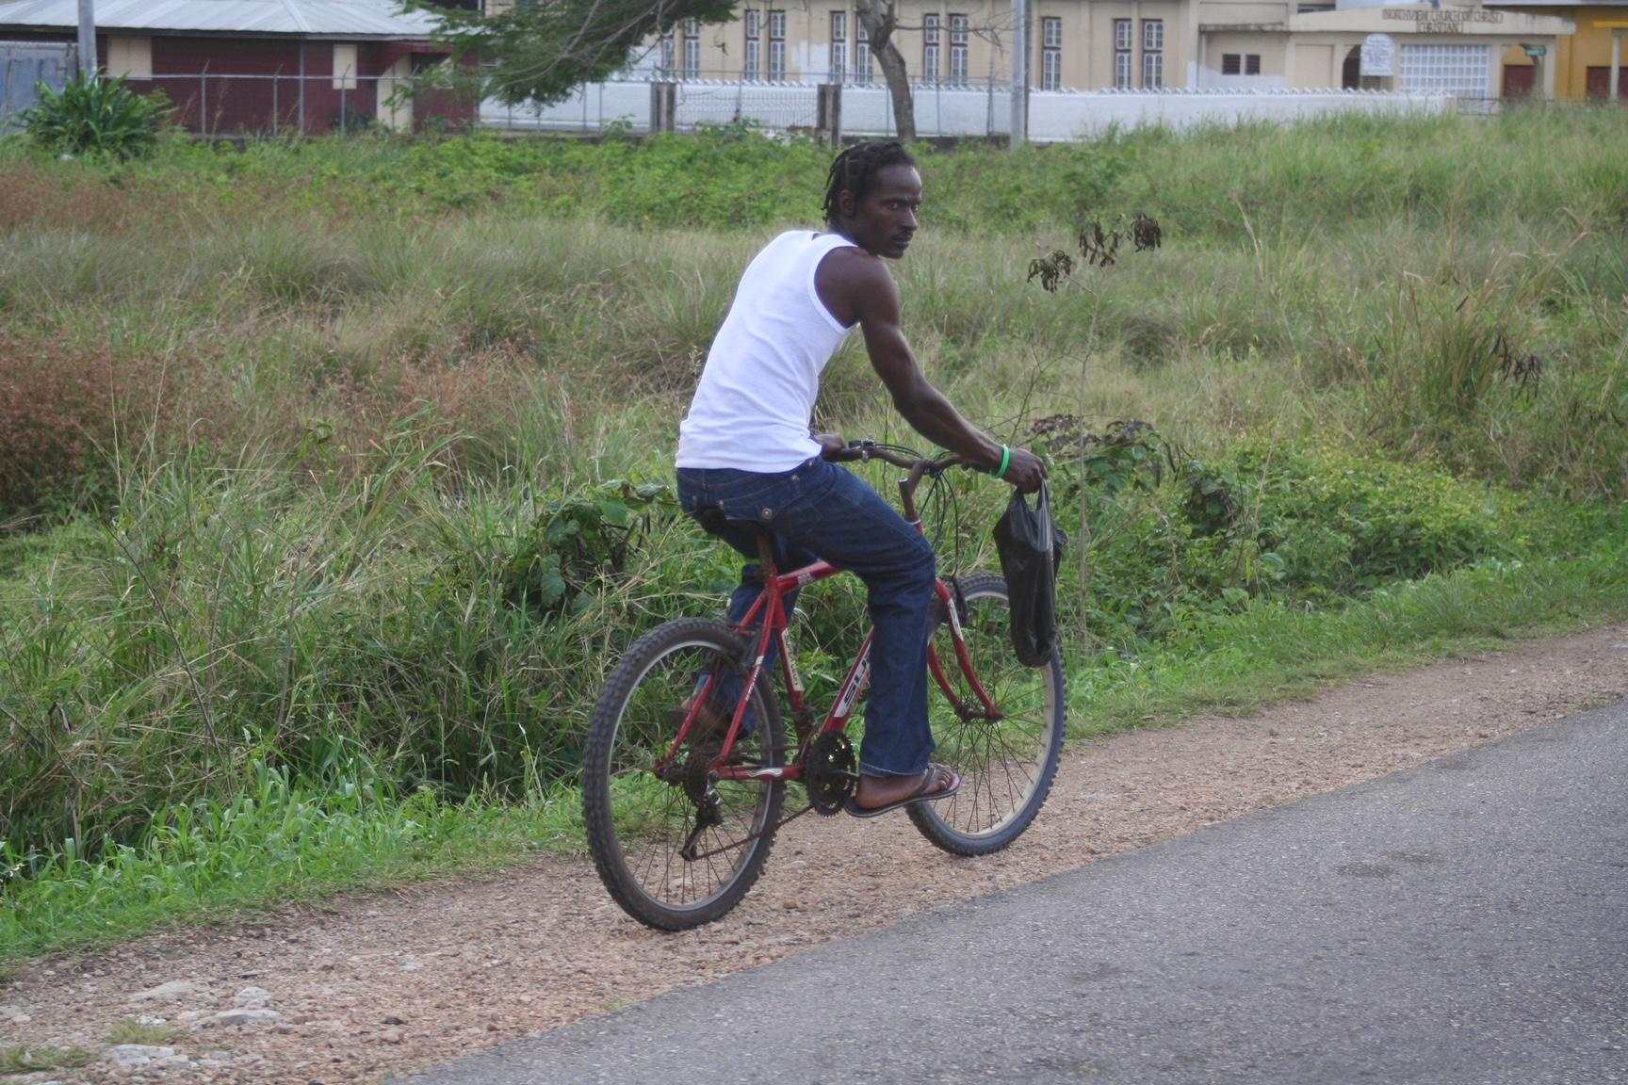
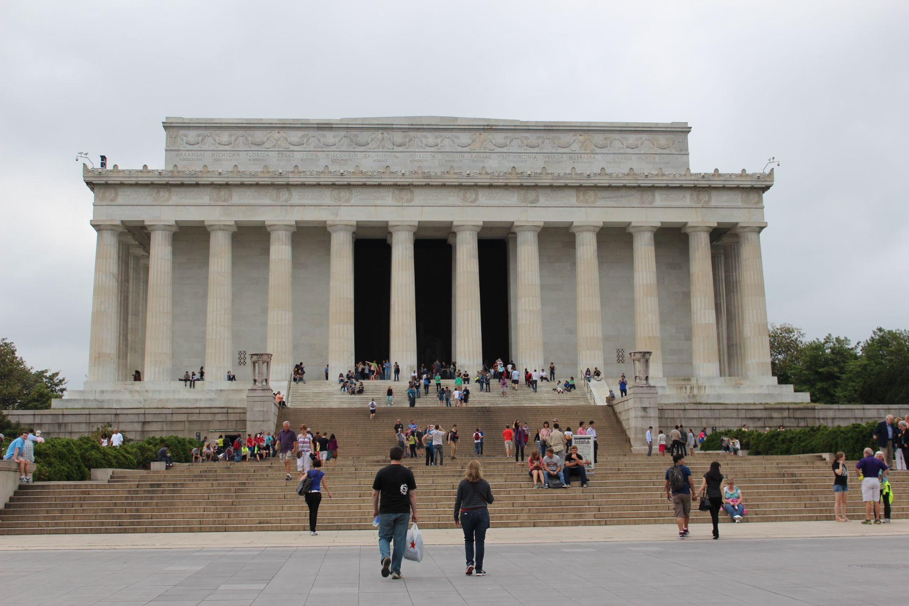
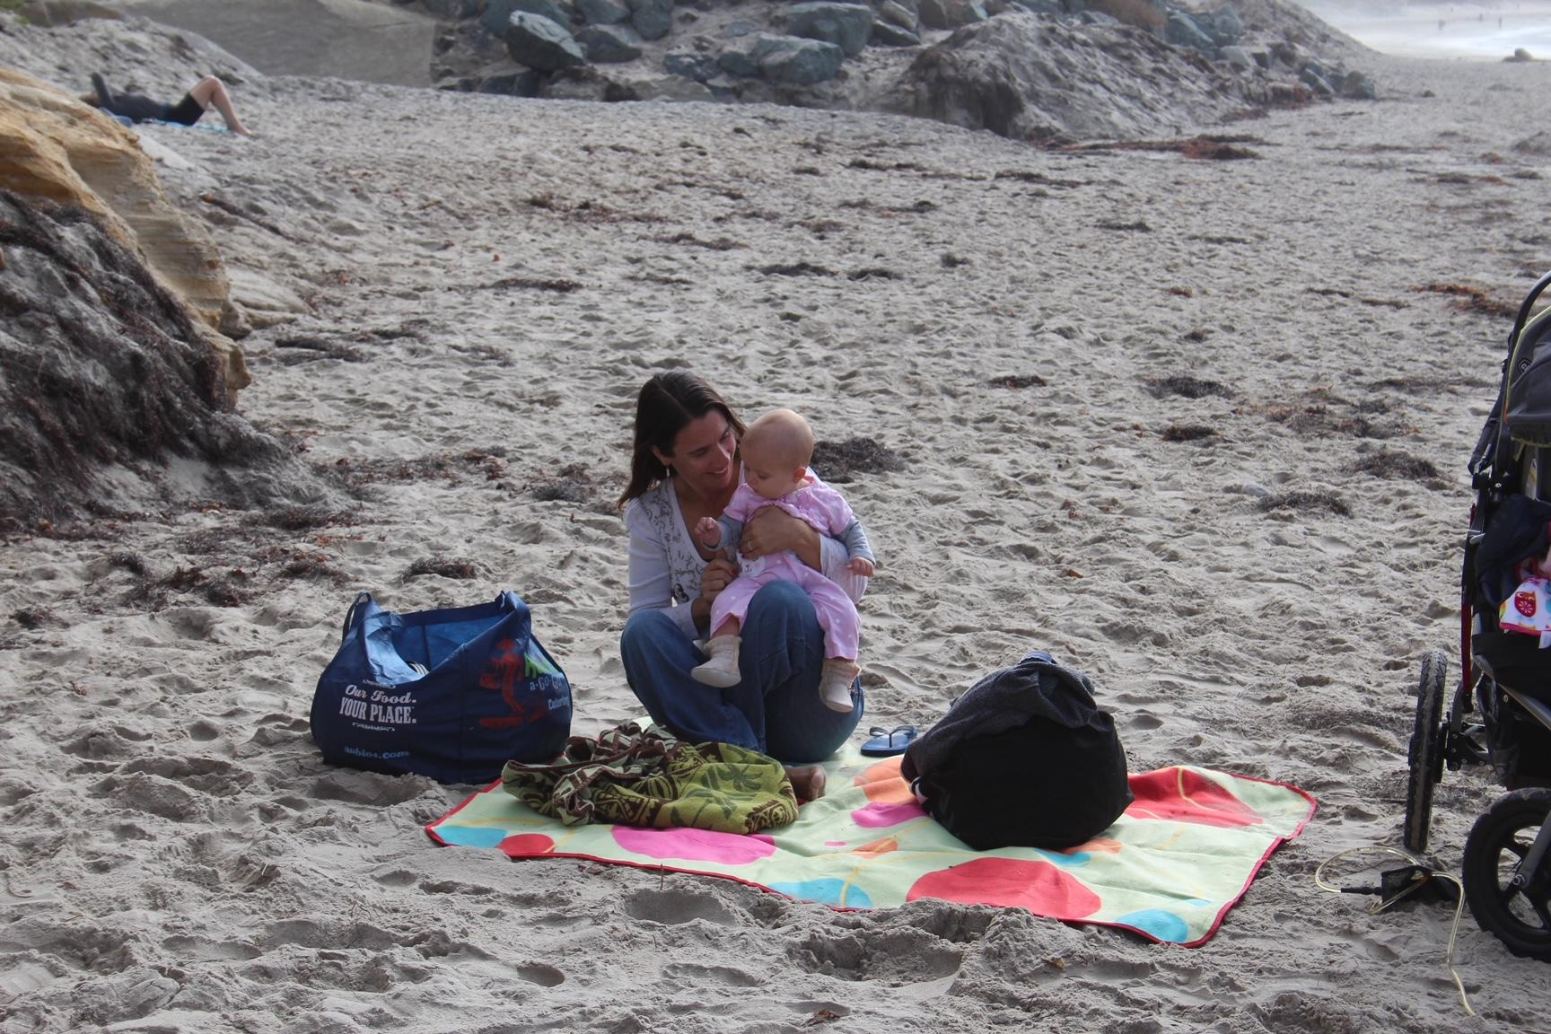
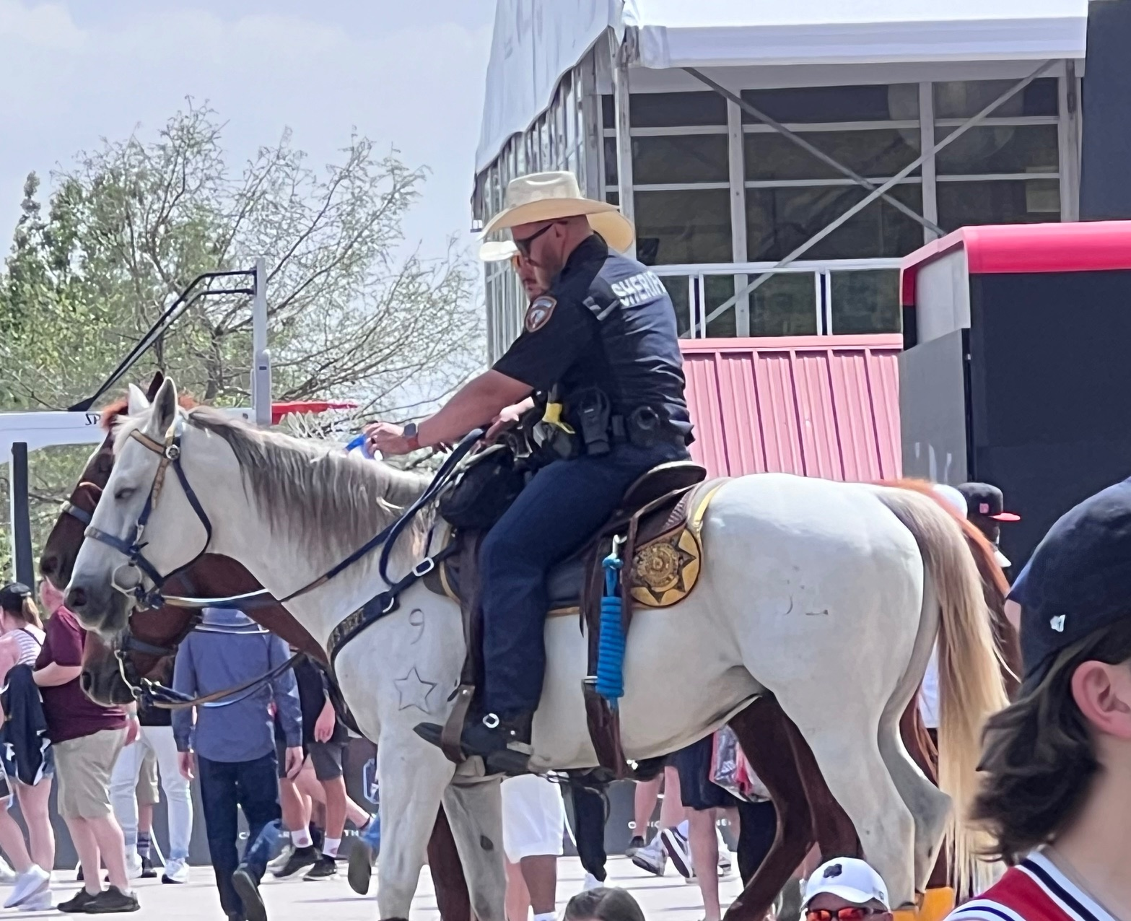
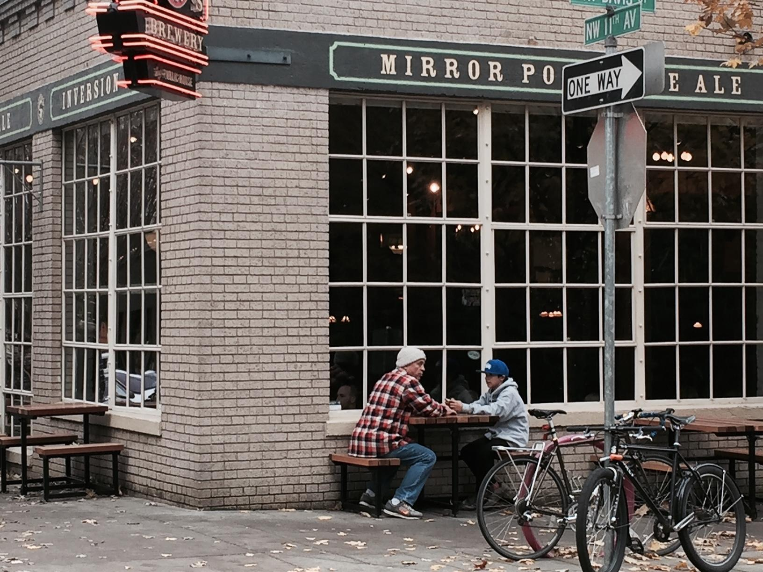
Candid Photography
As you look at these photos consider:
What do you notice?
What do you wonder?
How can you tell the photo is a candid shot?
image source: C. Cochrane
image source: C. Cochrane
image source: C. Cochrane
20
Notes:
image source: C. Cochrane

Slide 21
Telling a Story Through Photography
If you like to be outdoors, nature or scenic photography maybe for you. If you like to fly drones, aerial photography might be calling your name. If helping others tell their story sounds exciting, you might enjoy being an event photographer, being there to capture the highlights at an important event such as a wedding, quinceanera, bar mitzvah, or family reunion.
The work of a photographer doesn’t always end after the photo is taken. Photos can be edited and enhanced. Image enhancers such as filters, using multiple exposures in one frame, modifying color and brightness, and even removing objects can all happen after an image is taken. Photographers may enhance their images by combining two or more photos to achieve creative effects, fix errors, or improve the quality of their images.
21

Slide 22
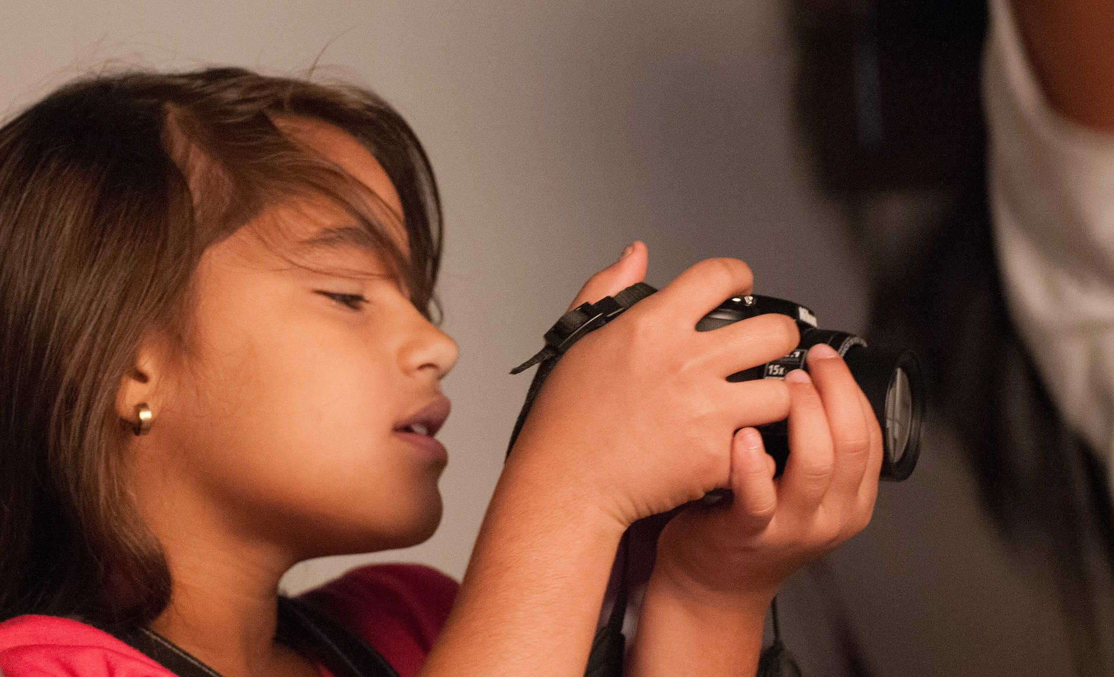
Telling a Story Through Photography
What type of photography interests you the most?
Think about:
What are some ideas you have for telling a story using pictures?
What kind of story do you want to tell?
Who or what do you want to be in your photograph?
How will you show the story - what props and clothing will you add to the photographs? Why are these props important?
(Image Source: pixabay.com)
22
Notes:
Have students use the storyboard planning page to plan and practice telling a story using pictures.

Slide 23
Planning Your Story
Use the storyboard planning page to sketch each image and list ideas for a photo story.
Think about the following questions:
Will you become a character in your photographs or will someone else be the focus of your pictures?
What story will the photos tell?
How can you show the story? What things can you wear or hold?
23

Slide 24
Planning Your Story
Share your storyboard with at least three other people and provide each other with feedback using the feedback prompts on the back of the storyboard.
Have each person respond to your storyboard by answering the following questions:
  What do my images make you wonder and feel?
  Do the images I planned match the story I told? Why or why not?
  What is one suggestion you have for me?
After you share your work, reflect on your storyboard:
  What are some new ideas you have for telling your story?
  How did getting feedback from others help you?
24

Slide 25
Part 5: Creating Art to Tell a Story
It’s time to take pictures.
Remember to take multiple photographs for each of the images you’ve planned. Once you have taken your pictures, select your final images and finalize the story you are telling.
Create a final display to share in the class gallery.
25

Slide 26
Creating Art to Tell a Story
Create your artist’s statement.
Include details such as the following:
Name of Photographer
Type of photography: staged, candid, or enhanced
Description of subject
Story told in words
26

Slide 27
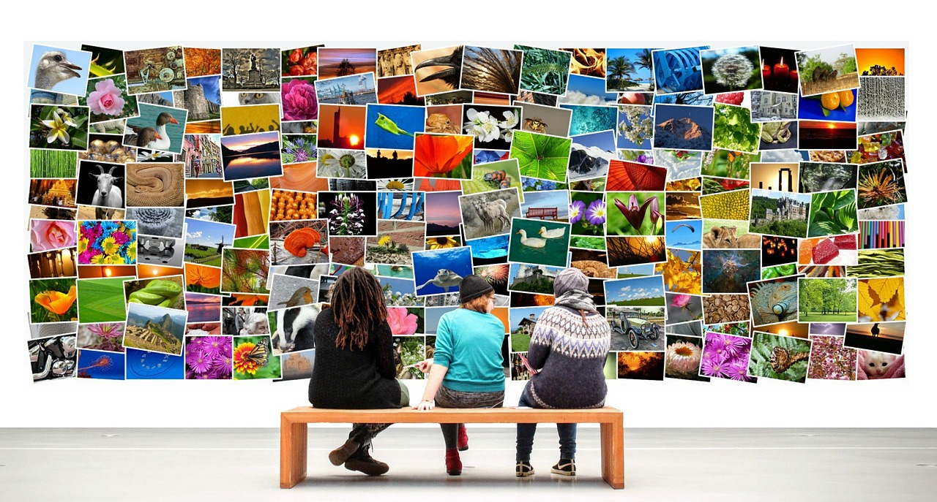
Class Art Gallery
The gallery is now open.
Visit projects and ask each other questions.
27

Slide 28
Reflection
How is your work like Cara Romero’s? How is it different?
Did you use props and/or clothing to help tell your story? If so, what did you use and why?
Did you include any traditional and/or modern elements in the photos? If so, what did you use and why?
What did you learn about yourself by telling the story in images? What parts of being a photographer did you like?
What did you learn about your classmates by experiencing their stories? Whose art captivated you?
28

Slide 29
Assessment: Interpreting Art
Complete the assessment independently.
Look at the seven images of skateboarders.
Think about the images from the photographer’s perspective. Which pictures do you think are staged, which ones seem to be candid shots, and which ones appear to be enhanced using technology after the photos were taken?
How can you tell? What makes you think they are staged, candid, and/or enhanced?
29

Slide 30
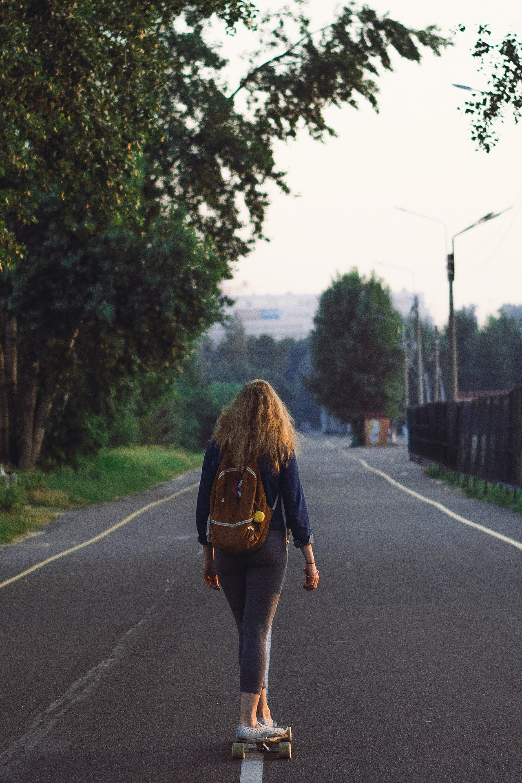
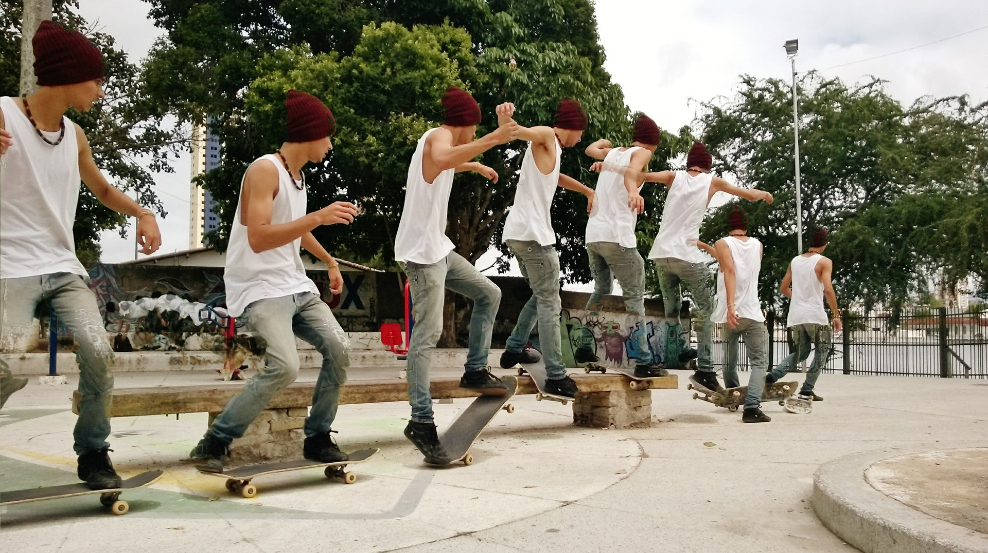
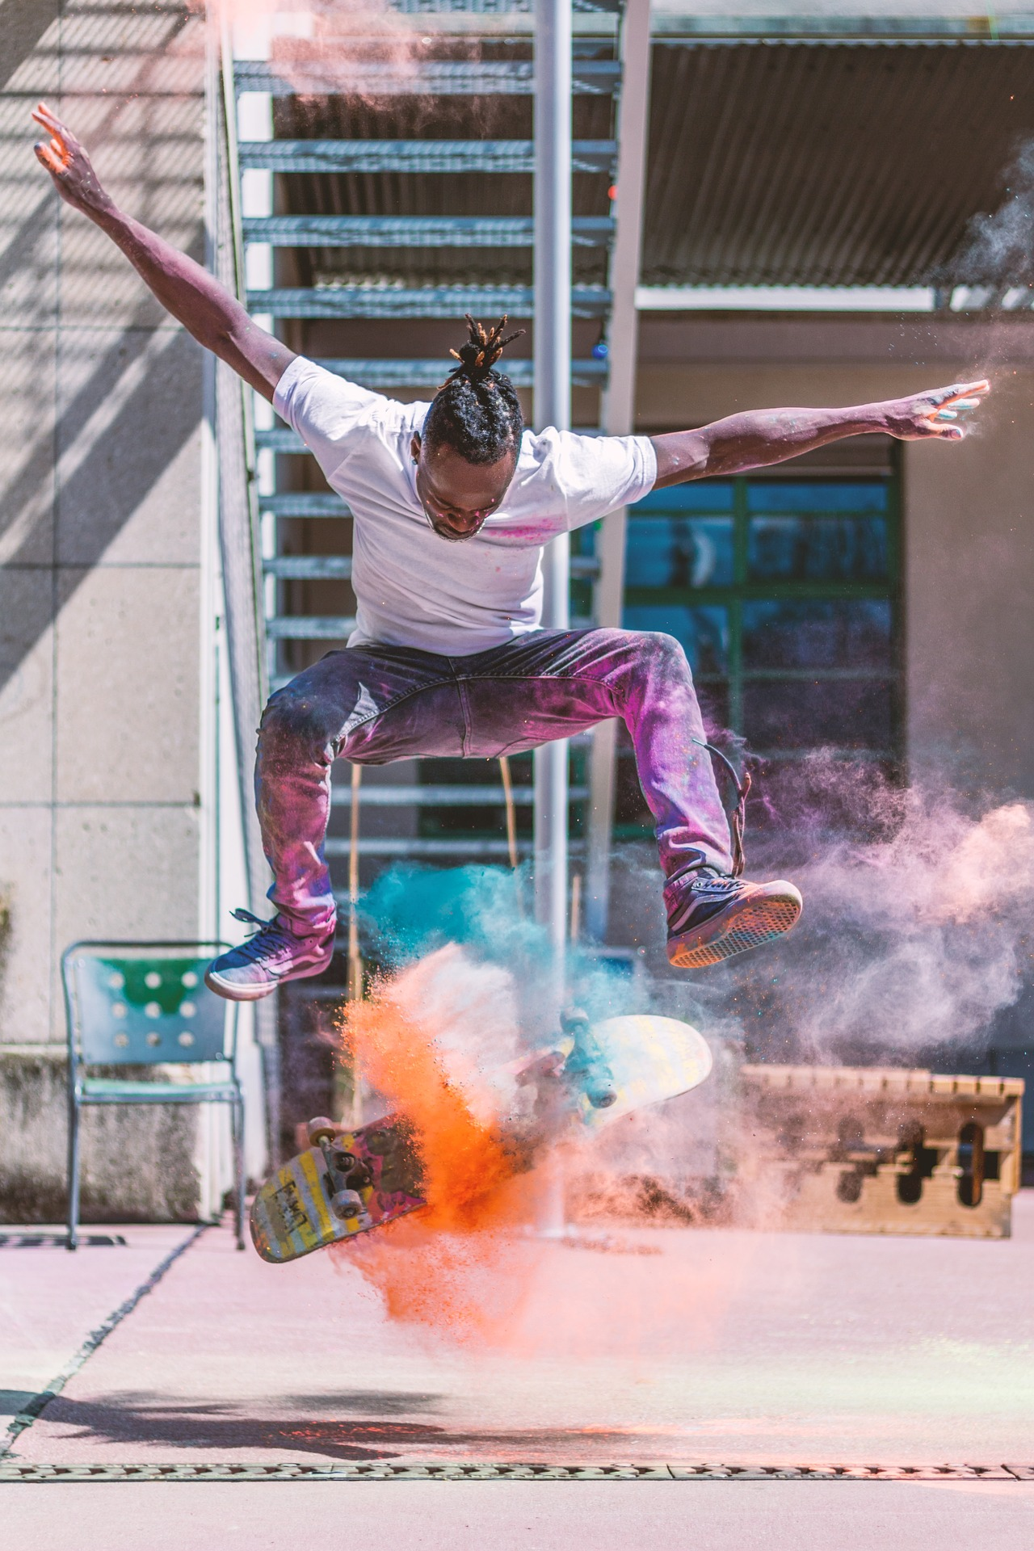
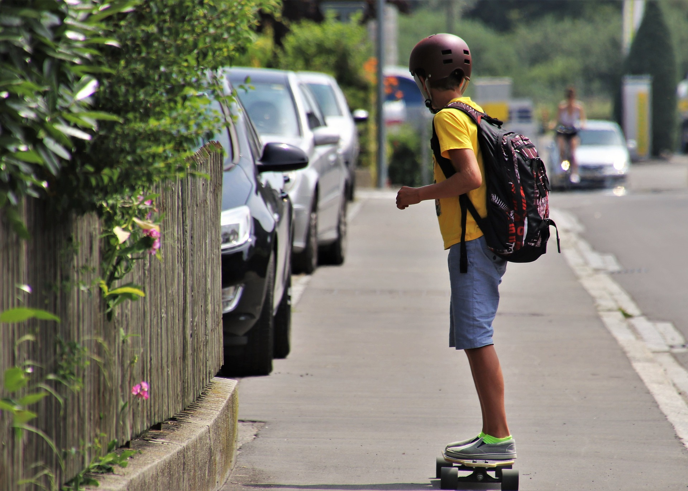
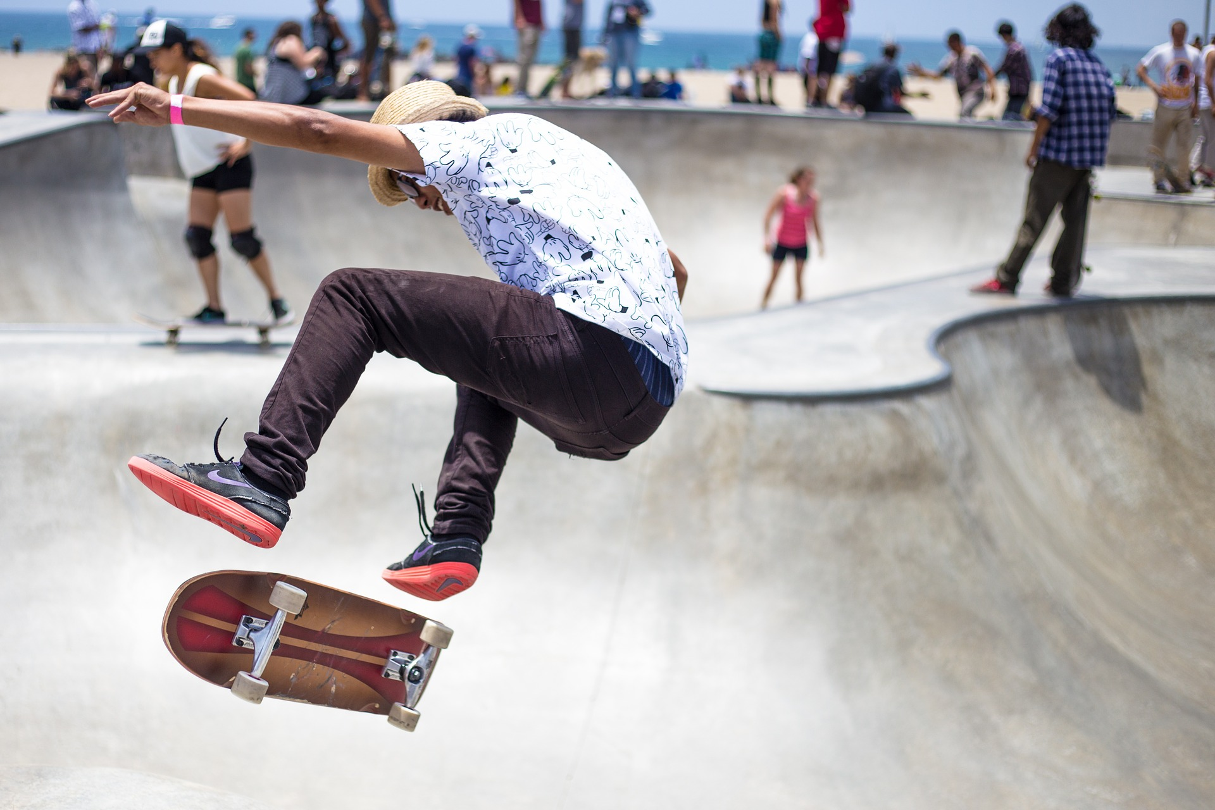
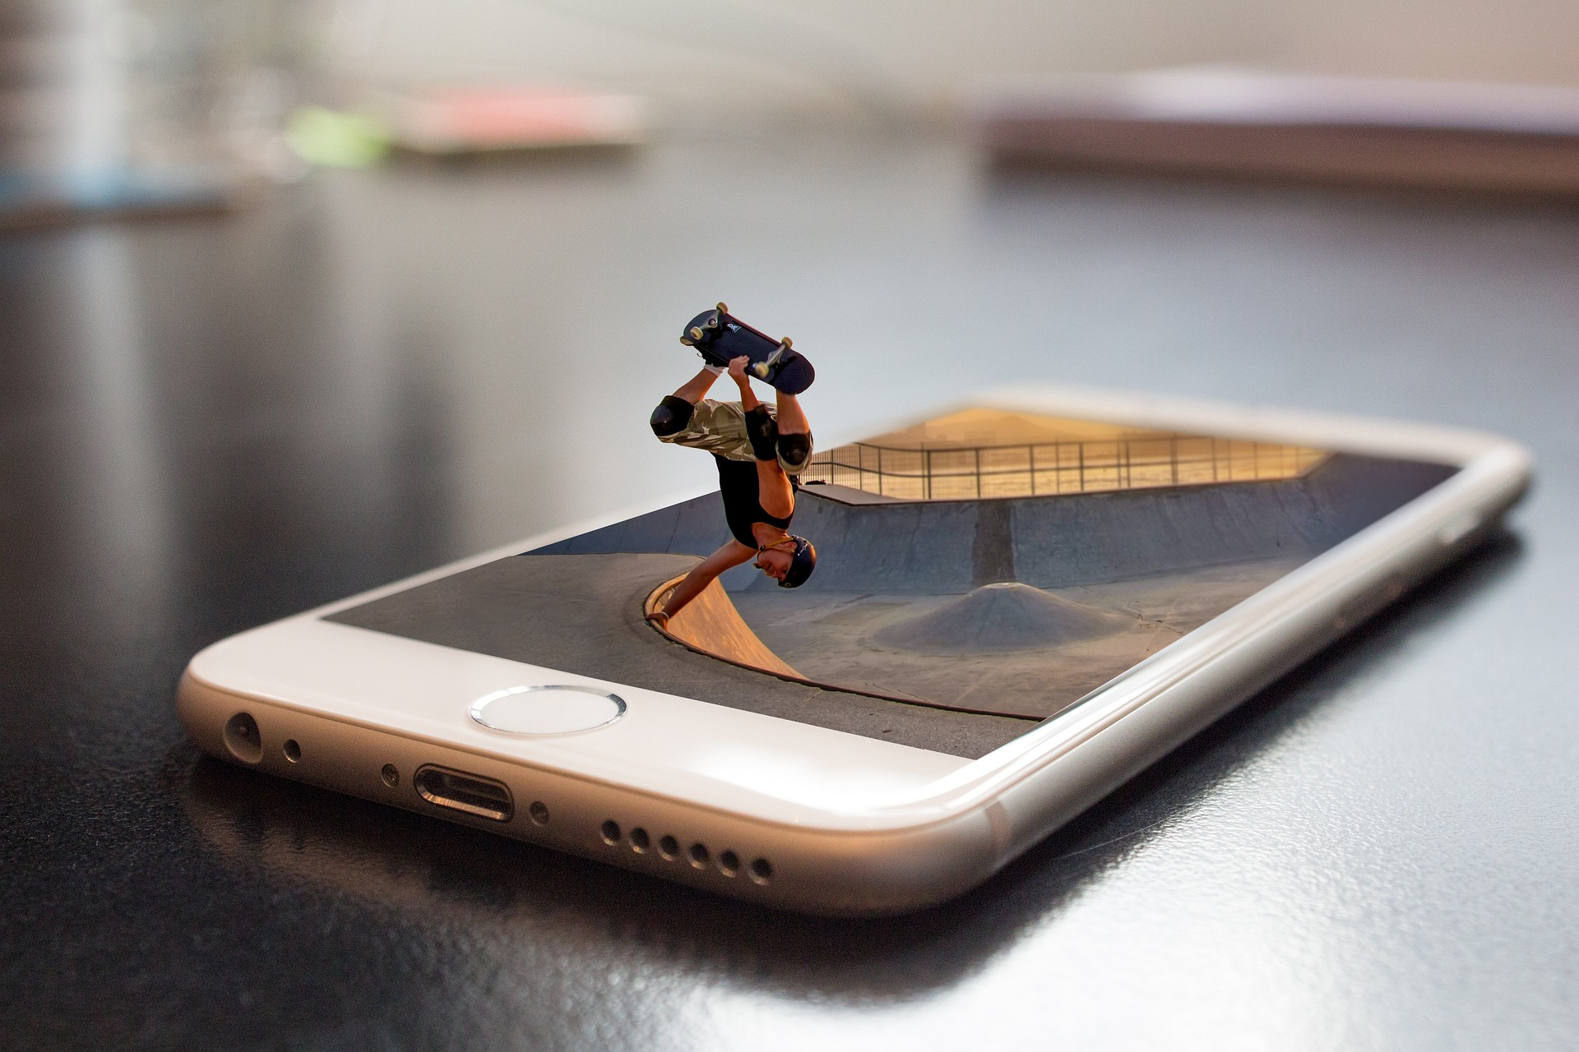
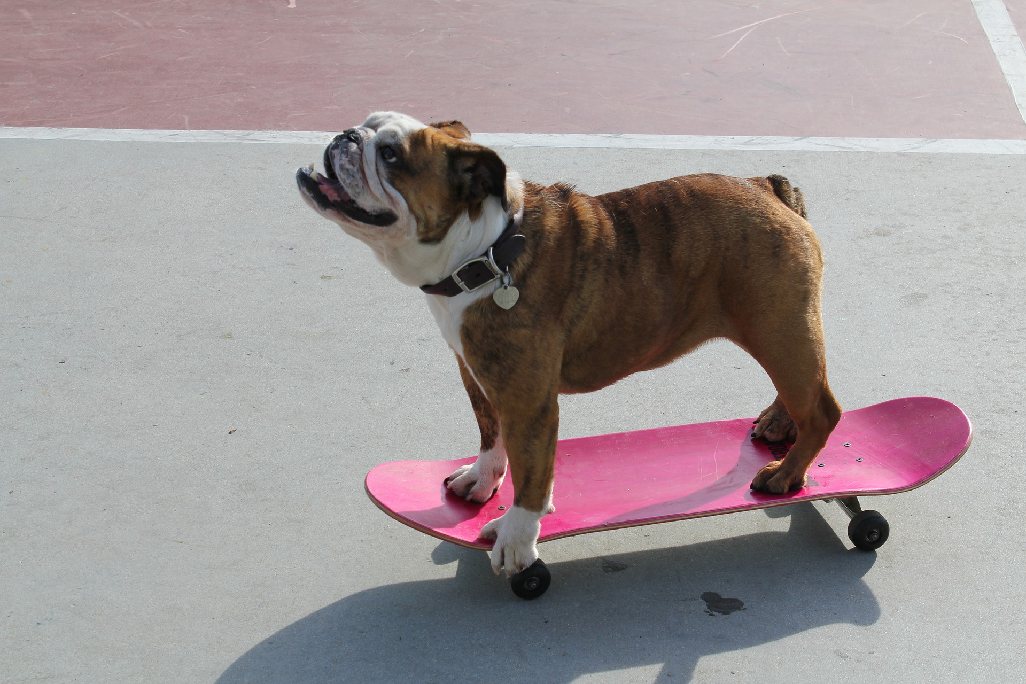
Assessment: Interpreting Art
30

Slide 31
Interpreting Art- Assessment
Whole class discussion.
Share your responses. Highlight the evidence you used to determine whether the image is staged, candid, or enhanced.
31

Slide 32
Learning Sequence #1: Reflection
Reflect on your thinking, learning, and work throughout this learning sequence.
What were you most proud of?
Where did you encounter struggles, and what did you do to deal with it?
What about your thinking, learning, or work brought you the most satisfaction? Why?
How were you curious throughout the learning sequence?
What new skills and/or information did you learn?
32

