Slide 1
4th Grade Arts & Science Integrated Unit
Learning Sequence #2
Focus on Visual Arts and Music

Slide 2
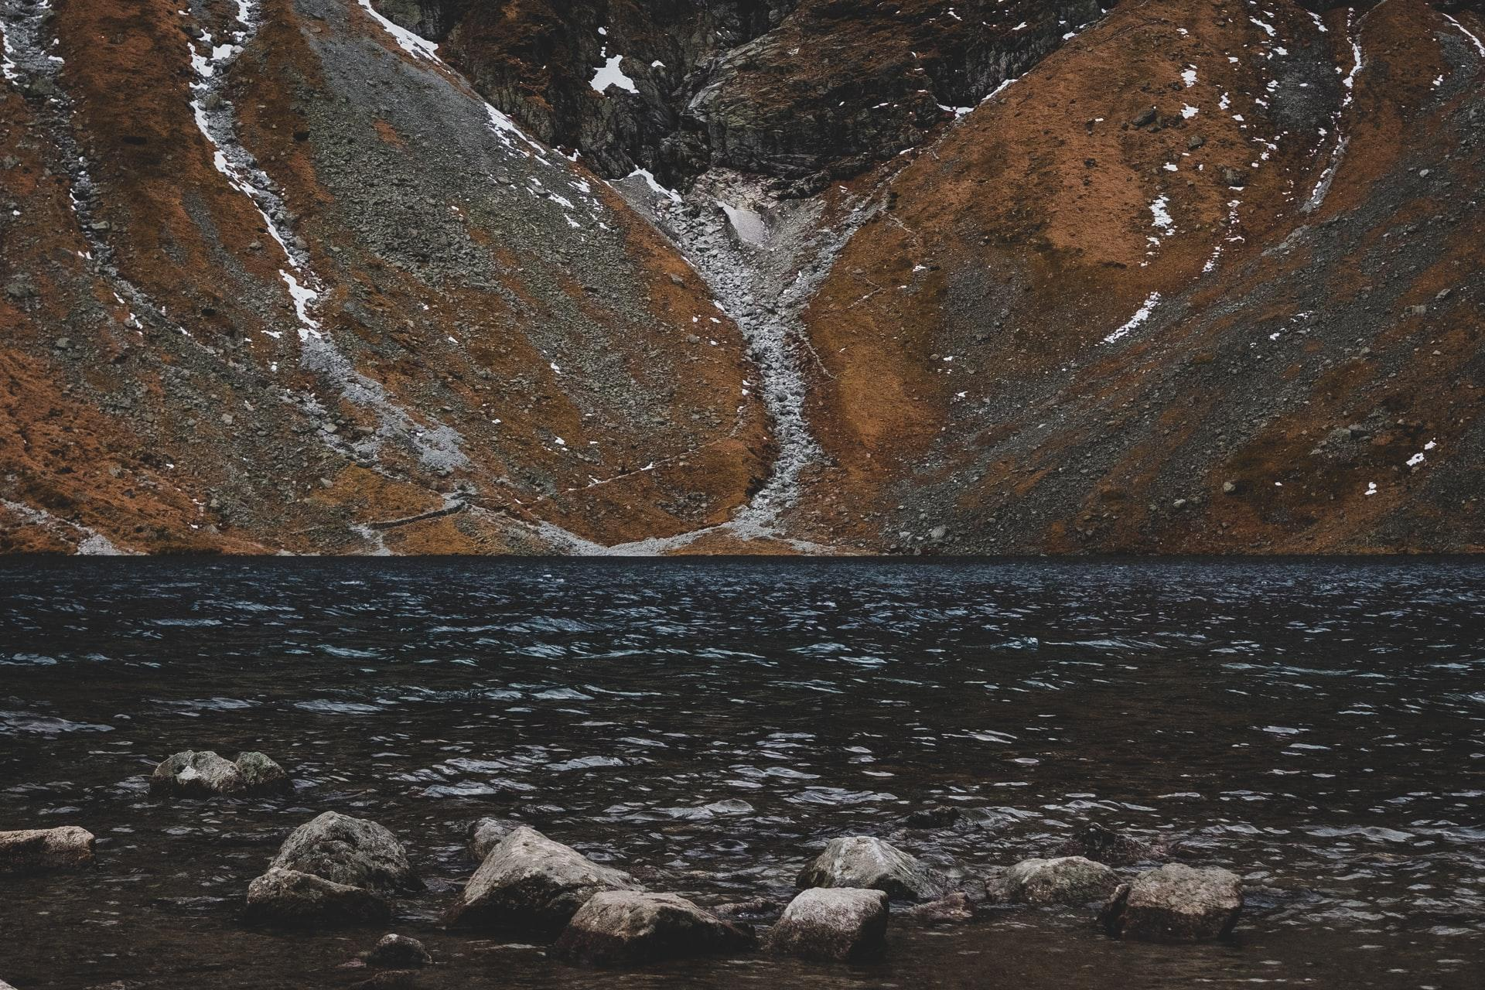
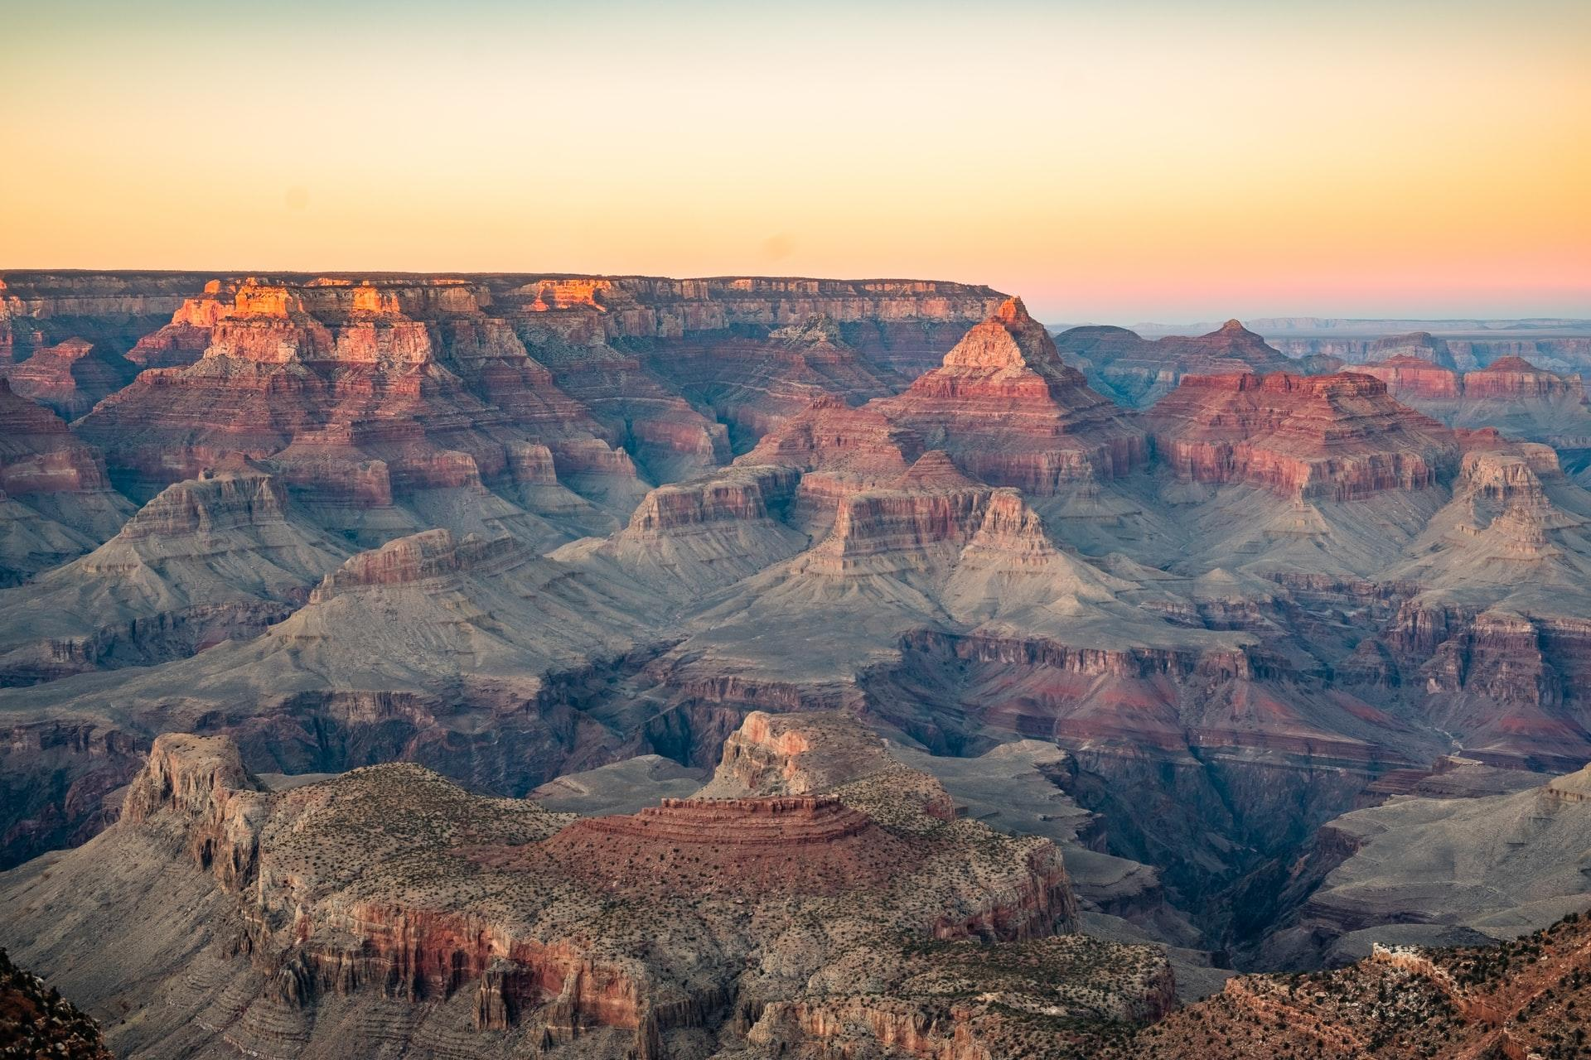
Observing Earth’s Surface
Look at the photographs below.
What do you notice? What do you wonder?
(Image source: Unsplash)
(Image source: Unsplash)

Slide 3
Observing Earth’s Surface
Movement happens all around. As we observe movement in nature we can look for evidence of change. Using photographs can help us notice changes over time. Share your initial thinking. How do you think the land formations in the images changed over time? What may have caused the changes?
(Image source: Unsplash)
(Image source: Unsplash)

Slide 4
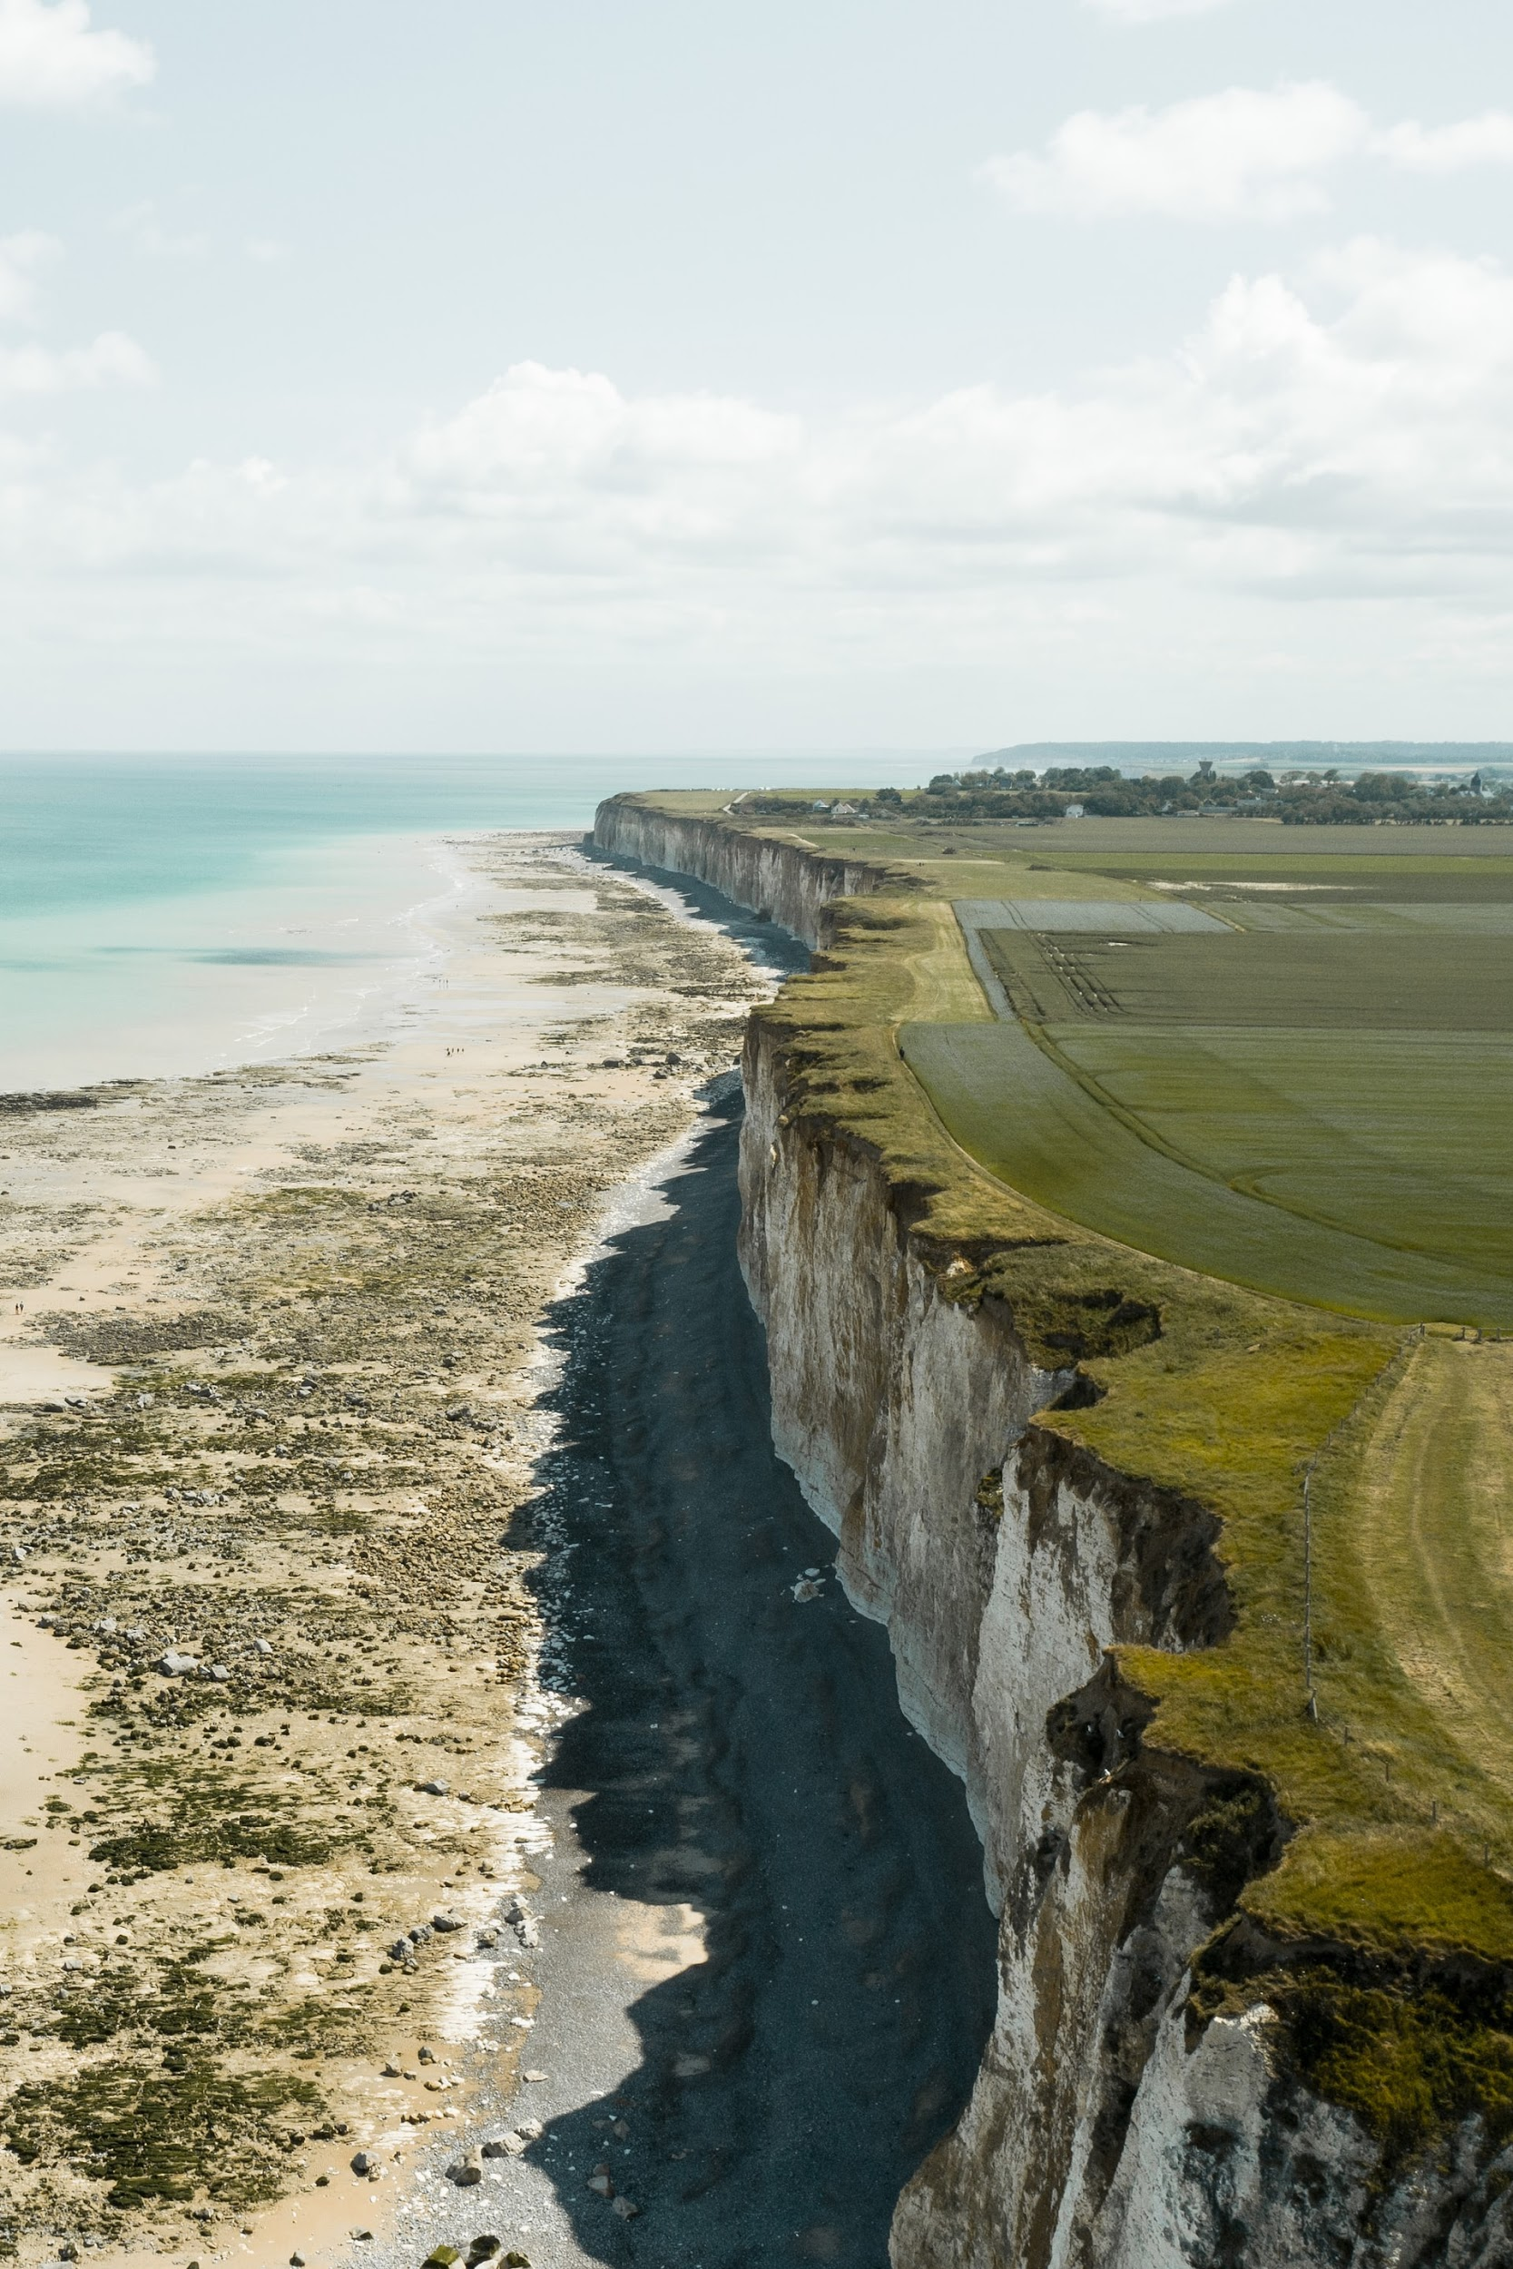
Observing Earth’s Surface
A landform is a feature on Earth's surface.
Erosion is caused when soil, rock, or other materials are removed from the earth’s surface and moved to another location.
Ask students:
What variables affect the erosion of earth materials?
(Image source: Unsplash)

Slide 5
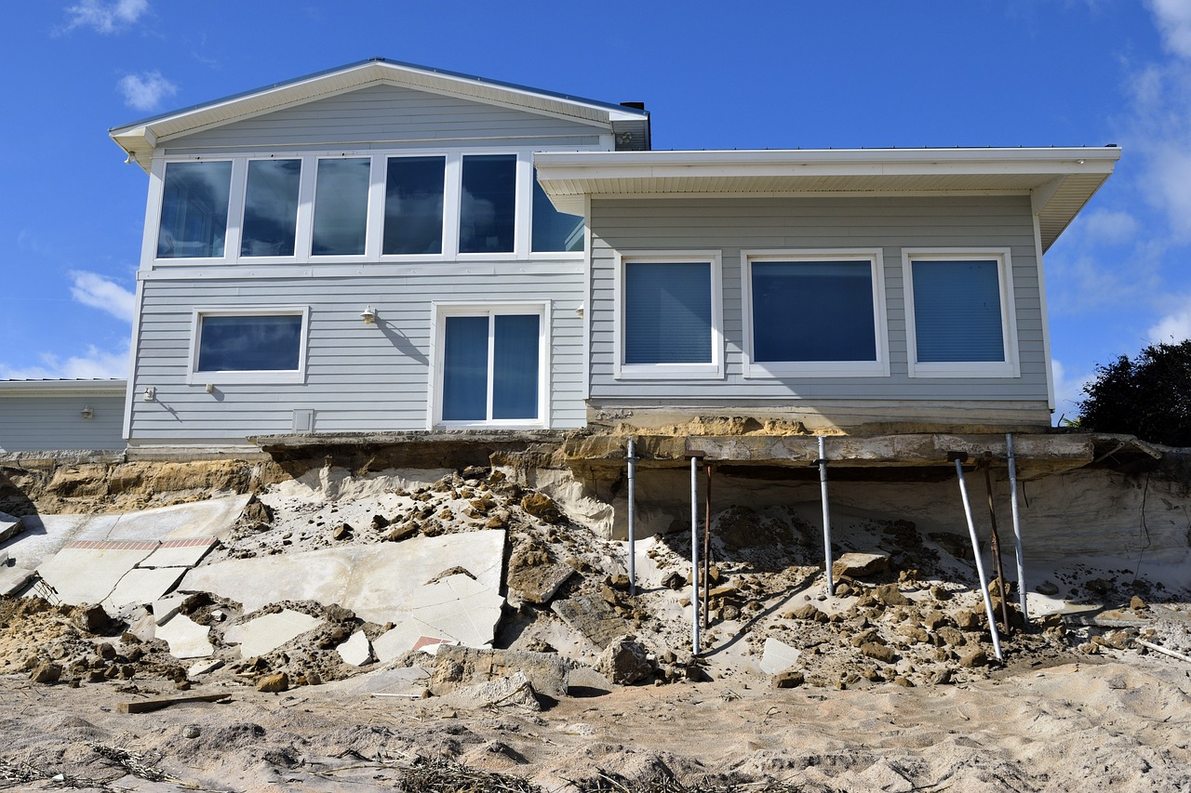
Investigating Erosion
Our goal is to learn how erosion affects the earth. Let’s investigate erosion using a stream table.
Materials we will need include:
Rectangle pan or tub
Cup
Scissors
Water
Earth materials; Sand, potting soil, small rocks
Small plastic or wooden objects (to represent natural and human-made structures, such as trees or houses)
(Image Source: pixabay.com)

Slide 6
Designing the Investigation
As a group, discuss your earthscape plan.
Which earth materials will you include in your stream table design?
Which landforms will you include; cliff, mountain, canyon, valley, plateau, etc
Sketch your plan.
Select a changing variable:
  stream table elevation (slope)
  quantity of water dispensed in stream table
Get your plan approved.
Gather materials and build your earthscape.

Slide 7
Conducting the Investigation
As you conduct the investigation, record your thinking in your science notebook:
What did you notice about the movement of the water?
What did you notice about the movement of the earth materials?
How can you show the movement of water in your notebook? How can you show the movement of the earth materials?
What connections are you making to erosion in our world?
What are you wondering?

Slide 8
Sharing Results
After conducting the investigation, share your results with another group with the same changing variable.
Discuss your results and share your conclusions.
What effect did the water amount have on erosion? Why?
What effect did the steeper slope have on erosion? Why?
Discuss any unexpected results your group encountered.

Slide 9
Connecting to the Natural World
Let’s connect our stream table experiences to water moving earth materials in the natural world.
What different surfaces in our schoolyard or in nature could we pour water on and observe how water moves the earth materials?
How else might earth material move?
How do you think these observations will compare with our observations of the stream table?

Slide 10
Connecting to the Natural World
Let’s go outside and try some of our ideas.
Make observations of the water and the earth materials. How do your observations compare to the results of the classroom experiments?
What connections can be made between how the water and the earth materials interact in the spots we investigated and the impact of the water in our stream table experiments?

Slide 11
Exploration
How might you revise your experiment to test some of your new ideas about erosion?
Discuss as a group and then test out one of your ideas.

Slide 12
Water in the Natural World
What do we already know about water in the natural world?
What types of water can we name?

Slide 13
Rivers
What do you already know about rivers?
Do we have any rivers in our community?
How do you think rivers are formed?
How do they differ from other bodies of water, like a lake or ocean?
How do they change over time or with the season?
How rivers affect the land? What changes might they cause?

Slide 14
Rivers
Let’s watch Rivers from DragonFlyTV to learn more about how the movement of rivers changes the land.
As you watch the video, think about these questions and write down new ideas you have for each question:
How does the movement of water affect the land?
Why is it helpful to control a river?

Slide 15
Part 2: Extending Our Science Learning Through Photography
In earlier lessons, we looked at how photography is used to capture images of nature, individual people, and events and moments in time as they happen. We curated photos to tell a story and investigated how erosion can change earth’s surface.
In this lesson, we will look at how photography can be used to help us learn new things about earth.

Slide 16
Extending Our Science Learning Through Photography
Art and science have a lot in common. Artists and scientists make close observations to make sense of what they’re studying.
Artists use line to convey movement and mood.
Geologists are scientists who study the materials that make up Earth and the processes that formed them. Geologists look closely at lines, shapes, colors and textures to do their jobs. Scientists see these features not just from the ground, but also in images taken from space – a process called remote sensing. Remote sensing images are taken with special instruments and cameras from high above Earth. They reveal information we may not be able to see from our perspective on the ground.

Slide 17
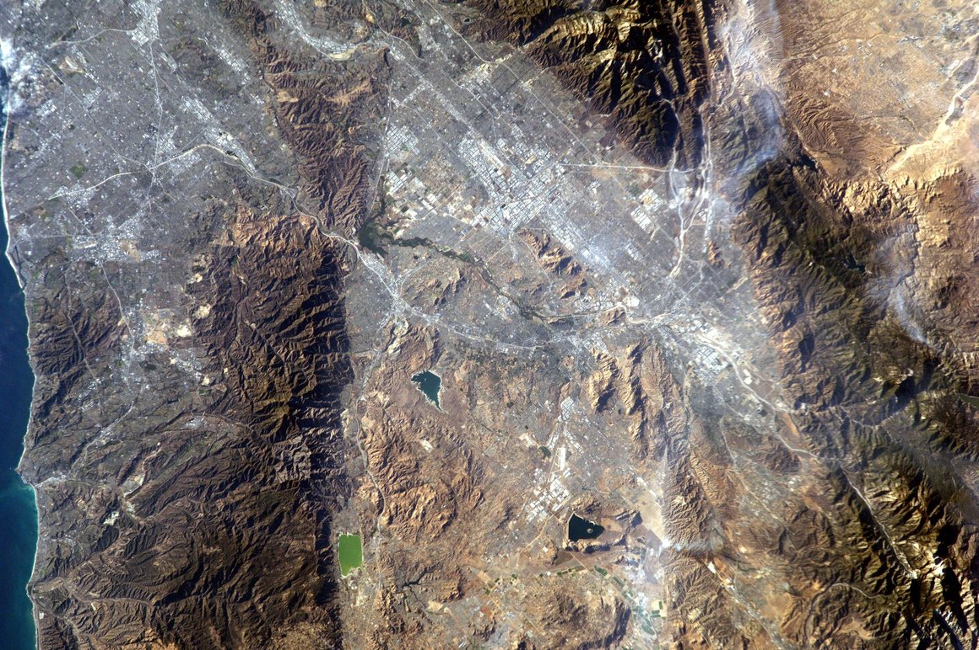
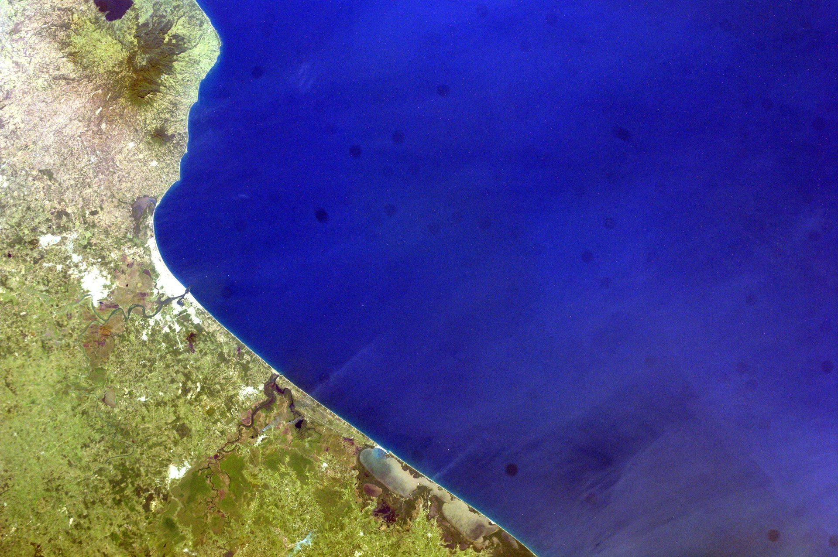
Extending Our Science Learning Through Photography
Let’s explore how scientists use line and other shapes, colors and textures in photograph taken from space to identify land features on earth.
What types of lines and shapes do you see?
What type of movement or motion do the lines and shapes convey?
What feelings do the lines and shapes evoke?
(Image Source: NASA, EarthKAM)
(Image Source: NASA, EarthKAM)

Slide 18
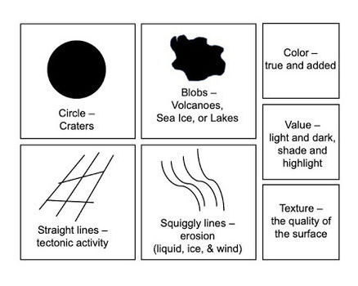
Connecting Art and Science
Look at each image again.
Use the Elements of Art and Their Geology Matches handout to identify signs of erosion and other land features based on the lines, shapes, colors, and textures you notice.

Slide 19
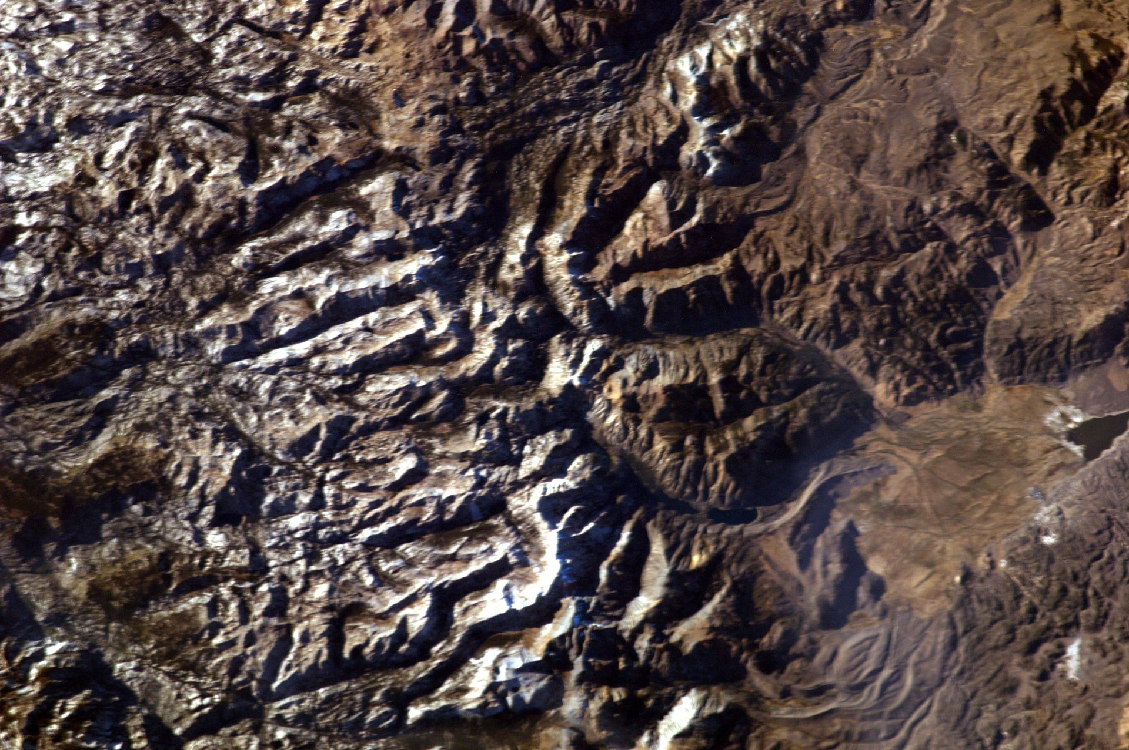
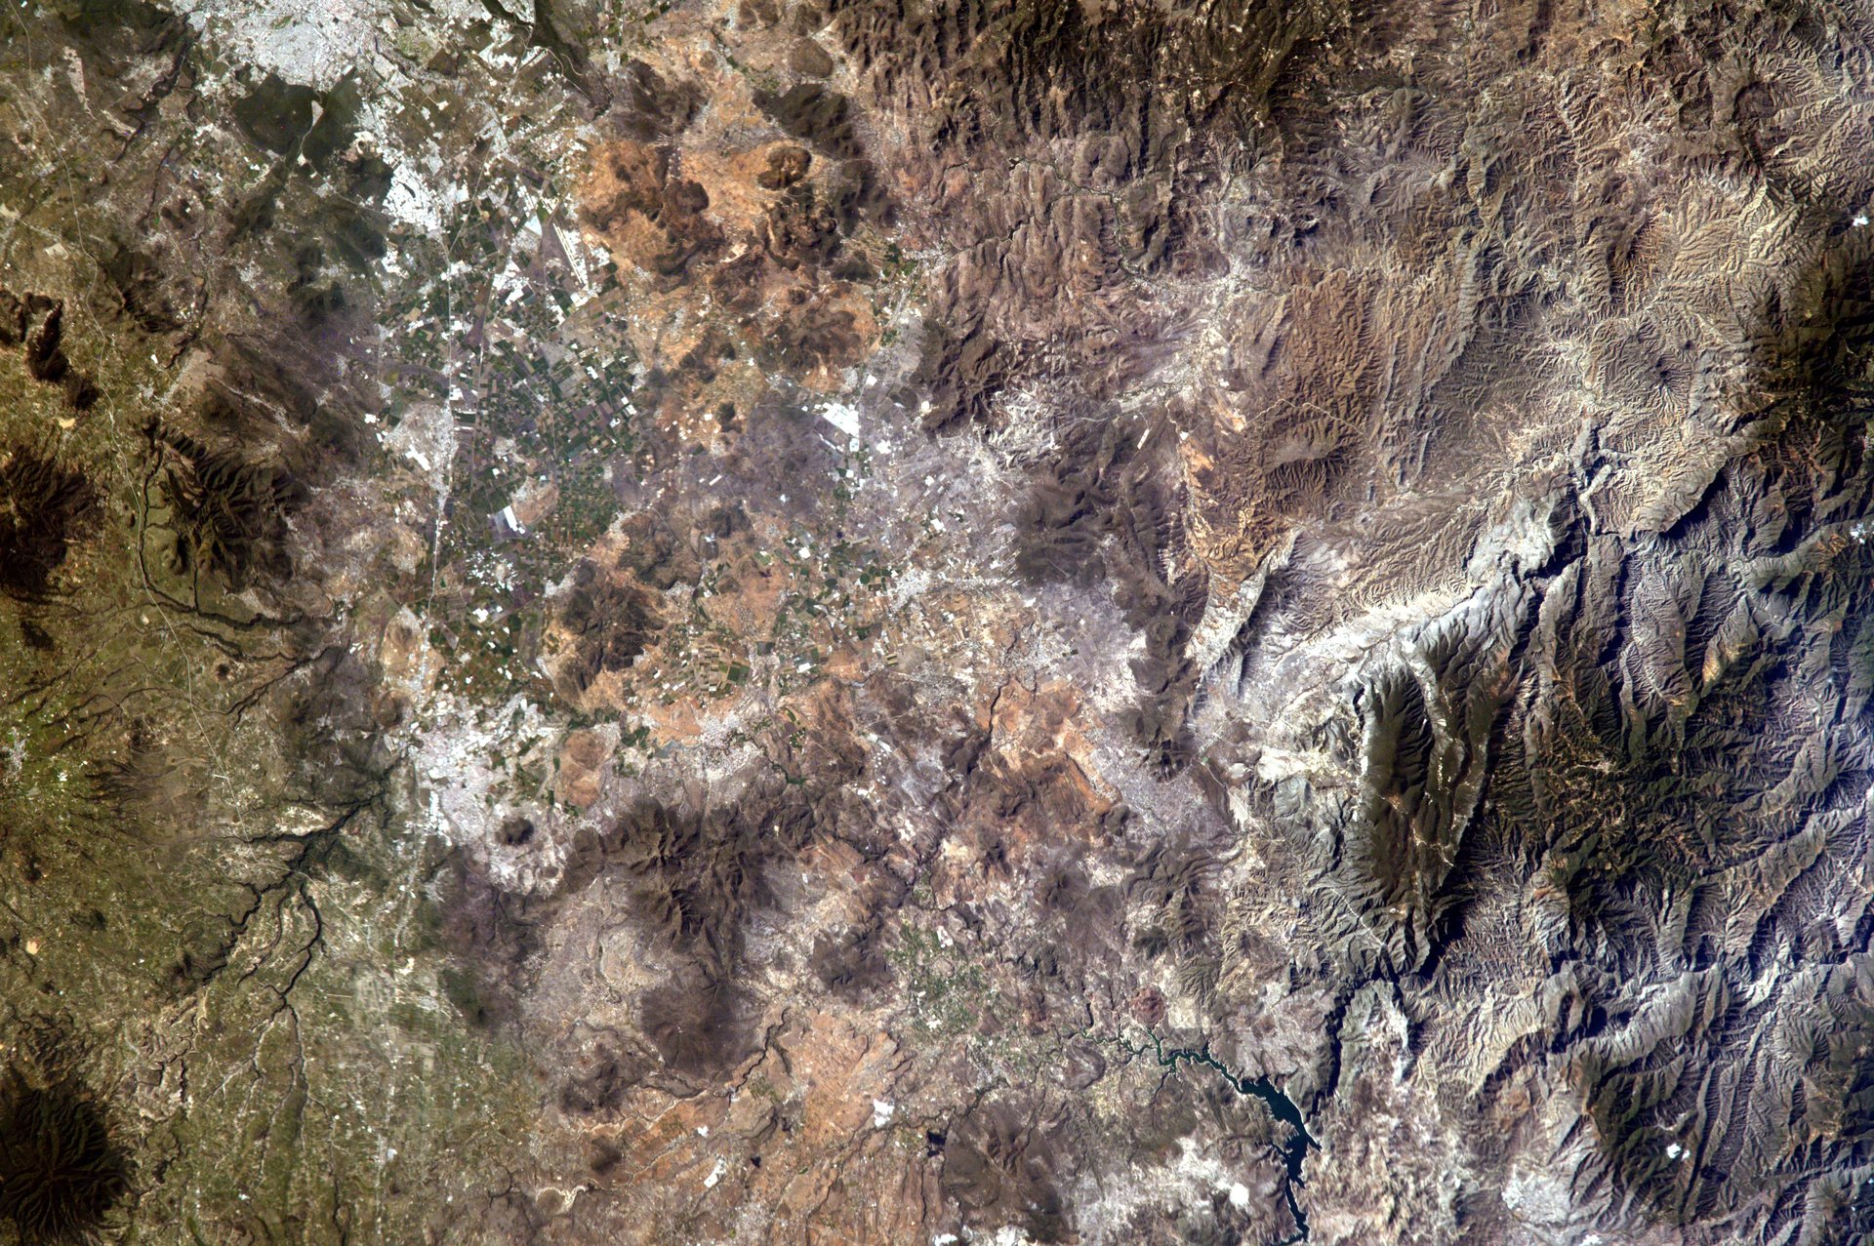
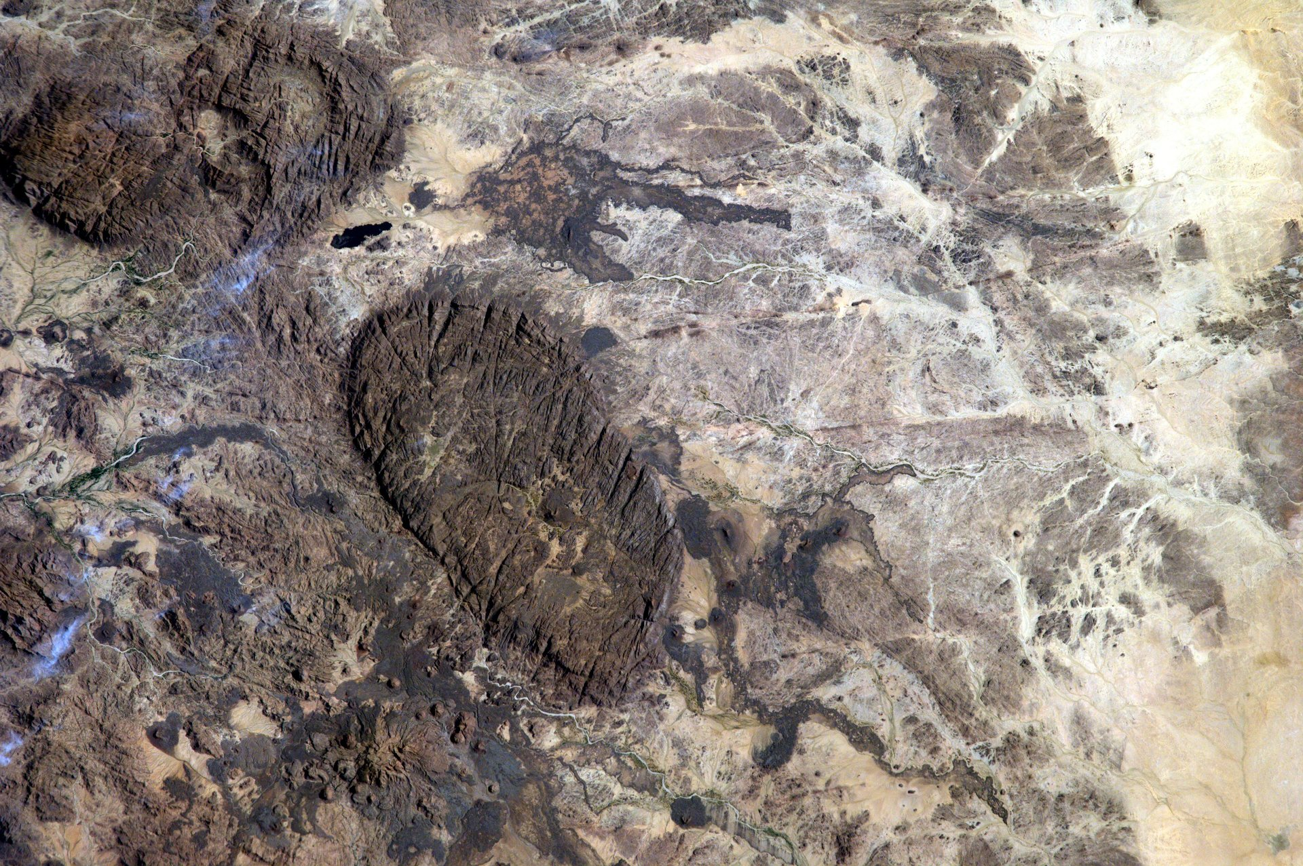
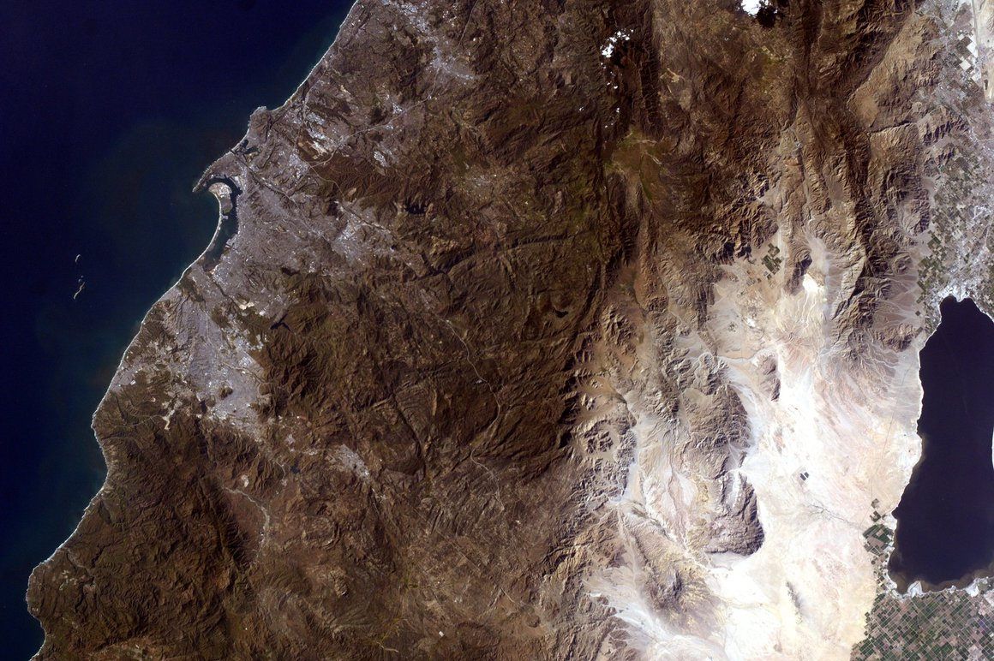
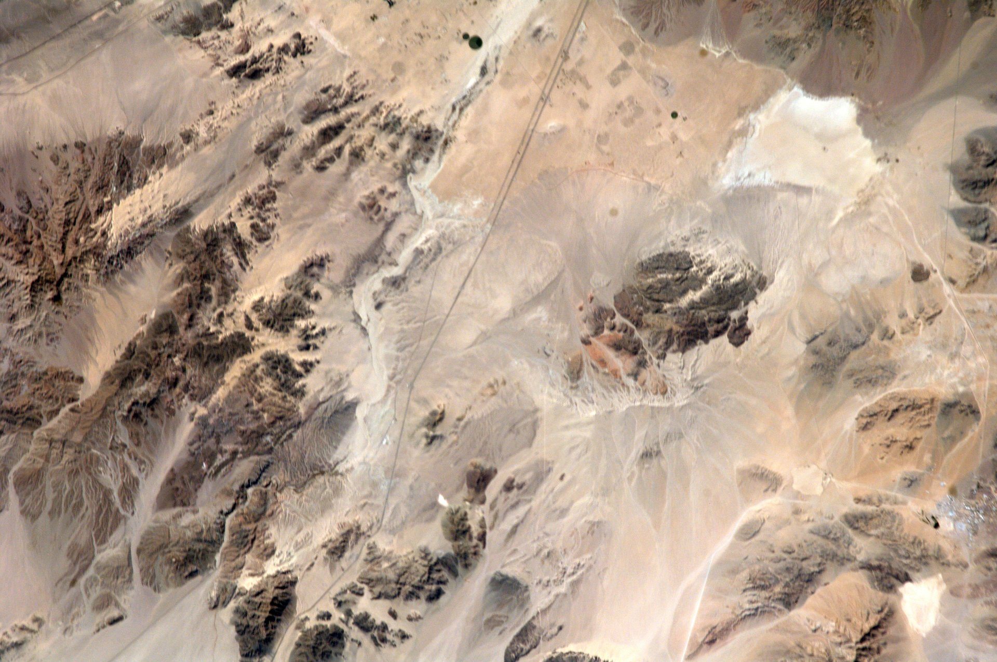
Connecting Art and Science
Select an image and make close observations using the Elements of Art and Their Geology Matches handout.

Slide 20
Connecting Art and Science
Work in a triad. Use these sentence frames as needed to discuss your observations.
We noticed _____________ so we think maybe it’s a _____________ .
This element (circle, blob, straight line, squiggle line) made us think this is a ________________ .
We noticed _________________, so we think it may be ______________ .

Slide 21
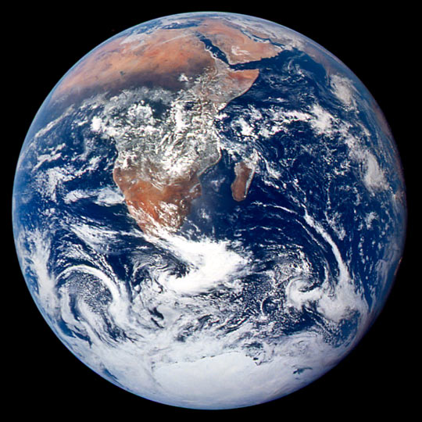
Photographing Earth from Space
This unique perspective of how earth changes over time comes from astronauts on the International Space Station and from satellites high in Earth’s atmosphere.
Pictures from space help us see how natural processes and human activity impact and change Earth over time.
(Image courtesy NASA Johnson Space Center Gateway to Astronaut Photography of Earth)

Slide 22

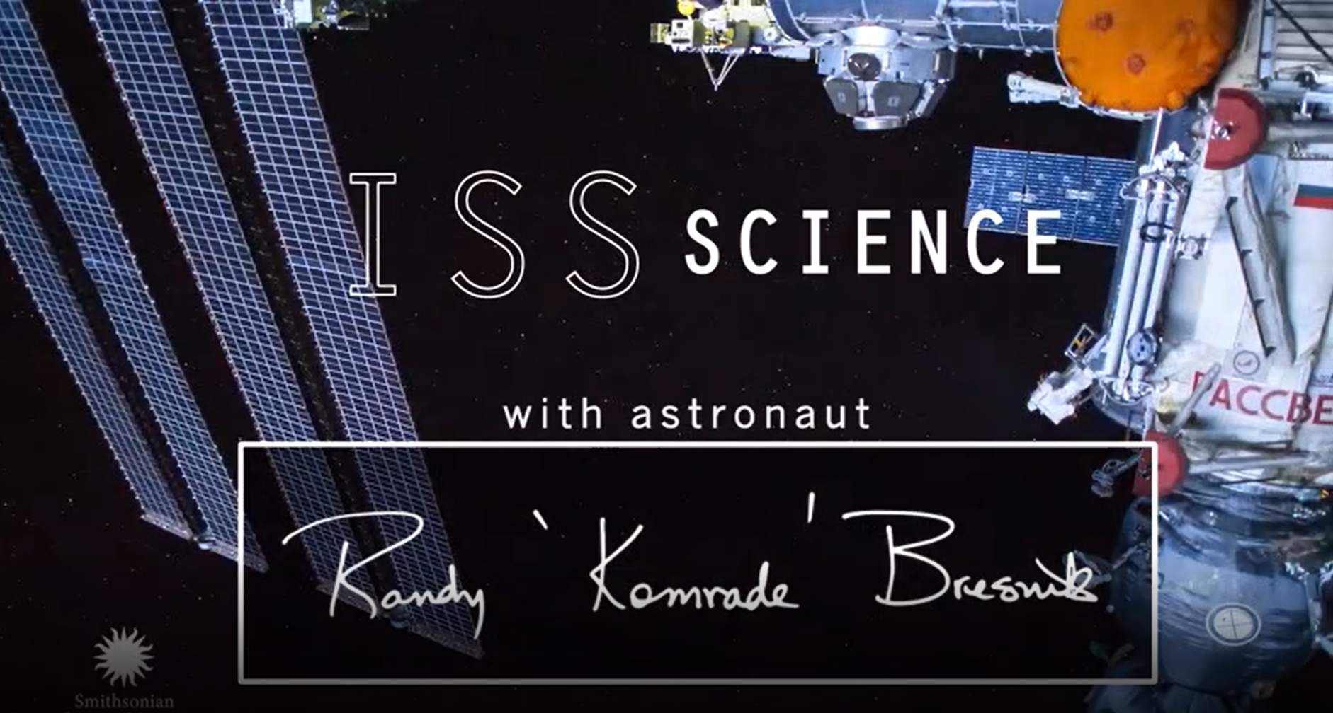
Astronaut Randy Bresnik
Watch the video of astronaut, Randy Bresnik, talking about his passion for photography and explaining how photography helps us learn about Earth from space.
As you watch, listen for Randy’s answers to these questions:
How did Randy’s passion for photography begin?
Why does Randy Bresnik feel it's important to take pictures in space?
Notes:
https://ca.pbslearningmedia.org/resource/role-of-photography-in-science-video/smithsonian-science-starters/

Slide 23
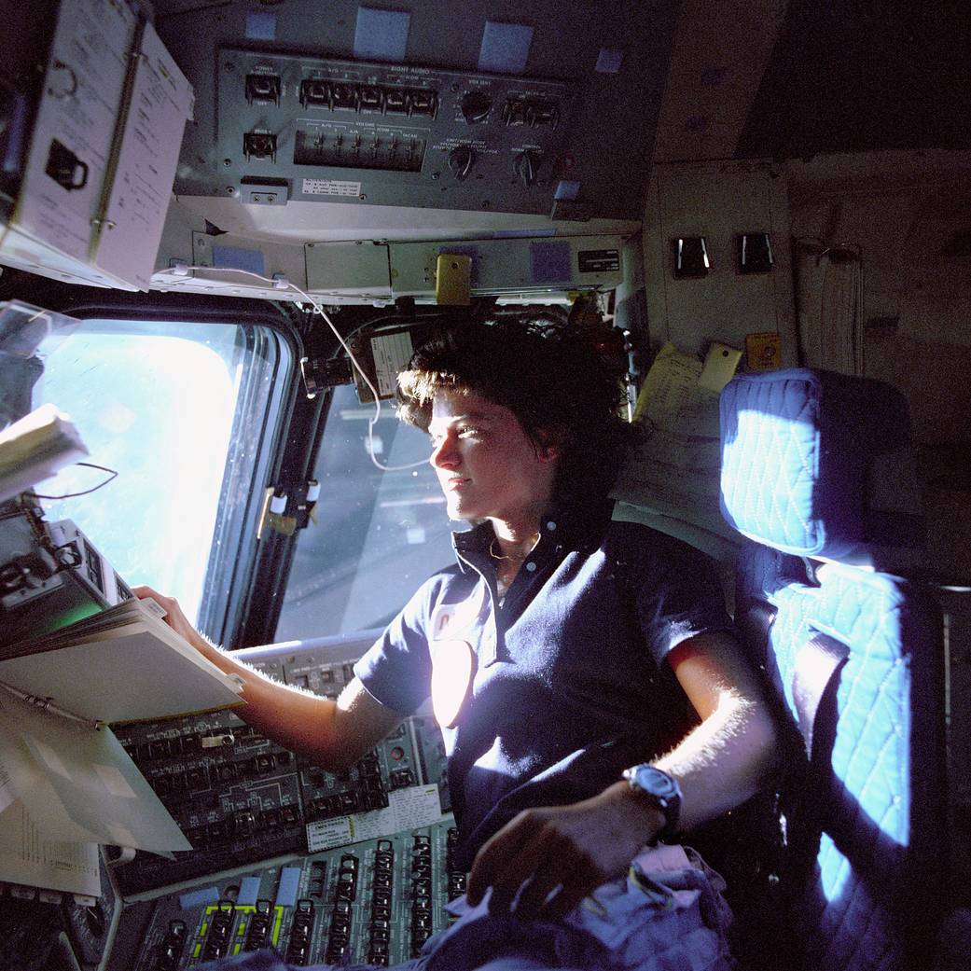
Getting to Know Sally Ride
Just like Randy Bresnik, astronaut Sally Ride loved the view of Earth from space and wanted to share it with others. Looking out the window of the space shuttle, Sally was amazed by the view of our beautiful planet. She wanted to share that view with young people all over the world. Sally had a thought! What if students could snap images of different places on Earth using a camera that NASA put in space?
(Image Credit: NASA)

Slide 24

Getting to Know Sally Ride
Sally talked with other people at NASA and started the KidSat (short for Kid Satellite) program in 1995. The KidSat camera flew on space shuttle flights before moving over to the International Space Station in 2001. NASA renamed the program Sally Ride EarthKAM in 2013. Sally Ride EarthKAM supports about four active missions a year and has an image gallery of over 20,000 pictures taken by students. The pictures we used earlier to identify land features were taken during EarthKAM missions by students just like you.

Slide 25
Getting to Know Sally Ride
Read the NASA biography Who Was Sally Ride?
What were some of the things Sally liked to do for fun?
What did Sally do after she worked at NASA?
How do you think Sally felt being the first woman to fly in space?

Slide 26
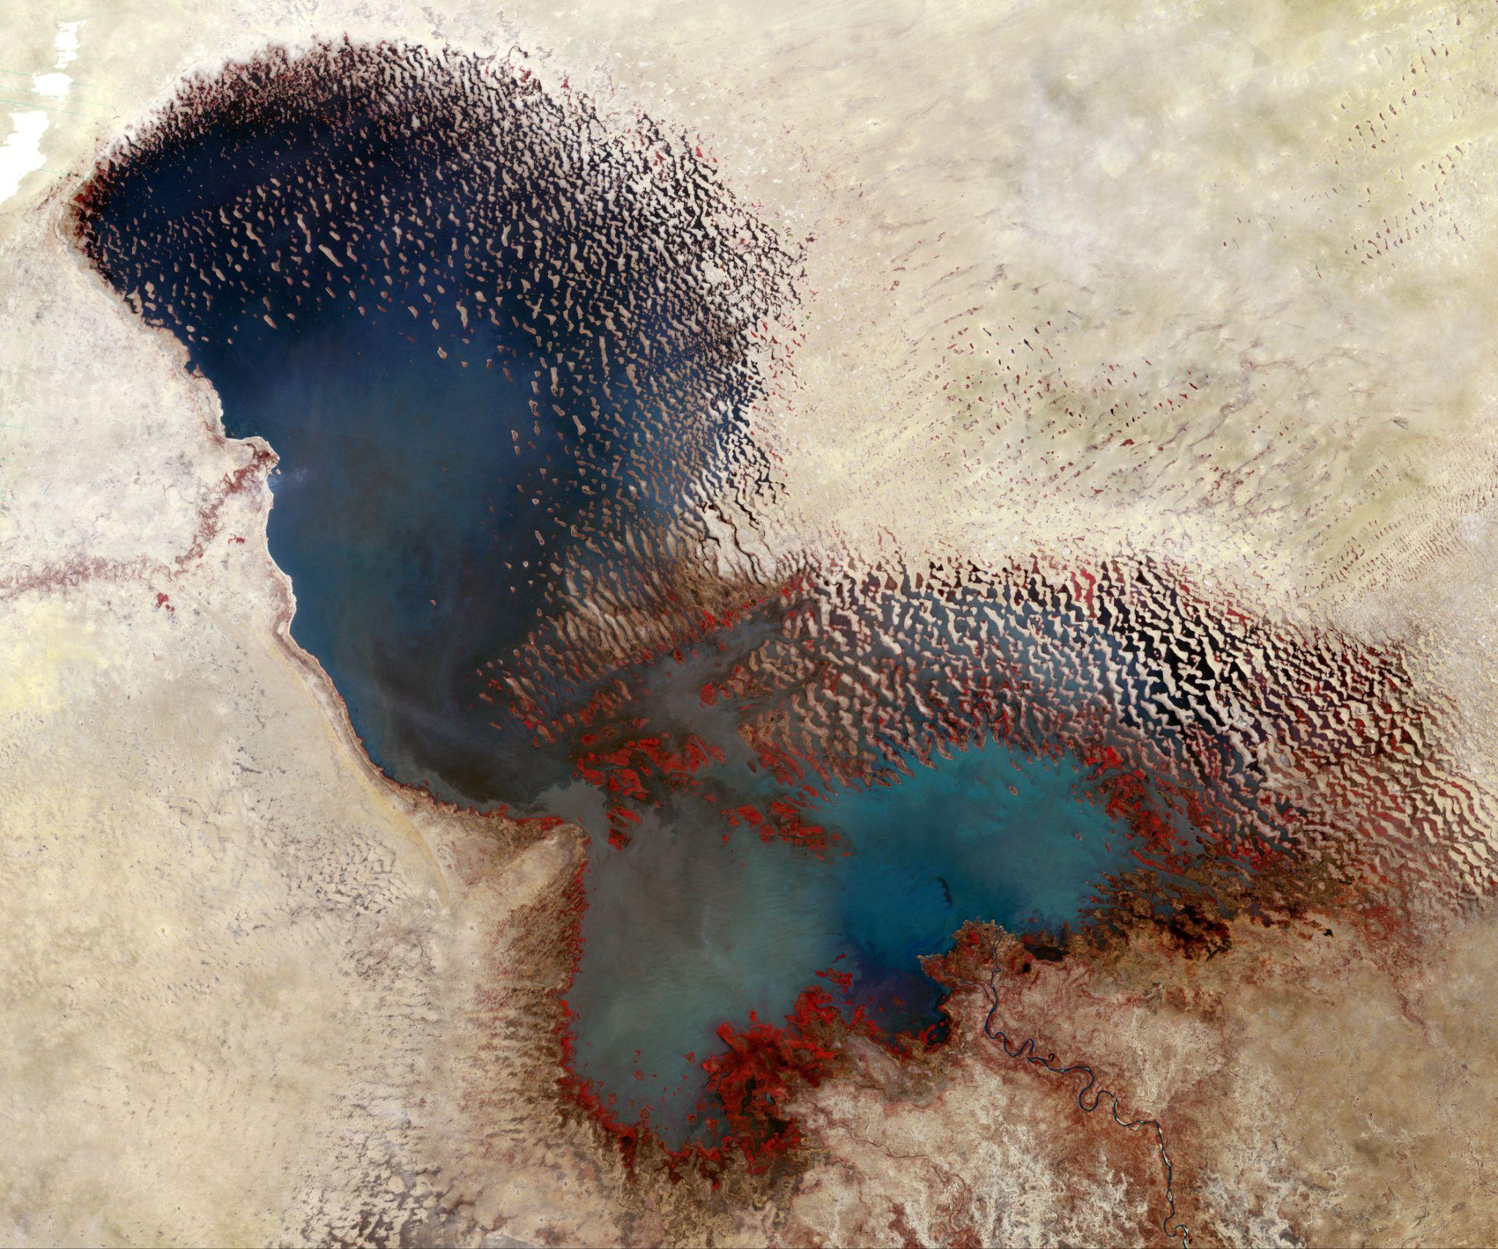
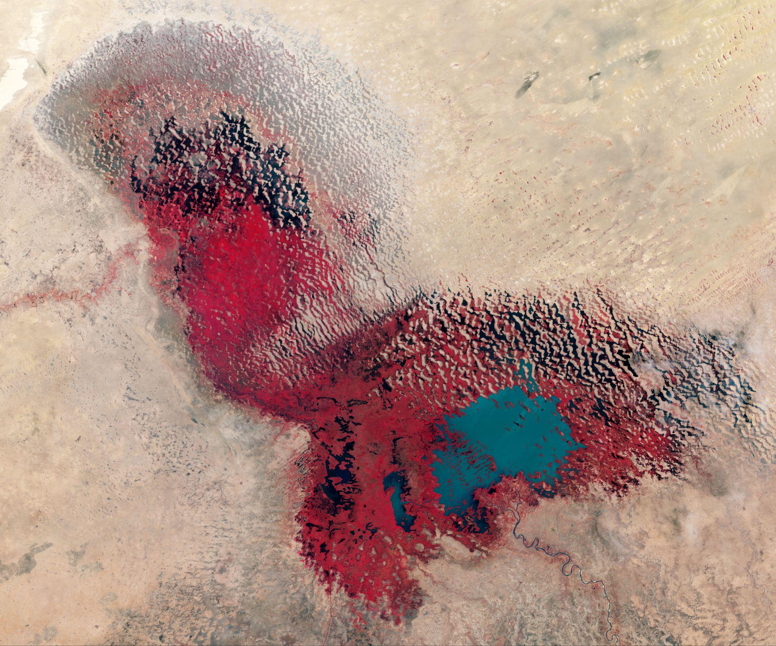
Learning About Earth From Space
We can learn about how people affect Earth by studying satellite photos.
Study the two images of Lake Chad in Northern Africa taken by NASA 35 years apart and answer the six questions on the Incredible Shrinking Lake Student Handout from Sally Ride EarthKAM:
What are the features in the pictures?
What is similar in these pictures? What is different?
What caused the difference?
What impact will the change in the lake have on the area?
What will happen if the change continues?
If you didn’t have photos from space, how could you measure the changes in Lake Chad?
(Image Source: NASA, Chad Lake 1973)
(Image Source: NASA, Chad Lake 2017)

Slide 27
Part 3: Creating Visual Art from Photographs
Let’s create some art of our own.
Select one of the NASA or EarthKAM images to work from.
We have white art paper and liquid and powdered tempera paint to work with.
What other mediums or objects might we want to use?

Slide 28
Creating Earth Art
You do not have to make your artwork look exactly like the image. Think of the Elements of Art we used earlier when we were identifying geologic features of Earth. When we are making art, we should feel free to interpret the image any way we would like.
You may choose to alter the composition; you may crop the image, include only one feature, add or change the colors, or even alter the orientation of the image.
Your imagination is a guide.
Talk with a partner. Discuss how you will use the image to inspire your artwork. Think about a plan before you create your earth art.

Slide 29
Creating Earth Art
Select materials and create your masterpiece.

Slide 30
A Title for Your Work of Art
Once you have completed your work of art and are waiting for it to dry, it is time to give it a title.
Consider how you the audience would know about your work if you weren’t present to tell them about it.
What would you like the audience to know about your art?
Does the work of art tell a story?
How would you like the audience to feel when looking at your art?

Slide 31
Gallery Exhibit- Earth Art on Display
Make observations about what strikes you in the artwork of your classmates.
Be sure to mention the elements of art such as line, shape, color, texture, and movement.
Leave sticky notes for the artist, sharing your positive thoughts.

Slide 32

Class Reflection
Reflect on the learning sequence by sharing something new you have learned about science or art. What helped you in your new learning?

Slide 33
Part 4: Exploring Music in Space
In addition to taking photos in space, astronauts explore their other talents and interests as well. Many astronauts enjoy playing instruments while in space. For many astronauts, bringing music to the ISS keeps them active and connected to home.
Before we listen to some music performed by astronauts, let’s look closely into some of the elements of music.

Slide 34
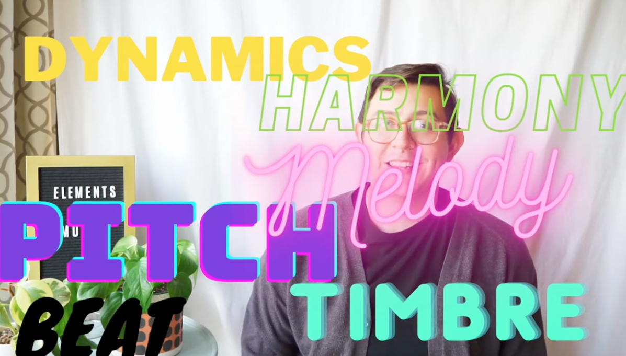
Elements of Music
Watch Elements of Music to learn more about dynamics, harmony, pitch, melody, beat, and timbre.
Notes:
https://www.youtube.com/watch?v=et6yNXm7ywc

Slide 35
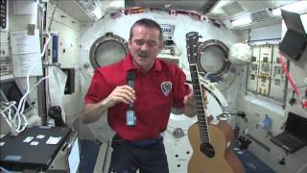
Exploring Music in Space
For many astronauts, bringing music to the ISS keeps them active and connected to home. Astronaut Chris Hadfield loves singing and playing the guitar at home and in space. Watch a short clip of Music Monday Comes to Space (04:51-09:17) to see him singing and playing the guitar.
Notes:
https://www.youtube.com/watch?v=wM7XerPy2kY&t=381s

Slide 36
Exploring Music in Space
Create a 2 column chart
Chris Hadfield Music Monday Comes to Space | Katy Coleman Space and Earth Duet
Elements of Music (dynamics, harmony, pitch, melody, beat, timbre): | Elements of Music (dynamics, harmony, pitch, melody, beat, timbre):
Patterns you notice: | Patterns you notice:
Similarities: | Similarities:
Differences: | Differences:

Slide 37
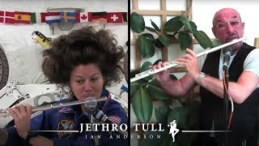
Exploring Music in Space
Chris isn’t the only astronaut that brings their instrument with them into space. Katy Coleman loves playing the flute. She participated in the first ever space and Earth duet when she played with Ian Anderson from the band Jethro Tull.

Slide 38
Exploring Musical Sound
We have learned that some astronauts play instruments in space and here on Earth. An astronaut is someone who is trained to travel in space.
A musicologist is someone who studies music. In 1914, two musicologists created a system for classifying musical instruments called the Sachs-Hornbostel system. Instruments are put into categories based on where the vibration takes place and where the instrument produces the sound.

Slide 39
Exploring Musical Sound
Let’s explore some instruments and see how they make sound.
Explore where the instrument vibrates and how the instrument produces sound.
Read the definitions on the Classifying Musical Instruments handout.
How would you classify the instrument you are exploring? How do you think your instrument is creating sound? Is it an aerophone, idiophone, chordophone, membranophone, or electrophone? What evidence did you use to make the classification?

Slide 40
Creating Music
Now that you have classified your instrument, let’s use the instruments to create music.
Step #1: Using one instrument, create a pattern that is 8, 16, or 32 counts long.
Step #2: Use symbols to represent your pattern. If you know standard notation for writing music you may use it. Create your own iconic notation, use a graphical representations of music, for your pattern that someone who can’t read music would be able to follow.
Step #3: Play your pattern with the instrument you made.
Step #4: Share your pattern with someone else. Play the pattern together.

Slide 41
Revising Music
Give each other feedback about your patterns using the following prompts:
Was the notation easy to understand?
How challenging was it to play the pattern after some practice?
What suggestions do you have to make the pattern better?

Slide 42

Creating Music
image Source: Noun Project
Play your pattern on two different instruments.
What did you like about your pattern? Did your pattern sound better on one instrument compared to the others? What would you change about your pattern and why? Change or revise your pattern and play your instrument(s) again.

Slide 43
Creating Music
image Source: Noun Project
Work with a partner to create two separate patterns for two separate instruments. Play your patterns with two instruments at the same time.
What do you think about how the patterns played simultaneously sounded? Is there anything you would change about one or both of the patterns you created?

Slide 44
Creating Music
image Source: Noun Project
Create patterns for additional instruments. How many can you play at one time? What do you notice about the sounds of the instruments when played together versus played individually?

Slide 45
Have a Music Performance
As a class, determine how you as the audience will act while you are watching and listening to one another perform. Will you move to the music during the performance? Will you clap or tap to the beat of the music during the performance? Will you sit still and in silence until the music stops and then clap for each performer?
Whatever you decide as a group is called audience etiquette. The style of music and location usually determine the audience etiquette.

Slide 46
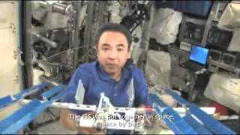
Part 5: Connecting to Ourselves
Just like all of us, astronauts are unique and have different interests. Music isn’t the only way astronauts relax and take a break on the ISS. In 2011, Japanese astronaut, Satoshi Furukawa assembled Legos he brought to the ISS.
Watch as he assembles the International Space Station Lego Set while on the International Space Station.
Notes:
https://www.youtube.com/watch?v=YYLMCepxNkU

Slide 47
Connecting to Ourselves
What talents and interests would you want to bring with you if you were going to stay on the International Space Station (ISS)?

Slide 48
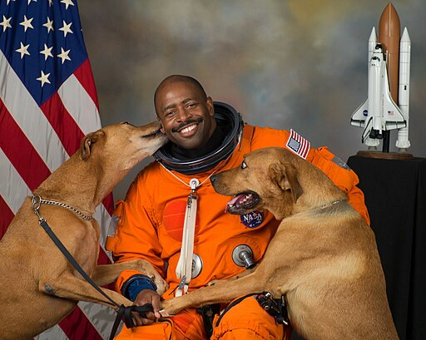
Getting to Know Leland Melvin
Let’s get to know one more astronaut, Leland Melvin. Leland is a former athlete and astronaut with many interests.
Image Credit: NASA, Robert Markowitz, Public domain, via Wikimedia Commons)
Notes:
https://www.youtube.com/watch?v=1VxB4hWzTA0

Slide 49

Getting to Know Leland Melvin
Let’s watch a short video to learn more about astronaut, Leland Melvin.
As you watch, think about your story.
What are you curious about?
How are you creative?
Notes:
https://www.youtube.com/watch?v=1VxB4hWzTA0

Slide 50
Getting to Know Leland Melvin
Explore Leland Melvin’s STEAMography webpage. Choose one of the eight videos in the Explore More section.
Watch the video and jot your thoughts in your notebook:
Record the title of the video you chose.
Write down one new fact you learned.
If you could ask Leland Melvin a question, what would you want to ask him?
Notes:
https://www.lelandmelvin.com/steamography.html#/

Slide 51
Getting to Know Leland Melvin
Select a partner that watched a different video than you chose. Share your thinking with your partner.
Use these discussion frames to get you started:
The title of the video I watched is ___________________________ .
I learned…
A question I would like to ask is…

Slide 52
Learning Sequence #2 Reflection
Reflect on your thinking, learning, and work throughout this learning sequence.
What were you most proud of?
Where did you encounter struggles, and what did you do to deal with it?
What about your thinking, learning, or work brought you the most satisfaction? Why?
How were you curious throughout the learning sequence?
What new skills and/or information did you learn?

