Slide 1
4th Grade Arts & Science Integrated Unit
Learning Sequence #3
Focus on Movement and Dance

Slide 2
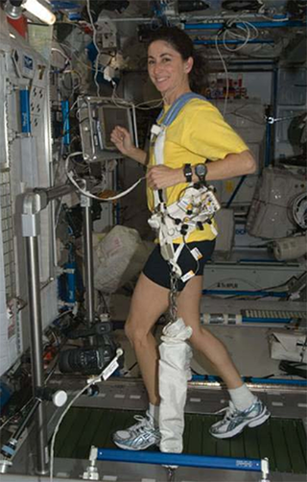
Movement in Space
In addition to working hard and exploring their interests, astronauts have to stay active and healthy when in space. Just like athletes, astronauts have to keep in shape both on Earth and in space. Staying active and keeping in shape is even more important when living on the International Space Station than it is on Earth. Due to the lack of gravity in space, astronauts experience a decrease in muscle mass and bone density. They have to exercise vigorously in space to stay healthy. They must do at least two hours of exercise every day.
Image Credit: NASA

Slide 3
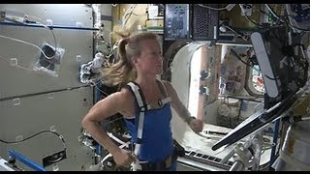
Running in Space
Let’s watch astronauts Running in Space!
Ask students:
How does running keep astronauts healthy when living on the ISS?
How do astronauts stay on the treadmill without floating away?
Notes:
https://www.youtube.com/watch?v=_ikouWcXhd0

Slide 4
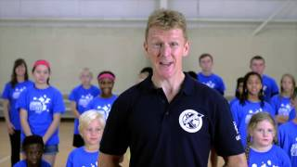
Train Like an Astronaut - Burpees
Make sure you have plenty of space around you to move without bumping into classroom furniture or each other. Then check the floor around you is clear of any debris. Let’s Train Like an Astronaut with Mission X. Learn how to do burpees from an astronaut.
What are the five steps to doing a burpee like an astronaut?
How many burpees can you do before you start to feel tired?
How might you do curl-ups, modified push-ups, or jumping jacks in space?
Notes:
https://www.youtube.com/watch?v=xLX-KKPx9ek

Slide 5
Movement in Dance
One of the best forms of movement exercise is Dance.
Not only does dance give people the opportunity to express themselves and have fun, but it is also a great tool to improve fitness. Technical dance skills develop strength, endurance, alignment, coordination, balance, core support and much more.
Dance is a combination of locomotor (associated with moving/traveling) and non-locomotor (done in place) movements that are manipulated using elements of dance.

Slide 6
Locomotor and Non-locomotor Movement
Explore non-locomotor movements. You may choose to bend, twist, turn, sway, or reach in place. The goal of a non-locomotor movement is to remain in one place.
Explore locomotor movements. You may choose to walk, tip-toe, roll, jump, or march throughout the room. The goal of a locomotor movement is to move from one place to another.

Slide 7
Even and Uneven Locomotor Movement
Walking, marching, jumping, and hopping are even locomotor movements. Go ahead and try one of the even locomotor movements. They are called even because they take place on even beats.
Uneven locomotor movements include skipping, galloping, or sliding. Go ahead and try one of the uneven locomotor movements. These movements are called uneven because they occur on uneven beats.

Slide 8
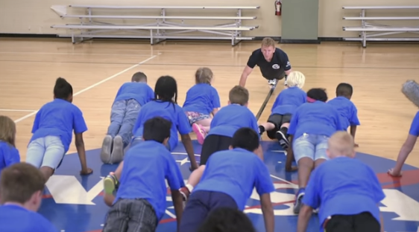
Locomotor and Non-locomotor Movement
Consider which of the exercises you explored in the last lesson were locomotor movements and which were non-locomotor movements. Could any of the exercises that were non-locomotor be changed into locomotor movements?

Slide 9
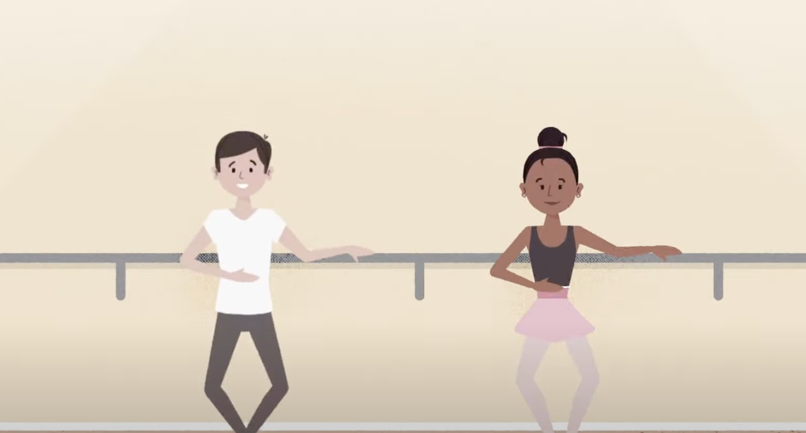
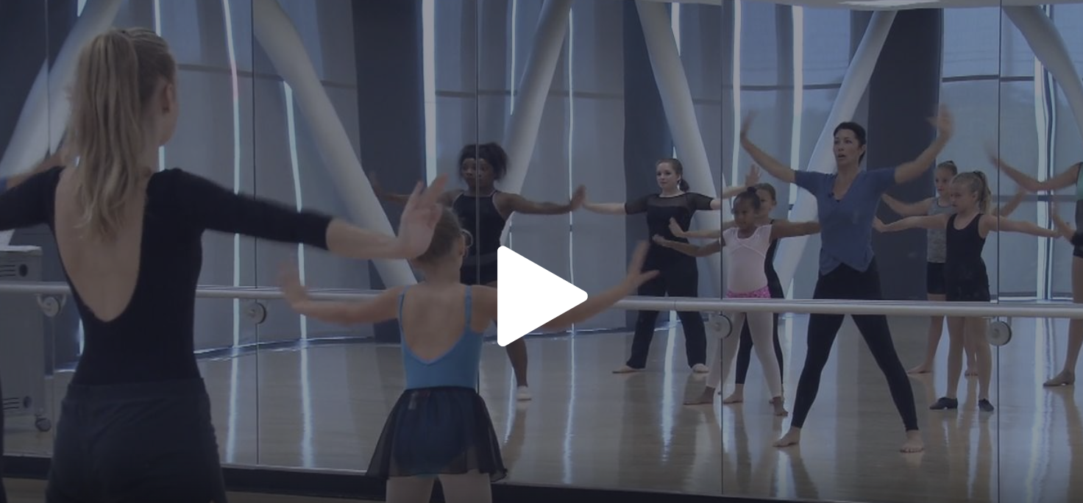
Exploring Elements of Dance
Elements of Dance include:
Space
Time
Energy
Watch these two videos to learn
more about Elements of Dance.
Notes:
https://www.youtube.com/watch?si=TovpP_z5OrmWyGqk&v=_h-DCc8kaLk&feature=youtu.be
https://ca.pbslearningmedia.org/resource/dance_terms/elements-of-dance-dance-arts-toolkit/

Slide 10
Explore Elements of Dance with Locomotor Movement
Pick one locomotor movement. What kind of pathway will you use to move throughout the room you are in? Will you move in a zigzag, straight, or curved pathway? Give it a try.
Now, focus on time. Will you move quickly or slowly along your pathway? Try your locomotor movement again with the time you selected.
Energy or force determines whether your movement is smooth, sharp, heavy, light, flowing, or controlled. Perform your locomotor movement and experiment with different types of energy.

Slide 11
Explore Elements of Dance with Locomotor Movement
Describe the changes in your locomotor movement when you added space, time, and energy.
Which element did you like best?
How might changes in the elements of dance influence how the performer feels?
How might changes in the elements of dance influence how the audience feels?
Share your responses with a partner.

Slide 12
Exploring Patterns in Dance
Dance is a performing art form consisting of sequences of movement.
We are going to have the opportunity to see some really great dances. First, let’s think about our experiences with dance and what we already know.
What are some types of dances you have been part of or watched?
What are some reasons people dance?
  Do you think people all over the world dance for the same reasons? Explain your thinking.
How do dance performances and dancing make people feel?
  How do they make you feel?

Slide 13
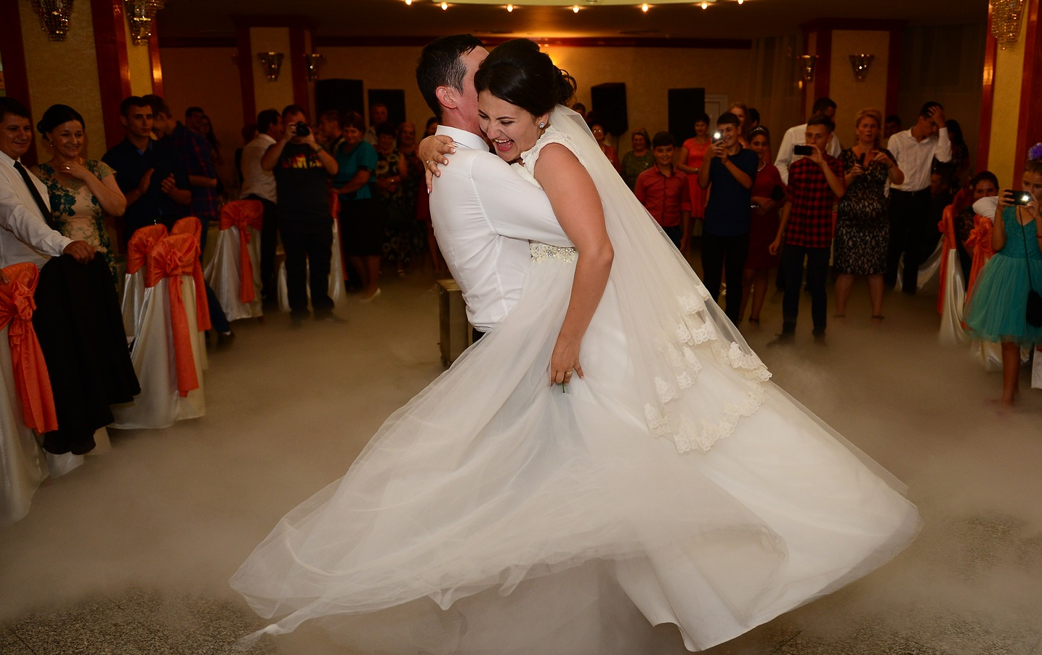
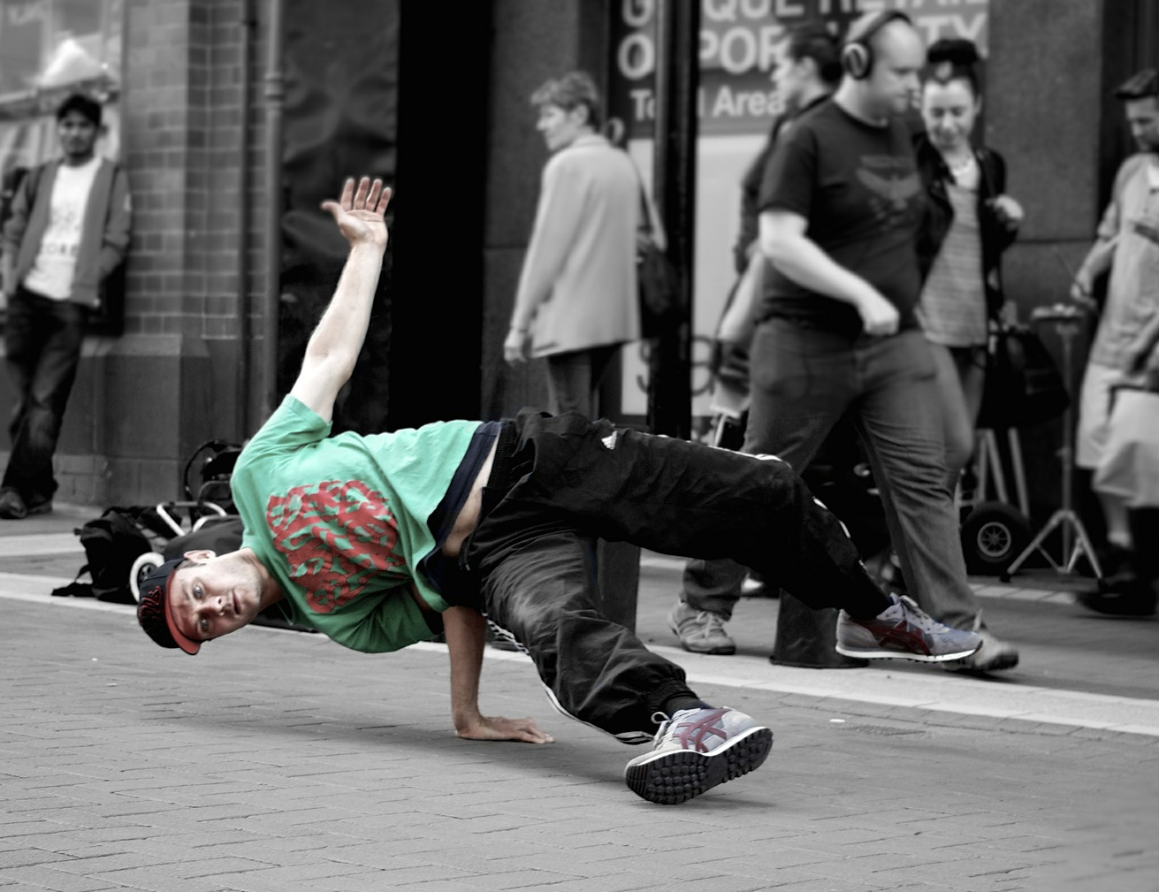
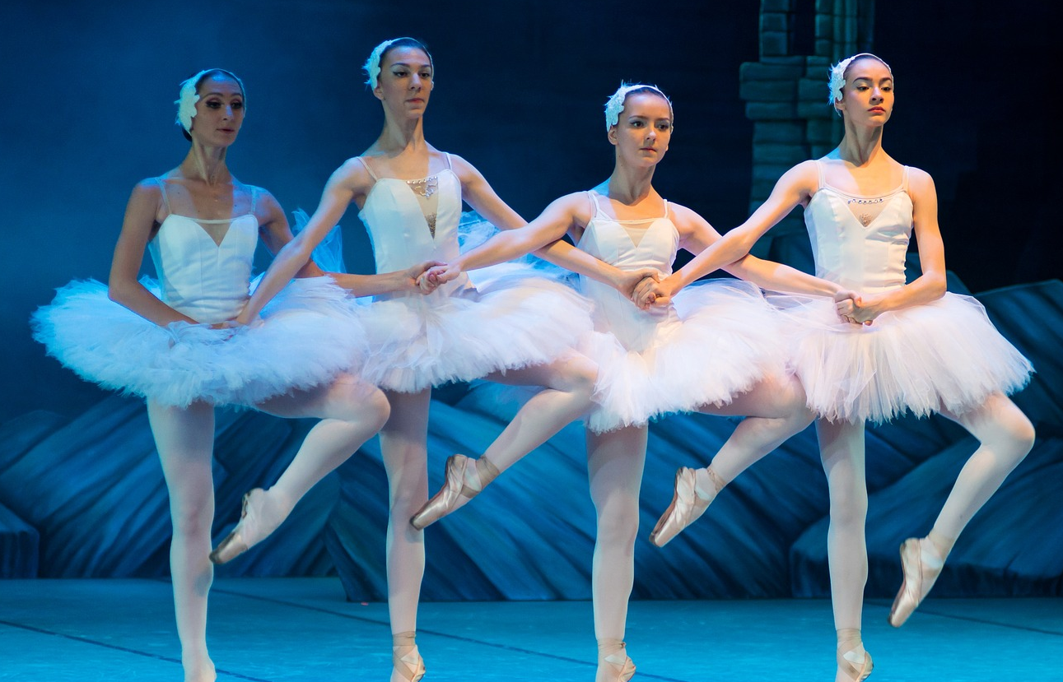
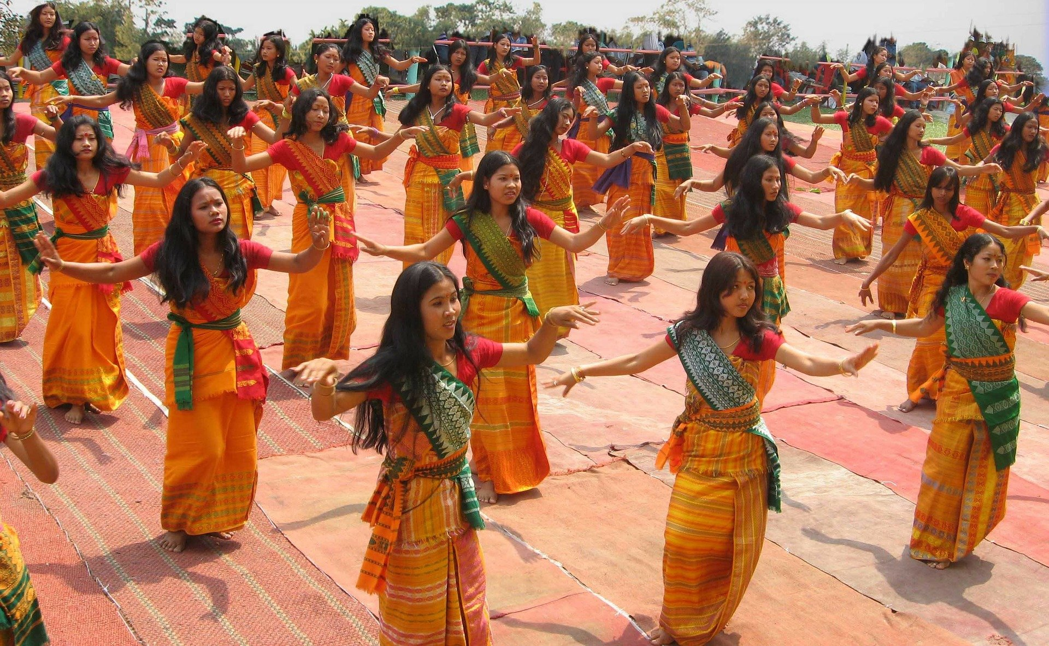
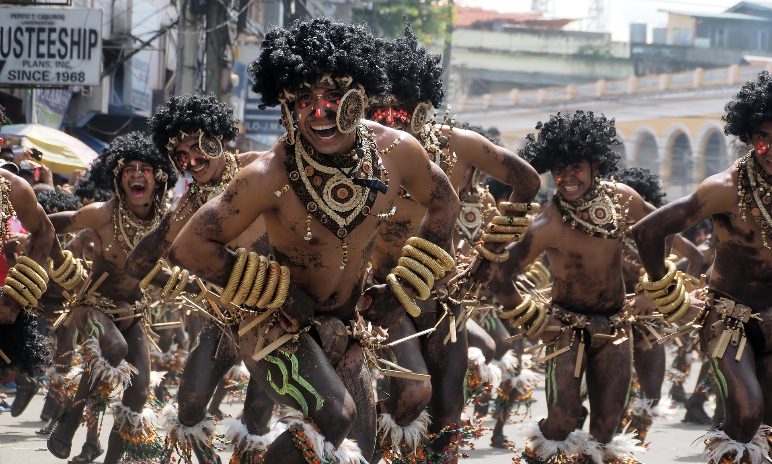
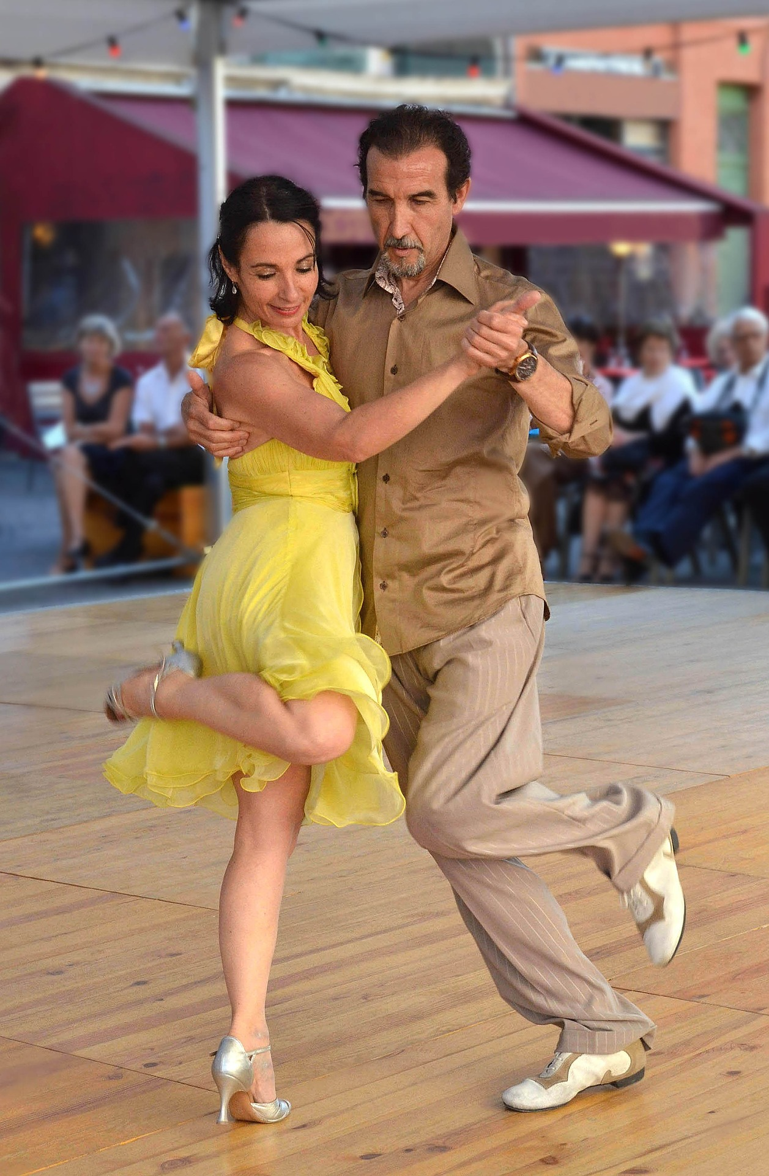
Exploring Patterns in Dance
What are you thinking as you look at these photographs?
Do you think dance has changed over time? Why?
  What has stayed the same? Why?
Are there patterns in dance? Explain your thinking.
(Source for all images: Pixabay)

Slide 14
Exploring Patterns in Traditional Native American Dances
Now we will have the opportunity and pleasure of viewing, and hearing from Native American dancers.
We will experience three different dances.
We will continue to look for and notice patterns in the dances and think about how the dances are similar and different.
The title of our video is Native American Dance and Regalia. While we watch the dances, let’s also pay attention to the “regalia”, the traditional attire, the dancers wear.

Slide 15
Exploring Patterns in Traditional Native American Dances
Create a 3-column chart.
Russell Harjo Pawnee/Seminole Men’s Grass Dance | Jennie Kappenman Ojibwe Jingle Dress Dance | Leya Hale Dakota/Dine Women’s Traditional Dance
Patterns you notice: | Patterns you notice: | Patterns you notice:
Your reaction/feelings: | Your reaction/feelings: | Your reaction/feelings:
Similarities: | Similarities: | Similarities:
Differences: | Differences: | Differences:
History and “why” of the dance: | History and “why” of the dance: | History and “why” of the dance:
Patterns and other noticings about the outfit: | Patterns and other noticings about the dress: | Patterns and other noticings about the dress:
What else are you noticing or wondering? | What else are you noticing or wondering? | What else are you noticing or wondering?

Slide 16
Exploring Patterns in Traditional Native American Dances
Native American Dance and Regalia (Pawnee/Seminole; Ojibwe/Dakota) Native American Dance and Regalia | Season 7 | Episode 10 | PBS
As you watch, jot your thoughts in your chart.
Notes:
https://www.pbs.org/video/Native-American-Dance-and-Regalia-655958H-1/

Slide 17
Exploring Patterns in Traditional Native American Dances
Join a group to discuss your observations and thinking. In your discussion be sure to refer to your charts and feel free to add to it when you hear new ideas.

Slide 18
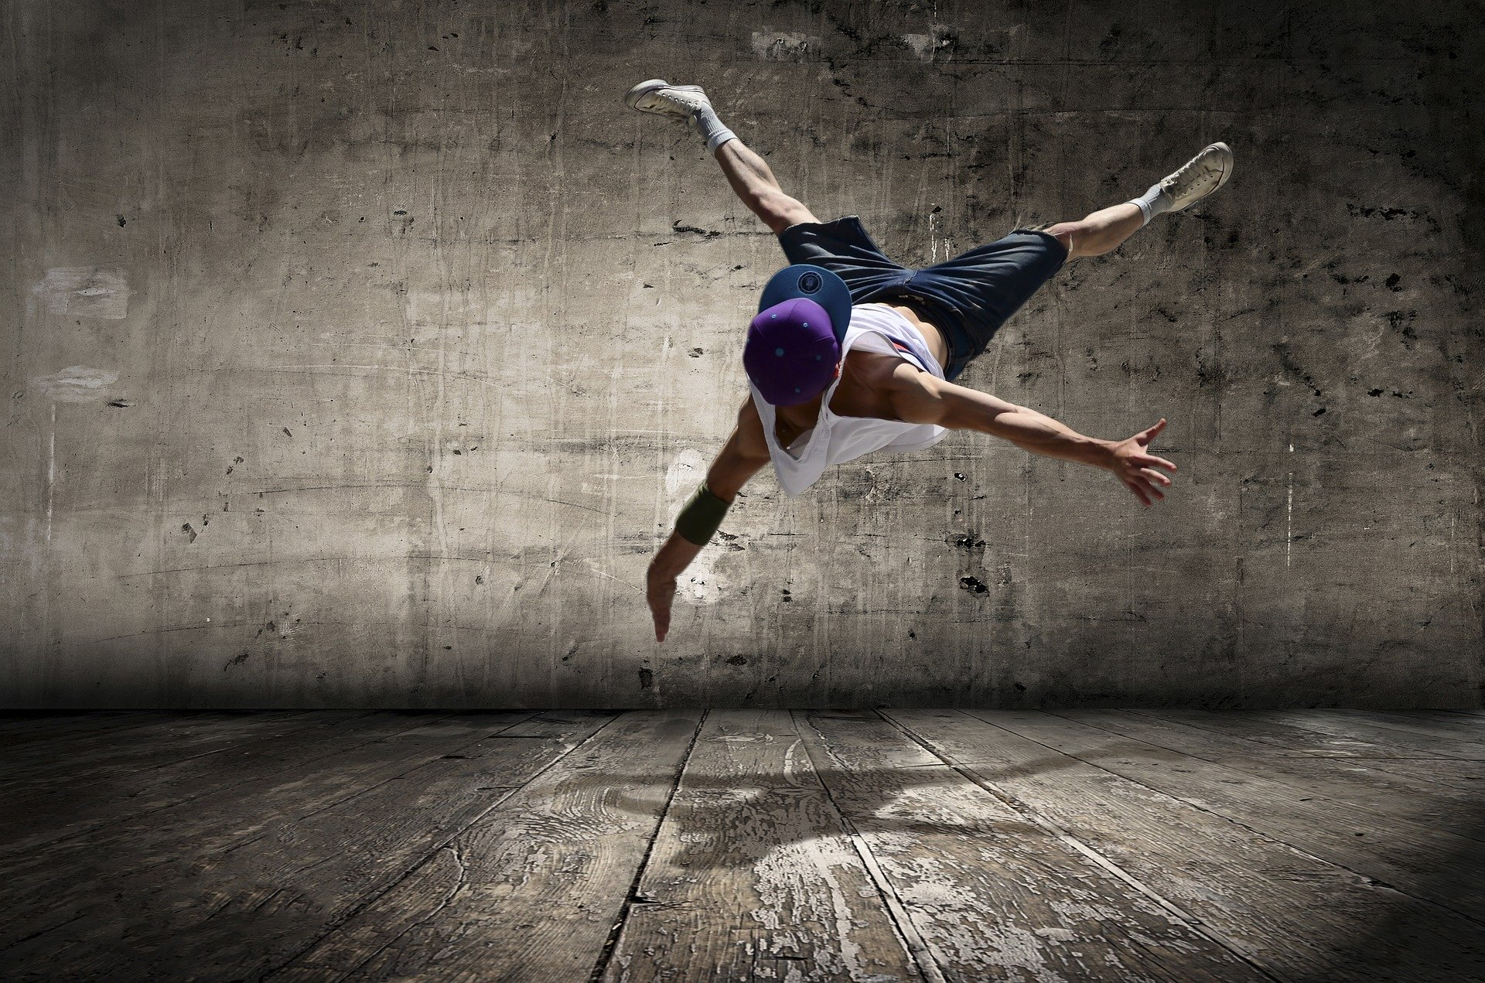
Using a Sequence of Movement Patterns to Create a Dance
Next we will learn “how to” perform two different styles of dance. Follow the directions in the videos to learn some of the basics of Hip Hop and Line dancing. After we try each style together, you will get to create your own dance movement sequence applying the Elements of Dance: Space, Time, and Energy. Do your best to perform the dance movements as instructed.
Photo of hip hop dancer in air
(Source: Bogdan Radu from Pixabay)

Slide 19
Explore Dance
Hip Hop: American Heart Challenge Intermediate School Routine (Hip Hop)
Line Dance: How to do the Cupid Shuffle
Which aspects of the dances were fun?
Which aspects of the dances were difficult?
What helped you perform the dances correctly?
How would you describe the artistic intent behind each dance?

Slide 20
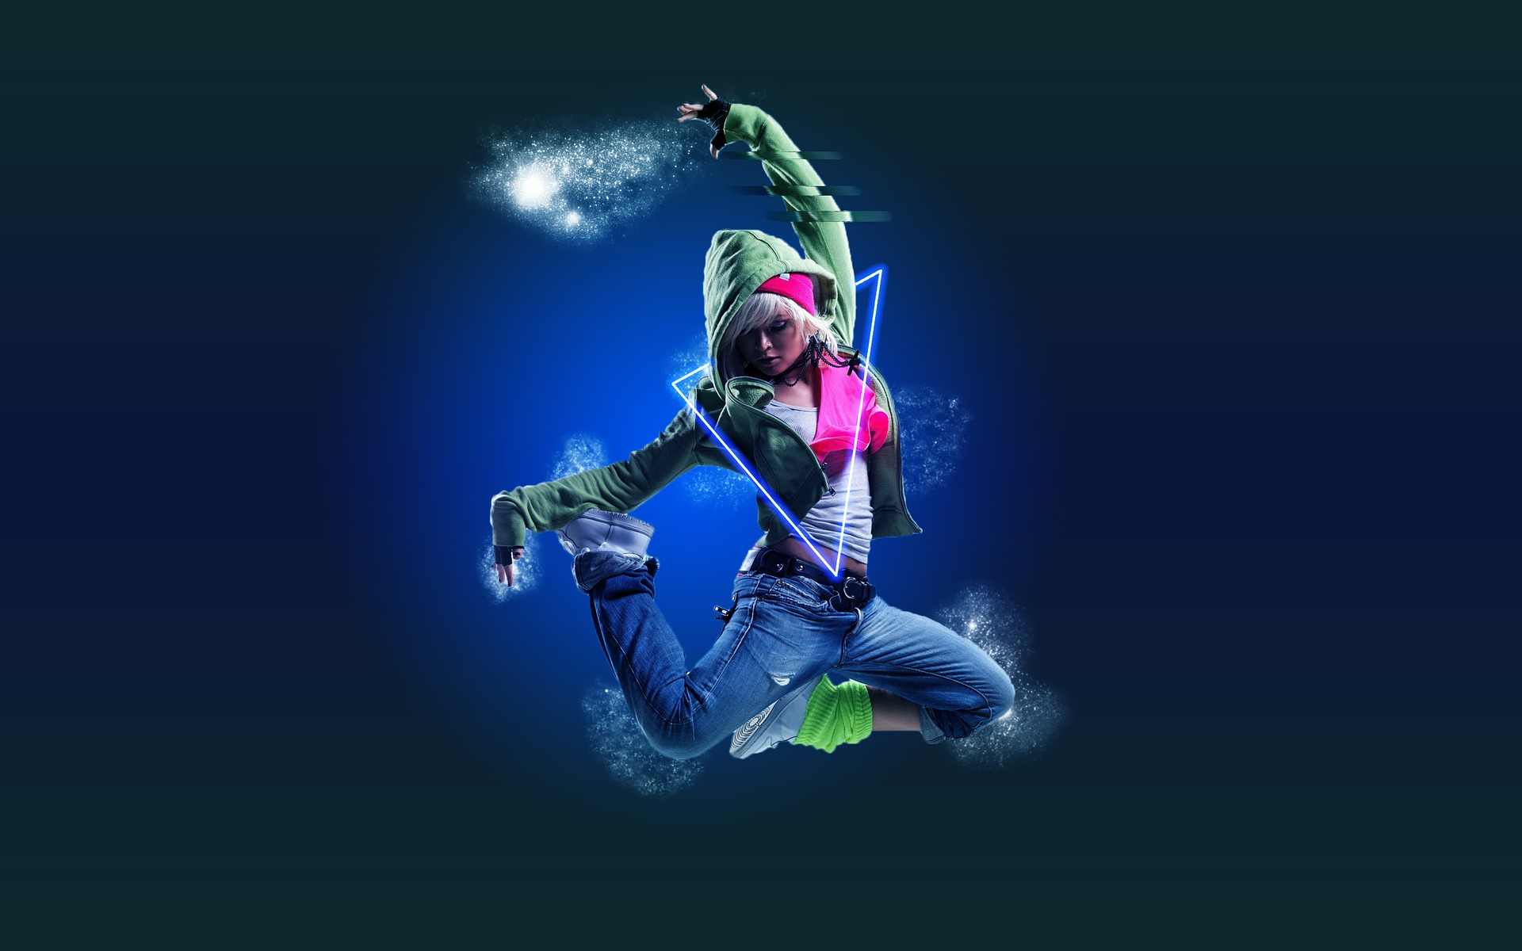
Apply the Elements of Dance
Now you will have the opportunity to add your own personal flare as you create your own movement sequence. Our goal is to create a dance sequence that incorporates the elements of dance and revise the movement sequence based on feedback.
Photo of dancer in air (Source: janisos from Pixabay)

Slide 21
Apply the Elements of Dance
Start with an 8 count movement sequence.
Be sure to include one even and one uneven locomotor pattern in your movement sequence.
Record your movement sequence using words and pictures so you can share the sequence with others.
Select or create an 8 count music pattern to accompany your dance. You could record the music or ask other students to play the music live for your performance.

Slide 22
Apply the Elements of Dance
Take turns performing your dance for a partner.
Discuss which elements of dance are present in your 8 count sequence with your partner. Discuss space, time, and force.
How can you change the dance sequence you just created and performed? Consider changing:
SPACE | TIME | FORCE/ENERGY
Shape of your body Level of your body (high or low) Pathway Locomotor Non-locomotor | Speed of movement (speed up or slow down) Length of movement Even Uneven | Smooth Sharp Heavy Light

Slide 23
Apply the Elements of Dance
Try out a few of your change ideas. How did the dance feel with each change? Which change do you feel improves your dance sequence? Record the new dance sequence using words and pictures. Perform your NEW dance that includes a change in one or more elements.
Give your dance sequence a title. Create a title that is connected to the main idea or purpose of how the dance sequence makes you feel or how you want the audience to feel when watching the dance sequence.

Slide 24
Apply the Elements of Dance
Perform your dance for someone else. Have them give you feedback using the TAG Feedback Protocol:
TELL something you noticed
ASK a question
GIVE a suggestion
Ask your audience to guess the title of your dance and share why they gave that response.

Slide 25
Apply the Elements of Dance
Respond to the following reflection questions:
How did it feel to create a dance sequence?
How did it feel to perform your dance sequence with music?
What revisions or changes did you make to your dance?
Did you like the change better? Why or why not?
Did the audience guess the title of your dance? Did their answers surprise you?

Slide 26
Learning Sequence #3 Reflection
Reflect on your thinking, learning, and work throughout this learning sequence.
What were you most proud of?
Where did you encounter struggles, and what did you do to deal with it?
What about your thinking, learning, or work brought you the most satisfaction? Why?
How were you curious throughout the learning sequence?
What new skills and/or information did you learn?

Slide 27
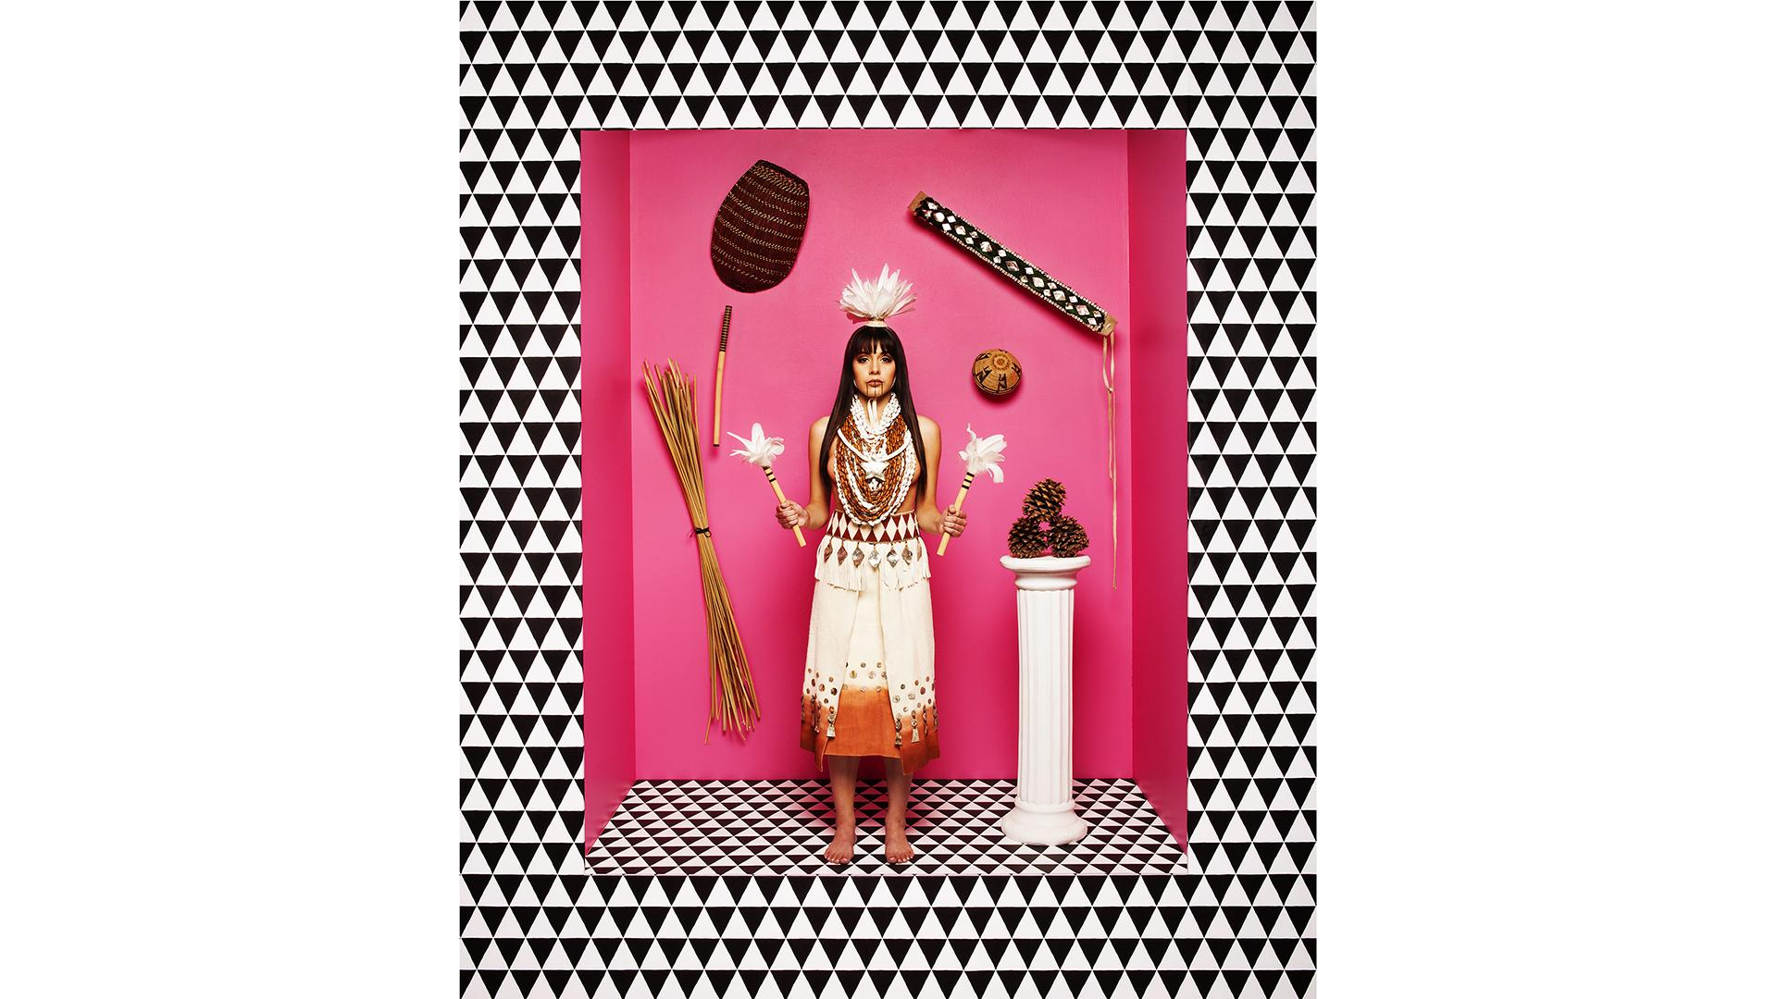
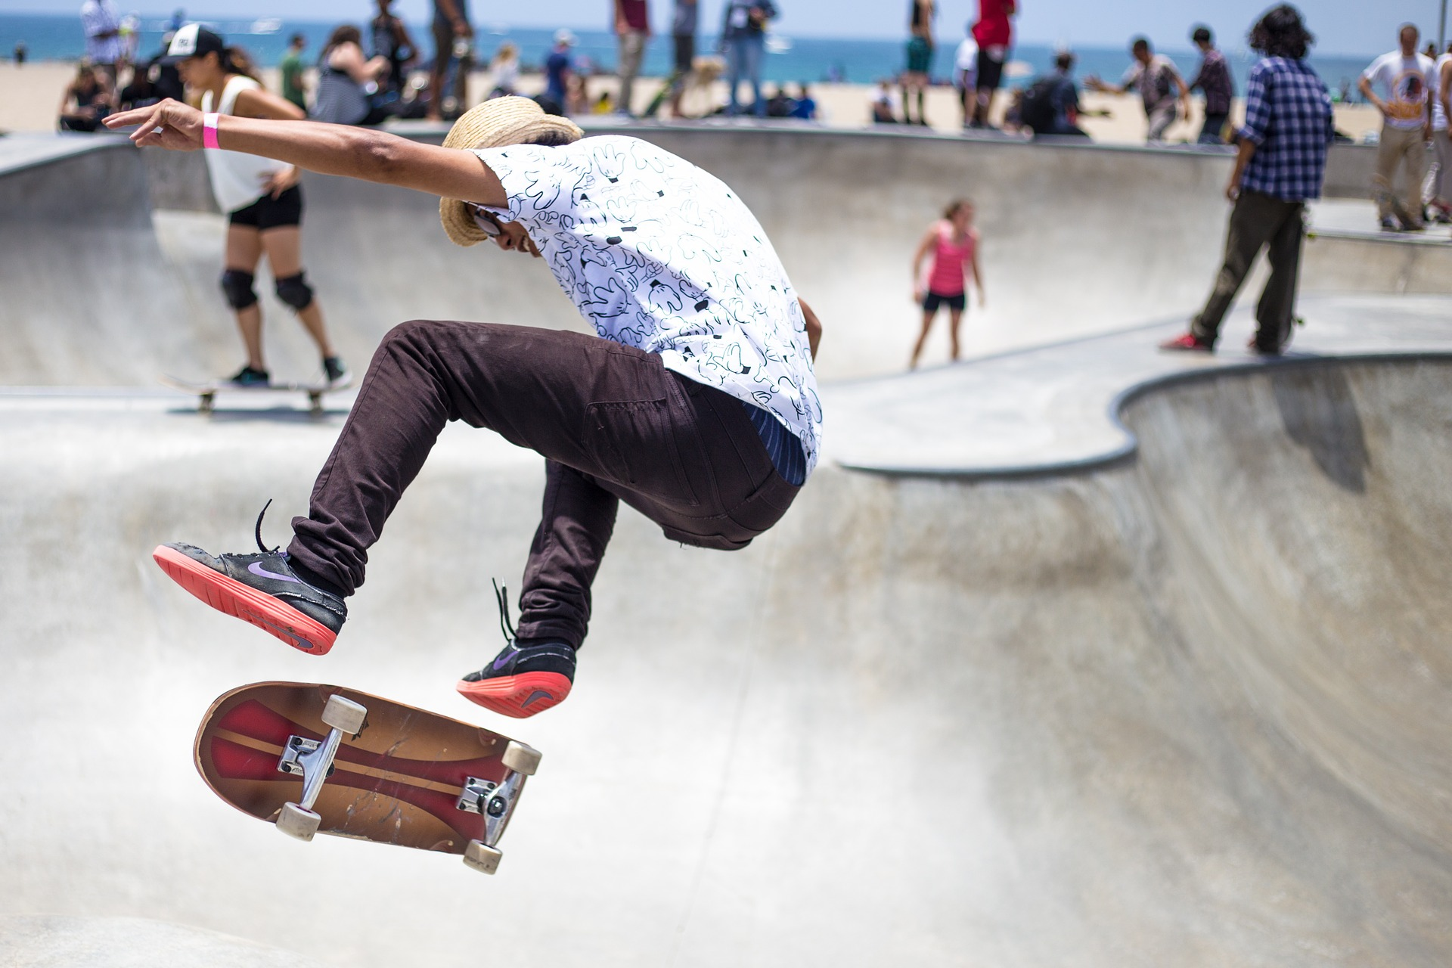

Integrated Unit Reflection
We have studied many types of art throughout this unit; we curated photos and told stories using photography and digital art, we created earth art using different art mediums, we explored music, and watched traditional dances.
Which art form did you enjoy most? Why?
How did you feel when you were experiencing your favorite art form?
Is there another art form you enjoy that we haven’t yet studied in class? If so, share about it here.

