Slide 1
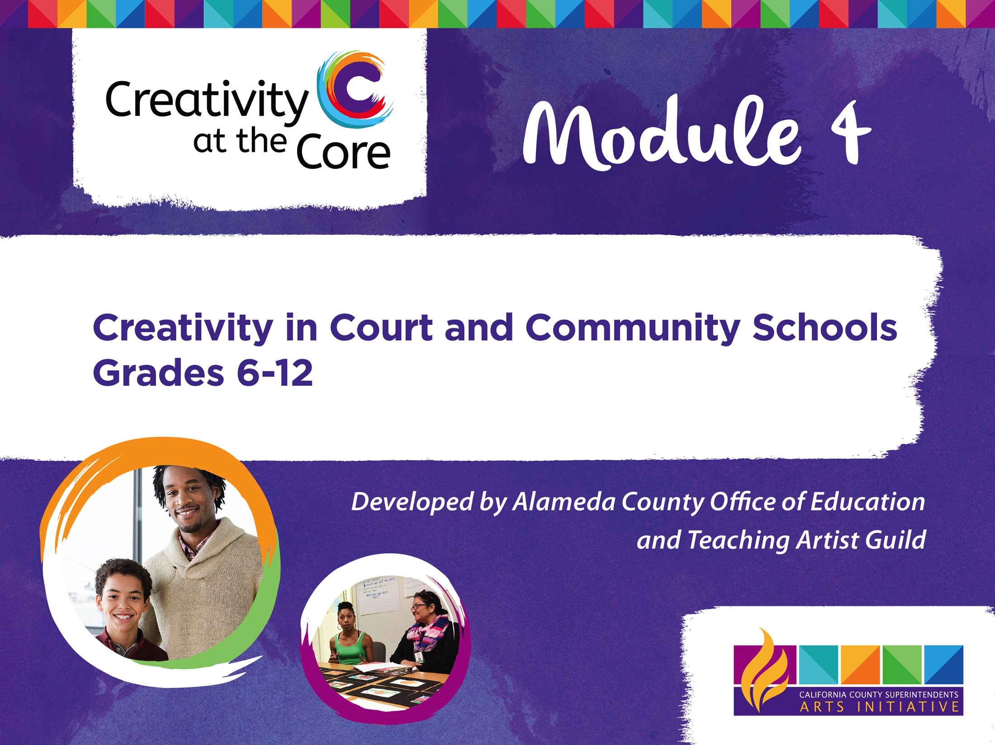


Slide 2
Until we…
support those impacted / targeted by the system in healing ways, and
build pathways to those not connected / impacted / targeted by the system to understand its harm on all of us,
we will never end youth incarceration or any of the other policies that lead to the prison industrial complex and the systemic systems of oppression operating daily in our communities.

Slide 3
Reasoning
While this module has many resources and strategies to explore that support learning in and through the arts in CA court and community schools, this opening slide deck is an opportunity to holistically support all educators and youth in moving beyond oppression analysis into healing pedagogies centering youth justice.

Slide 4
Overview
This slide deck contains the following:
Suggestions for BIPOC & white educators in holding space for this work;
Key frameworks and theories that support understanding youth justice;
A brief context of the juvenile justice system with resources to explore on the issue;
Promising strategies to support educators; and
Culturally sustaining pedagogies.

Slide 5
A Note for BIPOC Educators
Whether serving youth impacted/targeted by the system or not, it is our hope that you take the time to enter/continue the work in ways that aren’t harmful to your well-being. What follows are some resources that you may find useful.
The BIPOC Project
Why Self-Care is Crucial for People of Color
Identifying Your Role and Practicing Self-Care As a Young Black Activist
Liberate Meditation for the Black Community

Slide 6
A Note for BIPOC Educators
If You Listen We Will Stay: Why Teachers of Color Leave and How to Disrupt Teacher Turnover
Self Care Can Be Social Justice
The Nap Ministry
A List of Mental Health Resources Available for People of Color
Therapy Resources for People of Color
Grief is a Direct Impact of Racism: 8 Ways to Support Yourself

Slide 7
A Note for White Educators
White educators serving youth impacted/targeted by the system need to fully understand who they are in relation to their students. While many of the resources in this deck and module will assist you in this, we’ve add some additional ones here that are prerequisites if you are to do this work without causing harm.
How White Teachers Can Support BIPOC Colleagues
A Resource Guide for Anti-Racism + Being an Educated Ally for BIPOC

Slide 8
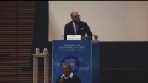
A Note for White Educators
Building Anti-Racist White Educators
Anti-Racist Action for White Educators
Video: Christopher Emdin, For White Folks Who Teach in the Hood and the Rest of Y’all Too – Book Talk

Slide 9
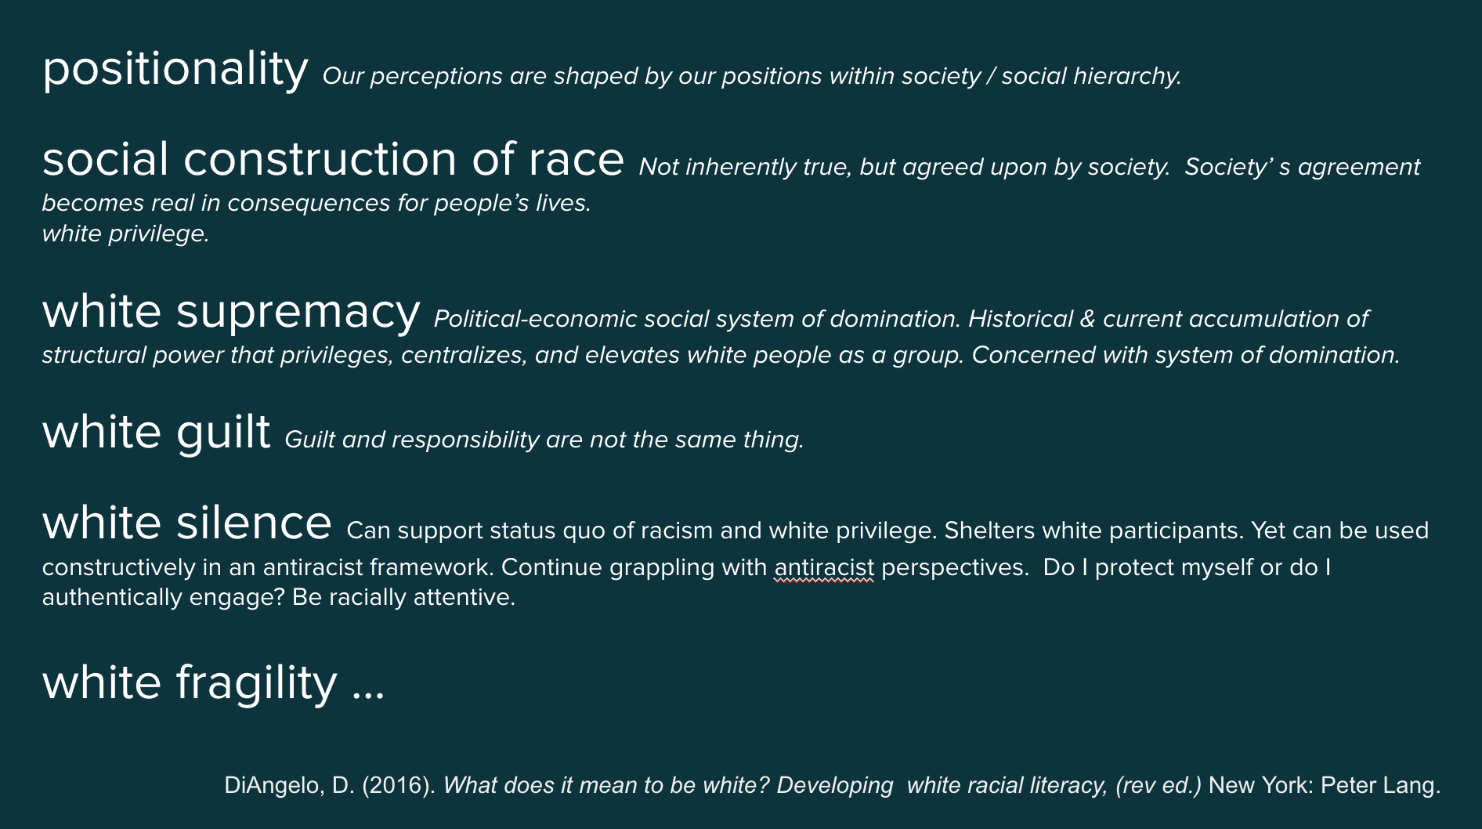
A Note for White Educators

Slide 10
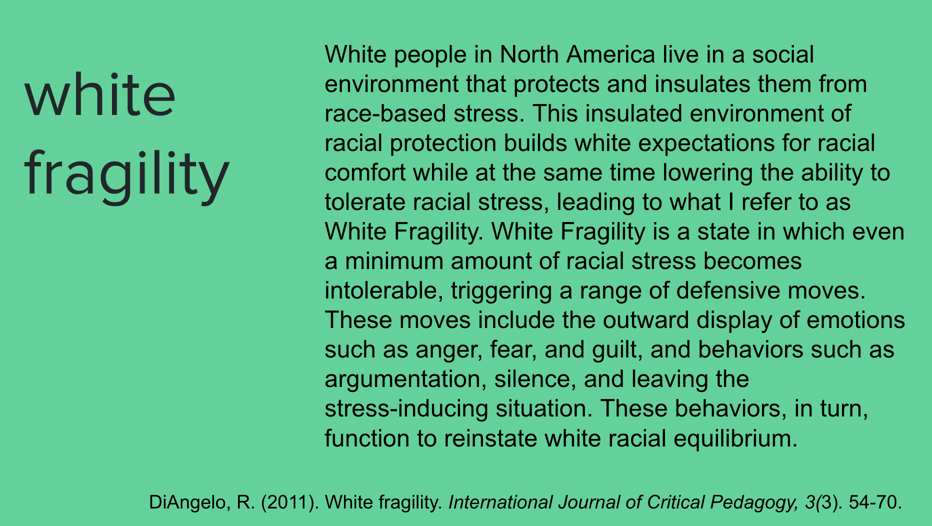
A Note for White Educators

Slide 11
A Note for White Educators
For white educators in classrooms of predominantly youth of color, racial literacy provides a foundation for holding conversations about racism that validate the lived experience of their students, and support art making to expand such dialogue and action.
For white educators in classrooms of predominantly white youth, racial literacy can help their students cultivate a stance of solidarity that prevents indoctrination in the systemic institutionalized racism that exists broadly in schools and educational settings.

Slide 12
A Note For Educators in White Communities
& Communities of Privilege
Any educator serving youth in communities ”not” impacted/targeted by the system will also find the resources in this module relevant. What follows are good starting places to support you in being sure we are not simply indoctrinating students in these communities into systems of oppression, but rather educating them on the harm these systems have on everyone.
Why Schools Need More Teachers of Color – for White Students

Slide 13
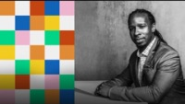
A Note For Educators in White Communities
& Communities of Privilege
Why White Students Need Multicultural and Social Justice Education
Video: Ibram X. Kendi: The Difference Between being ”Not Racist” and Anti-Racist

Slide 14
Key Frameworks / Theories
Further on in this module you will find resources on culturally responsive education and art-centered integrated learning. This section will focus specifically on resources around the following frameworks / theories:
Intersectionality; and
Courageous conversations.

Slide 15
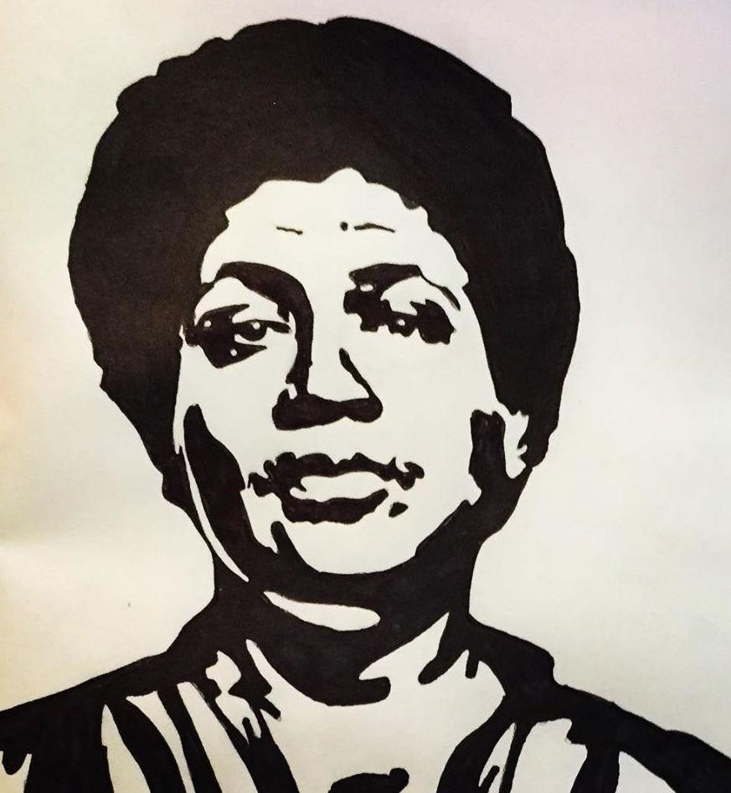
Intersectionality
“There is no such thing as a single-issue struggle.
We do not lead single-issue lives.”
Audre Lorde

Slide 16
Intersectionality
ALWAYS
START
WITH
INTERSECTIONALITY

Slide 17
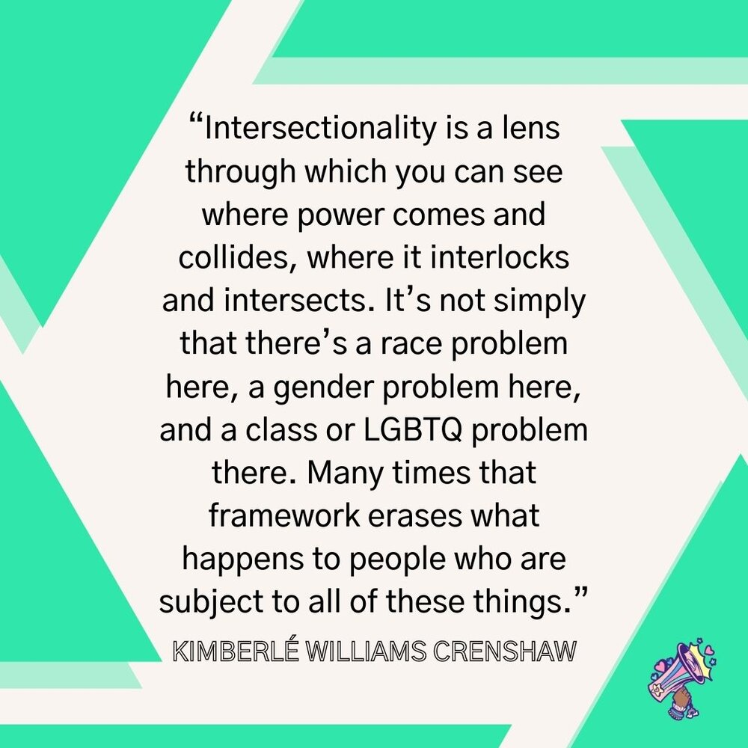
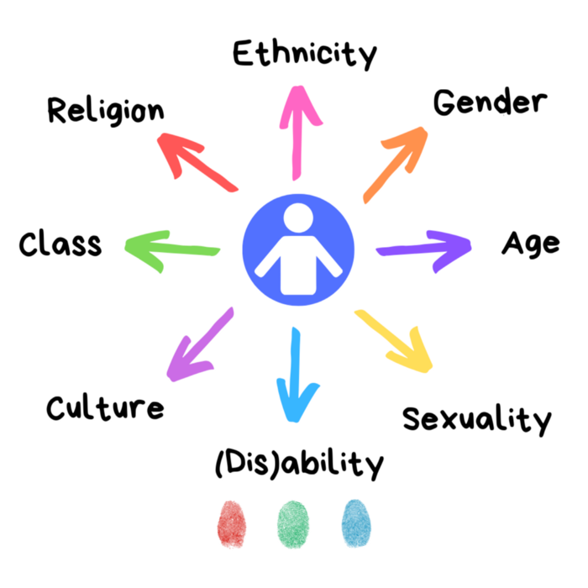
Intersectionality

Slide 18
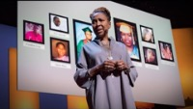
Intersectionality
The Urgency of Intersectionality – Kimberlé Crenshaw

Slide 19
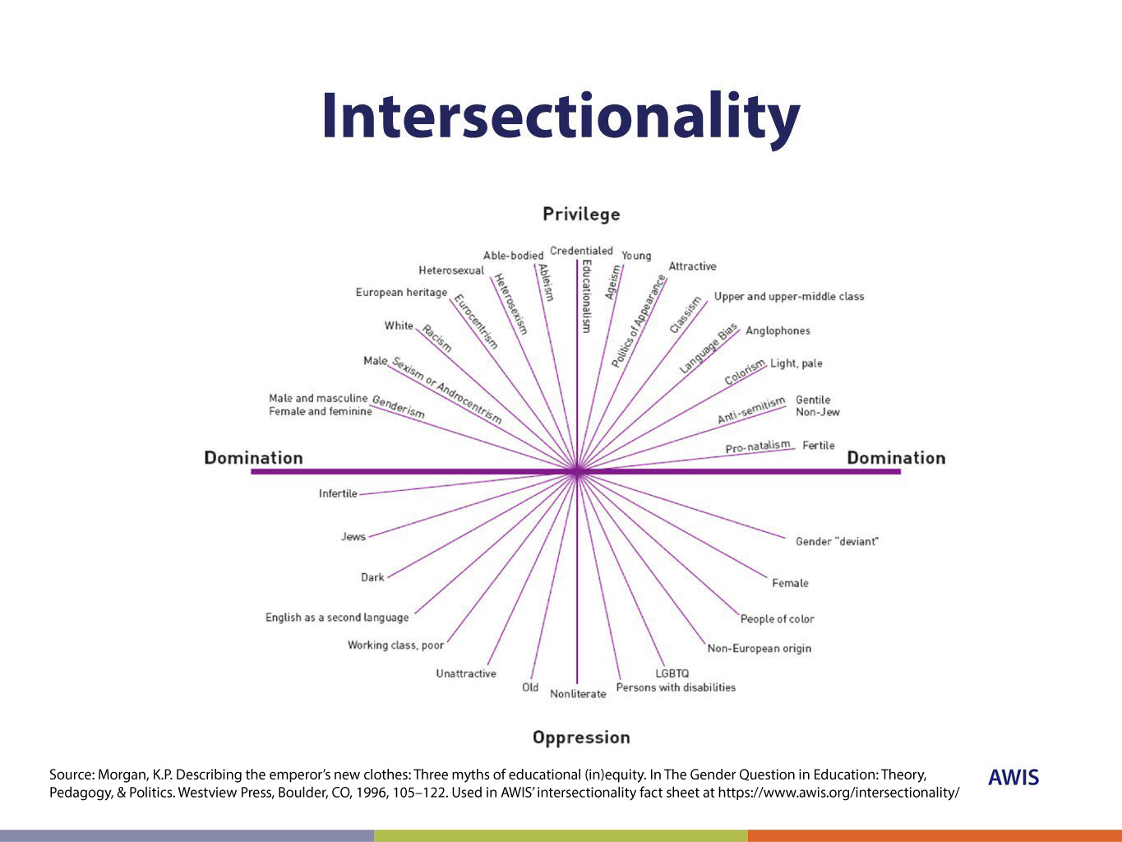
Intersectionality
Intersectionality: A Critical Framework for STEM Equity

Slide 20
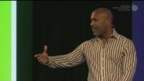
Courageous Conversations
Courageous Conversations About Race – Glenn Singleton

Slide 21
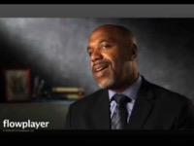
Courageous Conversations
Stay engaged: Staying engaged means “remaining morally, emotionally, intellectually, and socially involved in the dialogue.”
Experience discomfort: This norm acknowledges that discomfort is inevitable, especially, in dialogue about race & oppression, and that participants make a commitment to bring issues into the open. It is not talking about these issues that create divisiveness. The divisiveness already exists in the society. It is through dialogue, even when uncomfortable, the healing and change begin.
Speak your truth: This means being open about thoughts and feelings and not just saying what you think others want to hear.
Expect and accept non-closure: This agreement asks participants to “hang out in uncertainty” and not rush to quick solutions, especially in relation to racial understanding or oppression, which requires ongoing dialogue.
Glenn Singleton’s 4 Agreements

Slide 22
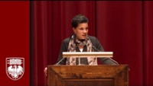
Context: The Juvenile Justice System
The New Jim Crow – Michelle Alexander

Slide 23

Context: The Juvenile Justice System
Why Black Girls Are Targeted for Punishment at School and How to Change That – Monique W. Morris

Slide 24
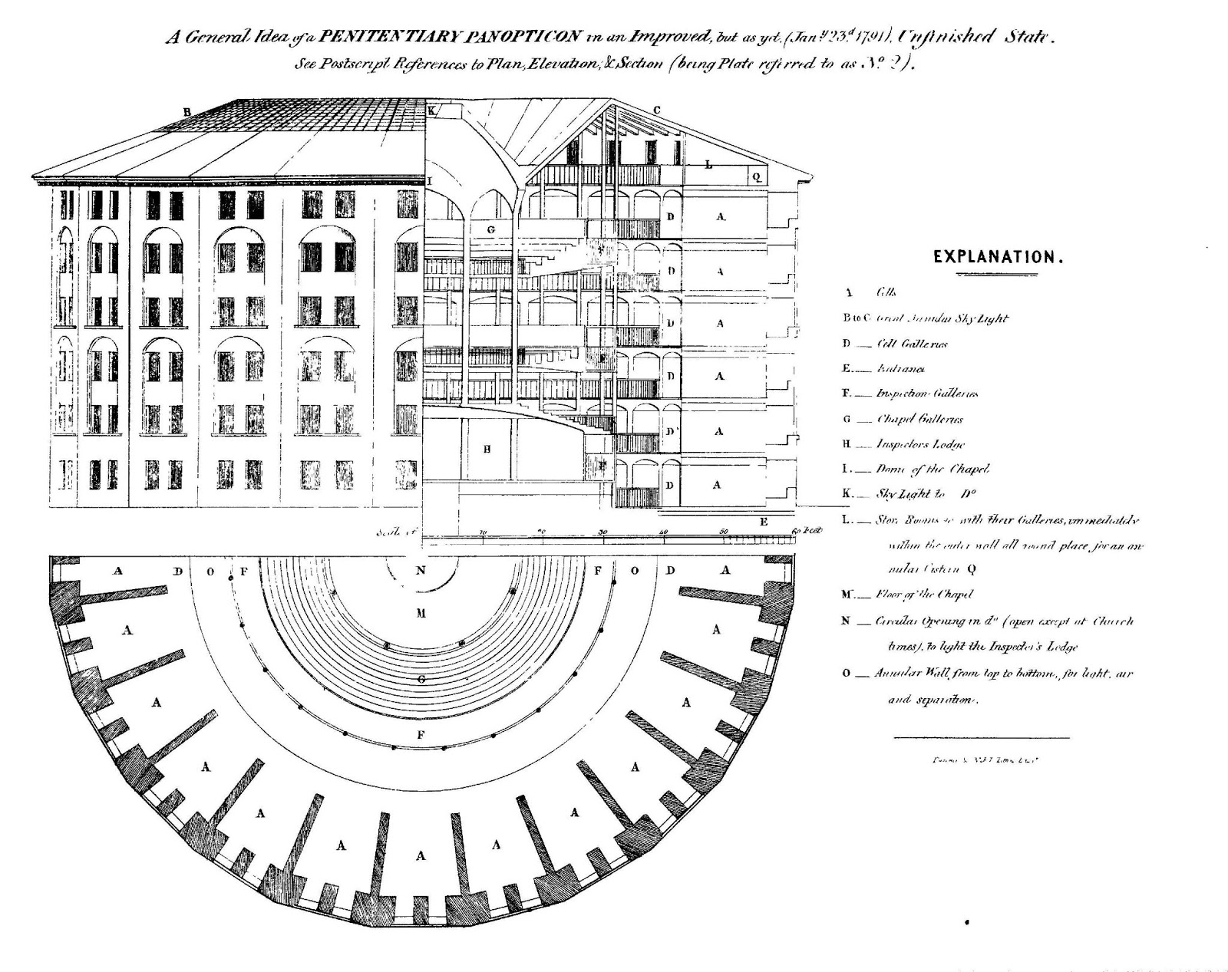
Context: The Juvenile Justice System
“Jeremey Bentham argued in The "Panopticon" that the perfect prison would be structured in a such a way that cells would be open to a central tower. In the model, individuals in the cells do not interact with each other and are constantly confronted by
the panoptic tower
(pan=all; optic=seeing).
They cannot, however, see when there is a person in the tower; they must believe that they could be watched at any moment: "the inmate must never know whether he is being looked at at any one moment; but he must be sure that he may always be so"
(Michel Foucault, Discipline 201).

Slide 25

Context: The Juvenile Justice System
Jeremy Benthem Panopticon Crash Course
Bentham’s Writings on the Panopticon

Slide 26
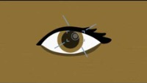
Context: The Juvenile Justice System
An Introduction to Michel Foucault’s Discipline and Punish

Slide 27
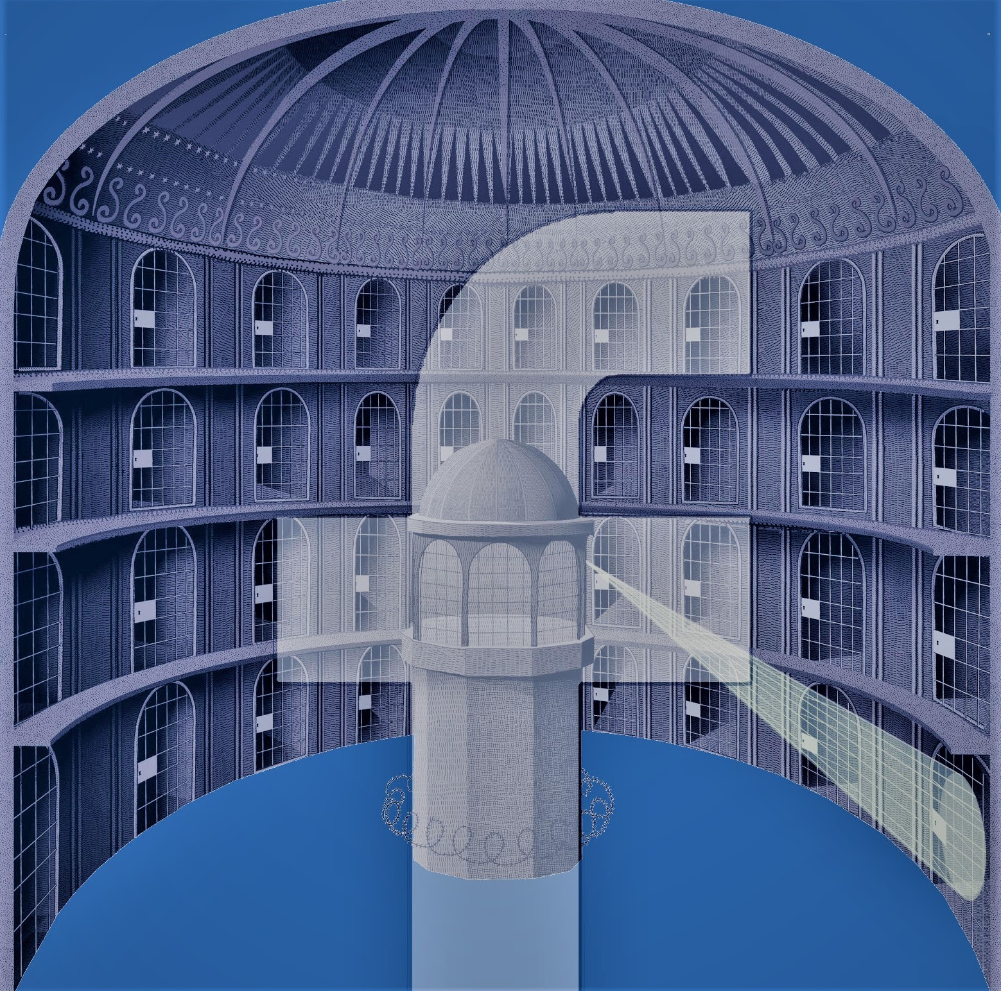
Context: The Juvenile Justice System
“Transparency makes the human being glassy. Therein lies its violence. Unrestricted freedom and communication switch into total control and surveillance. Social media are also coming to resemble, more and more, digital panoptica that discipline and exploit the social.
In disciplinary society, the occupants of the panopticon were isolated from each other for more thorough surveillance, and they were not permitted to speak. The inhabitants of the digital panopticon, on the other hand, engage in lively communication and bare themselves of their own free will. In this way, they actively collaborate in the digital panopticon.”
Byung-Chul Han
Pavel Kuczynski

Slide 28
Context: The Juvenile Justice System
“How many young people are in the juvenile justice system?
In 2018, the most recent year for which data are available, about 750,000 young people were referred to juvenile courts nationwide for delinquent offenses that violate the criminal code, and another 101,000 for status offenses (such as running away, consuming alcohol or skipping school) that would not be illegal if committed by adults.
Of the delinquency cases, 422,000 (57%) were formally processed in court, of which 220,000 were adjudicated delinquent (akin to a guilty conviction in adult court). Among youth who were adjudicated delinquent, the largest share (139,000) were placed on probation, and a much smaller number (62,000) were removed from home and placed in correctional institutions or other residential facilities.
The 2018 data did not include a national single-day count of all young people in institutions; the most recent recording of that number, on Oct. 25, 2017, found that 43,580 youth were held in residential facilities as a result of delinquency charges, including 16,000 in pretrial detention and 27,000 committed to residential facilities following adjudication. Annie E. Casey Foundation

Slide 29
Context: The Juvenile Justice System
Problems in America’s juvenile justice system
Widespread violence and maltreatment in juvenile facilities. Since the first juvenile reformatories were created in the 19th century, facilities dedicated to housing and rehabilitating youth have been prone to sometimes horrific abuses. The Casey Foundation has identified systemic or recurring violence in juvenile corrections facilities across the nation.
Pervasive overreliance on confinement, even for youth accused of minor misbehavior posing minimal risk to public safety.
Glaring racial and ethnic disparities. Youth of color, especially Black youth, are subject to harsher treatment than white youth at most every stage of juvenile justice.
Annie E. Casey Foundation

Slide 30
Context: The Juvenile Justice System
Failure to protect young people’s legal rights. Because the juvenile justice system was established to serve and support youth rather than punish them, the courts historically operated with few procedural safeguards to protect young people’s rights. This often led to egregious maltreatment of young people, including lack of legal representation, no presumption of innocence or right to question one’s accusers and harsh punishment (including incarceration) for behaviors that would never result in similar sanctions if committed by adults.
Annie E. Casey Foundation

Slide 31
Context: The Juvenile Justice System
A big drop in juvenile incarceration. Since juvenile confinement peaked in 1999 at more than 107,000 young people, the number of young people held in residential facilities as a result of delinquent conduct has declined steadily. By 2017, the last year for which data are available, total confinement on a single day was 43,580 — down 59% from the 1999 high. While much of the decline was due to substantial reduction in juvenile arrests, especially for serious violent offenses, many states have begun to limit the use of confinement, especially for less serious offenses. Many states have been closing large juvenile correctional institutions (sometimes called training schools, but more accurately described as youth prisons). From 2000 to 2018, the number of juvenile facilities housing more than 100 young people fell from 264 to 68, and the number of youth housed in these large facilities fell 84%.
Annie E. Casey Foundation

Slide 32
Context: The Juvenile Justice System
What are some challenges with the juvenile justice system?
Racial and ethnic disparities are getting worse. Whereas Black youth nationwide were confined at four times the rate of white youth in 2001, by 2017 the Black rate of confinement had grown to 4.5 times the rate for white youth.
The United States locks up more young people than other countries do. According to the 2019 United Nations Global Study on Children Deprived of Liberty, the U.S. youth confinement rate was four times higher than Canada and Mexico; 10 times higher than central and eastern Europe; and 12 times higher than western Europe.
Annie E. Casey Foundation

Slide 33
Context: The Juvenile Justice System
Correctional confinement facilities remain dangerous and problematic, rather than rehabilitative. Since 2000, systemic or recurring maltreatment of confined youth had been documented in the juvenile corrections facilities of 29 states plus the District of Columbia.
Juvenile probation, the most common response to delinquency, often does not operate according to best practice. Roughly 400,000 young people per year are placed on some form of juvenile probation. Yet research finds that probation is ineffective in reversing delinquent behavior and has especially poor results with youth at low risk of re-arrest.
Annie E. Casey Foundation

Slide 34
Context: The Juvenile Justice System
Far too many U.S. youth are arrested and referred to court, and far too few of those youth are diverted from court following arrest or referral. Also, there is far too little investment in effective community-driven diversion interventions to assist youth who are suffering with trauma, family crises and serious behavioral health challenges and to prevent their slide into serious delinquency.
Annie E. Casey Foundation

Slide 35
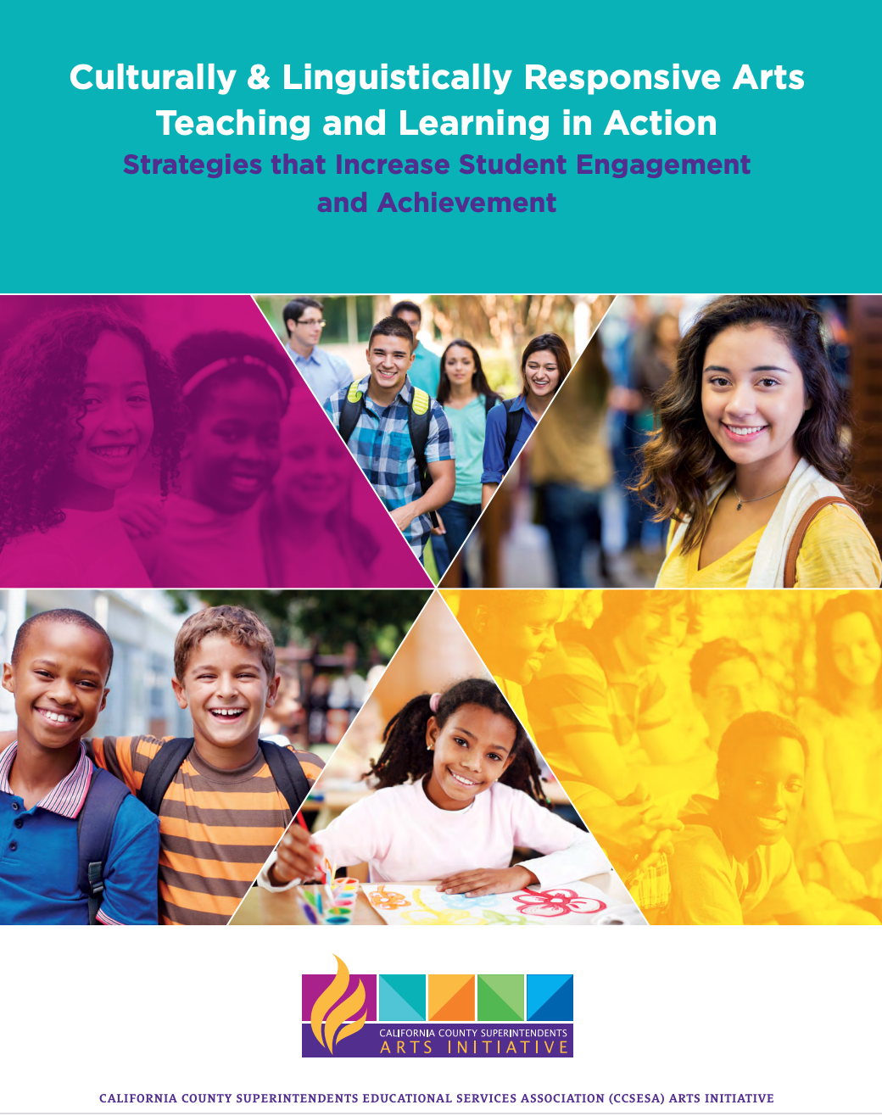

C
Promising Strategies: CCSESA Resources
Creativity at the Core Modules
Culturally & Linguistically Responsive Arts Teaching and Learning in Action

Slide 36
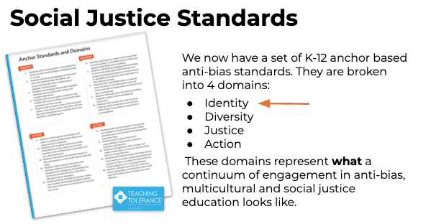
Promising Strategies: Social Justice Standards
Social Justice Standards

Slide 37
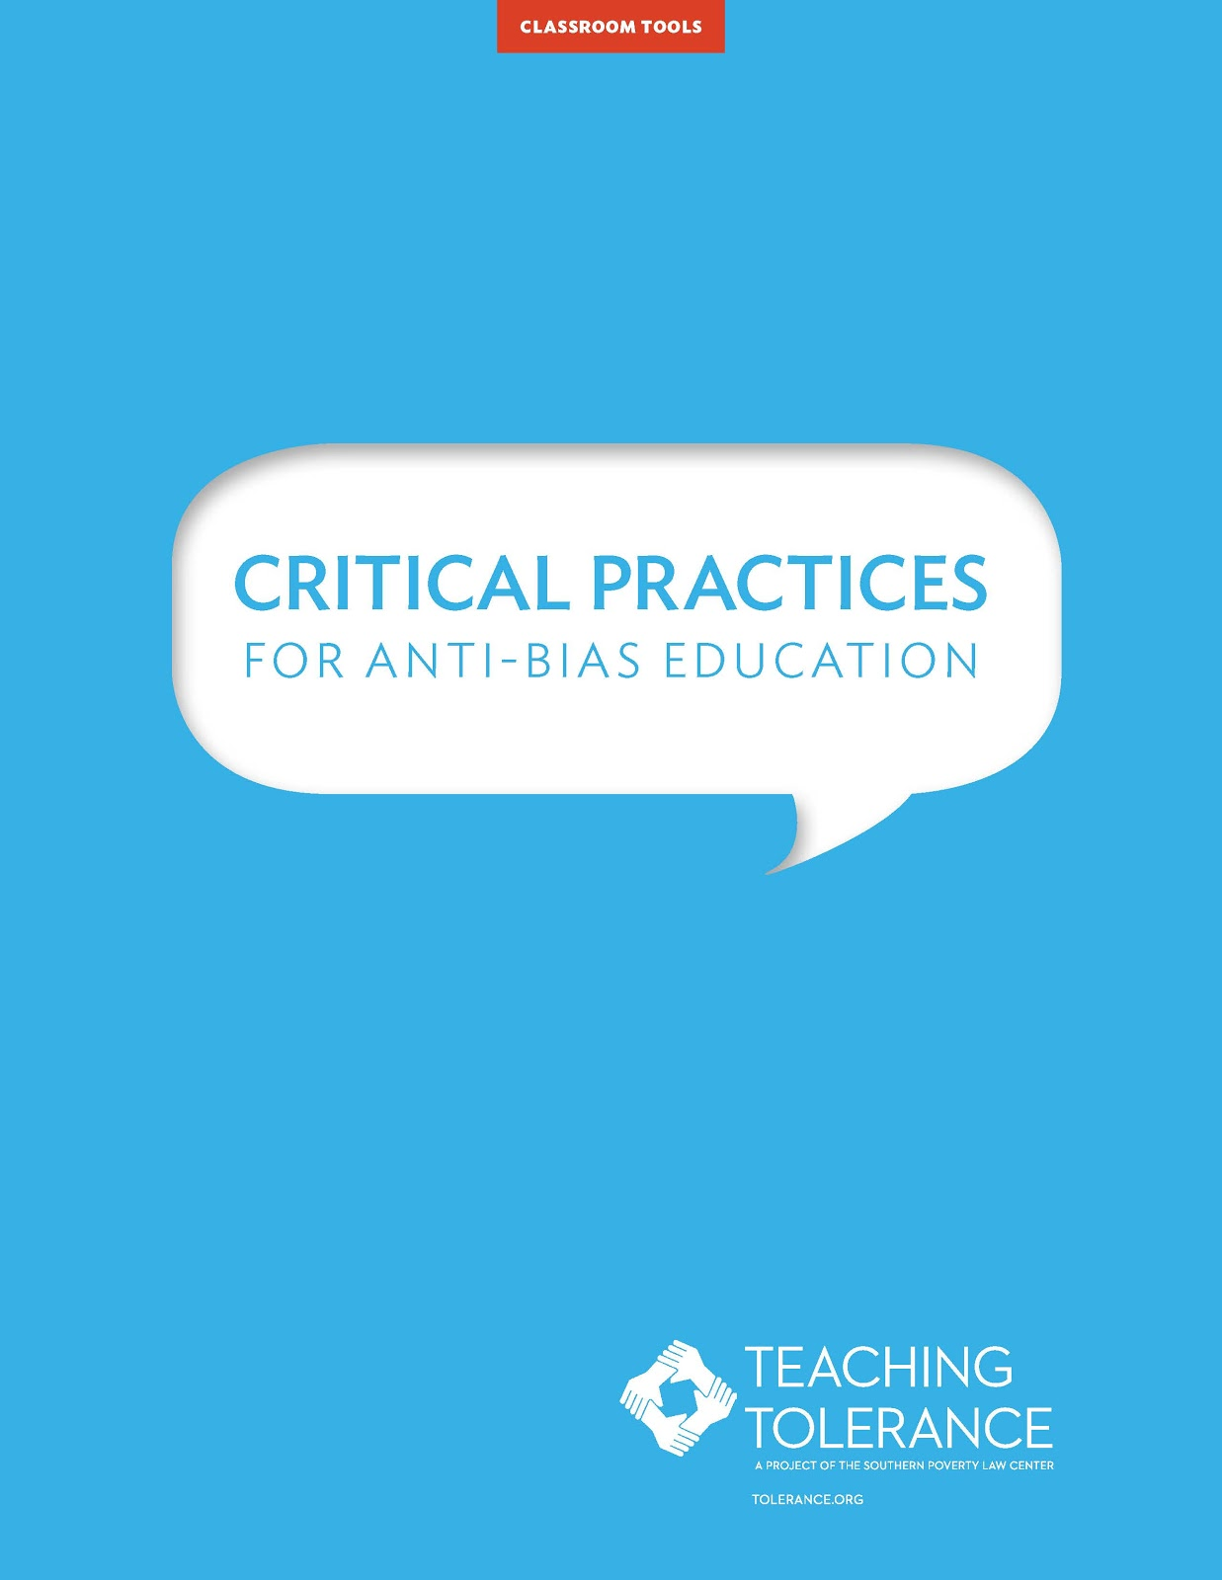
Promising Strategies: Critical Practices
for Anti-Bias Education
The critical practices guide offers strategies for how we create a space where academic and social-emotional goals are accomplished side by side.
Critical Practices for Anti-bias Education is organized into four sections: Instruction; Classroom Culture; Family and Community Engagement; and Teacher Leadership.
Critical Practices for Anti-Bias Education

Slide 38
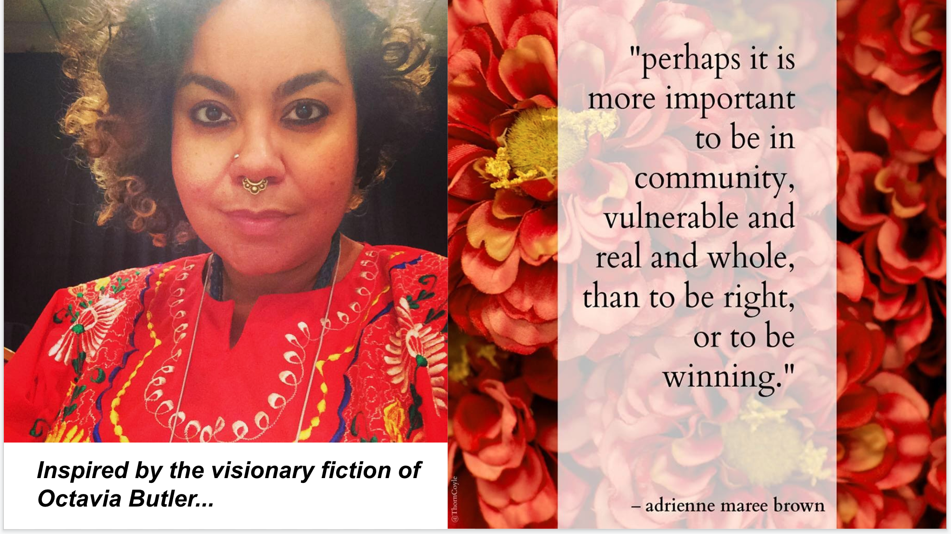
Promising Strategies: Emergent Strategy

Slide 39
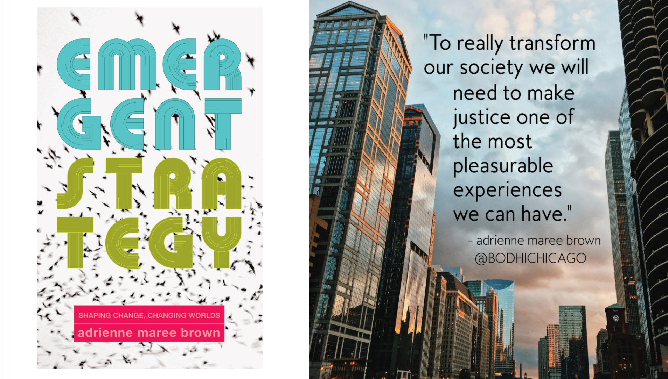
Promising Strategies: Emergent Strategy

Slide 40
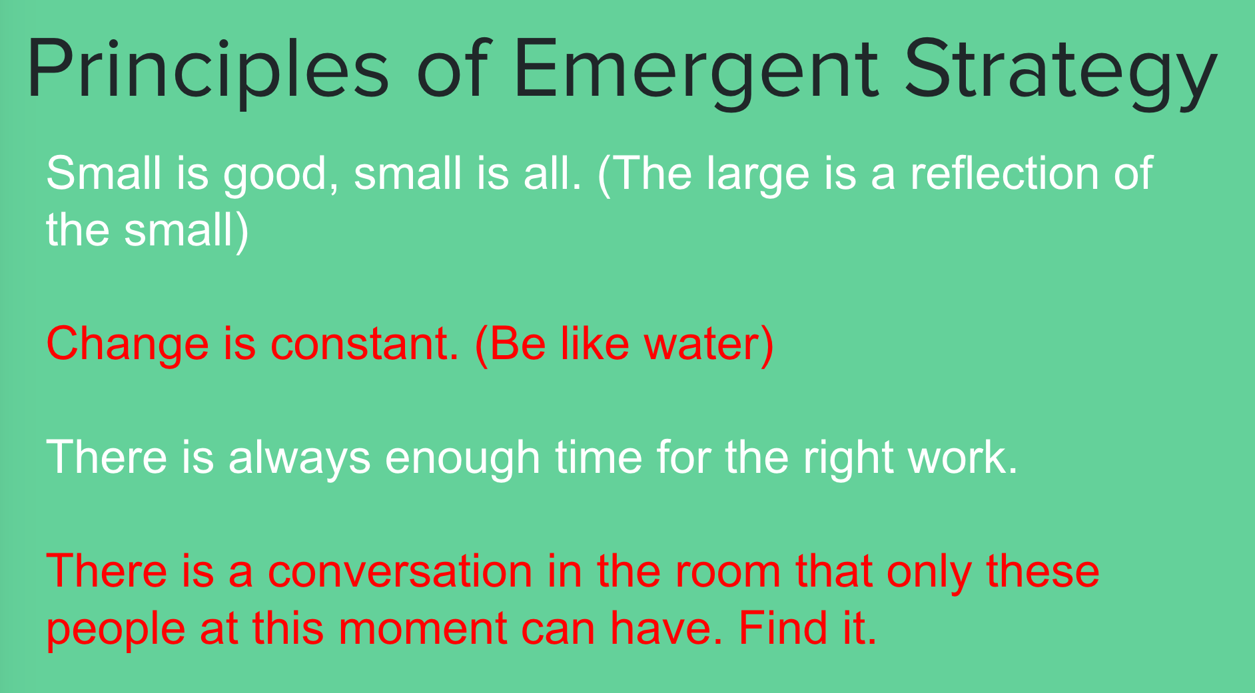
Promising Strategies: Emergent Strategy

Slide 41
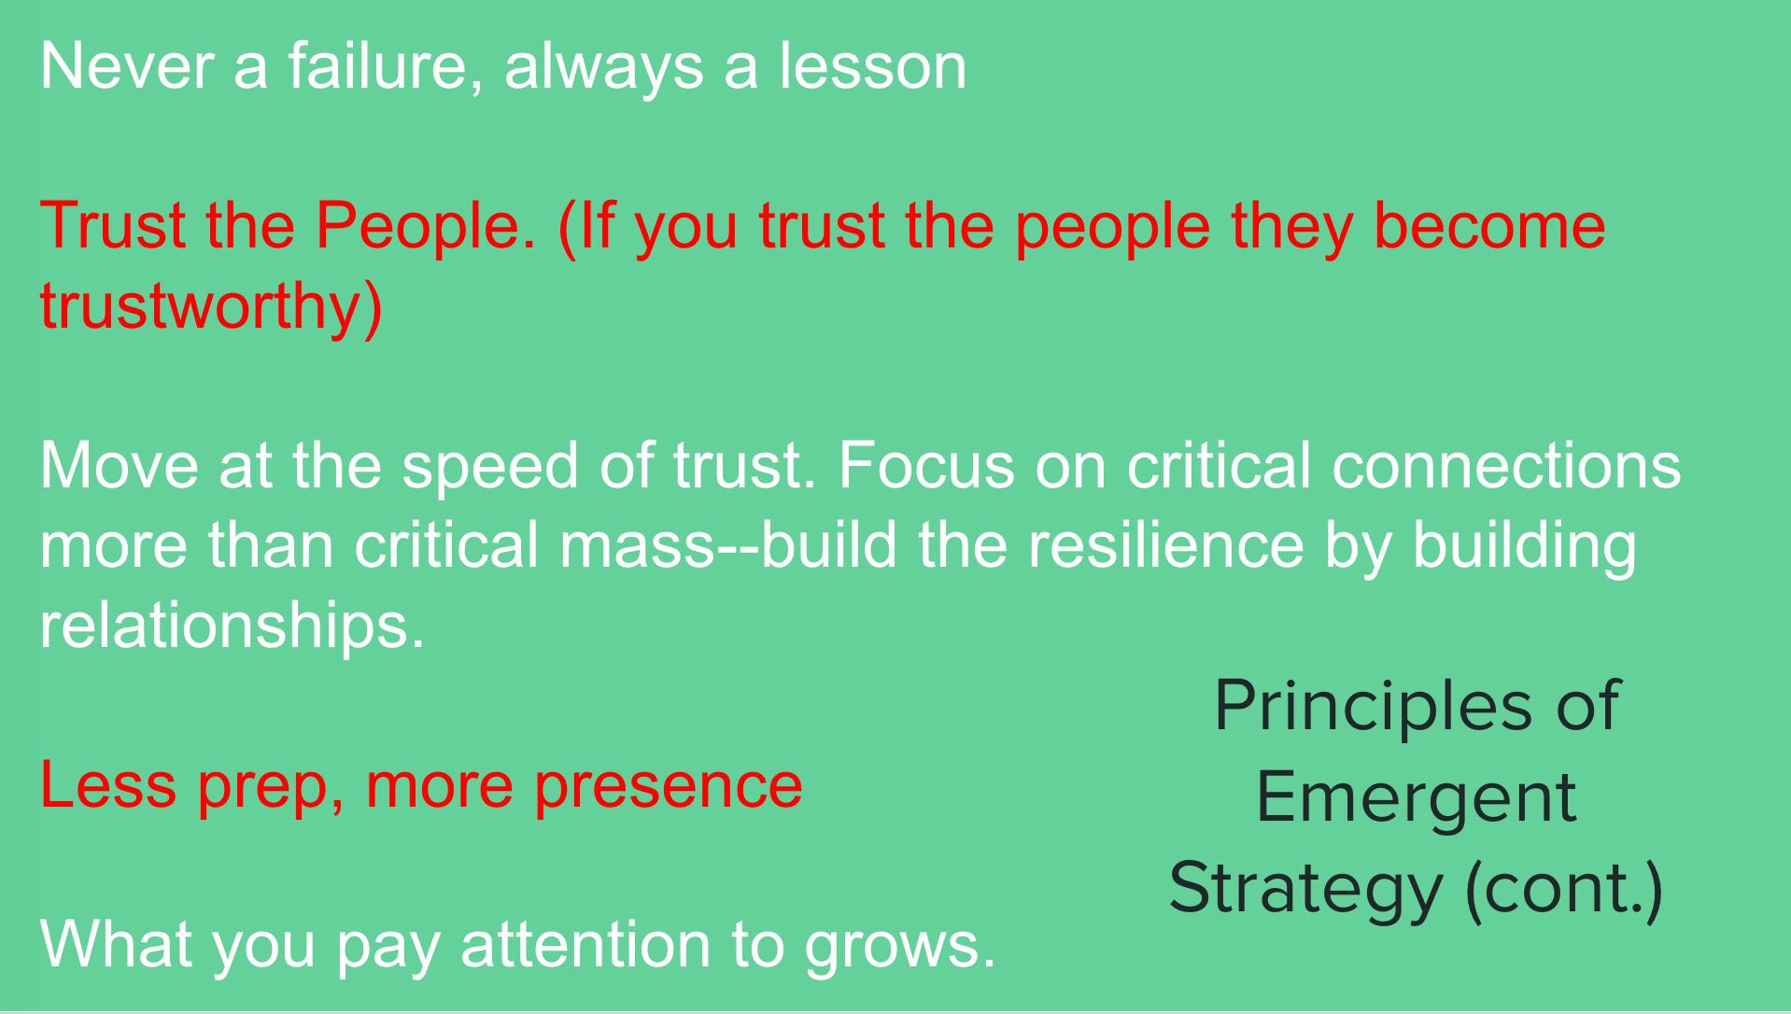
Promising Strategies: Emergent Strategy

Slide 42
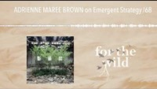
Promising Strategies: Emergent Strategy
Adrienne Maree Brown on Emergent Strategy

Slide 43
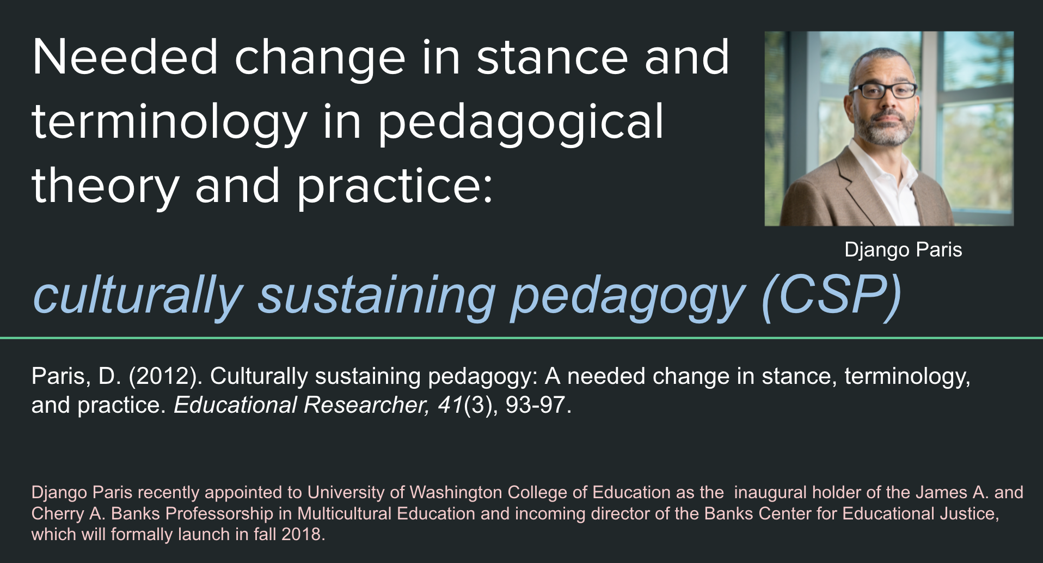
Culturally Sustaining Pedagogy

Slide 44
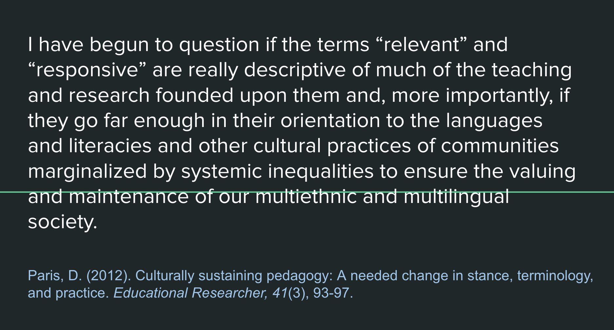
Culturally Sustaining Pedagogy

Slide 45
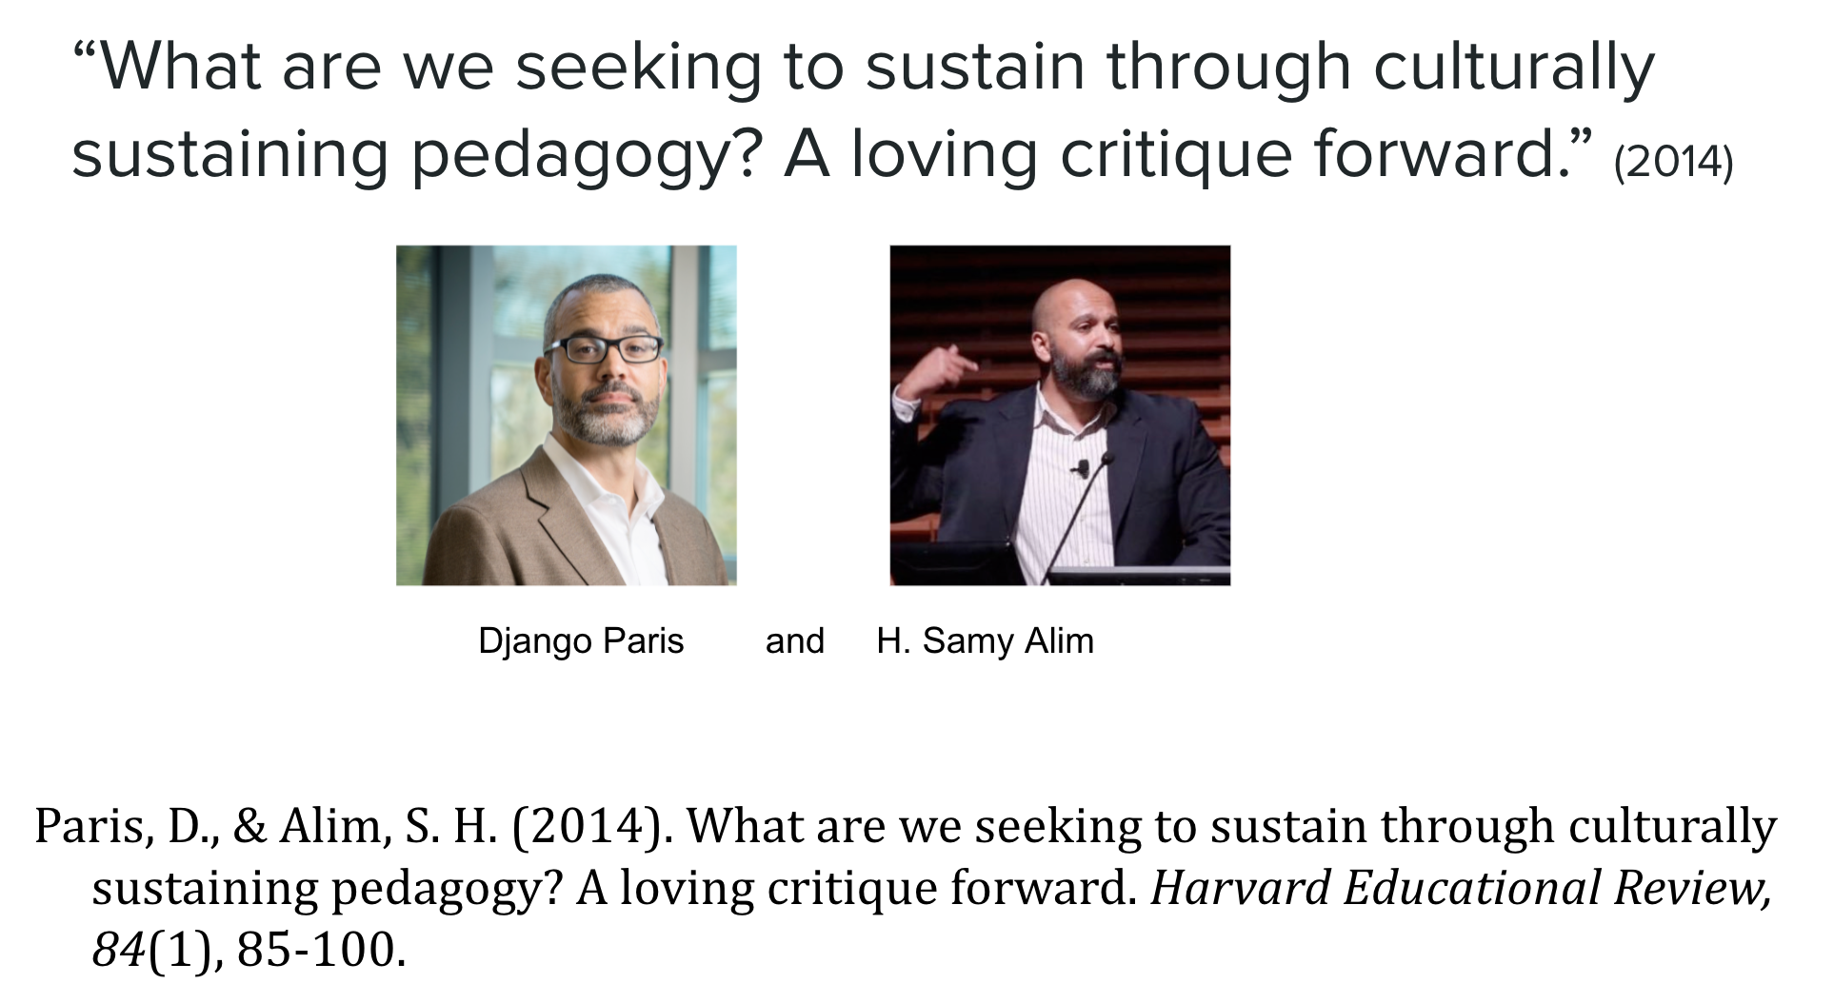
Culturally Sustaining Pedagogy

Slide 46
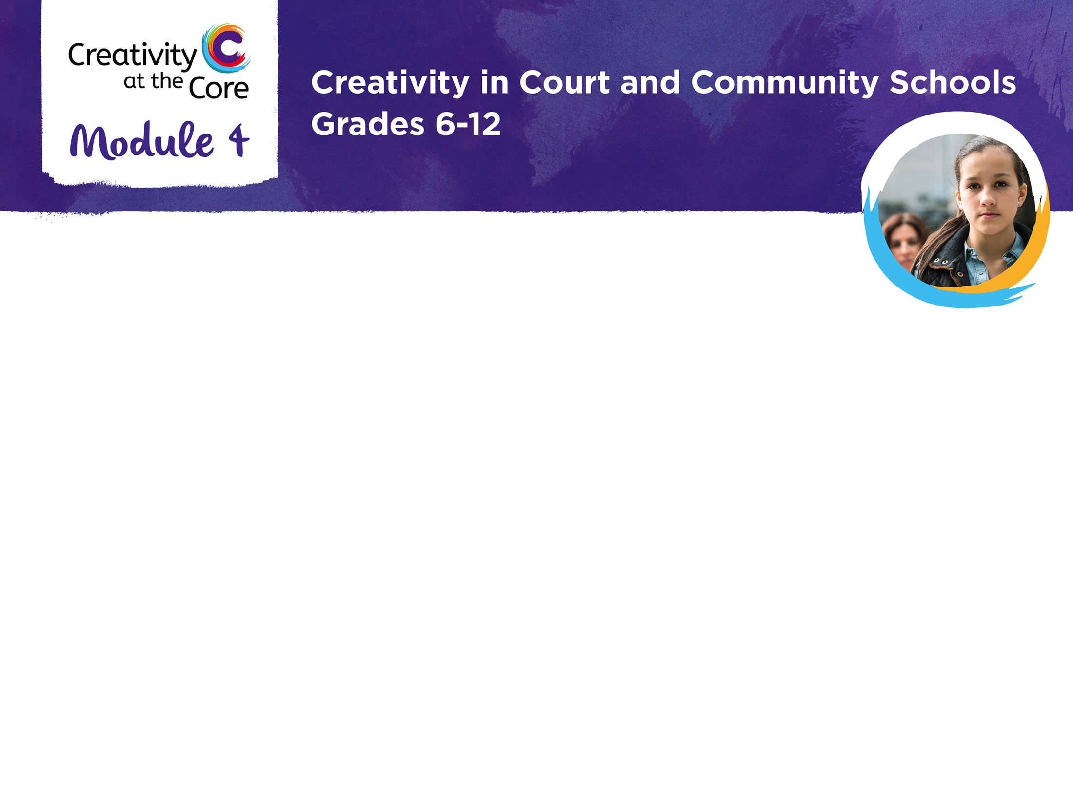
This resource was created by
Derek Fenner, former Arts Learning Program Manager, Alameda County Office of Education
Email: dfenner@acoe.org
Arts Learning at ACOE Website
With support from
The Core Learning Department, Alameda County Office of Education

